Slide 1

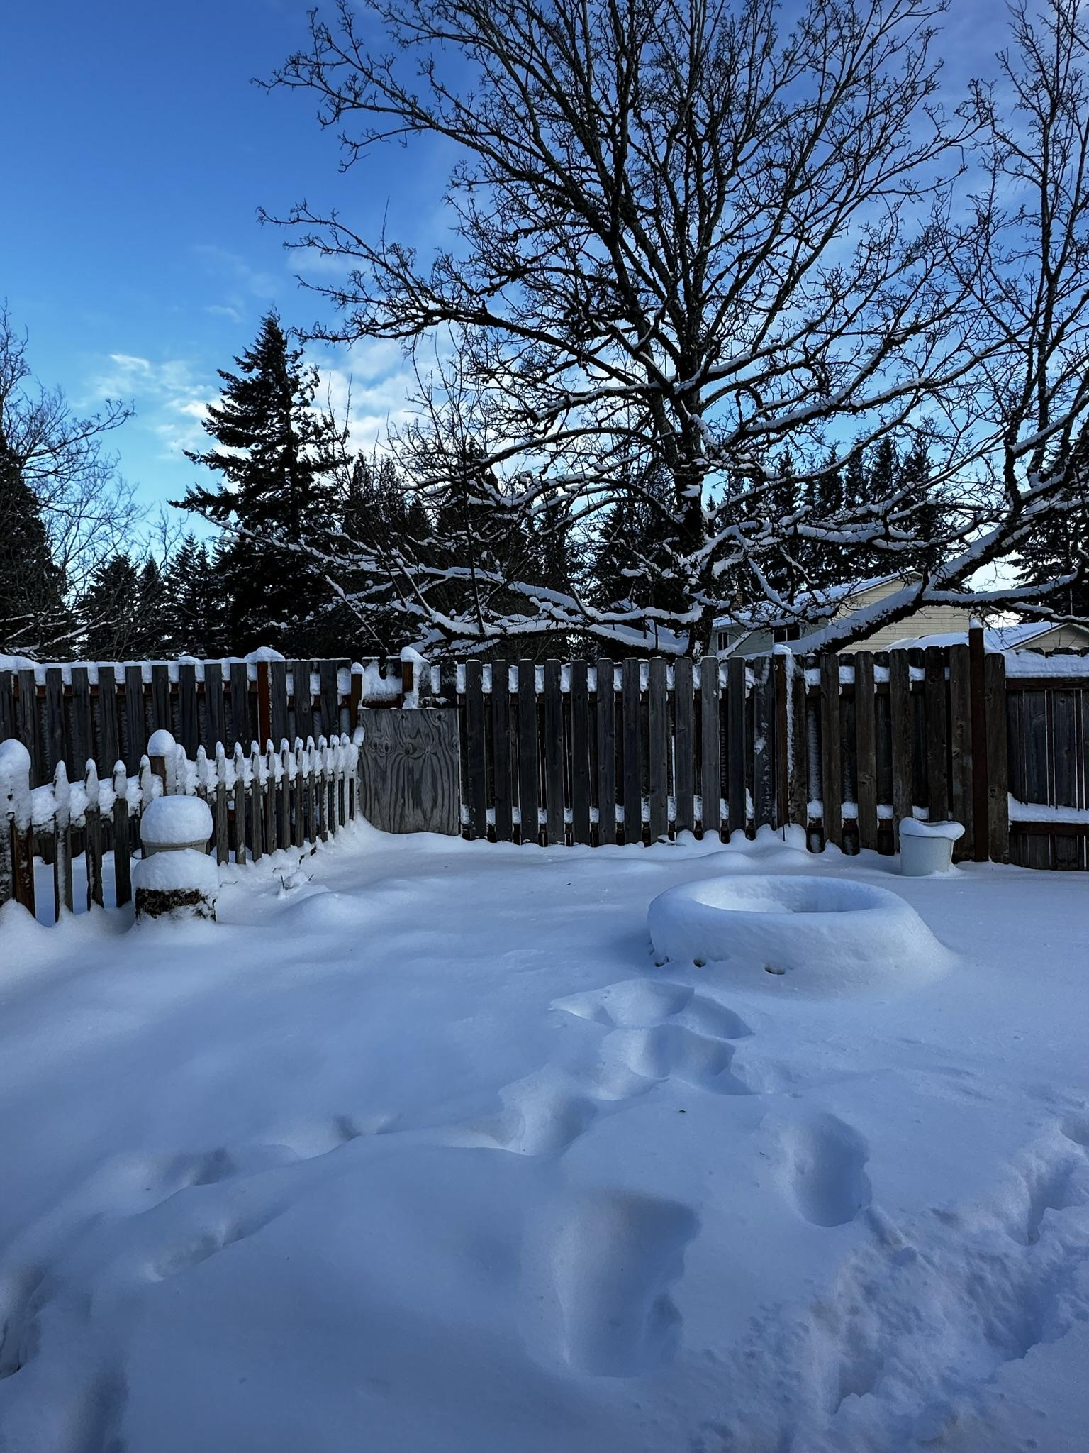
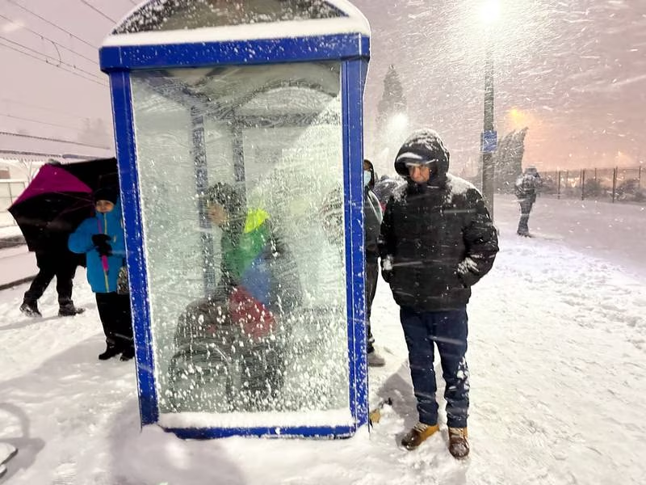
Portland, OR Snowmageddon
February 22-23, 2023
Presenter: Tyler Kranz, Lead Meteorologist, NWS Portland
Courtesy Tyler Kranz
Courtesy Mick Hangland-Skill

Slide 2

Event Overview
SECOND snowiest day ever recorded in Portland, OR on 2/22/23
  10.8” measured at NWS Portland (highest total ever is still 14.4” on Jan. 21, 1943)
Flash freeze conditions following the snowstorm turned roads into a sheet of ice for days to follow
Even portions of the Oregon coast recorded 6-12+” of snow due to repetitive heavy snow showers
Courtesy @marydillon - Twitter

Slide 3
Event Timeline
Wed, Feb 22
Thu, Feb 23
Cold rain in the early morning switched to snow by mid to late morning. Snow became heavy in the afternoon and evening, dumping 8-10” over the eastern Portland metro while people were at work, not expecting much more than an inch or two at best.
Snow ends, but temps below freezing through the day with gusty east winds. Very icy and hazardous driving conditions continued. Many abandoned vehicles on roads and highways.
Wed night
Thu night
Snow tapered off in the eastern metro but intensified over the western metro as another band of heavy snow lifted over the area from the south. Temps fell into the 20s with increasing east winds, resulting in a flash freeze. 8-10” fell over the western Portland metro. Hazardous road conditions across the metro due to ice/snow. Many people stuck in traffic through the night or trapped in snow.
Cold with temps in the mid 20s. Many roads remained covered in ice and/or snow. Abandoned vehicles still trapped on some roads. Temps finally warmed a few degrees above freezing Friday afternoon, 2/24.
Impact Level
Extreme
High
Medium
Low
Notes:
Visibilities at PDX were down to ¼ to ½ miles at times due to heavy snow and blowing snow

Slide 4
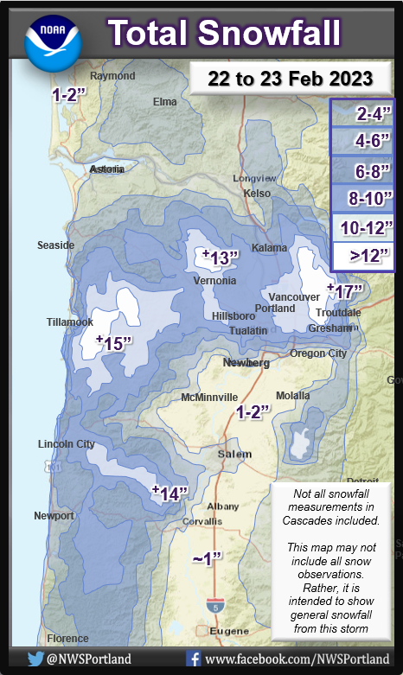
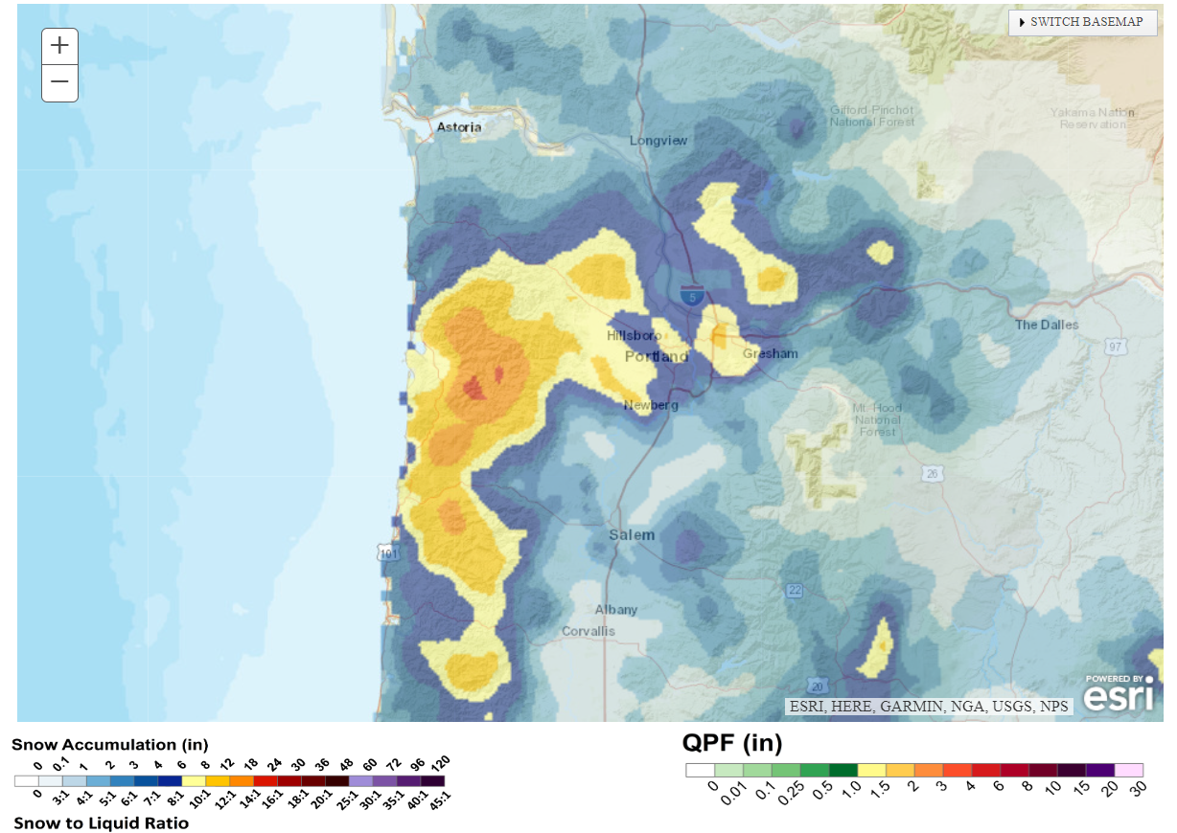
Observed Snow Amounts Feb 22-23, 2023
NOHRSC 24-hr Snowfall (ending 12z Feb. 23)
Notes:
Remind audience that the NOHRSC Snow analysis has some flaws. The small area of 8-12” over the eastern Portland metro should truly cover the entire Portland/Vancouver metro.

Slide 5
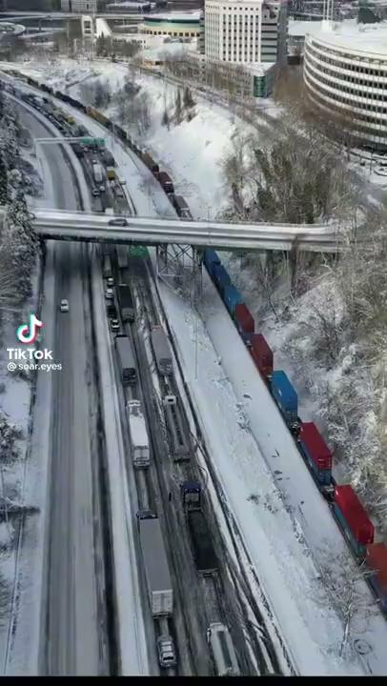
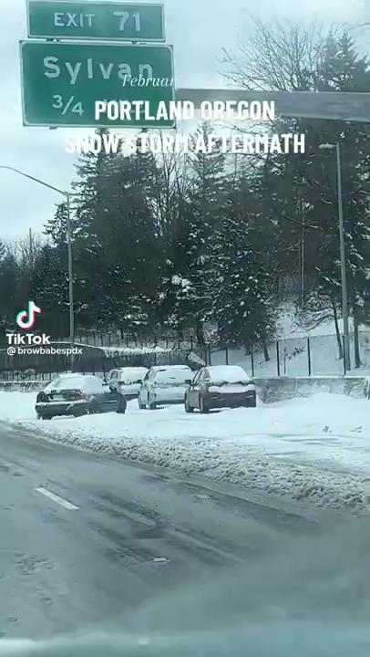
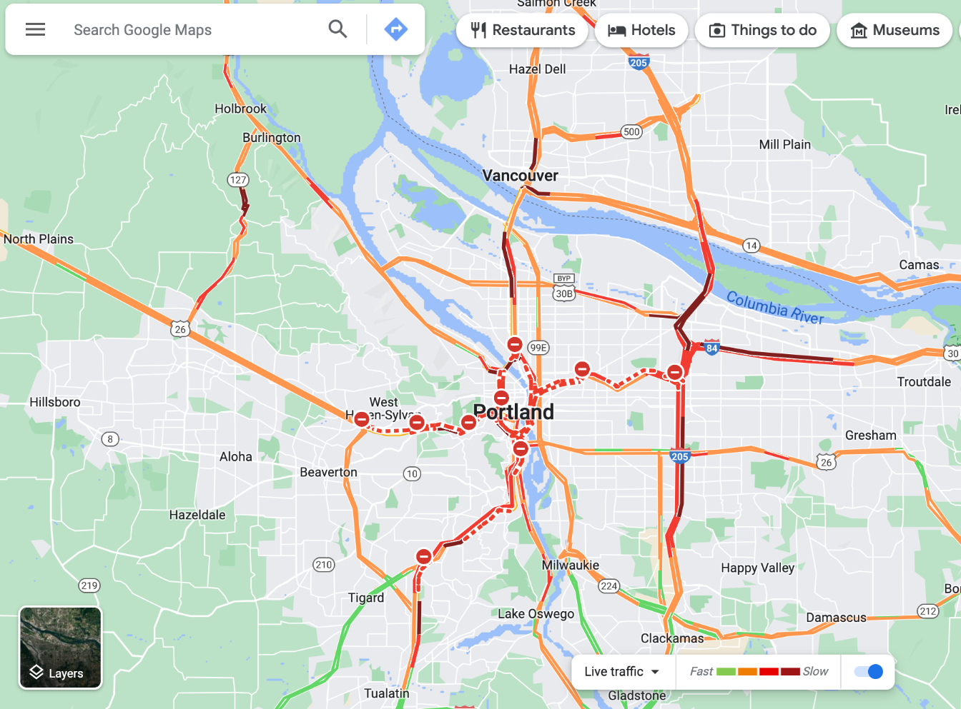
Impacts

Slide 6
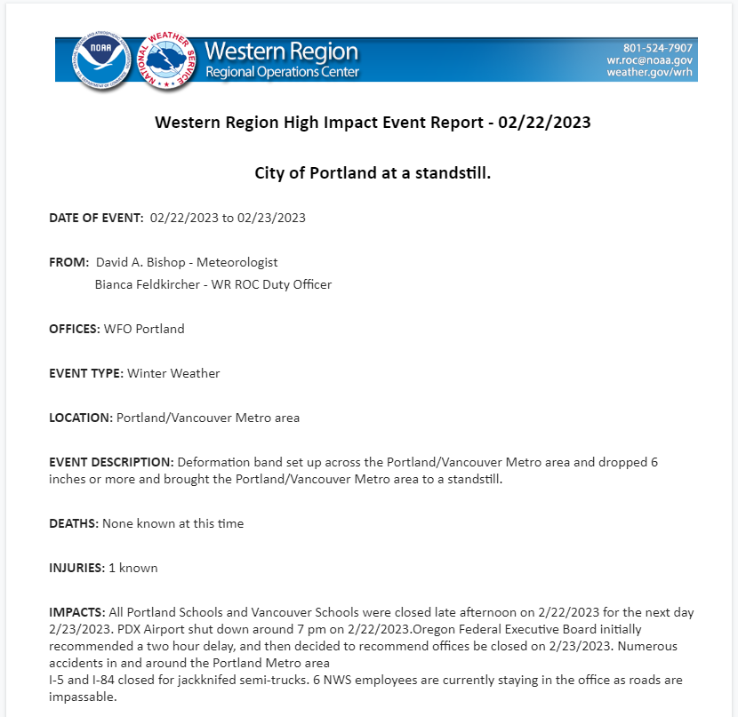
Impacts
All Portland/Vancouver schools closed 2/23, the day following the snowstorm
Portland International Airport shut down around 7 PM 2/22
Accidents all over, cars stuck, at least 600 cars left abandoned on roadways according to PBOT
I-5 and I-84 closed
20 minute commutes took several hours or longer

Slide 7
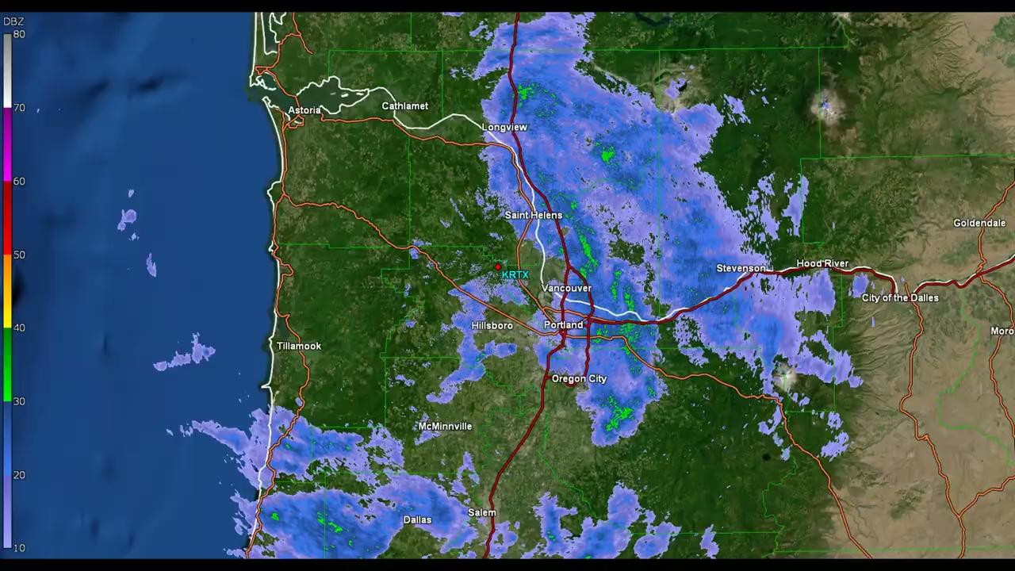
KRTX Base Reflectivity - Feb. 22, 2023
Notes:
This radar loop shows the FIRST mesoscale band of heavy snow that hit the EASTERN half of the Portland metro hardest on 2/22/23 and dumped 8-10+” of snow while people were at work.

Slide 8
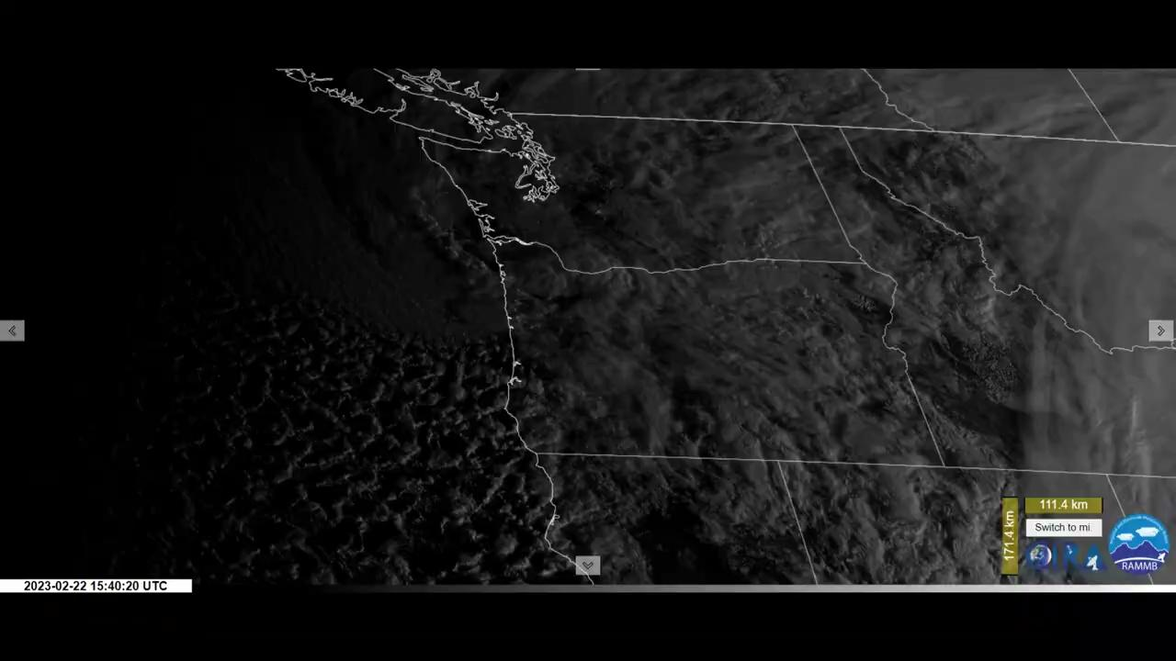
GOES-18 Visible Satellite Imagery

Slide 9
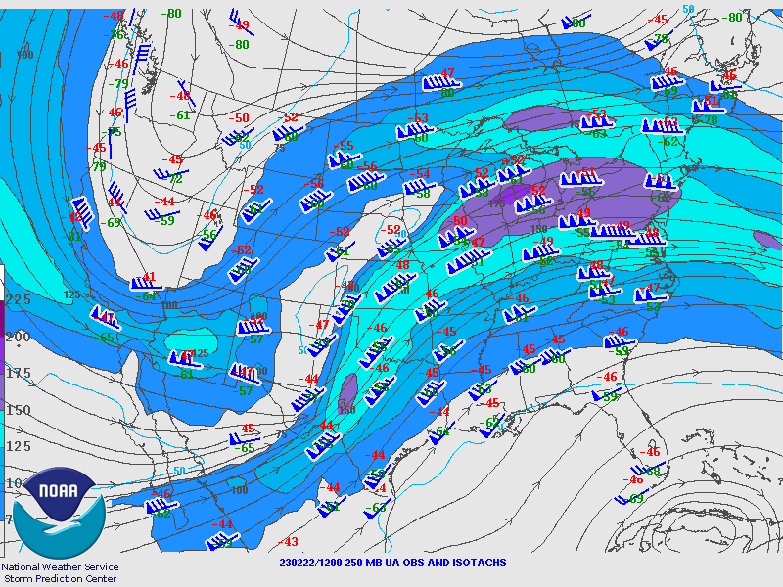
250 mb Analysis - Feb. 22 - 12z

Slide 10
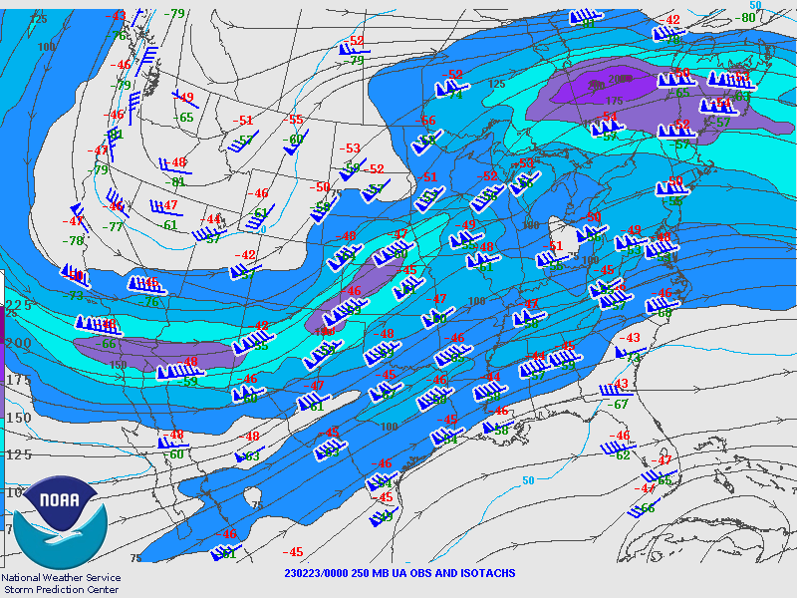
250 mb Analysis - Feb. 23 - 00z

Slide 11
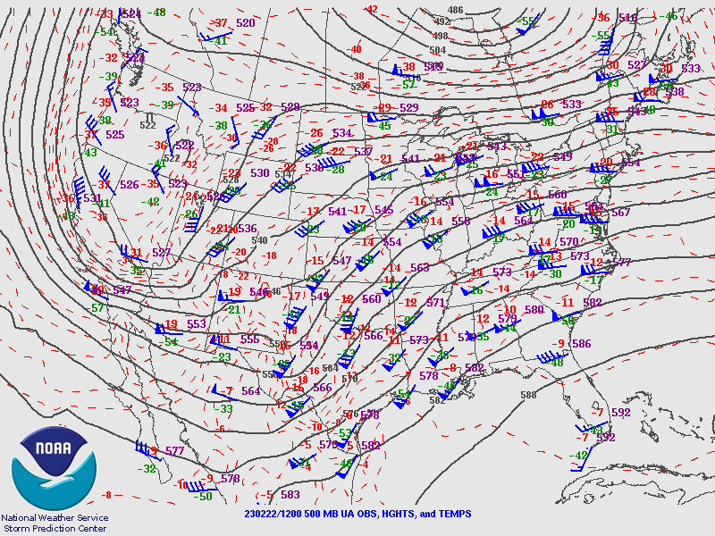
500 mb Analysis - Feb. 22 - 12z

Slide 12
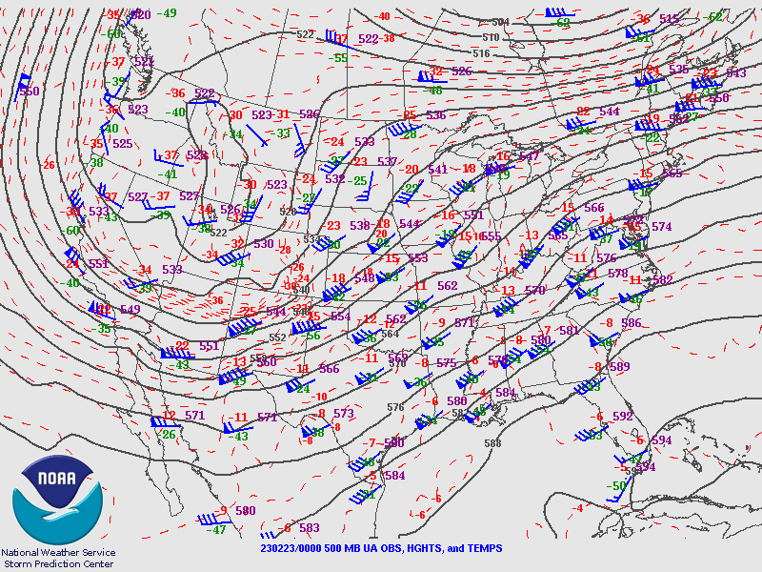
500 mb Analysis - Feb. 23 - 00z

Slide 13
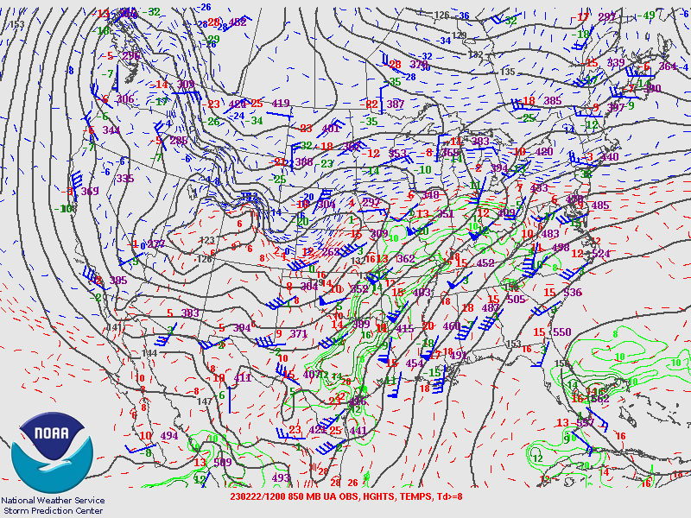
850 mb Analysis (Feb. 22 - 12z)

Slide 14
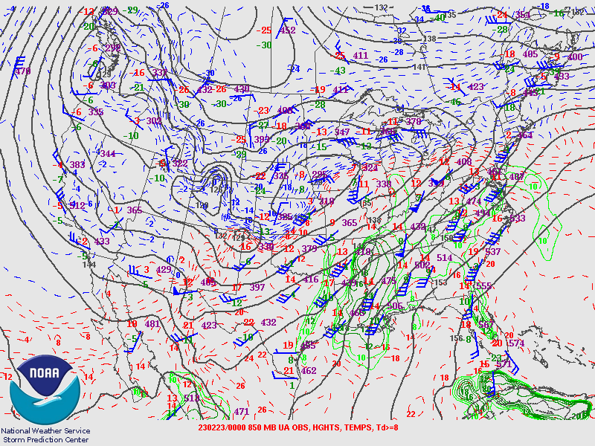
850 mb Analysis (Feb. 23 - 00z)

Slide 15
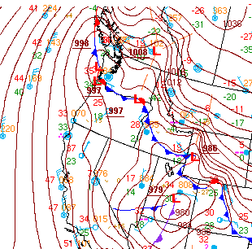
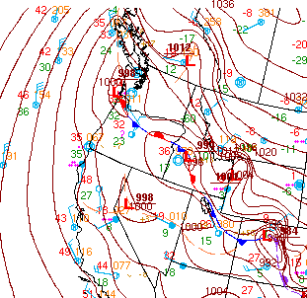
WPC Surface Analysis
Valid 2/22 12z
Valid 2/23 00z

Slide 16
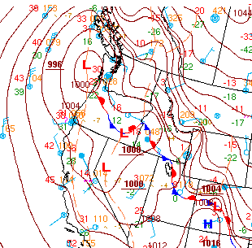
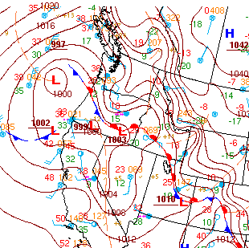
WPC Surface Analysis
Valid 2/23 12z
Valid 2/24 00z

Slide 17
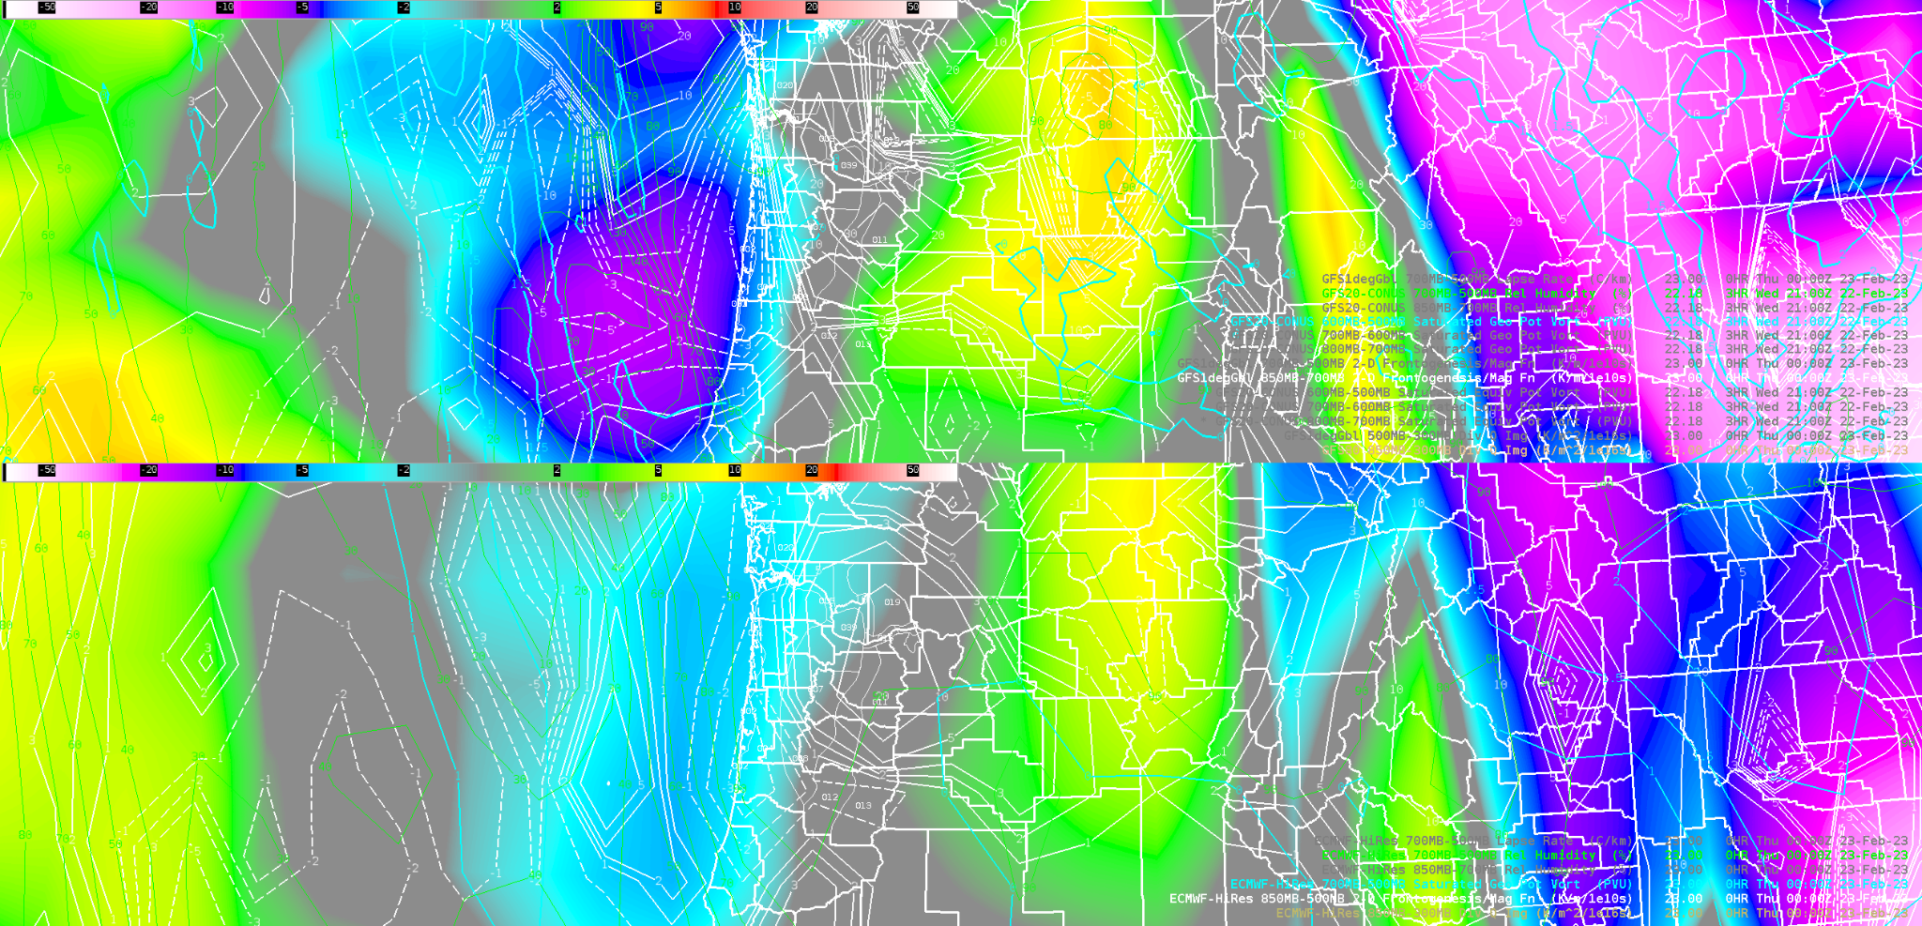
Synoptic and Mesoscale Forcing (GFS/EURO - Initialized/Valid 00z Feb. 23)
GFS 850-300 mb Q-vector Divergence, 850-700 mb 2-D Frontogenesis, 600-500 mb Sat. Geo. Pot. Vort., 700-500 mb RH
EURO 850-300 mb Q-vector Divergence, 850-500 mb 2-D Frontogenesis, 700-500 mb Sat. Geo. Pot. Vort., 700-500 mb RH

Slide 18
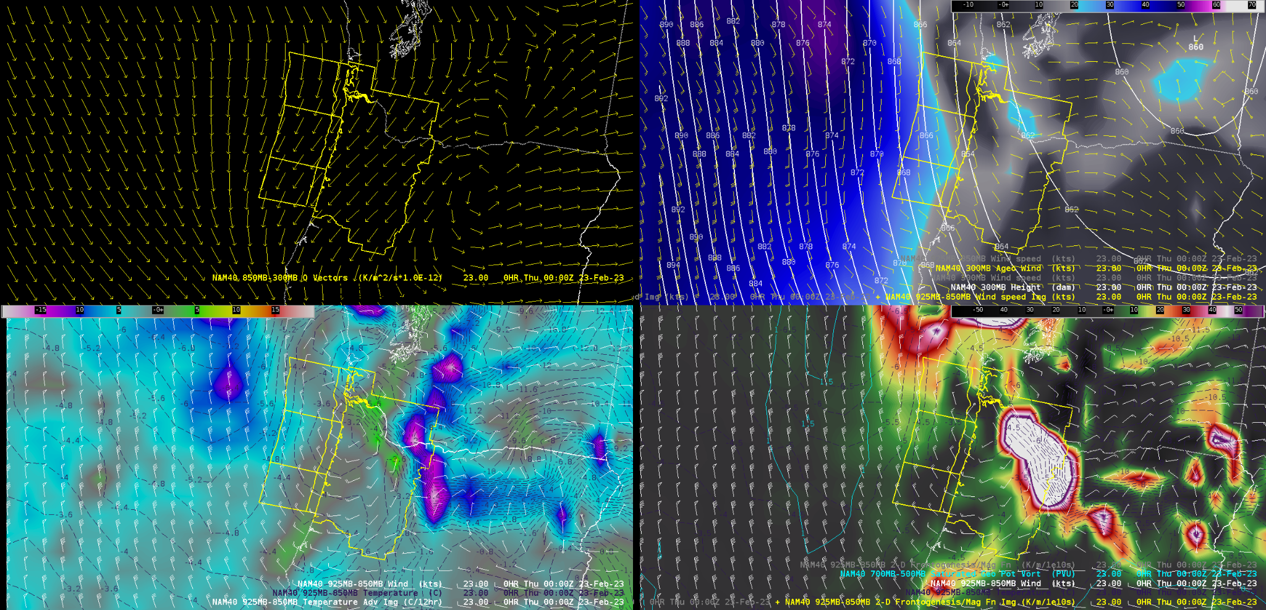
Synoptic and Mesoscale Forcing (NAM - Initialized/Valid 00z Feb. 23)
850-300 mb Q-vectors
300 mb Heights & Ageostrophic Wind with 925-850 mb Wind Speeds
925-850 mb Wind and Temp. Advection
925-850 mb 2-D Frontogenesis with 700-500 mb Saturated Geo Potential Vort. and 925-850 mb Wind
Notes:
Unfortunately the snow event in Portland had already begun by the time the NAM data shown here was available to forecasters.

Slide 19
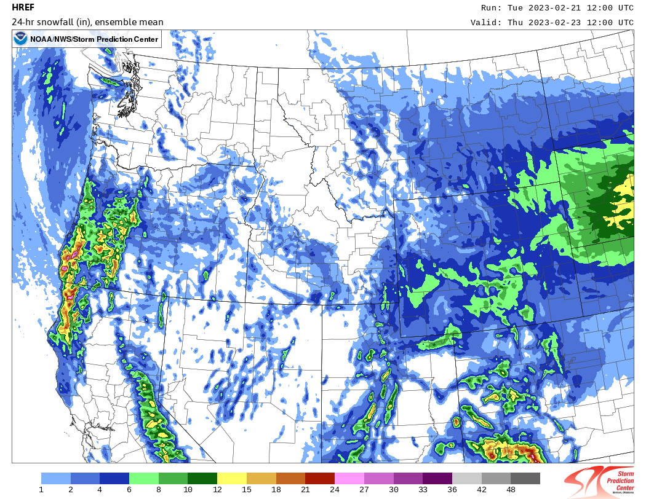
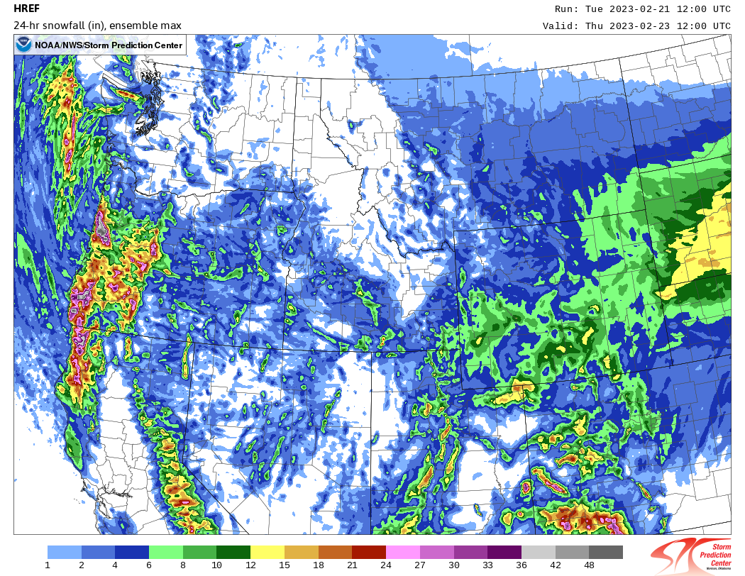
HREF 24-hr Snow Amounts - Initialized 12z Feb. 21
HREF Ensemble Mean
HREF Ensemble Max
Notes:
The HREF assumes a 10:1 SLR, but in this event the actual observed SLR ended up close to 10:1

Slide 20
Day 3 Model Data
Notes:
Break off to HMT page to view model data.

Slide 21
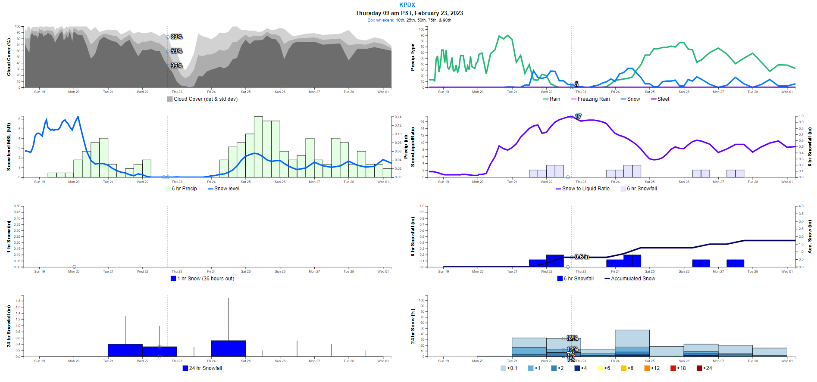
Day 3 - NBM Initialized 13z Feb. 19 - PDX
Notes:
The deterministic NBM was giving Portland 0.6 inches of snow.

Slide 22
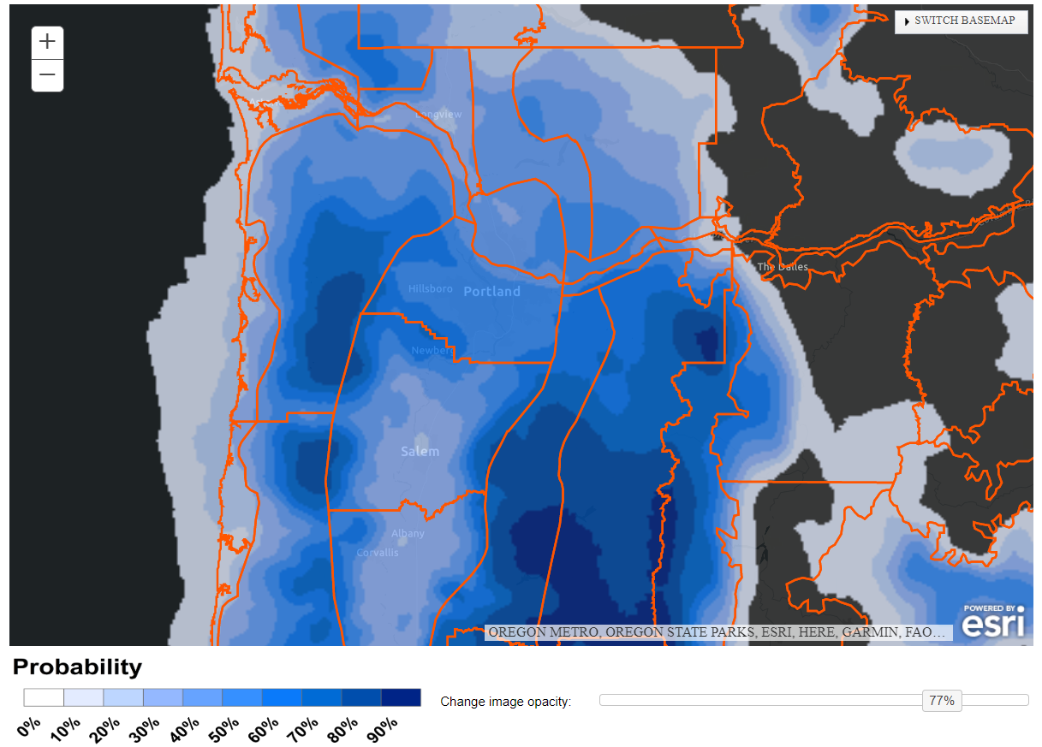
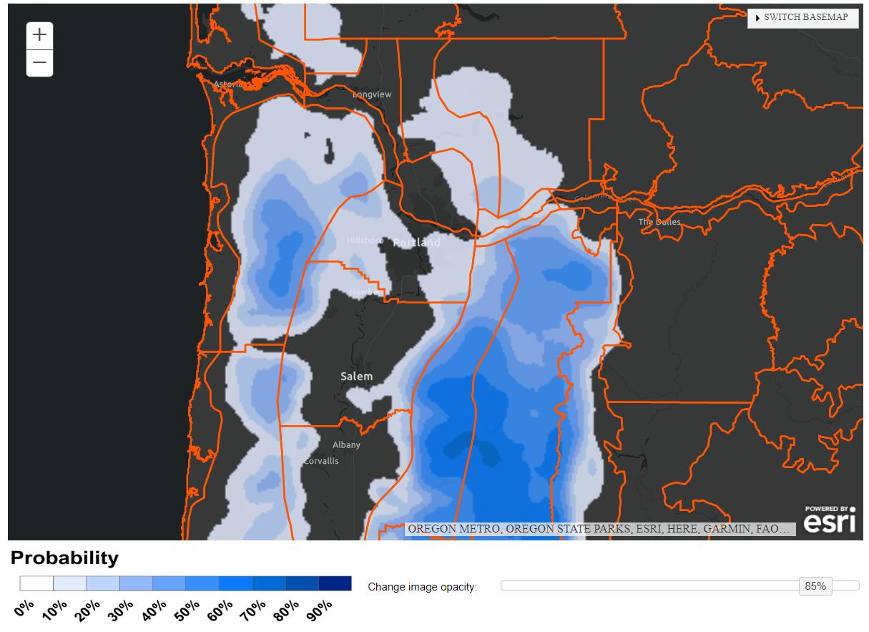
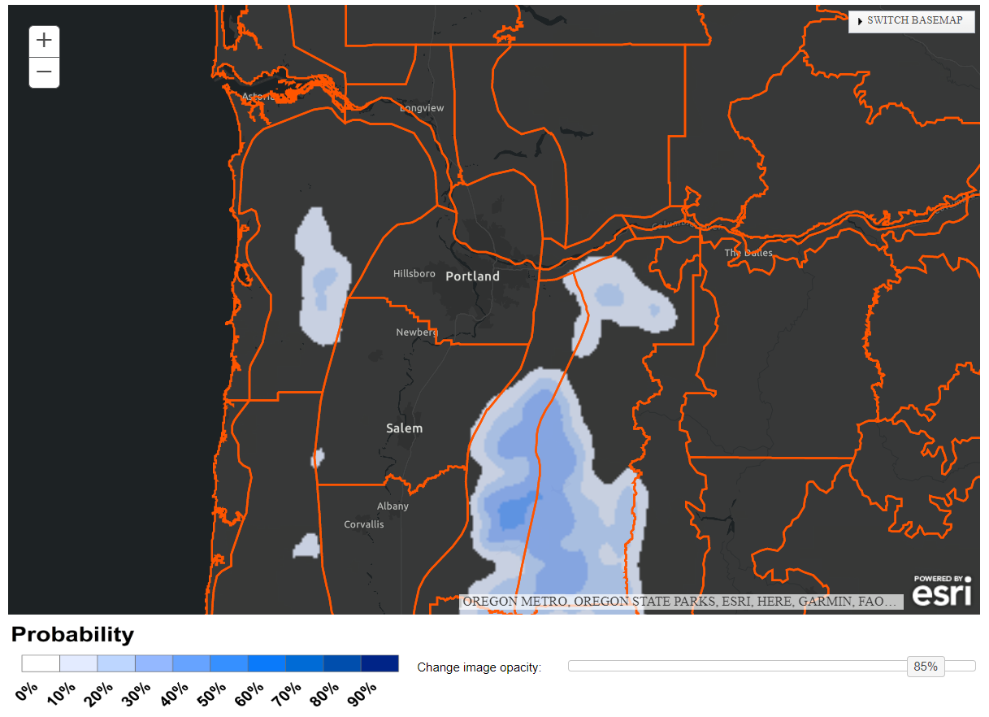
NBM 24-hr Snow Probs (forecast hr 84)
NBM 24-hr Snow
Prob >1” ending 2/23 12z (forecast hr 84)
NBM 24-hr Snow
Prob >4” ending 2/23 12z (forecast hr 84)
NBM 24-hr Snow
Prob >8” ending 2/23 12z (forecast hr 84)

Slide 23
Day 2 Model Data
Notes:
Break off to HMT page to view model data.

Slide 24
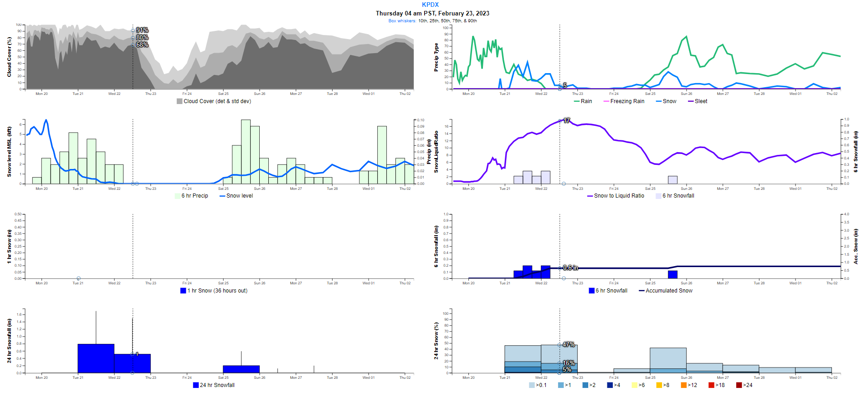
Day 2 - NBM Initialized 13z Feb. 20 - PDX
Notes:
The deterministic NBM was giving Portland 0.6 inches of snow.

Slide 25
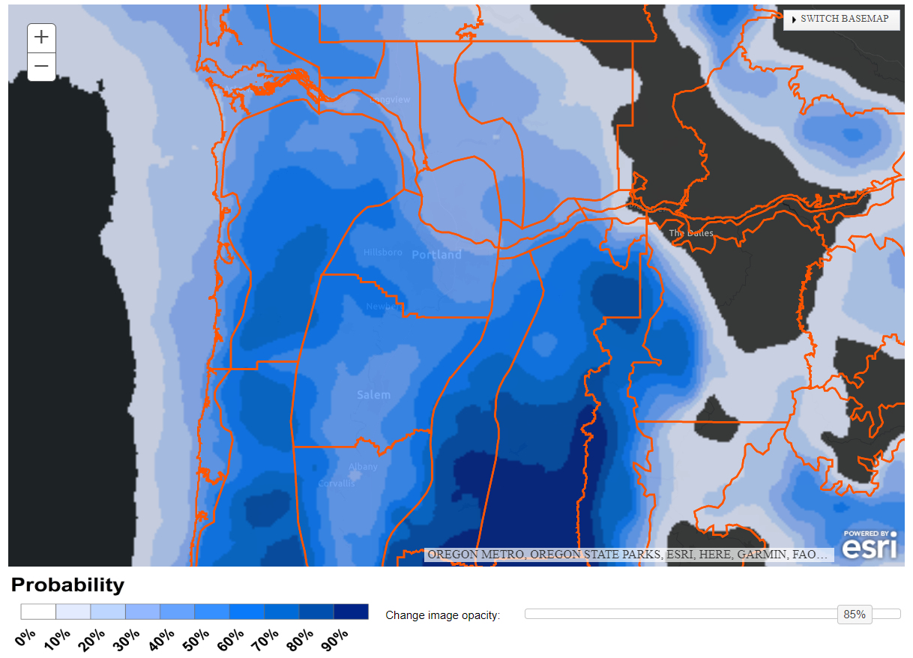
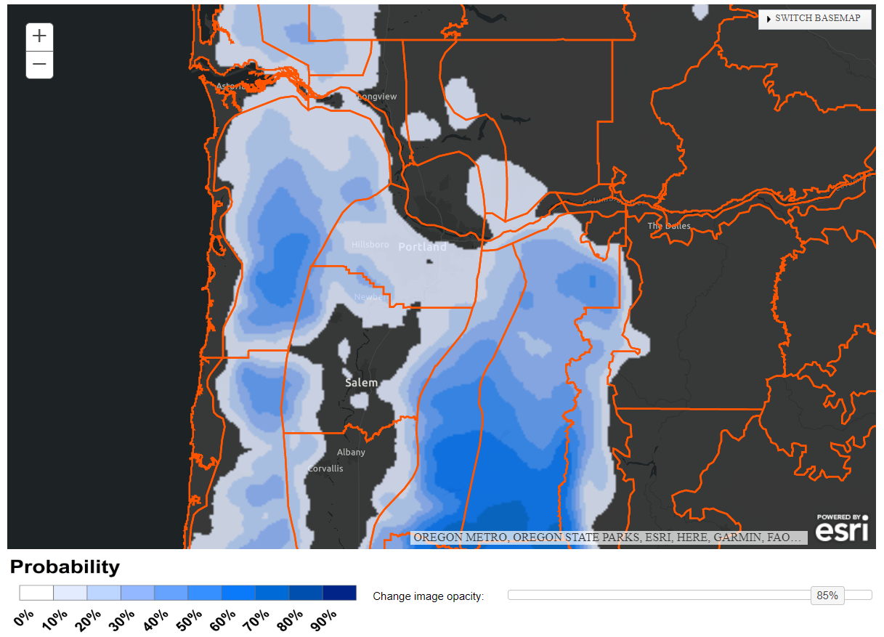
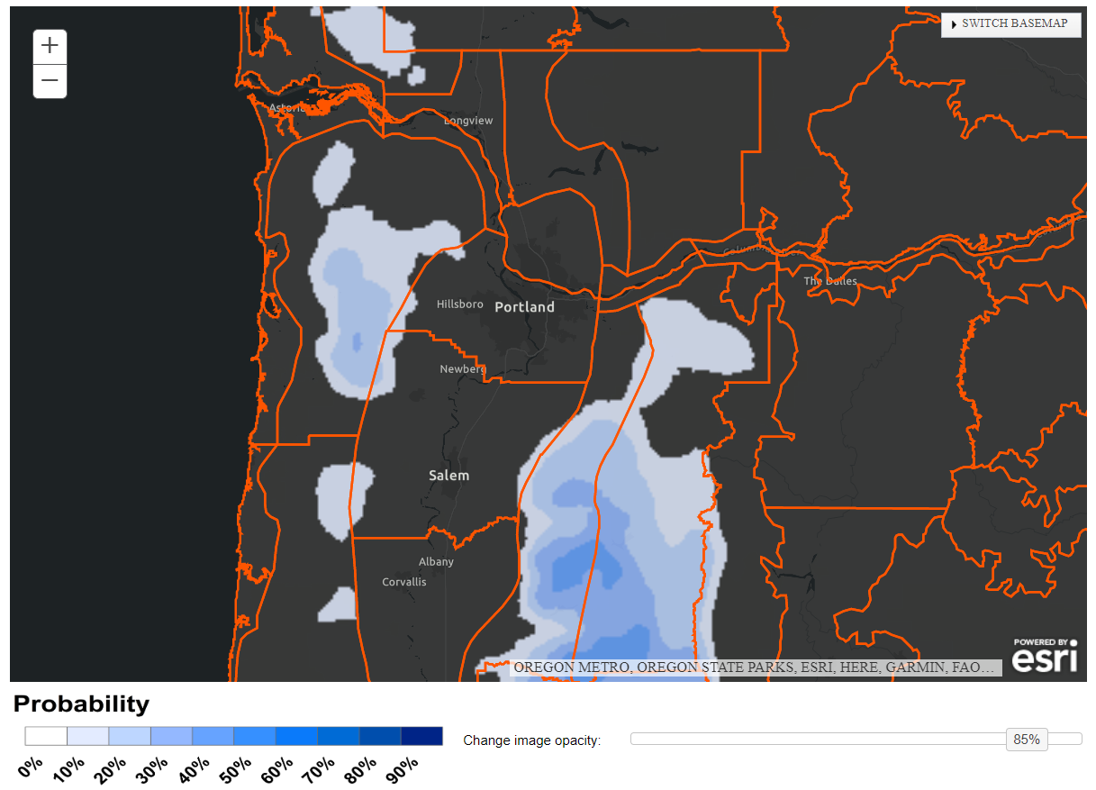
NBM 24-hr Snow Probs (forecast hr 60)
NBM 24-hr Snow
Prob >1” ending 2/23 12z (forecast hr 60)
NBM 24-hr Snow
Prob >4” ending 2/23 12z (forecast hr 60)
NBM 24-hr Snow
Prob >8” ending 2/23 12z (forecast hr 60)

Slide 26
Day 1 Model Data
Notes:
Break off to HMT page to view model data.

Slide 27
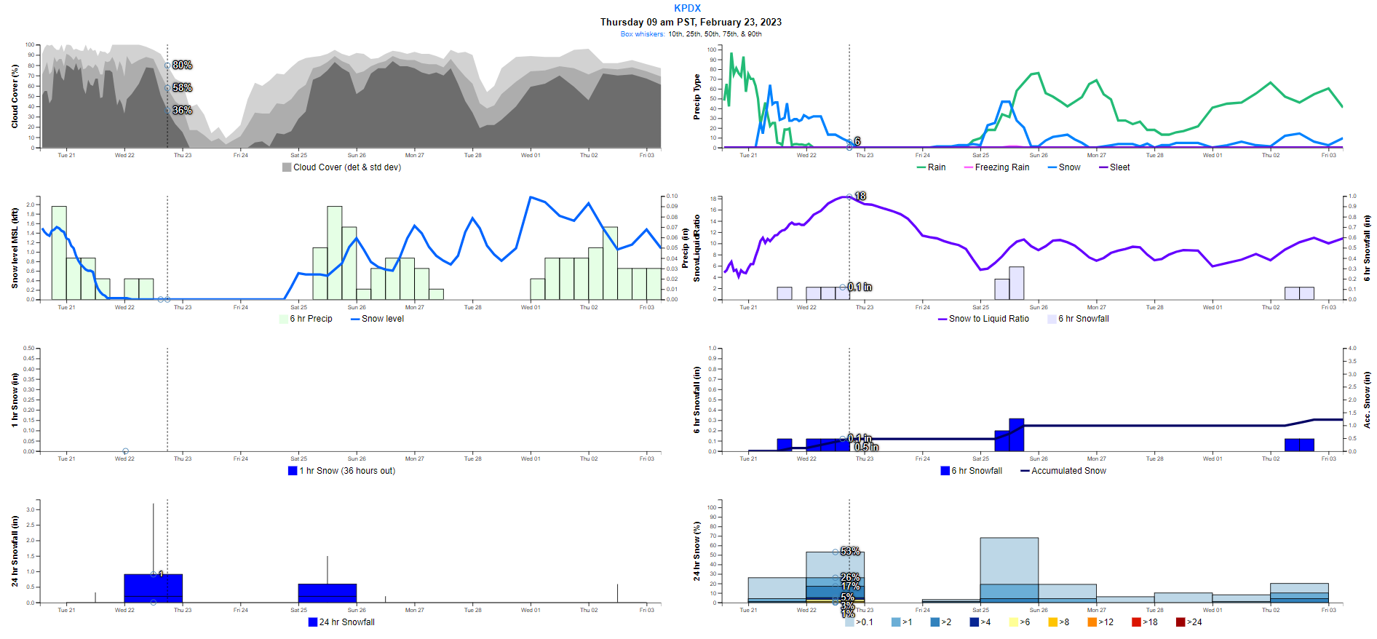
Day 1 - NBM Initialized 13z Feb. 21 - PDX
Notes:
The deterministic NBM was giving Portland 0.5 inches of snow.

Slide 28
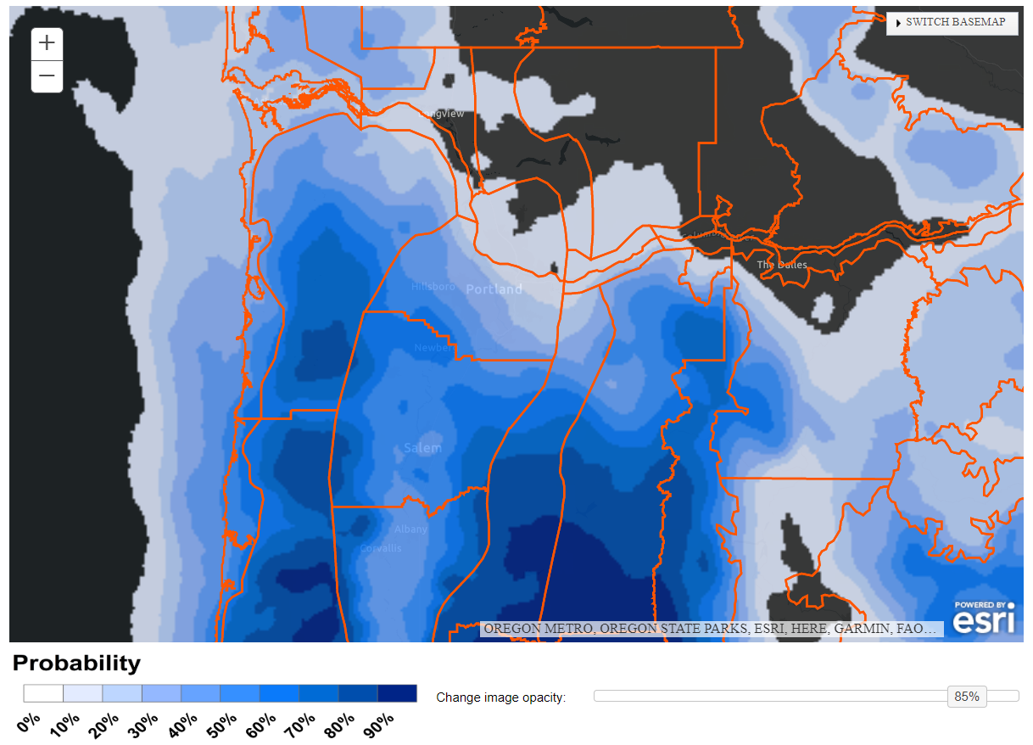
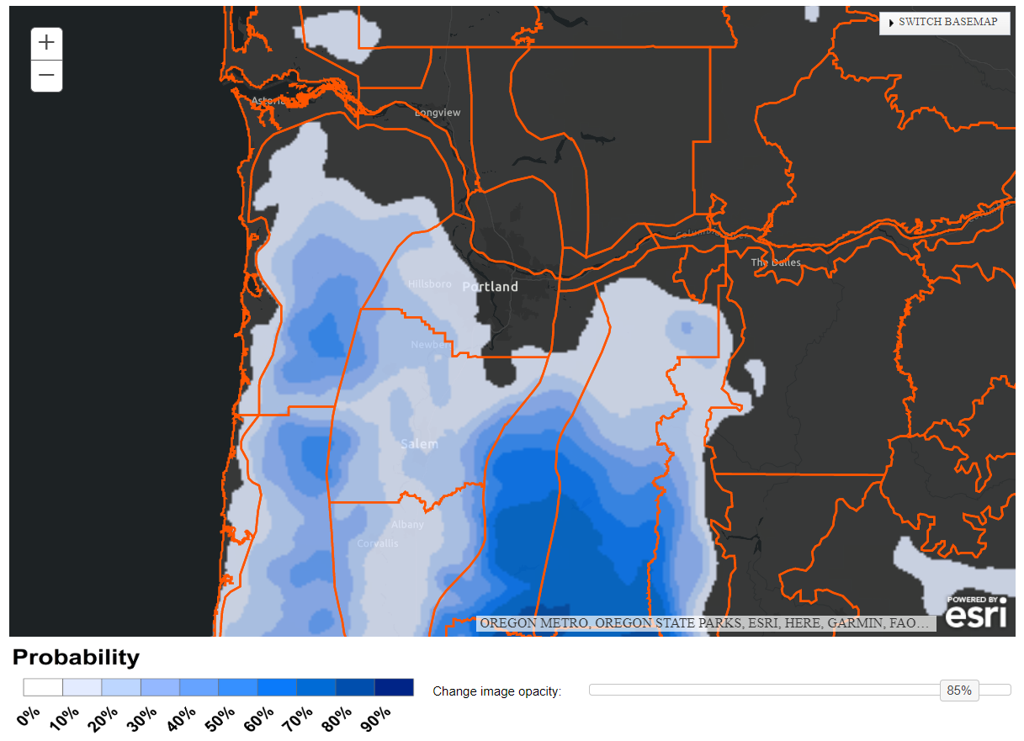
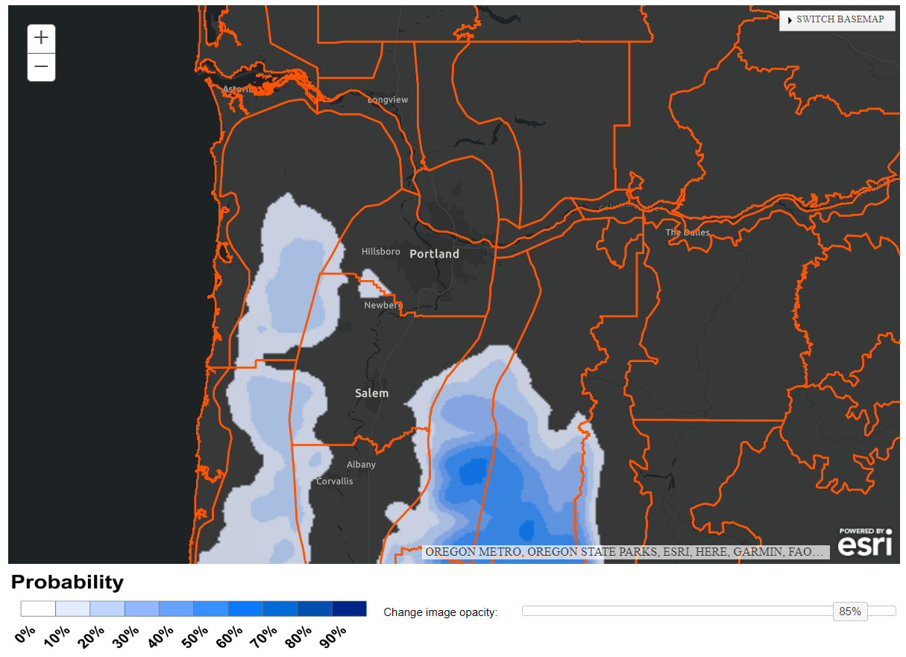
NBM 24-hr Snow Probs (forecast hr 36)
NBM 24-hr Snow
Prob >1” ending 2/23 12z (forecast hr 36)
NBM 24-hr Snow
Prob >4” ending 2/23 12z (forecast hr 36)
NBM 24-hr Snow
Prob >8” ending 2/23 12z (forecast hr 36)

Slide 29
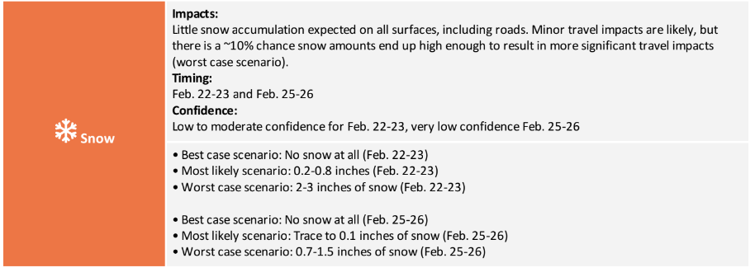
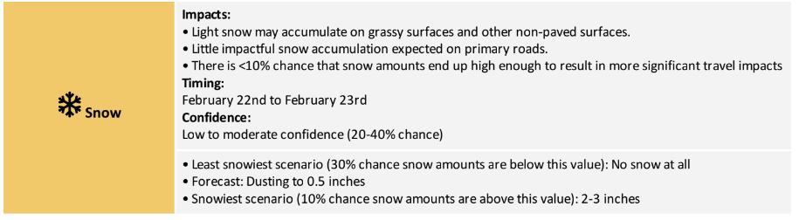
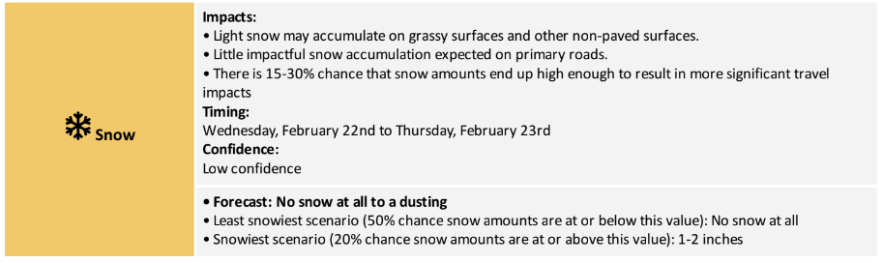
Decision Support & Probabilistic Messaging
5 days out
We began consistently messaging a small but non-zero chance of significant travel impacts 5 days in advance
4 days out
3 days out
However, our most reasonable worst case scenario messaging was around up to 4 inches, not a foot of snow
Notes:
Our briefing send 2 days in advance generally matched the briefing for 3 days out. We transitioned to office hours 1 day out.

Slide 30
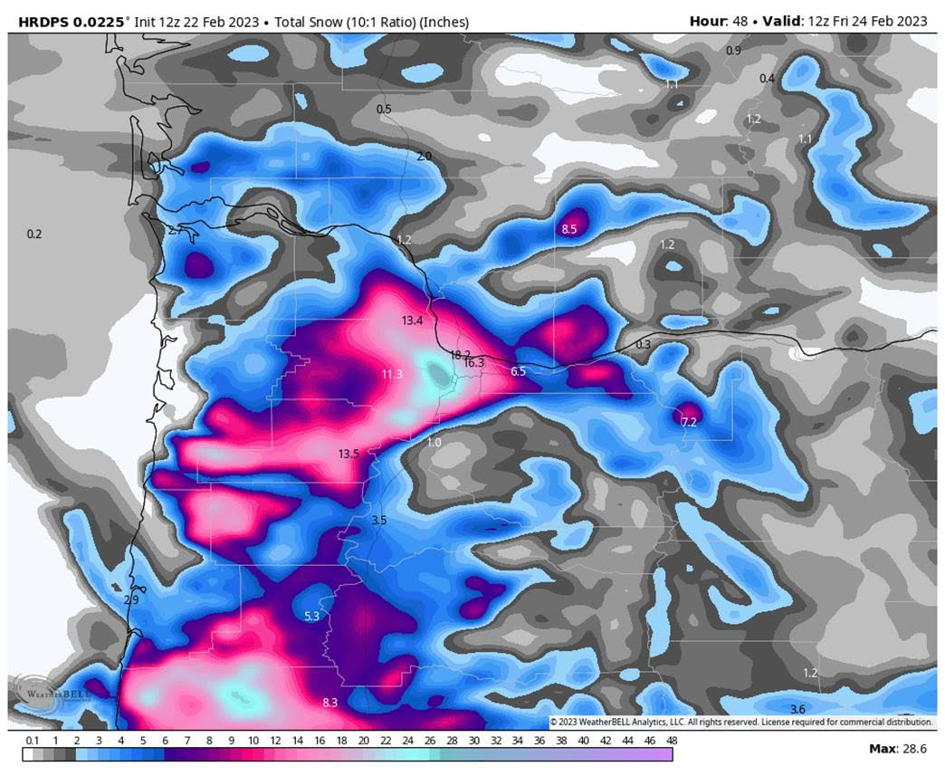
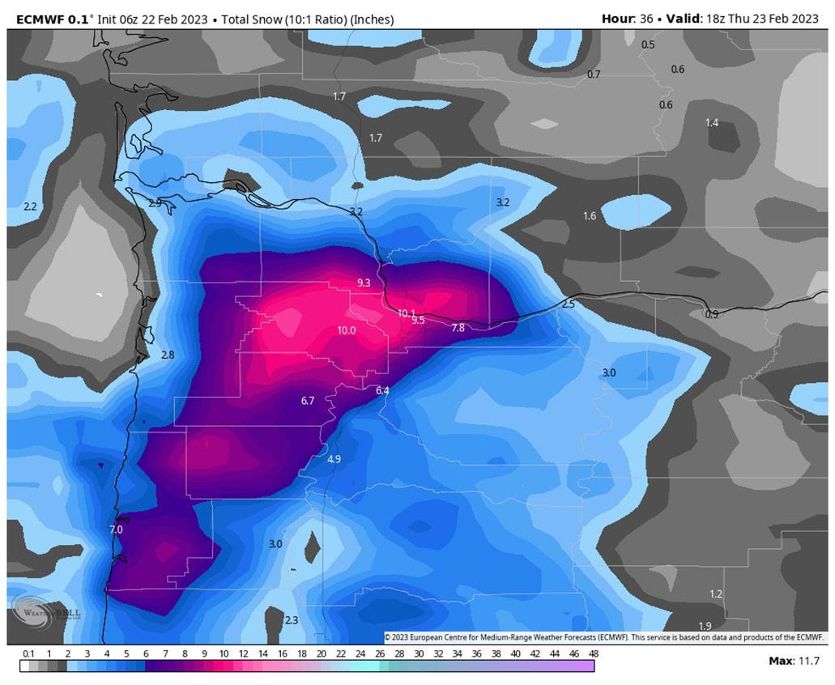
Did any model run show big snow amounts?

Slide 31
Operational Challenges
We expected snow, but not nearly this much!
Exact track of surface/mid-level low not handled well by most global/hi-res model guidance. Mesolows rotating counter-clockwise around the parent low were also not well handled
Model guidance 24+ hours in advance generally showed a surface low near Astoria, OR the morning of the 22nd moving slowly southward towards Florence, OR through the day. Most model guidance (but not all) showed precipitation shutting off completely across the Portland metro the morning of the 22nd as the low shifted south
  In reality, the low stalled over Astoria for around 24 hours and precipitation continued through the day in Portland
  Temps cooled below freezing due to cold easterly winds, allowing rain to switch over to snow in the morning
  This had drastic consequences on QPF/snow amounts, which wasn’t clear until the event was about to unfold
NBM v4.1 24-hour snow probs 12-24+ hours in advance of the event were too low (01z run on Feb. 22nd):
  5% or less for snow amounts >= 4”
  0-1% for snow amounts >=6”
  0% for snow amounts >=10”

Slide 32
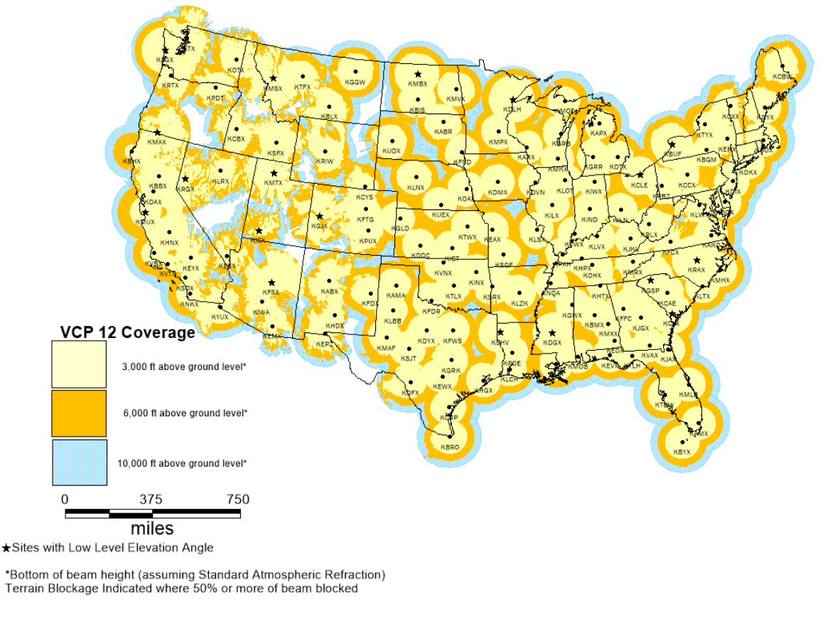
Radar Coverage Gap
Heavy precipitation occurred along and near the central Oregon coast where there is a large gap in radar coverage
Could this have negatively affected hi-res model guidance in the near-term? One would argue YES for any model that assimilates radar observations during initialization
Notes:
The large radar gap along and near the central OR coast may have played a role in the failure of hi-res models such as the HREF and HRRR even 6-12 hours in advance of the snowstorm.

Slide 33
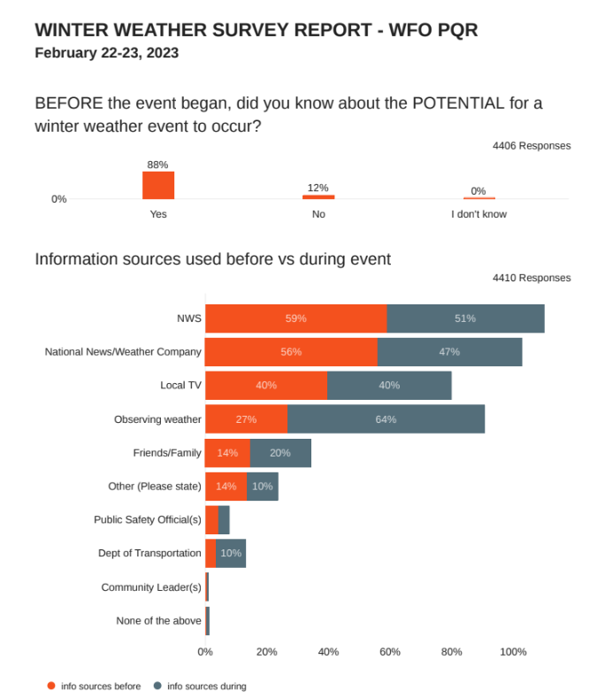
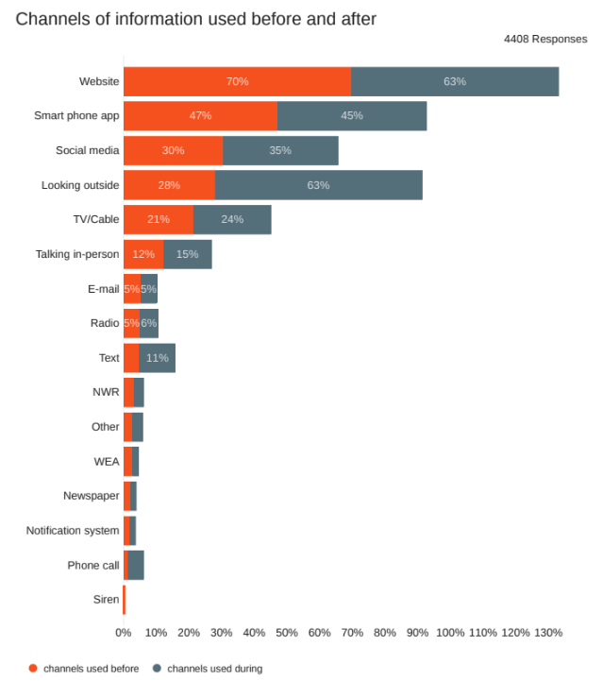
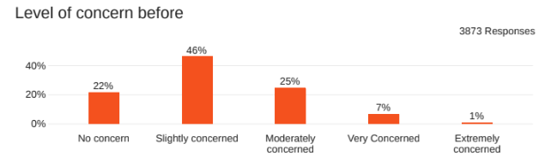
Quick Response Survey
Notes:
Responses came from anyone who follows NWS Portland on social media. This survey is provided by the NOAA Weather Program Office and funded through social science to research applications.

Slide 34
Key Takeaways
People are generally accustomed to having at least 1-3+ days notice for upcoming winter storms, but not every winter storm can be predicted this far in advance
Some winter storms, such as the Feb 22nd snowstorm, are best handled as short-fused events given the uncertainty involved leading up to the event
When models and their ensembles fail us, we have no choice but to quickly pivot our forecast, messaging and headlines once observations make it clear that our forecast isn’t going as planned
It’s natural to pick apart the NBM and HREF for events like this and jump to conclusions. However, there is no way for the NBM and HREF to perform well if their model inputs are out to lunch. Garbage in, garbage out!

Slide 35
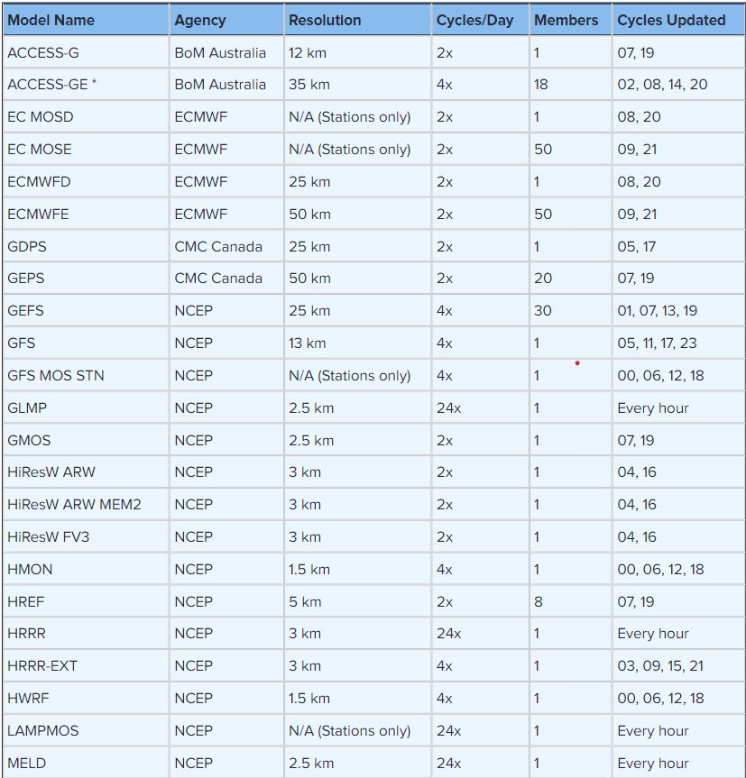
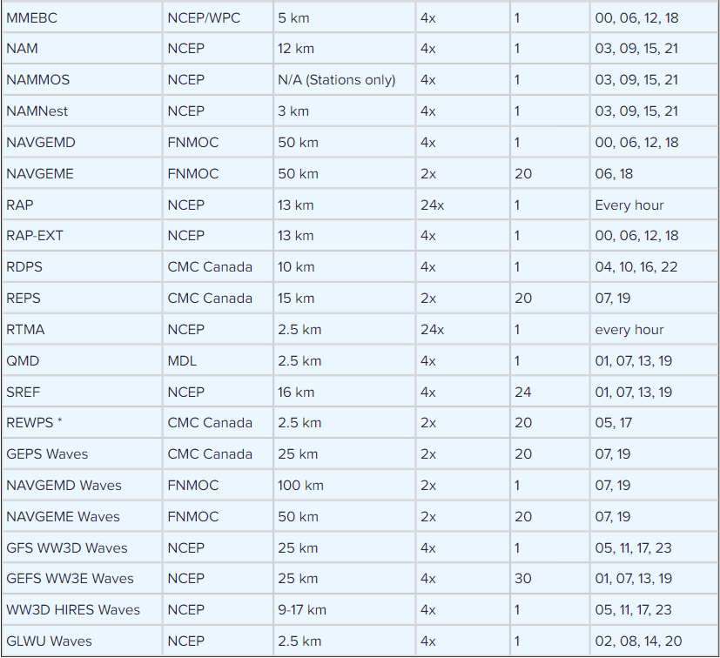
NBM Inputs

