Slide 1
2023-24 Winter Weather Forecast
By: Tanis Leach

Slide 2
Housekeeping
If you want to see how I forecasted for the February 22nd snowstorm, what went well and what didn’t, I do have a 38 min. recap video, in addition to all of my forecasts for the event on my YouTube channel: Weather and Travel with Tanis.

Slide 3
Disclaimer
This is a long range forecast and is intended to provide a general sense of what may happen in the coming months. It is not a “this is for sure happening,” nor is it an excuse not to be prepared for a wind/snow/ice storm or cold temperatures.

Slide 4



2022-23 Scorecard
Predictions | Actual/Projected | Oct | Dec
Water Year Rain: 28-36” Winter less than 14.97” | Winter Actual: 13.58” Water Year: 35.47”
Average Temperature Departure: 2.5°F below average to 1°F above average Dec: 0-4°F below average | 1.2°F below average
Lowest Winter Temperature: <20°F | 18°F
Peak Wind Gust: 45-55 mph | 51 MPH
Most Active Time: January 10th-31st (December update only) | Early November (Corvallis only), Late December, Late Feb | N/A
April 1st Snow Depth: 80-120% of normal December Update: 100-150% of normal | ~115% Basin, 99% at snowtel site.
Valley Snowfall: 1-5 in. (2-8 in. Central/South Valley) December Update: 2-8 in entire valley. | Portland: 11 in. Eugene: 2.2 in. All Valley Average (Population Weighted): 7.72 inches
½
½

Slide 5
Methodology
Adjusted analog year approach using:
  ENSO via the Oceanic Nino Index (ONI) and confirmed using the SOI.
  Pacific and Atlantic Multidecadal Oscillation.
  Sunspot Count.
  Analogs not weighted equally. Analogs that are closer condition wise to this year's conditions have a higher weighting.
Adjustments to analog years made using statistical analysis (since 1940):
  If there is a statistically likely/unlikely chance (90%) of something occurring, analogs will be adjusted unless there is a clear trend in the analog years showing the opposite.
  General trends based on previous season when appropriate.
Snow prior to 1970s have been adjusted to a 4.3-inch average per winter on analogs.
All forecasts will cover what has happened in 1 out of 3 winters at the Portland Airport.

Slide 6
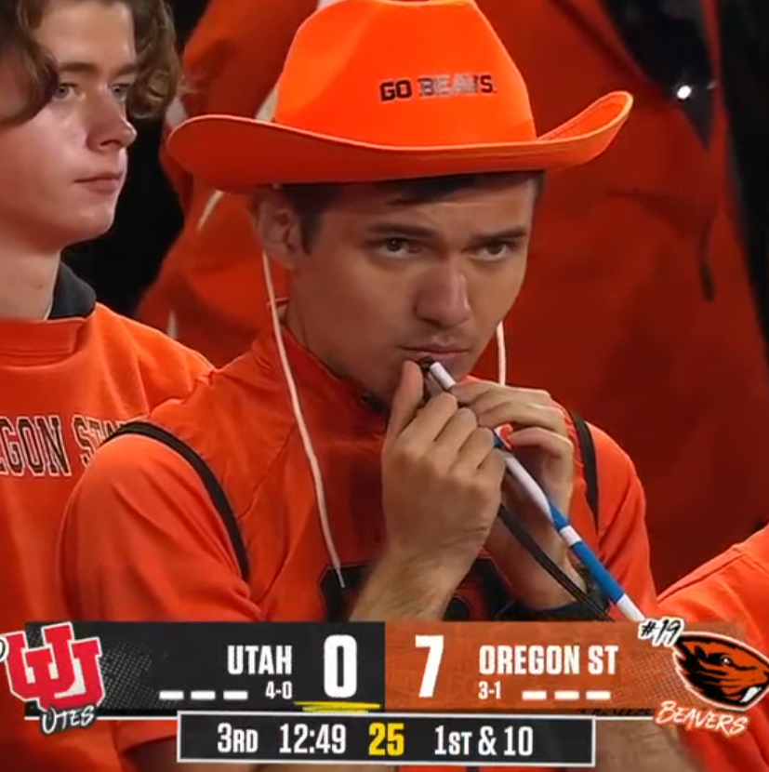
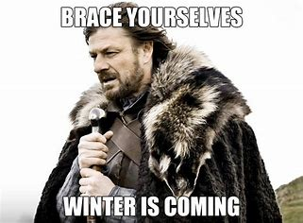
Should I be worried for the Worst Case Scenario?
75 inches of snow.
3 major arctic blasts
Temperature’s below 0.
9 degrees below average.
Image courtesy of FS1

Slide 7
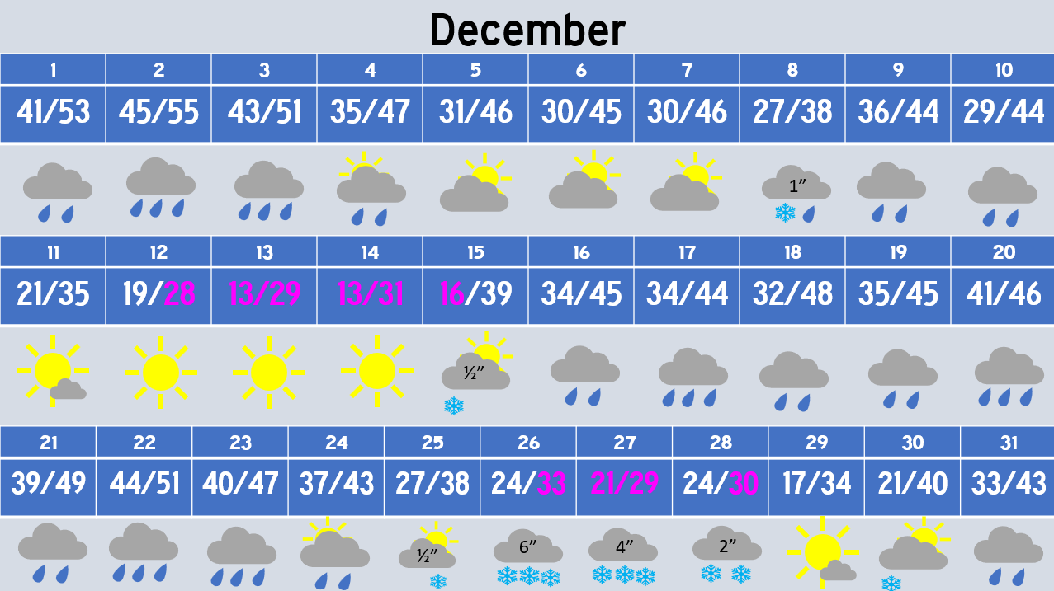

Slide 8
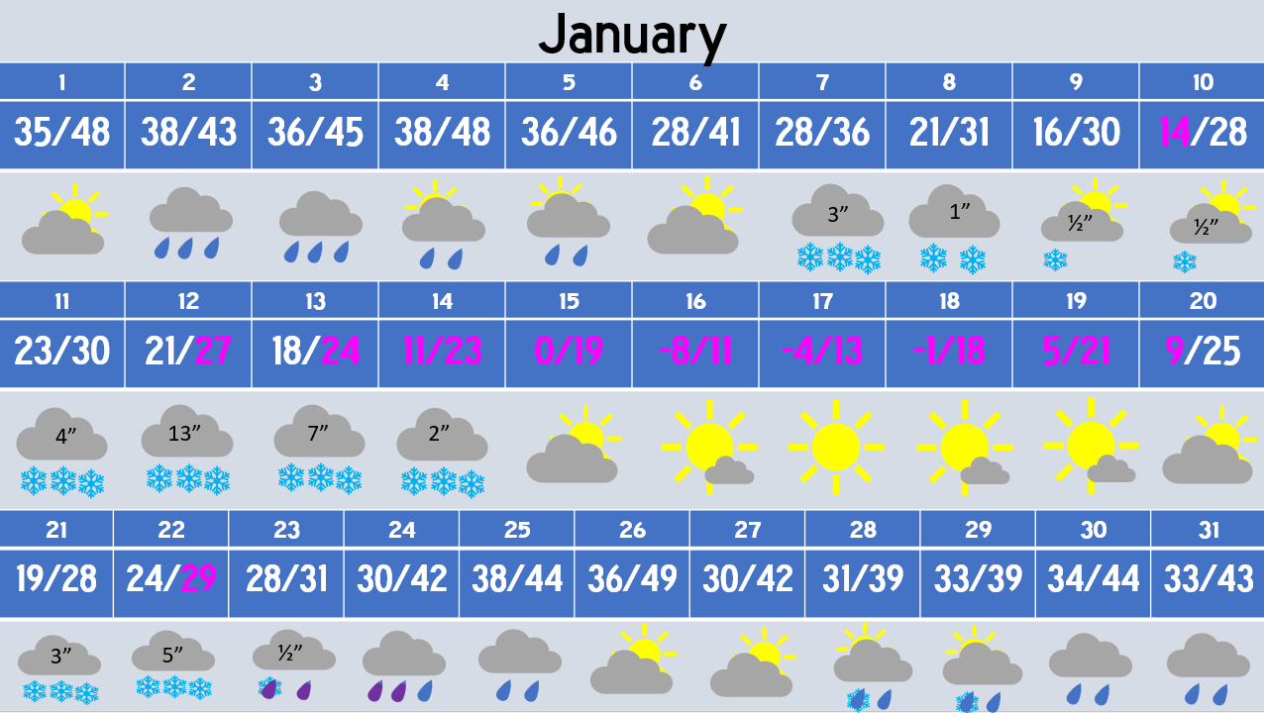

Slide 9
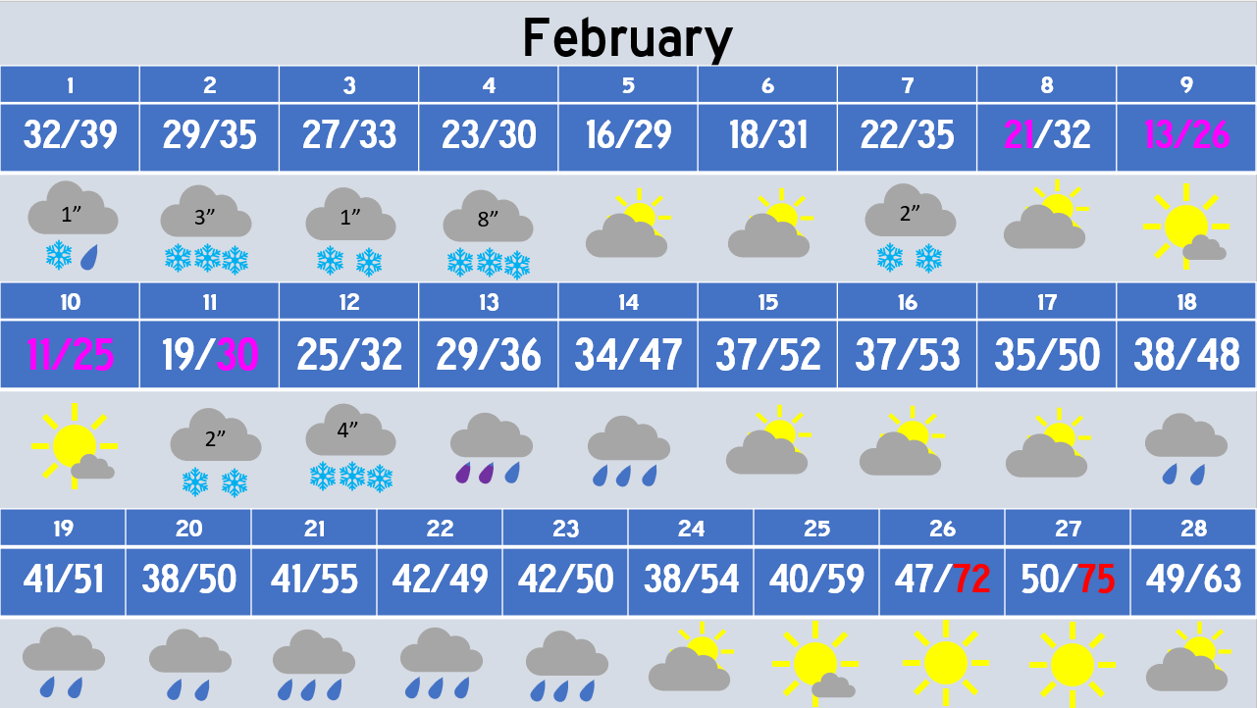

Slide 10
Worst Case Scenario Disclaimer
All patterns have a 1/50 year return period individually, not back to back. The -8°F is caused by a 1/30 year snowstorm with ideal position followed by a -21°C arctic blast (1/50 year).
I left the windstorm worst case out.

Slide 11
Data and Oscillations

Slide 12
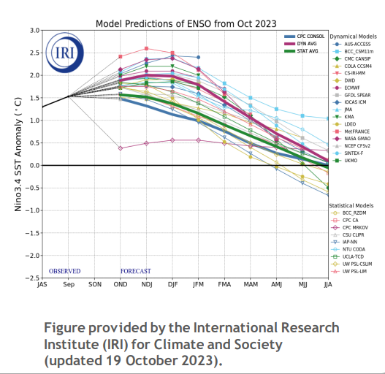
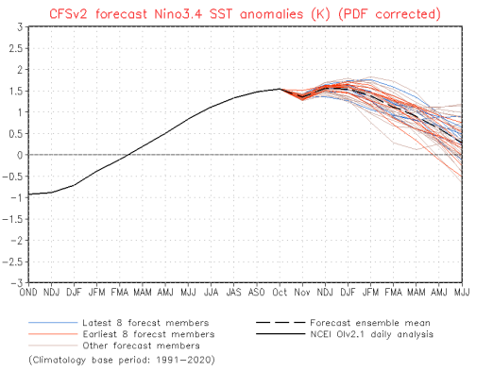
ENSO Outlook: The US’s Look

Slide 13
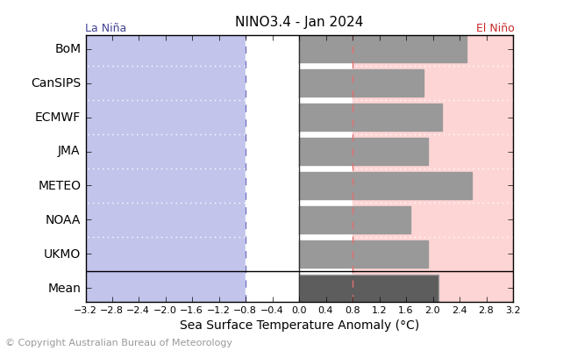
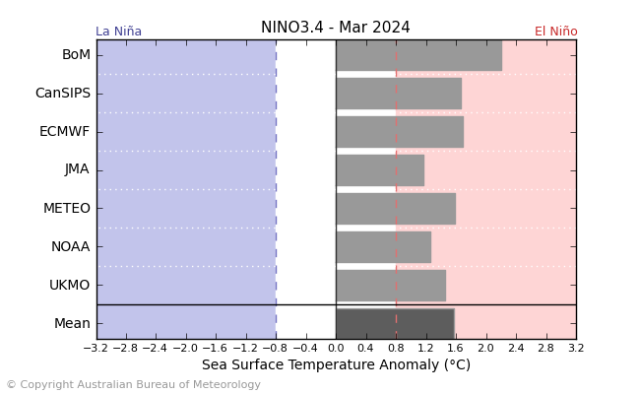
ENSO Outlook: The World’s Look

Slide 14
Moderate vs. Strong El Ninos
Moderate
Strong
4/9 years had no snowfall. 3/9 years had above 4 inches. Median was 1.25 inches.
Average temperature (decade adjusted): +0.25°F.
Median lowest temperature: 21°F
  Only one year (Dec. 1919) had an arctic blast.
Water year rainfall median: 3 inches below long term median.
Ok mountain snowfall (typically 70-90%).
7/13 years had no snowfall. 3/13 had more than 4 inches. Median was 0 inches.
Average temperature (decade adjusted): +1.5°F.
  No year has been below average more than 0.75°F.
Median lowest temperature: 22°F
  2 arctic blasts (Dec. 1972 and 2009).
Water year rainfall median: Right at long term median.
Bad mountain snowfall below 4500 feet (40-70%), ok above (70-90% typical).

Slide 15
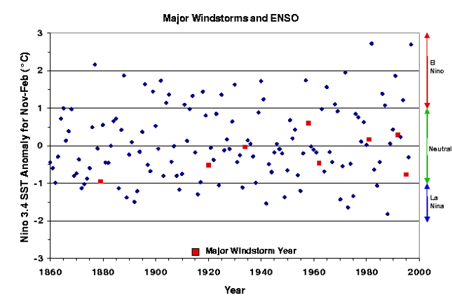
Major Windstorms and ENSO

Slide 16
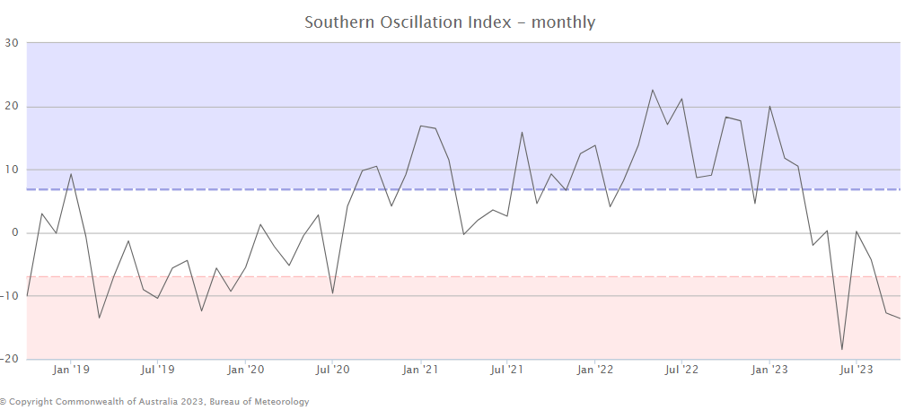
Southern Oscillation Index: Last 5 Years

Slide 17
Pacific Decadal Oscillation: Last 5 Years

Slide 18
Atlantic Multidecadal Oscillation: Last 5 Years

Slide 19
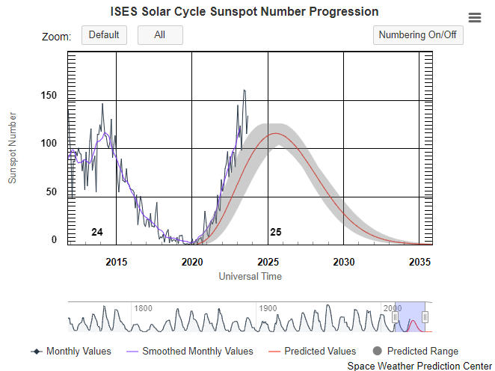
Sunspot Count

Slide 20
Analog Years and Statistics

Slide 21
Analog Years
1905-06
1911-12
1919-20
1925-26
1940-41
1946-47
1951-52
1957-58
1963-64
1965-66
1972-73
1976-77
1982-83
1986-87
1991-92
1993-94
1994-95
1997-98
2002-03
2006-07
2009-10
Top Analog Year
Enso Neutral Year
El Nino Year

Slide 22
Top Analog Year Comparisons
 | 1919-20 | 1951-52 | 1957-58 | 1965-66 | 1993-94 | 2022-23
El Nino Strength | Moderate | Moderate | Strong | Strong | Neutral (-SOI) | Moderate/Strong
PDO | Negative | Negative | Neutral | Neutral | Negative | Negative
AMO | Negative | Positive | Positive | Positive | Negative | Positive
Sunspot progression | 57% | 70% | 27% | 9% | 70% | 35%

Slide 23
Top Analog Year Extreme Events
1919-20
1951-52
1957-58
1965-66
1993-94
Dec. 9th-10th: 17.5 inches of snow.
Followed by 3 days with lows in the single digits (Downtown).
Only time Eugene failed to hit 10°F or higher high temp (Dec. 13th).
Consistently, but not extremely cold December and January.
9.6 inches of snow (mostly in January).
Dud winter. No snow Valley wide.
4.2°F above average (decade adjusted). This is the highest recorded at PDX, though not downtown (1917-18 with +4.9°F)
Dud in Portland. 0.6 inches of snow, though near average temps.
Eugene: 7.7 inches of snow (2/3 of which was in December
3rd driest water year on record (23.89 inches)
Valley wide snowstorm in February (2-4 inches).

Slide 24
Departure From Averages (Decade Adjusted)
Top Analog Year
All Analog Median: +0.7°F
Top Analog Median: -0.01°F
Weighted Analog: -0.4°F

Slide 25
Water Year Precipitation
Top Analog Year
All Analog Median: 33.42”
Top Analog Median: 33.42”
Weighted Analog: 32.41”

Slide 26
Lowest Winter Temperature
Top Analog Year
All Analog Median: 21°F
Top Analog Median: 20°F
Weighted Analog: 17°F

Slide 27
Adjusted Snowfall
Top Analog Year
All Analog Median: 1.25”
Top Analog Median: 2.6”
Weighted Analog: 3.2”

Slide 28
Historically Significant Trends:
8 consecutive winters have had measurable snowfall. (record high)
  Chance of a 9th occurring (unadjusted): 5.3% chance
Only 3 winters (1941-42, 1973-74, 1976-77) have produced a temperature under 20°F with less than 1.5 inches of snow (all with 0).
3 consecutive winters have had 6”+ of measurable snowfall in Portland.
  Chance of 4th occurring (unadjusted): 2.5%
9 winters without a regionwide arctic blast (-12°C at 850mb over Salem)
  Chance of 10th occurring: 7.3%
    Overruled by snow statistics.

Slide 29
Bonus Statistics (Not used in Forecast)
Chance of measurable January snow for the 1st time in 7 years: 99%
  Not an accurate statistic to use in any forecast when ENSO is a driving factor on when it snows.

Slide 30
The Predictions

Slide 31
The Basics
Rain: Near Median water year favored: 31-39” (87-109% of median)
  Winter: 13-16.5”.
  Best Estimate: 34”
Temperature Departure: Near Normal favored: Within 1.5°F of average
  Best estimate: Right at average
Windstorm(s): Nothing too crazy: Peak gust 45-55 mph.
Lowest Temperature: Above 20°F
  Best Estimate: 22°F
Most likely to be Active: December

Slide 32
Snowfall
Mountain Snow Depth on April 1st between 75-110% of normal above 4500 feet.
  60-100% from 3500-4500 feet.
Valley Snowfall:
  Below Normal Favored Portland: 0-3”
    Best estimate: T
  Central/South Valley Normal Snowfall Favored: 1-5”
    Central/South Valley: 3”
  Chance of 2 inch snowstorm: 40%
  Chance of 5 inch snowstorm: 20%
  Chance of 8 inch snowpocalypse: 5%
  Chance of bust winter: 50%

Slide 33
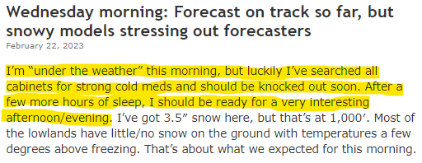
Want a Higher Chance of snow or Change the Peak Time?
Just get Mark Nelsen near-sick or find a way to act like he’s about to take time off.
  Last year proved Mother Nature can be fooled when he takes a vacation day.

Slide 34
Thank You.

Slide 35
Links
Full report: https://docs.google.com/document/d/1ApWfGnUACQS3F3RHr0ZEQ3D2EQYagSIr/edit?usp=sharing&ouid=102355074394437759895&rtpof=true&sd=true
YouTube Channel: https://www.youtube.com/@weatherandtravelwithtanis4589/videos
Storm Recap: https://youtu.be/BZYxN-9RqNE?si=4EQfMCl-8kAhZg-T

