Slide 1
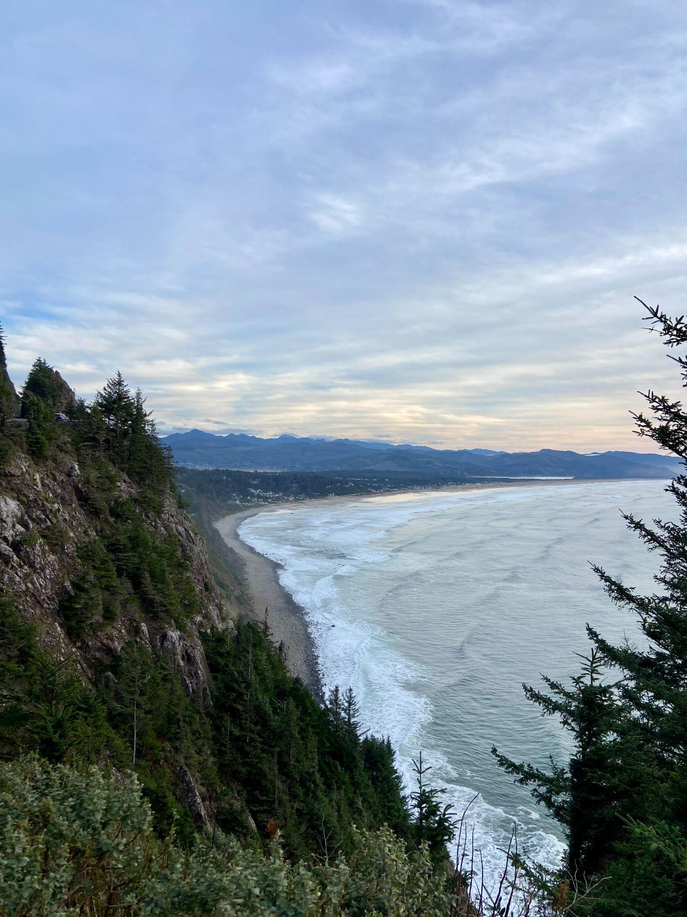
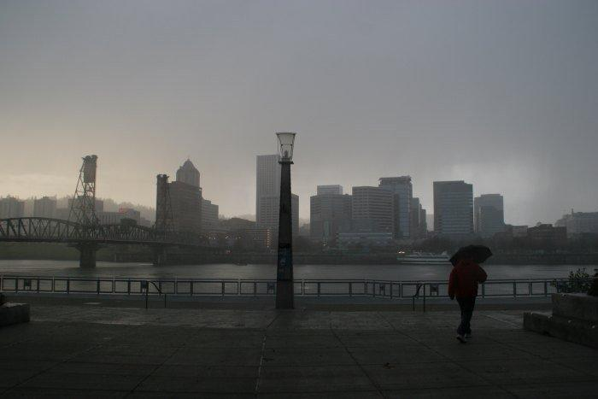
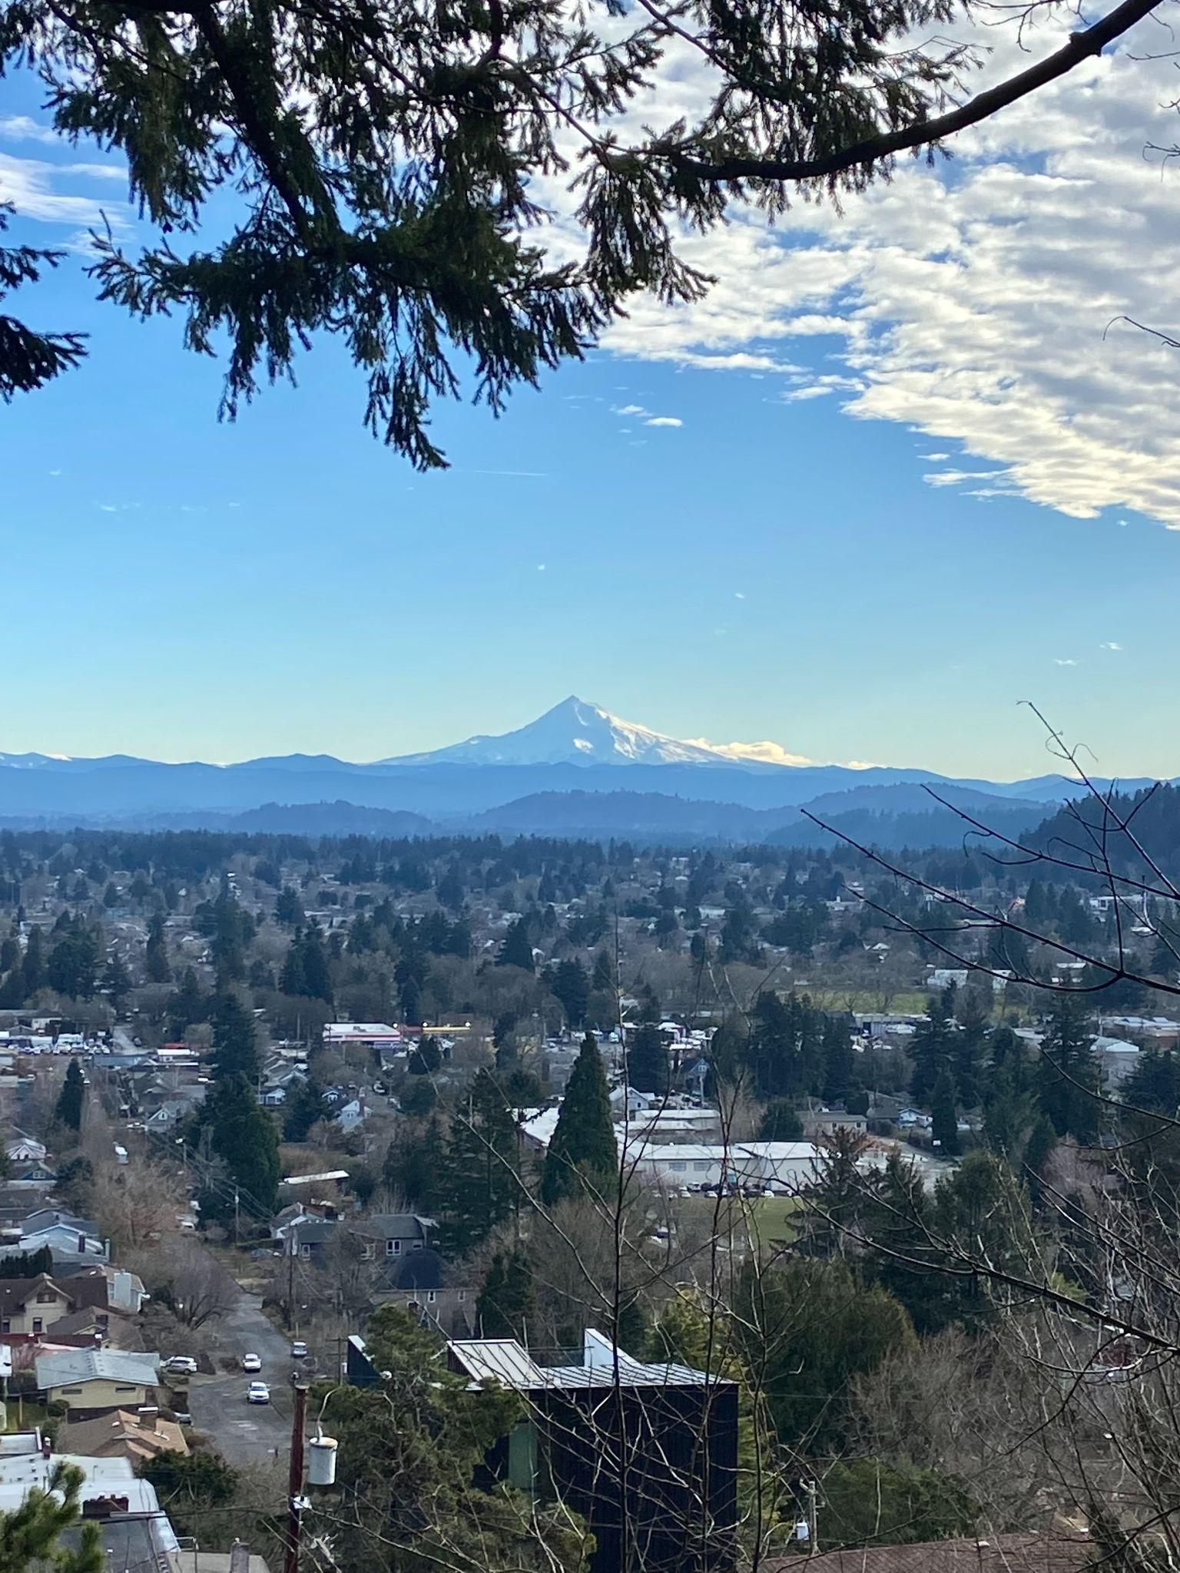
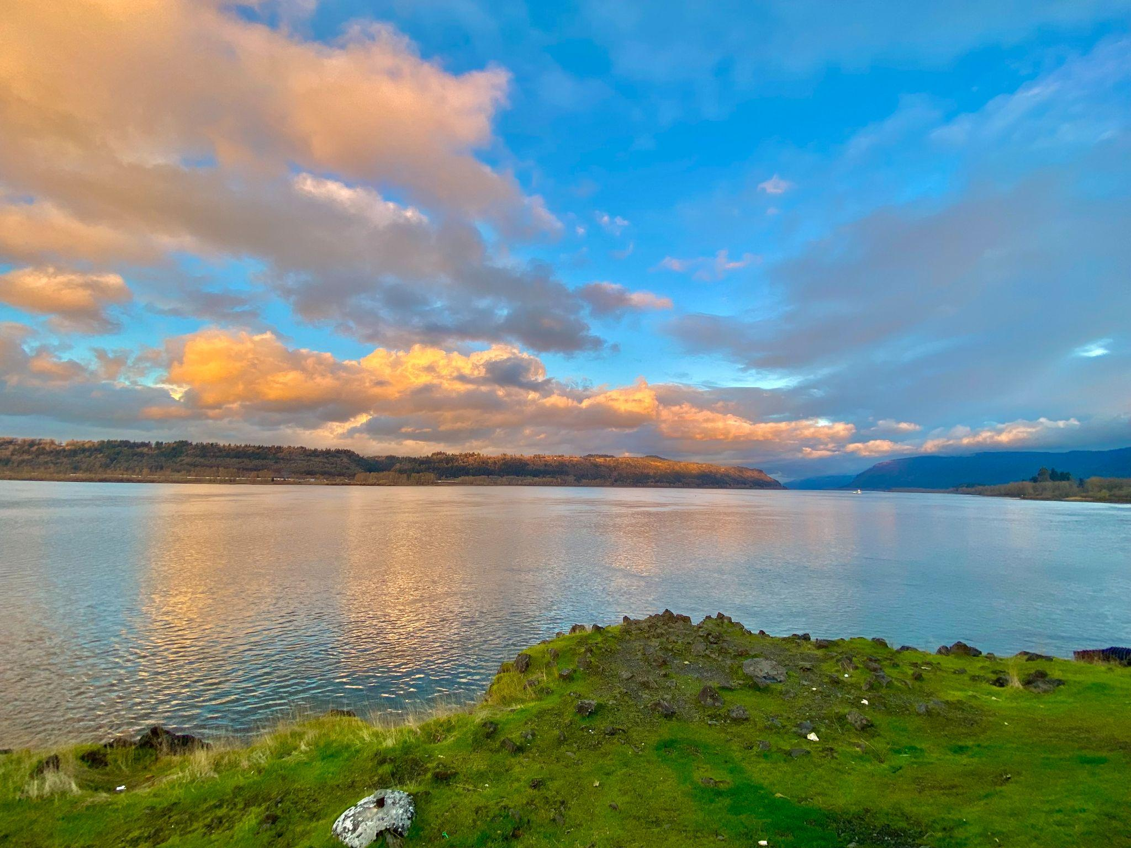
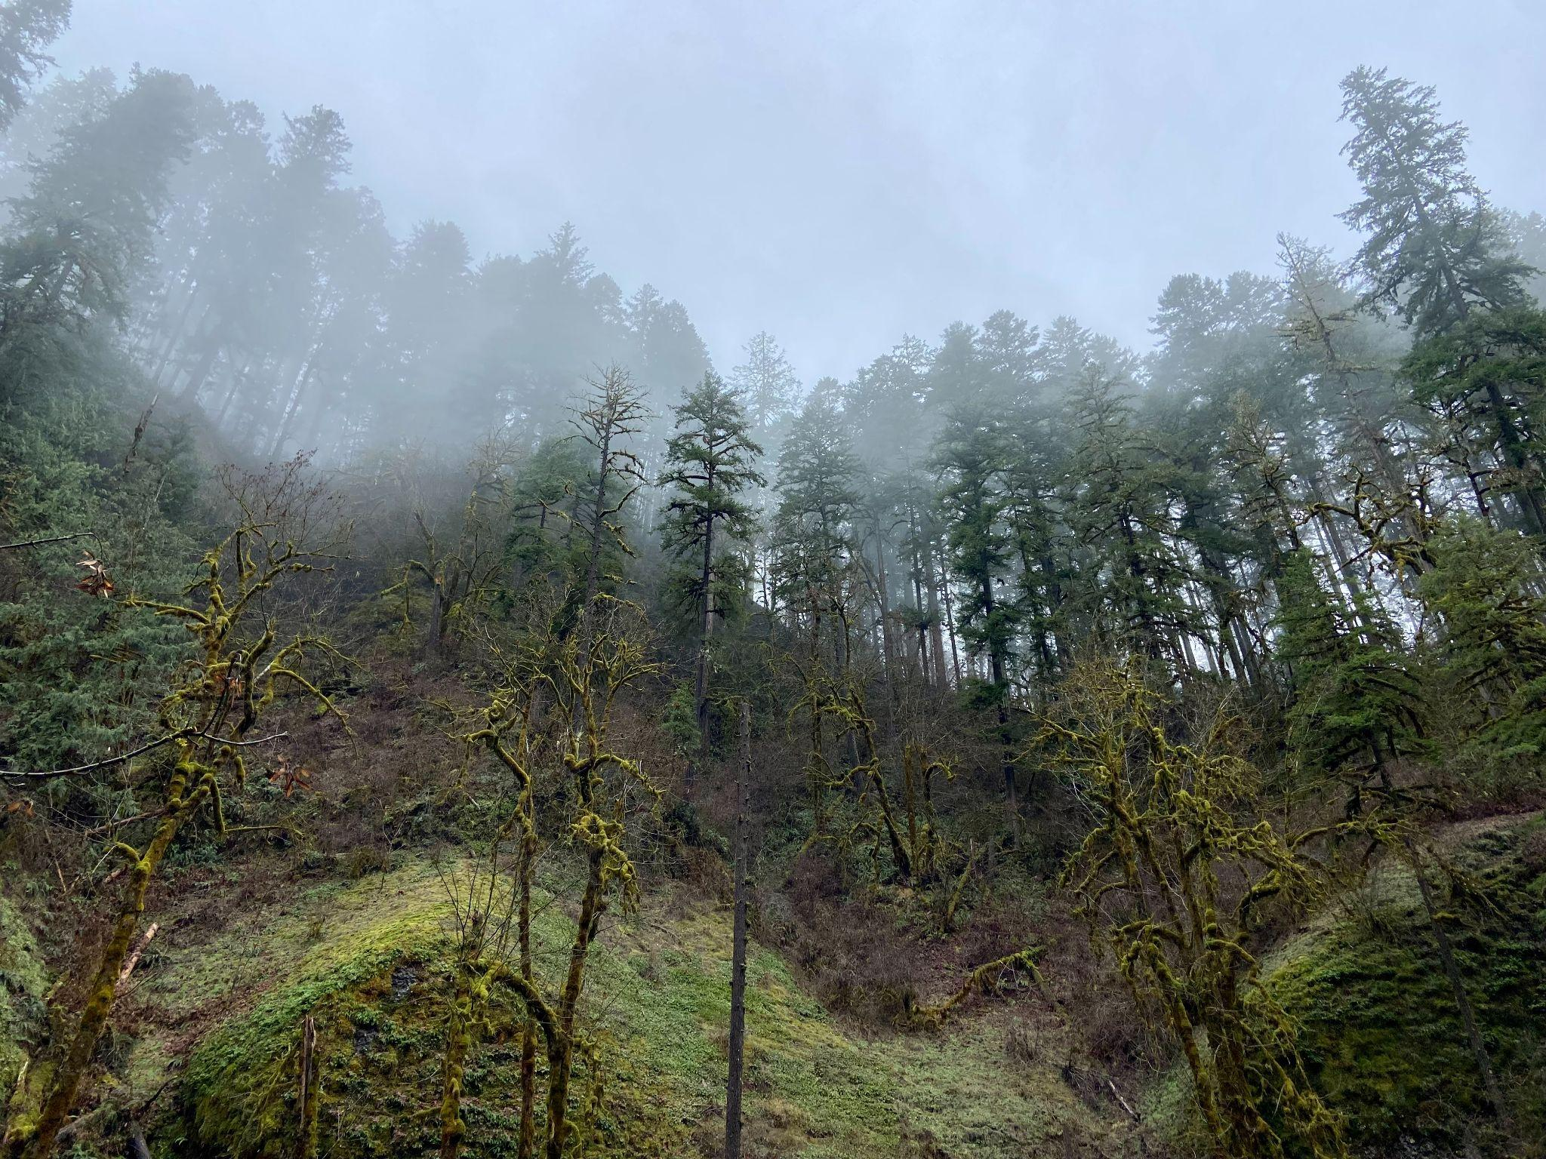
NWS Winter Outlook 2023-24
October 28, 2023
Oregon and Southwest Washington
Noah Alviz, NWS Portland Meteorologist

Slide 2
Key Points
October 28, 2023
What is El Niño-Southern Oscillation (ENSO)?
Current ENSO Status: El Niño
Historical implications of El Niño on our weather
NWS Climate Prediction Center Outlook
Other Implications (drought/hydrology)

Slide 3
El Niño-Southern Oscillation (ENSO)
October 28, 2023
What is ENSO?
A recurring climate pattern that involves periodic fluctuations in sea surface temperature and the overlying atmosphere across the equatorial Pacific Ocean.
Ability to modify the general flow of the atmosphere
Can affect local weather conditions!

Slide 4
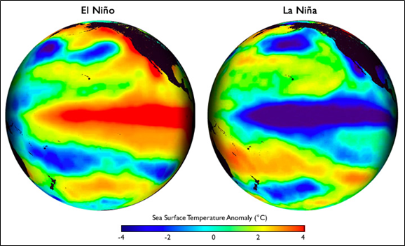
El Niño-Southern Oscillation (ENSO)
October 28, 2023
3 Possible ENSO Stages
ENSO-neutral (near-normal water temps across the equatorial Pacific)
La Niña (relatively cool water across the equatorial Pacific - right diagram)
El Niño (relatively warm water across the equatorial Pacific - left diagram)

Slide 5
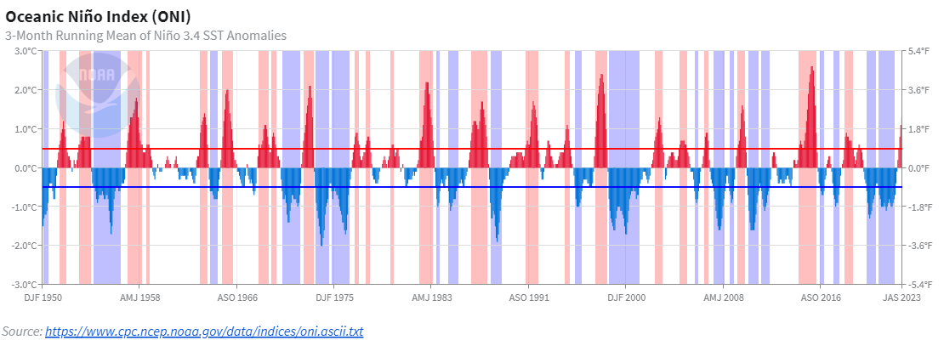
El Niño-Southern Oscillation (ENSO)
October 28, 2023
ENSO Stages fluctuate over time!
1950
1975
2000
2023
WEAK: +0.5 to +0.9°C
MODERATE: +1 to +1.4°C
STRONG: +1.5 to +1.9°C
VERY STRONG: ≥ +2°C
El Niño Categories:

Slide 6
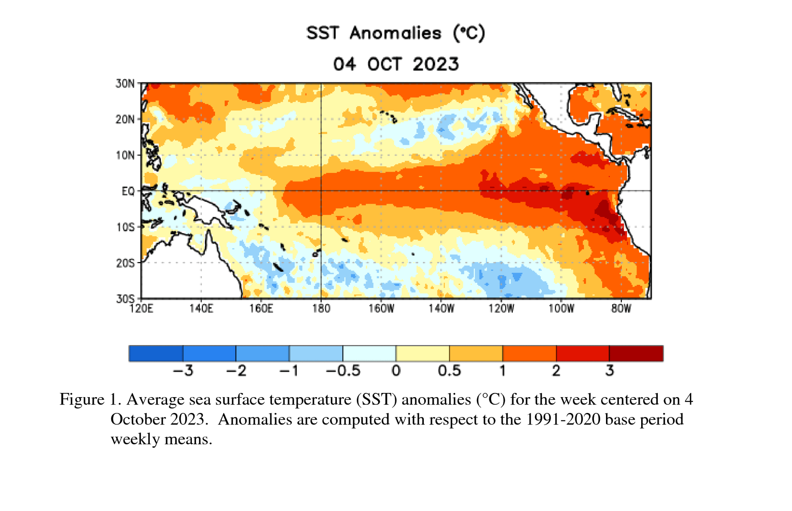
ENSO Status: El Niño Advisory
October 28, 2023
El Niño is anticipated through the Northern Hemisphere winter, with a 75-85% chance of a strong El Niño.
Sea surface temps are at least 1.5°C above average across the equatorial Pacific
A strong event does not guarantee strong global impacts
Notes:
A strong event doesn't guarantee strong global impacts, but it does increase the odds that some level of impacts will occur in places with a history of being affected by ENSO.

Slide 7
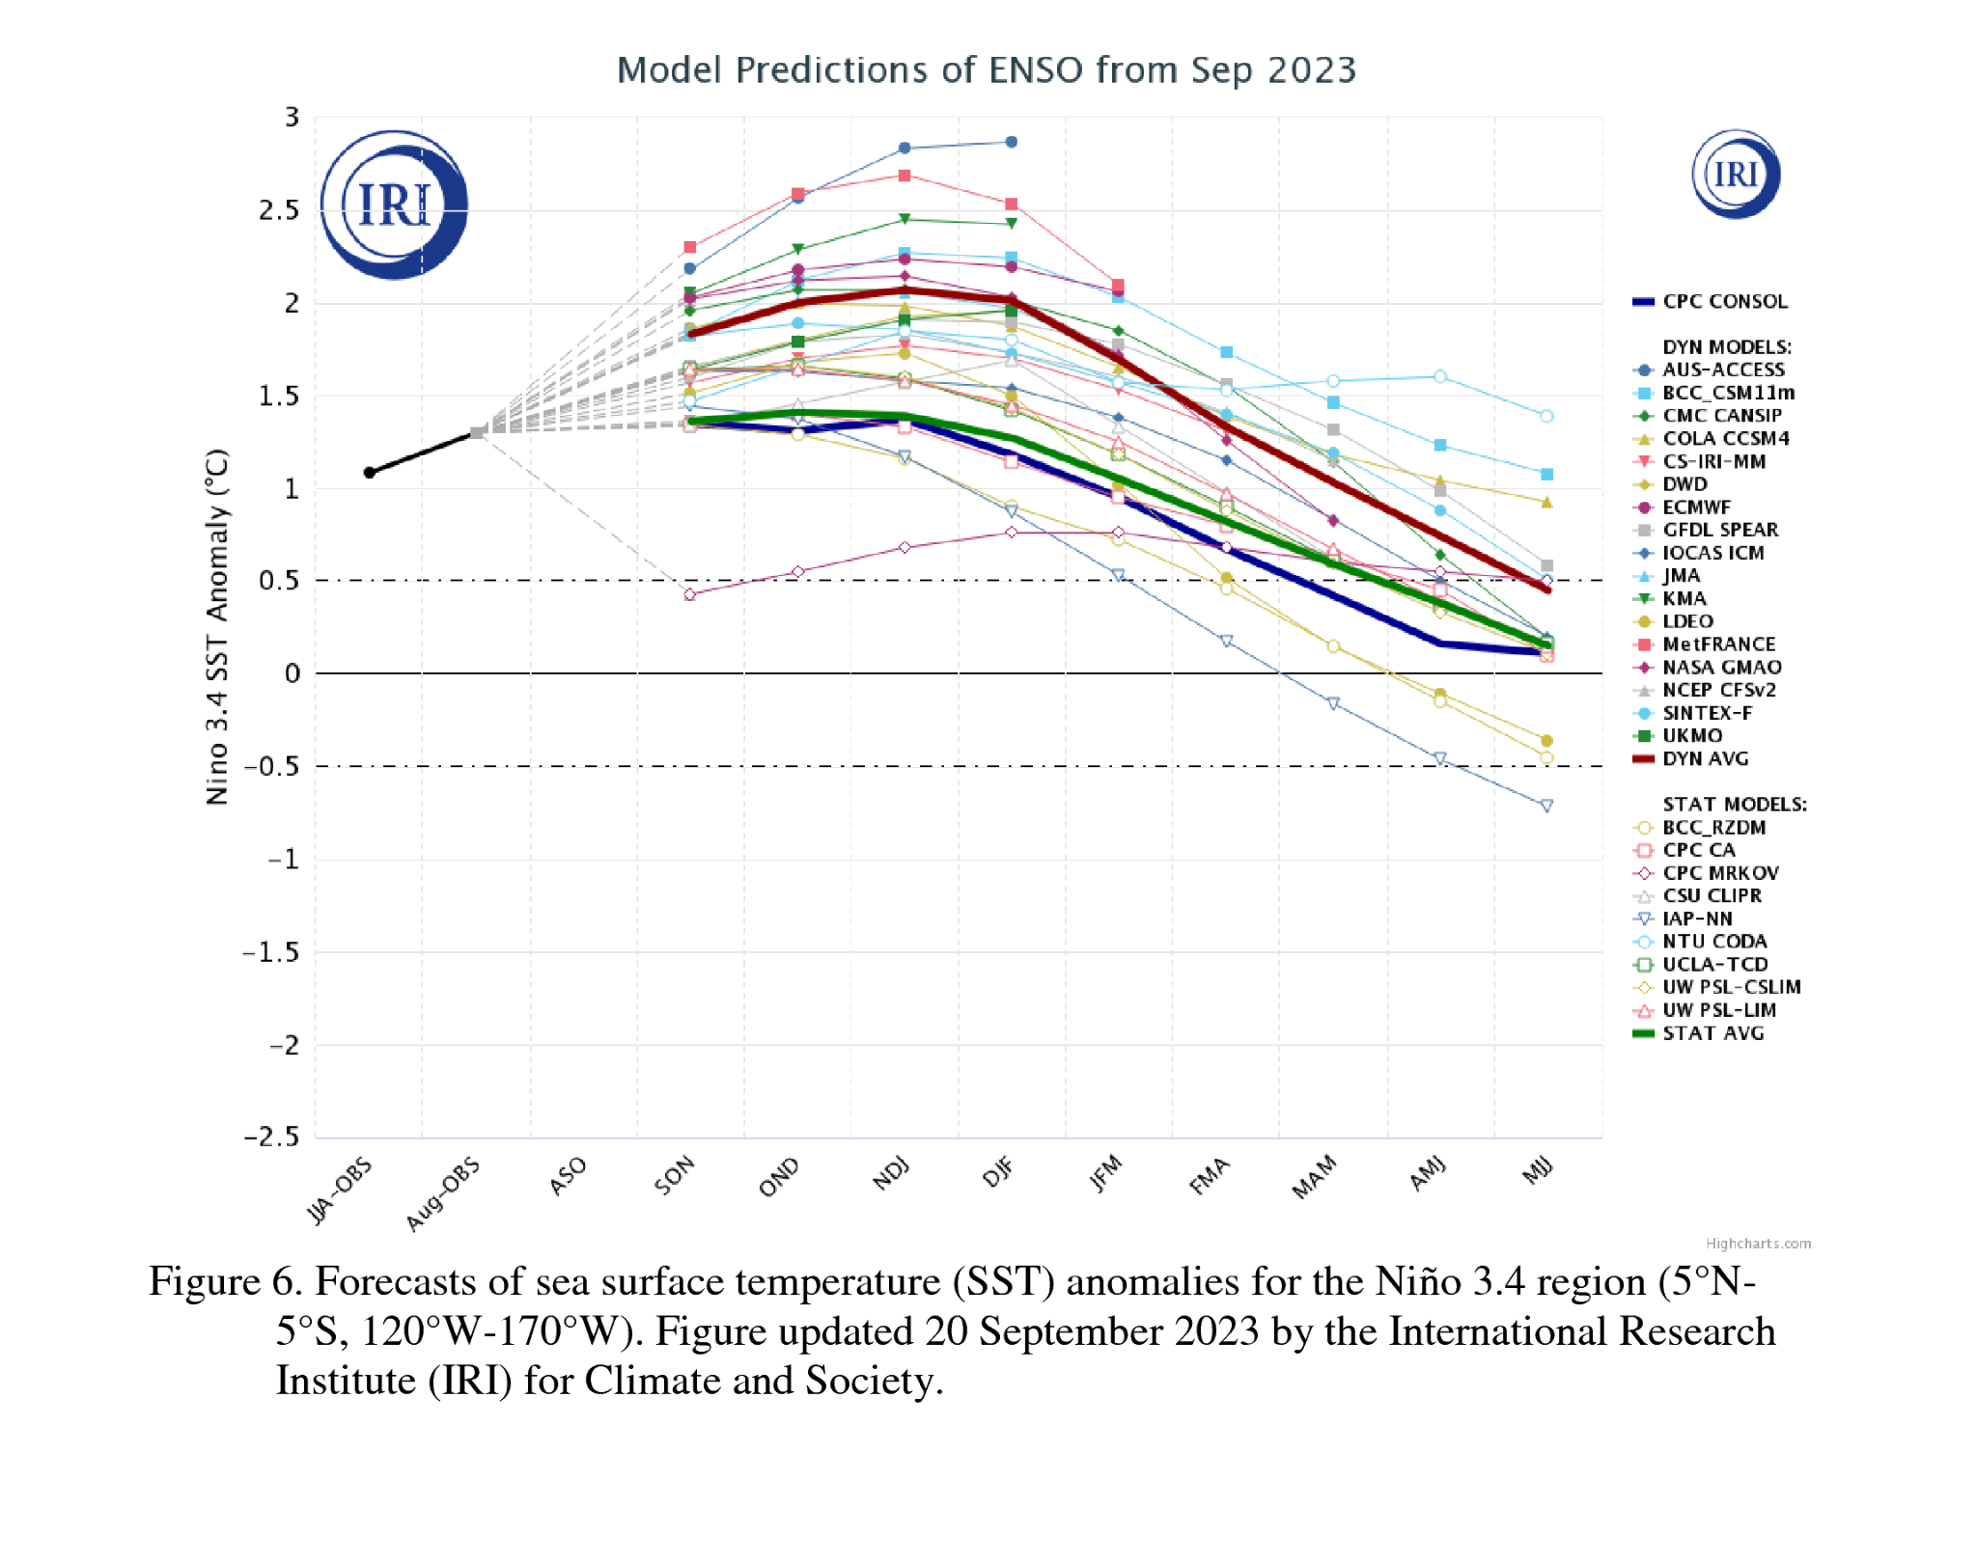
ENSO Status: El Niño Advisory
October 28, 2023
Strong El Niño
Good model agreement for at least a strong El Niño through this winter
Nov - Mar
80% chance El Niño continues this spring

Slide 8
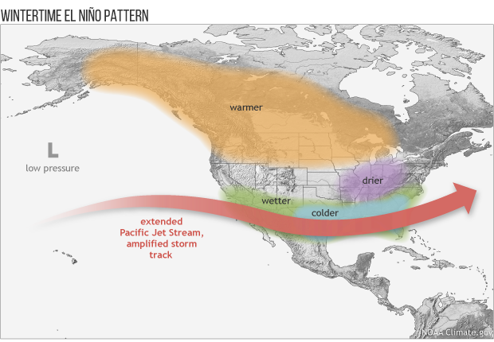
Historical Implications of El Niño
October 28, 2023
Pacific Jet Stream gets shifted southward
Winter PNW temperatures trend warmer than normal. Precipitation has less of a clear trend.

Slide 9
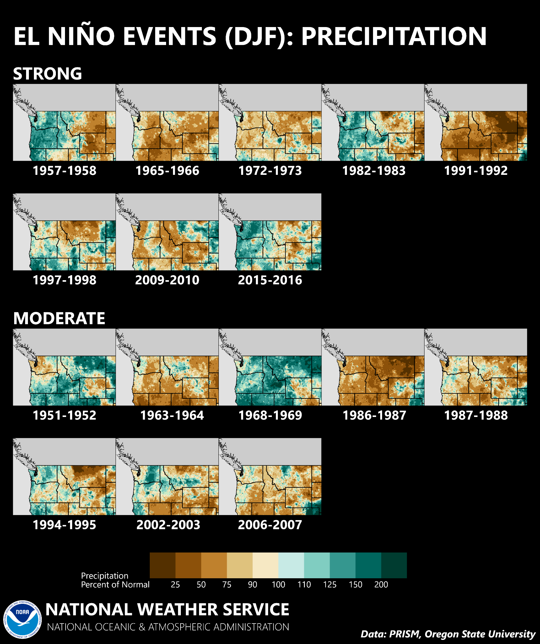
Historical Implications of El Niño
October 28, 2023
Winter (DJF) Precipitation Trends for STRONG El Niños
above-normal
below-normal
below-normal
above-normal
below-normal
Precipitation % of normal
mix
below-normal
above-normal

Slide 10
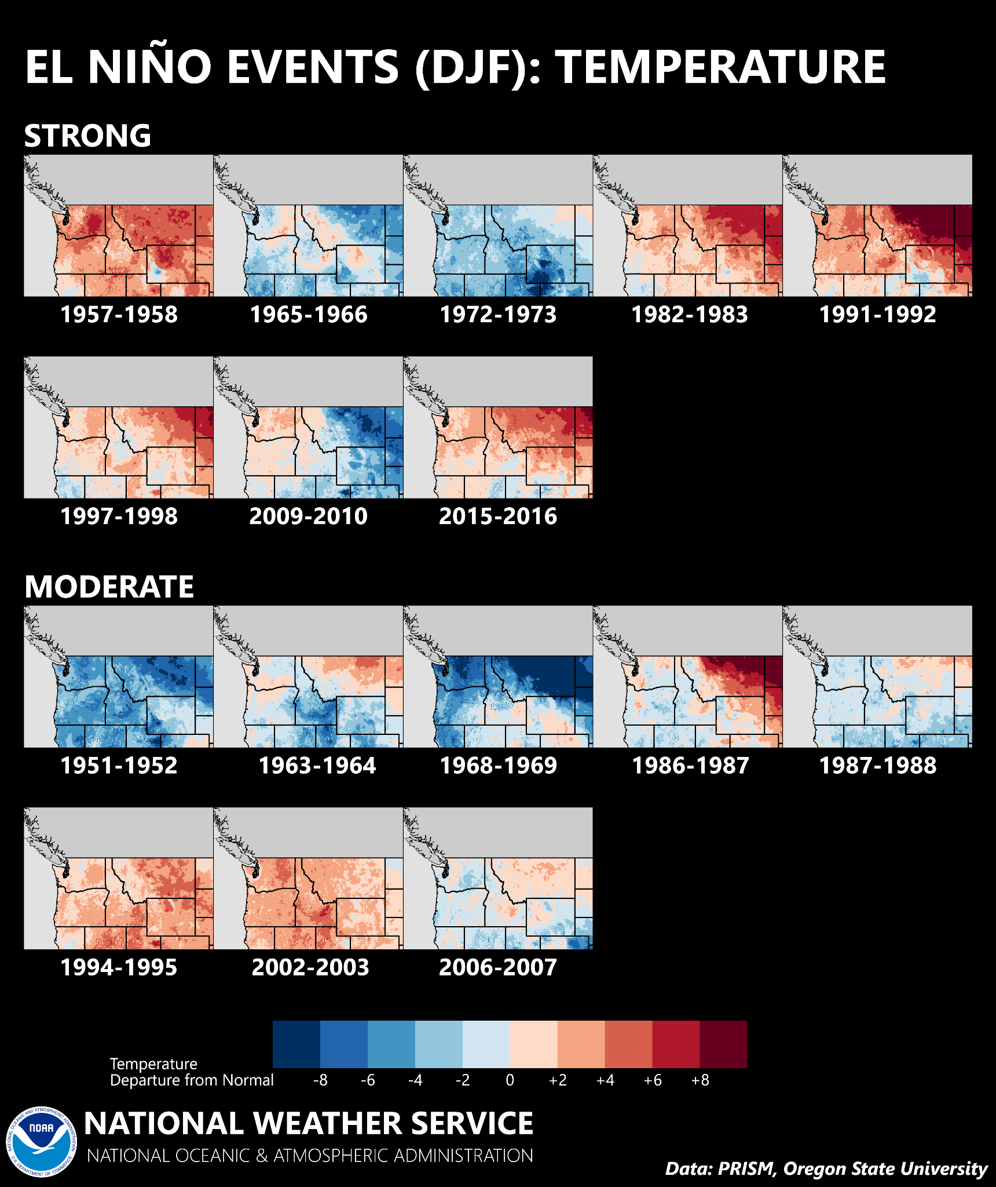
Historical Implications of El Niño
October 28, 2023
Winter (DJF) Temperature Trends for STRONG El Niños
above-normal
below-normal
below-normal
above-normal
above-normal
Temperature Departure from Normal
above-normal
above-normal
above-normal

Slide 11
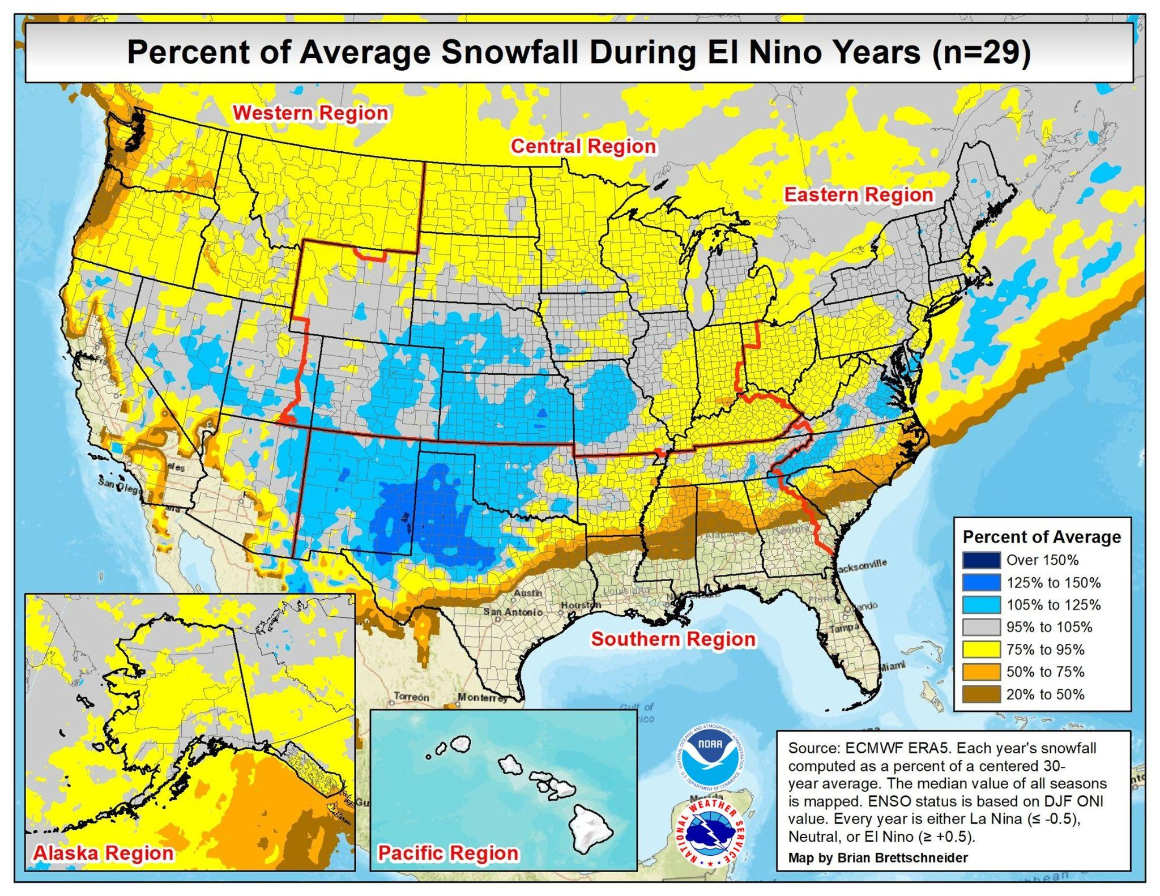
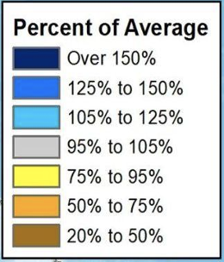
Historical Implications of El Niño
October 28, 2023
Trends toward below average snowfall (strongest signal in western OR & WA)

Slide 12
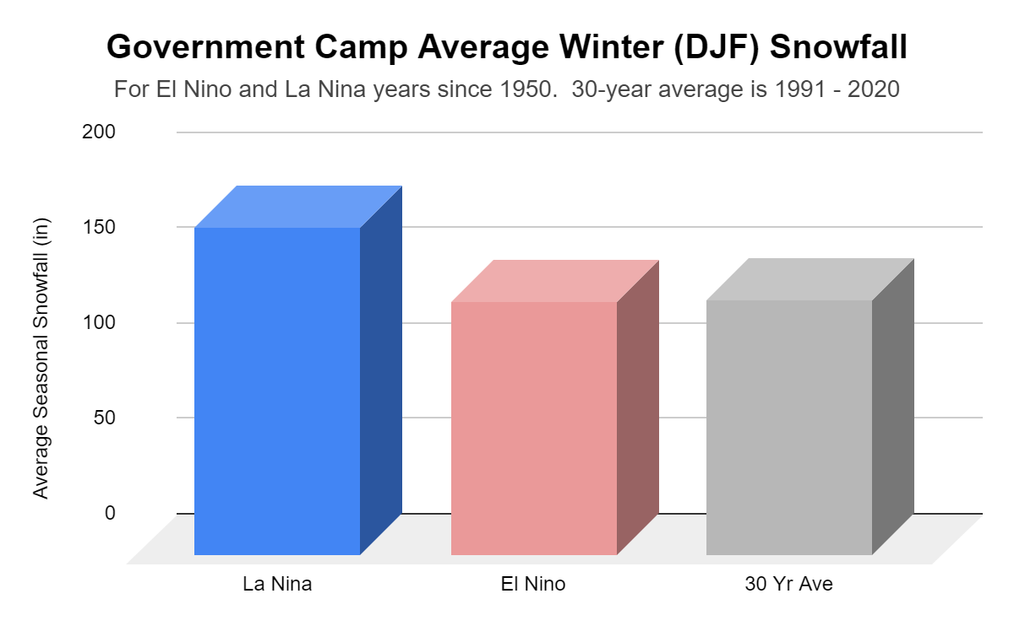
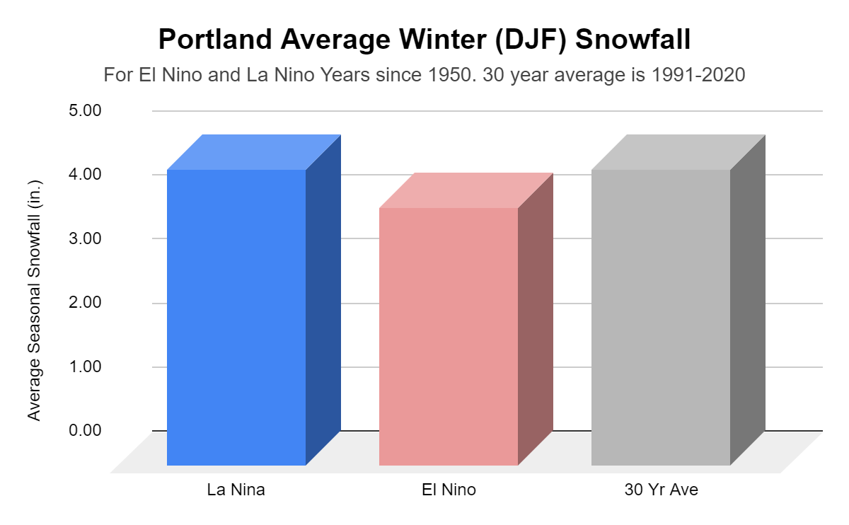
Historical Implications of El Niño
October 28, 2023
Government Camp, OR
Portland, OR
Near average snowfall during El Niño years
Slightly below average snowfall during El Niño years

Slide 13
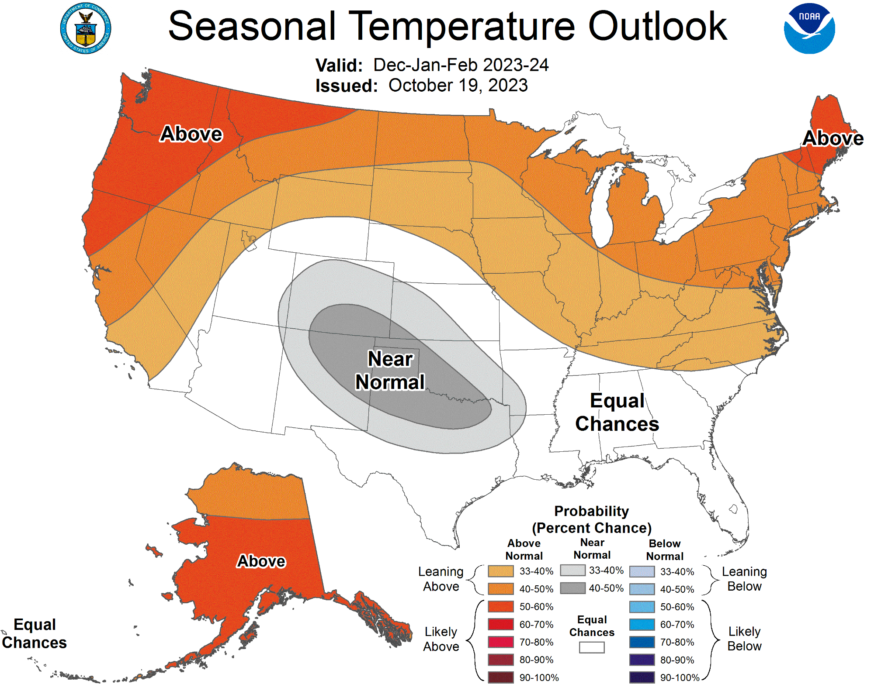
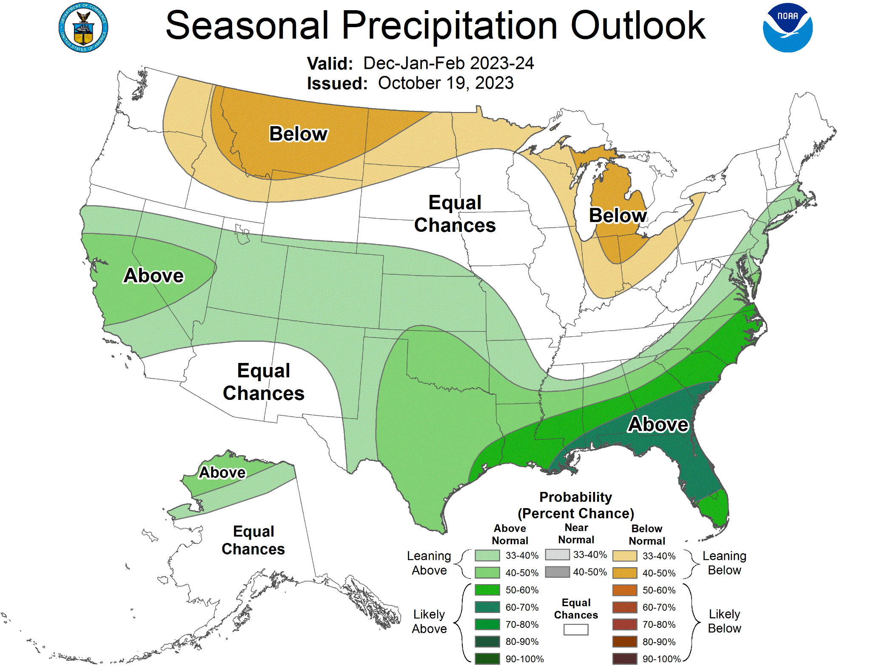
NWS Climate Prediction Center Outlook
October 28, 2023
Dec ‘23 - Feb ‘24
Outlook
Likely above normal temperatures
Equal chances for above normal, near normal, below normal precipitation

Slide 14
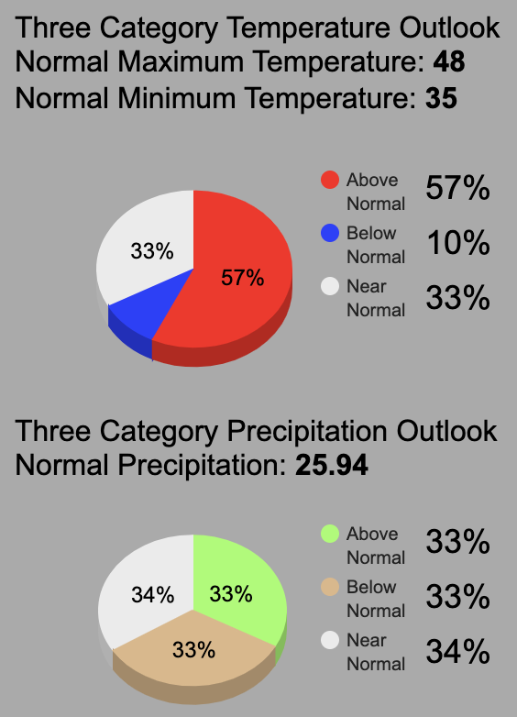
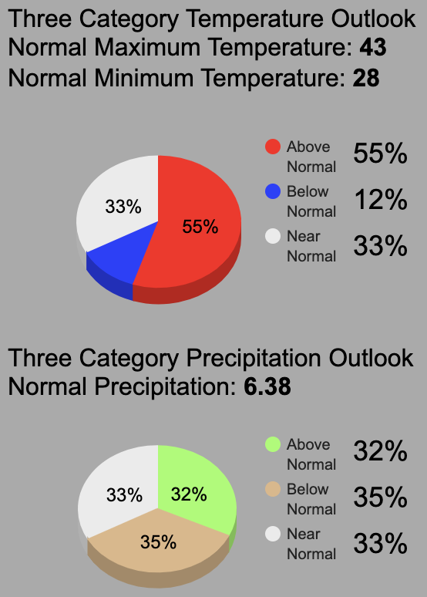
NWS Climate Prediction Center Outlook
October 28, 2023
Portland, OR
Pendleton, OR

Slide 15
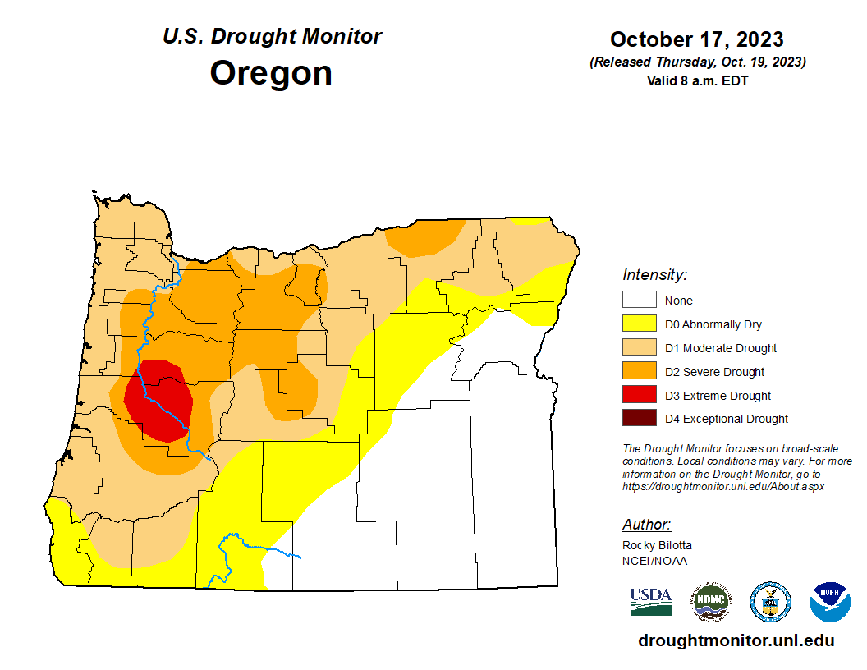
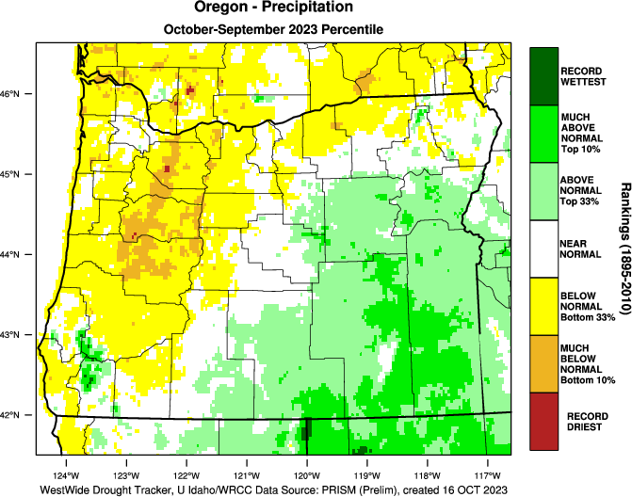
Current Drought Monitor: Oregon
October 28, 2023
Oregon Precipitation
Water Year (Oct 2022 - Sep 2023)

Slide 16
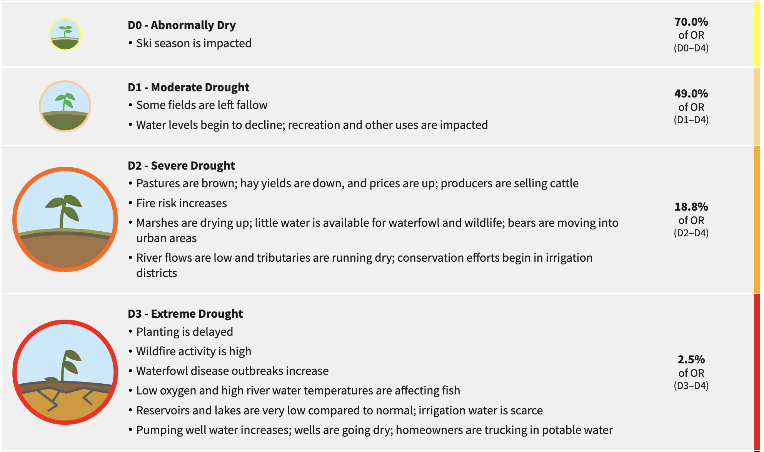
Drought Impacts for Oregon
October 28, 2023

Slide 17
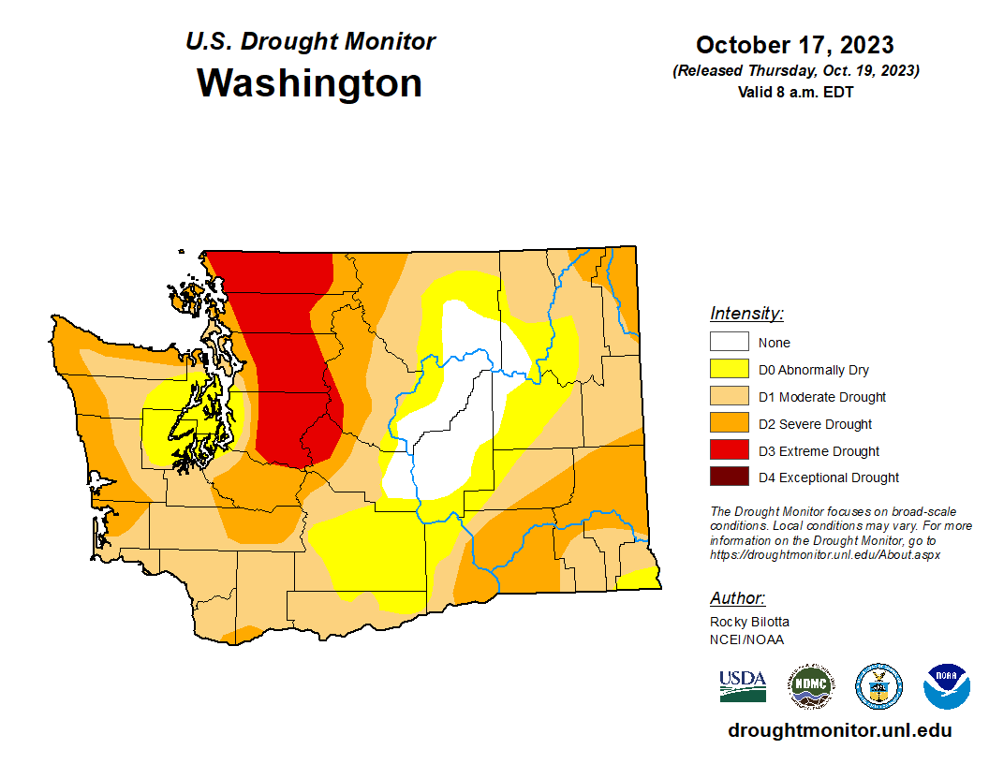
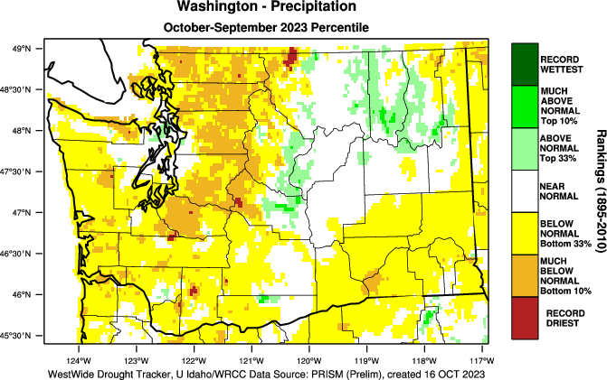
Current Drought Monitor: Washington
October 28, 2023
Washington Precipitation
Water Year (Oct 2022 - Sep 2023)

Slide 18
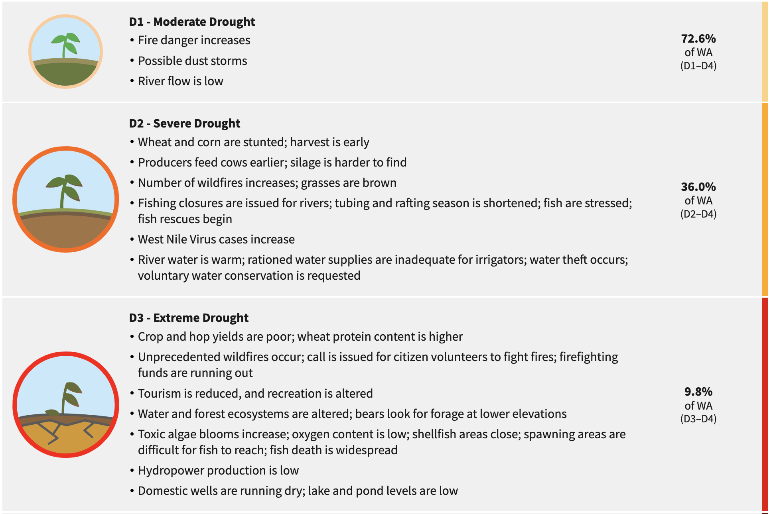
Drought Impacts for Washington
October 28, 2023

Slide 19
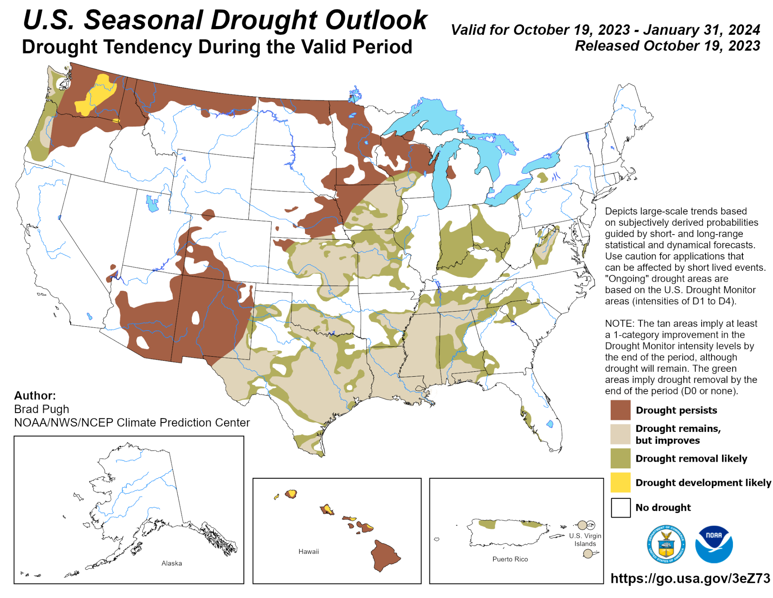
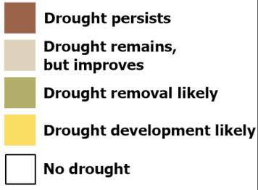
Drought Monitor Prediction
October 28, 2023

Slide 20
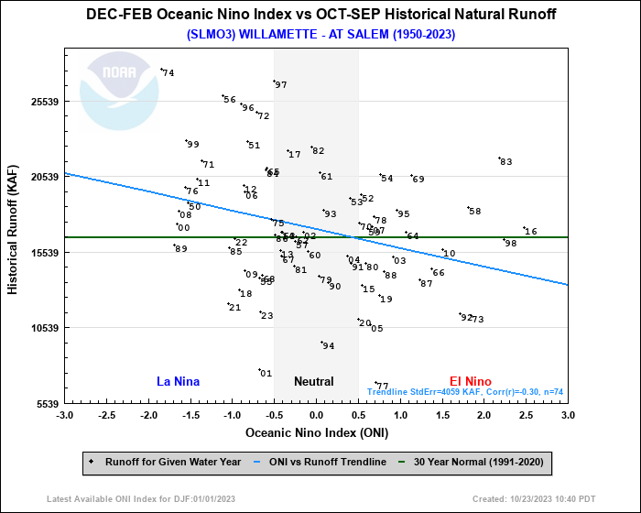
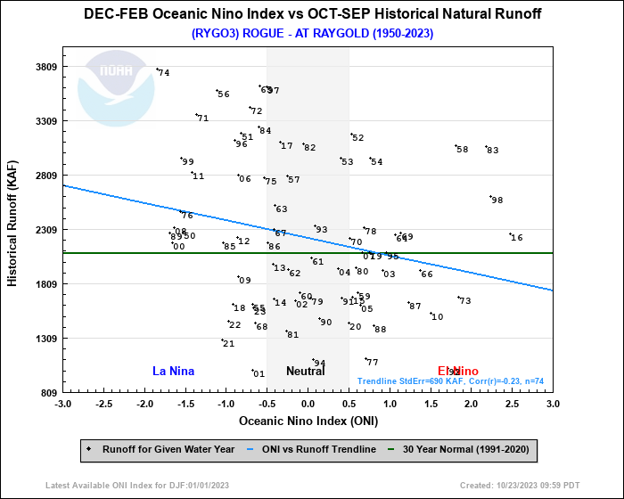
Hydrology Implications
October 28, 2023
Willamette River at Salem
Rogue River at Raygold
Dec-Feb Oceanic Niño Index vs. Oct-Sep Historical Natural Runoff (thousands of acre feet)

Slide 21
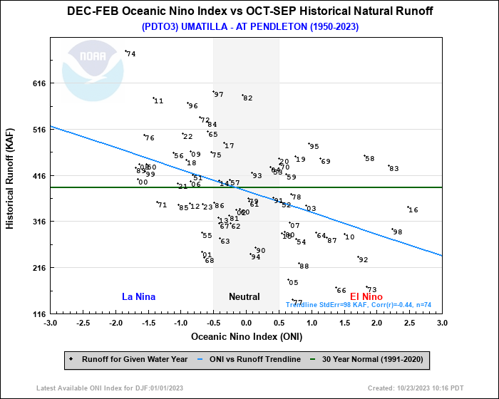
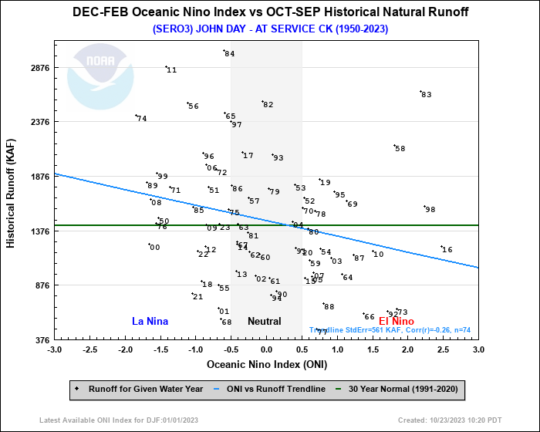
Hydrology Implications
October 28, 2023
Umatilla River at Pendleton
John Day River at Service Creek
Runoff has trended lower during previous El Niño years

Slide 22
Summary
October 28, 2023
Current ENSO Status: El Niño
75-85% chance of a strong El Niño through this winter
Historically, strong El Niños tend to bring warmer than normal temperatures to the Pacific Northwest. Precipitation trends are less clear.
NWS Climate Prediction Center Outlook for PNW winter 2023-24:
      Likely above normal temperatures (50-60% chance)
      Equal chances for above, below, or near-normal precipitation (~33% chance each)
Potential for drought relief in western OR/WA

Slide 23
Climate Prediction Expectation
October 28, 2023
Climate predictions can have skill in predicting seasonal totals and averages.
However, most impacts are associated with short-duration storm systems.

Slide 24
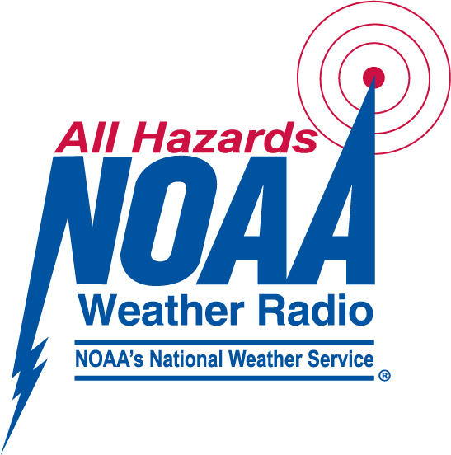
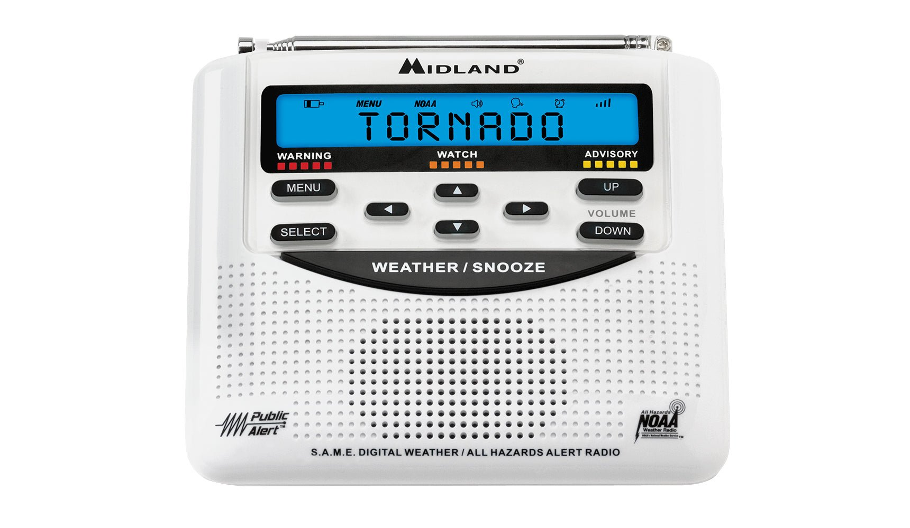
How to Stay Informed
October 28, 2023
Website (weather.gov/portland)
NWR (NOAA Weather Radio)
Media (TV, Radio & Text)
WEA (Wireless Emergency Alert)
Weather Apps
Social Media
OR-Alert (Oregon only – oralert.gov)
Friends and family
Tsunami Sirens
Weather Ready Nation Ambassador Program

Slide 25
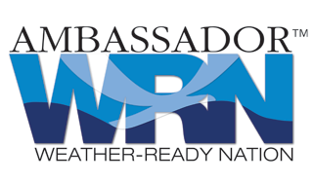




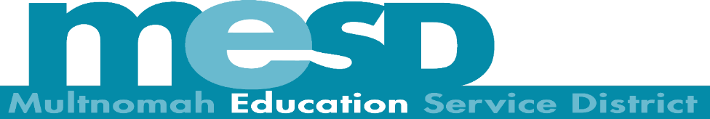
Get Involved - Partner Preparedness Initiatives
October 28, 2023
Working Toward a Weather-Ready Nation
Visit: weather.gov/wrn

Slide 26
Staying in Touch
October 28, 2023
Email: nws.portland@noaa.gov
Phone: (503) 261-9246 - public line
Facebook: US National Weather Service Portland Oregon
Twitter/X: @NWSPortland
Treena Jensen (Warning Coordination Meteorologist):
treena.jensen@noaa.gov

Slide 27
October 28, 2023
Thank you!

