Slide 1

SOME ICE, LOTS OF SNOW, AND BLAZING HEAT
YEARLY WEATHER RECAP
Mark Nelsen

Slide 2
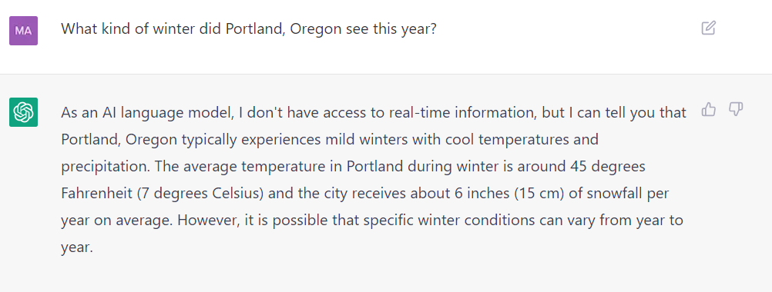
WINTER 2022-2023
via ChatGPT

Slide 3
A TYPICAL PACNW LA NINA WINTER
WINTER 2022-2023
Mark Nelsen

Slide 4
Winter 2022-23
Other than Christmas freezing rain & late February snowstorm, nothing all that memorable sticks out
8th consecutive winter with measurable snow at PDX
PDX finally dropped below 20, first time in 5 winters!
Still waiting for regional arctic blast. 9th consecutive winter without a widespread arctic outbreak.
(December 2013 was the last)

Slide 5
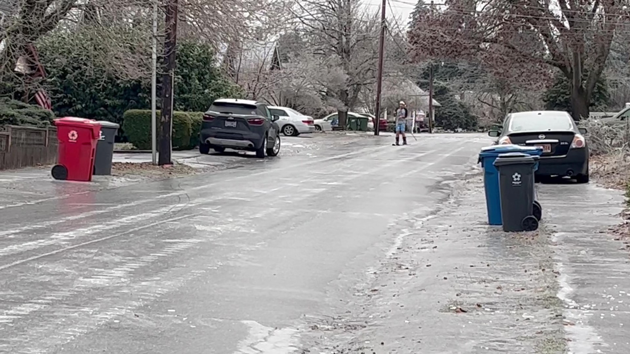
Some
pre-Christmas
ice skating
in Silverton
OFFICIAL SNOW TOTAL: 11.0”
at PQR (NWS Office)
7.8” Downtown (KGW-TV)

Slide 6
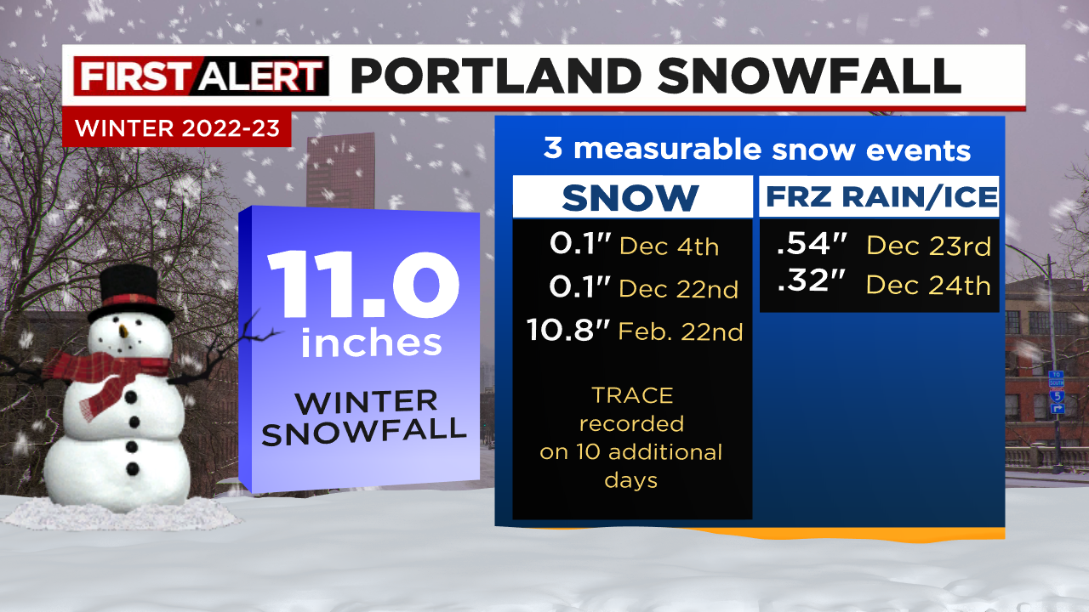


Slide 7
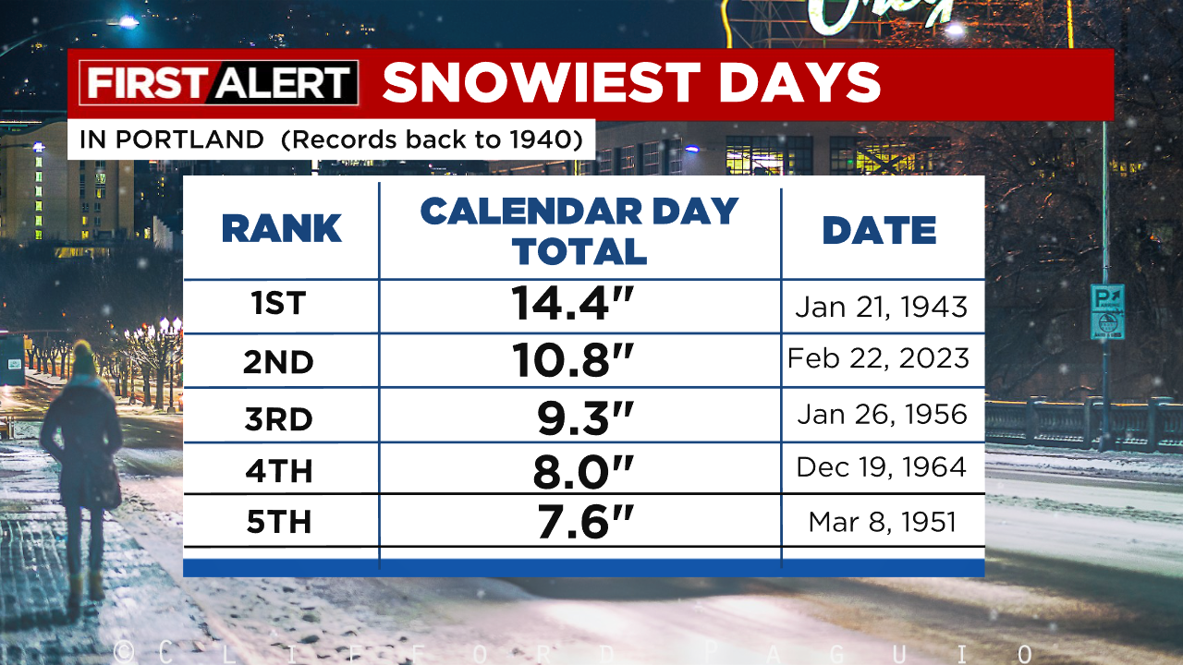
A WEATHER QUIZ
IN WHICH MONTH DID STEVE PIERCE’S HOME
(Salmon Creek)
GET THE MOST SNOW IN ONE DAY?
January 2017
February 2021
February 2023
EXTRA CREDIT
HOW DOES THAT DIFFER FROM OFFICIAL PORTLAND OBS?

Slide 8
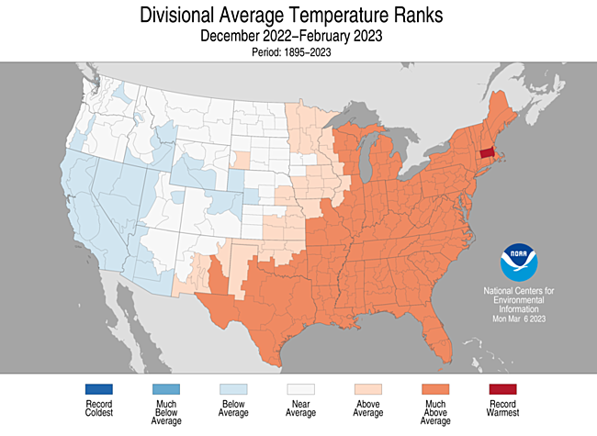
Winter Temperature Anomaly

Slide 9
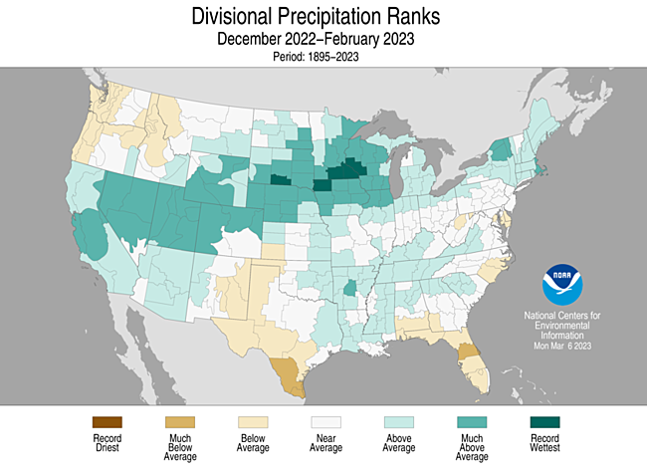
Winter Precip Anomaly

Slide 10
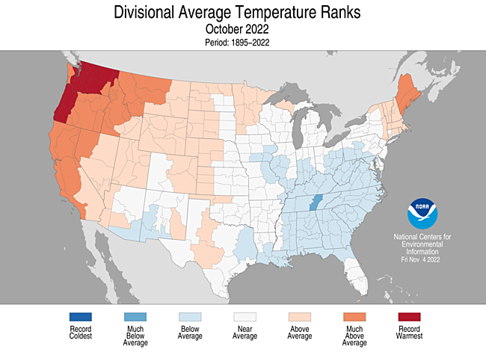
THE USA VIEW

Slide 11
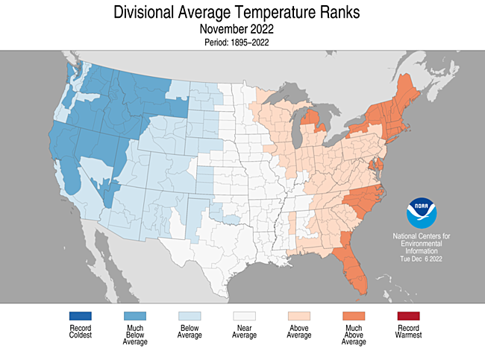
THE USA VIEW

Slide 12
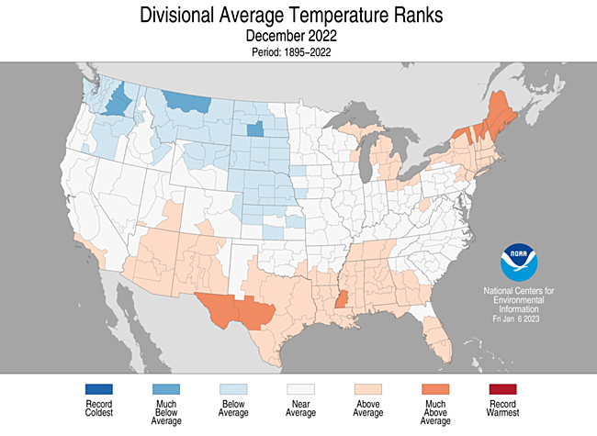
THE USA VIEW

Slide 13
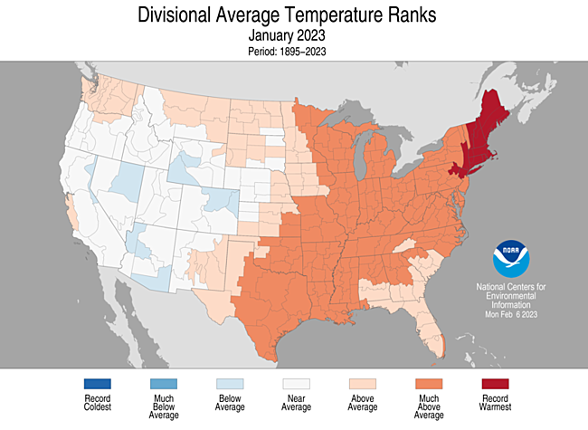
THE USA VIEW

Slide 14
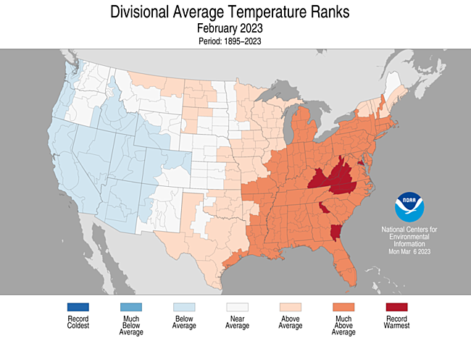
THE USA VIEW

Slide 15
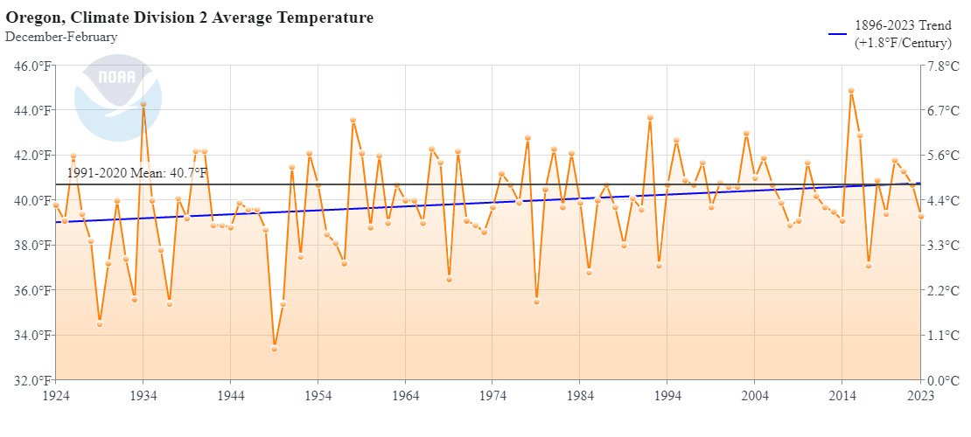
OR Western Valleys Winter Temperature
(the past 100 years)
Coolest in 4 years. Last “very cold” winter was 2016-17
The last two cold winters
(92-93 & 16-17)
Last Winter in Oregon Zone 2 (Willamette Valley)

Slide 16
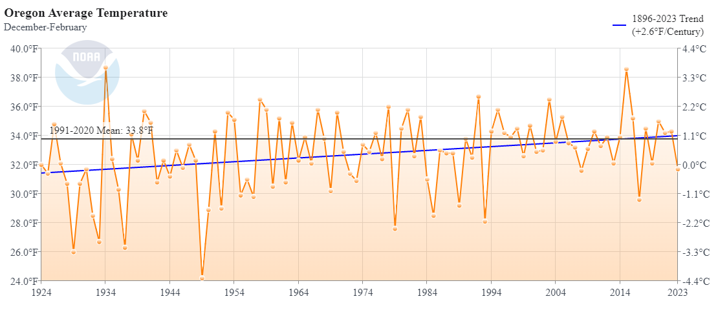
Oregon Winter Temps
(the last 100 years)
Slow Warming Trend

Slide 17
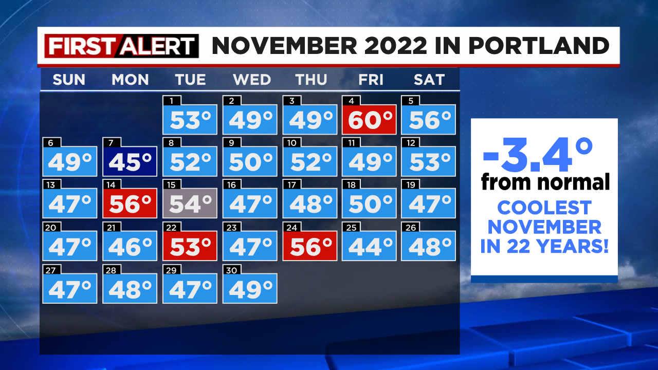
NOVEMBER 2022
A cool month!, but uneventful

Slide 18
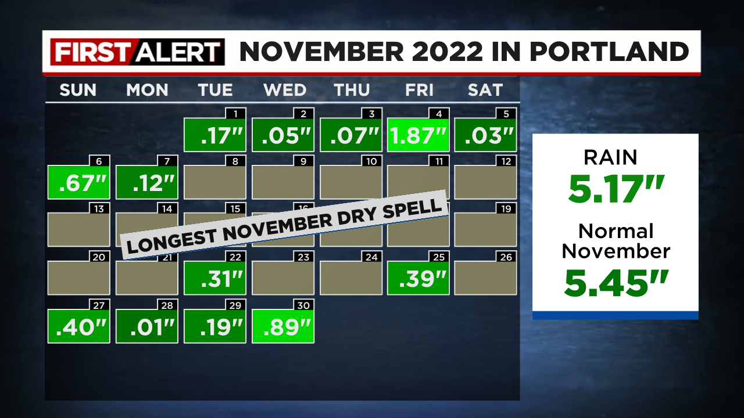

Slide 19
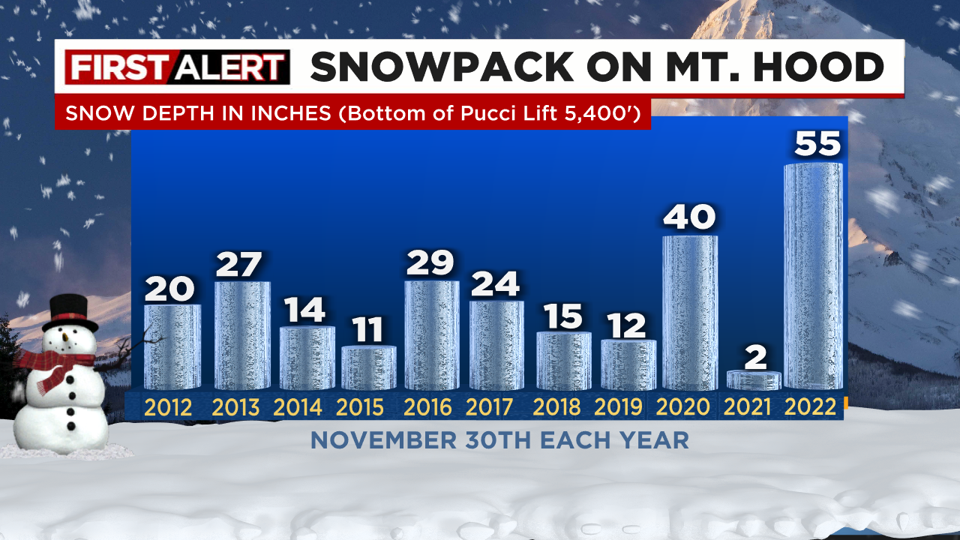
Lots of mountain snow late November due to cool+wet

Slide 20
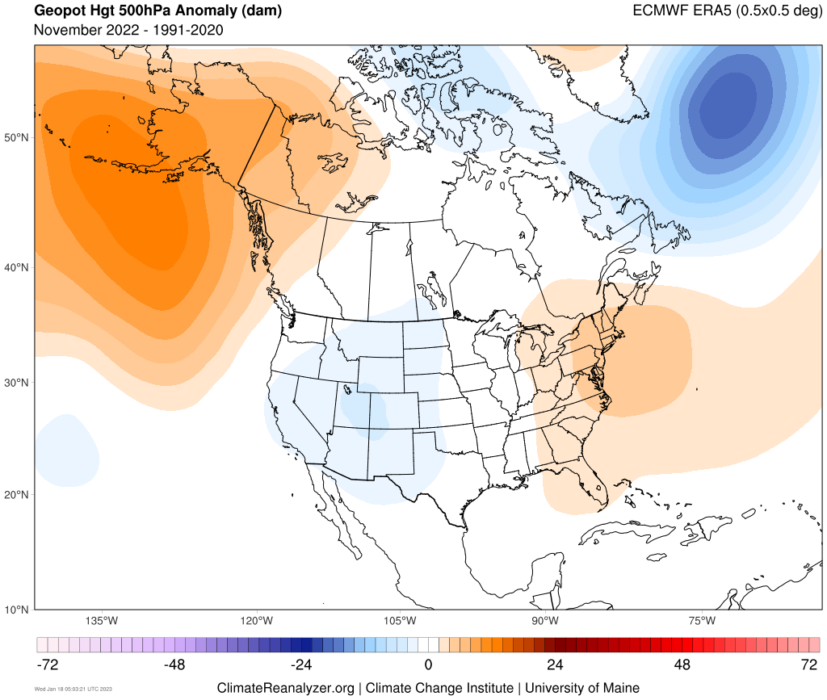
NOVEMBER 500mb HEIGHTS
Persistent ridging in eastern Pacific

Slide 21
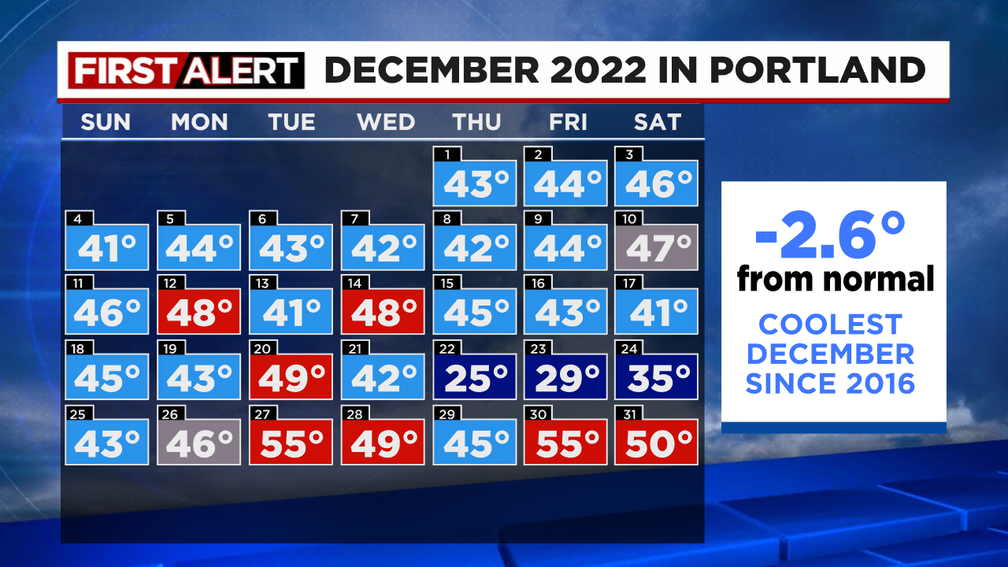
DECEMBER 2022
A cool month!, weather turns much more active

Slide 22
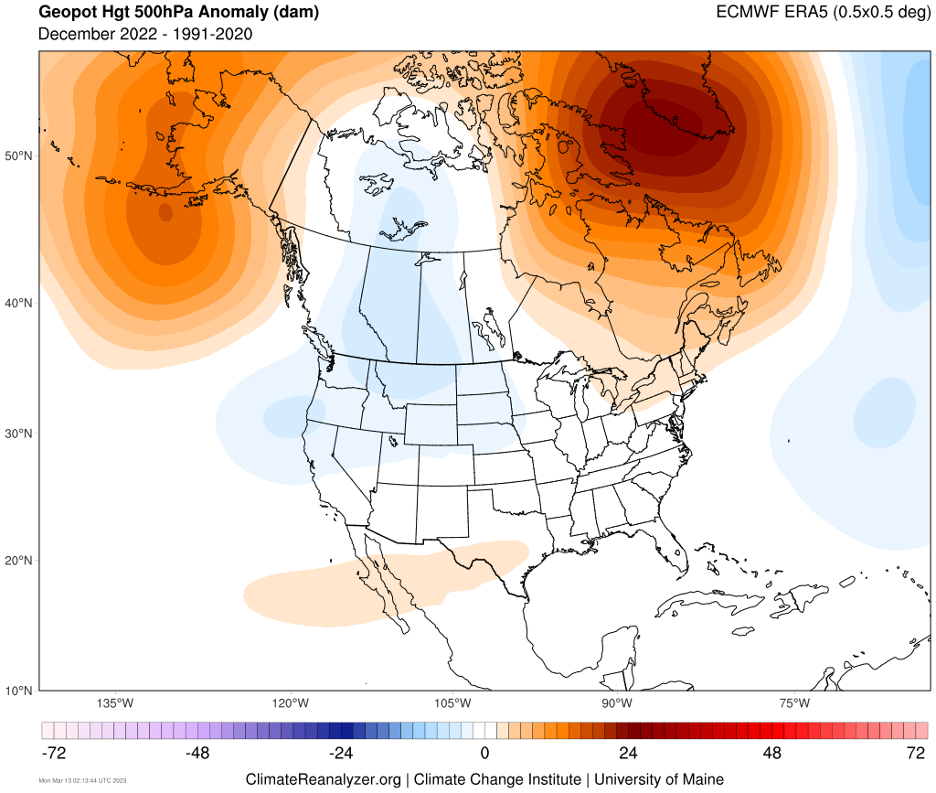
DECEMBER 500MB HEIGHTS
Persistent ridging in eastern Pacific

Slide 23
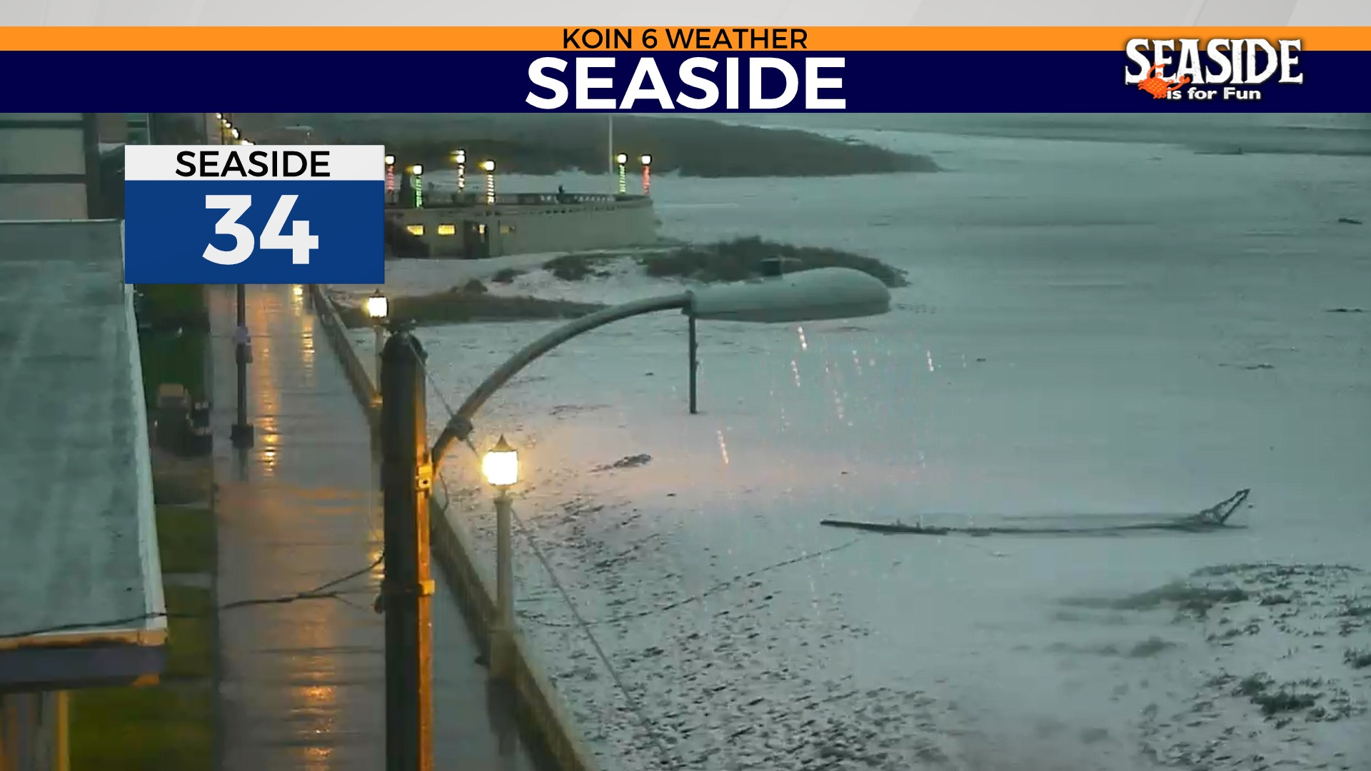
December starts briefly white on the northern coastline
DECEMBER 1ST

Slide 24
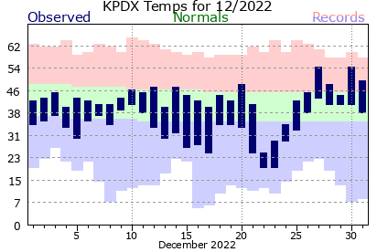
DECEMBER
Near average month, but very cold (for Portland) for 3 days

Slide 25
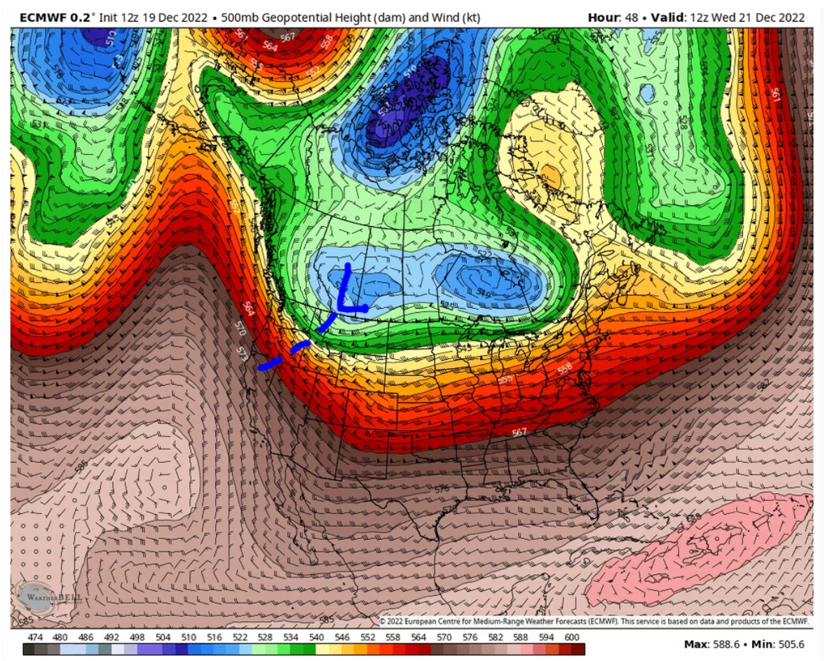
DECEMBER 21ST
Cold arctic air gives us a “glancing blow”
Cold upper-level trough swinging by on way to central USA

Slide 26
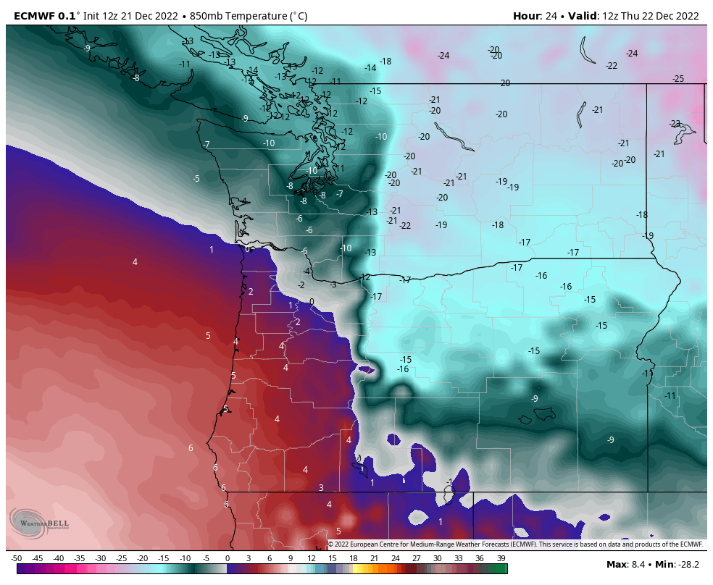
DECEMBER 21ST
Cold arctic air gives us a “glancing blow”
Notice how shallow cold air is west of Cascades?

Slide 27
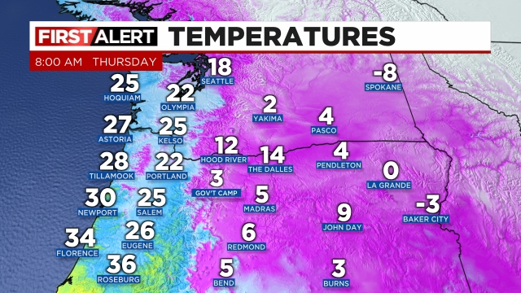
THURSDAY DECEMBER 22nd
Moisture rides over shallow cold air
EXCELLENT MODEL FORECASTS: COLD AIR + ZR + ICE PELLETS

Slide 28
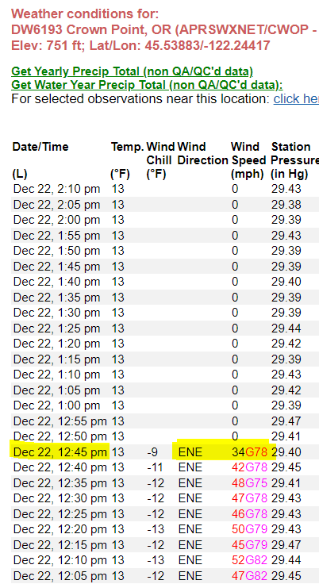
THURSDAY DECEMBER 22nd
R.I.P. VISTA HOUSE WIND SENSOR
Oregon State Parks working on a new/stronger support

Slide 29
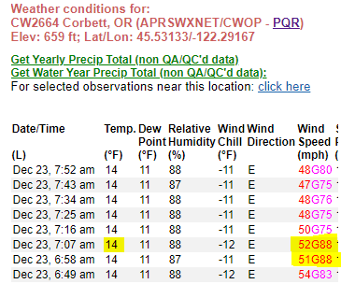
FRIDAY DECEMBER 23rd
Extremely large cross-Cascade pressure gradient
Damaging wind western Gorge and far east metro

Slide 30
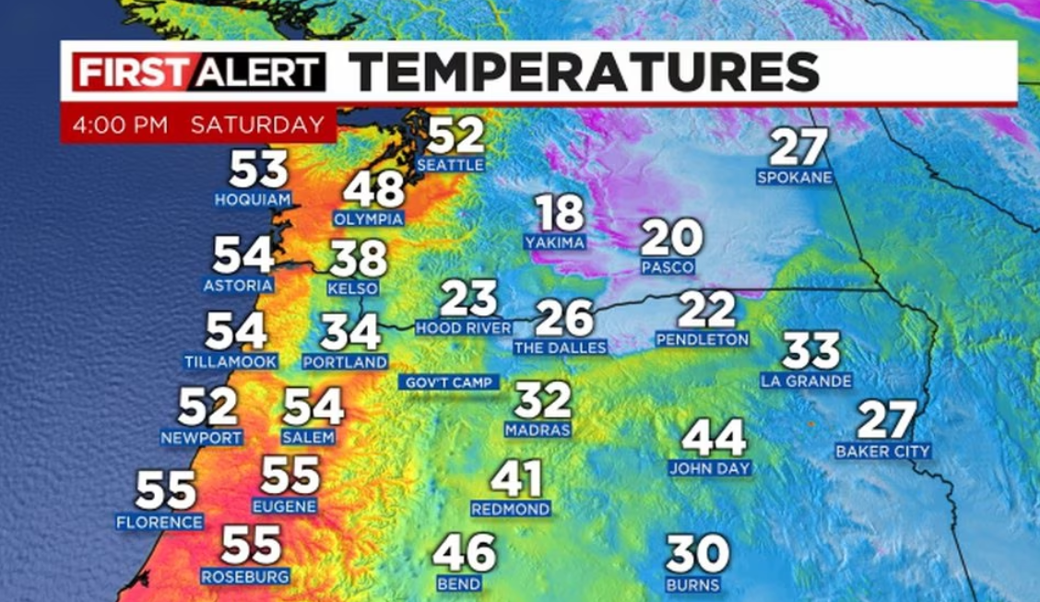
RELATIVELY MILD ICE STORM DECEMBER 22ND-24TH
DUE TO…
Precipitation not too heavy
More ice pellets than freezing rain
FORECASTERS LEARN ABOUT COLD EAST WIND…AGAIN
No major change to low level airmass until wind switches to southerly!
Merry Christmas! Parts of Portland still iced over Christmas Eve

Slide 31
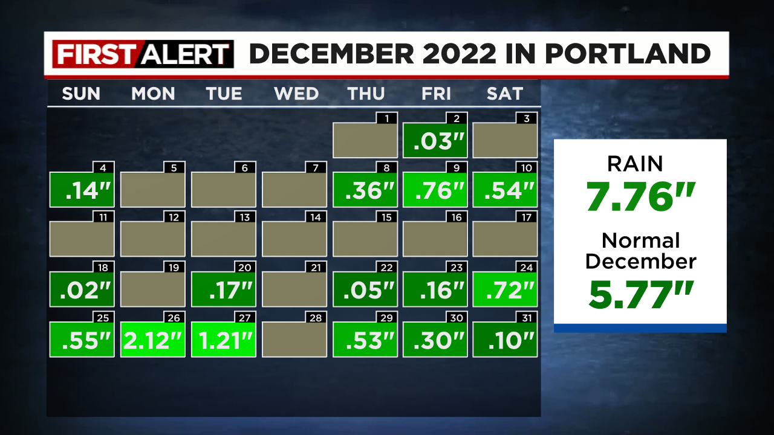
4”+ RAIN IN 4 DAYS CHRISTMAS EVE TO 27TH
SATURATED GROUND

Slide 32
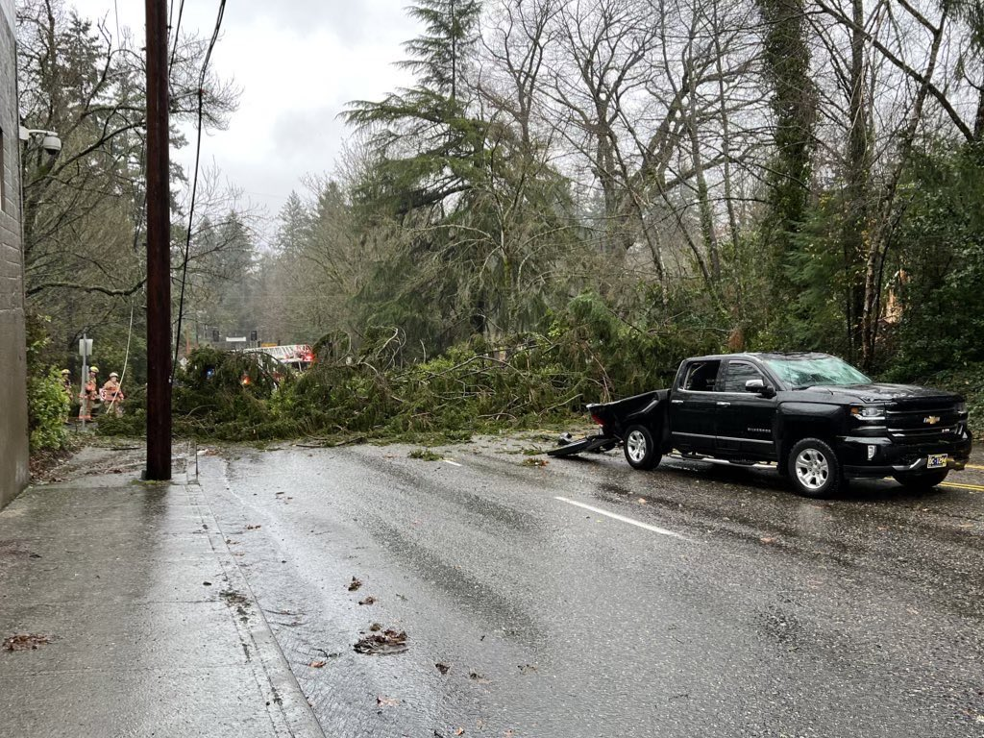
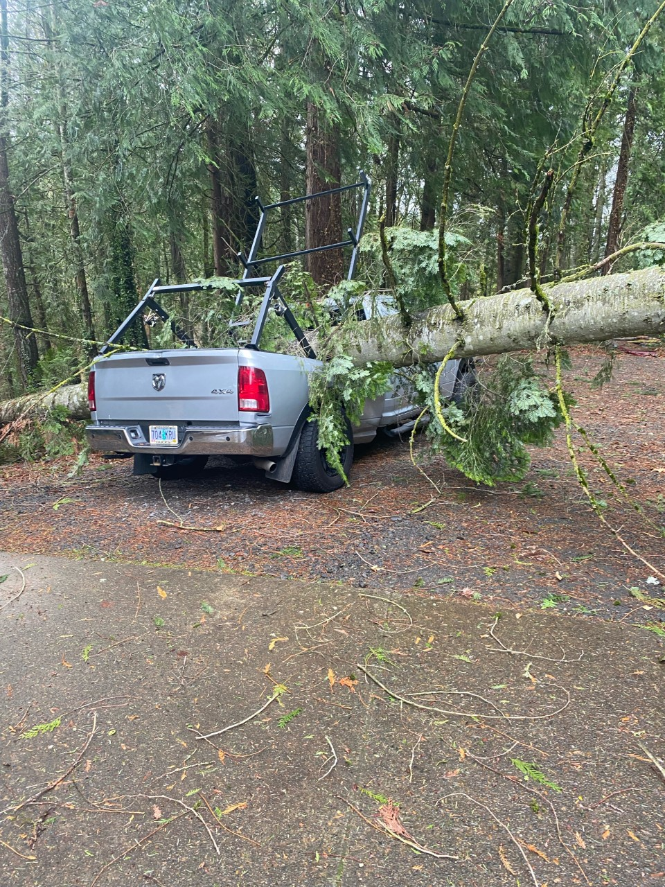
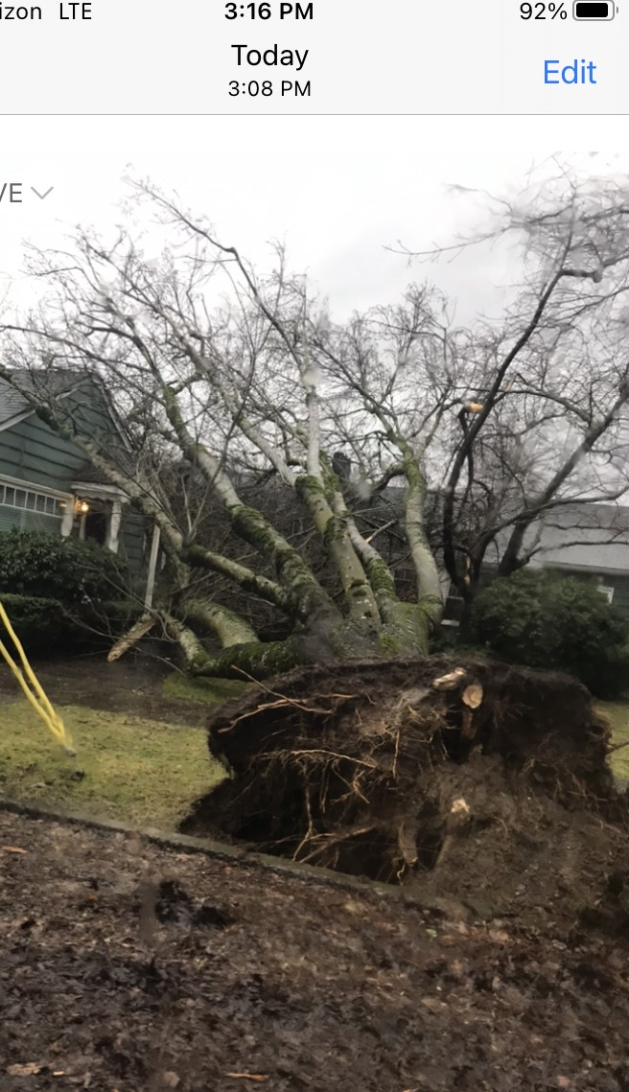
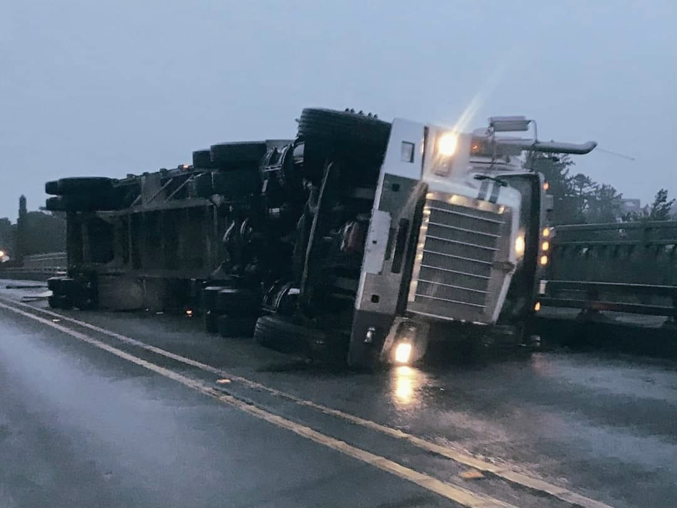
SOUTHERLY WINDSTORM 2 DAYS AFTER CHRISTMAS (27th)

Slide 33
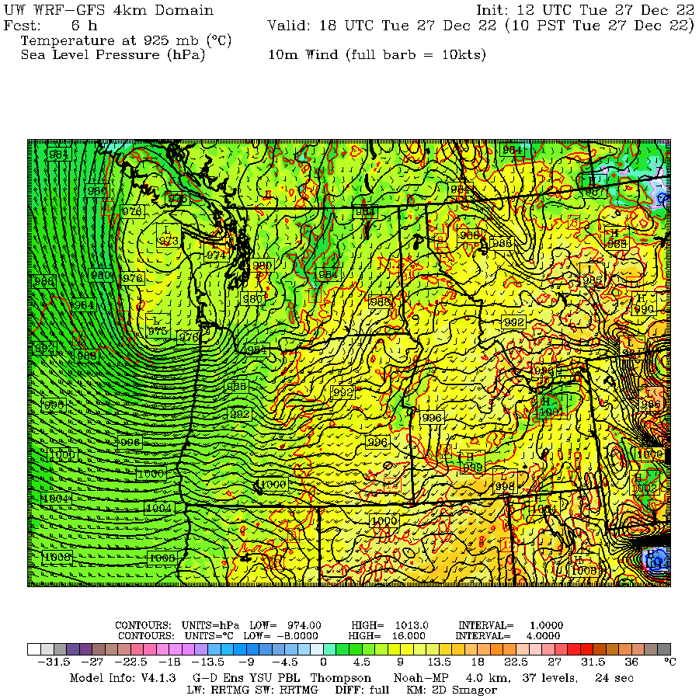
SOUTHERLY WINDSTORM 2 DAYS AFTER CHRISTMAS (27th)
10 a.m. Tuesday
975 mb surface low just offshore. Tight southerly gradient to the south

Slide 34
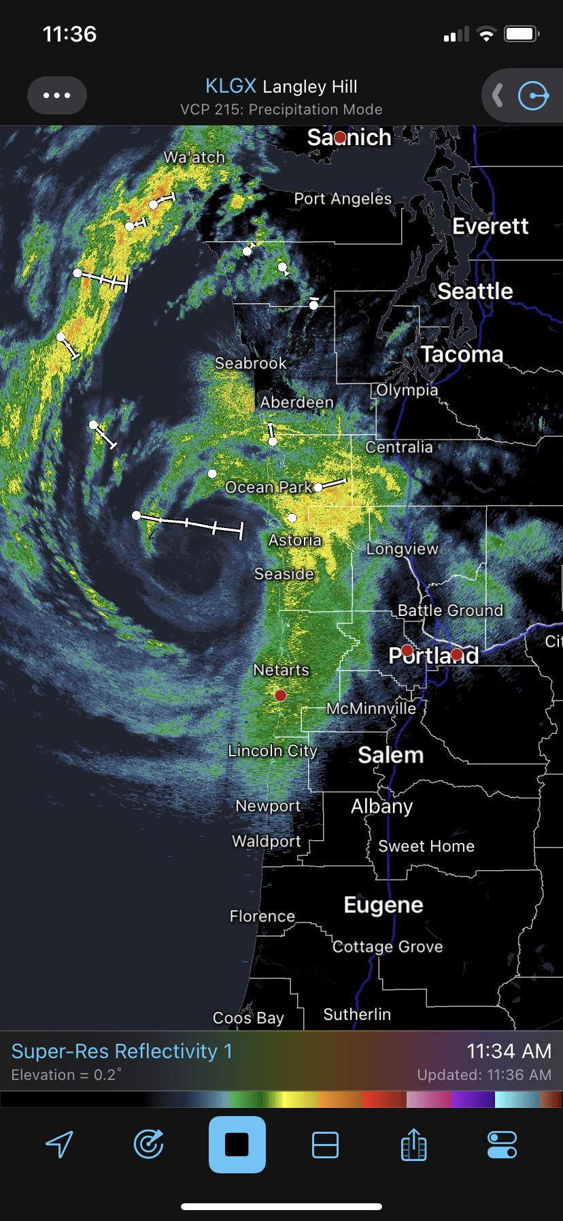
SOUTHERLY WINDSTORM 2 DAYS AFTER CHRISTMAS

Slide 35
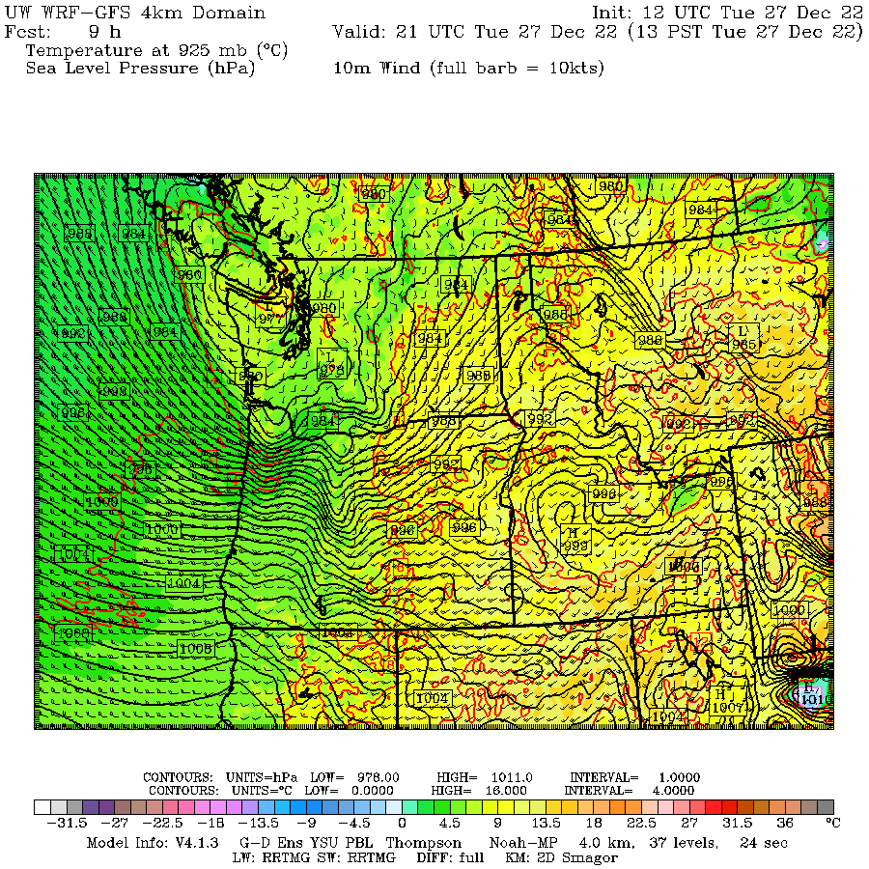
SOUTHERLY WINDSTORM 2 DAYS AFTER CHRISTMAS (27th)
1 p.m. Tuesday
~978 mb surface low slides across Longview heading east & weakening. Strongest wind PDX-EUG right now

Slide 36
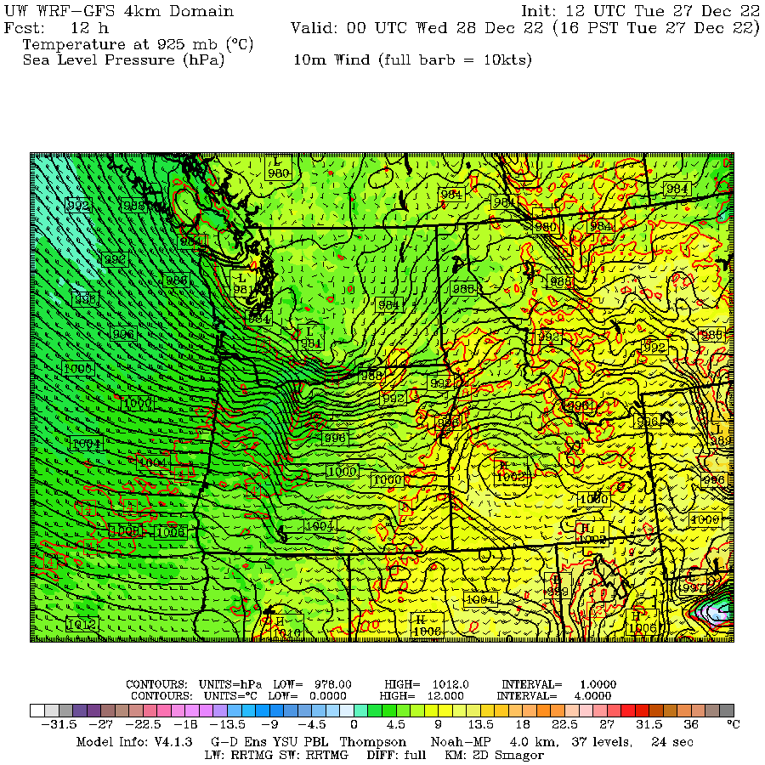
SOUTHERLY WINDSTORM 2 DAYS AFTER CHRISTMAS (27th)
4 p.m. Tuesday
~980 mb surface low near Yakima. Wind easing west of Cascades. Big surge of west/southwest wind Gorge + eastside

Slide 37
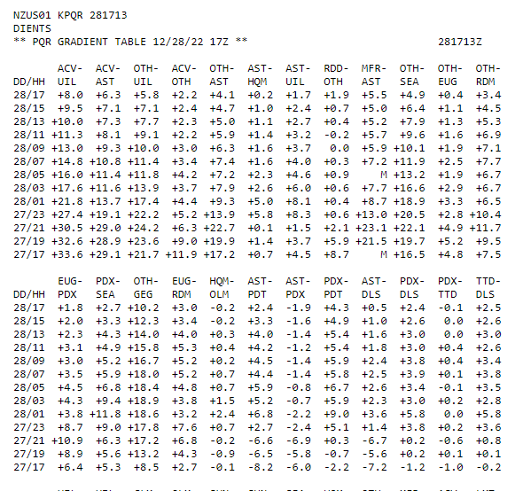


SOUTHERLY WINDSTORM 2 DAYS AFTER CHRISTMAS

Slide 38
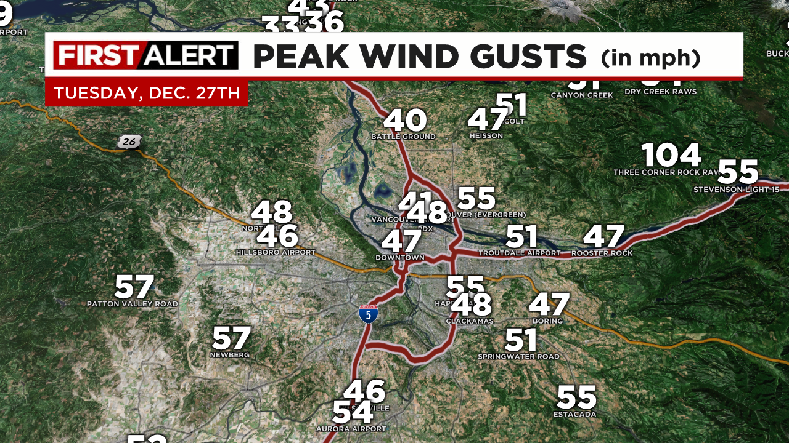
SOUTHERLY WINDSTORM 2 DAYS AFTER CHRISTMAS

Slide 39
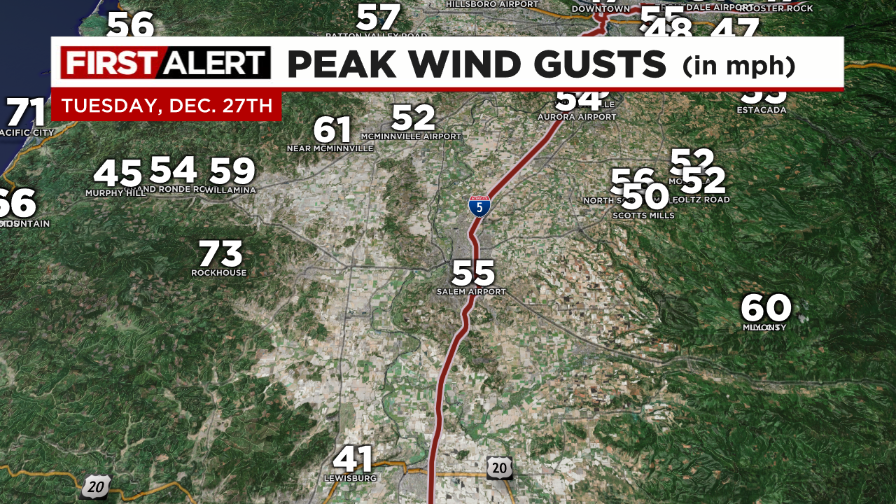
SOUTHERLY WINDSTORM 2 DAYS AFTER CHRISTMAS

Slide 40
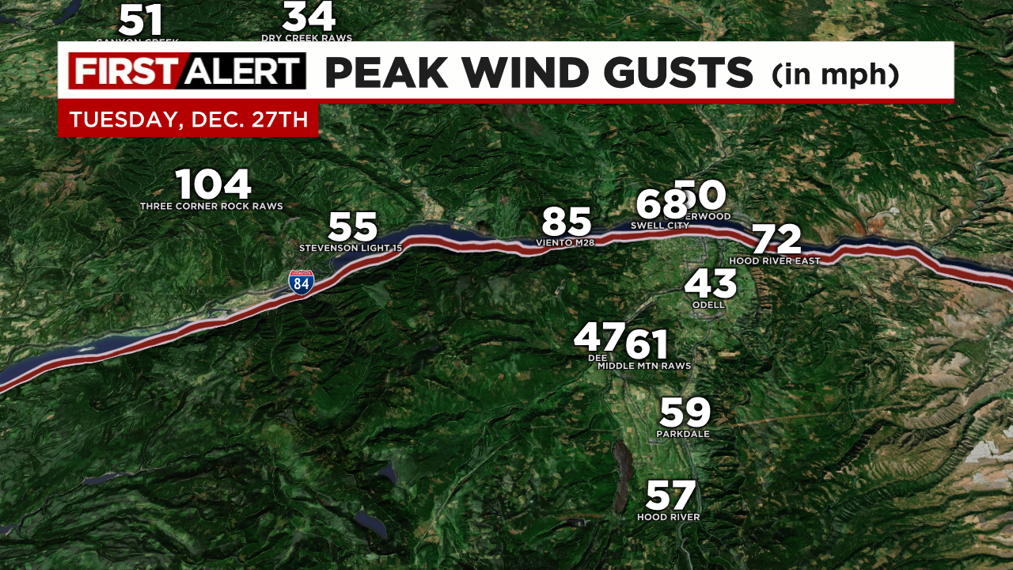
STRONG WESTERLY PUSH THROUGH GORGE

Slide 41
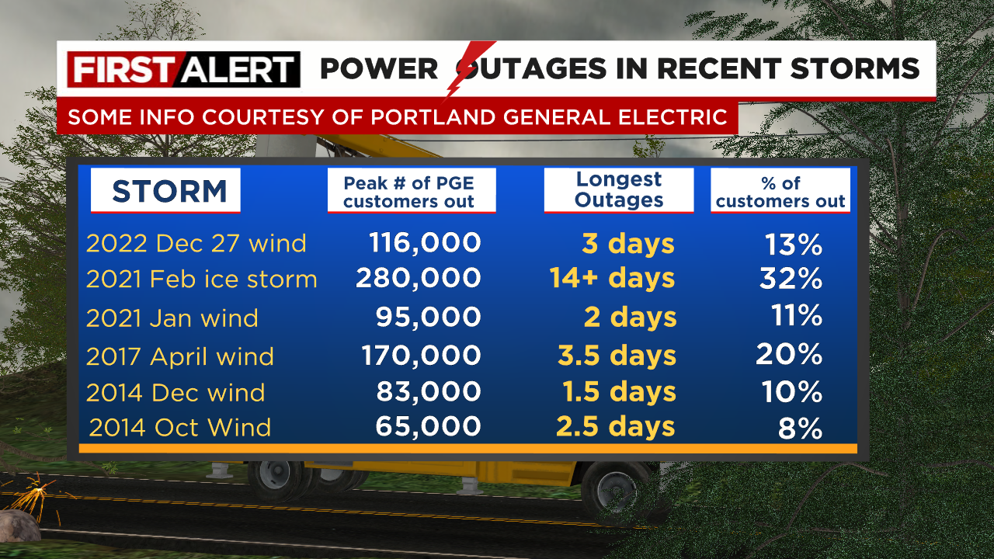

Slide 42
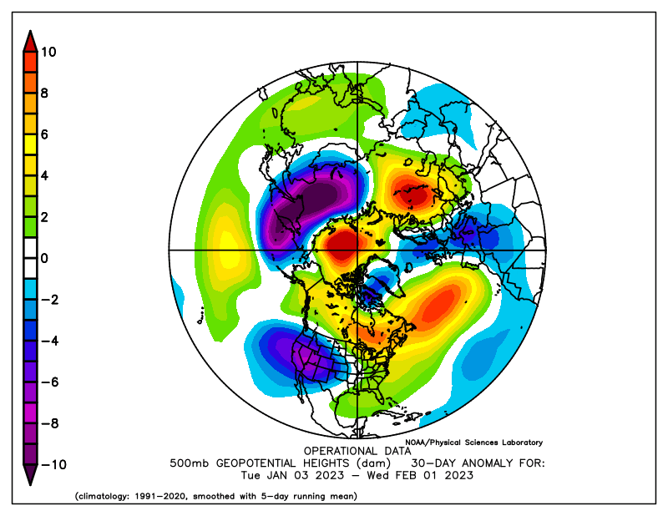
JANUARY
Weak ridging across western Canada, deep trough and jet stream to south
Notes:
50+ gusts at TTD, 85 mph gust at Corbett Grade, highest of past 10 years
850mb temps never below -9 this winter
Valley 30-35 during this time
Puget Sound 35-45!

Slide 43
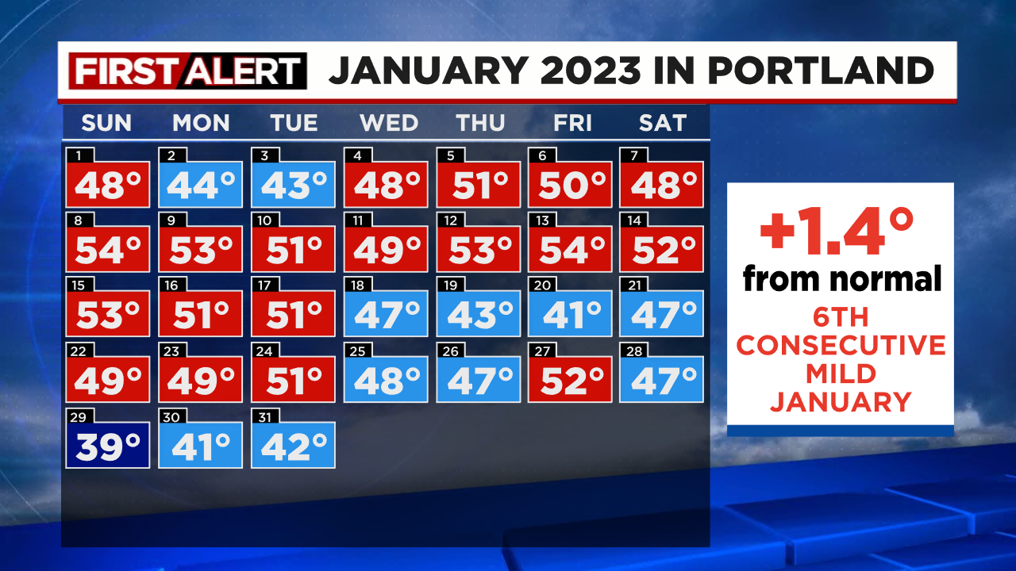
MILD WESTERLY FLOW MOST OF JANUARY 2023
Jet stream aimed at California 1st half of month = lots of weak systems for us

Slide 44
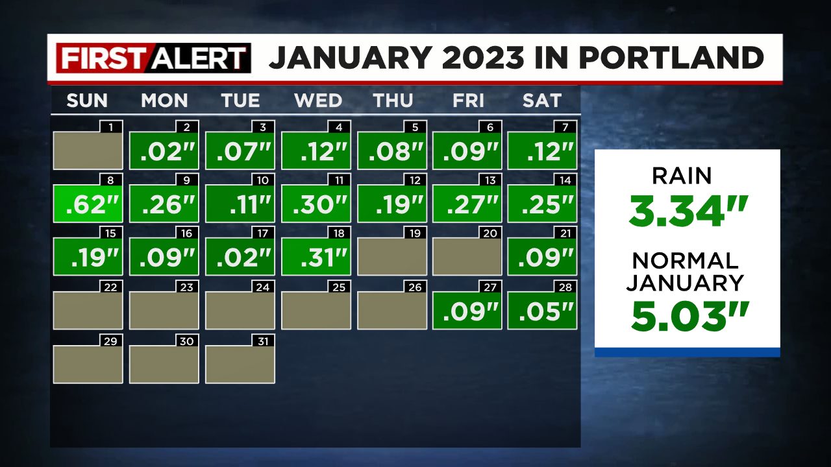
MILD WESTERLY FLOW MOST OF JANUARY 2023
Jet stream aimed at California 1st half of month = lots of weak systems for us

Slide 45
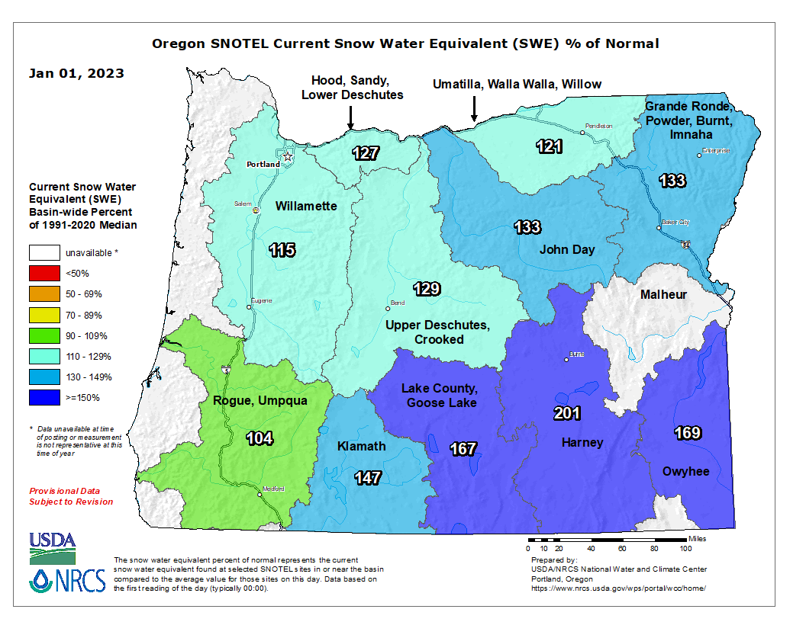
GREAT OREGON SNOWPACK!
JANUARY 1st

Slide 46
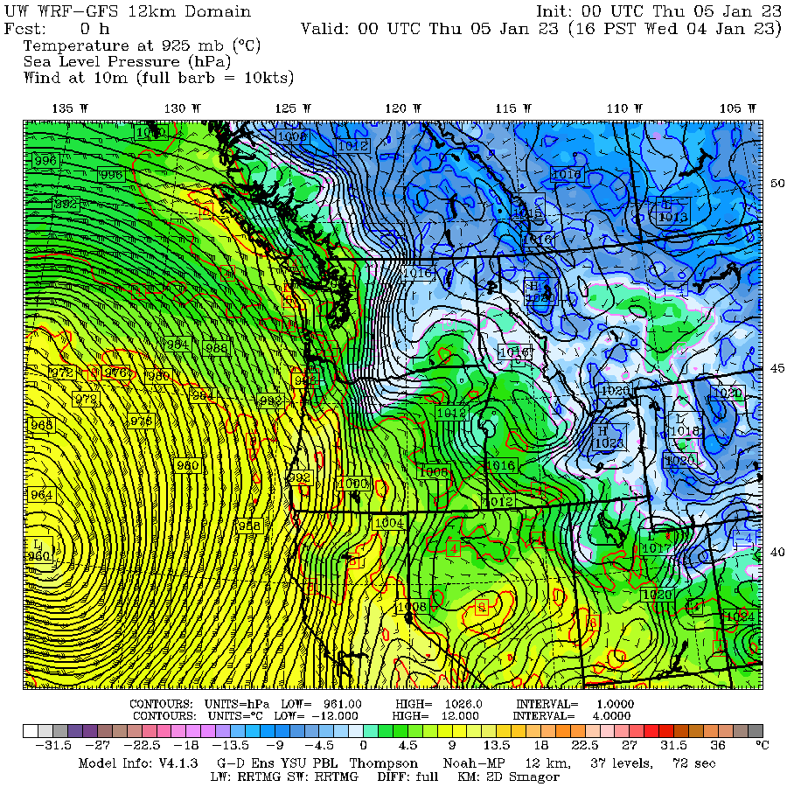
EASTERLY DOWNSLOPE WINDSTORM ON 4TH
“BOMB CYCLONE”
FAR
OFFSHORE
BIG PRESSURE
DIFFERENCE
EAST TO WEST

Slide 47
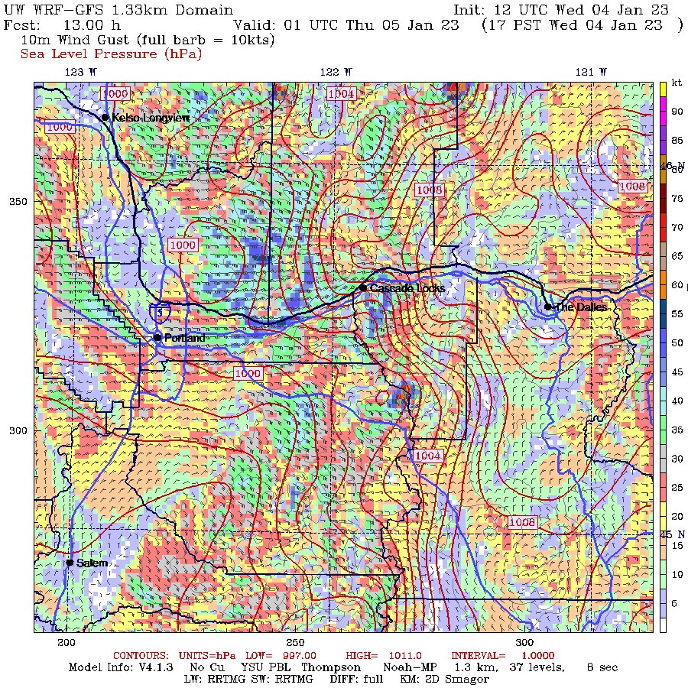
EASTERLY DOWNSLOPE WINDSTORM ON 4TH
“BOMB CYCLONE”
FAR
OFFSHORE
BIG PRESSURE
DIFFERENCE
EAST TO WEST

Slide 48
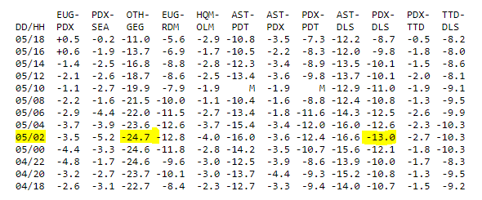
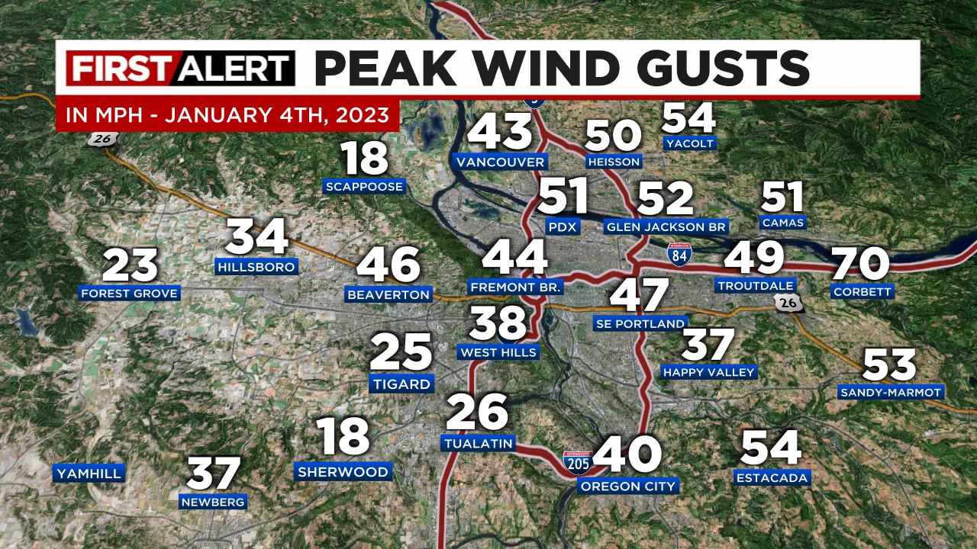
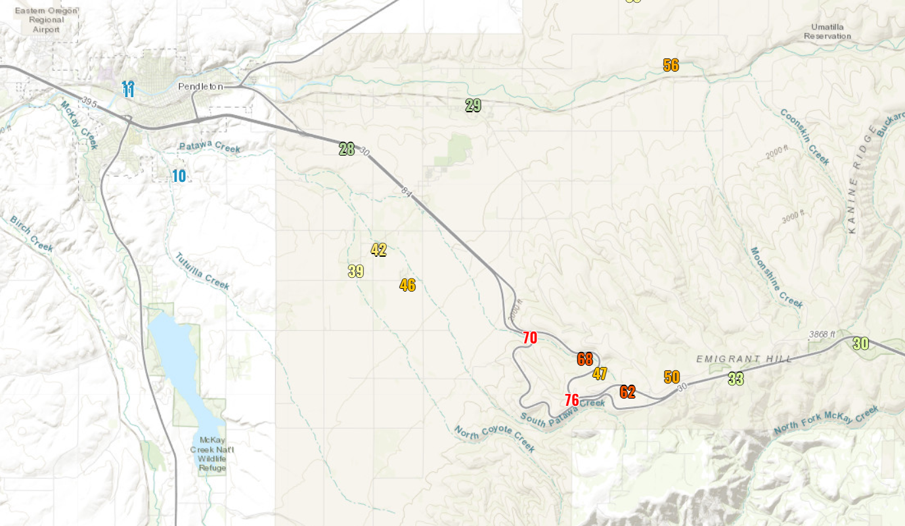
EASTERLY DOWNSLOPE WINDSTORM ON 4TH
“BOMB CYCLONE”
FAR
OFFSHORE
BIG PRESSURE
DIFFERENCE
EAST TO WEST

Slide 49

BRIEF COLD SPELL LATE JANUARY
MODELS VERY COLD AT ONE POINT
Still ended up with coldest airmass of season
@ 850mb (-9.3 C) on Salem sounding 29th

Slide 50

FEBRUARY
Anomalous ridging in eastern Pacific + cold trough over western USA developed 2nd half of month
Notes:
50+ gusts at TTD, 85 mph gust at Corbett Grade, highest of past 10 years
850mb temps never below -9 this winter
Valley 30-35 during this time
Puget Sound 35-45!

Slide 51

FEBRUARY
Notes:
50+ gusts at TTD, 85 mph gust at Corbett Grade, highest of past 10 years
850mb temps never below -9 this winter
Valley 30-35 during this time
Puget Sound 35-45!

Slide 52

FEBRUARY
Valentine’s Day snow for some
Notes:
50+ gusts at TTD, 85 mph gust at Corbett Grade, highest of past 10 years
850mb temps never below -9 this winter
Valley 30-35 during this time
Puget Sound 35-45!

Slide 53

FEBRUARY
Valentine’s Day snow for some
Notes:
50+ gusts at TTD, 85 mph gust at Corbett Grade, highest of past 10 years
850mb temps never below -9 this winter
Valley 30-35 during this time
Puget Sound 35-45!

Slide 54


FEBRUARY
Valentine’s Day snow for some
Notes:
50+ gusts at TTD, 85 mph gust at Corbett Grade, highest of past 10 years
850mb temps never below -9 this winter
Valley 30-35 during this time
Puget Sound 35-45!

Slide 55

FEBRUARY
3rd episode of cold upper-troughing drops through region last week of the month
Notes:
50+ gusts at TTD, 85 mph gust at Corbett Grade, highest of past 10 years
850mb temps never below -9 this winter
Valley 30-35 during this time
Puget Sound 35-45!

Slide 56

A “perfect setup” with surface low lingering near coastline
w/east wind drawing in cold/dry air
4 a.m.
Wednesday
Forecast

Slide 57

A “perfect setup”; surface low lingering near coastline
w/east wind drawing in cold/dry air
4 a.m.
Thursday
Forecast

Slide 58


A “perfect setup”; surface low lingering near coastline
w/east wind drawing in cold/dry air
Models had the basic synoptic situation correct, but widely varying precipitation forecasts

Slide 59

Forecast available 8am Wednesday, T-8 hours to gridlock
Strong hints from several models that “something big may happen”

Slide 60



Euro forecasts 00z and 06z night before
Strong hints from several models that “something big may happen”

Slide 61


Canadian (HRDPS) 12z & final Euro 12z
Strong hints from several models that “something big may happen”

Slide 62



Gridlock for hours, then a snowy/frozen city the next day

Slide 63

SNOW ARRIVES AT BEACHES NIGHT OF 22nd into 23rd

Slide 64

FEBRUARY 24th

Slide 65

FEBRUARY 24th

Slide 66




Slide 67




Slide 68

FEBRUARY 25TH
Coldest morning of winter for most of us
Calm + clear + 3-8” snow on ground

Slide 69

A COLD MARCH!
Much colder than normal, although precip near normal

Slide 70

A COLD MARCH!
Much colder than normal, although precip near normal

Slide 71

Excellent snowpack
La Nina delivered this year

Slide 72



Mountain Snowpack @ 5,400’
Bottom of Pucci Lift @Timberline
Peak snow depth 3 weeks late
Big snow mid-December to early January
AVERAGE
2020-21
Several snow, then melting events Oct/Nov
Not much snow
Early Jan-March
2020-21

Slide 73



Southern Cascades Snowpack @ 5,300’
Diamond Lake
No big snow events for 2.5 months!
Slowed melting in spring
Big snow mid-December to early January
AVERAGE
2020-21

Slide 74

Cascade Snowfall
Early ski season start with cold November
Best weeks of winter end of February and early March
MISSING snow totals February at Government Camp!

Slide 75


Slide 76


Slide 77

Blue = Widespread PACNW Arctic Air Outbreak

Slide 78

Last “arctic blast” was December 2013
Previous events: Nov 2010, Dec 2009, Dec 1998, Dec 1990
Been working on arctic air events, along with Tanis Leach

Slide 79


Slide 80


Slide 81


Slide 82


Slide 83


Slide 84

NO INLAND WIND STORMS
27 winters without a major REGIONAL storm
Notes:
Calmest south wind season of the last 20-30 years

Slide 85

ROUGH EAST WIND SEASON
November + December = most “east wind days” since 2006!

Slide 86
FINAL WINTER THOUGHTS
- Models are great, but still have (fewer) issues mixing warmer air into easterly flow at end of cold spells/ice storms in metro area
- Silver Christmas was kind of fun…
- A lack of storms coming at us from westerly direction = few south wind events last winter
- We are “due” for a snowless winter, arctic blast, and a widespread flood

Slide 87




SUMMER HEAT ARRIVES IN MAY
Warmest May on record in Portland & parts of Washington
MAY 14TH

Slide 88

SUMMER HEAT ARRIVES IN MAY
6 records in 3 days

Slide 89

SUMMER 2023, ANOTHER HOT ONE

Slide 90

SUMMER: BLAZING HOT
3rd hottest in western valleys (2015 & 2021 = #1/2)
WESTERN VALLEYS: 11th consecutive warm (or hot) summer, longest stretch on record

Slide 91


Slide 92

SUMMER: AT THE COAST
3rd warmest in coastal zones too
COAST: 11th consecutive warm summer, no other period like this in last 100 years

Slide 93


Slide 94


Slide 95

AUGUST 13TH SUNDAY

Slide 96


Slide 97


Slide 98

AUGUST HEAT WAVE
Smoke keeps central/south valley “cool” Tuesday 14th

Slide 99

WINTER OUTLOOKS & THOUGHTS
Old Farmer’s Almanac
Farmers’ Almanac
AccuWeather
Pete Parsons – ODF
Kelley Bayern - KOIN
Models

Slide 100

Pete Parson’s Forecast Highlights
Pete uses 3 analog years for his forecast
Notes:
Charts generated at: https://www.esrl.noaa.gov/psd/cgi-bin/data/composites/printpage.pl

Slide 101

Pete Parson’s Forecast Highlights
Pete uses 3 analog years for his forecast
Notes:
Charts generated at: https://www.esrl.noaa.gov/psd/cgi-bin/data/composites/printpage.pl

Slide 102

Pete Parson’s Forecast Highlights
Pete uses 3 analog years for his forecast
Notes:
Charts generated at: https://www.esrl.noaa.gov/psd/cgi-bin/data/composites/printpage.pl

Slide 103


Kelley Bayern – Meteorologist KOIN-TV
Notes:
Charts generated at: https://www.esrl.noaa.gov/psd/cgi-bin/data/composites/printpage.pl

Slide 104


TWO MODEL FORECASTS
ECMWF DEC-FEB 500MB
CANSIPS DEC-FEB 500MB

Slide 105


WHAT ABOUT THE WEAKER MEI VS. ONI?
MEI SAYS THIS IS A WEAK EVENT SO FAR
Similar to 86-87 and 91-92
Similar El Nino to 02-03, 04-05, 06-07, 09-10, 18-19 when using MEI

Slide 106

Lots of warm sea surface across globe
Will El Niño behave differently when “extra warm” water is surrounded by “warm”?
Will this
affect
our winter?

Slide 107

What about the strongly “cold” PDO?
Doesn’t happen w/El Niño often
Mod/strong El Niño + Cold PDO years? 1994-95, 1972-73, 1968-69
YOU ARE HERE

Slide 108


