Slide 1
Portland Snow and the Maui Wildfire:
Why such different skill??
Cliff Mass
University of Washington

Slide 2
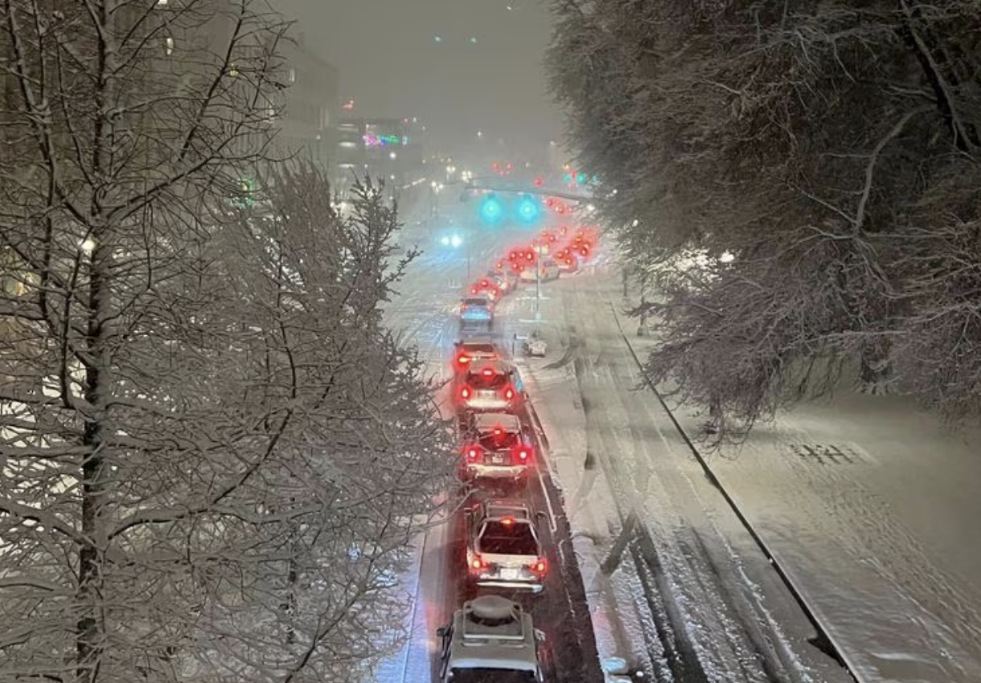
On February 22, 2023, a significant snowstorm hit Portland, with up to 10 inches.
The high-resolution UW WRF forecasts and NOAA HRRR had only had very light amounts.

Slide 3
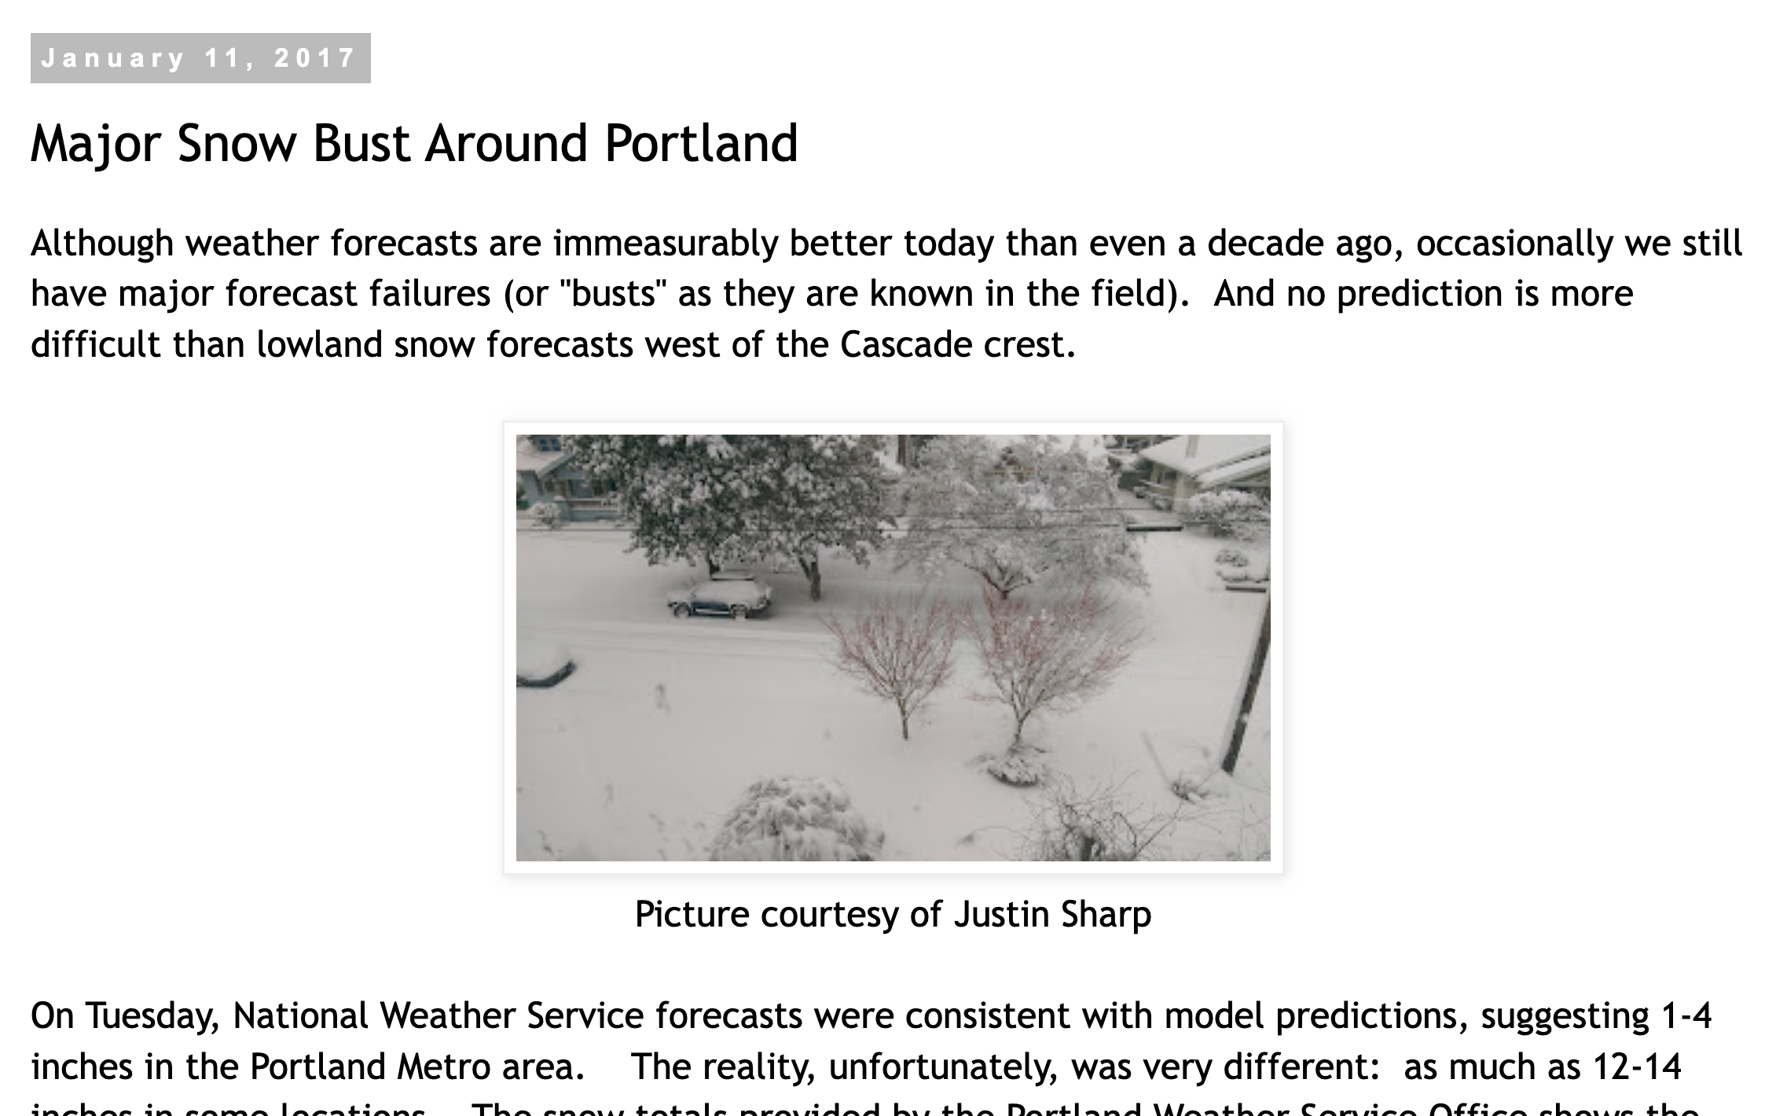
And there have been other recent snow busts in Portland

Slide 4
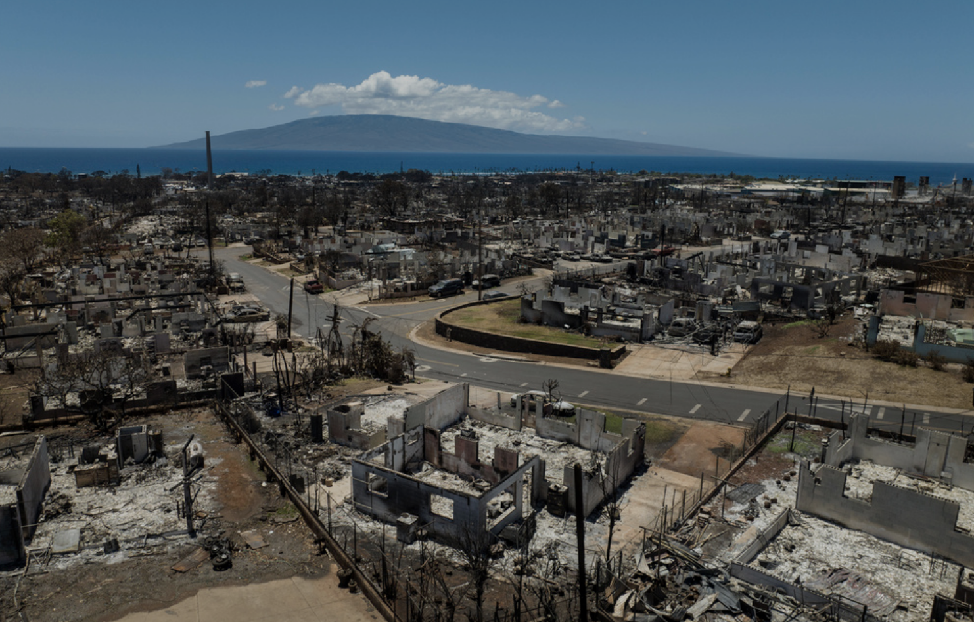
On August 8, 2023 very strong winds hit western Maui, producing a huge wildfire

Slide 5
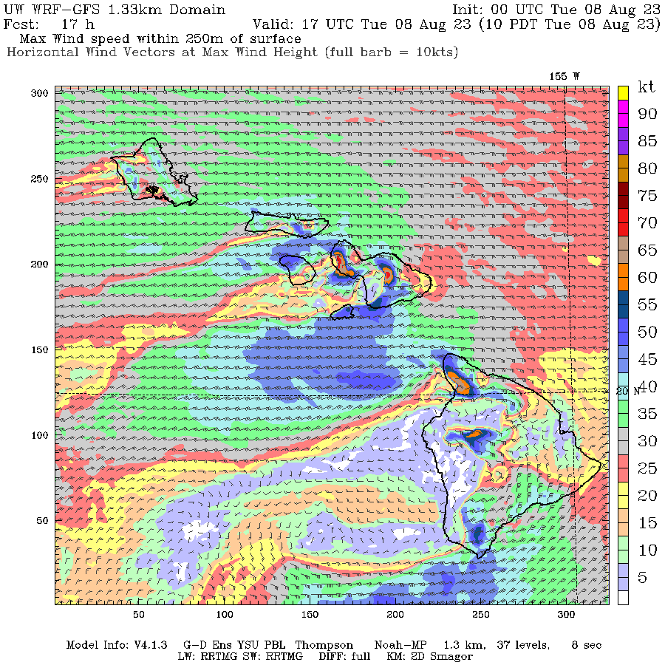
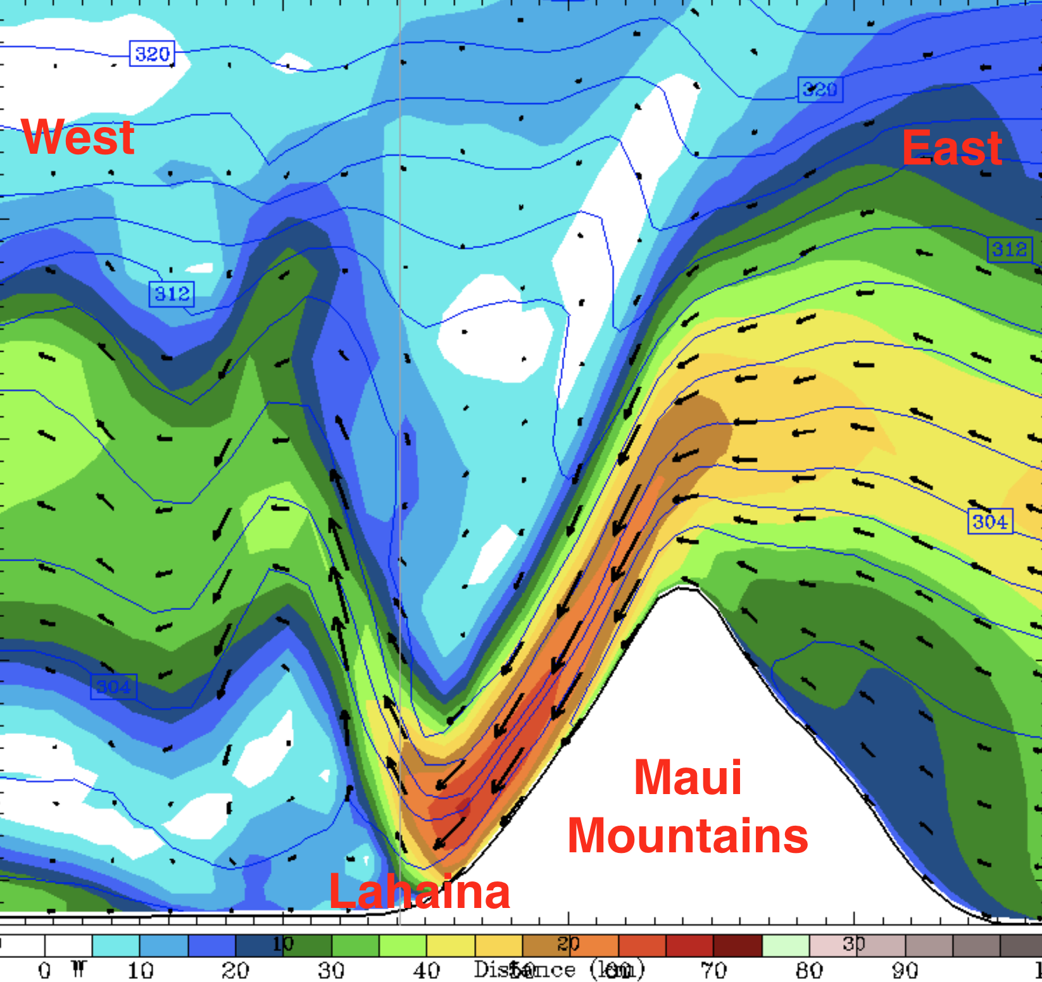
High-resolution models predicted the winds almost perfectly (such as WRF and HRRR)

Slide 6
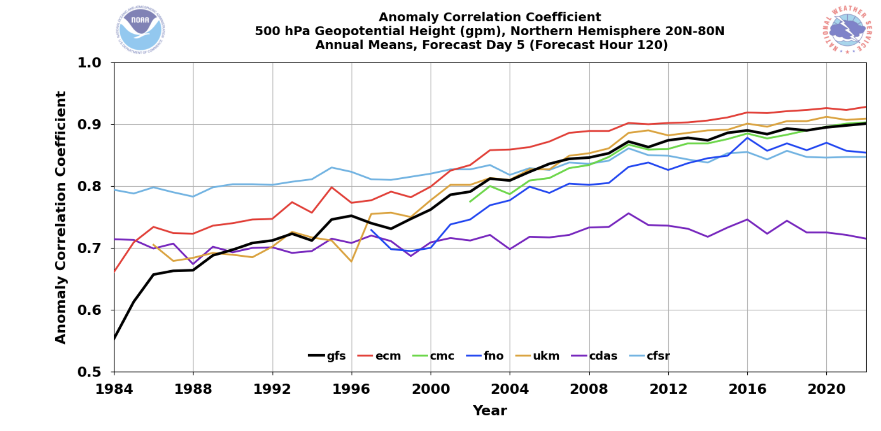
High-Resolution Weather Prediction Models Have Gained the Ability to Produce Far Better Local Forecasts
Why?
Much higher resolution
Much better physics
MUCH better synoptic forecasts driven by hugely increased satellite assets and better data assimilation.

Slide 7
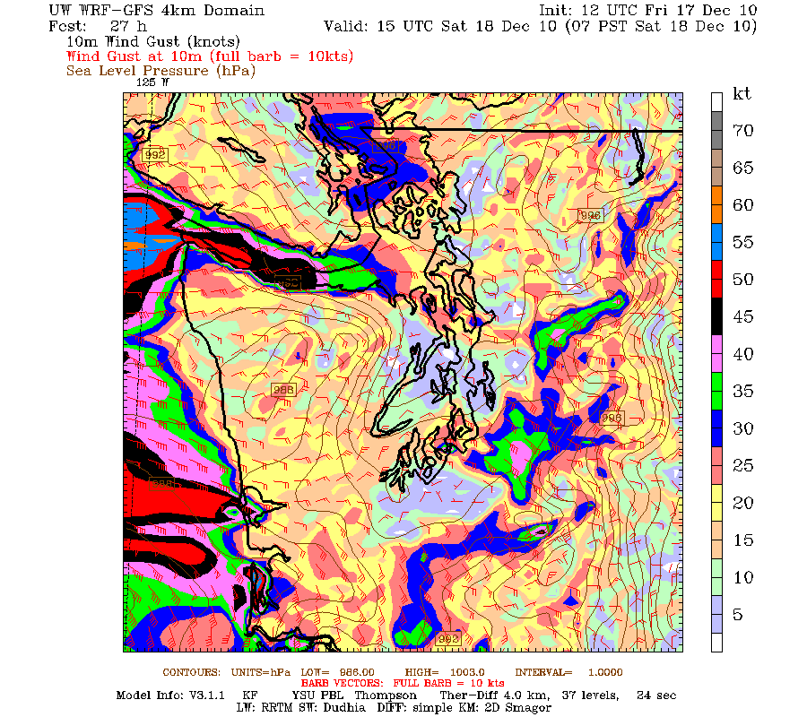
Sometimes high-resolution models are very skillful, but sometimes they fail. Why?
When the large-scale, synoptic flow is well forecast, high-resolution models are particularly skillful in predicting the effects of terrain.

Slide 8
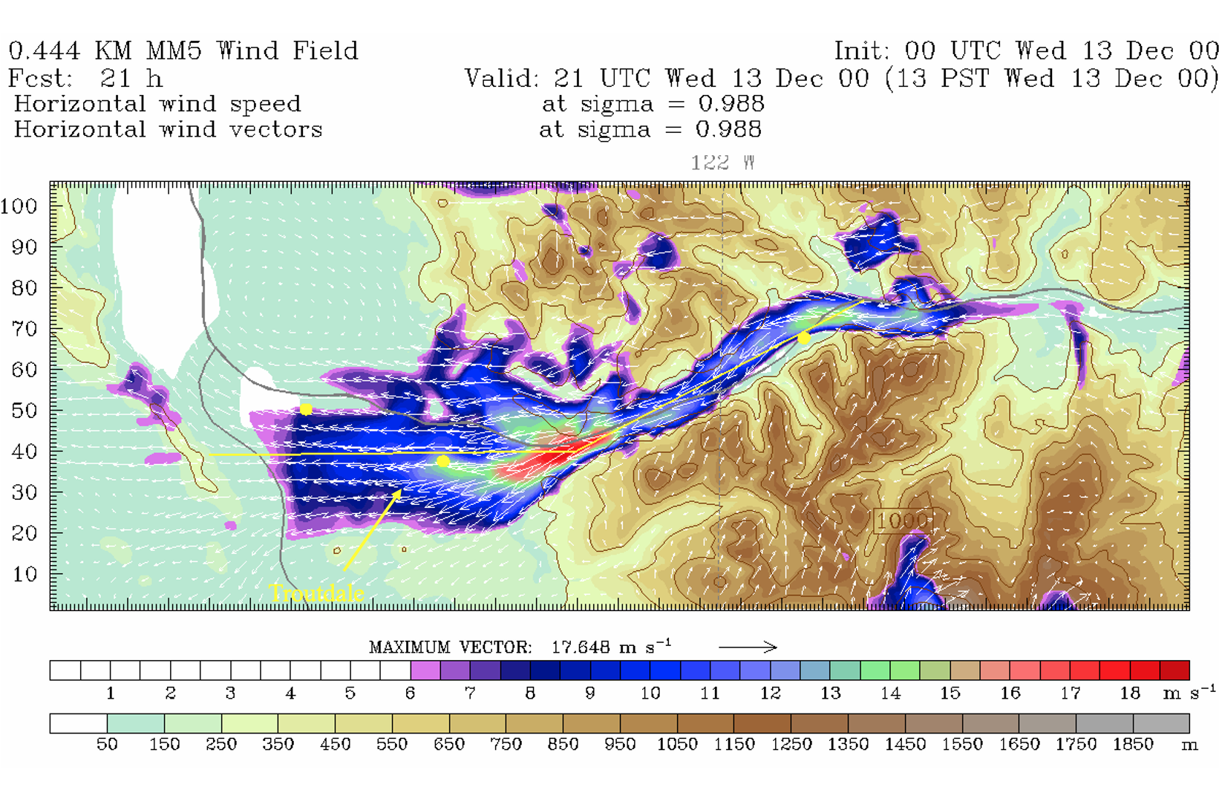

Slide 9
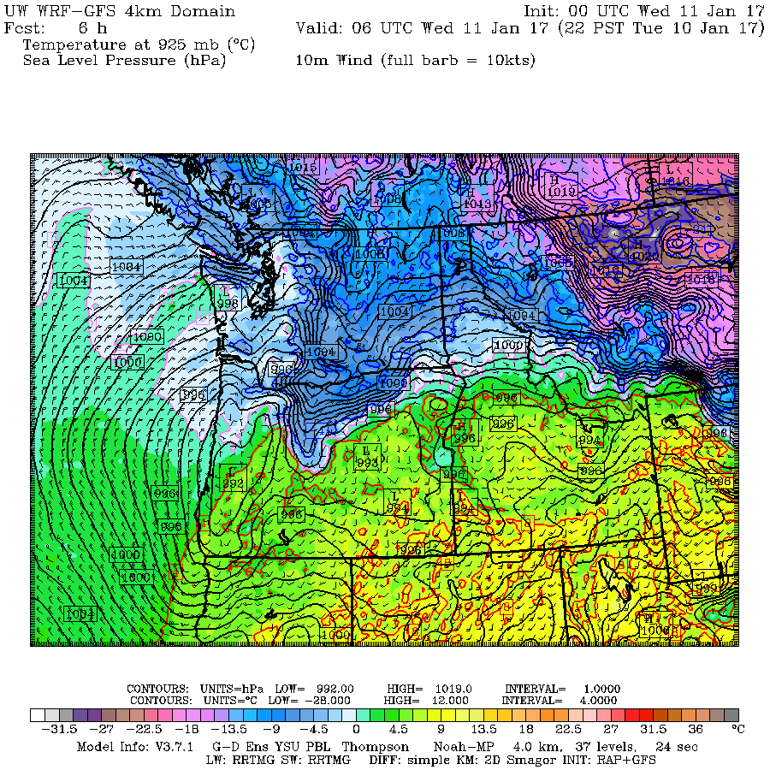
But when smaller scale lows and troughs are involved…and particularly those moving down the coast or off the ocean… skill can decline.
2017 Portland Snow Bust

Slide 10
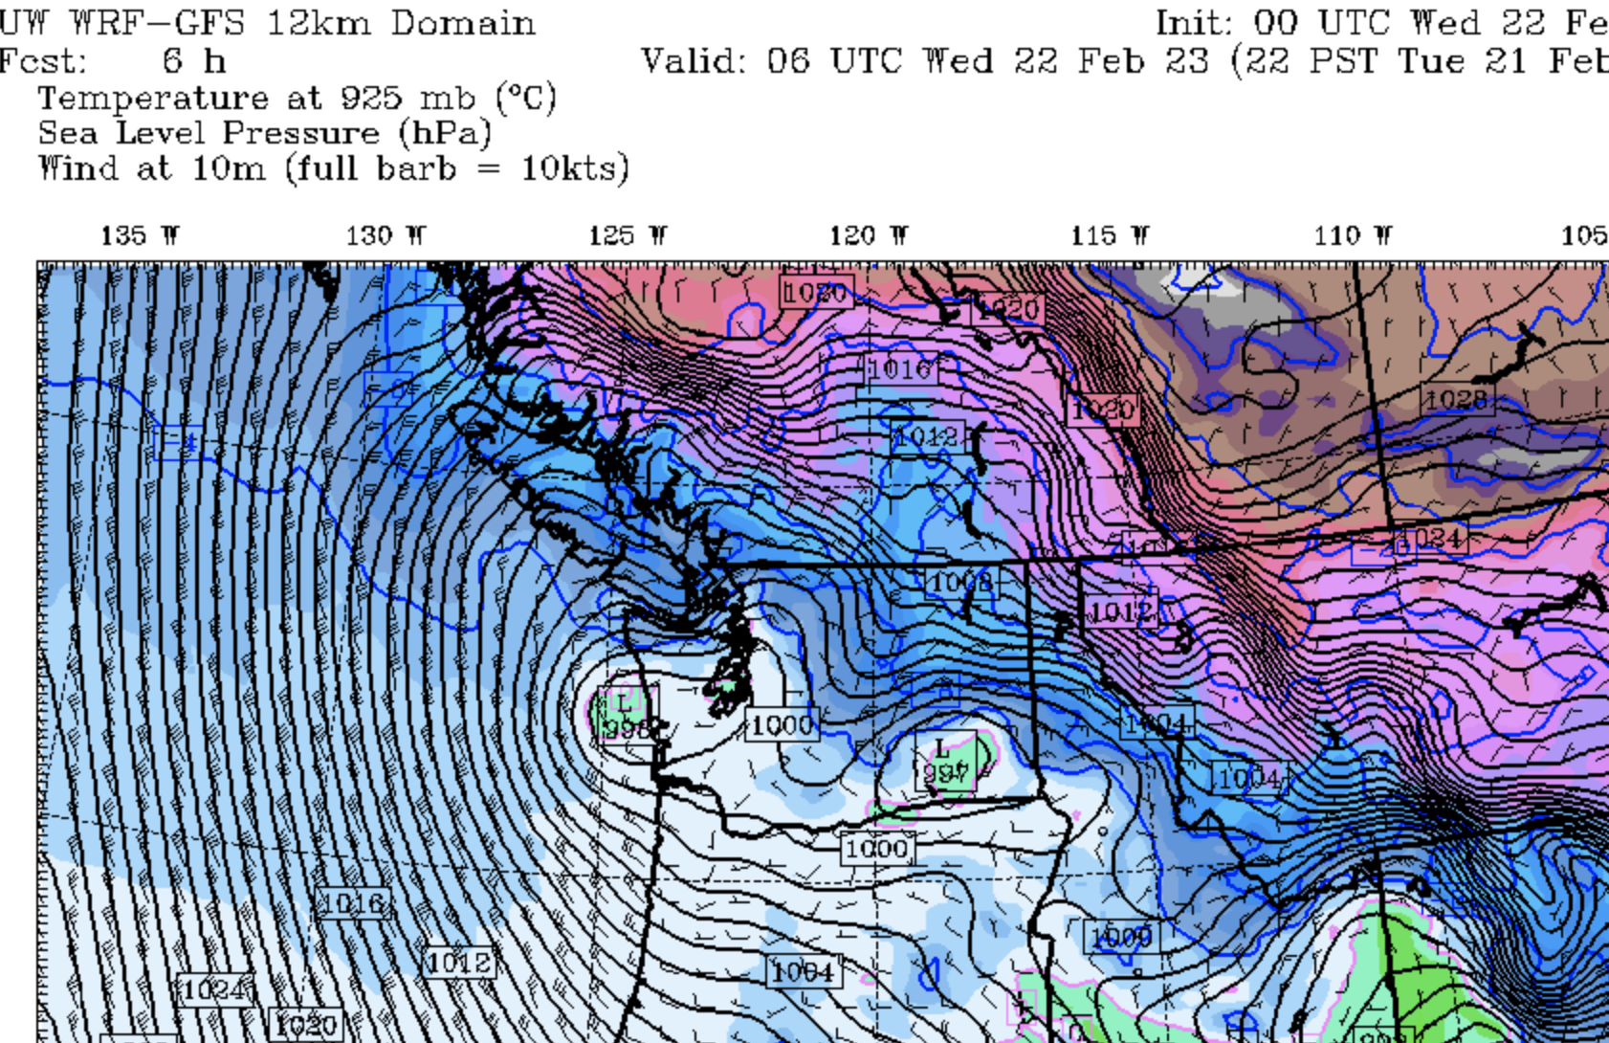
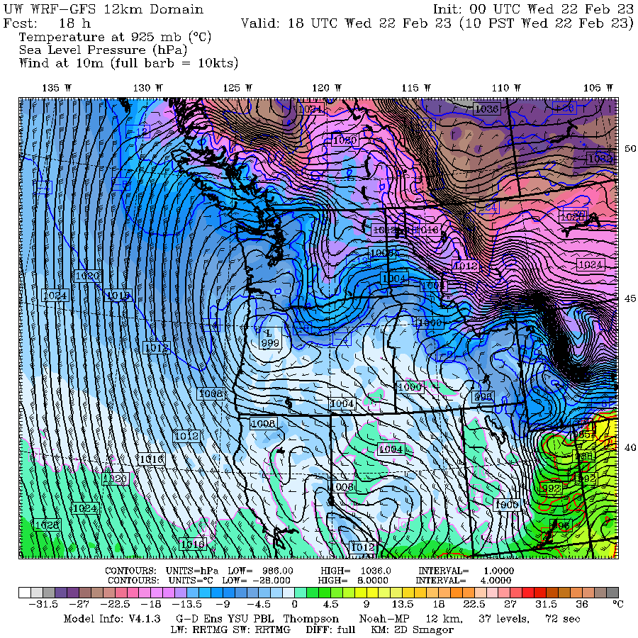
2023 Portland Snow Bust

Slide 11
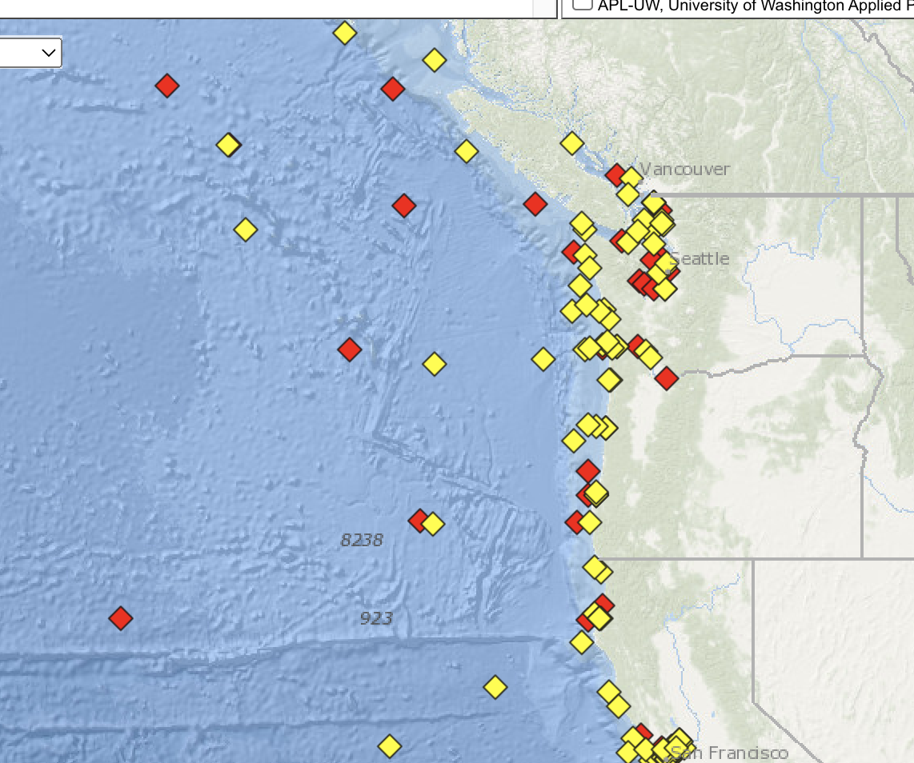
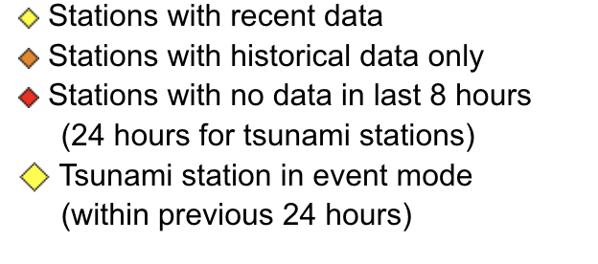
So how can we deal with the Portland snow bust problem?
The situations with lows coming down the coast are essentially less predictable, with small errors having huge implications on where the heavy snow will fall.
There is less data over the ocean and southwestern BC than over U.S. mainland.
Broken buoys and a lack of Oregon coastal radars are problems THAT COULD BE FIXED.
Better data assimilation approaches, particularly mesoscale ensemble DA.

Slide 12
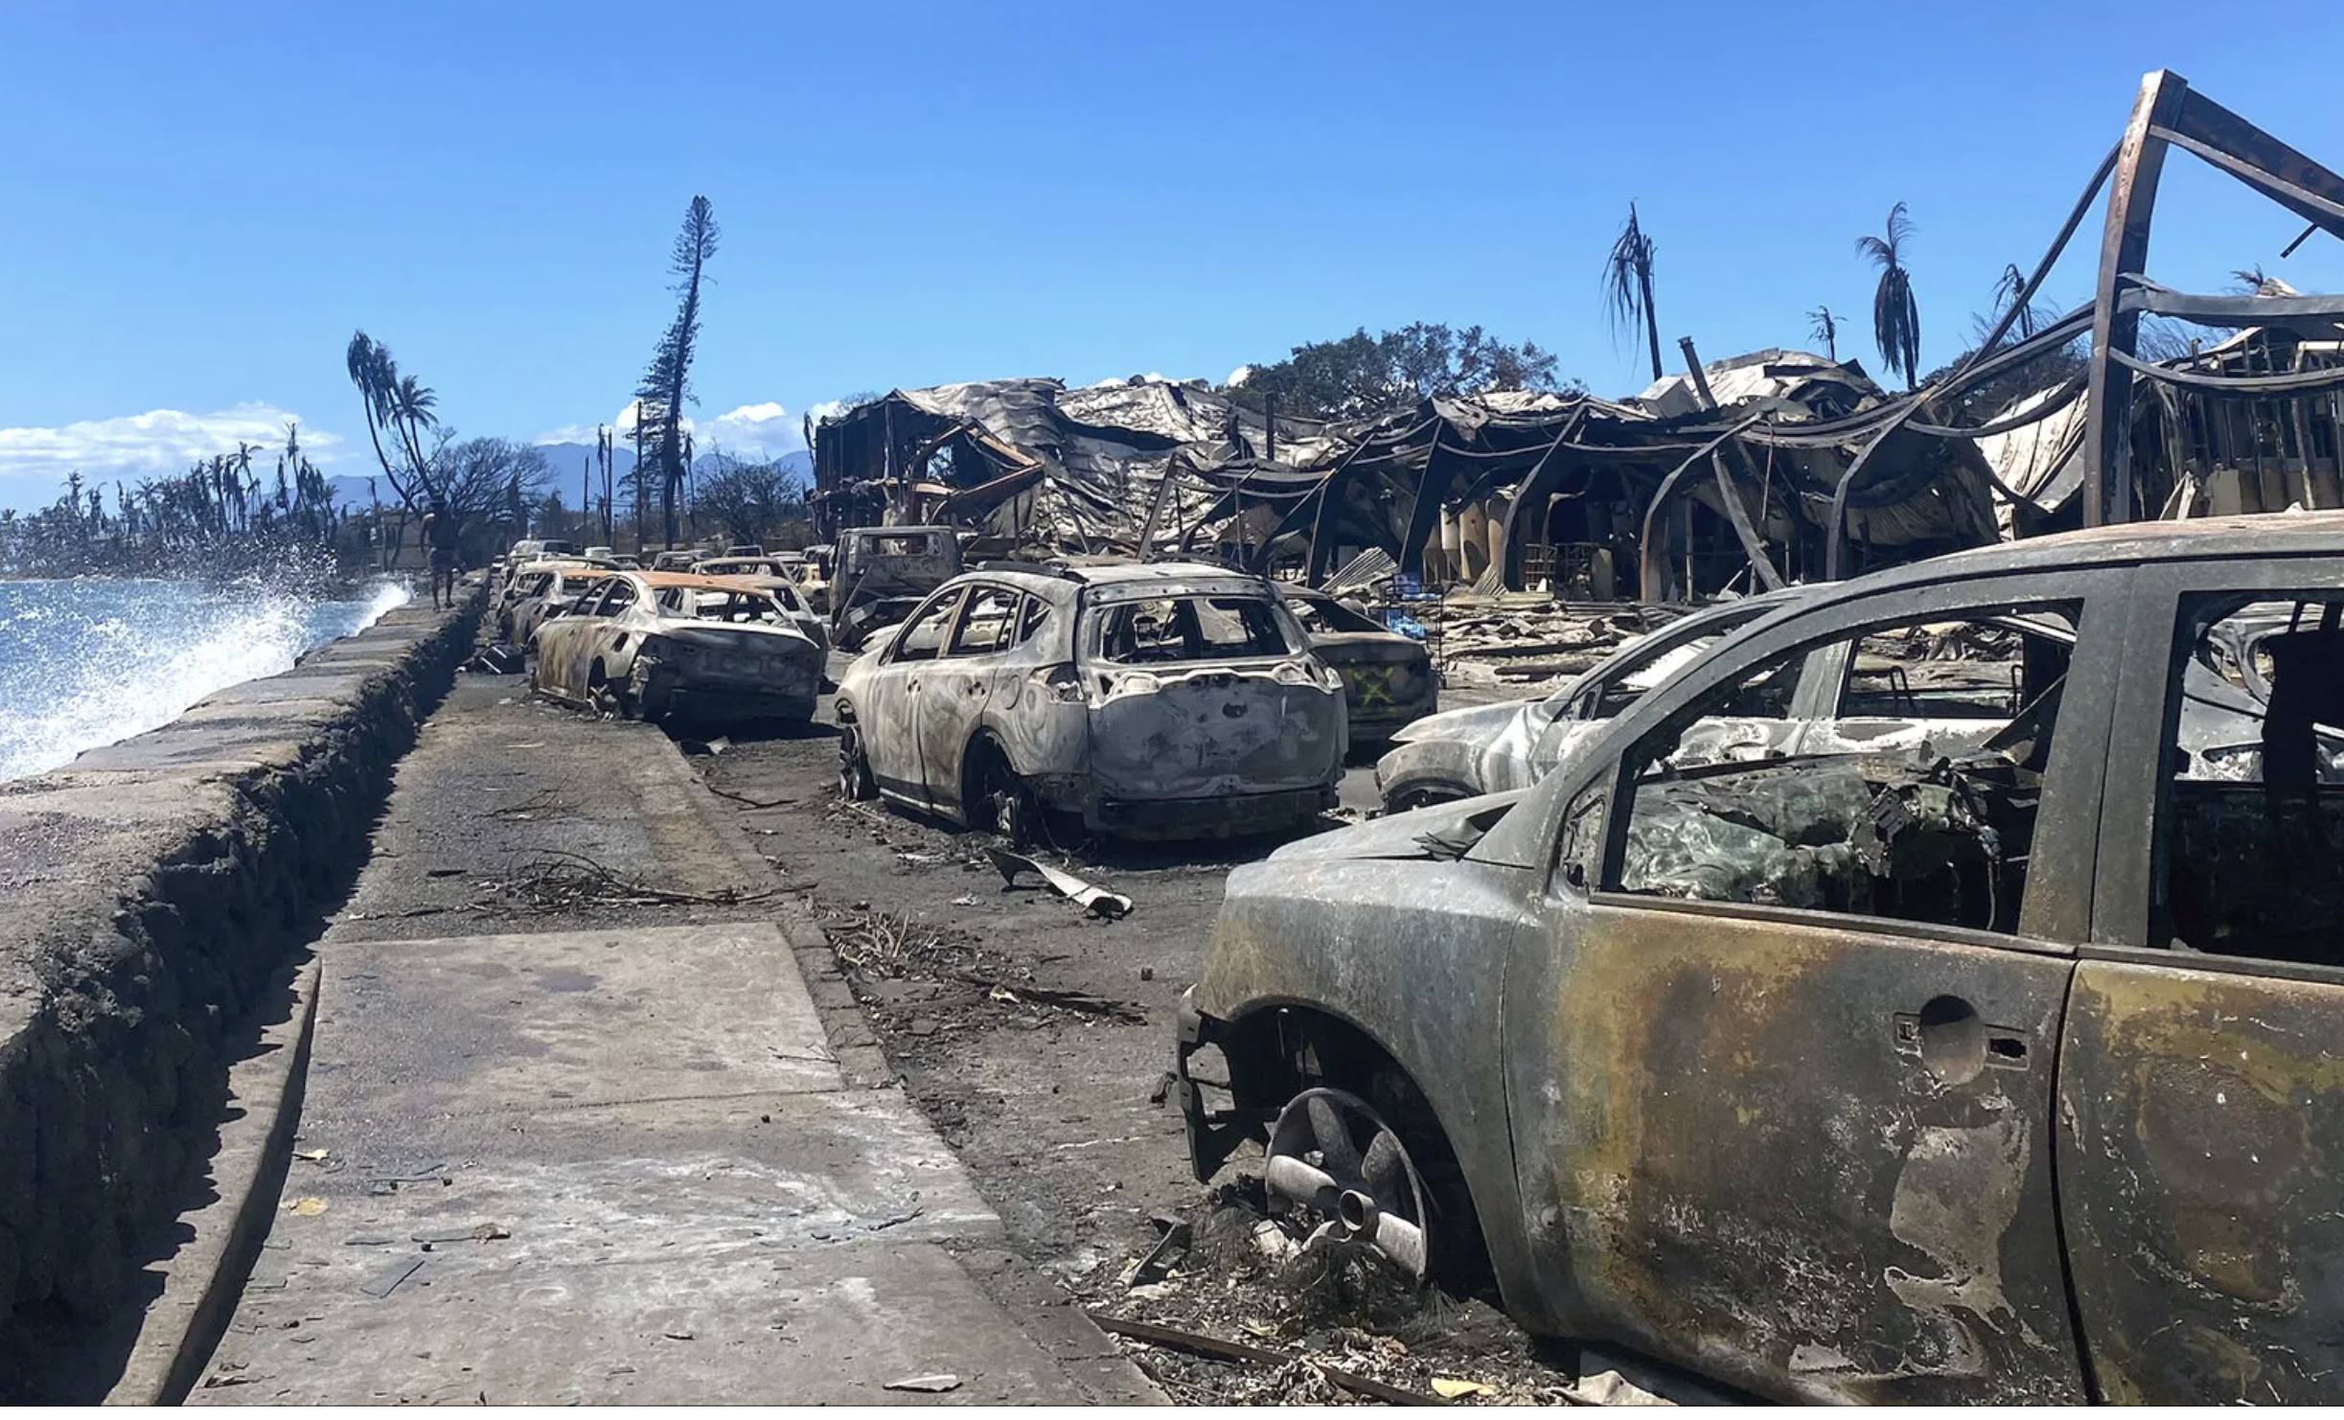
What was the meteorological contribution to the August 8 Maui Wildfire?

Slide 13
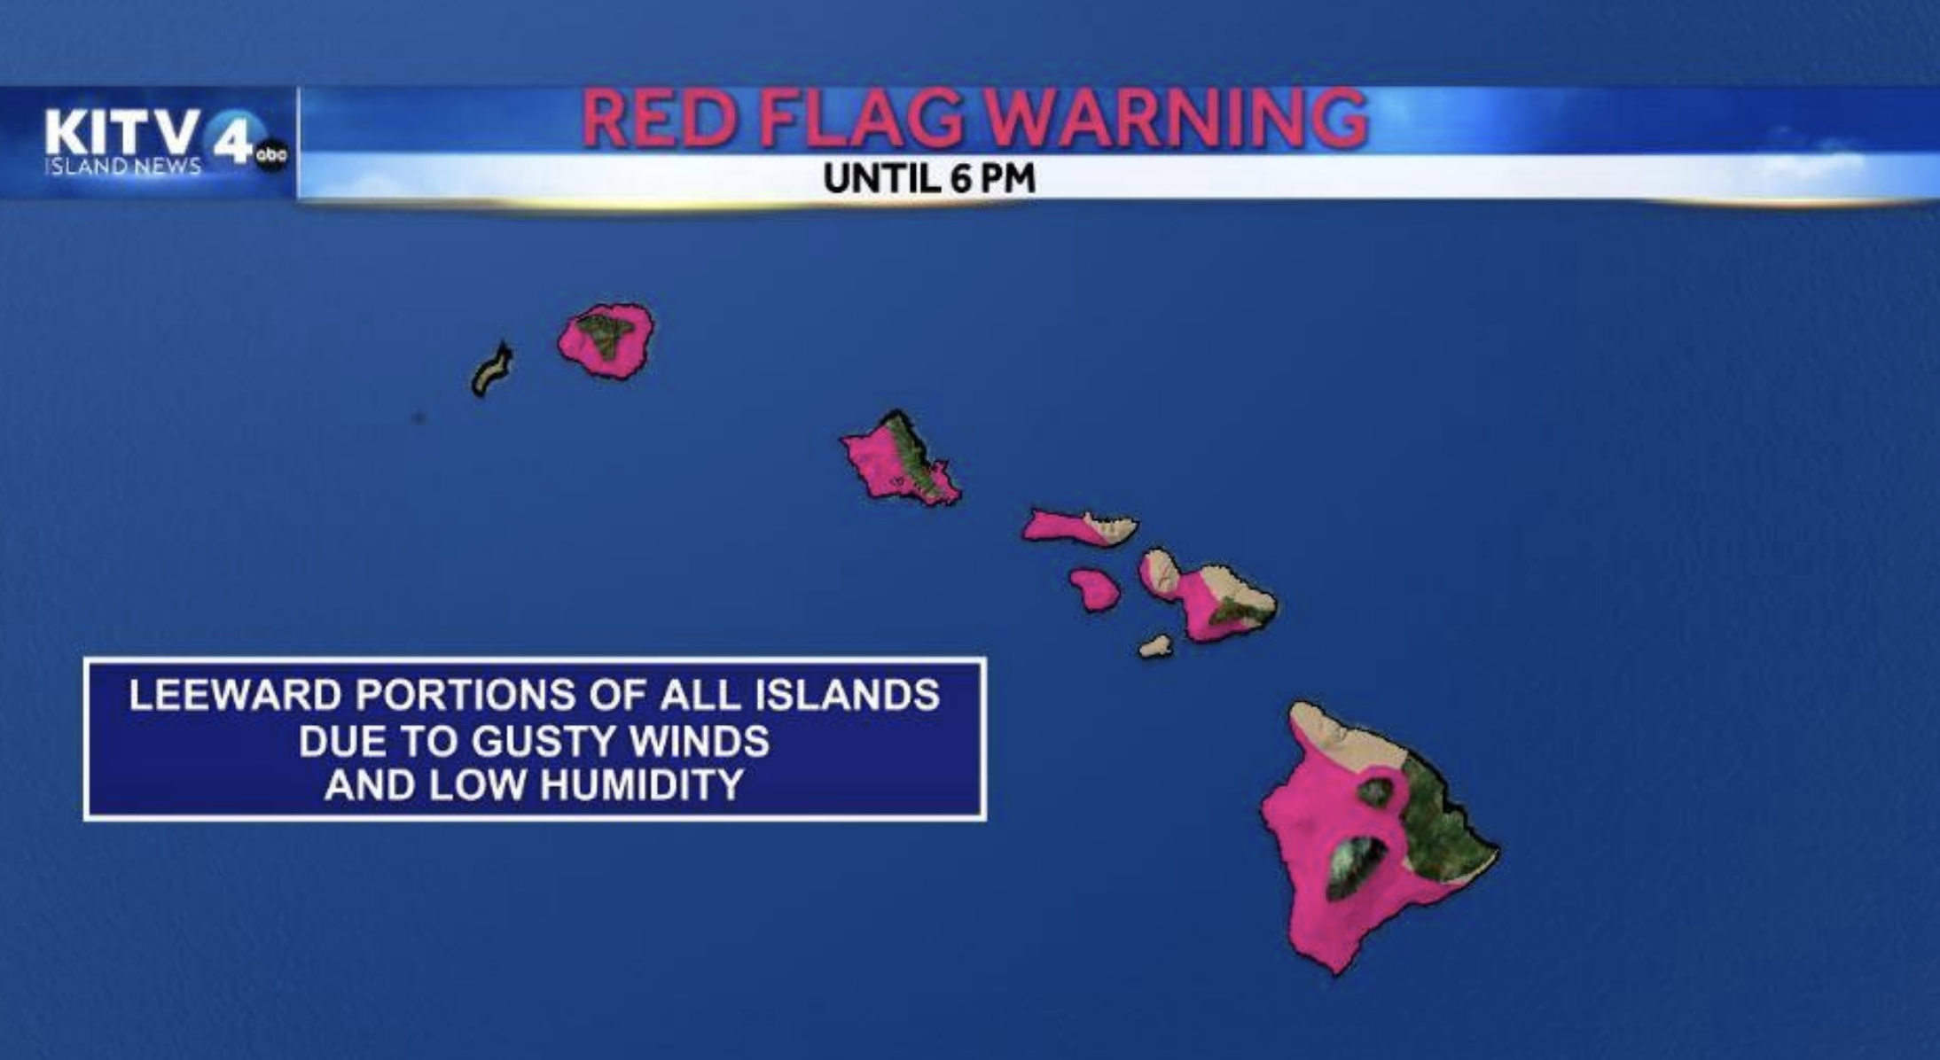
And why were the weather forecasts so good?

Slide 14
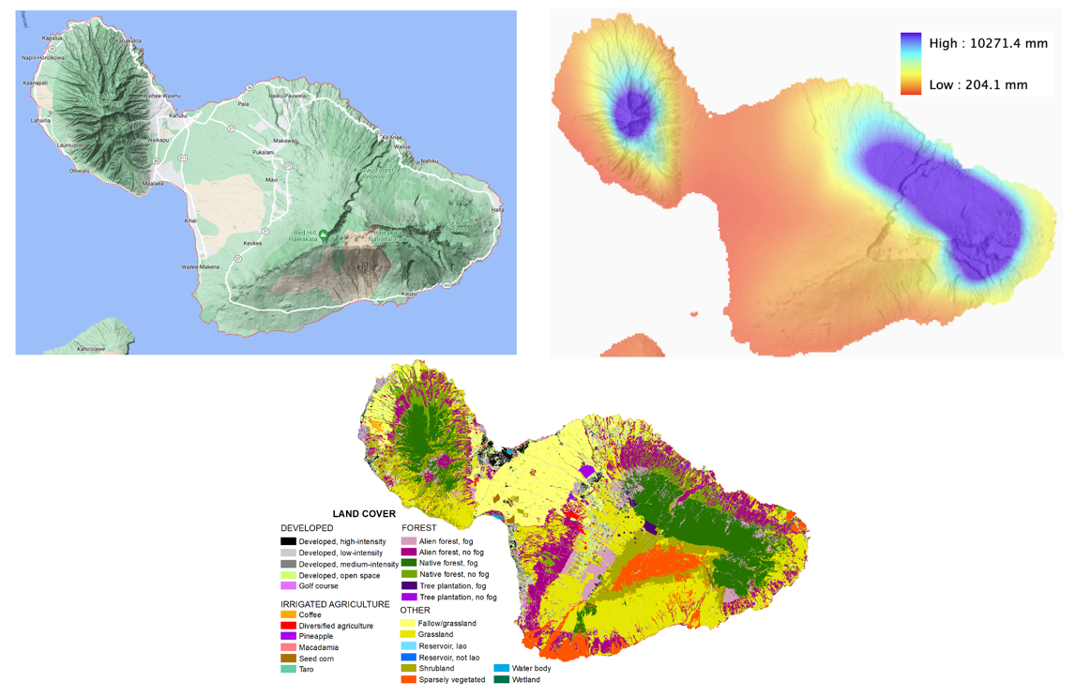
Maui 101

Slide 15
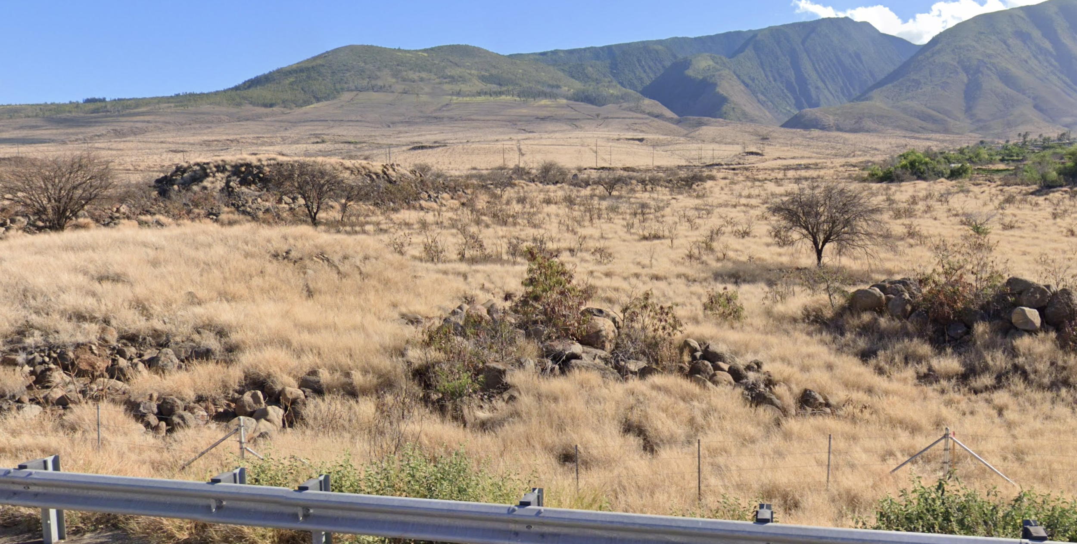
Maui is full of abandoned agriculture lands that are full of flammable invasive, non-native grasses

Slide 16
Lahaina

Slide 17
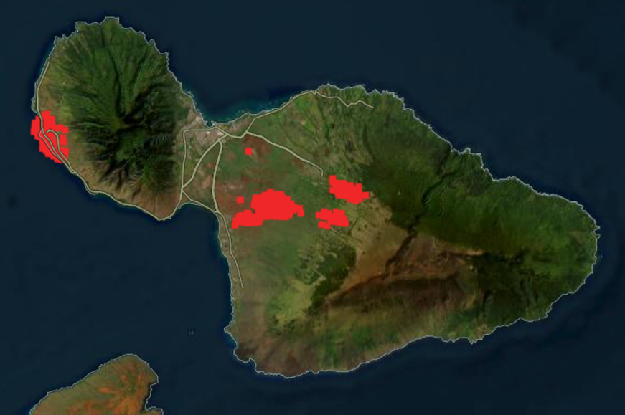
August 8 wildfires were in grass

Slide 18
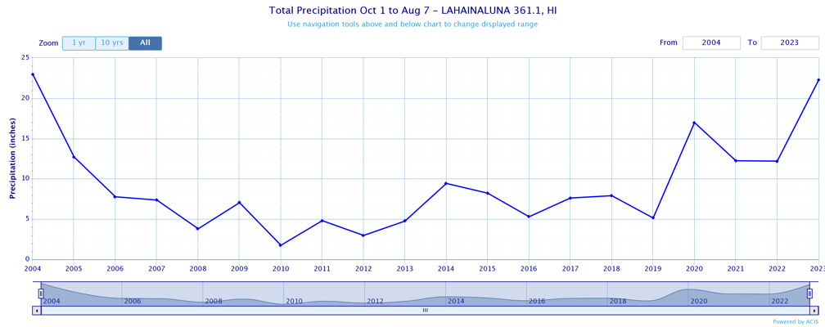
The summer is the dry season on Maui and the grasses were dry
The previous winter was wetter than normal resulting in abundant grass.

Slide 19
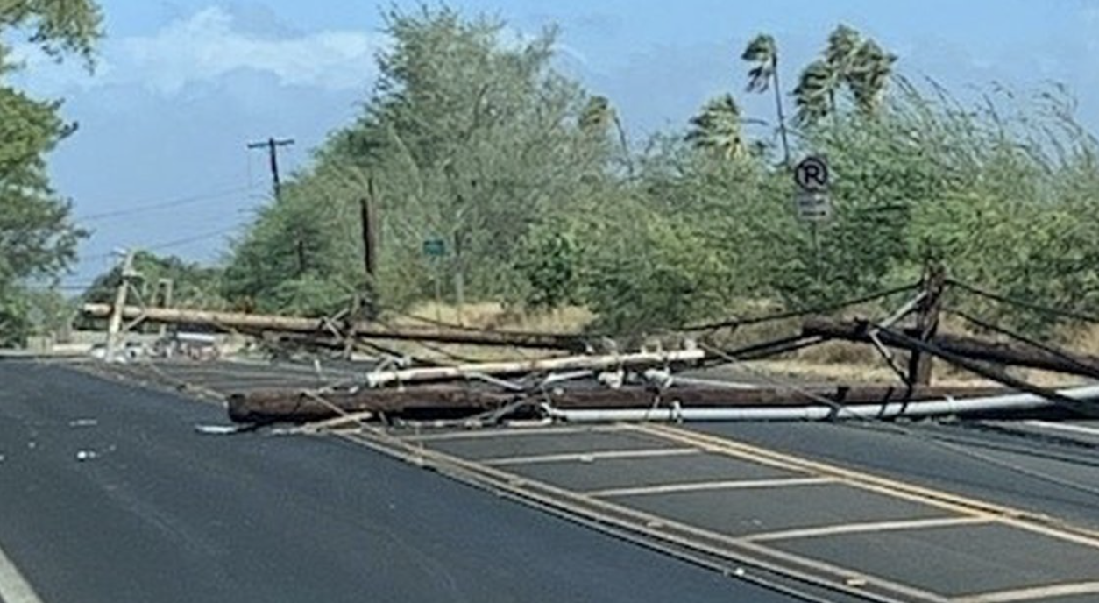
Strong winds developed late on August 7 and accelerated on August 8
Very poor observational network on western Maui.
An amateur station reached 67 mph before the power failed.
Damage (snapped power poles, toppled trees, roofs destroyed) suggested gusts of 60-90 mph.
The strongest winds were from the northeast and east: downslope off the West Maui Mountains.

Slide 20
Model simulations suggest there was a downslope windstorm on the lee side of the West Maui Mountain
WRF simulation 1.3 km grid spacing

Slide 21
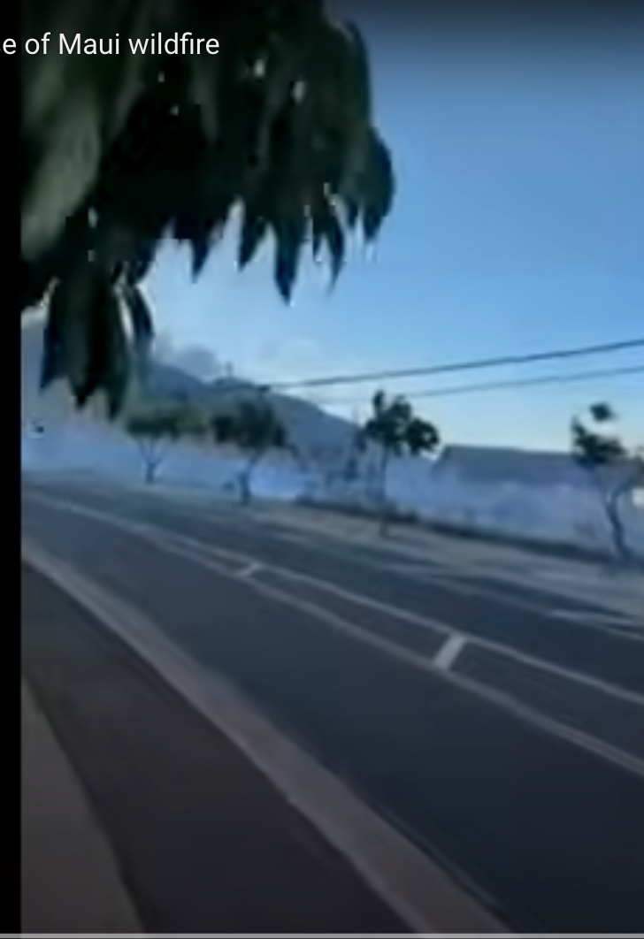
The Origin of the Maui Wildfire
The strong winds contributed to ignition by damaging the power infrastructure, which produced sparks that ignited the grass
Strong winds provided oxygen and pushed the fire forward rapidly into homes/buildings that provided additional fuels.

Slide 22
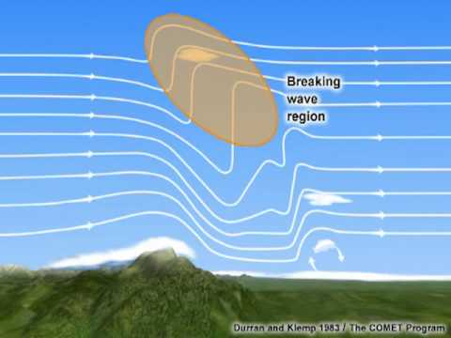
Downslope windstorms require certain conditions
Strong wind approaching the mountain crest
Either a stable layer or critical level (wind reversal) at or just above crest level.

Slide 23
High Resolution Model Simulations Produced This Structure

Slide 24
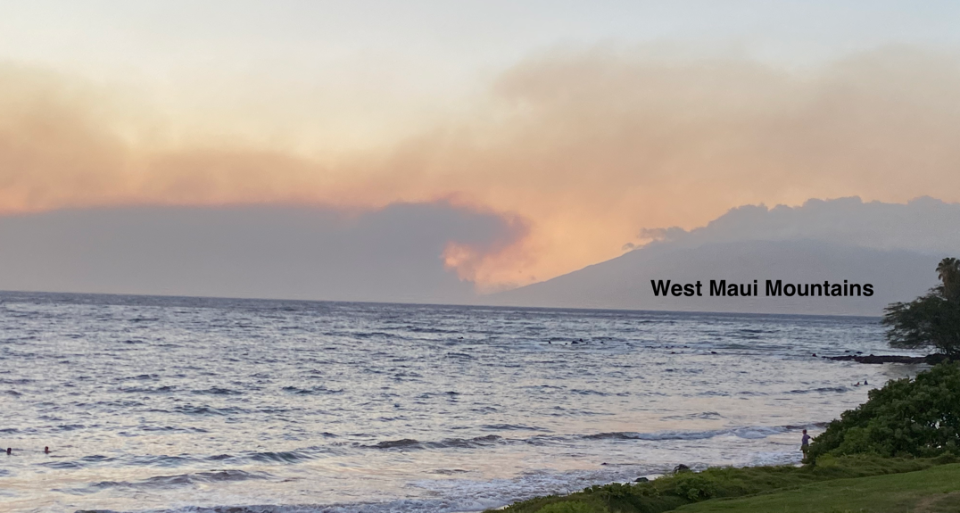
And Photos Suggested it…

Slide 25
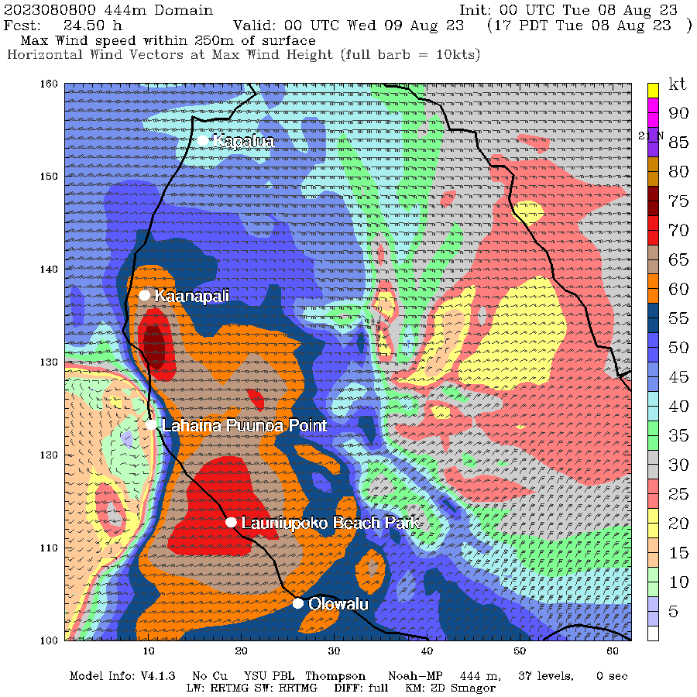
Running at ultra-high resolution (444 m)

Slide 26
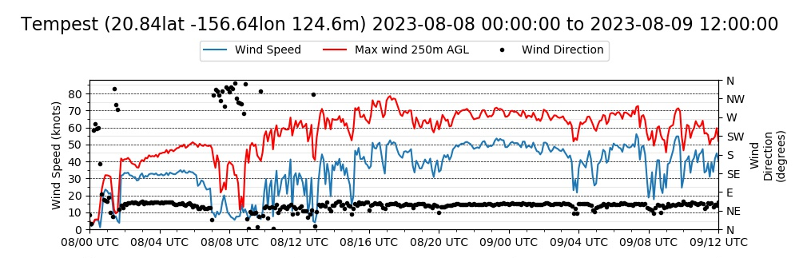
Location a few miles SE of Lahaina

Slide 27
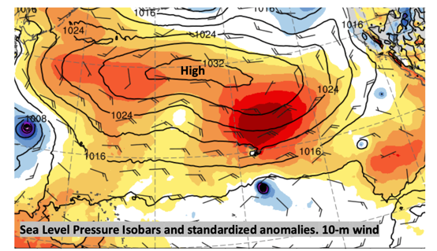
Super tradewinds existed on that Day
Thus, strong winds approaching the crest
Unusually strong high pressure to the north.
This resulted in very strong winds
Also note smaller Hurricane Dora to the south

Slide 28
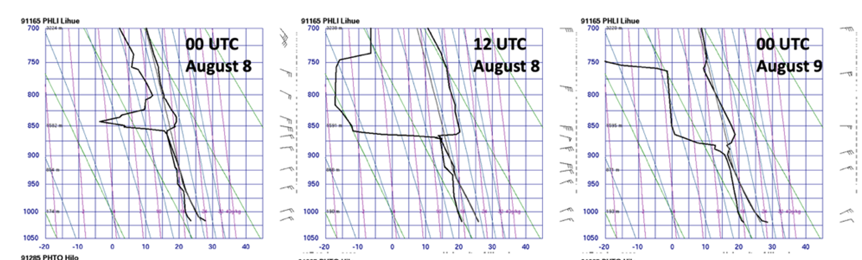
A stable layer, associated with the trade-wind inversion, was also evident
Radiosonde data at Lihue, Kauai

Slide 29
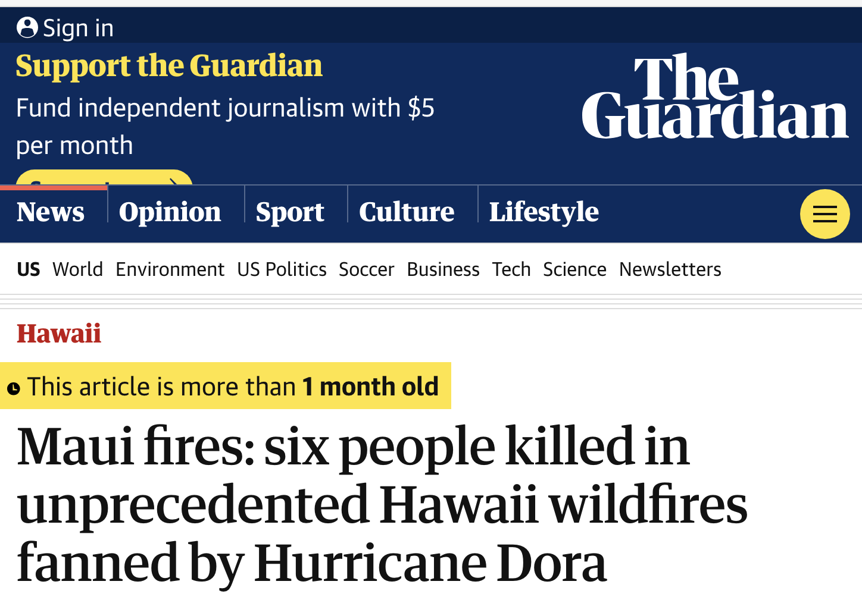
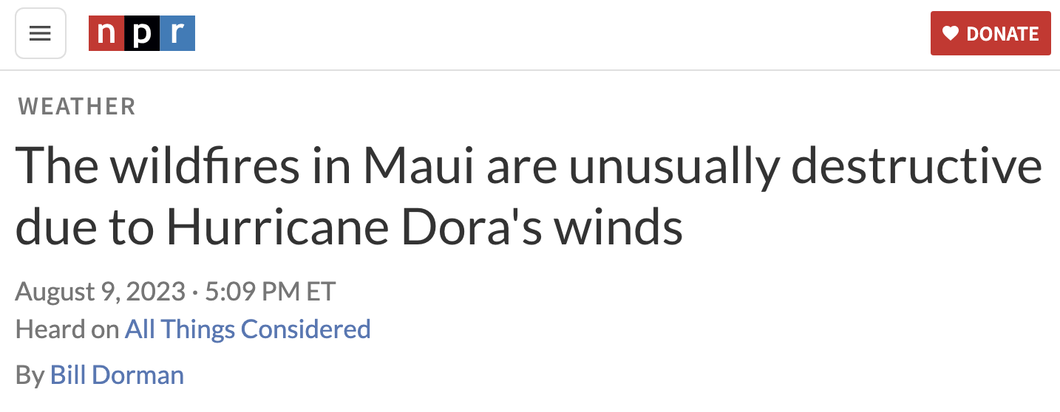
What was the role of Hurricane Dora?

Slide 30
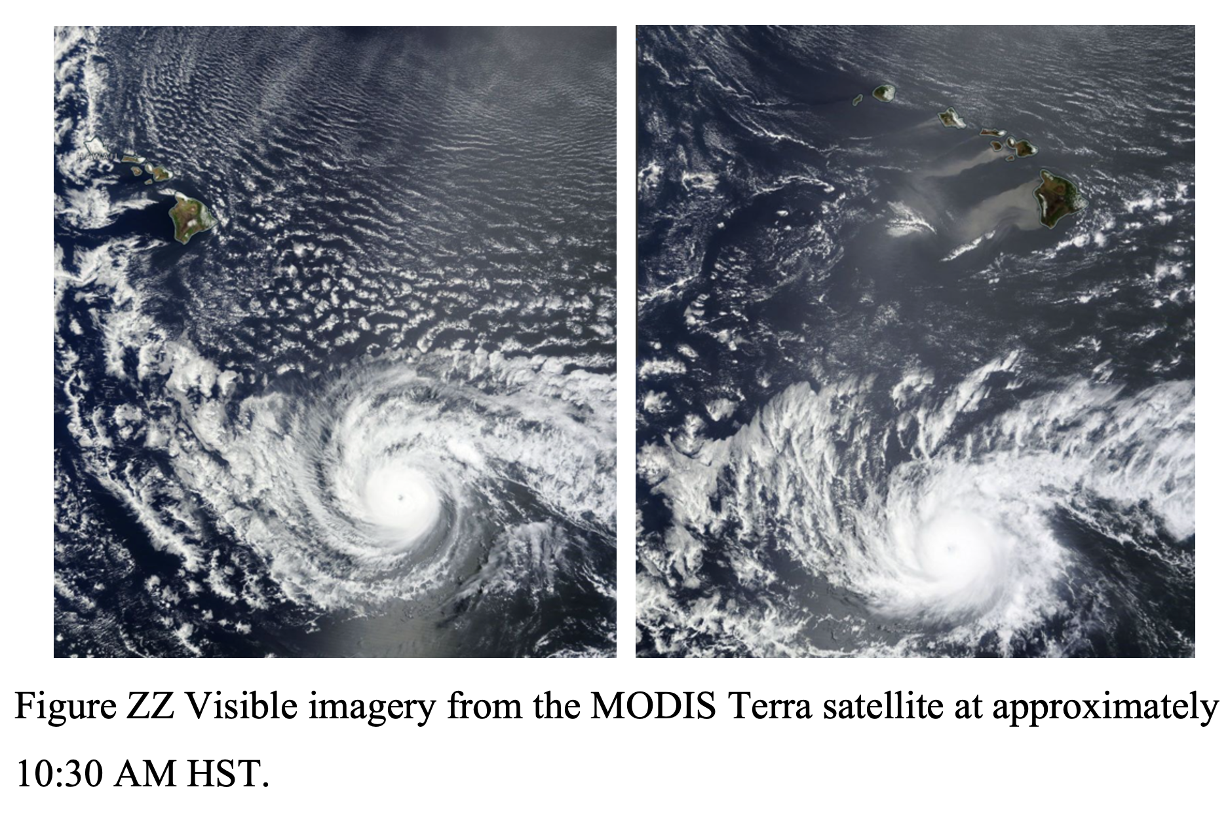
It’s small scale and distance (500 miles) suggests only a minor direct contribution
But why not run simulations in which Dora is “killed”

Slide 31
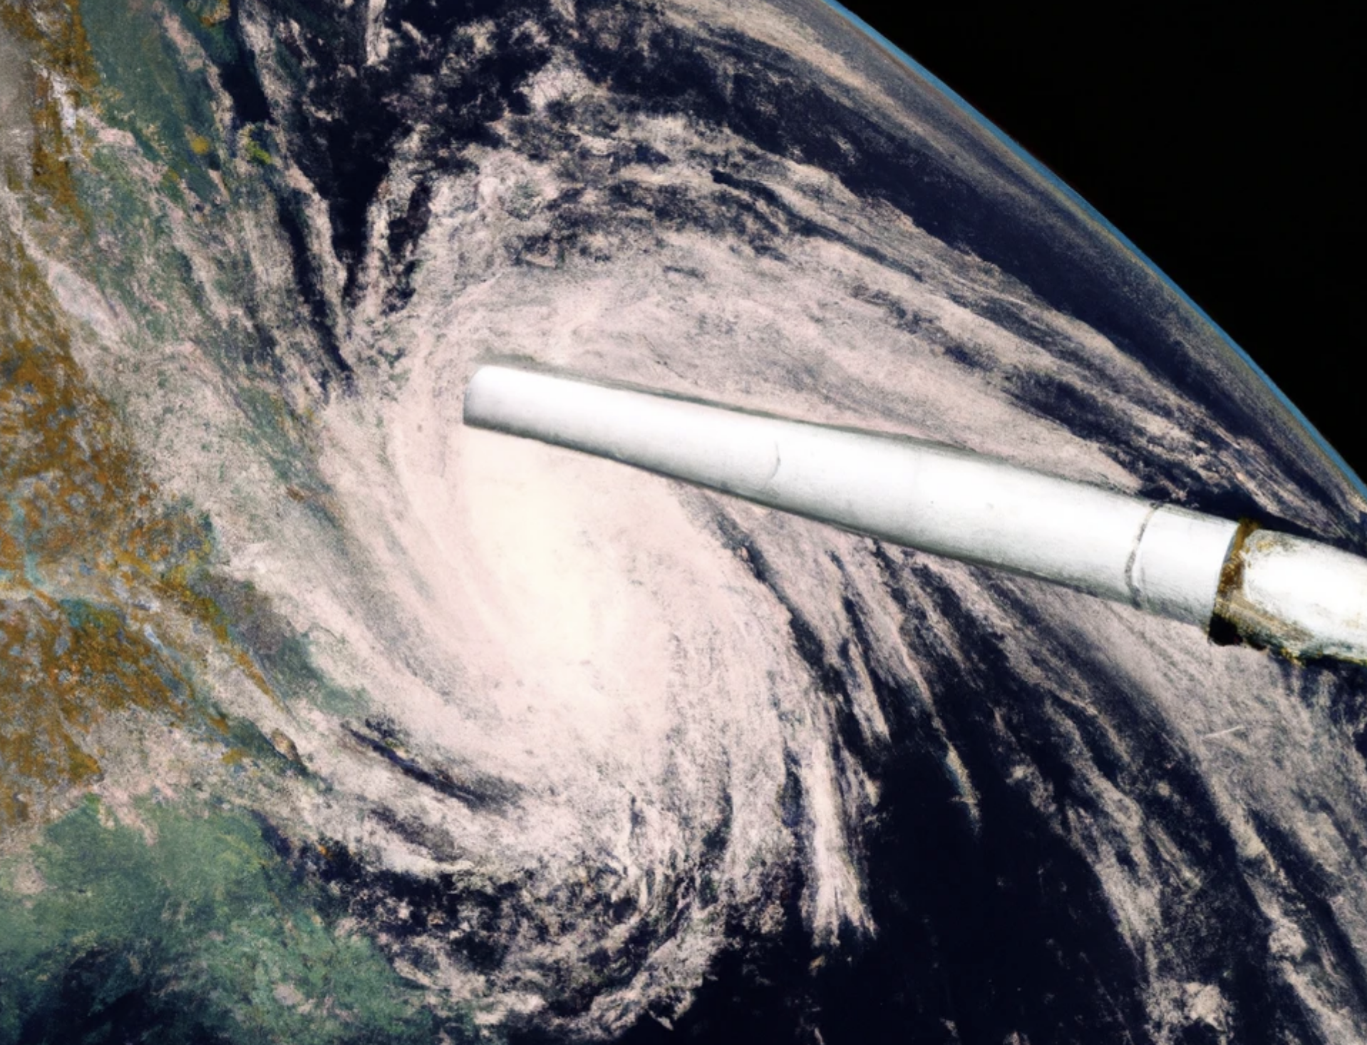
We completed simulations, where warm tropical water near the Hurricane is cooled to about 75F

Slide 32
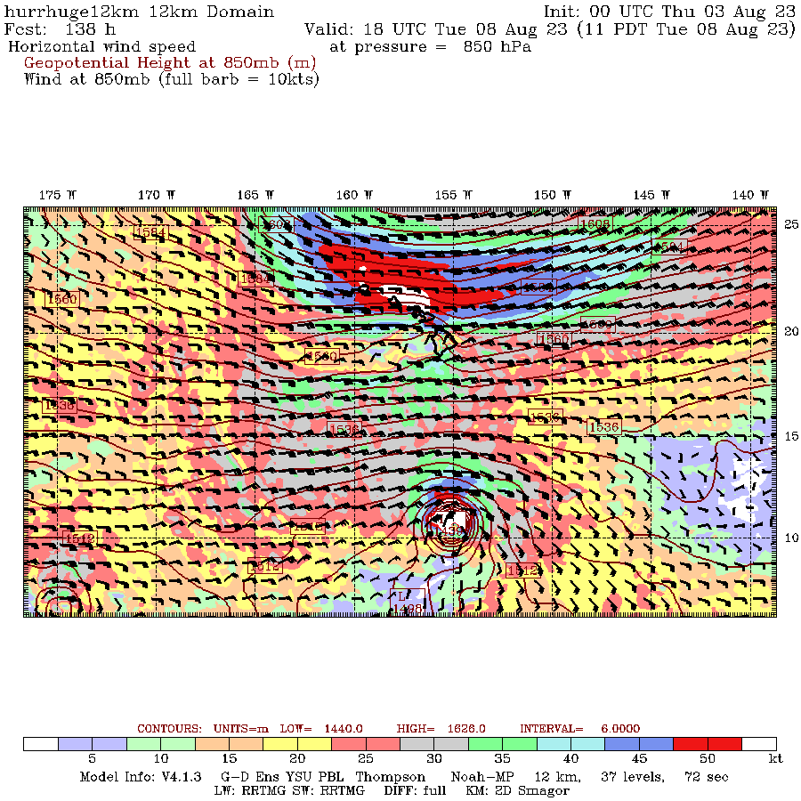
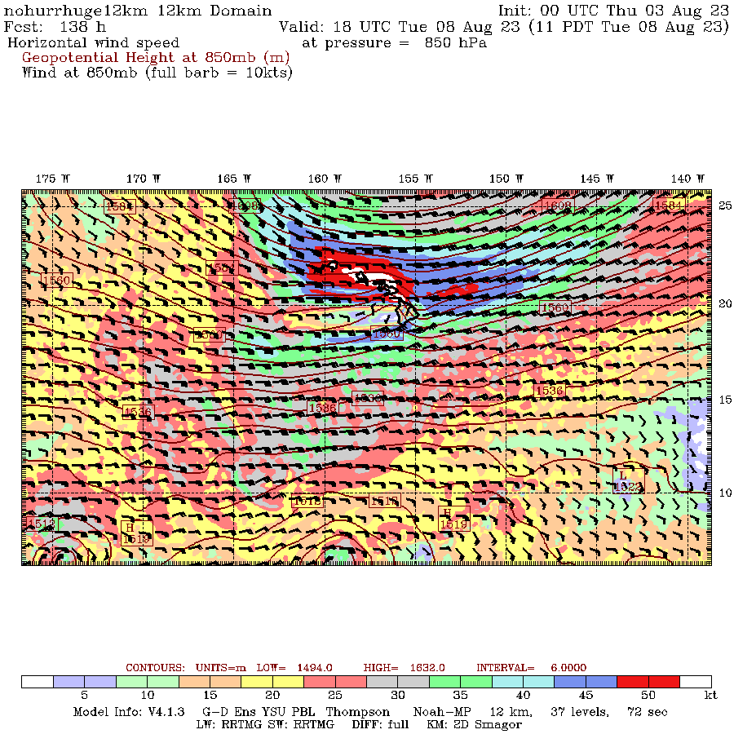
Pressure and wind (color shading) at 850 hPa

Slide 33
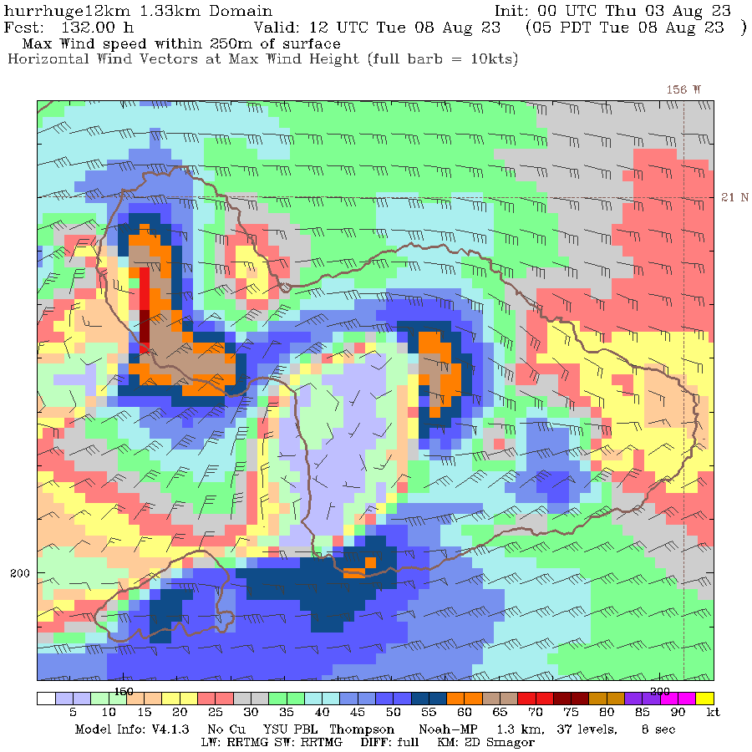
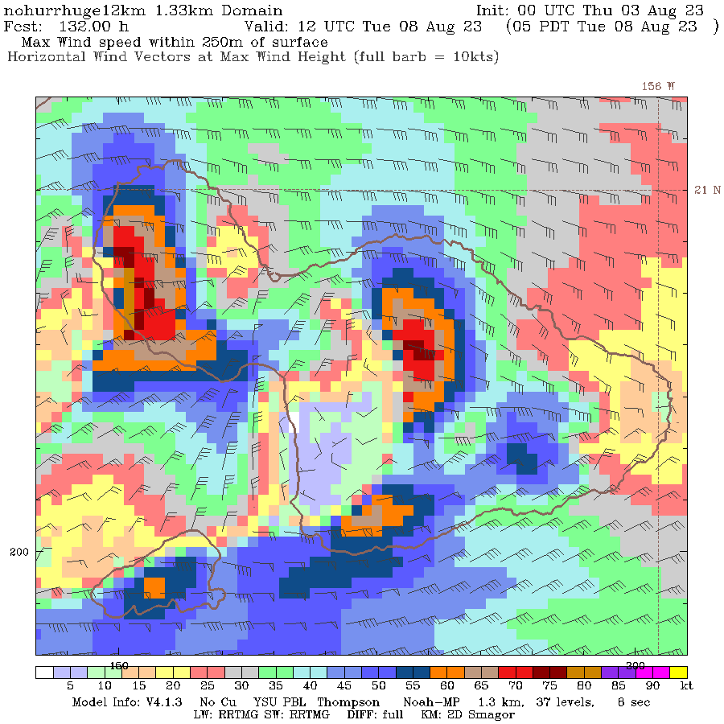
Gusts near surface (12 UTC 8 Aug)
NO Hurricane is STRONGER

Slide 34
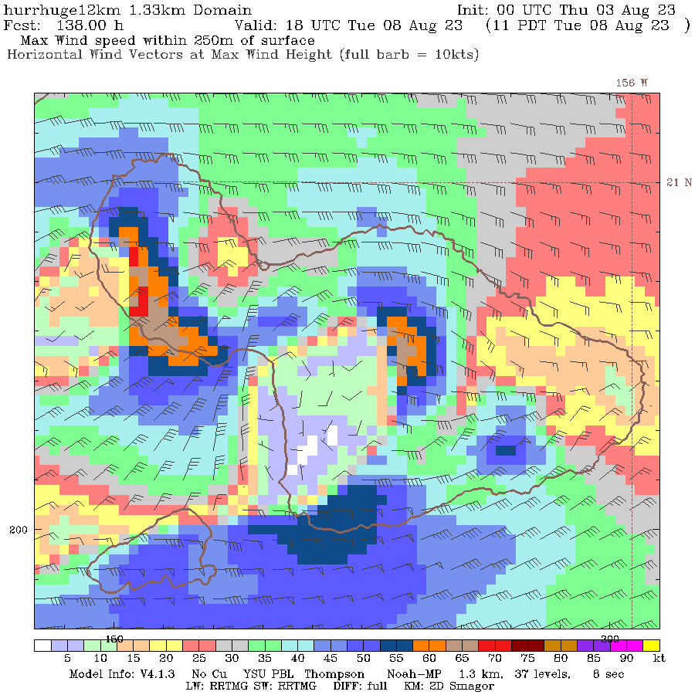
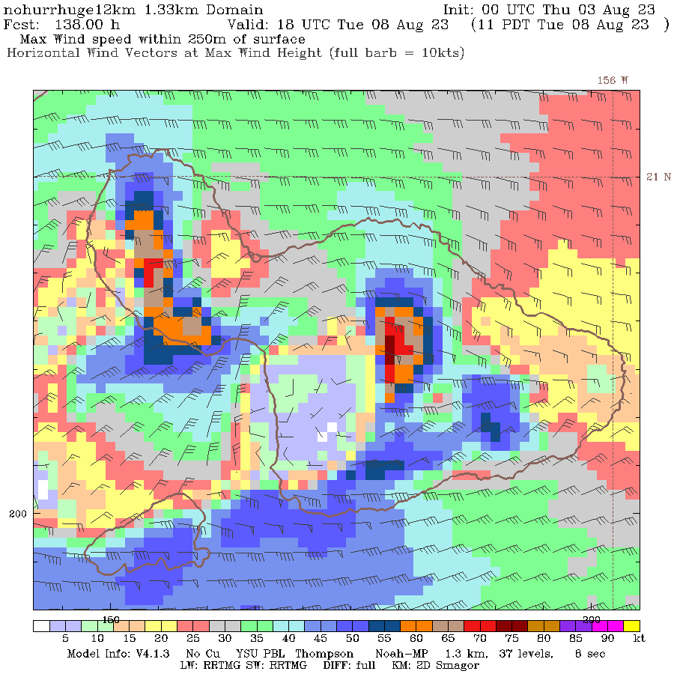
Gusts near surface (18 UTC 8 Aug)
About the Same

Slide 35
Maui Wildfire Bottom Lines
High-resolution forecasts were excellent
Synoptic forcing was well predicted
Hurricane Dora had little impact
Previous drought and “climate change” had little impact.
Strong winds from an unusually intense downslope windstorm, plus dry-flammable grasses, plus poor power infrastructure were the causes.

Slide 36
Well Predicted Synoptic Scale Flow
+
Terrain-Forced Mesoscale Feature
+
High-Resolution Model
= GOOD FORECAST

Slide 37
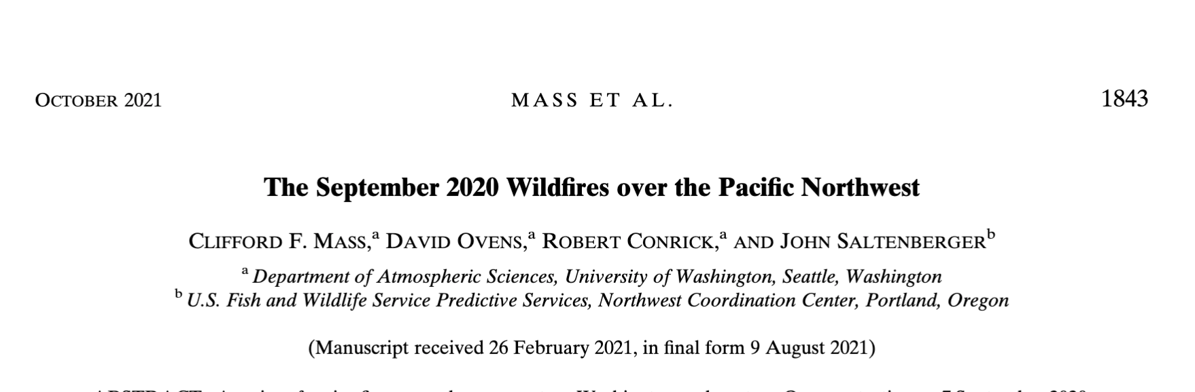
Similar Modeling and Forecasting Success for MANY Northwest Wildfire Events Caused by Strong Winds

