Slide 1
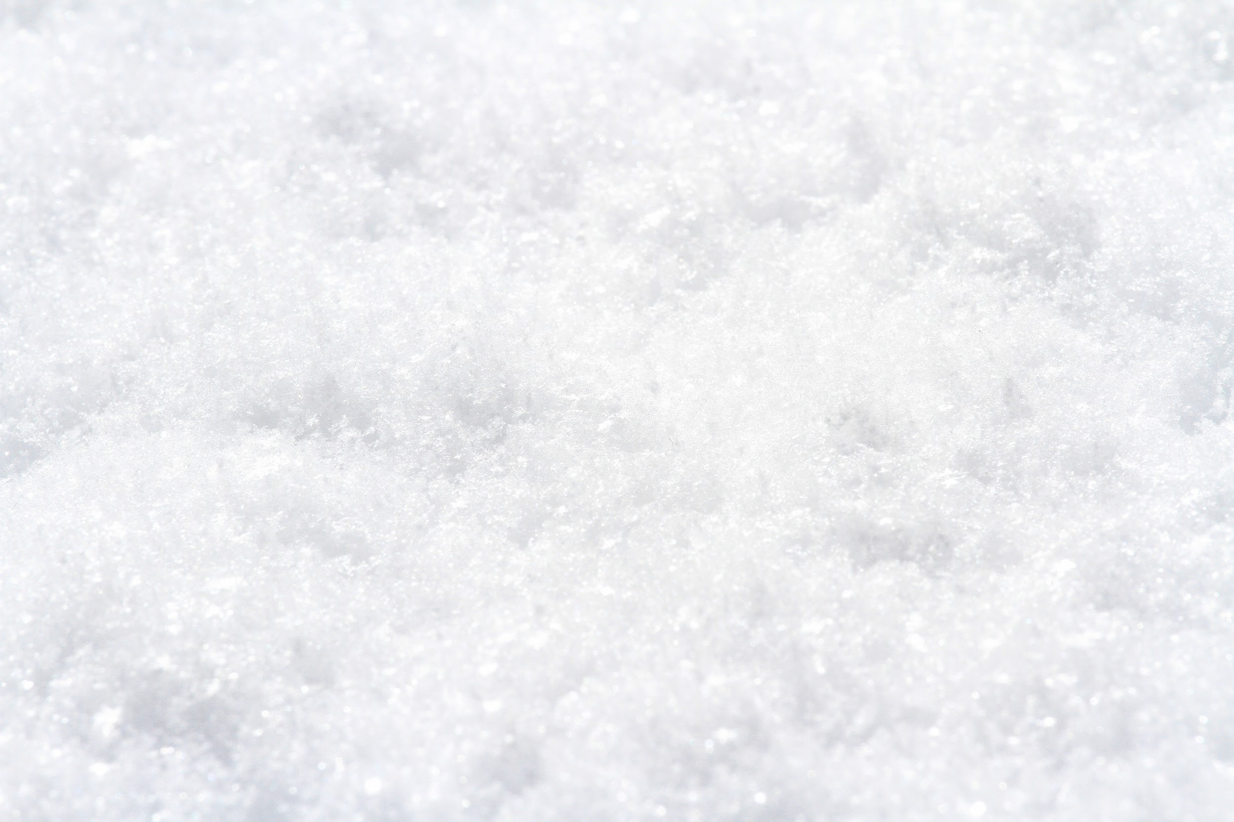
Strong El Nino; What does this mean for PDX’s 2023-2024 Snow Forecast?
By April R. Vogt

Slide 2
2022-2023 Winter Forecast Recap:
2022 Forecasted: Stormy winter:
  Upper-low offshore tightened gradients allowing for a small southerly “windstorm” 12/27/23 (peak wind gusts between 40-50 mph).
  Offshore Bomb Cycle caused a small “windstorm” on 1/4/2023 (peak wind gust at PDX 51 mph).
2022 Forecasted: Some mild spells:
  Mild January (2023): We were about 1.4°F above normal for the month
2022 Forecasted: Cold spells:
  2022 Forecasted: Possible “Arctic Blast”:
    Arctic Air 12/21/23-12/24/23
      High/Low 12/21: 42°F /25°F
      High/Low 12/22: 25°F/20°F
      High/Low 12/23: 29°F/20°F
      High/Low 12/24: 35°F/29°F
  2022 Forecasted: Ice:
    Mild Ice Storm 12/22-12/24 (more ice pellets than freezing rain)
  2022 Snow Forecast: Seasonal Accumulations at PDX ~3”- 9” (An Arctic Blast with high moisture storm could give us a significant snow storm.)
    Official Snow Total at PDX for 2022-2023: 11”
    Significant Snow Storm 2/21/23-2/23-23: 10.8” accumulated during this storm
      Cold arctic air funneled in through the Gorge

Slide 3

What is going to happen at PDX for winter 2023-2024?
Gif Source: https://media.giphy.com/media/l4Ep72Bm68Nkn8mju/giphy.gif
Before we jump into this, let's start by taking a look at the projected ENSO cycles.

Slide 4

Why Should I Care About ENSO Cycles? Just Tell Me About PDX SNOW!!
Gif Source:https://media.giphy.com/media/81FFCdNQbhbtDOiMI9/giphy.gi f
If you care about knowing the likelihood of snow in Portland this winter (or any winter for that matter), you need to care about the ENSO Cycles.

Slide 5
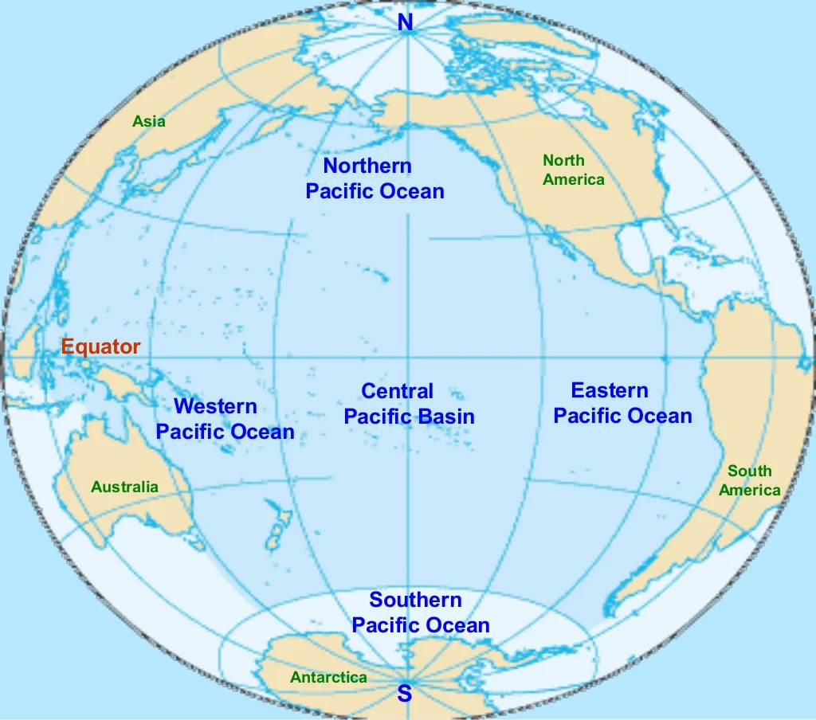
Brief Overview of ENSO
What is ENSO
“El Niño-Southern Oscillation”. The National Weather Service defines it as “a recurring climate pattern involving changes in the temperature of waters in the central and eastern tropical Pacific Ocean”
In other words: Surface ocean water in the central and eastern tropical Pacific heats and cools between ~1°C - 5°C (~1.8°F- 9°F) on a 3 to 7 year cycle.

Slide 6
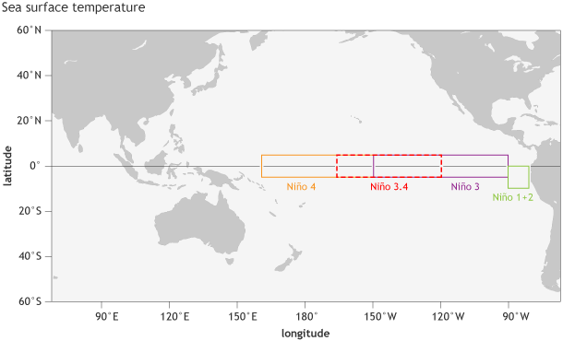
ENSO Cycles
ENSO Cycles are important because they change the global atmospheric circulation, which in turn, influences weather across the globe (YES this includes affecting the chances of PDX seeing snow).
We use the ONI (Oceanic Niño Index) to monitor, asses, and predict ENSO Cycles.
  The ONI is based on shifts of sea surface temperatures from average temperatures in the Niño 3.4 region (120˚W to 170˚W; the dashed red box).
Image from climate.gov: https://www.climate.gov/news-features/understanding-climate/climate-variability-oceanic-ni%C3%B1o-index

Slide 7
ENSO Cycles Cont.
3 ENSO Cycles (As defined by the National Weather Service)
El Niño: A warming of the ocean surface, or above-average sea surface temperatures (SST), in the central and eastern tropical Pacific Ocean.
La Niña: A cooling of the ocean surface, or below-average sea surface temperatures (SST), in the central and eastern tropical Pacific Ocean.
ENSO Neutral: Neither El Niño or La Niña. Often tropical Pacific sea surface temperature are generally close to average.
Note: There are some instances when the ocean can look like it is in an El Niño or La Niña state, but the atmosphere is not playing along (or vice versa).

Slide 8
ENSO Cycle Strengths
Weak El Niño: Episode when the peak Oceanic Niño Index (ONI) range from .5°C to 0.9°C.
Moderate El Niño: Episode when the peak Oceanic Niño Index (ONI) range from 1.0°C to 1.4°C.
Strong El Niño: Episode when the peak Oceanic Niño Index (ONI) is greater than or equal to 1.5°C.
ENSO Neutral: Episode when the peak Oceanic Niño Index (ONI) is “equal” (+/- 0.4°C) to mean sea surface temperature.
Weak La Niña: Episode when the peak Oceanic Niño Index (ONI) range from -0.5°C to -0.9°C.
Moderate La Niña: Episode when the peak Oceanic Niño Index (ONI) range from -1.0°C to -1.4°C.
Strong La Niña: Episode when the peak Oceanic Niño Index (ONI) is less than or equal to -1.5°C.

Slide 9
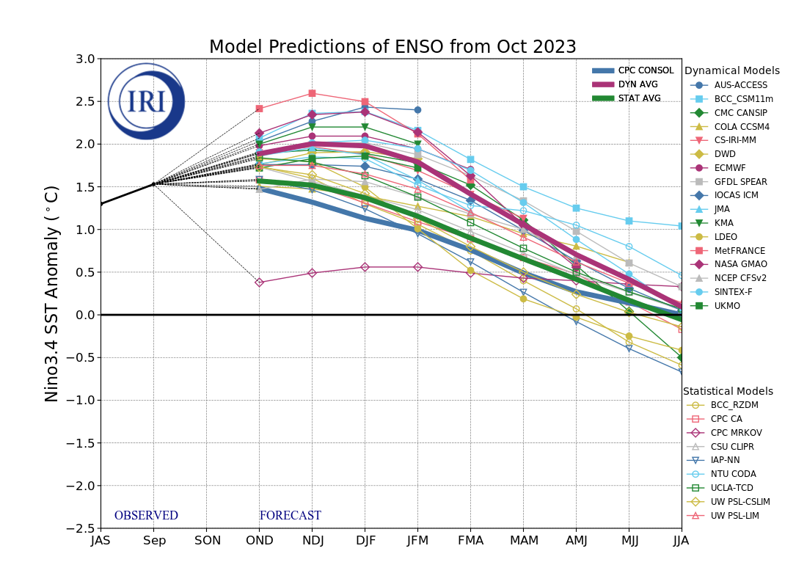
ENSO Model Predictions for Winter 2023-2024
Modeled projections as of October 2023 (IRI ONI) suggest that we will the following Sea Surface Temperature Anomalies:
Model | NDJ | DJF | JFM
Average Dynamical models | 2.073°C (Strong El Niño) | 2.009°C (Strong El Niño) | 1.692°C (Strong El Niño)
Average Statistical Models | 1.392°C (Moderate El Niño) | 1.273°C (Moderate El Niño) | 1.052°C (Moderate El Niño)
Average All Models | 1.838°C (Strong El Niño) | 1.754°C (Strong El Niño) | 1.431°C (Moderate El Niño)
Data Source: IRI – International Research Institute for Climate and Society | October 2023 Quick Look (columbia.edu)
Image from Columbia Climate School International Research Institute for Climate and Society: https://iri.columbia.edu/our-expertise/climate/forecasts/enso/current/

Slide 10
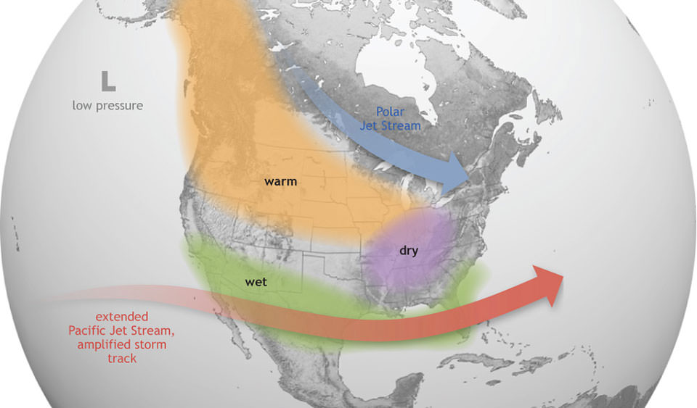
El Niño Winters in the Pacific Northwest
Tends to be milder and dryer
Polar Jet Stream stays a bit further to our north.
  The Polar Jet Stream is our primary driver of storms.
    The Polar Jet Stream is also our primary driver of large air masses in the Pacific Northwest.
  The jet stream staying a bit further to our north allows warmer air masses that typically are to our south to lift into the region.
Image Source: https://oceanservice.noaa.gov/facts/elnino.jpg

Slide 11
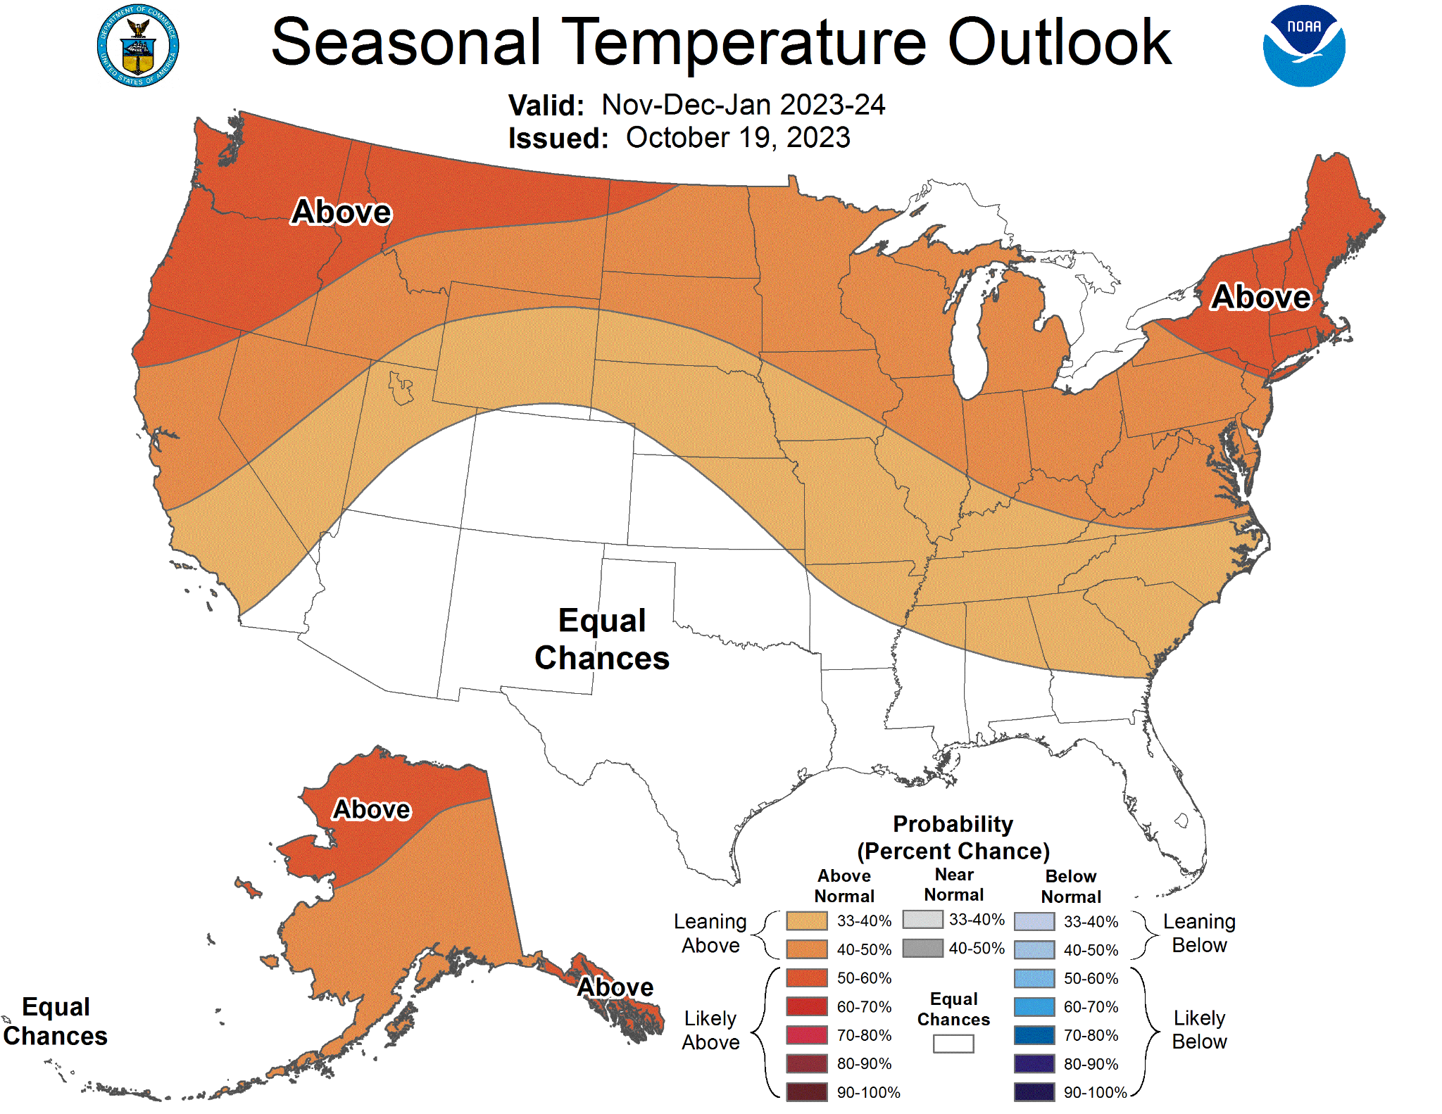
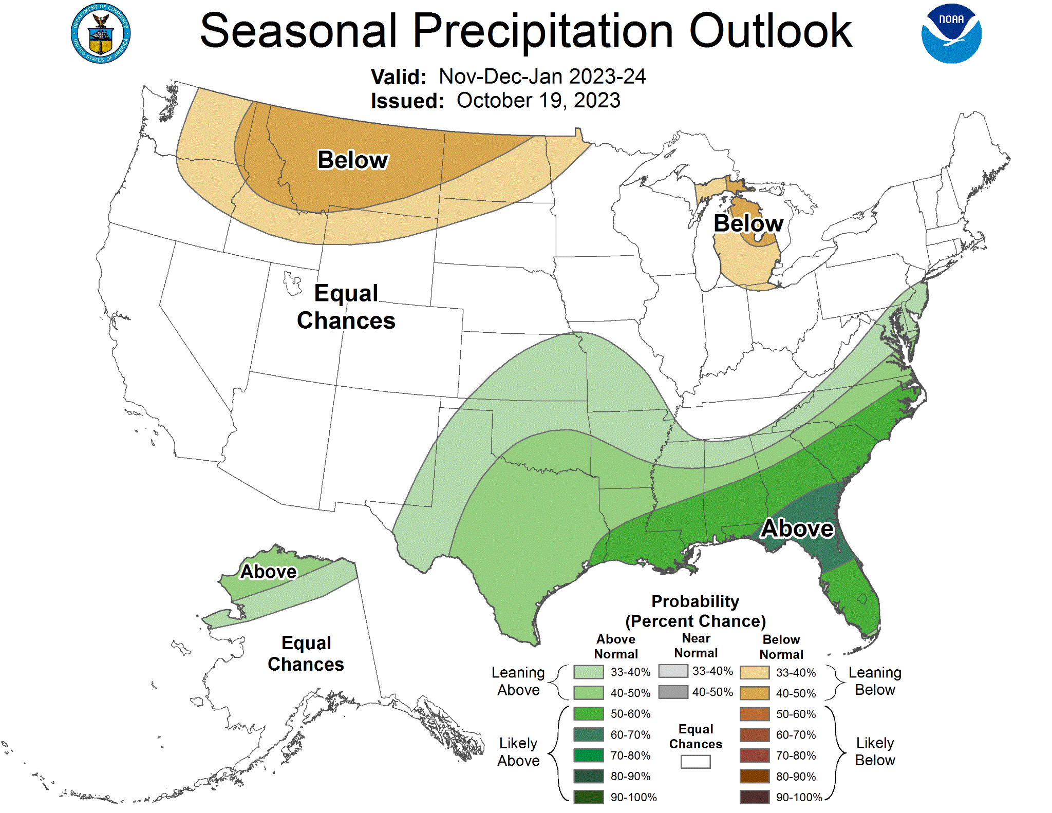
Climate Prediction Center Seasonal Outlook
November, December, and January (NDJ) 2023-2024
Image Source: https://www.cpc.ncep.noaa.gov/products/predictions/long_range/seasonal.php?lead=1

Slide 12
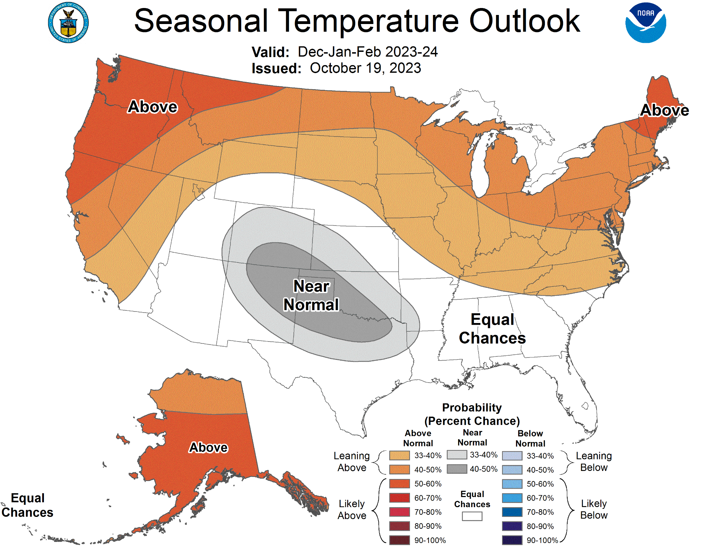
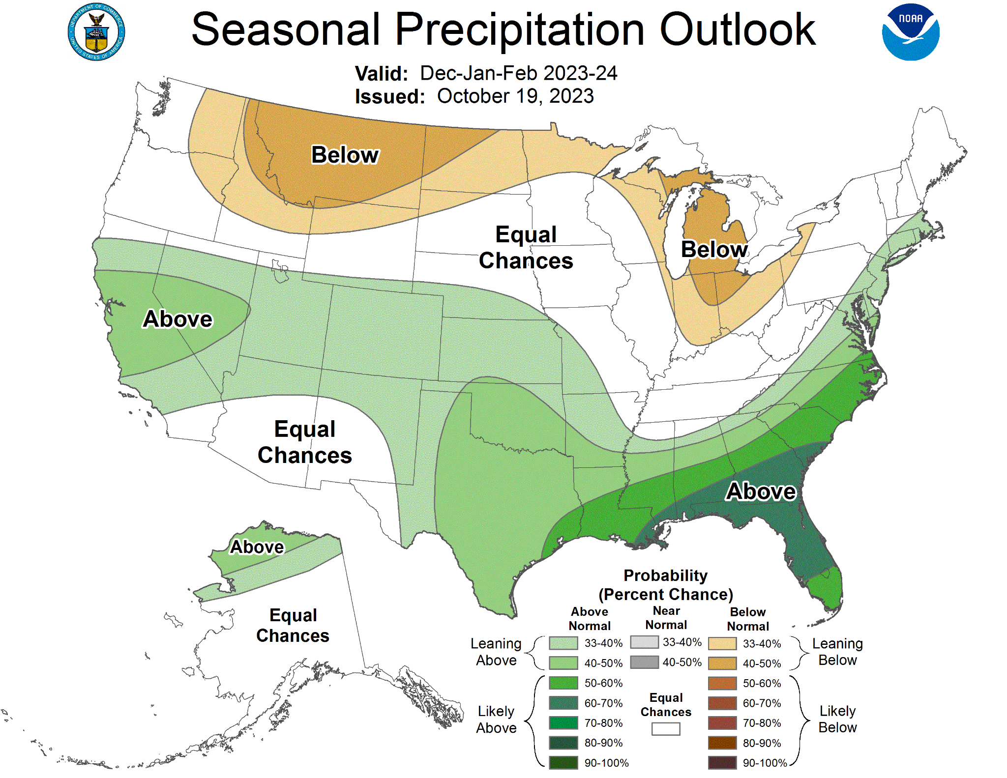
Climate Prediction Center Seasonal Outlook Cont:
December, January, and February (DJF) 2023-2024
Image Source: https://www.cpc.ncep.noaa.gov/products/predictions/long_range/seasonal.php?lead=1

Slide 13
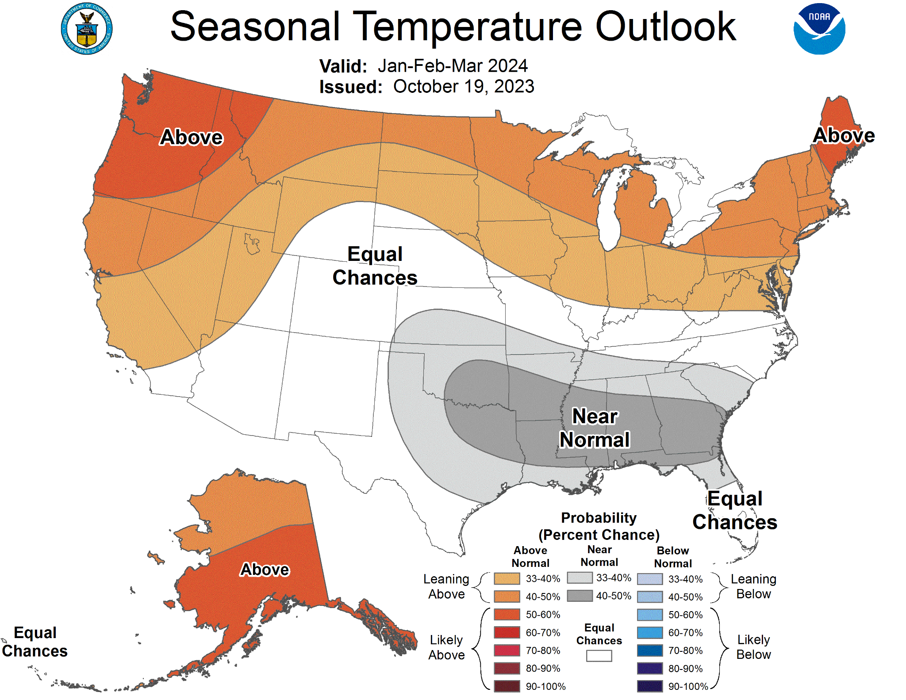
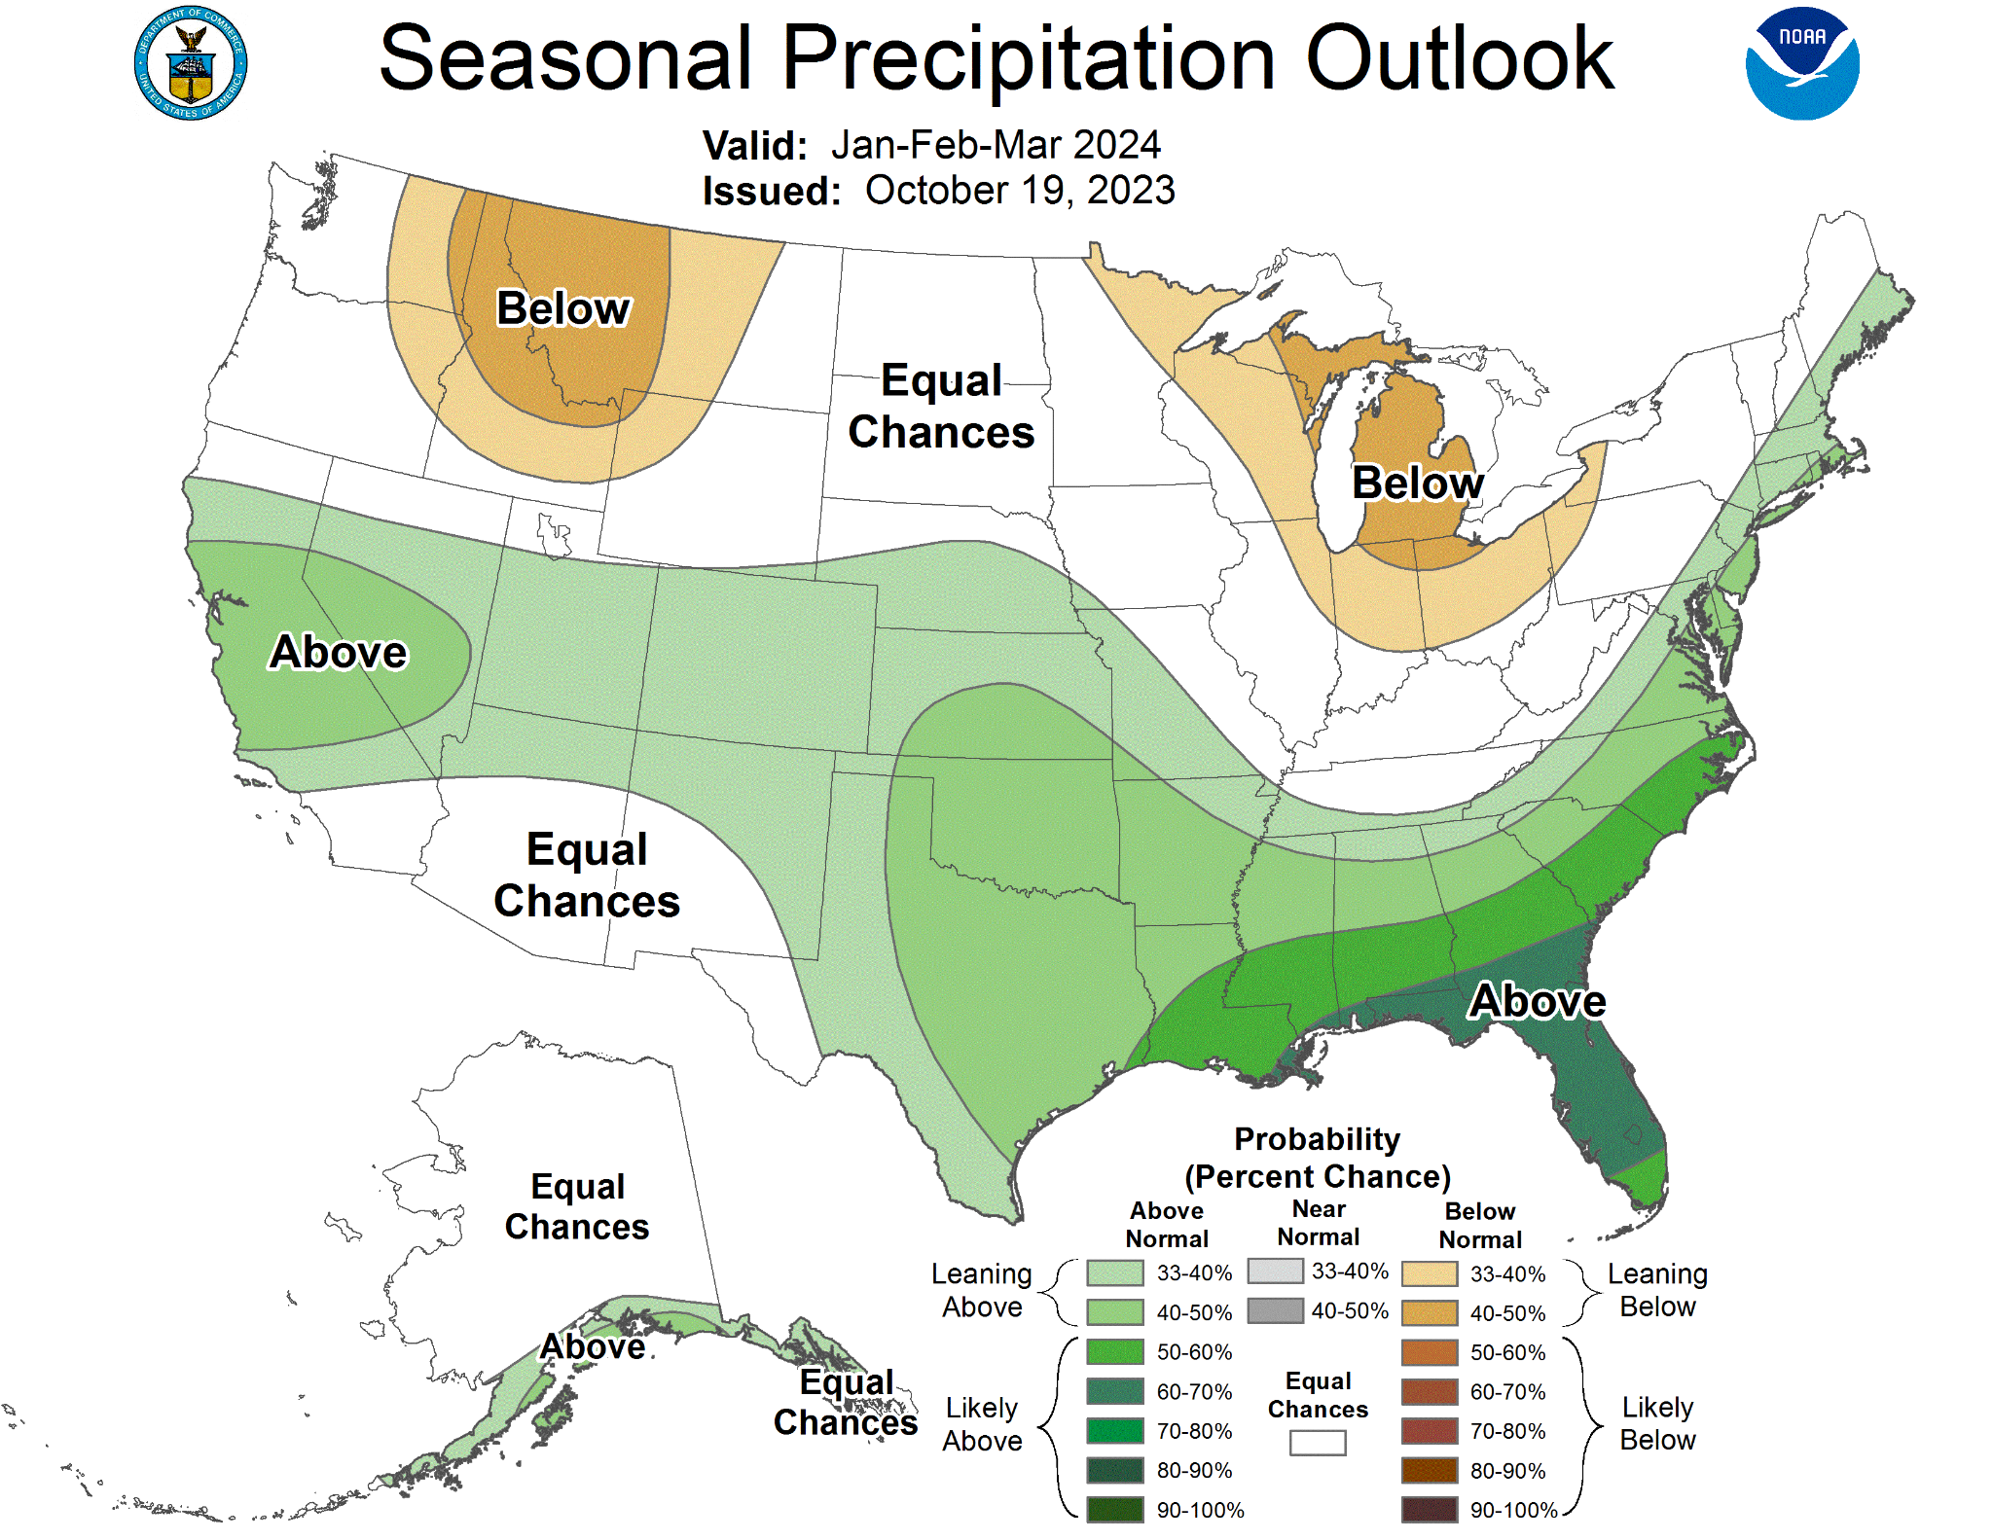
Climate Prediction Center Seasonal Outlook Cont:
January, February, and March (JFM) 2024:
Image Source: https://www.cpc.ncep.noaa.gov/products/predictions/long_range/seasonal.php?lead=1

Slide 14

Digging into the data:
Model averages suggest that we will see a strong El Niño NDJ and DJF followed by a transition to a moderate El Niño JFM.
  Looking at data since 1950, we will look at the following:
Years where we saw a strong El Niño NDJ and DJF followed by a moderate El Niño JFM.
Years where we saw a strong El Niño NDJ, DJF, and JFM.
Years where we saw similar ONI temperature threshold patterns observed in 2023 that do not meet the the credentials outlined in 1 and 2.
Base Image Source: https://file.forms.app/sitefile/40-Hilarious-research-memes-that-will-make-you-smile-2.jpg

Slide 15
Analog years where we saw a strong El Niño NDJ and DJF, followed by a moderate El Niño JFM since 1950:
Year | NDJ | DJF | JFM
1972-1973 | 2.1°C (Strong El Niño) | 1.8°C (Strong El Niño) | 1.2°C (Moderate El Niño)
2009-2010 | 1.6°C (Strong El Niño) | 1.5°C (Strong El Niño) | 1.2°C (Moderate El Niño)
Table Data Source: Climate Prediction Center - ONI (noaa.gov)

Slide 16
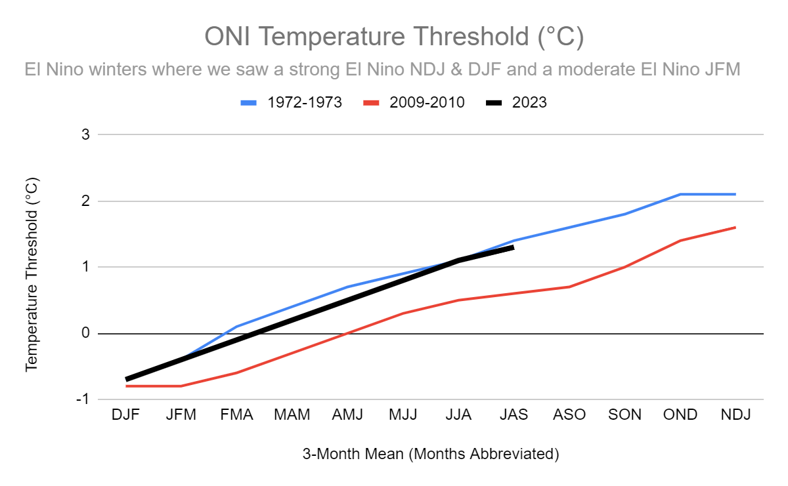
Analog years where we saw a strong El Niño NDJ and DJF, followed by a moderate El Niño JFM since 1950 cont:
Data Source: https://origin.cpc.ncep.noaa.gov/products/analysis_monitoring/ensostuff/ONI_v5.php

Slide 17
Analog years where we saw a strong El Niño NDJ, DJF, and JFM since 1950:
Years | NDJ | DJF | JFM
1957-1958 | 1.7°C (Strong El Niño) | 1.8°C (Strong El Niño) | 1.7°C (Strong El Niño)
1982-1983 | 2.2°C (Strong El Niño) | 2.2°C (Strong El Niño) | 1.9°C (Strong El Niño)
1991-1992 | 1.5°C (Strong El Niño) | 1.7°C (Strong El Niño) | 1.6°C (Strong El Niño)
1997-1998 | 2.4°C (Strong El Niño) | 2.2°C (Strong El Niño) | 1.9°C (Strong El Niño)
2015-2016 | 2.6°C (Strong El Niño) | 2.5°C (Strong El Niño) | 2.1°C (Strong El Niño)
Table Data Source: Climate Prediction Center - ONI (noaa.gov)

Slide 18
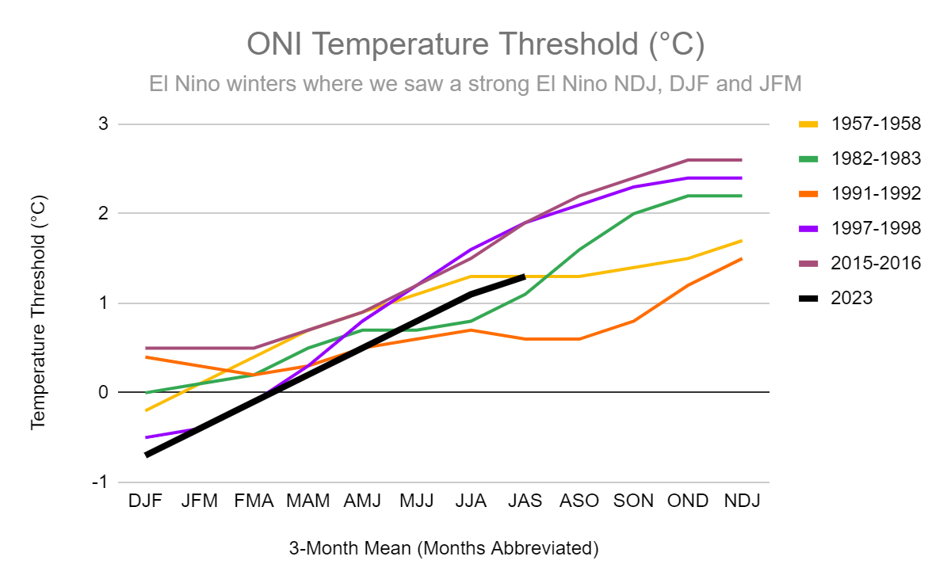
Analog years where we saw a strong El Niño NDJ, DJF, and JFM since 1950 cont:
Data Source: https://origin.cpc.ncep.noaa.gov/products/analysis_monitoring/ensostuff/ONI_v5.php

Slide 19
Other analog years where we saw similar ONI threshold temperature patterns observed so far in 2023 that did not meet the strong or strong/moderate El Nino credentials since 1950:
Years | NDJ | DJF | JFM
1951-1952 | 0.8°C (Weak El Niño) | 0.5°C (Weak El Niño) | 0.4°C (ENSO Neutral)
1965-1966 | 1.7°C (Strong El Niño) | 1.4°C (Moderate El Niño) | 1.2°C (Moderate El Niño)
Data Source: https://origin.cpc.ncep.noaa.gov/products/analysis_monitoring/ensostuff/ONI_v5.php

Slide 20
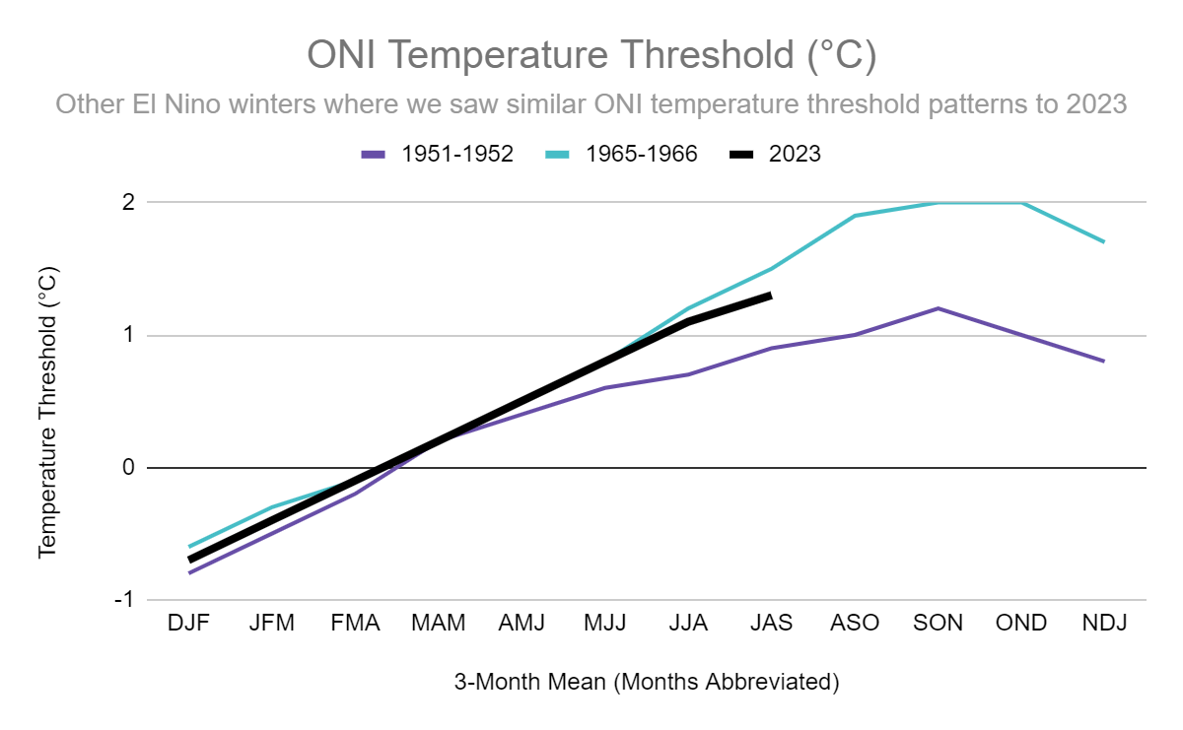
Other analog years where we saw similar ONI threshold temperature patterns observed so far in 2023 that did not meet the strong or strong/moderate El Nino credentials since 1950 cont:
Data Source: https://origin.cpc.ncep.noaa.gov/products/analysis_monitoring/ensostuff/ONI_v5.php

Slide 21
Let’s take a look at the “goods” 😉❄️:
Seasonal snow accumulation for analog years where we saw a strong El Niño NDJ and DJF, followed by a moderate El Niño JFM since 1950:
Years | Total Seasonal Snow Accumulation (in)
1972-1973 | 6.5”
2009-2010 | 2.5”
Average seasonal snow accumulation= 4.5”
Table Data Source: Online Data Request Submitted | Climate Data Online (CDO) | National Climatic Data Center (NCDC) (noaa.gov)

Slide 22
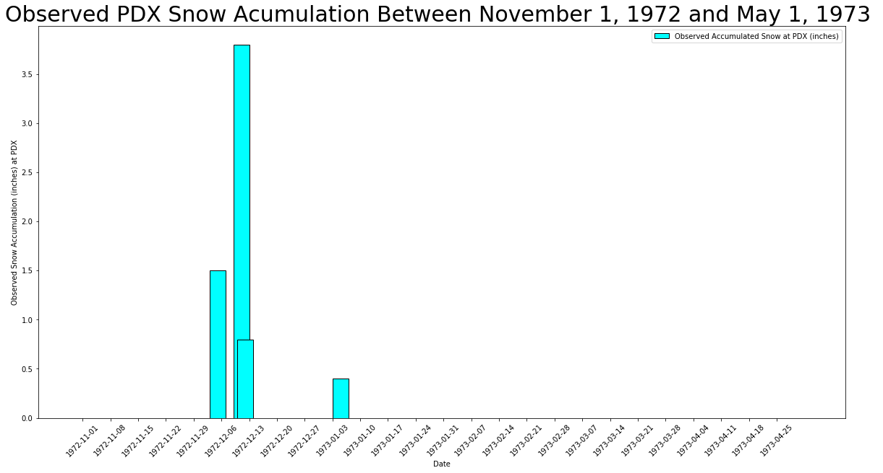
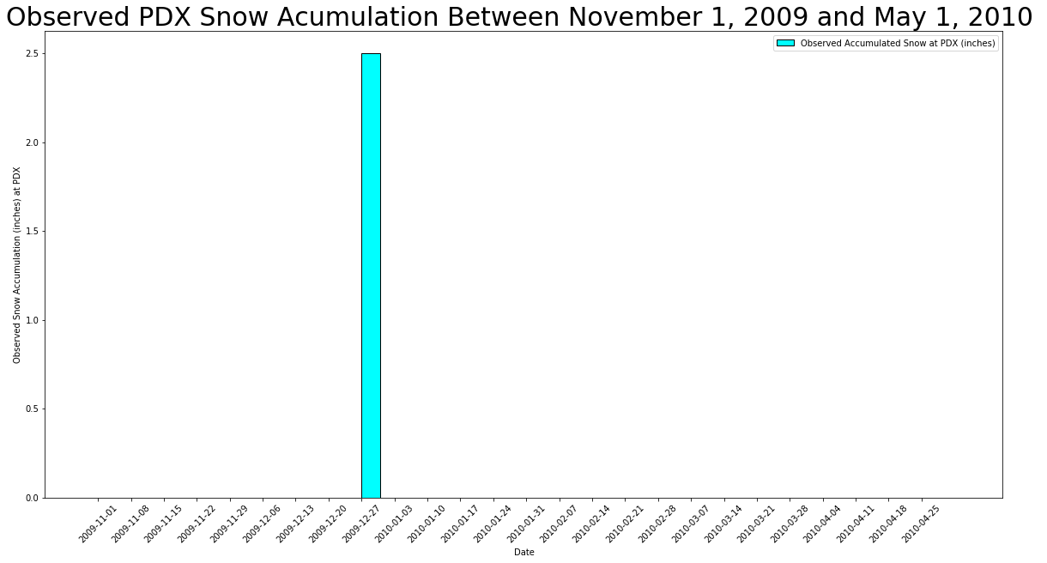
Let’s take a look at the “goods” 😉❄️ cont:
Graphed seasonal snow accumulation for analog years where we saw a strong El Niño NDJ and DJF, followed by a moderate El Niño JFM since 1950:
Graph Data Source: Online Data Request Submitted | Climate Data Online (CDO) | National Climatic Data Center (NCDC) (noaa.gov)

Slide 23
Let’s take a look at the “goods” 😉❄️ cont:
Seasonal snow accumulation for analog years where we saw a strong El Niño NDJ, DJF, and JFM since 1950:
Years | Total Seasonal Snow Accumulation (in)
1957-1958 | 0.0”
1982-1983 | 0.0”
1991-1992 | 0.0”
1997-1998 | 8.5”
2015-2016 | 1.4”
Average seasonal snow accumulation= 1.98”
Table Data Source: Online Data Request Submitted | Climate Data Online (CDO) | National Climatic Data Center (NCDC) (noaa.gov)

Slide 24
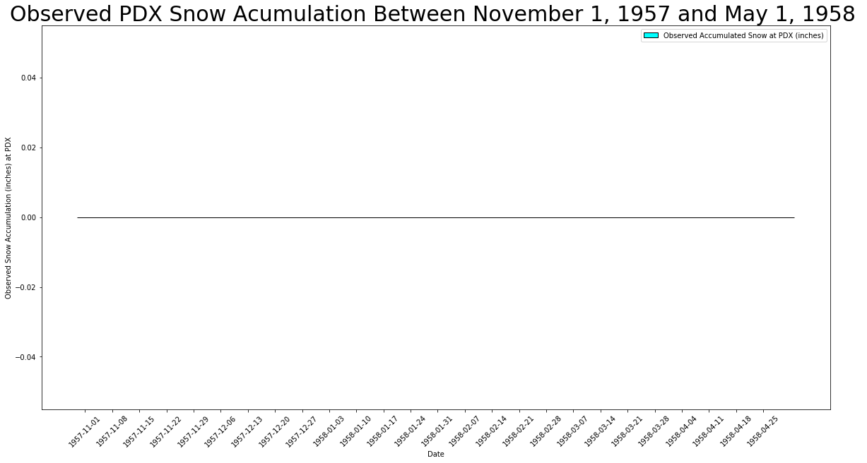

Let’s take a look at the “goods” 😉❄️ cont:
Graphed seasonal snow accumulation for analog years where we saw a strong El Niño NDJ, DJF, and JFM since 1950:
Graph Data Source: Online Data Request Submitted | Climate Data Online (CDO) | National Climatic Data Center (NCDC) (noaa.gov)

Slide 25

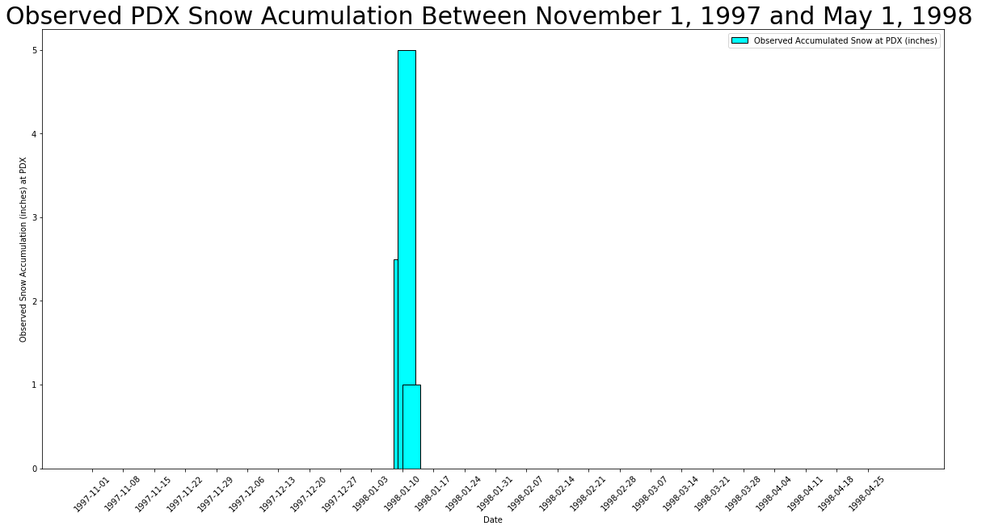
Let’s take a look at the “goods” 😉❄️ cont:
Graphed seasonal snow accumulation for analog years where we saw a strong El Niño NDJ, DJF, and JFM since 1950 cont:
Graph Data Source: Online Data Request Submitted | Climate Data Online (CDO) | National Climatic Data Center (NCDC) (noaa.gov)

Slide 26
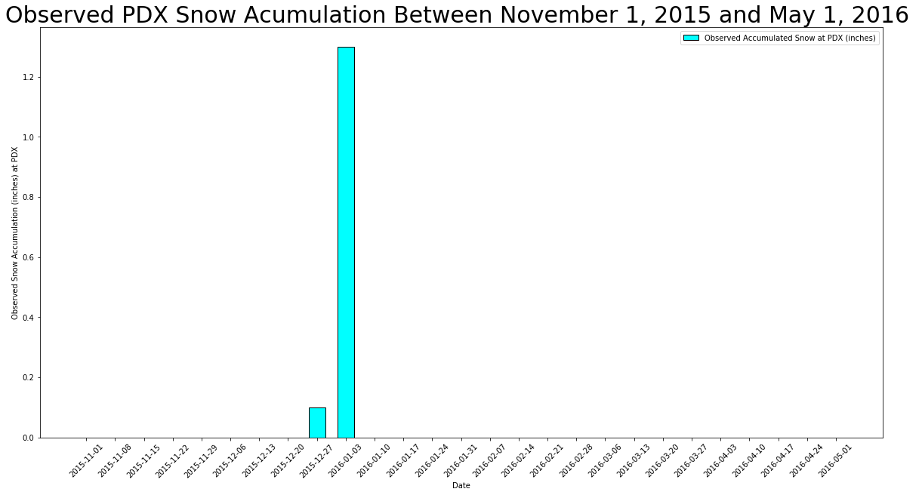
Let’s take a look at the “goods” 😉❄️ cont:
Graphed seasonal snow accumulation for analog years where we saw a strong El Niño NDJ, DJF, and JFM since 1950 cont:
Graph Data Source: Online Data Request Submitted | Climate Data Online (CDO) | National Climatic Data Center (NCDC) (noaa.gov)

Slide 27
Let’s take a look at the “goods” 😉❄️ cont:
Seasonal snow accumulation for other analog years where we saw similar ONI temperature threshold patterns observed so far in 2023 that did not meet the strong or strong/moderate El Niño credentials since 1950:
Years | Total Seasonal Snow Accumulation (in)
1951-1952 | 9.6”
1965-1966 | 0.6”
Average seasonal snow accumulation= 5.1”
Table Data Source: Online Data Request Submitted | Climate Data Online (CDO) | National Climatic Data Center (NCDC) (noaa.gov)

Slide 28
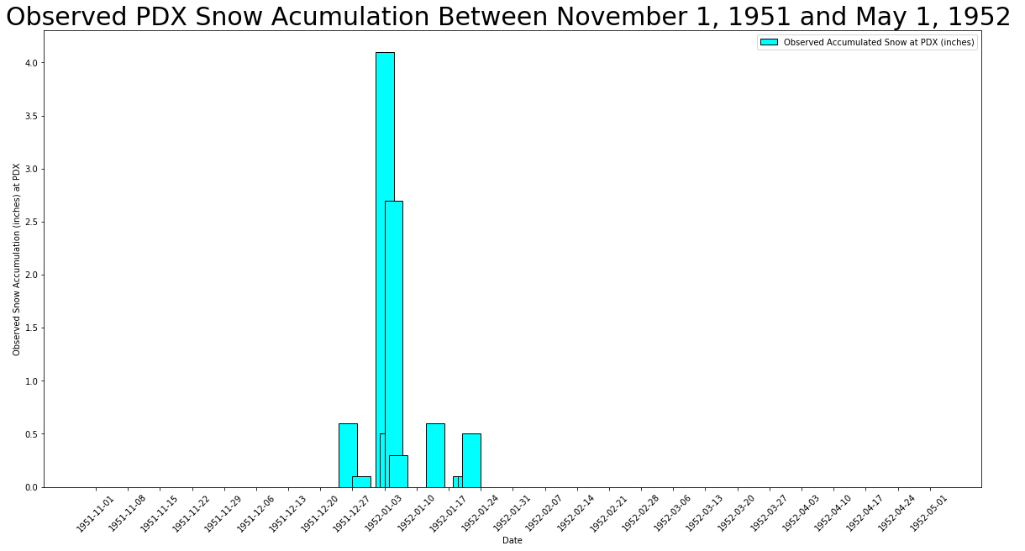
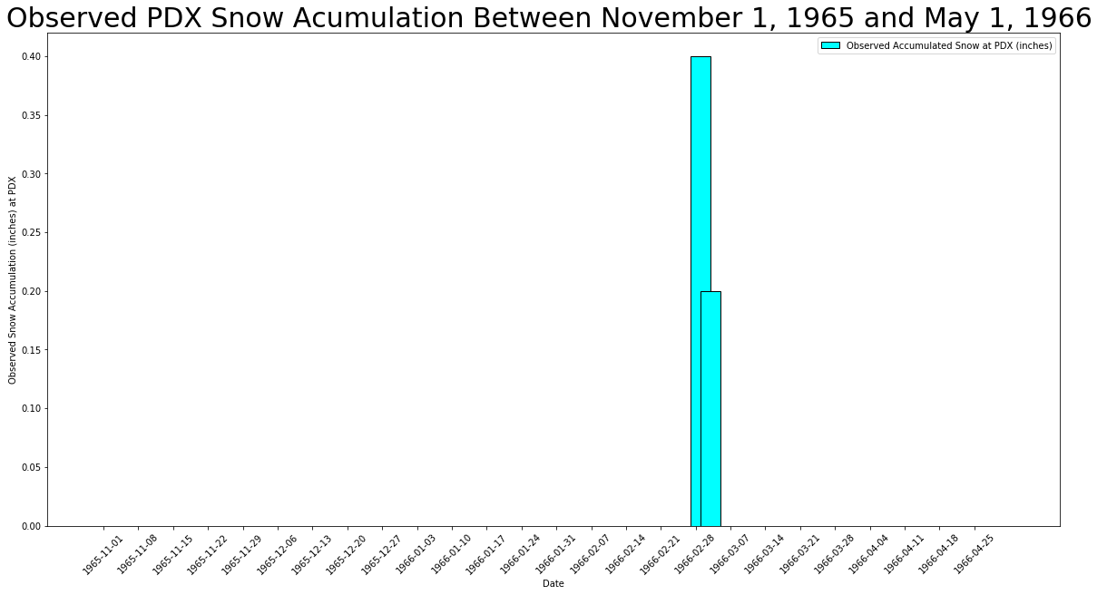
Let’s take a look at the “goods” 😉❄️ cont:
Graphed seasonal snow accumulation for other analog years where we saw similar ONI threshold temperature patterns observed so far in 2023 that did not meet the strong or strong/moderate El Niño credentials since 1950:
Graph Data Source: Online Data Request Submitted | Climate Data Online (CDO) | National Climatic Data Center (NCDC) (noaa.gov)

Slide 29
Let’s take a look at the “goods” 😉❄️ cont:
Seasonal snow accumulation for BOTH other analog years where we saw similar ONI threshold temperature patterns observed so far in 2023 that did not meet the strong or strong/moderate El Niño credentials and for analog years that DID meet the strong or strong/moderate El Niño credentials since 1950:
Years | Total Seasonal Snow Accumulation (in)
1951-1952 | 9.6”
1965-1966 | 0.6”
1972-1973 (strong El Niño NDJ & DJF/Moderate El Niño JFM) | 6.5”
Average seasonal snow accumulation= 5.57”
Table Data Source: Online Data Request Submitted | Climate Data Online (CDO) | National Climatic Data Center (NCDC) (noaa.gov)

Slide 30
Let’s take a look at the “goods” 😉❄️ cont:
Graphed seasonal snow accumulation for BOTH other analog years where we saw similar ONI threshold temperature patterns observed so far in 2023 that did not meet the strong or strong/moderate El Niño credentials and for analog years that DID meet the strong or strong/moderate El Niño credentials since 1950:
Graph Data Source: Online Data Request Submitted | Climate Data Online (CDO) | National Climatic Data Center (NCDC) (noaa.gov)

Slide 31
Let’s take a look at the “goods” 😉❄️ cont:
Combining all analog years:
Years | Total Seasonal Snow Accumulation (in)
1951-1952 | 9.6”
1957-1958 | 0.0”
1965-1966 | 0.6”
1972-1973 | 6.5”
1982-1983 | 0.0”
1991-1992 | 0.0”
1997-1998 | 8.5”
2009-2010 | 2.5”
2015-2016 | 1.4”
Average seasonal snow accumulation= 3.23”

Slide 32
Let’s take a look at the “goods” 😉❄️ cont:
Other notable weather events that occurred during the analog year winters:
  Note: All storm event data derived from NCDC Storm Event Database and strictly looked at the Greater Portland Metropolitan area.
Years | Weather Events
1957-1958 | Thunderstorm Wind Event- 03/23/58 at 5:00PM PST: Thunderstorm wind event reported in western Washougal, WA. No deaths, injuries, or property damage
1972-1973 | Cold Snap- 12/4/72-12/13/72: A deep upper-level trough allowed arctic air to engulf the region resulting in temperatures to remain below 32°F (with a low 6°F on 12/8/72) for 9 days.**
1991-1992 | Tornado- 11/12/1991 at 4:35 PST: F1 tornado occurred just east of the Portland-Troutdale airport. The tornado occurred during a cold frontal passage. 80’ of fencing was damaged, part of a roof was torn off, and part of a wall was ripped out of a steel building. No deaths or injuries reported.
1997-1998 | Snow/Ice Storm- 1/10/98-1/13/98: Arctic air in combination with a series of storms brought snow and freezing rain into northern OR and SW WA. The Portland Metropolitan area (notably the east side) reported upwards of 6” of snow overnight between 1/10/98 (Saturday) and 1/11 (Sunday), followed by a mixture of freezing rain, sleet, and snow fell intermittently 1/11/98-1/13/98 (Tuesday). The bulk of the storm occurred over the weekend causing widespread down trees and large tree limbs. 3 fatalities and numerous injuries (primarily from slips on icy streets and sidewalks) were reported.
2009-2010 | Heavy Rain/Urban Flooding- 11/2/09: An unstable airmass resulted in strong convective storms moving over the Portland Metropolitan Area dropping heavy amounts of rain (one observer reported 0.98” over a 2.5 hr period). Urban flooding was reported around the Portland Metropolitan Area. No deaths or injuries reported. High Wind Event- 11/16/09-11/17/09: A strong Pacific storm brought strong winds (50 kts) to the PNW starting late 11/16 and continuing through the early morning hours of 11/17. Wind speeds were estimated based on reports of damage to a downtown Portland residential home due to downed trees. Power outages were reported across Clackamas county with 1700 homes affected. No deaths or injuries reported. Heavy Snow- 12/29/09: A quick moving storm moved across NW OR over the top of some very cold air, replacing the cold air, resulting in a surprise afternoon snow storm. Between 2”-4” fell across the Portland Metropolitan area (PDX reported 2.5”) with some reporting up to 7” locally at the end of the event. No deaths or injuries were reported.
Data Source: https://www.ncdc.noaa.gov/stormevents/choosedates.jsp?statefips=41%2COREGON
**Event not in NCDC Storm Event Database

Slide 33
Let’s take a look at the “goods” 😉❄️ cont:
Other notable weather events that occurred during the analog year winters cont:
  Note: All storm event data derived from NCDC Storm Event Database and strictly looked at the Greater Portland Metropolitan area cont.
Years (cont) | Weather Events (cont)
2015-2016 | Snow/Ice Storm- 12/1/15-12/2/15: East winds through Columbia RIver Gorge maintained below freezing temperatures as a front moved through NW OR causing a mix of snow, sleet, ice, and freezing rain that resulted in ¼”-½” of ice observed on the east side of the Portland Metropolitan area. Ice and downed tree limbs resulted in widespread power outages across eastern Multnomah county. No deaths or injuries reported. Heavy Rain/Flooding/High Wind Event- 12/7/15-12/10/15: A series of moist Pacific fronts produced heavy rainfall and high winds (39 kts) that resulted in urban flooding, river flooding, small stream flooding, landslides, and a few sinkholes over a three day period. Property damage was reported. No deaths or injuries reported. Heavy Rain- 12/17/15: An atmospheric river resulted in river flooding, urban flooding, landslides, and sinkholes across NW Oregon causing catastrophic damage. Heavy rain resulted in a new daily rainfall record at PDX of 1.87” breaking the previous record set back in 1972 (1.02”) and downtown Portland broke its previous daily rainfall record measuring 2.42” (the previous record was 2.26” set back in 1884). Standing water was reported on roads and a landslide was reported on HWY 30 near the St. John Bridge. No deaths or injuries reported. High Wind Event- 12/21/15: A strong upper-level low (980mb) moved onshore in Pacific County, WA causing high winds (52 kts) across NW OR. Significant damage was reported across the Portland Metropolitan area due to trees falling onto homes and cars. No deaths or injuries were reported. Snow/Ice Storm- 1/3/16-1/4/16: East winds through the Columbia River Gorge maintained below freezing temperatures as a couple of precipitating events moved through the region on Jan 3 and 4. This resulted in 1”-2” of snow to fall on Jan 3rd followed by 0.10”-0.20” of freezing rain fell on Jan 4th. This caused several car accidents and minor injuries as a result of slips and falls. No deaths reported. High Wind Event- 3/13/16: A strong low pressure system produced strong winds (40 kts) across the Portland Metropolitan area. Several trees were downed as a result of the event causing power outages and obstructed roadways. One home reported minor roof damage as a result of a downed tree. No injuries or deaths were reported.
Data Source: https://www.ncdc.noaa.gov/stormevents/choosedates.jsp?statefips=41%2COREGON

Slide 34
Let’s take a look at the “goods” 😉❄️ cont:
Summary of our historical findings:
Snow events:
  Analog years since 1950 that had a strong El Niño that occurred in NDJ and DJF, followed by a moderate El Niño that occurred in JFM (1972-1973 and 2009-2010), all had reported snow events at PDX. These events occurred between early December to early January.
    Keep in mind, current model averages are projecting that we will see a strong El Niño in NDJ and DJF, followed by a moderate El Niño in JFM.
  Analog years since 1950 that had a strong El Niño that occured NDJ, DJF, and JFM had no reported snow events at PDX for the earliest three winters (1957-1958, 1982-1983, and 1991-1992), but DID have reported snow events at PDX for the latest two winters (1997-1998 and 2015-2016). These reported snow events occurred late December through early January.
  Analog years since 1950 that closely followed ONI trends observed in 2023, but did not meet the above two El Niño strength credentials (1951-1952 and 1965-1966) had reported snow events at PDX both winters. These reported snow events occurred late December through late February.
    Note: If we considered analog years that closely followed ONI trends observed in 2023 regardless of El Niño strength credentials, we could include the winter of 1972-1973 in this analysis. In this case, all three winters (1951-1952, 1965-1966, and 1972-1973) had reported snow events at PDX with most events occurring between late December to early January, with one outlying event occurring in late February (1965).

Slide 35
Let’s take a look at the “goods” 😉❄️ cont:
Summary of our historical findings cont:
Other notable weather events that occurred in “winter” (November-March; NCDC Storm Event Database):
  1- Thunderstorm Wind Event (March 1958)
  1- Tornado (November 1991)
  1- Heavy Snow Event (December 2009)
  1- Significant Cold Snap (December 1972)**
  3- Heavy Rain/Flooding Events (November 2009 and two in December 2015)
  3- Snow/Ice Storms (January 1998, December 2015, and January 2016)
  4- High Wind Events (November 2009, two in December 2015, and March 2016)
**Event not in NCDC Storm Event Database

Slide 36
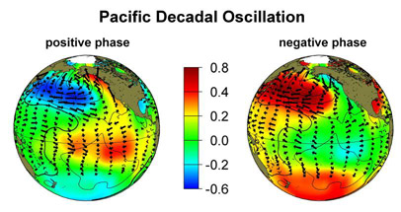
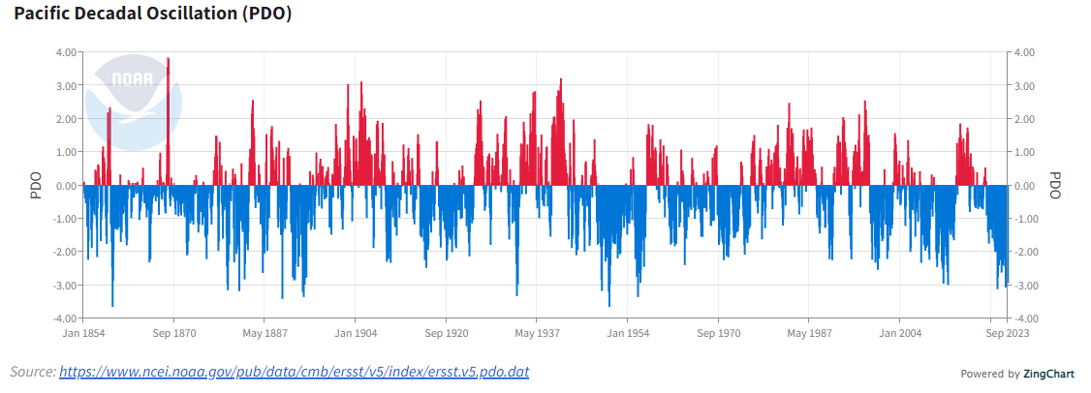
Let’s take a look at the “goods” 😉❄️ cont:
Other climate factors to consider this winter:
We are are in a negative PDO phase:
  The Pacific Decadal Oscillation (PDO) is a long-term ocean fluctuation of the Pacific Ocean. The PDO waxes and wanes from a positive (warm) and negative (cool) phases approximately every 20 to 30 years.
    September 2023: PDO= -2.94
    Negative PDO usually results in below average temperatures for the Pacific Northwest
Image Source: https://sealevel.jpl.nasa.gov/data/el-nino-la-nina-watch-and-pdo/pacific-decadal-oscillation-pdo/
Graph Source: https://www.ncei.noaa.gov/access/monitoring/pdo/

Slide 37
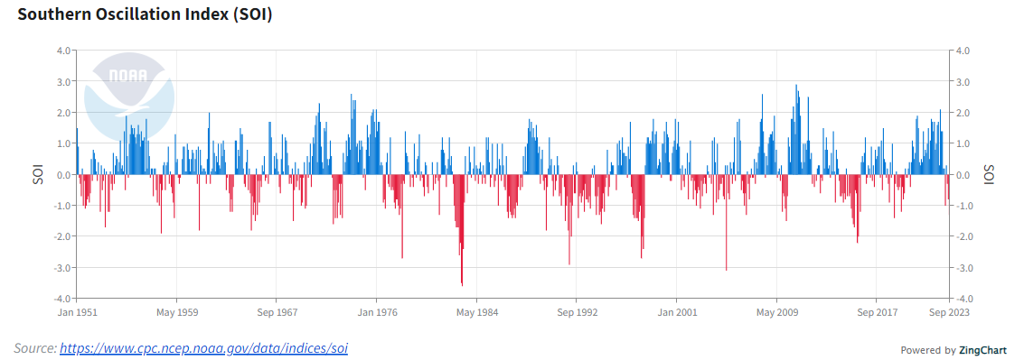
Let’s take a look at the “goods” 😉❄️ cont:
Other climate factors to consider this winter:
  Southern Oscillation Index (SOI)
    The Southern Oscillation Index (SOI) is a standardized index based on the observed sea level pressure differences between Tahiti and Darwin, Australia.
    Negative SOI values coincide with abnormally warm ocean waters across the eastern tropical Pacific and is typical of El Niño.
    September 2023: SOI= -1.3
Graph source: https://www.ncei.noaa.gov/access/monitoring/enso/soi

Slide 38
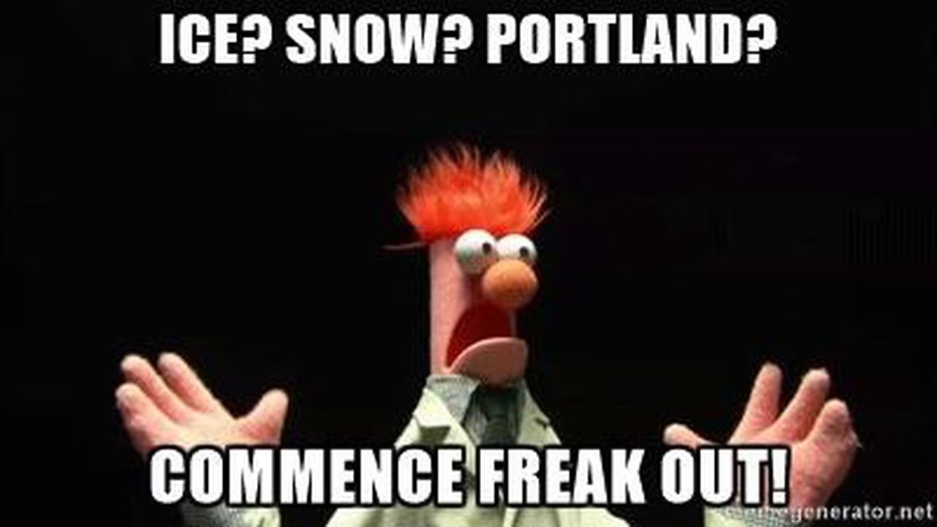
❄️❄️❄️Winter Weather Forecast for 2023-2024 ❄️❄️❄️
Significant Weather Events:
High Wind Event
  Likely in the November/December time frame (can’t rule out a late season event, but less likely).
Heavy Rain/Flooding Event
  November/December
Possible Cold Snap
  December/possibly early January
Snow:
Snow event is possible, but not guaranteed. If we do see a snow event, it will likely occur between December and early January (honing in on the late December to January time frame).
  I am forecasting seasonal totals to range of 0”- 6”
  An ice event (or even two) is also possible, notably on the east side, especially if we get some good easterlies through the Columbia River Gorge.
    If we do see an ice event, it would most likely late December/early January.
Meme Source: https://www.oregonlive.com/resizer/SQhB2rGG9tCa7Qn2Kt5j3YPiOp8=/1280x0/smart/advancelocal-adapter-image-uploads.s3.amazonaws.com/image.oregonlive.com/home/olive-media/width2048/img/trending/photo/2017/03/15/snow.jpg

Slide 39
References:
US Department of Commerce, N. (2016, July 19). What is Enso? National Weather Service. NOAA’s National Weather Service. https://www.weather.gov/mhx/ensowhat. Accessed 9 October 2023
US Department of Commerce, N. (2019, December 9). Information about the el nino and La Nina cycles. National Weather Service. NOAA’s National Weather Service. https://www.weather.gov/ama/elnino. Accessed 9 October 2023
Halpert, M. (n.d.). United States El Niño impacts . NOAA Climate.gov. https://www.climate.gov/news-features/blogs/enso/united-states-el-ni%C3%B1o-impacts-0. Accessed 10 October 2023
IRI- International Research Institute for Climate and Society. (2023, October). Enso Forecast Navigation. IRI- International Research Institute for Climate and Society. IRI- International Research Institute for Climate and Society. https://iri.columbia.edu/our-expertise/climate/forecasts/enso/current/?enso_tab=enso-sst_table. Accessed 14 October 2023
NCEP-National Center for Environmental Prediction. (2023, September). El Nino Southern Oscillation. Climate prediction center - El Nino Southern Oscillation. NCEP-National Center for Environmental Prediction. https://www.cpc.ncep.noaa.gov/products/analysis_monitoring/enso_advisory/strengths/index.php. Accessed 14 October 2023
National Centers for Environmental Information (NCEI). (n.d.). Climate Data Online Search. Search | Climate Data Online (CDO) | National Climatic Data Center (NCDC). National Centers for Environmental Information (NCEI). https://www.ncei.noaa.gov/cdo-web/confirmation. Accessed 14 October 2023
NCEP-National Center for Environmental Prediction. (n.d.). ENSO SOI Indices for comparison by year Data. Climate prediction center. NCEP-National Center for Environmental Prediction. https://www.cpc.ncep.noaa.gov/data/indices/soi. Accessed 22 October 2023
NASA. (2020, September 25). Pacific Decadal Oscillation (PDO). NASA. NASA. https://sealevel.jpl.nasa.gov/data/el-nino-la-nina-watch-and-pdo/pacific-decadal-oscillation-pdo/. Accessed 23 October 2023
National Centers for Environmental Information (NCEI). (2023, September). Pacific Decadal Oscillation (PDO). Pacific Decadal Oscillation (PDO) | National Centers for Environmental Information (NCEI). National Centers for Environmental Information (NCEI). https://www.ncei.noaa.gov/access/monitoring/pdo/. Accessed 23 October 2023
National Centers for Environmental Information (NCEI). (2023, September). El Niño/Southern Oscillation (ENSO). El Niño/Southern Oscillation (ENSO) | National Centers for Environmental Information (NCEI). National Centers for Environmental Information (NCEI). https://www.ncei.noaa.gov/access/monitoring/enso/soi. Accessed 23 October 2023
US Department of Commerce, N. (2019a, May 17). Climate graphs. National Weather Service. NOAA’s National Weather Service. https://www.weather.gov/pqr/Cliplot. Accessed 23 October 2023
US Department of Commerce, N. (2023, September 17). Climate Book Portland. National Weather Service. NOAA’s National Weather Service. https://www.weather.gov/pqr/ClimateBookPortland. Accessed 23 October 2023
NOAA- National Weather Service. (n.d.). NOAA NWS NCEP reanalysis data by WPC. NOAA- National Weather Service. https://www.wpc.ncep.noaa.gov/ncepreanal/. Accessed 26 October 2023

