Slide 1
Mountain Weather Conditions and Forecast Challenges
Mark Ingalls
Meteorologist, Avangrid Renewables

Slide 2
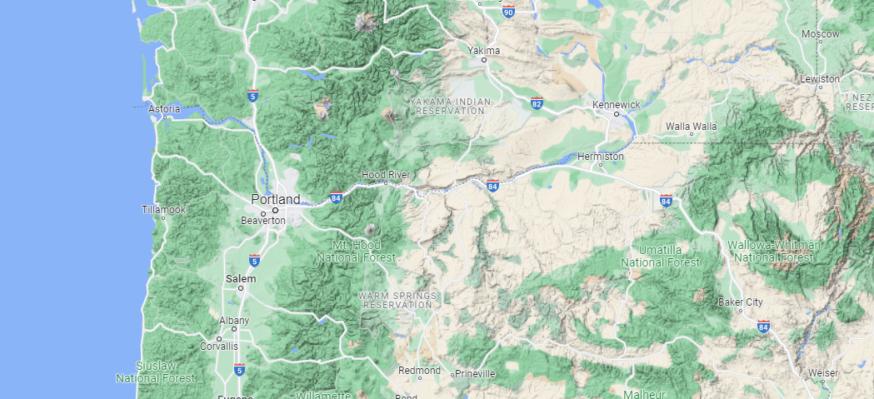
Geographical Context
Map: Google

Slide 3
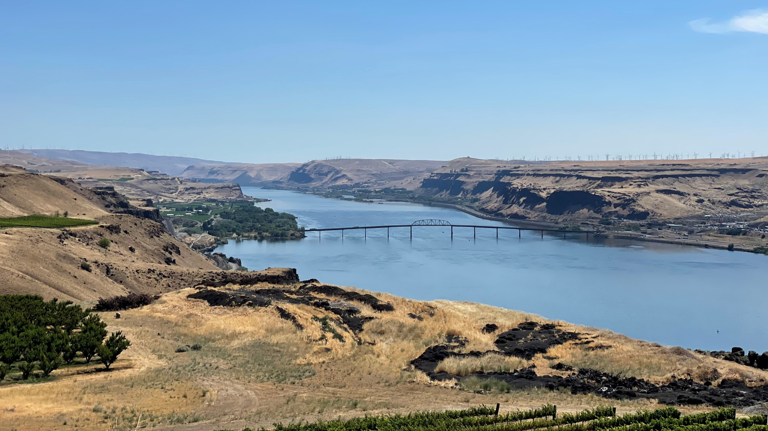
Avangrid
wind park
Biggs Jct., Oregon
Arid mid-elevation tableland east of the Cascades
on both sides of the Columbia River.

Slide 4
Mountain Weather Conditions

Slide 5
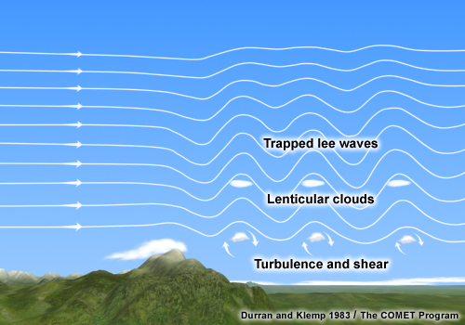
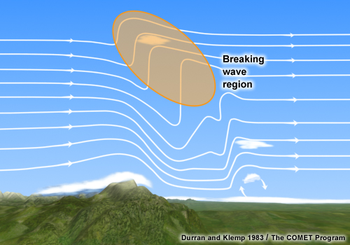
Mountain Waves
TRAPPED WAVES
Wind increases with height
Stability decreases with height
VERTICALLY PROPAGATING WAVES
Wind stays the same with height
Stability increases with height

Slide 6
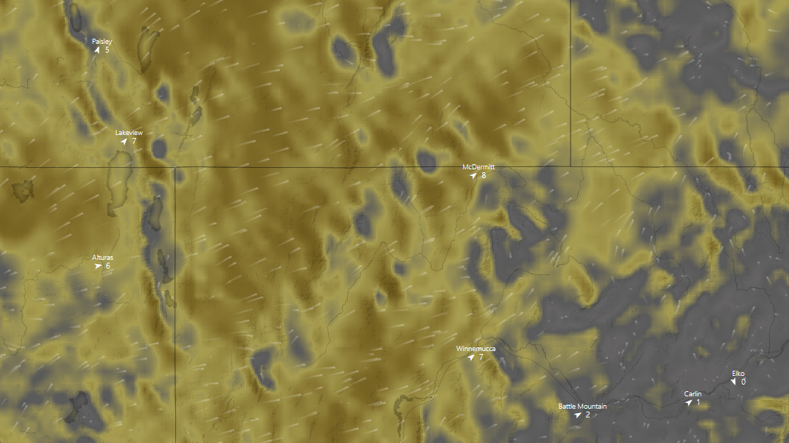
HRRR modeled mountain waves in the lee
of the Sierra Nevada/Cascades extending
all the way to SW Idaho.
Narrow, linear areas
of alternating strong
and weak surface wind
due to mountain waves.
Wind Direction
Map: Windy

Slide 7
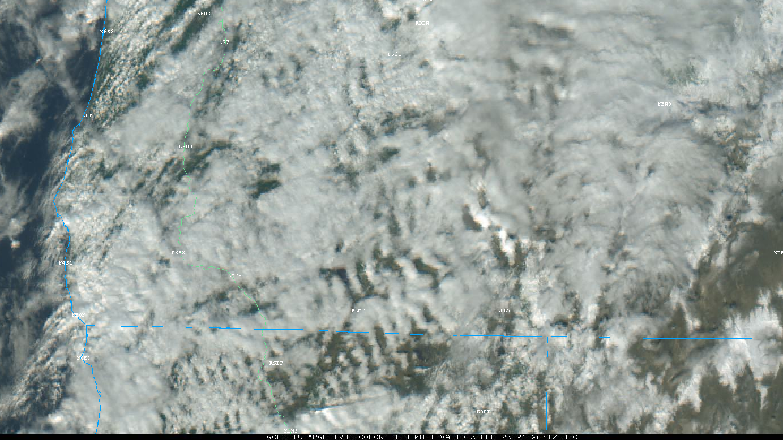
Satellite imagery showing mountain waves
in the lee of the Sierra Nevada/Cascades
for roughly the same time period.
Narrow, linear areas
of alternating cloudy
and clear skies
show mountain waves
but don’t necessarily
correspond to ground wind.
Wind Direction
Map: College of DuPage

Slide 8
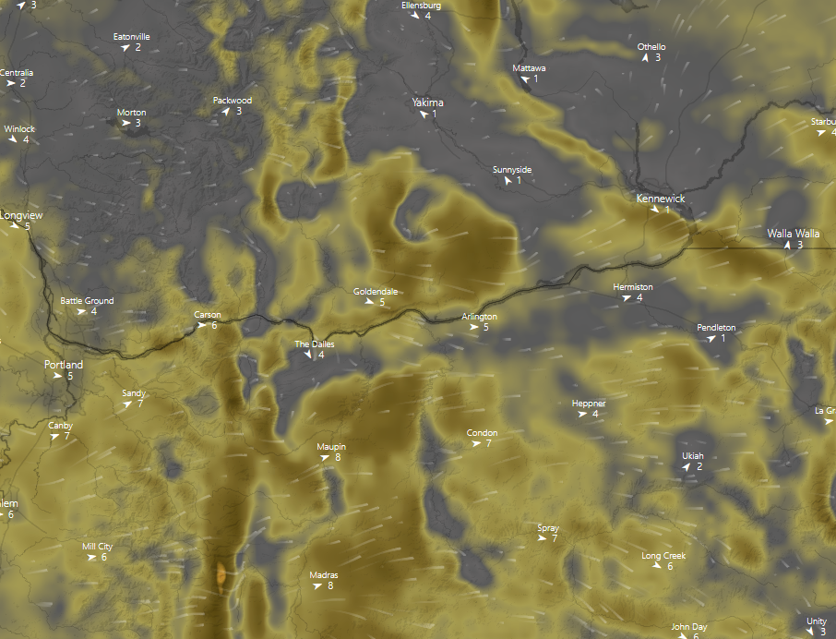
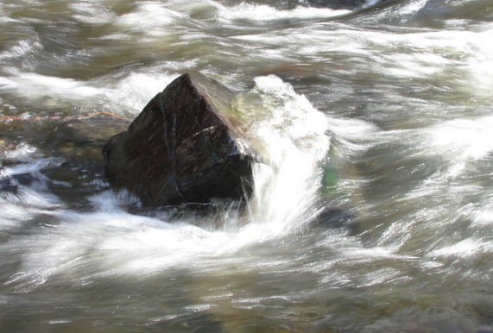
Mountain Waking
Mt. Adams
Narrow area of lighter wind
extending downwind from
Mount Hood.
Mt. Hood
Works similar to what you
would see downstream of
a rock in a shallow river.
Map: Windy, Image: Flickr/lisaluvz

Slide 9
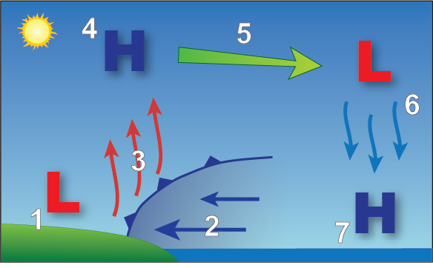
Summer Diurnal Pattern
Diurnal pattern for our wind
parks is similar to a sea breeze,
but instead of a large body of
water the colder area is usually
the Willamette Valley with the
warmer “land” the Columbia
Basin.
Image: NWS JetStream

Slide 10
Forecast Tools and Challenges

Slide 11
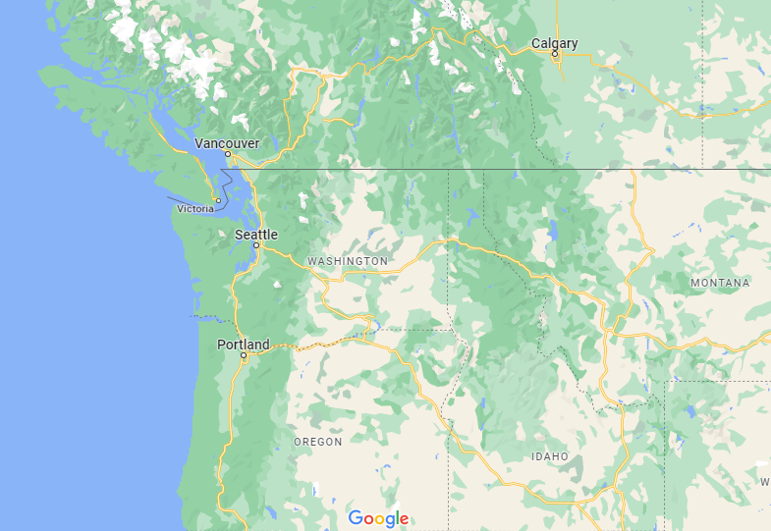
Pressure Gradients
YYC
GEG
AST
YKM
HRI
PDX
TTD
DLS
RDM

Slide 12
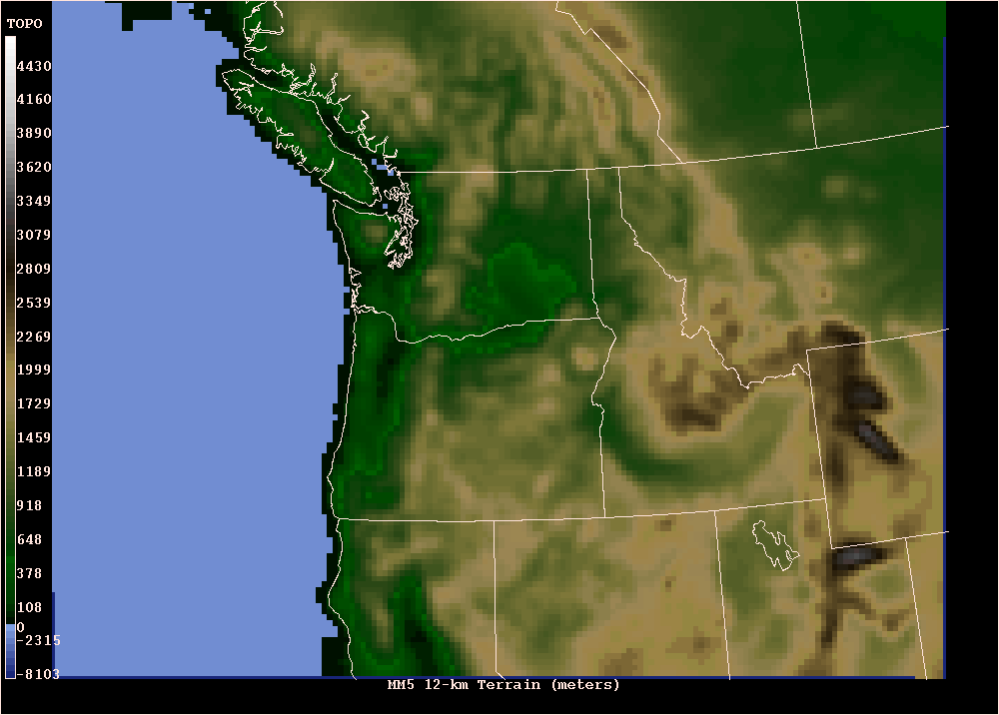
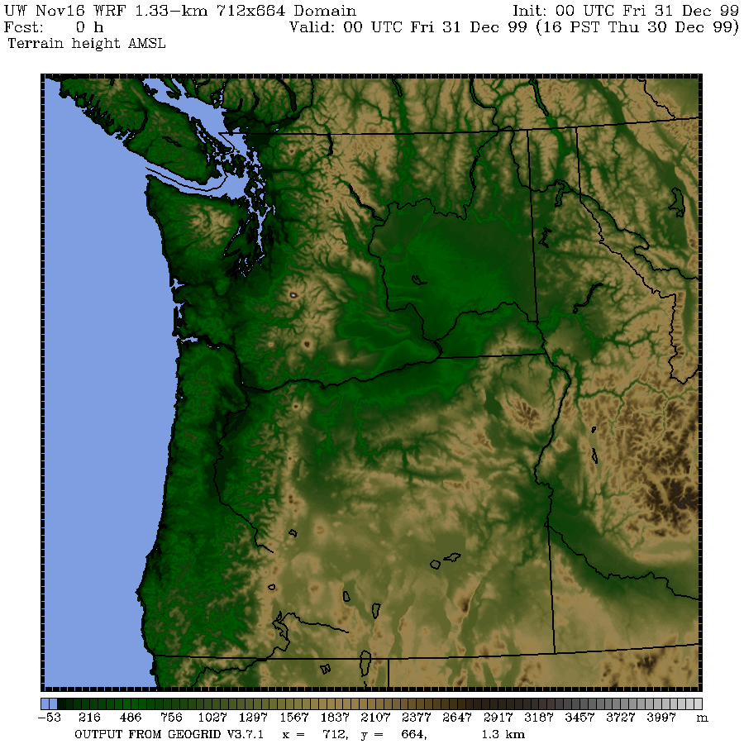
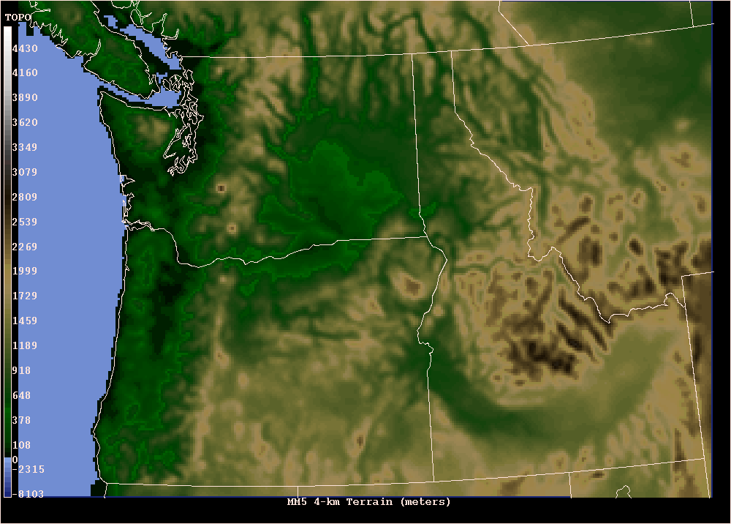
Model Resolution
12 km
1 1/3 km
4 km
Images: Univ. Of Washington

Slide 13
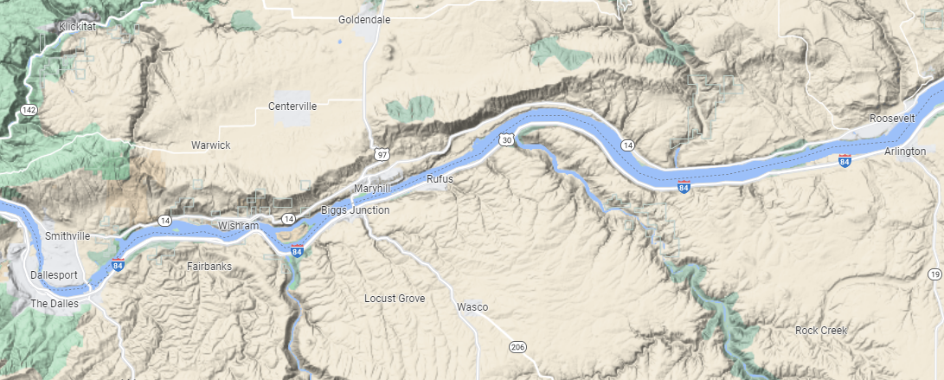
Actual Topography
3120 ft
3.5 km
2.2 mi
158 ft
Map: Google

Slide 14
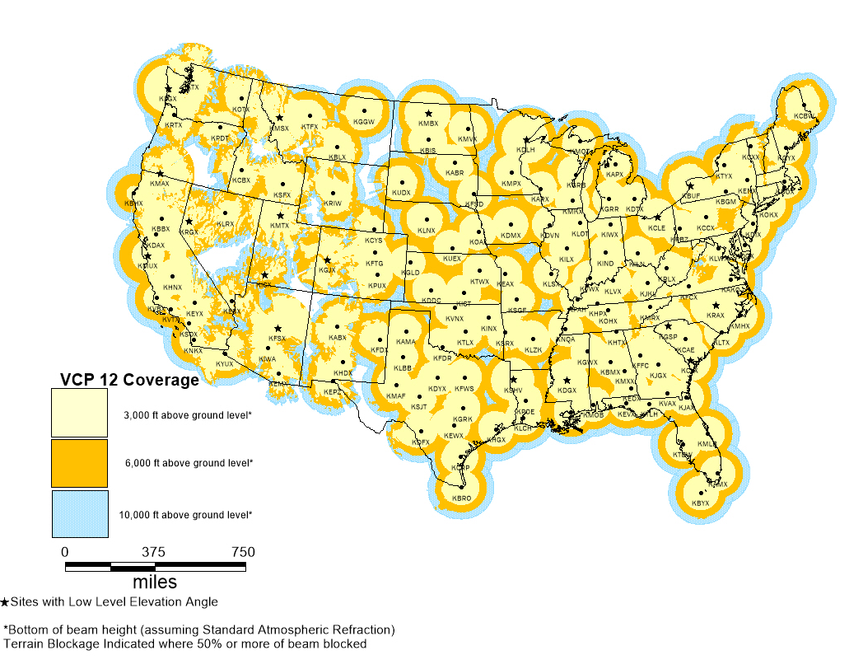
Radar Coverage
Large radar gap makes it so
we have limited ability to
forecast the strength and
timing of impacts from
thunderstorms along the east
slopes of the Cascades.
We can use satellite and
lightning data to approximate,
but often the outflow will hit
before we can see the storm.
Map: NWS

Slide 15
Questions and Comments

