Slide 1

Wind Power
101
Chris Callais
Senior Meteorologist
Avangrid Renewables LLC

Slide 2
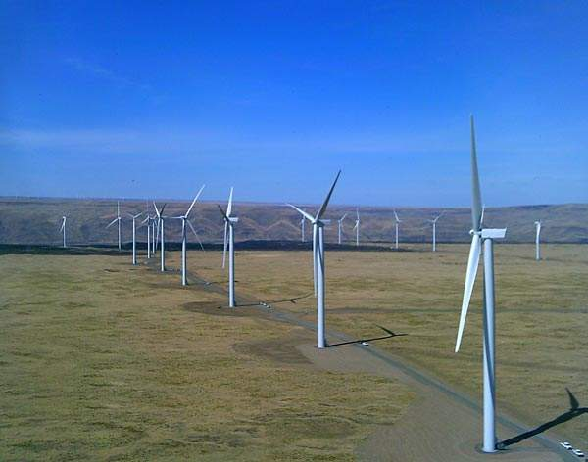
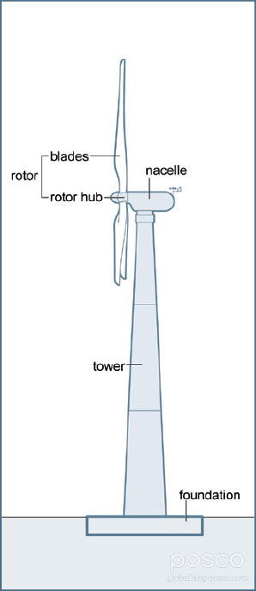
The Five Parts of a Wind Turbine
Foundation – the base of the turbine, a large block of concrete below the ground surface that anchors the turbine…at the surface there is only a small footprint allowing for other land uses like farming or ranching.
Tower – column extending upward to between 75 and 100 meters above ground level. Within the tower is a ladder used to climb the tower as well as wiring to transport generated electricity.
Nacelle – houses the equipment needed to generate electricity such as the generator and the turbine shaft used to transfer mechanical energy from the blades to the generator via a gearbox. The core of the wind turbine.
Rotor and Hub - the rotating part of the turbine, generally including three blades. The hub is where the blades connect to the nacelle.
Generator – converts the mechanical energy of the rotor into electrical energy which is then transmitted down the tower and to the park substation.
Shepherd’s Flat Wind Farm (Arlington, OR)

Slide 3
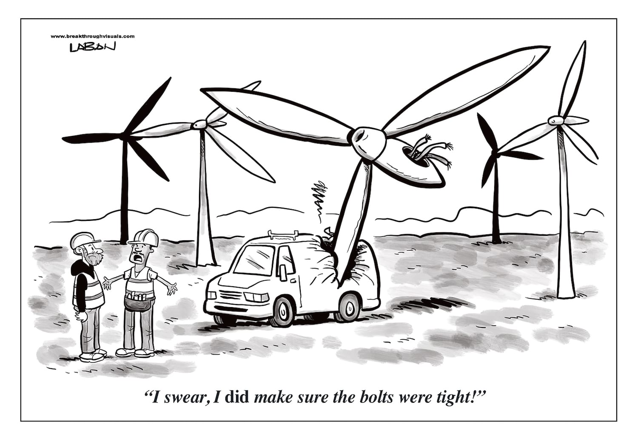

Slide 4
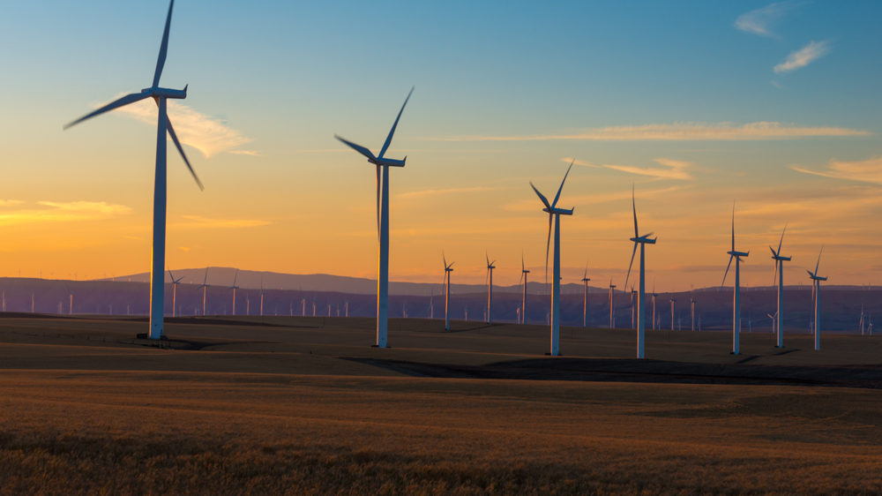
Yaw and Pitch (Rotor hub movement)
In order to accommodate changes in wind speed and direction the rotor hub and nacelle assembly must be able to pivot 360 degrees about the vertical axis and adjust blade position for optimum transmission of mechanical energy from the wind to the turbine shaft and generator.
Pitch – The pitch system adjusts the angle of the wind turbine's blades with respect to the wind, controlling the rotor speed. By adjusting the angle of a turbine's blades, the pitch system controls how much energy the blades can extract.
Yaw – The yaw system of wind turbines is the component responsible for the orientation of the wind turbine rotor towards the wind, thereby controlling how much energy is transmitted to the turbine shaft and generator.
Klondike Wind Farm (Wasco, OR)

Slide 5
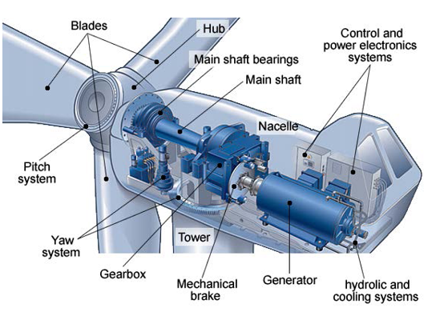
US Dept of Energy

Slide 6
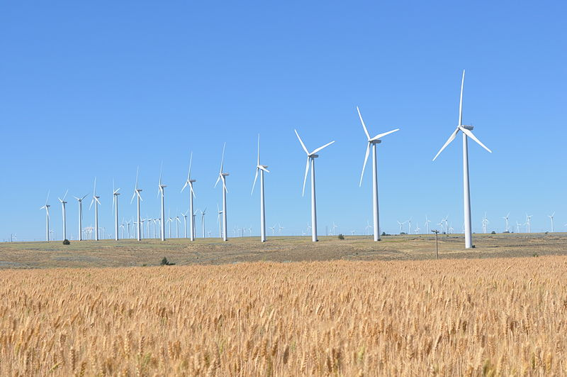
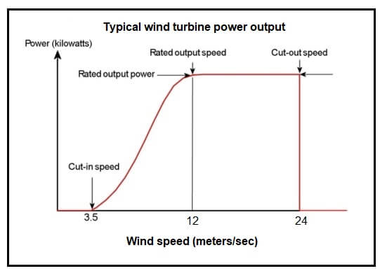
Power Curve – How Wind Speed Relates to Power Output
Power curves are non-linear and feature several key “inflection points”. Cut-in speed is the speed at which the turbine begins to produce power, generally around 3.5 m/s. Rated output power and rated output speed refer to the maximum power output (usually 1-3 MW) and the wind speed at which maximum power output is realized (12-13 m/s for most commercial models). Cut-out speed is the speed at which the turbine goes into a zero-power state to protect the components from damage. This generally ranges from 20-24 m/s depending on the turbine model and ambient air temperature.
Bighorn Wind Farm (Bickleton, WA), © Brian R. Lind

Slide 7
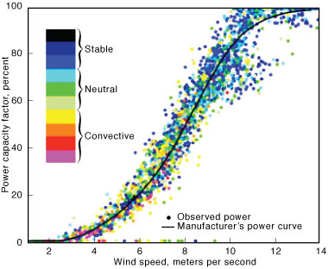
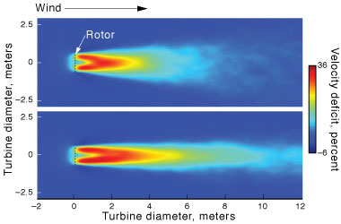
However, power output doesn’t always cleanly follow the manufacturer’s power curve. A study by Miller et al (2014) at the Lawrence Livermore National Laboratory illustrated that background atmospheric turbulence from convective instability influences turbine wakes leading to the variation in actual power versus expected power based on the power curve.
Convective
Stable
Miller et al (2014) “Predicting Wind Power With Greater Accuracy”, Lawrence Livermore National Laboratory (https://str.llnl.gov/april-2014/miller)

Slide 8
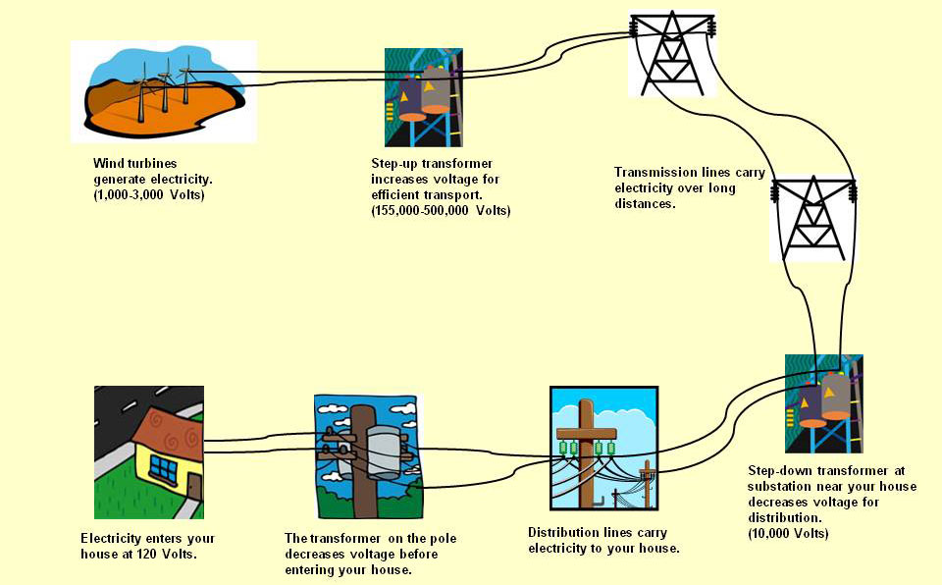
1. Generation
2. Substation
3. Transmission
How electricity gets from a wind turbine to your home
https://ei.lehigh.edu/learners/energy/wind6.html
4. Substation
7. Home Sweet Home
5. Distribution
6. Pole Transformer

Slide 9
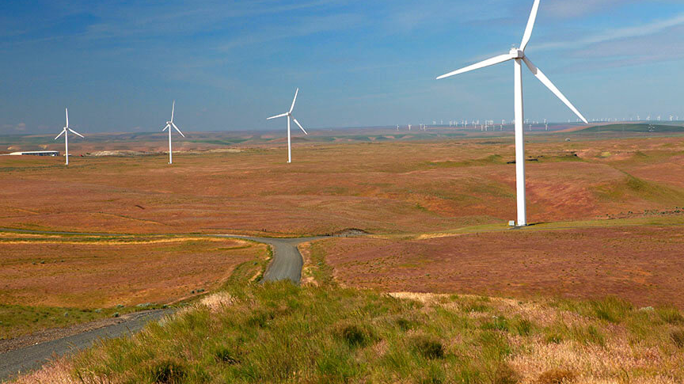
A Simplified Look At Renewable Energy Business Operations
Development Group – tasked with moving new projects along the path from drawing board to completion. This may involve siting a future wind park (such as localized modeling of wind resource), contracts with landowners, and coordinating during the permitting and building phase.
Origination Group – tasked with developing long-term power products and working with other market entities to develop and finalize contracts for the exchange of power between the generating entity (seller) and the market counterparty (buyer), typically through contracts of relatively long duration (1-10 years) where the conditions of the contract are in force for the duration of the contract (power price etc.)
Trading Group – tasked with the day-to-day trading operations in the real-time, day-ahead, forward and term markets. An operational meteorology group within trading helps facilitate accurate prediction of VERs (variable energy resources) like wind and solar power facilities as well as general weather analysis with an eye to mitigating weather risk.
Bighorn Wind Farm (Bickleton, WA)

Slide 10

Electrical Grid Reliability:
Balancing Authorities and Independent System Operators

Slide 11
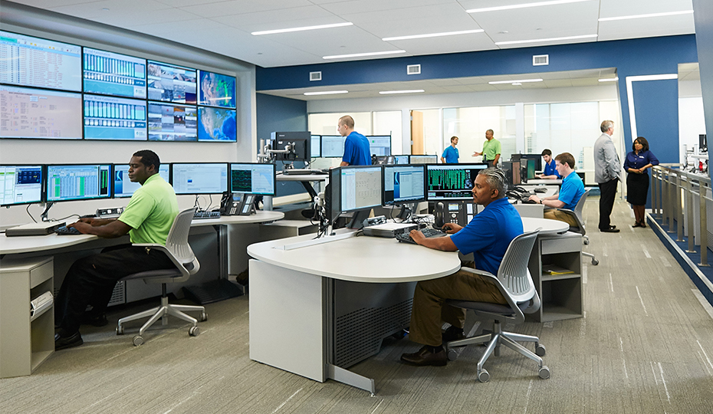
A Balancing Authority (BA) is responsible for maintaining the electricity balance within its region. Energy that is produced (sourced) must have a destination (sink). The sink is often the native load (customer demand) of the producing entity (i.e., Portland General generates power that then flows to its customers). Some BAs don’t serve load and trade all generated power on the market through either short-term trades or longer-term contracts.
BAs work together to ensure the generation, transmission, and distribution systems are all working properly to meet the needs of customers.
BAs have various tools to aid in balancing, from turning on or off generating facilities, to importing or exporting excess energy to or from neighboring counterparties.
Today there are 38 BAs within WECC (Western Energy Coordinating Council) that comprise a diverse region from California and Arizona in the United States, to BC and Alberta in Canada. Connections between the neighboring electricity systems have improved reliability and efficiency of the whole system, while still allowing the individual power companies to keep control over serving their own customers’ needs. The development of BAs helps to maintain the stability and safety of the entire grid because any problems, such as outages caused by fires or earthquakes, can be isolated and controlled without causing a risk to other parts of the electric grid.

Slide 12
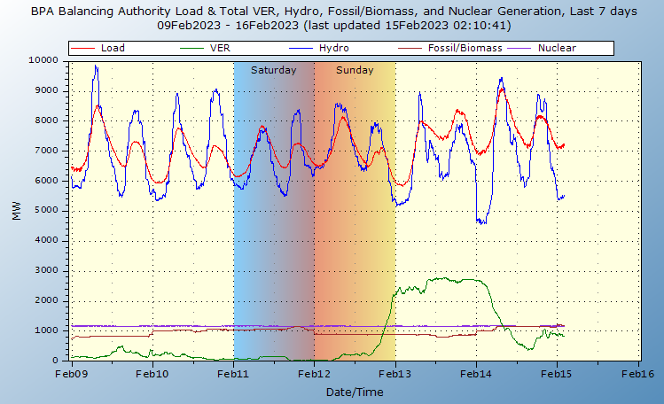

Slide 13
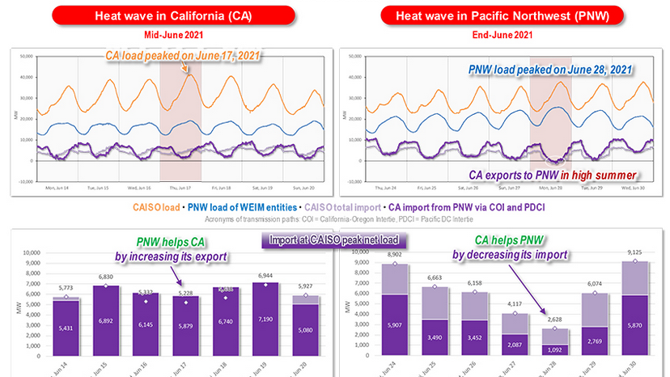

Slide 14
An Independent System Operator (ISO) is an independent grid operator that handles electric grid operations, market facilitation, and bulk electric system planning (for instance coordinating facility outages to maintain the integrity of the bulk electric system).
ISOs work to create a fair “playing field” for the various market participants. Some market participants own their own transmission, some both generate power and serve load (customers), others generate power and operate as wholesalers in the market. To avoid conflicts a ISO does not own, but manages, core assets in the electric system such as transmission lines. The ISOs handle all the system operation functions of scheduling generation, transmission, and reserves; acquiring ancillary services; managing the system in real-time and system planning. For example, if a generating entity wants to take a facility offline for an outage it seeks approval from the managing ISO.
ISOs in the United States are managed by an independent board of directors and are subject to Federal Energy Regulatory Commission (FERC) regulations, with the notable exception of ERCOT which is solely within Texas.

Slide 15
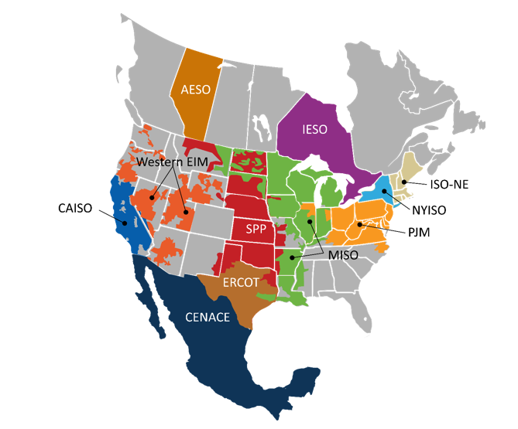
Independent System Operators (ISOs) in the United States, Canada, and Mexico.
The Western EIM is a relatively new ISO that is managed by CAISO but is separate from CAISO. It includes most major market participants in the Pacific Northwest, other than power companies that solely serve load (example would be many of the smaller electric cooperatives and PUCs in the Pacific Northwest).
ERCOT is the only ISO that is under state regulatory jurisdiction rather than FERC jurisdiction. This unique arrangement has contributed to recent cases of system instability within ERCOT (Feb 2021).

Slide 16
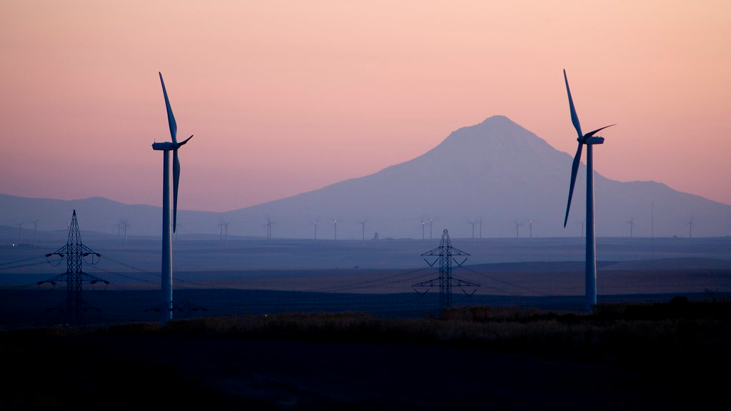
The End
Questions?
Leaning Juniper Wind Park (Arlington, OR)

