Slide 1
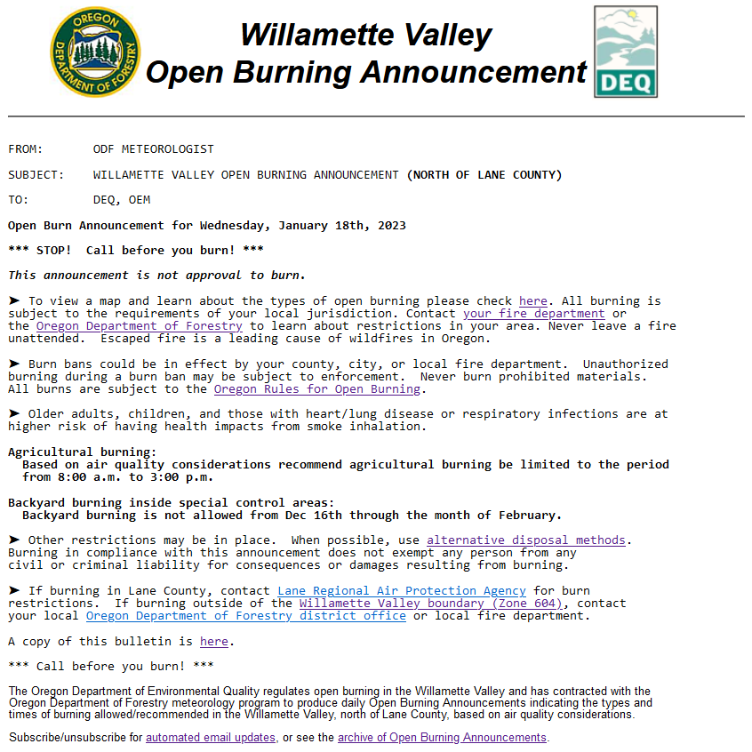
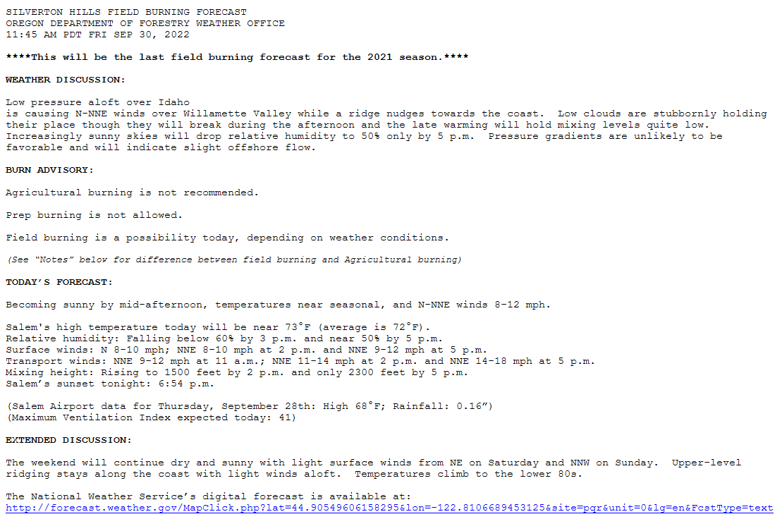
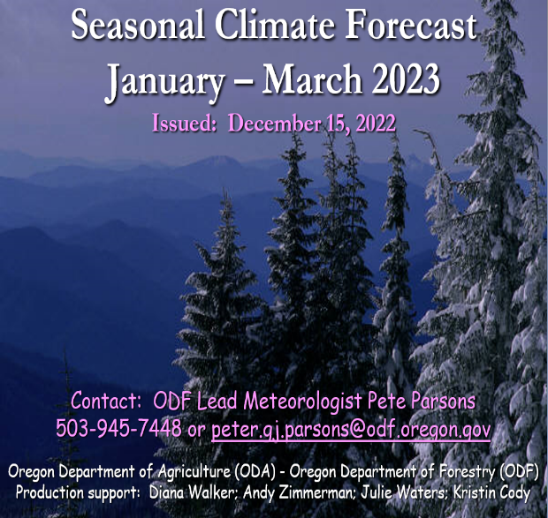
“Forecast Services” Provided by ODF
(Not Part of the Smoke Management Program)
Willamette Valley Open Burning Announcement (contract - DEQ).
Field-Burning Forecasts – Willamette Valley; Jefferson County; Union County (contract with ODA).
Seasonal Climate Forecast – (cooperative agreement with ODA).
WV Open Burning
WV Field Burning
Seasonal Forecast
Notes:
Weekly ENSO update: https://www.cpc.ncep.noaa.gov/products/analysis_monitoring/lanina/enso_evolution-status-fcsts-web.pdf

Slide 2
Open Burning Announcement
Issued Daily

Slide 3
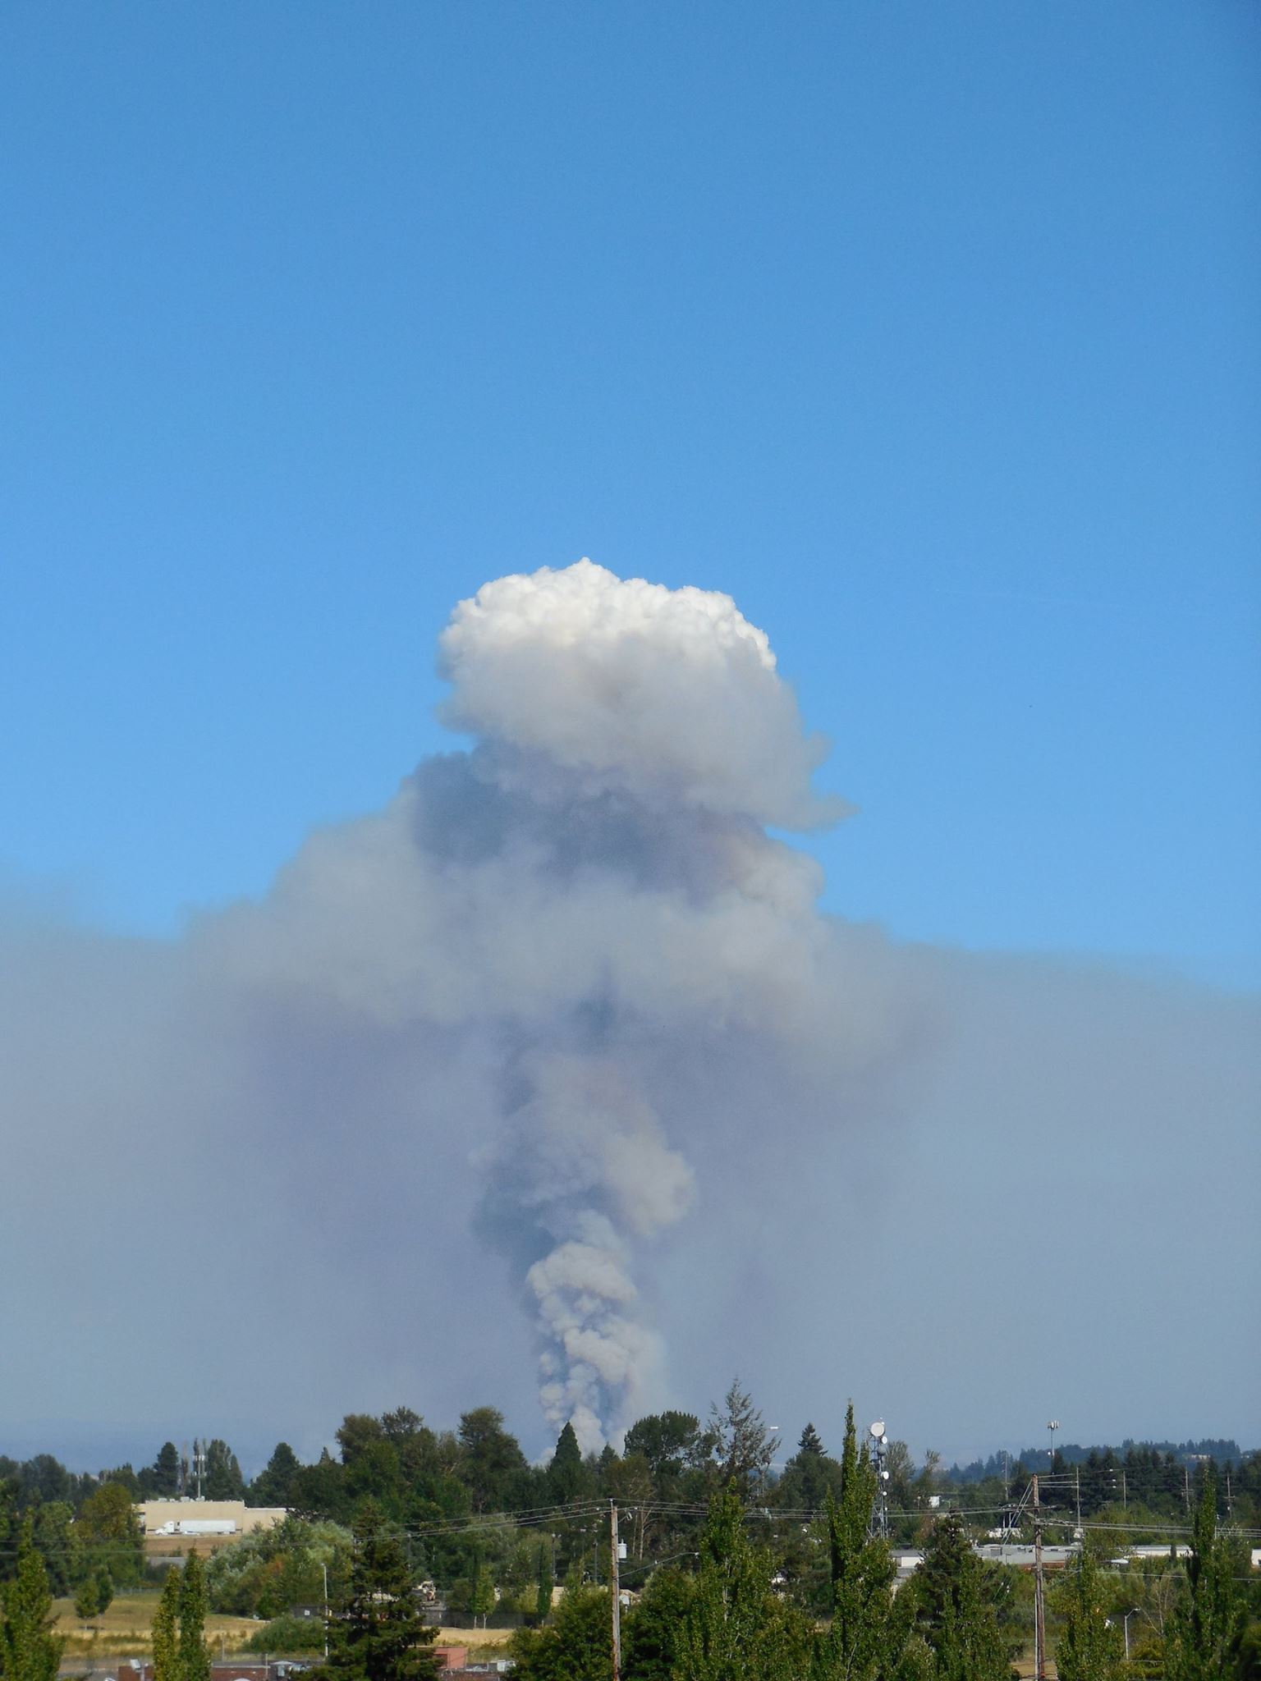
Field-Burning Forecasting
Seasonal – Summer/Fall

Slide 4
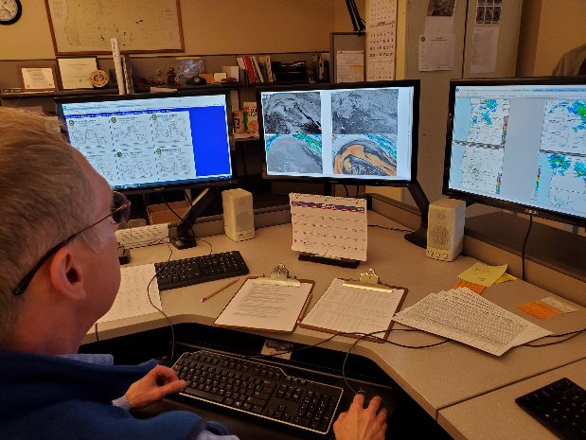
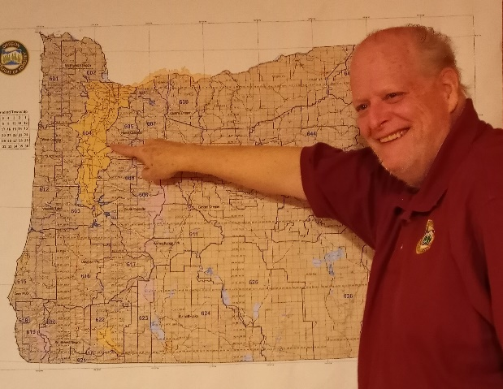
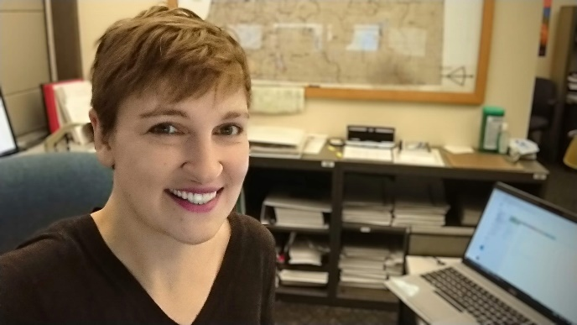
Oregon Department of Agriculture (ODA)
Runs the Field-Burning Program
Weather Forecasting is contracted to the Oregon Department of Forestry (ODF) Smoke Management Department (since 2010).
ODF has 3 full-time meteorologists dedicated to this program from July 1 through October 15 each year.
Pete Parsons
Sherri Pugh
Gary Votaw
Notes:
Weekly ENSO update: https://www.cpc.ncep.noaa.gov/products/analysis_monitoring/lanina/enso_evolution-status-fcsts-web.pdf

Slide 5



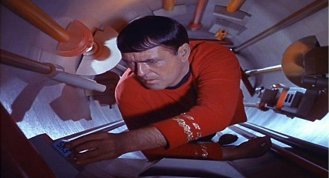
ODA & Growers Assignments
Command Decisions
Communications
Navigation
Engineering

Slide 6

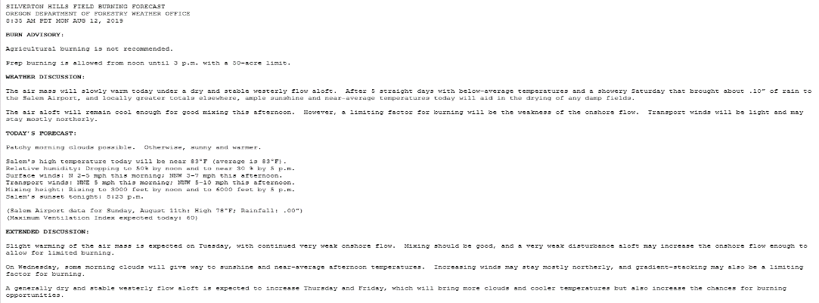

ODF Provides Science-Related Support
Real-Time Monitoring
Twice-Daily Forecasts
Daily/Hourly Briefings
Annual Summary

Slide 7
ODF Smoke Management Objective
Maximize burning opportunities while minimizing smoke impacts to the public.
Fields need to be receptive to fire (not too damp).
Smoke must elevate to at least 3000 feet (mixing height).
Light surface winds minimizes low-level drift (< 15 mph).
Minimal down-mixing of smoke (proper gradient stacking).
Enough transport wind (at the mixing height) to evacuate smoke east of the Cascade passes (SW-NW at > 10 mph).
No complicating factors (i.e., showers, wildfire smoke, etc.).

Slide 8
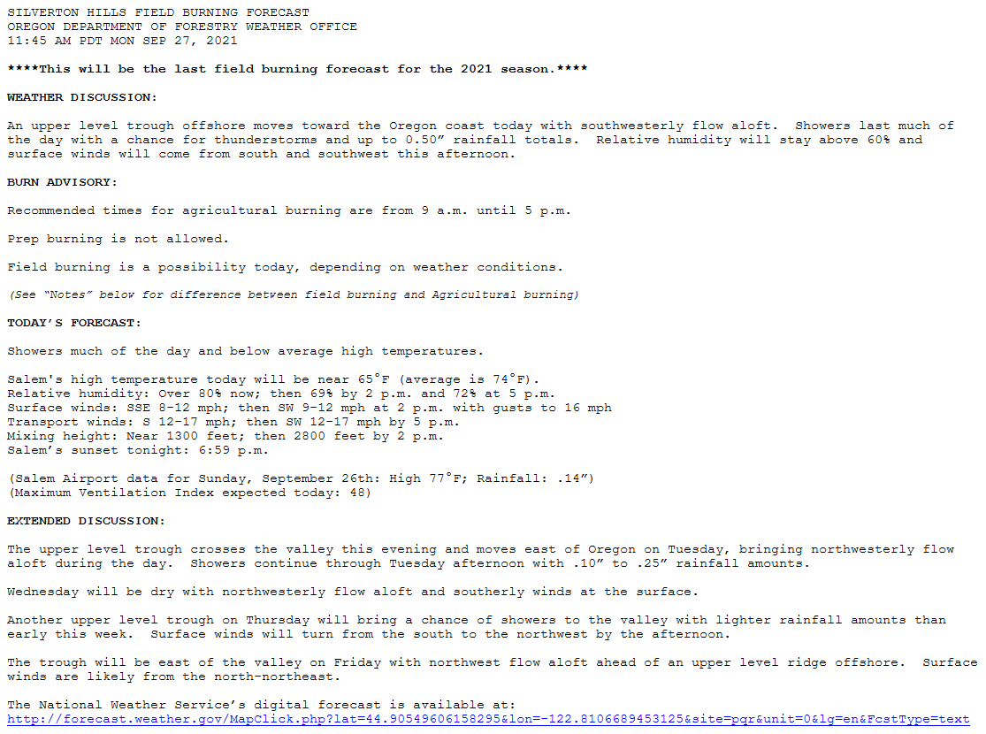
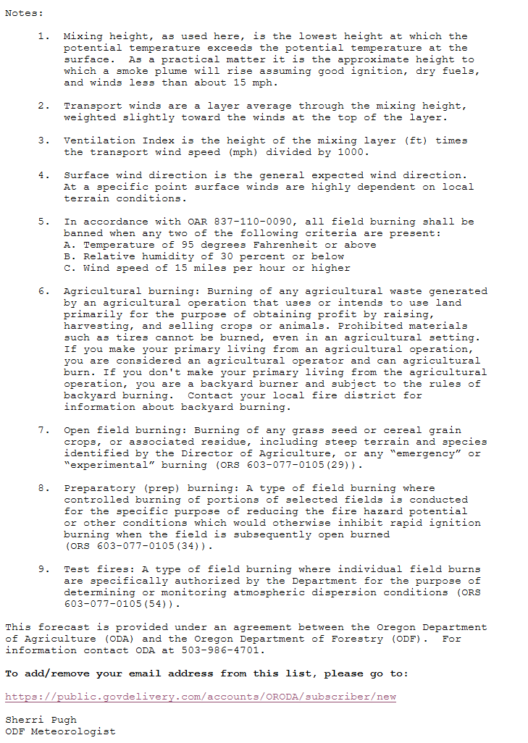
ODF Field-Burning Forecast http://www.odf.state.or.us/DIVISIONS/protection/fire_protection/DAILY/fbs.htm
Issued at 9 a.m. and noon Monday-Friday during the field-burning season (typically after July 4th through September 30th).

Slide 9
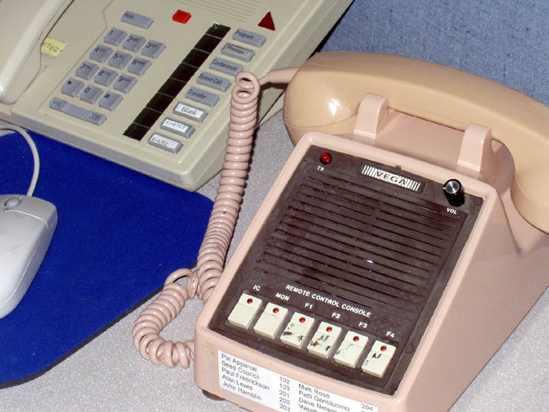
ODF Field-Burning Forecast http://www.odf.state.or.us/DIVISIONS/protection/fire_protection/DAILY/fbs.htm
Issued at 9 a.m. and noon Monday-Friday during the field-burning season (typically after July 4th through September 30th).
Grower’s Radio Network

Slide 10
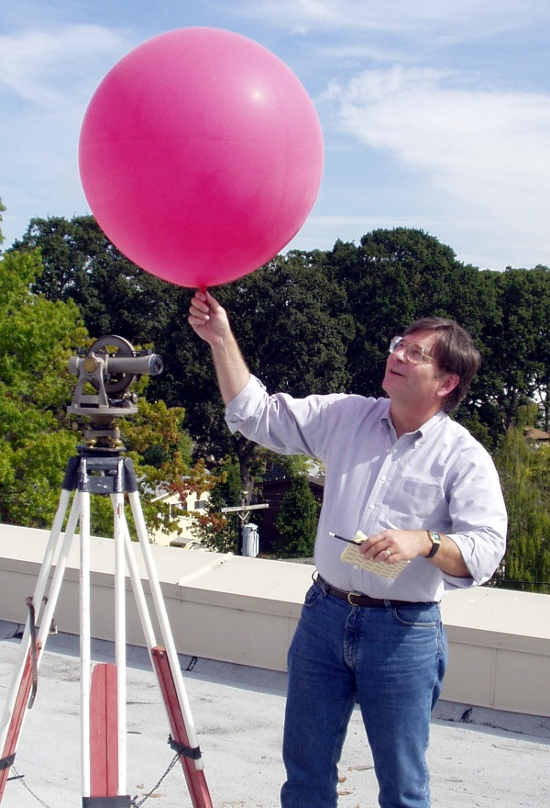
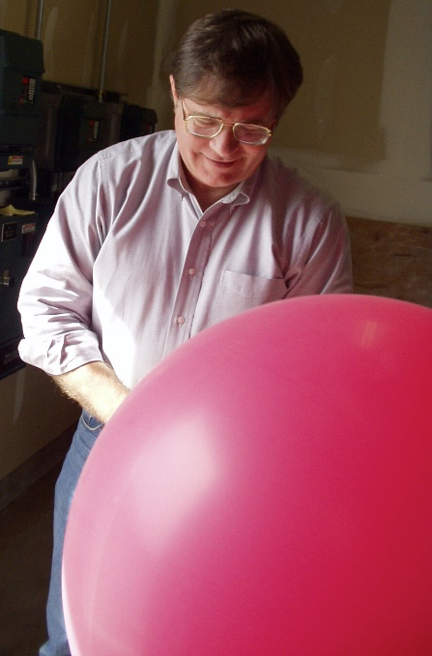
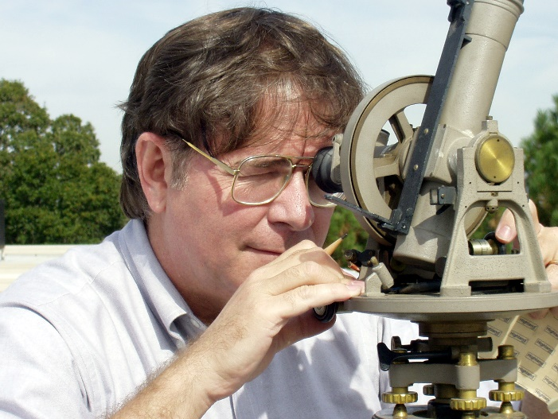
PIBALS
Pibal = Pilot Balloon
Measure Azimuth and Elevation with a Theodolite
Convert to layer-averaged winds

Slide 11
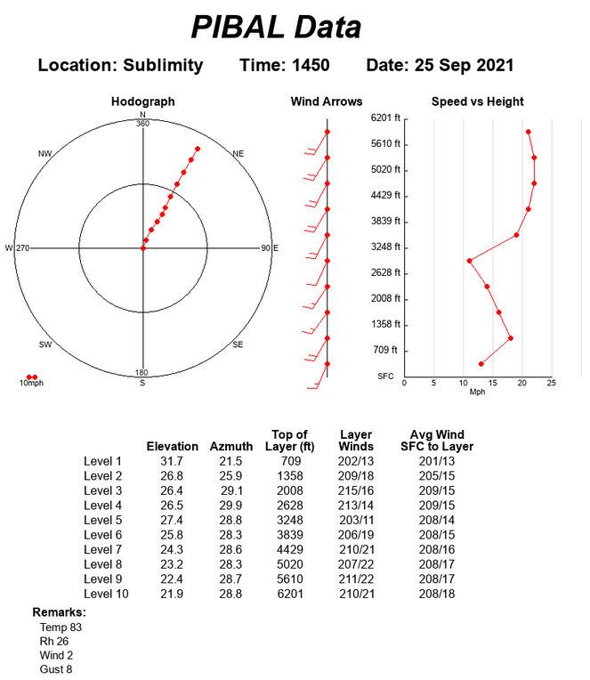
PIBALS

Slide 12
What Do We Want?
Good plume above
active portion of fire
“Mixing Height” > 3000 Feet
Minimal surface drift
Minimal down-mixing

Slide 13
What Do We Want?
SW-NW Transport Winds > 10 mph

Slide 14
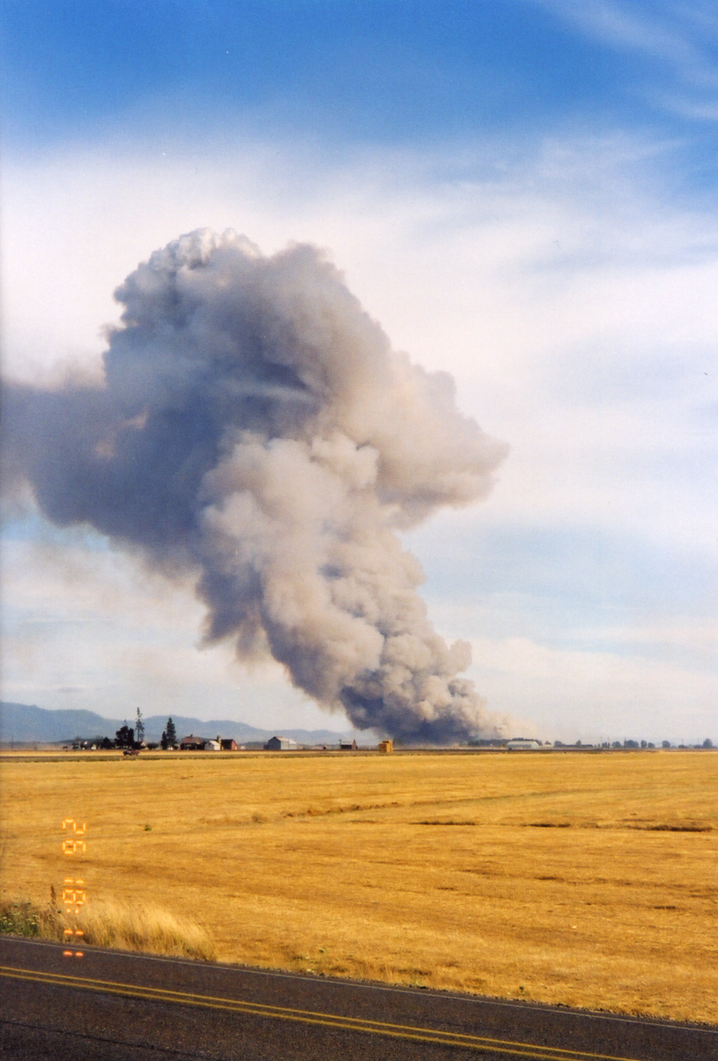
Stronger Surface Winds
More surface drift

Slide 15
Oregon Field-Burning Forecasting
There are lots of boxes to check before burning.
Limited number of days for burning each year (< 20 ).
Important to take advantage of every opportunity.
Some days may only allow of the burning of 1 or 2 fields.
There are typically about 3-6 days suitable for substantial burning in the Willamette Valley (i.e., >1000 acres).
More “suitable” burning days in Jefferson/Union counties.
July and September tend to have the most-favorable burning conditions (poor mixing and north winds in August).

Slide 16
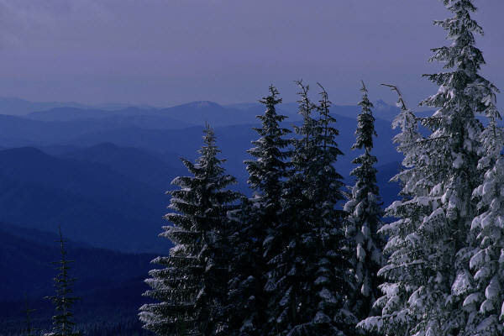
Seasonal Climate Forecast
January – March 2023
Issued: December 15, 2022
Contact: ODF Lead Meteorologist Pete Parsons
503-945-7448 or peter.gj.parsons@odf.oregon.gov
Oregon Department of Agriculture (ODA) - Oregon Department of Forestry (ODF)
Production support: Diana Walker; Andy Zimmerman; Julie Waters; Kristin Cody

Slide 17
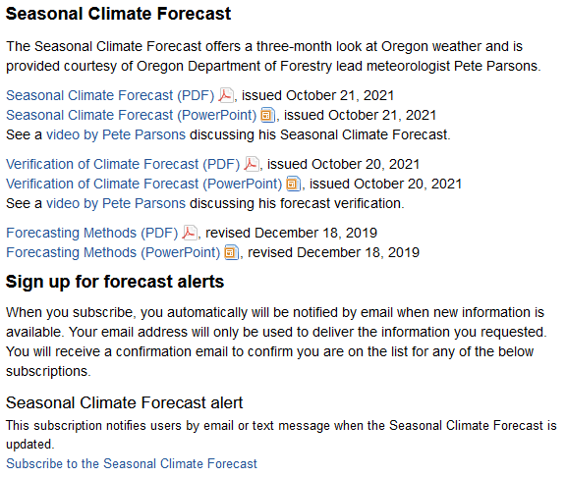
Seasonal Climate Forecast
http://www.oregon.gov/ODA/programs/NaturalResources/Pages/Weather.aspx
Notes:
ONI data from: https://origin.cpc.ncep.noaa.gov/products/analysis_monitoring/ensostuff/ONI_v5.php

Slide 18

To Get the Job Done...
We Are All In This Together!
Sinking air aloft
Trapped smoke
Stable, layered clouds

