Slide 1


SMOKE MANAGEMENT FIELD COORDINATOR
CHRISTINA CLEMONS
OREGON DEPT. OF FORESTRY, SALEM, OR

Slide 2

FIELD OPERATIONS
On-site ground truth of burns as well as technical application of SMP.
Monitoring and audit of prescribed fires.
Fire season harbingers; share intel of trends and anomalies.
Liaison between burners and ODF forecasters/Smoke Management

Slide 3
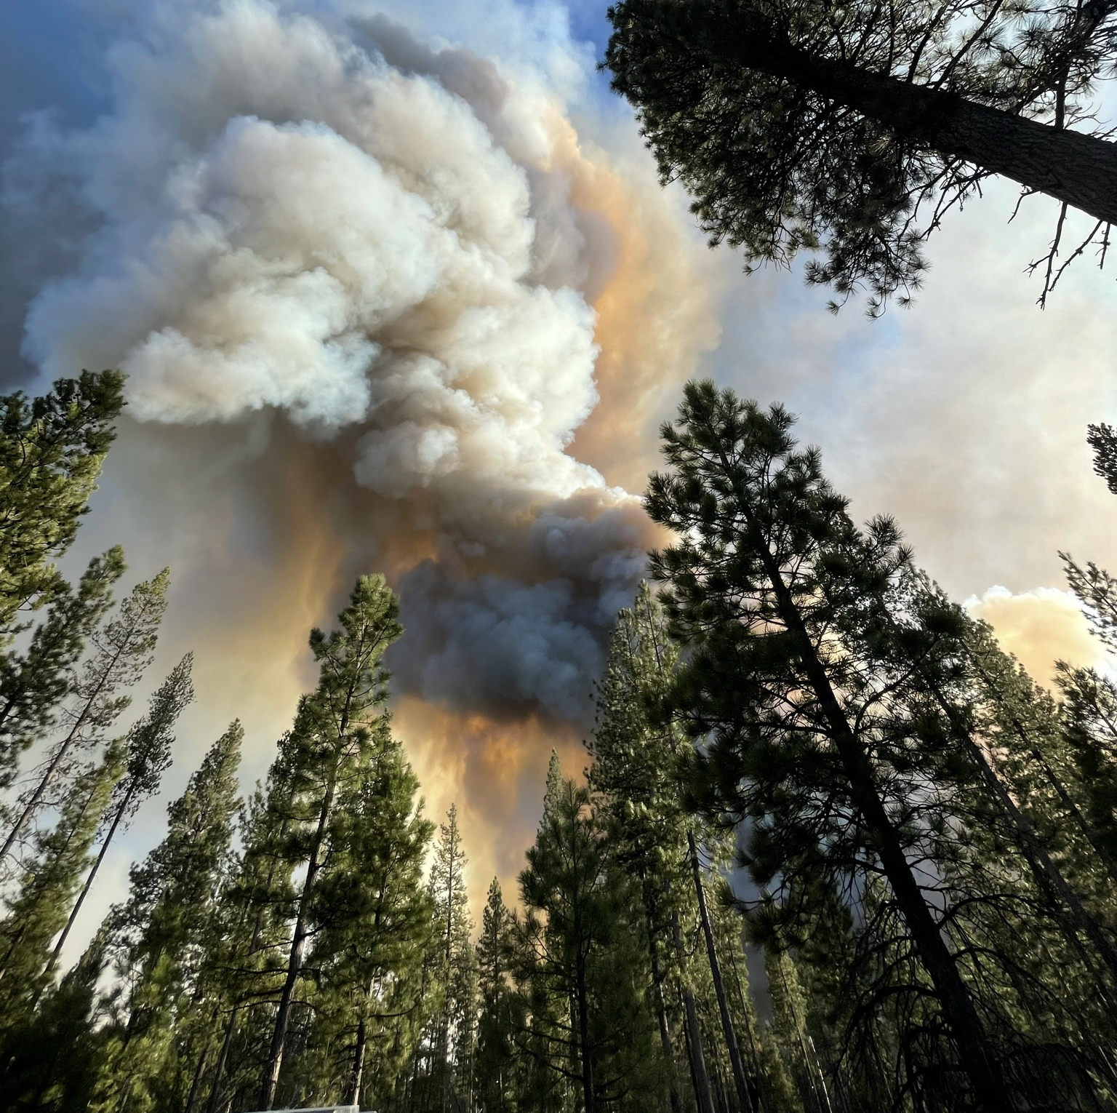
ESCAPED RX!
Fuel Load Estimation Low – large, complex unit with various aspects.
Long drought – more fuel consumption than anticipated.
Fire Season Harbinger – more large fires in the area that summer.
Smoke Intrusion Thresholds exceeded.

Slide 4
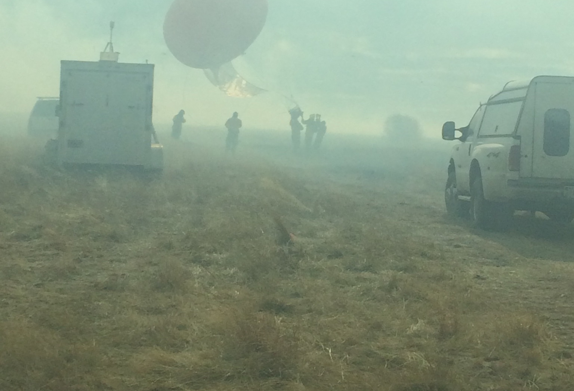
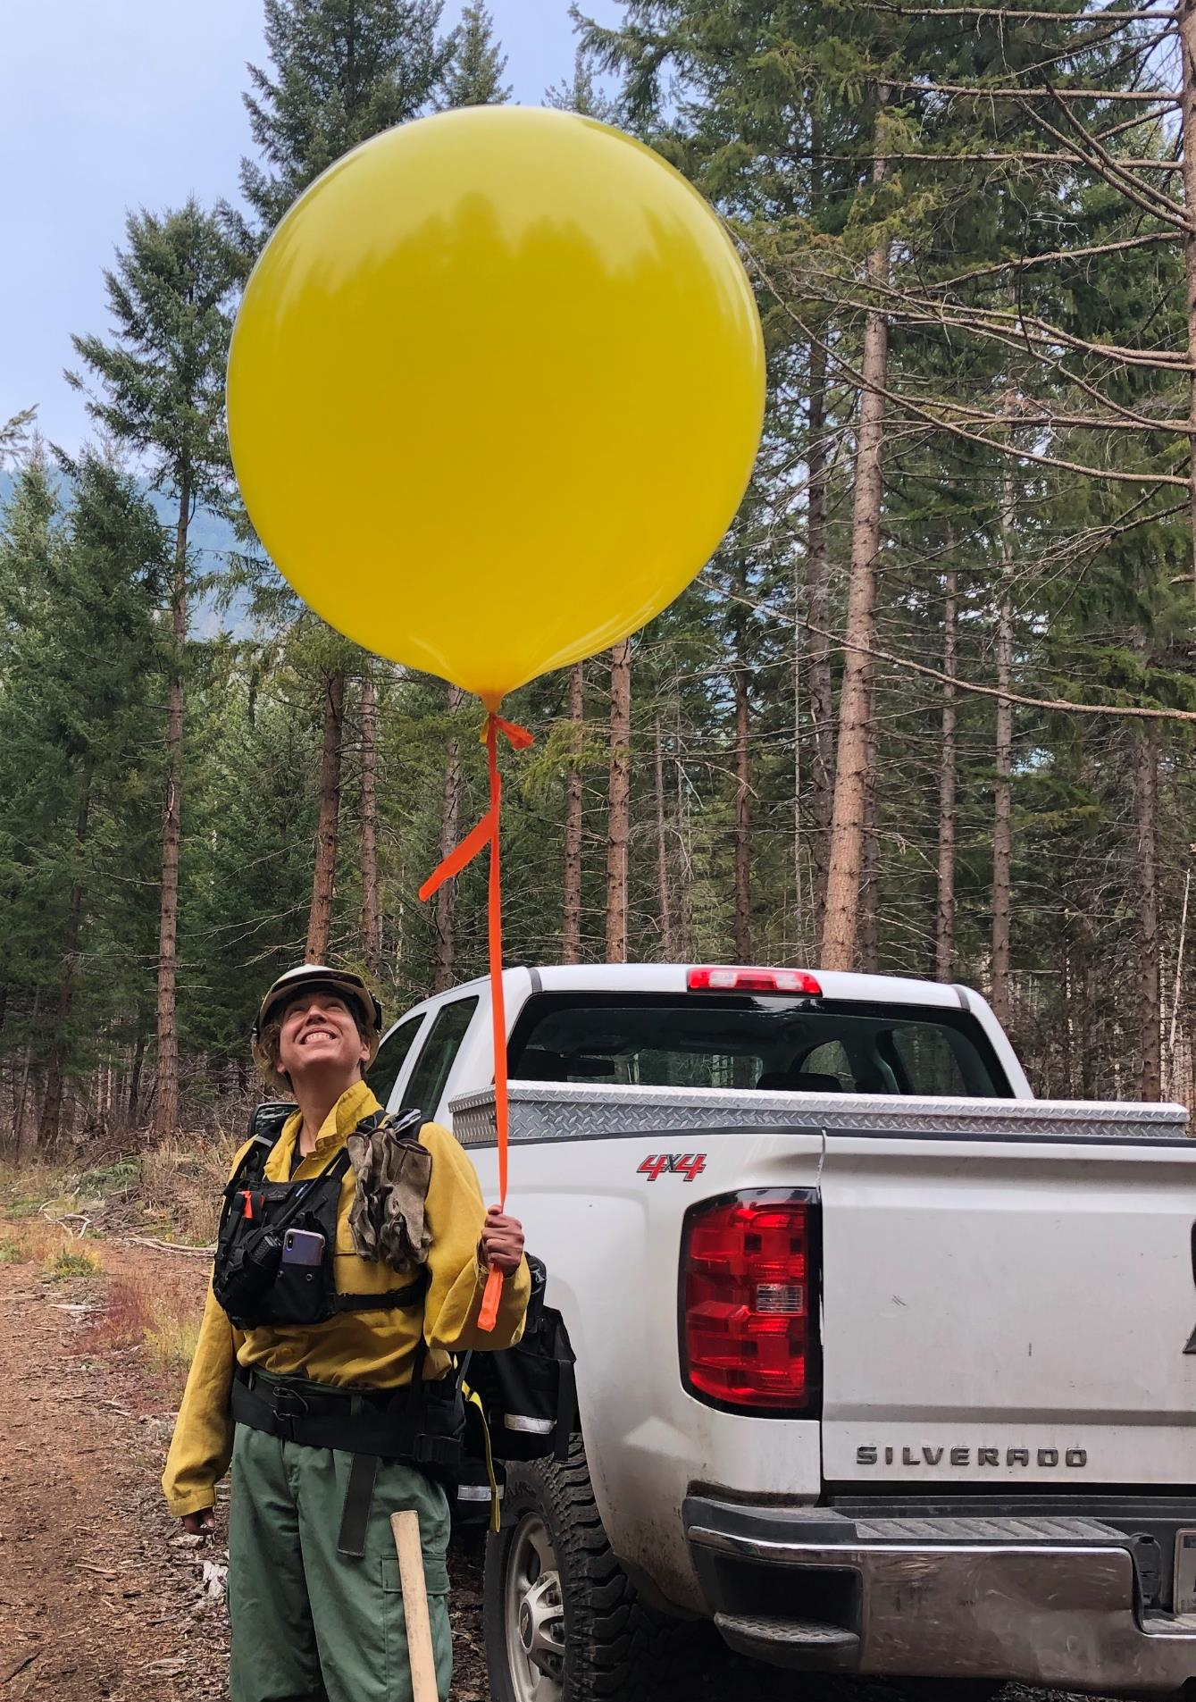
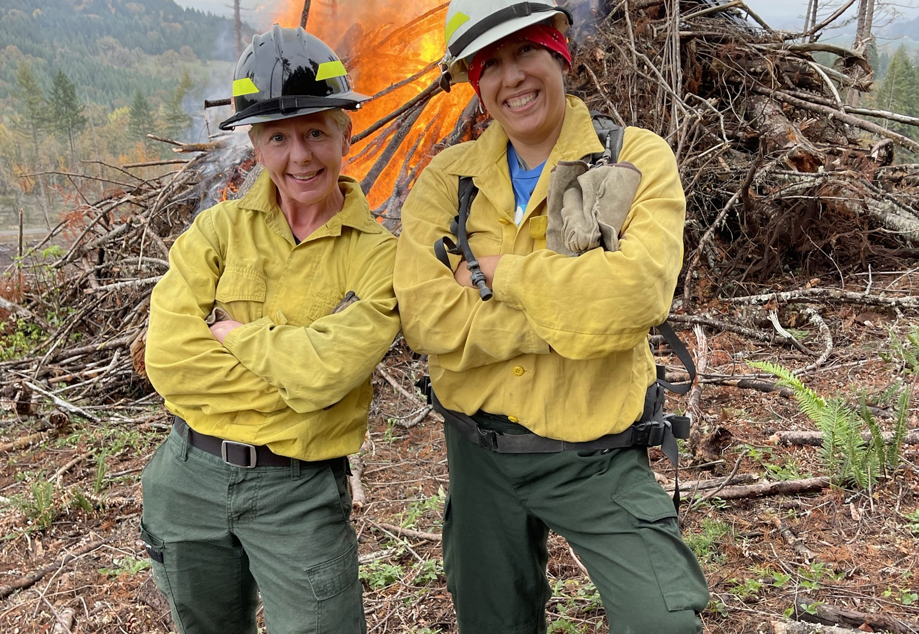
On-site
GROUND TRUTH
Partner with EPA, OSU, Missoula Fire Labs, NRCS, etc.
Collecting data with high tech equipment like the “flyer” equipment to practical ground application for the burners in the field.

Slide 5
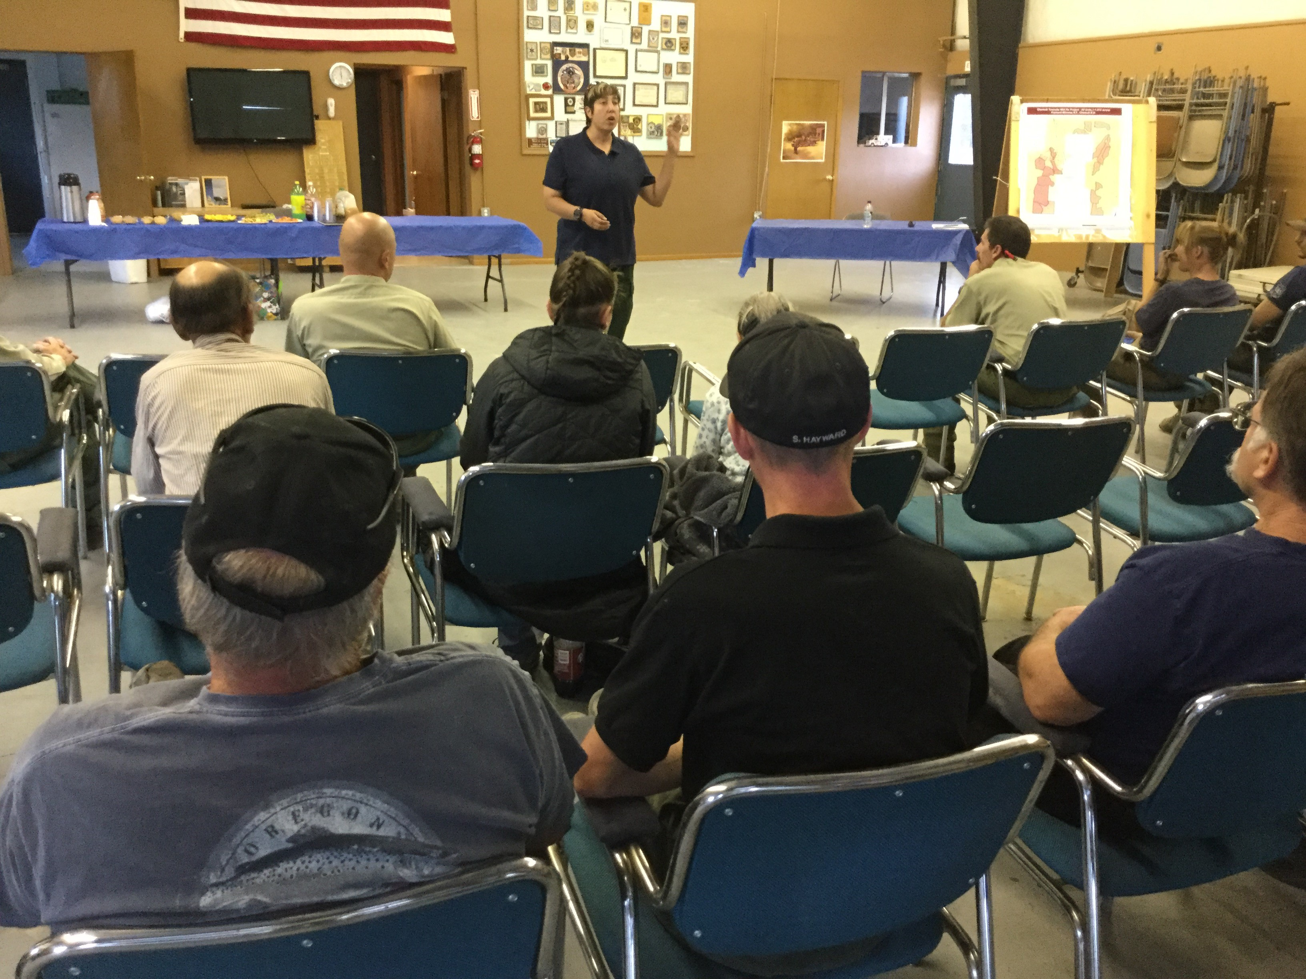
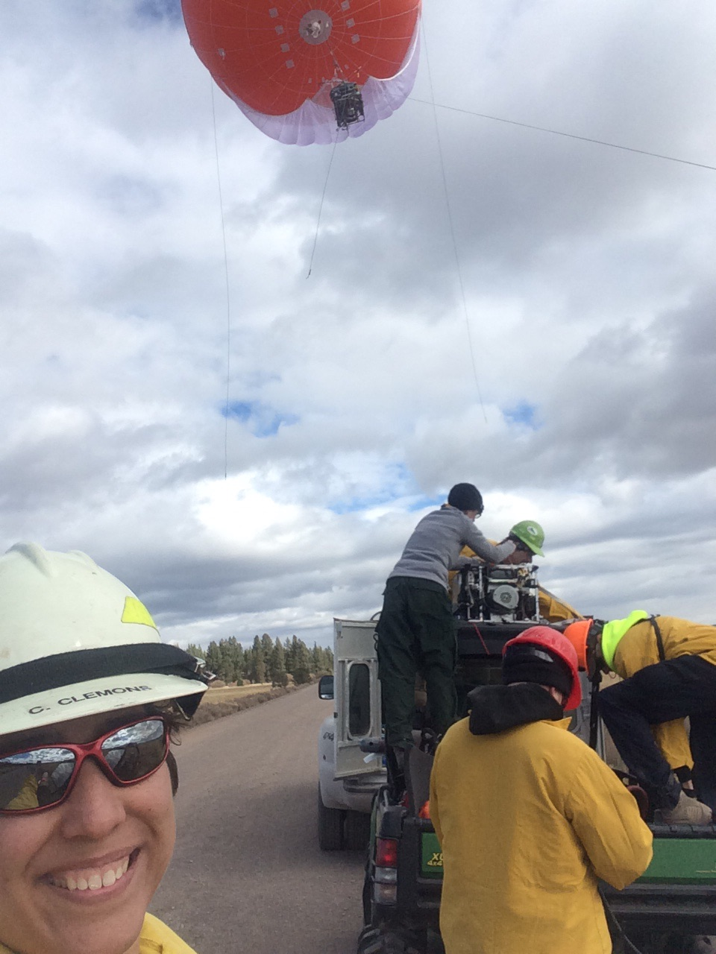
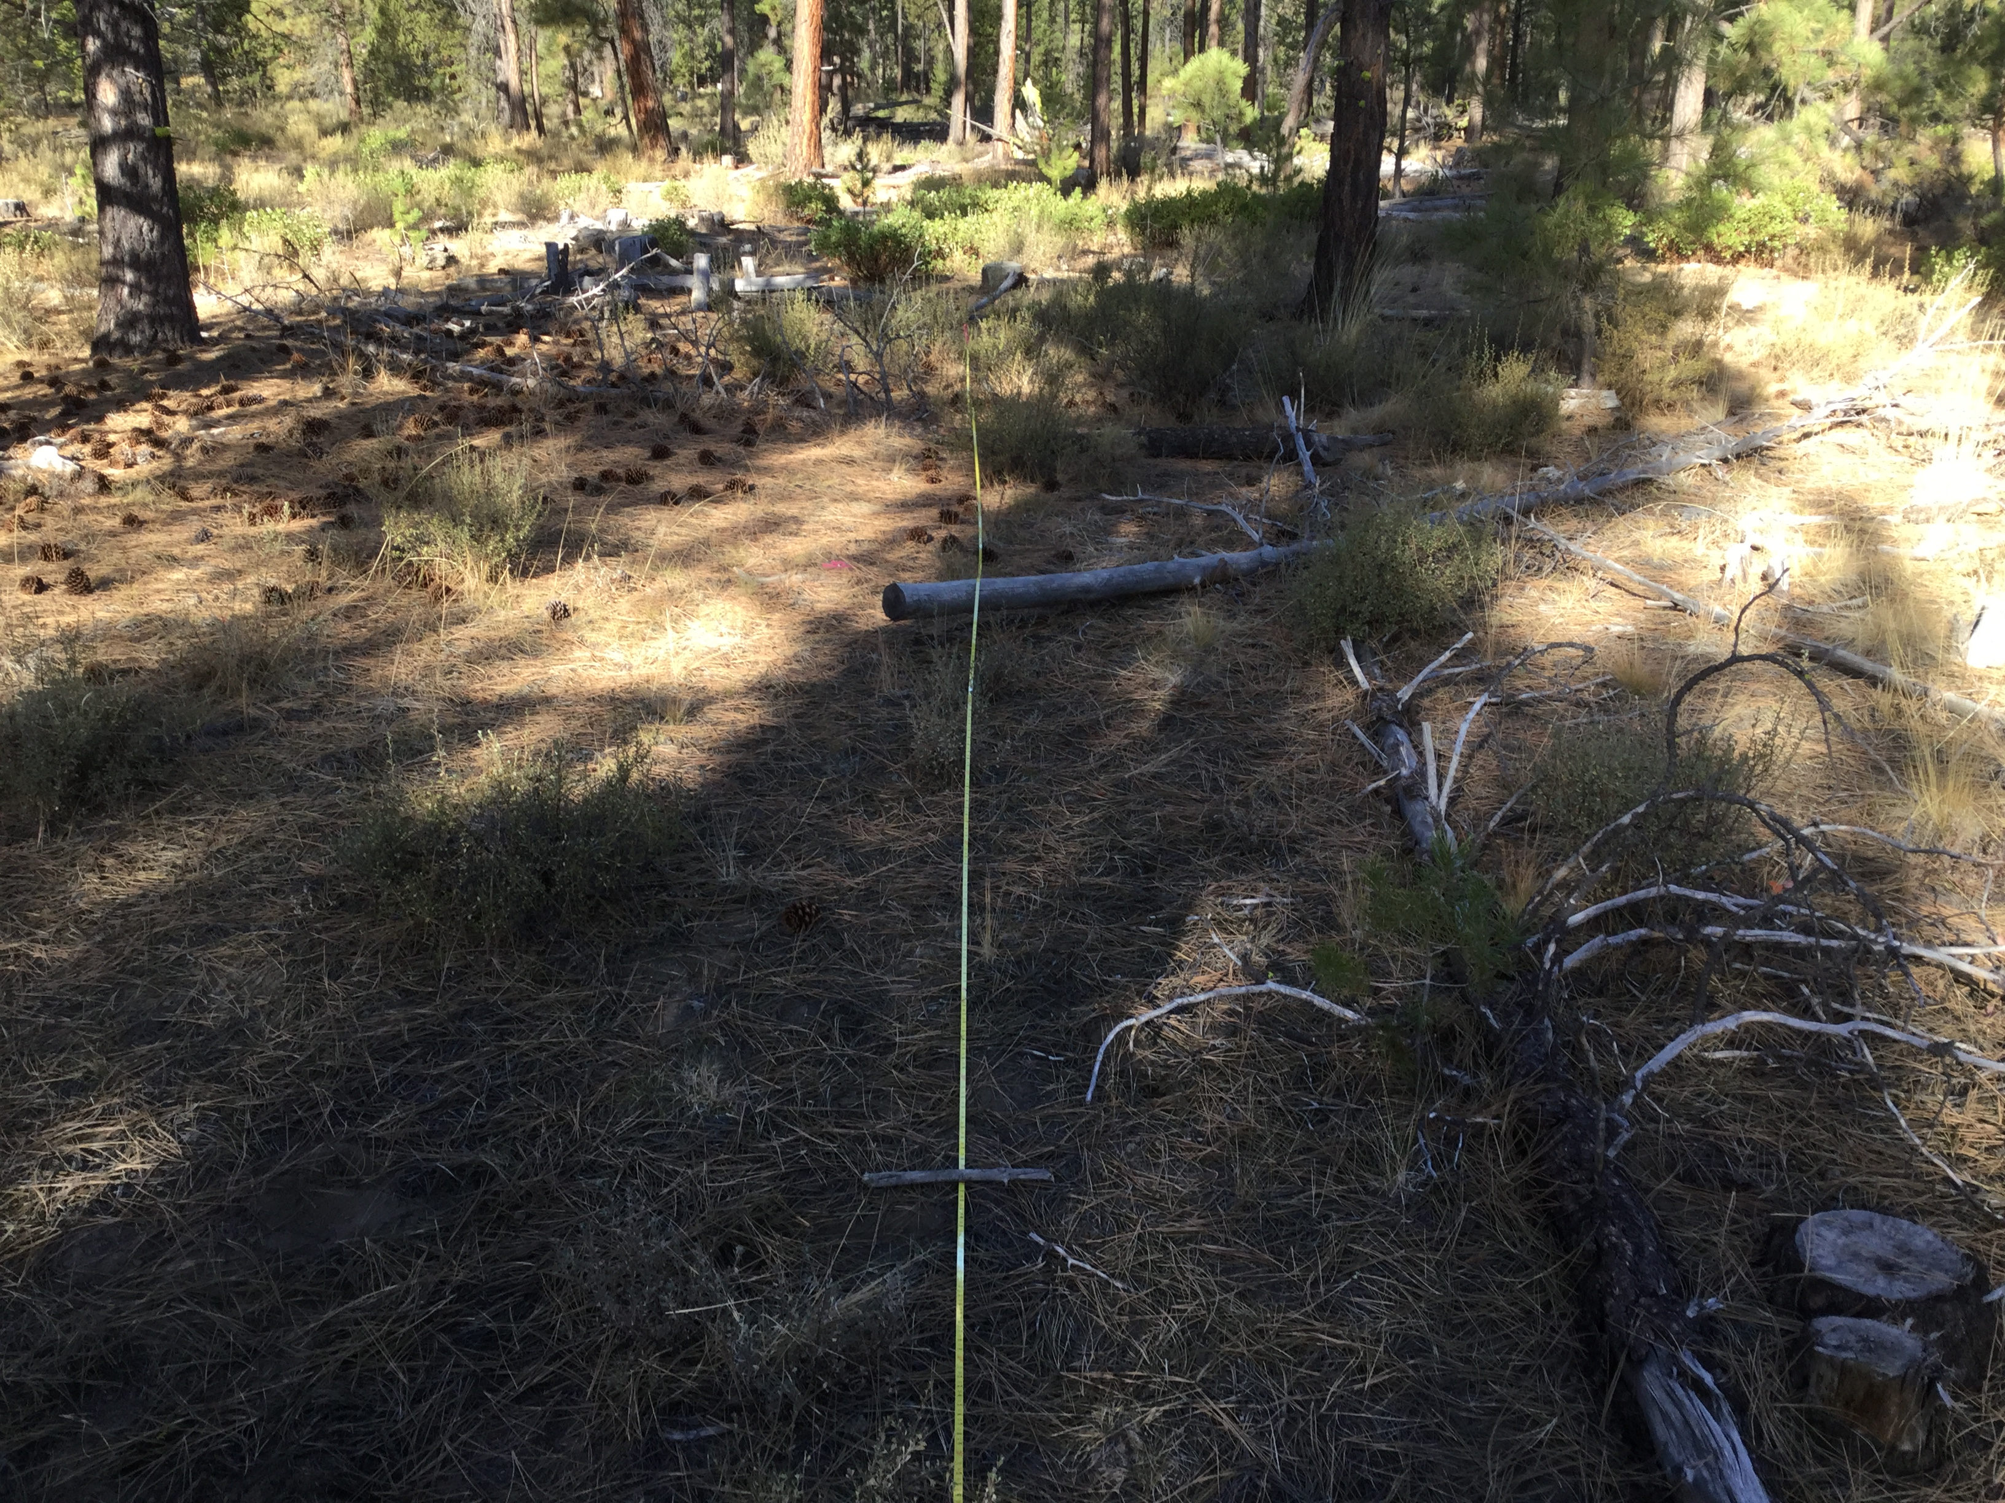
PUBLIC EDUCATION
Weather Patterns
Fuel Loading
Air Quality
Smoke Regulations
Social Licensing
Alternatives to Burning
Polyethylene Usage
Maximizing Burning Opportunities

Slide 6
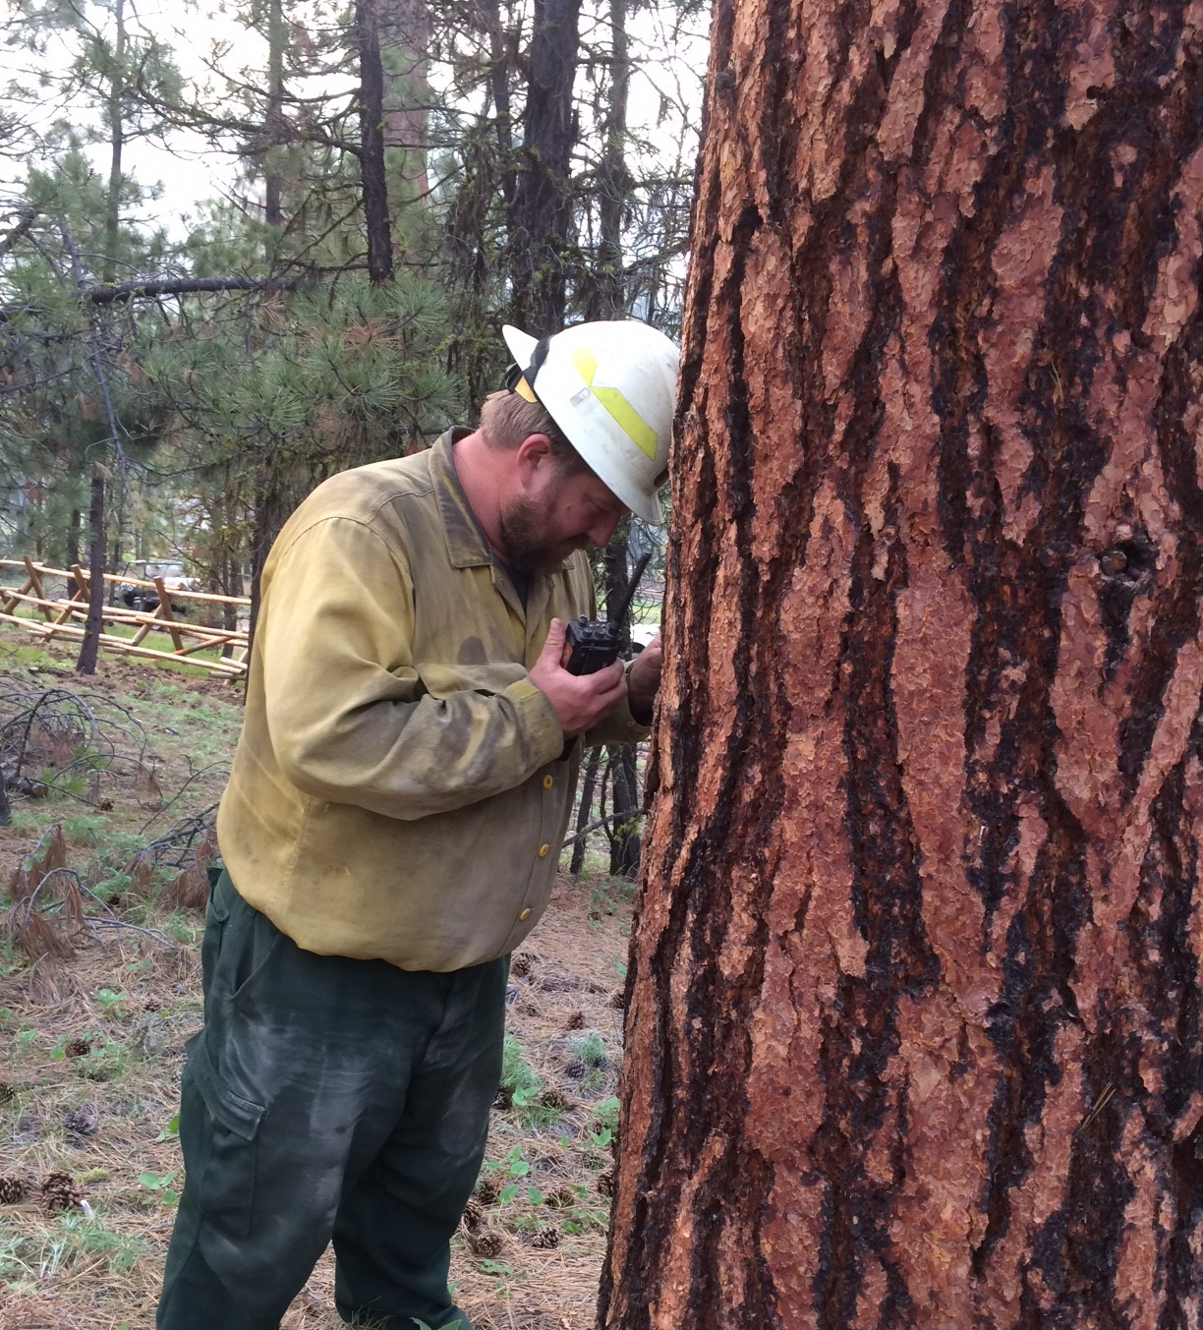
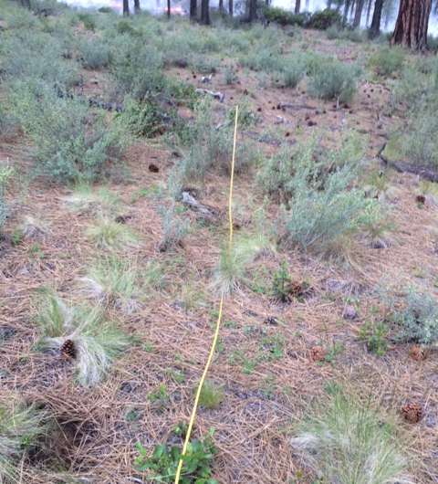
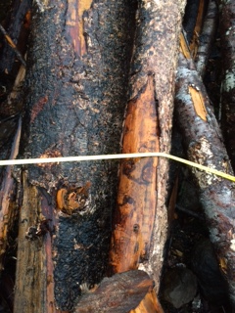
FUEL LOADING ESTIMATION

Slide 7
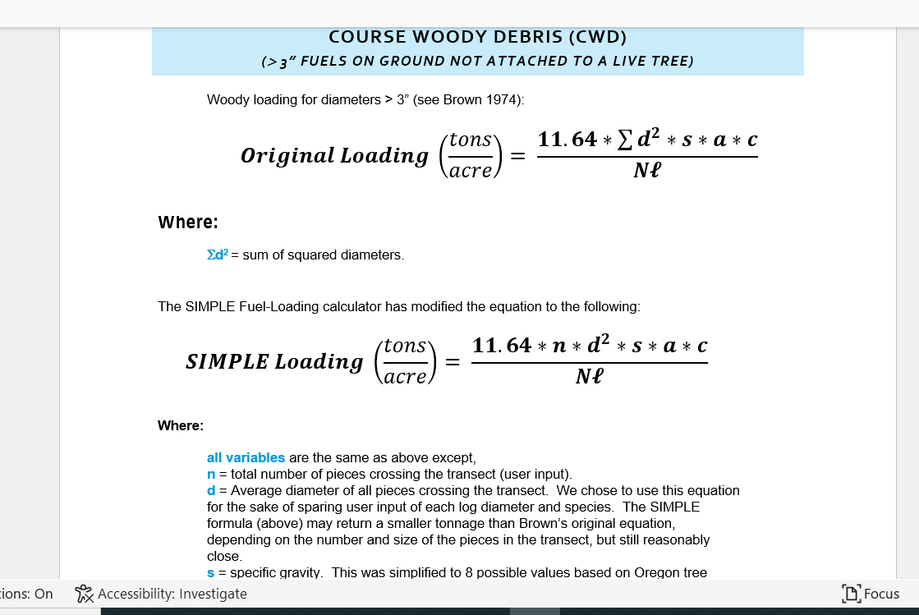
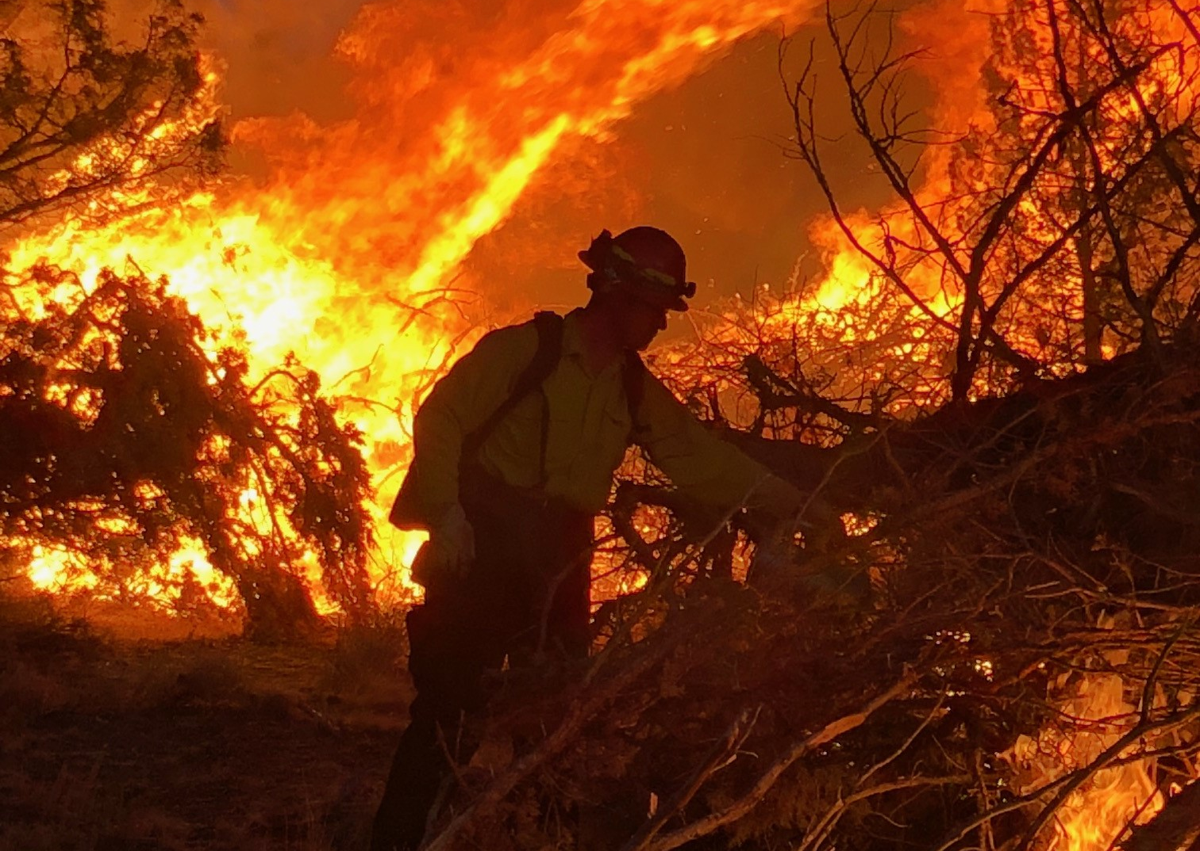
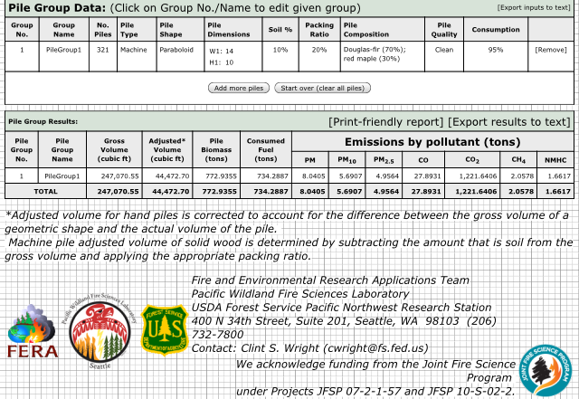
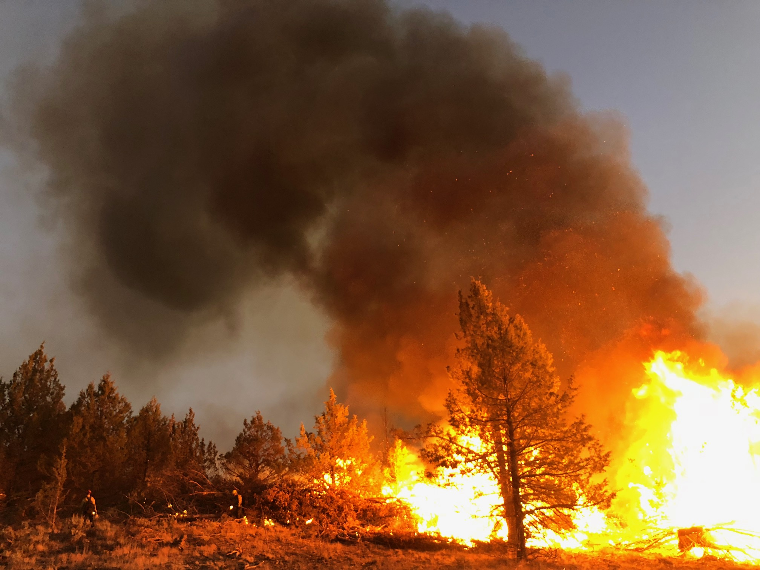
SMOKE AUDIT PROGRAM
Researched and created best SOP’s for the state.
Developed a fuel-loading calculator to estimate tonnage
Monitor smoke to ensure burners are doing due diligence in keeping Oregon air quality good.

Slide 8

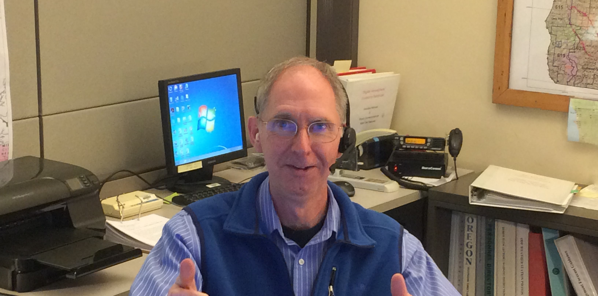
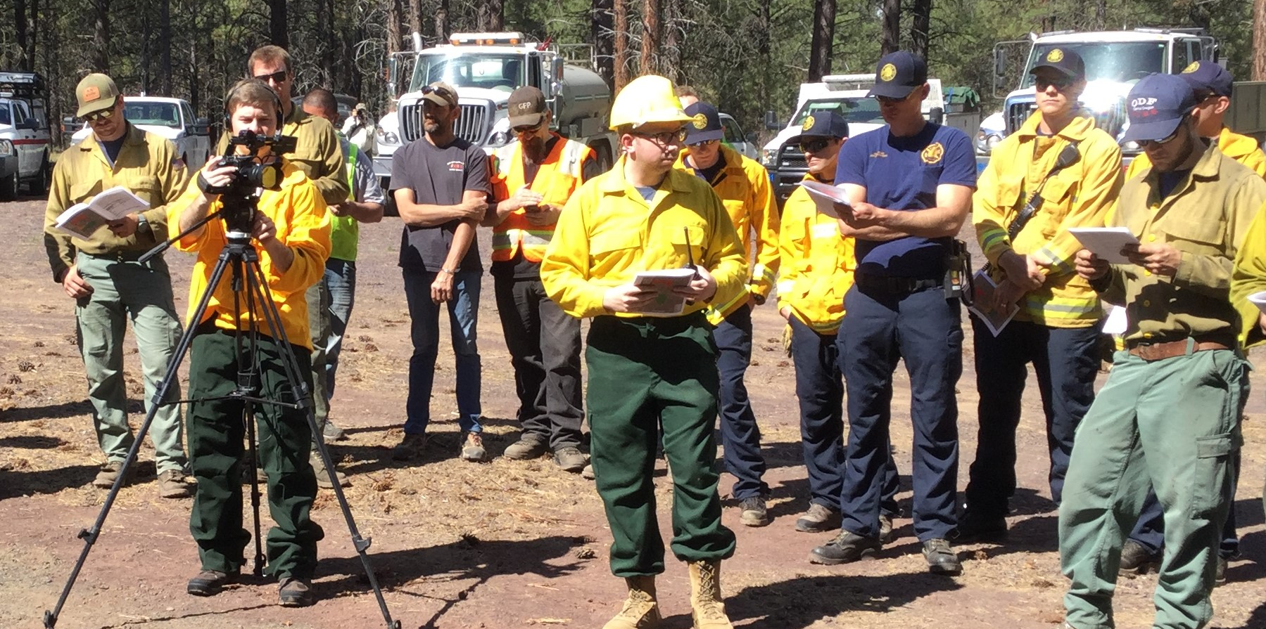
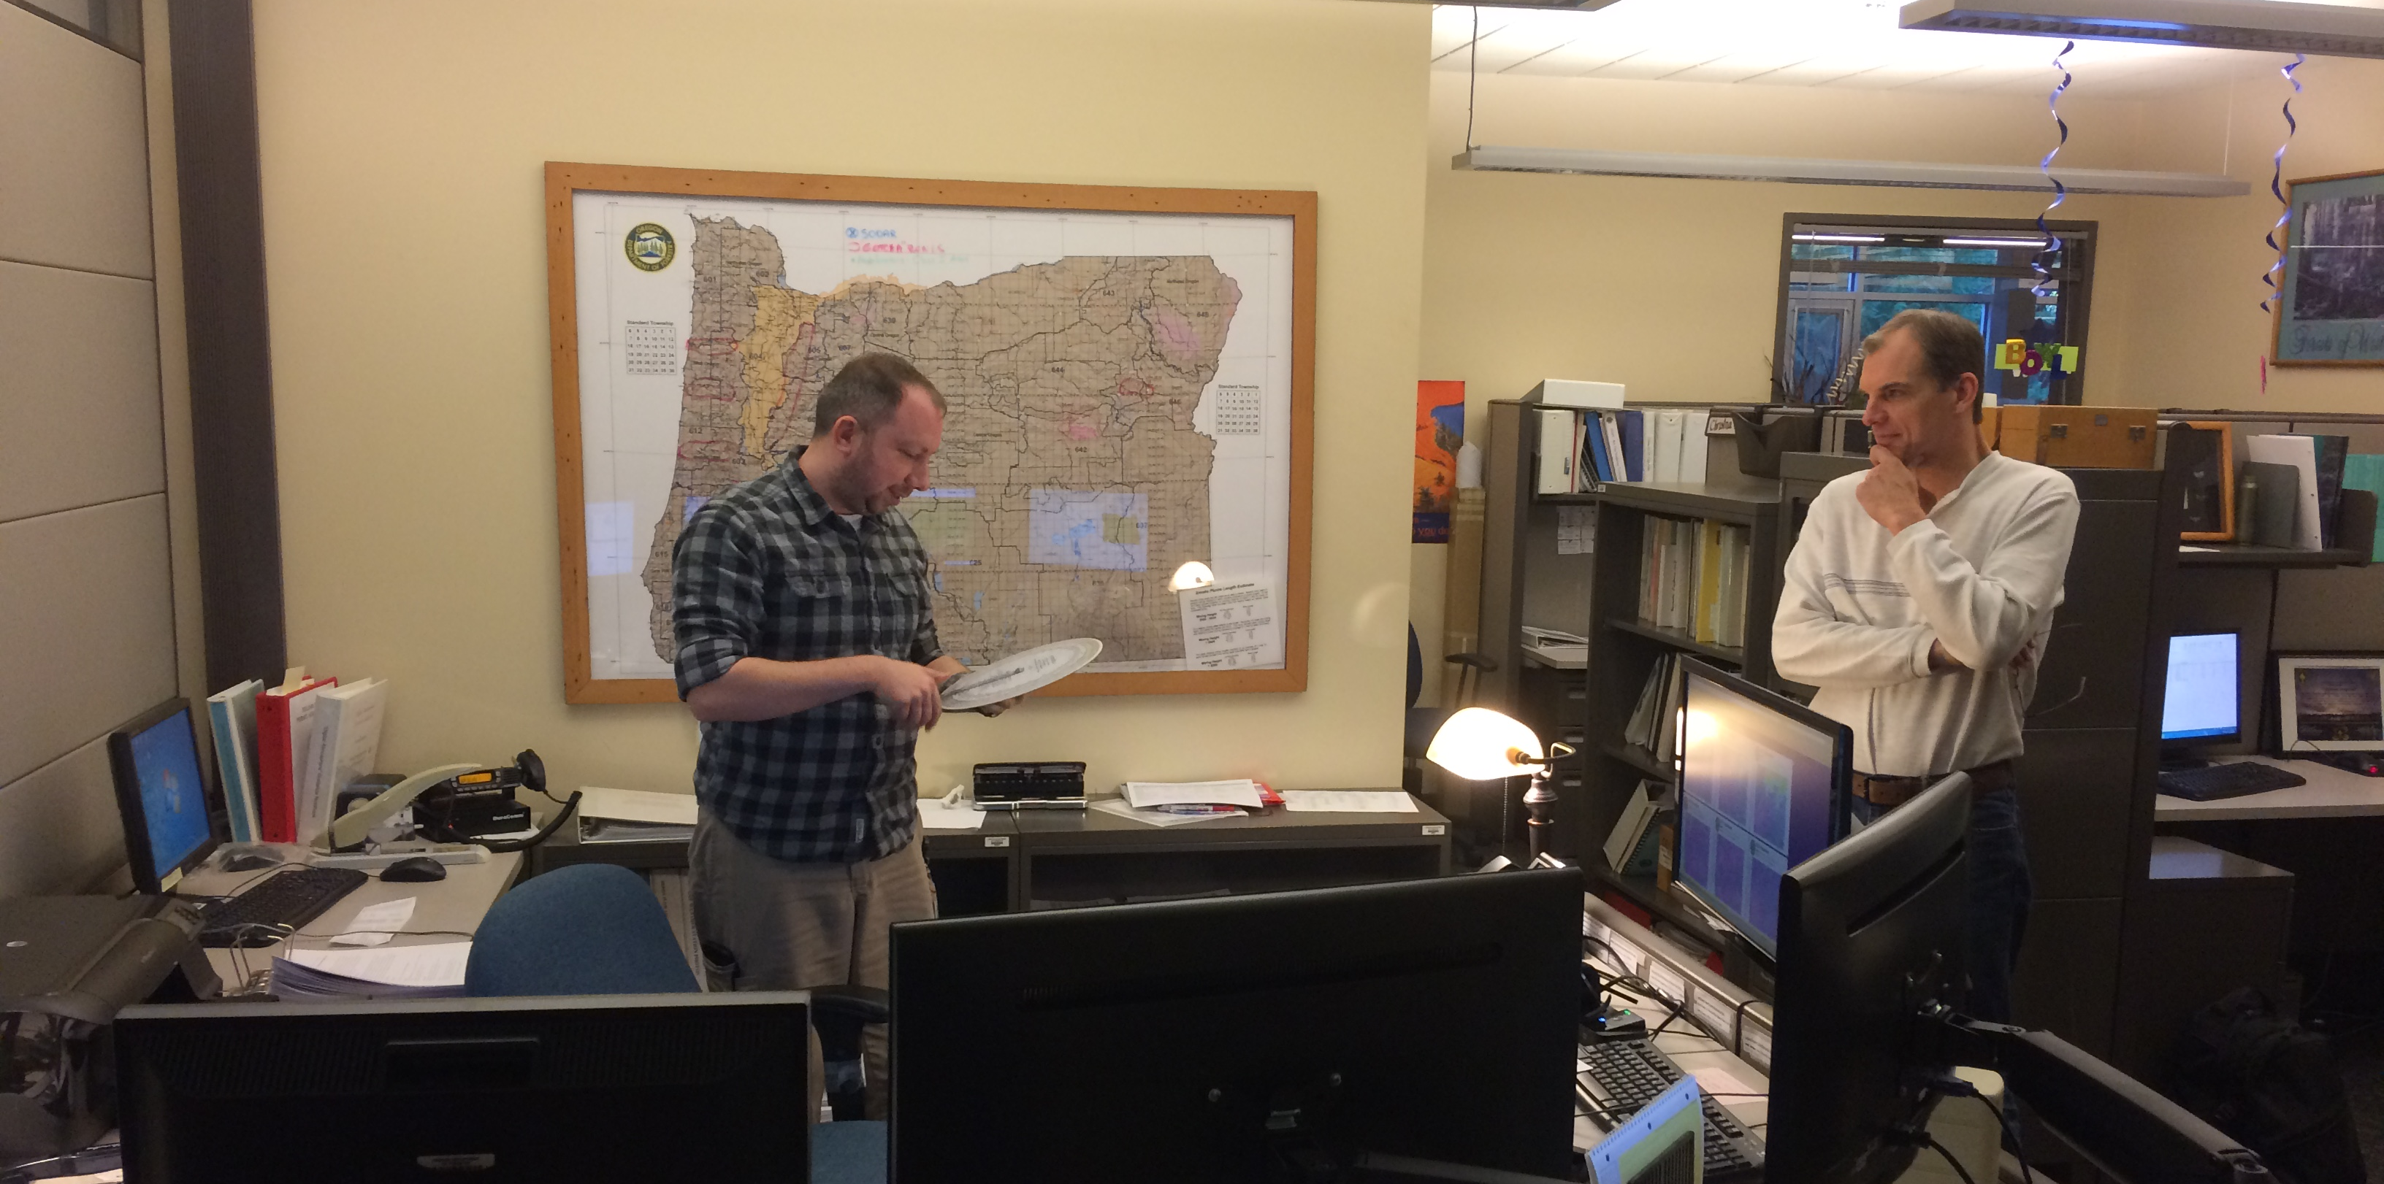
LIASON BETWEEN THE GROUND AND ODF SMOKE
Help to build the bridge in communication.
Be a voice for the field
Feedback from the forecasters
Ensure that SMP is practical and beneficial from both air quality and prescribed fire perspectives.

Slide 9

What if…
CHRISTINA CLEMONS
You could apply best management practices to every acre…
What if the solution is just waiting to be seen by you?
Would you rise to the occasion?
971-707-0866

