Slide 1
ODF’s Prescribed Fire Program
Amanda Rau
Prescribed Fire Coordinator
503-949-9673
amanda.rau@odf.oregon.gov

Slide 2
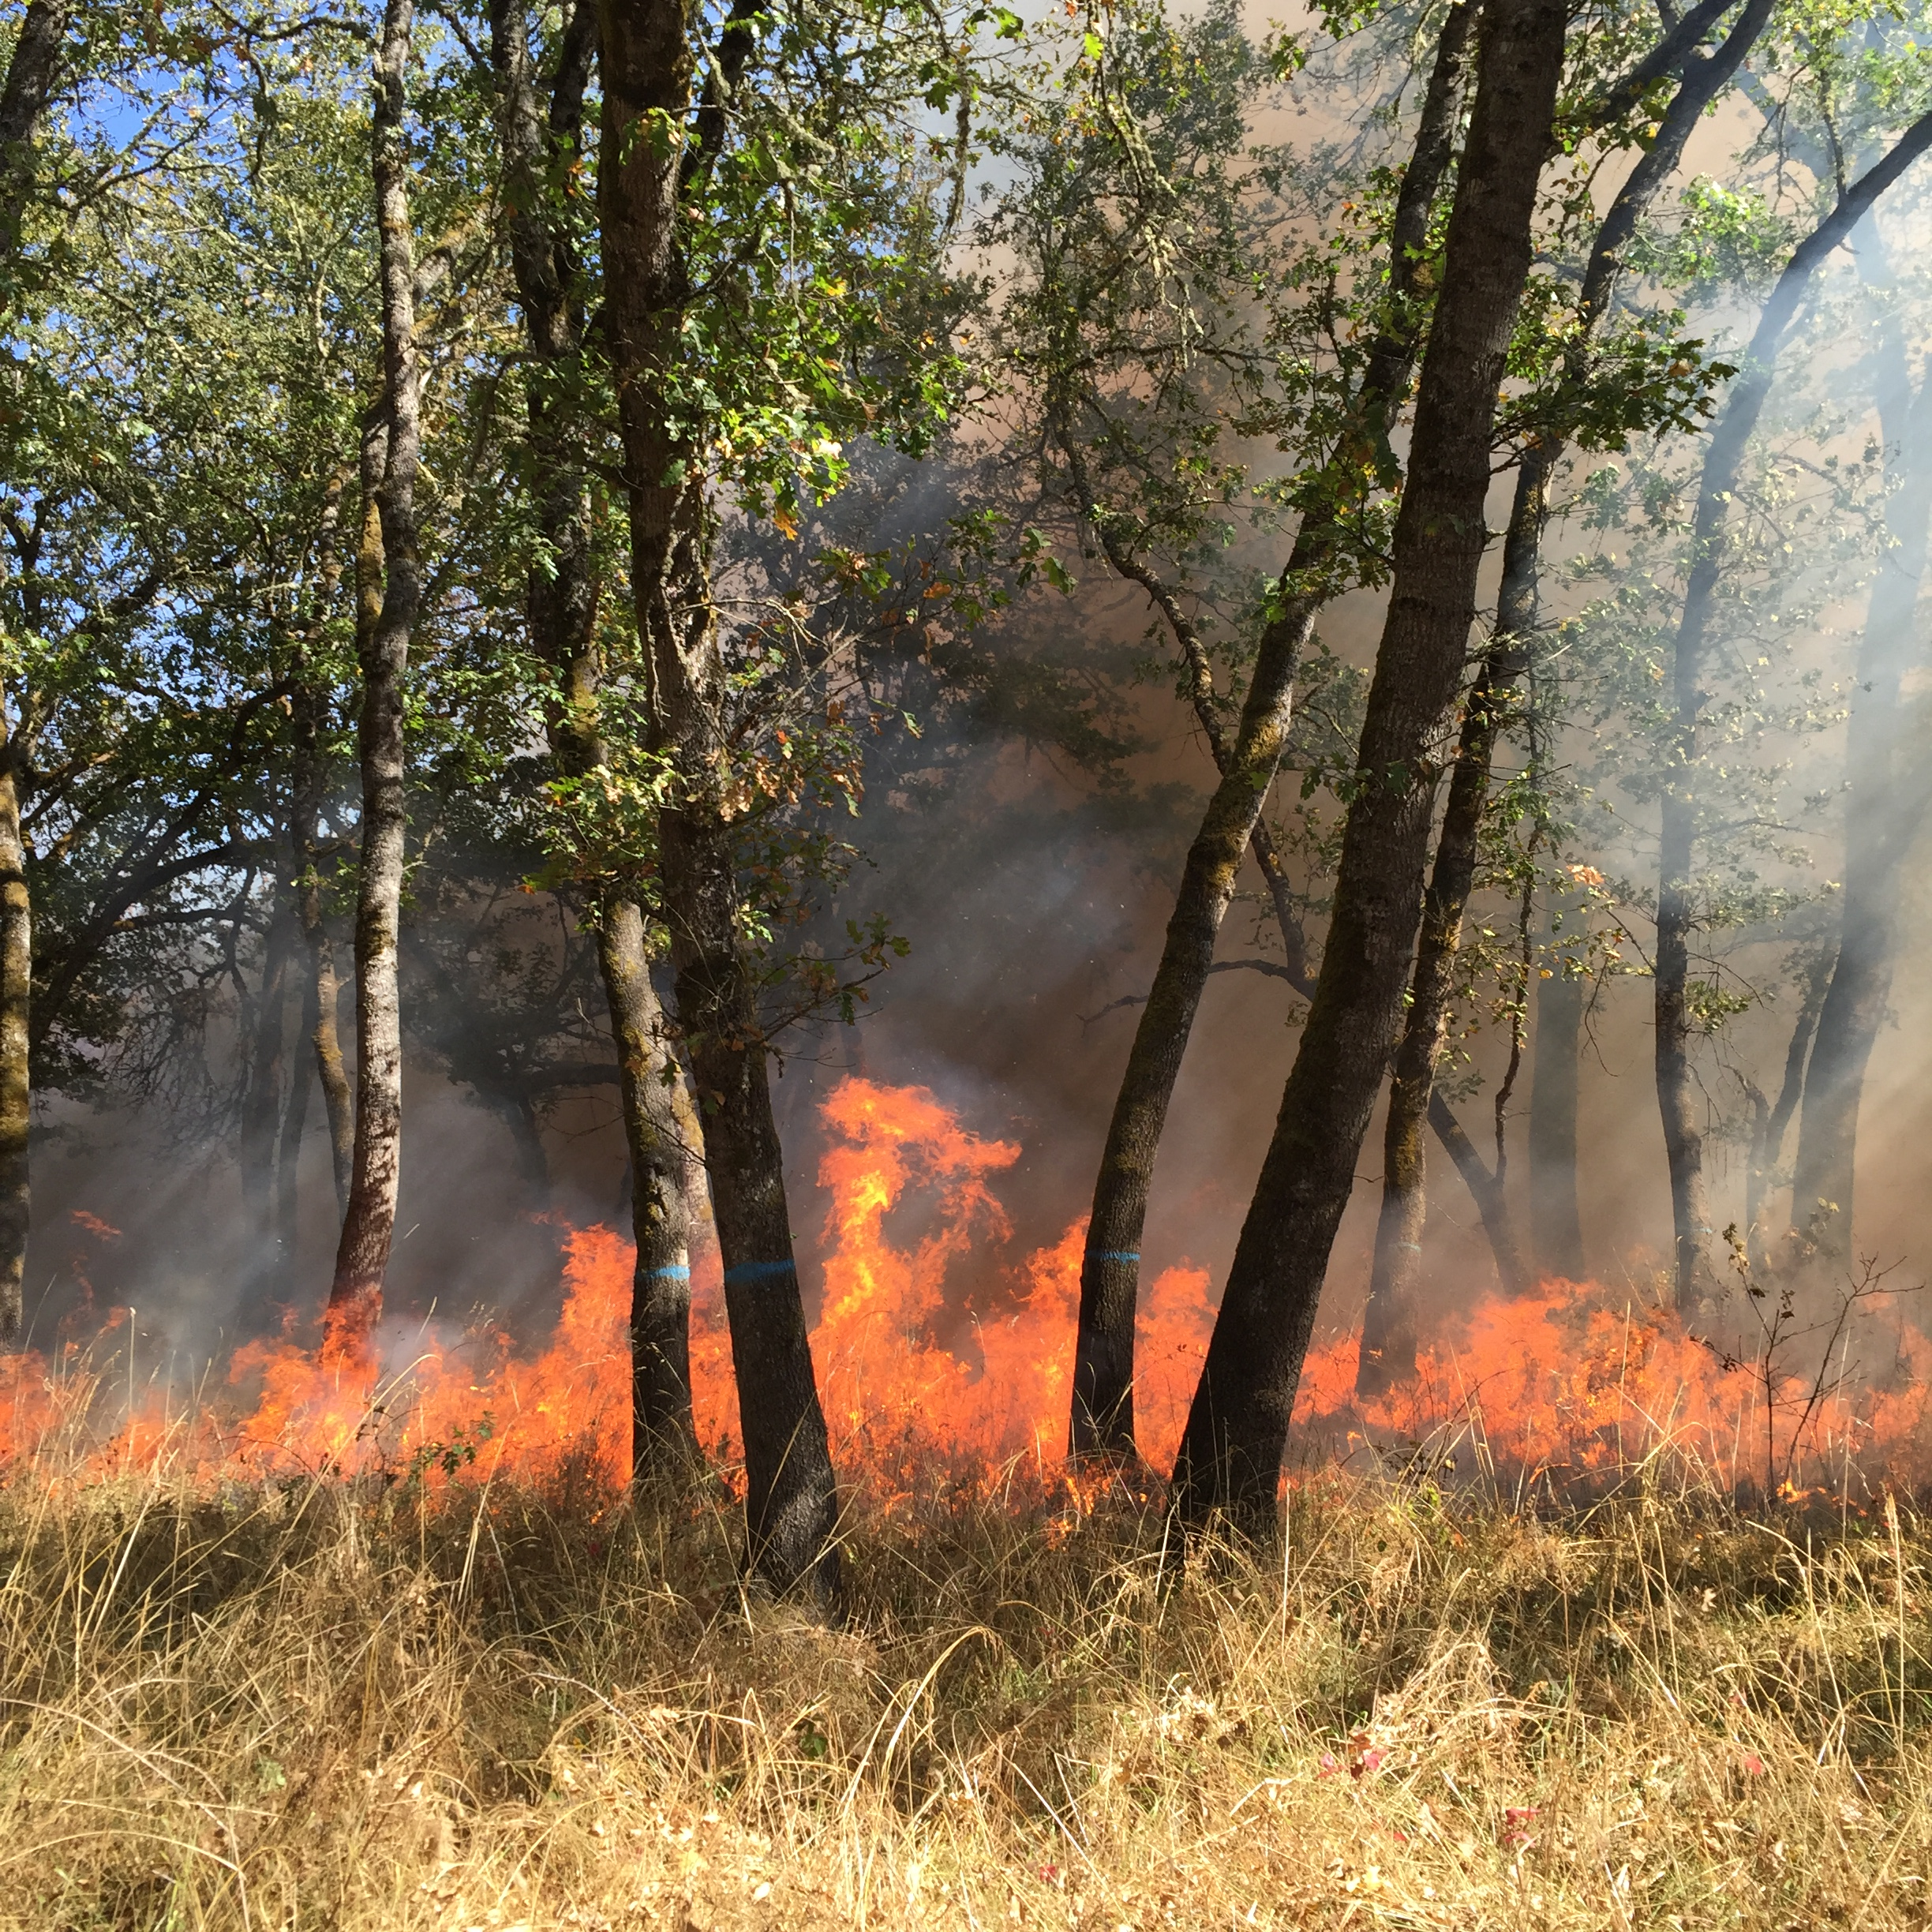
Reasons for Burning
OAR 629-042-1000
Purpose - to set forth the standards, requirements, and procedures by which the Certified Burn Manager program will be operated, pursuant to ORS 526.360(3).
  Removing a fire hazard to any property;
  Preparing seed beds;
  Removing obstructions to or interference with the proper seeding or agricultural or grazing development or use of that land;
  Promoting the establishment of new forest crops on cutover, denuded or underproductive lands;
  Implementing pest prevention and suppression activities; or
  Promoting improvements to forest health, including improvements to fish and wildlife habitat.
Notes:
The purpose statements of administrative rules are to connect the rule sections to the respective authorizing statutes.
The purpose statement proposed correlates to the authorizing statutes of ORS 526.360.

Slide 3
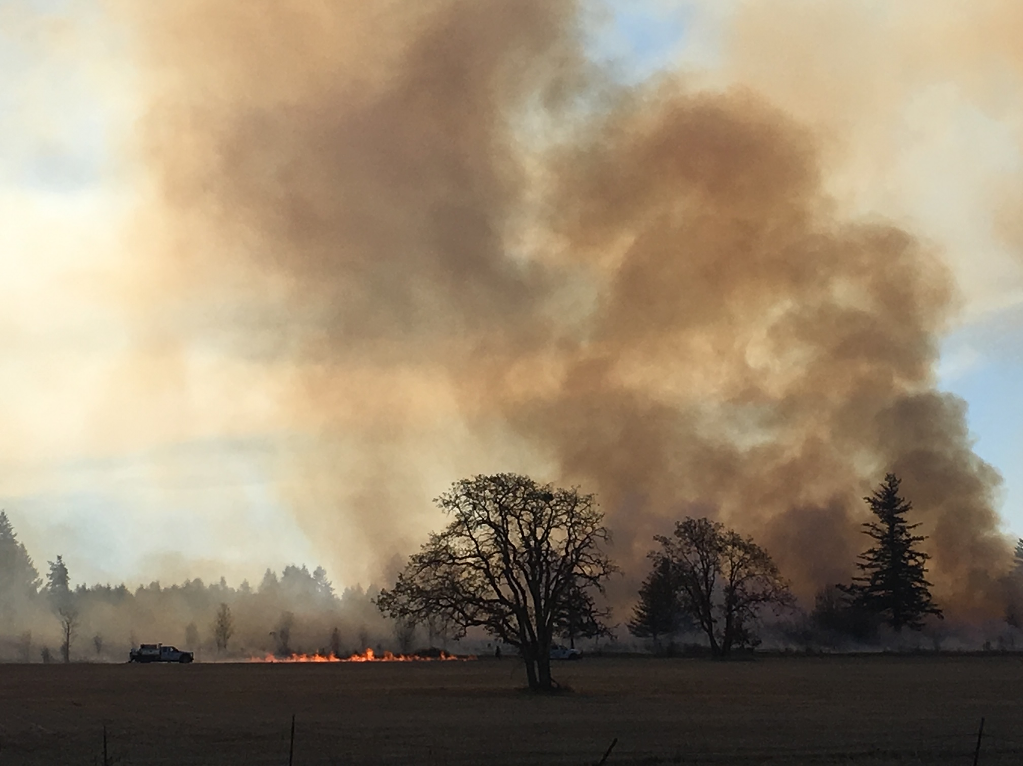
Planning for a Burn
Pre-identified environmental conditions documented in a written plan outlining:
Weather
Resource objectives
Fuels
Equipment
Safety
Smoke

Slide 4

HB2571
SB762
Requires the Department of Consumer and Business Services, in consultation with other industry groups, to:
Study liability for prescribed fires
Examine the accessibility of and barriers to insurance coverage for prescribed fires
Examine the simple and gross negligence standards for liability, and whether states that have shifted from one standard to another observed a shift in the use of prescribed fire
Due to the Legislative Assembly by July 1, 2022.

Slide 5
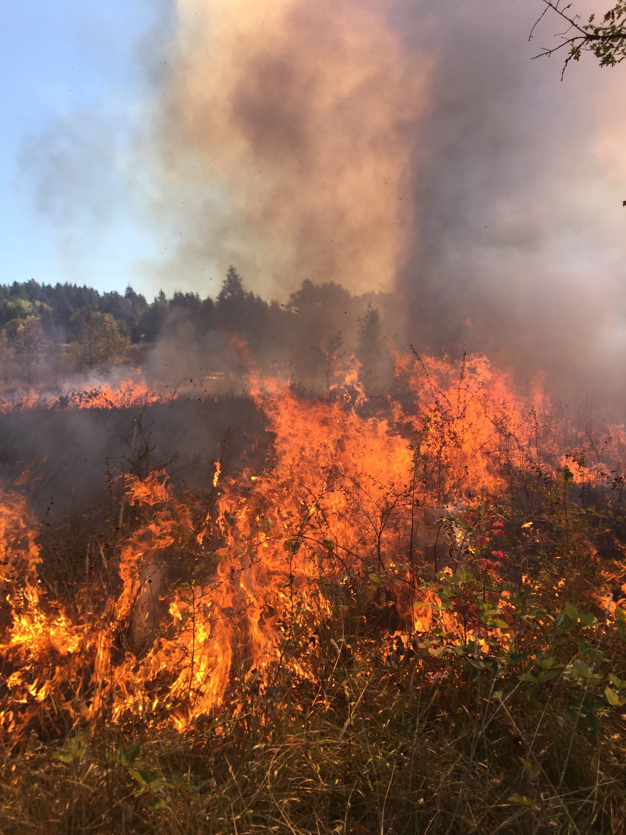
HB2571
Requires the Oregon Department of Forestry, in consultation with the Oregon Prescribed Fire Council, to:
Establish by rule a Certified Burn Manager Program
Clarify cross-boundary prescribed fire permitting process to allow prescribed fires to burns across land ownership boundaries if the person obtains a permit, complies with its conditions, and obtains consent from relevant landowners.
Rulemaking must be complete by Nov. 30, 2022

Slide 6
ORS 526.360
To accomplish the purposes set forth in subsection (1) of this section, the State Board of Forestry may establish by rule a Certified Burn Manager program.
(4)When any burning for any of the purposes stated in subsection (1) of this section on forestland classified pursuant to ORS 526.328 (Hearing) or 526.340 (Classification by State Forester) is started under the supervision of and supervised by the forester or a Certified Burn Manager, no person shall be liable for property damage resulting from that burning unless the damage is caused by the negligence of the person. [Amended by 1965 c.253 §42; 1967 c.429 §33; 1999 c.101 §2]

Slide 7
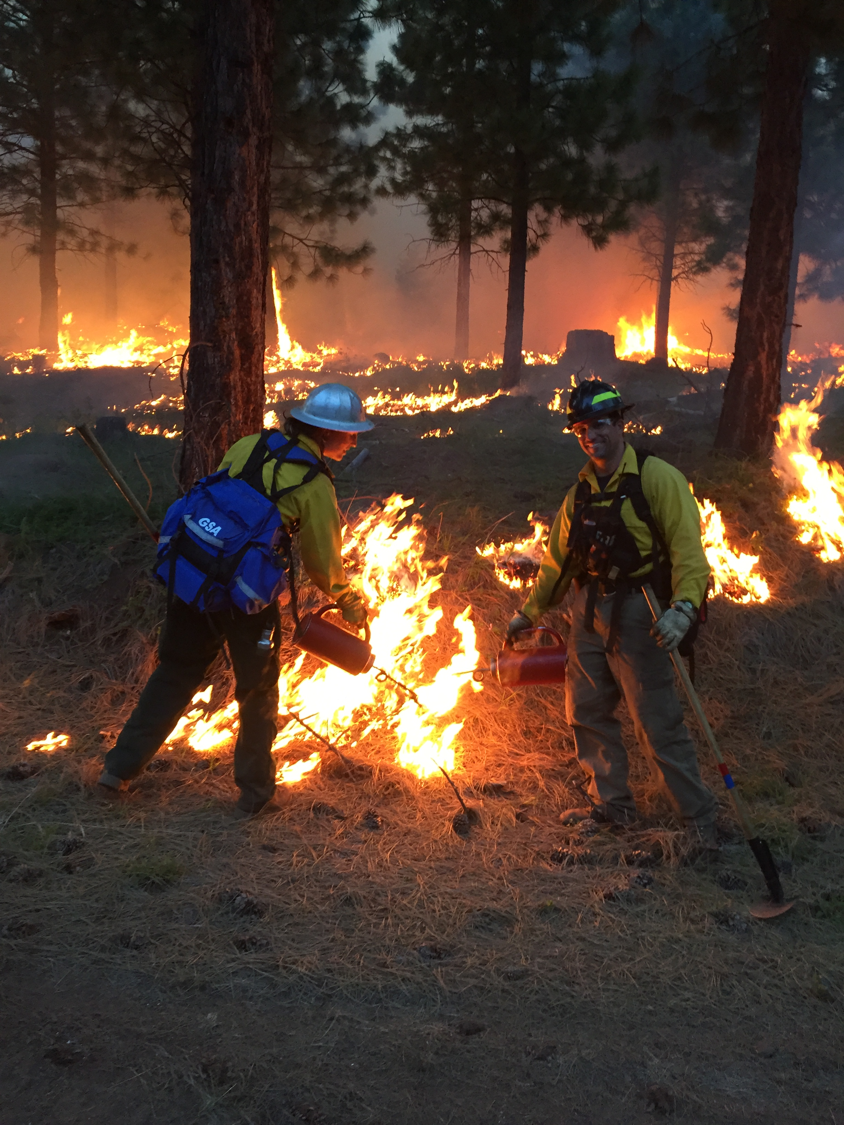
Intent
OAR 629-042-1010
  The Certified Burn Manager program is intended to provide oversight of training and certification concerning the safe and effective use of prescribed burning and to promote the use of prescribed burning for the purposes outlined in ORS 526.360(1).
  Participation in the Certified Burn Manager program is voluntary.
  Nothing in OAR 629-042-1000 to 629-042-1070 is intended to reduce the ability of a district to exercise their responsibility to ensure that burning in their jurisdiction is conducted in a safe and lawful manner.
Notes:
2. The forester may not require or condition the approval of a plan, or the issuance of a burning permit on the presence of a certified burn manager, for any prescribed burning.

Slide 8
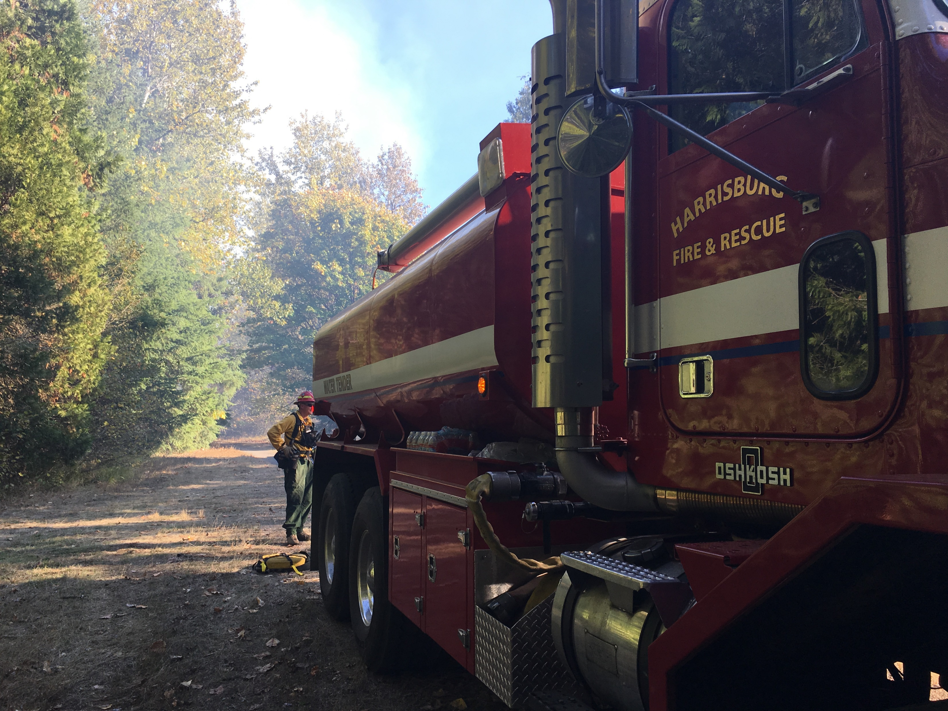
Certified Burn Manager Required Actions
OAR 629-042-1040
  Prepare or review burn plan
  Confirm landowner notified adjacent landowners
  Be on site during ignition, and initial stages of mop up
  Be available during mop-up, until responsibility for burn is terminated.
  Must notify ODF prior to ignition, and after burn meets plan parameters and responsibility is terminated.
  Shall not permit dangerous activities; must cooperate with investigations.

Slide 9
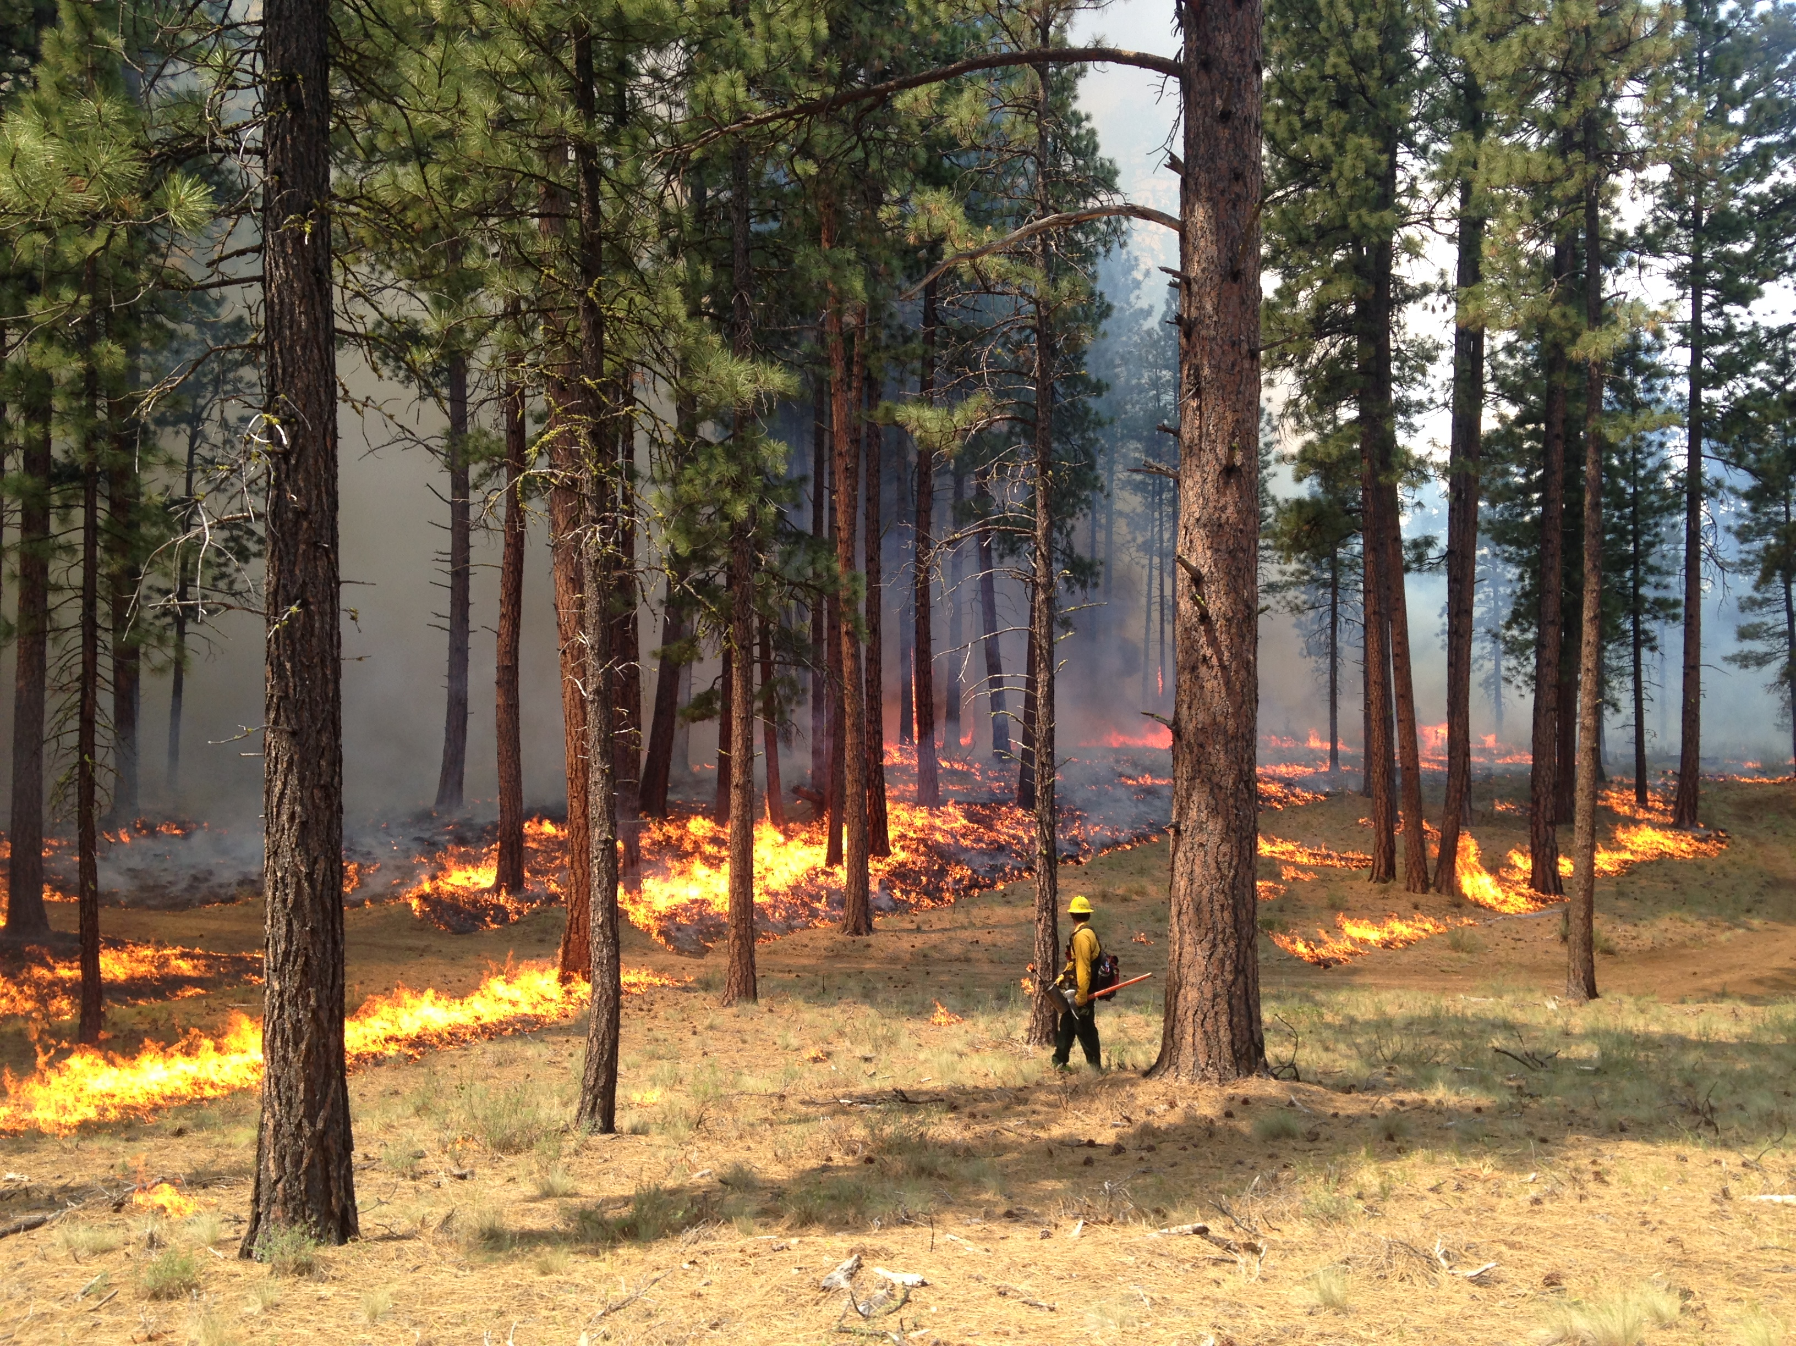
Prohibited Actions and Limitations
OAR 629-042-1045 and 1050
  May only conduct burns that align with ORS 526.360(1)
  May not terminate responsibility for the burn unless replaced, burn transferred to landowner, and ODF district notified
  May only use “Certified Burn Manager” title if holding a valid certificate
  May not falsify records
  Activities must be identified in burn plan;
  Must be a type of burn the CBM is certified to conduct;
  Must be conducted on classified forestland.
Notes:
Limited to within Forest Protection Districts, and classified forestland.

Slide 10
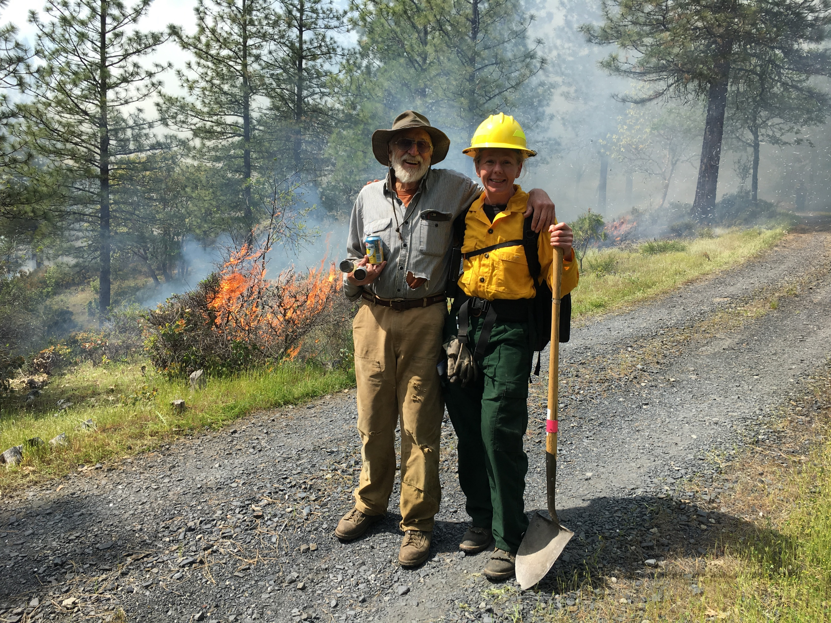
Landowner Requirements and Prohibitions
OAR 629-042-1055
  Notify adjacent landowners
  Provide a copy of the burn plan if requested.
  Landowner may not terminate a Certified Burn Manager’s responsibility unless:
    Transfer conditions have been met;
    Certified Burn Manager has been replace with another;
    Landowner has assumed responsibility for the burn and executing the burn plan; and
    Local ODF district has been notified.
Notes:
Landowner may be the Certified Burn Manager and have both responsibilities.

Slide 11
Current and Future Progress
July 2022 – Notice of Proposed Rulemaking and Fiscal Impact Statement sent to Secretary of State. Legislators and interested parties notified.
August 2022 – Public hearings.
November 2022 – ODF submitted final proposed rule with public comments to Board of Forestry for approval.
November 2022 – Rule submitted to Secretary of State and Legislative Counsel for filing.
Certified Burn Manager Advisory Committee Convenes, Winter, 2023
Spring, 2023 – Program launch
Notes:
$50 fee for cost of materials/printing and testing

Slide 12
Questions?
Amanda Rau
Prescribed Fire Coordinator
503-949-9673 amanda.rau@odf.oregon.gov
12

