Slide 1
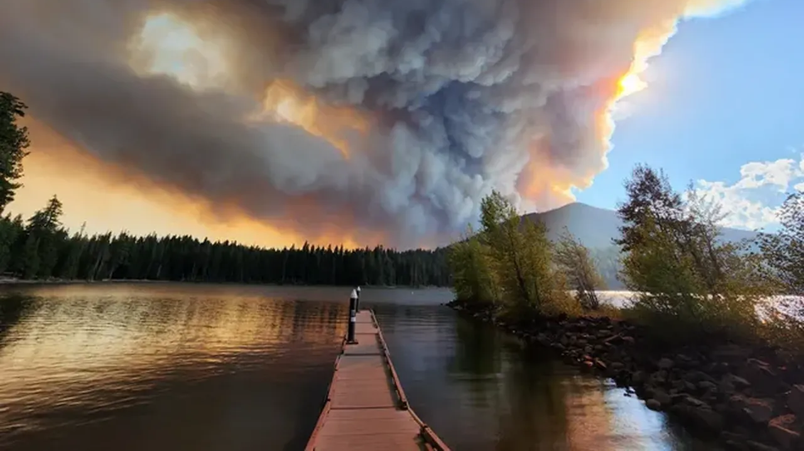
Smoke Management
ODF’s Unique Approach
Gary S. Votaw, Ed.D.
gary.s.votaw@odf.oregon.gov
ODF Meteorologist, U.S. Navy, NWS (retired)
Lakehurst, NJ – Keflavik, Iceland – Pensacola, FL – Monterey, CA – New Orleans, LA – Cheyenne, WY – Columbia, MO – Alpena, MI – Washington, D.C. – Missoula, MT – Eureka, CA – Grand Forks, ND – Jackson, KY – San Juan, PR – Salem, OR
Cedar Creek Fire
https://www.oregonlive.com/

Slide 2
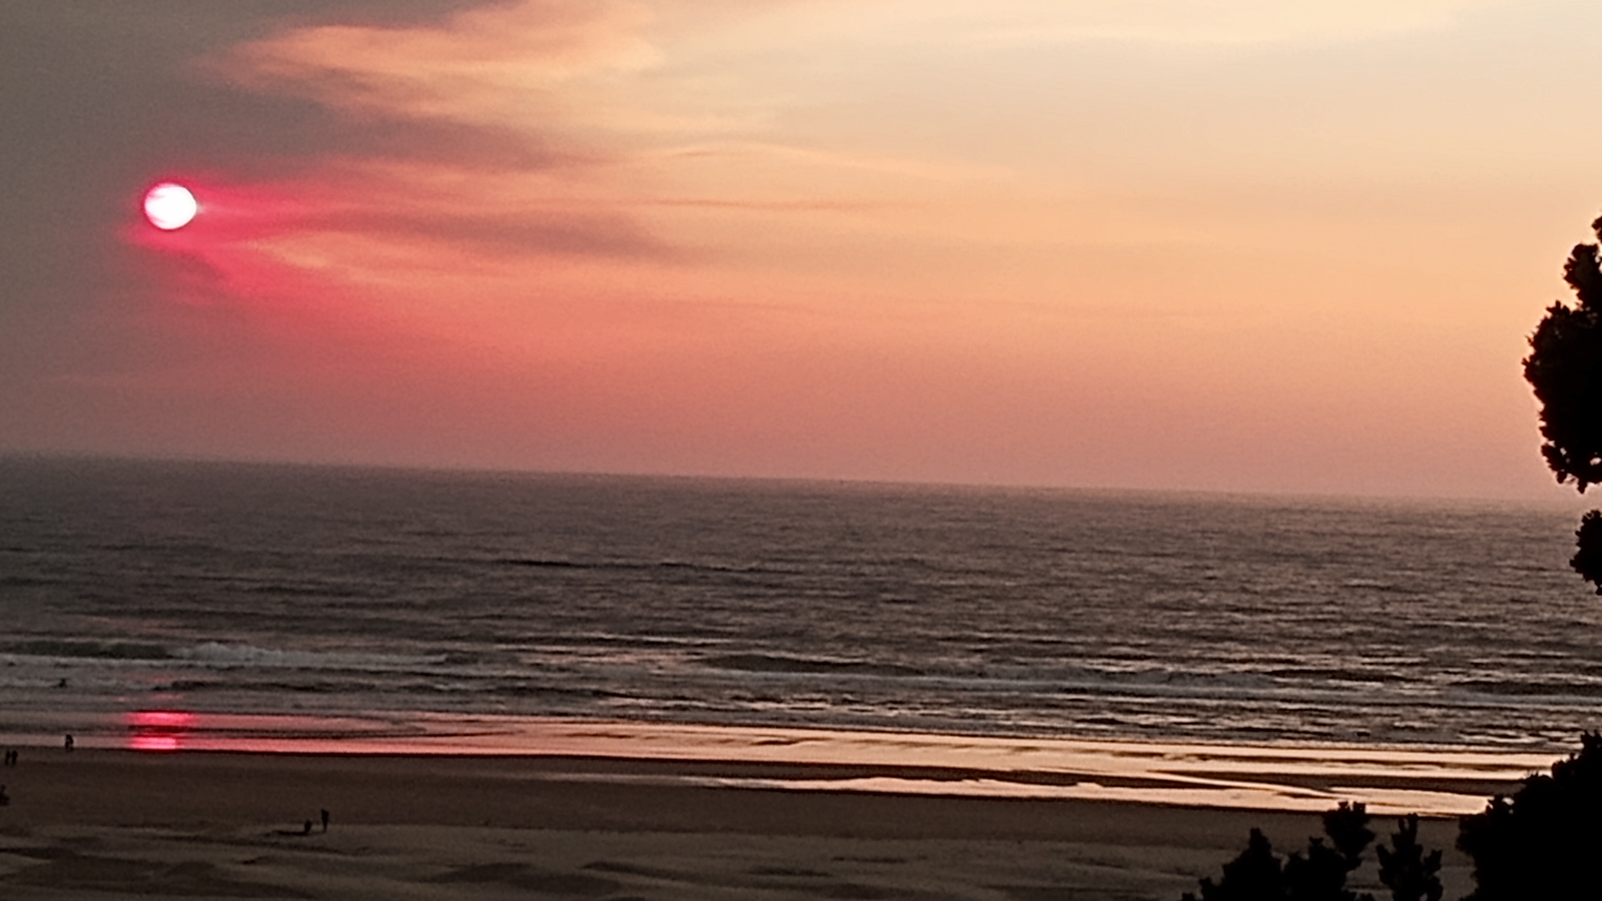
All states, except Oregon, rely on the National Weather Service to provide data, discussions, and forecasts of smoke especially pertaining to prescribed burning and wildfire.
Newport, OR
Sept. 9, 2022

Slide 3
All states, except Oregon, rely on the National Weather Service to provide data, discussions, and forecasts of smoke especially pertaining to prescribed burning and wildfire.
These websites provide supplemental discussions and/or forecasts of air quality (AQI) to those offered by NWS
https://ssl.arb.ca.gov/pfirs/cb3/cb3.php? (CA, forecast)
https://www.airnow.gov (national, EPA product)
https://mi.airshedgroup.org (ID & MT, forecast & discussion)
https://www.tceq.texas.gov/airquality/monops/forecast_today.html (TX, forecast & discussion)
Newport, OR
Sept. 9, 2022

Slide 4
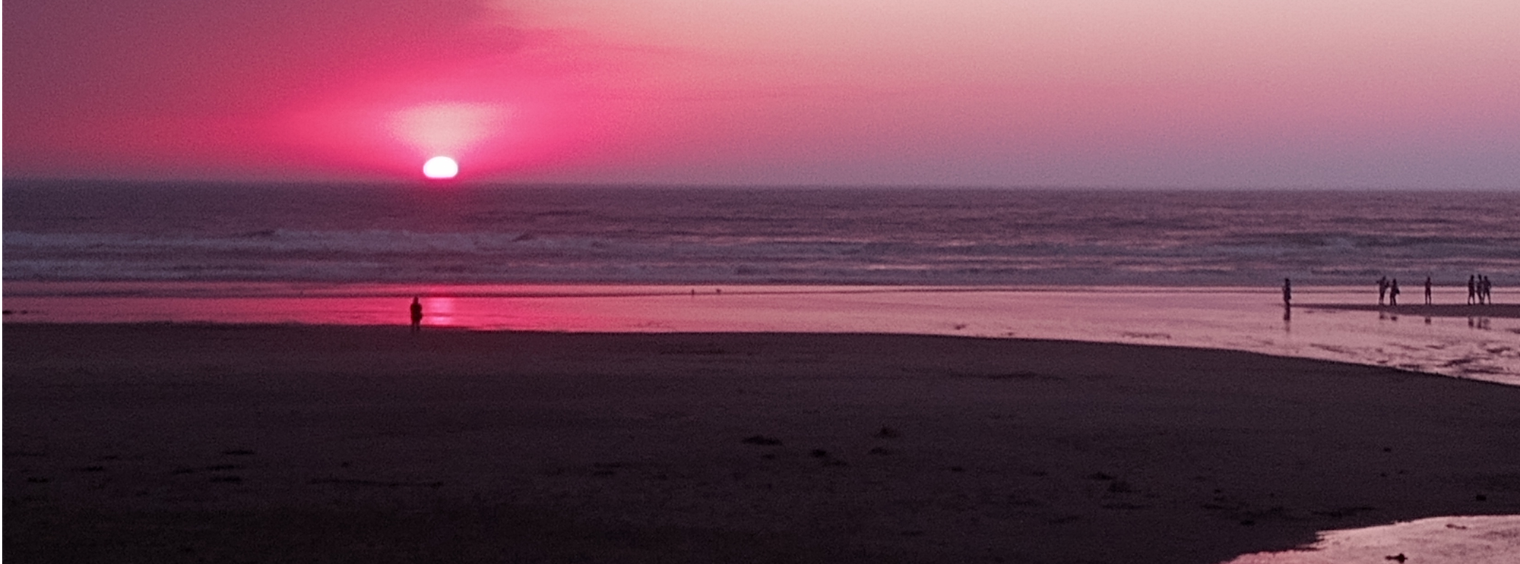
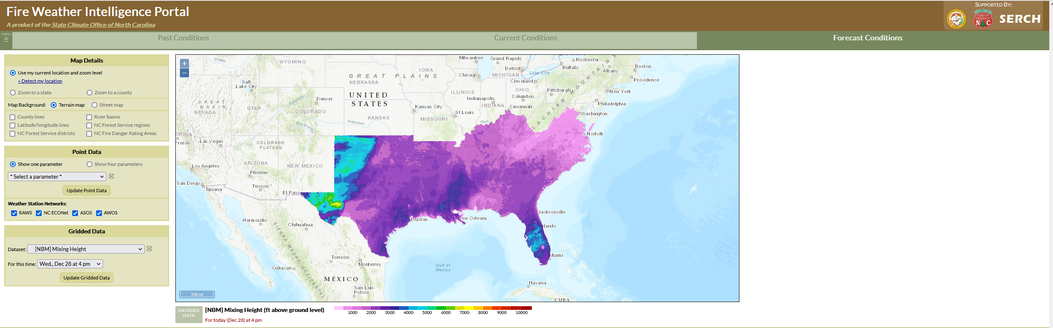
Fire Weather Intelligence Portal
A collaborative effort between the Climate Office of North Carolina, North Carolina State Univ. and the National Weather Service
All states other than Oregon rely on spot forecasts from the National Weather Service as the most site-specific forecast for a prescribed burn, providing the final piece supporting a burn/no burn decision.
Newport, OR
Sept. 9, 2022
Newport, OR
Sept. 9, 2022
https://products.climate.ncsu.edu/fwip/

Slide 5
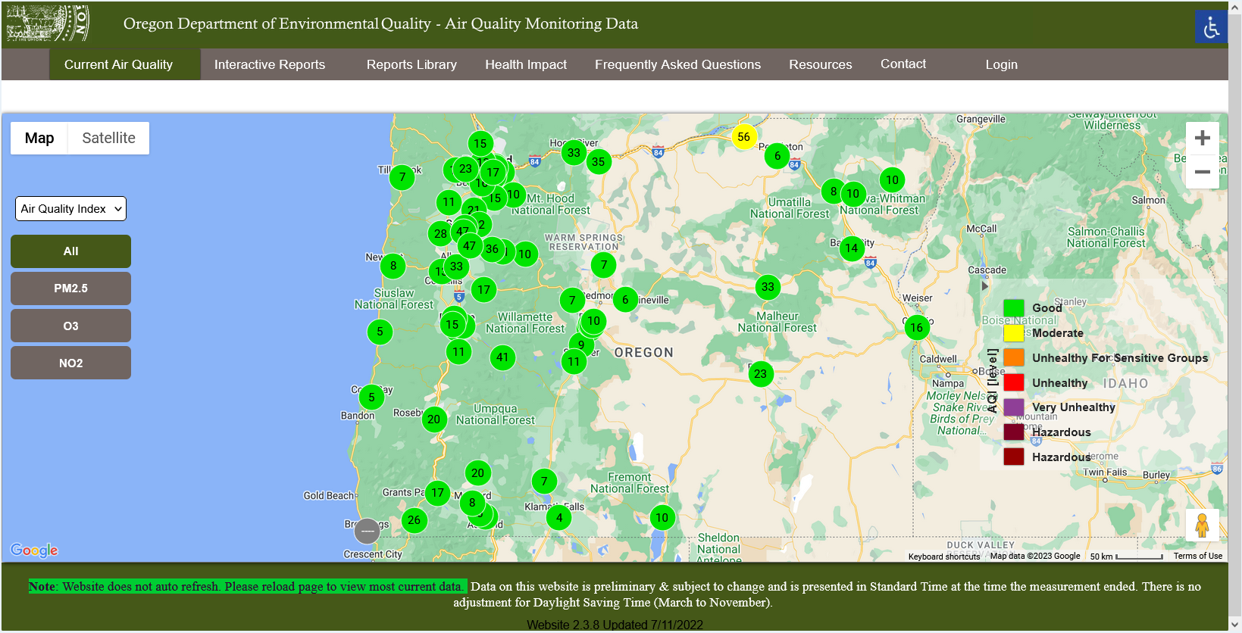
Airnow defines AQI to include ground-level ozone, particulate matter (PM2.5 and PM10), carbon monoxide, sulfur dioxide, and nitrogen dioxide (https://www.airnow.gov/).
LRAPA defines AQI to include ozone and PM2.5 (https://www.lrapa.org/air-quality-protection/current-aqi/)
ODF uses PM2.5 only to monitor smoke from prescribed burns
70 nephelometers across Oregon monitor conditions

Slide 6
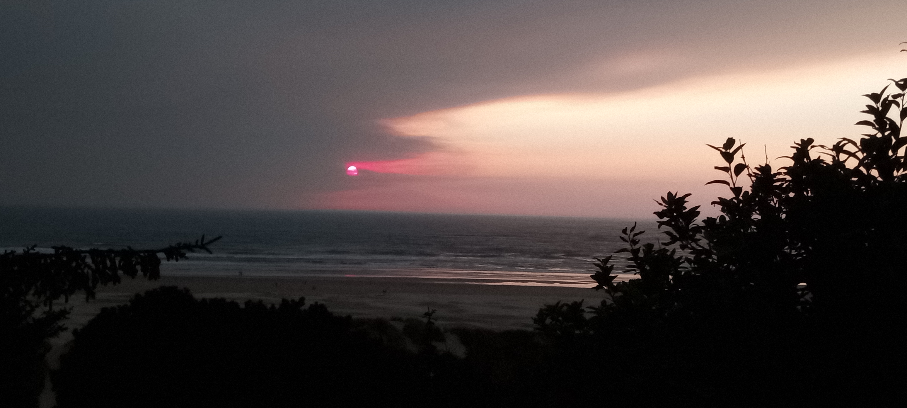
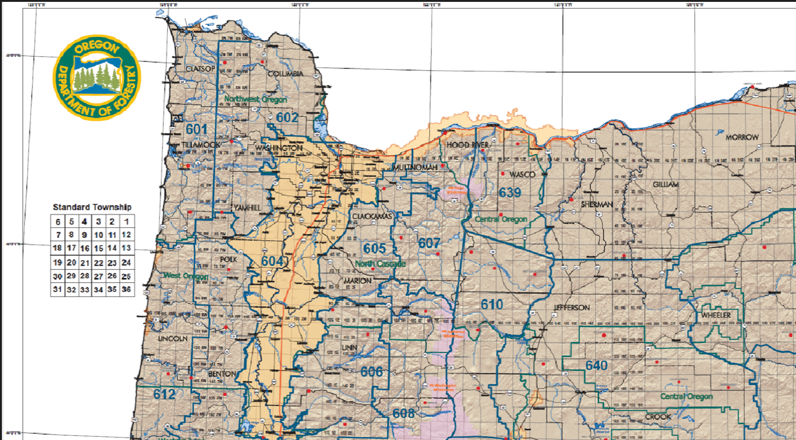
THURSDAY
Zone 601-612 and 639 (North Coast Range and Cascades):
MORNING
Mixing height 3500 - 4500 ft.
Transport wind SSE to SSW at 15 - 25 mph.
Surface wind SE to SSW at 8 - 12 mph.
AFTERNOON
Mixing height 3500 - 4500 ft.
Transport wind similar to morning.
Surface wind similar to morning.
EVENING
Mixing height 3500 - 4500 ft.
Transport wind SSE to SSW at 10 - 22 mph.
Surface wind SE to S at 5 - 9 mph.
Zone 615-623 (South Coast Range and Cascades):
MORNING
Mixing height 2500 - 3500 ft.
Transport wind SSE to SSW at 12 - 22 mph.
Surface wind SE to S at 8 - 12 mph.
AFTERNOON
Mixing height 2500 - 3500 ft.
Transport wind similar to morning.
Surface wind similar to morning.
EVENING
Mixing height 2500 - 3500 ft.
Transport wind SE to S at 10 - 22 mph.
Surface wind ESE to SSE at 6 - 10 mph.
OUTLOOK:
FRIDAY
Mixing height 3600 to 4600 ft throughout the day. Transport wind SSW to SW at 18 - 30 mph. Surface wind SSW to SW at 10 - 18 mph.
SATURDAY
Mixing height 1500 to 2500 ft during the morning rising to 4000 to 5000 ft during the afternoon. Transport wind NNW to NNE at 5 - 9 mph. Surface wind light and variable during the morning becoming NW to N at 4 - 8 mph during the afternoon.
SUNDAY
Mixing height below 1000 ft early rising to 1500 to 2500 ft by late morning rising to 3500 to 4500 ft during the afternoon. Transport wind light and variable. Surface wind light and variable.
Newport, OR
Sept. 9, 2022

Slide 7
BURNING INSTRUCTIONS FOR ALL ZONES IN THE WESTERN OREGON AREA
- Valid for burning done Thursday, December 29, 2022.
=================================================================
Coast Range
Zone 601
Units should be 1500 tons or less, spaced 6 miles apart, and 8 miles from downwind SSRAs. North of Tillamook, use standard guidance matrix - see section 5 below.
Zone 602 and 603
Units should be 600 tons or less, spaced 6 miles apart, and 8 miles from downwind SSRAs. North of T3N in Zone 602, use standard guidance matrix - see section 5 below. Units may be 900 tons or less, spaced 6 miles apart, south of the Siuslaw River in Zone 603.
Zone 612, 615, 616 west of R8W, 618, 619, and 620
Use standard guidance matrix - see section 5 below. Avoid burning directly upwind of coastal SSRAs. Higher tonnage is possible south of T29S in Zone 616 - call the forecaster.
Zone 616 east of R9W
Units should be 900 tons or less, spaced 8 miles apart, and 10 miles from downwind SSRAs. Higher tonnage is possible south of T29S - call the forecaster.
Cascades
Zone 605 and 606
Units should be 1000 tons or less, spaced 6 miles apart, and 8 miles from downwind SSRAs.
Zone 607, 608, 639, 610, 617, and 623
Use standard guidance matrix - see section 5 below. Ensure adequate distance from downwind SSRAs for smoke to dissipate.
Zone 611
Units should be 1500 tons or less, spaced 6 miles apart, and 8 miles from downwind SSRAs.
Zone 616
Units should be 1000 tons or less, spaced 8 miles apart, and 10 miles from downwind SSRAs. Avoid ignitions north of T24S. South of T29S higher tonnage is possible - call the forecaster.
Zone 620 and 622
Units should be 1200 tons or less, spaced 8 miles apart, and 10 miles from downwind SSRAs.
Siskiyous
Units should be 900 tons or less, spaced 8 miles apart, and 10 miles from downwind SSRAs.nd SSRAs.
Newport, OR
Sept. 9, 2022

Slide 8
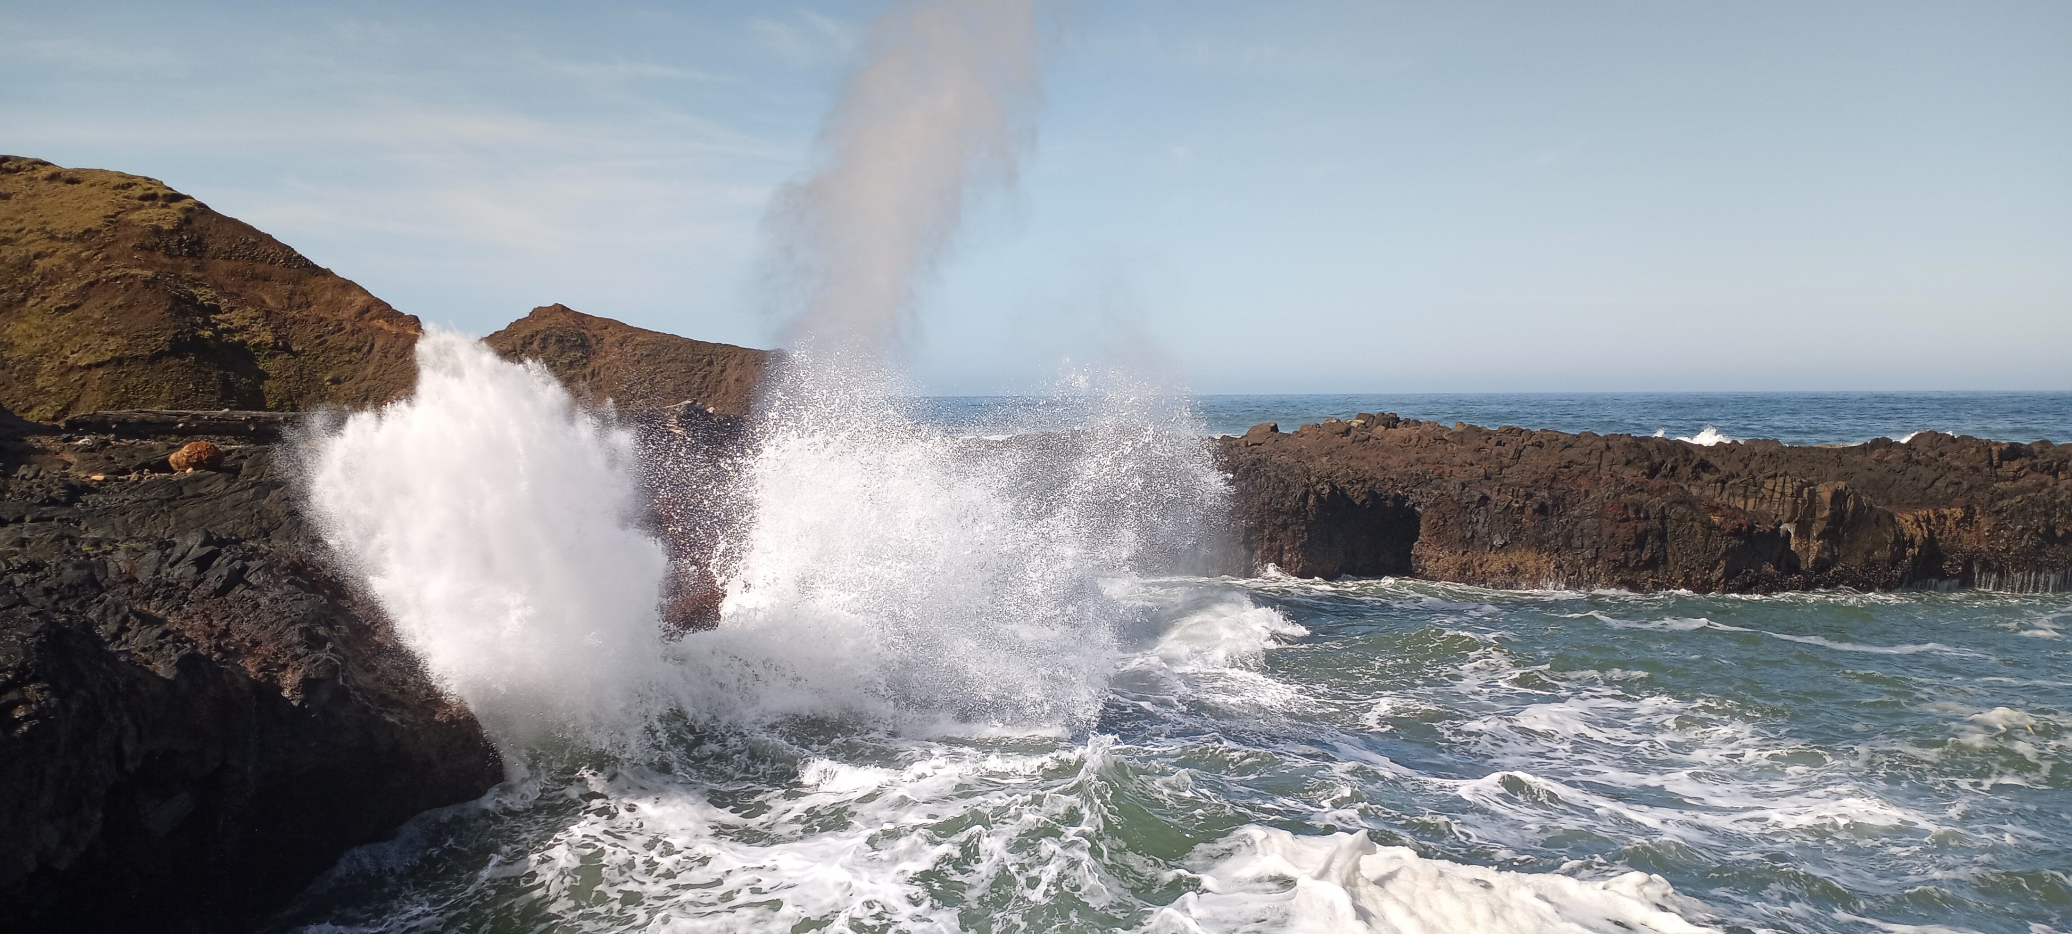
Questions/ Discussion?
Spouting Horn, OR
March 21, 2021

