Slide 1
Smoke Management and
Forecasting in Oregon
Sherri Pugh • 1-19-2023 American Meteorological Society, OR
Meteorologist, Smoke Management
Oregon Department of Forestry Mitigation Program

Slide 2
Acknowledgements
Tim Holschbach, Deputy Chief Policy & Planning
Stacy McCarter, Mitigation Program Manager
Pete Parsons, Lead Meteorologist
Gary Votaw, Meteorologist
Christina Clemons, Smoke Management Field Coordinator
Amanda Rau, Prescribed Burn Coordinator
Christie Shaw, National Fire Plan Coordinator
Nick Yonker, retired program manager (31 years)

Slide 3
Our History
Oregon Smoke Management Plan (SMP), nation’s first state smoke management program.
Began as voluntary program in 1969.
Expanded statewide with mandatory instructions in 1985.
SMP regulated to forestland protection boundaries (or 1/8th mile beyond).

Slide 4
Mandatory compliance to instructions instead of advisories
Voluntary program began - then became regulatory
Voluntary program for South Central OR
1969 - 1972
1975
1985
1989
1990-1991
Computerized smoke management system to house data
Smoke Management Advisory Committee established by OR legislature

Slide 5
Field burning forecasts for Oregon Department of Agriculture
Voluntary program for Northeast OR
Conference presentation for AMS
1994
2002-2005
2010
2019
2023
Nearly all forestland regulated under SMP; pile covers used
Change to small amount of smoke into protected communities
Notes:
EQC = Environmental Quality Commission

Slide 6
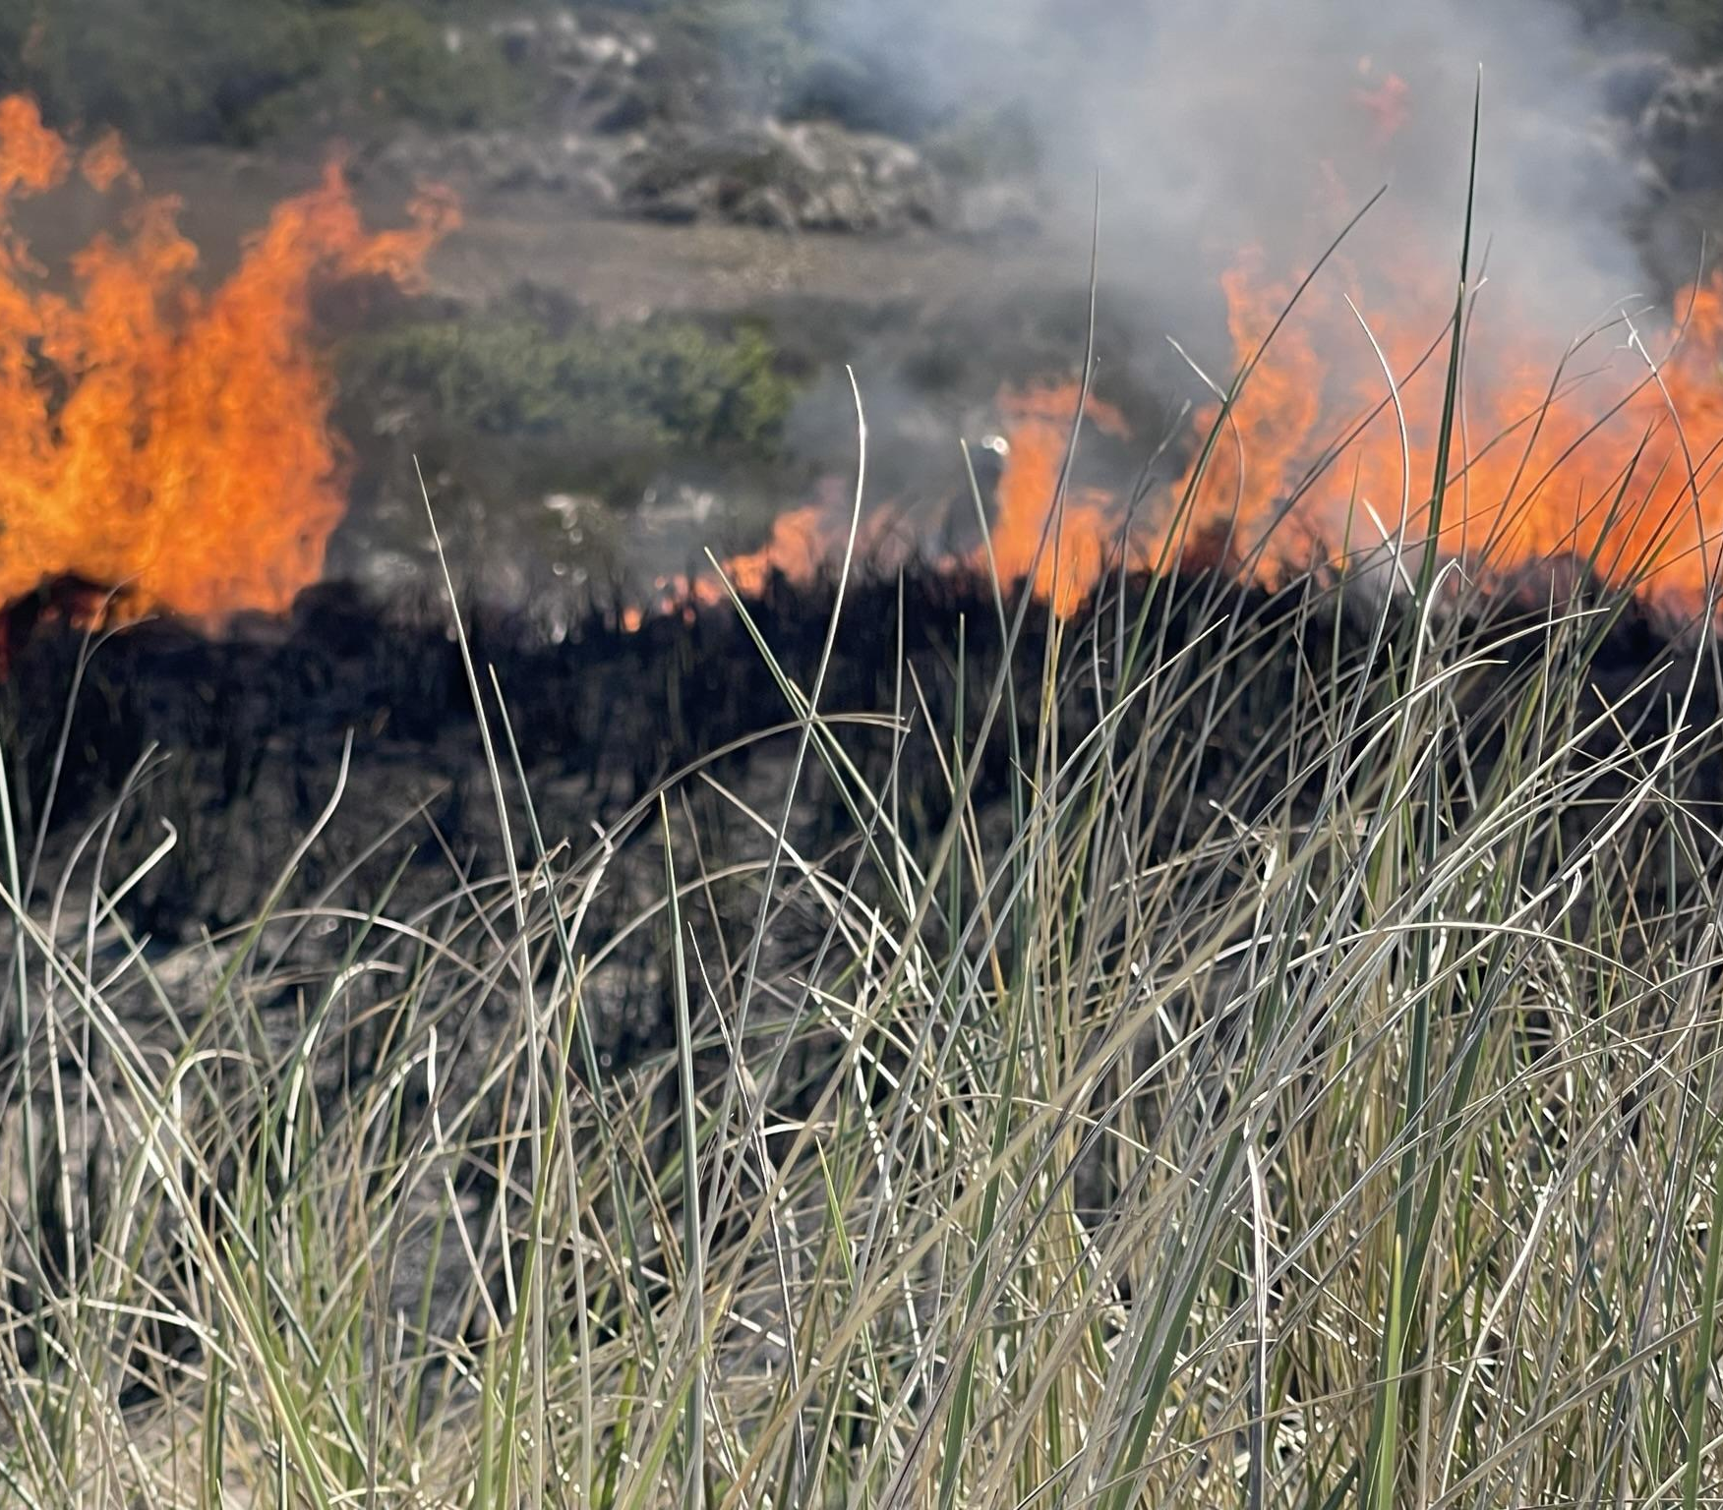

Who we support
Smoke Management Advisory Committee: committee of five various statewide stakeholders (SMAC, 1989)
Meteorological support for
Oregon Smoke Management Plan (SMP)
Oregon Department of Environmental Quality
Oregon Department of Agriculture

Slide 7
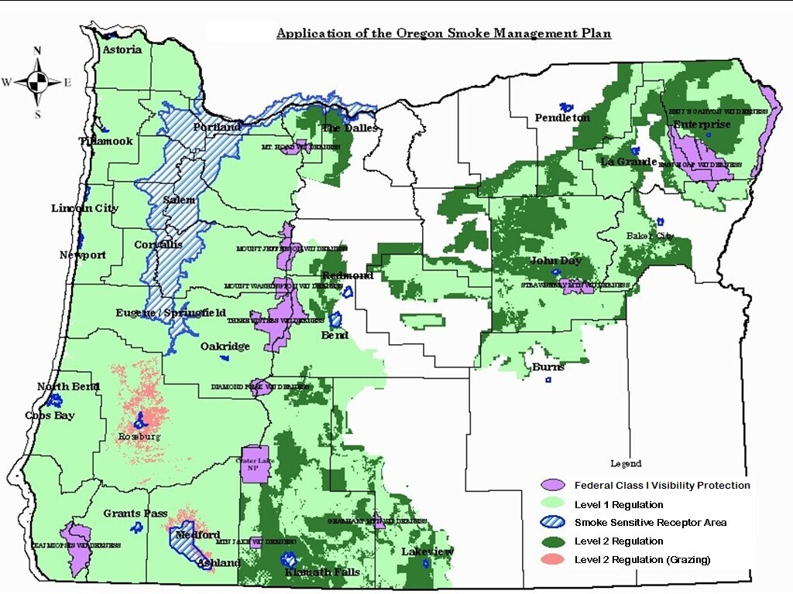
ODF Map

Slide 8
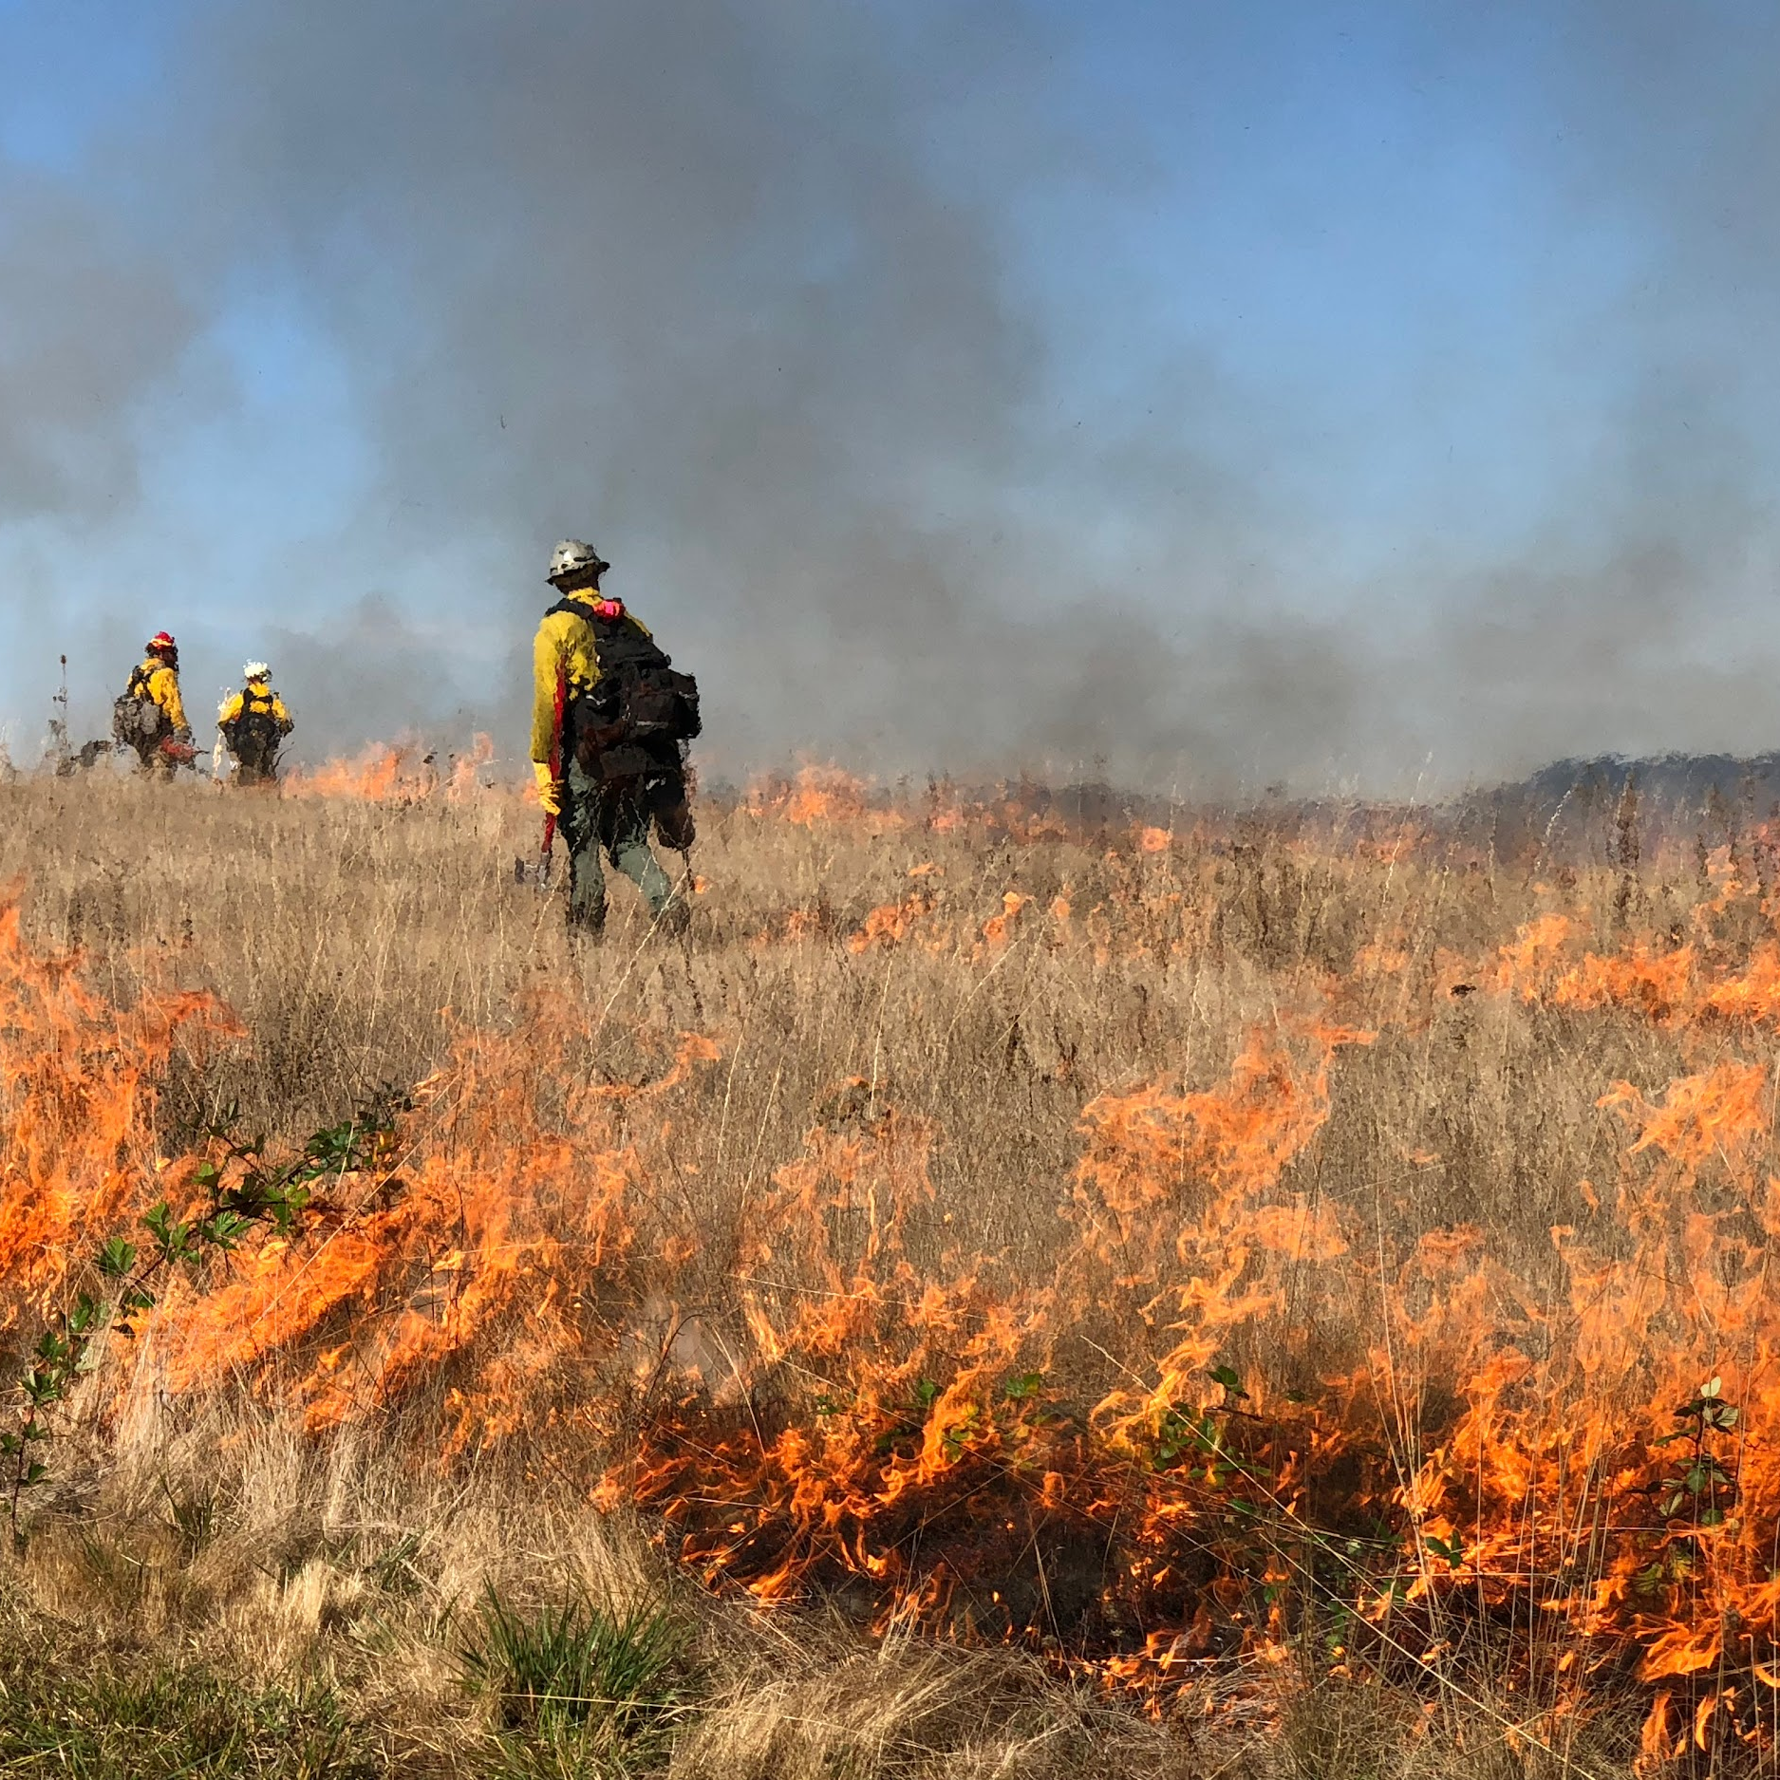
Our Mission
Maximize essential forestland burning while minimizing smoke emissions and smoke impacts to public health.

Slide 9
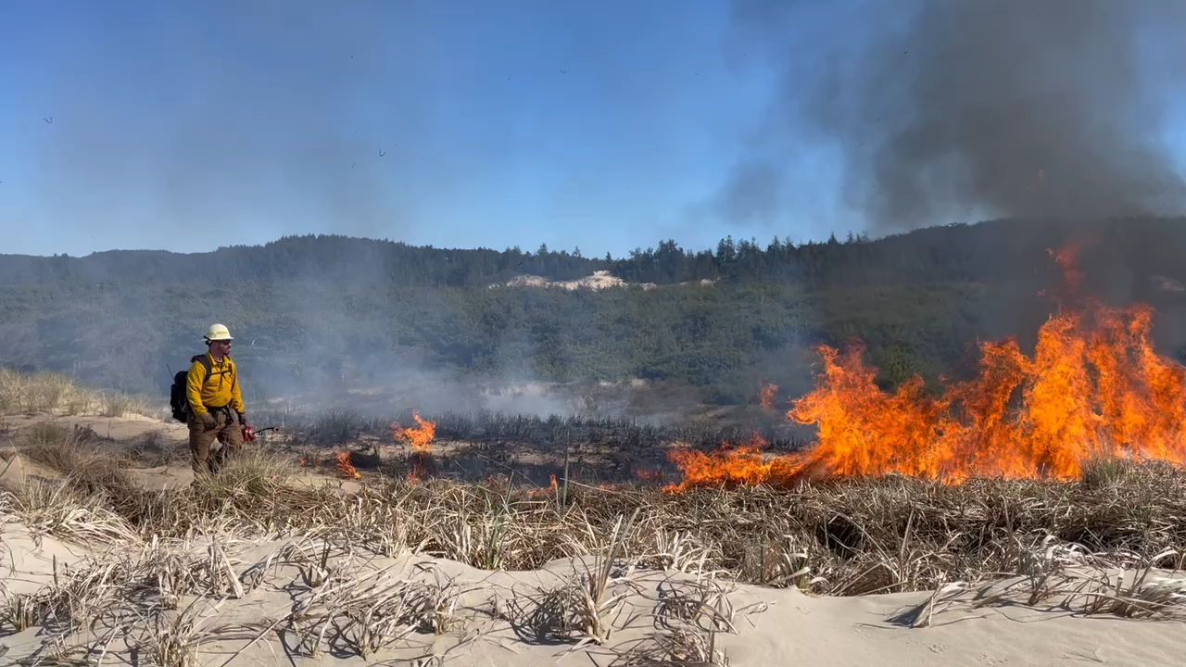
In a Year
Spring
Prescribed burning
July - September
Agriculture field burning
Fall, Early Winter
Prescribed burning
Notes:
Fall, after equinox, shortening days, Oct-Nov
Spring, after equinox, longer days, Apr-May

Slide 10
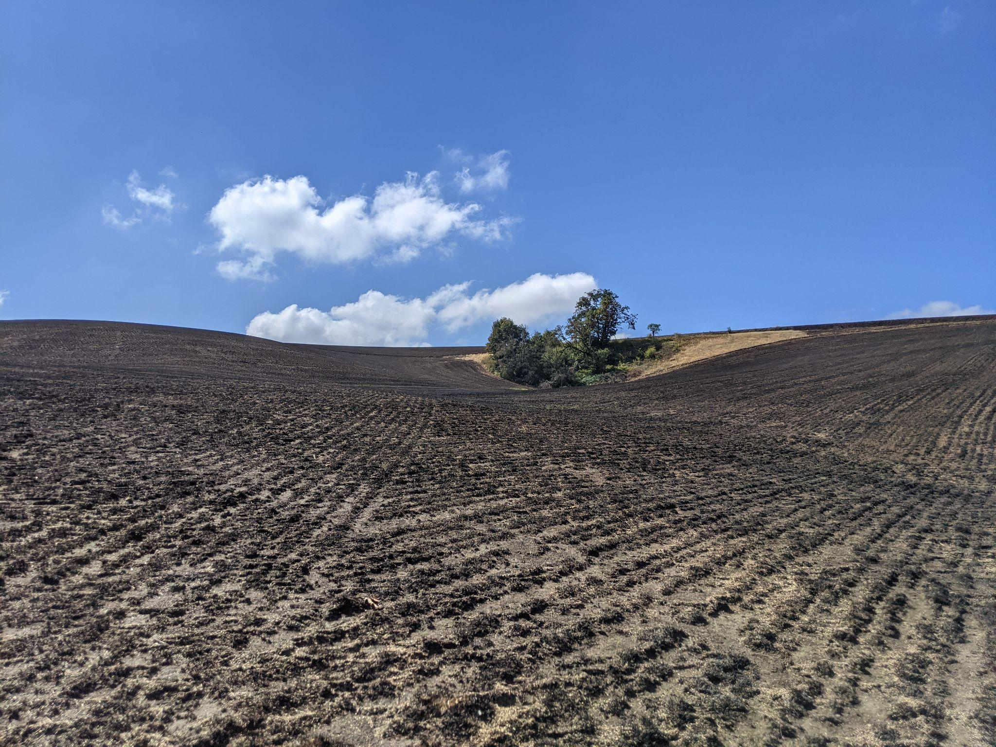
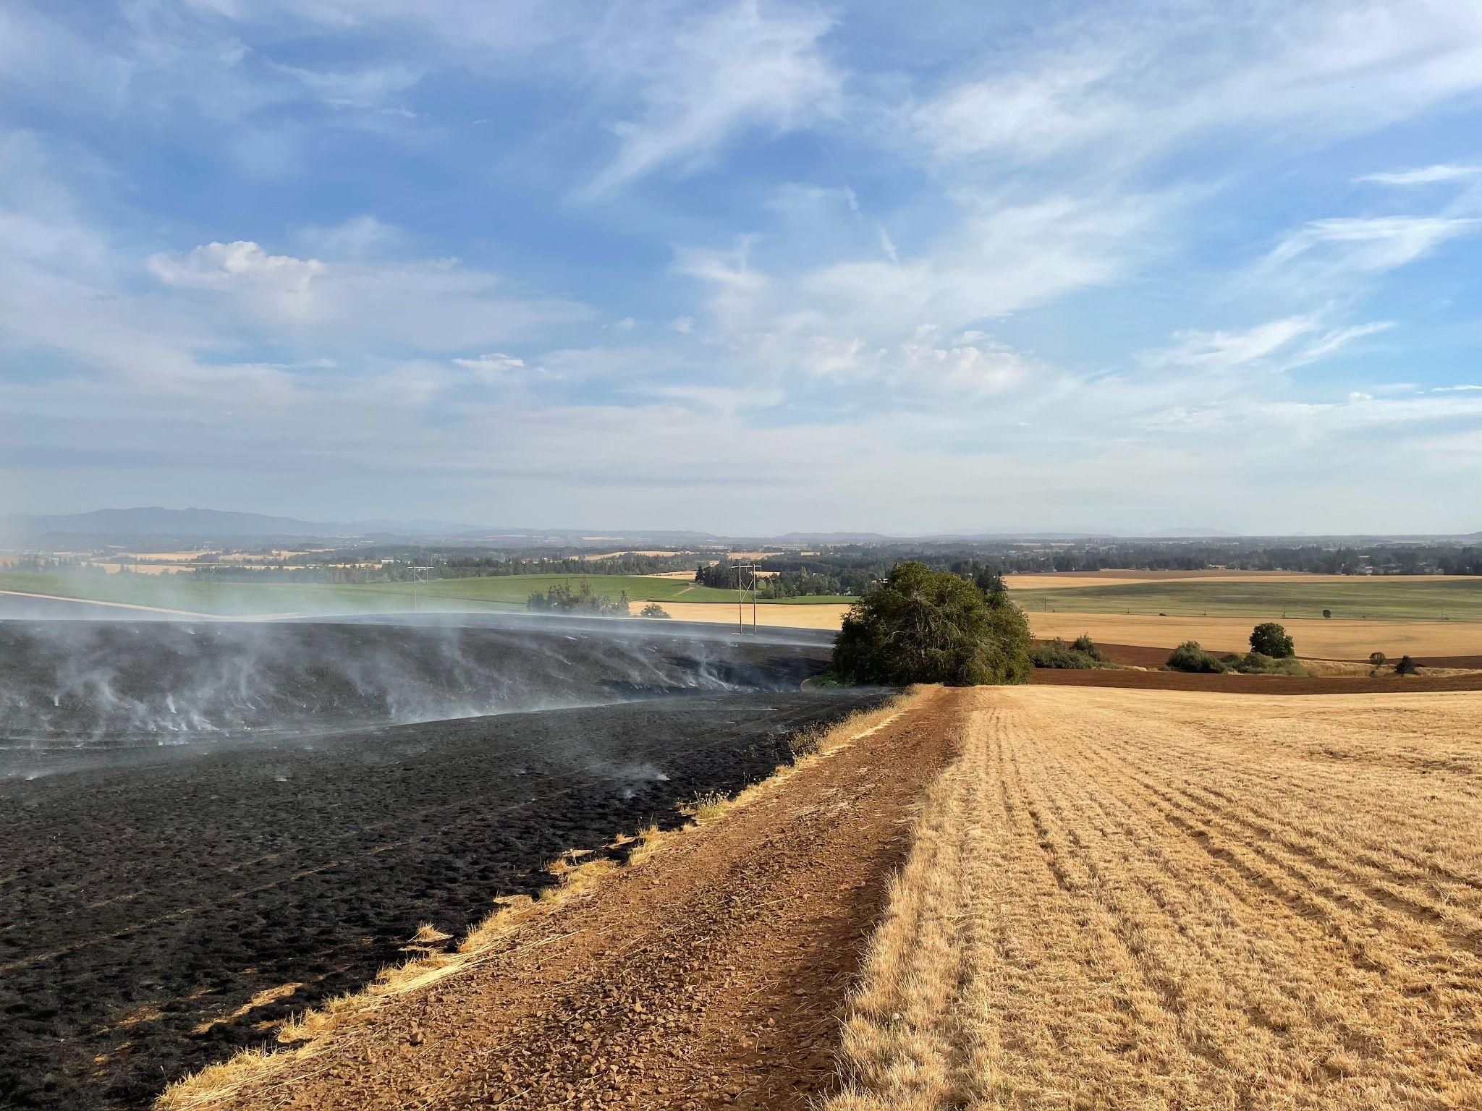
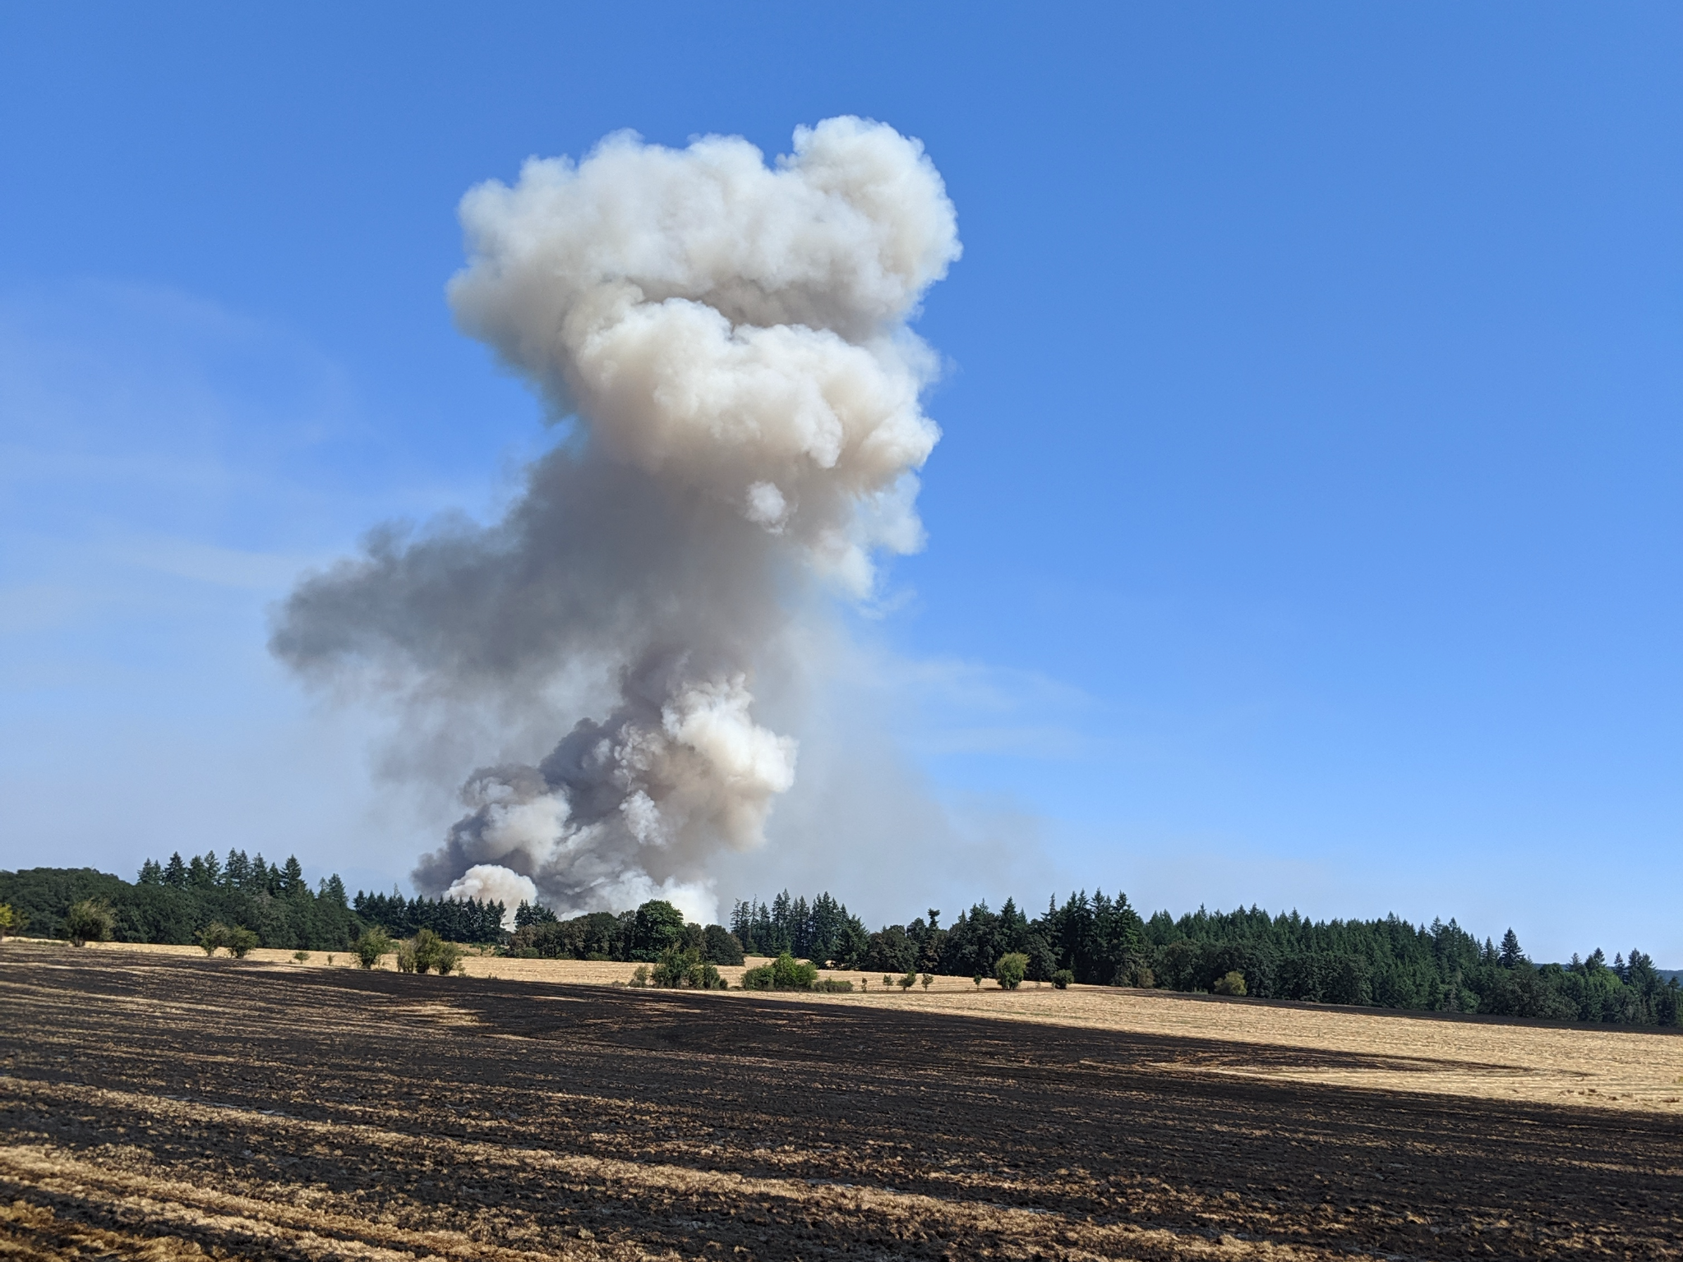
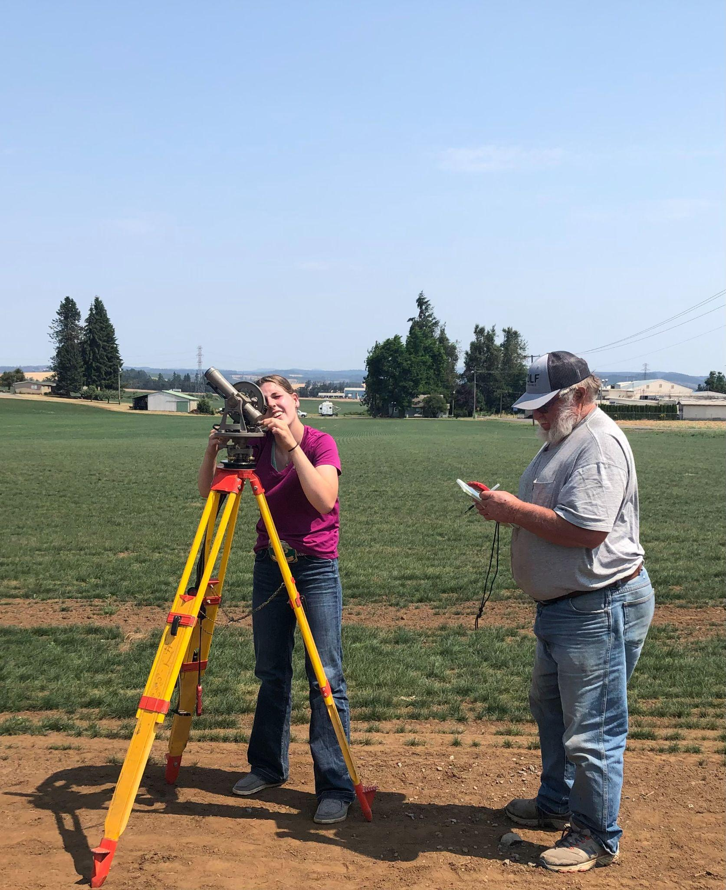
Field burning
Wheat and grass seed burning
Benefits:
Reduction of pests, weeds, and diseases
Increase in seed yields
Increase in stand life
Minimizes the need for tillage and controls erosion
Notes:
https://www.oregon.gov/oda/programs/MarketAccess/SmokeBurning/Pages/FieldBurning.aspx

Slide 11
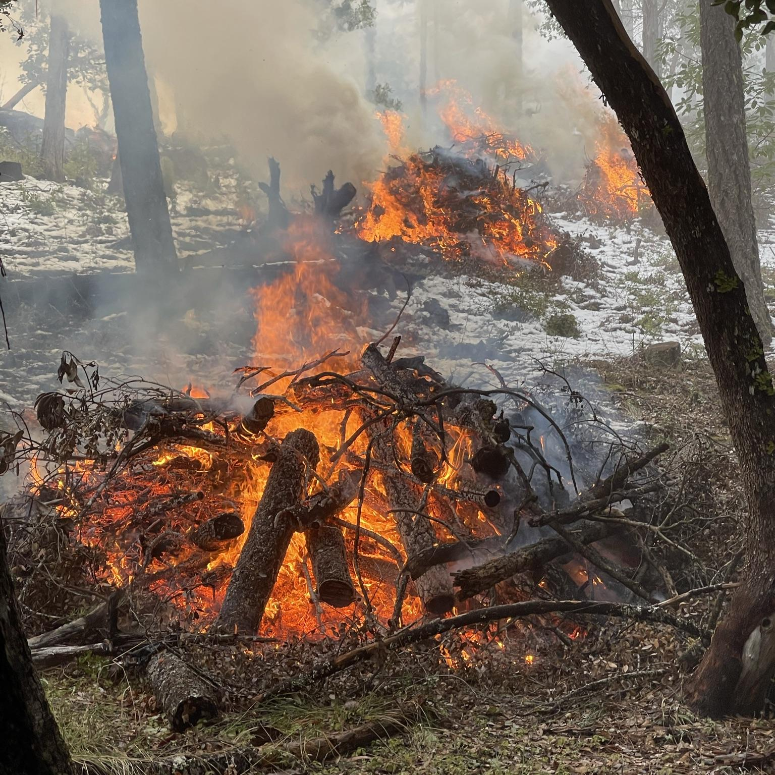
Prescribed fire
Reduces hazardous forest fuels
Reduces the potential for high-intensity wildfires and the huge volume of smoke produced by them
Provides for safer fire suppression where controlled burns have occurred
Prepares logged sites for replanting, recycling nutrients back into the soil and reducing pests and disease
Lit when fire danger is low and weather conditions are favorable for protecting smoke sensitive receptor area (SSRA) communities from smoke

Slide 12
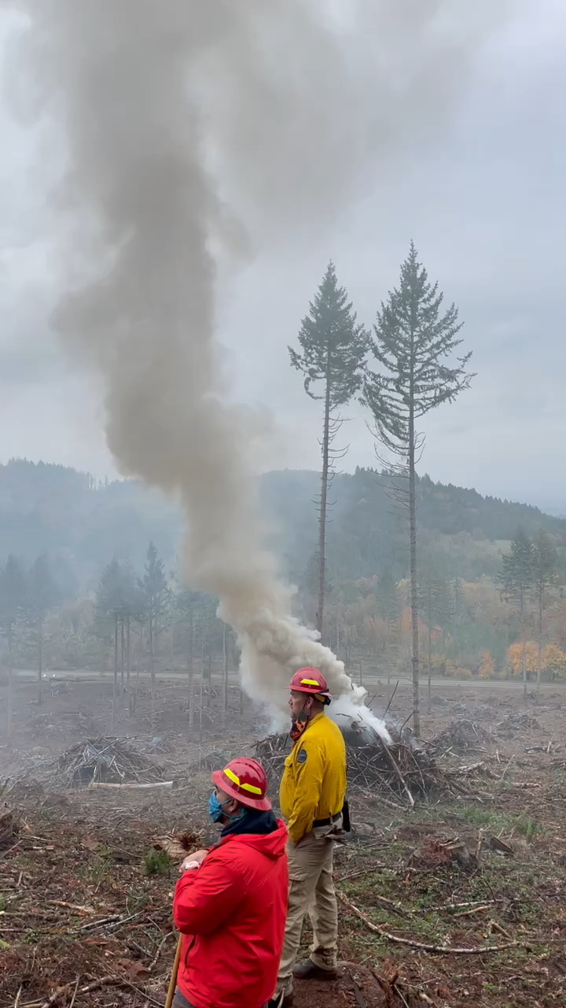
Pile Burning

Slide 13
Prescribed burning forecast
Mixing heights
Sounding forecast and actual, model analysis
Transport wind direction & speed
Surface to mixing height wind
Distance to SSRA
Highest level of protection; calculate plume length
Drainage flows & other effects
Reduce burning to avoid excessive/funneling smoke

Slide 14
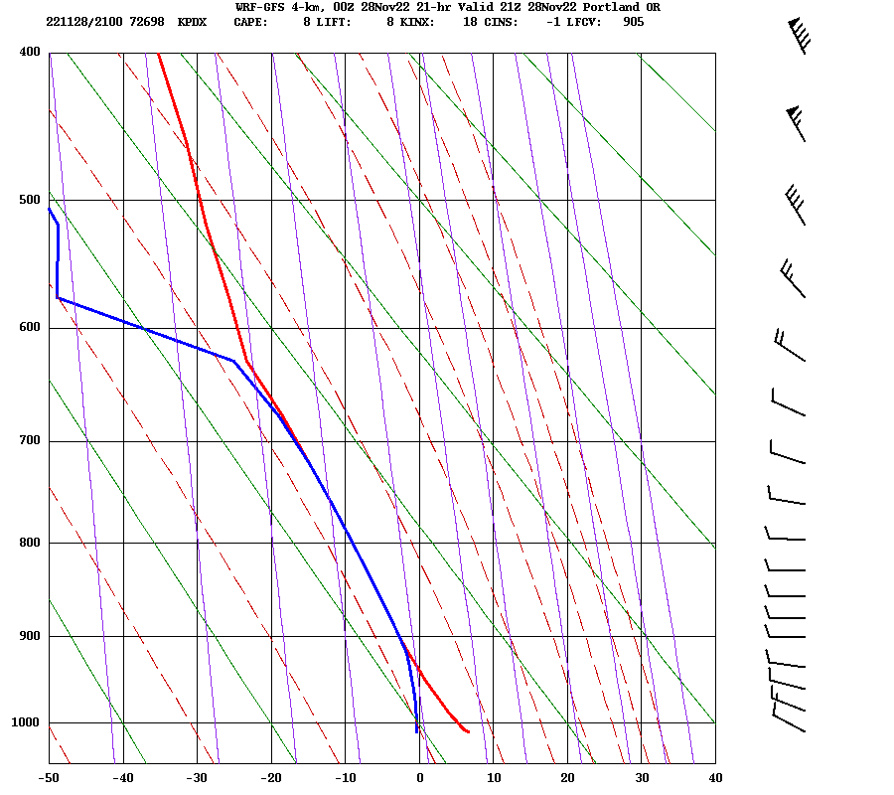
Mixing Height
5000+ feet best, 2-3000 feet minimum
Transport/Surface Wind
Depends on location, onshore vs offshore
Other factors
Inversions
Ventilation/Dispersion

Slide 15
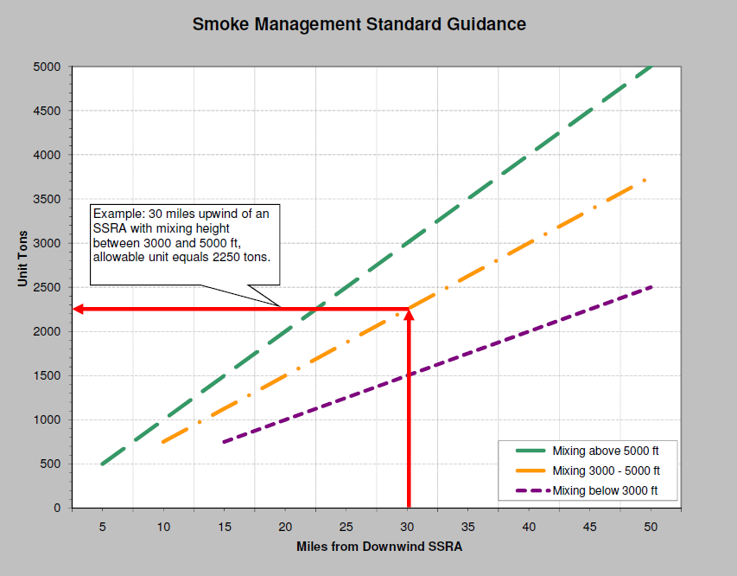
Smoke Plume Distance
Lower mixing height =
farther plume travel

Slide 16
Forecast Preparation
Surface Data
Vertical Sounding
Upper Air
Weather Models
Pressure pattern
Thermal trough
Fronts
Moisture
Stability
Wind shear
Trough/Ridge
Short waves
Atmospheric River
Sounding
Vertical motion
Moisture
Dispersion Forecast
(Mixing Heights & Transport Winds)
continued…

Slide 17
Instruction Preparation
Coast Range
Cascades & Eastward
SSRAs - Corridors - Elevation
SSRAs - Drainages - Elevation - Wilderness
Zone by Zone Instructions
Existing air quality
Special considerations

Slide 18
Prescribed Burning Instructions
SMOKE MANAGEMENT FORECAST AND INSTRUCTIONS
SALEM FORESTRY WEATHER CENTER
OREGON DEPARTMENT OF FORESTRY
ISSUED: Sunday, November 6, 2022 2:30 PM Pete Parsons
1. DISCUSSION AND FORECAST FOR THE WESTERN OREGON AREA FORECAST ZONES 601-623 and 639
SHORT-TERM DISCUSSION
A strong cold front will progress SE across the region this evening. Steady rain and mountain snow will turn showery overnight with a chance of thundershowers. Snow levels will drop to near 2000 feet and locally lower under heavier showers. Precipitation totals from .25” to .75” can be expected at lower elevations with several inches of new snow at higher elevations.
A strong upper-level trough will maintain considerable shower activity on Monday with snow levels remaining near 2-3000 feet. Precipitation totals from .10” to .25” will be common. Cold air aloft will promote good mixing with SE-SW transport winds.
EXTENDED DISCUSSION
The upper-level trough will slowly weaken and drop southward on Tuesday with showers tapering off from the north. A significant change will be a switch to offshore transport winds, which will dry the low levels of the atmosphere. The air aloft will remain unseasonably cold, with little change in snow levels. That should continue to support good daytime mixing.
A drier northerly flow aloft takes over on Wednesday. After a frosty start, surface temperatures will struggle into the mid-to-upper 40s, even with partial afternoon clearing. Upper-level ridging will also suppress daytime mixing. Offshore flow will weaken and may reverse to lightly onshore in the afternoon.
2. DISPERSION
MONDAY
Zone 601-612 and 639 (North Coast Range and Cascades):
MORNING
Mixing height 3000 - 4000 ft.
Transport wind SSE to SSW at 12 - 22 mph.
Surface wind SE to SSW at 8 - 12 mph.
AFTERNOON
Mixing height rising above 5000 ft.
Transport wind SSE to SSW at 15 - 29 mph.
Surface wind similar to morning.
EVENING
Mixing height 2000 - 3000 ft.
Transport wind decreases to SSE to SSW at 8 - 12 mph.
Surface wind decreases to ESE to S at 4 - 8 mph.
Zone 615-620 (South Coast Range):
MORNING
Mixing height 3000 - 4000 ft.
Transport wind SSE to SSW at 10 - 16 mph.
Surface wind SSE to SSW at 8 - 12 mph.
AFTERNOON
Mixing height rising above 5000 ft.
Transport wind similar to morning.
Surface wind similar to morning.
EVENING
Mixing height 2000 - 3000 ft.
Transport wind decreases to SSE to SSW at 6 - 10 mph.
Surface wind SE to SSW at 4 - 8 mph.
3. BURNING INSTRUCTIONS FOR ALL ZONES IN THE WESTERN OREGON AREA
- Valid for burning done Monday, November 7, 2022.
======================================================
Coast Range
All Zones
Use standard guidance matrix - see section 5 below. Ensure adequate distance from downwind SSRAs for smoke to dissipate.
Cascades
Zone 605, 606, 607, 608, 639, 610, 617, 620, 622, and 623
Use standard guidance matrix - see section 5 below. Ensure adequate distance from downwind SSRAs for smoke to dissipate. Verify transport winds away from SSRA if burning within 10 miles of the SSRA in Zone 605 and 606.
Zone 611 and 616
Units should be 1500 tons or less, spaced 3 miles apart, and 5 miles from downwind SSRAs. In zone 616 avoid ignitions north of T24S. South of T29S higher tonnage is possible - call the forecaster.
Siskiyous
Units should be 1500 tons or less, spaced 3 miles apart, and 5 miles from downwind SSRAs.
======================================================
Three regions of Oregon
General forecast discussion (1)
Dispersion details (2)
Where/how much may be burned (3)
Maximum consumable tons
Distance from SSRAs
Based on fire weather zones
Extra rules, advisories

Slide 19
5. STANDARD GUIDANCE MATRIX:
Greater than 5000 ft mixing height: Limit to 150 tons per mile from downwind SSRAs.
Example: 75 tons allowed if burned a half mile from a downwind SSRA.
3000 - 5000 ft mixing height: Limit to 50 tons per mile if burning within 5 miles of downwind SSRAs. Limit to 100 tons per mile if burning 5 miles or beyond downwind SSRAs.
Example #1: 200 tons allowed if burned 4 miles from a downwind SSRA.
Example #2: 500 tons allowed if burned 5 miles from a downwind SSRA.
Less than 3000 ft mixing height: No burning within 5 miles of downwind SSRAs. Limit to 60 tons per mile from downwind SSRAs.
Example: 300 tons allowed if burned 5 miles from a downwind SSRA.
Ensure adequate spacing between units when burning near downwind SSRAs.
Use of polyethylene (PE) sheeting on greater than 75 percent of piles in a unit with 60 percent coverage per pile will allow a 50 percent increase in tonnage over the existing instruction tonnage for that zone.
All exceptions must be coordinated with the duty forecaster prior to ignition.

Slide 20
Sherri Pugh
Oregon Department of Forestry
sherri.pugh@odf.oregon.gov
social: wxsherri

