Slide 1
The Perfect Recipe For Portland Snow; What Conditions Are Needed For a Portland Snow Day.
By April Vogt

Slide 2
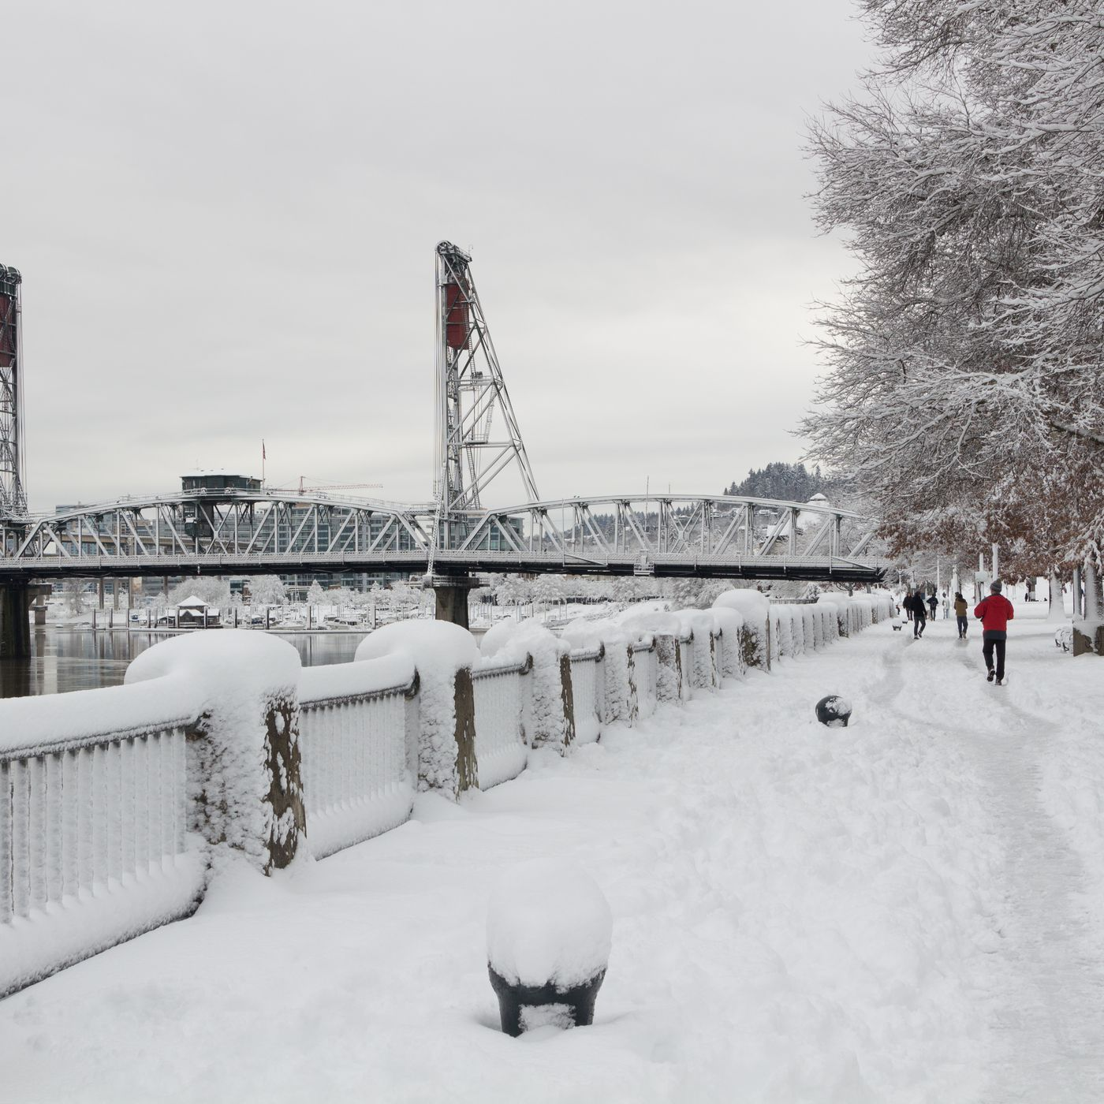
Overview
Key “Ingredients” for snow accumulation in the Portland metropolitan area
Why is snow so hard to forecast for Portland, OR
“Close Call” Days VS Confident Snow Days
Notable Portland snow events since 2000
Wrap-Up
Questions
Portland, Oregon / United States - January 11, 2017 Image credit: hellophotopdx; https://www.shutterstock.com/image-photo/portland-oregon-united-states-january-11-1610947024

Slide 3
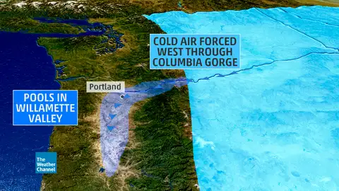
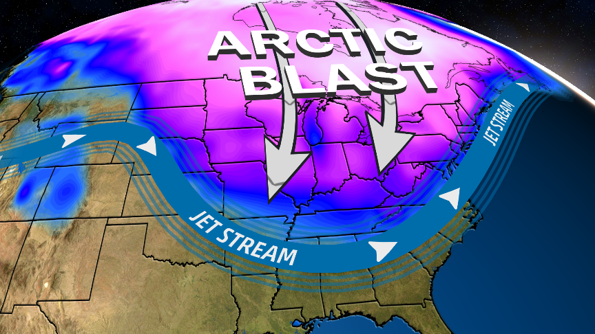
Key “Ingredients” for Snow Accumulation
Cold Air Source:
  Easterlies funneling cold air from the continental U.S. through the Gorge and into the Willamette Valley.
  Upper-trough over the Pacific Northwest that brings cold arctic air south into the lower latitudes.
The Weather Channel: https://s.w-x.co//util/image/w/columbia-gorge-explain.jpg?crop=16:9&width=480&format=pjpg&auto=webp&quality=60
Image Credit: ://s.w-x.co/arcticblastthrusday2.png

Slide 4
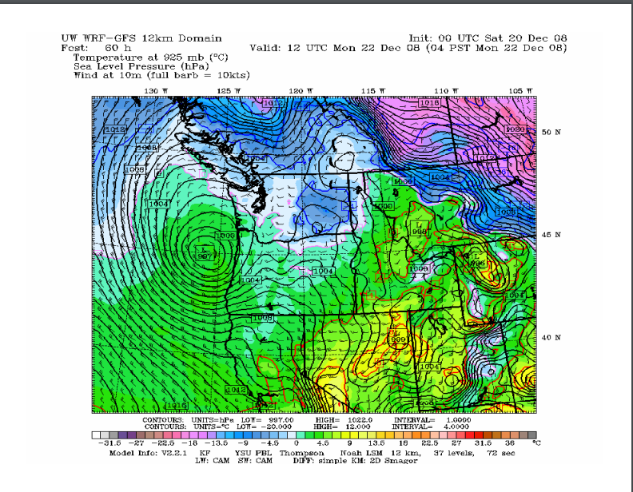
Key “Ingredients” for Snow Accumulation
2. Moisture:
  Pacific Moisture
    Low pressure system
    Upper level Disturbance
    Fronts
Winter 200 2009 Minutes AMSOC- https://www.ametsoc.org/chapters/oregon_archive/Minutes/2009/2009_3_12_Minutes_Winter_Review_2008-09.pdf

Slide 5
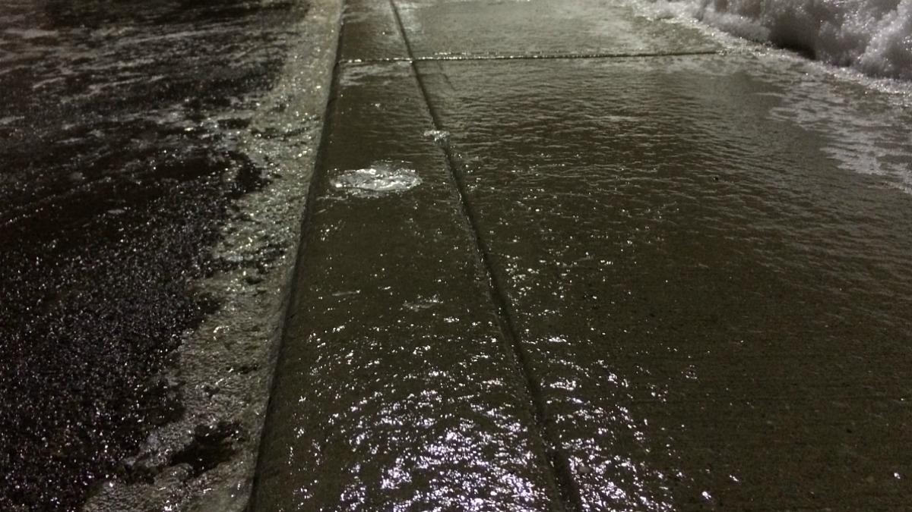
Key “Ingredients” for Snow Accumulation
3. Cold Enough Surface for Accumulation:
  The Surface must be at or below freezing
    Dry surfaces drop to freezing faster than wet surfaces.
Image Credit: https://www.forensicdjs.com/wp-content/uploads/2016/11/black-ice.jpg

Slide 6
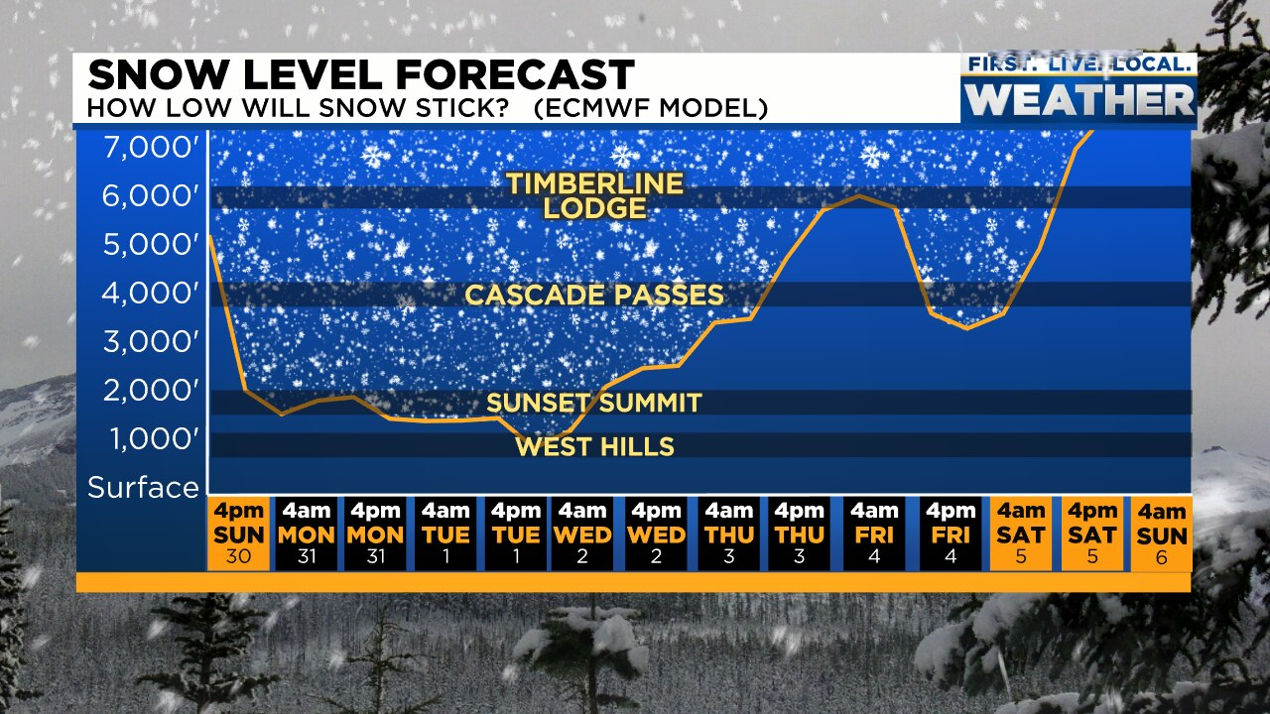
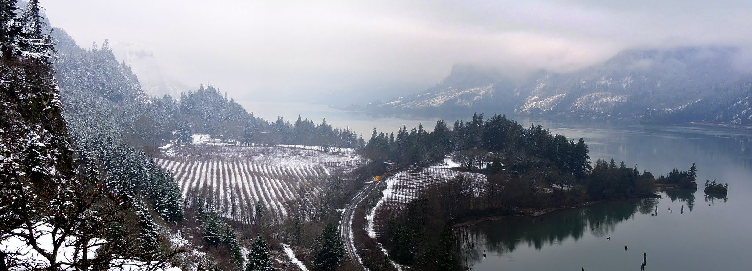
Why is snow so hard to forecast for Portland, OR
Geography
  Location:
    Eastside vs Westside
  Elevation
    PDX (~25’-30’)
    Downtown (~50’)
    Powell Butte (614′)
    Mt. Tabor (636′)
    West Hills (Council Crest: 1,073’)
  Marine Influences
    Regional: Pacific Ocean
    Local: Columbia River
    Local: Willamette River
Snow Level Forecast Fox 12 Oregon- https://www.kptv.com/2022/02/02/another-snow-free-january-portland-are-snowier-februarys-becoming-more-common/
Image Credit- https://assets.gorgefriends.org/images/events/DSCN74261542236187-31804.jpg

Slide 7
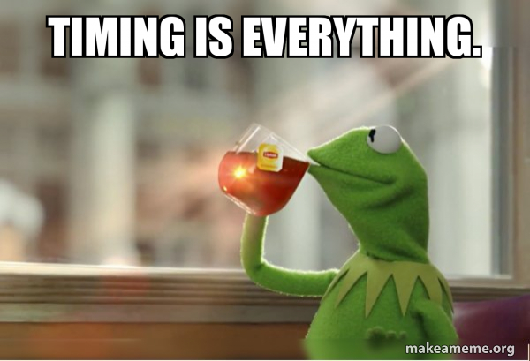
Why is snow so hard to forecast for Portland, OR
Timing
  Cold air arrival vs when our moisture source arrives.
    Who is at freezing and who is not.
      Is the surface cold enough for snow to stick?
      Will winds at the surface shift bringing temperatures above freezing before the arrival of moisture?
Who sees moisture vs who does not.
Image Credit: https://media.makeameme.org/created/timing-is-everything-e077d16529.jpg

Slide 8

“Close Call” Days VS Confident Snow Days
Close Call Days (AKA a hair-pulling day for all local meteorologists) :
  850 mb temperatures are right around 0°C.
  Freezing levels are between 500’-1000’ while our moisture source is likely to produce locally stronger (convective) cells:
    Stronger Cells can result in evaporative cooling dropping the snow-level lower locally resulting in local accumulations.
  When the timing of a system and cold air arriving are fairly close:
    Especially when a system has limited moisture
    Any shift in this could result in cold rain or simply icy roads.
  When easterlies (or northerlies) are expected to shift southerly at some point while a moisture system is pushing through.
Image Credit: https://i.imgflip.com/2t6p09.jpg

Slide 9
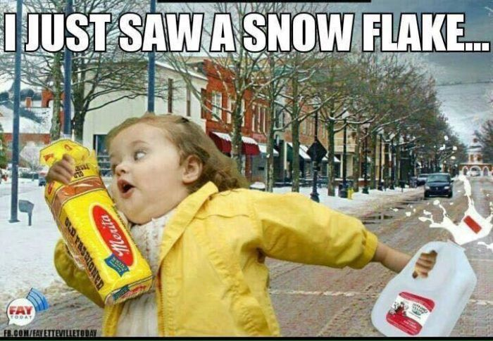
“Close Call” Days VS Confident Snow Days
Confident Snow Days:
  Freezing levels are near or at sea-level:
    850 mb temps are below 0°C.
    A parked upper-level trough ushering cold arctic air south into the Willamette Valley.
      Sudden Stratospheric Warming Event.
    Strong easterlies ushering cold, freezing air from eastern Oregon into the Willamette Valley.
      These ideally extend into the western valley (or dare I say, the coast).
  Decent Moisture Source:
    Primarily an upper-level low from the Gulf of Alaska or NE Pacific.
  Surface is at freezing:
    Dry surface with freezing temperatures prior to the arrival of moisture.
    Wet Surface with freezing levels near or at sea-level for an extended period of time.
Image Credit- https://i.pinimg.com/736x/2b/ea/1a/2bea1aa5f112afba667eaaf04d875a64.jpg

Slide 10
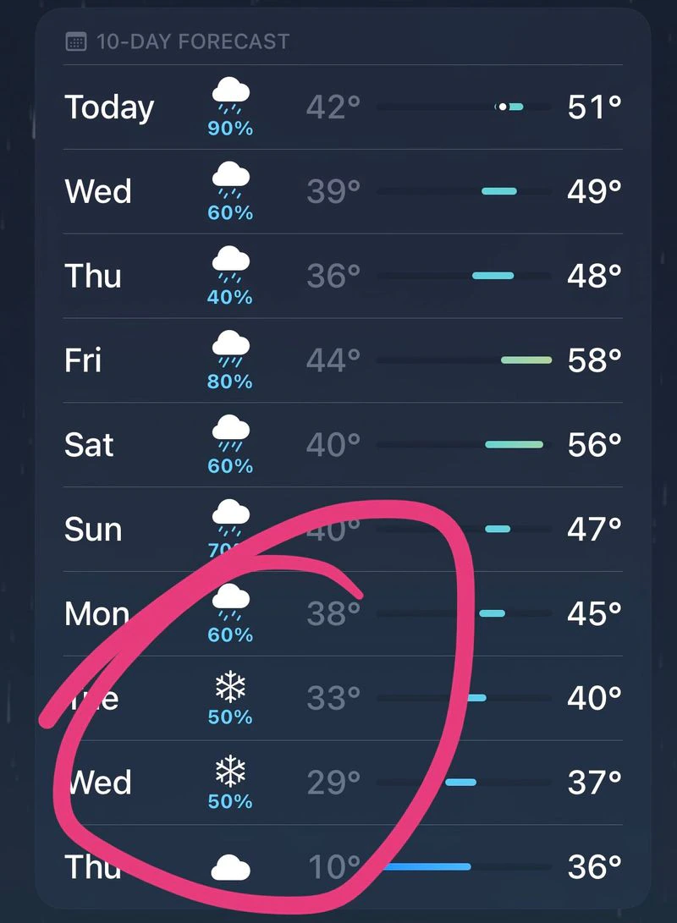
First “Close Call” Day of the Season
Snow around the “Portland Area”
November 6, 2022 but none in Portland.
Upper-level trough drawing cold air from Canada south into the Pacific Northwest.
Upper-level low deriving from the Gulf of Alaska.
iPhone weather app/OregonLive- November 1, 2022- https://www.oregonlive.com/news/2022/10/after-a-warm-start-to-october-weather-forecasters-predict-a-chilling-winter.html

Slide 11
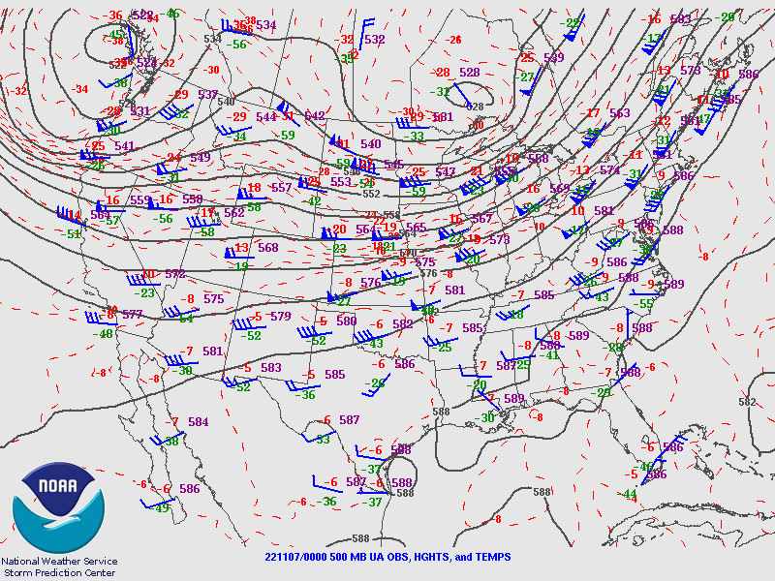
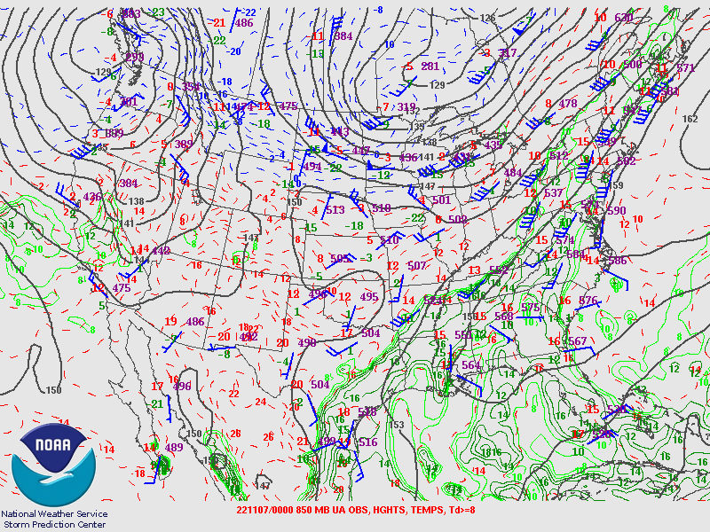
First “Close Call” Day of the Season
November 6, 2022 at 4:00 PM (00Z)

Slide 12
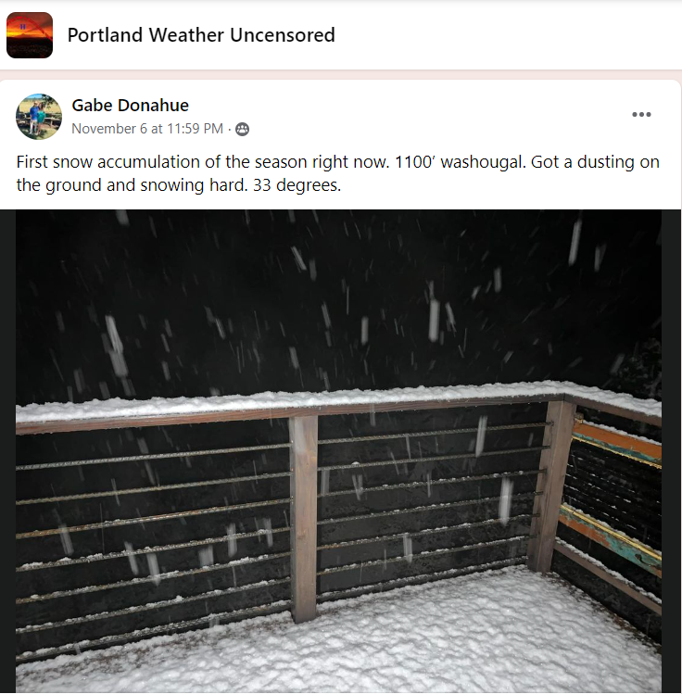
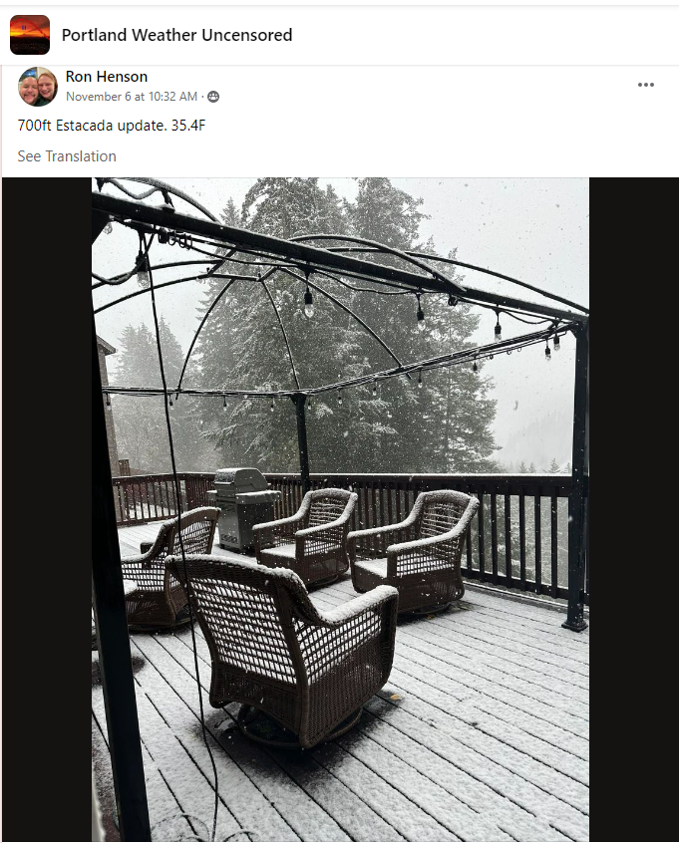
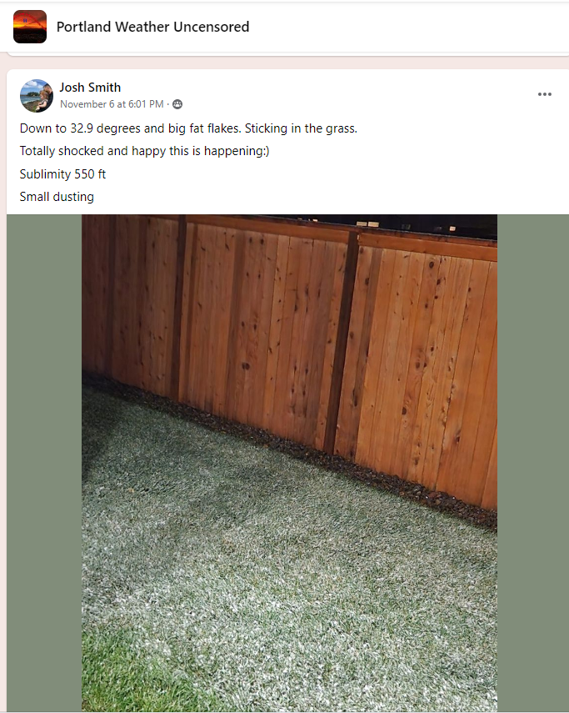
First “Close Call” Day of the Season

Slide 13
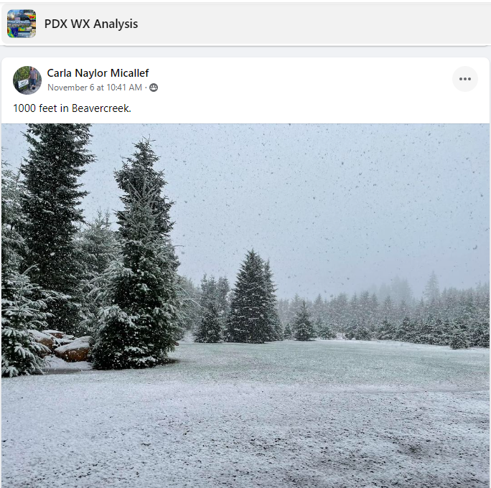
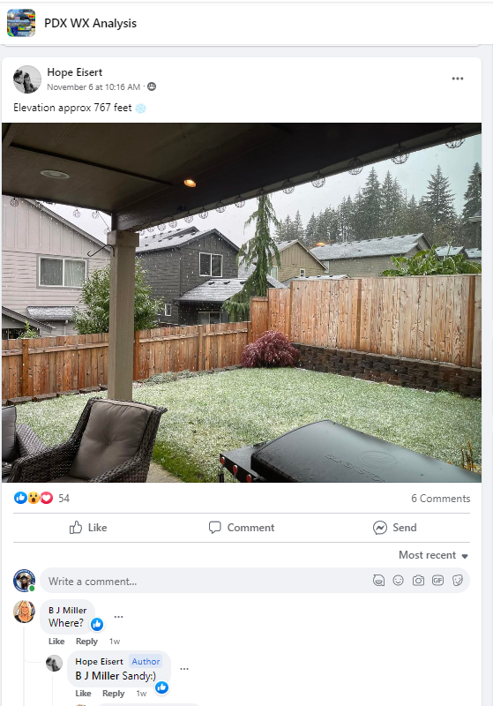
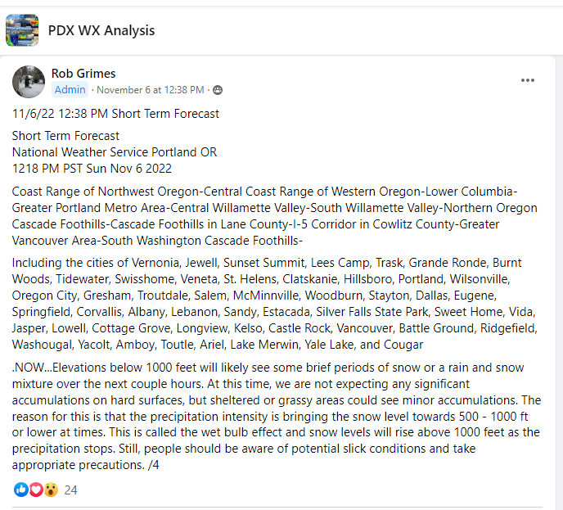
First “Close Call” Day of the Season

Slide 14
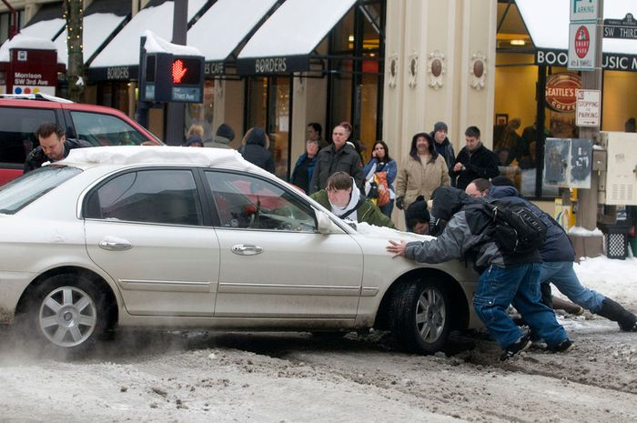
Notable Portland Snow Events Since 2000
Since 2000 (PDX totals):
April 11, 2022: 1.6”
February 11-14, 2021: 10.1”
January 10-11, 2017: 8.0”
December 18-25, 2008: 18.0”
December 2008- Stephanie Yao/The Oregonian- https://www.oregonlive.com/news/erry-2018/12/0e131ca88d8678/10-years-later-the-2008-blizza.html

Slide 15
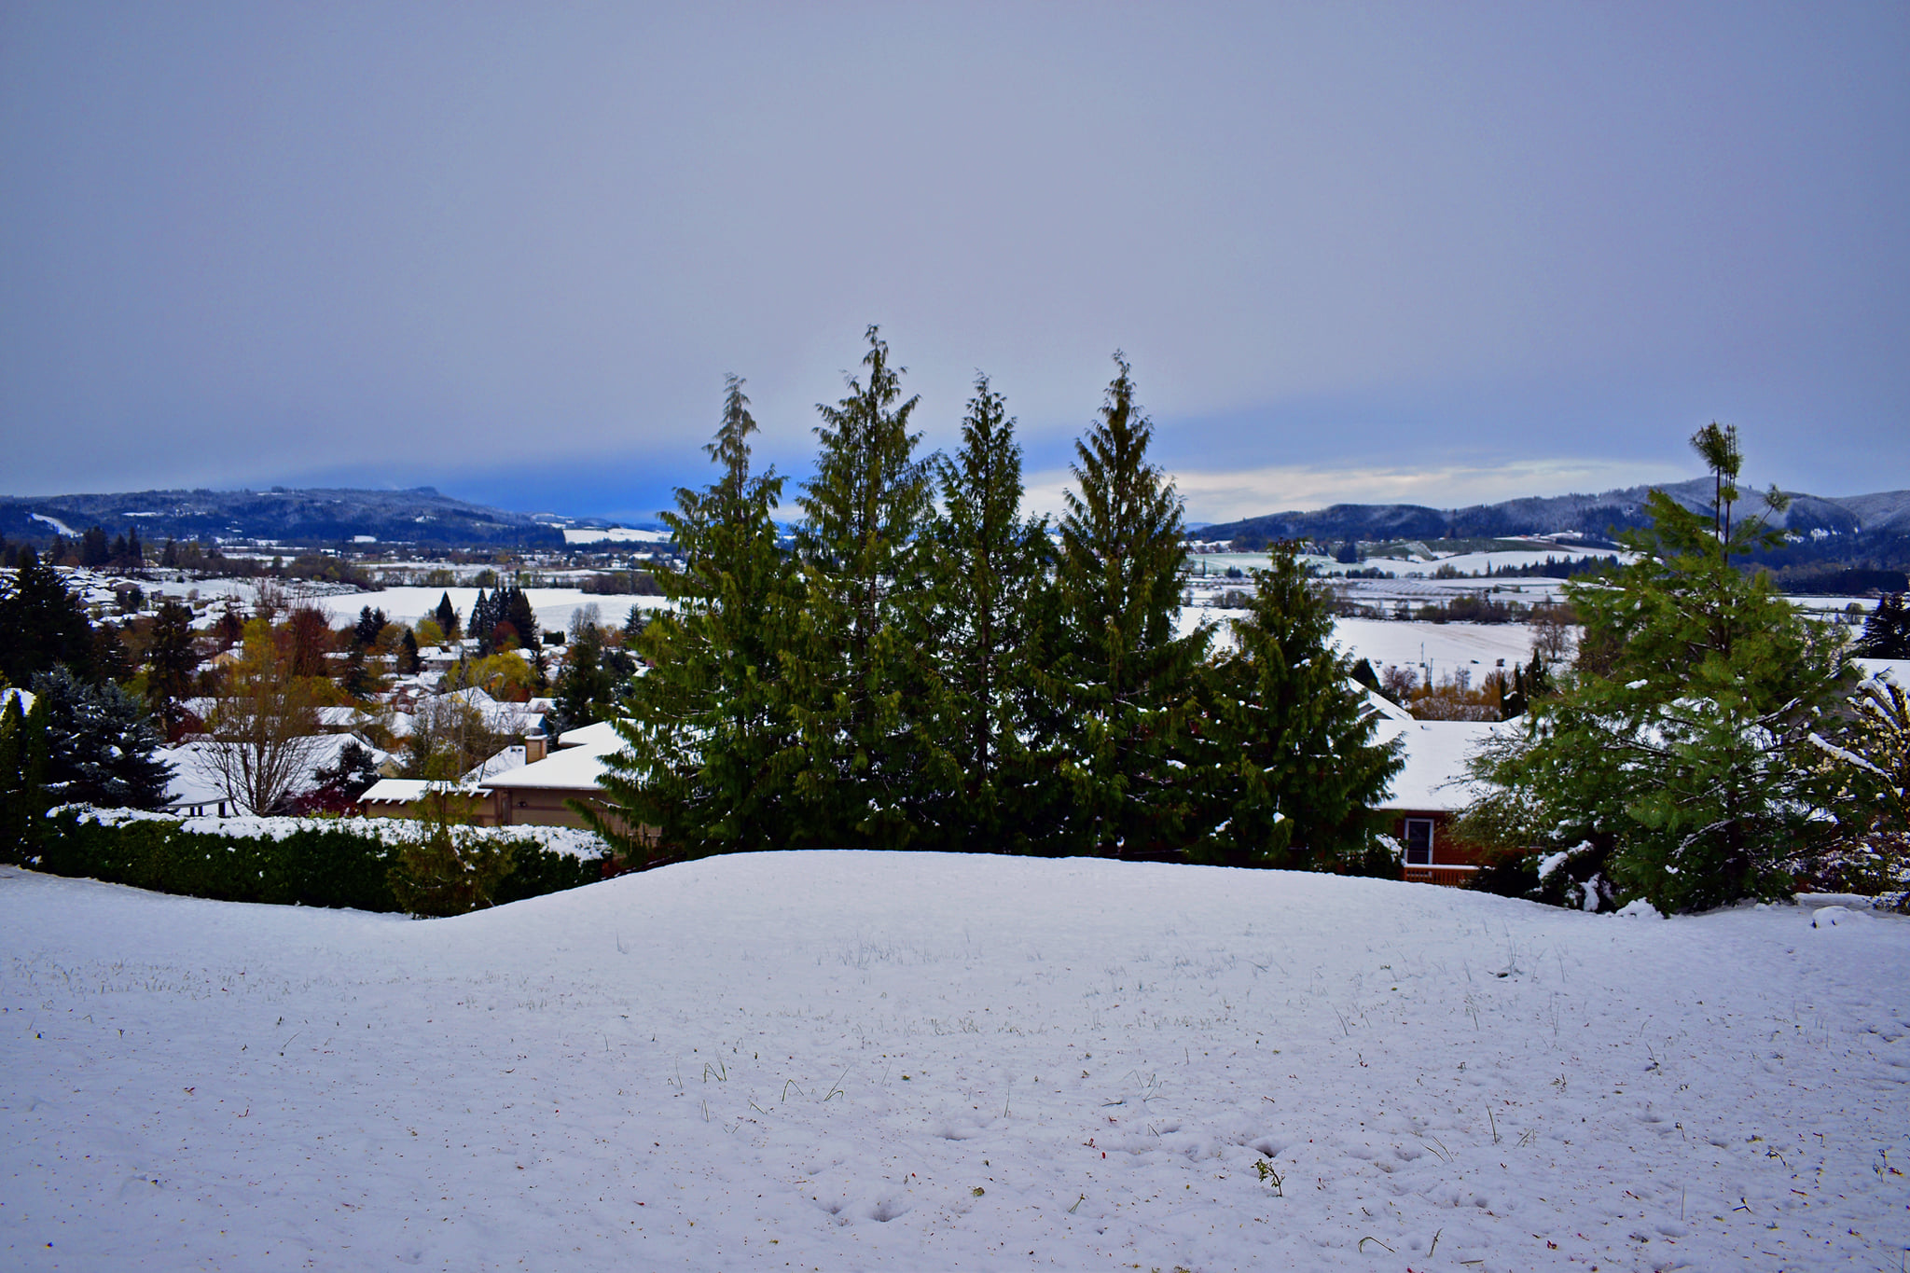
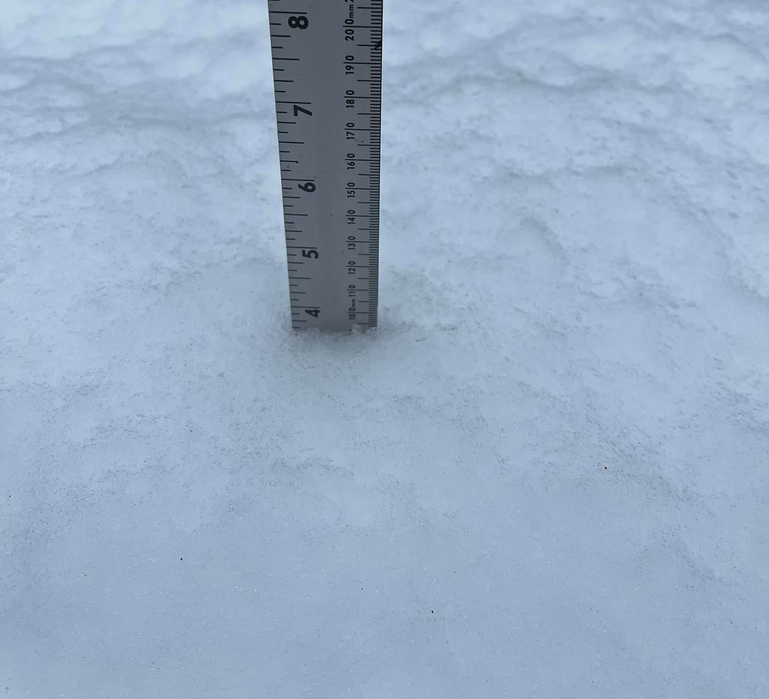
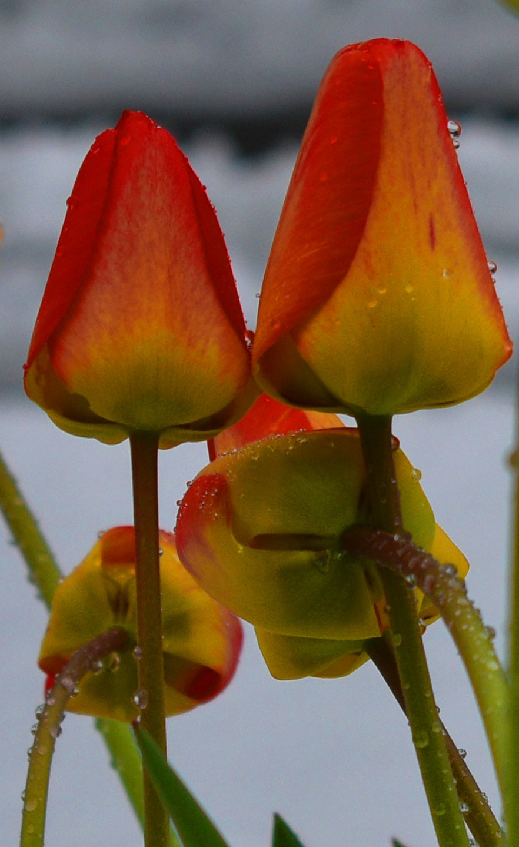
Notable Portland Snow Events Since 2000
April 11, 2022:
PDX accumulated a total of 1.6” on April 11, 2022
  April 11, 2021- 1.6”*
Portland NWS Tweeted: “In 82 years of record keeping, (Portland International Airport) had never recorded more than a trace of snow in April, that ended today.”
*Data is from NWS: https://www.weather.gov/wrh/climate?wfo=pqr

Slide 16
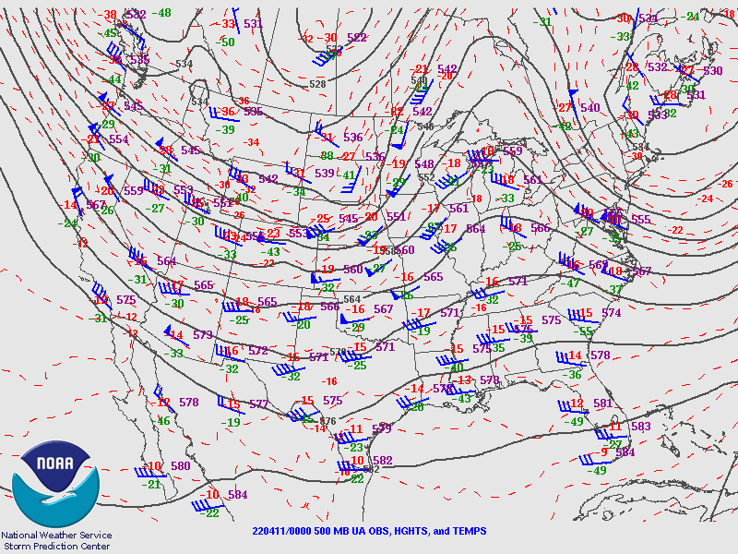
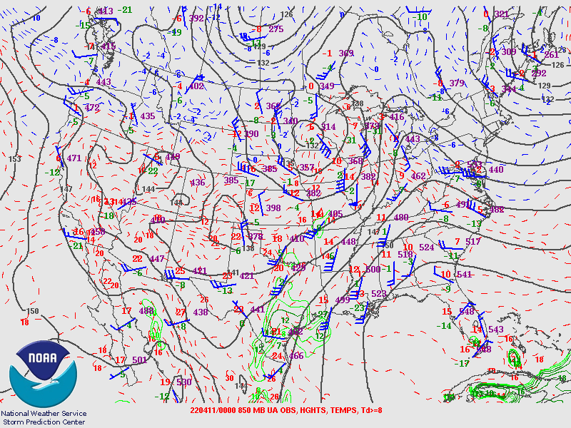
Notable Portland Snow Events Since 2000
April 11, 2022 at 4:00 PM (00Z)

Slide 17
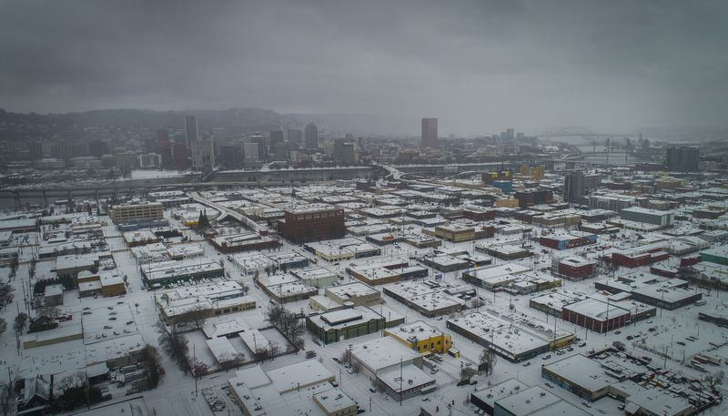
Notable Portland Snow Events Since 2000
February 11-14, 2021:
PDX accumulated a total of 10.1” between February 11-14, 2021
  February 11, 2021- 0.1”*
  February 12, 2021- 6.1”*
  February 13, 2021- 3.8”*
  February 14, 2021- 0.1”*
Ice event Saturday, February 13, 2021 through Sunday, February 14, 2021
  PDX: 0.50” of ice
  Downtown: 0.70” of ice
  Oregon City: 1.50” of ice
  Sherwood: 1.25” of ice
  Salem: 0.80” of ice
*Data is from NWS: https://www.weather.gov/wrh/climate?wfo=pqr
**Ice data is from KOIN 6: https://www.koin.com/weather/2021icestorm/february-snow-and-ice-the-past-present-and-future/
Brooke Herbert/The Oregonian- Portland Oregon 2/12/21- https://www.oregonlive.com/galleries/MSHJ3SBYLRC7RKTL654MZN3LL4/

Slide 18
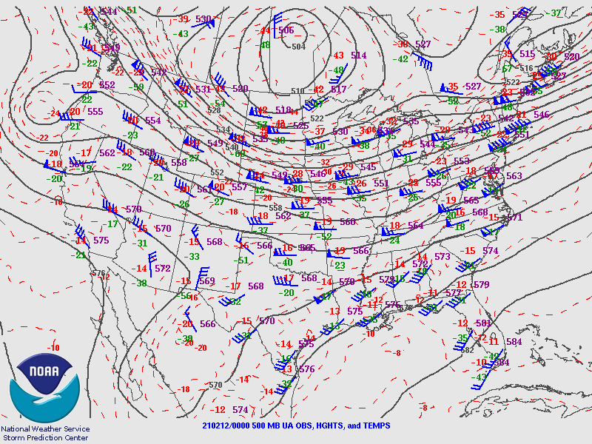
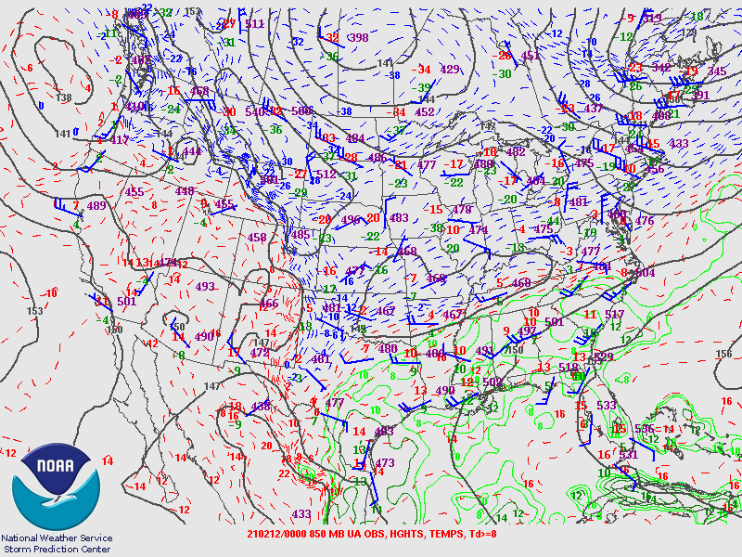
Notable Portland Snow Events Since 2000
February 11, 2021 at 4:00 PM (00Z)

Slide 19
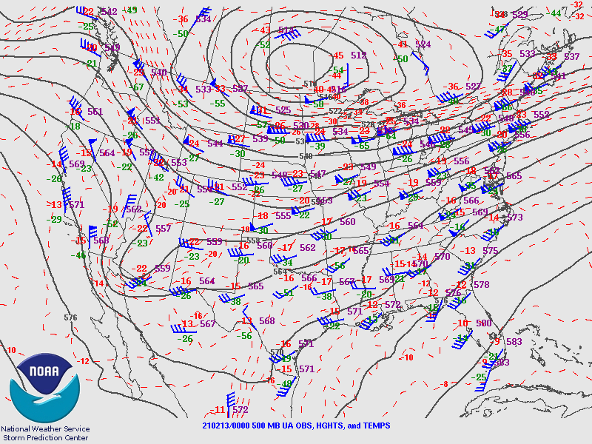
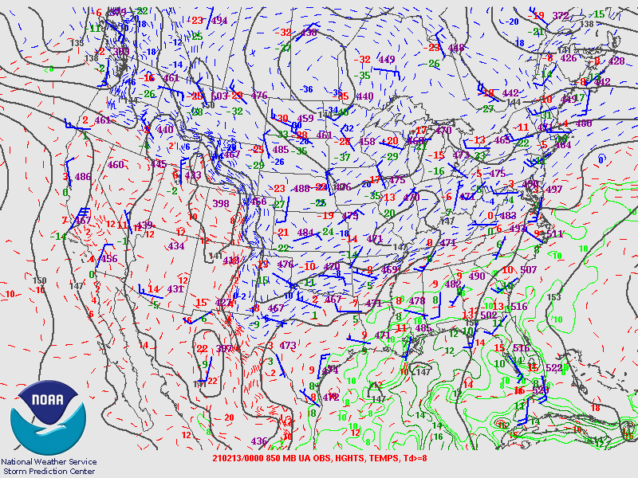
Notable Portland Snow Events Since 2000
February 12, 2021 at 4:00 PM (00Z)

Slide 20
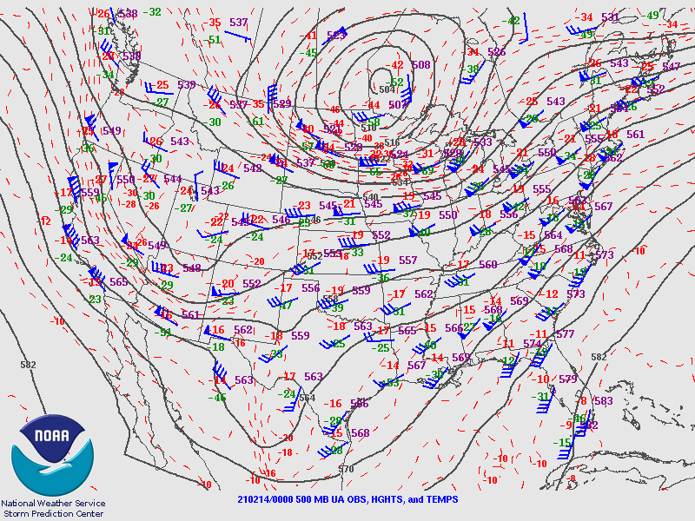
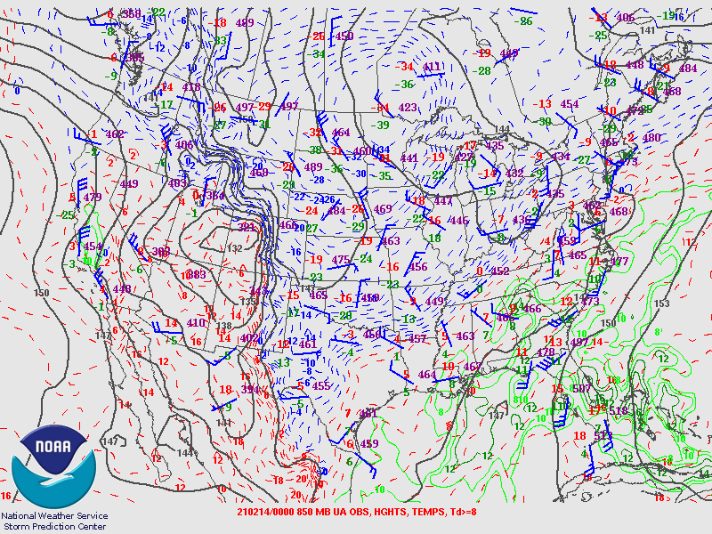
Notable Portland Snow Events Since 2000
February 13, 2021 at 4:00 PM (00Z)

Slide 21
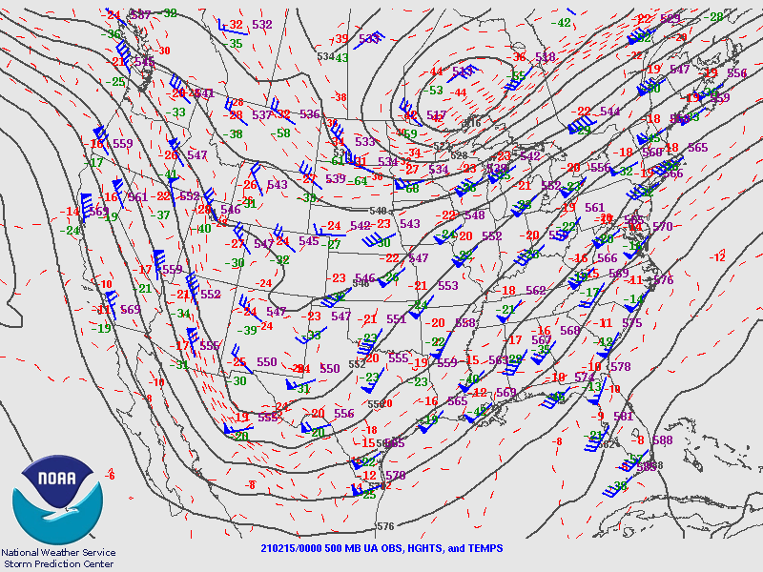
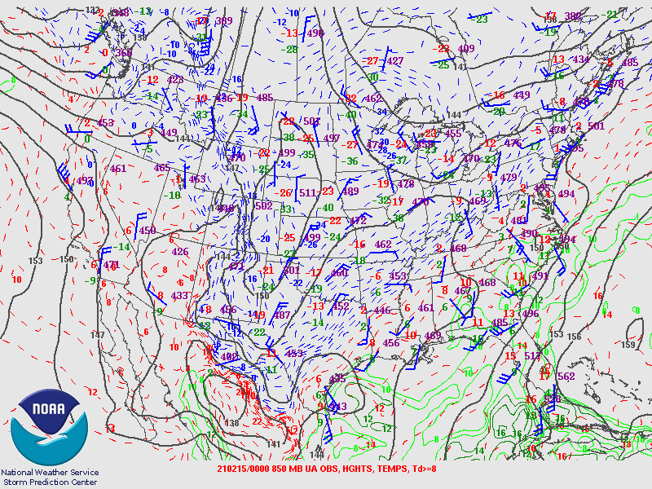
Notable Portland Snow Events Since 2000
February 14, 2021 at 4:00 PM (00Z)

Slide 22
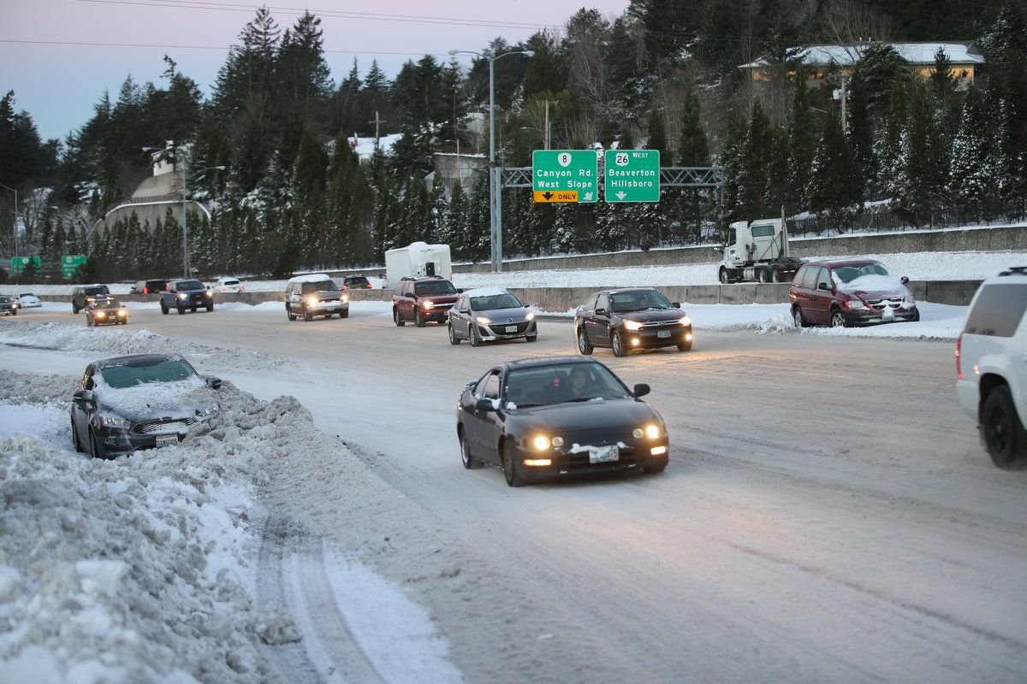
Notable Portland Snow Events Since 2000
January 10-11, 2017 (AKA Snowpocalypse):
PDX accumulated a total of 8.0” between January 10-11, 2017
  January 10, 2017: 6.5”*
  January 11, 2017: 1.5”*
Overnight convective showers were responsible for center of the metro area seeing some impressive accumulations
  Downtown Portland: 13”**
  Vancouver: 12”**
  Lake Oswego: 10”**
  West Hills: 15”**
*PDX data is from NWS: https://www.weather.gov/wrh/climate?wfo=pqr
**Other location data is from Mark’s Weather Blog: https://fox12weather.wordpress.com/2017/01/11/biggest-snow-storm-since-2008-in-portland/
Stephanie Yao Long/Staff-The Oregonian- Portland Oregon 1/12/17- http://media.oregonlive.com/oregonian/photo/2017/01/12/-9680df41baa823f3.JPG

Slide 23
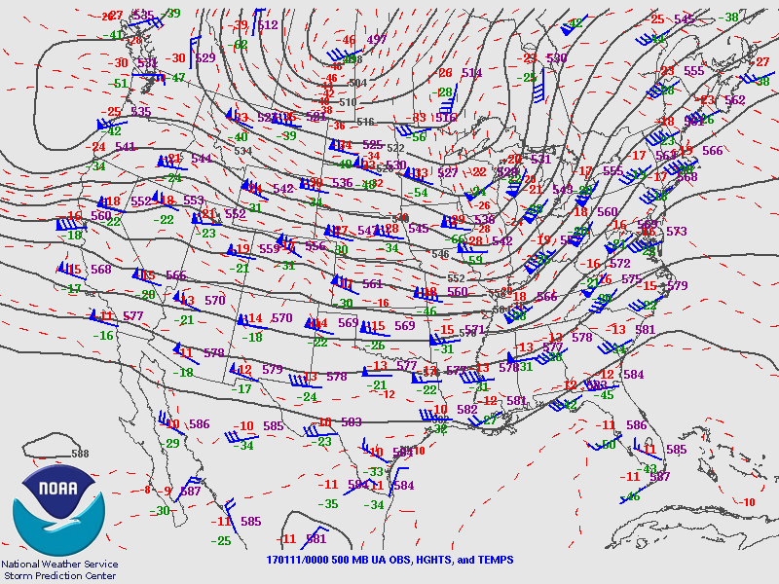
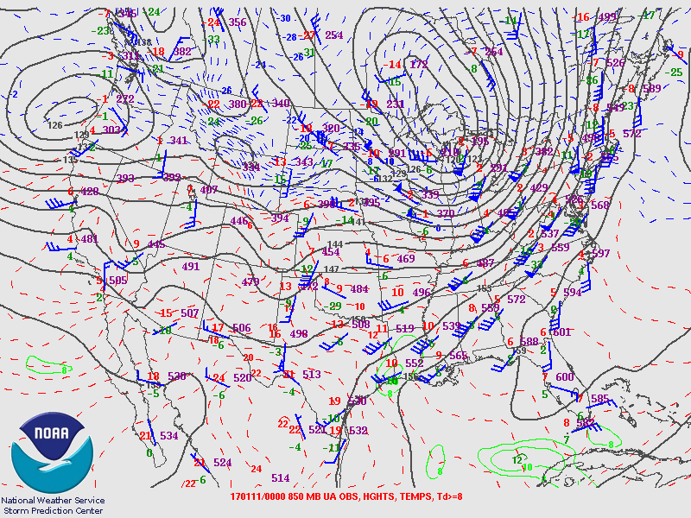
Notable Portland Snow Events Since 2000
January 10, 2017 at 4:00 PM (00Z)

Slide 24
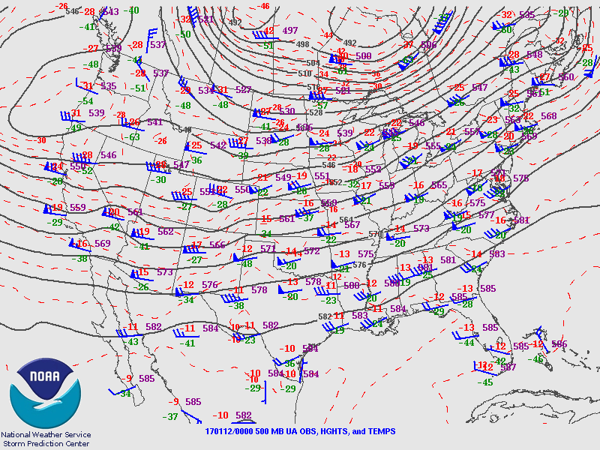
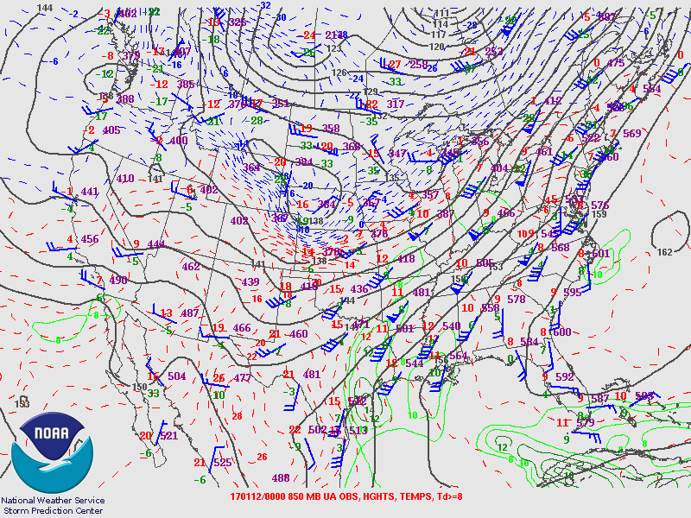
Notable Portland Snow Events Since 2000
January 11, 2017 at 4:00 PM (00Z)

Slide 25
Notable Portland Snow Events Since 2000
December 18-25, 2008:
PDX accumulated a total of 18” between December 18-25, 2008
  December 18, 2008: 1.0”
  December 19, 2008: 0.5”
  December 20, 2008: 7.0”
  December 21, 2008: 2.0”
  December 22, 2008: 3.4”
  December 23, 2008: 0.1”
  December 24, 2008: 3.1”
  December 25, 2008: 0.9”
December 17, 2008 and December 26,2008 we saw a trace of snow at PDX
We saw a total of 19” of snow at PDX during December 2008 (1.0” occurred on December 14, 2008).
*PDX data is from NWS: https://www.weather.gov/wrh/climate?wfo=pqr
Stephanie Yao Long/Staff-The Oregonian- Portland Oregon 1/12/17- http://media.oregonlive.com/oregonian/photo/2017/01/12/-9680df41baa823f3.JPG

Slide 26
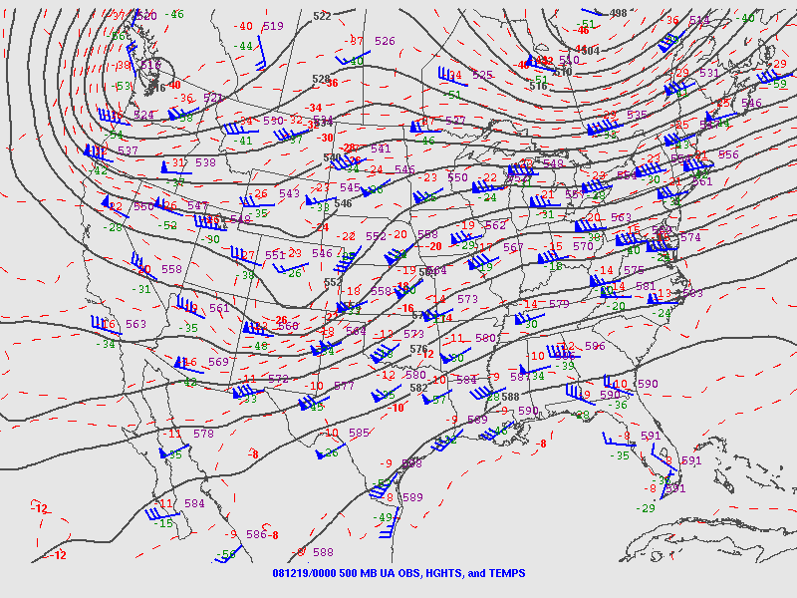
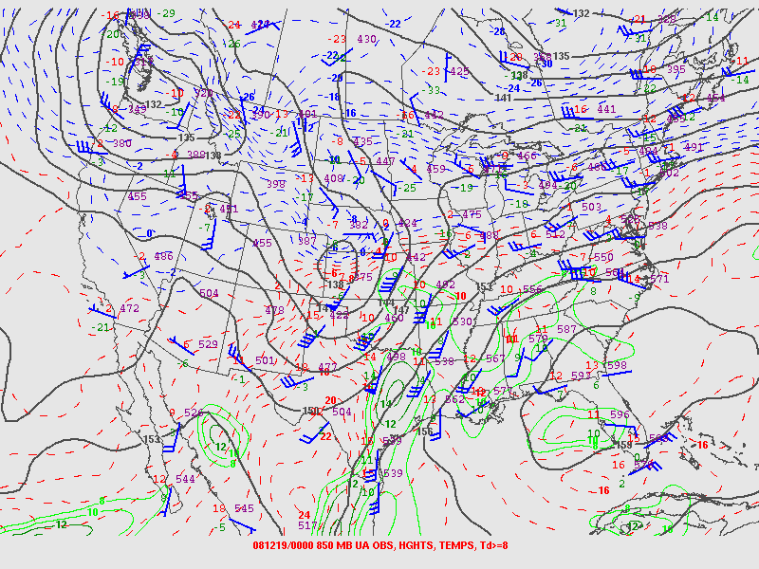
Notable Portland Snow Events Since 2000
December 18, 2008 at 4:00 PM (00Z)

Slide 27
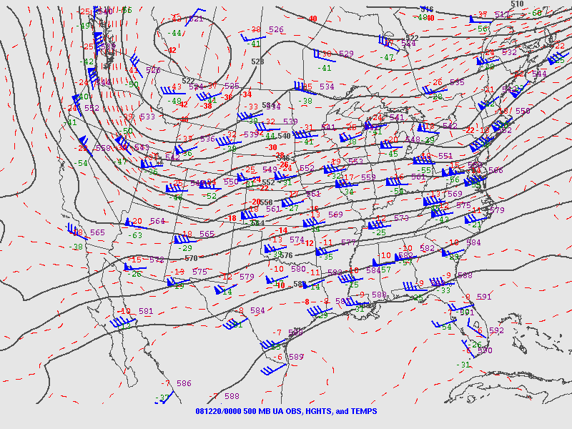
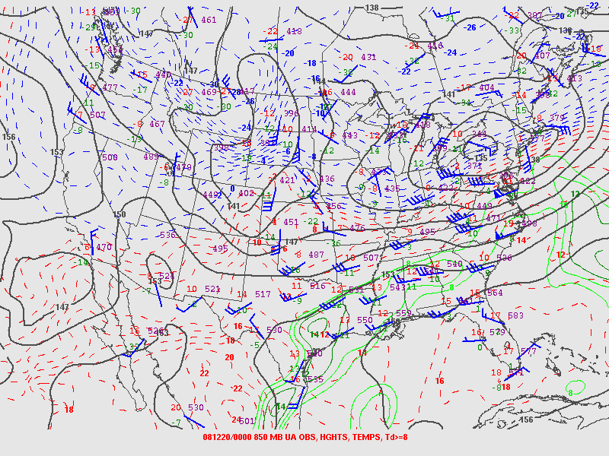
Notable Portland Snow Events Since 2000
December 19, 2008 at 4:00 PM (00Z)

Slide 28
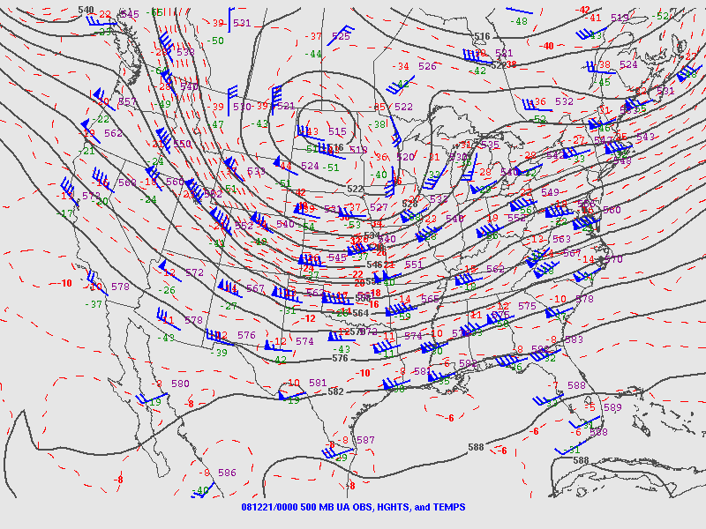
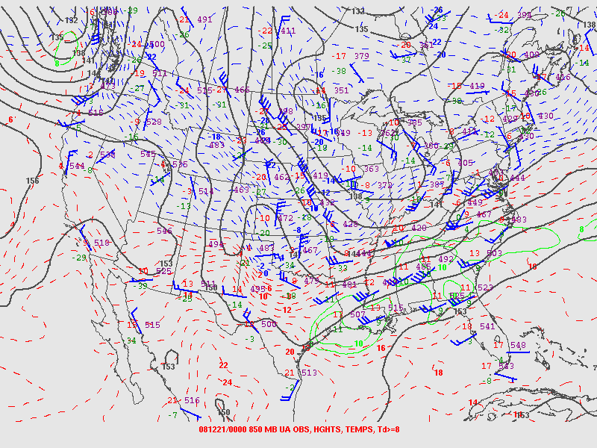
Notable Portland Snow Events Since 2000
December 20, 2008 at 4:00 PM (00Z)

Slide 29
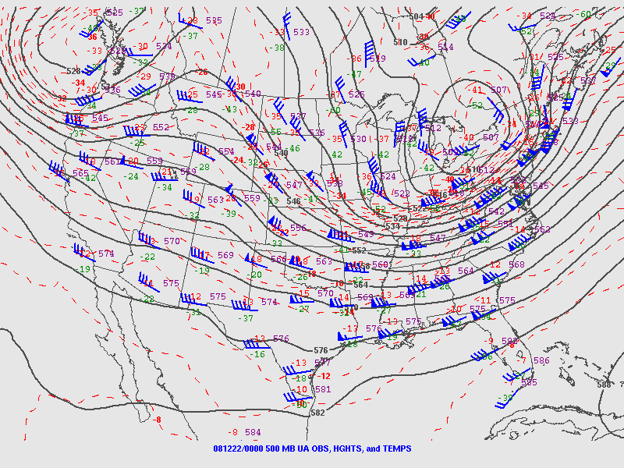
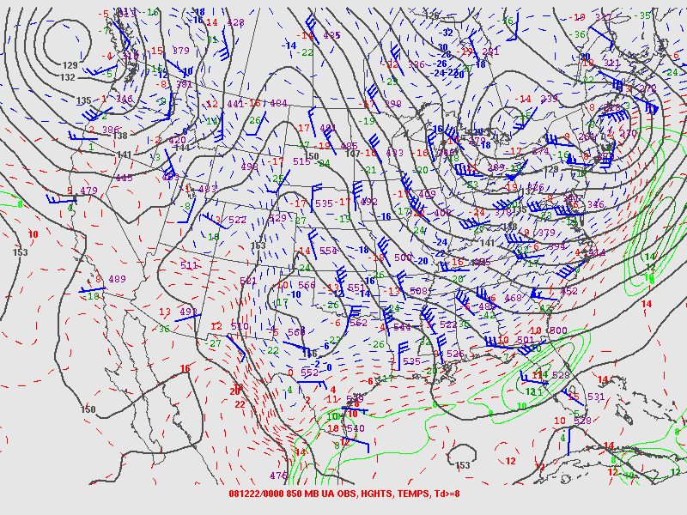
Notable Portland Snow Events Since 2000
December 21, 2008 at 4:00 PM (00Z)

Slide 30
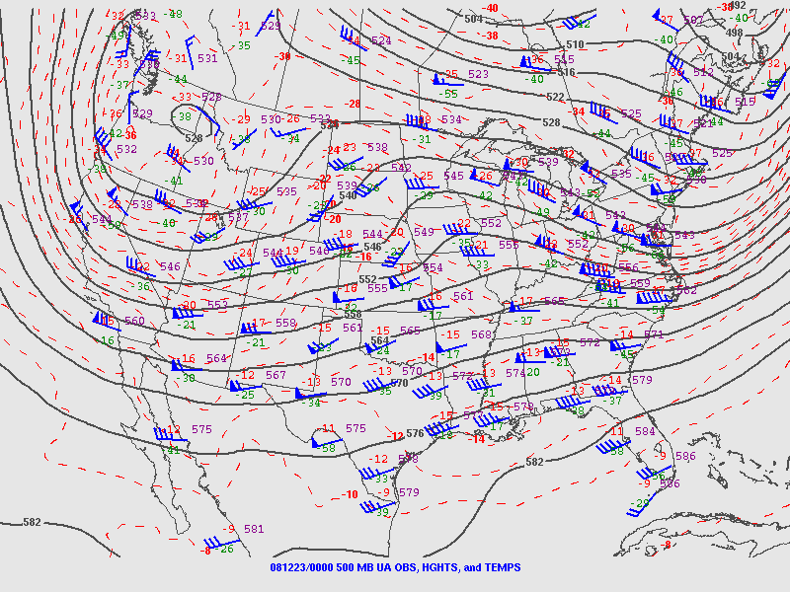
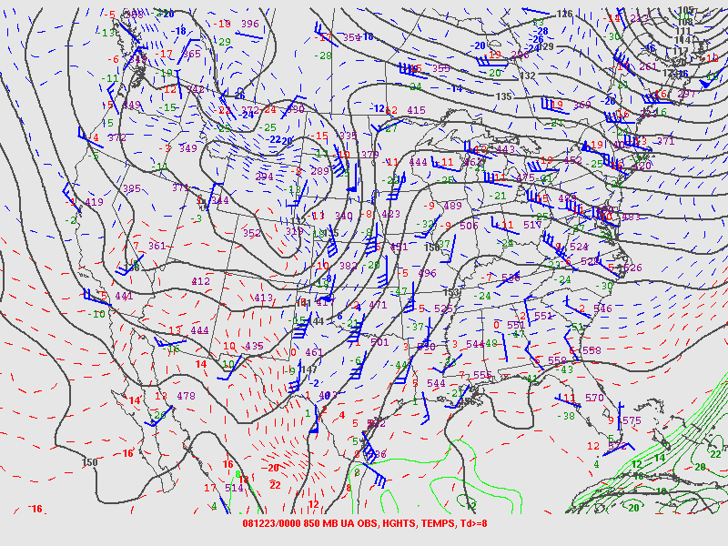
Notable Portland Snow Events Since 2000
December 22, 2008 at 4:00 PM (00Z)

Slide 31
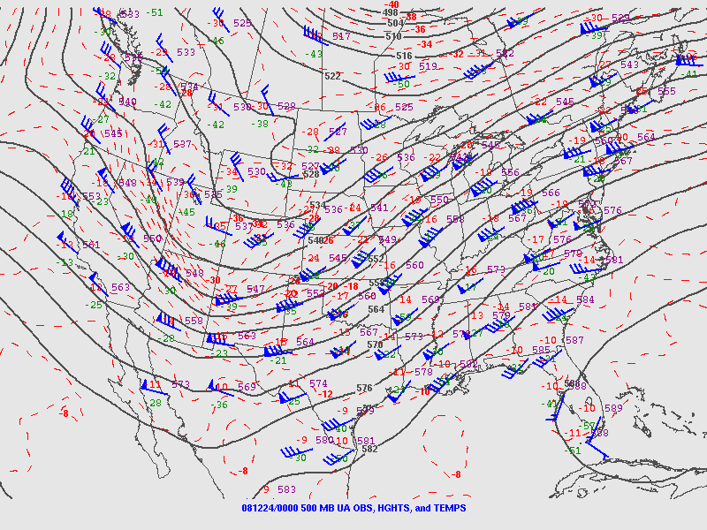
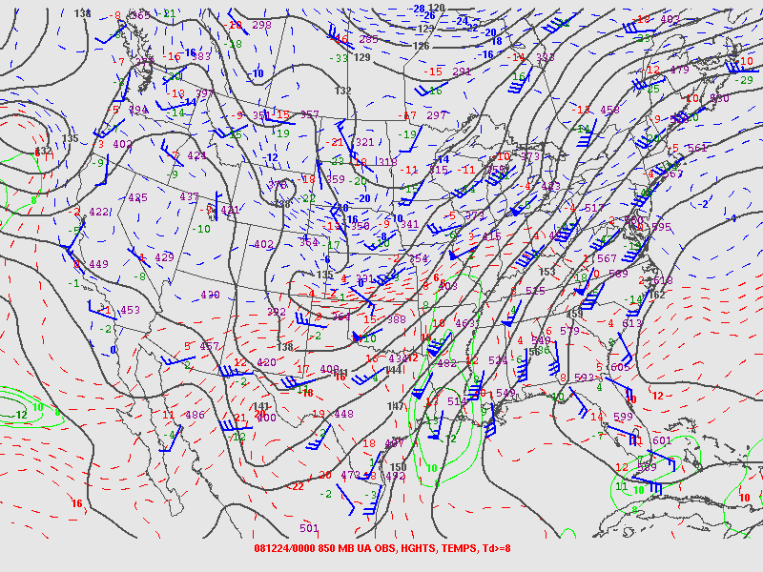
Notable Portland Snow Events Since 2000
December 23, 2008 at 4:00 PM (00Z)

Slide 32


Notable Portland Snow Events Since 2000
December 24, 2008 at 4:00 PM (00Z)

Slide 33


Notable Portland Snow Events Since 2000
December 25, 2008 at 4:00 PM (00Z)

Slide 34

Wrap-Up
Forecasting snow accurately is challenging in Portland due to:
  The geography of the region
    Location
    Elevation
    Marine Influence
  Timing
    Cold air and moisture
  Shifting winds
    Easterlies (or northerlies) shifting southerly
KATU 4/12/22- https://katu.com/news/local/snow-on-valley-floor-possible-wednesday-morning

Slide 35
Thank you for your time =)
Any Questions?

