Slide 1

A MILD LA NIñA WINTER
WINTER 2021-2022
Mark Nelsen

Slide 2
Winter 2021-22
Near normal temperatures & precipitation in the end, but…
Tons of mountain snow mid/late December,
then mid-winter lull with no storminess lasted 7 weeks!
Poor snowpack UNTIL cool/wet April turnaround
It snowed in April!
Still waiting for regional arctic blast.
8th consecutive winter without a widespread arctic outbreak. (December 2013 was the last)

Slide 3

Waiting on the “winter storm” the day after Christmas
OFFICIAL SNOW TOTAL: 6.3”
at PQR (NWS Office)
3.1” Downtown (KGW-TV)

Slide 4
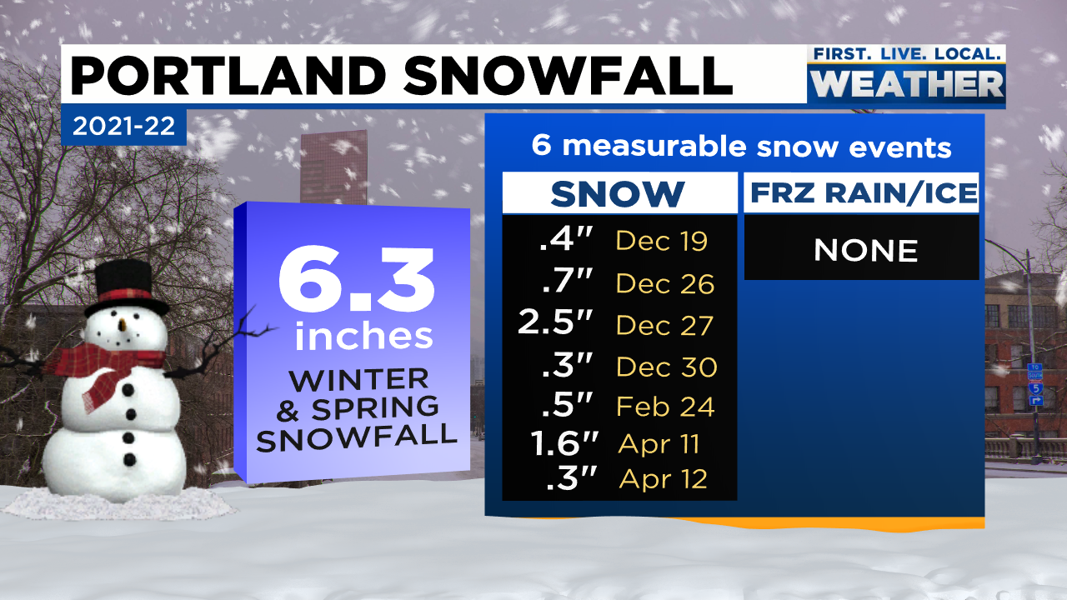


Slide 5
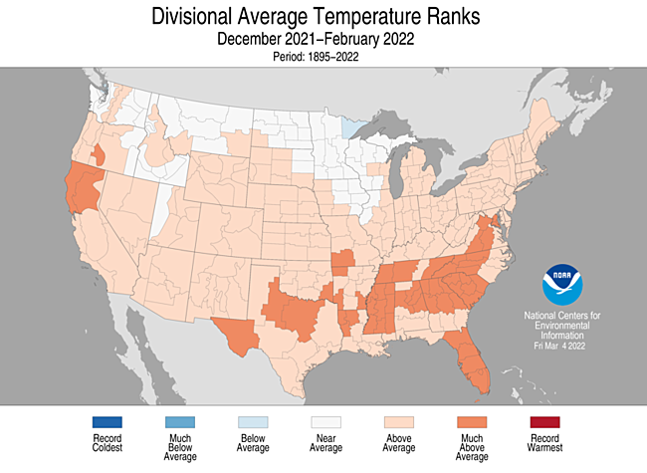
Winter Temperature Anomaly

Slide 6
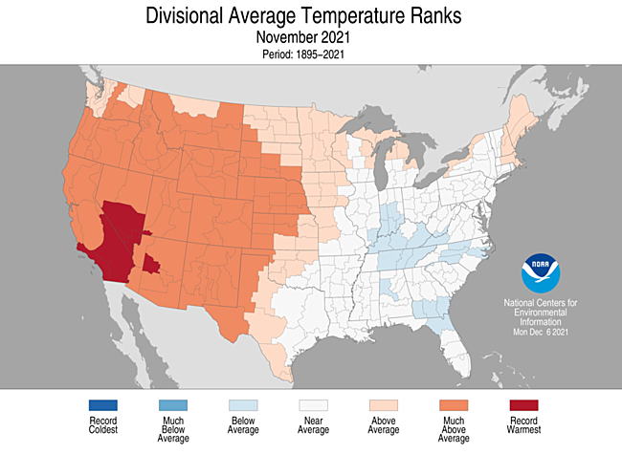
THE USA VIEW

Slide 7
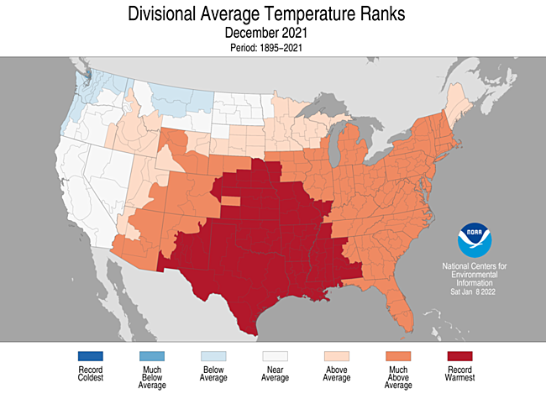
THE USA VIEW

Slide 8
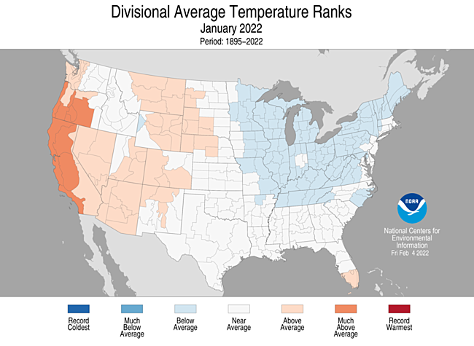
THE USA VIEW

Slide 9
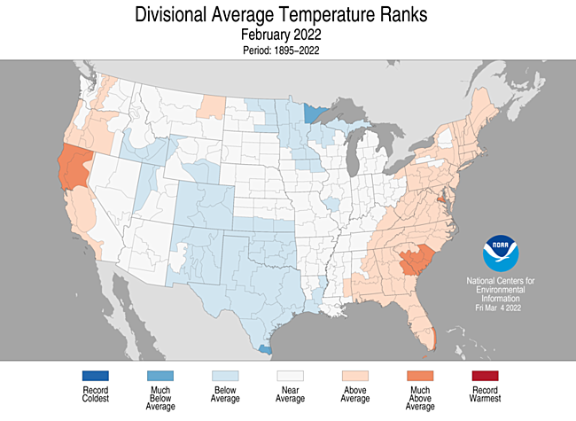
THE USA VIEW

Slide 10
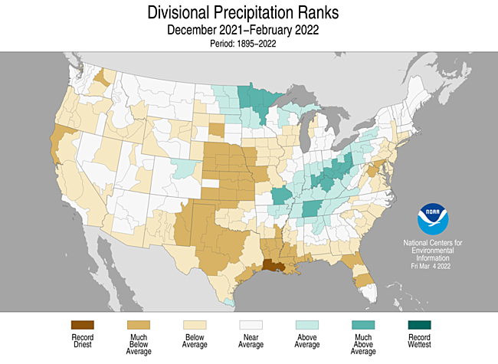
Winter Precip Anomaly

Slide 11
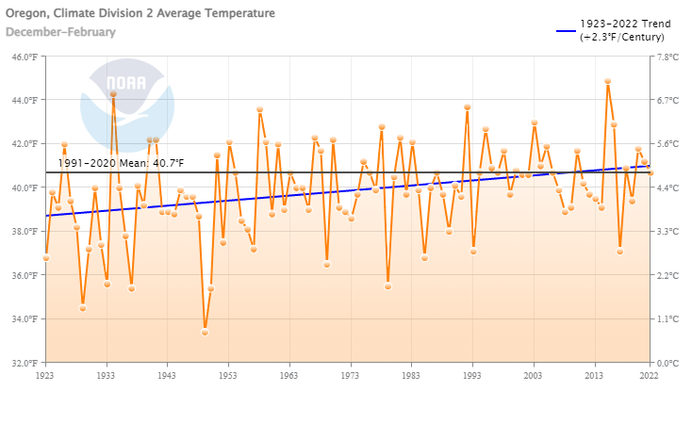
Western Valleys Winter Temperature
(the past 100 years)
Another mild one. Last “cold” winter was 2016-17
Last Winter in Oregon Zone 2 (Willamette Valley)
The last two cold winters
(92-93 & 16-17)

Slide 12
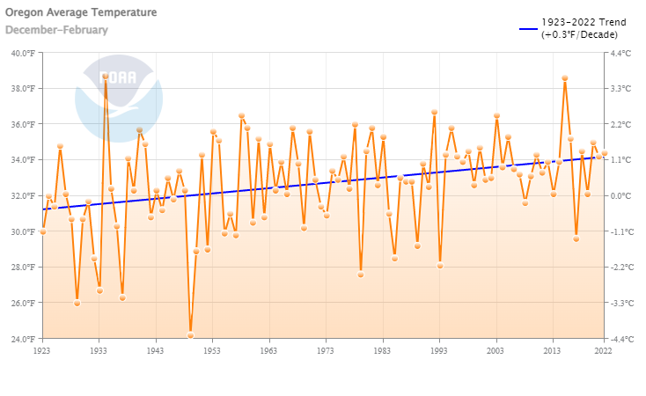
Oregon Winter Temps
(the last 100 years)
Slow Warming Trend (3 deg/century)

Slide 13
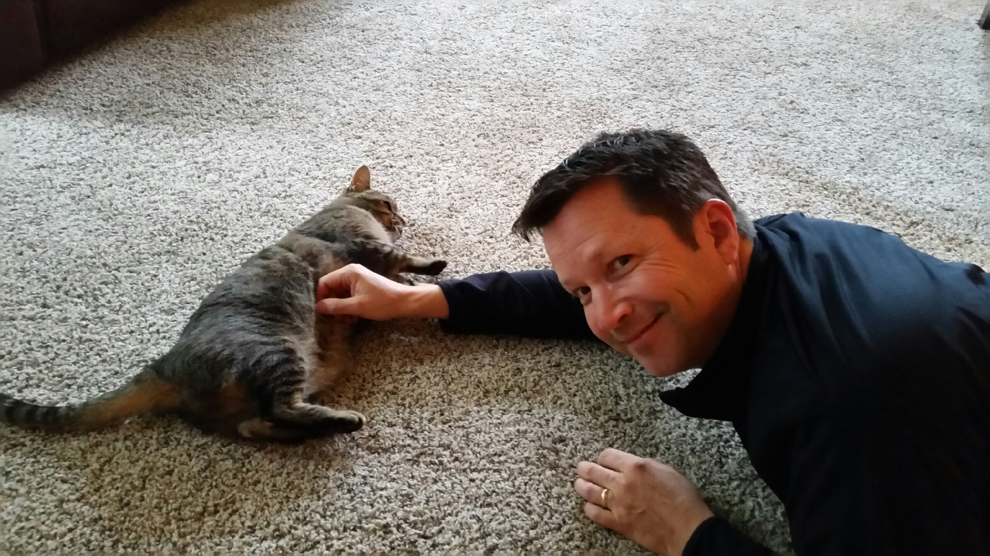
A WEATHER QUIZ
WHY IS MARK HANGING OUT WITH STEVE’S CAT?
PLUS, WHAT IMPORTANT METEOROLOGICAL EVENT WAS ABOUT TO OCCUR IN THE PACNW?

Slide 14
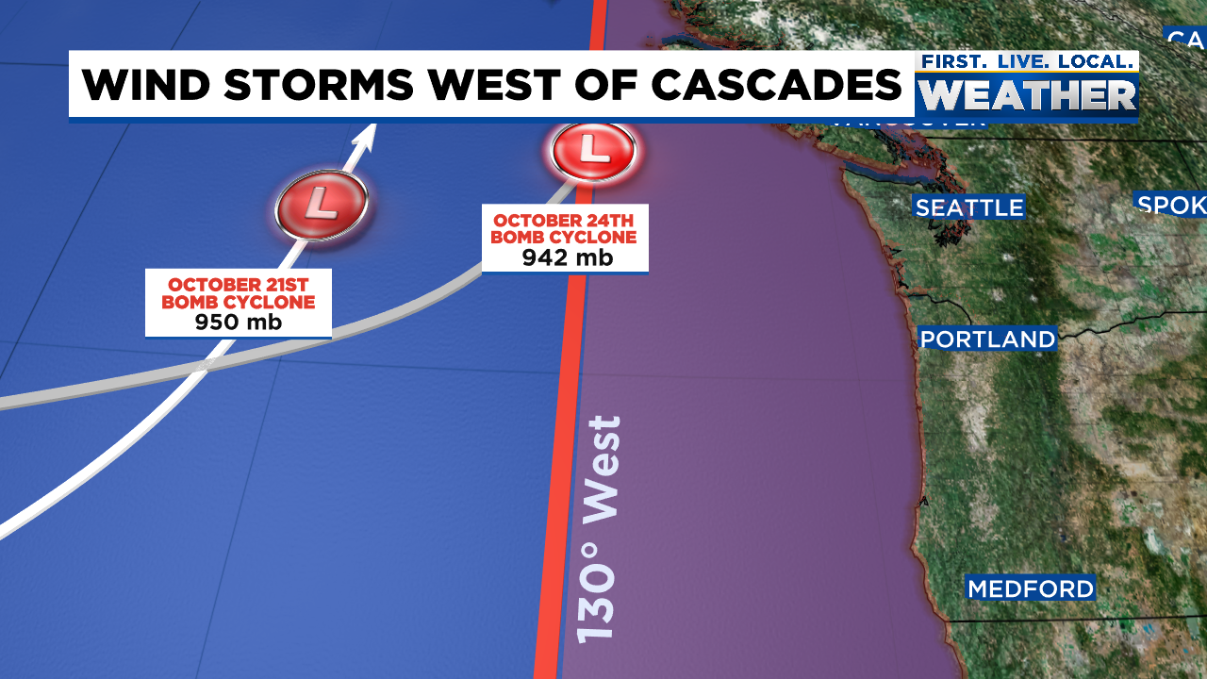
LAST WEEK OF OCTOBER
Huge mid-latitude cyclones in Eastern Pacific

Slide 15
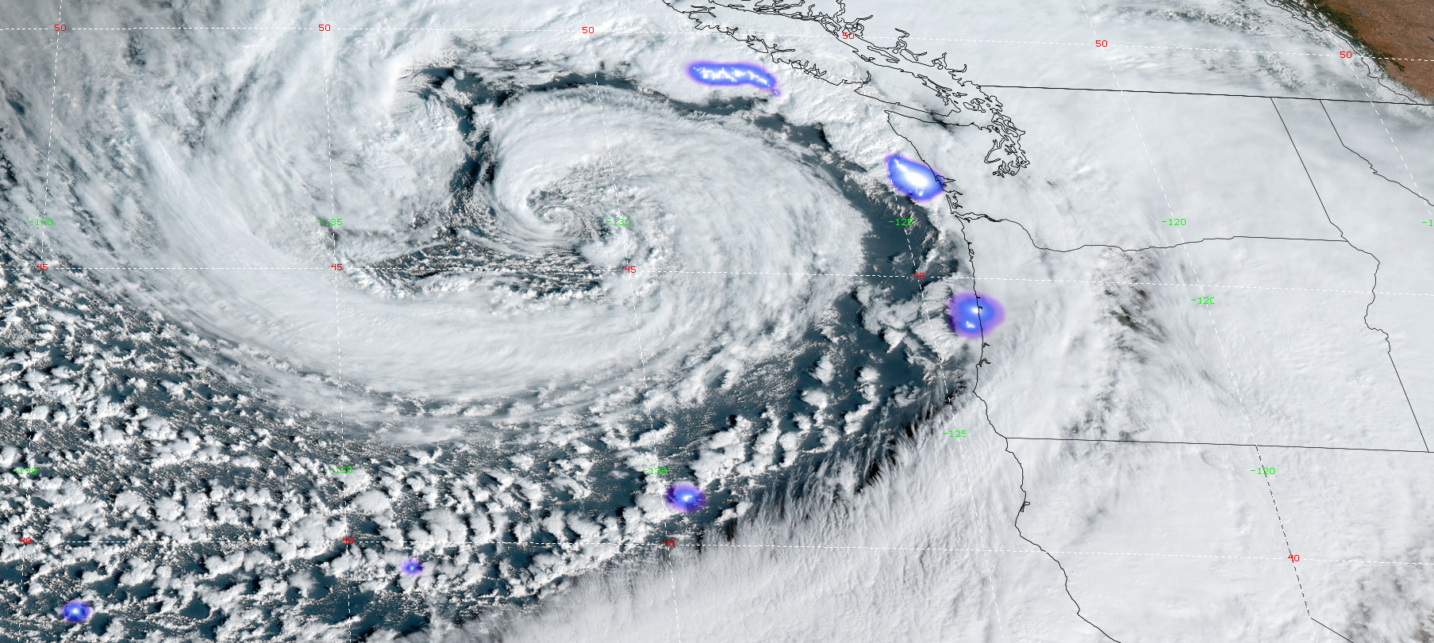
LAST WEEK OF OCTOBER
942 millibar low October 24, 2021
Deepest on record for this part of N.E. Pacific

Slide 16
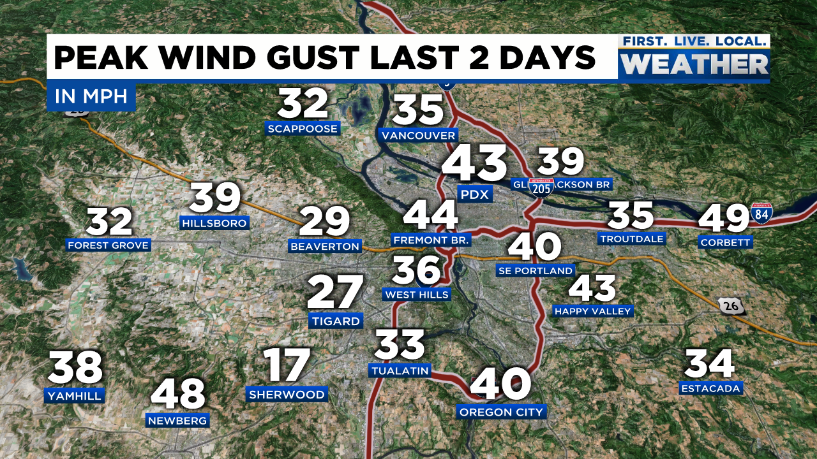
LAST WEEK OF OCTOBER
Strong gradient and wind remains offshore with big cyclones

Slide 17
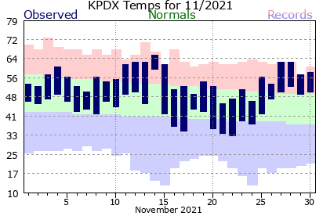
NOVEMBER
Mild & wet weather. Lots of fronts/systems, but no big storms

Slide 18
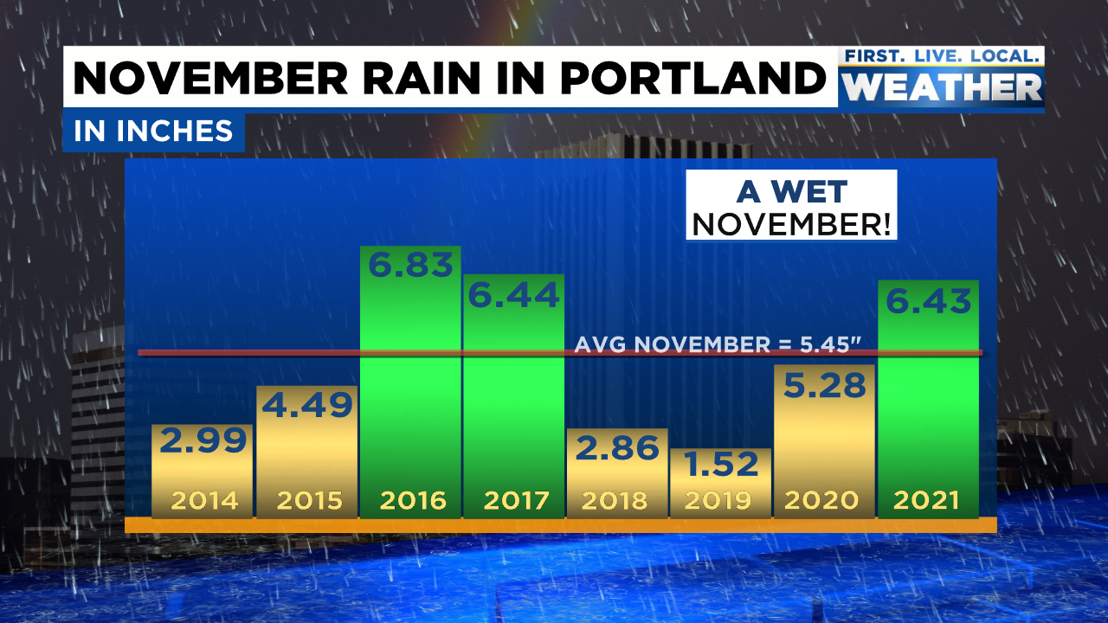
Much-needed wet fall

Slide 19
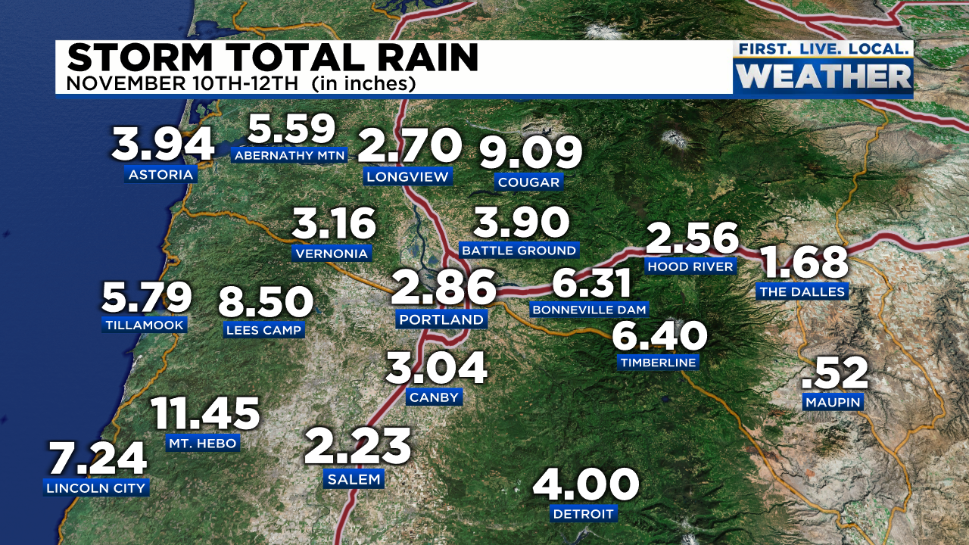
NOVEMBER
Atmospheric river hits N.W. Oregon 2nd week of month

Slide 20
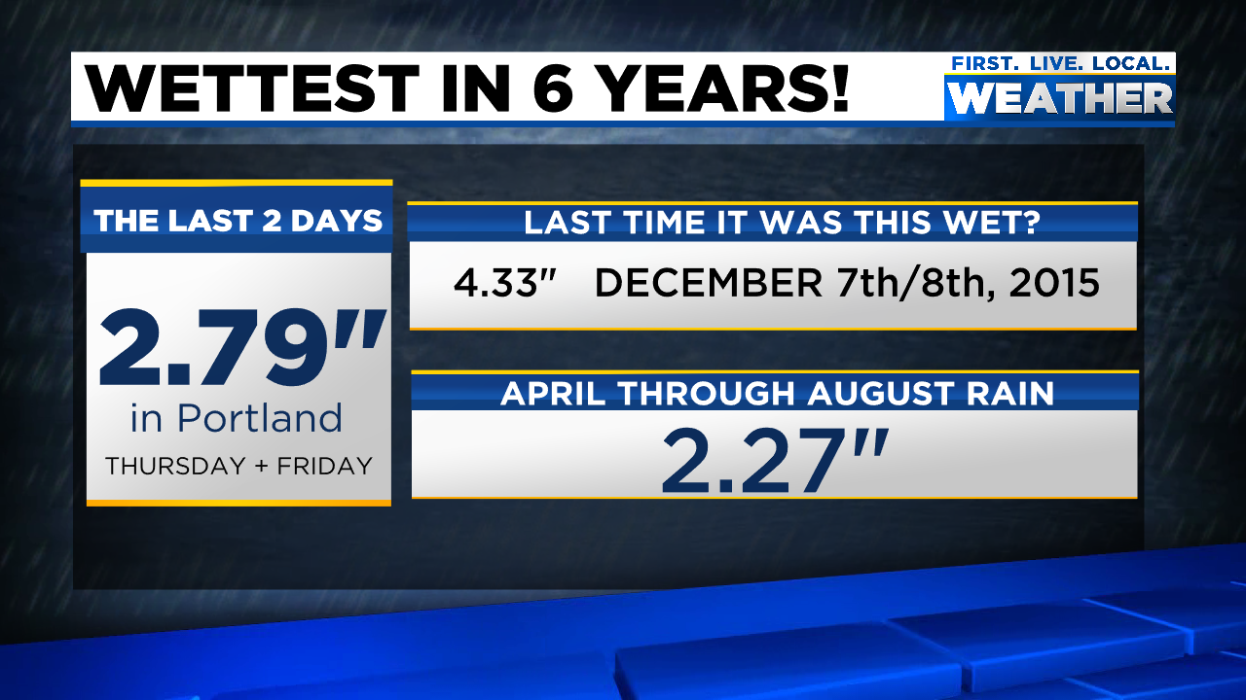
NOVEMBER
Atmospheric river hits N.W. Oregon 2nd week of month

Slide 21
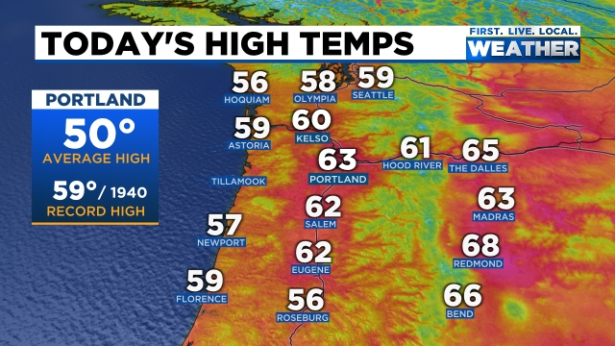
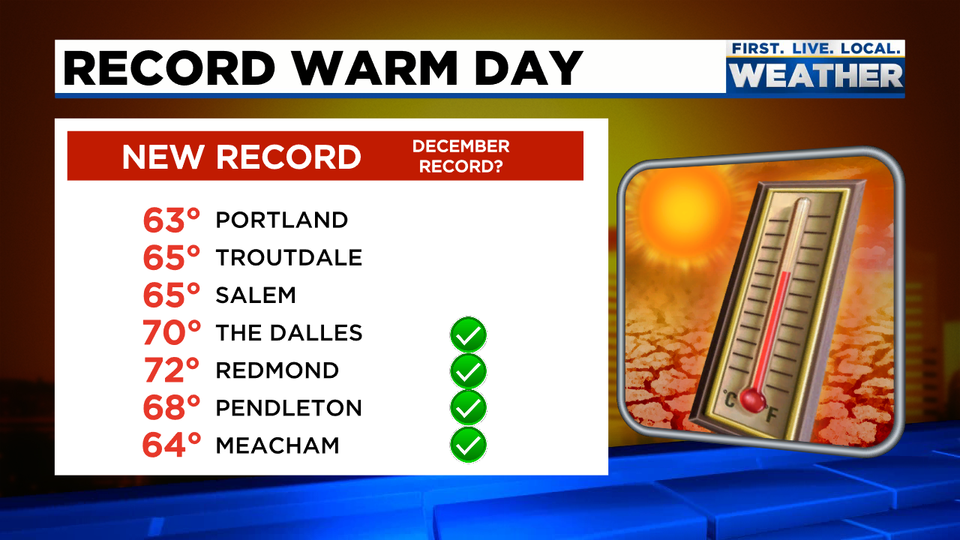
CHRISTMAS JUST 3+ WEEKS AWAY!
DECEMBER 1ST

Slide 22
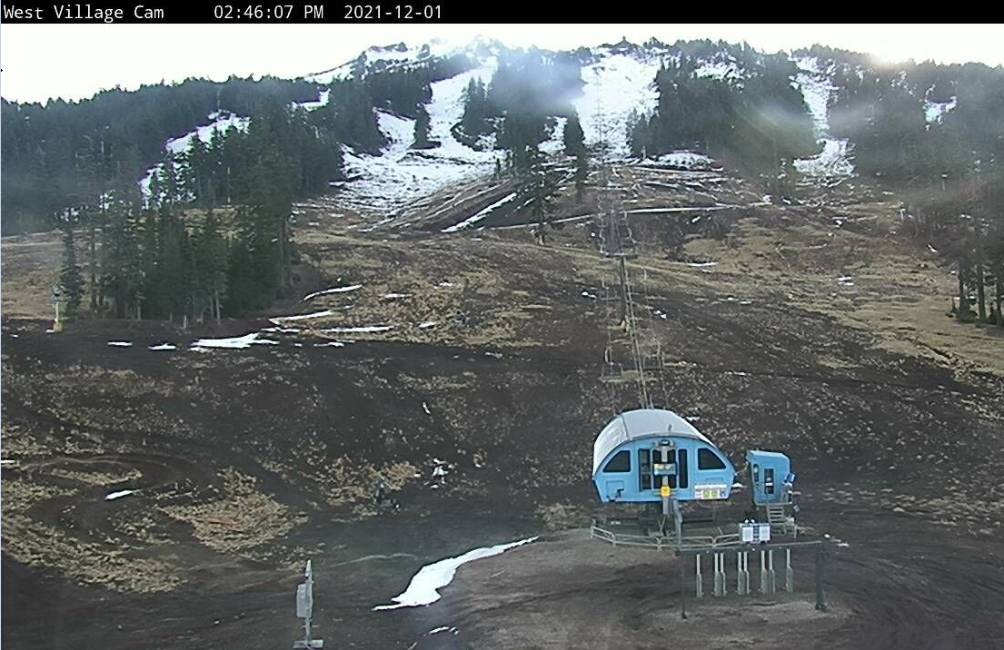
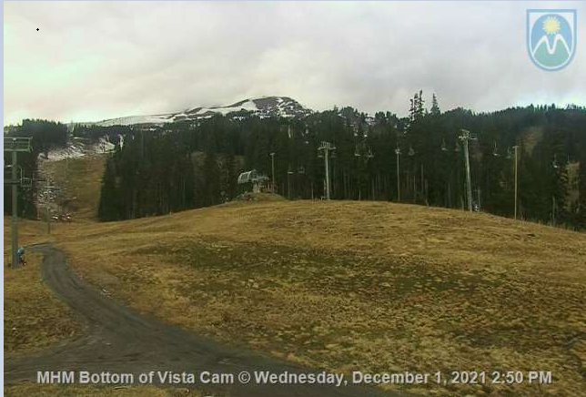
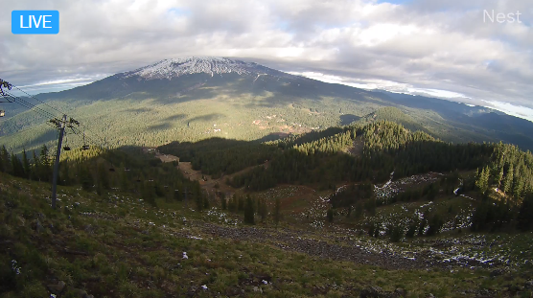
Little or no snow at ski areas through first week of December.
Several snowstorms followed by warm rains Oct/Nov
Late starts more common recently
DECEMBER 1ST

Slide 23
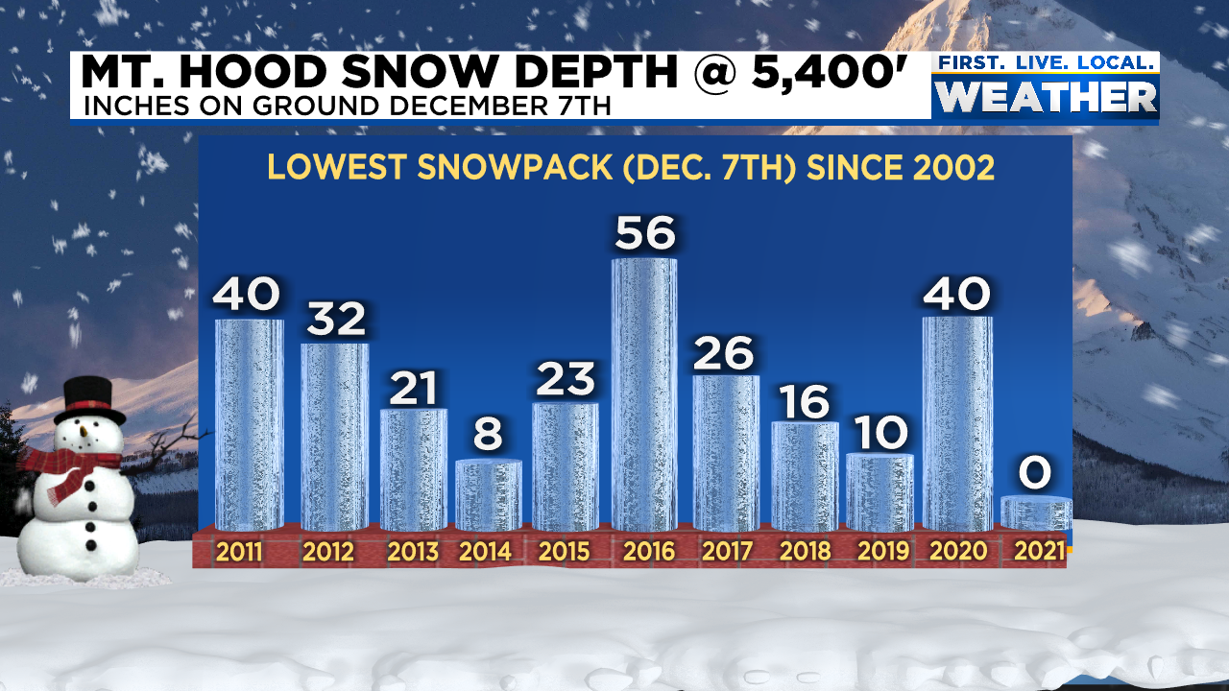
Little or no snow at ski areas through first week of December.
Several snowstorms followed by warm rains Oct/Nov
Late starts more common recently

Slide 24
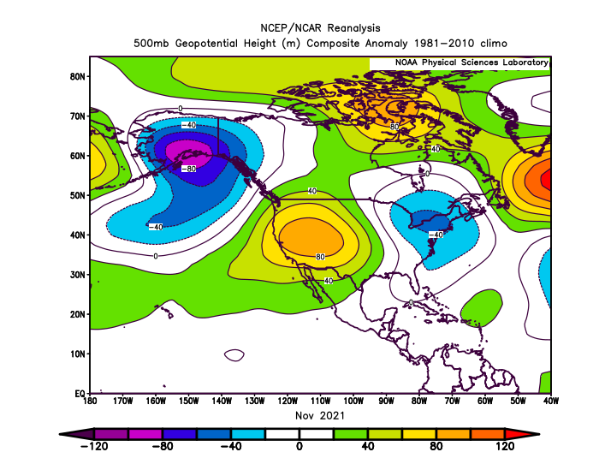
NOVEMBER 500mb HEIGHTS

Slide 25
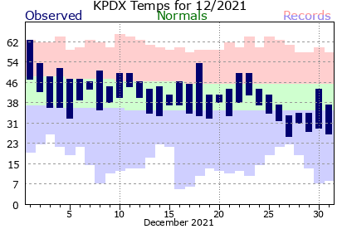
DECEMBER
3 mild/normal weeks, then cold/snowy last week

Slide 26
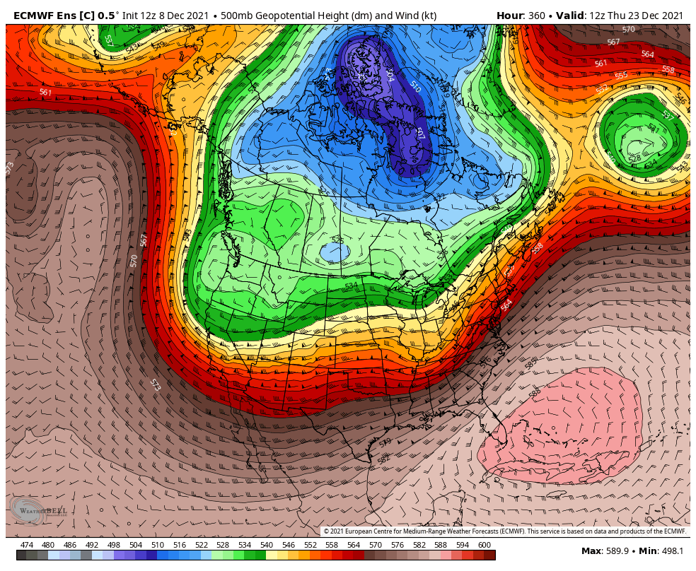
2-week forecast from December 8th (ECMWF ensembles)
Models showing pattern change to ridging in EPAC
and troughing over Western North America = looking exciting!

Slide 27
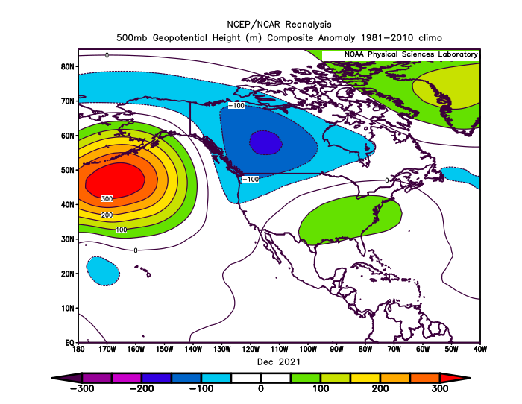
Actual December 500 millibar height anomaly
Ridging in N.E. Pacific, troughing in western North America

Slide 28
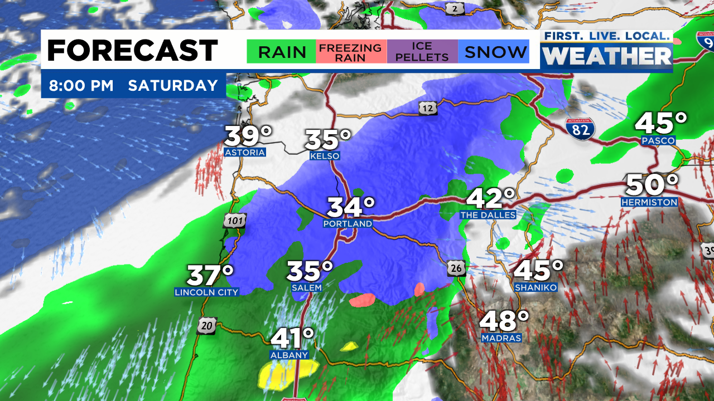
FIRST SNOW “EVENT”
Saturday, December 18th “Anafront”

Slide 29
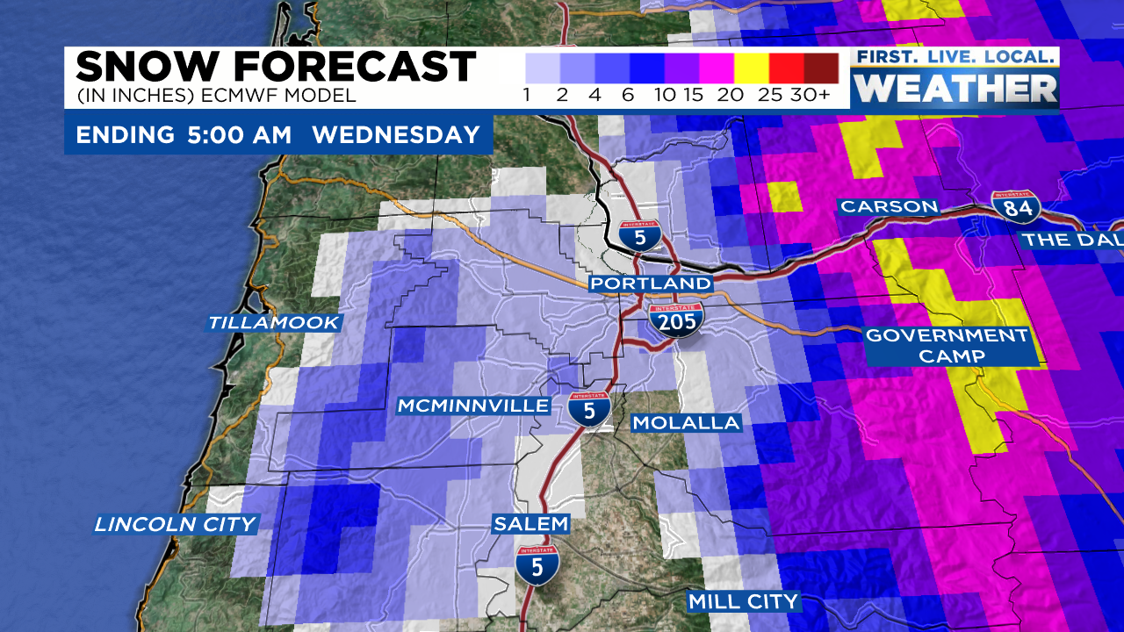
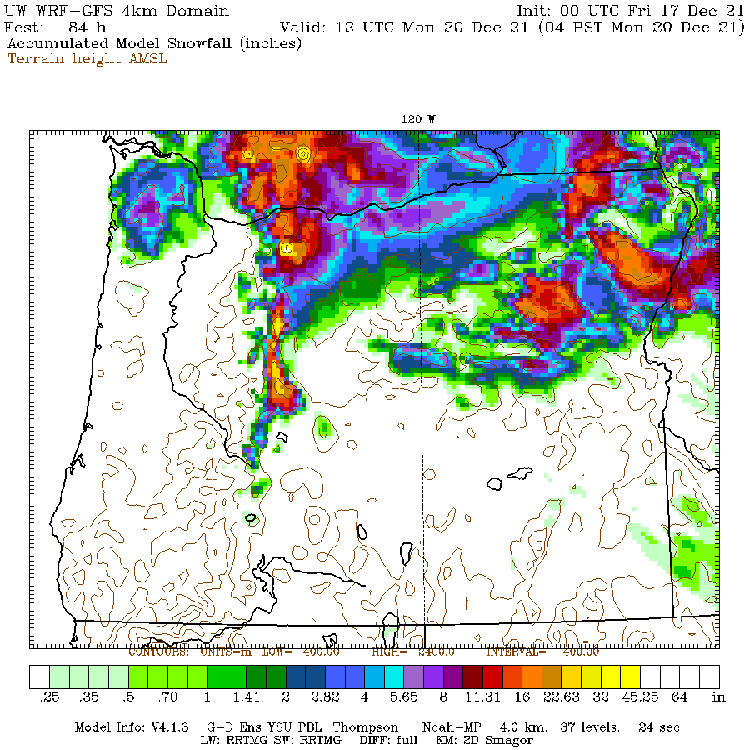
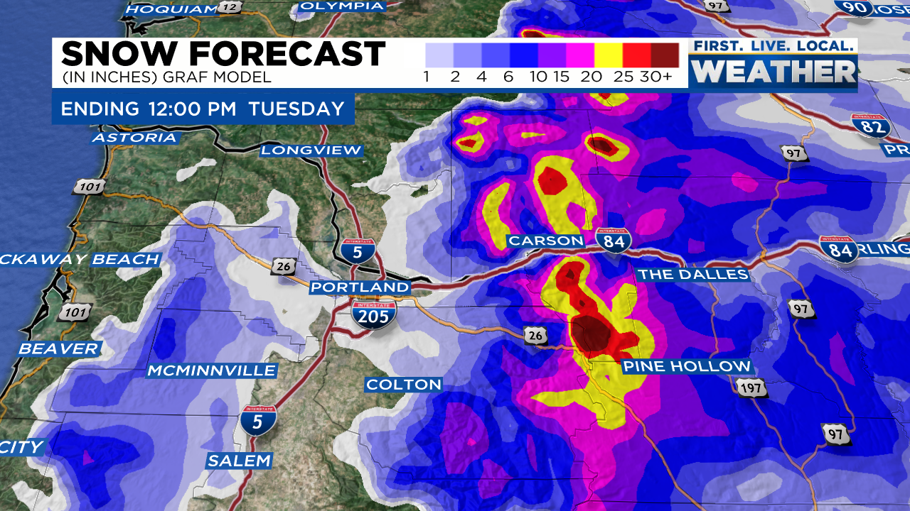
FIRST SNOW “EVENT”
Saturday, December 18th “Anafront”
HEAVY RAIN > HEAVY EVENING SNOW > LIGHT RAIN BY SUNRISE

Slide 30
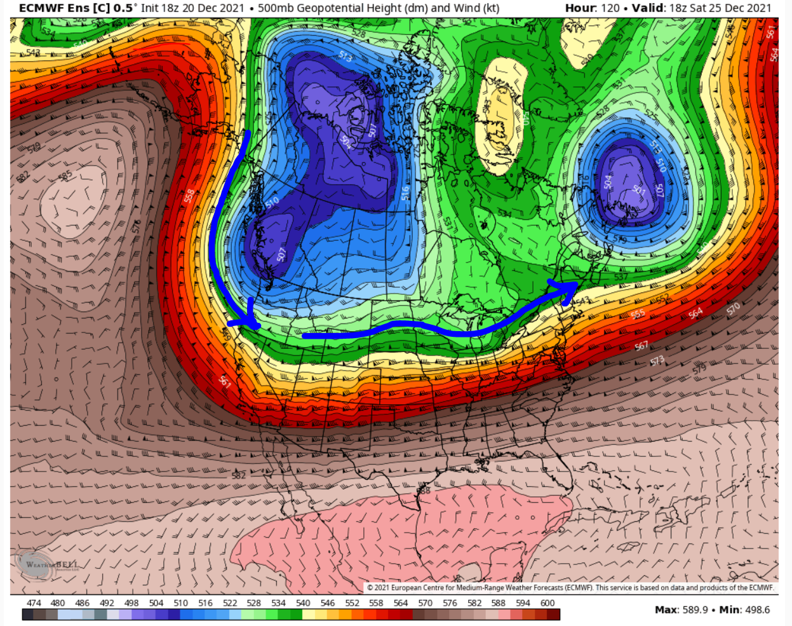
THEN…MODELS ALL FORECAST VERY COLD UPPER TROUGH
FOR CHRISTMAS WEEKEND…CHRISTMAS SNOW???
The usual issues: How much moisture, does arctic air make it to Oregon, snow?
Euro forecast on 20th …for 25th

Slide 31
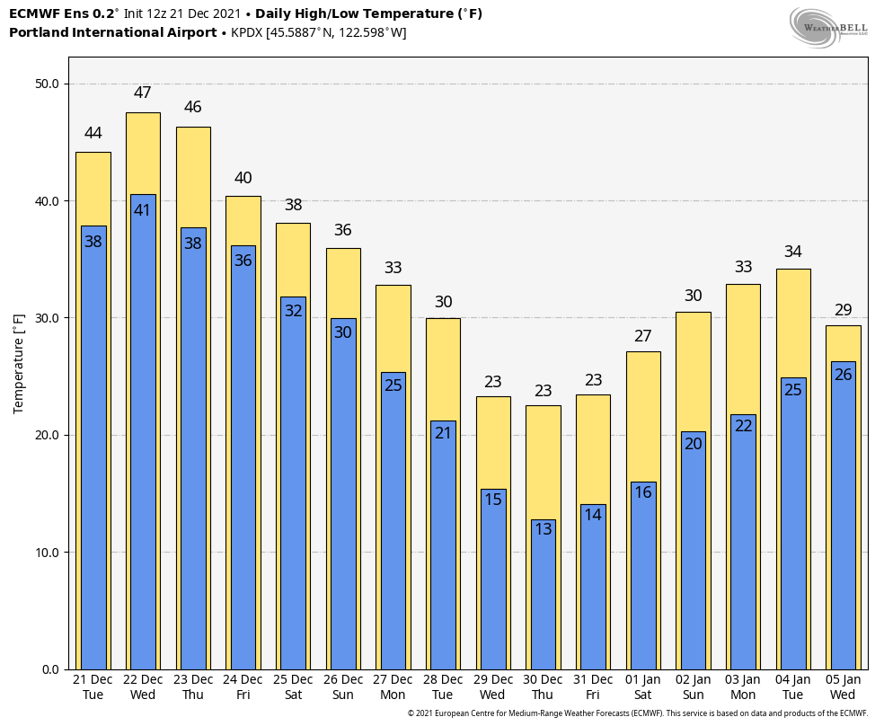
MODELS ALL FORECAST COLD UPPER TROUGH
FOR CHRISTMAS WEEKEND
The usual issues: How much moisture, does arctic air make it to Oregon, snow?
Euro forecast on 21st

Slide 32
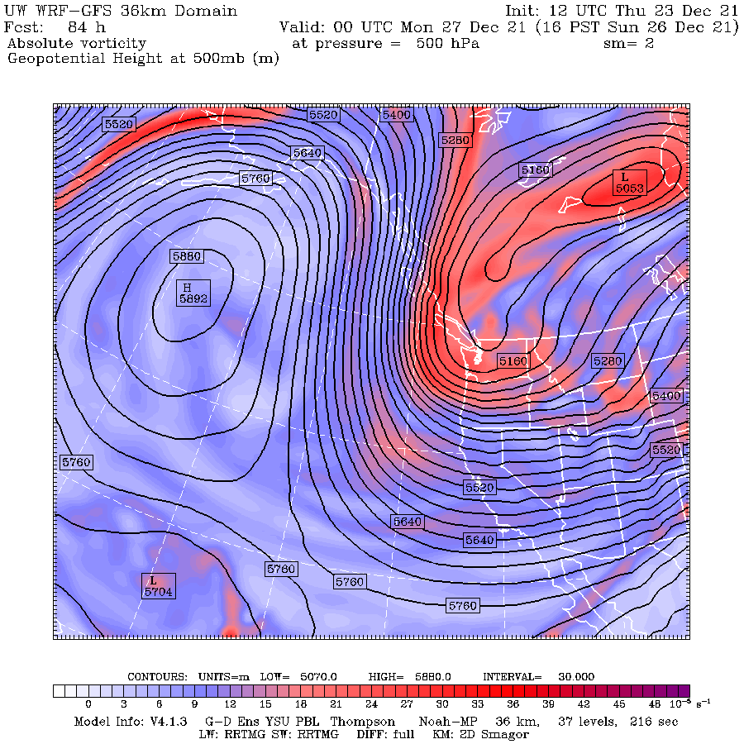
FORECAST FOR SUNDAY, DEC 26TH
Exact orientation
and how
far cold upper trough
pushes south
determines how cold we get in PACNW

Slide 33
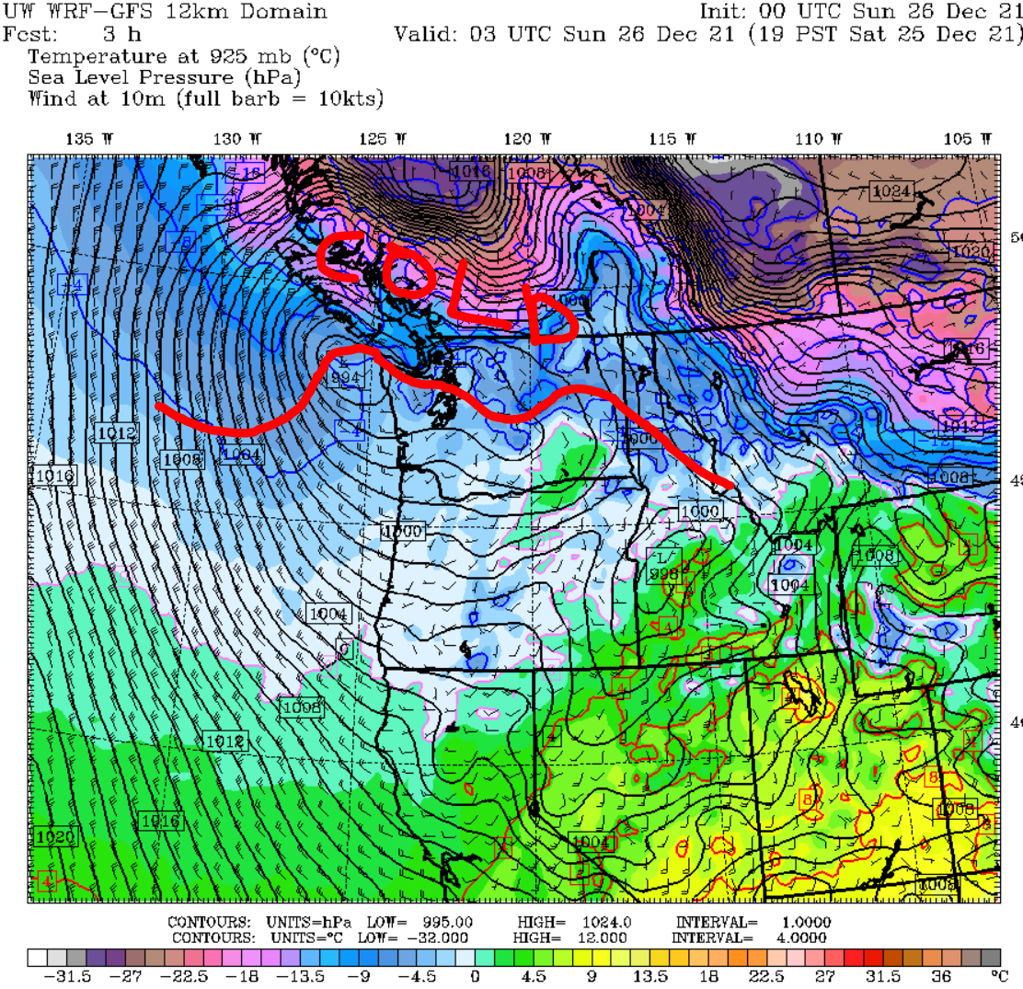
COLD ONSHORE FLOW = SNOW TO SEA LEVEL
(Where there was enough moisture for showers)
Christmas Evening (25th)

Slide 34
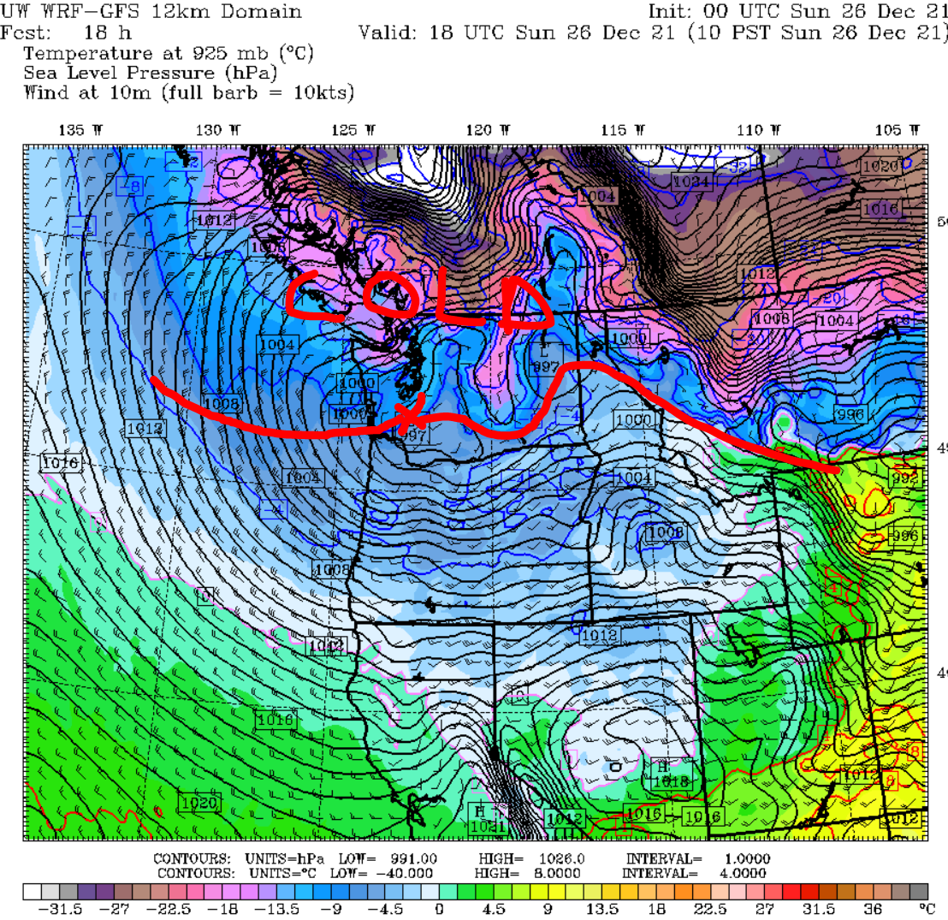
ONSHORE FLOW CONTINUES SUNDAY (Snow for some of us)
Forecast for midday on 26th (Sun)

Slide 35
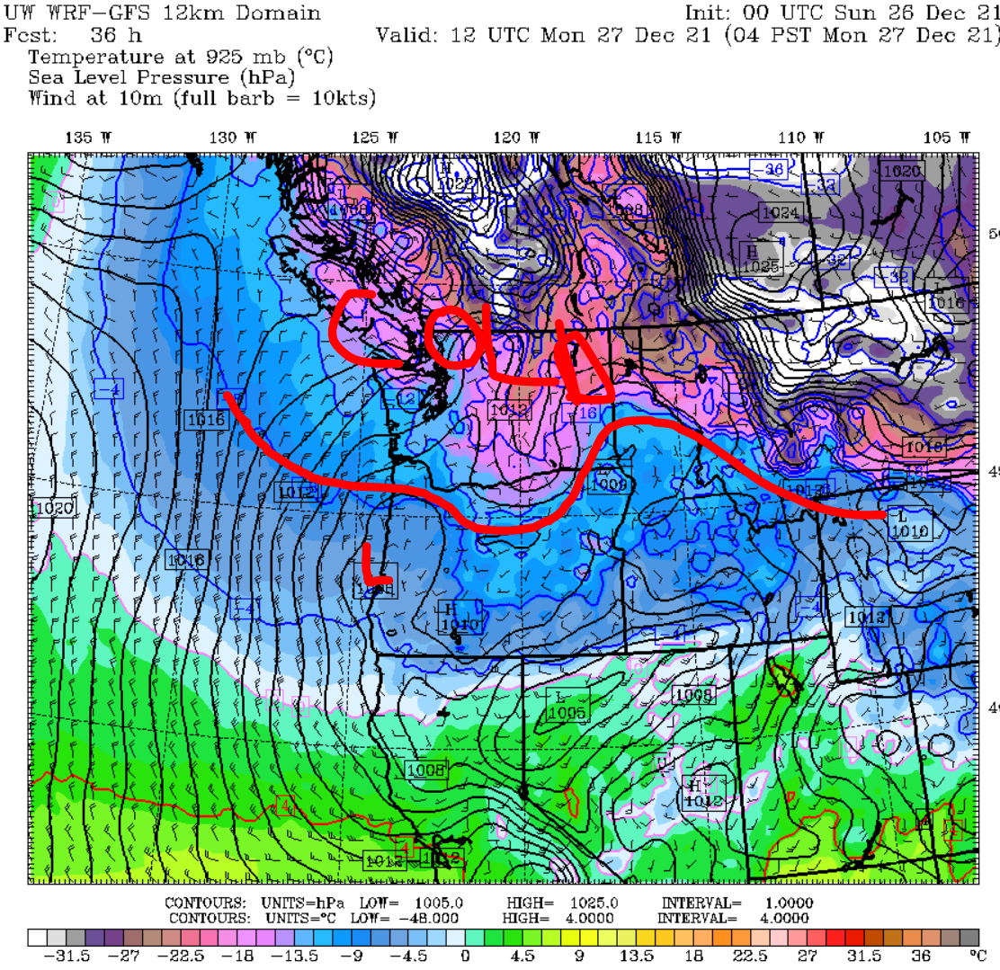
Thin layer of surface arctic air noses into Portland/Salem Monday
Forecast for 26th (Mon AM)

Slide 36
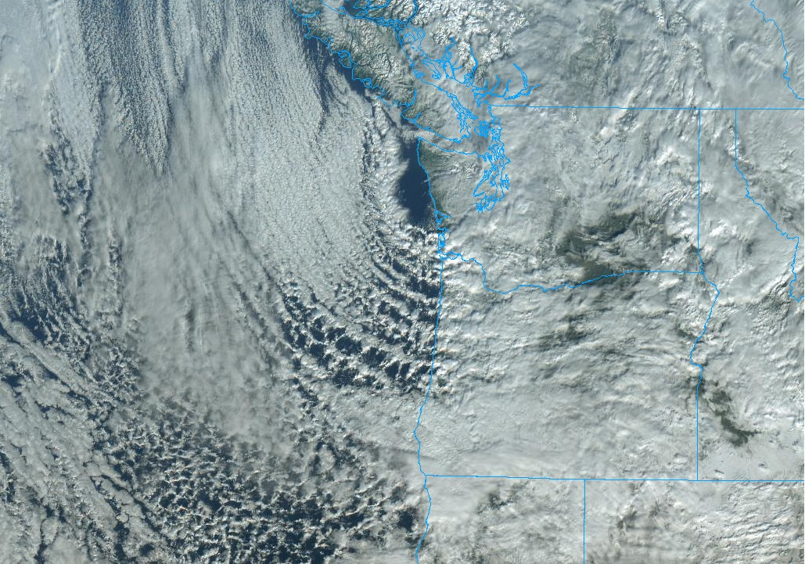
“Ocean Effect” snow showers moving inland
Sunday the 26th

Slide 37
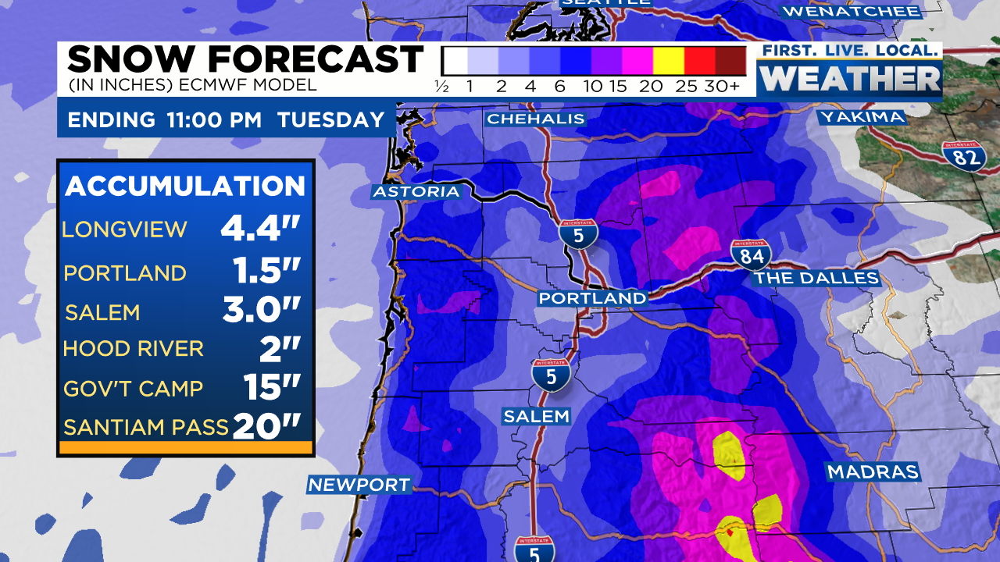
MODELS STRUGGLE WITH COLD SHOWER PATTERN
Global models don’t handle situation well

Slide 38
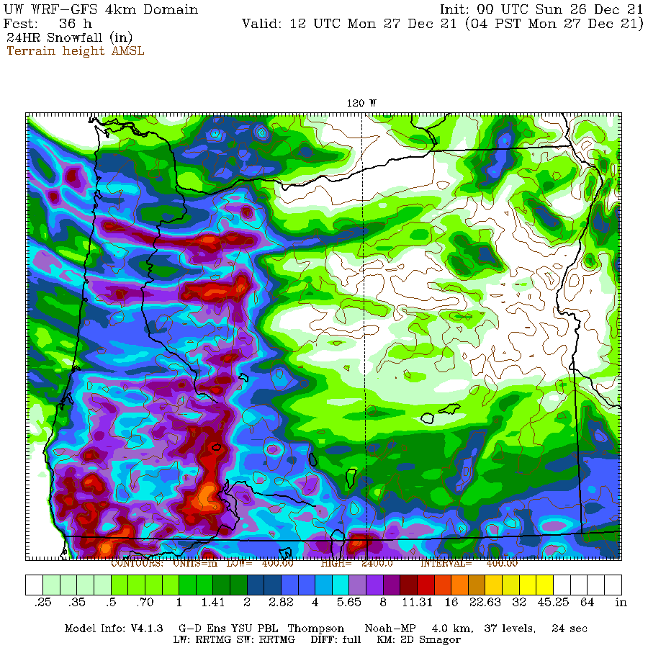
MODELS STRUGGLE WITH COLD SHOWER PATTERN
Mesoscale models
show “banding”
of heavy showers = correct,
but who gets them???

Slide 39
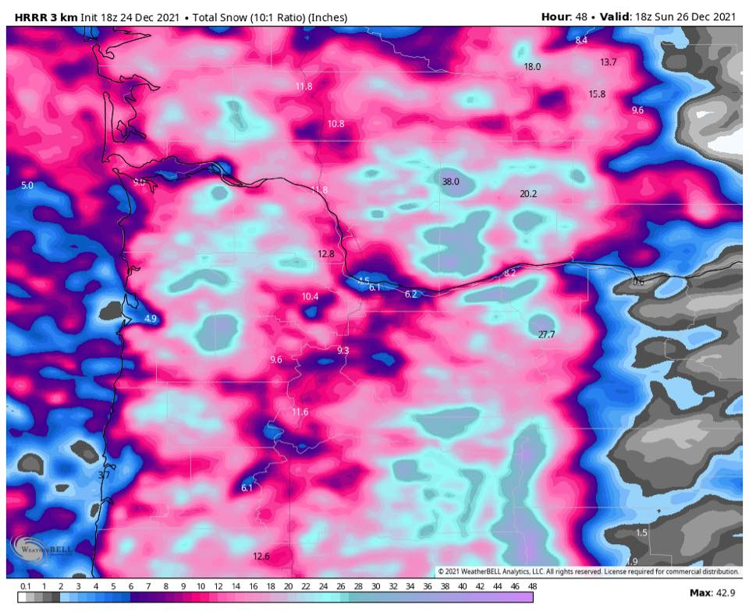
MODELS STRUGGLE WITH COLD SHOWER PATTERN
Just a tad aggressive
with snow forecast…no?

Slide 40
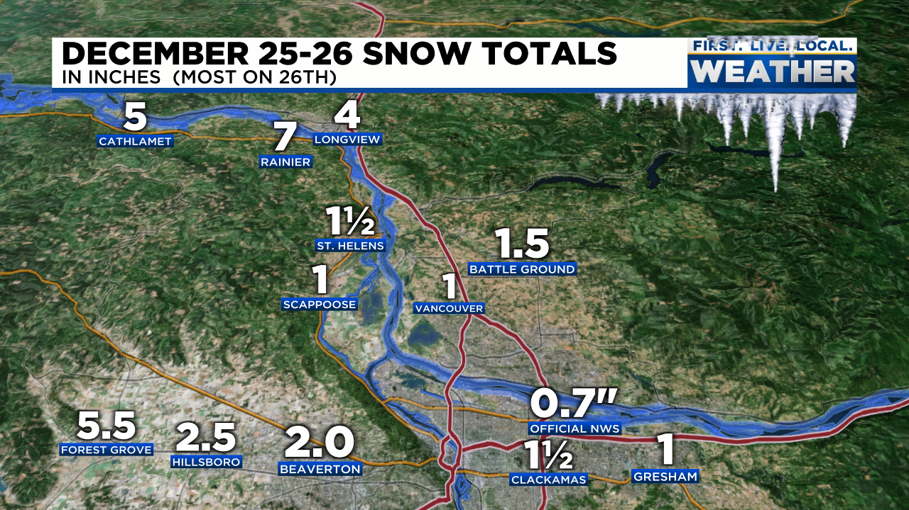
WHAT HAPPENED?
Not much in most of metro area

Slide 41
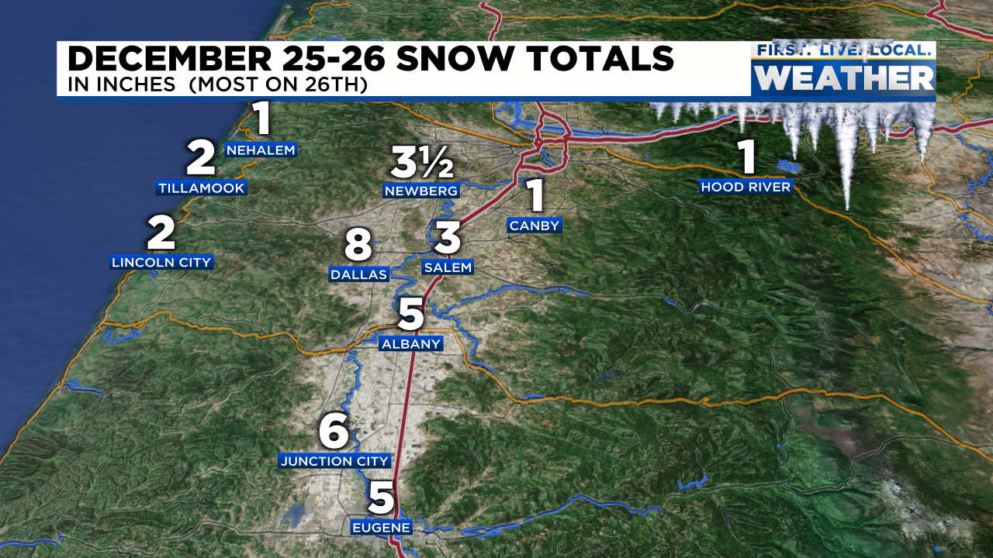
LOTS OF SNOW IN PARTS OF CENTRAL/SOUTH VALLEY
Could be more in Eugene, totals from Portland NWS

Slide 42
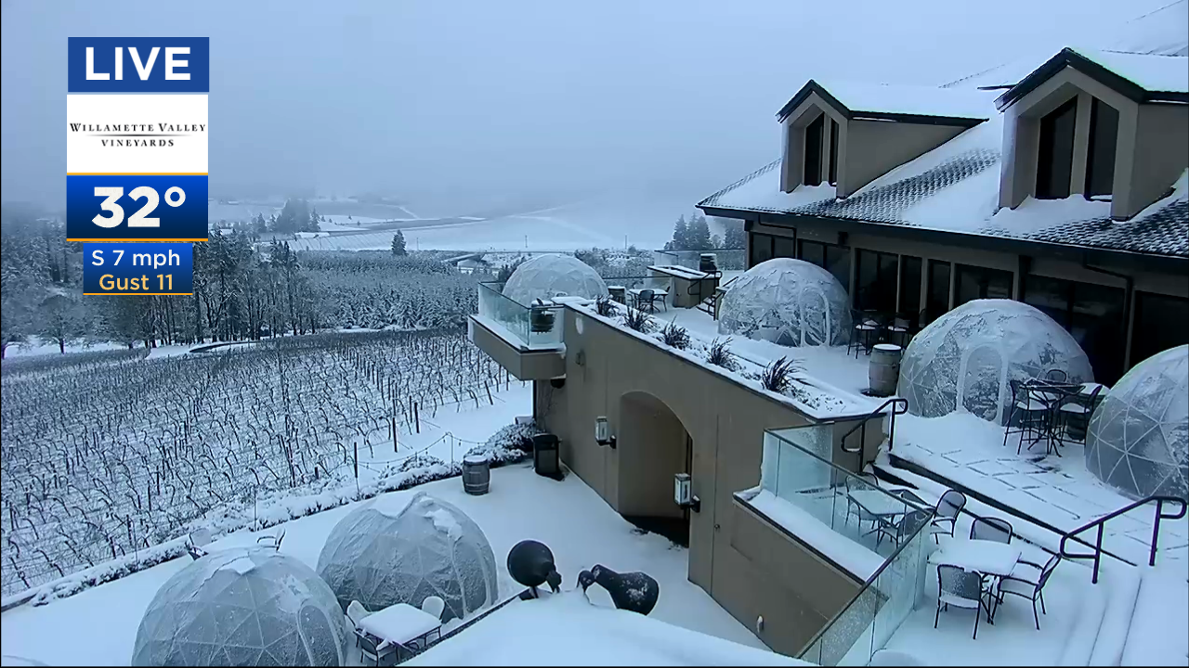
REAL SNOW IN PARTS OF CENTRAL/SOUTH VALLEY
December 26th in South Salem Hills

Slide 43
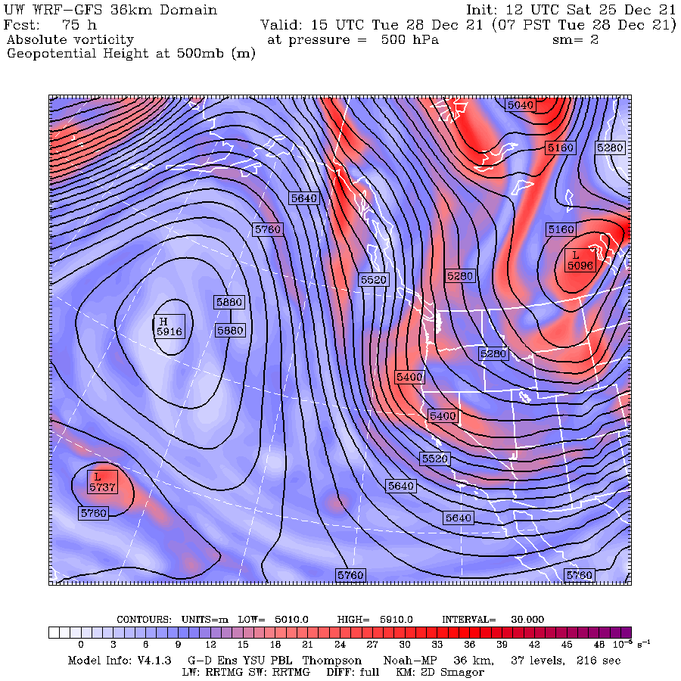
COLD FINAL WEEK OF DECEMBER
Cold northerly flow follows
December 27th-January 1st
Several “BC Sliders”
bring light snow

Slide 44
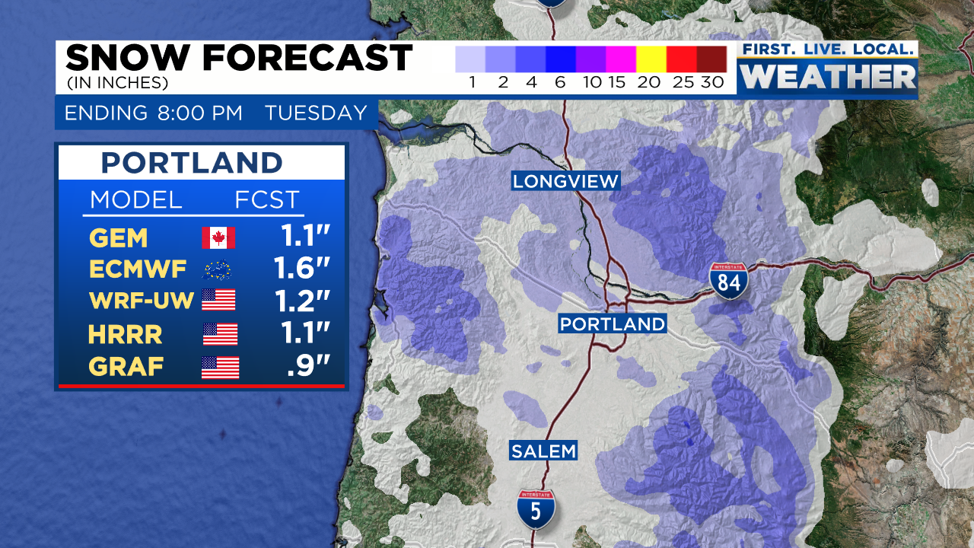
WIDESPREAD METRO SNOW 2 DAYS AFTER CHRISTMAS
Nice forecast for late 27th into 28th

Slide 45
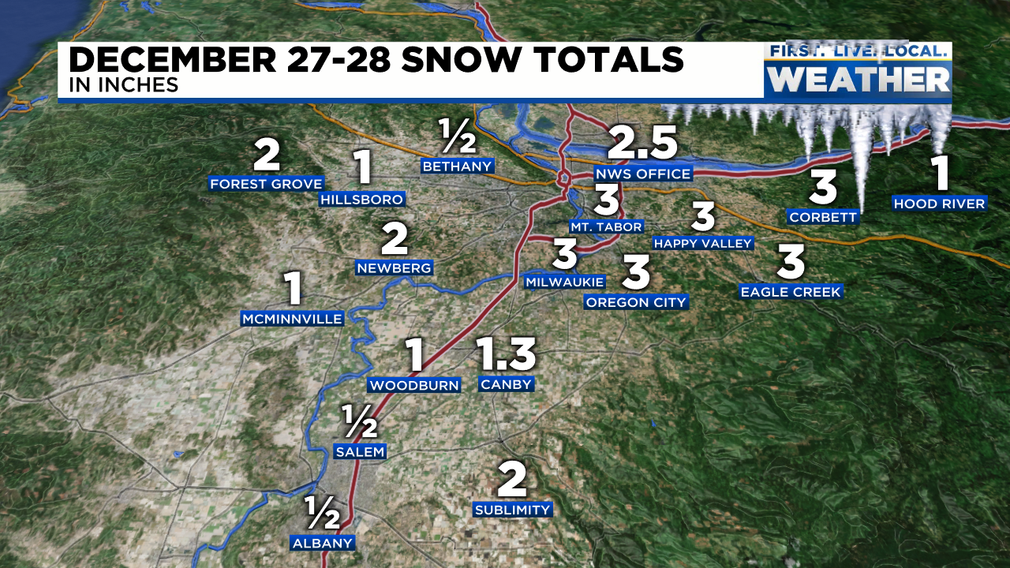
WIDESPREAD METRO SNOW 2 DAYS AFTER CHRISTMAS

Slide 46
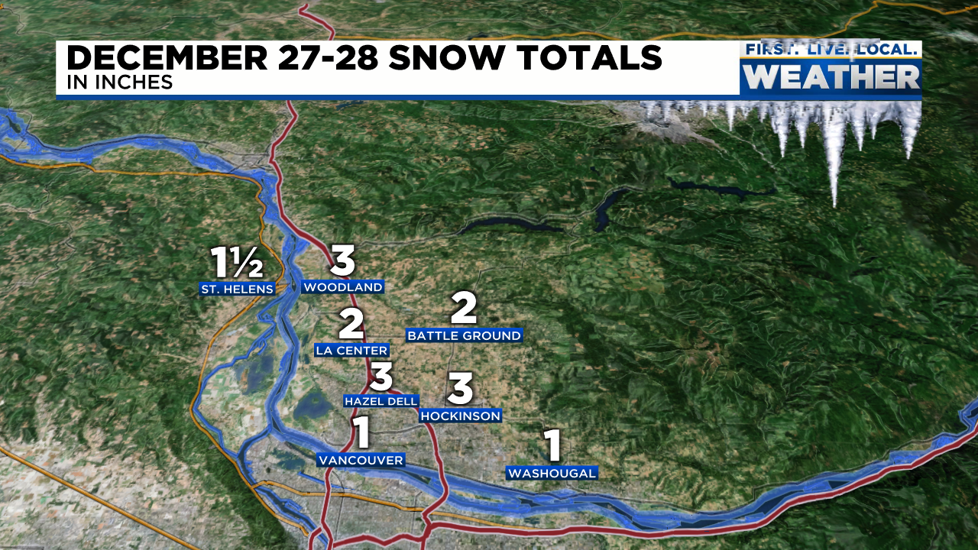
WIDESPREAD METRO SNOW 2-3 DAYS AFTER CHRISTMAS

Slide 47
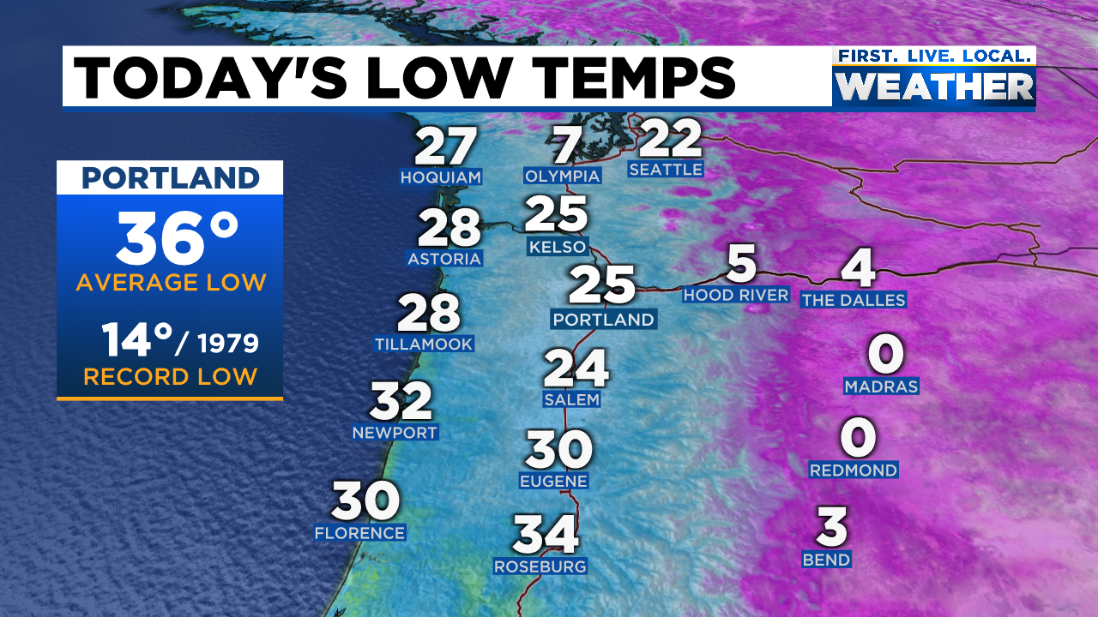
FRIGID AIRMASS NEW YEAR’S EVE & DAY
Good morning 2022! Low temps on January 1st

Slide 48
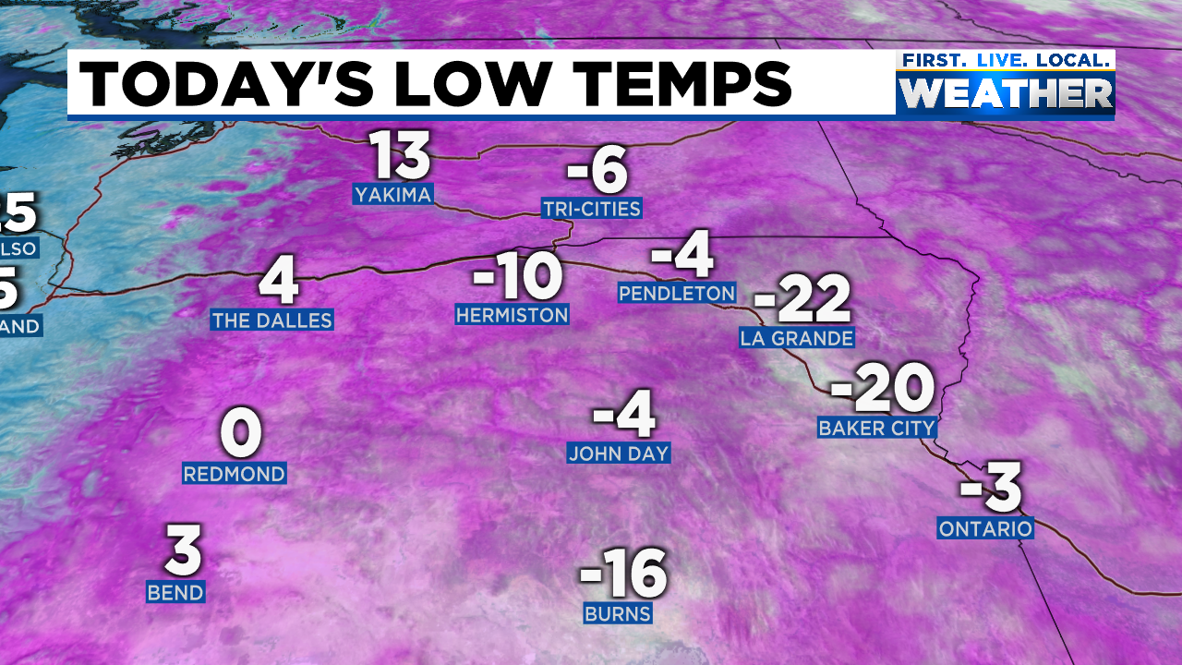
FRIGID AIRMASS NEW YEAR’S EVE & DAY
Good morning 2022! Low temps on January 1st

Slide 49

FRIGID AIRMASS NEW YEAR’S EVE & DAY
Good morning 2022! Low temps on January 1st

Slide 50

MILD WESTERLY FLOW RETURNS JANUARY 2ND & BEYOND
Deep cold air in Eastern Oregon and Gorge leads to big snowstorm!
Huge snow dump closes I-84, 1-2 feet on night of January 2nd!

Slide 51

MILD WESTERLY FLOW RETURNS JANUARY 2ND & BEYOND
Deep cold air in Eastern Oregon and Gorge leads to big snowstorm!
Huge snow dump closes I-84, 1-2 feet on night of January 2nd!

Slide 52

BIG SNOW STORM IN GORGE JANUARY 2-3, 2022

Slide 53



Stevenson & Hood River snow January 2nd-3rd

Slide 54

MILD WESTERLY FLOW RETURNS JANUARY 2ND & BEYOND
Deep cold air in Eastern Oregon and Gorge leads to big snowstorm!

Slide 55

TOO MUCH SNOW!
Ski areas shut down
I-84, OR35, & US26 shut down = Entire Mt. Hood Loop closed

Slide 56


BLIZZARD IN LA GRANDE
OSP PARKING LOT

Slide 57

JANUARY
Best snowpack (on Jan 3rd) on Mt. Hood in 25 years!
Notes:
50+ gusts at TTD, 85 mph gust at Corbett Grade, highest of past 10 years
850mb temps never below -9 this winter
Valley 30-35 during this time
Puget Sound 35-45!

Slide 58

GREAT OREGON SNOWPACK!
JANUARY 4th

Slide 59

JANUARY
Mild and unusually dry after 1st week
Notes:
50+ gusts at TTD, 85 mph gust at Corbett Grade, highest of past 10 years
850mb temps never below -9 this winter
Valley 30-35 during this time
Puget Sound 35-45!

Slide 60

JANUARY
Mild & wet conditions return by 4th-5th
Notes:
50+ gusts at TTD, 85 mph gust at Corbett Grade, highest of past 10 years
850mb temps never below -9 this winter
Valley 30-35 during this time
Puget Sound 35-45!

Slide 61

JANUARY
Mild & wet conditions return after New Year’s Day
Notes:
50+ gusts at TTD, 85 mph gust at Corbett Grade, highest of past 10 years
850mb temps never below -9 this winter
Valley 30-35 during this time
Puget Sound 35-45!

Slide 62

JANUARY
Skies clear & high pressure takes over after 1st week
January 9th
Notes:
50+ gusts at TTD, 85 mph gust at Corbett Grade, highest of past 10 years
850mb temps never below -9 this winter
Valley 30-35 during this time
Puget Sound 35-45!

Slide 63

JANUARY
Skies clear & high pressure takes over after 1st week
Notes:
50+ gusts at TTD, 85 mph gust at Corbett Grade, highest of past 10 years
850mb temps never below -9 this winter
Valley 30-35 during this time
Puget Sound 35-45!

Slide 64

FEBRUARY
Upper level ridging over/west of us much of time mid-January to early March
This image = Feb 9th-March 10th
Notes:
50+ gusts at TTD, 85 mph gust at Corbett Grade, highest of past 10 years
850mb temps never below -9 this winter
Valley 30-35 during this time
Puget Sound 35-45!

Slide 65

FEBRUARY
Normal temps
Near record warmth 11th-13th balanced out by cold in last week
Notes:
50+ gusts at TTD, 85 mph gust at Corbett Grade, highest of past 10 years
850mb temps never below -9 this winter
Valley 30-35 during this time
Puget Sound 35-45!

Slide 66

Cold & dry returns February 22nd
Notes:
50+ gusts at TTD, 85 mph gust at Corbett Grade, highest of past 10 years
850mb temps never below -9 this winter
Valley 30-35 during this time
Puget Sound 35-45!

Slide 67

Coldest morning of winter for some of us
February 23rd
Notes:
50+ gusts at TTD, 85 mph gust at Corbett Grade, highest of past 10 years
850mb temps never below -9 this winter
Valley 30-35 during this time
Puget Sound 35-45!

Slide 68

Coldest temp in February
4 of last 5 years
Notes:
50+ gusts at TTD, 85 mph gust at Corbett Grade, highest of past 10 years
850mb temps never below -9 this winter
Valley 30-35 during this time
Puget Sound 35-45!

Slide 69


FEBRUARY 21st
100+ car pileup near Meacham on I-84 as arctic air arrives
Notes:
50+ gusts at TTD, 85 mph gust at Corbett Grade, highest of past 10 years
850mb temps never below -9 this winter
Valley 30-35 during this time
Puget Sound 35-45!

Slide 70

Flurries to ½” as upper-level wave passes by early AM February 24th
5th and LAST SNOW OF WINTER = 0.5” at PQR
MOST CLARK COUNTY SCHOOLS CLOSE FOR THE DAY
Some delays in eastern Multnomah county too, nothing west/south
Notes:
50+ gusts at TTD, 85 mph gust at Corbett Grade, highest of past 10 years
850mb temps never below -9 this winter
Valley 30-35 during this time
Puget Sound 35-45!

Slide 71

2 MONTHS OF MILD & DRY WEATHER TAKES A TOLL
Snowpack well below normal March and into early April
except Mt. Hood area
April 1st
Notes:
50+ gusts at TTD, 85 mph gust at Corbett Grade, highest of past 10 years
850mb temps never below -9 this winter
Valley 30-35 during this time
Puget Sound 35-45!

Slide 72

RARE APRIL SNOWFALL ON THE 11TH
Deep/Cold upper-level trough passes through
Notes:
50+ gusts at TTD, 85 mph gust at Corbett Grade, highest of past 10 years
850mb temps never below -9 this winter
Valley 30-35 during this time
Puget Sound 35-45!

Slide 73

RARE APRIL SNOWFALL ON THE 11TH
Predicted by models somewhat well
WRF-GFS FORECAST
Trace-5” metro area, even more on highest hills
Notes:
50+ gusts at TTD, 85 mph gust at Corbett Grade, highest of past 10 years
850mb temps never below -9 this winter
Valley 30-35 during this time
Puget Sound 35-45!

Slide 74

RARE APRIL SNOWFALL ON THE 11TH
Predicted by models somewhat well
8-12” at/above 1,000’ in spots
Notes:
50+ gusts at TTD, 85 mph gust at Corbett Grade, highest of past 10 years
850mb temps never below -9 this winter
Valley 30-35 during this time
Puget Sound 35-45!

Slide 75

RARE APRIL SNOWFALL ON THE 11TH
Predicted by models somewhat well
Near record
cold airmass
Notes:
50+ gusts at TTD, 85 mph gust at Corbett Grade, highest of past 10 years
850mb temps never below -9 this winter
Valley 30-35 during this time
Puget Sound 35-45!

Slide 76



Mountain Snowpack @ 5,400’
Bottom of Pucci Lift @Timberline
Peak snow depth 3 weeks late
Big snow mid-December to early January
AVERAGE
2020-21
Several snow, then melting events Oct/Nov
Not much snow
Early Jan-March
2020-21

Slide 77



Southern Cascades Snowpack @ 5,300’
Diamond Lake
No big snow events for 2.5 months!
Slowed melting in spring
Big snow mid-December to early January
AVERAGE
2020-21

Slide 78

Cascade Snowfall
Delayed ski season start again, has become more common
Incredible series of snowstorms for 1 month (early Dec-early Jan)
Not much fresh snow mid January to Spring Break, but still a good ski season
MISSING snow totals December/January at Government Camp!

Slide 79


Slide 80

Blue = Widespread PACNW Arctic Air Outbreak

Slide 81

Last “arctic blast” was December 2013
Previous events: Nov 2010, Dec 2009, Dec 1998, Dec 1990
Been working on arctic air events, along with Tanis Leach

Slide 82


Slide 83


Slide 84


Slide 85


Slide 86


Slide 87

NO INLAND WIND STORMS
26 winters without a major REGIONAL storm
Notes:
Calmest south wind season of the last 20-30 years

Slide 88

EASY EAST WIND SEASON
Only one period of very strong wind in late January

Slide 89
FINAL WINTER THOUGHTS
- I think we have a communication issue with La Nina
(Public & media believe La Nina = cold/wet winters)
- It was nice to see “the goods” during the holidays! Cold and snowy
- First time Salem & Portland have gone 5 winters without sub-20° reading.
- PDX hasn’t had sub-30° daytime high in last 5 winters, happened in 1940s

Slide 90




SUMMER: BLAZING HOT AGAIN
#3 hottest in Portland after 2021 & 2015
#3-Salem, #4-Eugene+Medford+Astoria, #2-Redmond

Slide 91

2022 Heatwaves
(3 days at/above 90 degrees, or one day 95+)

Slide 92


Slide 93

Historic Mid-Summer Heat Wave
End of July – Early August

Slide 94


Slide 95


Slide 96


Slide 97

SUMMER: BLAZING HOT
4th hottest in western valleys (2015 & 2021 = #1/2)
WESTERN VALLEYS: 10th consecutive warm (or hot) summer

Slide 98

COLLECTION OF WINTER OUTLOOKS
Old Farmer’s Almanac
Farmers’ Almanac
AccuWeather
Pete Parsons – ODF
Models

Slide 99


Pete Parson’s Forecast Highlights
Nov-Jan Mean Upper-Air Pattern
Nov-Jan Upper-Air Anomalies
Analogs all show a highly amplified pattern (typical of La Niña), with anomalous ridging centered somewhere in the eastern Pacific Ocean.
This set-up has the potential to produce “extreme” weather events, which can skew monthly averages but “balance out” over 3 months.
Notes:
Charts generated at: https://www.esrl.noaa.gov/psd/cgi-bin/data/composites/printpage.pl

Slide 100
Pete Parson’s Forecast Highlights
La Niña is expected again this winter, which typically brings highly anomalous weather, but “swings” in opposite directions can “balance” over a 3-month period.
1999-2000, 2008-09, & 2011-12 were used to generate the forecast charts
Temperatures may have significant swings with the 3-month period likely being a little warmer than average. December and January have heightened chances for Arctic intrusions, which could be severe.
Precipitation should be near average but may exhibit significant month-to-month variation. Even “average” precipitation should bring improvement to drought/dry regions of the state.

Slide 101


TWO MODEL FORECASTS
ECMWF DEC-FEB 500MB
CANSIPS DEC-FEB 500MB

Slide 102


TWO MODEL FORECASTS
ECMWF DEC-FEB PRECIP ANOMALY
CANSIPS DEC-FEB PRECIP ANOMALY

Slide 103


Sea surface temp is much warmer compared to Autumn 2021
Will this
affect
our winter?

Slide 104


