Slide 1
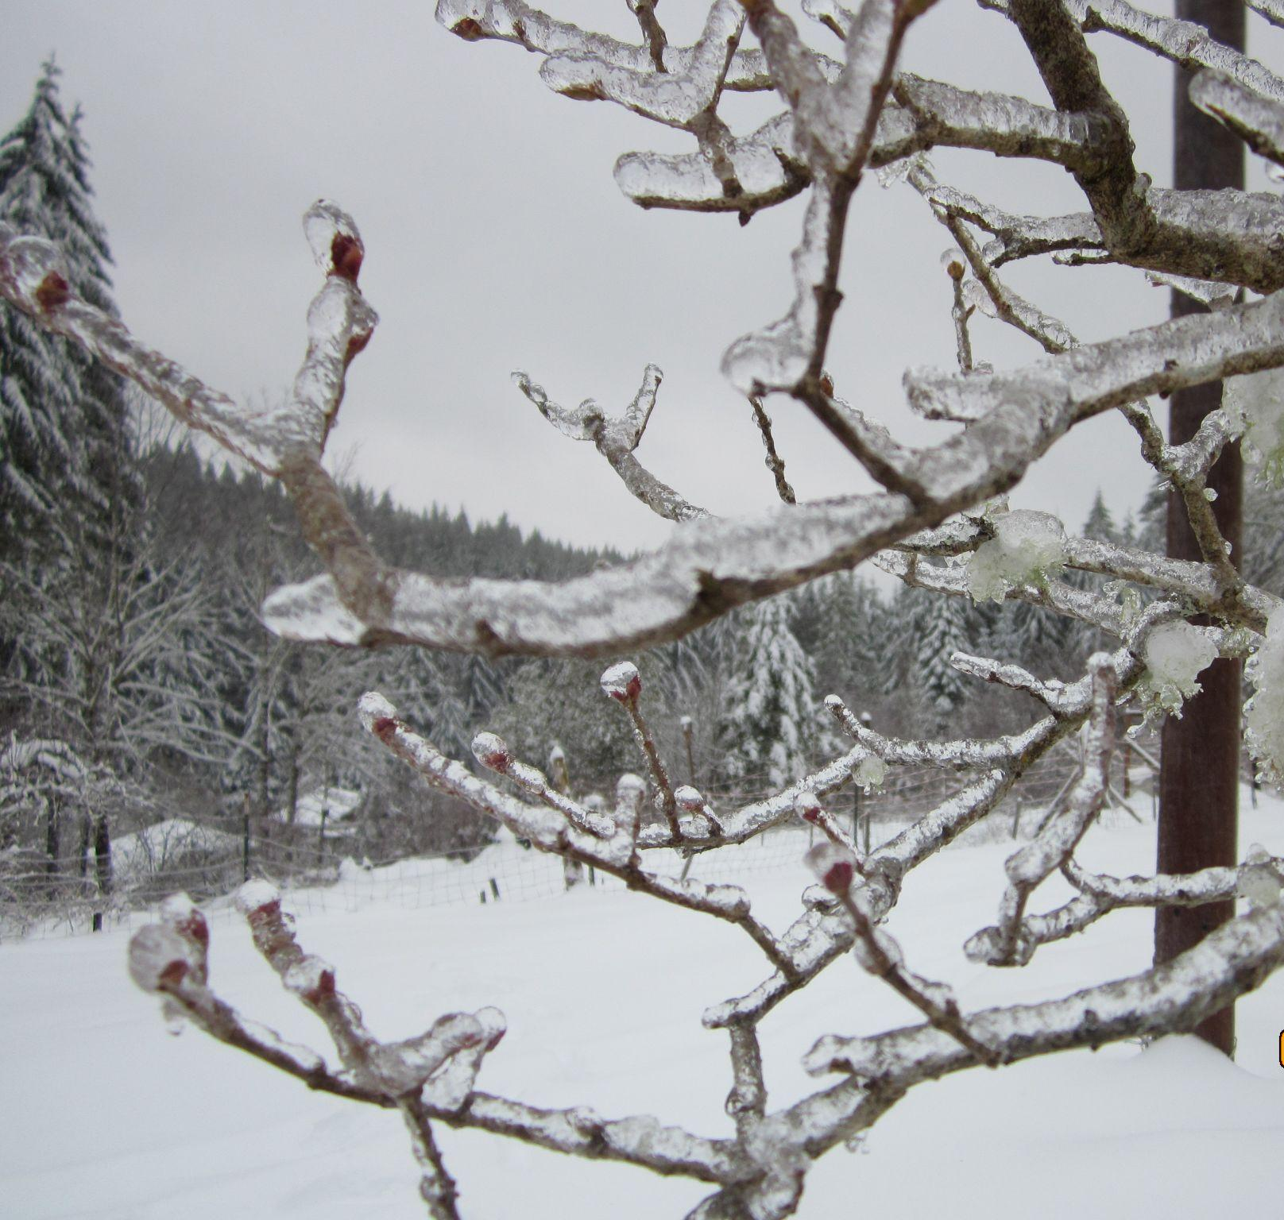
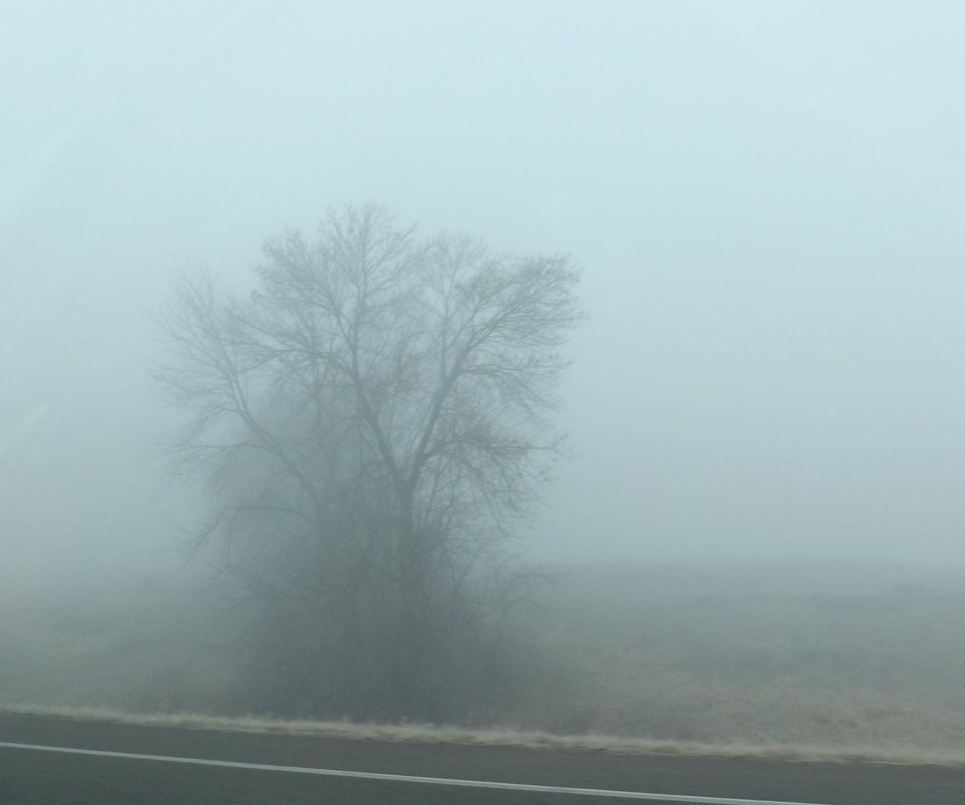
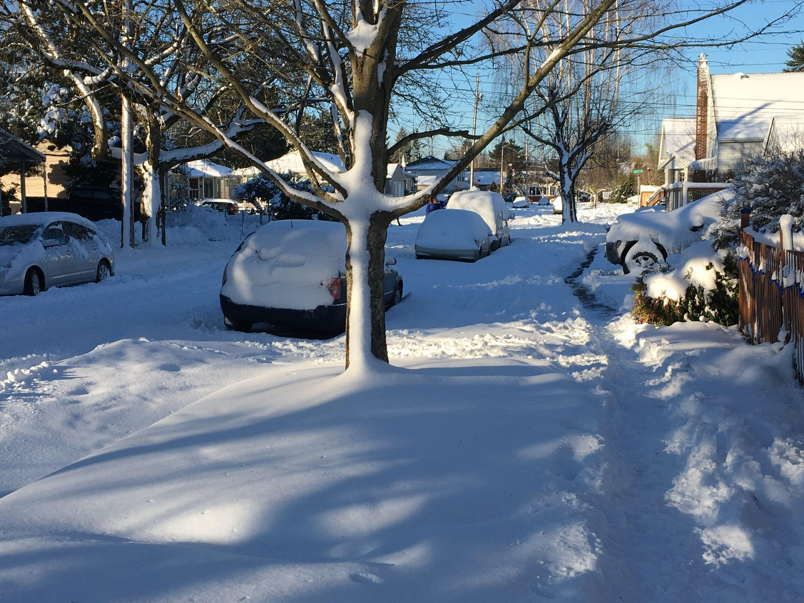
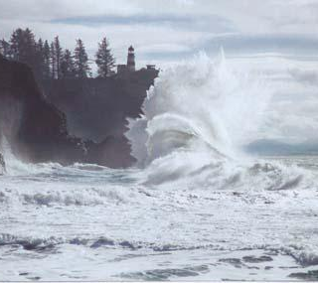
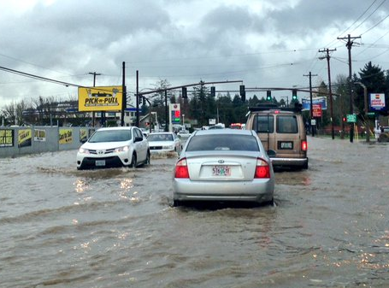
NWS Winter Seasonal Outlook
2022-2023
Rebecca Muessle - Meteorologist

Slide 2
Key Points
La Niña conditions now and 80-90% likely to continue through mid-winter
Third winter of La Niña
NWS Climate Prediction Center (CPC) outlooks:
1) Wetter than Normal Fall 2022
2) Equal chances of wetter, drier or near normal precipitation DJF
3) Greater chance for slightly cooler than normal DJF

Slide 3
Winter Season Outlook 2022/2023

Slide 4
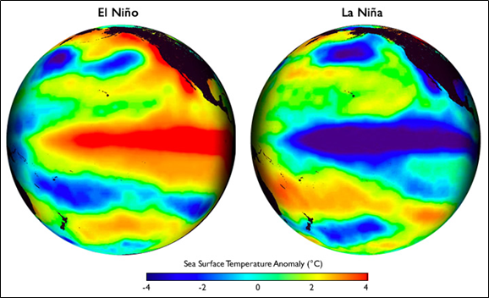
El Niño-Southern Oscillation (ENSO)
What is ENSO?
El Niño and the Southern Oscillation, commonly referred to as ENSO, is a periodic fluctuation in sea surface temperature (SST) and the overlying atmosphere across the equatorial Pacific Ocean
ENSO has three possible stages:
  ENSO-neutral (near-normal water temps across the equatorial Pacific)
  La Niña (relatively cool water across the equatorial Pacific - above right)
  El Niño (relatively warm water across the equatorial Pacific - above left)
Notes:
ENSO is one of the most important climate phenomena on Earth due to its ability to change the global atmospheric circulation, which in turn, influences temperature and precipitation across the globe. We also focus on ENSO because we can often predict its arrival many seasons in advance of its strongest impacts on weather and climate.

Slide 5
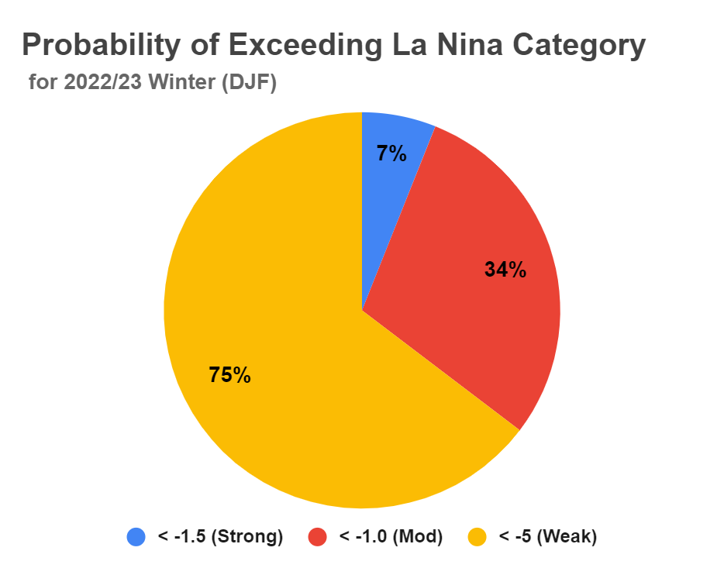
ENSO Status: La Niña Advisory
La Niña Categories:
3 consecutive overlapping 3-mo periods with SST anomalies of the following categories:
WEAK: -0.5 to -0.9 ℃
MODERATE: -1 to -1.4 ℃
STRONG: -1.5 to -1.9 ℃
VERY STRONG: ≥ -2 ℃
Best chance are for a WEAK La Niña for 2022/23 Winter (DJF).
However, a moderate La Nina is possible, especially in December, as La Niña is expected to weaken in Jan and Feb
Forecast from Oct 13.
Notes:
For this winter DJF, models forecast a range from -1.9 degC to + o.9 deg C anomalies, but cluster around -1.0 and -0.5 deg C. With La Nina expecting to weaken in January and February, the odds lean towards WEAK La NINA conditions for the winter season, but could be moderate strength at the beginning of the winter season (December).
If someone asks why numbers in chart do not add up to 100%, it is because CPC does not allow for 0 or 100 % probabilities. An outcome is never guaranteed.
probabilities are found https://www.cpc.ncep.noaa.gov/products/analysis_monitoring/enso_advisory/strengths/index.php and are updated the 2nd Thu of every month.

Slide 6
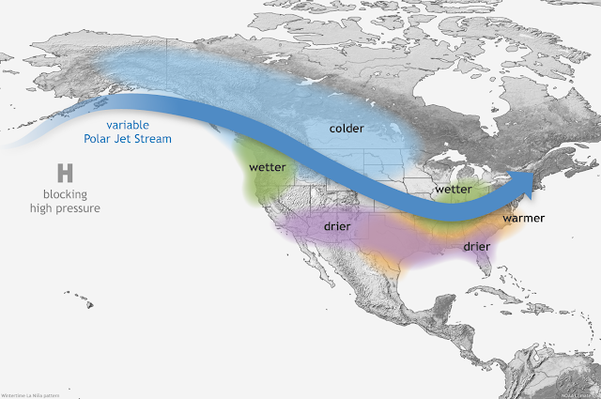
ENSO Status: La Niña Advisory
Equatorial sea surface temperatures (SSTs) are below average across most of the Pacific Ocean.
There is a 75% chance La Niña will continue this winter.
A 54% chance of transitioning to ENSO -Neutral Spring (FMA) 2023
Favors wetter and cooler than normal conditions for the PNW this winter.
Notes:
The Pacific NW tends to have wetter than normal conditions during La Nina winters with less of a signal in temperatures.

Slide 7
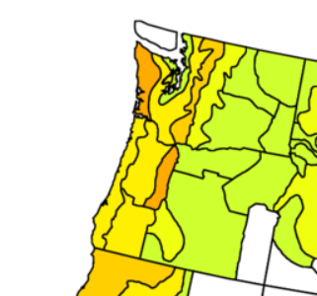
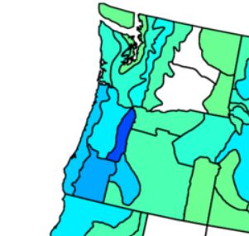
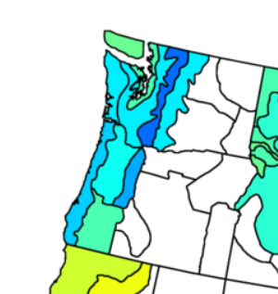
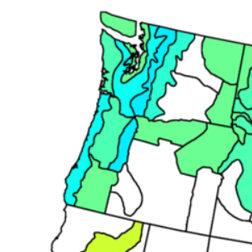
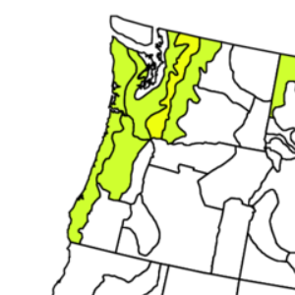
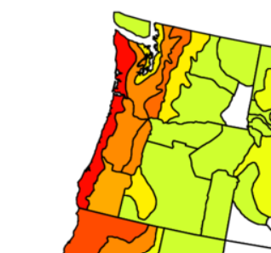
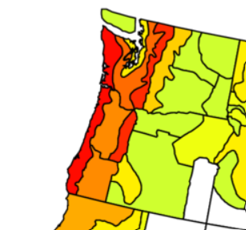
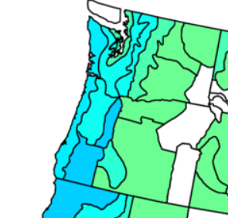
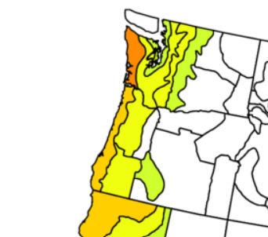
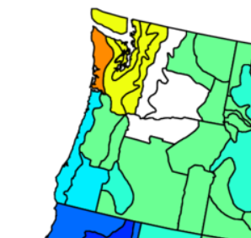
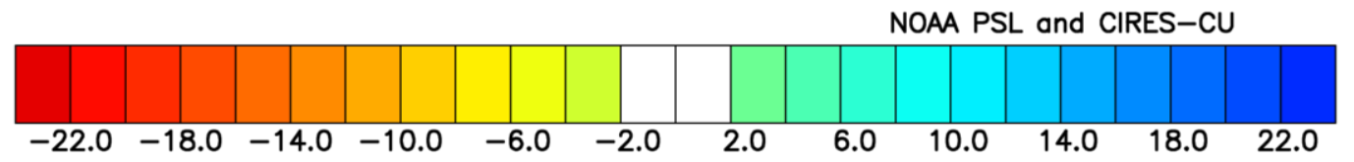
Winter (DJF) Precipitation History: Weak La Niñas
1954-55
1964-65
1971-72
1974-75
1983-84
Dry
Very Wet
Very Wet
Wet
Near
Normal
1984-85
2000-01
2005-06
2008-09
2016-17
Very Dry
Very Dry
Wet
Dry
WA: Dry
OR: Wet
Average Precipitation Anomaly (in.)
Weak La Nina: 5 consecutive overlapping 3-month periods with SST anomalies between -0.5 to -0.9 ℃.
Notes:
All Weak La Nina winters since 1950. There isn’t a clear precip bias; 4 of the weak La Nina winters leaned towards wetter than normal, 4 leaned towards drier than normal, 1 had near normal precipitation, and one winter was variable with drier than normal conditions in WA and wetter than normal in OR. Historically, we have not seen a strong bias towards wetter than normal winters for weak La Nina years.
https://psl.noaa.gov/data/usclimdivs/ Variable: Precipitation, Type: Average Anomaly (compared to 1991-2020 30-yr average), Season: Dec to Feb, Contour Interval: 2 -22 22, White for central values: yes

Slide 8
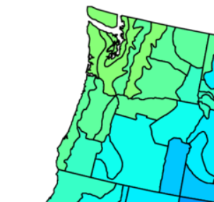
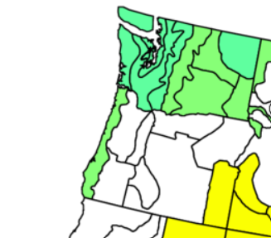
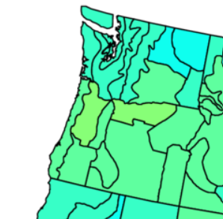
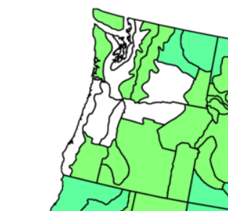
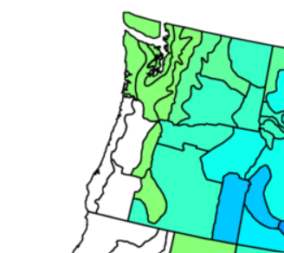
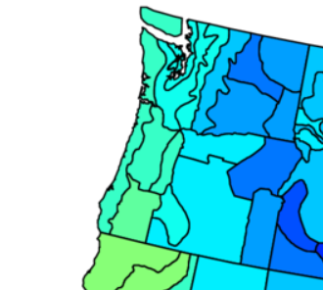
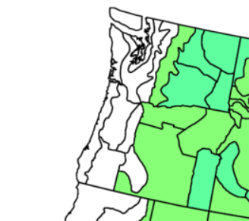
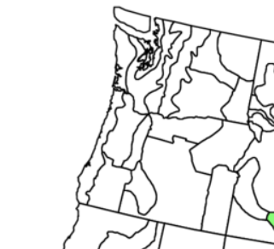
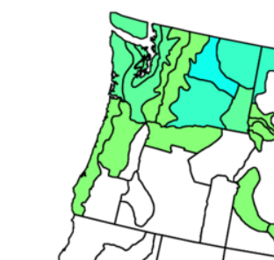
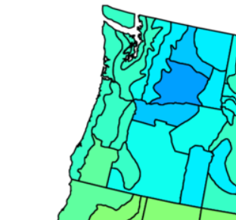
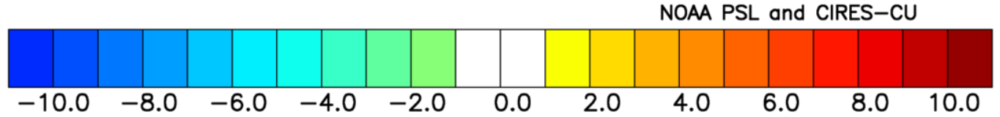
Winter (DJF) Temperature History: Weak La Niñas
1954-55
1964-65
1971-72
1974-75
1983-84
Near Normal
Near Normal
Near
Normal
Cool
Cool
1984-85
2000-01
2005-06
2008-09
2016-17
Very
Cool
Near Normal
Near Normal
WA: Cool
Very
Cool
OR: Near
Normal
Average Temperature Anomaly (℉)
Weak La Nina: 5 consecutive overlapping 3-month periods with SST anomalies between -0.5 to -0.9 ℃.
Notes:
All Weak La Nina winters since 1950. There is more of a bias with temperatures than what we saw with precipitation for weak La Nina winters; than there is a wet bias; 5of the weak La Nina winters leaned towards near normal average temperatures, 4 leaned towards cooler than normal winters, and 1 winter was variable with had near normal temperatures for OR and cooler than normal conditions on WA. There are no weak La Nina winters that have had warmer than normal temperatures. It doesn’t mean that it can’t happen, we just have not seen it yet.
https://psl.noaa.gov/data/usclimdivs/ Variable: Temperature, Type: Average Anomaly, Season: Dec to Feb, Contour Interval: 1 -10 10, White for central values: yes

Slide 9
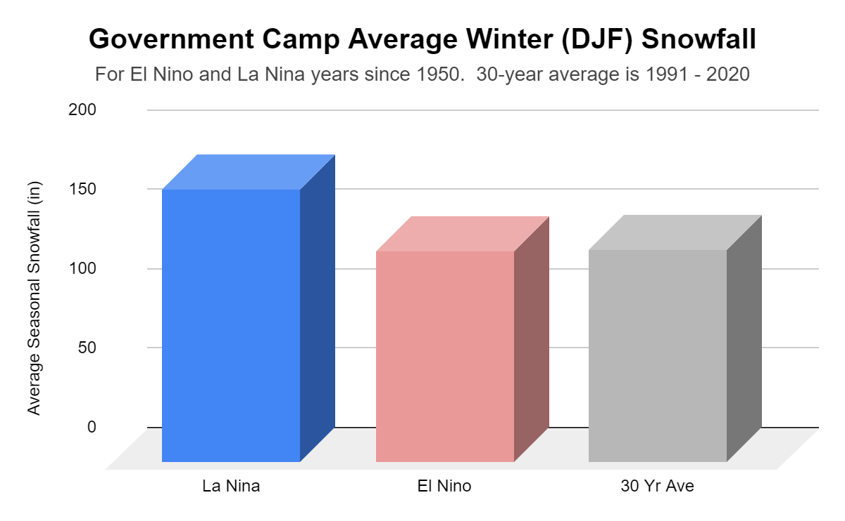
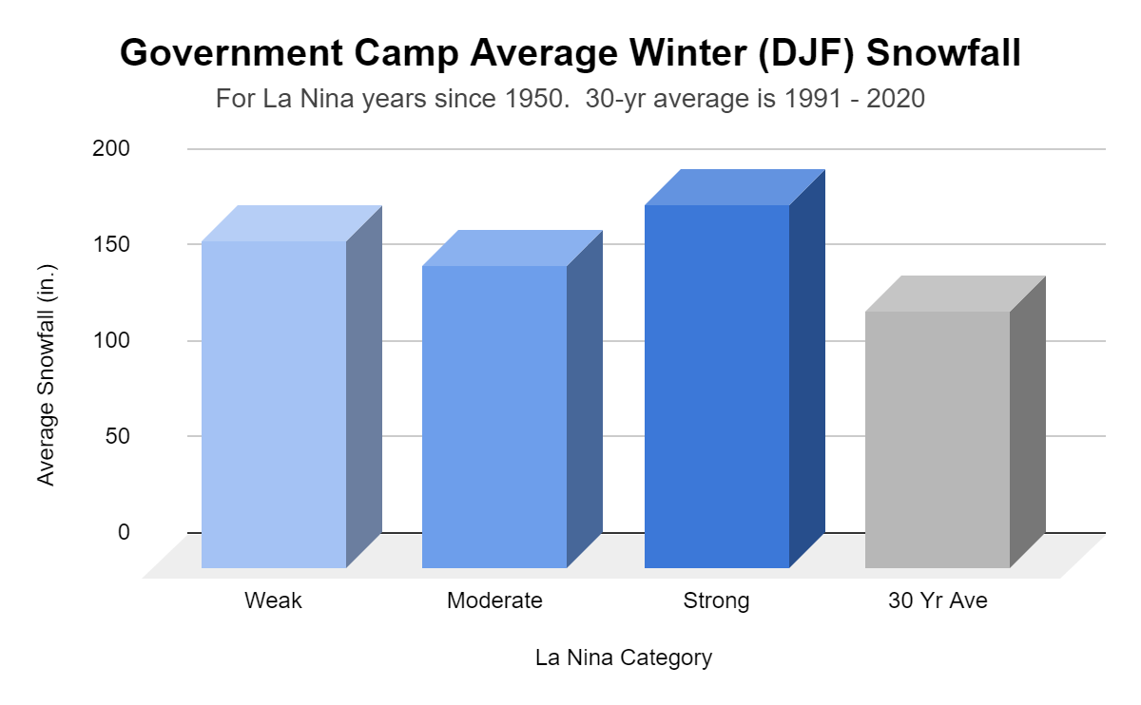
Winter (DJF) Cascade Snow History: Government Camp
Government Camp Average DJF Snowfall:
La Nina: 172 inches
El Nino: 133 inches
1991-2020: 134 inches
Departure from normal:
Weak: 37 inches
Moderate: 23 inches
Strong: 56 inches
Notes:
Government Camp Winter Average Snowfall is higher for La Nina years than El Nino ones, and higher than the 30 year average. Strong La Nina winters have produced more snow than the other categories, with weak La nina years having the 2nd highest.

Slide 10
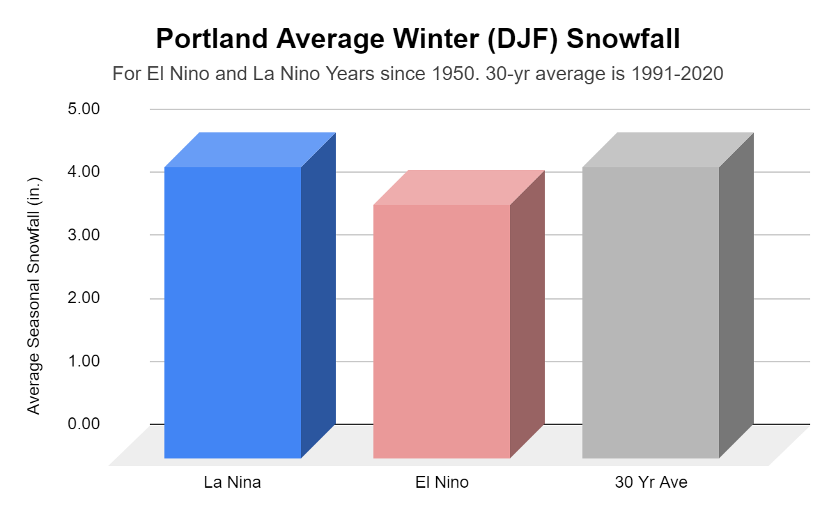
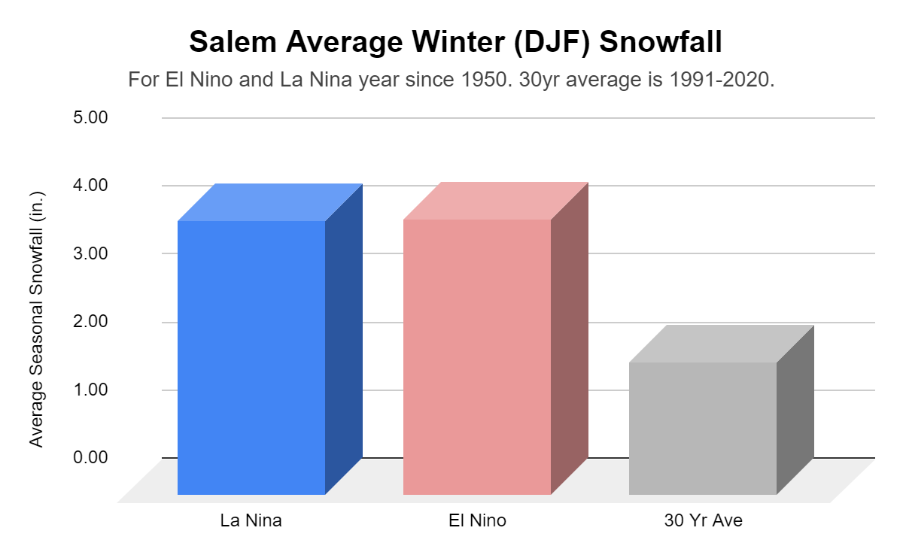
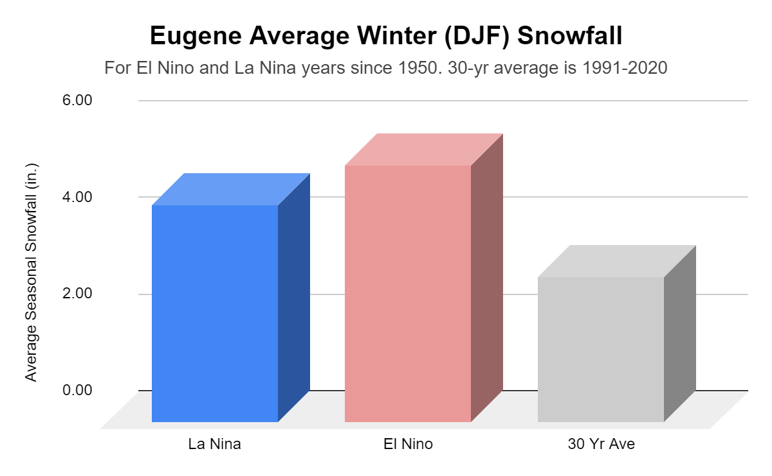
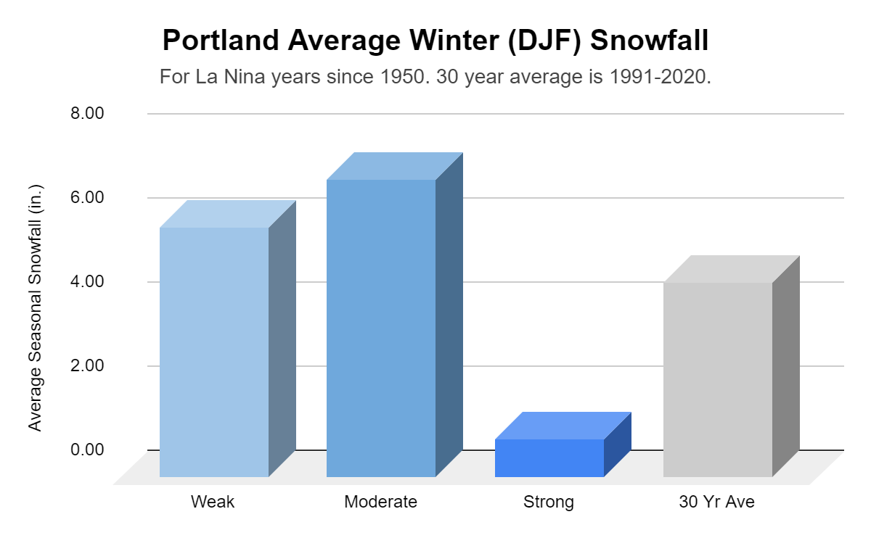
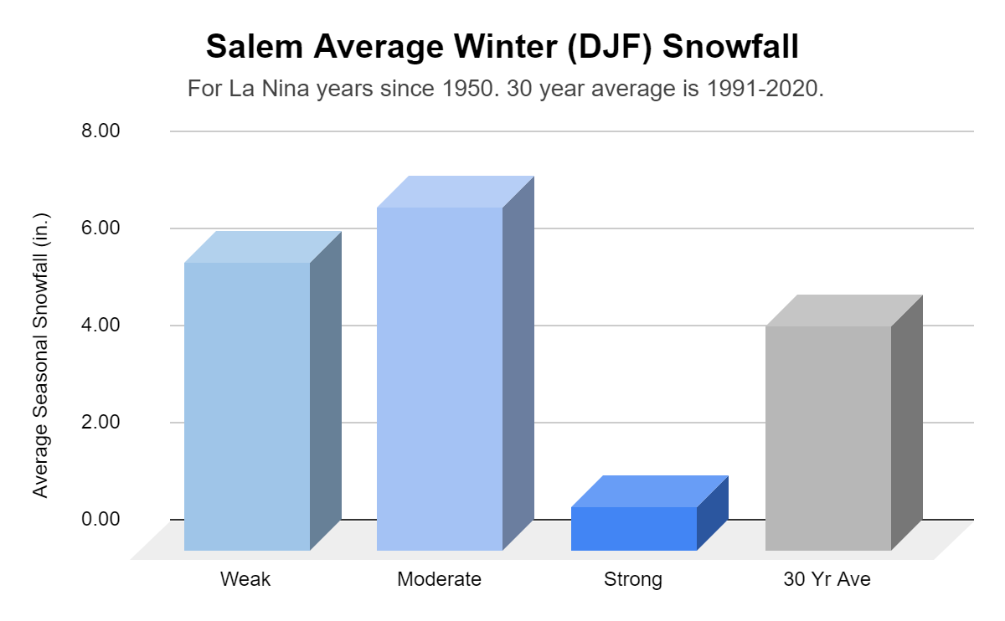
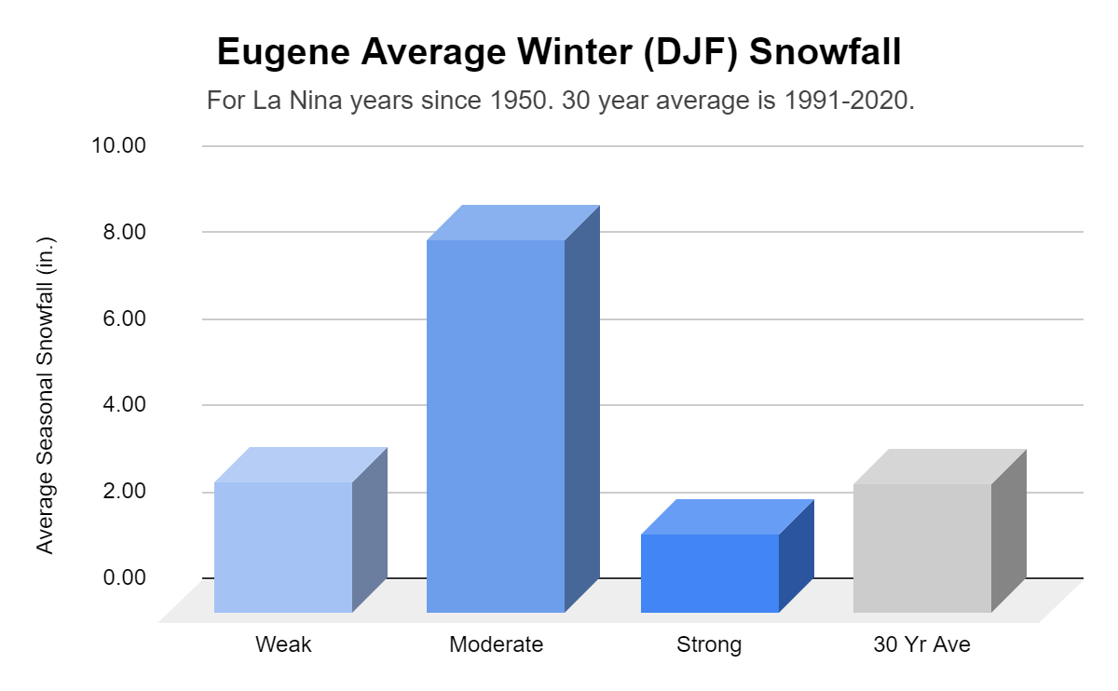
Winter (DJF) Willamette Valley Snow History:
Notes:
Snow bias is un clear when comparing La Nia and El Nino years to the 30 year average for Portland. THere is slightly more seasonal snow for the ENSO phases for Salem and Eugene, but it is for a n in ch of snow at most.
When looking only at the La Nina phase, the most striking attribute to me is that strong La Nina years on average produce the least amount of winter snow for all three of the these Willamette Valley locations.

Slide 11
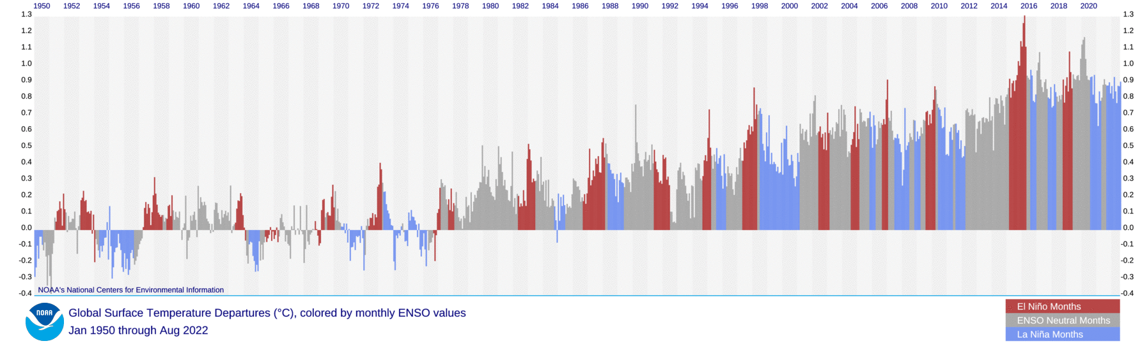
ENSO Status: ‘Triple Dip’ La Niña Advisory
Monthly Global Temperature Departures (°C) since 1950.
Blue shaded = La Nina Years, Red = El Nino Years.
1954-1957*
1973-1976
1998-2001
Three* occurrences since 1950 - very small sample size
* SST anomalies > -0.5 ℃ in Oct 1956
Notes:
Three occurrences is generous; For the 1954-1957 La Nina’s, the SST anomaly warmed above -0.5 in October of 1956. SST anomaly was around -0.4 through winter of 1957.
Citing for graphic: NOAA National Centers for Environmental Information, State of the Climate: Monthly Global Climate Report for August 2022, published online September 2022, retrieved on October 10, 2022 from https://www.ncei.noaa.gov/access/monitoring/monthly-report/global/202208/supplemental/page-4.

Slide 12
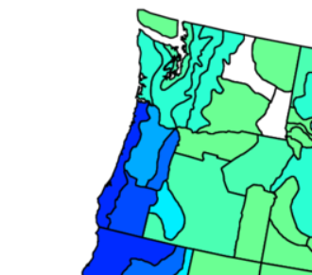
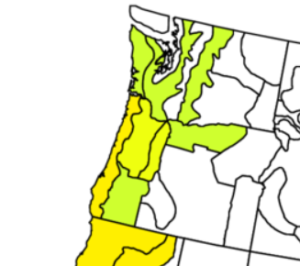
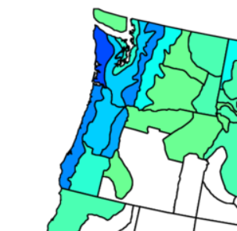
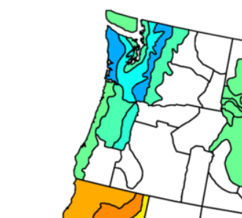
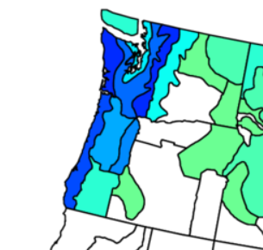
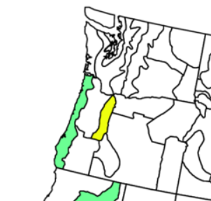
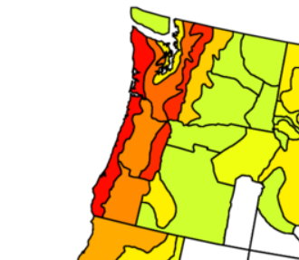
Winter (DJF) Precipitation History: Triple Dip La Niñas
1954-55
1955-56
1956-57
Near
Normal
Dry
Very Wet
Weak
Moderate
Uncategorized
1973-74
1974-75
1975-76
Very Wet
Wet
Very Wet
Strong
Weak
Strong
1998-99
1999-2000
2000-01
Near
Normal
Very Dry
Very Wet
Strong
Strong
Weak
Notes:
Sample size for triple dip La Nina’s is very low. Of the three examples, we had one with a very wet 3rd year winter, one with a very dry one, and the third (which is technically not considered a La Nina event, had near normal conditions. No clear precip bias for third year winters of triple dip La Ninas.
https://psl.noaa.gov/data/usclimdivs/ Variable: Precipitation, Type: Average Anomaly (compared to 1991-2020 30-yr average), Season: Dec to Feb, Contour Interval: 2 -22 22, White for central values: yes

Slide 13
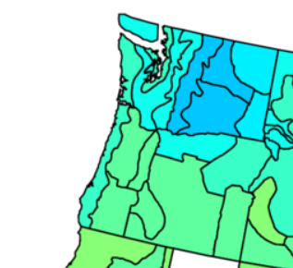
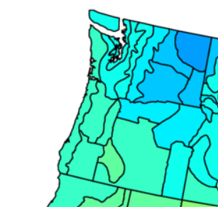
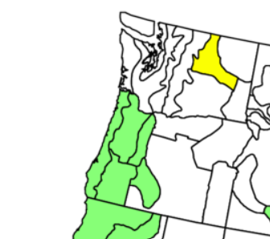
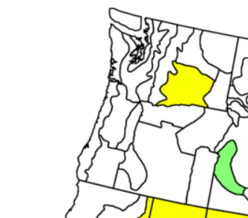


Winter (DJF) Temperature History: Triple Dip La Niñas
1954-55
1955-56
1956-57
Cool
Cool
Cool
Average Temperature Anomaly (℉)
Weak
Moderate
Uncategorized
1973-74
1974-75
1975-76
Near Normal
Near Normal
Near Normal
Strong
Weak
Strong
1998-99
1999-2000
2000-01
Near Normal
Near
Normal
Near Normal
Strong
Strong
Weak
Notes:
Looking at temperatures of the triple dip La Ninass, there may be a pattern in a temperatures. As there is very little change in the winter temperatures from the three consecutive years. However, the sample size for triple dip La Nina’s is low, and difficult to tell if this is a legitimate pattern.
https://psl.noaa.gov/data/usclimdivs/ Variable: Temperature, Type: Average Anomaly, Season: Dec to Feb, Contour Interval: 1 -10 10, White for central values: yes

Slide 14




Triple Dip La Niña: in Progress
2020-21
2021-22
2022-23
Winter (DJF) Precipitation
Wet
Near
Normal
TBD
Moderate
Moderate
Average Precipitation Anomaly (in.)
2020-21
2021-22
2022-23
Winter (DJF) Temperature
Near
Normal
Near
Normal
TBD
Moderate
Moderate
Average Temperature Anomaly (℉)
Notes:
Let’s looking at the Triple dip La Nina that is in progress. THe first winter (2020/21) was a moderate La nina that ended wetter than normal, and with near normal temperatures. The 2nd year winter ended near normal in precipitation and temperatures. What can we expectied year? Purely looking at patterns within other triple dip events, the sample size is too small to provide any skill for a prediction, especially with precipitation. If we glean that there is a trend in the temperature profiles of triple dip La Ninas, then we may predict that 2022/23 winter will end near normal. Lets look to see what the NWS Climate Prediction Center is forecasting for the winter.
https://psl.noaa.gov/data/usclimdivs/
Variable: Precipitation, Type: Average Anomaly (compared to 1991-2020 30-yr average), Season: Dec to Feb, Contour Interval: 2 -22 22, White for central values: yes
Variable: Temperature, Type: Average Anomaly, Season: Dec to Feb, Contour Interval: 1 -10 10, White for central values: yes

Slide 15





CPC Dec 2022 - Feb 2023: 3 Month Outlook
Dec-Feb
Outlook Favors
Precipitation
Greater Chances for
Above Normal
Temperatures
Greater Chances for Below Normal
Notes:
Updated on the 3rd Thursday of every month (Nov 20)

Slide 16


Oregon Drought Monitor

Slide 17


Washington Drought Monitor

Slide 18

CPC Oct - Dec 2022: Seasonal Drought Outlook
Oct-Jan
Outlook Favors
Drought conditions improving or even ending across much of Oregon & Washington

Slide 19
Climate Prediction Expectation
Climate predictions can have skill in predicting seasonal totals and averages.
However, most impacts are associated with short-duration storm systems.

Slide 20






Get Involved - Partner Preparedness Initiatives
Working Toward a Weather-Ready Nation
Visit: weather.gov/wrn

Slide 21
Summary
La Niña conditions now and 80-90% likely to continue through mid-winter
Third winter of La Niña
NWS Climate Prediction Center (CPC) outlooks:
1) Wetter than Normal Fall 2022
2) Equal chances of wetter, drier or near normal precipitation DJF
3) Greater chance for slightly cooler than normal DJF

