Slide 1

Some Future Changes in Weather Prediction Technology
Cliff Mass
University of Washington

Slide 2
A Probabilistic World
Forecasts will be mainly given in terms of probabilities
Will be based on ensembles of many forecasts and calibrated using machine learning.

Slide 3
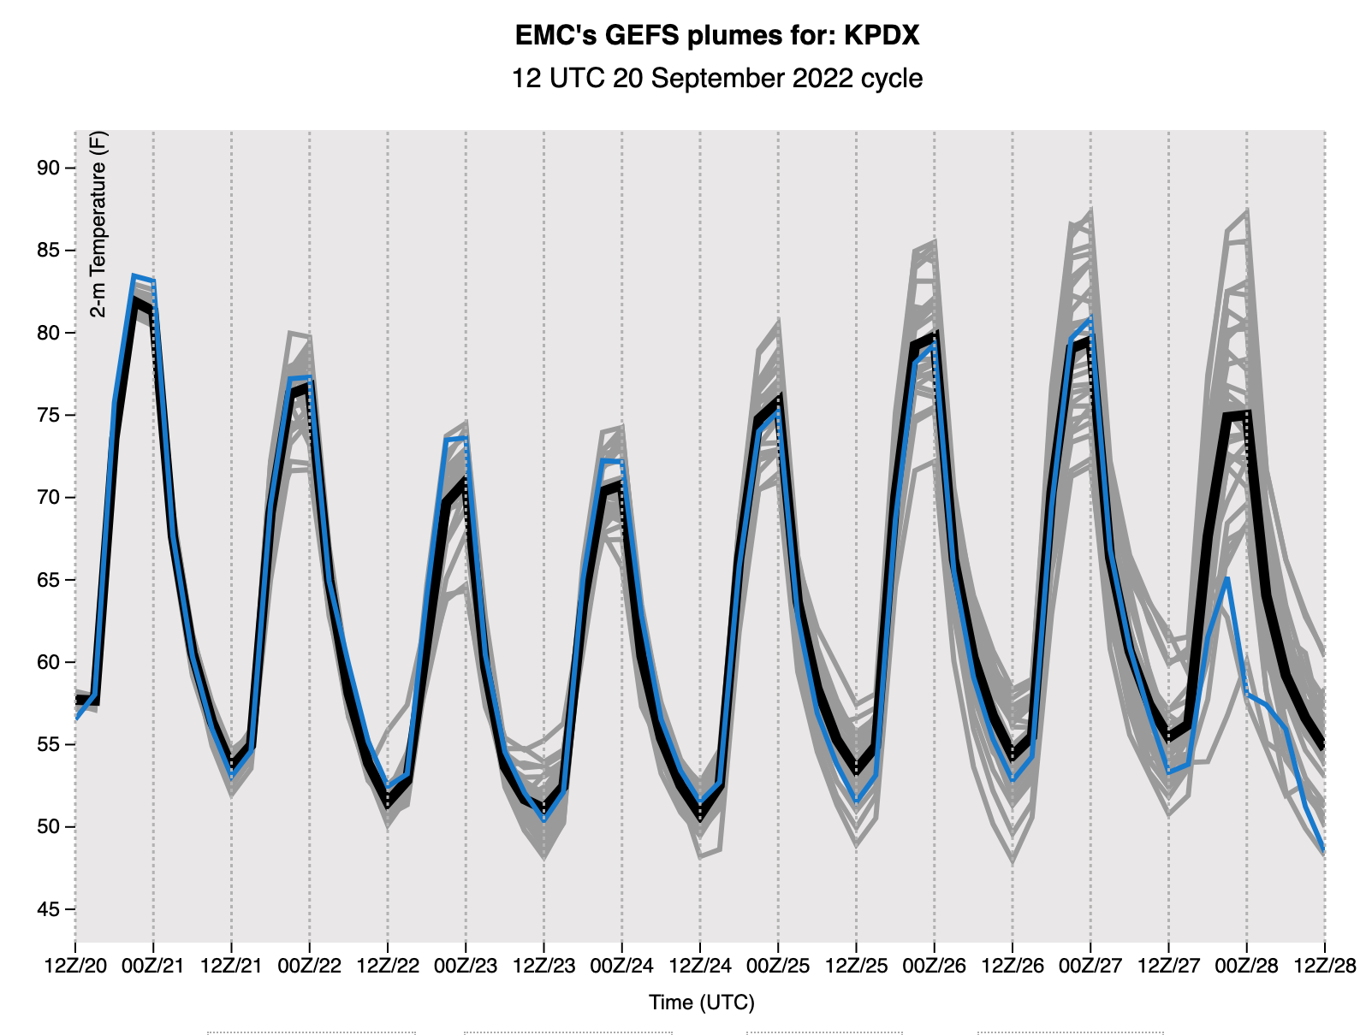
Ensemble forecasting: running weather models many times, each slightly differently
Ensembles are growing in size
Ensembles are being run at increasing resolution
Insufficient computer resources are the main roadblock

Slide 4
How do we communicate the probabilities effectively?

Slide 5
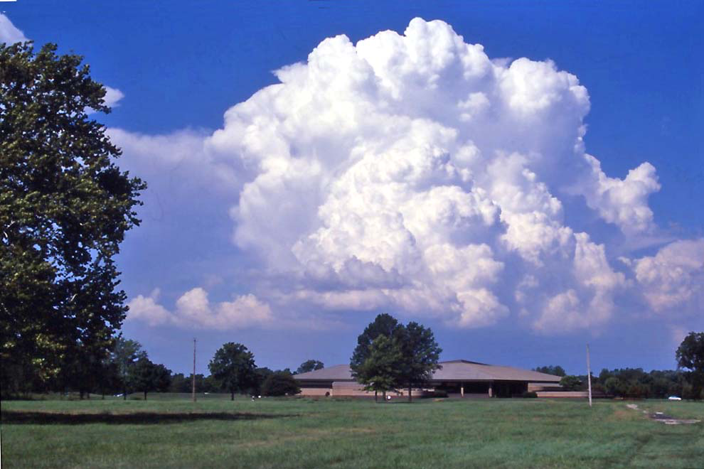
Running models at a higher resolution will solve some weather prediction problems

Slide 6
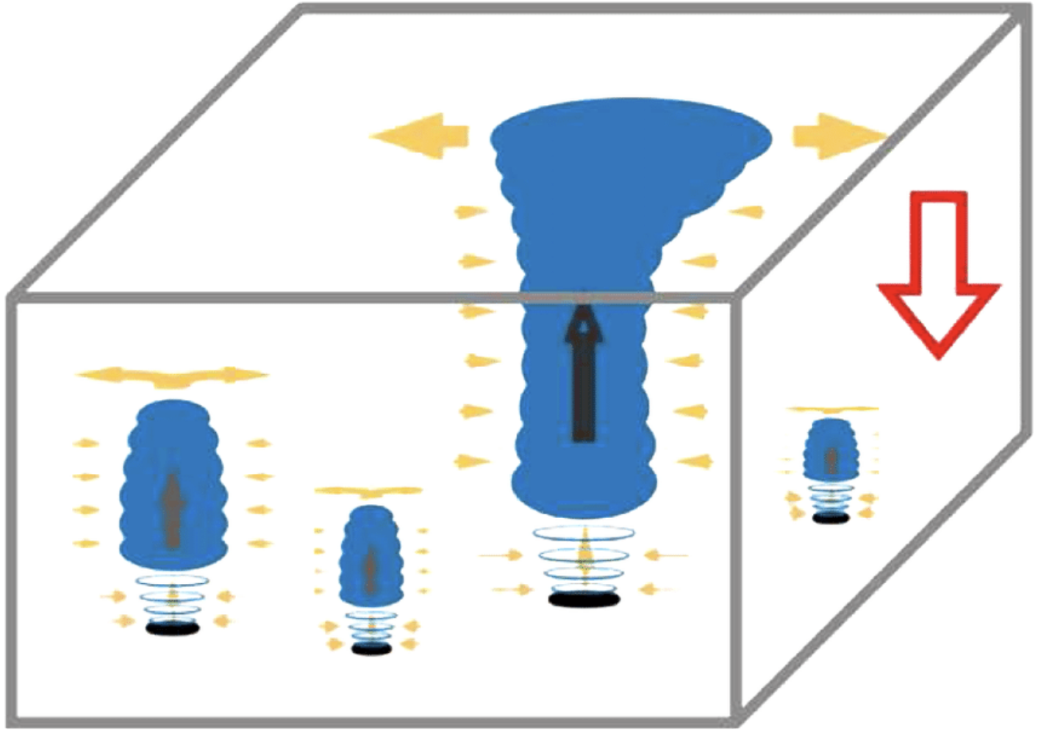
Most current forecast models lack the resolution to directly predict convection/thunderstorms.
Must use a kludge called parameterization.

Slide 7
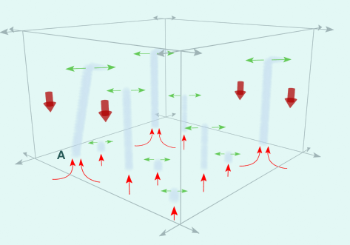
Convective Parameterization
Express small scale convective processes in terms of the large-scale variables available on the model grid.

Slide 8
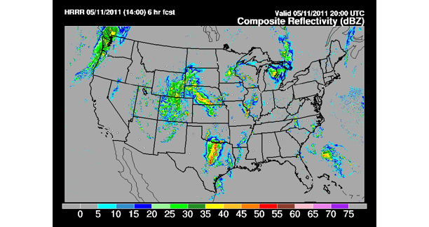
But with faster computers and more resolution, we can directly simulate cumulus convection

Slide 9
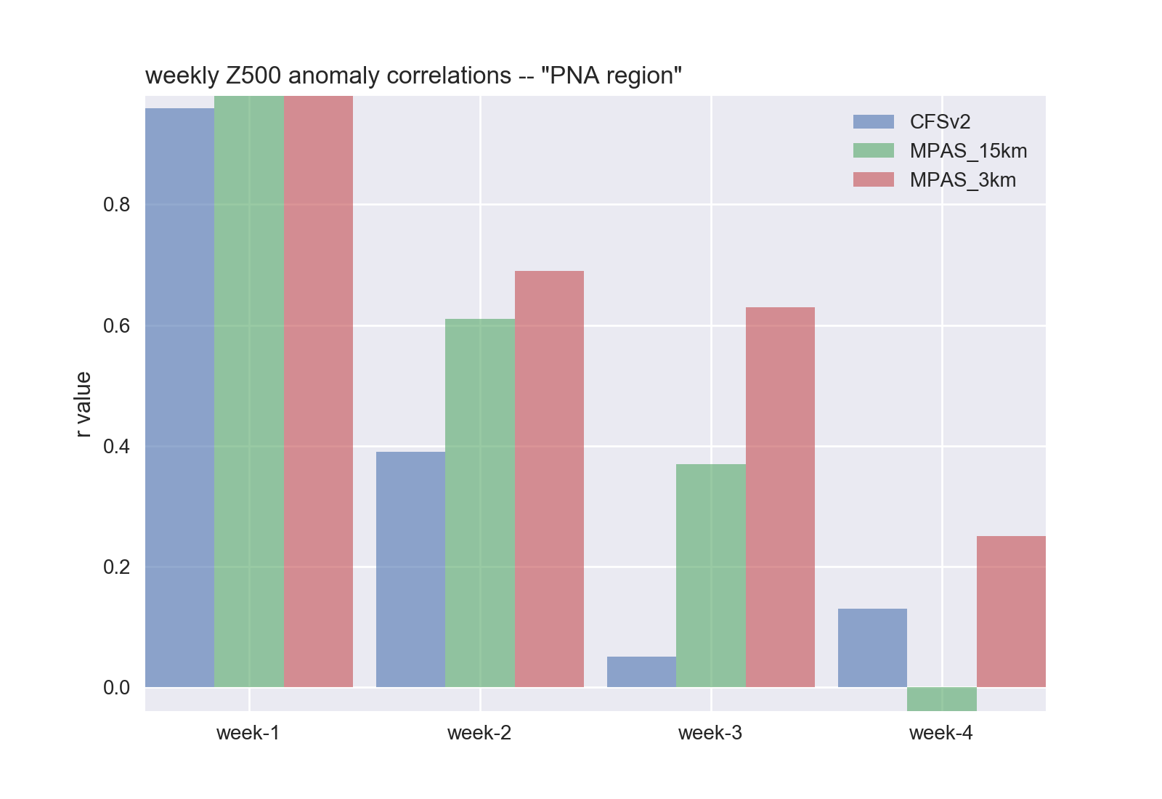
Running Global Models at High Resolution Could Greatly Improve Weather Prediction, Particularly for the Third Week

Slide 10
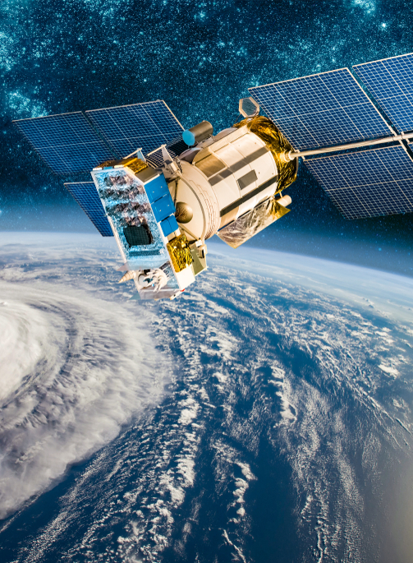
Better Satellite Observations Will Observe the Atmosphere in Greater Detail
Will improve model initializations and forecasts.

Slide 11
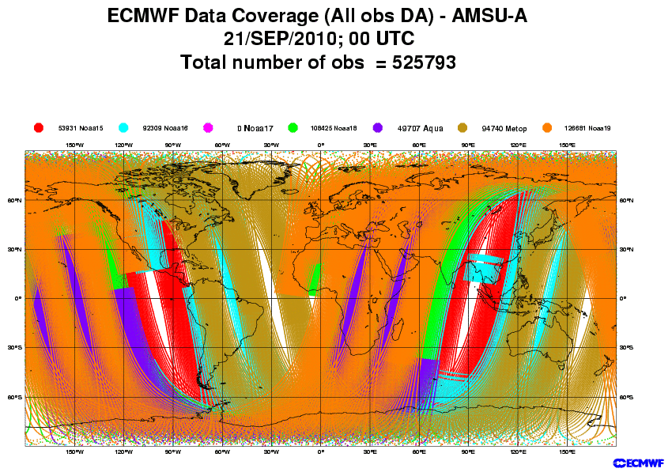
Satellites Provide Three-Dimensional Weather Information EVERYWHERE

Slide 12
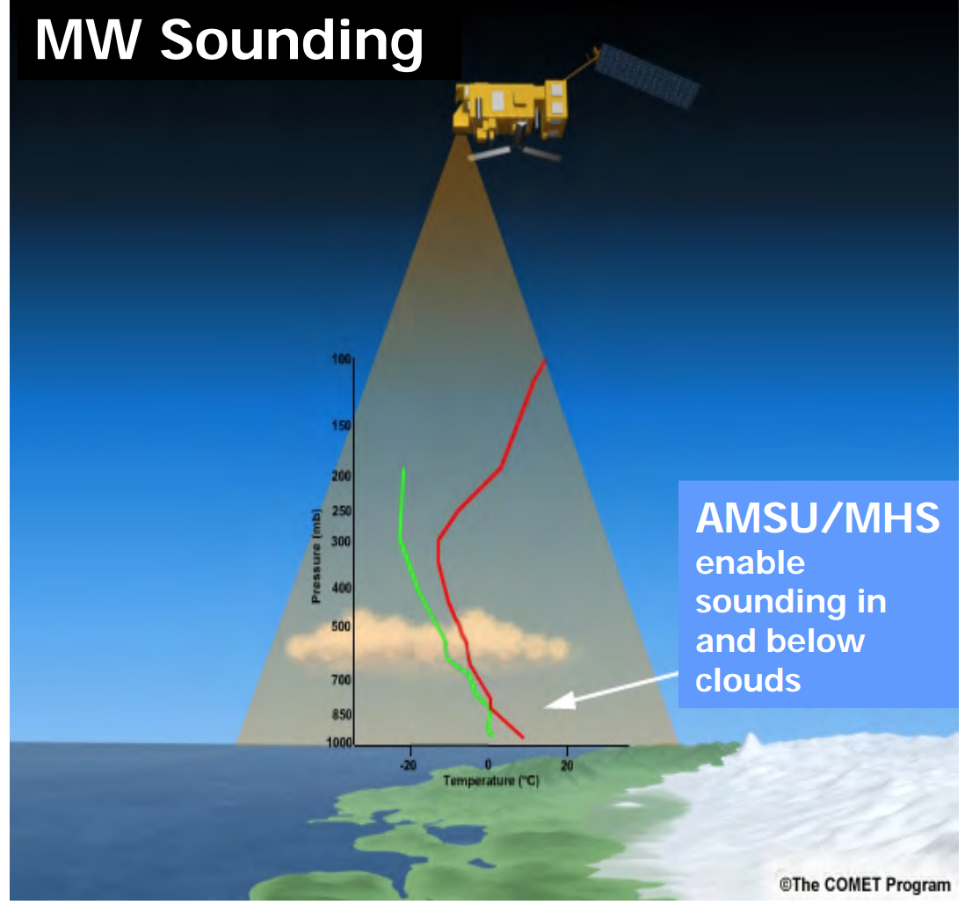
Next Generation Weather Satellites will Provide Much More: Including High Resolution Vertical Soundings Everywhere

Slide 13
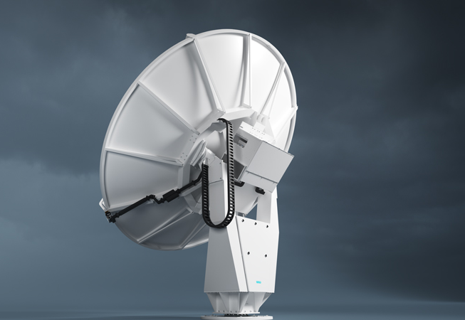
Better Weather Radar Coverage
Some areas of the U.S. and world have little or poor weather radar coverage.

Slide 14
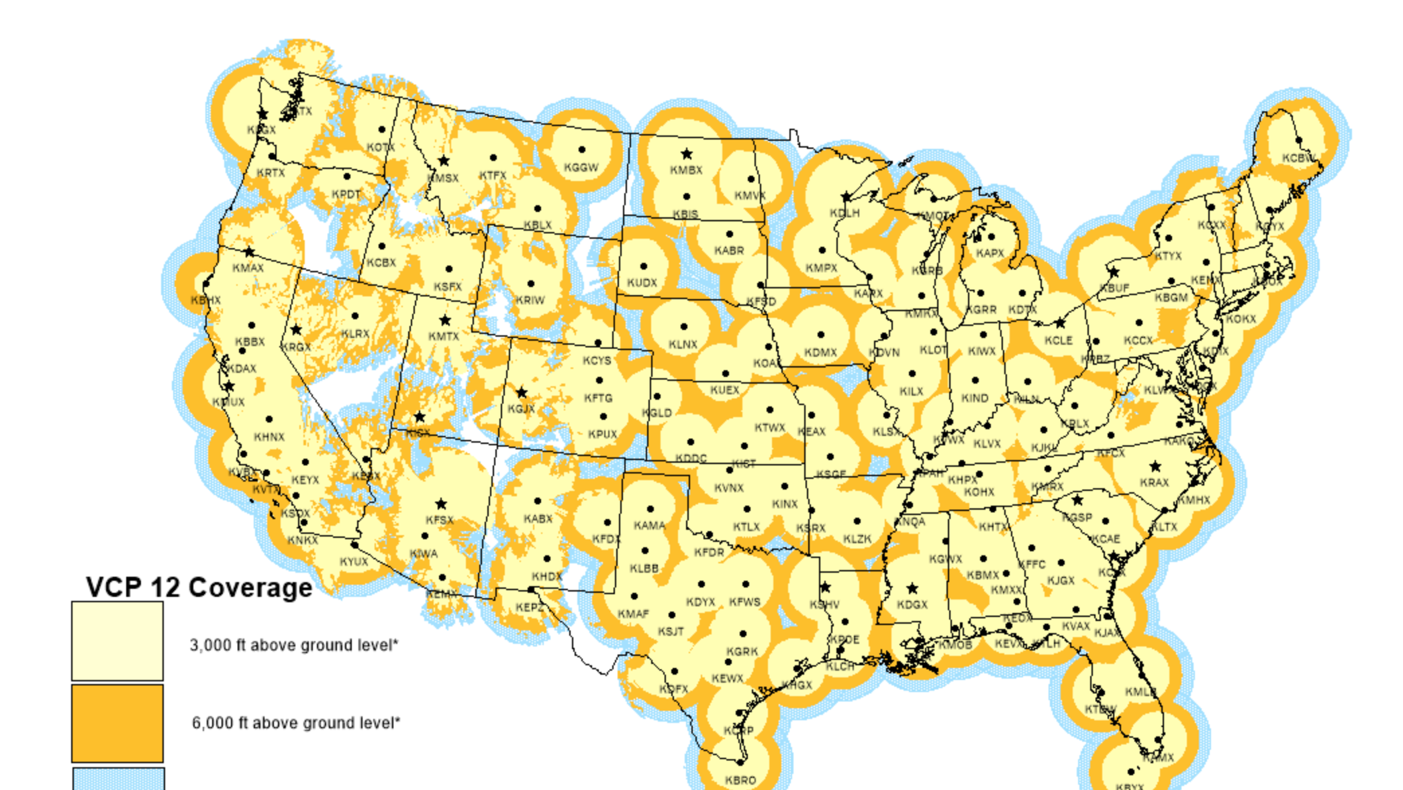
LIKE THE OREGON COAST

Slide 15
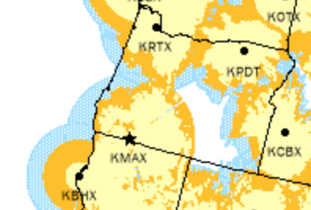
Oregon has of the biggest radar gaps in the U.S.

Slide 16
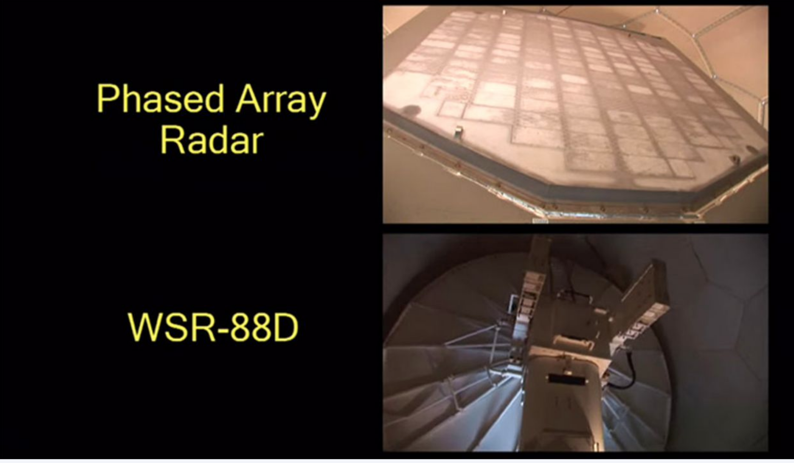
Need to fill radar gaps (hint to Oregon folks)
Next Generation Radars (e.g., phased array radar)

Slide 17
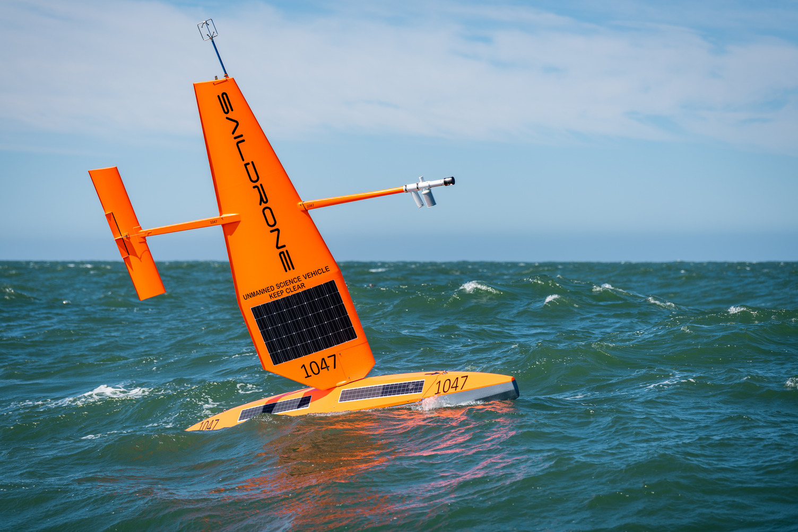
Much Greater Use of Unmanned Drones to Collect Weather Information

Slide 18
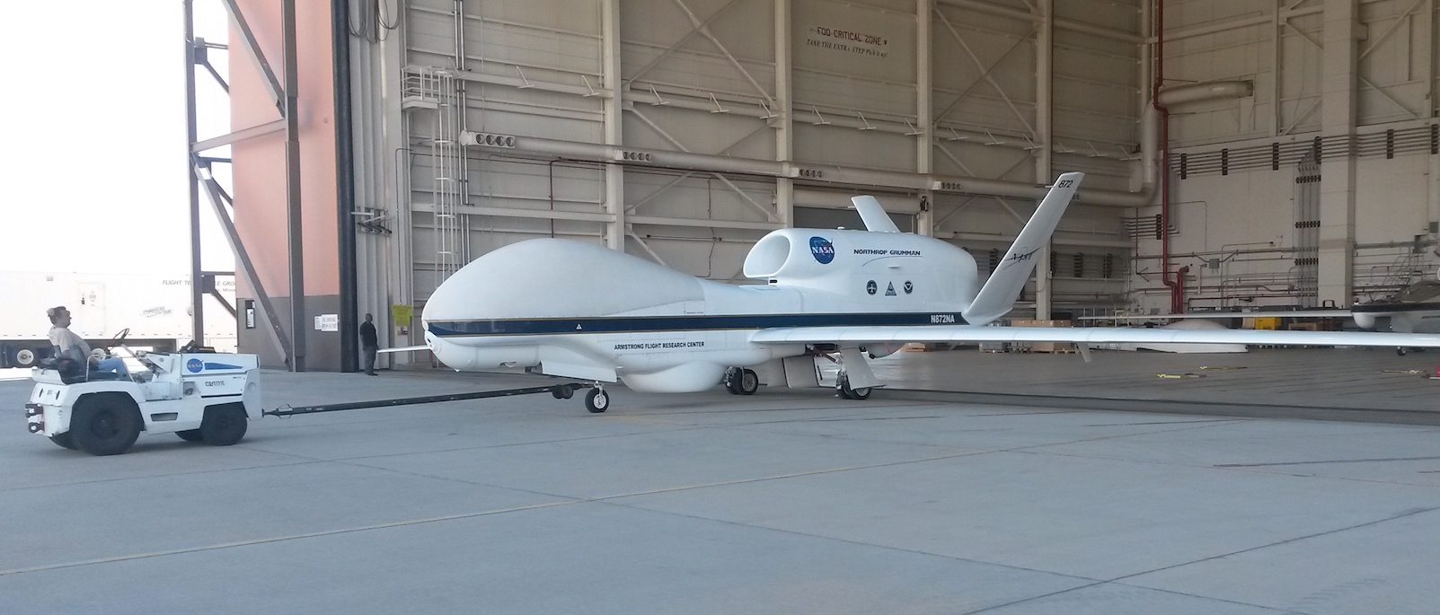
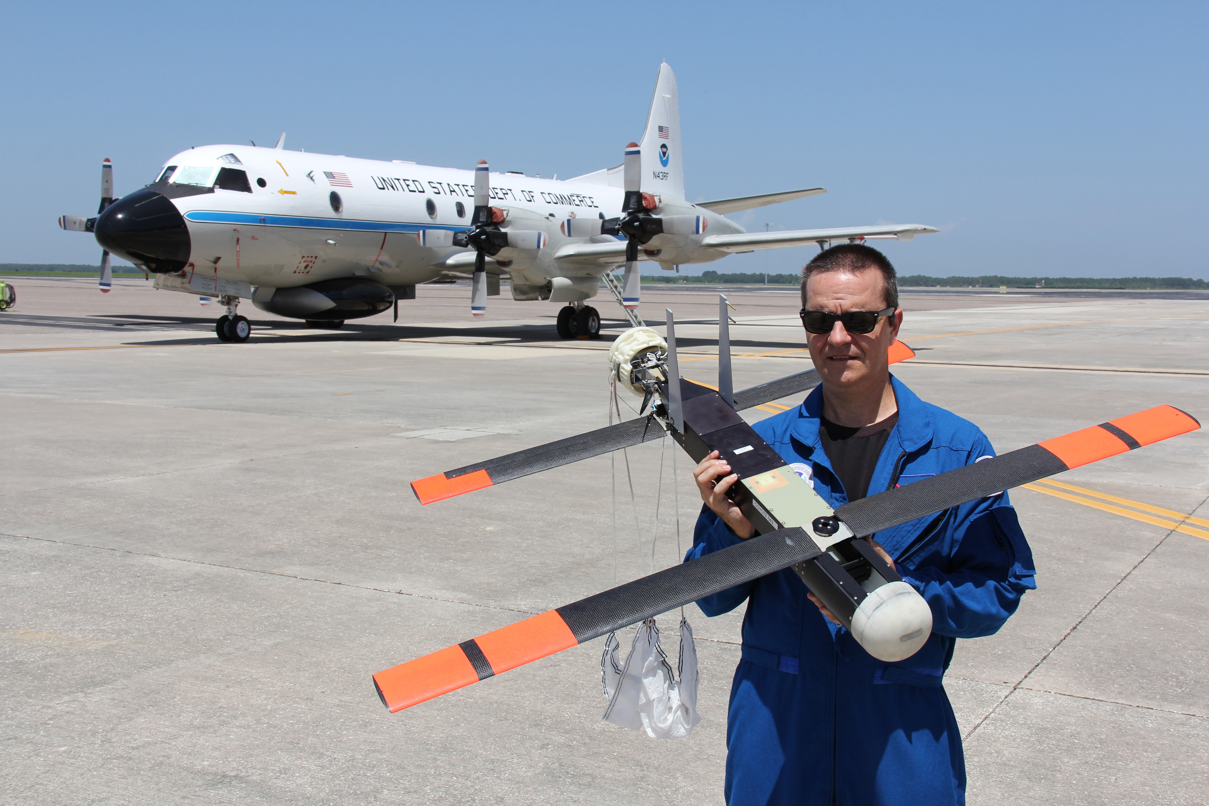

Slide 19
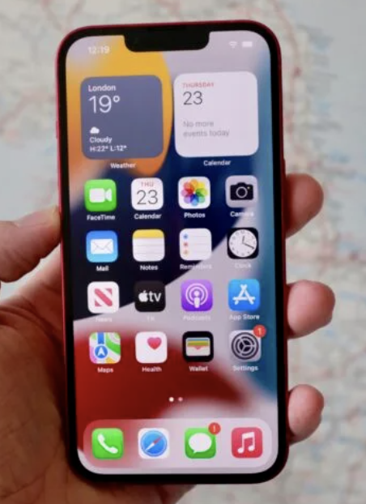
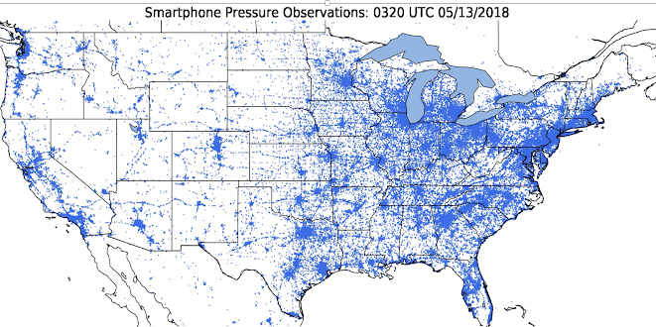
Crowdsourcing Weather Observations
Smartphone Pressure Observations

Slide 20
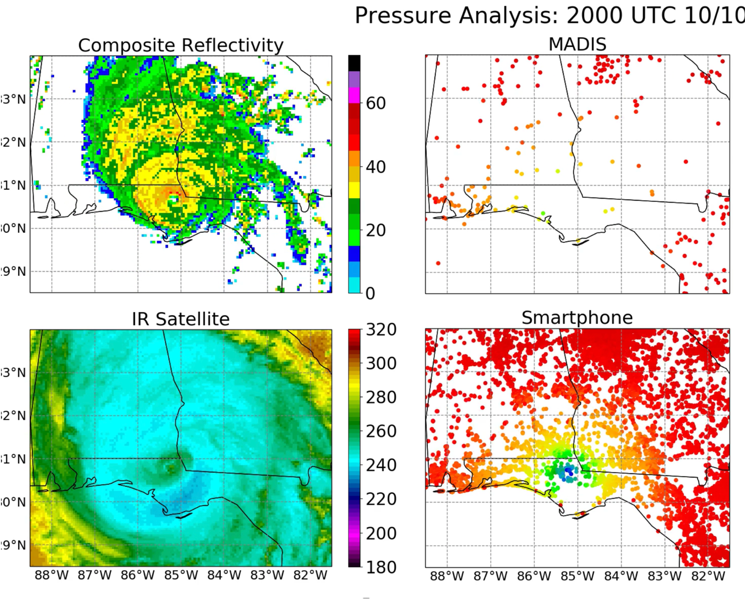

Slide 21
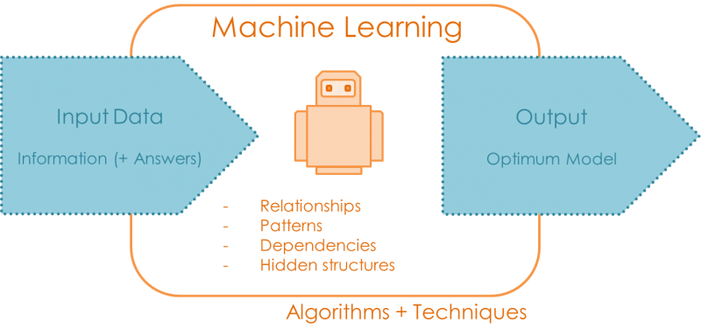
Machine Learning
Machine learning connects inputs with outputs

Slide 22
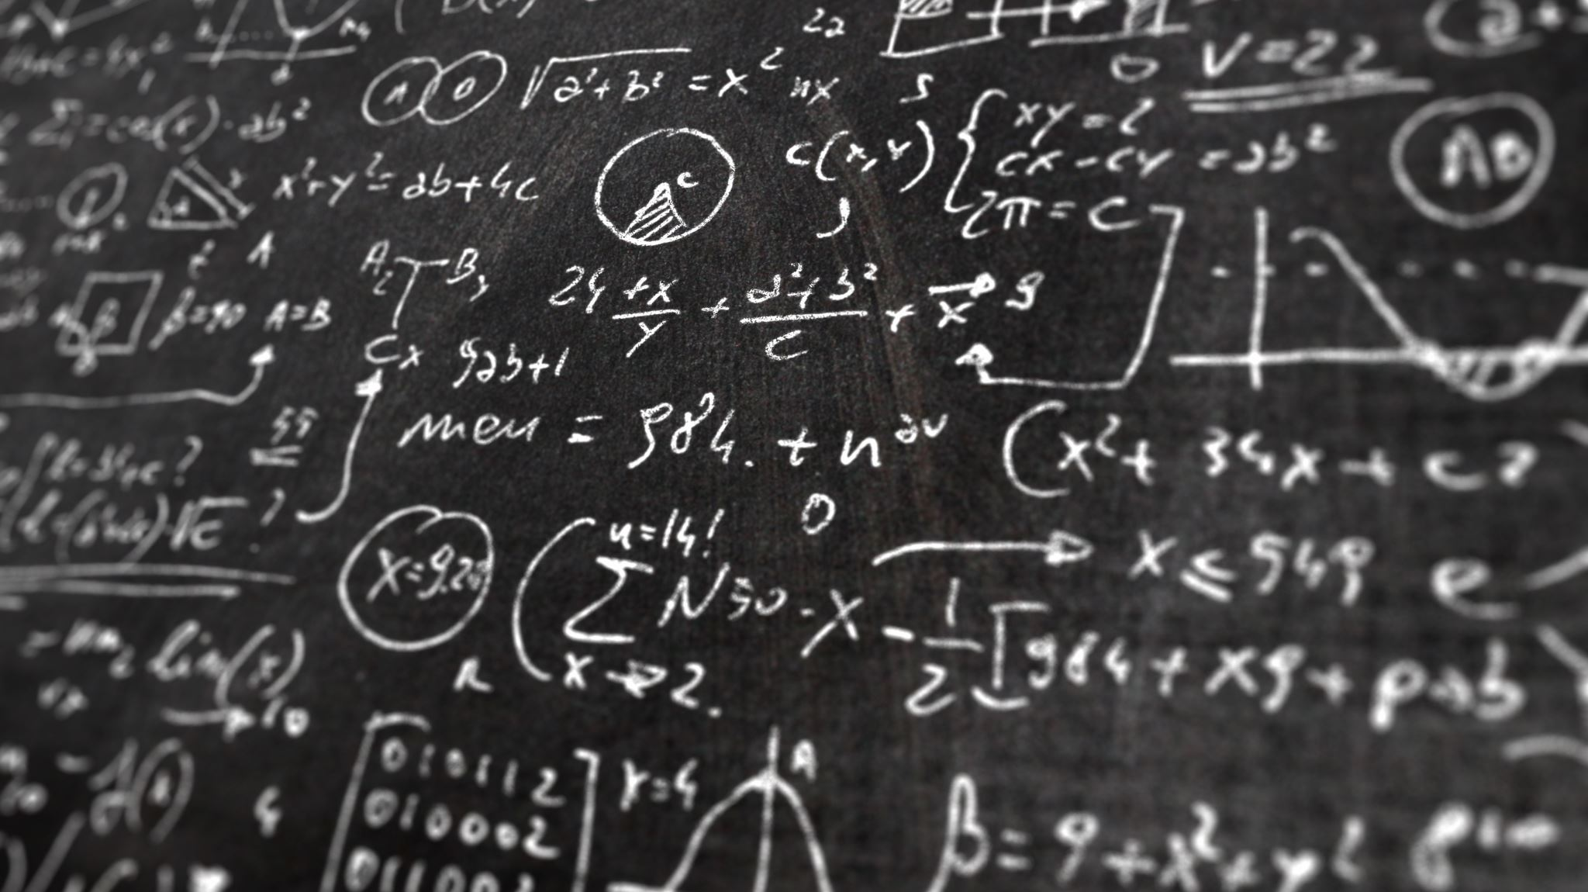
Lots of meteorological applications

Slide 23
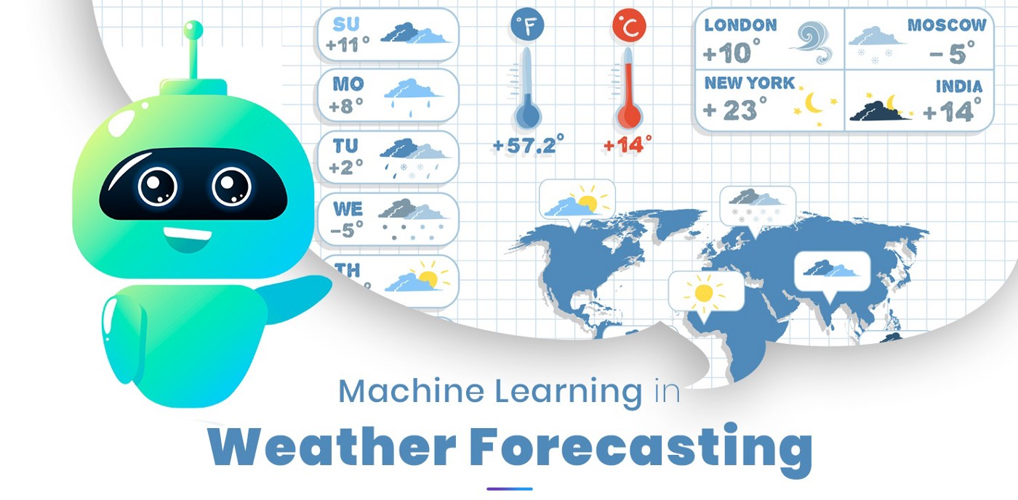
Potential Machine Learning Applications
Bias correction of observations
Replacement of poorly known physical parameterizations
Calibration of model forecasts
Some are even trying to replace the entire models!

Slide 24
The End

