Slide 1
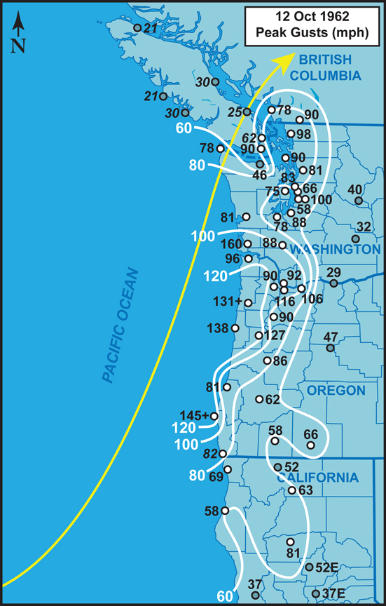
The Terrible Tempest of the 12th
Being an Exploration of the Infamous 1962 Columbus Day and Similar Storms
By Wolf Read
wolfread@me.com

Slide 2
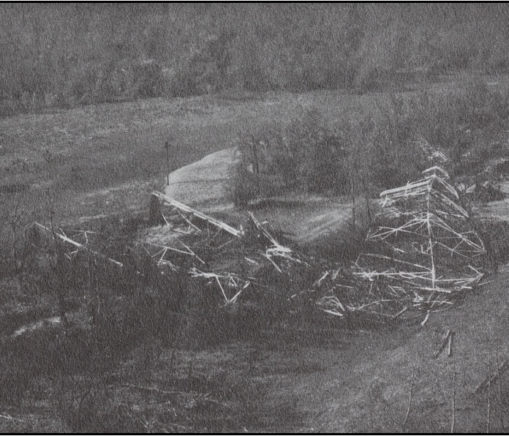
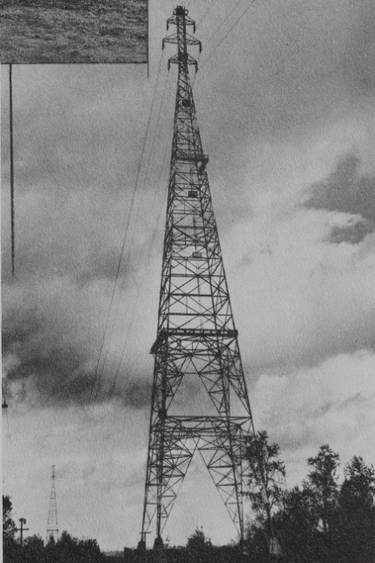
Outline
After the storm…
Classic path windstorms
Importance of the classic path to peak gust speeds and distribution
Observed peak gusts during the Columbus Day Storm (CDS)
Modeled surface pressure field of the CDS
Modeled wind and gust speeds of the CDS
Intercomparison of modeled winds to two other big events: 13-14 Nov 1981 and 12 Dec 1995
  Some conclusions
Return intervals of major classic-path events
Before
Near Vancouver, WA. $1 million (1962 USD) transmission tower, one of two destroyed by the storm. (Bonneville Power Administration photos from “West Coast Disaster,” Franklin, Dorothy)

Slide 3
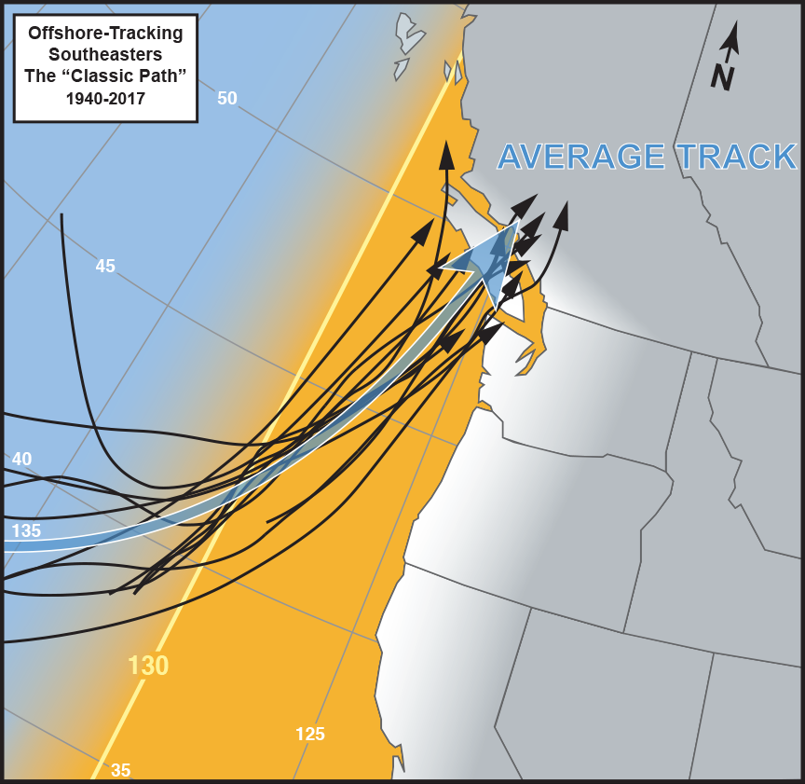
Classic Path
The 1962 Columbus Day Storm (CDS) is part of a family of extratropical cyclones that follow marked meridional (south to north) paths “inside 130ºW”
Referred to here as “Classic Path” storms
This path supports strong south to southeast winds–sometimes southwest on the coast–in the coastal lowlands
From California into British Columbia (white shading on map)

Slide 4
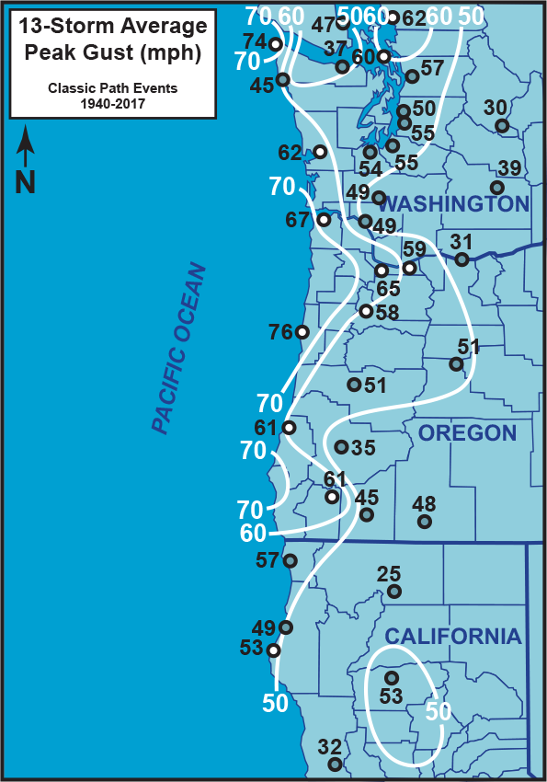
Classic Windstorm Peak Gust
The peak gust pattern is a mix of southerly and southeasterly windstorm patterns
Often favor NW Oregon and SW Washington with the highest wind speeds
Also SW Oregon coast

Slide 5
Classic Windstorm Peak Gust
In the Willamette Valley, peak wind speeds tend to increase from Eugene to Portland/Vancouver
Portland/Vancouver seem to be singled out for the most intense treatment of interior locations west of the Cascades
Wind-prone Bellingham is a close second–this site is favored in a southeasterly pattern such as tends to occur with classic-path windstorms

Slide 6
Classic Windstorm Peak Gust
The 1962 Columbus Day Storm fit the pattern on the map well, as will be shown
With extreme gust speeds in many areas

Slide 7
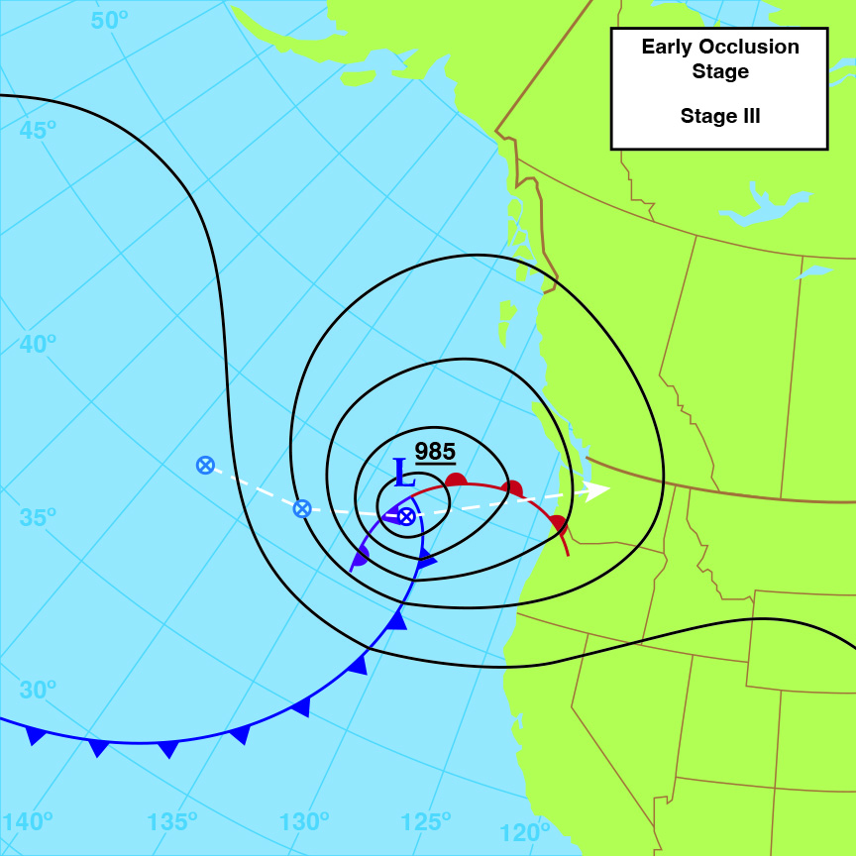
Importance of
Classic Path
A conceptual model that may help explain things

Slide 8
Importance of
Classic Path
Start with a fairly typical situation with a low-pressure system tracking ENE
This is what might be termed a “west-jet” storm
Develops in W to WNW flow

Slide 9
Importance of
Classic Path
The placement of key storm features, such as fronts, are in part the outcome of interaction with the jet stream
The path of the storm is also steered in part by the jet stream
Thus, jet stream orientation is important to storm structure
Approximate Jet Stream Path

Slide 10
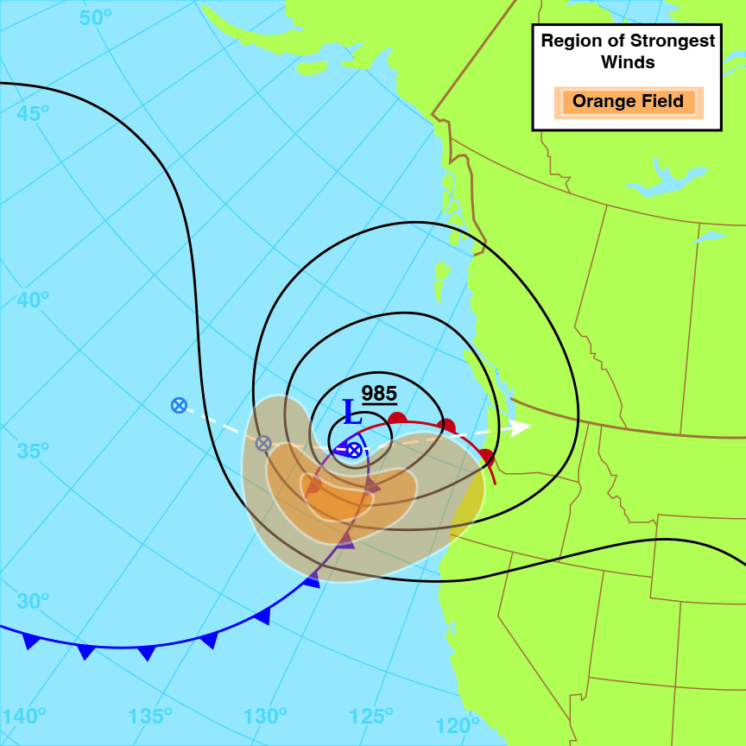
Importance of
Classic Path
With west-jet systems, the strongest winds tend to be found in the S and SW sides of the storm (orange)
This is where the strongest pressure gradients tend to occur
Call it the “heart” of the storm

Slide 11
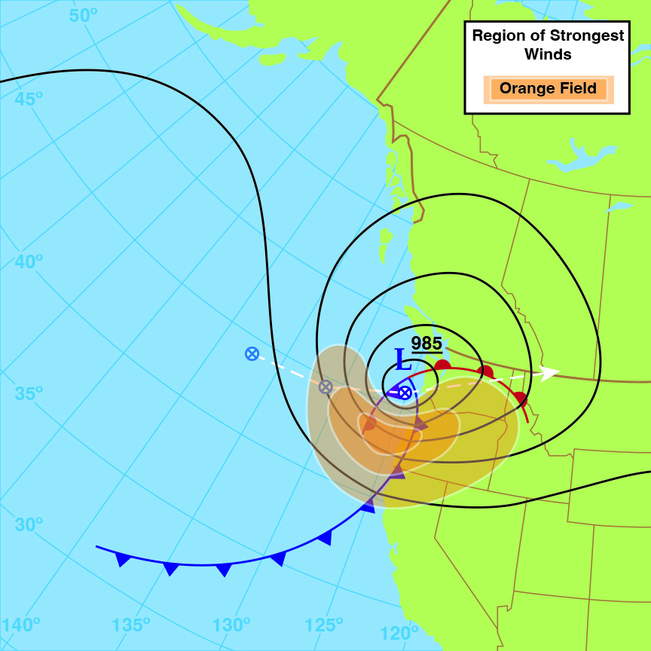
Importance of
Classic Path
When these storms land and track inland, the region affected by the strongest winds tends to be rather narrow
A key example is the 07 Feb 2002 windstorm

Slide 12
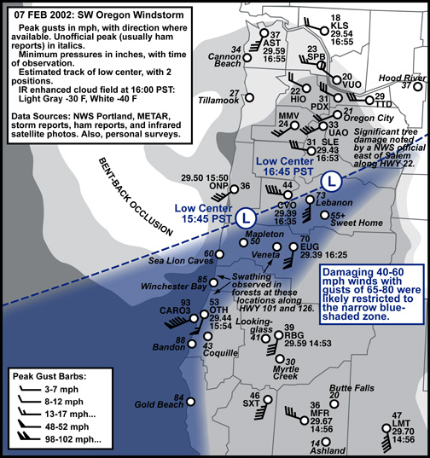
Importance of
Classic Path
This windstorm delivered the most punishing blow since the 1962 Columbus Day Storm to the southern Willamette Valley
Region affected buy the strongest winds perhaps 50 miles (80 km) wide north-south (blue) over the interior

Slide 13
Importance of
Classic Path
Most west-jet storms do not tend to affect large regions
There have been a few extraordinary exceptions (e.g. 14-15 Dec 2006), but it is a good rule of thumb

Slide 14
Importance of
Classic Path
A classic path storm has a different jet stream orientation
Aligned more north-south (meridionally)
This suggests a shifting of key storm features
West Jet Storm
Classic Path Jet Stream

Slide 15
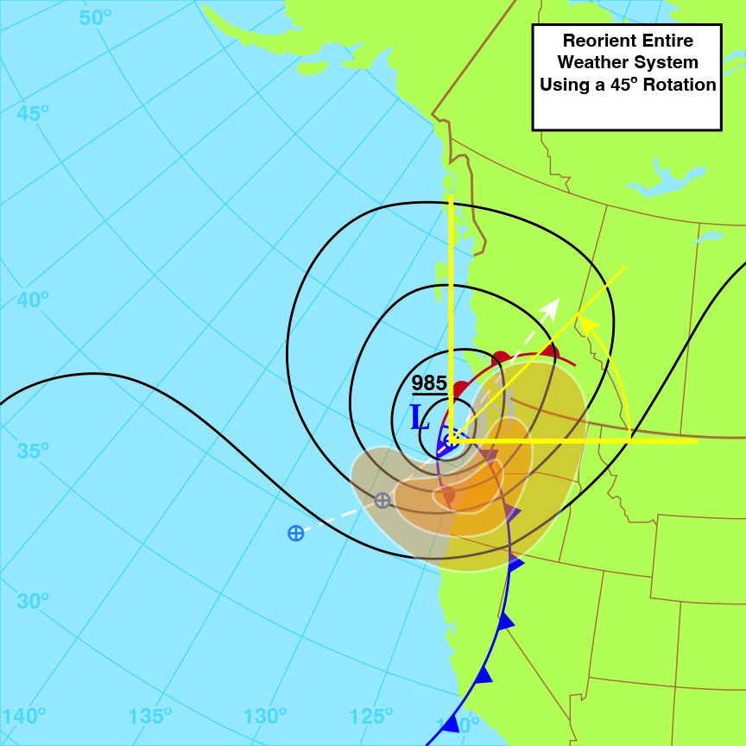
Importance of
Classic Path
Shifting the entire weather system—fronts, pressure gradient field and all—by 45º yields an interesting result
Approximate Jet Stream Path

Slide 16
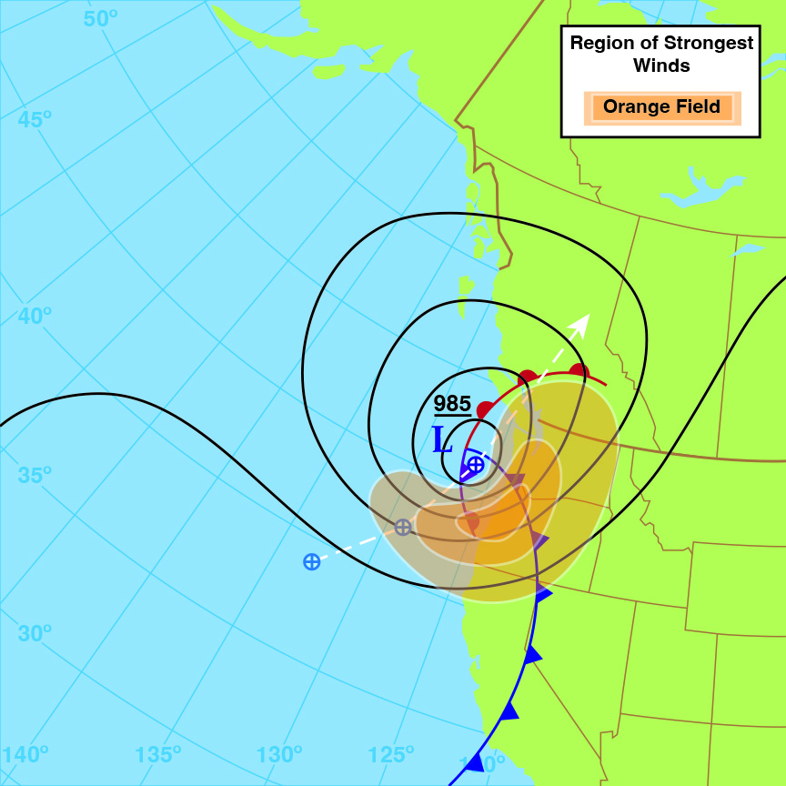
Importance of
Classic Path
The region where the strongest pressure gradient occurs is now on the S to SE side of the low
No longer the SW to S side

Slide 17
Importance of
Classic Path
This puts the region of strongest winds inland while the low-pressure center remains offshore

Slide 18
Importance of
Classic Path
Staying over the low-friction over-water environment helps the low maintain strength
When lows track inland, they tend to weaken fast, with some exceptions

Slide 19
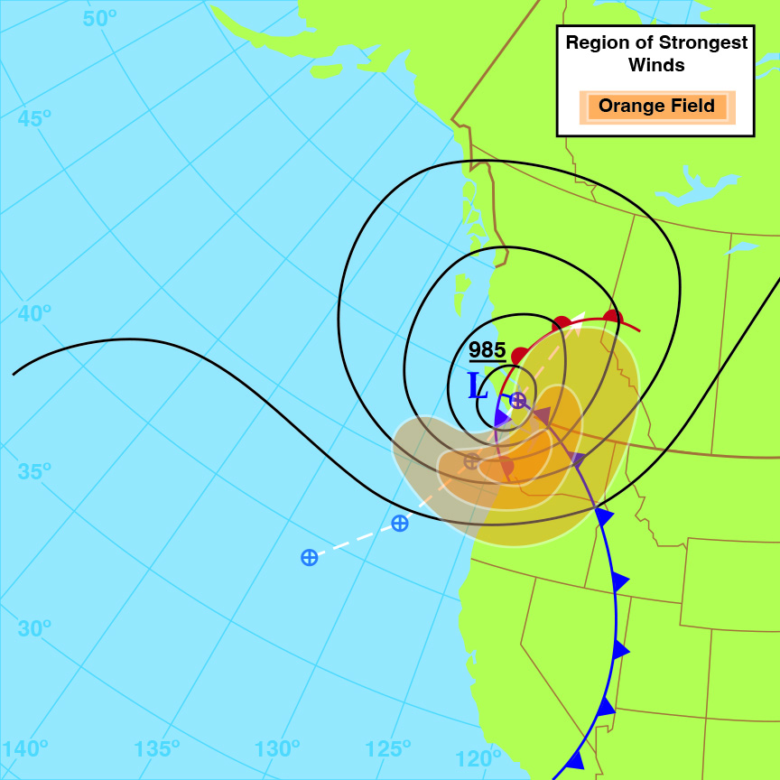
Importance of
Classic Path
As the low tracks N to NNE, the region of maximum pressure gradient is lifted north
Directly hitting the coastal and interior lowlands from CA into BC
Thus, strongly affecting a very large region

Slide 20
Importance of
Classic Path
This underscores the potence and importance of Classic Path systems
And helps explain—in part—the magnitude of wind speeds and size of region affected by the 1962 Columbus Day Storm…

Slide 21
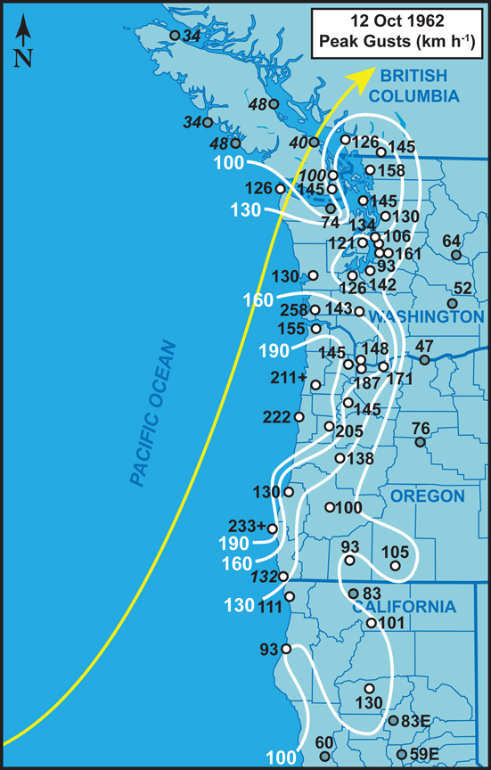
Columbus Day Storm Peak Gusts
Western Oregon and southwest Washington bore the brunt of the storm
Many of the peak gusts reported in this region still stand today as the all-time highest on record

Slide 22
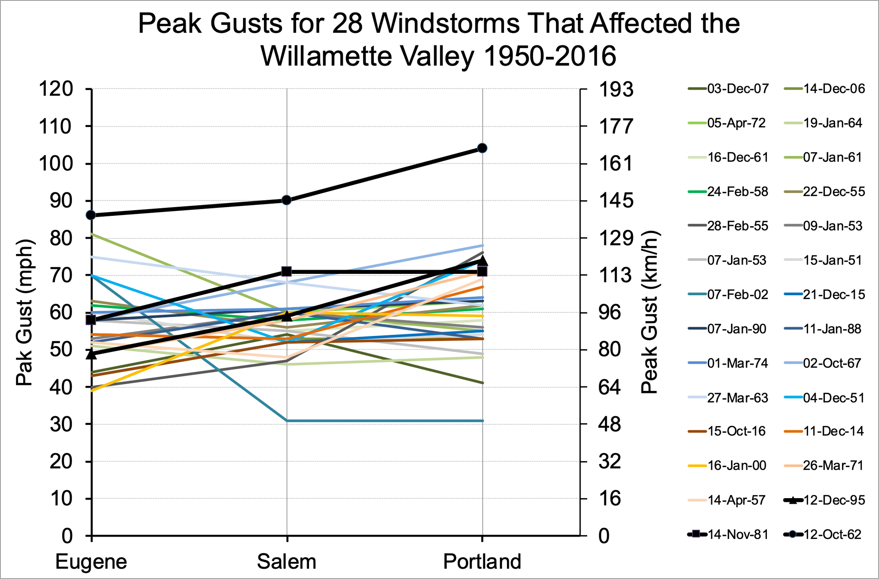
Columbus Day Storm Peak Gusts
In the Willamette Valley, no official weather station has reported a gust ≥80 mph since the CDS
60 years!

Slide 23
Columbus Day Storm Peak Gusts
Caveat: Eugene, OR (KEUG), during 07 Feb 2002 likely received instantaneous gusts approaching 80 mph
  Not measured by the automated observing system in place at the time, which reported 70 mph
So perhaps more like 40 years
Still likely short of the 86 mph that occurred at KEUG during the CDS

Slide 24
Columbus Day Storm Peak Gusts
Even for a major classic path windstorm, the CDS gust speeds are unusual
They are one of the key mysteries of the storm

Slide 25
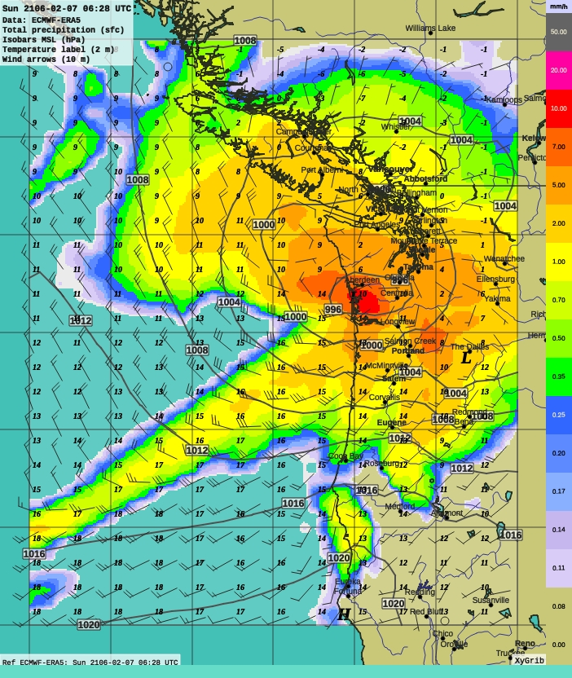
ERA5 Reanalysis Data
1958-11-04 02:00 UTC
Combines model data with observations to make a consistent dataset using the laws of physics
Uses the ECMWF–European–model
Has a 0.25º grid spacing
Horizontal resolution at 45ºN:
  Approximately 27 km N-S, 20 km E-W
Offers a chance to look at Pacific Northwest windstorms in a different light
1958-11-04 02:00 UTC

Slide 26
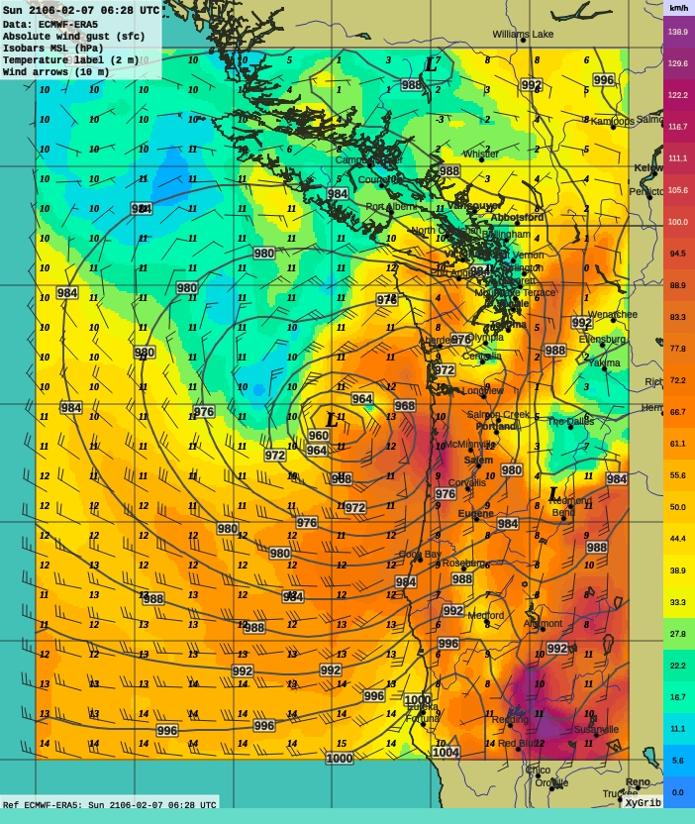
1962 OCT 13 – 0000 UTC
Surface: SLP Gust Temp
1962-10-13 00:00 UTC
138.9 km/h = 80 knots = 92 mph
111.1 km/h = 60 knots = 69 mph
To look at a couple of frames
Here is the ERA5 estimate for 4:00 PM PST on 12 OCT 1962
  Showing sea-level pressure: dark grey isobars
  Peak near-surface gust: color fields
  Gridded wind speed/direction: wind barbs
  Near-surface temperature: gridded italicized/boldface numbers
1962-10-13 00:00 UTC

Slide 27
1962 OCT 13 – 0000 UTC
Surface: SLP Gust Temp
1962-10-13 00:00 UTC
138.9 km/h = 80 knots = 92 mph
111.1 km/h = 60 knots = 69 mph
At this time, much of the central and southern Willamette Valley was under the main guns of this windstorm
Corvallis being shredded with gusts to 127 mph (200 km/h)
1962-10-13 00:00 UTC

Slide 28
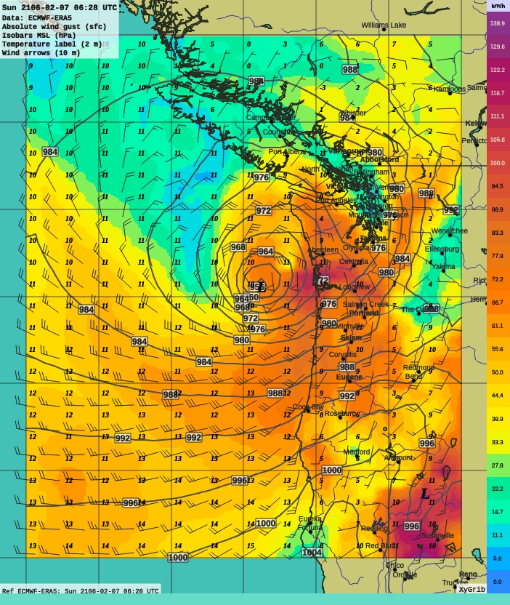
1962 OCT 13 – 0200 UTC
Surface: SLP Gust Temp
1962-10-13 02:00 UTC
138.9 km/h = 80 knots = 92 mph
111.1 km/h = 60 knots = 69 mph
Two hours later, 6:00 PM PST
Portland now being hammered by gusts that would soon reach and estimated 104 mph (167 km/h)
Astoria just about to join the fray, with winds ramping up around 18:30
How well is the ERA5 performing here?
1962-10-13 02:00 UTC

Slide 29
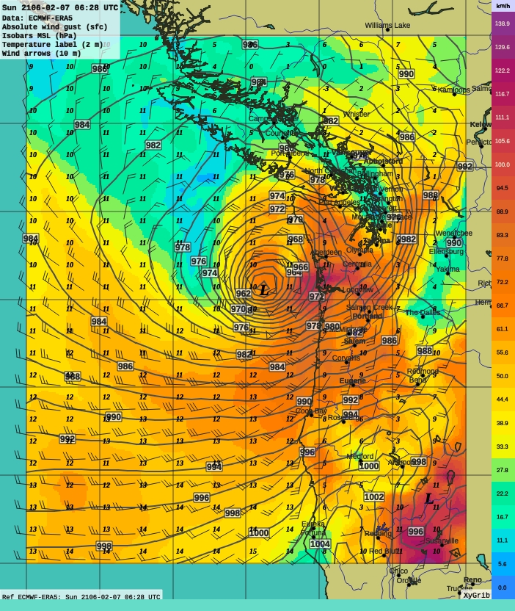
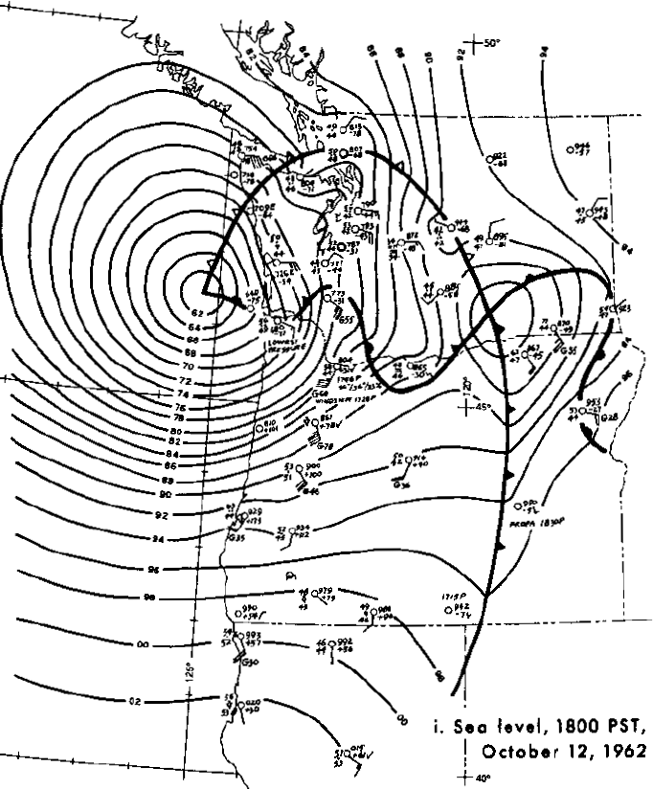
1962 OCT 13 – 0200 UTC
Surface: SLP Gust Temp
1962-10-13 02:00 UTC
138.9 km/h = 80 knots = 92 mph
111.1 km/h = 60 knots = 69 mph
Region of strongest winds concentrated in the E quadrant of the low
Lynott & Cramer 1966
Changed isobar spacing from 4 hPa to 2 hPa
1962-10-13 02:00 UTC

Slide 30
1962 OCT 13 – 0200 UTC
Surface: SLP Gust Temp
1962-10-13 02:00 UTC
ERA5 isobar depiction very close to Lynott & Cramer’s detailed analysis
138.9 km/h = 80 knots = 92 mph
111.1 km/h = 60 knots = 69 mph
Region of strongest winds concentrated in the E quadrant of the low
Lynott & Cramer 1966
1962-10-13 02:00 UTC

Slide 31
1962 OCT 13 – 0200 UTC
Surface: SLP Gust Temp
1962-10-13 02:00 UTC
ERA5 indicates at least 956 hPa (28.23” Hg) for central pressure
Lynott & Cramer estimated 960 hPa
138.9 km/h = 80 knots = 92 mph
111.1 km/h = 60 knots = 69 mph
Region of strongest winds concentrated in the E quadrant of the low
Lynott & Cramer 1966
1962-10-13 02:00 UTC

Slide 32
1962 OCT 13 – 0200 UTC
Surface: SLP Gust Temp
1962-10-13 02:00 UTC
However, the ERA5 model falls far short on estimating gust speeds
138.9 km/h = 80 knots = 92 mph
111.1 km/h = 60 knots = 69 mph
Region of strongest winds concentrated in the E quadrant of the low
Lynott & Cramer 1966
1962-10-13 02:00 UTC

Slide 33
1962 OCT 13 – 0200 UTC
Surface: SLP Gust Temp
1962-10-13 02:00 UTC
138.9 km/h = 80 knots = 92 mph
111.1 km/h = 60 knots = 69 mph
At this time, most locations in the northern half of the Willamette Valley were receiving gusts of ≥90 mph (140 km/h)
This includes Salem
For the southern Valley, Eugene 52 mph (80 km/h), the indicated speed is good for the depicted timeframe
1962-10-13 02:00 UTC

Slide 34
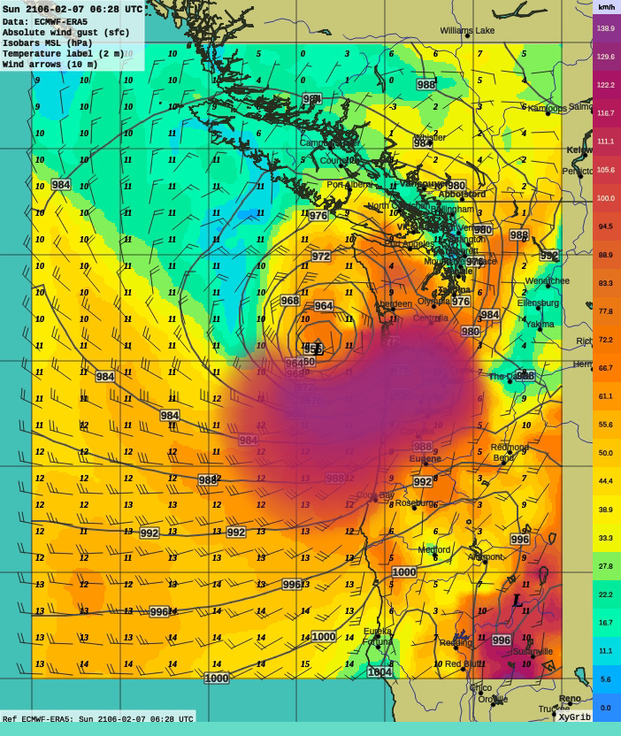
1962 OCT 13 – 0200 UTC
Surface: SLP Gust Temp
1962-10-13 02:00 UTC
138.9 km/h = 80 knots = 92 mph
111.1 km/h = 60 knots = 69 mph
This is a closer approximation
Based on wind observations
  Astoria overdone here–the main wind surge is about to arrive (~18:30 PST)
Over the Pacific more guesswork involved
The main point is that NW Oregon should be painted in the deep reds and purples at this time
1962-10-13 02:00 UTC

Slide 35
1962 OCT 13 – 0200 UTC
Surface: SLP Gust Temp
1962-10-13 02:00 UTC
138.9 km/h = 80 knots = 92 mph
111.1 km/h = 60 knots = 69 mph
Given that the surface pressure filed is depicted very well…
It appears that this pressure information does not inform the wind/gust estimate in the ERA5 data–or it is not incorporated well
1962-10-13 02:00 UTC

Slide 36
1962 OCT 13 – 0200 UTC
Surface: SLP Gust Temp
1962-10-13 02:00 UTC
138.9 km/h = 80 knots = 92 mph
111.1 km/h = 60 knots = 69 mph
This discrepancy is likely due in part to two key factors:
Grid resolution missing the fine wind speed details
  Likely plays a role, but probably not the key factor
During the “early years” of the ERA5 dataset (<1979), there simply were not as many observations to work with to feed into the numerical models
Storm depictions appear to get better going forward in time, as indicated by other major classic path events…
1962-10-13 02:00 UTC

Slide 37
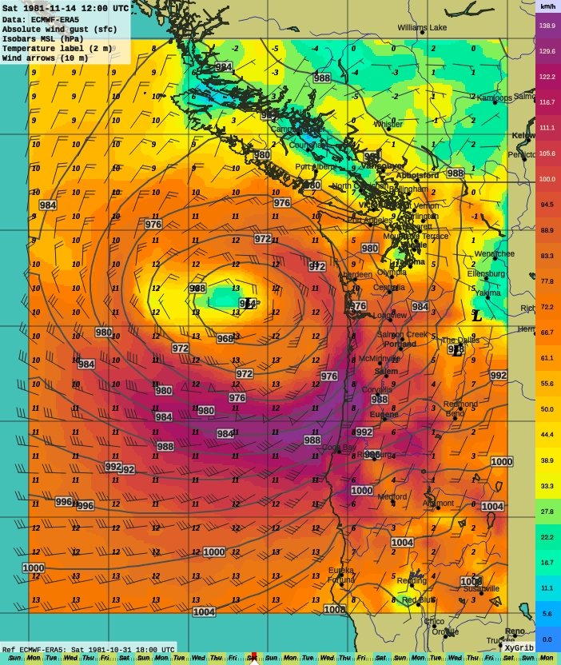
1981 NOV 14 – 1200 UTC
Surface: SLP Gust Temp
138.9 km/h = 80 knots = 92 mph
111.1 km/h = 60 knots = 69 mph
This is at 04:00 PST, right around the time of peak gust at Salem and Portland: 71 mph (115 km/h)
This depiction is closer, but still lags:
  PDX: 56 mph (90 km/h) | best 61 mph 07:00
  SLE: 62 mph (100 km/h) | best 65 mph 05:00
The large field of deep purple along the coast is encouraging
Here is indication of 85 mph (~140 km/h)
Actual observations at some coastal sites 90-100 mph

Slide 38
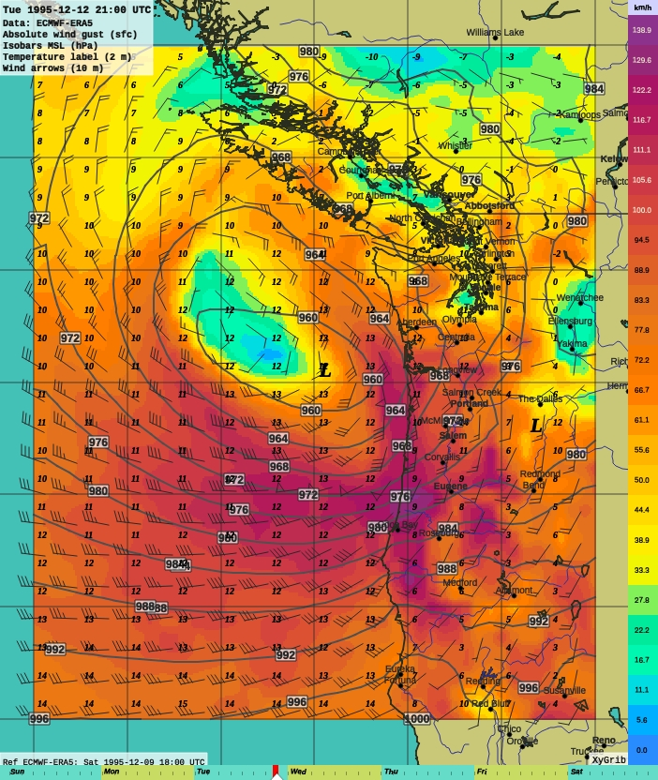
1995 DEC 12 – 2100 UTC
Surface: SLP Gust Temp
138.9 km/h = 80 knots = 92 mph
111.1 km/h = 60 knots = 69 mph
This storm captured even better
Observed 5-sec peak gust ~1300 PST:
  PDX: 62 mph (100 km/h)
  SLE: 59 mph (94 km/h)
Observed instant (1-sec) gust:
  PDX: 74 mph (119 km/h)
Modeled gust (1300 PST):
  PDX: 53 mph (85 km/h)
  SLE: 63 mph (101 km/h)

Slide 39
1995 DEC 12 – 2100 UTC
Surface: SLP Gust Temp
138.9 km/h = 80 knots = 92 mph
111.1 km/h = 60 knots = 69 mph
This storm captured even better
Observed 5-sec peak gust ~1300 PST:
  PDX: 62 mph (100 km/h)
  SLE: 59 mph (94 km/h)
Observed instant (1-sec) gust:
  PDX: 74 mph (119 km/h)
Highest modeled gust using 1-h steps:
  PDX: 63 mph (101 km/h) 15:00 PST
  SLE: 68 mph (110 km/h) 14:00 PST

Slide 40
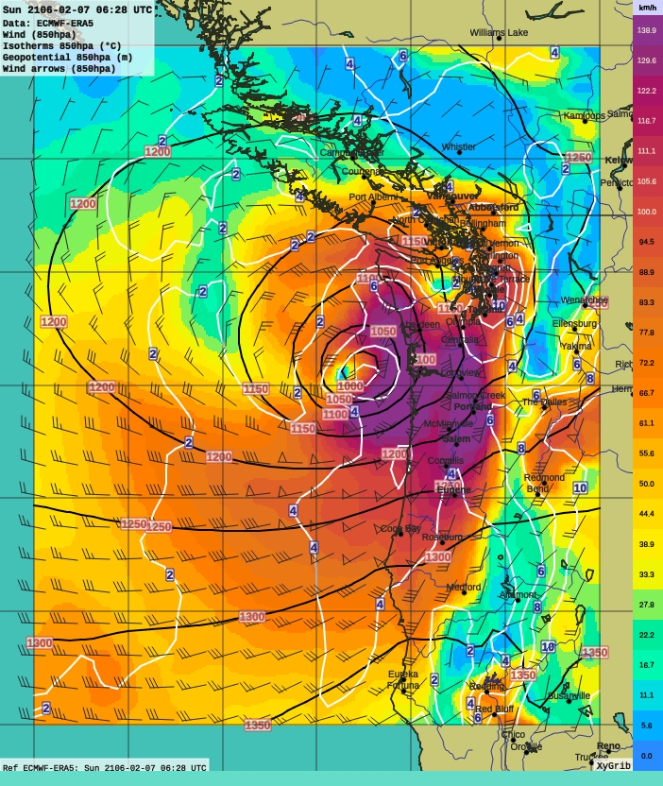
1962 OCT 13 – 0200 UTC
850 Heights Temp Wind
1962-10-13 02:00 UTC
138.9 km/h = 80 knots = 92 mph
111.1 km/h = 60 knots = 69 mph
Since the ERA5 surface wind estimate for the CDS falls short, one must look elsewhere
Perhaps the modelling did better in the upper levels, where terrain friction is not as significant
1962-10-13 02:00 UTC

Slide 41
1962 OCT 13 – 0200 UTC
850 Heights Temp Wind
1962-10-13 02:00 UTC
138.9 km/h = 80 knots = 92 mph
111.1 km/h = 60 knots = 69 mph
Here are the 850 hPa winds–about 1.1 km above sea-level–for the Columbus Day Storm
850 hPa winds are often a reasonable proxy for surface gust speeds
This is looking better
1962-10-13 02:00 UTC

Slide 42
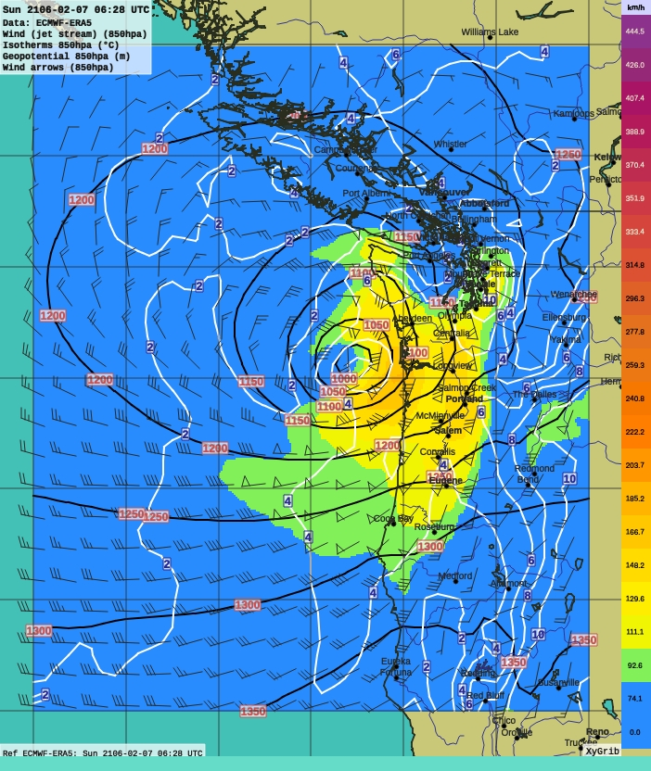
1962 OCT 13 – 0200 UTC
850 Heights Temp Wind
1962-10-13 02:00 UTC
166.7 km/h = 90 knots = 104 mph
111.1 km/h = 60 knots = 69 mph
Changing the color scheme to highlight the most significant wind speeds
There are areas of 100 to 110 mph (160 to 180 km/h) over the coast
Over the Willamette Valley 80 to 95 mph (130 to 150 km/h)
Very rare 850 values and an indication of a potent storm
1962-10-13 02:00 UTC

Slide 43
1962 OCT 13 – 0200 UTC
850 Heights Temp Wind
1962-10-13 02:00 UTC
166.7 km/h = 90 knots = 104 mph
111.1 km/h = 60 knots = 69 mph
Only the coastal 850 hPa winds are unusually high for a major classic-path storm
1962-10-13 02:00 UTC

Slide 44
1962 OCT 13 – 0200 UTC
850 Heights Temp Wind
1962-10-13 02:00 UTC
166.7 km/h = 90 knots = 104 mph
111.1 km/h = 60 knots = 69 mph
And modeled height 850 speeds still fall short of measured surface winds
So probably not quite capturing the real storm
1962-10-13 02:00 UTC

Slide 45
1962 OCT 13 – 0200 UTC
850 Heights Temp Wind
1962-10-13 02:00 UTC
166.7 km/h = 90 knots = 104 mph
111.1 km/h = 60 knots = 69 mph
This map also offers a chance to intercompare with the other two major classic path storms
This provides some idea of significance
1962-10-13 02:00 UTC

Slide 46
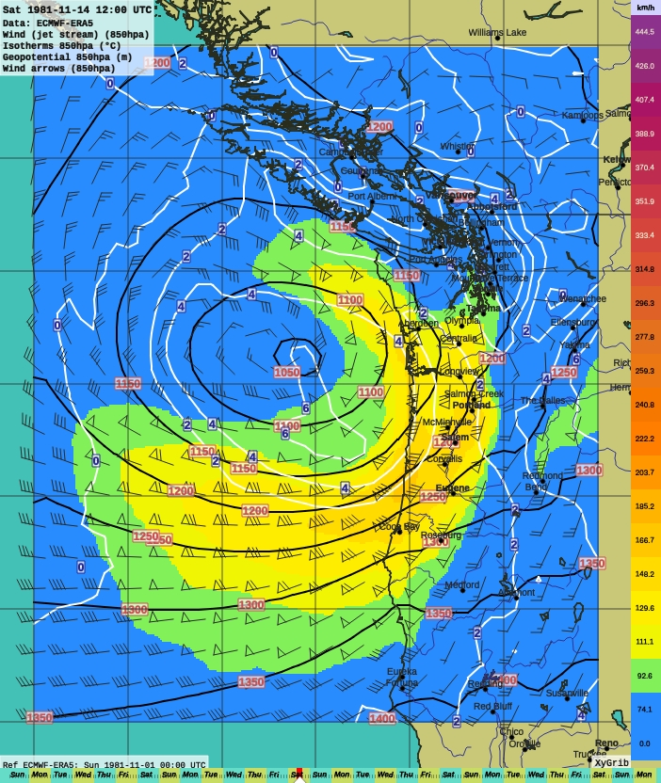
1981 NOV 14 – 1200 UTC
850 Heights Temp Wind
166.7 km/h = 90 knots = 104 mph
111.1 km/h = 60 knots = 69 mph
Height 850 winds over coast not as fast as the CDS
  85 to 100 mph (140 to 160 km/h)
They are, however, similar to CDS over the Willamette Valley
  80 to 95 mph (130 to 150 km/h)
Larger area of coverage–CDS appears to have been a fairly compact storm

Slide 47
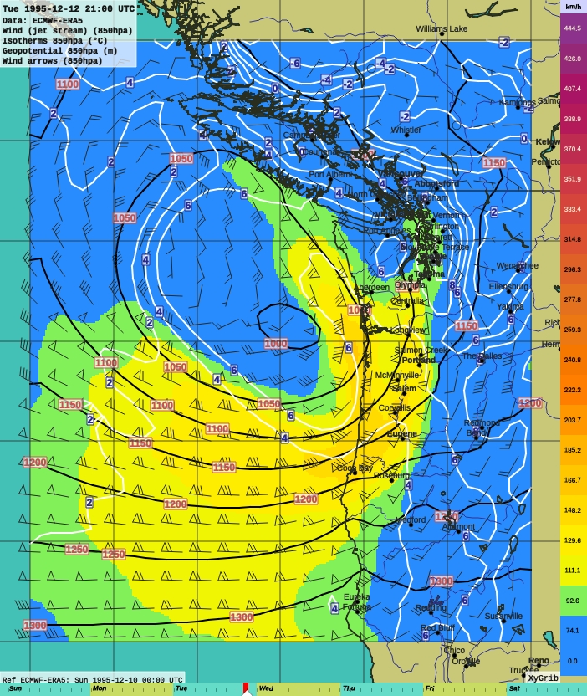
1995 DEC 12 – 2100 UTC
850 Heights Temp Wind
166.7 km/h = 90 knots = 104 mph
111.1 km/h = 60 knots = 69 mph
Dec 1995 has similar coastal height 850 wind speeds to Nov 1981
  85 to 100 mph (140 to 160 km/h)
Somewhat less over the Willamette Valley
  75 to 85 mph (120 to 140 km/h)

Slide 48
1962 OCT 13 – 0200 UTC
850 Heights Temp Wind
1962-10-13 02:00 UTC
166.7 km/h = 90 knots = 104 mph
111.1 km/h = 60 knots = 69 mph
ERA5 conclusions:
While capturing surface pressure field well, the ERA5 data fall short of capturing the measured near-surface gusts of the CDS
Depictions of major storms appear to get better in recent years, likely owing to more information being available
Analysis using ERA5 appears most useful for events from approximately 1980 and later
1962-10-13 02:00 UTC

Slide 49
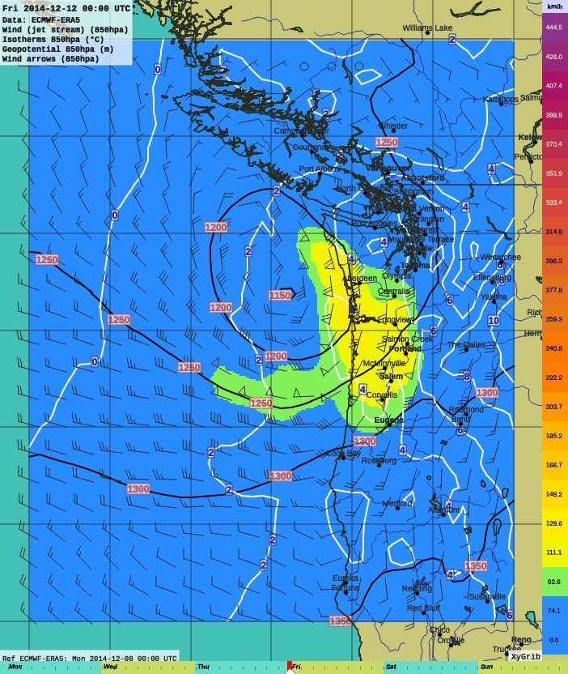
2014 DEC 12 – 0000 UTC
850 Heights Temp Wind
166.7 km/h = 90 knots = 104 mph
111.1 km/h = 60 knots = 69 mph
Before closing…
Here are the height 850 winds for the 11 Dec 2014 classic path windstorm
Among a number of classic path windstorms since Dec 1995, this one is perhaps the most significant (16 Jan 2000 being a close second)
It is a pipsqueak relative to the major events of 1962, 1981 and 1995
Dec 2014 made a “good effort”, but fell short of being a major event

Slide 50
2014 DEC 12 – 0000 UTC
850 Heights Temp Wind
166.7 km/h = 90 knots = 104 mph
111.1 km/h = 60 knots = 69 mph
This underscores an important fact:
There has not been a major classic-path windstorm in 27 years

Slide 51
2014 DEC 12 – 0000 UTC
850 Heights Temp Wind
166.7 km/h = 90 knots = 104 mph
111.1 km/h = 60 knots = 69 mph
This underscores an important fact:
There has not been a major classic-path windstorm in 27 years
Given these dates for major events: 1945, 1962, 1981 and 1995
An average of 17 years between storms is returned
Looks like we may be overdue!

Slide 52
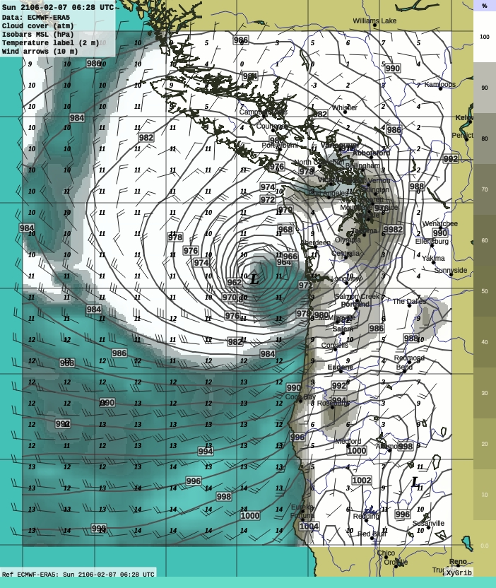
Questions / Comments?
Image is a cloud cover estimate for the CDS at 18:00 on 12 Oct 1962, showing what the storm may have looked like from a satellite’s vantage
Thank you!

Slide 53
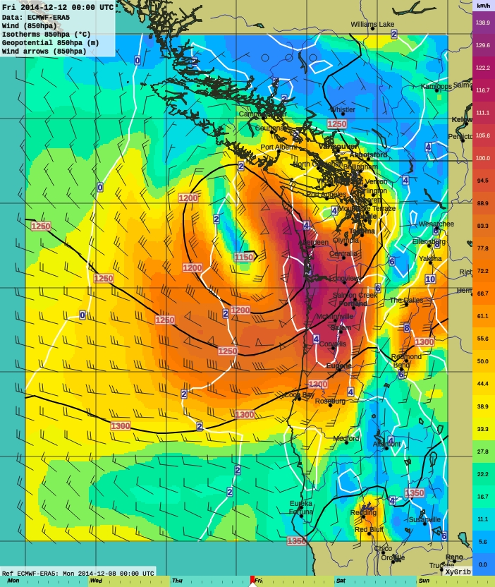
2014 DEC 12 – 0000 UTC
850 Heights Temp Wind
138.9 km/h = 80 knots = 92 mph
111.1 km/h = 60 knots = 69 mph
Region of strongest winds concentrated in the E quadrant of the low

Slide 54
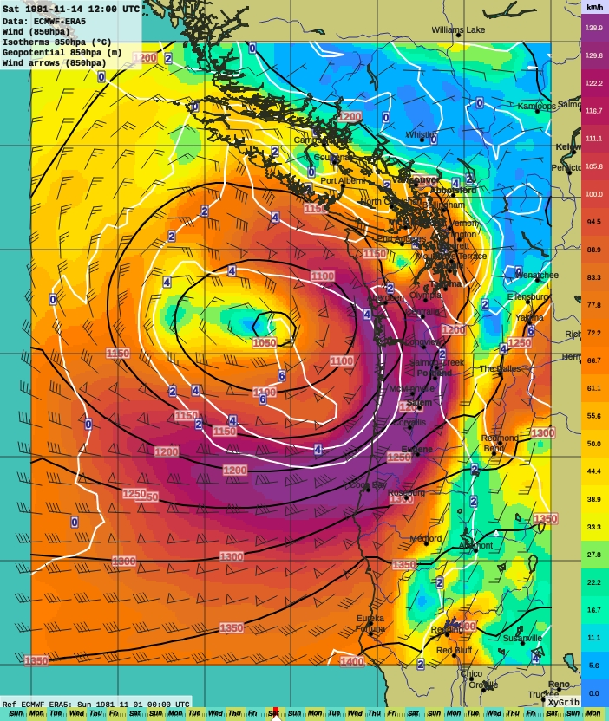
1981 NOV 14 – 1200 UTC
850 Heights Temp Wind
138.9 km/h = 80 knots = 92 mph
111.1 km/h = 60 knots = 69 mph
Nov 1981 had a much broader region of strong 850 hPa winds…

Slide 55
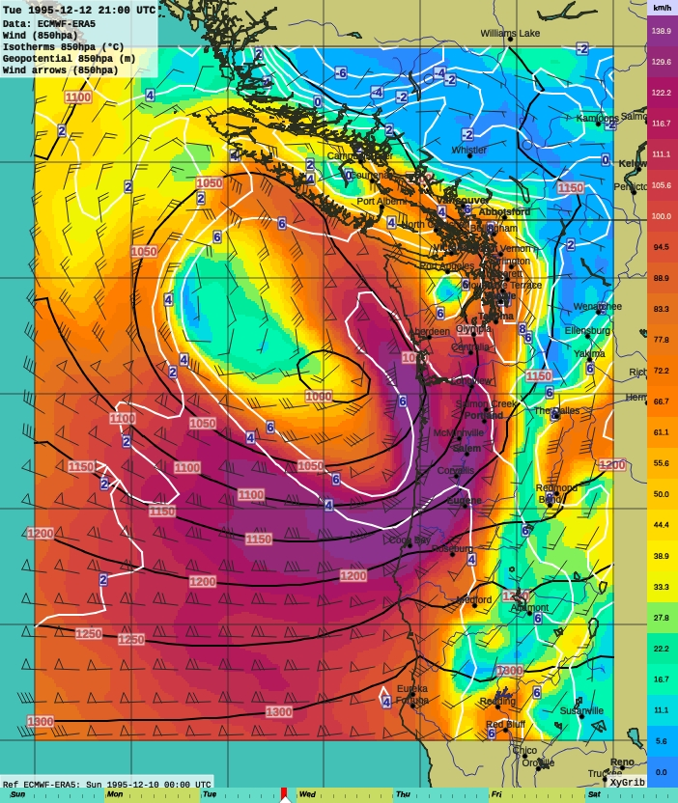
1995 DEC 12 – 2100 UTC
850 Heights Temp Wind
138.9 km/h = 80 knots = 92 mph
111.1 km/h = 60 knots = 69 mph
Region of strongest winds concentrated in the E quadrant of the low

Slide 56
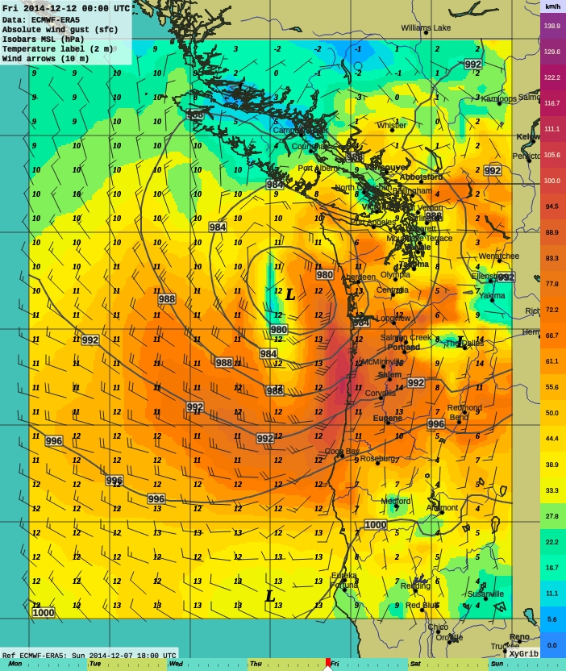
2014 DEC 12 – 0000 UTC
Surface: SLP Gust Temp
138.9 km/h = 80 knots = 92 mph
111.1 km/h = 60 knots = 69 mph
Region of strongest winds concentrated in the E quadrant of the low

