Slide 1
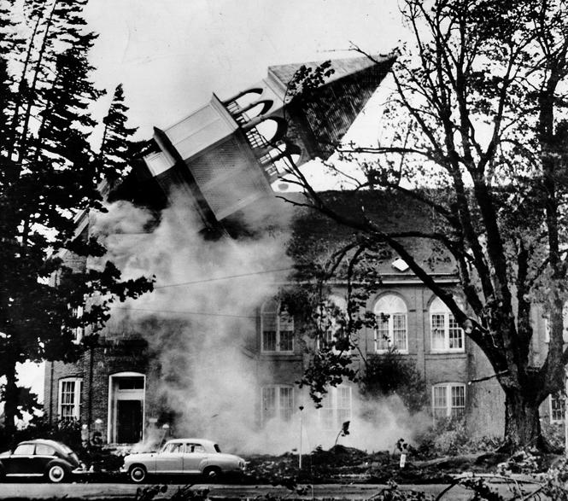
The Columbus Day Storm
October 12, 1962
Cliff Mass, Atmospheric Sciences
The steeple atop historic Campbell Hall, on the Oregon College of Education Campus, Monmouth.

Slide 2

Native Americans knew about the threat
… and had several legends regarding their origin.
The Thunderbird

Slide 3
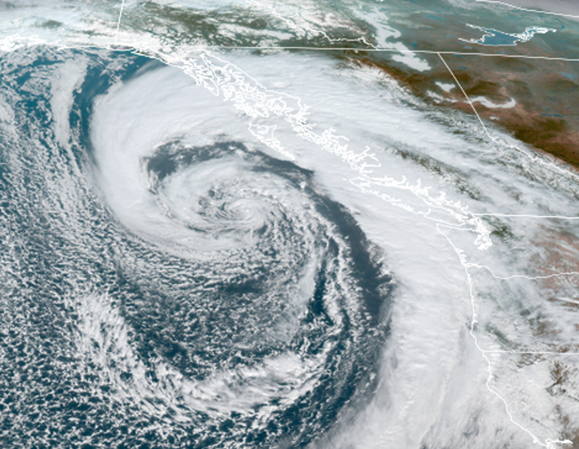
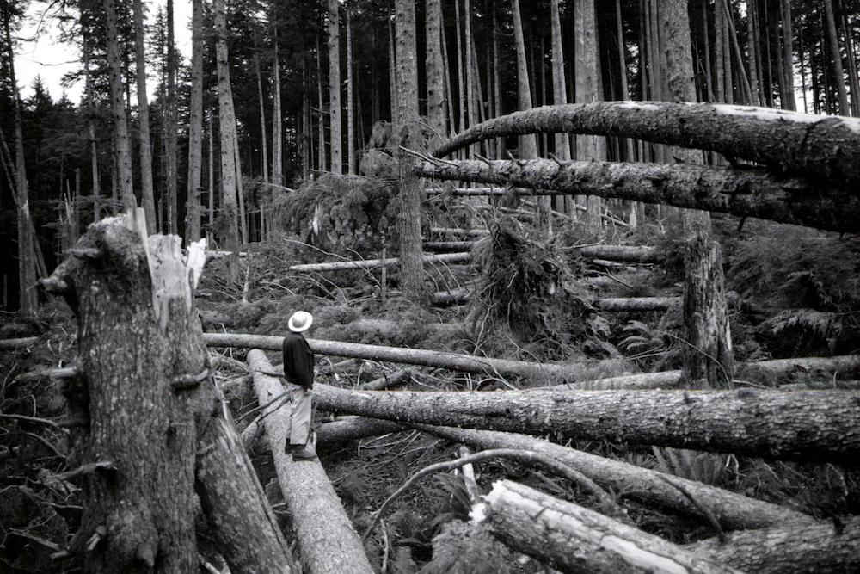
The Pacific Northwest is a region that can experience intense storms

Slide 4
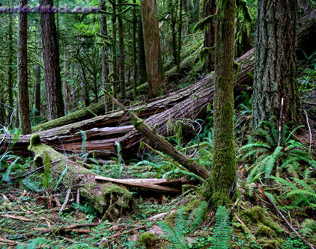
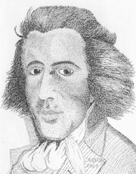
European explorers knew…
John Meares,1788, off of Cape
Flattery of the Olympics Peninsula
“The force of southerly storms was evident to every eye; large and extensive woods being laid flat by their power, the branches forming one long line to the North West, intermingled with the roots of innumerable trees, which have been torn from their beds and helped to mark the furious course of their tempests.”

Slide 5
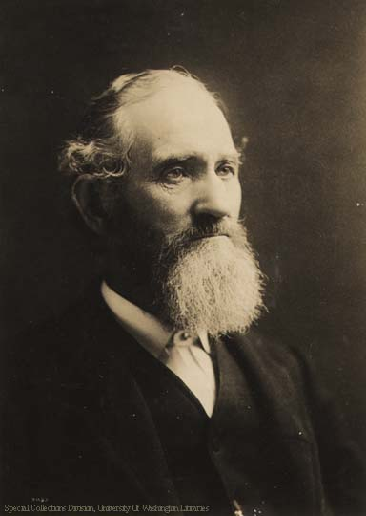
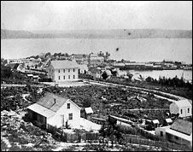
Early settlers learned quickly about the impacts of the great Northwest windstorms
Arthur Denny
Seattle

Slide 6
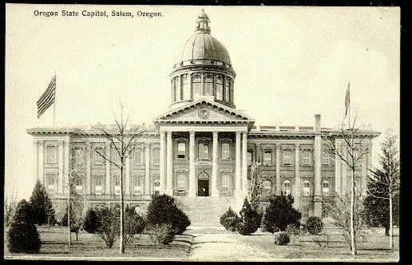
January 9, 1880
Hit northern Oregon and southern Washington
Toppled tens of thousands of trees.
Wind gusts reached 138 mph on the coast and 70-80 mph in the interior.
Buildings throughout the Willamette Valley, were damaged or destroyed.
Part of the roof of the Oregon State Capital in Salem was blown off.
~955 hPa

Slide 7
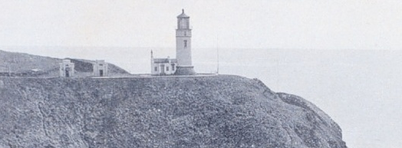
January 29, 1921
Hurricane-force winds struck the entire Washington Coast
  At North Head sustained winds reached 126 mph, with a maximum one-minute wind of 150 mph before the sensor failed.
  At Tatoosh Island, 150 miles to the north, winds reached 110 mph.

Slide 8
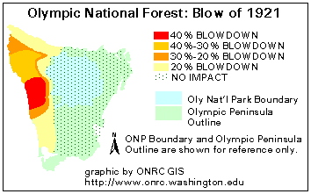
In some areas over 40% of the trees were blown down
As a result, this event has become known as the
“The Olympic Blowdown Storm”

Slide 9
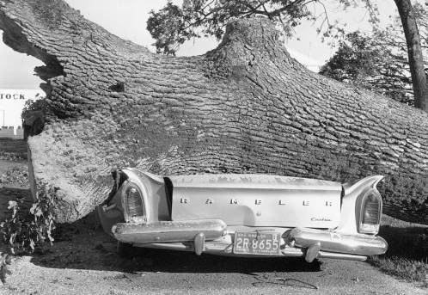
All overshadowed by the Columbus Day Storm
The strongest Pacific storm to strike the NW since the arrival of European settlers
Probably the most powerful non-tropical cyclone to hit the lower-48 states in a century.

Slide 10
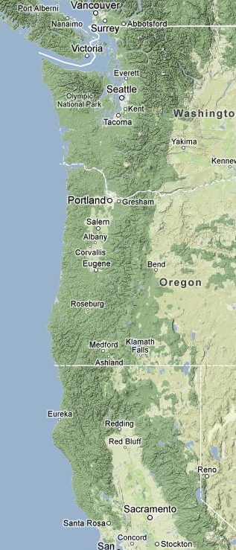
Extraordinary Impact
Northern California to southern British Columbia experienced hurricane-force winds, massive treefalls, and power outages.
Sustained winds reaching 60-70 mph and gusts over 120 mph.
In Oregon and Washington, 46 died and 317 required hospitalization.
Flooding and landslides in northern California.

Slide 11
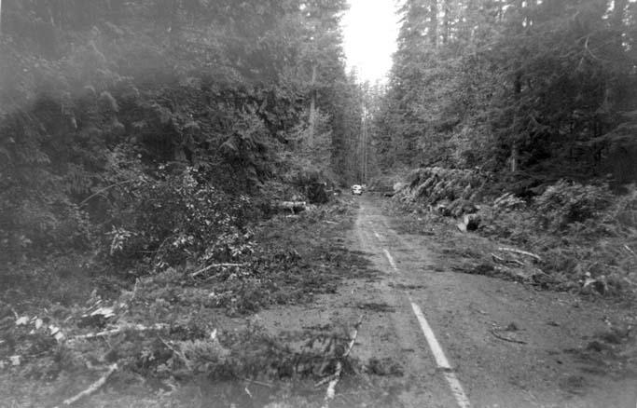
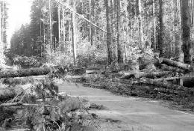
Impacts
Ten to 15 billion board feet of timber were downed
Enough to build a million.
53,000 homes were damaged, thousands of utility poles were toppled, and the twin 520-ft steel towers that carried the main power lines of Portland were crumpled.

Slide 12
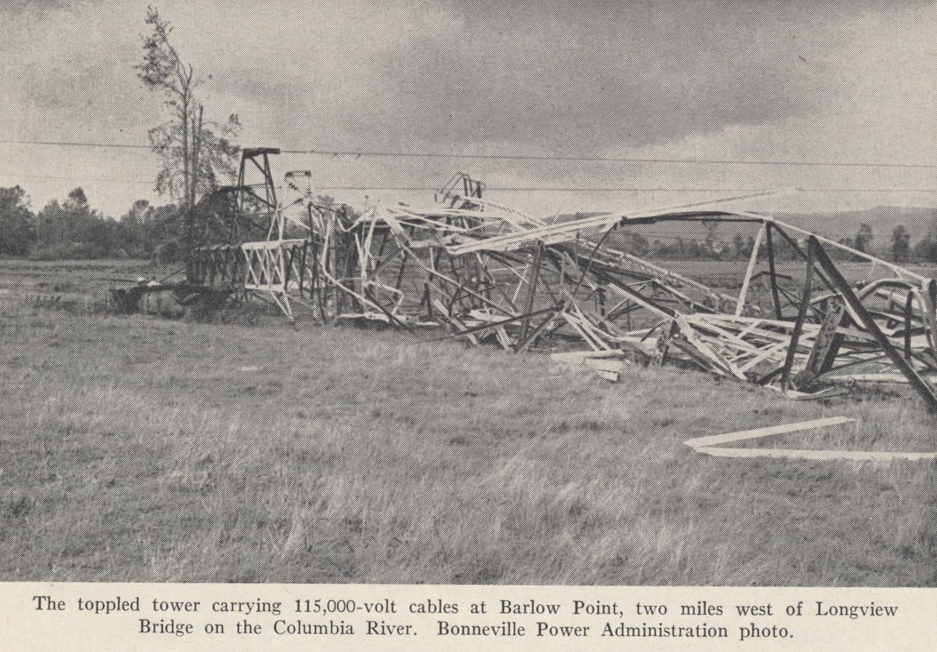

Slide 13
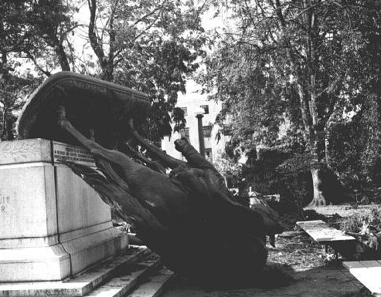
On the state capitol ground in Salem, Oregon, the bronze status, the Circuit Rider was toppled

Slide 14
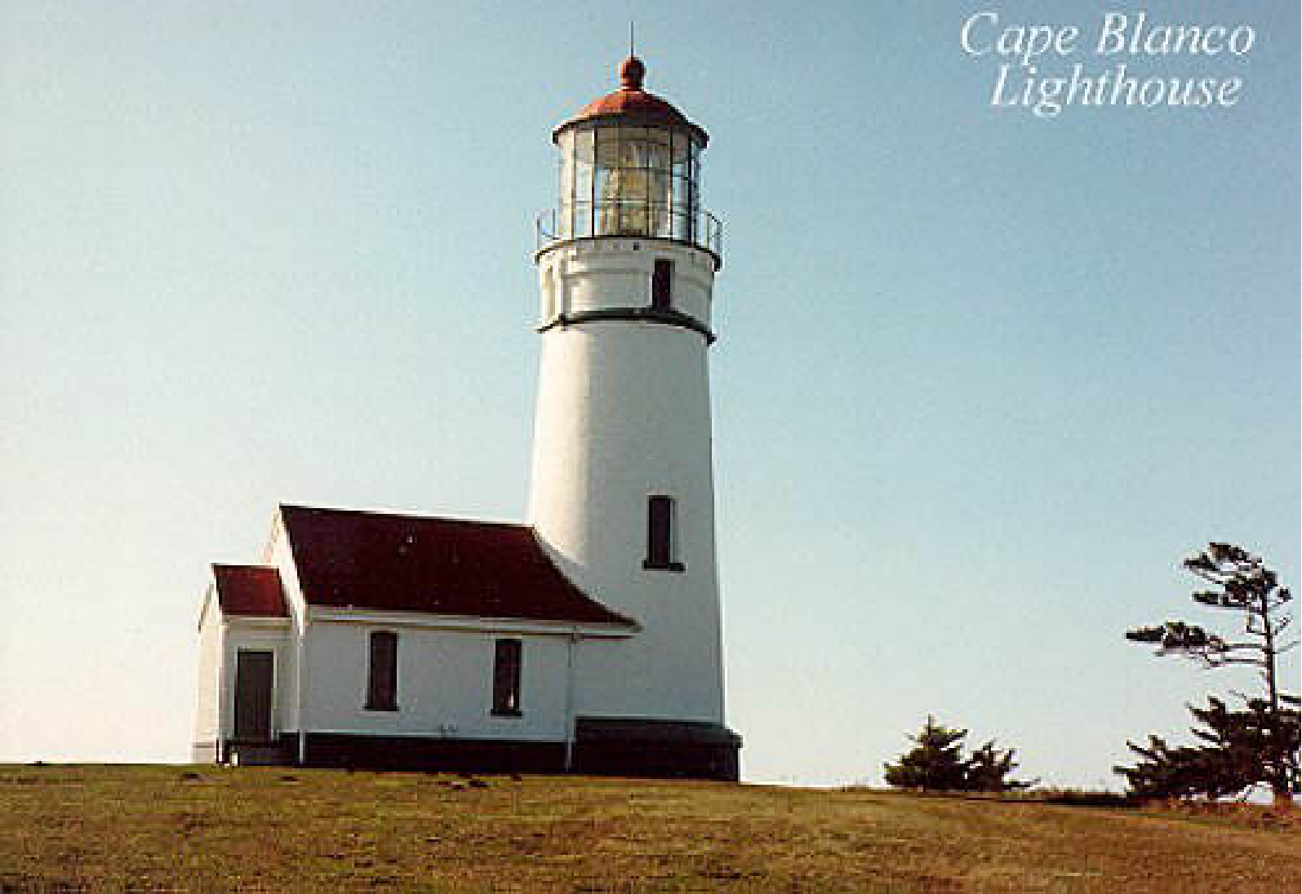
Columbus Day 1962: At Cape Blanco estimated winds were 150 mph with gusts to 179!

Slide 15
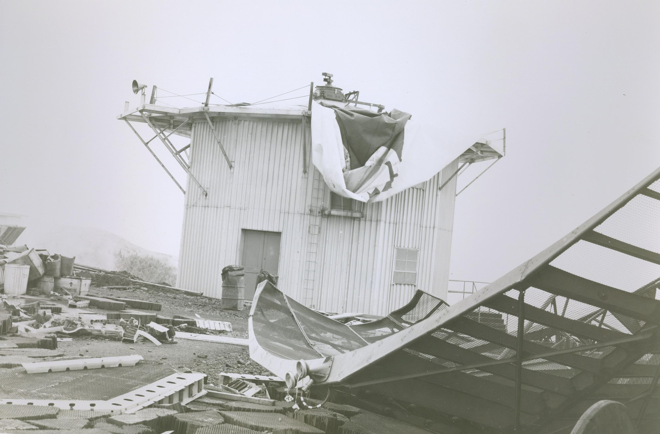
Mt. Hebo Radar Facility:
Gusts exceeding 130 mph
Courtesy: Mark Cole

Slide 16
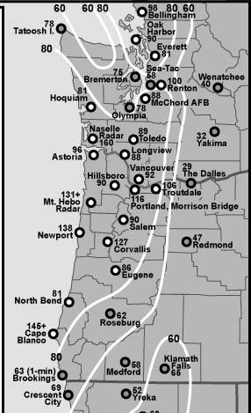
Max Winds (mph)
Columbus Day Storm 1962
Credit:
Wolf
Read

Slide 17
The Columbus Day Storm had a central pressure as low as 955 hPa.
The Saffir-Simpson Hurricane Scale
Note that 1-minute average winds are used below.
Category One:
  Winds 74-95 mph, above 980 mb
Category Two:
  Winds 96-110 mph, 965-980 mb
Category Three:
  Winds 111-130 mph , 945-965 mb
Category Four:
  Winds 131-155 mph, 920-945 mb
Category Five:
  Winds greater than 155 mph, below 920 mb
  Category Six:
  Only in the imagination of TV scriptwriters

Slide 18
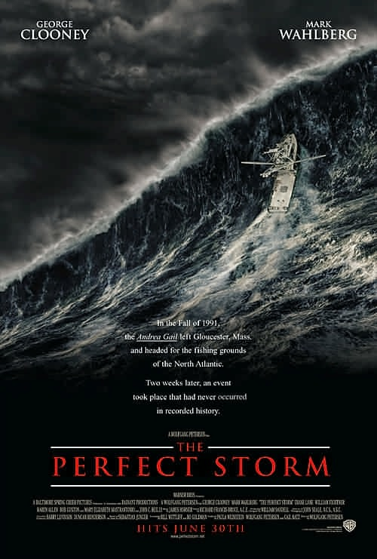
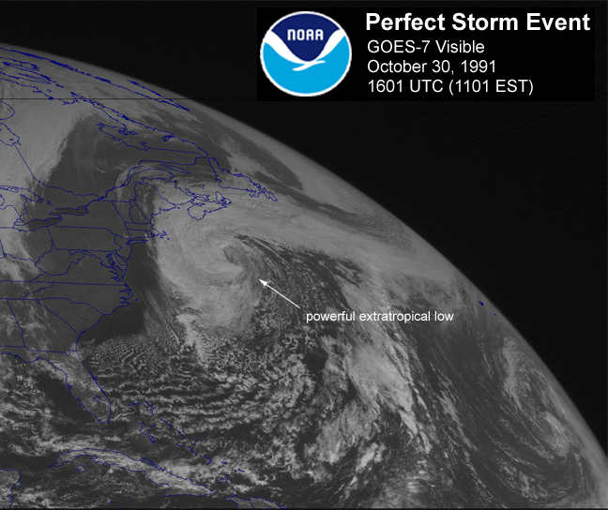
There is a lot of talk back east about the “Perfect Storm”

Slide 19
But our Columbus Day Storm was more perfect than theirs…
Their “Perfect Storm” had a low center of 972 hPa and maximum (estimated) sustained winds of 60 knots (observed 53 knots) with observed gusts to 65 knots.
The Columbus Day storm had a central low pressure of 955 hPa and many reports of gusts above 110 knots
NO CONTEST!

Slide 20
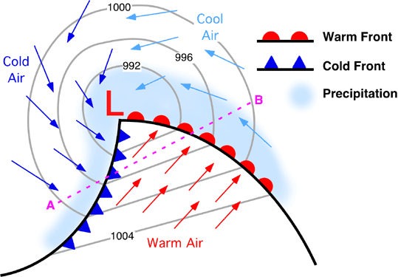
Midlatitude Storm 101

Slide 21
The Landfalling Columbus Day Storm was a midlatitude cyclone—also known as an extratropical cyclone
A cyclone is an area of low pressure around which air circulates in a counterclockwise direction (in the northern hemisphere)

Slide 22
Midlatitude Cyclones
The lower the central pressure the stronger the winds. Typical winter low 990-1000 hPa.
hPa --hPa is a unit of pressure (same as mb). 1013 hPa is equivalent to 29.92 inches--average sea level pressure
The energy source of these storms is the temperature difference between relatively warm air from the south and cooler air from the north.
Dominate north of approximately 30N

Slide 23
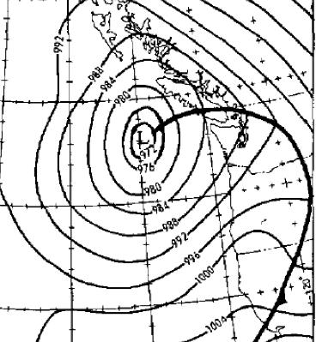
The Day Before, October 11th, a deep low pressure system moved northward offshore, producing a windy day over western Washington and Oregon
4 PM October 11, 1962

Slide 24
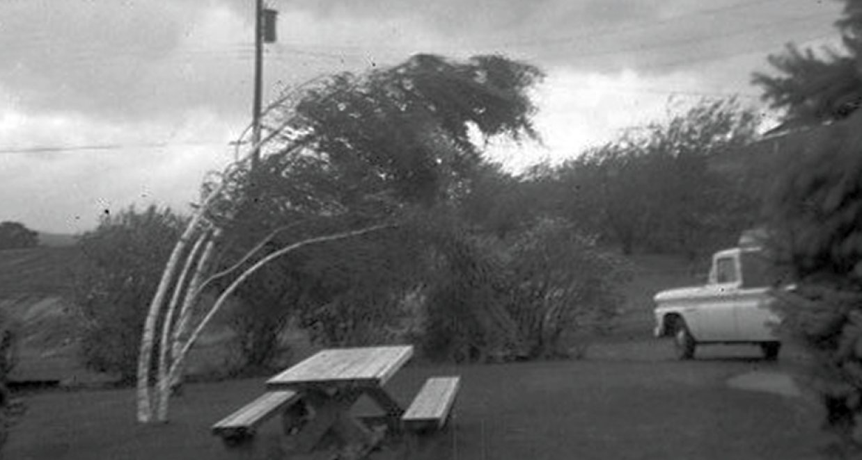
The Lead-Up Storm
Strong winds (40-50 mph) struck the Oregon and Washington coast
Forecasters in the Portland and Seattle offices of the Weather Bureau knew there was another disturbance out there.
The primitive computer models of the day wereonly predicting a weak system making landfall south of Portland.

Slide 25
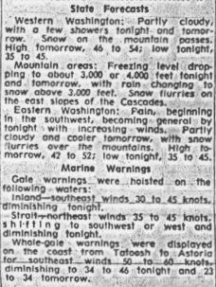
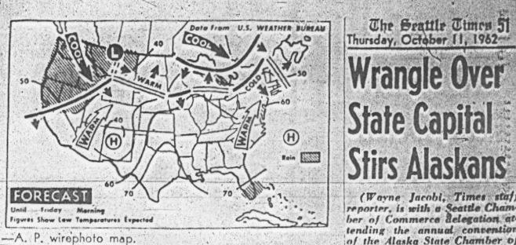
October 11th Forecast: No Storm on October 12th For Washington
Seattle Times

Slide 26
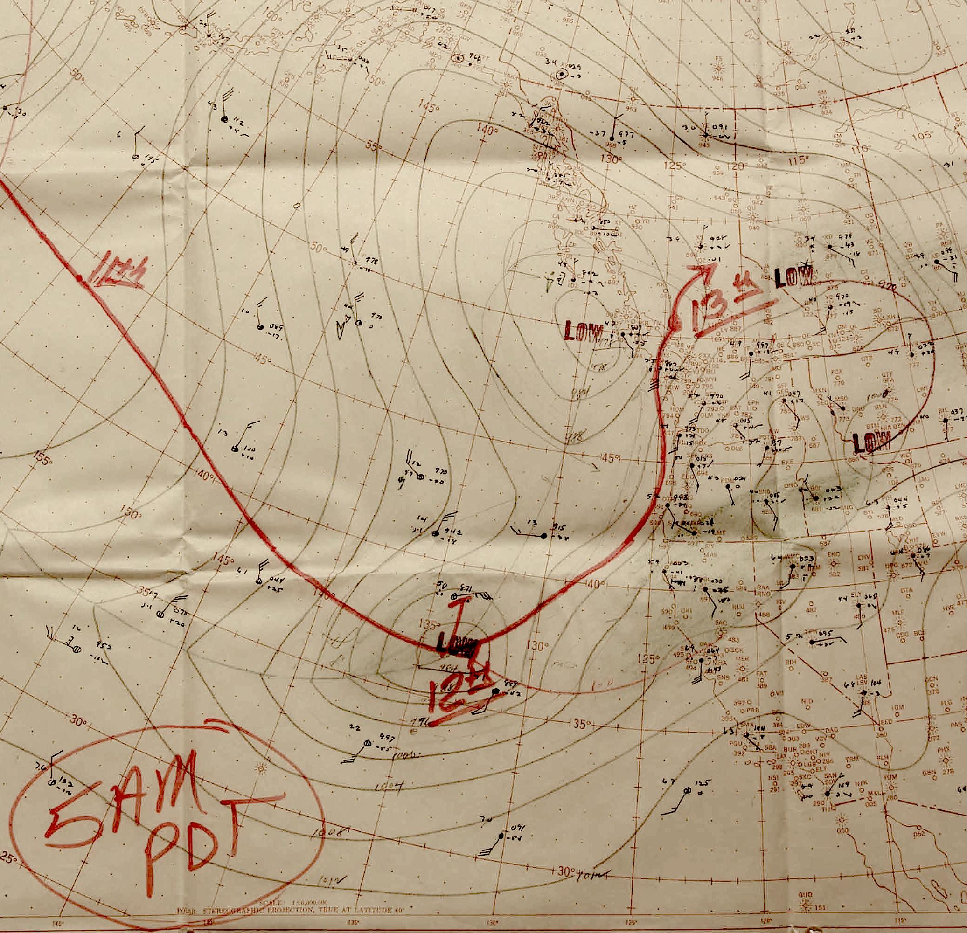
As Weather Bureau forecasters analyzed the sparse data over the Pacific for the 5 AM October 12th chart, they realized that the storm was stronger and the threat to the NW was substantial

Slide 27
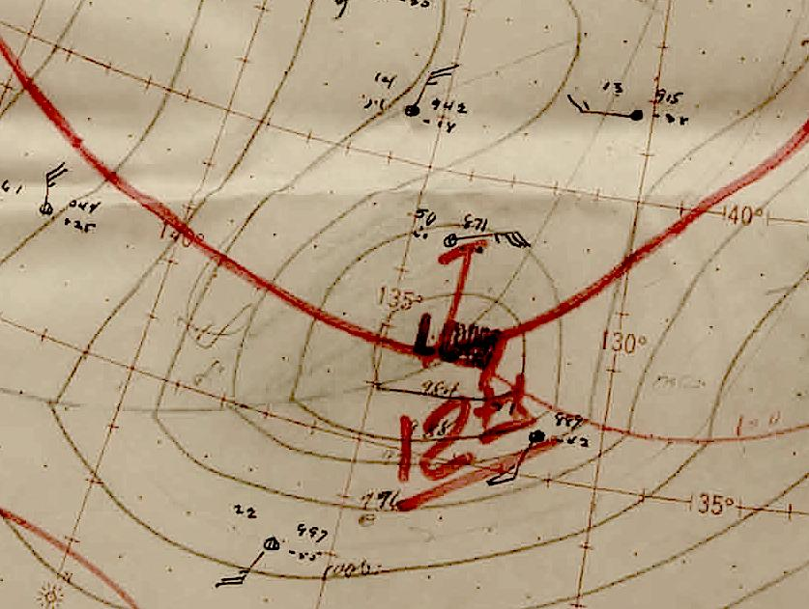

Slide 28
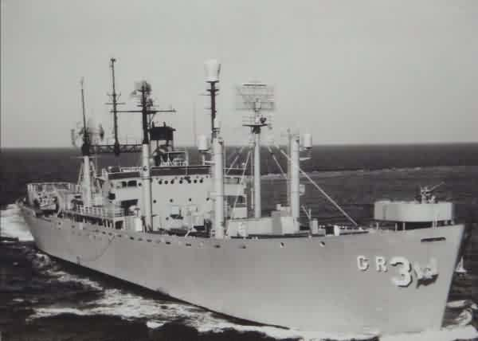
Jaw-dropping observations
At 7 AM, the reports from picket ships off the coast started to come in.
A ship at 40N, 130W reported a pressure fall of 22.5 hPa in 3 hours with sustained southeast winds of 50 knots!
Another ship had northwest winds at 80 knots (92 mph), a pressure of 962 hPa, and a pressure fall of 33 hPa in 3 hr.
A Brazilian ship, 60 miles SW
of Cape Blanco, 964 hPa, SE
85 mph
U.S.S Skywatcher

Slide 29
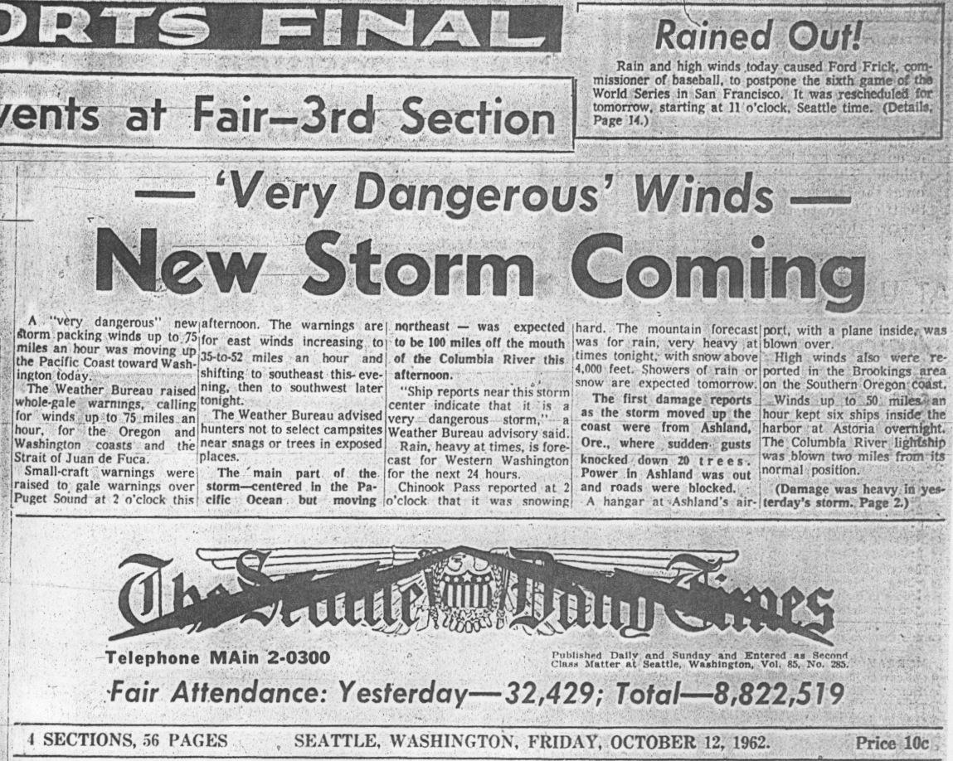
Forecasts were updated to predict a more dangerous storm

Slide 30
A Wall of Wind Spread Northward
1 PM; Crescent City, 69 mph, Red Bluff 71
3 PM: North Bend, 69 mph
4 PM: Eugene 67 mph, gusting to 86. Corvallis sustained 98 mph, gusts to 127 mph.
5:30 PM: Winds gusting to 79 mph at Portland AP.
6:14 PM 116 mph at Portland’s Morrison St. Bridge

Slide 31
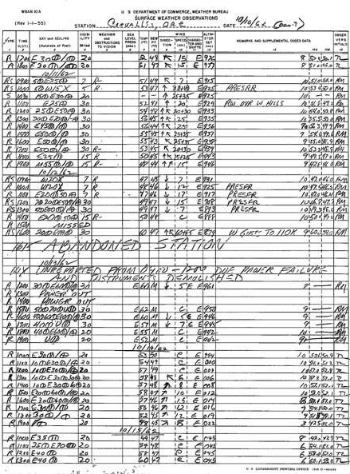
CorvallisWeather Station Abandoned!
Winds were 60 knots gusting to 85 (69 mph gusting to 98), with a peak gust of 110 knots (127 mph)!
Just a few moments later, at 16:15, "ABANDONED STATION" is written in the middle of the form.
This is the only time in the history of the Pacific Northwest that an officially supervised weather station had to be abandoned due to severe weather.

Slide 32
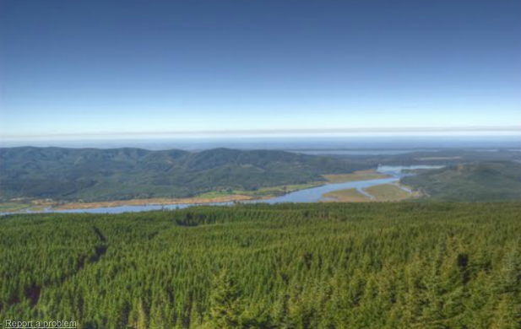
Western Washington that night
Olympia SW 58 G 78mph
Sea-Tac SSW 44 G 58 mph
Bellingham SSE 58 G 98 mph
Renton G 100 mph
Naselle Radar Site: G 160 mph

Slide 33
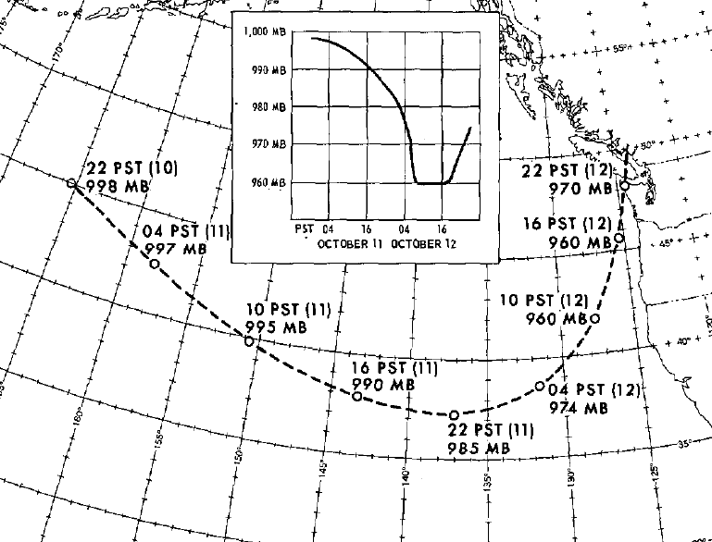

Slide 34
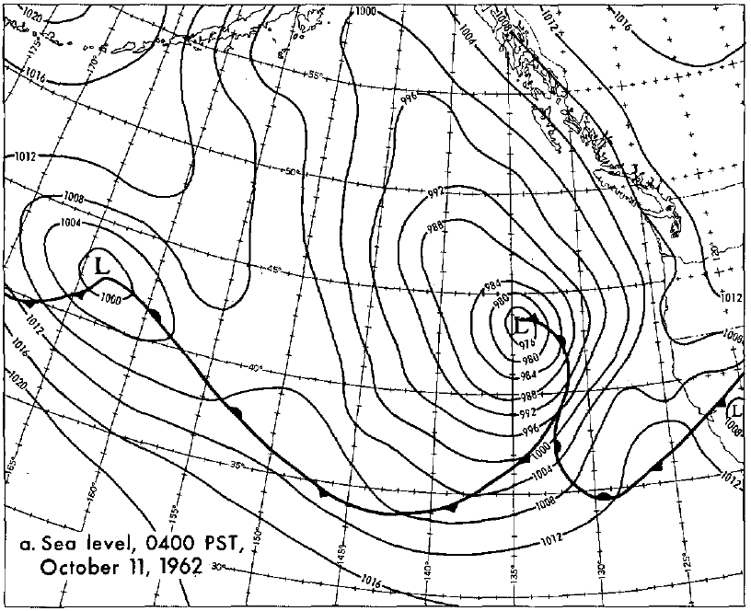

Slide 35
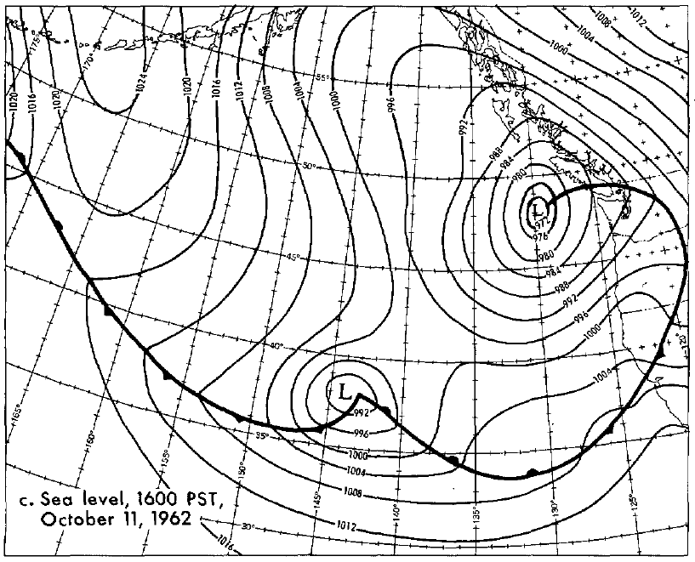

Slide 36
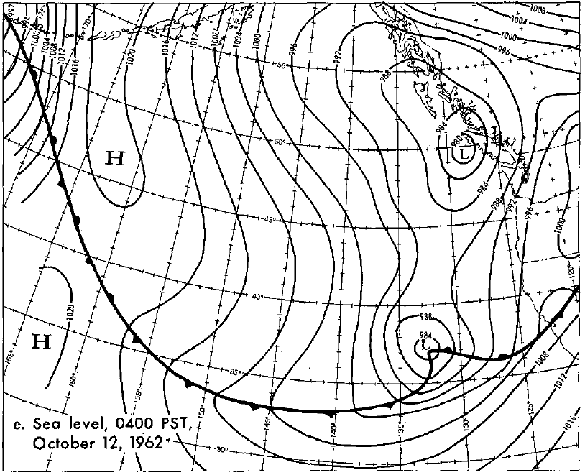

Slide 37
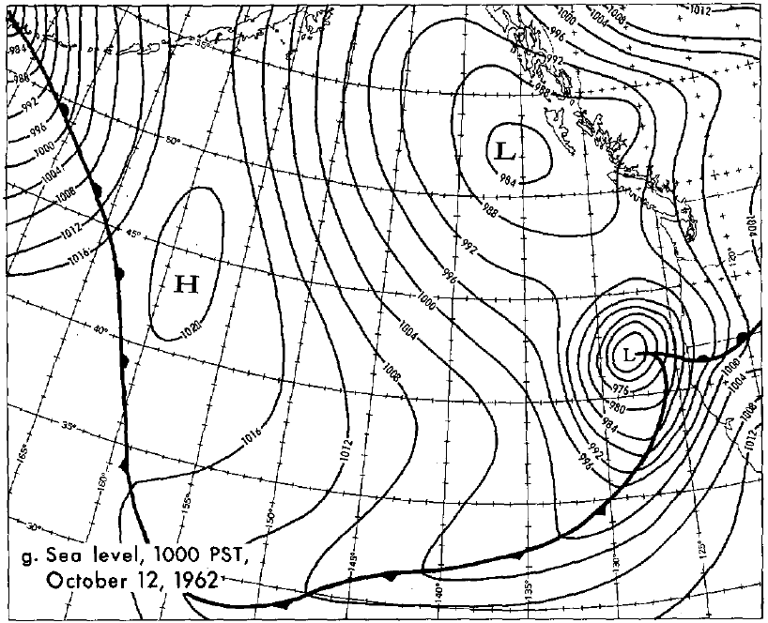

Slide 38
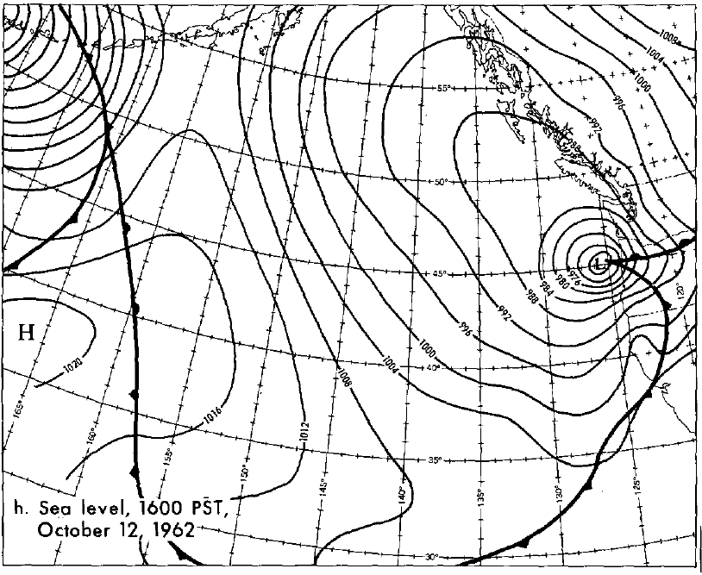

Slide 39
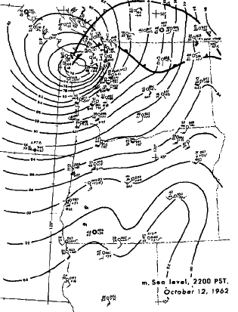
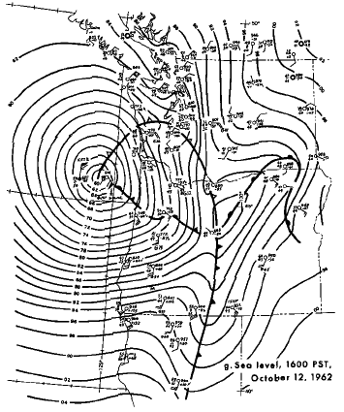
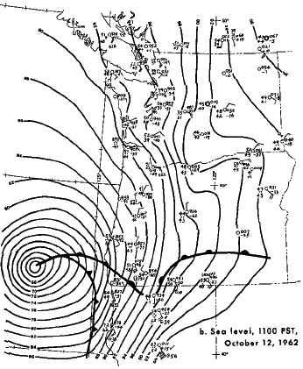
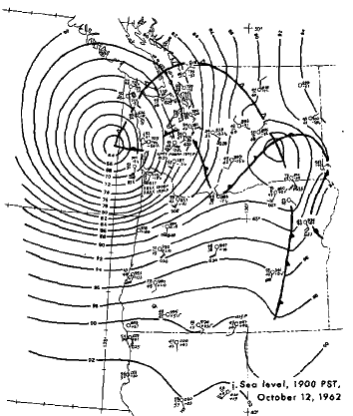
Lynott
And Cramer
1966

Slide 40
Some interesting aspects to the storm

Slide 41
The storm was the middle storm of a three-storm sequence
We have often seen big storms as one of a multiple storm event (e.g., Nov 13-15th, 1981)
The reason: storms depend on a large-scale upper-level flow pattern—large trough over the eastern Pacific—that remains in place for a while.
Brings warm and cold air together and provides lift.

Slide 42
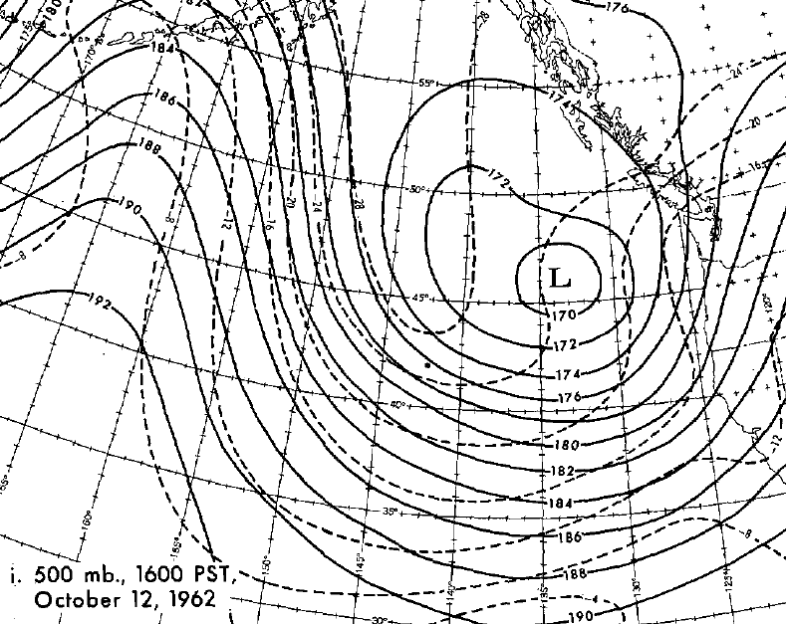

Slide 43
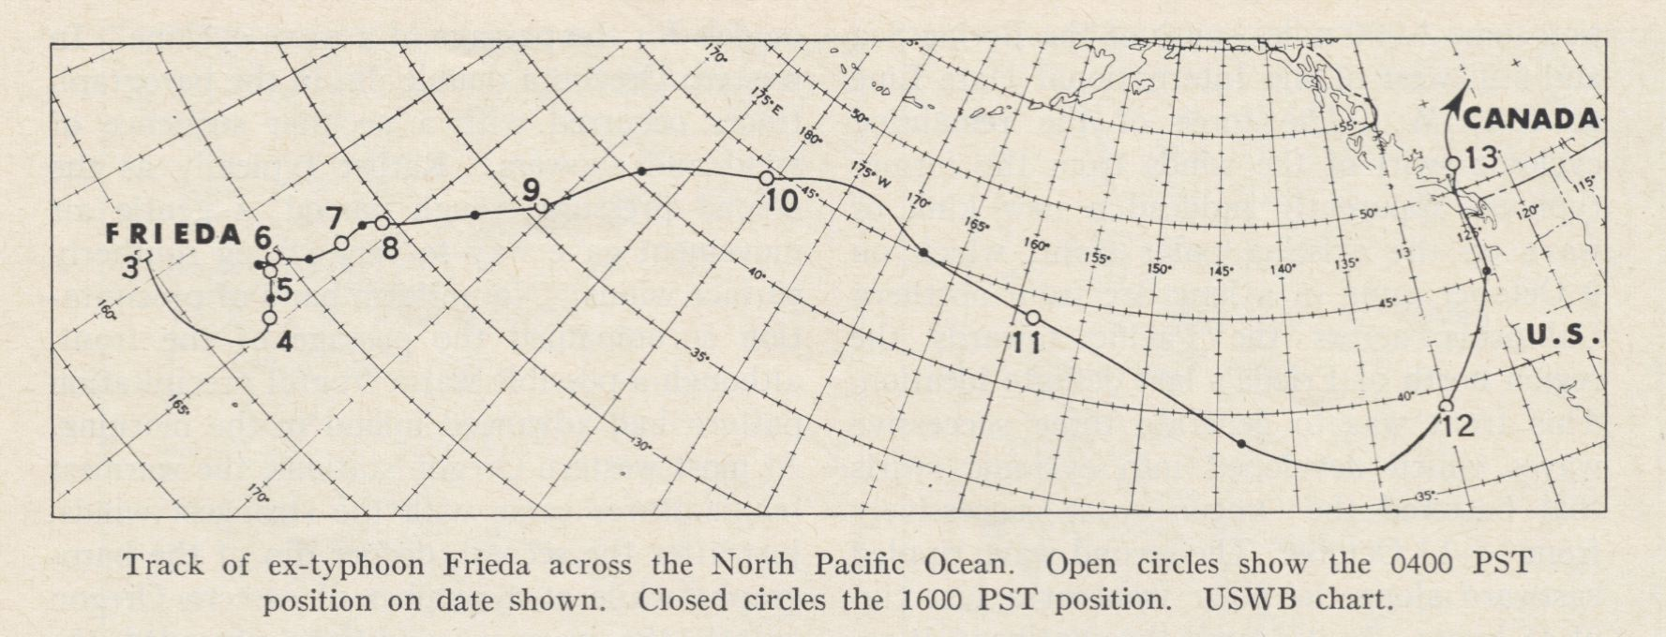
The Columbus Day Storm began as a tropical disturbance in the western Pacific.
Typhoon Frieda (Freda) moved northeastward and transformed into a midlatitude cyclone.

Slide 44
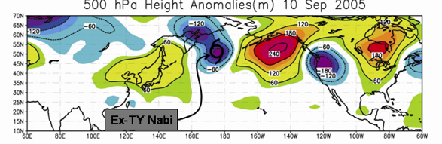
Why the tropical connection helps
When a tropical storm moves northward, it can experience extratropical transition (ET), in which its structure and energy source changes.
During ET the tropical storm can interact with the jet stream, producing an amplification of the atmospheric wave pattern, sometimes producing a deep trough over the eastern Pacific.

Slide 45
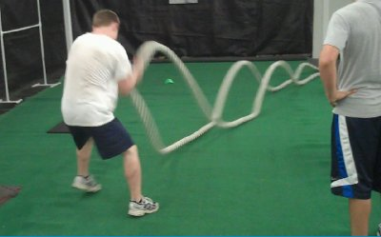

Slide 46
The Tropical Connection II
Some tropical disturbances maintain some of the lower circulation and then move through the large-scale pattern until they get into a favorable position over the eastern Pacific.
There they explode!
Most of our big storms have such tropical origins.

Slide 47

An ET Storm—like the Columbus Day Storm -- is Analogous to a Hybrid Car

Slide 48

The Hybrid
Starts as a tropical storm, deriving its energy from release of latent heat as tropical water vapor condenses in storm.
Transforms to a midlatitude storm, which acquires energy from horizontal temperature differences.

Slide 49
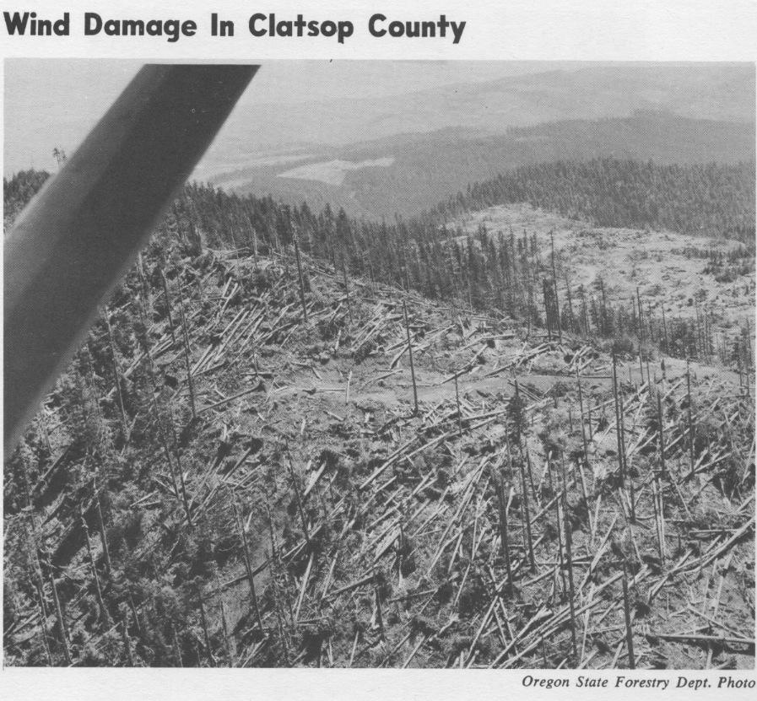
Impact on the Forestry Industry

Slide 50

Could a modern weather prediction model run at high resolution get the forecast right?
Rick Steed, Research Scientist in the UW Atmospheric Sciences Department, ran the WRF model…the same one we use for real-time weather prediction.
Initialized the model with the NCEP reanalysis grids.

Slide 51
Consider a forecast begun the day before (October 11th) at 5 AM.

Slide 52
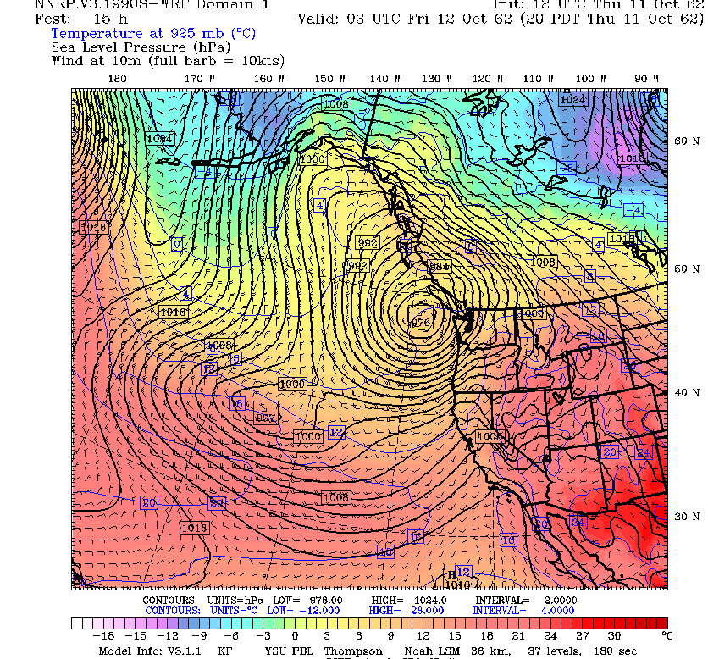

Slide 53
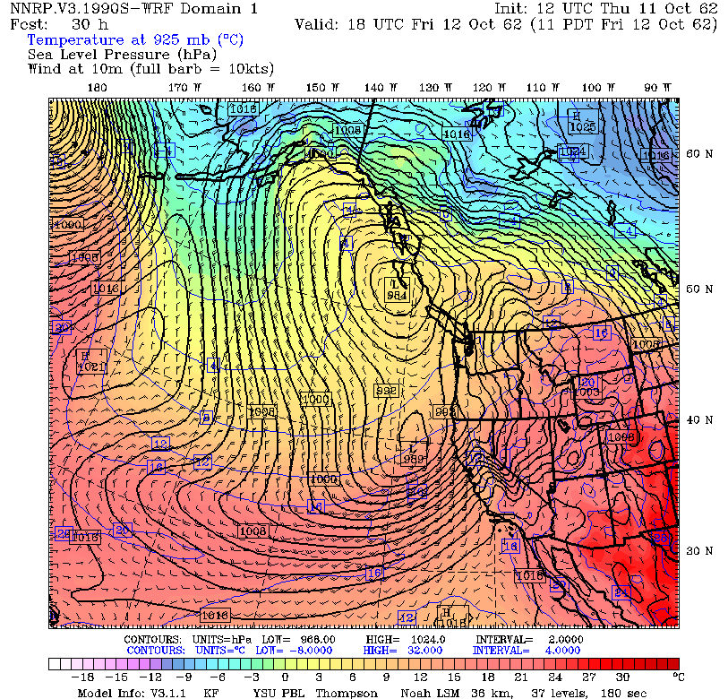
1

Slide 54
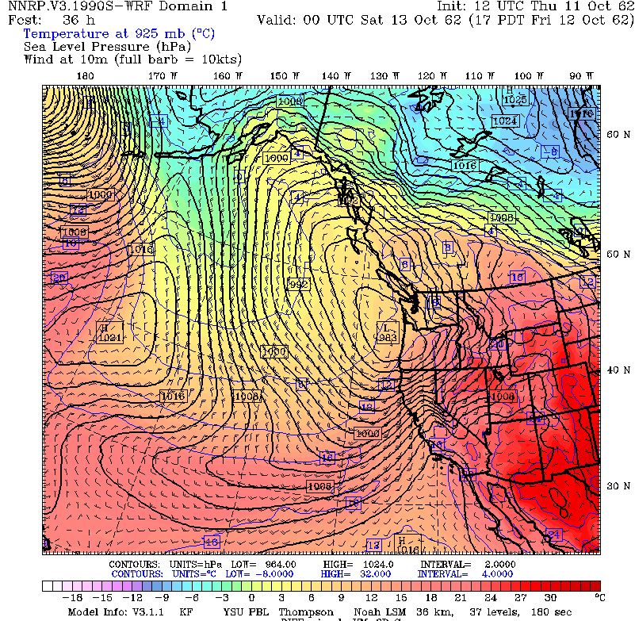

Slide 55


Slide 56

Not strong enough

Slide 57


Dave Ovens Tried Again this Week: Higher Resolution (4-km)

Slide 58

The Problem?
Probably the lack of data over the Pacific.
Just a few ship reports and island stations.
Today we have massive satellite data assets, buoys, ships, and more.

Slide 59

Ever since the early 1990s meteorologists have successfully predicted nearly every major windstorm the day before…and many several days before.

Slide 60




Slide 61
But we have had problems forecasting “Columbus Day” type storms more than a few days out

Slide 62


Slide 63


Slide 64

Reality Was Pretty Disappointing

Slide 65

Necessary Food for Meteorologists

Slide 66
The Future of Northwest Windstorms

Slide 67
Question:
Big Windstorm This Year?

Slide 68

El Nino/La Nina and Major Windstorms
Major windstorms appear to avoid El Nino and La Nino years
They like neutral (“La Nada”) winters.
Right now it looks like we will have a La Nina Winter

Slide 69

La Nina Right Now and Through First Half of Cool Season.

Slide 70

Implication: Lower Probability than Normal

Slide 71

Will Northwest Windstorms
Increase in Intensity Under Global Warming?

Slide 72
The Answer Appears to be No
No observed increasing trend
None suggested by climate models.
UW investigated this issue for Seattle City Light

Slide 73

Number of times per year winds exceed a high-wind threshold (DJF) at Seattle for several simulations

Slide 74

The End

