Slide 1
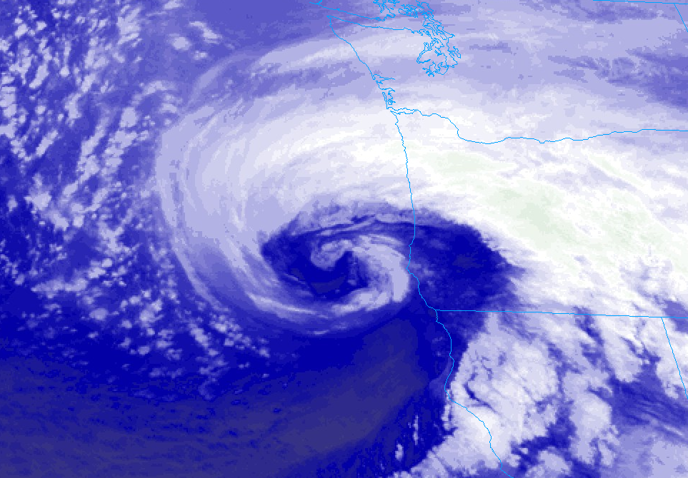

DID WE REALLY SEE A WINTER THIS YEAR?
WINTER 2019-2020
Mark Nelsen

Slide 2
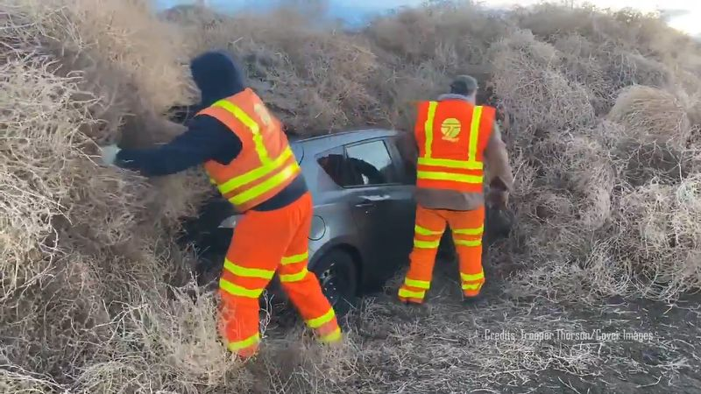
IT DIDN’T GET MUCH MORE EXCITING THAN THIS!

Slide 3
Quick Summary
Most boring winter I’ve seen in 29 winters of forecasting.
>> Or at least one of the top 2 <<
A snow-free winter for most west of Cascades
Stormy weather pattern never really set up this year
Terrible ski season start, reasonable by mid-January
5 feet in one week mid-January at Government Camp!
No PACNW Arctic Blast (6th consecutive winter), although correct synoptic pattern Thanksgiving Weekend

Slide 4

OFFICIAL
SNOW TOTAL
0.0”
at PQR (NWS Office)
0.0” Downtown (KGW-TV)

Slide 5

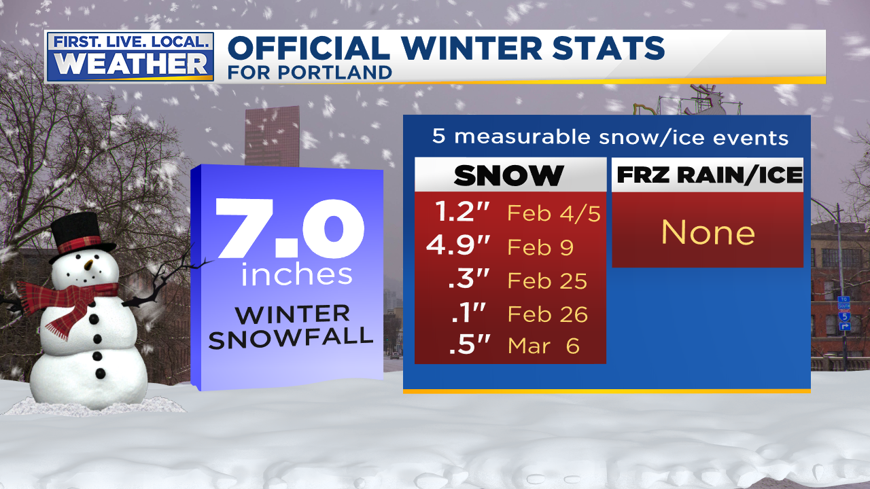


Slide 6
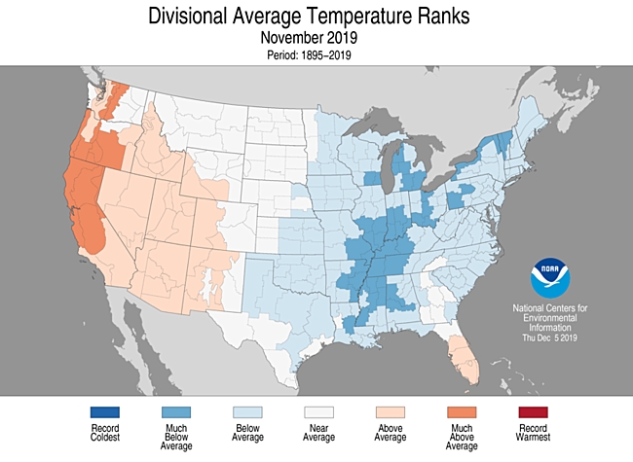
THE USA VIEW

Slide 7
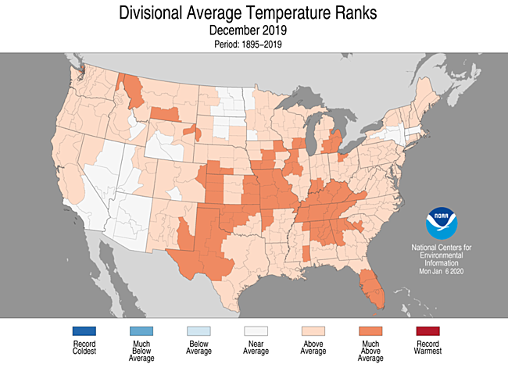
THE USA VIEW

Slide 8
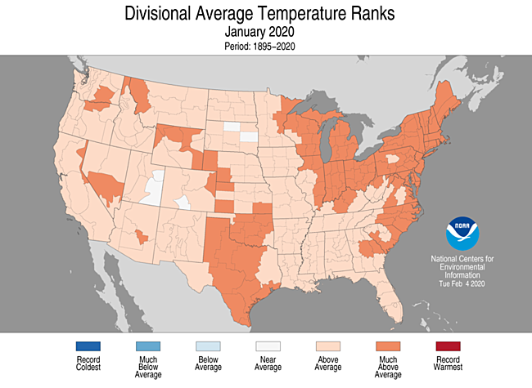
THE USA VIEW

Slide 9
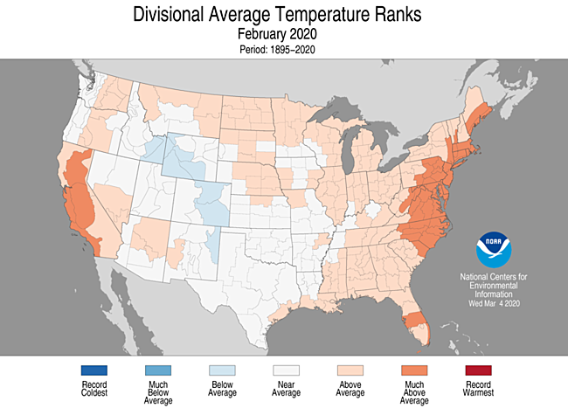
THE USA VIEW

Slide 10
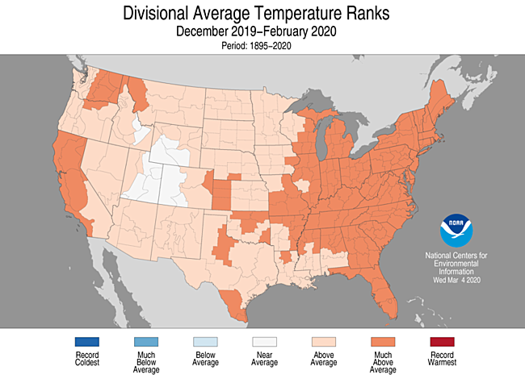
6th warmest USA winter

Slide 11
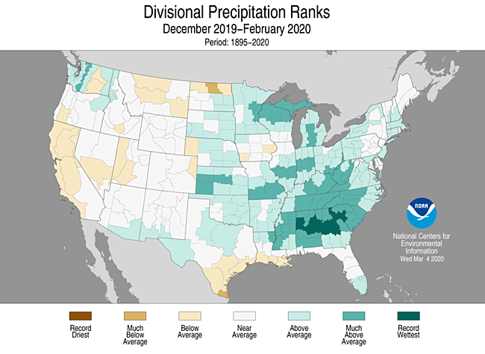
3 MONTH PRECIPITATION

Slide 12
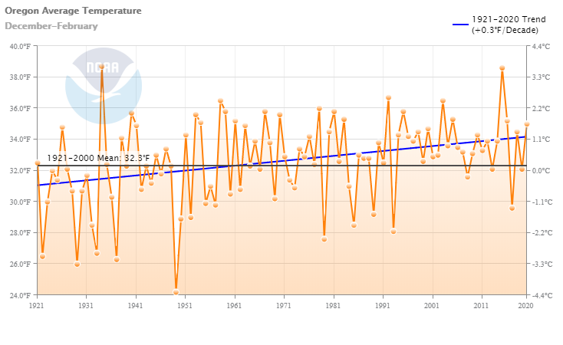
Oregon Winter Temps
(the last 100 years)
Slow Warming Trend (0.3/decade)

Slide 13
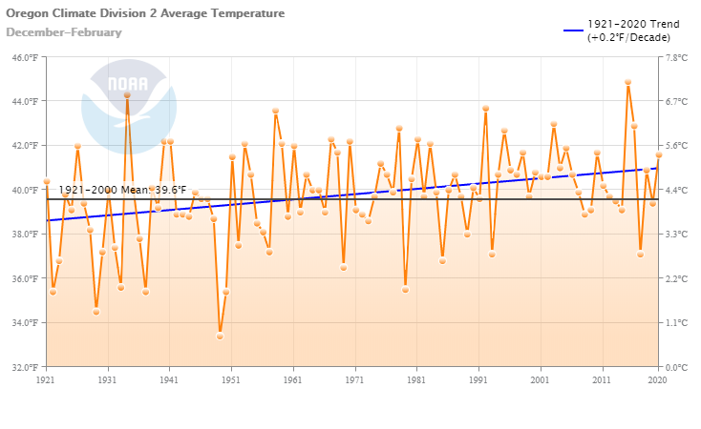
Western Valleys Winter Temps
(the past 100 years)
A bit above average…warmest since 2015-16
Last Winter in Oregon Zone 2 (Willamette Valley)

Slide 14
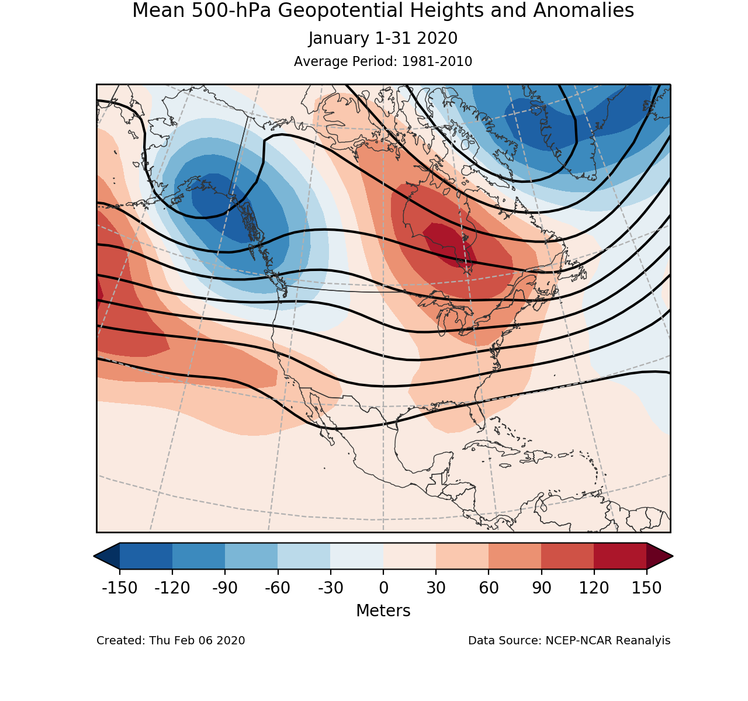
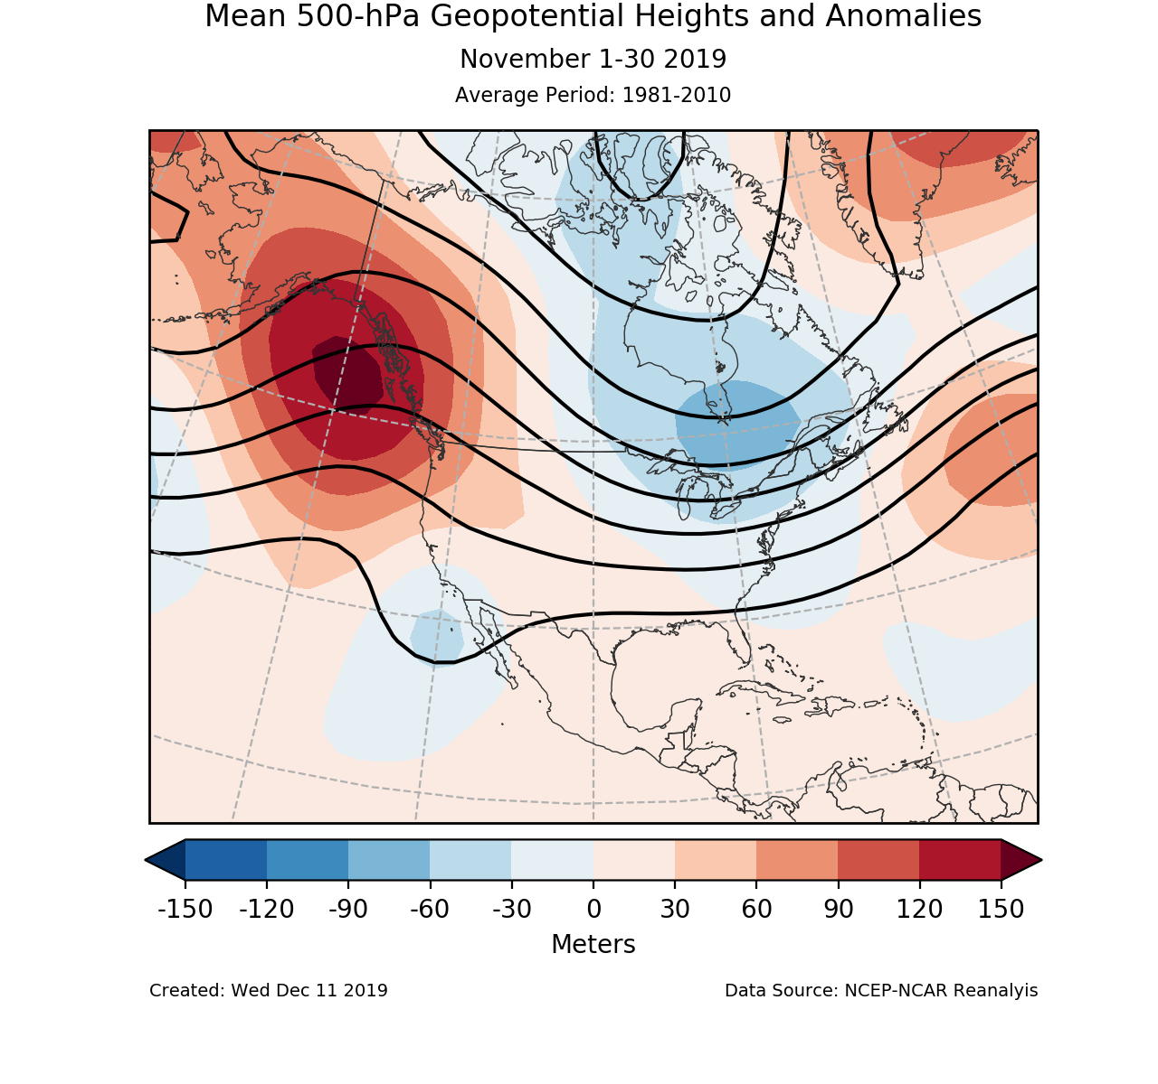
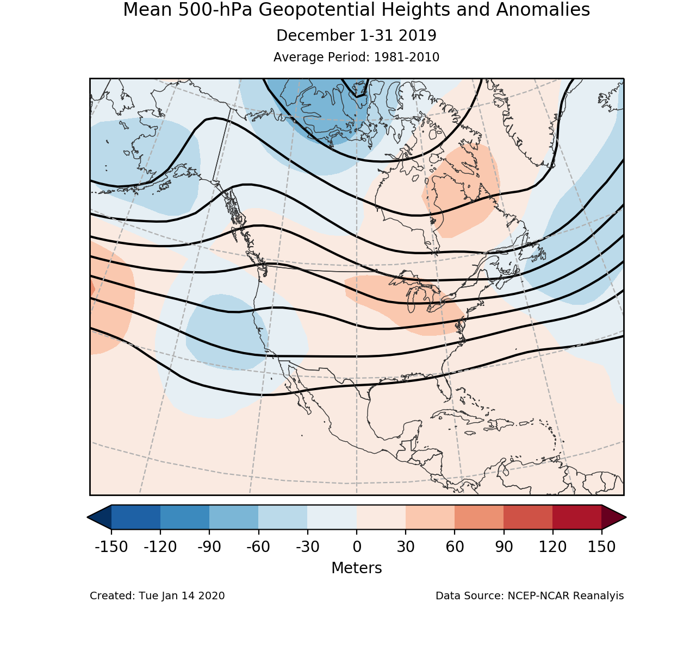
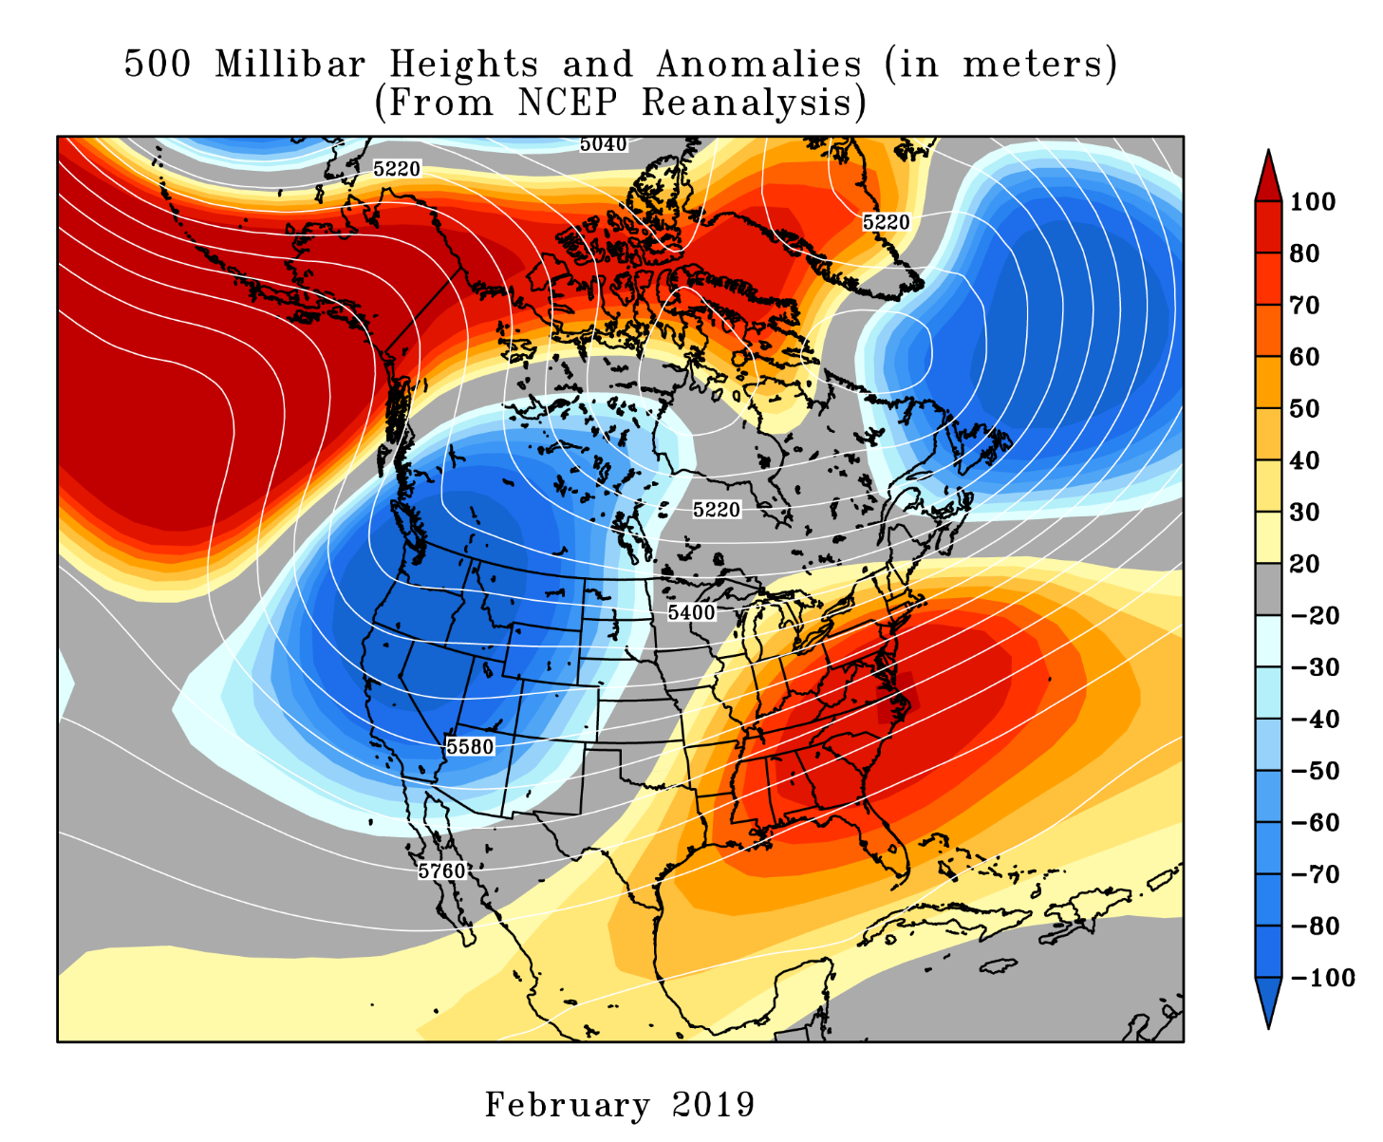
UPPER LEVEL PATTERN

Slide 15
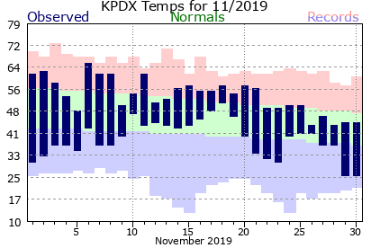
NOVEMBER
A mild & relatively dry month, no stormy weather
Blast of cold air from north Thanksgiving Week
- I-5 shuts down to California. Tough Thanksgiving travel!

Slide 16
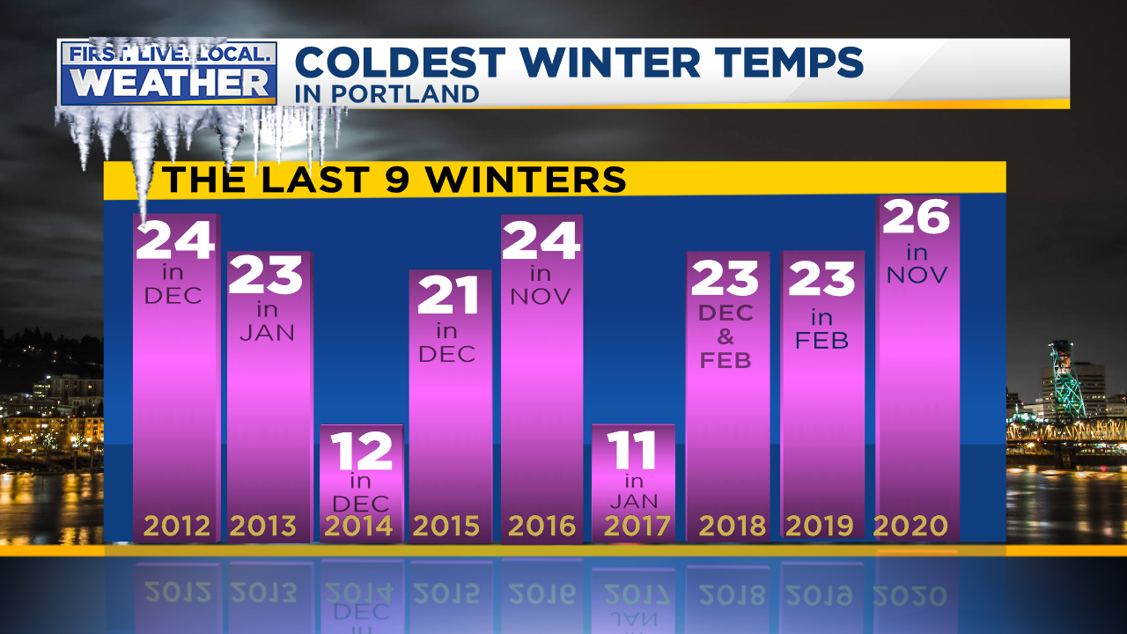
NOVEMBER
A mild & relatively dry month, no stormy weather
Blast of cold air from north Thanksgiving Week
- I-5 shuts down to California. Tough Thanksgiving travel!

Slide 17
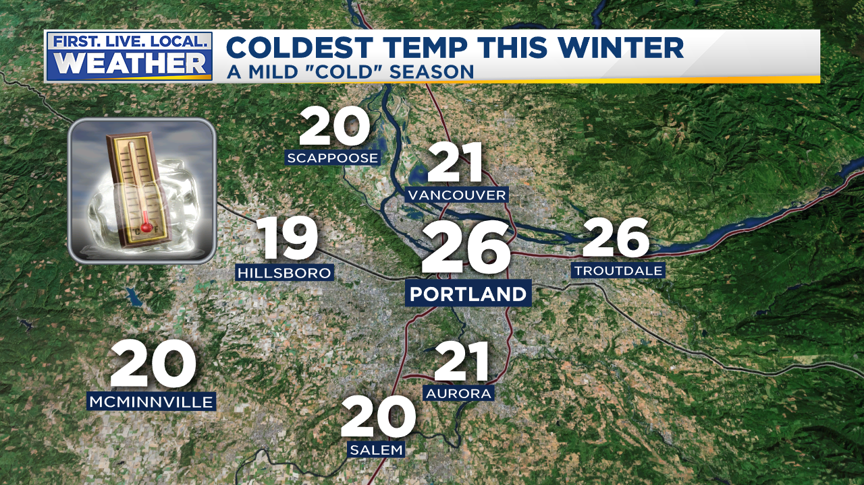
NOVEMBER
A mild & relatively dry month, no stormy weather
Blast of cold air from north Thanksgiving Week
- I-5 shuts down to California. Tough Thanksgiving travel!

Slide 18
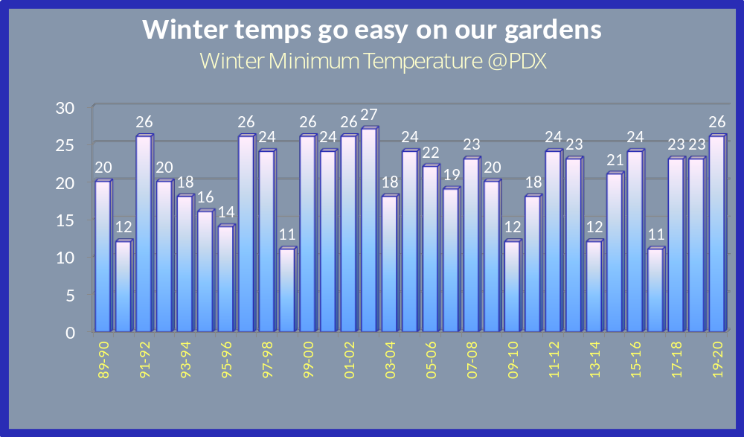

Slide 19
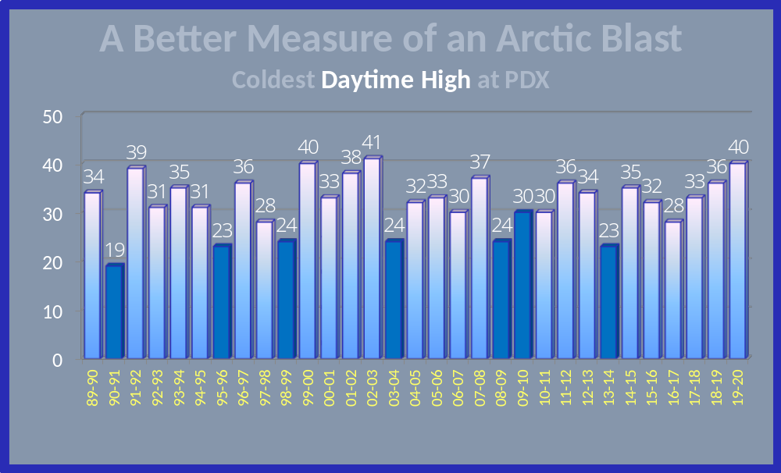
Blue = Widespread PACNW Arctic Air Outbreak

Slide 20
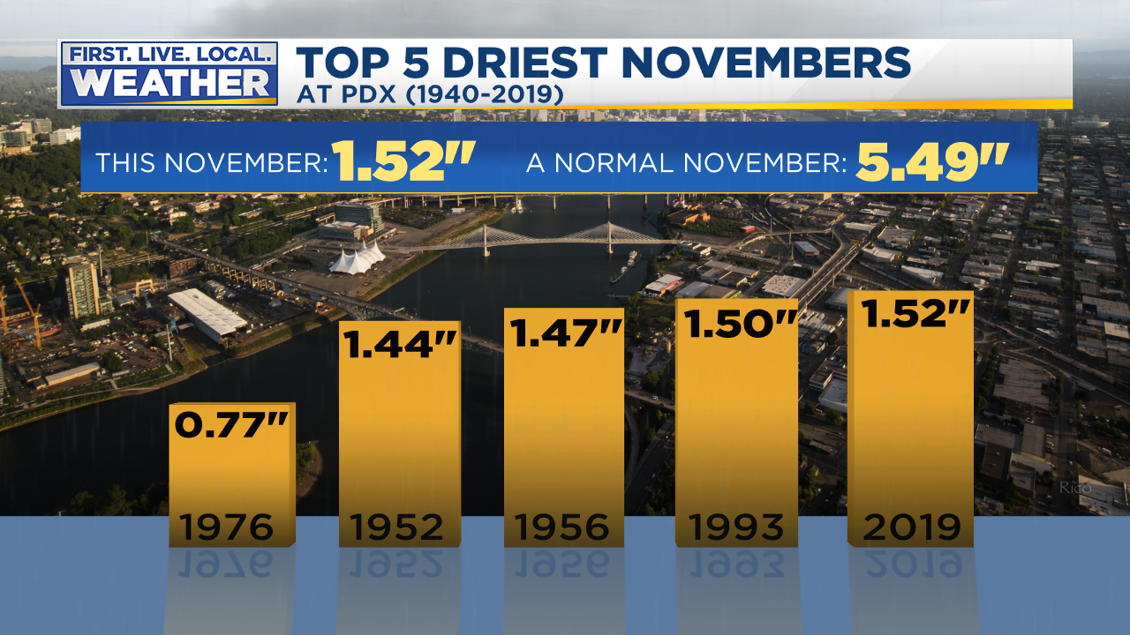
NOVEMBER
A mild & relatively dry month, no stormy weather
Blast of cold air from north Thanksgiving Week
- I-5 shuts down to California. Tough Thanksgiving travel!

Slide 21
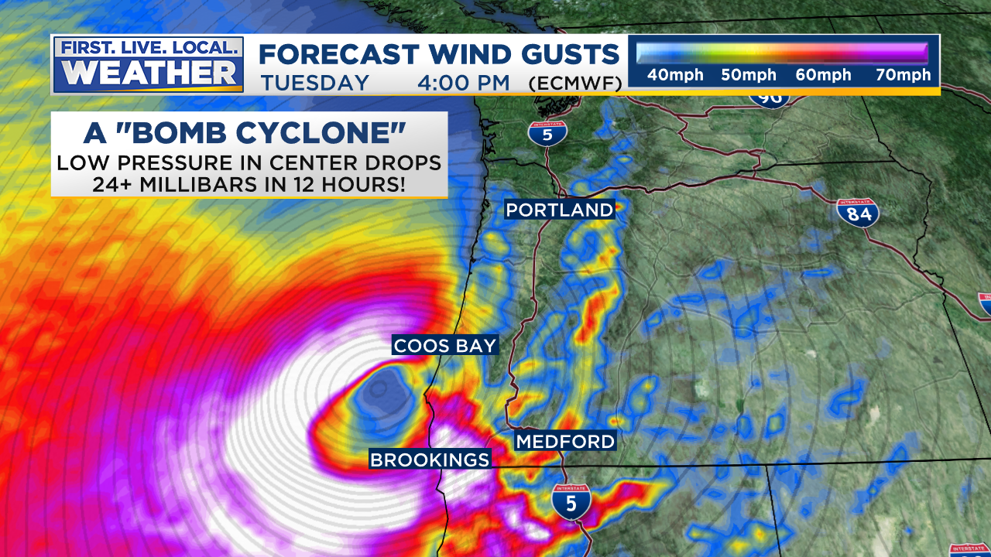
Southern Oregon “Bomb Cyclone”
November 26th, Tuesday of Thanksgiving week
Late Start, Mild & Dry November
Latest “First Snow” at Government Camp since 2002

Slide 22
Southern Oregon “Bomb Cyclone”
November 26th, Tuesday of Thanksgiving week
Late Start, Mild & Dry November
Latest “First Snow” at Government Camp since 2002

Slide 23
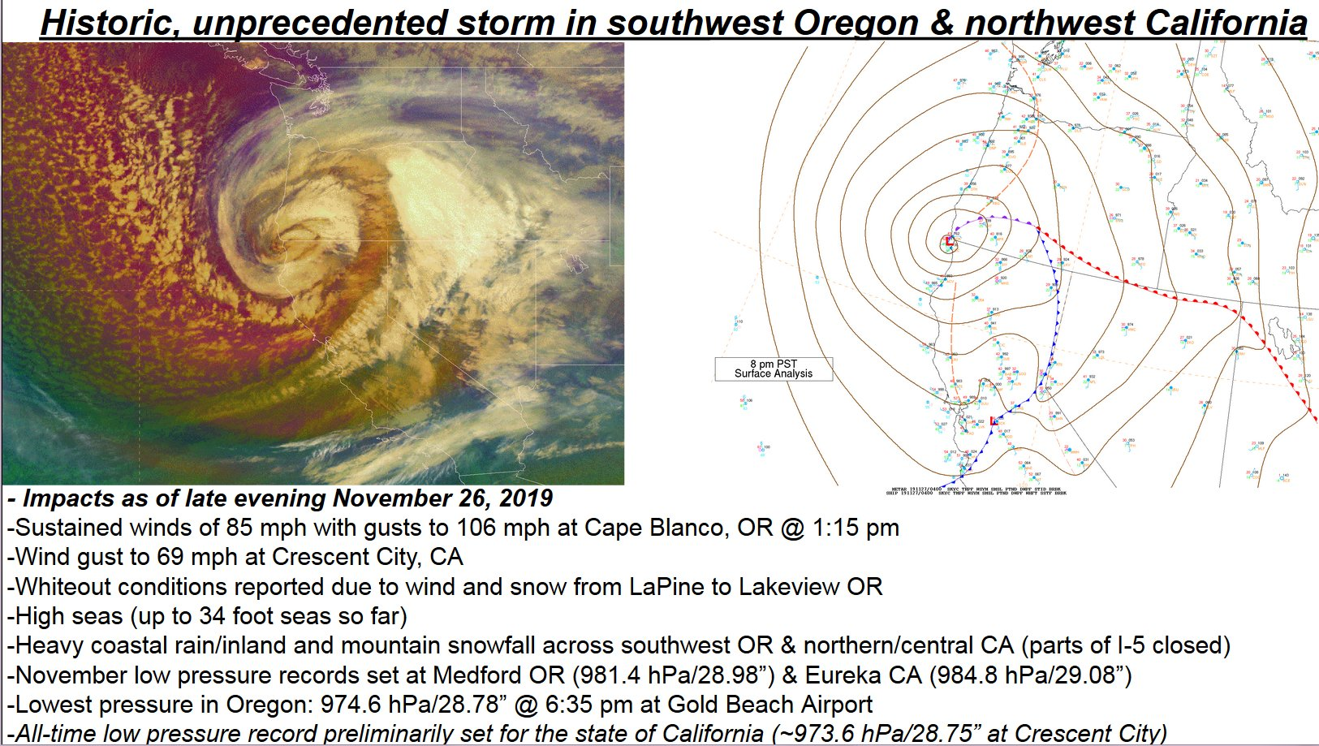
Southern Oregon “Bomb Cyclone”
November 26th, Tuesday of Thanksgiving week
Late Start, Mild & Dry November
Latest “First Snow” at Government Camp since 2002

Slide 24
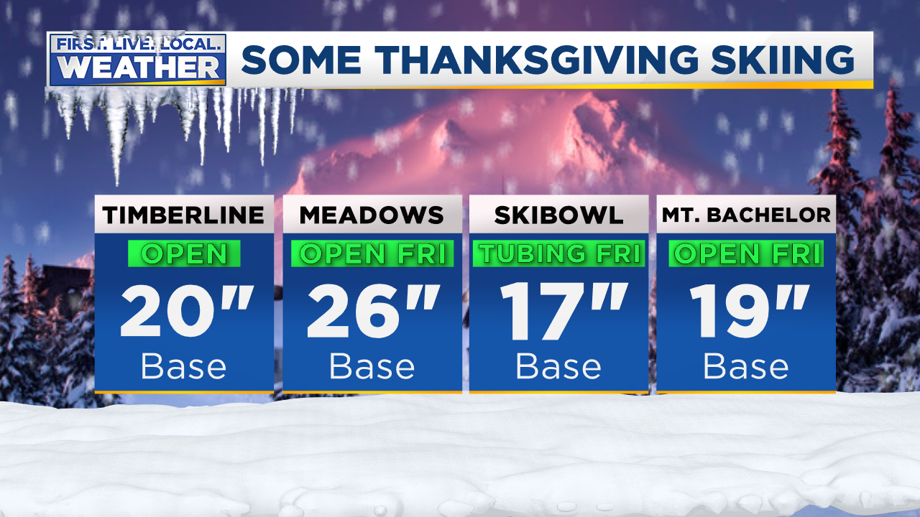
Ski Areas Have Limited Terrain Thanksgiving through Christmas Vacation
No skiing at Mt. Hood Skibowl until early January!
Late Start, Mild & Dry November
Latest “First Snow” at Government Camp since 2002

Slide 25
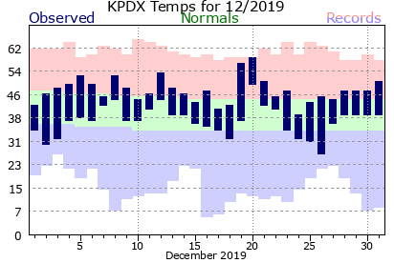
DECEMBER
* Another unremarkable month *
Not much storminess, but a brief mid-month Atmospheric River
(notice the 20th?)

Slide 26
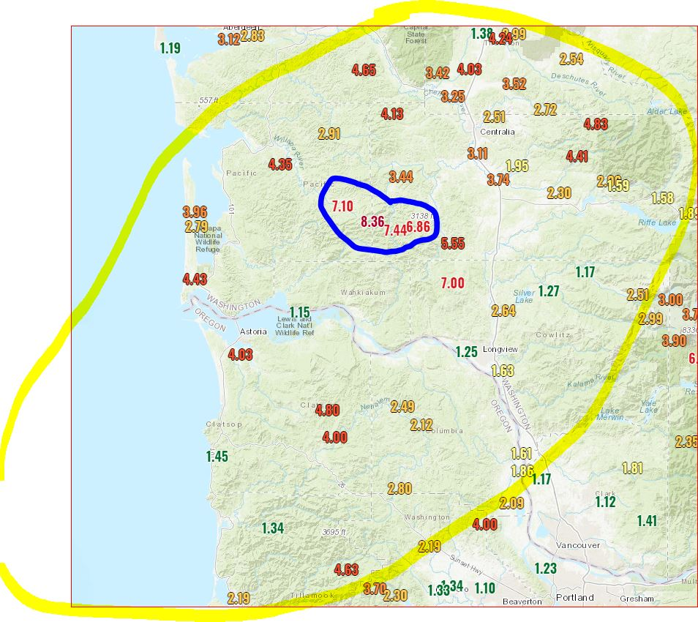
DECEMBER
HEAVY RAIN CLIPS N.W. OREGON
Flooding north of us on December 20th

Slide 27
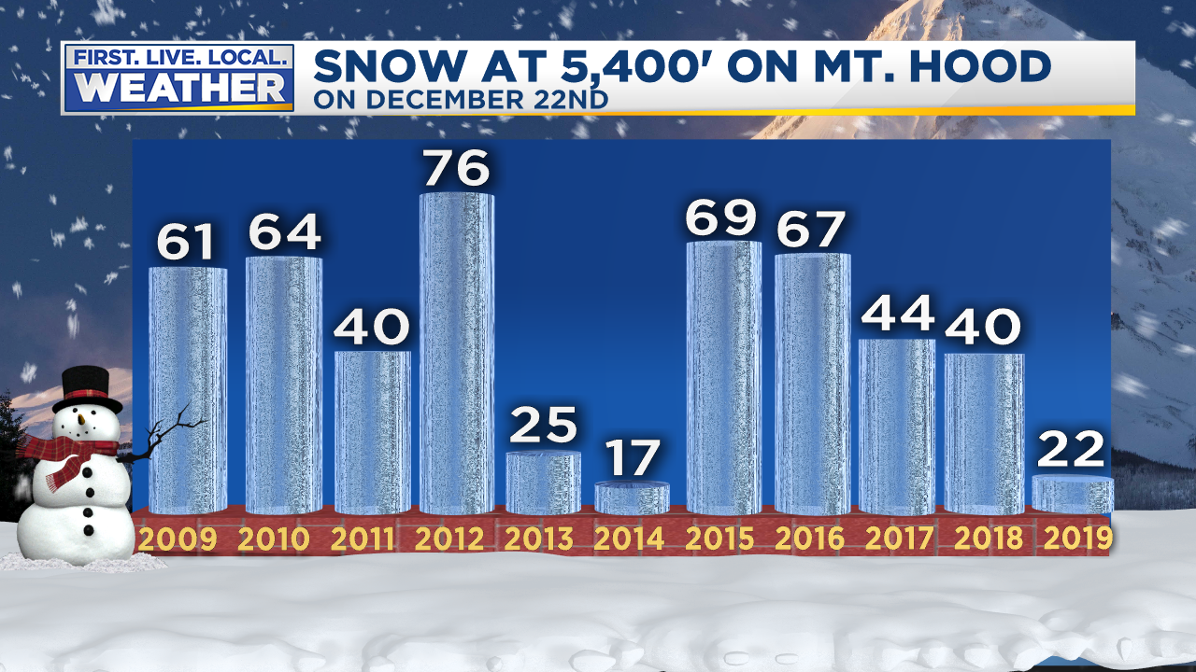
Ski Areas Have Limited Terrain Thanksgiving through Christmas Vacation
No skiing at Mt. Hood Skibowl until early January!
Late Start, Mild & Dry November
Latest “First Snow” at Government Camp since 2002

Slide 28
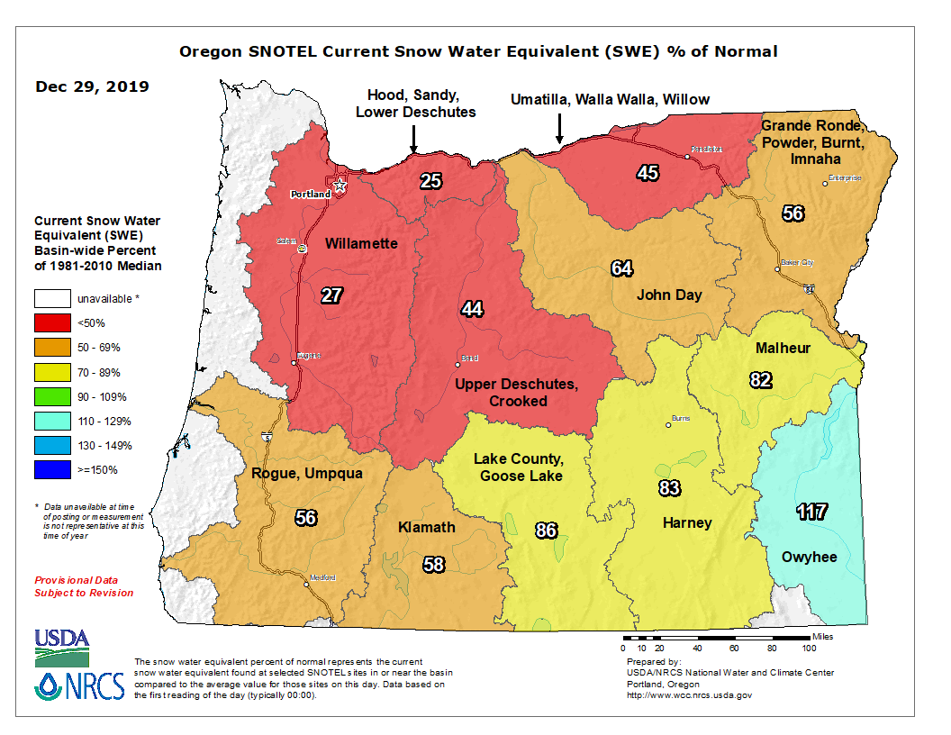
Ski Areas Have Limited Terrain Thanksgiving through Christmas Vacation
No skiing at Mt. Hood Skibowl until early January!
DECEMBER 29TH

Slide 29
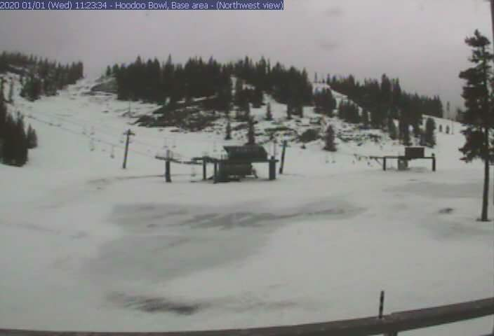
Ski Areas Have Limited Terrain Thanksgiving through Christmas Vacation
No skiing at Mt. Hood Skibowl until early January!
HOODOO SKI AREA – NEW YEAR’S DAY

Slide 30
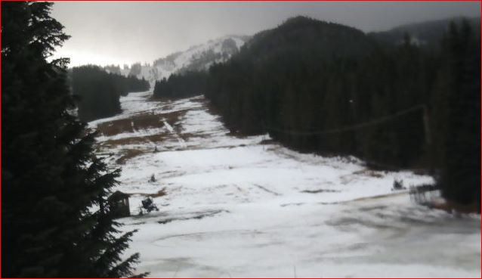
Ski Areas Have Limited Terrain Thanksgiving through Christmas Vacation
No skiing at Mt. Hood Skibowl until early January!
MT HOOD SKIBOWL
Worst early January snowpack since 1990! (at 5,400’)

Slide 31
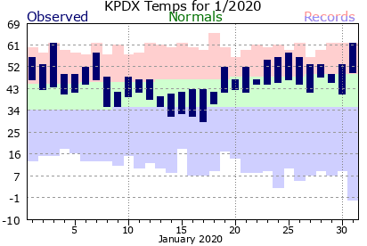
JANUARY
A very mild month
Only “wet” month of the entire cold season!
Notes:
50+ gusts at TTD, 85 mph gust at Corbett Grade, highest of past 10 years
850mb temps never below -9 this winter
Valley 30-35 during this time
Puget Sound 35-45!

Slide 32
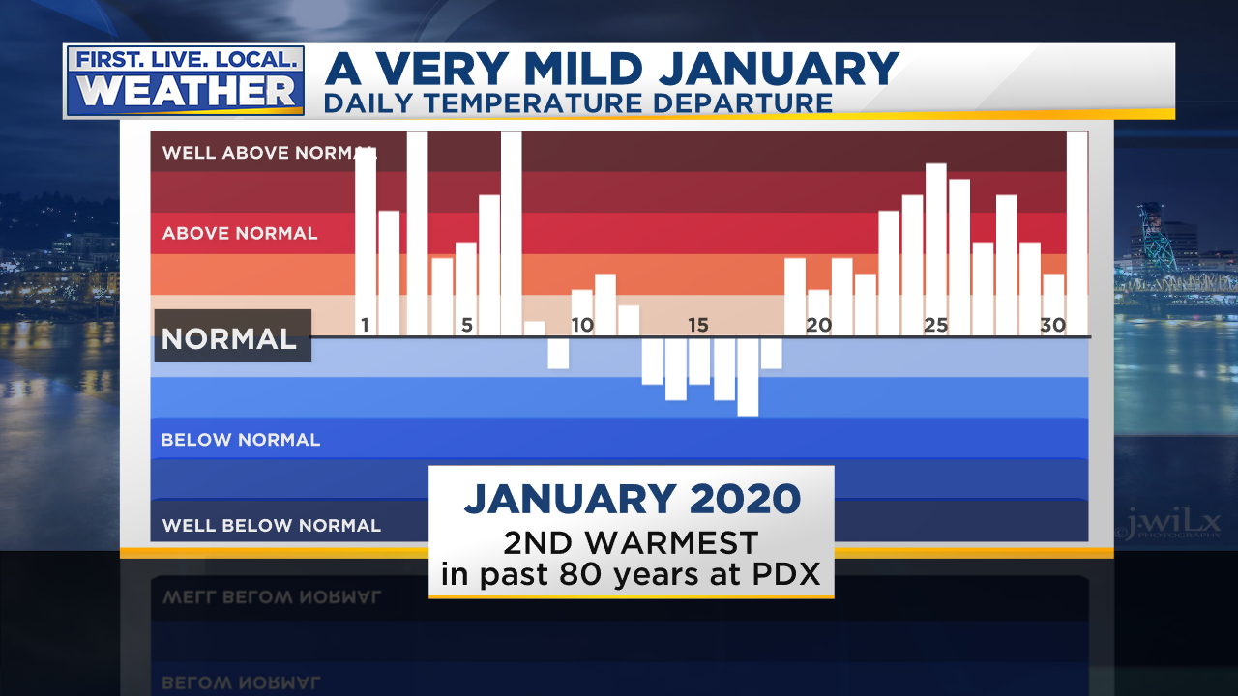
JANUARY
A very mild month
Only “wet” month of the entire cold season!
Notes:
50+ gusts at TTD, 85 mph gust at Corbett Grade, highest of past 10 years
850mb temps never below -9 this winter
Valley 30-35 during this time
Puget Sound 35-45!

Slide 33
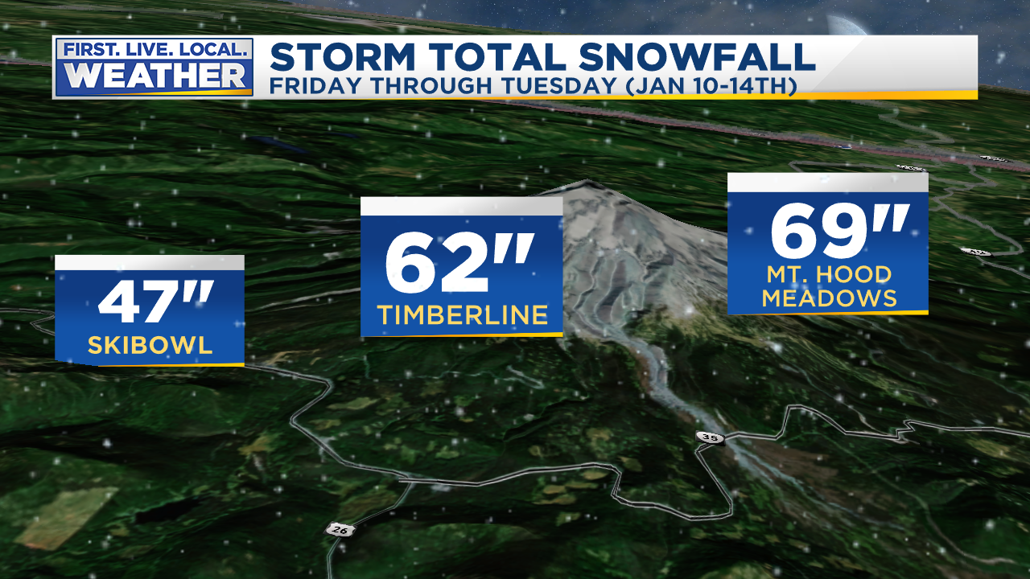
JANUARY
THE ONLY “BIG SNOW WEEK”OF THE WINTER
In the Cascades January 10th-17th
Notes:
50+ gusts at TTD, 85 mph gust at Corbett Grade, highest of past 10 years
850mb temps never below -9 this winter
Valley 30-35 during this time
Puget Sound 35-45!

Slide 34
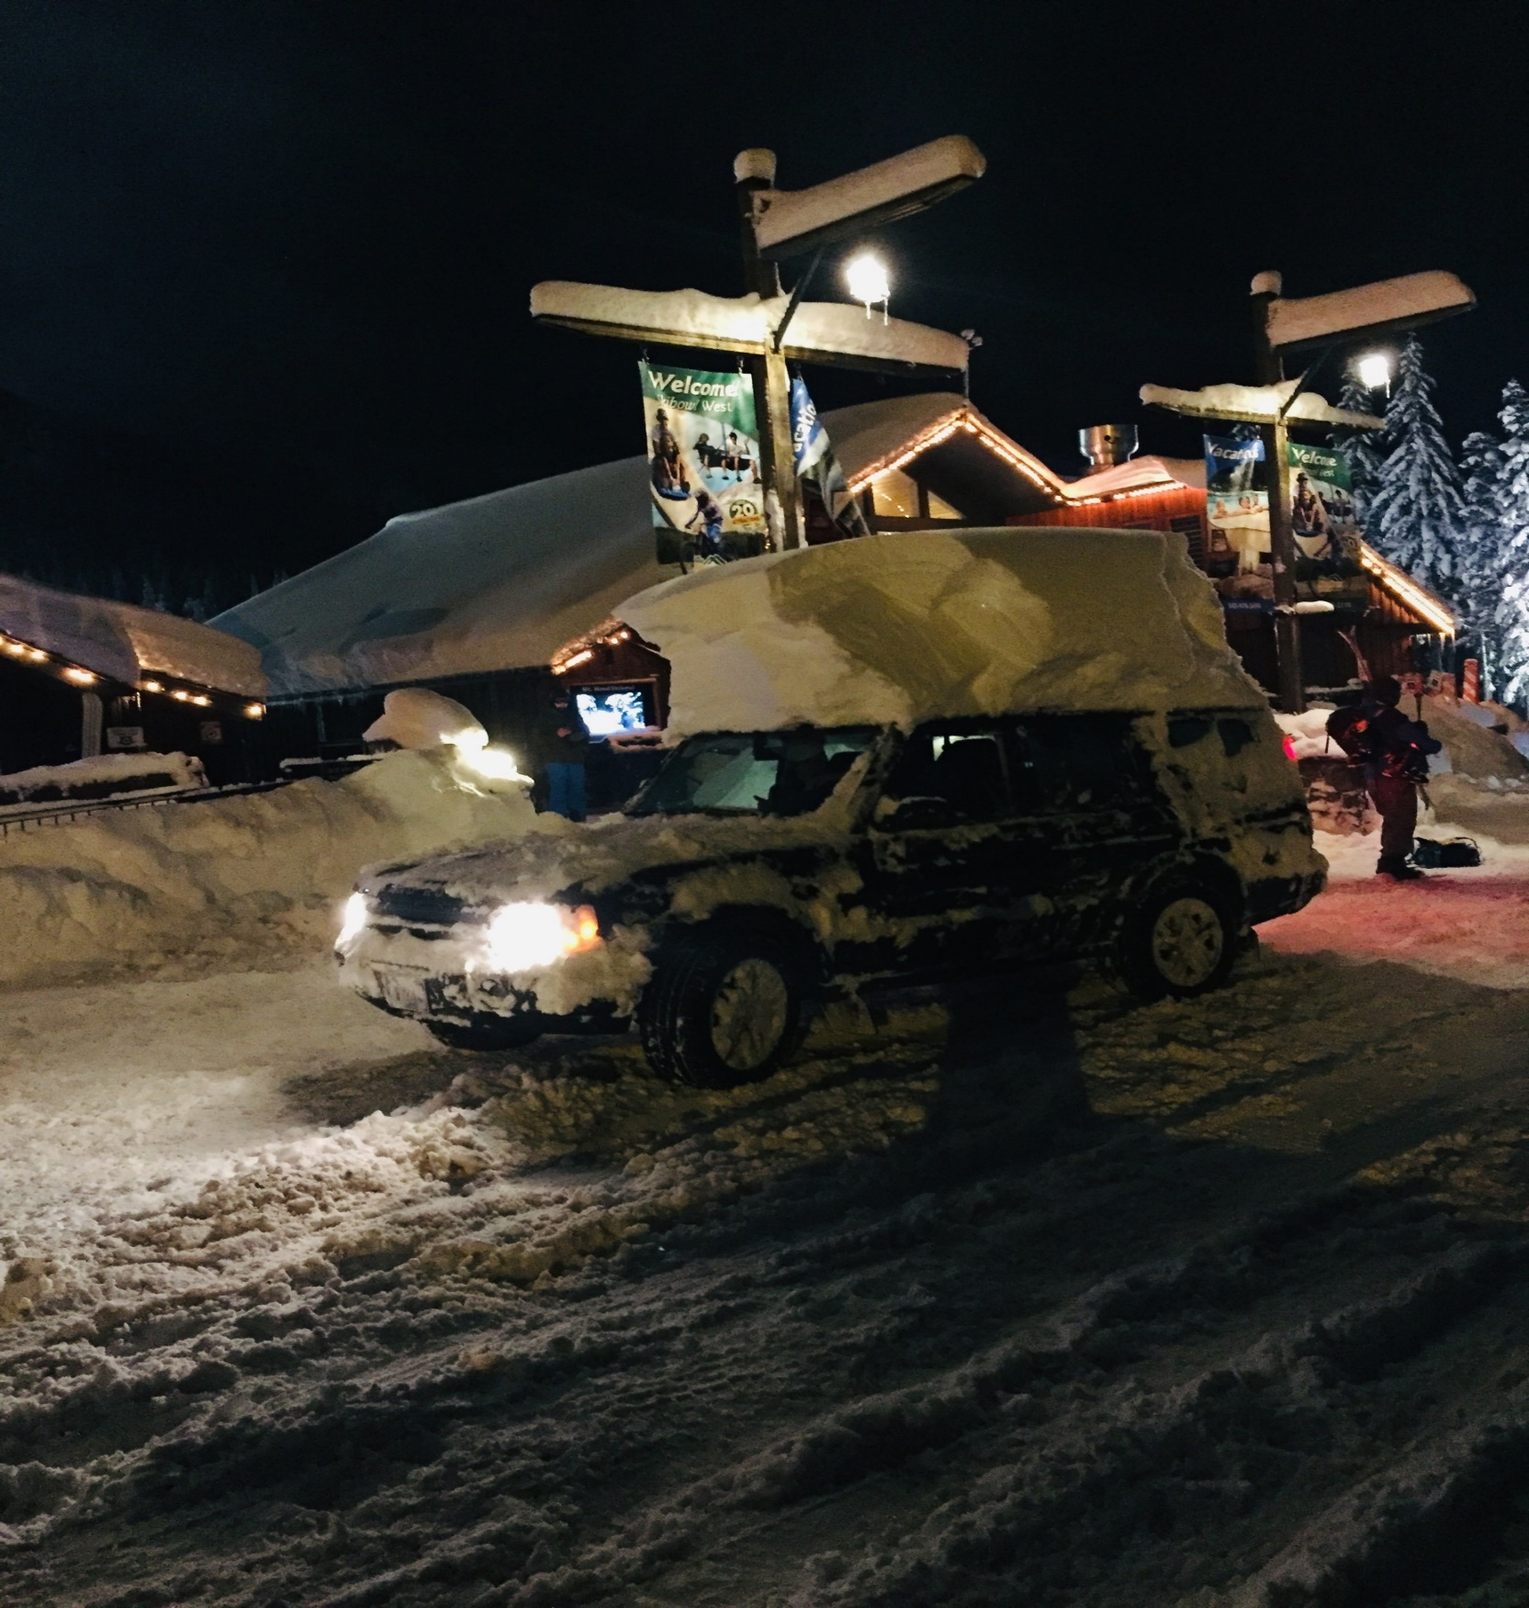
JANUARY
THE ONLY “BIG SNOW WEEK” OF WINTER
In the Cascades January 10th-17th
Notes:
50+ gusts at TTD, 85 mph gust at Corbett Grade, highest of past 10 years
850mb temps never below -9 this winter
Valley 30-35 during this time
Puget Sound 35-45!

Slide 35
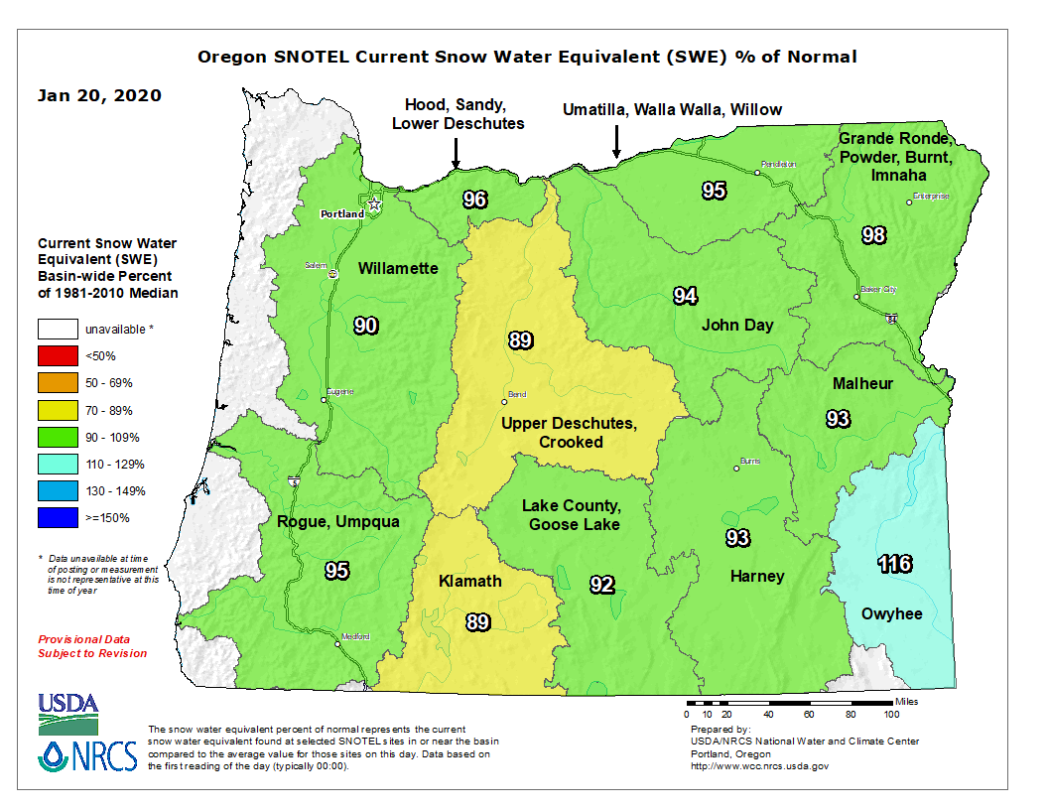
Ski Areas Have Limited Terrain Thanksgiving through Christmas Vacation
No skiing at Mt. Hood Skibowl until early January!
JANUARY 20TH

Slide 36
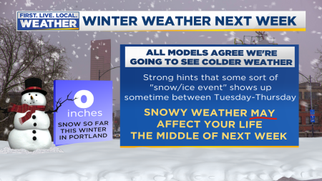
JANUARY
MODELS SHOW POSSIBLE BIG SNOW/ICE EVENT
In the lowlands Wednesday/Thursday the 15th
Notes:
50+ gusts at TTD, 85 mph gust at Corbett Grade, highest of past 10 years
850mb temps never below -9 this winter
Valley 30-35 during this time
Puget Sound 35-45!

Slide 37
JANUARY
WHAT HAPPENED? NOT MUCH
Close to snow for a few days, but big surface low headed too far north for big event
Luckily models (especially ECMWF/GEM) caught on 2-3 days out
Notes:
50+ gusts at TTD, 85 mph gust at Corbett Grade, highest of past 10 years
850mb temps never below -9 this winter
Valley 30-35 during this time
Puget Sound 35-45!

Slide 38
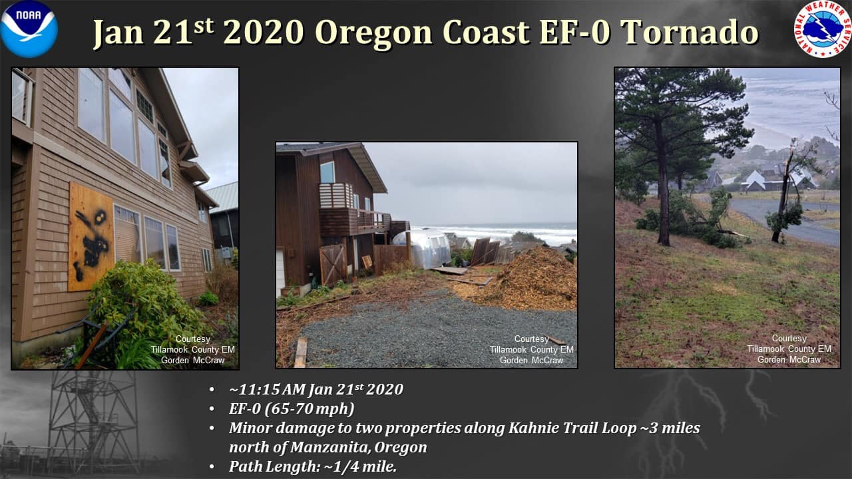
JANUARY
A very mild month
Only “wet” month of the entire cold season!
Notes:
50+ gusts at TTD, 85 mph gust at Corbett Grade, highest of past 10 years
850mb temps never below -9 this winter
Valley 30-35 during this time
Puget Sound 35-45!

Slide 39
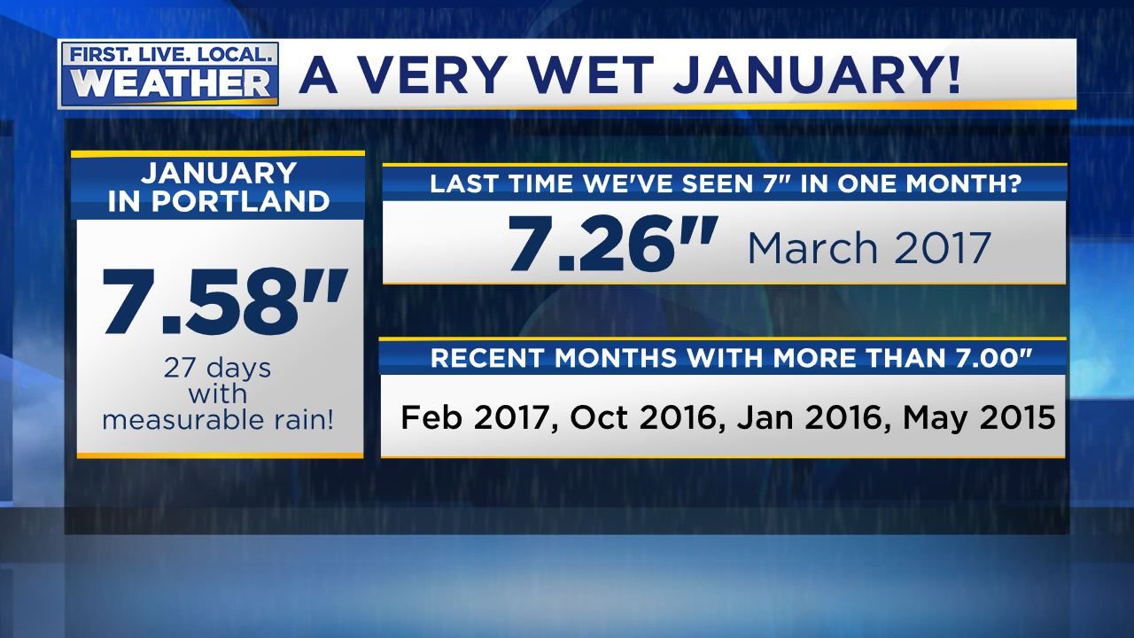
JANUARY
A very mild month
Only “wet” month of the entire cold season!
Notes:
50+ gusts at TTD, 85 mph gust at Corbett Grade, highest of past 10 years
850mb temps never below -9 this winter
Valley 30-35 during this time
Puget Sound 35-45!

Slide 40
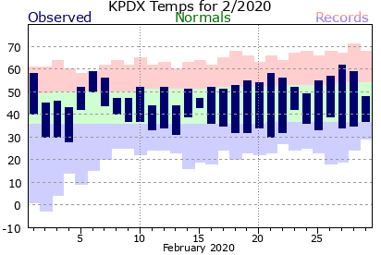
FEBRUARY
A VERY SLOW MONTH FOR GEEKS
Near normal temps, large diurnal range 2nd half of month…chilly nights!
Notes:
50+ gusts at TTD, 85 mph gust at Corbett Grade, highest of past 10 years
850mb temps never below -9 this winter
Valley 30-35 during this time
Puget Sound 35-45!

Slide 41
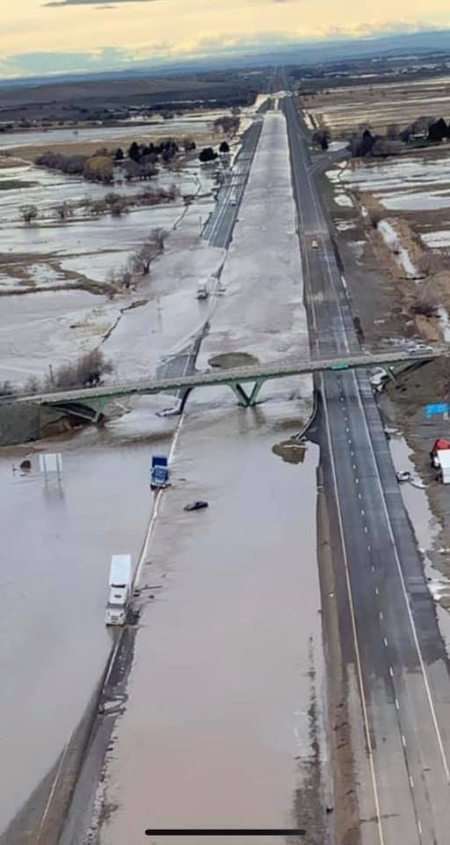
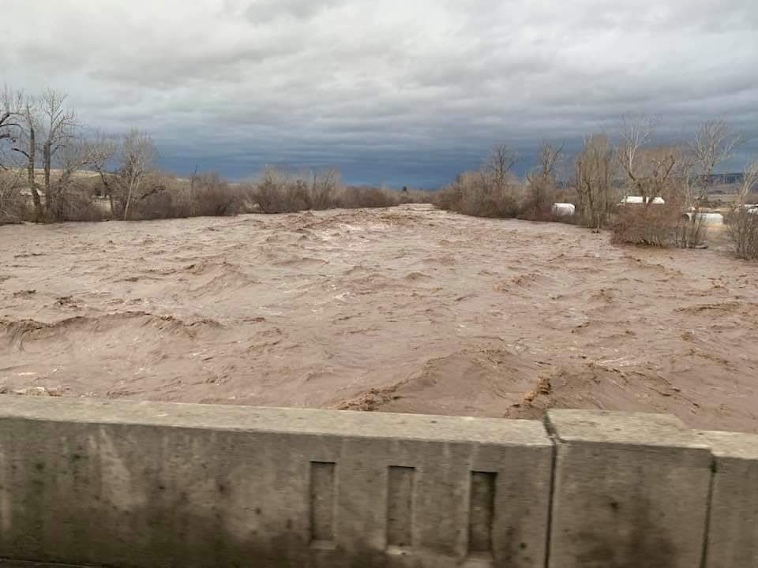
FEBRUARY
Flooding 7th-9th in Blue Mountains
Heavy snow followed by heavy rain
AR coming over top of offshore ridge = unusual
Flooding in western Washington at same time
Notes:
50+ gusts at TTD, 85 mph gust at Corbett Grade, highest of past 10 years
850mb temps never below -9 this winter
Valley 30-35 during this time
Puget Sound 35-45!

Slide 42
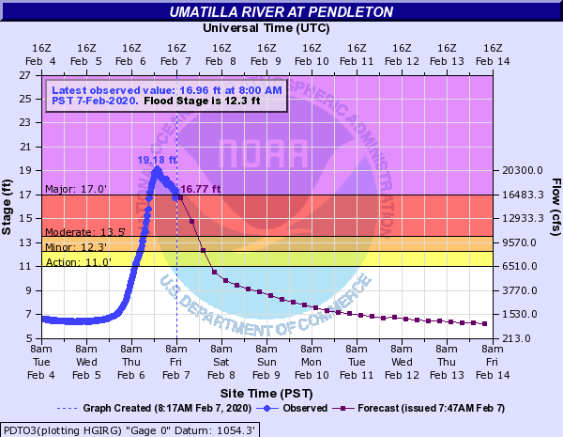
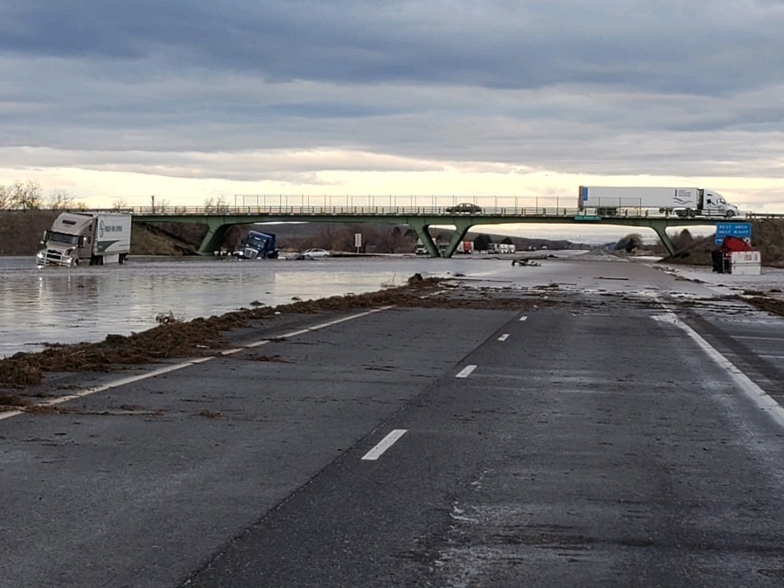
FEBRUARY
Flooding 7th-9th in Blue Mountains
Heavy snow followed by heavy rain
AR coming over top of offshore ridge = unusual
Flooding in western Washington at same time
Notes:
50+ gusts at TTD, 85 mph gust at Corbett Grade, highest of past 10 years
850mb temps never below -9 this winter
Valley 30-35 during this time
Puget Sound 35-45!

Slide 43
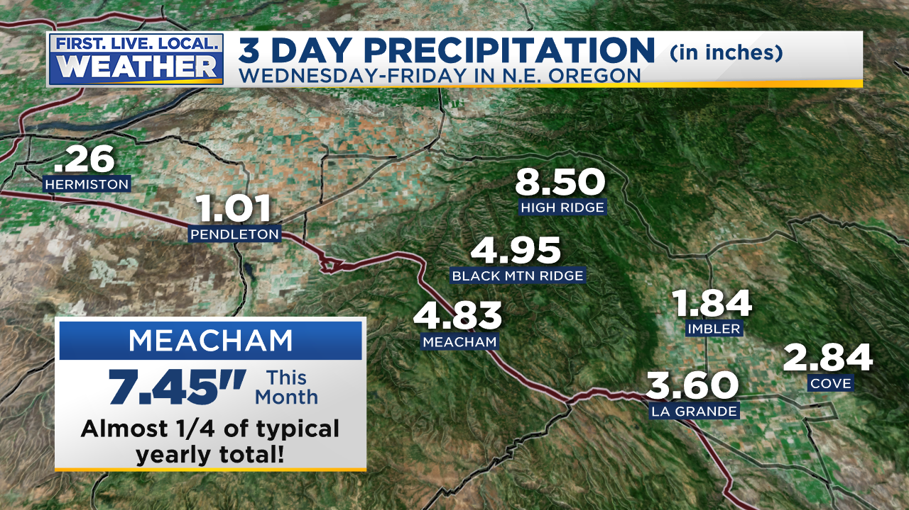
FEBRUARY
Flooding 7th-9th in Blue Mountains
Heavy snow followed by heavy rain
AR coming over top of offshore ridge = unusual
Flooding in western Washington at same time
Notes:
50+ gusts at TTD, 85 mph gust at Corbett Grade, highest of past 10 years
850mb temps never below -9 this winter
Valley 30-35 during this time
Puget Sound 35-45!

Slide 44
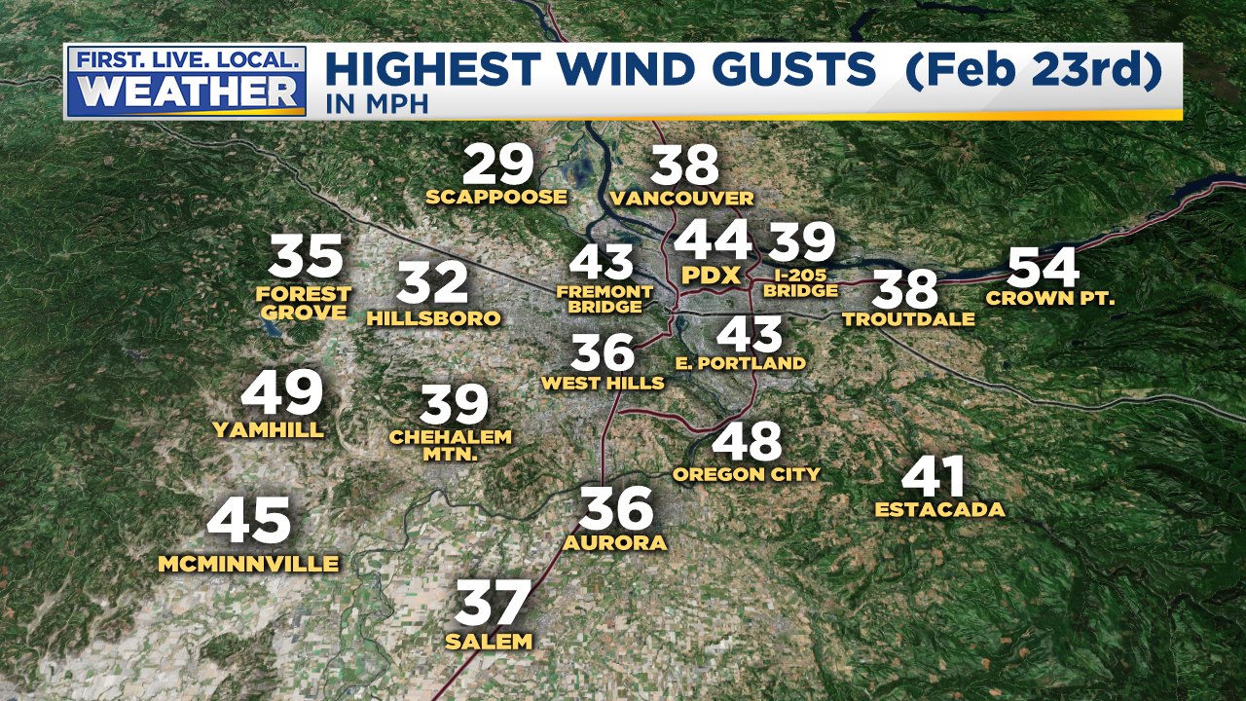
FEBRUARY
The best south wind “event” we had this winter… #SAD
Notes:
50+ gusts at TTD, 85 mph gust at Corbett Grade, highest of past 10 years
850mb temps never below -9 this winter
Valley 30-35 during this time
Puget Sound 35-45!

Slide 45
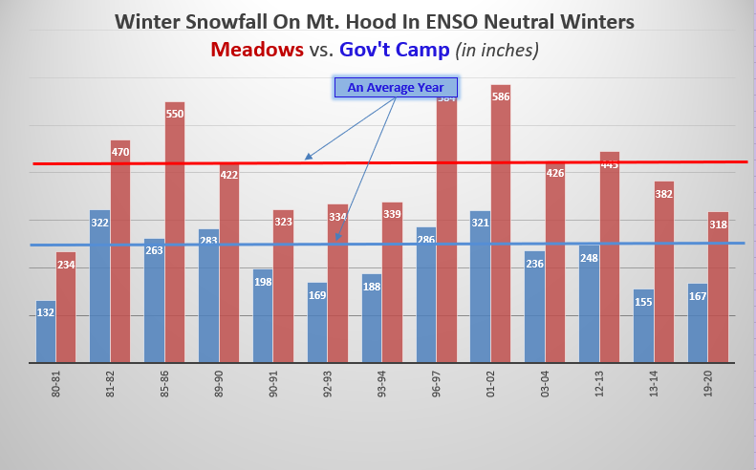
Cascade Snowfall
Tough first half, much better mid-January
Well below normal through early January
BIG SNOW WEEK MID-JANUARY
February near-normal…an okay ski season

Slide 46
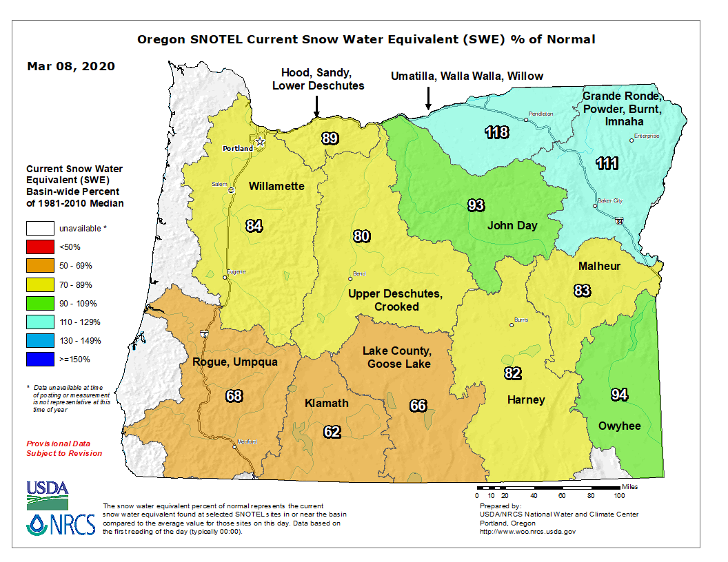
Early March Snowpack
Drier than average since late January = not so good west & south
Notes:
50+ gusts at TTD, 85 mph gust at Corbett Grade, highest of past 10 years
850mb temps never below -9 this winter
Valley 30-35 during this time
Puget Sound 35-45!

Slide 47
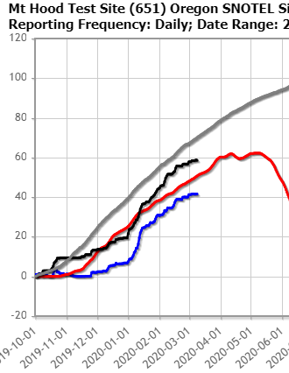
Mountain Snowpack @ 5,400’
Bottom of Pucci Lift @Timberline
Water Year Precipitation: BELOW AVERAGE
Snowpack: BELOW AVERAGE
Courtesy
NRCS
Oregon Office
Precip: Gray Line = Average
Snow Water
Red Line
=
Average

Slide 48
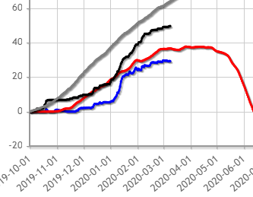
Mountain Snowpack @ 4,700’
Central Oregon Cascades – McKenzie SNOTEL
Water Year Precipitation: BELOW AVERAGE
Snowpack: ABOVE AVERAGE
Courtesy
NRCS
Oregon Office
Precip: Gray Line = Average
Snow Water
Red Line
=
Average

Slide 49
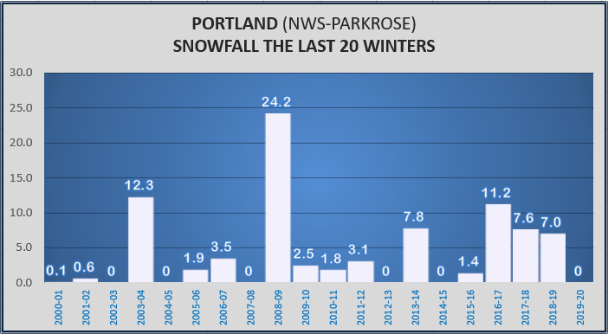

Slide 50


Slide 51


Slide 52

No Wind Storms
24 winters without a major REGIONAL storm
Notes:
Calmest south wind season of the last 20-30 years

Slide 53


A VERY QUIET EAST WIND SEASON
I actually had a “complaint” wondering “where is the wind this year?”

Slide 54

FINAL THOUGHTS
For discussion too!
Seemed like typical slow El Nino season this year, but with no stormy periods
Never had a stormy westerly flow pattern…odd. Weak systems coming over ridge produced several of the rainy periods
Persistent pattern produced coldest Alaska winter in years
Social media and 24/7 news coverage of approaching snow is a real problem for forecasters

Slide 55

HOW DID FORECASTERS DO?
LIGHTNING ROUND
OF WINTER FORECASTS
Organizations/individuals who can’t make it here today or don’t want to be here
OR
They don’t know (or care) that we exist.

Slide 56




Slide 57

Oregon Dept of Ag/Forestry
(Pete Parsons)
Top Analog
Years
1969-70
1977-78
1980-81
Analogs favor mild weather (relative to average).
Arctic outbreaks can’t be ruled out, especially from late November through early January, but not prevalent in the analogs

Slide 58


Rod Hill KGW-TV

Slide 59

Kelley Bayern KOIN-TV

Slide 60


Kyle Dittmer - CRITFC
Government Camp Forecast

Slide 61

WHAT HAPPENS THIS SUMMER?
The last time we’ve been near/below average? Summer 2012

Slide 62

Oregon Coast Summer Temps

