Slide 1
Oregon AMS
January 2020
Weather’s Role in the National Fire Danger Rating System

Slide 2
Lesson Objectives
Define fire danger
Understand the purpose of fire danger rating
Understand NFDRS and its components
Interpret various NFDRS indices
Understand the environmental conditions that contribute to variations in fire danger.

Slide 3

Fire Danger
What is “fire danger” anyway?

Slide 4
Fire Danger
What is “fire danger?”
Fire Danger is description of the combination of both constant and variable factors that affect
  Risk of Ignition
  Rate of Growth
  Difficulty of Control
  of a fire in a given wildland rating area.

Slide 5
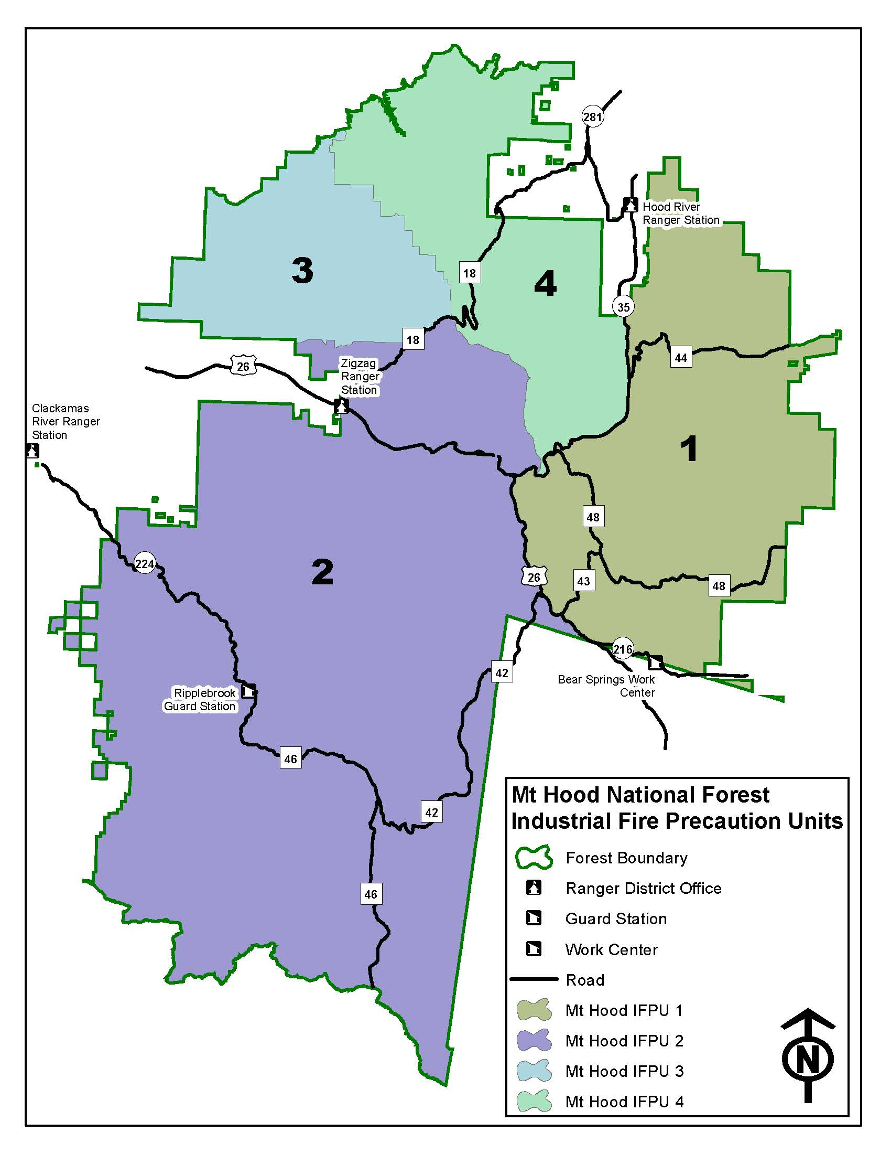

Fire Danger Rating Areas
Mount Hood National Forest
Fire Danger Rating Areas

Slide 6
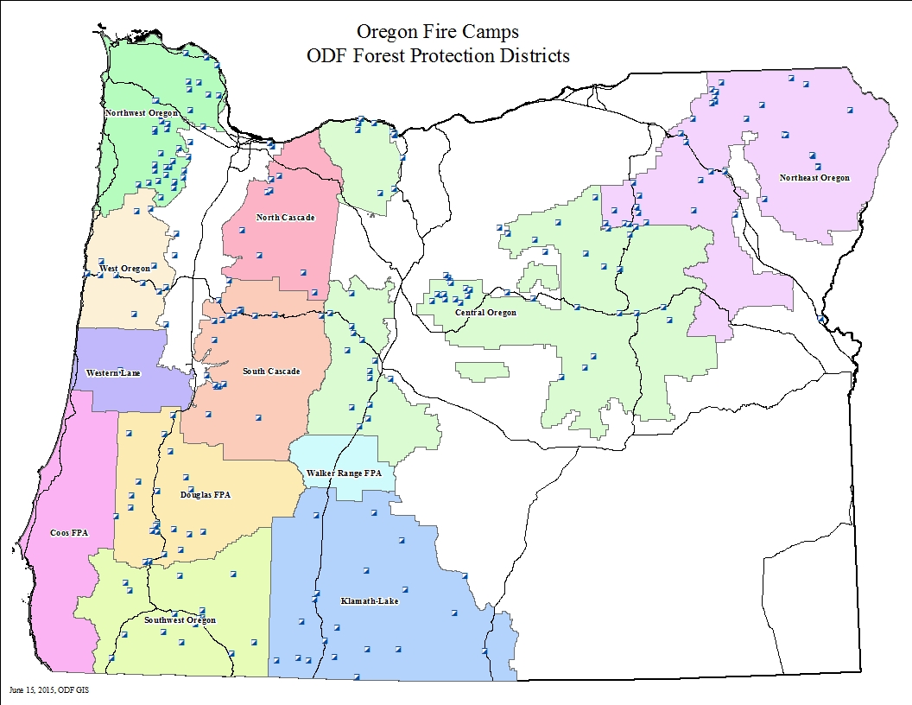

Fire Danger Rating Areas

Slide 7
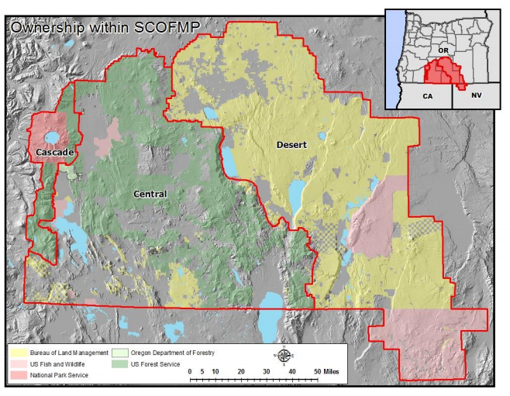

Fire Danger Rating Areas

Slide 8
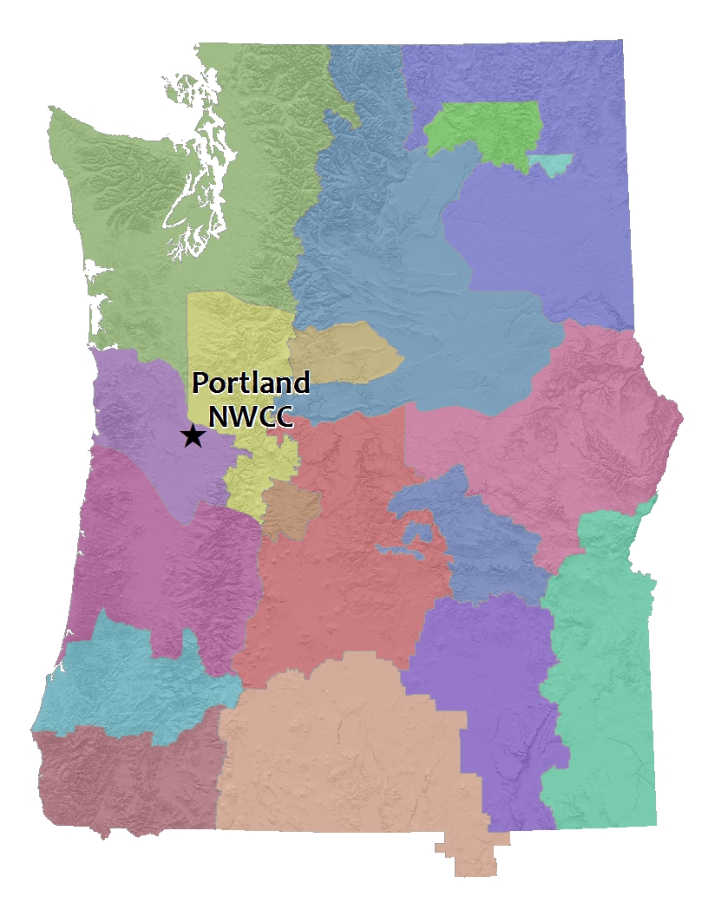
Fire Danger Rating Areas
Eventual Goal

Slide 9
Fire Danger Rating Areas
Rating areas chosen by specialists (called fire planners) who consider:
Predominant fuel type
Terrain steepness
Predominant weather
Fire history
Agency mission and priorities

Slide 10
Fire Danger Rating Areas
Rating areas chosen by specialists (called fire planners) who consider:
Predominant fuel type
Terrain steepness
Predominant weather
Fire history
Agency mission and priorities

Slide 11
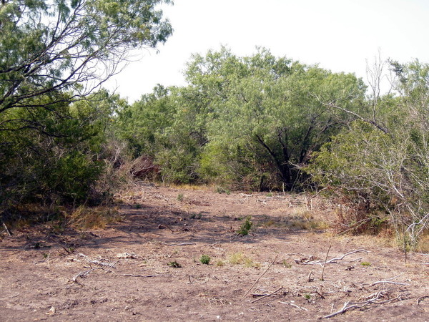
Fuel Type
Brushlands

Slide 12
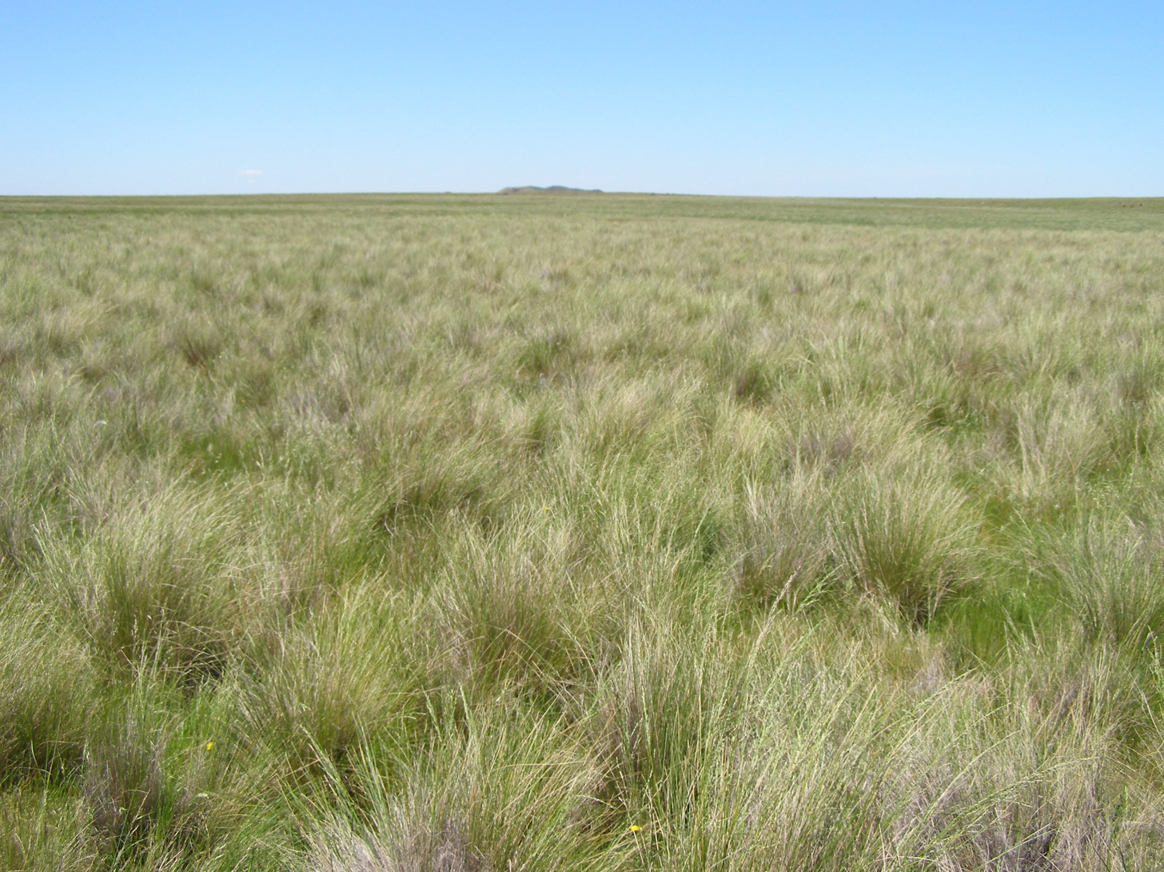
Fuel Type
Grasslands

Slide 13
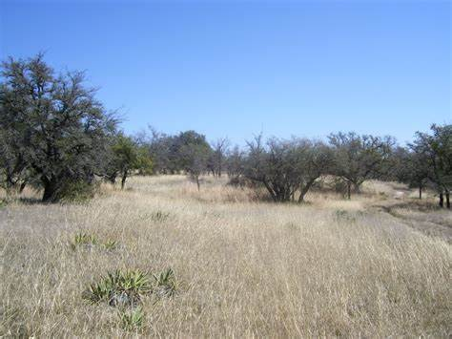
Fuel Type
Combination: Grass & Brush

Slide 14
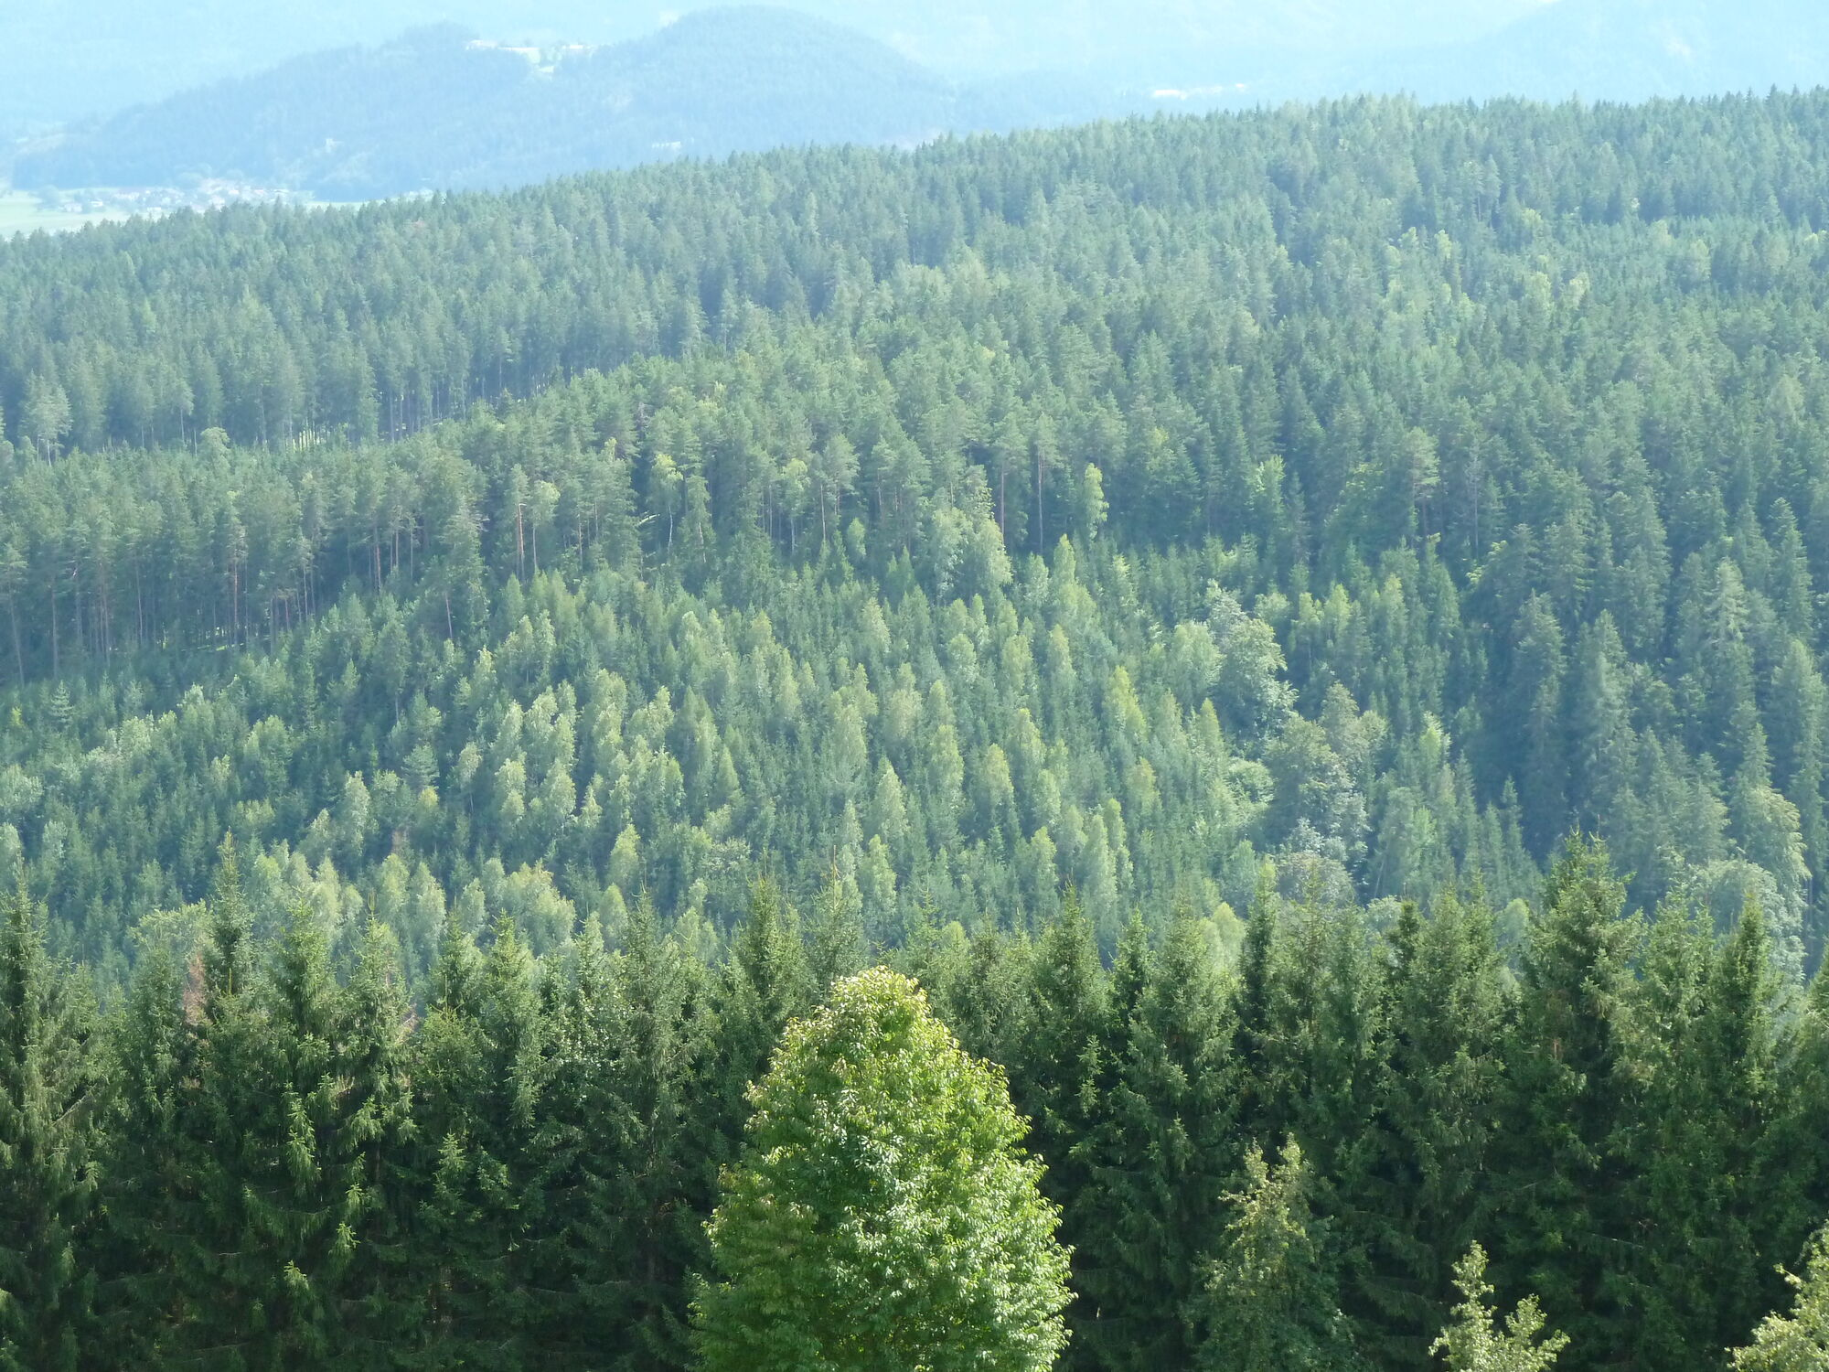
Fuel Type
Timber

Slide 15
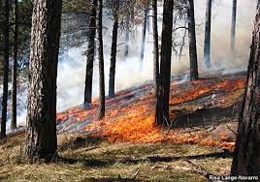
Fuel Type
(Timber Litter)

Slide 16
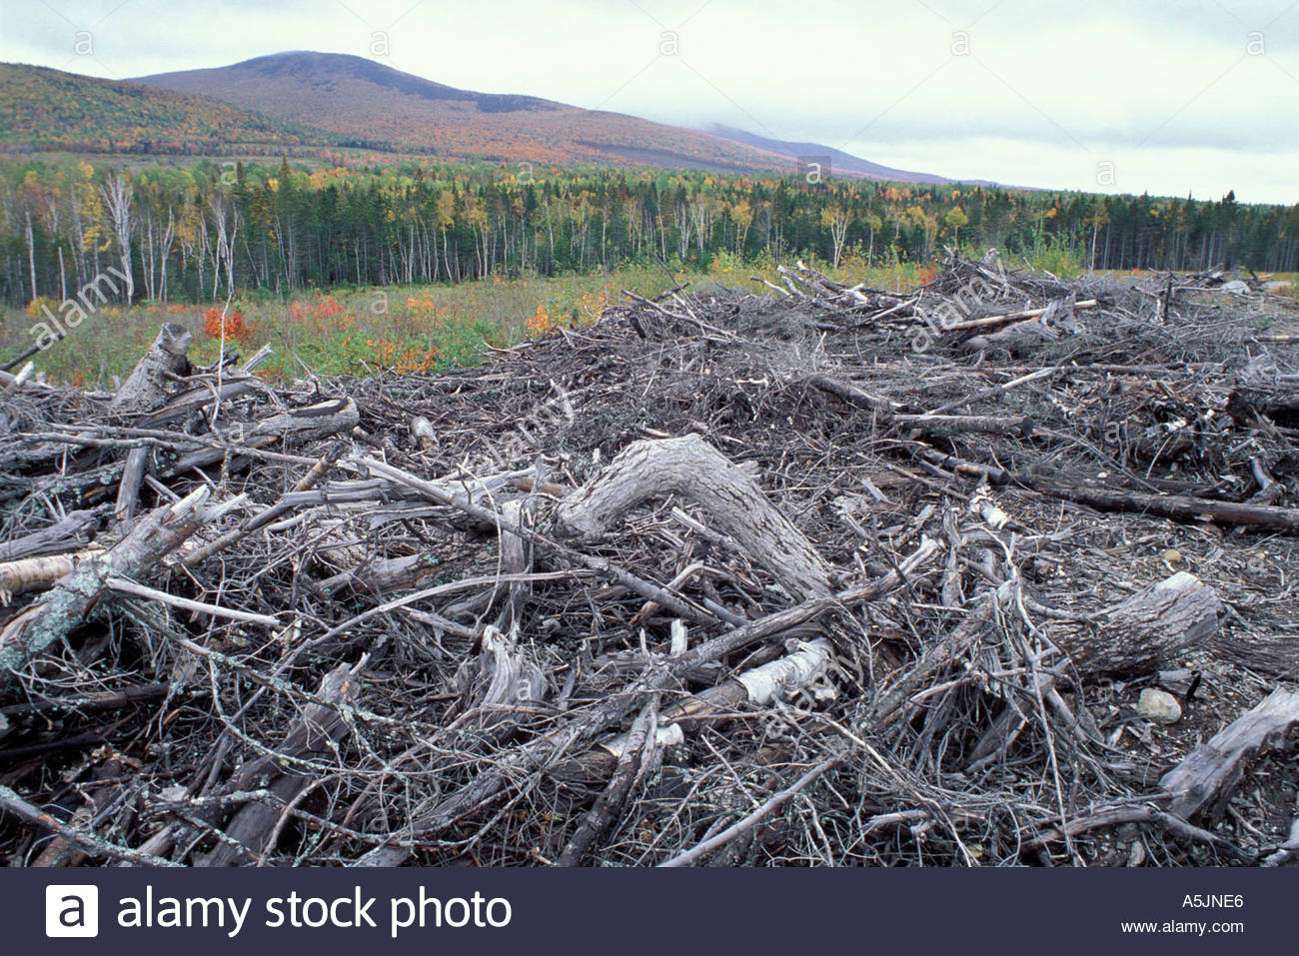
Fuel Type
Logging Slash

Slide 17
Fire Danger Rating Areas
Rating areas chosen by specialists (called fire planners) who consider:
Predominant fuel type
Terrain steepness
Predominant weather
Fire history
Agency mission and priorities

Slide 18
Fire Danger Rating Areas
Rating areas chosen by specialists (called fire planners) who consider:
Predominant fuel type
Terrain steepness
Predominant weather
Fire history
Agency mission and priorities

Slide 19
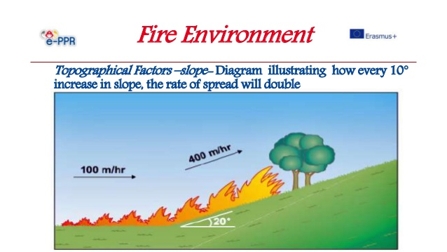

Fire Danger Rating Areas
Higher Intensity
Lower Intensity

Slide 20
Fire Danger Rating Areas
Rating areas chosen by specialists (called fire planners) who consider:
Predominant fuel type
Terrain steepness
Predominant weather
Fire history
Agency mission and priorities

Slide 21
Fire Danger Rating Areas
Rating areas chosen by specialists (called fire planners) who consider:
Predominant fuel type
Terrain steepness
Predominant weather
Fire history
Agency mission and priorities

Slide 22
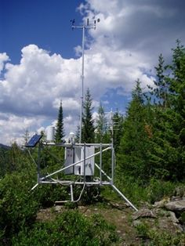
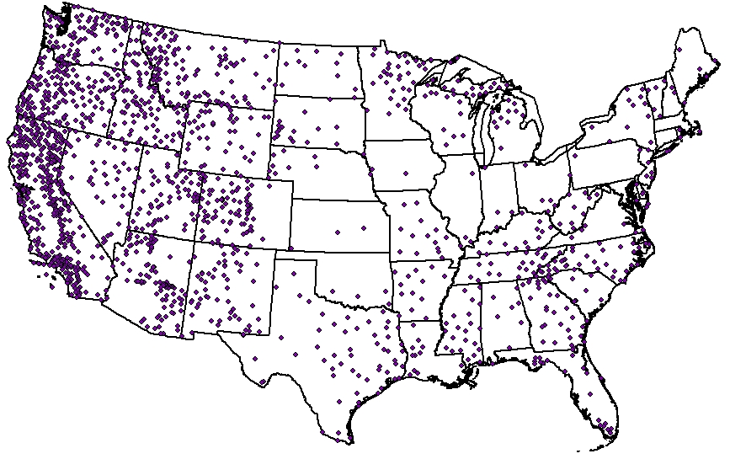
RAWS

Slide 23

RAWS
Remote Automatic Weather Station
Decades of data

Slide 24
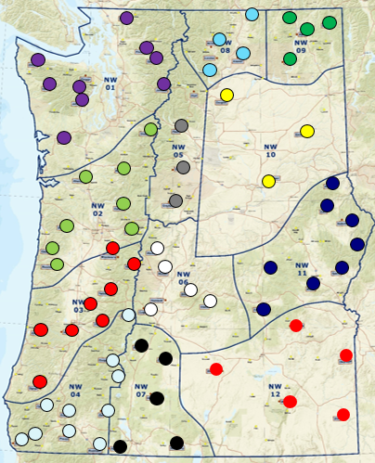
Fire Danger Rating Areas
Remote Automatic Weather Station
  Scattered across a sampling area
  Various terrain elevations
  Exposed to winds

Slide 25
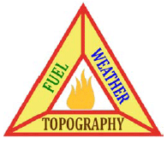
Evolution of a
Fire Danger Rating System

Slide 26
National Fire Danger Rating System
History
Eight different fire danger rating systems prior to the 1950s in various regions of the US.
A unified and comprehensive system was proposed by the federal gov in the 1960s.
Research began in 1968.

Slide 27
National Fire Danger Rating System
Fire Danger Rating is objective, numeric scaling of wildland fire potential.
Fire Danger Rating is generalized over the rating area. Its not intended to be site-specific
(fire behavior is intended to be site-specific).
Fire Danger Rating relies on the context provided by historical conditions observed over a rating area.

Slide 28
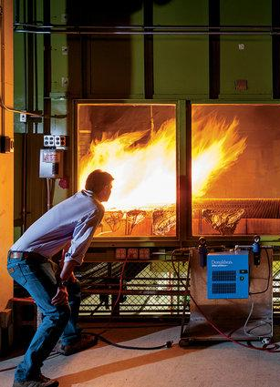
National Fire Danger Rating System
1960s NFDRS Guidelines:
Objective scaling of fire physics based on laboratory measurements.
Adaptable to areas anywhere in the US.
  Many fuel types.
  Variety of climates
Data relayed rapidly
Fire danger analysis tools accompanied development

Slide 29

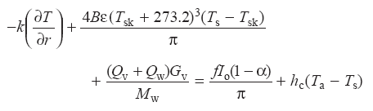
National Fire Danger Rating System
Fire danger research established numerical constants & coefficients reflecting relationships between various fuels, weather, topography and fire risk.

Slide 30
National Fire Danger Rating System
Eight different fire danger rating systems prior to the 1950s in various regions of the US.
A unified and comprehensive system was proposed by the federal gov in the 1960s.
Research began in 1968.
First NFDRS version was operational in 1972.
Improved version in 1978.
State of Oregon retired its legacy system and transitioned to NFDRS around 1990.
Latest NFDRS update operational in 2020.

Slide 31
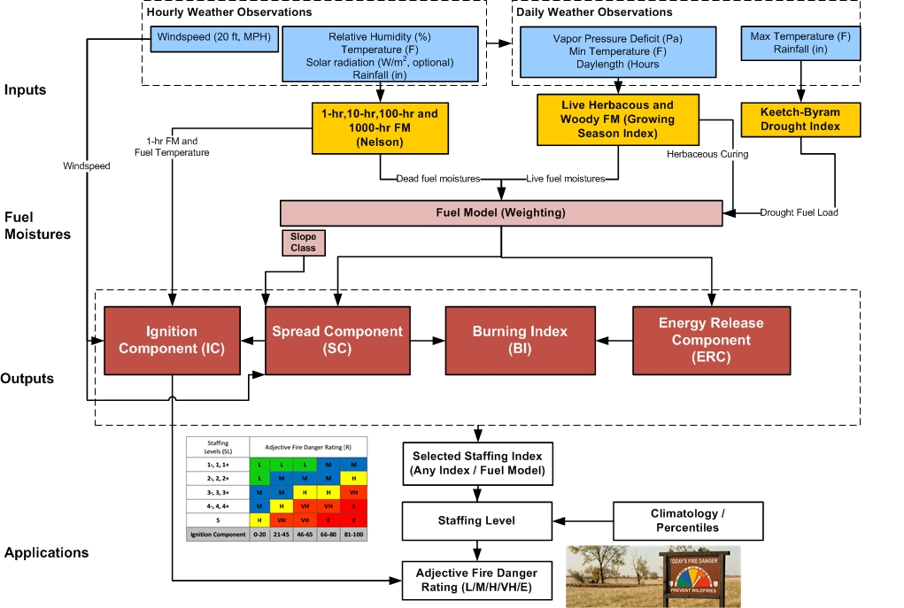
NFDRS schematic
Four main NFDRS elements

Slide 32
NFDRS weather inputs

Slide 33
NFDRS weather inputs
Hourly Wind Speed (not direction).
Hourly Relative Humidity
Hourly Air Temperature
Hourly Solar Radiation (proxy for cloud cover).
Hourly Rainfall Accumulation(dur./amount)
Calculated Vapor Pressure Deficit

Slide 34
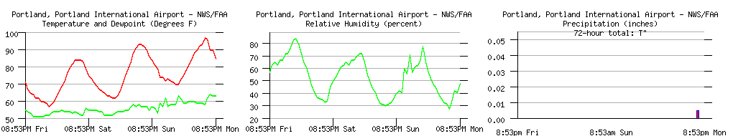
NFDRS weather inputs

Slide 35
NFDRS weather inputs

Slide 36
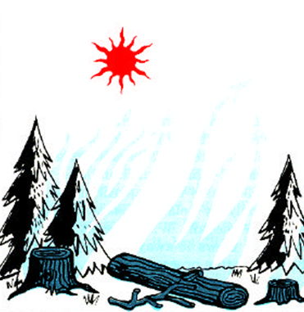
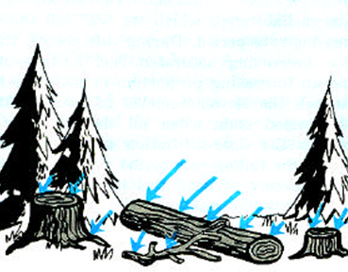
NFDRS calculations
Dead plant fiber is hygroscopic

Slide 37
NFDRS calculations
Relative Humidity
RH & moisture
percent
Fuel Moisture
0
12PM 6AM NOON 6PM 12PM

Slide 38
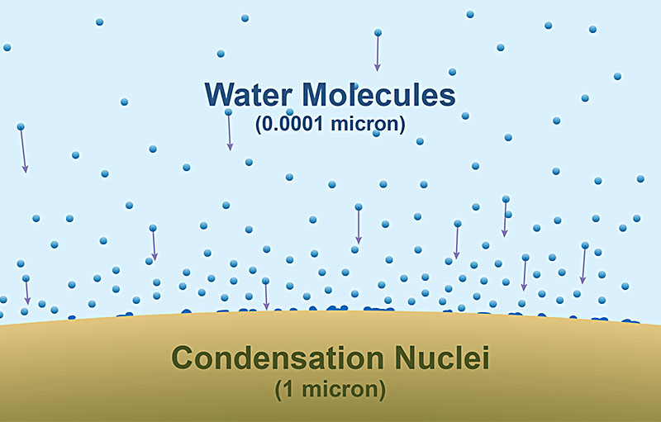
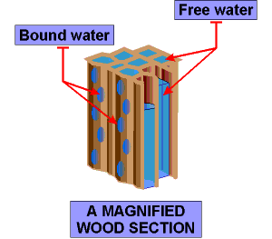
NFDRS calculations
Dead Plant Fiber
is hygroscopic

Slide 39
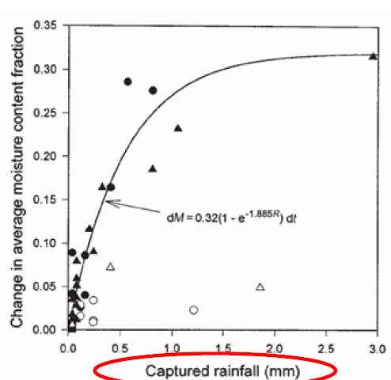
NFDRS calculations
Wood and Plant Fiber Microphysics

Slide 40
NFDRS calculations
Moisture content of four dead fuel size categories
Expressed in Percent

Slide 41
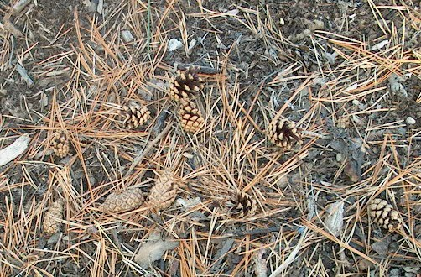
NFDRS fuel moisture
.16” diameter or less
One Hour
Fuels
Daily Value expressed in percent

Slide 42
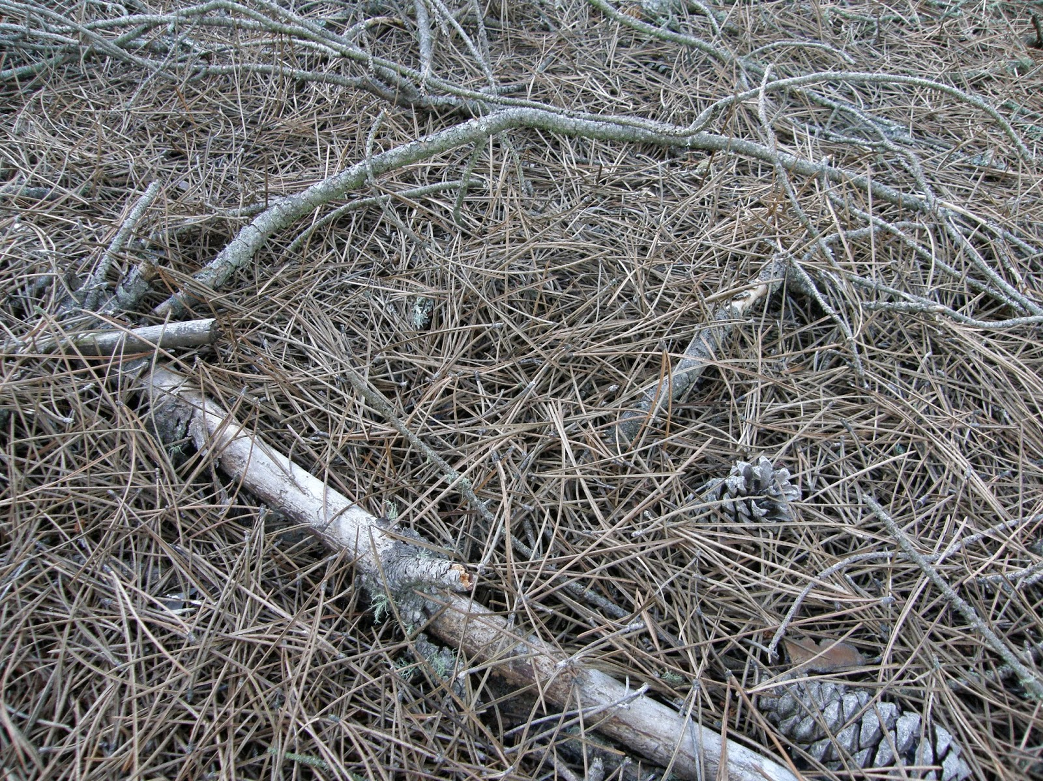
NFDRS fuel moisture
.5” diameter
Ten Hour
Fuels
Daily Value expressed in percent

Slide 43
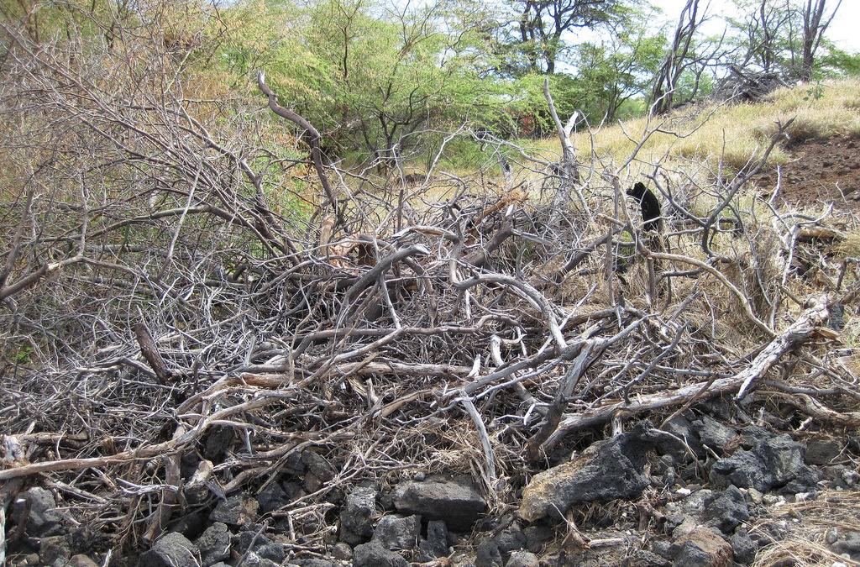
NFDRS fuel moisture
1.6” diameter
Hundred Hour
Fuels
Daily Value expressed in percent

Slide 44
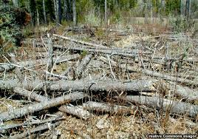
NFDRS fuel moisture
3” or greater diameter
Thousand Hour
Fuels
Daily Value expressed in percent

Slide 45
NFDRS calculations
Typical Ranges: 5% to 30%
30%: Too wet to burn
(flammability low)
5%: Kiln dried
(flammability high)

Slide 46
National Fire Danger Rating System
Interpretation
100 hour fuel moisture:
How dry has it been over the last 4 days?
1000 hour fuel moisture:
How dry has it been over the last month?
Especially compared to daily normal

Slide 47
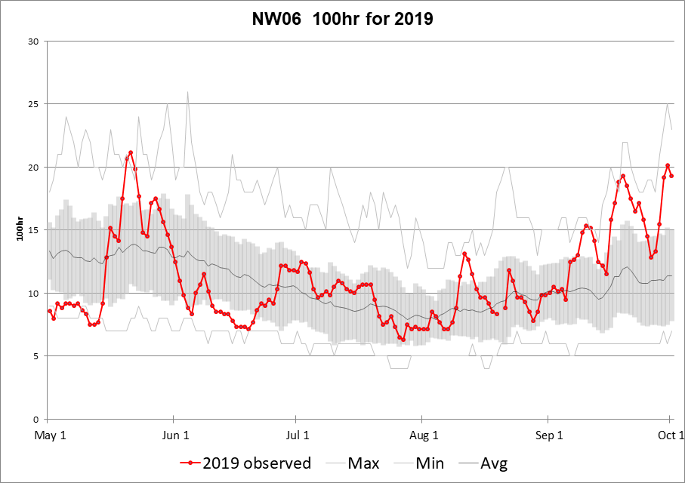
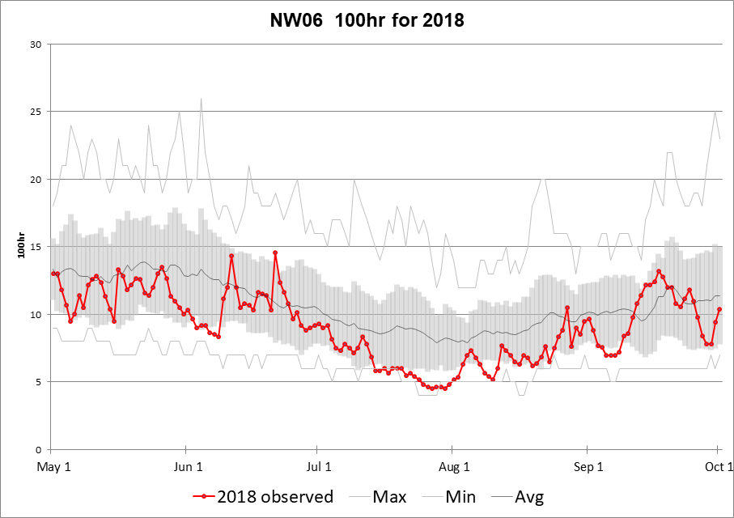
National Fire Danger Rating System
Frequent variation in volatility!

Slide 48
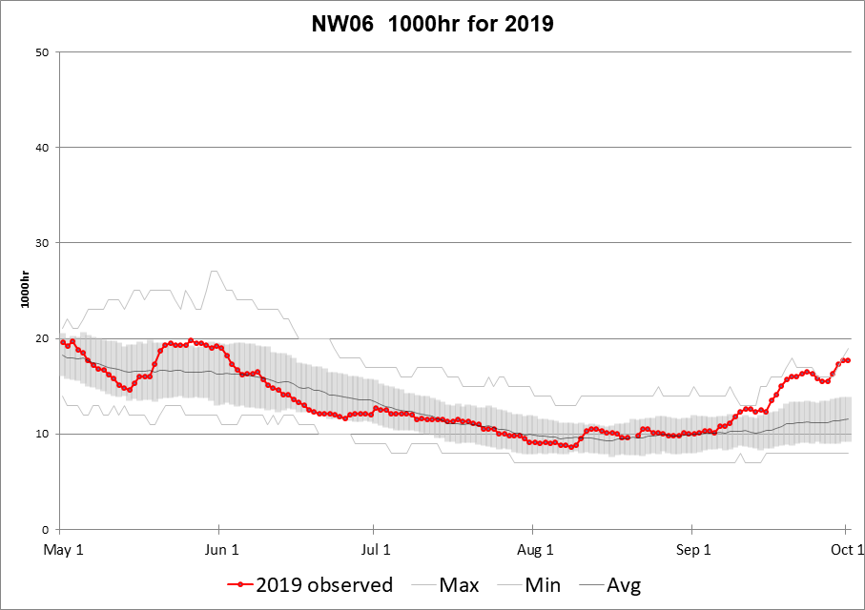
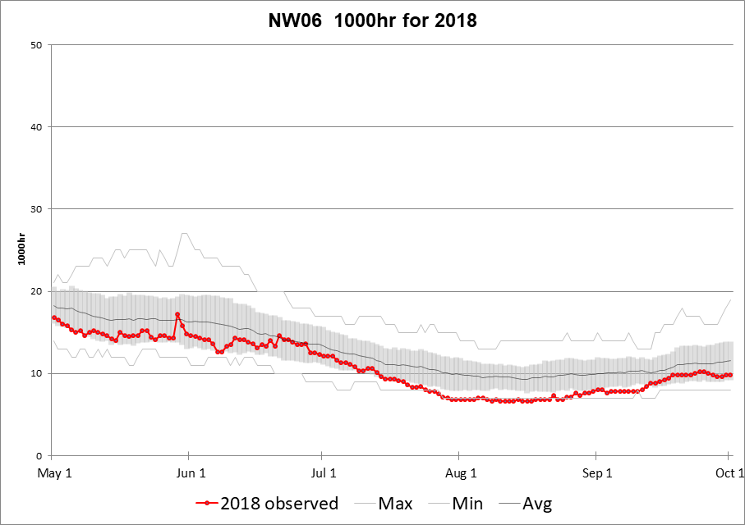
National Fire Danger Rating System
Less variation!

Slide 49
National Fire Danger Rating System
Interpretation
1 hour fuel moisture:
How dry has it been in the last hour?
10 hour fuel moisture:
How dry has it been today?
Used more in Fire Behavior Calculations

Slide 50
Fire Danger vs Fire Behavior
Fire Danger
Fire Behavior

Slide 51
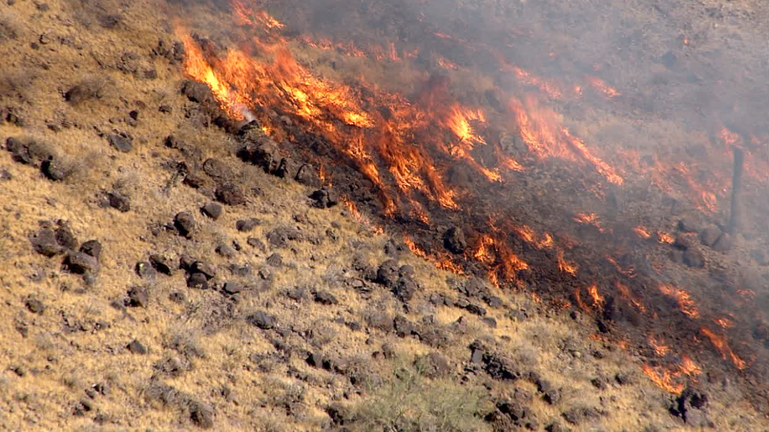
Fire Danger vs Fire Behavior
What is the risk that a fire will break out in the rating area?

Slide 52
NFDRS calculations
Moisture content for two live fuel types

Slide 53
NFDRS calculations
Not only atmospheric influence but also plant growth cycles

Slide 54

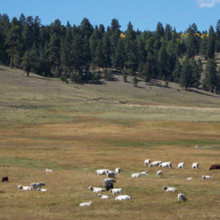
Live Fuel Moisture
Water
Light
Heat
Automated

Slide 55
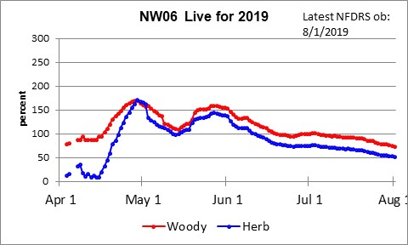
Live Fuel Moisture
Volatility of living vegetation

Slide 56
NFDRS calculations

Slide 57
NFDRS outputs
Applying to NFDRS fuel models

Slide 58
Fuel Type
1hr dead fuels
Live herbaceous fuels
Grasslands

Slide 59
Fuel Type
1hr dead fuels
10hr dead fuels
100hr dead fuels
Live herbaceous fuels
Combination: Grass & Brush

Slide 60
Fuel Type
1hr dead fuels
10hr dead fuels
100hr dead fuels
1000hr dead fuels
Live herbaceous fuels
Live woody fuels
Timber

Slide 61
NFDRS outputs

Slide 62
NFDRS outputs
NFDRS indices

Slide 63




NFDRS outputs
The probability that a fire will result if a firebrand is introduced into fine fuels.
Expressed in percent (0-100).
The forward rate of spread of a fire numerically expressed in feet-per-minute.
Describes the available energy (BTU) per unit area (square foot) released within the flaming front of a fire.
Combines the Spread Component and Energy Release Component to relate to the length of flames in the actively moving head of a fire.

Slide 64
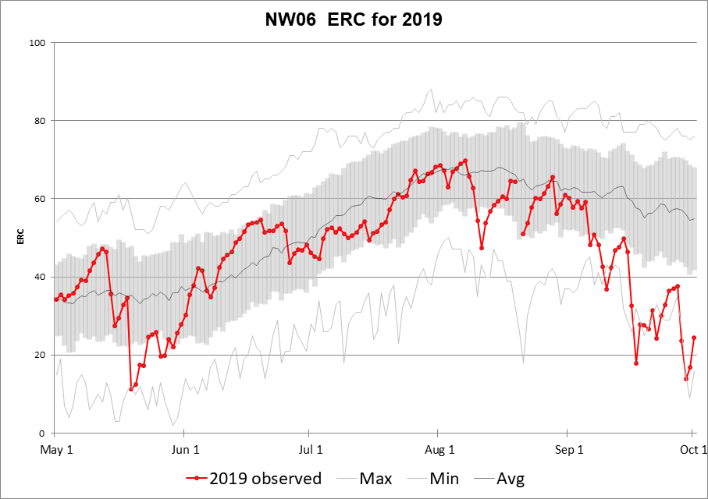
National Fire Danger Rating System

Slide 65
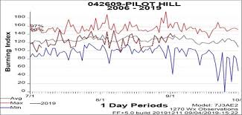
National Fire Danger Rating System

Slide 66
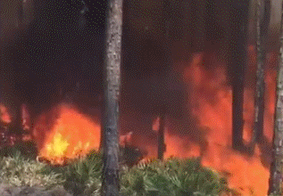
NFDRS outputs
Burning Index and flame length

Slide 67
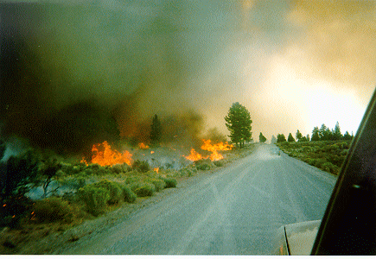
NFDRS outputs
Probability of Ignition

Slide 68
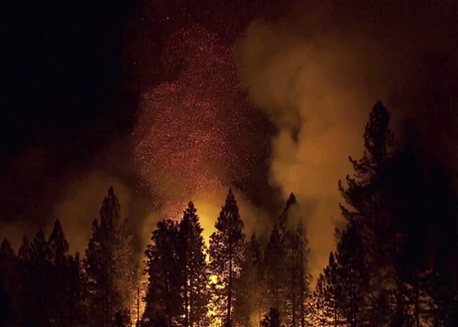
NFDRS outputs
Energy Release Component

Slide 69
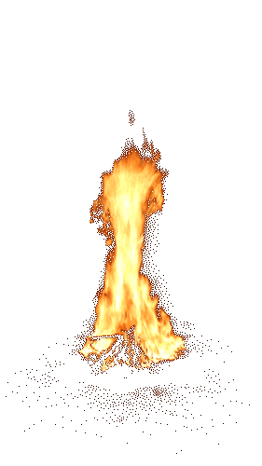
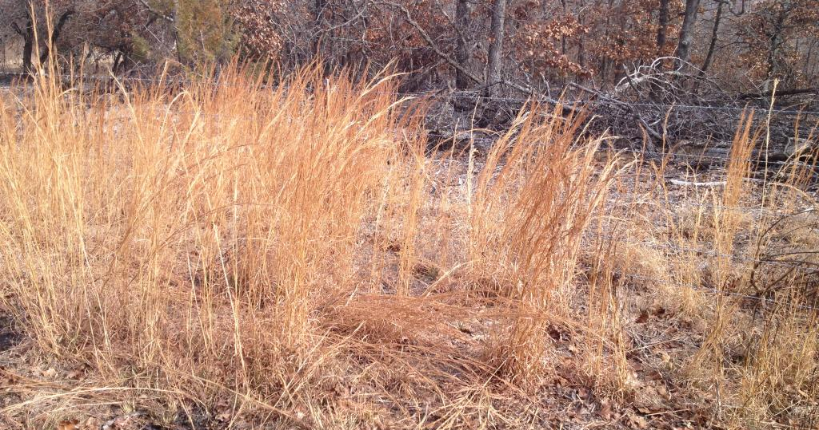
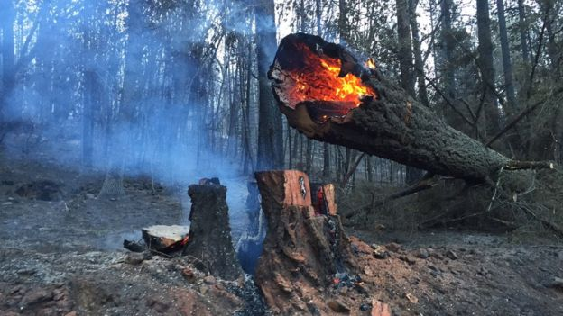

NFDRS outputs
Differing fuel types: Differing volatility
NFDRS objectively assists determination of fire danger

Slide 70
NFDRS outputs
Lots of information for
any one rating area!

Slide 71
NFDRS outputs
Lots of information!

Slide 72
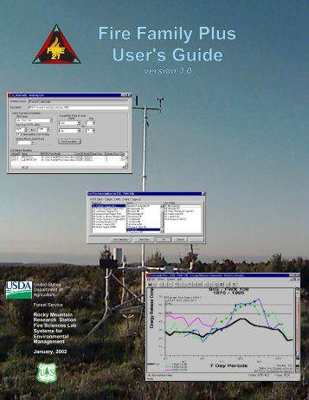
NFDRS interpretation
Software that allows easy gathering and objective statistical analysis of NFDRS and weather for fire danger rating areas.
Used to develop NFDRS fire histories and fire danger or adjective class breakpoints.

Slide 73
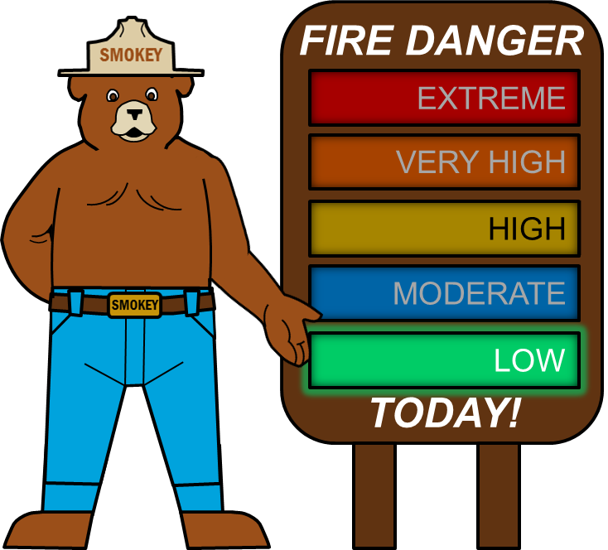
NFDRS interpretation

Slide 74
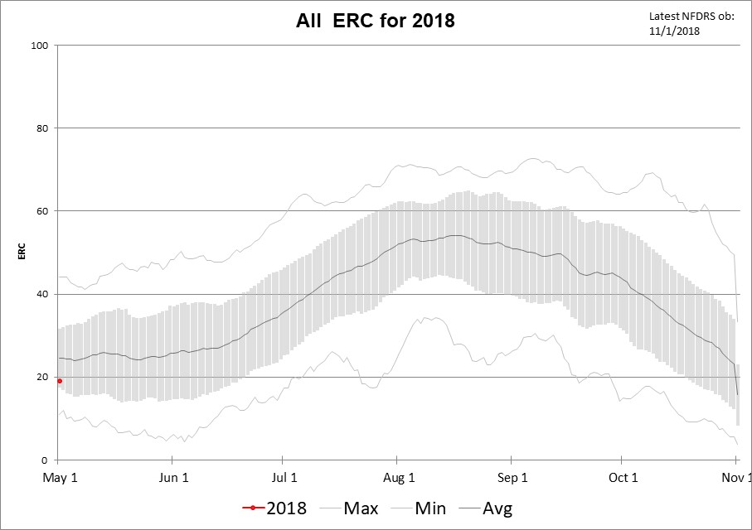
Typical Fire Season Variation in ERC

Slide 75
Typical Fire Season Variation in ERC
Low

Slide 76
Typical Fire Season Variation in ERC
Mod
Low

Slide 77
Typical Fire Season Variation in ERC
High
Mod
Low

Slide 78
Typical Fire Season Variation in ERC
V High
High
Mod
Low

Slide 79
Typical Fire Season Variation in ERC
Extreme
V High
High
Mod
Low

Slide 80
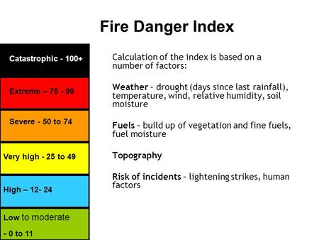
NFDRS interpretation

Slide 81
NFDRS interpretation

Slide 82
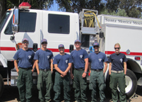
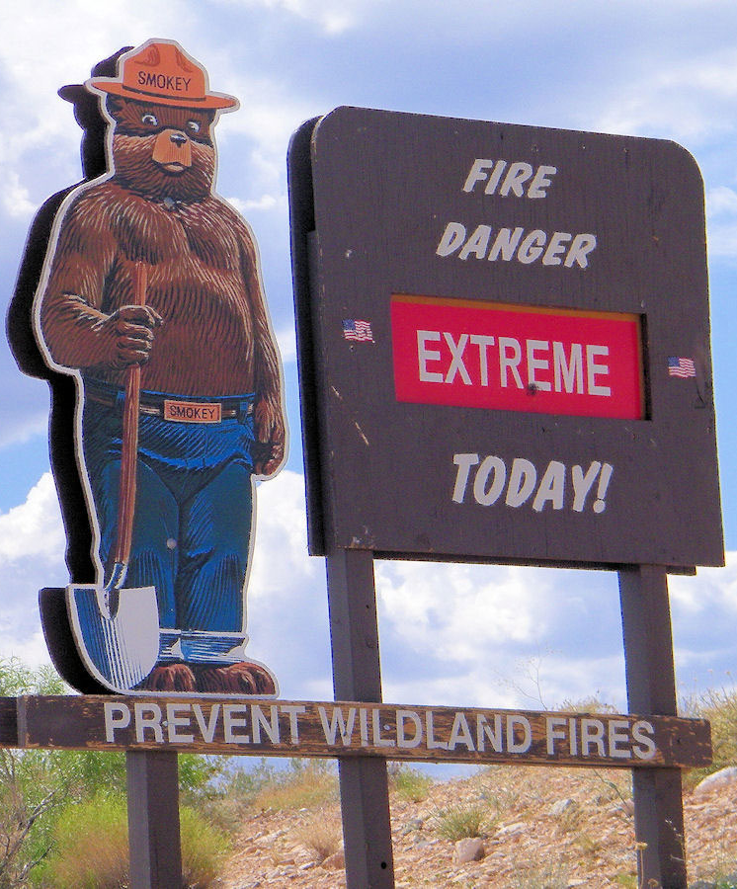
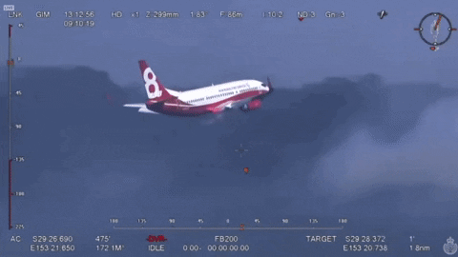
NFDRS interpretation
Firefighter Readiness
and
Public Safety!
“Every fire management activity is undertaken with firefighter and public safety as the primary consideration” -GP FMP

Slide 83

NFDRS interpretation

Slide 84

NFDRS interpretation

Slide 85


NFDRS interpretation
* High Fire Danger
* Critical Weather Pattern

Slide 86



NFDRS interpretation
Burn / No Burn
decisions

Slide 87

NFDRS interpretation
Nationwide

Slide 88
Coming for the future!

Slide 89






Automated NFDRS weather inputs from NDFD grids:

Slide 90

NFDRS outputs
NDFD grids are being used to forecast these out to seven days in the future

Slide 91


Thanks for listening

Slide 103


Slide 104

Typical Fire Season Variation in ERC

Slide 105


Slide 107


Slide 119
Typical summer rise in Regional Fire Danger
Historical Average Peak
Aug 10
Begin tracking
May 1
End tracking
Nov 1

Slide 120
Typical Fire Season Variation in ERC

Slide 121

2018 Regional ERC
8/11 – 8/22
Boyds
McLeod
Horns Mtn
Watson Creek
StubbleField
Terwilliger
Ramsay Cnyn

Slide 122
2018 Regional ERC
9/7 – 9/8
Iron East
Glade Creek
Teepee
Crystal

