Slide 1
Oregon AMS Twitter Takeover
Tuesday January 28th on the AMS’ Local Chapter Affairs Committee Twitter Account
@AMSLCAC

Slide 2
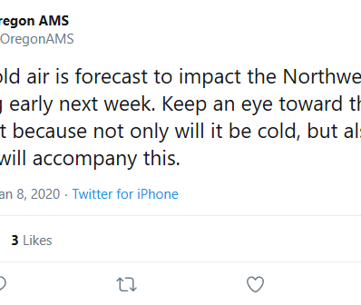
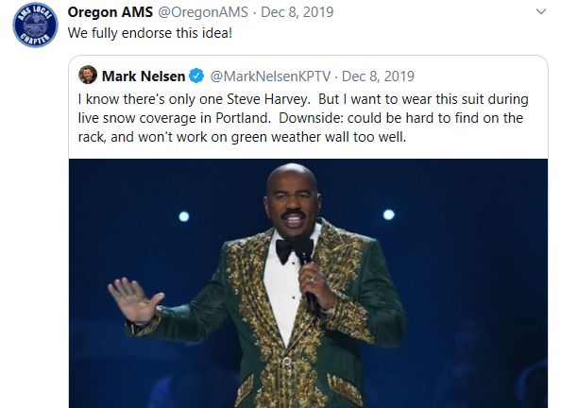
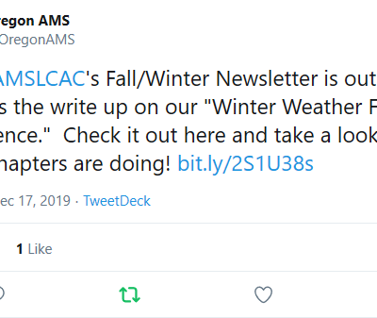
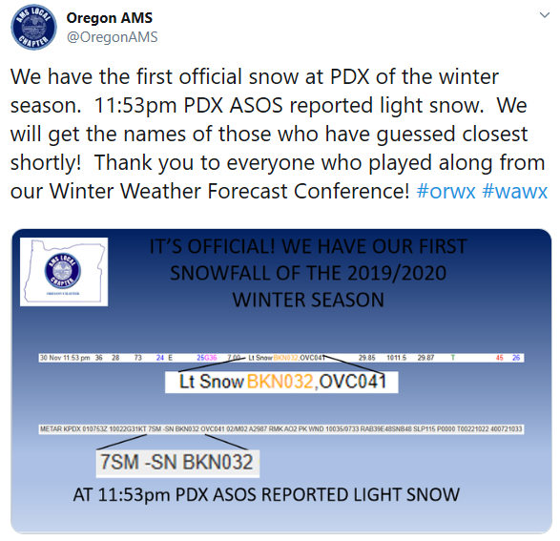
@OregonAMS takes over the @AMSLCAC account…
Tuesday January 28th

Slide 3

National AMS’ New Logo…
The AMS adopted a new logo last week at the 100th Annual Meeting in Boston!

Slide 4


Slide 5
For more on the new logo, check out http://www.ametsoc.org

