Slide 1
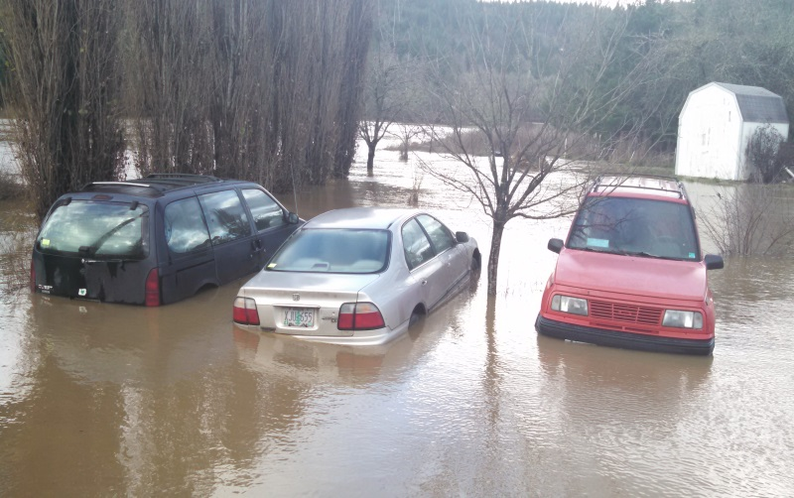
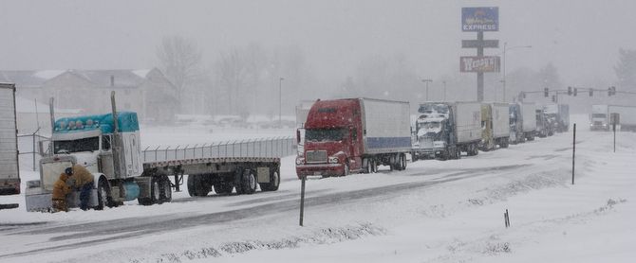
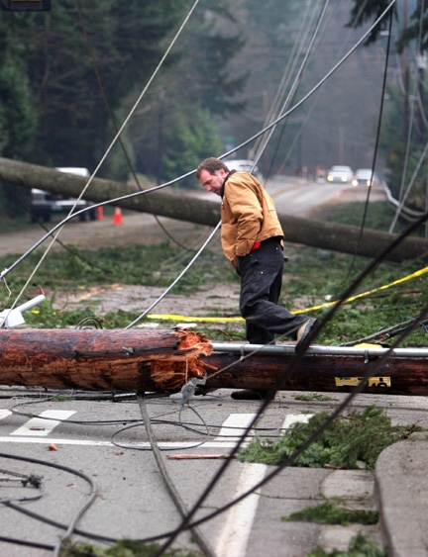

Winter Outlook (2019-2020)
AMS Winter Weather Meeting
Oct 26, 2019
Tyree Wilde
Warning Coordination Meteorologist
National Weather Service
Portland, OR

Slide 2
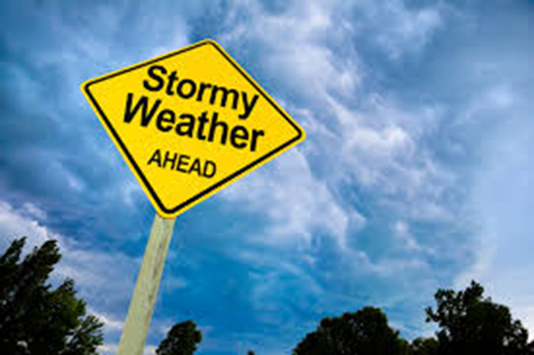
Winter Outlook

Slide 3
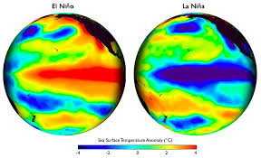
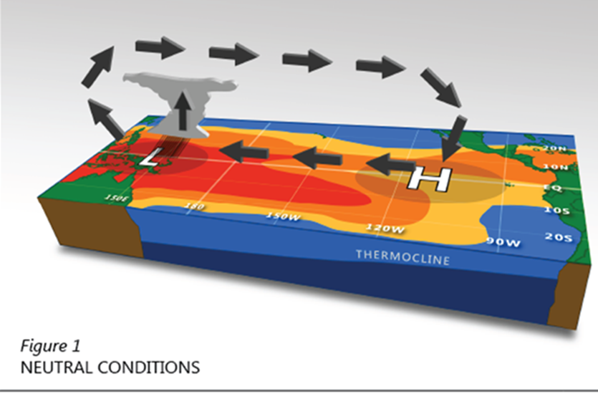
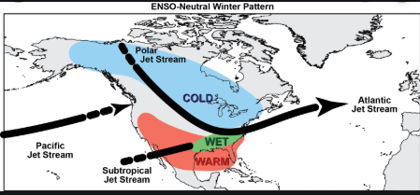

What will happen this Winter
El-Nino ? Neutral? La-Nina ?

Slide 4
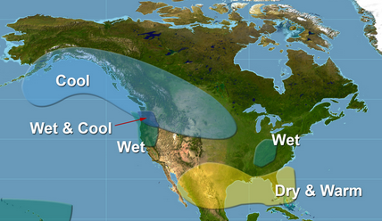
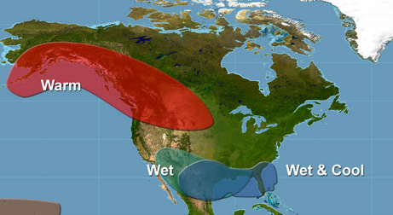
ENSO Types
La Niña
El Niño
Cooler than average waters in the central and eastern tropical Pacific
Cooler temperatures with an increase in precipitation.
Neutral
Warmer than average waters in the central and eastern tropical Pacific
Warmer temperatures and a decrease in precipitation
Winter Conditions

Slide 5
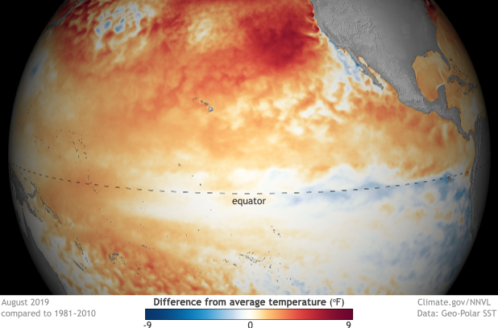
Current Status - ENSO Neutral

Slide 6
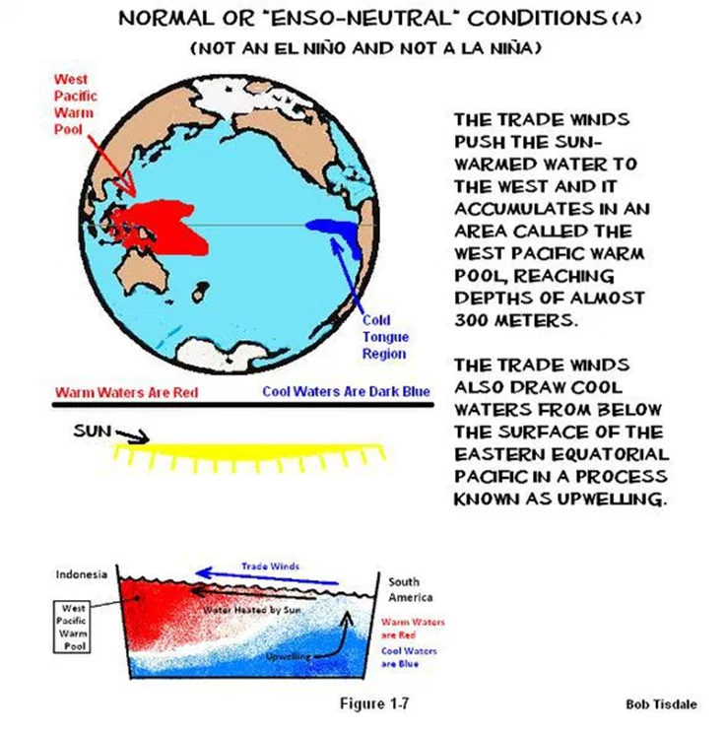
Winter Outlook
The El-Nino of 2019 is over
Neutral conditions have returned to the tropical Pacific
ENSO-Neutral (what does it mean):
  Don’t see the predictable influences from El-Nino and La-Nina
  Tropical SSTs, rainfall and wind patterns are close to long term avg

Slide 7
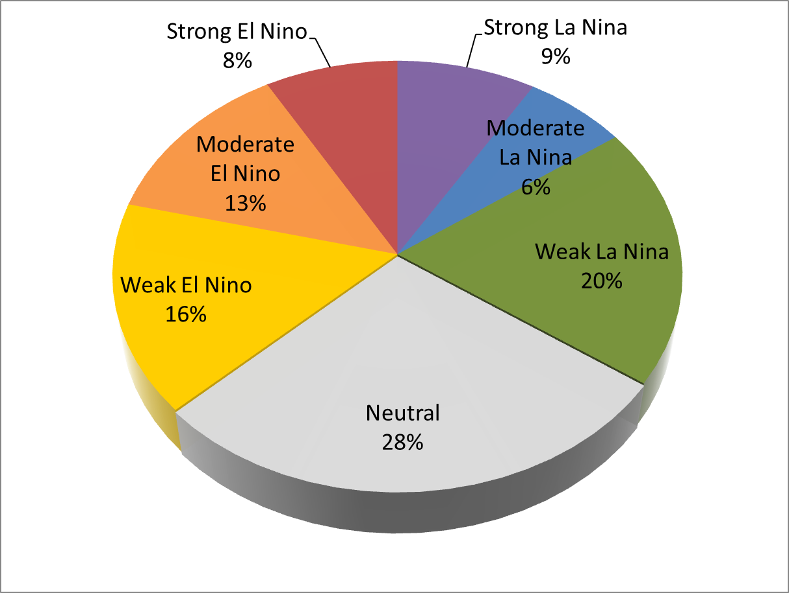
ENSO Occurrence
El- Niño
37%
La- Niña
35%
ENSO Neutral
28%

Slide 8
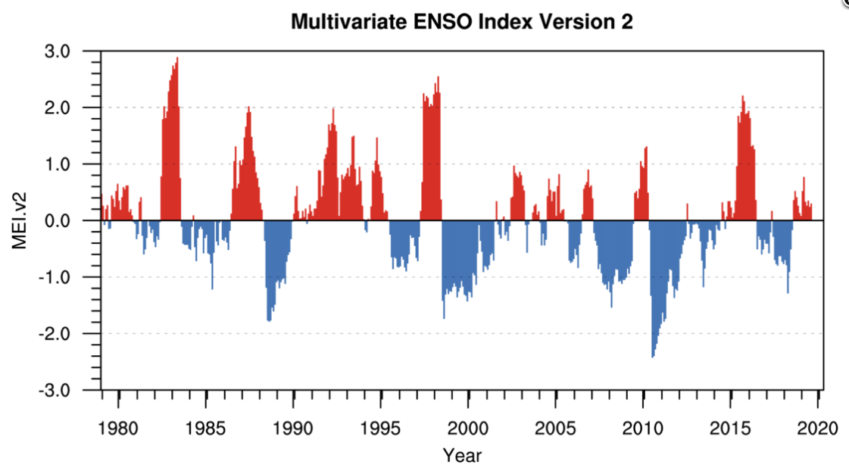
ENSO episodes since 1980

Slide 9
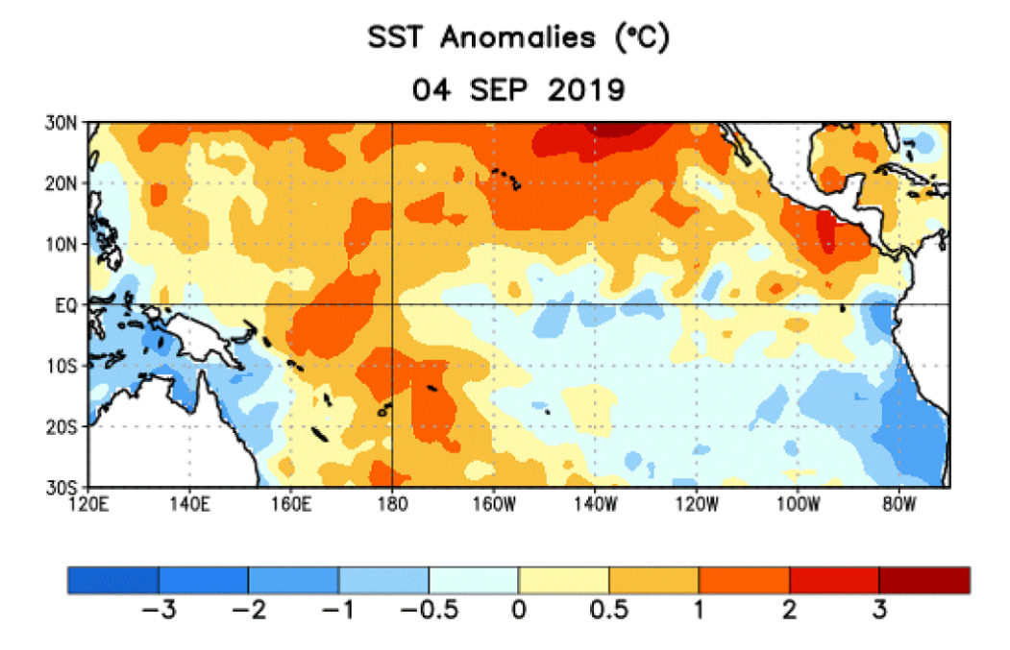
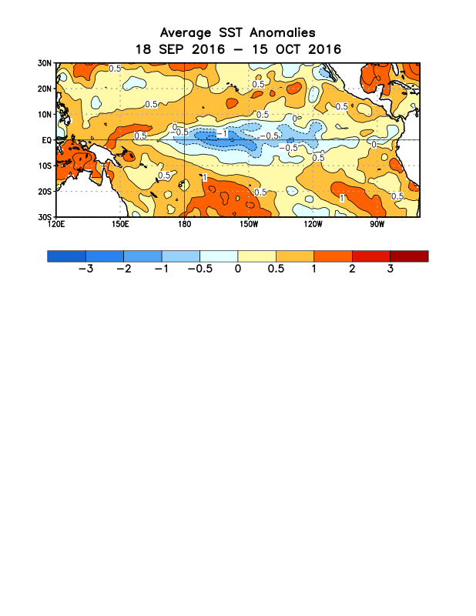
2019 ENSO Neutral Conditions
Sea Surface Temperature (SST) Anomalies
Near average SST’s
Mexico
Australia
Weak
La Niña
La Niña
Neutral
El Niño
-2.0°
(°C)
-1.0°
-0.5°
0.5°
1.0°
2.0°

Slide 10
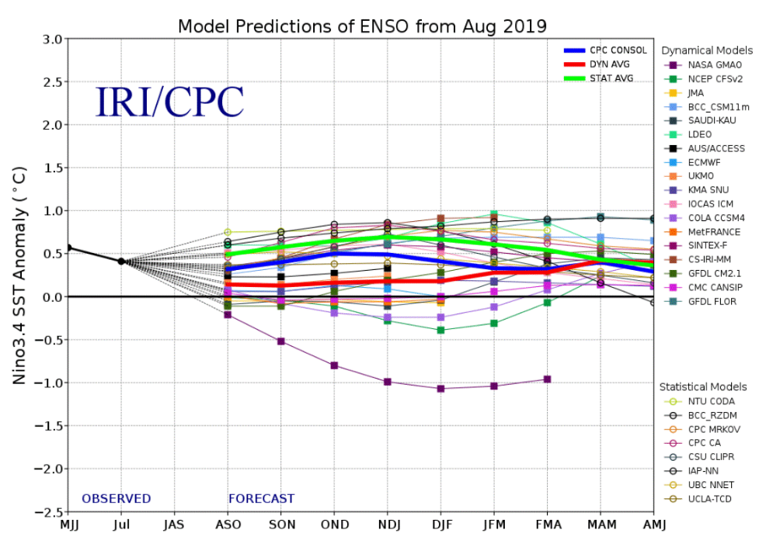

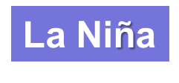
ENSO Outlook
El Niño
ENSO-Neutral
ENSO-Neutral conditions favored through the spring 2020

Slide 11
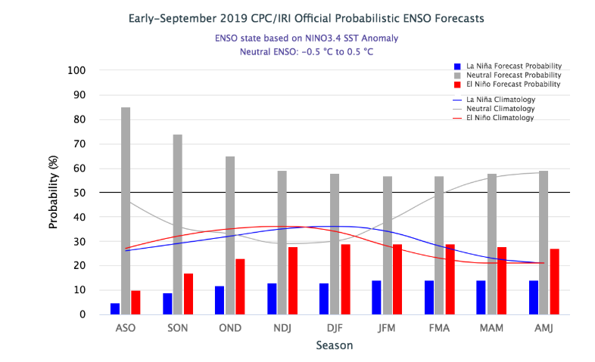
ENSO Outlook
ENSO Neutral is favored through the spring

Slide 12
Willamette Valley

Slide 13
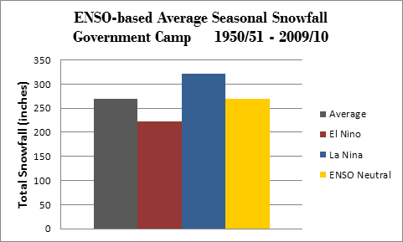
ENSO Snow Signal

Slide 14
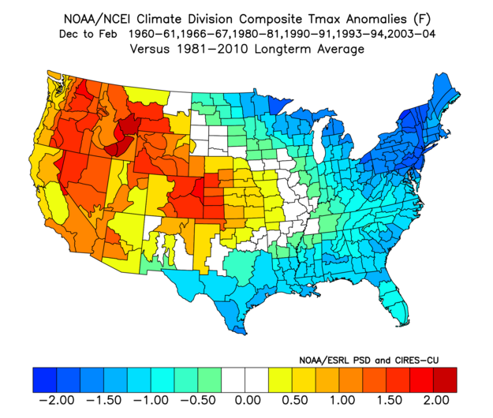
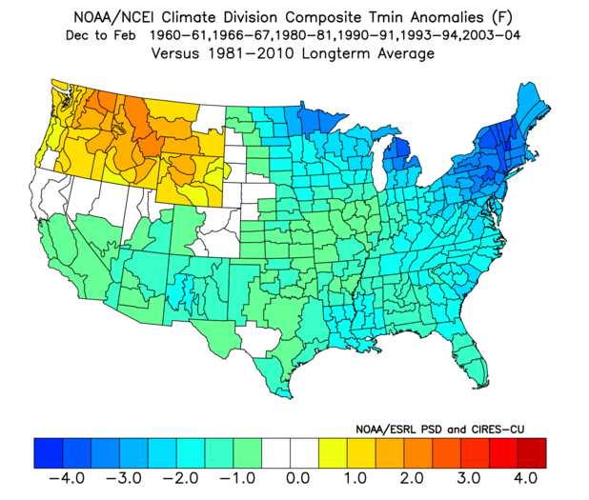
Analog Years – Temperature
TMax
TMin

Slide 15
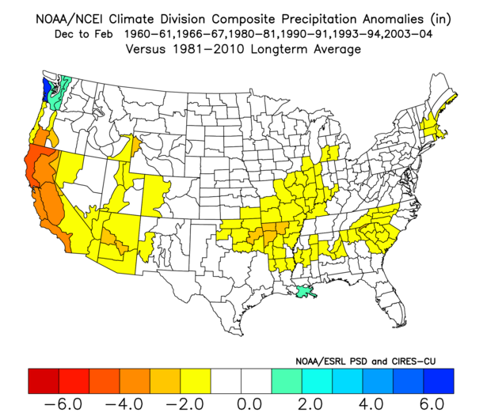
Analog Years – Precipitation

Slide 16
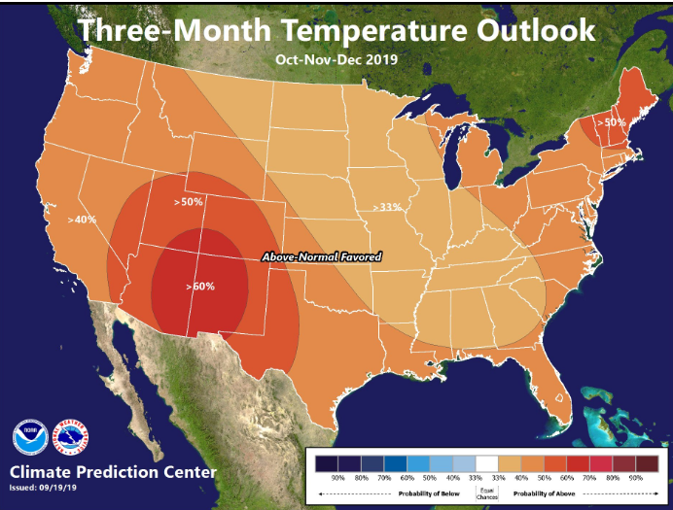
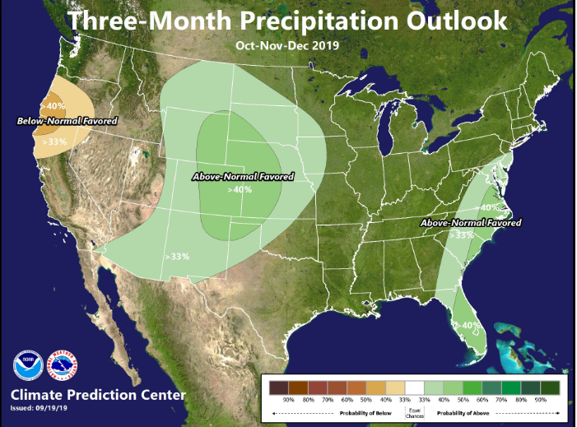
U. S. Seasonal Outlooks
Oct-Nov-Dec
Temperature
Precipitation

Slide 17
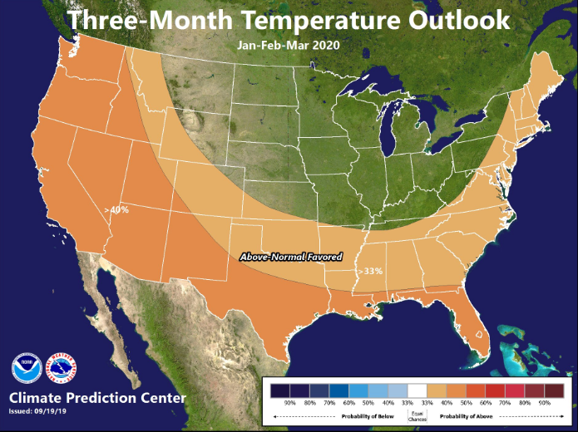
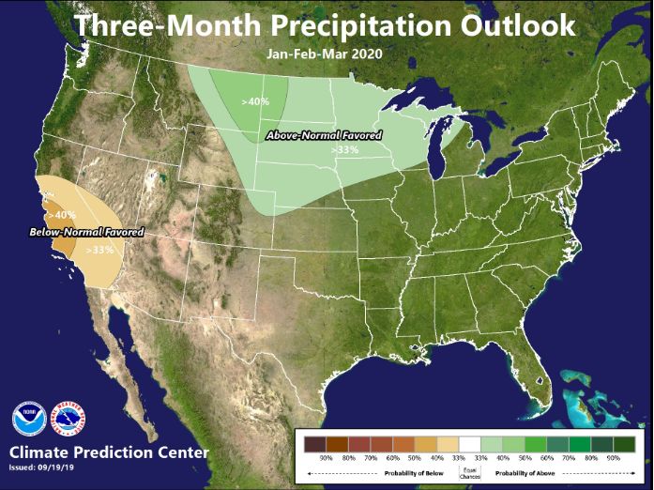
U. S. Seasonal Outlooks
Jan-Feb-Mar
Temperature
Precipitation

Slide 18
Analog Years – Temperature
TMax
TMin

Slide 19
Analog Years – Precipitation

Slide 20
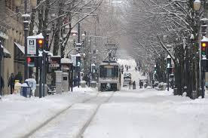
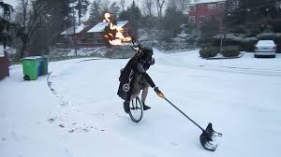
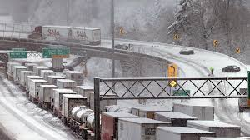
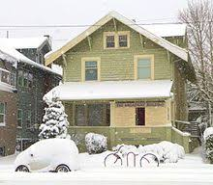
What about Snow Forecast?

Slide 21
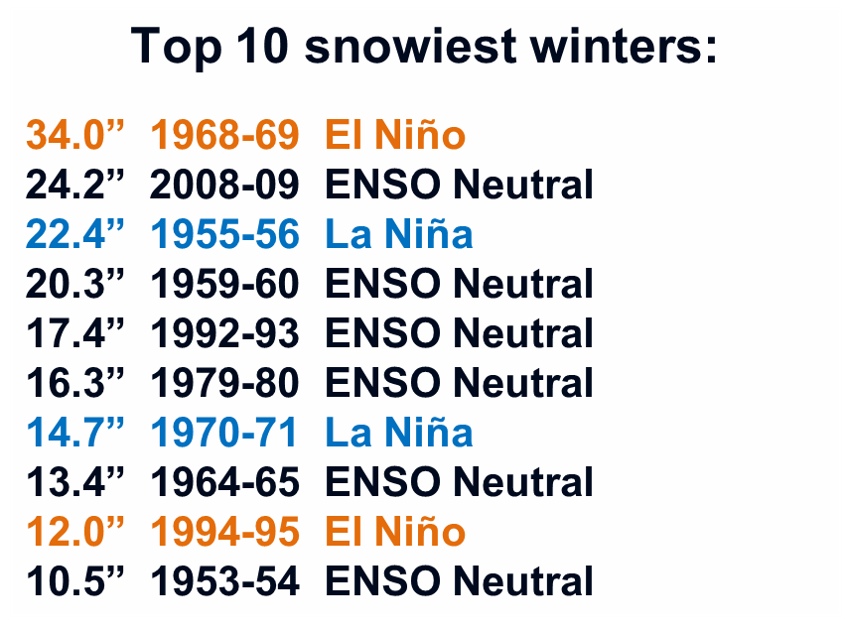
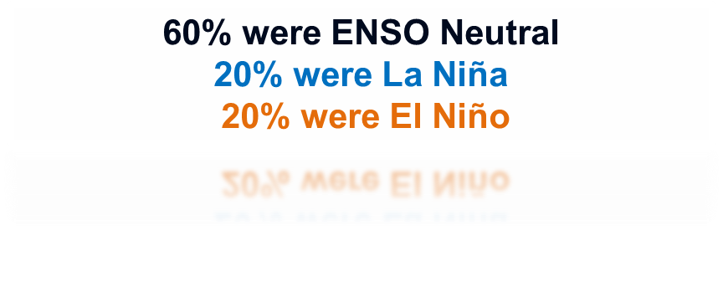
Lowland Snowfall History 1951 to 2017

Slide 22
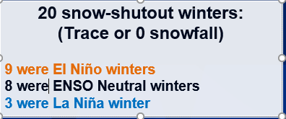


Lowland Snowfall History 1951 to 2017

Slide 23
Summary
ENSO Neutral now favored through the spring of 2020
Can expect this Winter to be (on average):
  Temperature: Above average
  Precipitation: Near to slightly below average
  Snowpack: Cascades near average
  Valley snow: Odds favor some valley snow
Be Aware – Be Prepared
  High-impact storms can occur during any ENSO state
  Some snowfall likely in the lowlands
  Some flooding possible

Slide 24
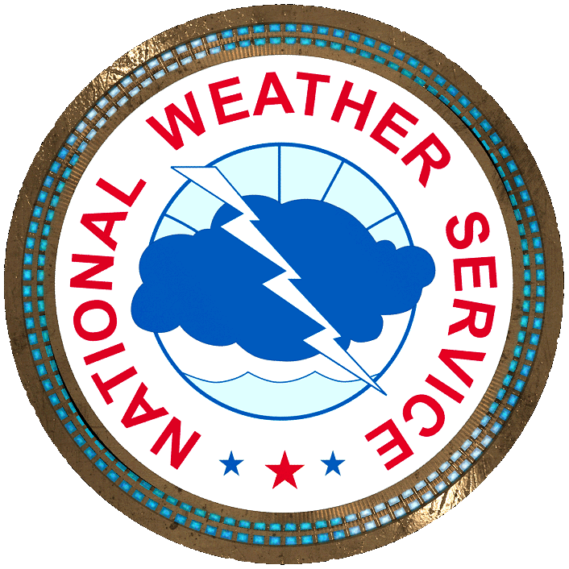

Questions?

