Slide 1

2019-2020 Winter Outlook
Kelley bayern
meteorologist
Koin 6 news, portland, or

Slide 2
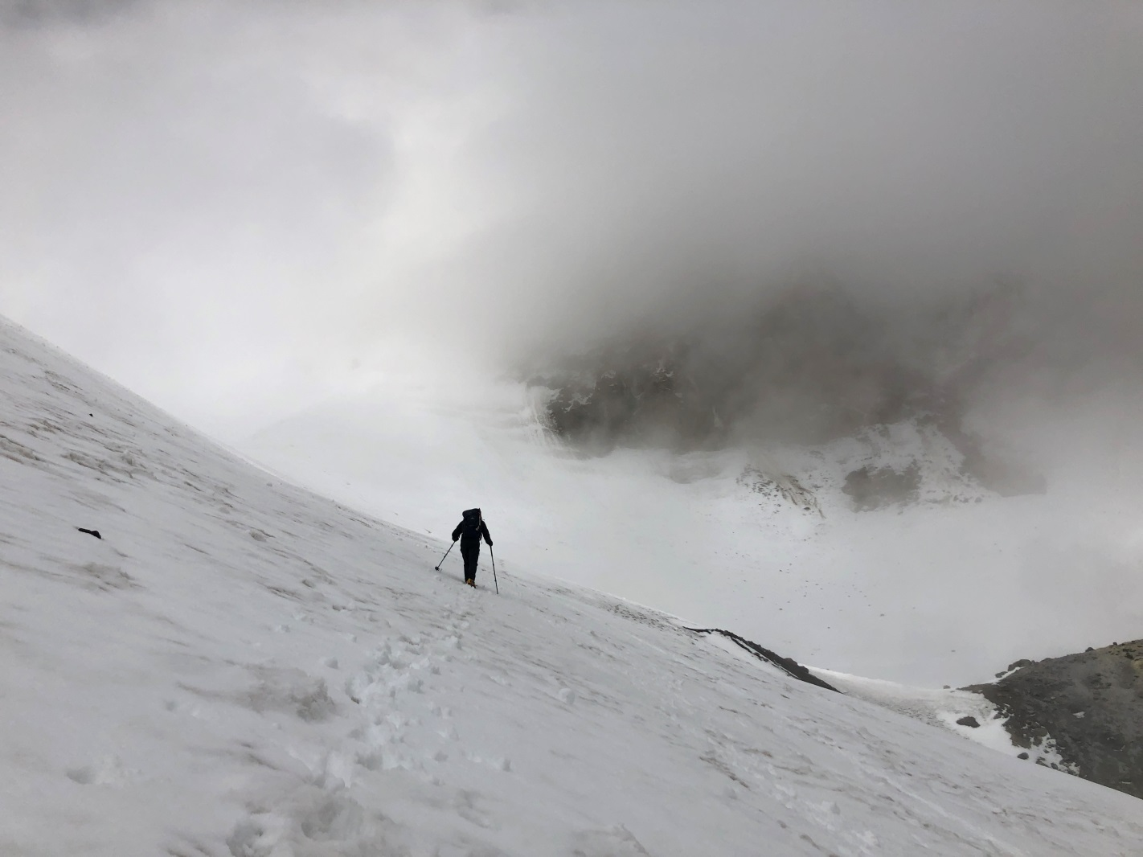
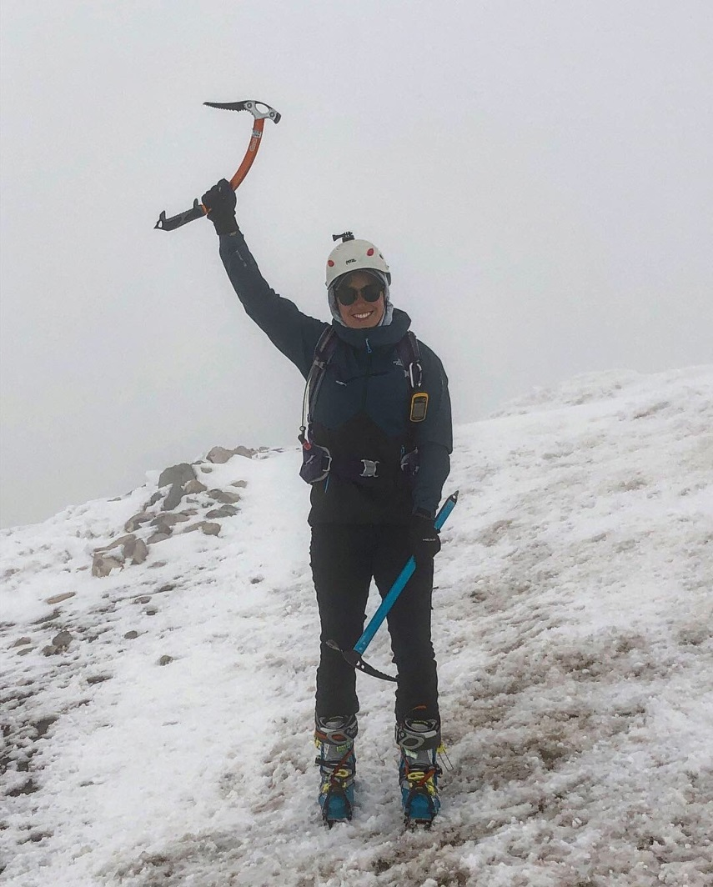
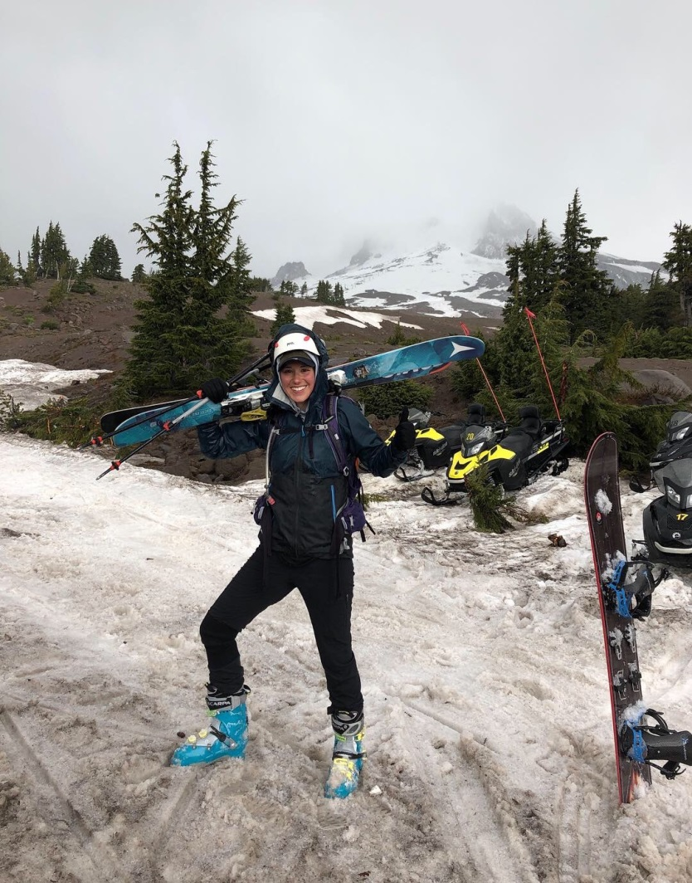
Mt. Hood Summit – June 2019
Summer Top Out and Ski Down

Slide 3
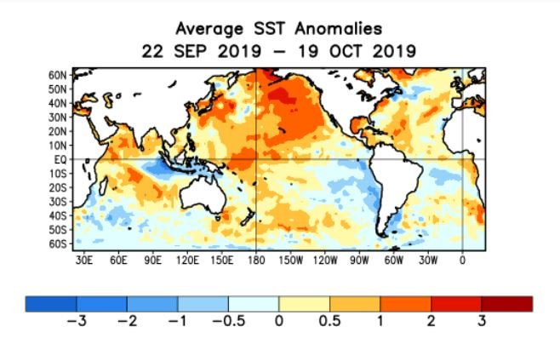
E. Pacific cooling trend?
Equitorial sea surface temps:
  - above average in western & central Pacific
  - below average in eastern Pacific

Slide 4
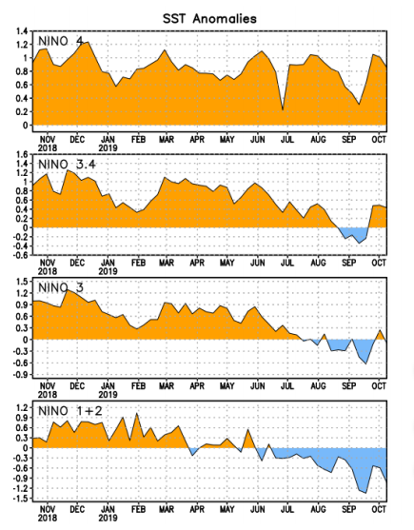
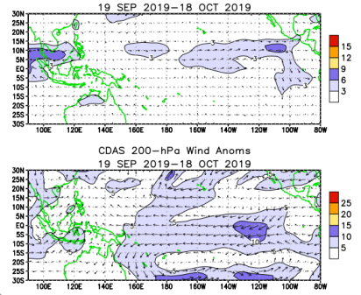
E. Pacific cooling trend?

Slide 5
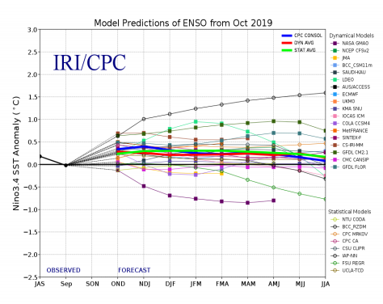
Currently ENSO-Neutral
ENSO-Neutral favored through:
- Fall: ~85% chance
- Winter: 55-60% chance

Slide 6
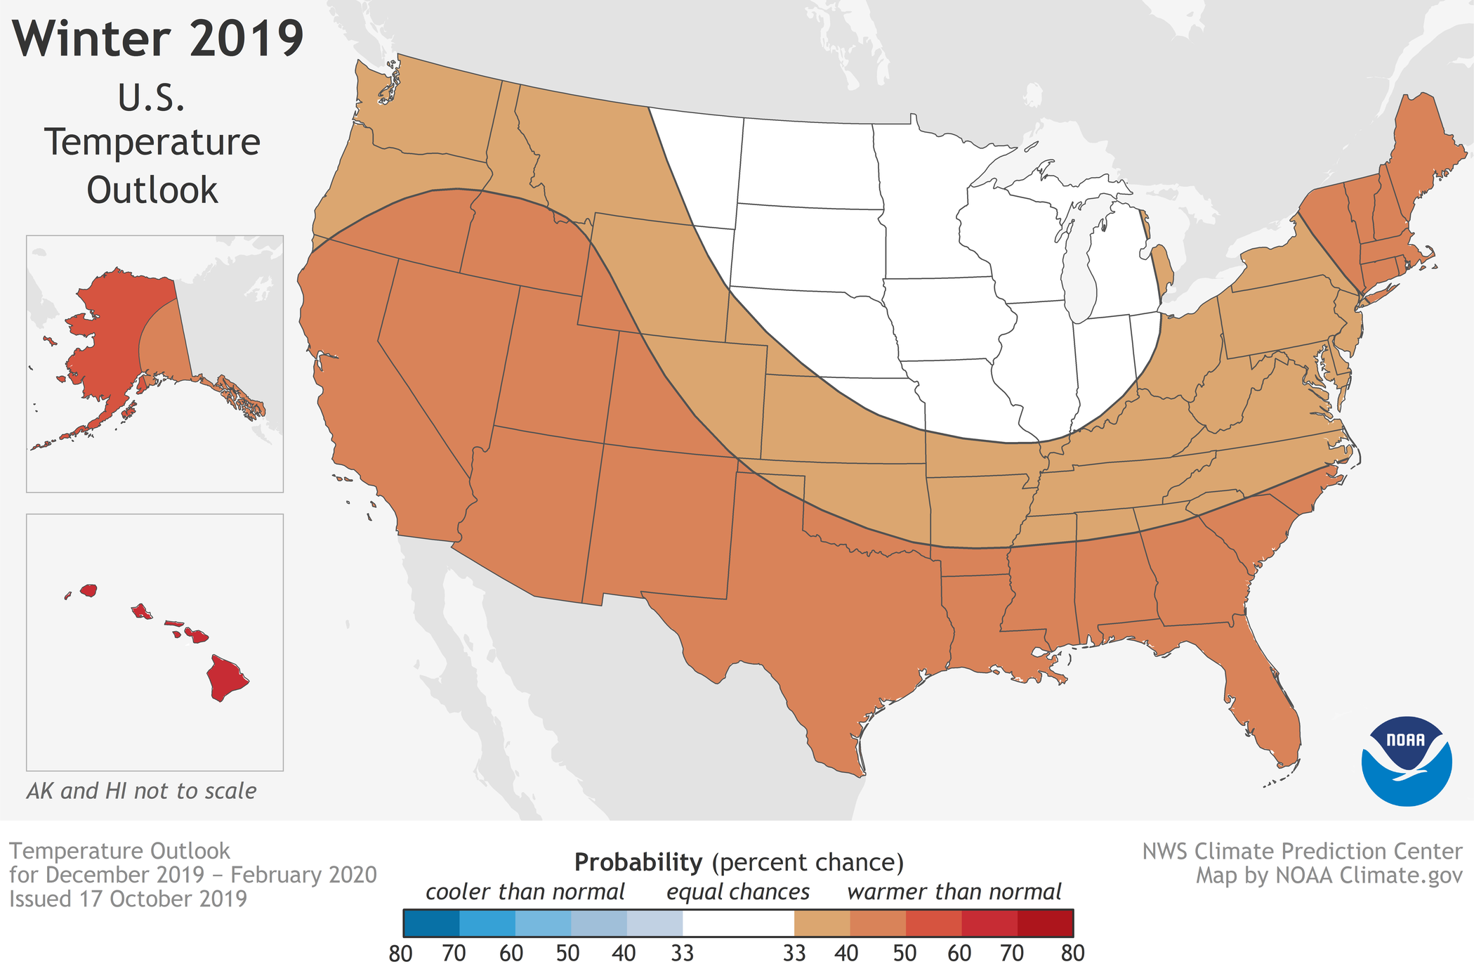
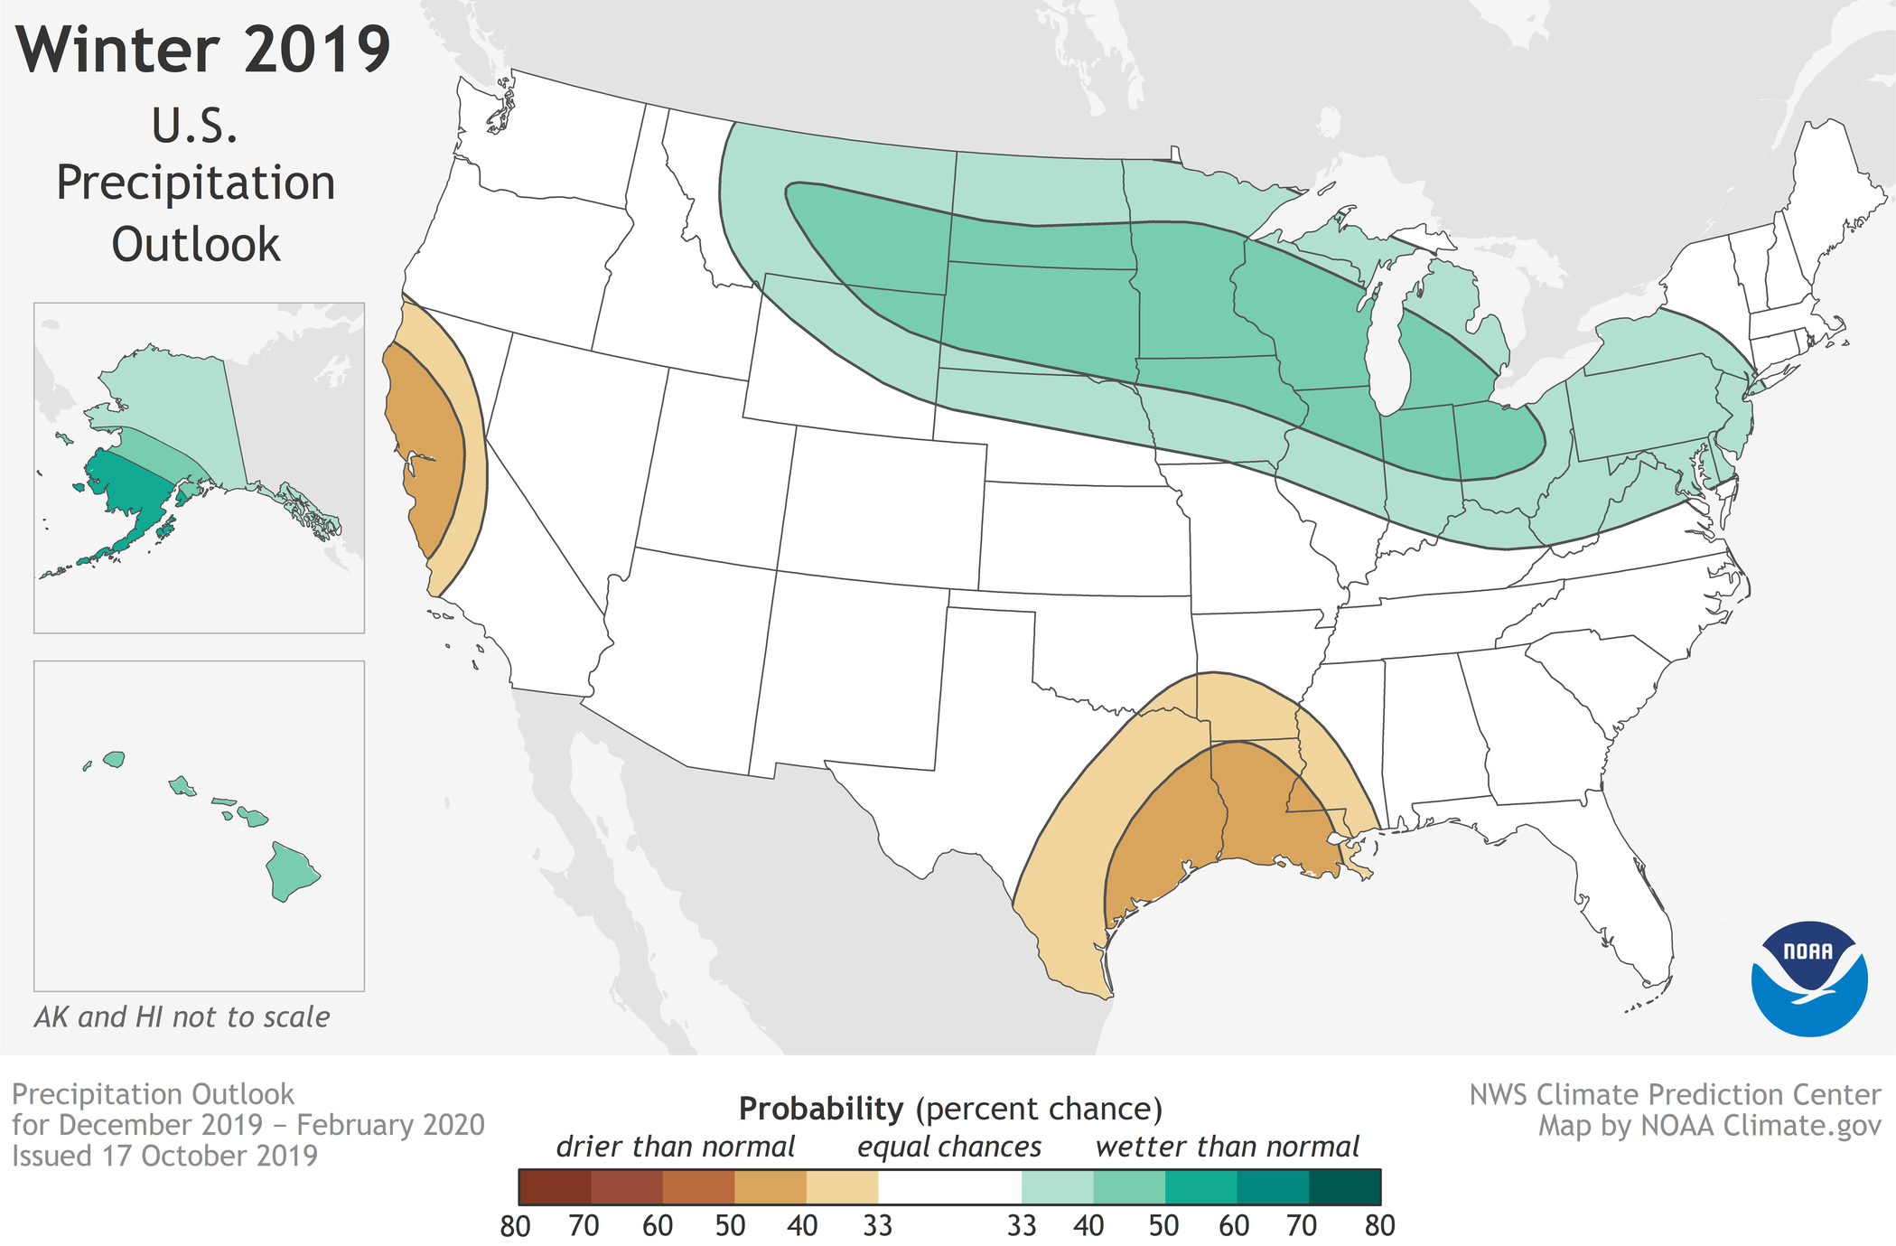
NOAA - Likelihood of temperature & precipitation above, near, or below average
Equal chance of below, near, or above average precipitation
No part of the U.S. favors below-average temperatures, PNW favoring warmer than normal temperatures.

Slide 7
ENSO-Neutral Years: 20 Samples
1989-1990
1990-1991
1992-1993
1993-1994
1996-1997
2001-2002
2003-2004
2012-2013
2013-2014
2016-2017
1959-1960
1960-1961
1961-1962
1962-1963
1966-1967
1967-1968
1978-1979
1980-1981
1981-1982
1985-1986
1978-1979
1980-1981
1992-1993
2003-2004
2016-2017
Following Any El Niño

Slide 8
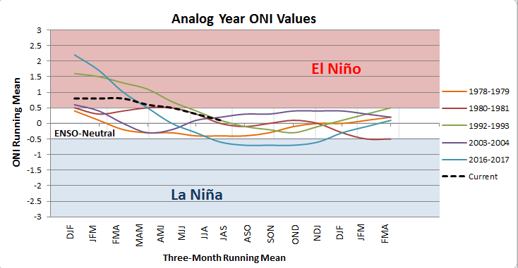
Oceanic Niño Index
running 3-month mean SST anomaly for the Niño 3.4 region

Slide 9
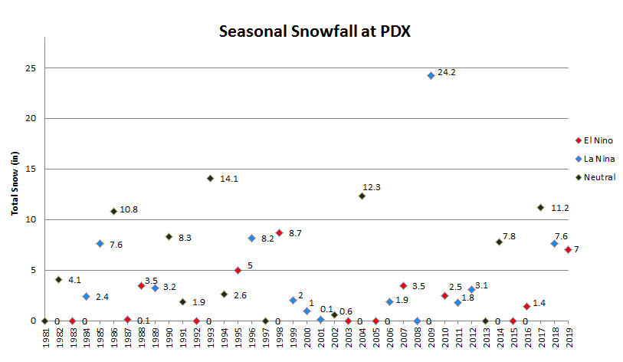
pDX Snowfall
High Variability
Avg. Snow/Season Since 1960:
  - ENSO-Neutral: 6.5”
  - El Niño: 5.0”
  - La Niña: 5.3”
  - Normal: 6.0” (Since 1940)
Top 10 Snowiest Winters Since 1980:
  - 60% ENSO-Neutral
  - 20% El Niño
  - 20% La Niña

Slide 10
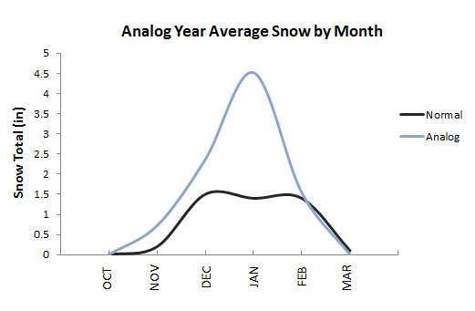
PDX Snowfall
  Active December & January
  30% odds of 10” or more
  65% odds of at least 2”
  25% odds of Trace amounts
  or less
  Never been 4 winters in a
  row with at or above - normal
  snow totals: 2017: 11.2”
  2018: 7.6”
  2019: 7.0”
The Break Down
Average snow totals following El Niño Year: 9.2”

Slide 11
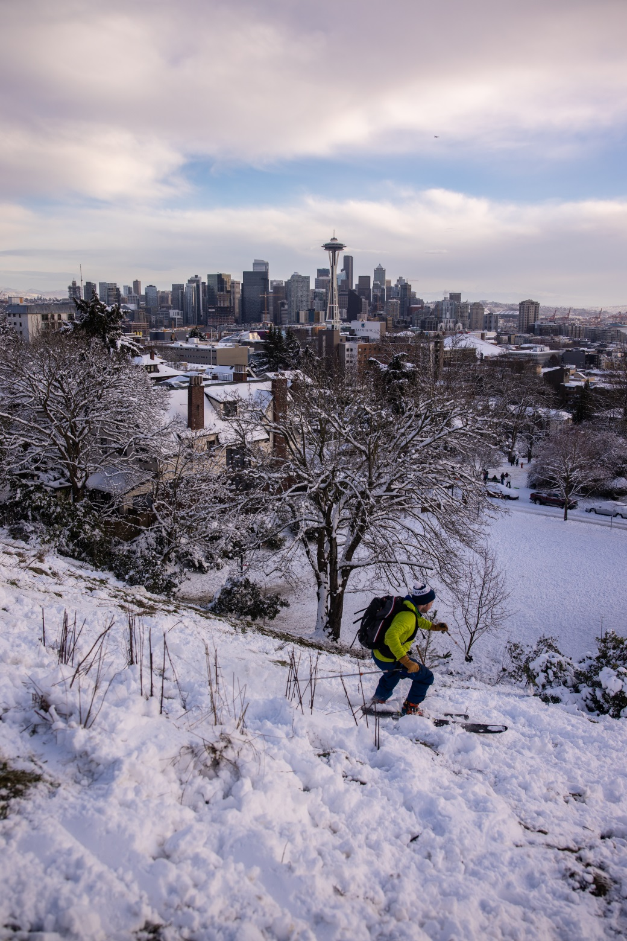
the north
Snowy seatte
KSEA - February 2019:
20.2”
Second Snowiest February on record
KPDX: 6.5”
Wishcast:
November | December | January | February
1” | 4” | 3” | 1”
Photo by: Mitch Pittman

Slide 12
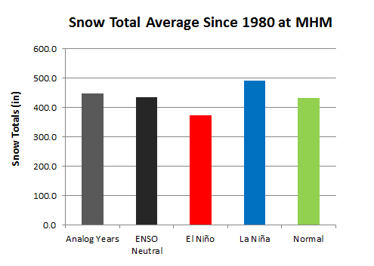
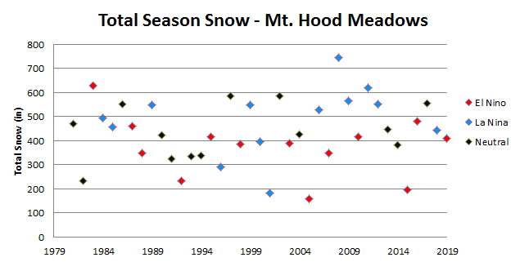

Mountain Snow - Meadows
Odds favor an EXCELLENT Season!
Already good snowfalls this season
- Sept. 28: 7”
- Oct. 18: 13”
Average Opening Date over past 25 seasons: Nov. 23th
All ENSO-Neutral years since 1980 have opened for business before Thanksgiving
Trendcast: 440”

Slide 13
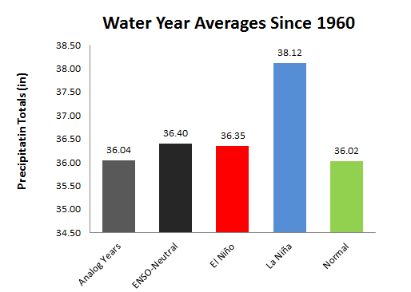
PDX Water Year
PDX Normal: 36.02”
ENSO-Neutral Year Extreme:
1996-1997: 58.67”
1993-1994: 23.89”
Trendcast: 36.04”

Slide 14


Wind Storms?
John Dodge - PNW natural disaster reporting guru (now retired)
Wolf Read: The Storm King
What are the odds of Columbus Day Storm size event in the near future?

Slide 15
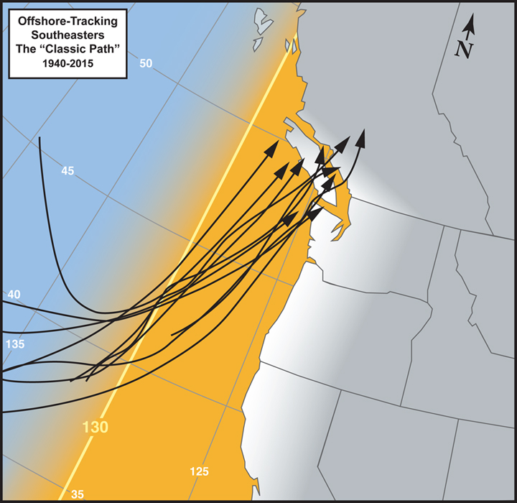
“classic Storm path”
Extra-tropical cyclone travels inside 130ºW, south of 45ºN
Upper Threshold 70 to 80 mph
Oregon sees highest wind gusts in this classic offshore trajectory:
  Columbus Day Storm 1962 – 116mph
  Double Windstorms of Nov 1981 – 71mph
  Major Windstorm of 1995 – 74 mph
  The Ides of October of 2016 – 53 mph
H
Wolf Read

Slide 16
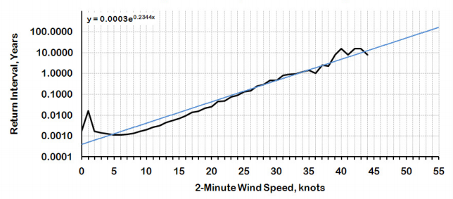
Wind speed Return intervals (YVCR)
Moderate: 35 kt – 50 mph gust
- Once per year
Extreme: 45 kt - 68 mph gust
- Once every ~10 years
Catastrophic: 55kt - 82 mph gust
- Once per 100 years
- Columbus Day Storm
*Similar projections for stations like Portland & Seattle

Slide 17
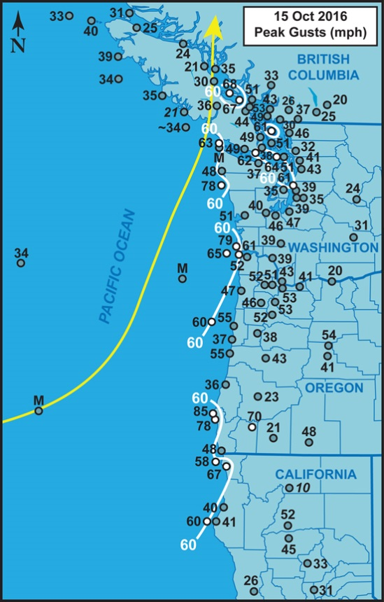
Enso-neutral storms
The Ides Windstorm ~ Typhoon Songda
Trends:
  1981 – 71mph gusts
  1995 – 74 mph gusts
  Windstorm 2014 – 67 mph gusts
Windstorms are most common in ENSO-Neutral years
  Columbus Day Storm 1962
  Inauguration Day Storm 1993
  The Ides of October Storm 2016
  Trendcast: Overdue for something big! (70+ mph)

Slide 18
Overview:
  Low Level Snow:
  - Early snow, active December (4”) through January (3”)
  - Going Bold: 9”
  Plentiful Mountain Snow: Great Ski Season!
  - Likely open for business before Thanksgiving
  Near-normal Water Year: 36.04”
  Wind Storms: No CDS, but expect some action.

