Slide 1
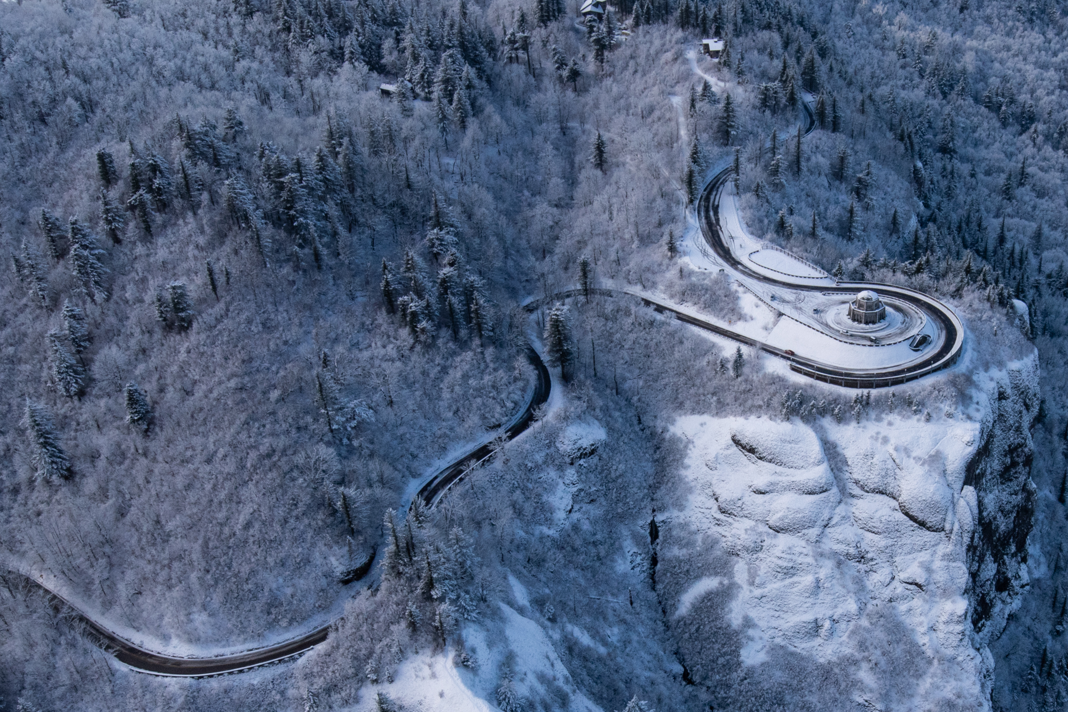

EL NiñO
VERY BORING WINTER…
UNTIL FEBRUARY
WINTER 2018-2019
Mark Nelsen

Slide 2
Quick Summary
November thru January: Most boring winter I’ve seen in 28 winters of forecasting
February & first week of March: Lots of cold/snow; historic in parts of PACNW
Snowiest February On Mt. Hood in an El Niño winter
3rd consecutive snowy year in Portland
As always, not everyone saw the same thing (Poor Beaverton…)
No PACNW Arctic Blast (5th consecutive winter)

Slide 3

OFFICIAL
SNOW TOTAL
7.0”
at PQR (NWS Office)
1.8” Downtown (KGW-TV)

Slide 4

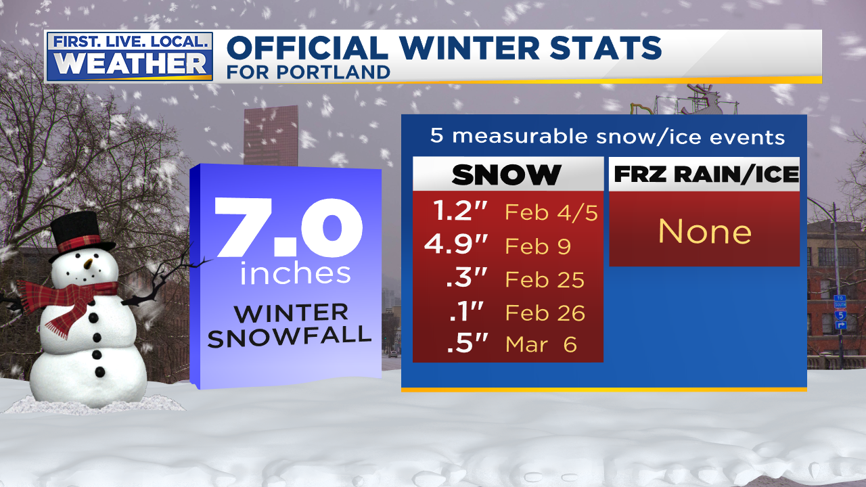


Slide 5
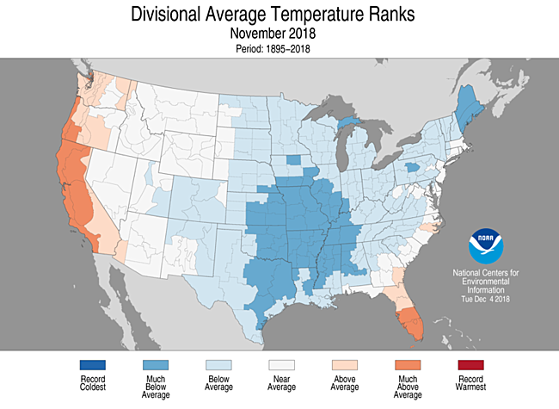
THE USA VIEW

Slide 6
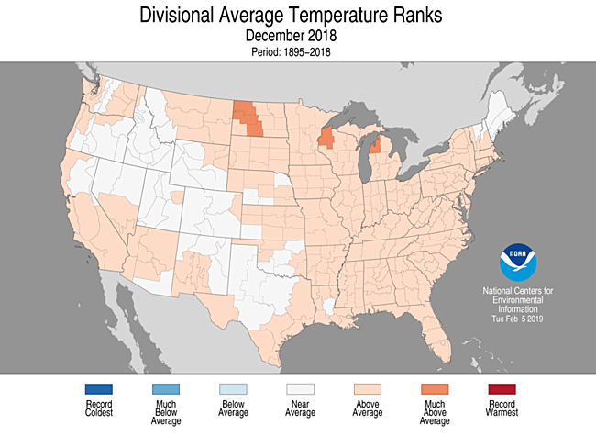
THE USA VIEW

Slide 7
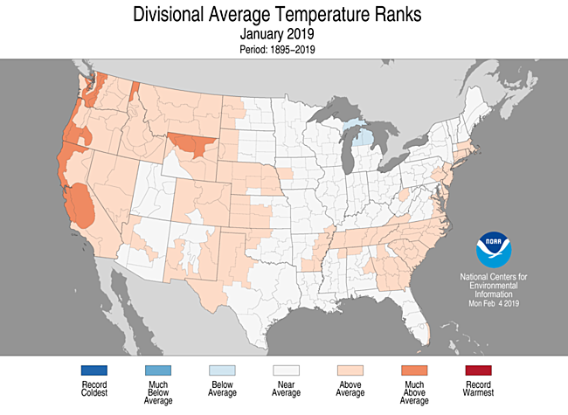
THE USA VIEW

Slide 8
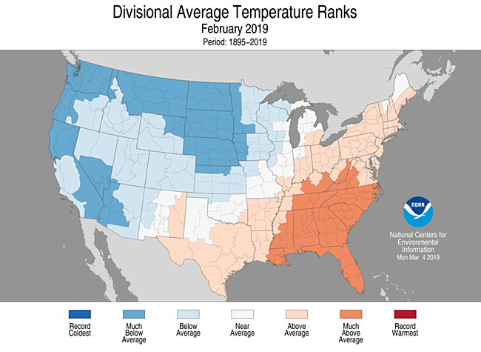
THE USA VIEW

Slide 9
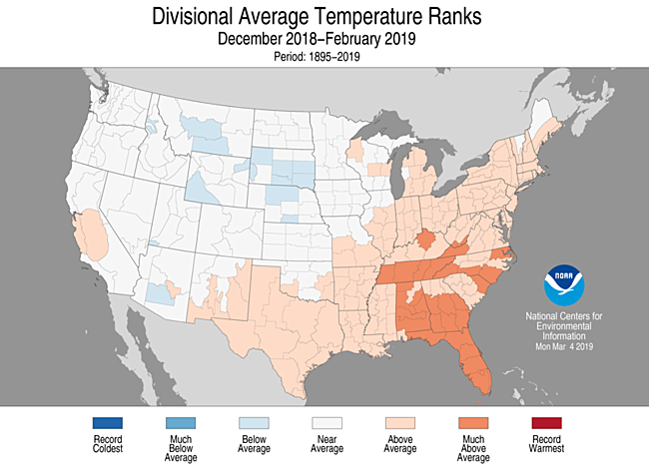
THE 3 MONTH PERIOD

Slide 10
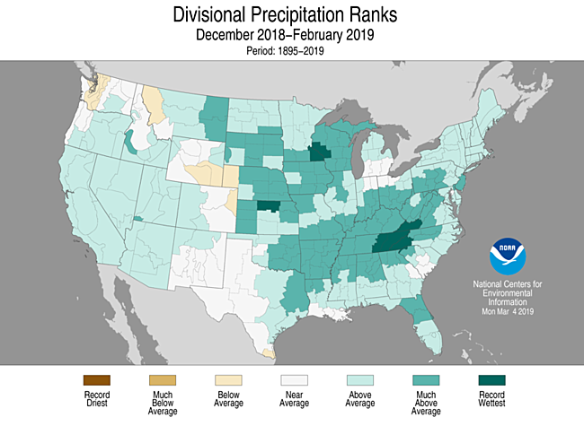
3 MONTH PRECIPITATION

Slide 11
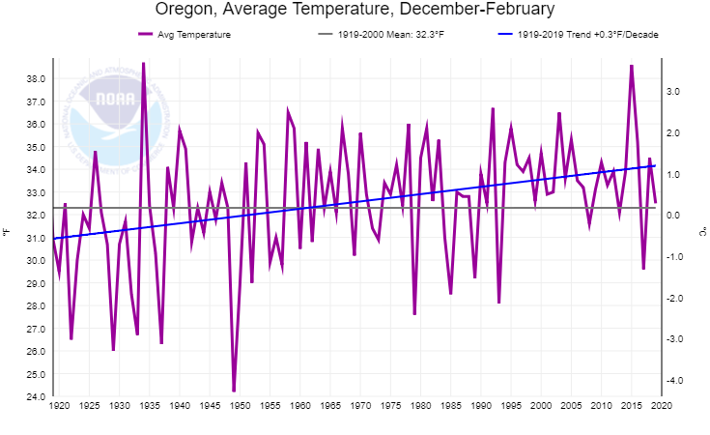
Oregon Winter Temps
(the last 100 years)
Slow Warming Trend (0.3/decade)

Slide 12
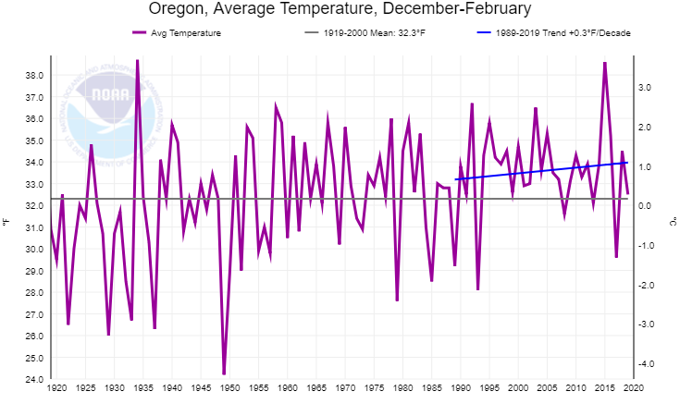
Oregon Winter Temps
(the last 100 years)
Similar 30 year trend

Slide 13
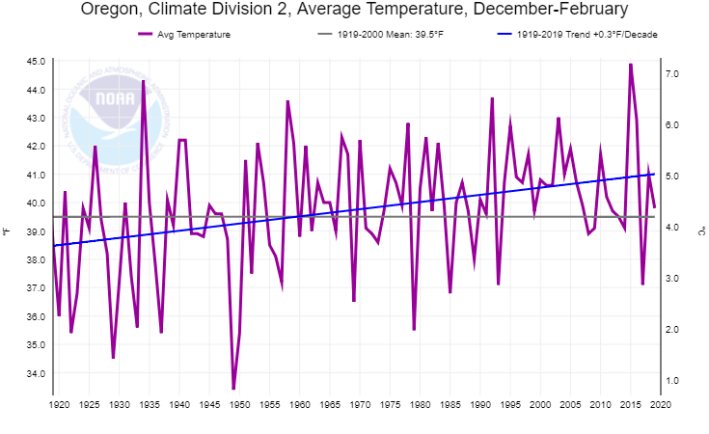
Western Valleys Winter Temps
(the past 100 years)
Near average, a bit cooler than last year
Last Winter in Oregon Zone 2 (Willamette Valley)

Slide 14
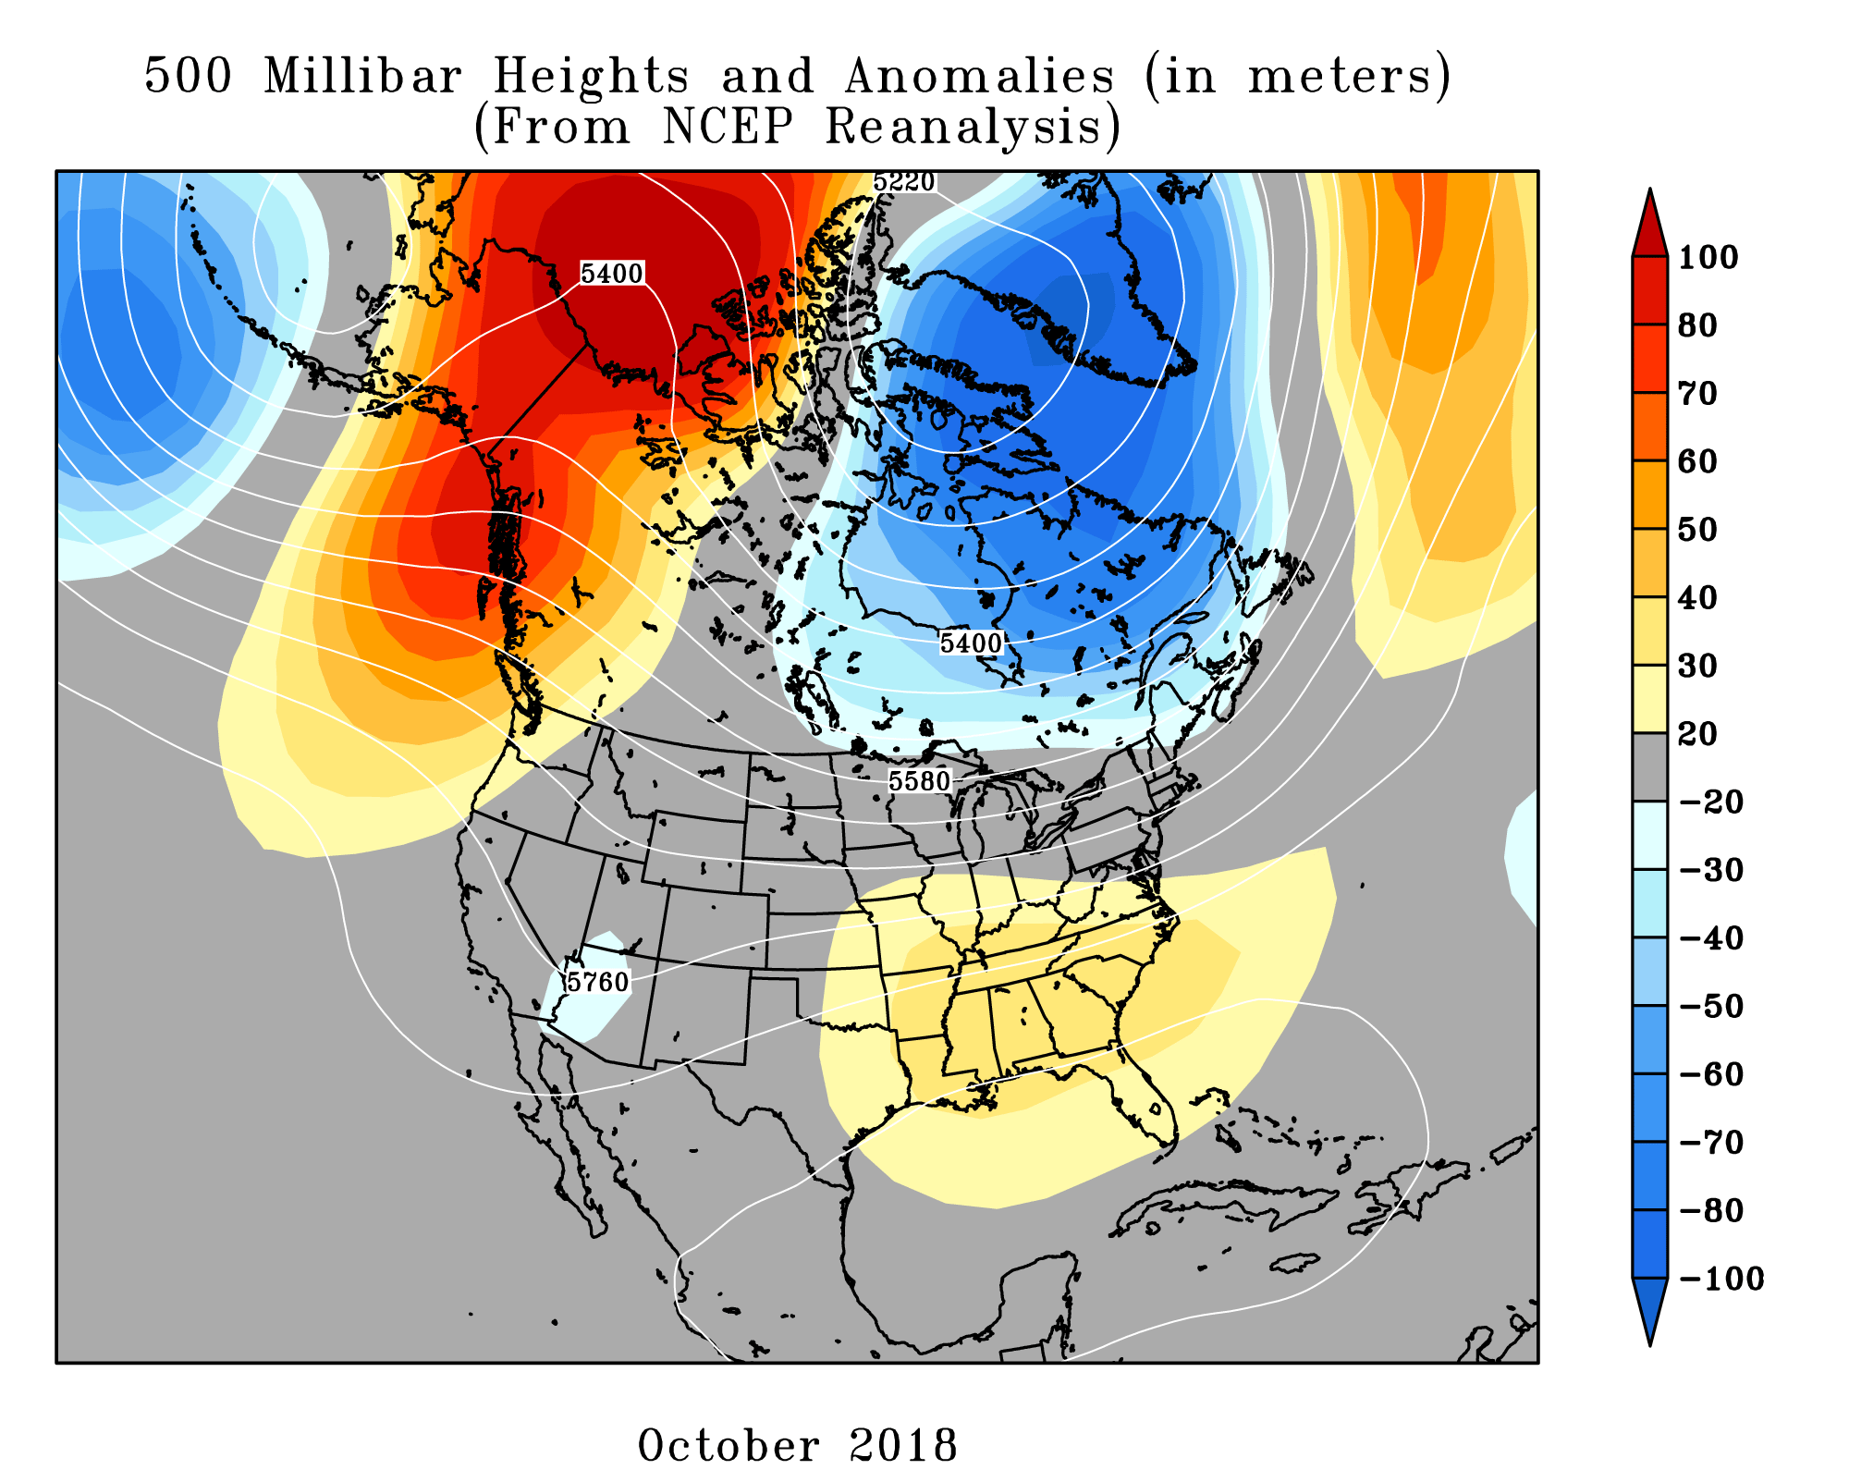
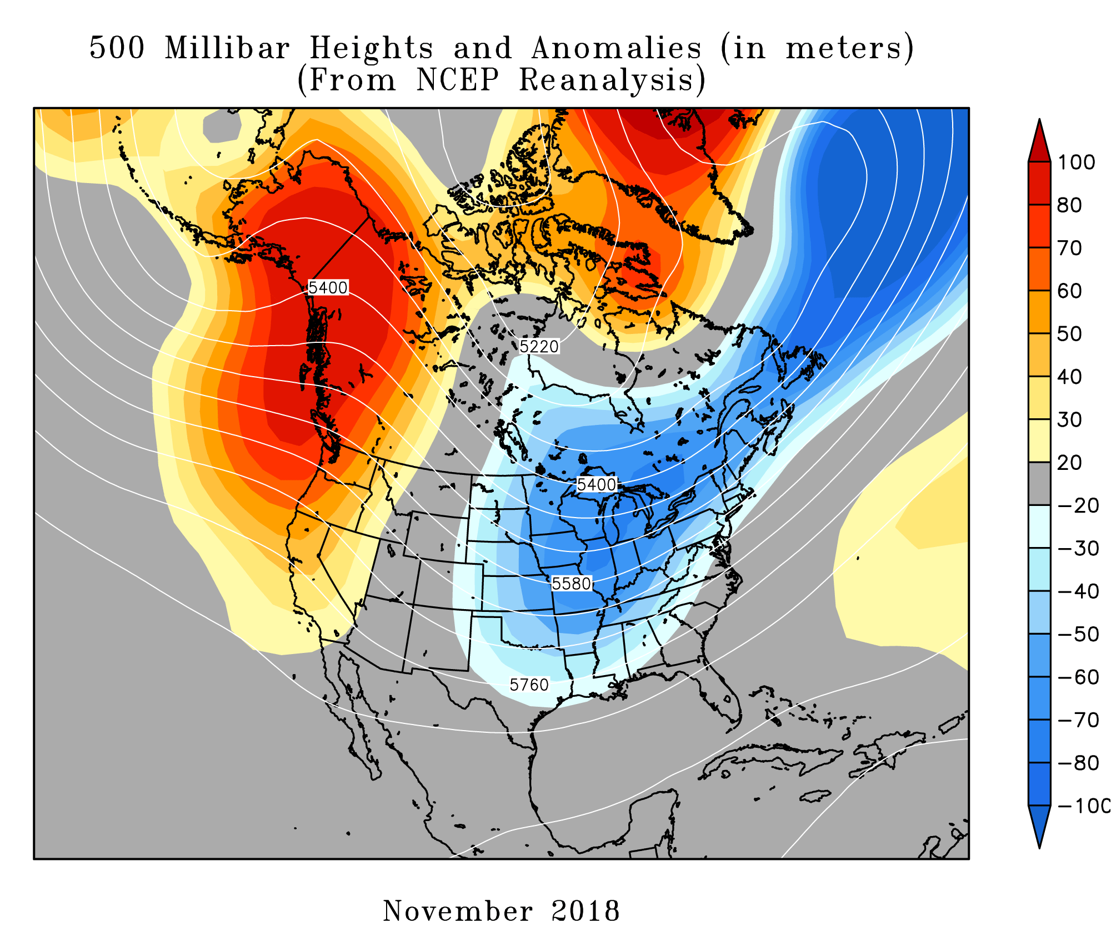
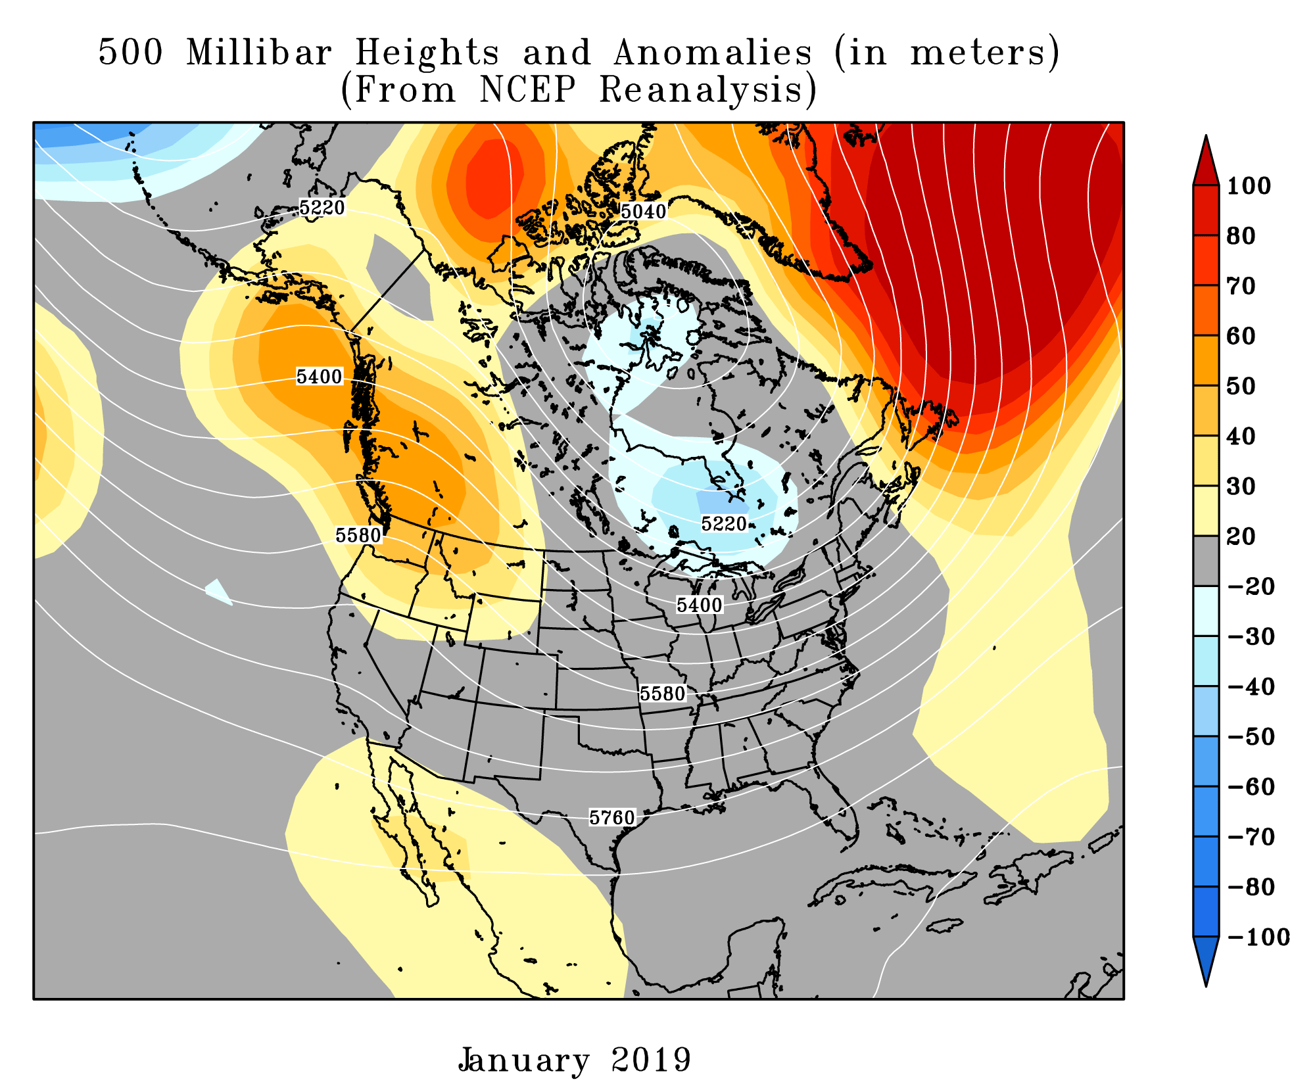
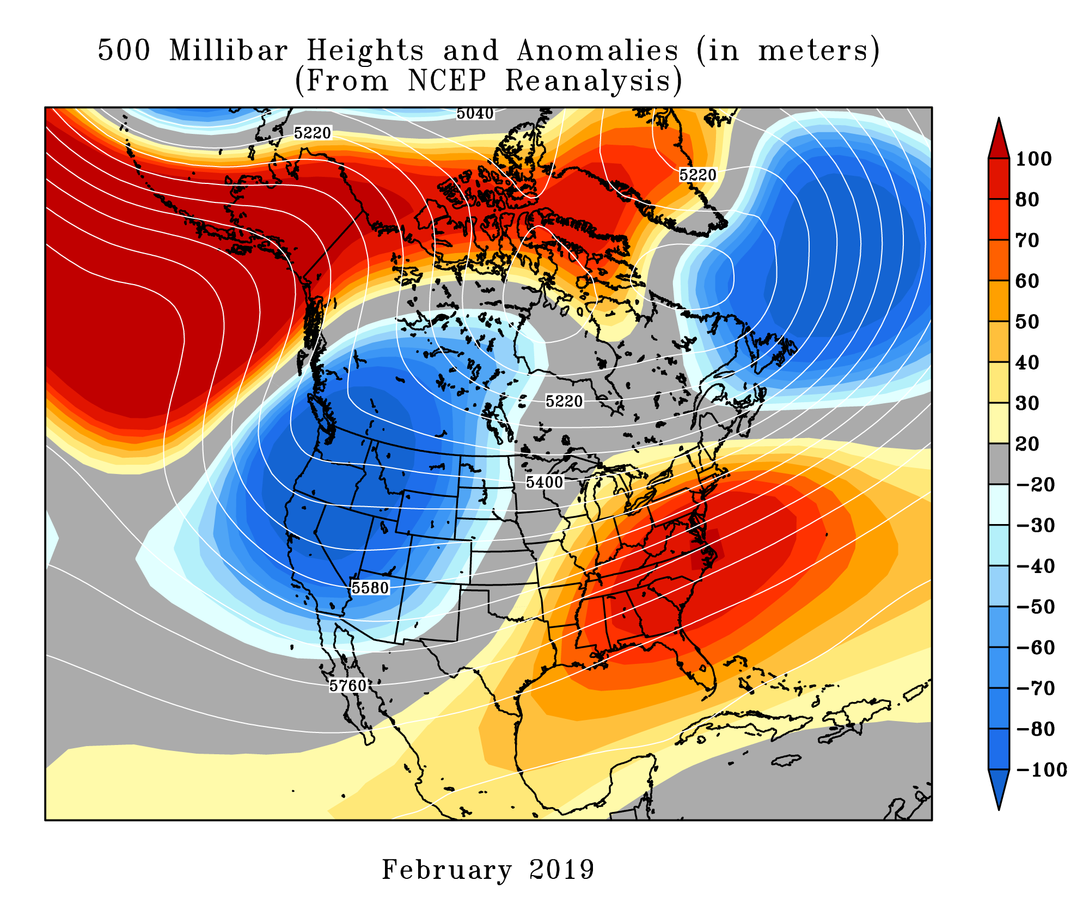
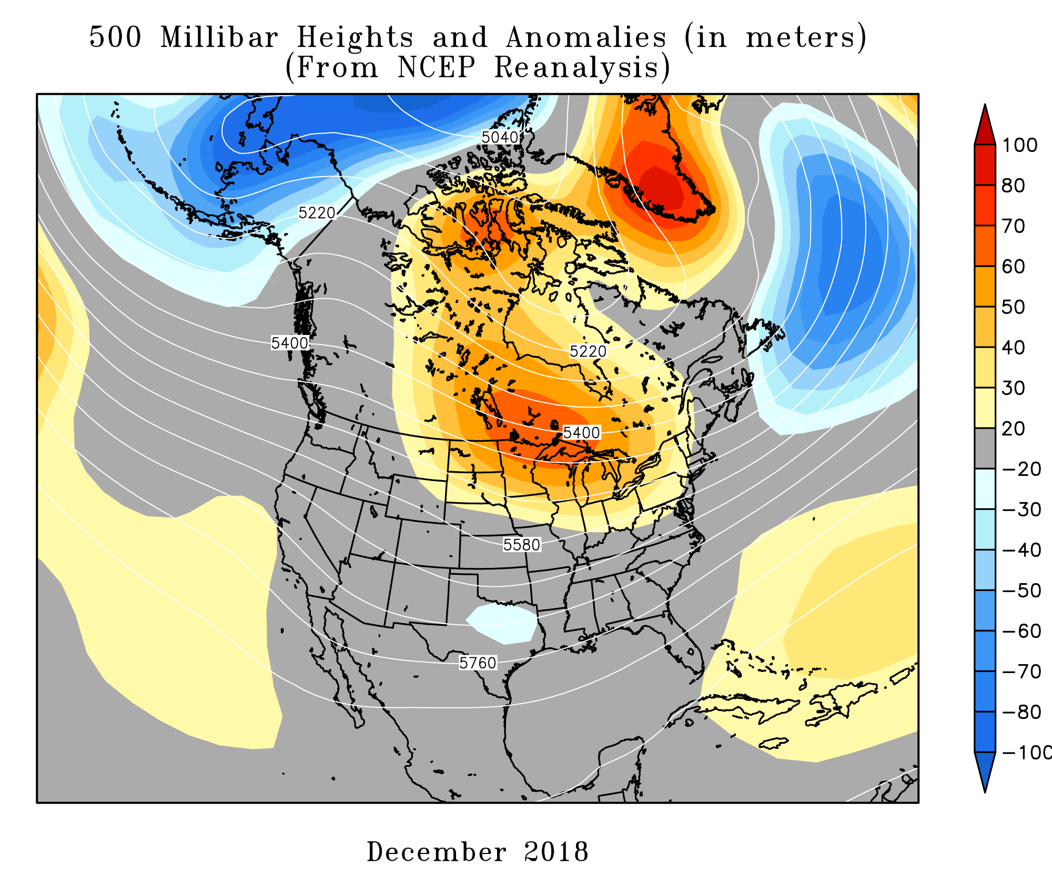
UPPER LEVEL PATTERN

Slide 15
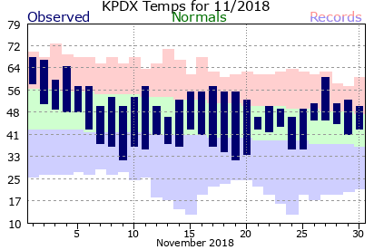
NOVEMBER
A mild & relatively dry month, no storms!

Slide 16
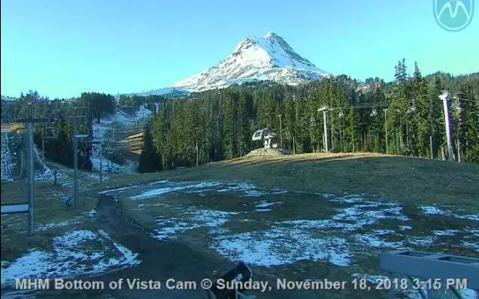
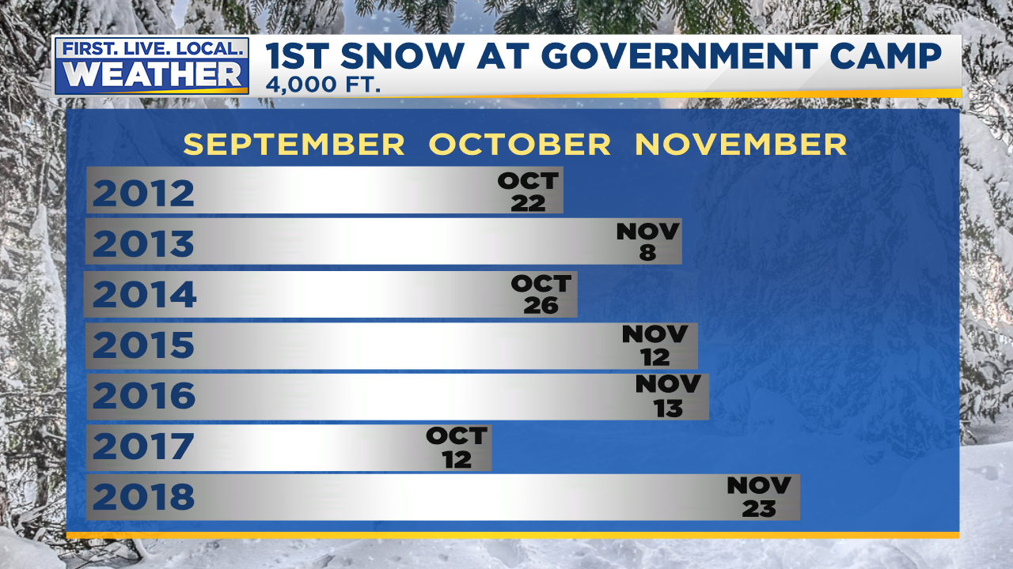
SKI SEASON
Late Start, Mild & Dry November
Latest “First Snow” at Government Camp since 2002

Slide 17
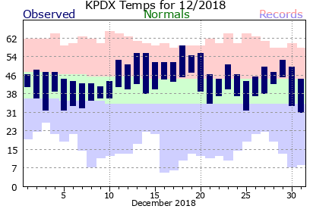
DECEMBER
Another unremarkable month
Not much storminess, briefly mid-month

Slide 18
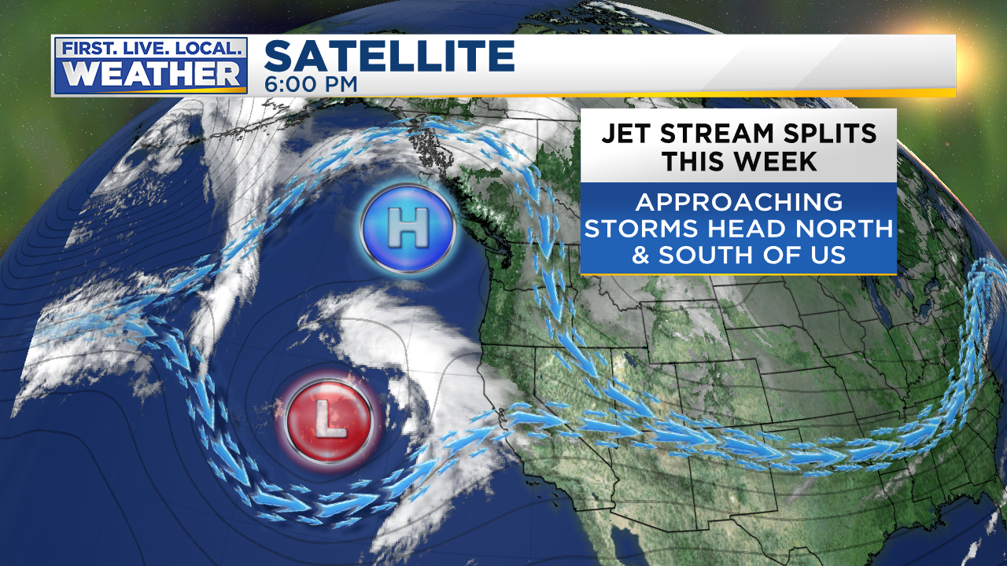
DECEMBER
Ridging or Split-Flow
Common through much of November, December, January
December 3rd

Slide 19
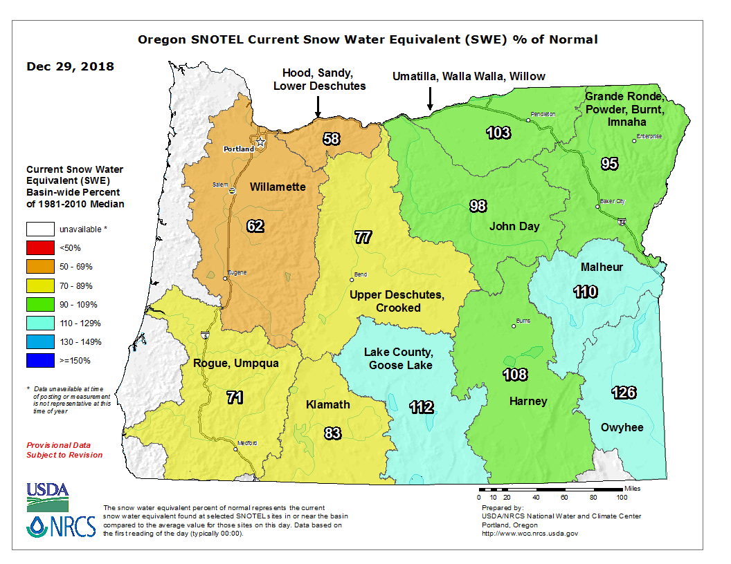
SKI SEASON
Slowly got moving in mid December
Brief stormy pattern = good snow for Christmas Break!

Slide 20
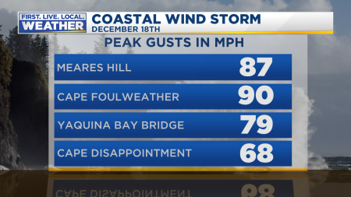
DECEMBER
One strong coastal storm, weak inland (18th)

Slide 21
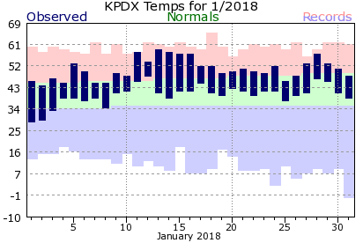
JANUARY
ANOTHER mild month, unusually dry
Only one interesting weather event; wind “storm” on 5th
Notes:
50+ gusts at TTD, 85 mph gust at Corbett Grade, highest of past 10 years
850mb temps never below -9 this winter
Valley 30-35 during this time
Puget Sound 35-45!

Slide 22
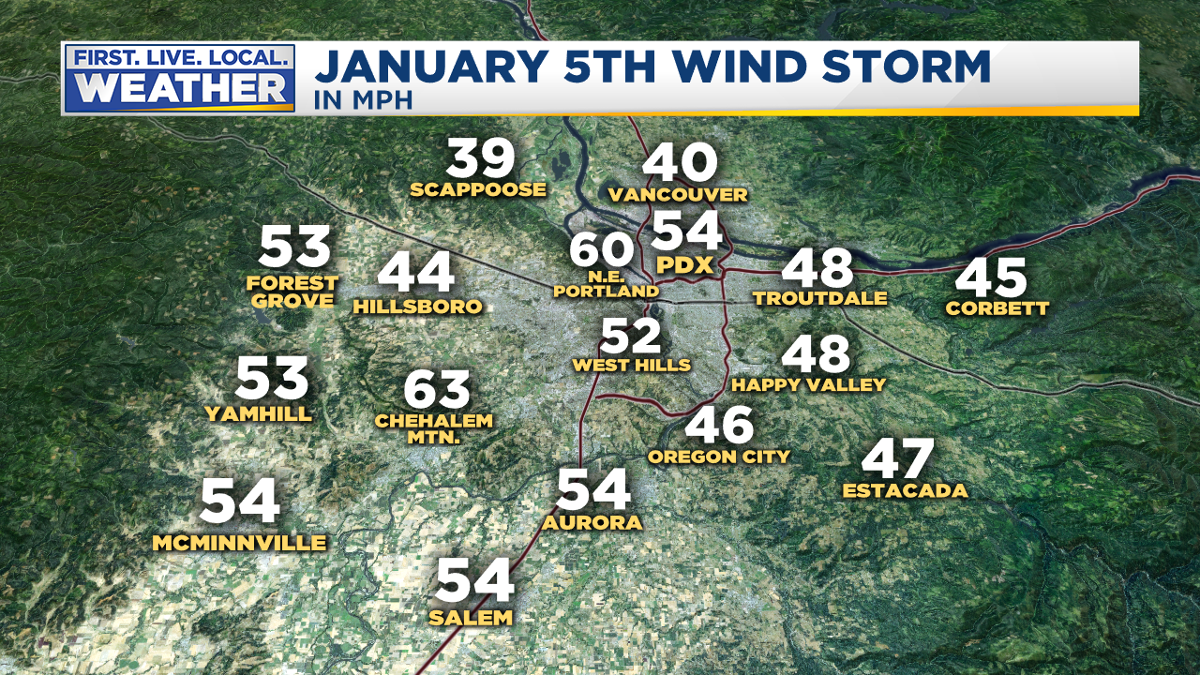
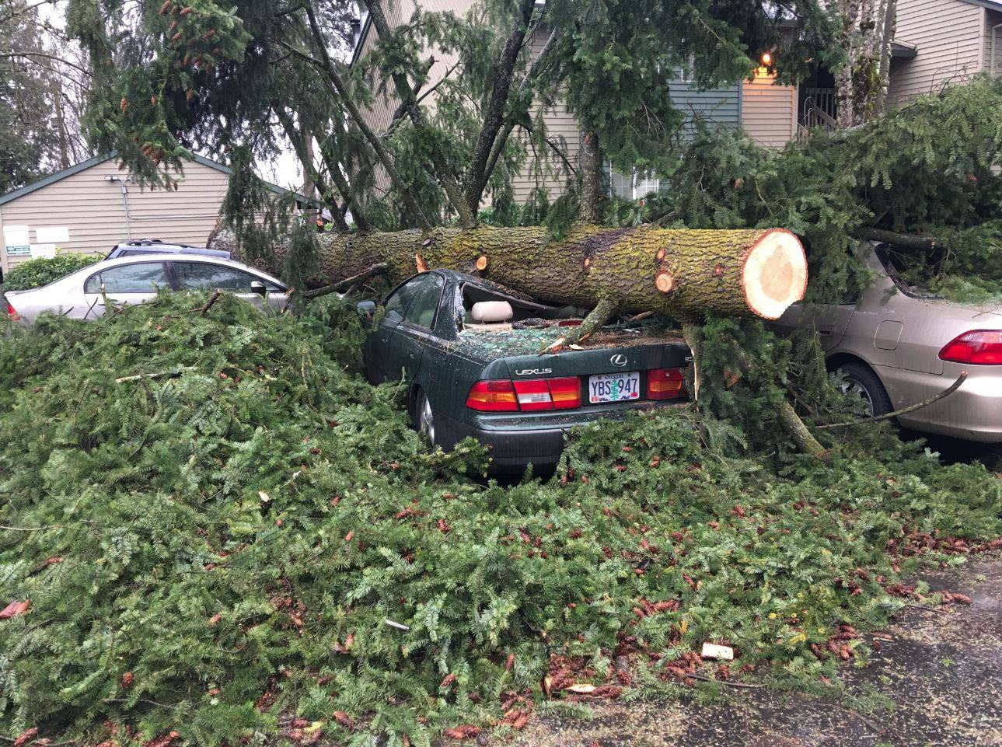
JANUARY
Notes:
50+ gusts at TTD, 85 mph gust at Corbett Grade, highest of past 10 years
850mb temps never below -9 this winter
Valley 30-35 during this time
Puget Sound 35-45!

Slide 23
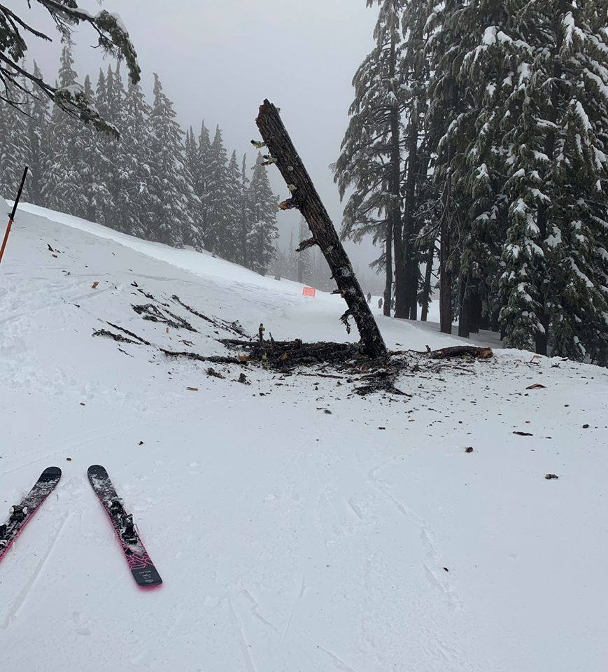
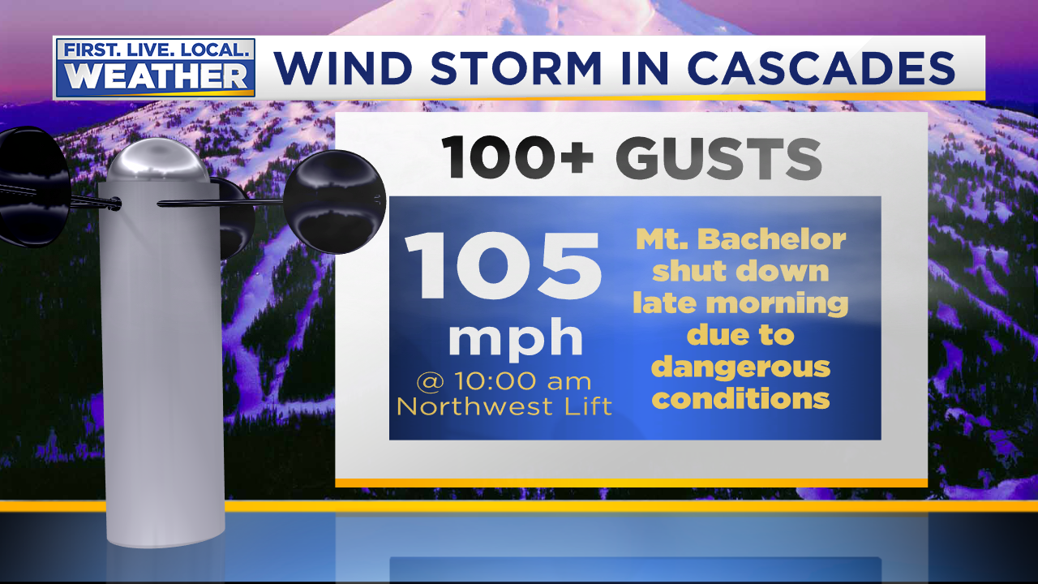
JANUARY
Central Oregon Wind Storm on 23rd
Notes:
50+ gusts at TTD, 85 mph gust at Corbett Grade, highest of past 10 years
850mb temps never below -9 this winter
Valley 30-35 during this time
Puget Sound 35-45!

Slide 24
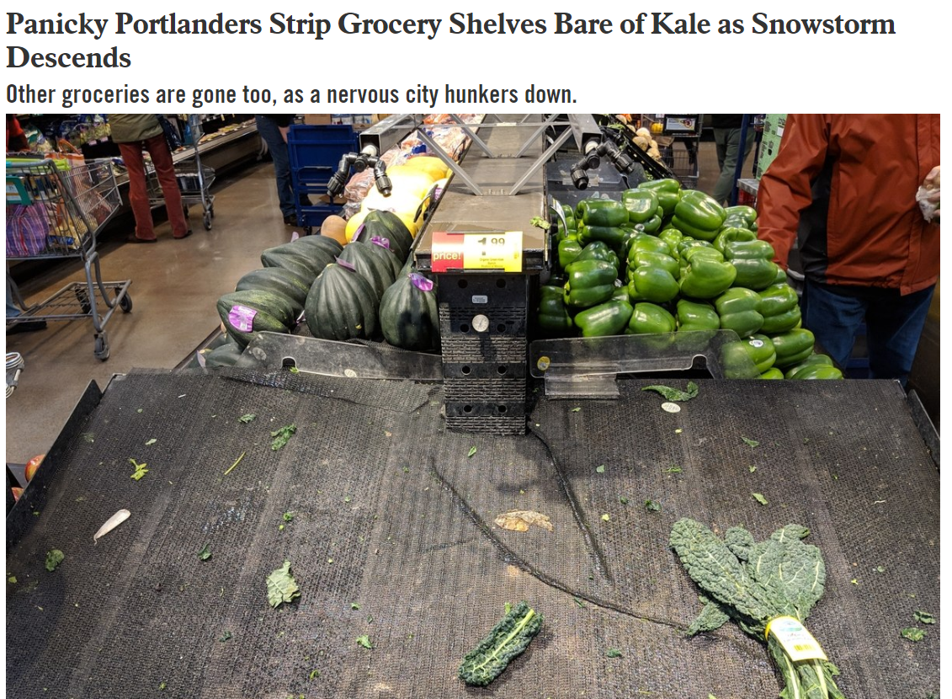
FEBRUARY
Winter Finally Arrives, And Hits PACNW Hard!
Panicked Portlandia, more on that in a minute…
Notes:
50+ gusts at TTD, 85 mph gust at Corbett Grade, highest of past 10 years
850mb temps never below -9 this winter
Valley 30-35 during this time
Puget Sound 35-45!

Slide 25
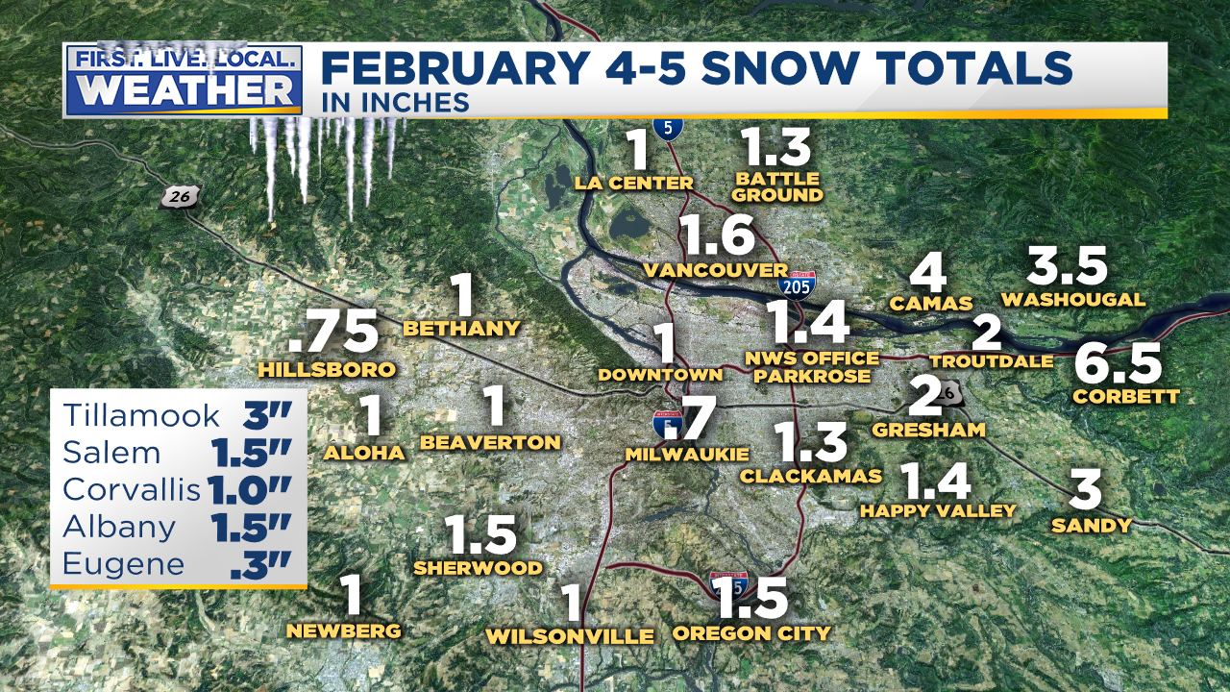
1ST MEASURABLE SNOW EVENT
February 4th-5th
Everybody gets a little with this one,
a rare sub-freezing snow with northerly wind, no Gorge east wind help
Notes:
50+ gusts at TTD, 85 mph gust at Corbett Grade, highest of past 10 years
850mb temps never below -9 this winter
Valley 30-35 during this time
Puget Sound 35-45!

Slide 26
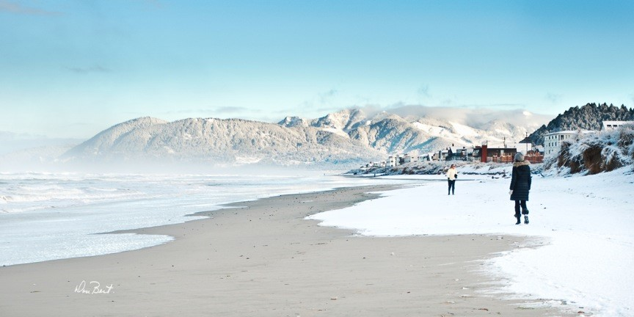
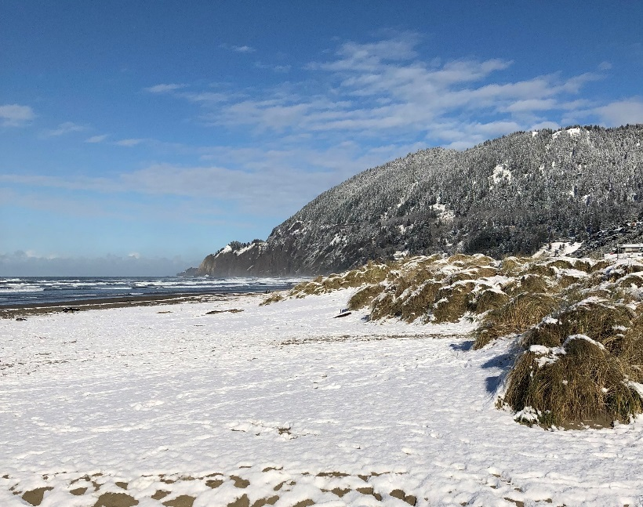
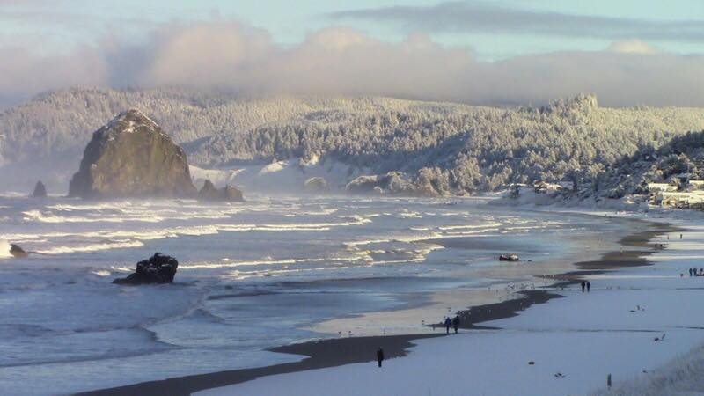
4 MEASURABLE SNOW EVENTS
February 4th-5th
Coast gets a nice coating as surface low drifts south offshore
Notes:
50+ gusts at TTD, 85 mph gust at Corbett Grade, highest of past 10 years
850mb temps never below -9 this winter
Valley 30-35 during this time
Puget Sound 35-45!

Slide 27
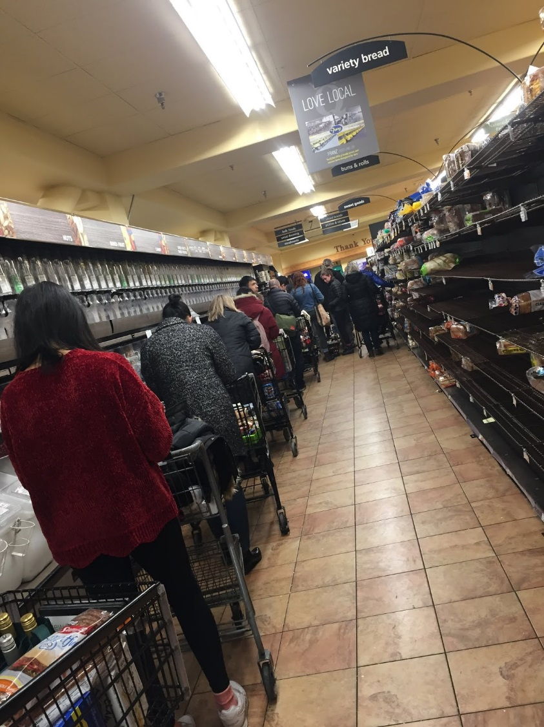


On Thur 7th & Fri 8th
Portland area stores get crazy
Rumors of a big snow storm show up, BUT HOW DID THIS HAPPEN?
Notes:
50+ gusts at TTD, 85 mph gust at Corbett Grade, highest of past 10 years
850mb temps never below -9 this winter
Valley 30-35 during this time
Puget Sound 35-45!

Slide 28
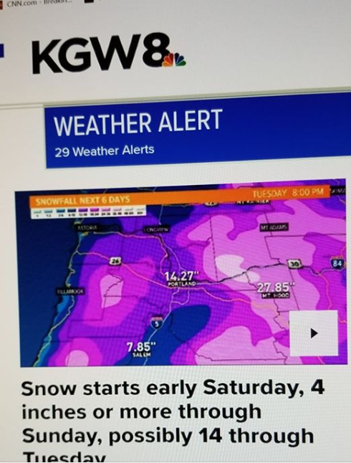
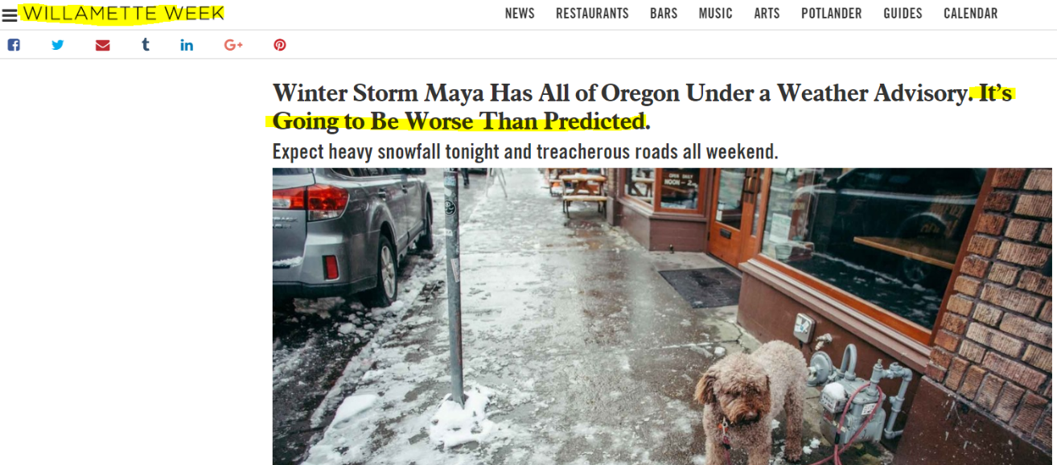
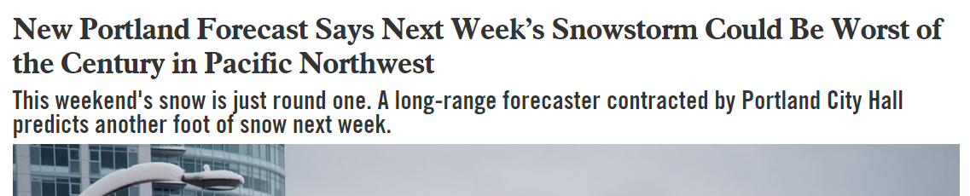

On Thur 7th & Fri 8th
I kept seeing & hearing about these tweets/FB posts/articles
Wouldn’t YOU be worried if these kept popping up on your browser?
Notes:
50+ gusts at TTD, 85 mph gust at Corbett Grade, highest of past 10 years
850mb temps never below -9 this winter
Valley 30-35 during this time
Puget Sound 35-45!

Slide 29
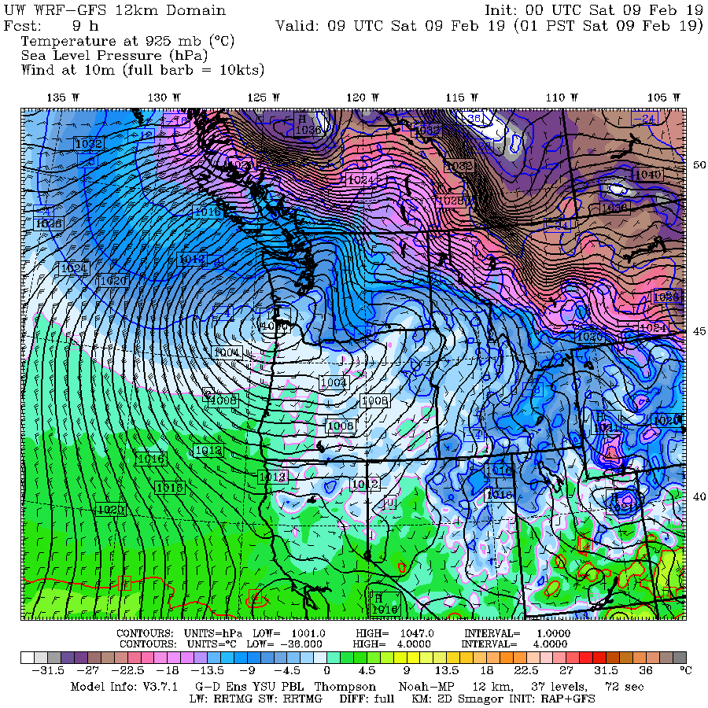
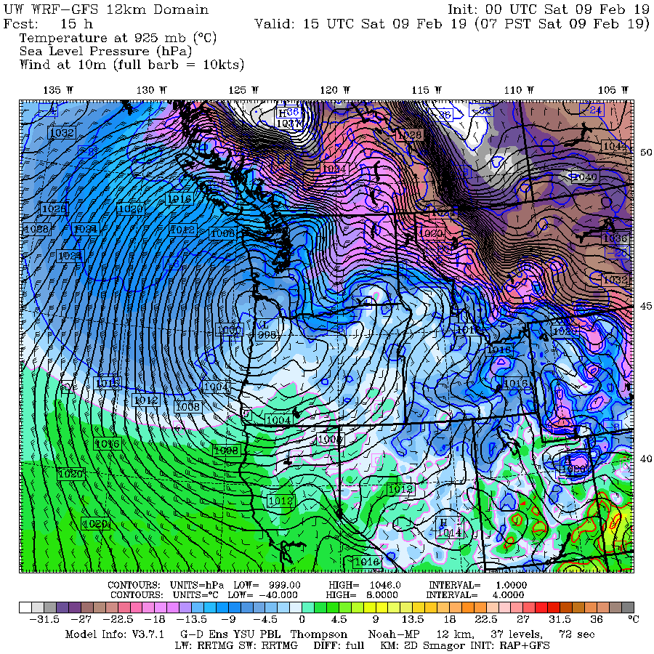
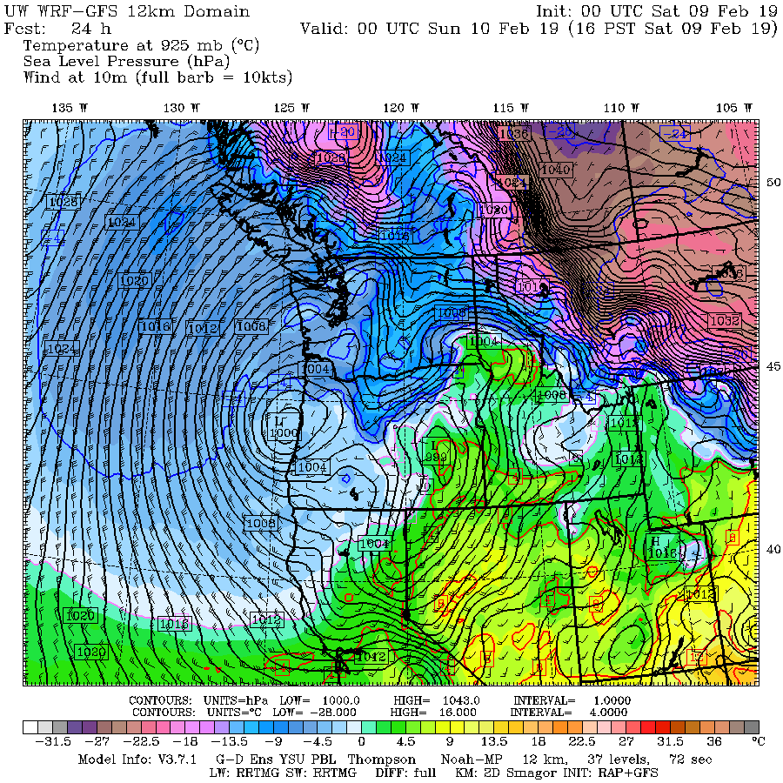
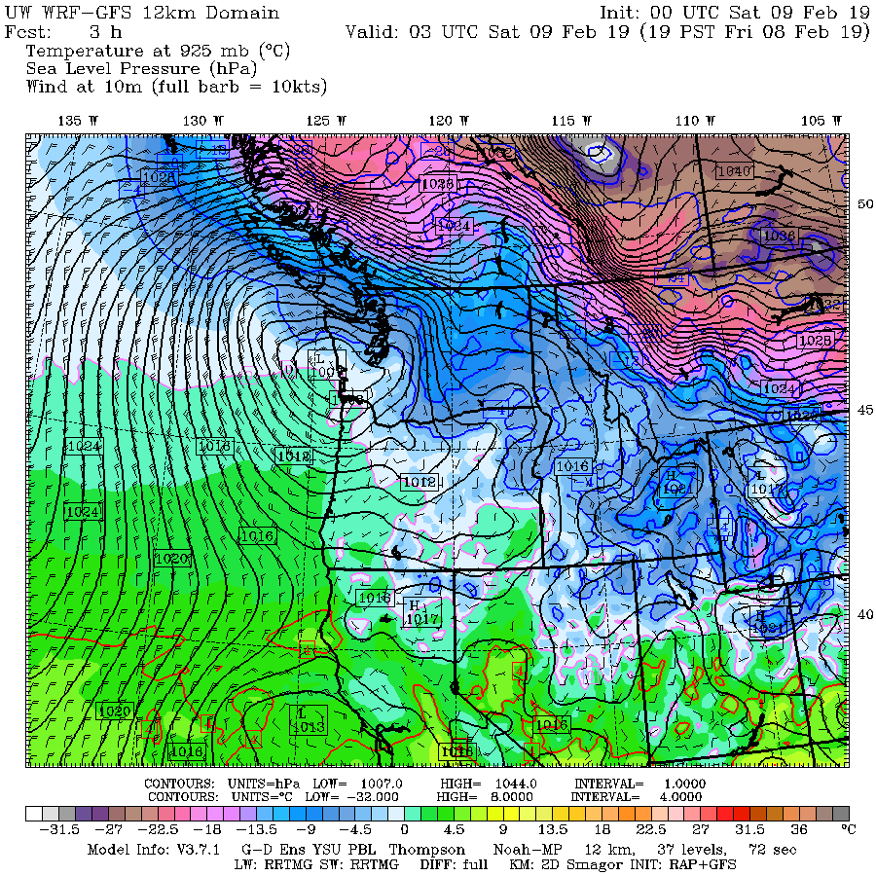
Surface Low Drops Down Coast Sat. Feb 9th
Gusty southerly wind as low drops down coastline.
Cold easterly wind eventually takes over.
Notes:
50+ gusts at TTD, 85 mph gust at Corbett Grade, highest of past 10 years
850mb temps never below -9 this winter
Valley 30-35 during this time
Puget Sound 35-45!

Slide 30
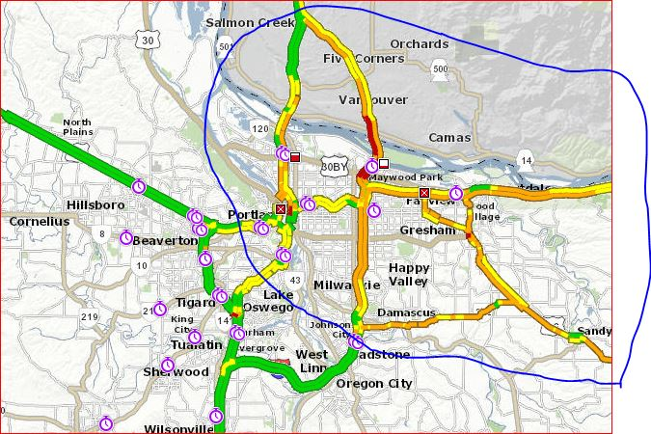
2ND MEASURABLE SNOW EVENT
What actually happened Saturday February 9th?
Can you guess based on 8am traffic map?
Notes:
50+ gusts at TTD, 85 mph gust at Corbett Grade, highest of past 10 years
850mb temps never below -9 this winter
Valley 30-35 during this time
Puget Sound 35-45!

Slide 31
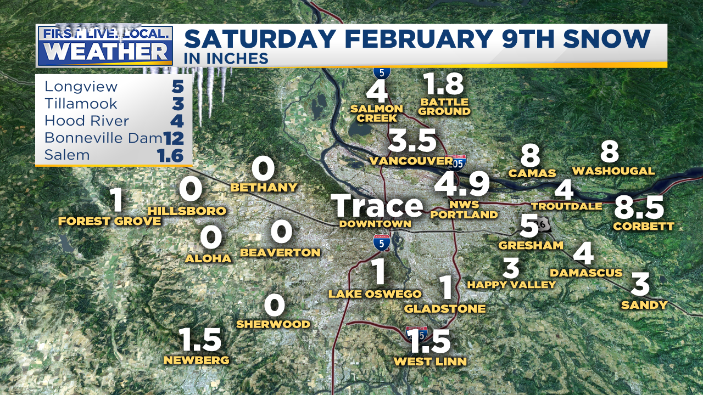
2ND MEASURABLE SNOW EVENT
What actually happened Saturday February 9th ?
East/north metro gets the goods, downtown & west/south metro cry…
Precipitation ran out before cold east wind arrived to freeze us up
Notes:
50+ gusts at TTD, 85 mph gust at Corbett Grade, highest of past 10 years
850mb temps never below -9 this winter
Valley 30-35 during this time
Puget Sound 35-45!

Slide 32
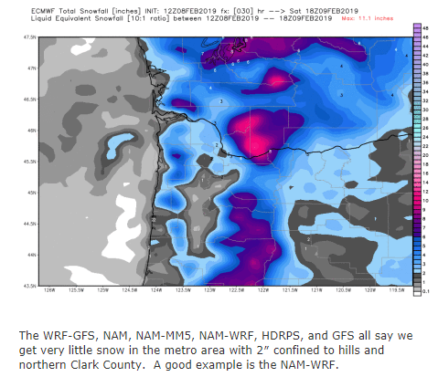
2ND MEASURABLE SNOW EVENT
King Euro let us down, too much snow central/west metro
But using just the other models would have been far too light east/north
Notes:
50+ gusts at TTD, 85 mph gust at Corbett Grade, highest of past 10 years
850mb temps never below -9 this winter
Valley 30-35 during this time
Puget Sound 35-45!

Slide 33
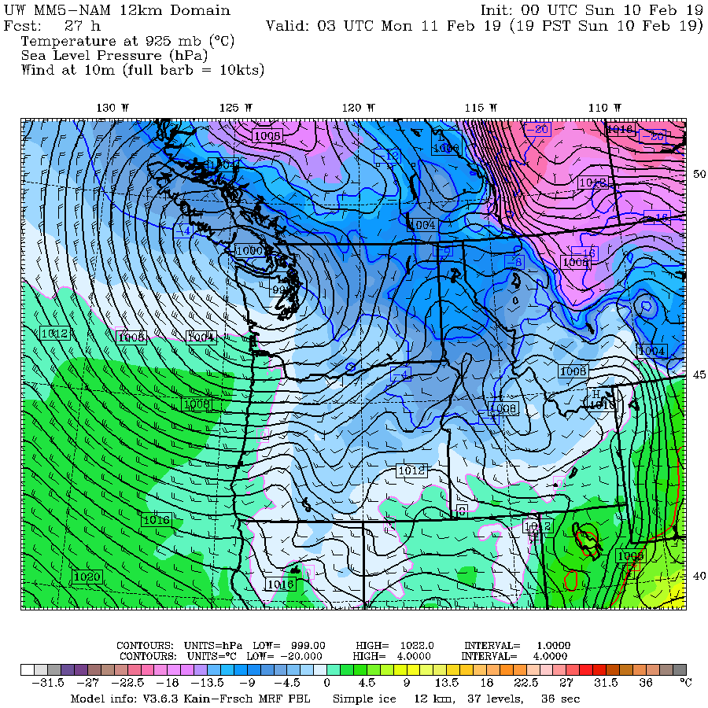
Then…
Low pressure goes by to the north = milder southwest wind Sunday 10th/11th
Instead Puget Sound & the Gorge saw historic snowfall 11th-13th

Slide 34
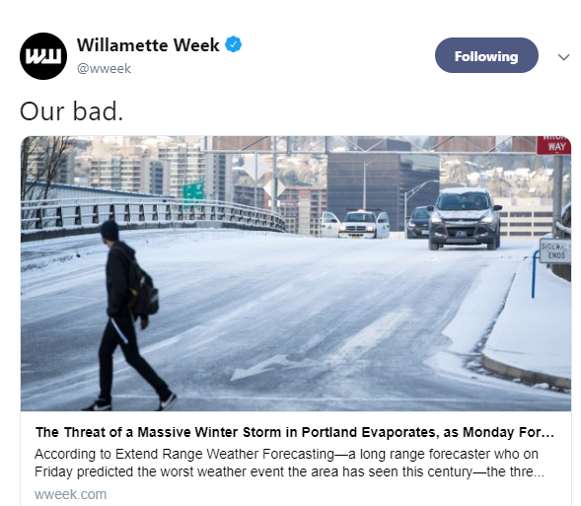
The Aftermath
Forecasters were “irrationally exuberant” about Euro and other models
showing systems staying over/south of us the following days
Instead Puget Sound & the Gorge saw historic snowfall 11th-13th
A GOOD LESSON!
(for forecasters AND media)
In today’s social media world we must be very careful with weather information

Slide 35
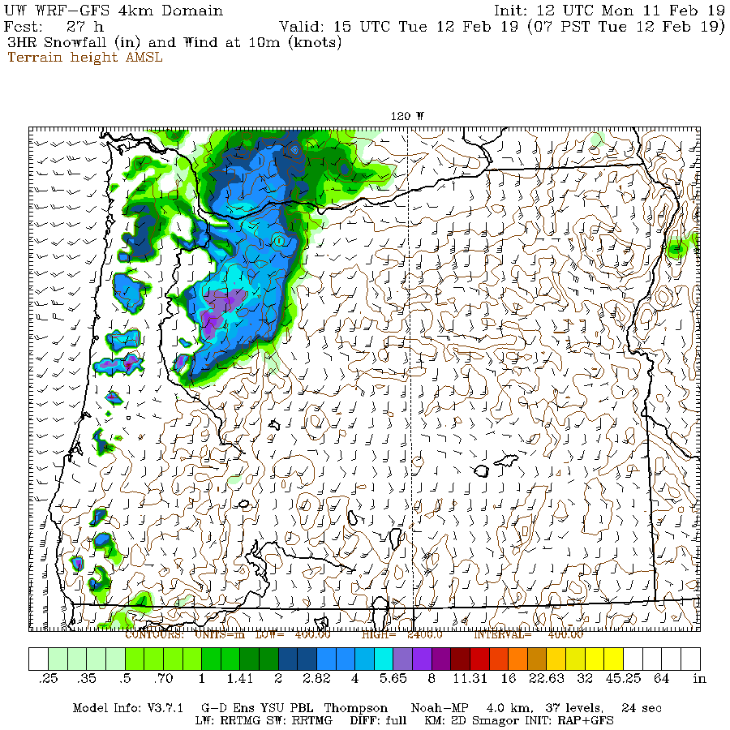
Flood Watch & Winter Storm Watch
at the same time, Mon PM Feb 11th
Hints from a few models that back edge
of wet front will go isothermal
& we get heavy/wet snowfall
Front slows down/less intense = no snow
Oops…
Notes:
50+ gusts at TTD, 85 mph gust at Corbett Grade, highest of past 10 years
850mb temps never below -9 this winter
Valley 30-35 during this time
Puget Sound 35-45!

Slide 36
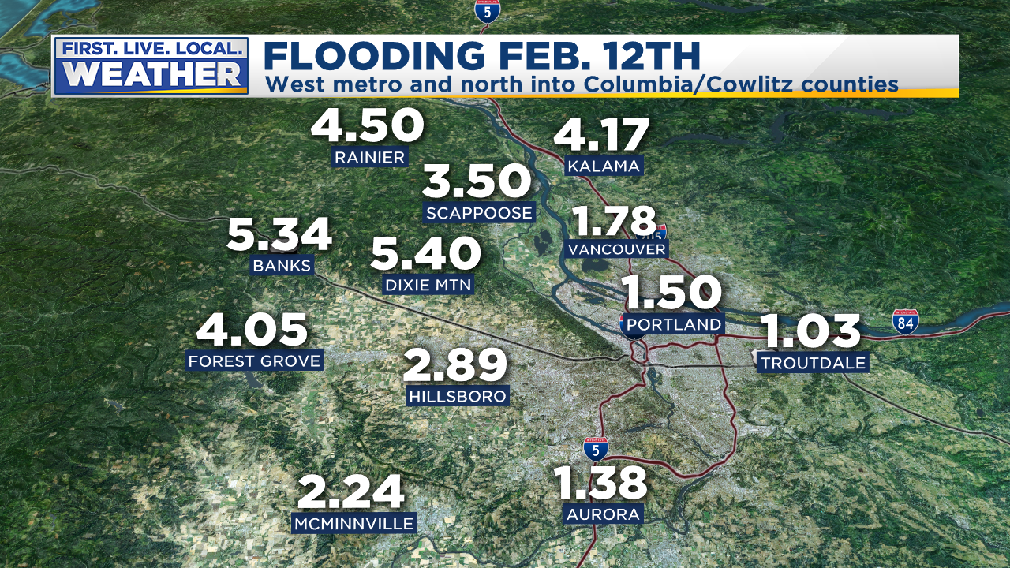
Wet!
Winter’s only flooding event; would have been our massive winter snow storm
(mentioned 4 days previous ☹)
Notes:
50+ gusts at TTD, 85 mph gust at Corbett Grade, highest of past 10 years
850mb temps never below -9 this winter
Valley 30-35 during this time
Puget Sound 35-45!

Slide 37
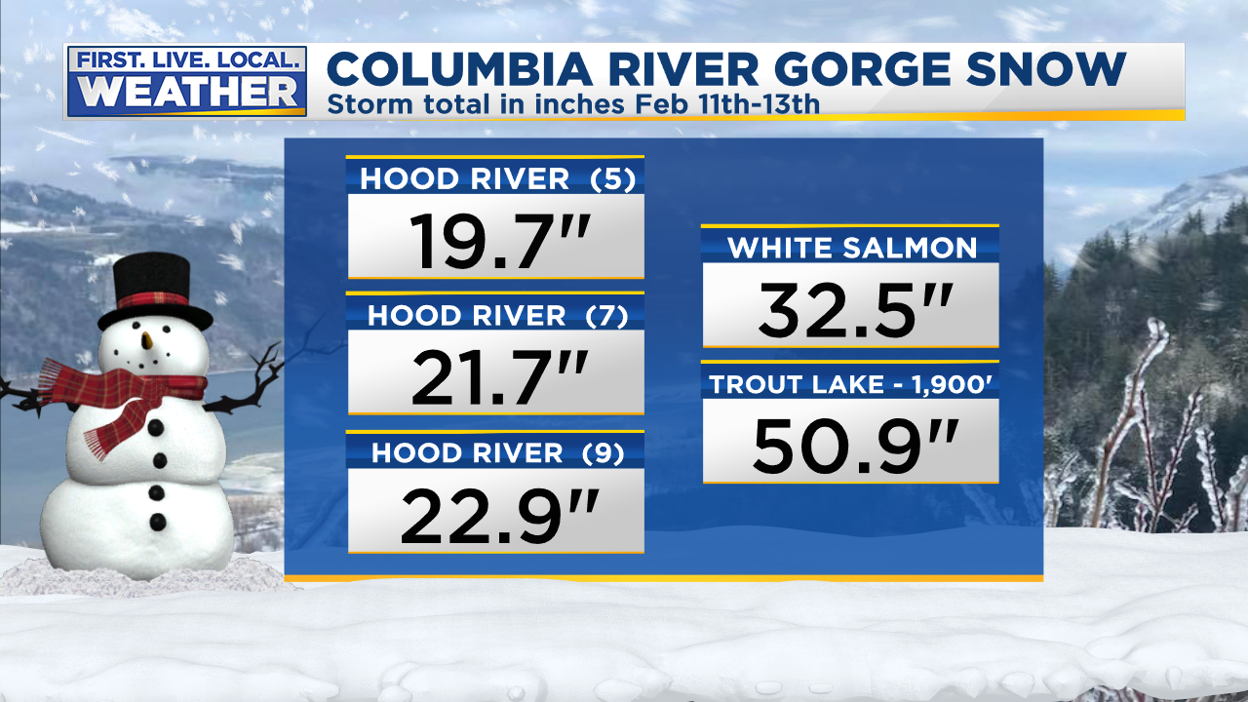
Meanwhile in The Gorge…
Notes:
50+ gusts at TTD, 85 mph gust at Corbett Grade, highest of past 10 years
850mb temps never below -9 this winter
Valley 30-35 during this time
Puget Sound 35-45!

Slide 38
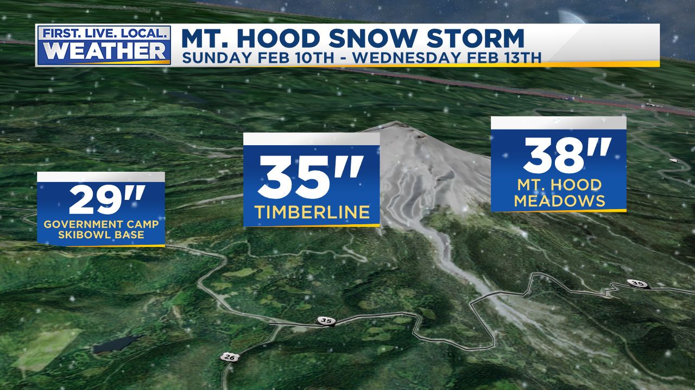
Biggest Storm of Winter In Cascades
Notes:
50+ gusts at TTD, 85 mph gust at Corbett Grade, highest of past 10 years
850mb temps never below -9 this winter
Valley 30-35 during this time
Puget Sound 35-45!

Slide 39

Big Snowstorm Starts Showing Up Around February 20th
Media far more under control this time. No crazy snow graphics show up online!
Notes:
50+ gusts at TTD, 85 mph gust at Corbett Grade, highest of past 10 years
850mb temps never below -9 this winter
Valley 30-35 during this time
Puget Sound 35-45!

Slide 40

Big Snowstorm Starts Showing Up Around February 20th
Media far more under control this time. No crazy snow graphics show up online!
Notes:
50+ gusts at TTD, 85 mph gust at Corbett Grade, highest of past 10 years
850mb temps never below -9 this winter
Valley 30-35 during this time
Puget Sound 35-45!

Slide 41

Big Snowstorm Starts Showing Up Around February 20th
Cold northerly flow will get overrun by lots of moisture!
Models ALL show SOMEONE will get buried by heavy & wet snow Sunday/Monday 24th/25th
Notes:
50+ gusts at TTD, 85 mph gust at Corbett Grade, highest of past 10 years
850mb temps never below -9 this winter
Valley 30-35 during this time
Puget Sound 35-45!

Slide 42









Big Snowstorm Starts Showing Up Around February 20th
9 RUNS OF THE ECMWF leading up to event Sunday night & Monday AM
Notes:
50+ gusts at TTD, 85 mph gust at Corbett Grade, highest of past 10 years
850mb temps never below -9 this winter
Valley 30-35 during this time
Puget Sound 35-45!

Slide 43

Final model forecast numbers
No models give metro significant snow (Only GEM contoured below)
Notes:
50+ gusts at TTD, 85 mph gust at Corbett Grade, highest of past 10 years
850mb temps never below -9 this winter
Valley 30-35 during this time
Puget Sound 35-45!

Slide 44

What Happened on 24th/25th?
West Metro and Salem Finally Get Some Snow. Not much east metro
Notes:
50+ gusts at TTD, 85 mph gust at Corbett Grade, highest of past 10 years
850mb temps never below -9 this winter
Valley 30-35 during this time
Puget Sound 35-45!

Slide 45

What Happened on 24th/25th?
Historic snow storm shows up Eugene to Roseburg
Notes:
50+ gusts at TTD, 85 mph gust at Corbett Grade, highest of past 10 years
850mb temps never below -9 this winter
Valley 30-35 during this time
Puget Sound 35-45!

Slide 46

What Happened on 24th/25th?
Historic snow storm shows up Eugene to Roseburg
Notes:
50+ gusts at TTD, 85 mph gust at Corbett Grade, highest of past 10 years
850mb temps never below -9 this winter
Valley 30-35 during this time
Puget Sound 35-45!

Slide 47

What Happened on 24th/25th?
Historic snow storm shows up Eugene to Roseburg & Central Oregon
Notes:
50+ gusts at TTD, 85 mph gust at Corbett Grade, highest of past 10 years
850mb temps never below -9 this winter
Valley 30-35 during this time
Puget Sound 35-45!

Slide 48



What Happened on 24th/25th?
Widespread damage/power outages due to heavy/wet snow
Notes:
50+ gusts at TTD, 85 mph gust at Corbett Grade, highest of past 10 years
850mb temps never below -9 this winter
Valley 30-35 during this time
Puget Sound 35-45!

Slide 49



Last Measurable Snow Event; February 27th
Not much expected and not much fell. But cold east wind = all frozen for AM commute
Notes:
50+ gusts at TTD, 85 mph gust at Corbett Grade, highest of past 10 years
850mb temps never below -9 this winter
Valley 30-35 during this time
Puget Sound 35-45!

Slide 50

February Temps; Only One Day Reaches Average
Notes:
50+ gusts at TTD, 85 mph gust at Corbett Grade, highest of past 10 years
850mb temps never below -9 this winter
Valley 30-35 during this time
Puget Sound 35-45!

Slide 51

February Temps; Only One Day Reaches Average
Notes:
50+ gusts at TTD, 85 mph gust at Corbett Grade, highest of past 10 years
850mb temps never below -9 this winter
Valley 30-35 during this time
Puget Sound 35-45!

Slide 52

Oregon Snowpack Increase
Who would have thought a huge increase at end of El Nino winter?
Notes:
50+ gusts at TTD, 85 mph gust at Corbett Grade, highest of past 10 years
850mb temps never below -9 this winter
Valley 30-35 during this time
Puget Sound 35-45!

Slide 53

Oregon Snowpack Increase
Who would have thought a huge increase 2nd half of El Nino winter?
Notes:
50+ gusts at TTD, 85 mph gust at Corbett Grade, highest of past 10 years
850mb temps never below -9 this winter
Valley 30-35 during this time
Puget Sound 35-45!

Slide 54


MARCH
Record Cold First Week
All of Gorge and Eastern OR/WA snow-covered
=
Unusually cold March east wind pattern, Pics from MARCH 11th & 17th
Notes:
50+ gusts at TTD, 85 mph gust at Corbett Grade, highest of past 10 years
850mb temps never below -9 this winter
Valley 30-35 during this time
Puget Sound 35-45!

Slide 55


MARCH
Record Cold First Week
All of Gorge and Eastern OR/WA snow-covered
=
Unusually cold March east wind pattern
Notes:
50+ gusts at TTD, 85 mph gust at Corbett Grade, highest of past 10 years
850mb temps never below -9 this winter
Valley 30-35 during this time
Puget Sound 35-45!

Slide 56


MARCH
Notes:
50+ gusts at TTD, 85 mph gust at Corbett Grade, highest of past 10 years
850mb temps never below -9 this winter
Valley 30-35 during this time
Puget Sound 35-45!

Slide 57


MARCH
Notes:
50+ gusts at TTD, 85 mph gust at Corbett Grade, highest of past 10 years
850mb temps never below -9 this winter
Valley 30-35 during this time
Puget Sound 35-45!

Slide 58

A “SOUTH WIND” INDEX

Slide 59

Cascade Snowfall
Typical for El Nino winter SO FAR
Well below normal through January
2nd snowiest February on record at Gov’t Camp
Snowiest El Nino February!

Slide 60

Cascade Snowfall
Well below average, then HUGE February Snow
March 13th…All is well! Good Melt Season Ahead

Slide 61

Mountain Snowpack @ 5,400’
Bottom of Pucci Lift @Timberline
Water Year Precipitation: BELOW AVERAGE
Snowpack: BELOW AVERAGE
Courtesy
NRCS
Oregon Office
Precip: Gray Line = Average
Snow Water
Red Line
=
Average

Slide 62

Mountain Snowpack @ 3,000’
Above Multnomah Falls – North Fork SNOTEL
Water Year Precipitation: BELOW AVERAGE
Snowpack: WELL ABOVE AVERAGE
Courtesy
NRCS
Oregon Office
Precip: Gray Line = Average
Snow Water
Red Line
=
Average

Slide 63

Notes:
First time we’ve had two back to back decent snow years since mid 1980s

Slide 64


Slide 65

One winter to go
this decade
1940-1995 = PDX 1996-Present = PQR
Notes:
3 years to go
These are not totals, but decade snowfall divided by 7

Slide 66


Slide 67


Slide 68

Blue = Widespread Arctic Air Outbreak

Slide 69

No Big Wind Storms
23 winters without a regional MAJOR storm
Notes:
Calmest south wind season of the last 20-30 years

Slide 70


EAST WIND SEASON
Nothing Too Crazy, Spread Out Through the Season

Slide 71

HOW DID FORECASTS
TURN OUT?
Big surprise was the “slow” winter.
No one anticipated a terrible Cascade winter snowpack
Remember that every once in awhile we get a “dud” La Niña winter!
We got lucky at the very end of the season

Slide 72

A CRAZY HOT & DRY SUMMER
After record warm May!

Slide 73

UNPRECEDENTED HOT SUMMER STREAK
Will it end this year?

Slide 74

UNPRECEDENTED HOT SUMMER STREAK
Will it end this year?

Slide 75

UNPRECEDENTED HOT SUMMER STREAK
Willamette Valley last 100 years

Slide 76

UNPRECEDENTED HOT SUMMER STREAK
Southwest Oregon last 100 years

Slide 77

UNPRECEDENTED HOT SUMMER STREAK
Southwest Oregon last 100 years

Slide 78

UNPRECEDENTED HOT SUMMER STREAK
Oregon Coast last 100 years

Slide 79
FINAL THOUGHTS
For discussion too!
Seemed like typical slow El Nino season until February
Finally some great foothill snow (February only). Has been lacking past few winters.
Never had a stormy westerly flow pattern…odd. Weak systems and then persistent northerly flow. ???
Imagine if February pattern had been in Dec/Jan?
Weatherwise article: SSW events & cosmic rays = cold?

Slide 80

A CRAZY HOT & DRY SUMMER
After record warm May!

Slide 81

A CRAZY HOT & DRY SUMMER
After record warm May!

Slide 82

LET’S FORECAST!
LIGHTNING ROUND
OF WINTER FORECASTS
Organizations/individuals who can’t make it here today or don’t want to be here
OR
They don’t know (or care) that we exist.

Slide 83
COLLECTION OF WINTER OUTLOOKS
Old Farmer’s Almanac
Farmer’s Almanac
AccuWeather
Pete Parsons (OR Dept of Forestry)
Rod Hill (KGW) < He’s here!
WeatherBELL

Slide 84

Remember the accuracy…

Slide 85

Remember the accuracy…

Slide 86

AccuWeather
…A phenomenon known as a pineapple connection could take place this winter, drawing a deep flow of moisture into the western U.S…

Slide 87

Oregon Dept of Ag/Forestry
(Pete Parsons)
Top Analog
Years
1996-97
2006-07
2012-13
Enhanced SW flow aloft in November and December with anomalous ridging developing in January…
Above-average storm activity early in the period, followed by more placid conditions entering the new year

Slide 88

Rod Hill Is Here!

Slide 89


WeatherBELL

Slide 90


THREE MODEL FORECASTS
ECMWF DEC-FEB 500MB
JAMSTEC DEC-FEB SFC TEMP

Slide 91

WILL A NEW “BLOB” AFFECT OUR WINTER?

