Slide 1
2018-2019 WINTER FORECAST
Presented By
Rod Hill
OMSI
October 27, 2018
Notes:
10/26/18
2
2

Slide 2
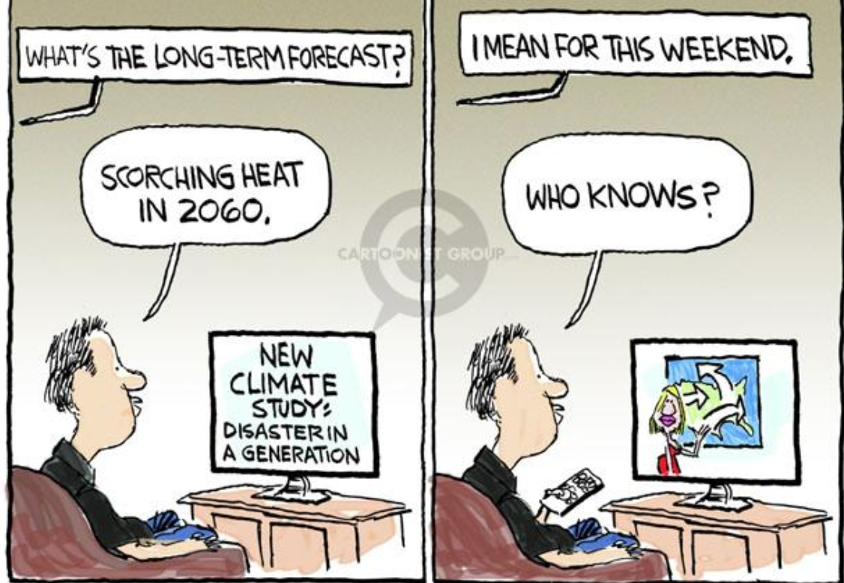

Why?
3
Notes:
10/26/18
3
3

Slide 3
Seasonal Forecast Skill
3 Choices
33.3%
33.3%
33.3%
Below Normal
Normal
Above Normal
4
Notes:
10/26/18
4
4

Slide 4

Rod's Report Card
2017-2018 Winter Forecast
Valley Snow: Quiet Year, No Big Storms
Portland Rainfall: 67% Below Normal Year, Highest Probability 30.10” (Actual 30.03”)
Temperatures: 1-3 Degrees Below Normal X (2nd warmest January, +4.2º)
Mt. Hood Snow Year: 105% or Better X
Wind Storms: No Big Event, 50 mph Peak Gust
Notes:
10/26/18
5
5

Slide 5
Rod's Report Card
Seasonal Forecast 2000-2018
Accuracy 66%
Industry Standard 55%
6
Notes:
10/26/18
6
6

Slide 6
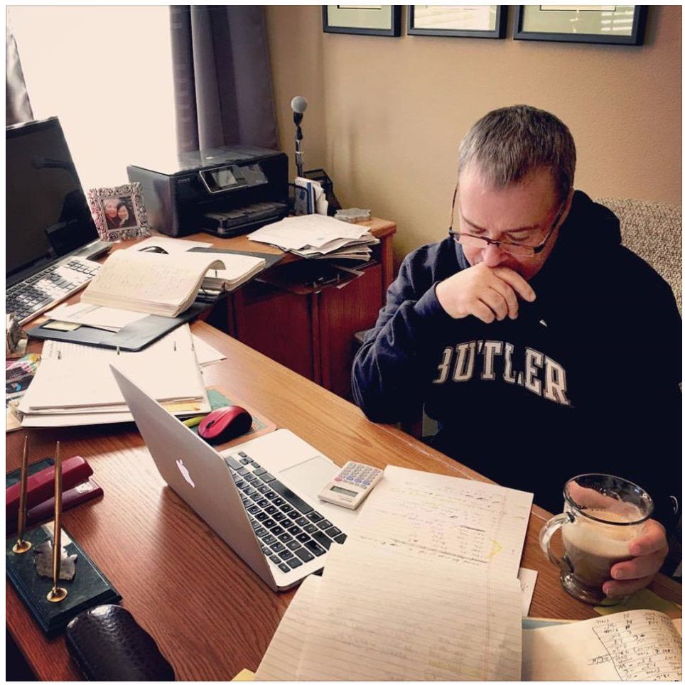
Day One on the Job
Researching Trends
Creating Data Sets
20+ Hours
Crunching Numbers
7
Notes:
10/26/18
7
7

Slide 7
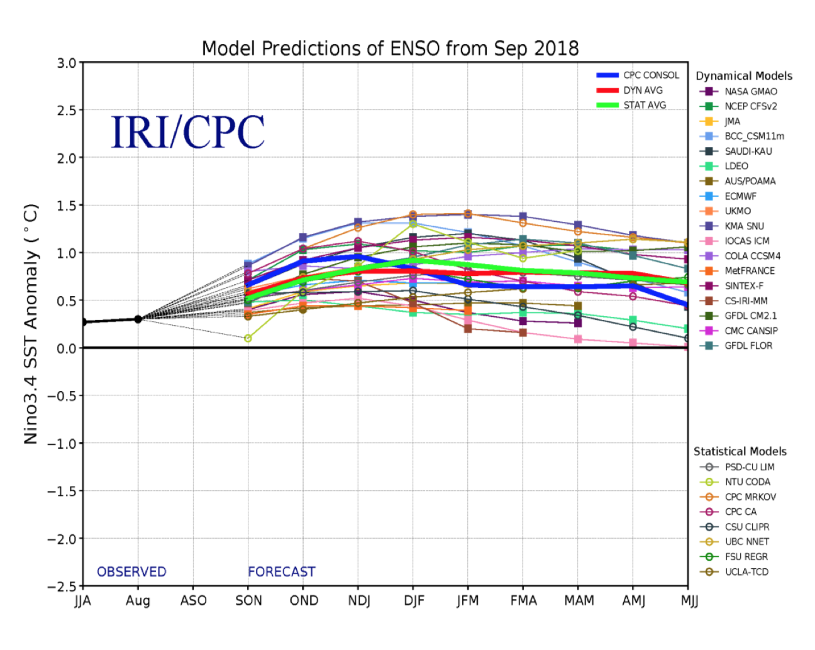
Where I Begin
Neutral Conditions, into a Weak or Moderate El Nino
Near Normal to Quiet
Possible Extremes: - PDX 34” Valley Snow - Record Low
Mt. Hood Snowpack
8
Notes:
10/26/18
8
8

Slide 8
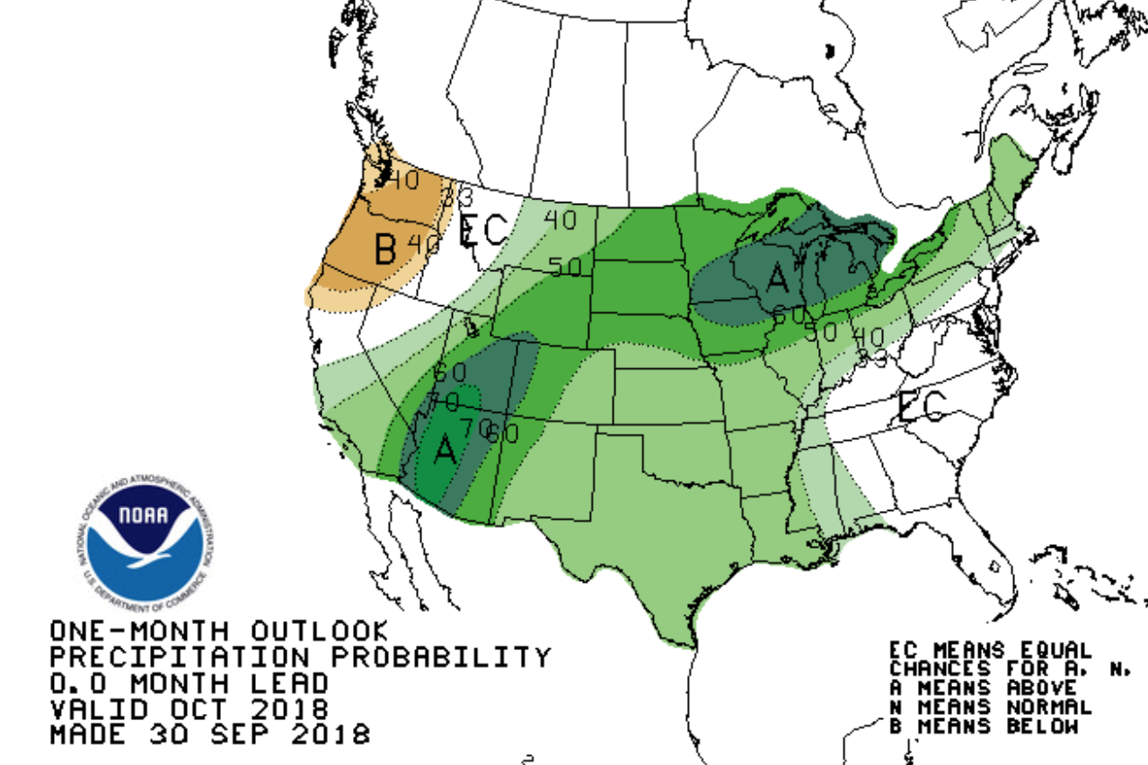
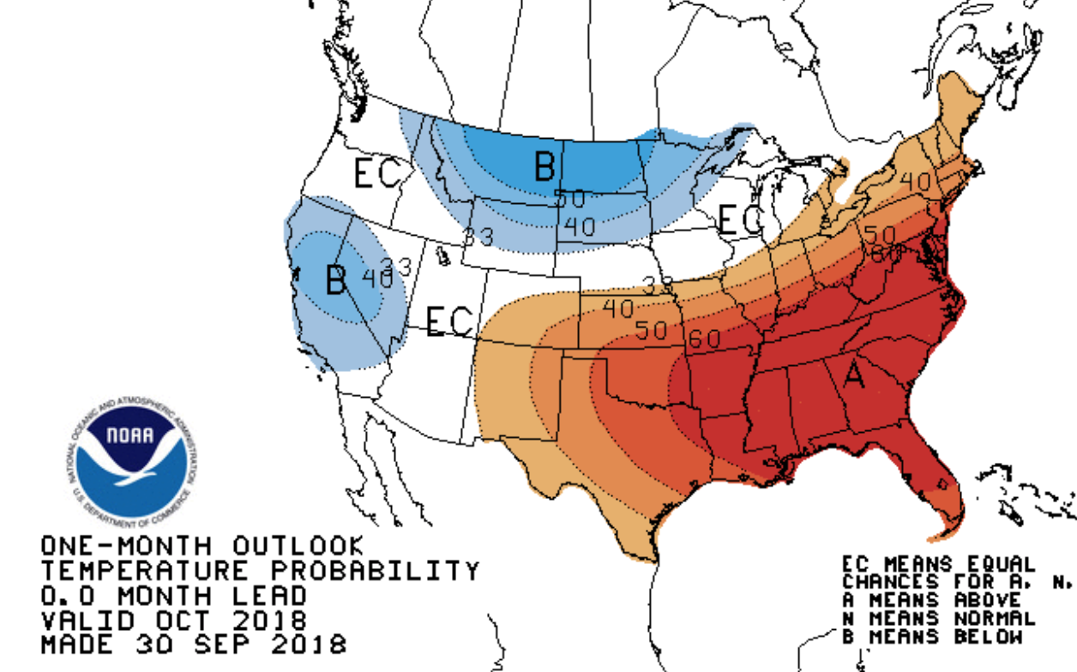
Oct Nov Dec - Outlook
Temperature Outlook
Precipitation Outlook
9
Notes:
10/26/18
9
9

Slide 9
Analog Years
1. | 1951 - 1952
2. | 1952 - 1953
3. | 1953 - 1954
4. | 1968 - 1969
5. | 1976 - 1977
6. | 1977 - 1978
7. | 1979 - 1980
8. | 1986 - 1987
9. | 1990 - 1991
10. | 1993 - 1994
11. | 1994 - 1995
12. | 2003 - 2004
13. | 2004 - 2005
14. | 2006 - 2007
15. | 2014 - 2015
10
Notes:
10/26/18
10
10

Slide 10
Analog Year Extremes
1. | 1951 - 1952
2. | 1952 - 1953
3. | 1953 - 1954
4. | 1968 - 1969
5. | 1976 - 1977
6. | 1977 - 1978
7. | 1979 - 1980
8. | 1986 - 1987
9. | 1990 - 1991
10. | 1993 - 1994
11. | 1994 - 1995
12. | 2003 - 2004
13. | 2004 - 2005
14. | 2006 - 2007
15. | 2014 - 2015
Water Year 45.17” Valley Snow 34”
Oct 2014: 10 Consecutive 70º Days
Water Year 31.96”
Mt. Hood Snowpack,
Record Low 25% of Average
Dec 2014: 67 mph Gust

Slide 11
Rod’s Analog Years
Analog Precip Average: 35.43”
Analog Snow Average: 7.3”
Temp Normal to Warm: 73% Confidence
12
Notes:
10/26/18
12
12

Slide 12
Look At Recent Patterns
Hot Summers
2018 = 31, 90º Days
❄️
El Nino Winters
Following Hot Summer
13
Notes:
10/26/18
13
13

Slide 13
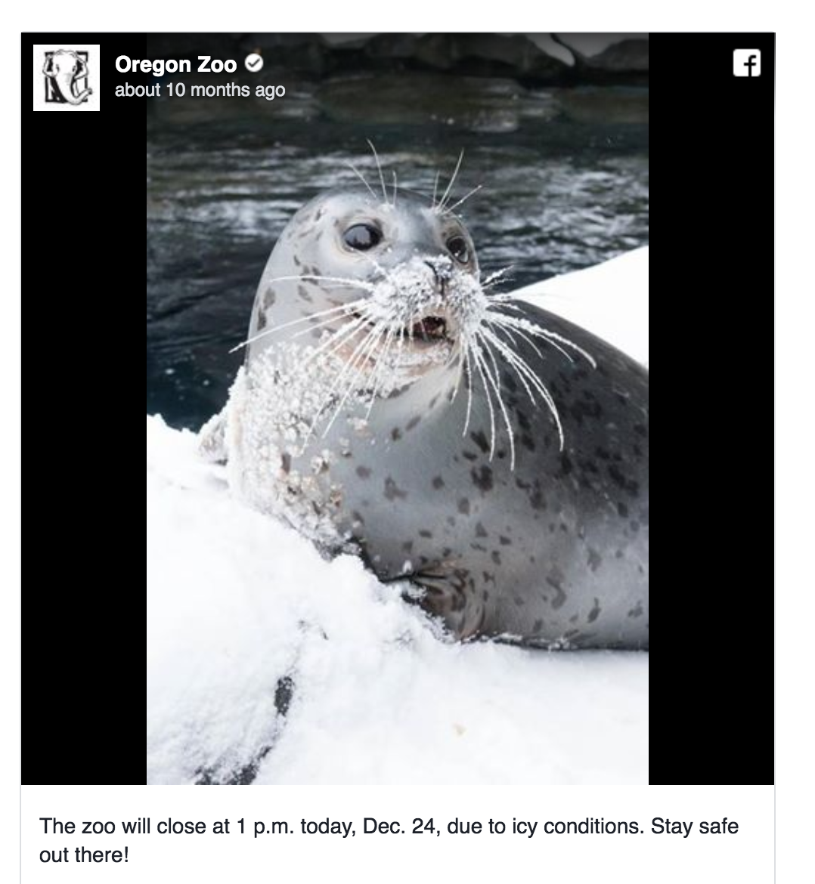
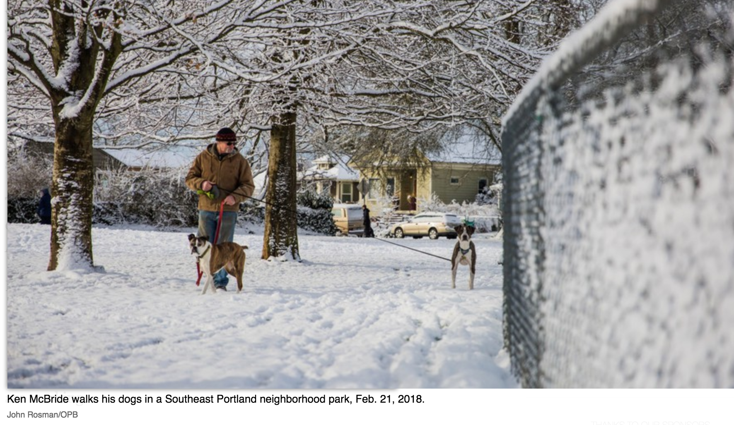
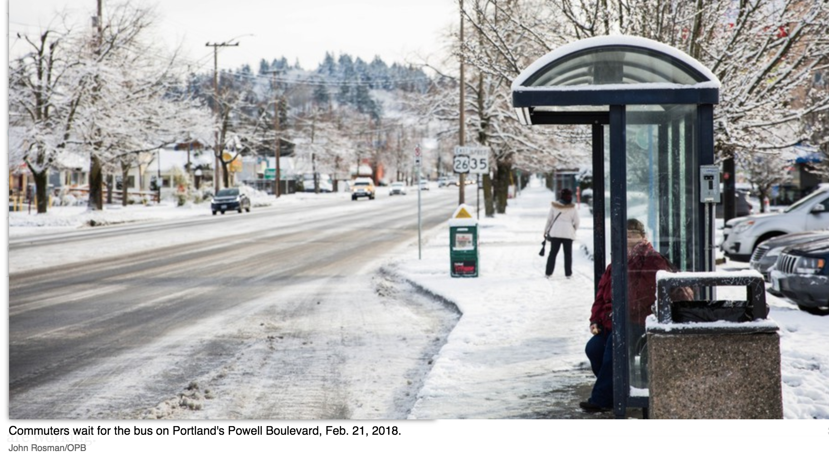
Last Winter
14
Notes:
10/26/18
14
14

Slide 14
Valley Snow – What to Expect
Odds Favor No Big Storm
Only 8% Chance of 6 Inches or More
Why???
2016-2017 = 11.7 Inches
2017-2018 = 7.6 Inches
Historic Trends Show 3rd Season of 6” or more has only happened twice since 1950
15
Notes:
10/26/18
15
15

Slide 15
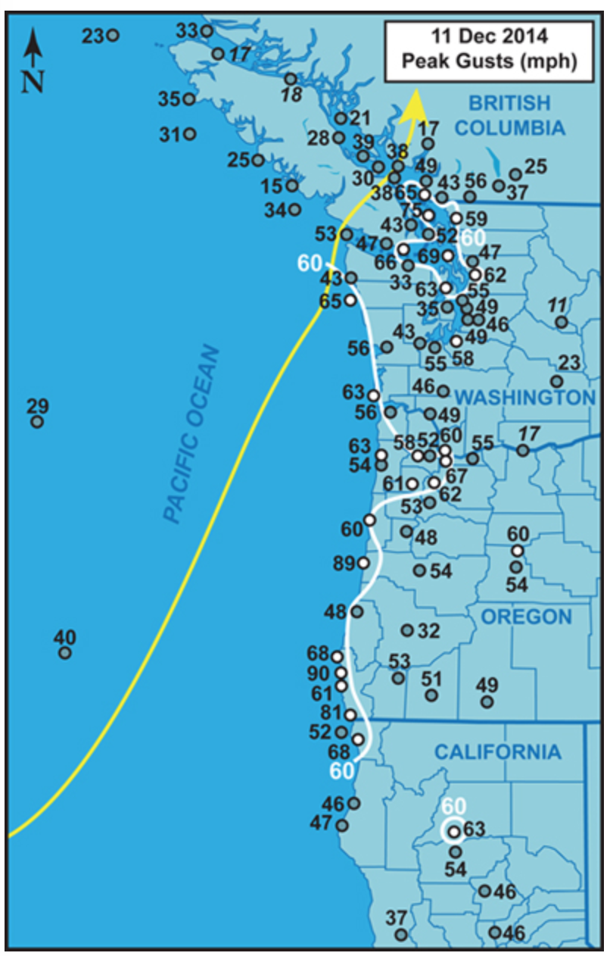
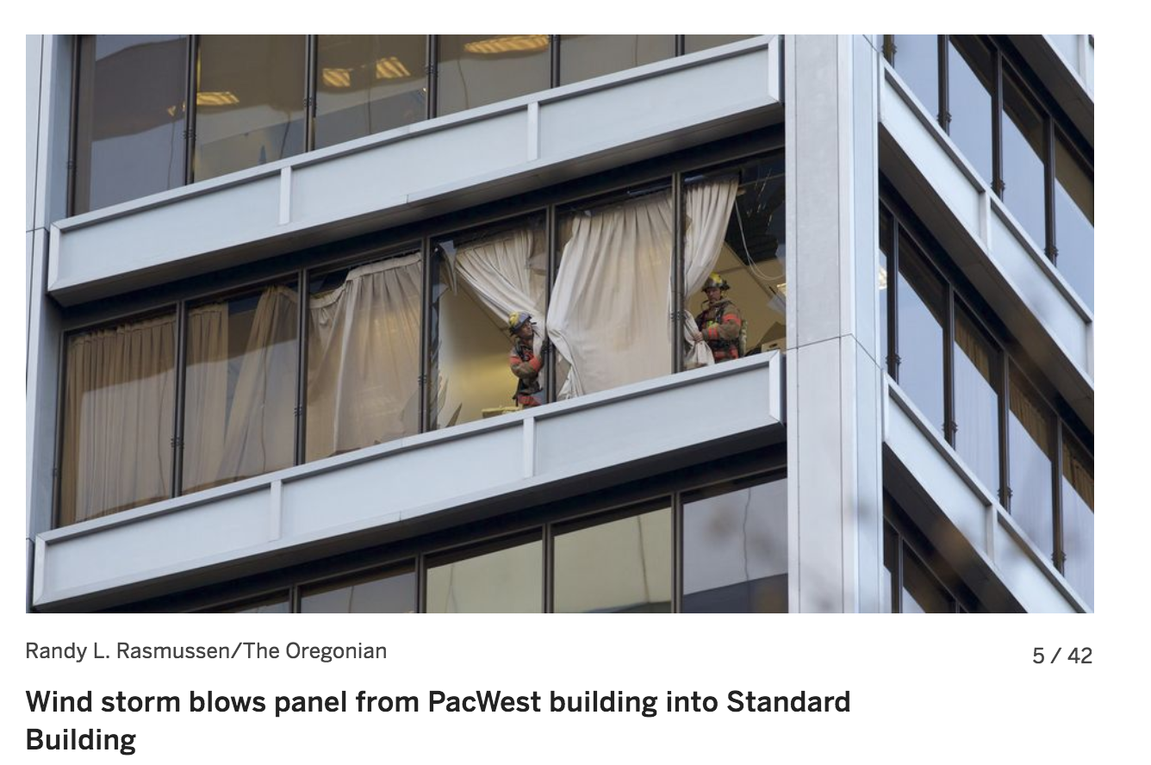
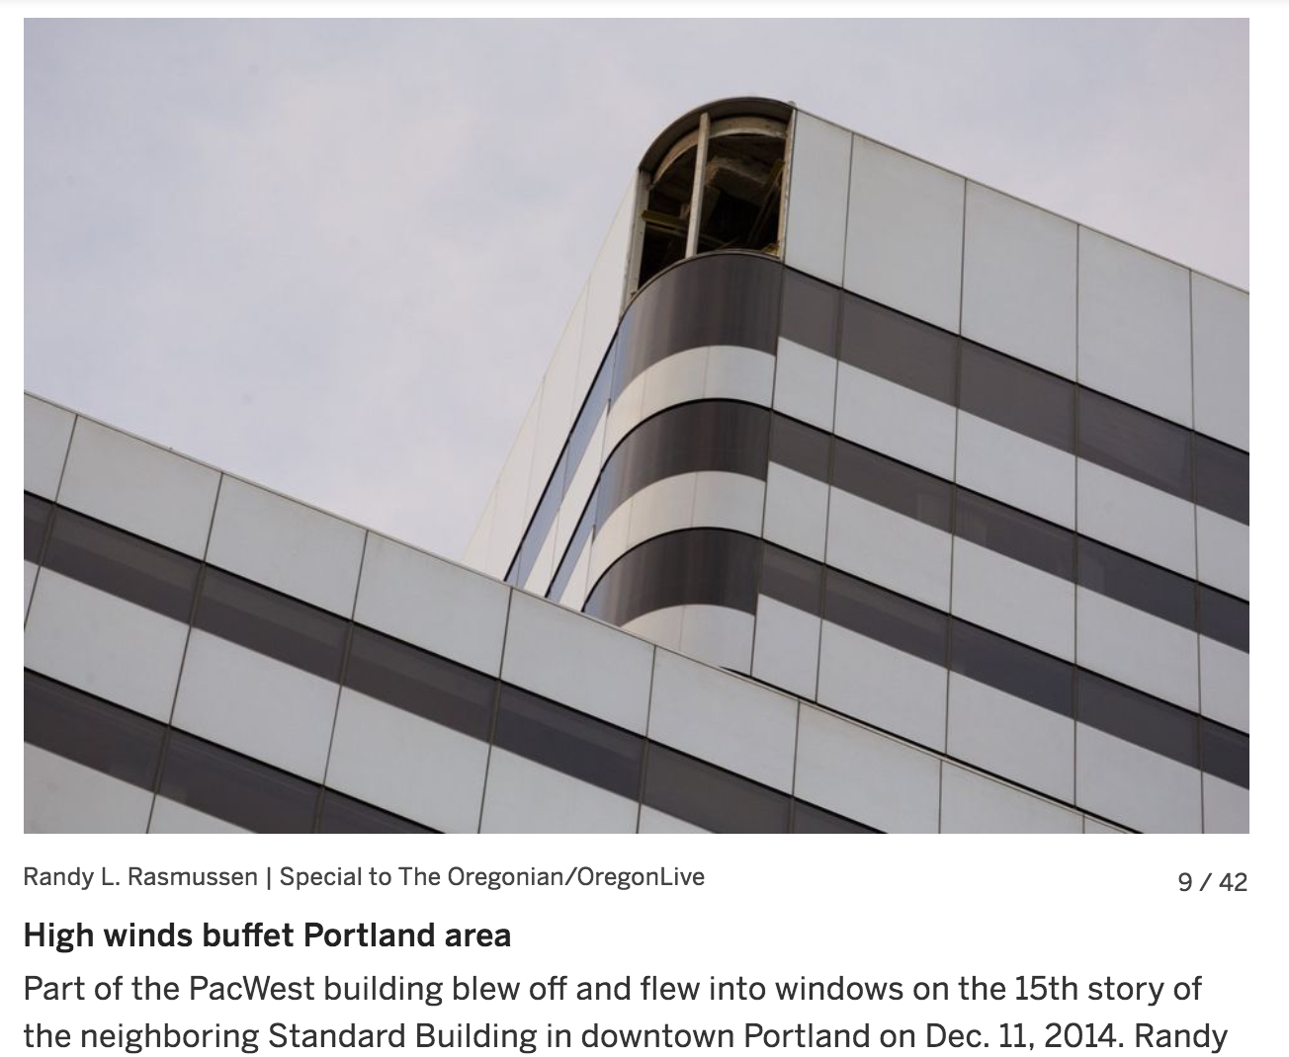
Winter 2014-2015
Windstorm Chance This Winter: 40%

Slide 16
Following Top Five Hot Summers
(# of 90° Days)
Only One Wet Winter, 2015-2016
Moderate El Nino 35.36”
Water Year Average 36.06”
17
Notes:
10/26/18
17
17

Slide 17
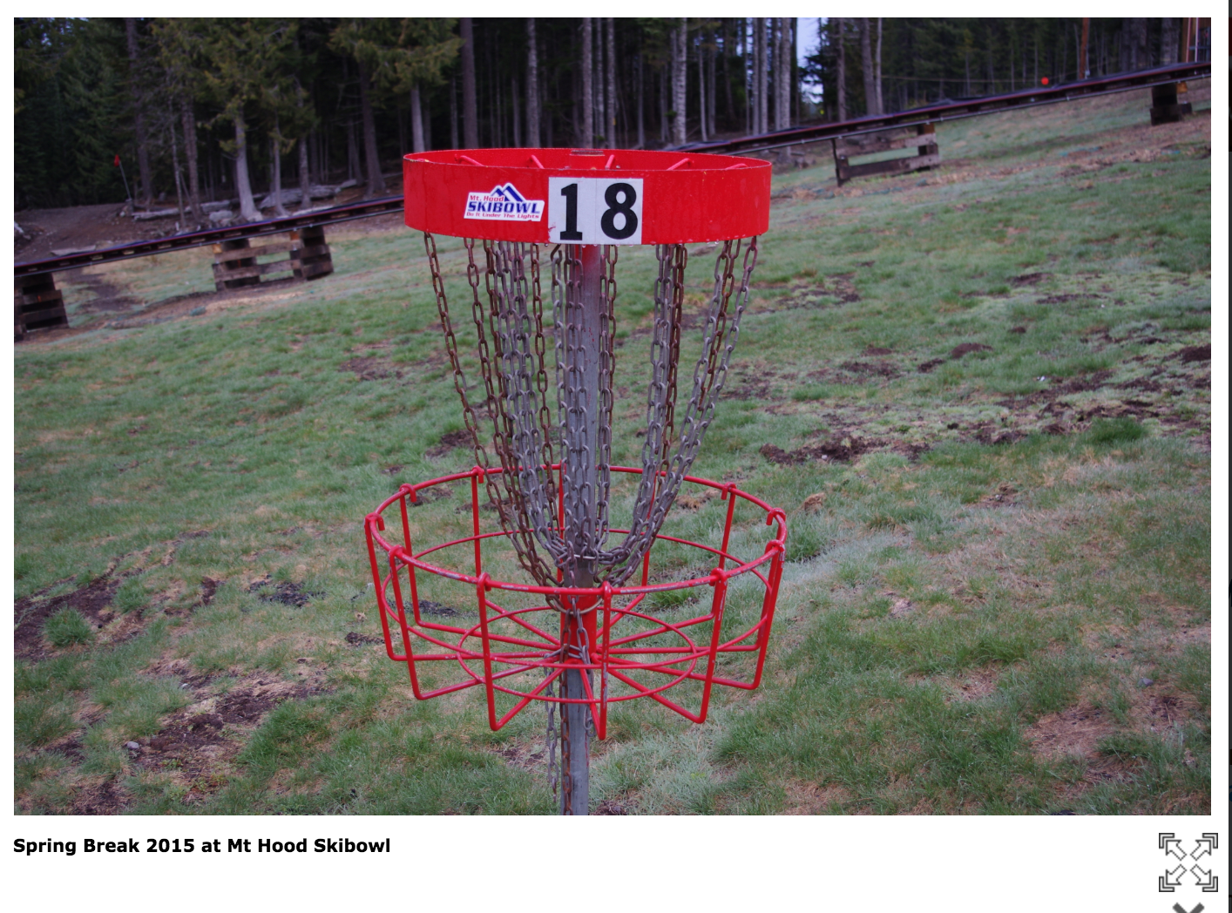
Mt. Hood Snowpack – Reason for Concern?
Analog Winter 2014-2015 | Record Low Snowpack
25% of Normal
18
Notes:
10/26/18
18
18

Slide 18
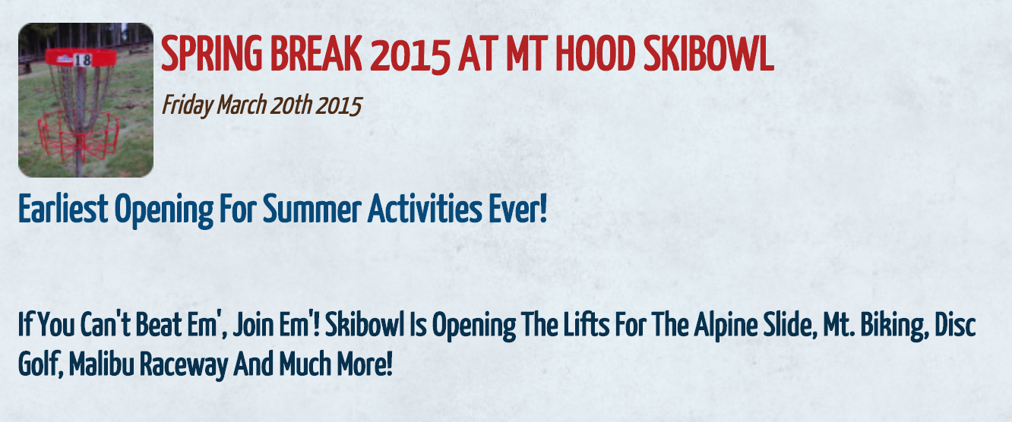
Mt. Hood Snowpack – Reason for Concern?
Analog Winter 2014-2015 | Record Low Snowpack
25% of Normal
19
Notes:
10/26/18
19
19

Slide 19
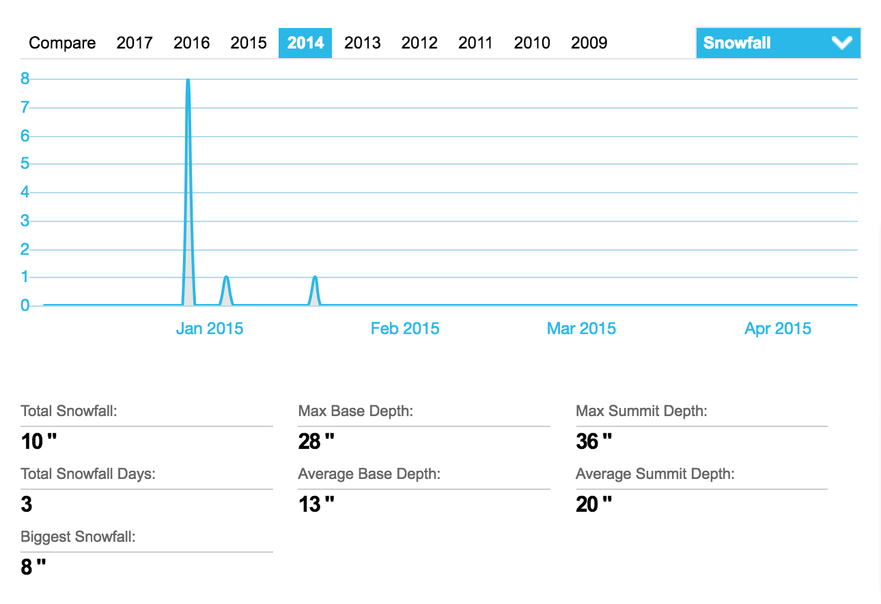
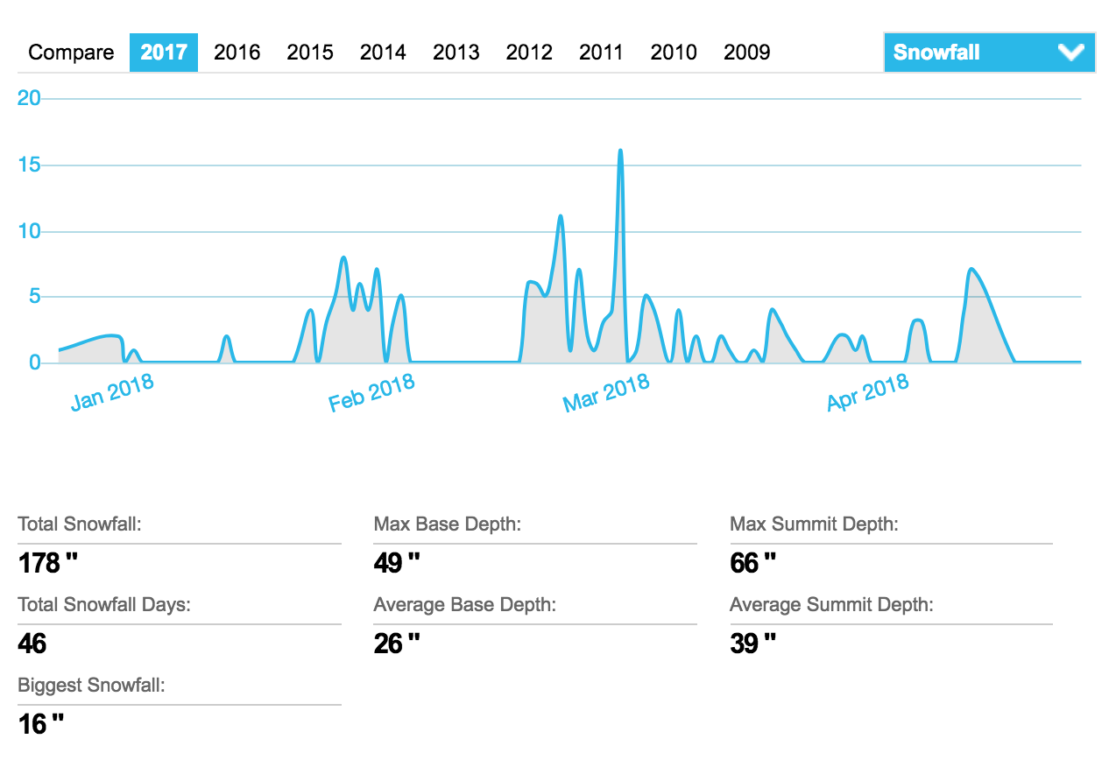
Mt. Hood Snowpack – Reason for Concern?
Mt. Hood Skibowl
20
Notes:
10/26/18
20
20

Slide 20
Rod's 2018-2019 Winter Outlook
Portland Temperature Normal to Above 73% Confidence
Water Year Precipitation Near Normal
Possible Range 30-39”, Best Chance 35.40”
Valley Snow Less than 6” of Snow
Chance of a Big Snow Storm 8%
Wind Storms 40% Chance 60 mph Gusts
21
Notes:
10/26/18
21
21

Slide 21
Rod's 2018-2019 Winter Outlook
Mt. Hood Snow Pack
  50-50% Chance Normal Year
  Snow Pack Forecast 66% Average
  Reason for Concern:
      - Record Dry Winter 2014-2015; 25% Average
      - 2nd Driest Winter 2004-2005; 44% of Average
22
Notes:
10/26/18
22
22

Slide 22
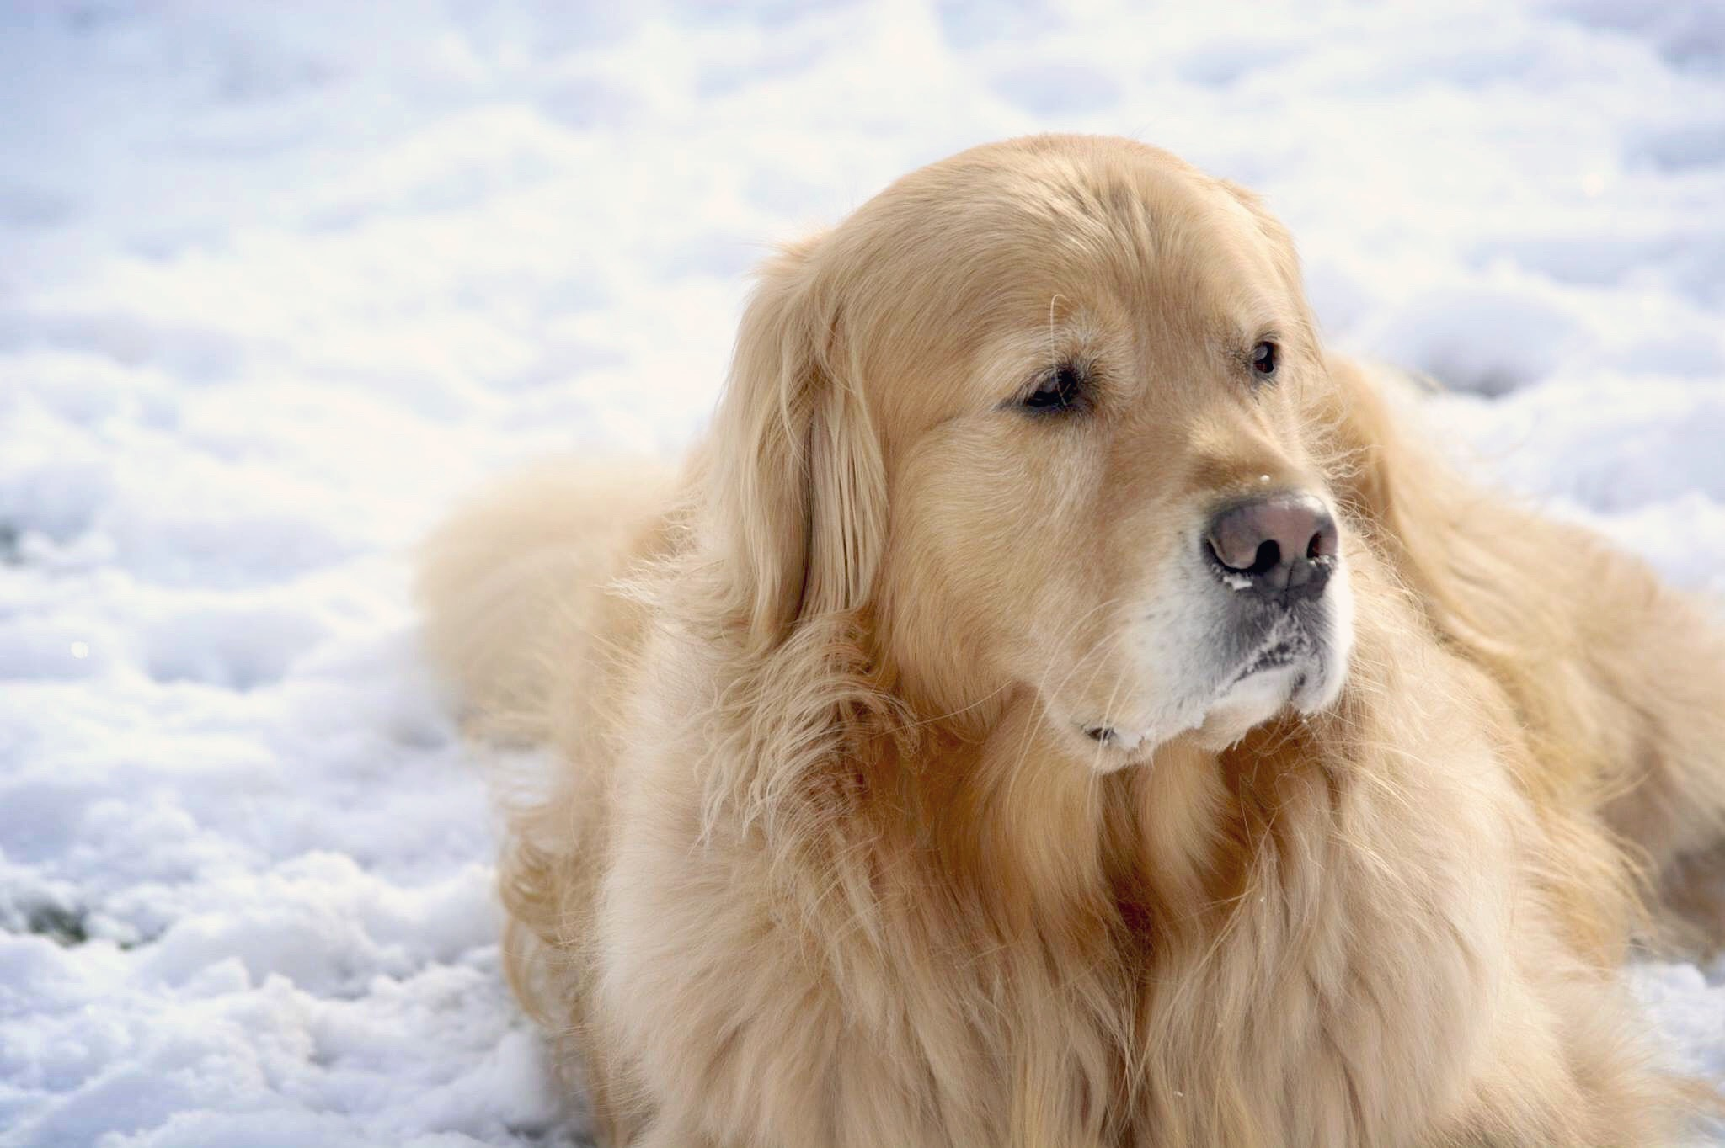
Waiting and Watching…
23
Notes:
10/26/18
23
23

