Slide 1

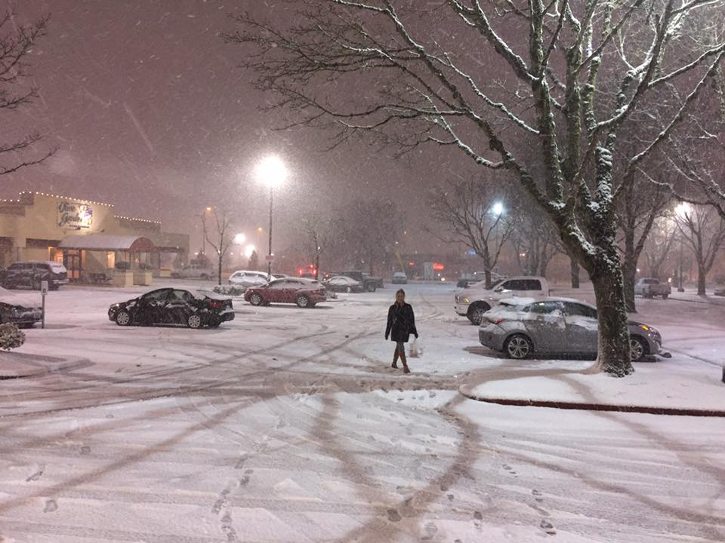
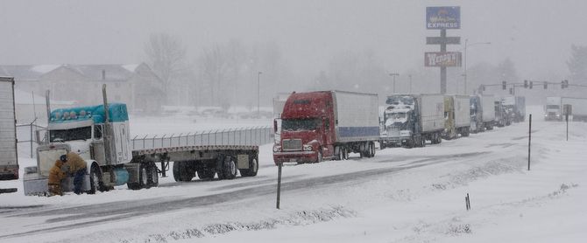

Winter Outlook - 2018-2019
AMS Oregon Chapter
Winter Weather Meeting
Oct 27, 2018
Tyree Wilde
Warning Coordination Meteorologist
National Weather Service
Portland, OR

Slide 2
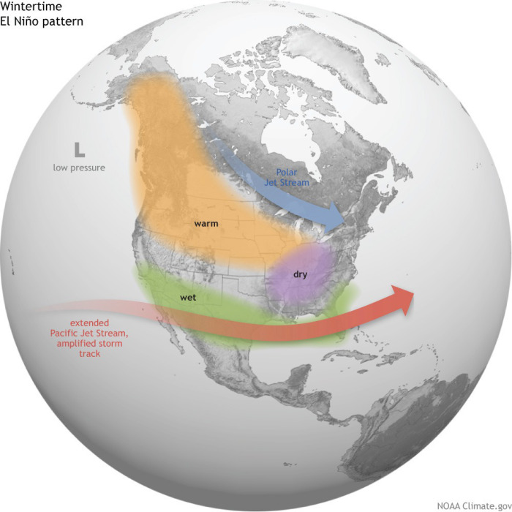
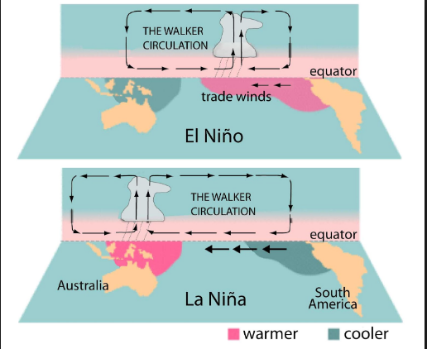
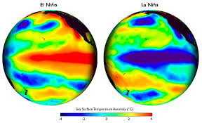
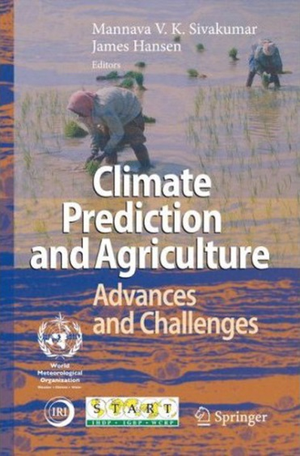

What Kind of Winter is Expected
El-Nino ? LaNina ?

Slide 3
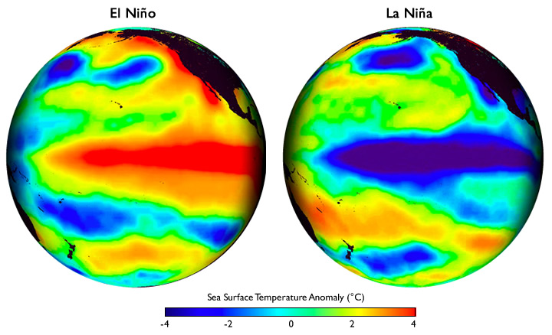
El Niño & La Nina
USA
USA
Pacific Ocean
Pacific Ocean
Warmer than usual
ocean temperatures
Cooler than usual
ocean temperatures
Notes:
Choose this slide or next el nino/la nina slide

Slide 4
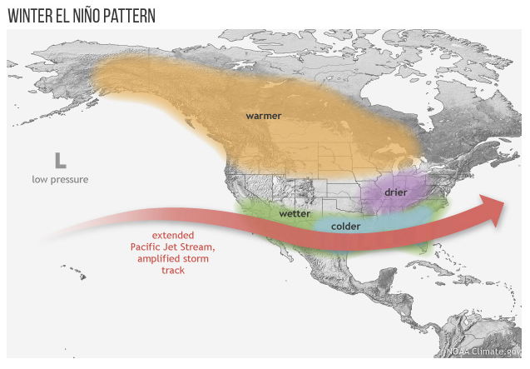
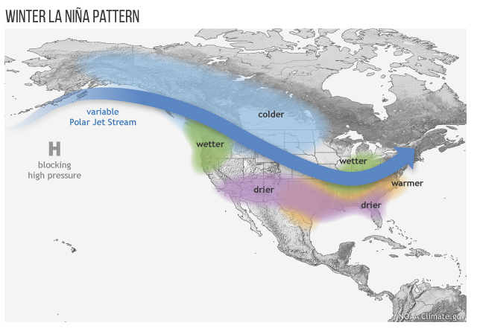
El Nino & La Nina Patterns
Notes:
Choose this or next slide

Slide 5
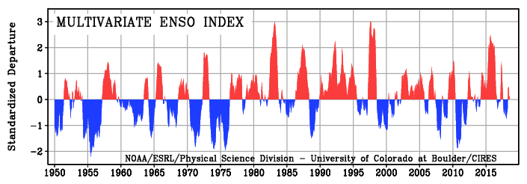
ENSO episodes since 1950

Slide 6
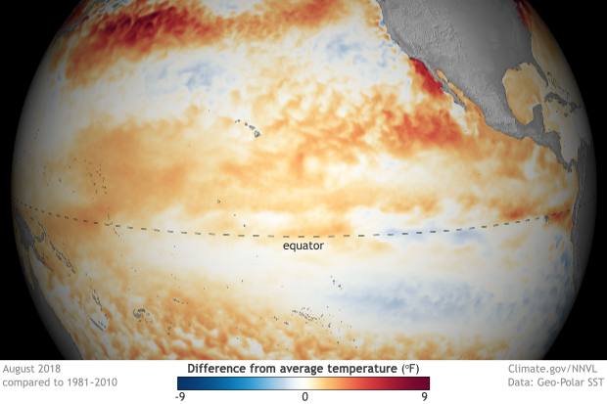
El Niño Developing
Notes:
Choose this slide or next el nino/la nina slide

Slide 7
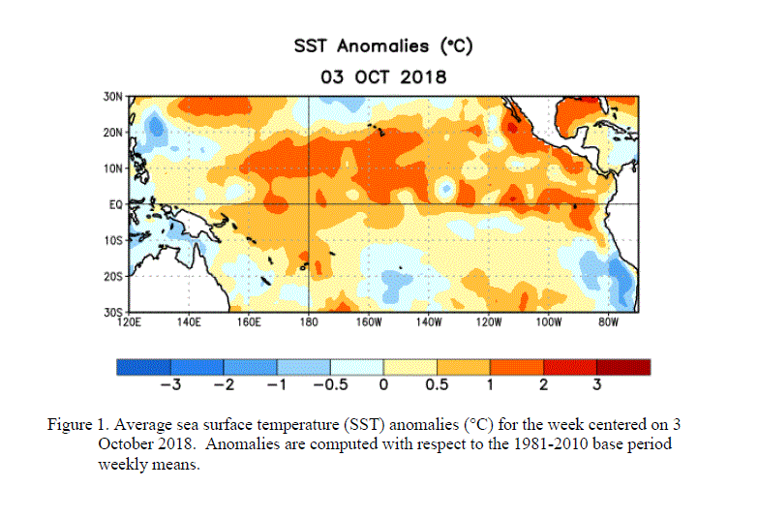
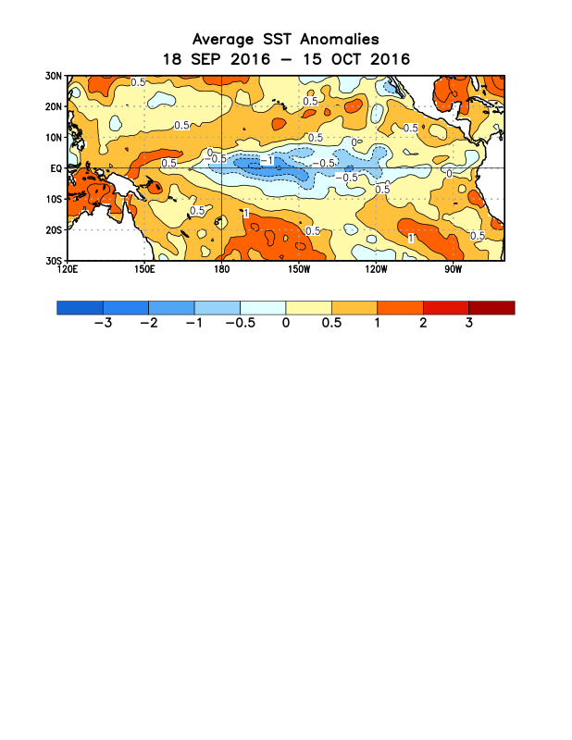
El Niño
Warmer than usual
West Coast So. America
Weak
La Niña
La Niña
Neutral
El Niño
-2.0°
(°C)
-1.0°
-0.5°
0.5°
1.0°
2.0°

Slide 8
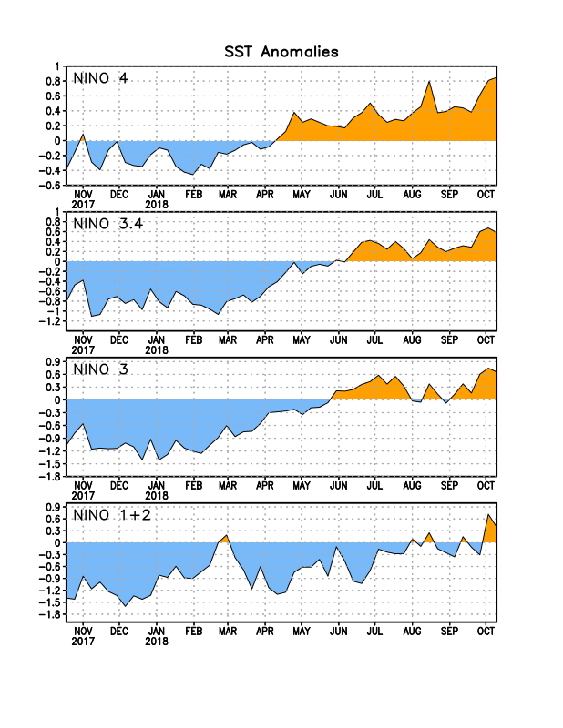
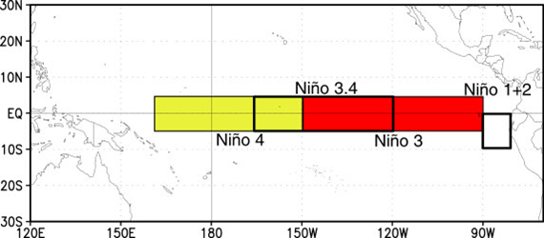
Niño Region SST Departures (ºC)
The latest weekly SST departures are:
Niño 4
0.9ºC
Niño 3.4
0.6ºC
Niño 3
0.7ºC
Niño 1+2
0.4ºC

Slide 9
Classifying ENSO Phases
  >1.9°C Very Strong El Niño
  1.5 to 1.9°C Strong El Niño
  1.0 to 1.4°C Moderate El Niño
  0.5 to 0.9°C Weak El Niño
  0.4 to -0.4°C Neutral
  -0.5 to -0.9°C Weak La Niña
  -1.0 to -1.4°C Moderate La Niña
  -1.5 to -1.9°C Strong La Niña
  <-1.9°C Very Strong La Niña

Slide 10
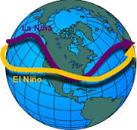
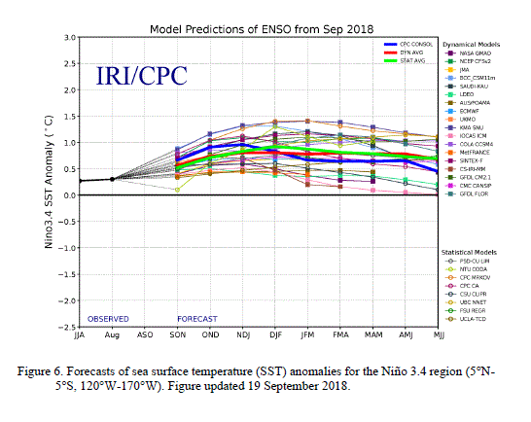
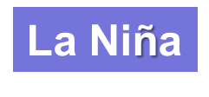
ENSO Outlook
El Niño
ENSO-Neutral
Model projections of ENSO conditions:
ENSO-Neutral conditions currently
Weak El-Nino now favored for fall and winter months

Slide 11
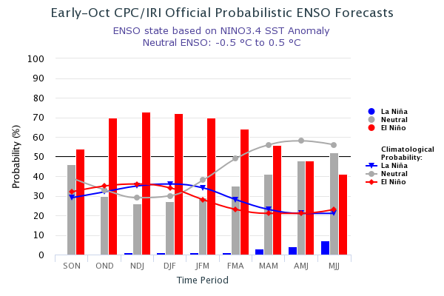
Probabilistic ENSO Outlook
El Niño is favored to form in the next couple of months and continue through the Northern Hemisphere winter 2018-19 (70-75% chance).

Slide 12
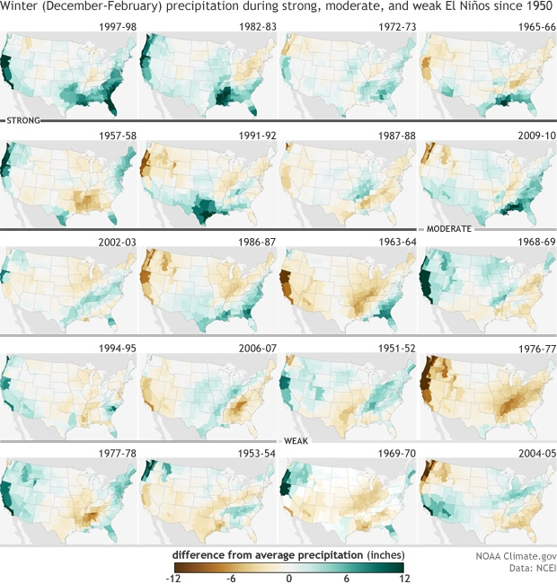
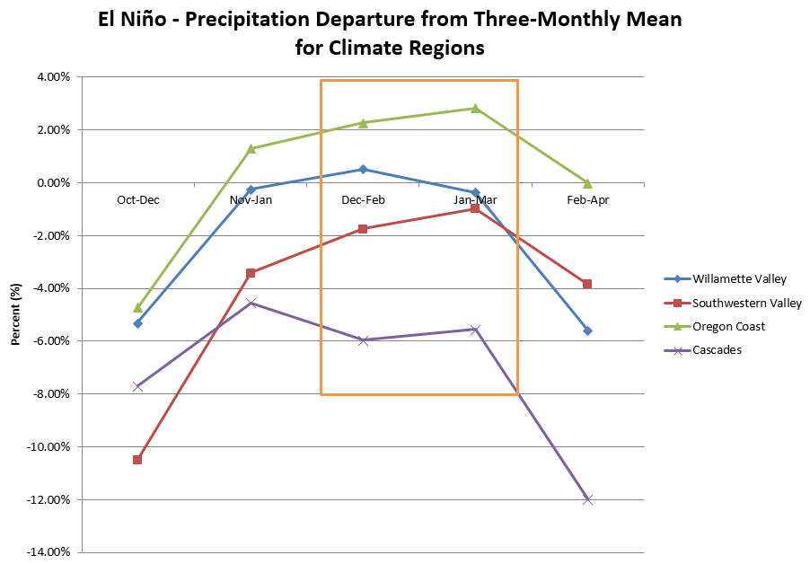
El-Nino Events
Model projections of ENSO conditions:
ENSO-Neutral conditions currently
Weak El Niño now favored for fall and winter months

Slide 13
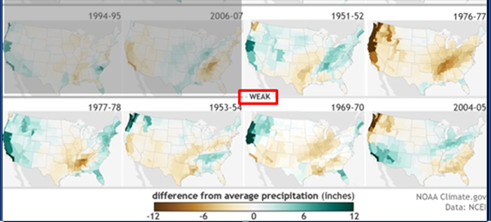
El-Nino Events

Slide 14
El-Nino Precipitation - Locally
Willamette Valley
Cascades
Oct-Dec
Nov-Jan
Dec-Feb
Jan-Mar
Feb-Apr

Slide 15
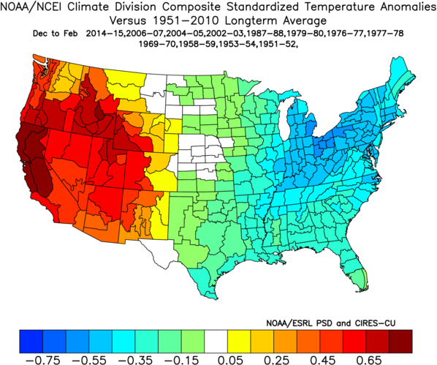
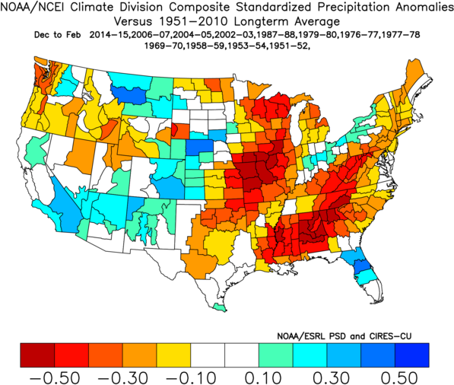
Weak El Nino Cases
1950-2010 Base Period
Temperature Anomalies
Precipitation Anomalies

Slide 16
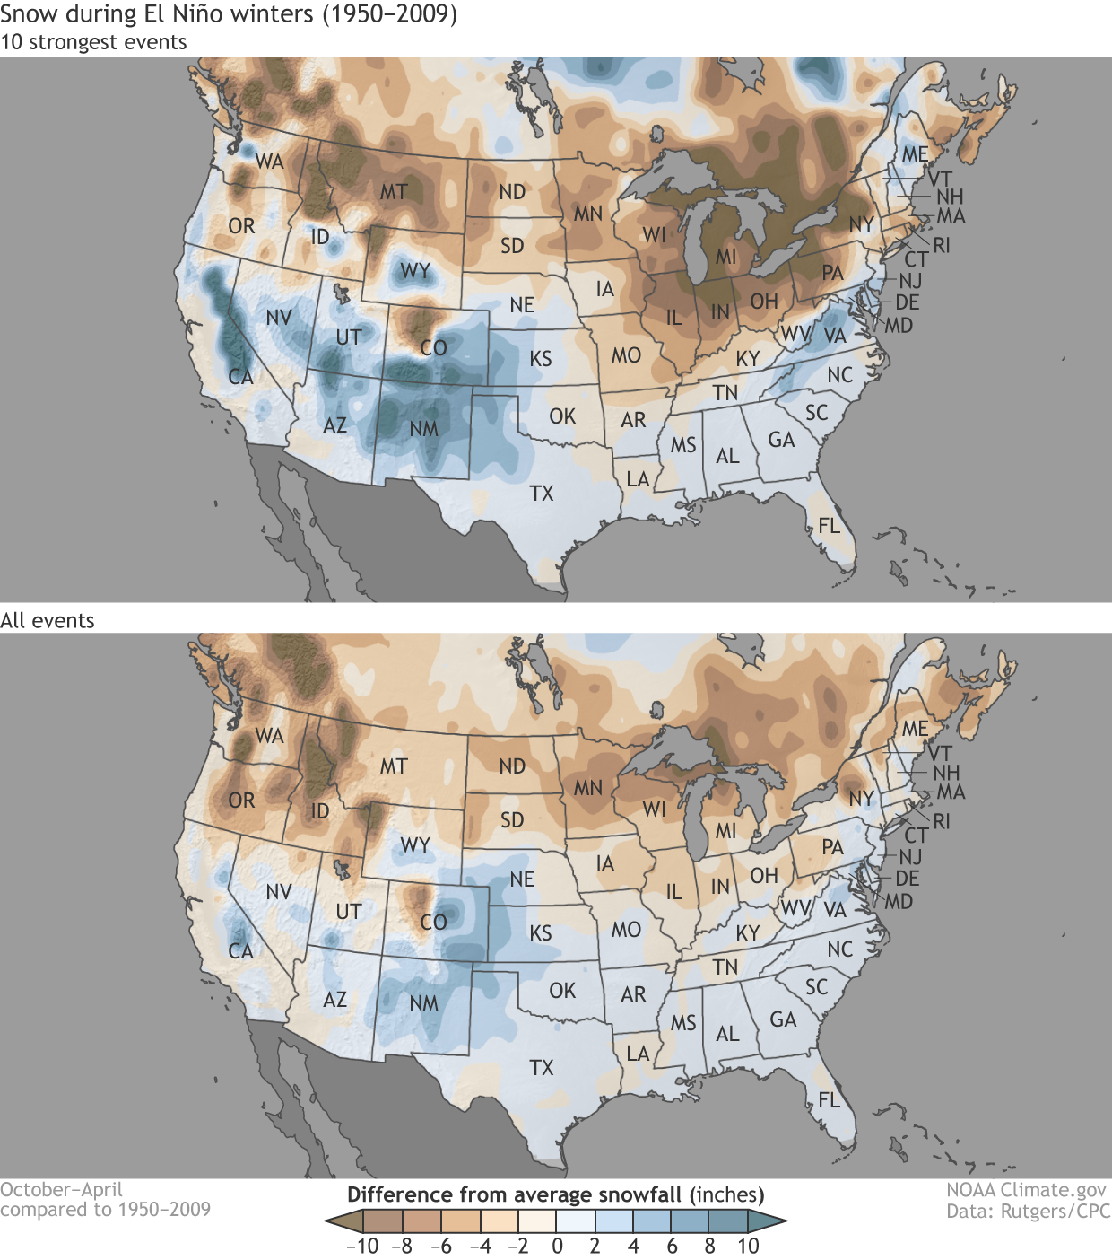
Snowfall Anomalies: El Niño years

Slide 17
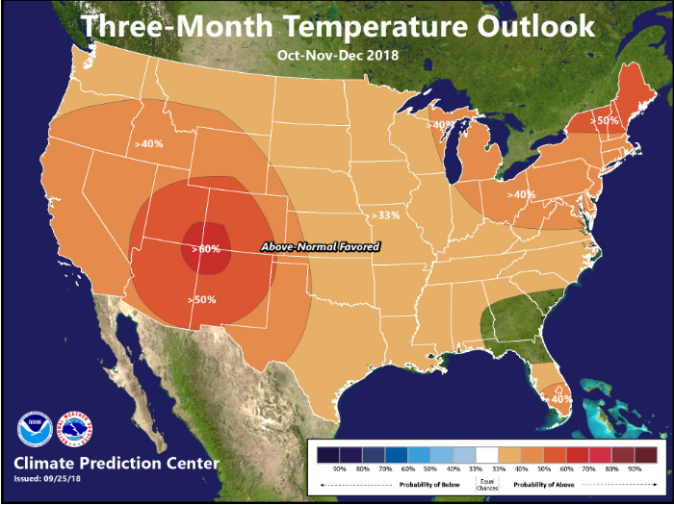
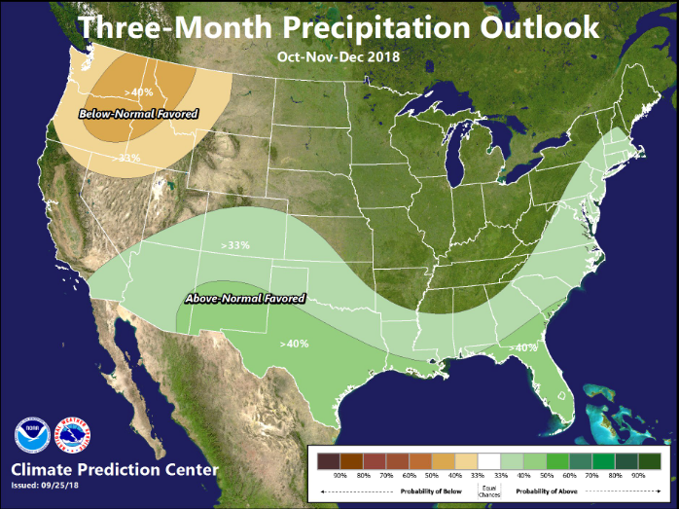
Seasonal Outlook
Oct-Nov-Dec 2018
Climate Prediction Center
http://www.cpc.ncep.noaa.gov/

Slide 18
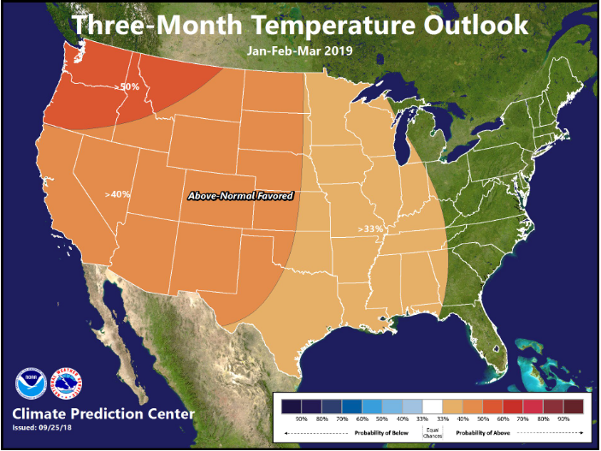
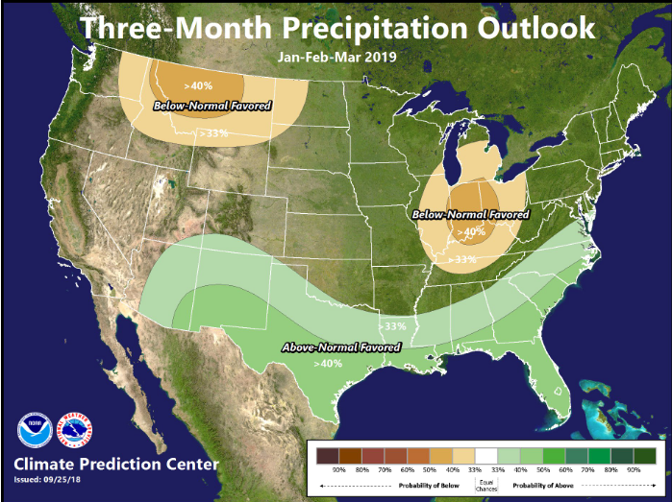
Seasonal Outlook
Jan-Feb-Mar 2019
Climate Prediction Center
http://www.cpc.ncep.noaa.gov

Slide 19
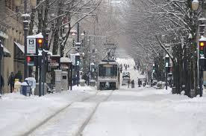
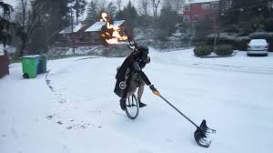
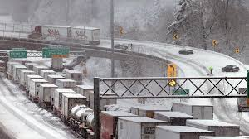
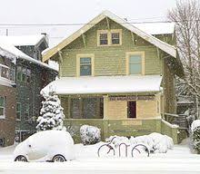
What about Snow Forecast?

Slide 20
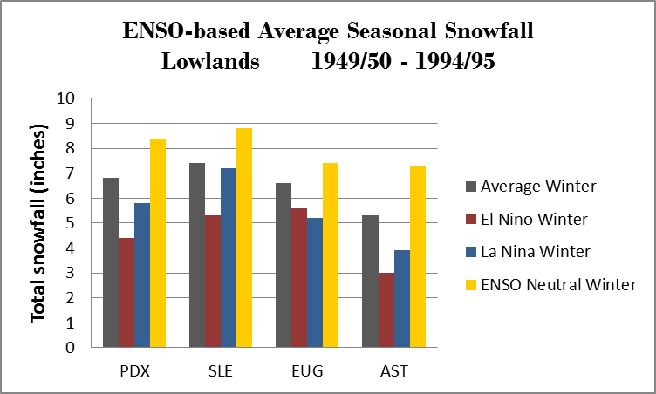
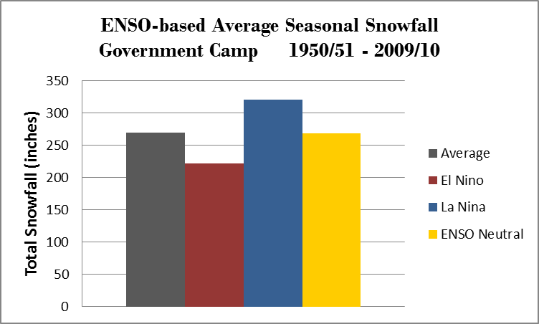
Snowfall History 1950 to 1995
Lowlands
Cascades

Slide 21
Lowland Snowfall History 1951 to 2015
Top 10 snowiest winters:
34.0” 1968-69 El Niño
24.2” 2008-09 ENSO Neutral
22.4” 1955-56 La Niña
20.3” 1959-60 ENSO Neutral
17.4” 1992-93 ENSO Neutral
16.3” 1979-80 ENSO Neutral
14.7” 1970-71 La Niña
13.4” 1964-65 ENSO Neutral
12.0” 1994-95 El Niño
10.5” 1953-54 ENSO Neutral
60% were ENSO Neutral
20% were La Niña
20% were El Niño

Slide 22
Lowland Snowfall History 1951 to 2015
20 snow-shutout winters:
(Trace or 0 snowfall)
9 were El Niño winters
8 were ENSO Neutral winters
3 were La Niña winter
45% were El Niño
40% were ENSO Neutral
15% were La Niña

Slide 23
Summary
Weak El-Nino favored for winter (70-75% chance)
Favored this Winter:
  Temperature: Above average
  Precipitation: Slightly below average favored, but uncertainty exists
  Snowpack: Likely a little below average
Remember:
  High impact weather events possible in any ENSO state (low-elevation snow, damaging wind, flooding)
  As always, be prepared for the any type of extreme weather Mother Nature sends our way in Oregon this winter!

Slide 24
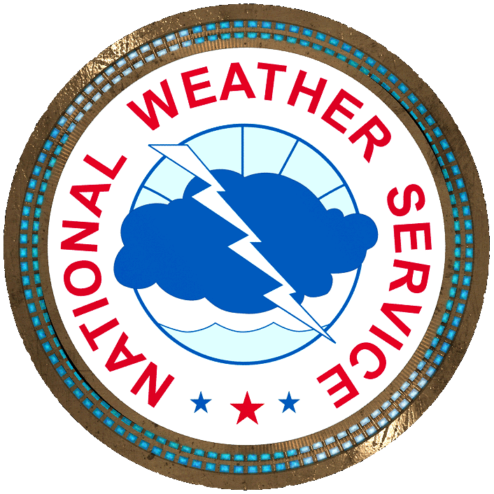

Thank You

Slide 25
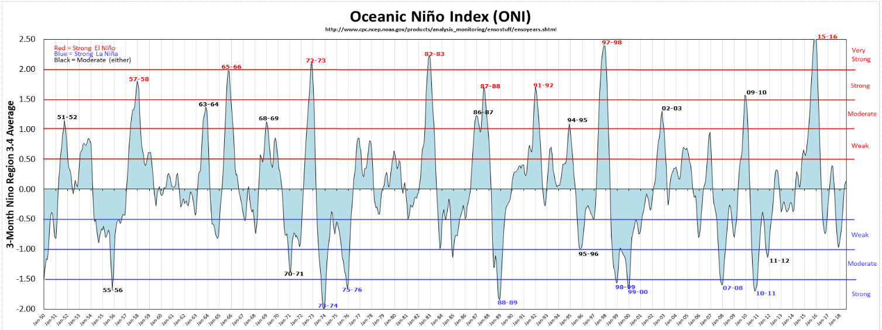
Extra Slide

