Slide 1
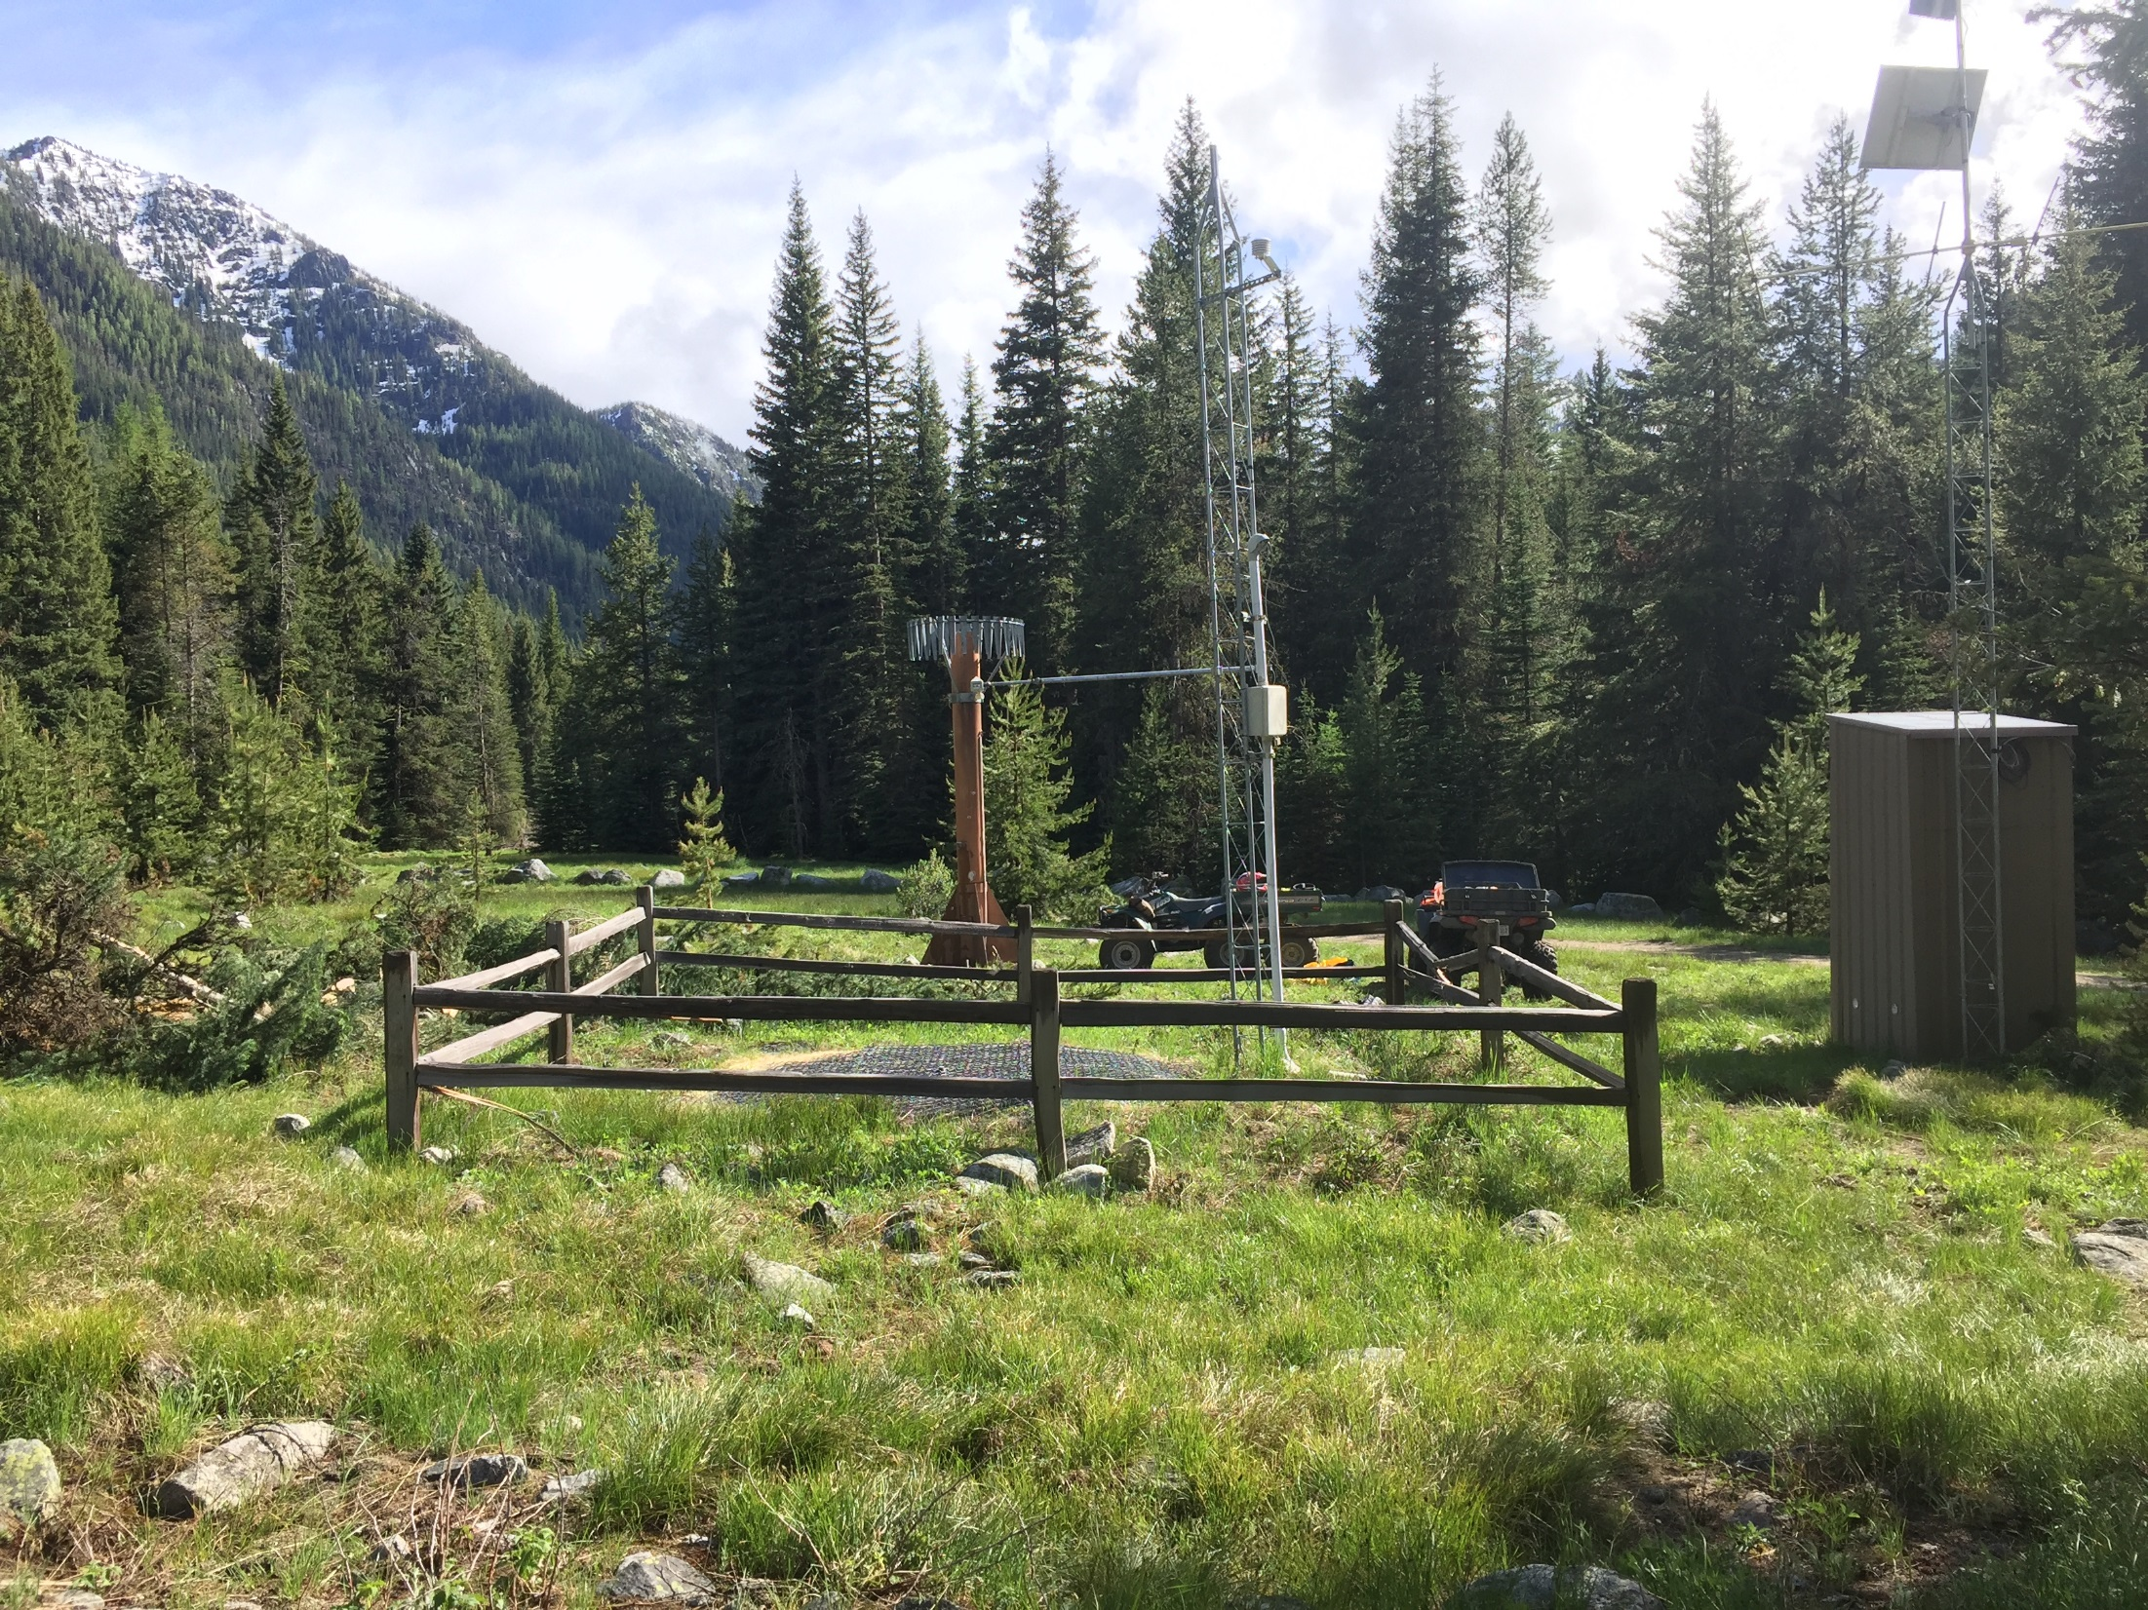
American Meteorological Society - Portland Oregon Chapter Meeting
April 24, 2018
H. Scott Oviatt
Snow Survey Supervisory Hydrologist
USDA Natural Resources Conservation Service
Scott.Oviatt@or.usda.gov
503-414-3271
http://www.nrcs.usda.gov/wps/portal/nrcs/main/or/snow/

Slide 2

TOPICS
Overview of History of NRCS Snow Survey and Water Supply Forecasting Program
Snow Survey Data uses and Products
Synopsis of 2018 Water Year to date

Slide 3
OVERVIEW
Approximately 50-80% of western water supply comes from snowmelt run-off
Measurement of snow water content for determination of water supply has been on-going for over 100 years
Due to the significance of snowmelt run-off as a major contributor to streamflow, the federal government funded a program to measure western snowpack and ultimately forecast future streamflows volumes
Snow measurements are conducted using several methods, both manual and automated
Forecasts and numerous other products generated from snow data are used for water supply, drought identification, recreation, flood forecasting, and many other applications

Slide 4
Brief History - Snow Survey Measurement and Water Supply Forecasting in the West
Snow has been measured and data disseminated in the Western United States for over 100 years, beginning with Dr. James Church in Lake Tahoe Region in 1906-1910.
Snow surveys were initiated with the concept that streamflow could be forecast using snow data as a primary input. Cooperative snow survey programs were established in:
  California 1917
  Nevada, Wyoming 1919
  Washington 1920
  Montana 1922
  Utah 1923
  Oregon 1928
  These programs were administered by cooperators, such as State Engineers, Irrigation Districts, Power and Utility Companies, Universities

Slide 5
Brief History - Snow Survey Measurement and Water Supply Forecasting in the West
(continued)
In 1935 cooperatives were brought under federal coordination after the 1934 drought. Among the agencies considered to administer the new program were the Weather Bureau (then a part of USDA) and the Forest Service.
The program was merged into the Bureau Of Agricultural Engineering (USBAE). In 1939 USBAE was transferred to Soil Conservation Service, (SCS) Research Division.
In 1953, the SCS Research Division was transferred to Agricultural Research Service (ARS), however the Snow Survey program remained an SCS program.
In 1994, SCS became the Natural Resources Conservation Service (NRCS), snow surveys remains a program within the agency

Slide 6
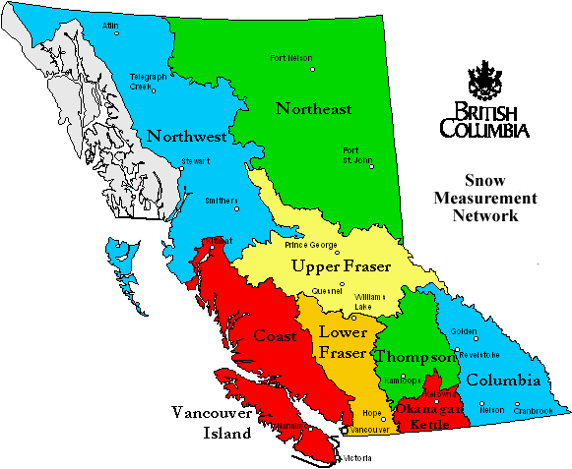
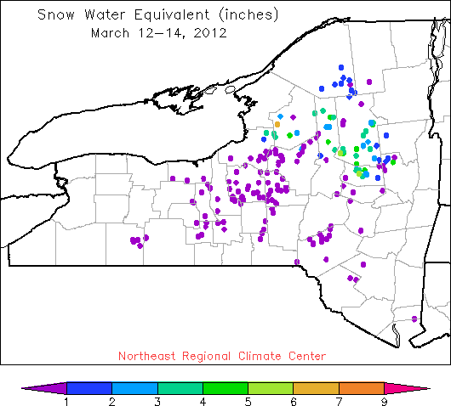
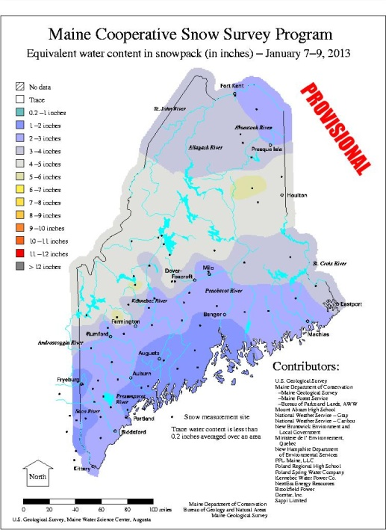

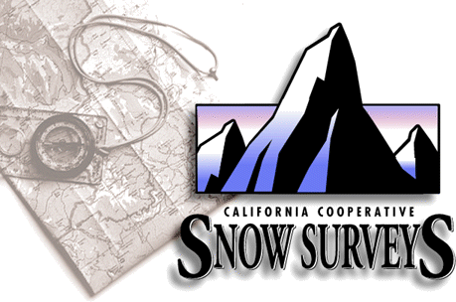
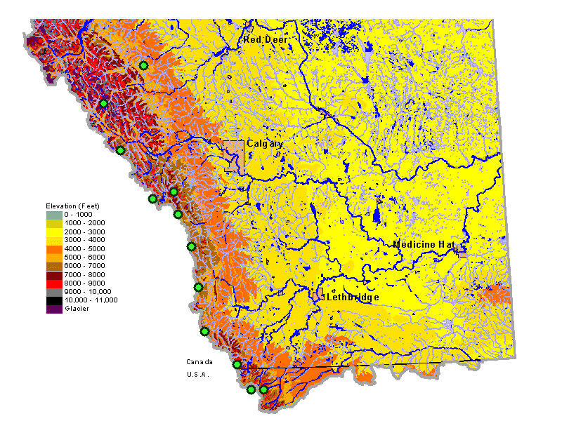
Notes:
6
Other agencies that gather snow information in the West are: California Cooperative Snow Surveys, British Columbia Hydro, and Alberta Environment. There are individual state cooperative snow survey programs in the East.

Slide 7
COMMON TERMINOLGY
SWE = Snow Water Equivalent, the depth of water in inches if snow was melted to liquid
Water Year Precipitation = The amount of precipitation (liquid and frozen)
Accumulated from October 1 through date of reference. Water year 2018 is the period – October 1, 2017 through September 30, 2018
Streamflow Forecast = A water supply forecast issued on the first of each month (from January through June). Refers to the volume of water
(Thousands of Acre Feet) forecast to pass by a real-time stream gaging station.

Slide 8
Data Collection Efforts
Snow Courses:
Site maintenance, data collection, quality control and archival
SNOTEL Sites:
  Site maintenance/repair, data collection, quality control and archival
Snow and water supply data analysis, interpretation, and dissemination:
Develop and release state water supply outlook reports
Handle media contacts and issue news releases
Work with state and federal entities in assessing/mitigating flood and drought conditions

Slide 9
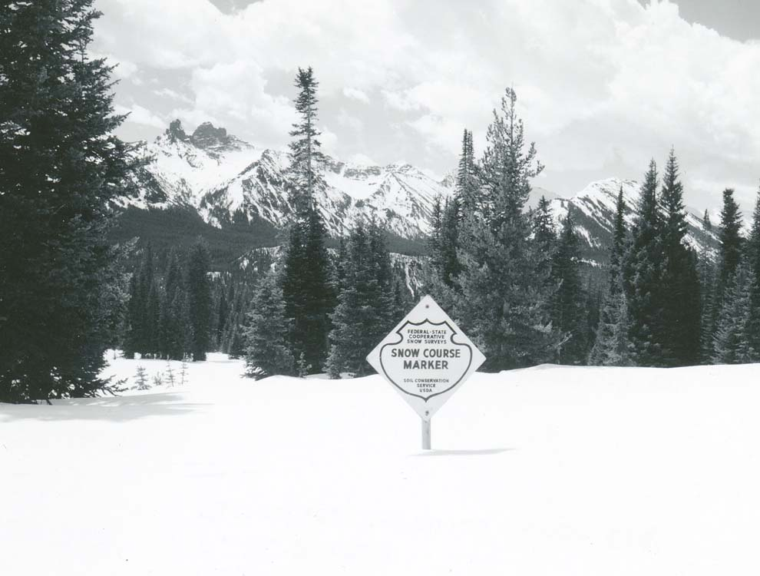
SNOW COURSES
155 Snow Courses & Aerial Markers
Manual Monthly Measurements:
Snow Water Equivalent (SWE)
Snow Depth

Slide 10
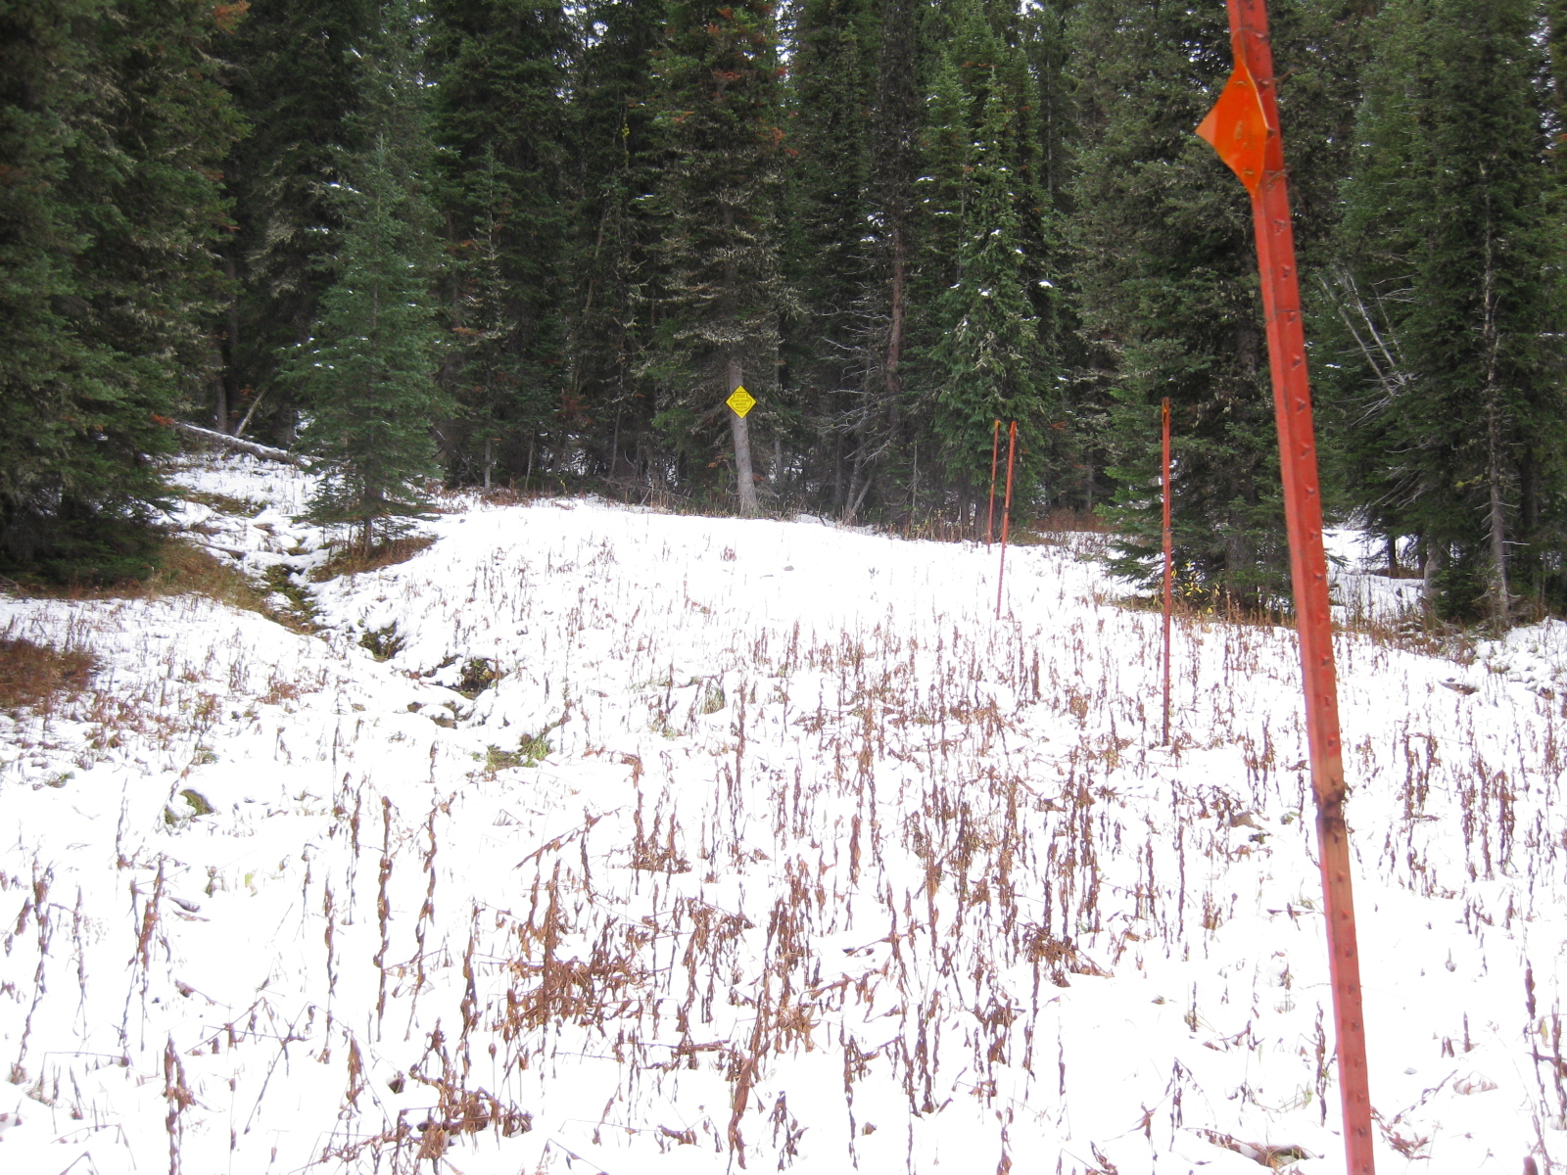

Slide 11
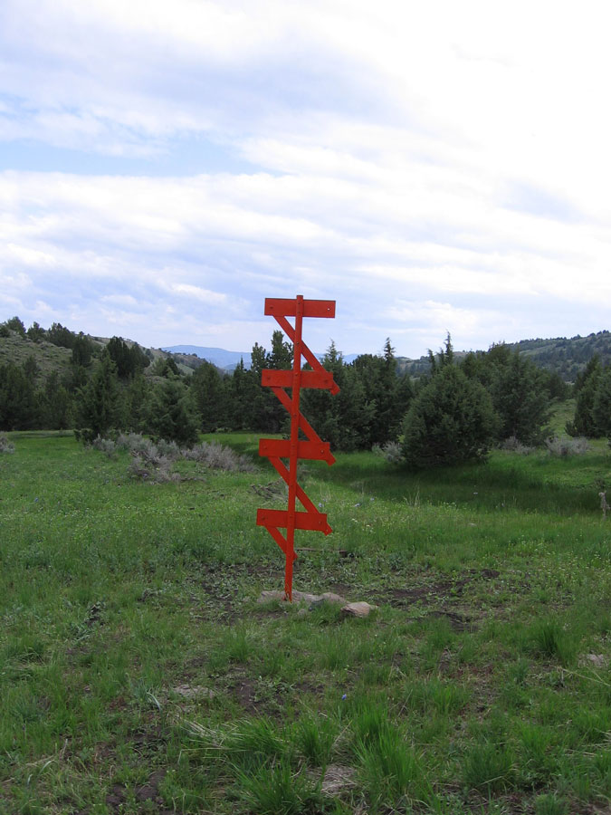
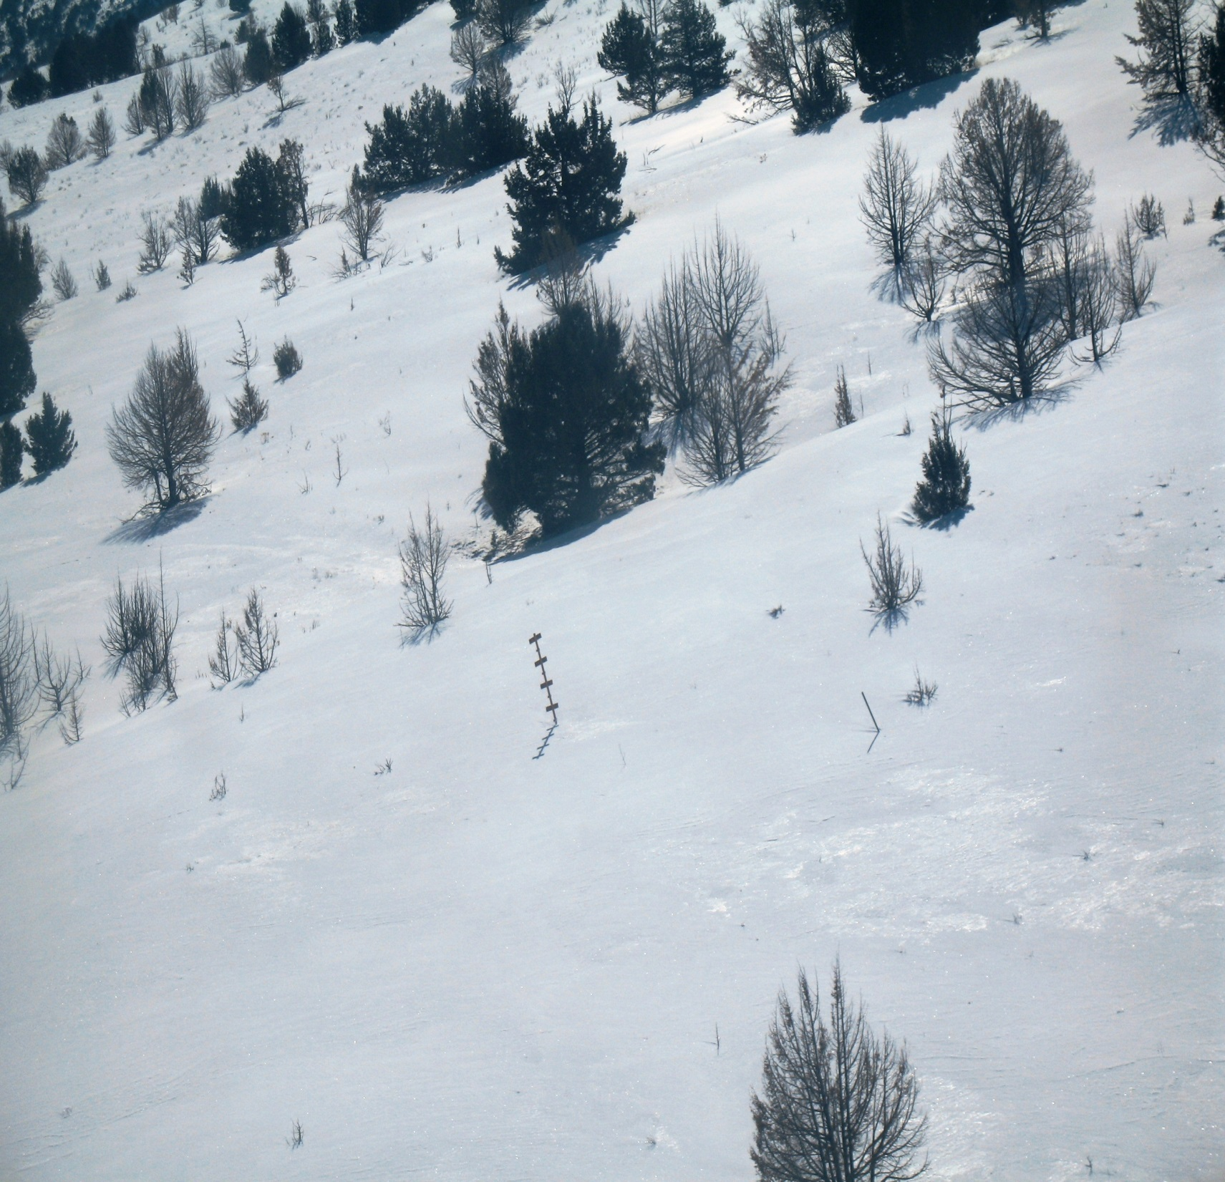
Aerial Markers
Manually
Measured
Monthly
Data

Slide 12
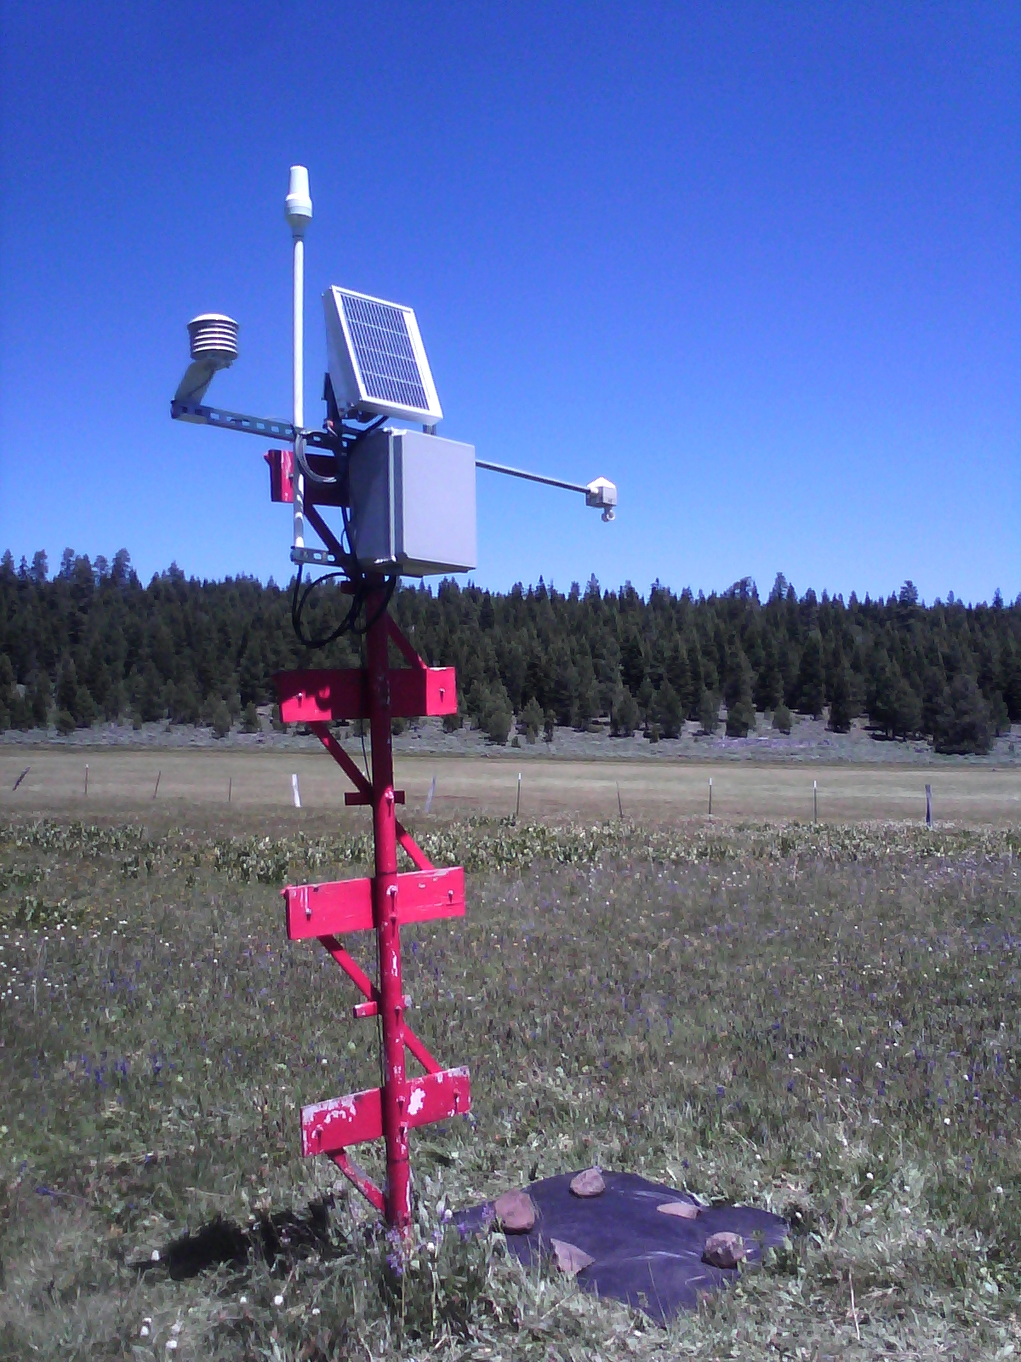
SNOLITE SITES
Satellite Antenna
Solar Panel
Air Temperature Sensor
Snow Depth Sensor
18 SNOLITE (Automated Aerial Marker) Sites
Automated Telemetered Measurements:
Air Temperature
(Max, Min, Current, Average)
Snow Depth

Slide 13
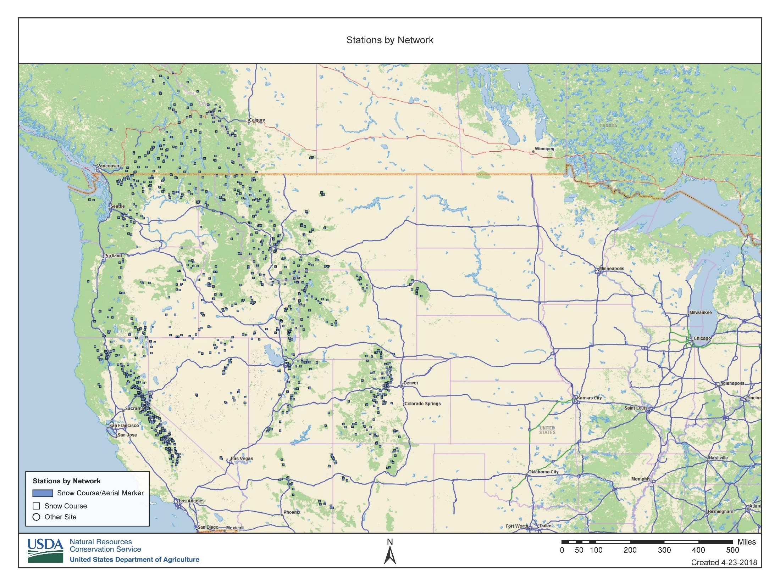
Manual Snow Courses and Aerial Markers

Slide 14
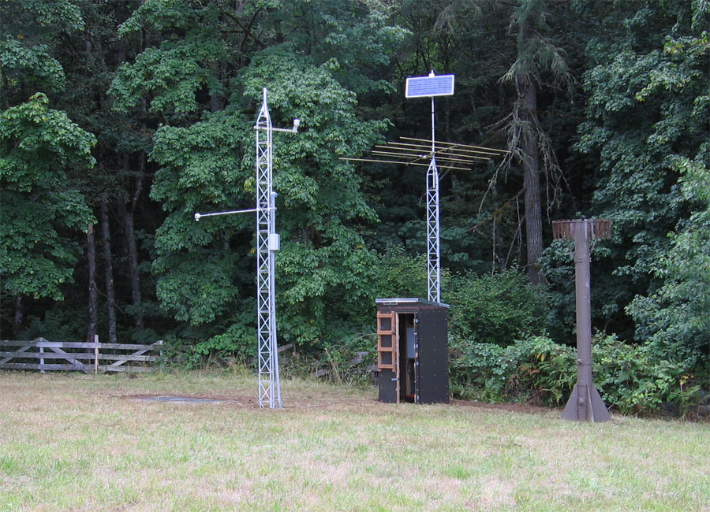
156 Automated SNOwpack TELemetry (SNOTEL) Sites
Automated Telemetered Measurements:
Snow Water Equivalent (SWE)
Precipitation (Rain and Frozen)
Air Temperature (Max, Min, Current, Average)
Snow Depth
Wind Speed and Direction*
Relative Humidity*
Solar Radiation*
Soil Moisture and Soil Temperature*
*Parameters measured at select sites
SNOTEL
Automated
Daily &
Hourly Data
Air Temperature Sensor
Antenna and Solar Panel
Snow Depth Sensor
Snow Pillow
Precipitation Storage Gage

Slide 15
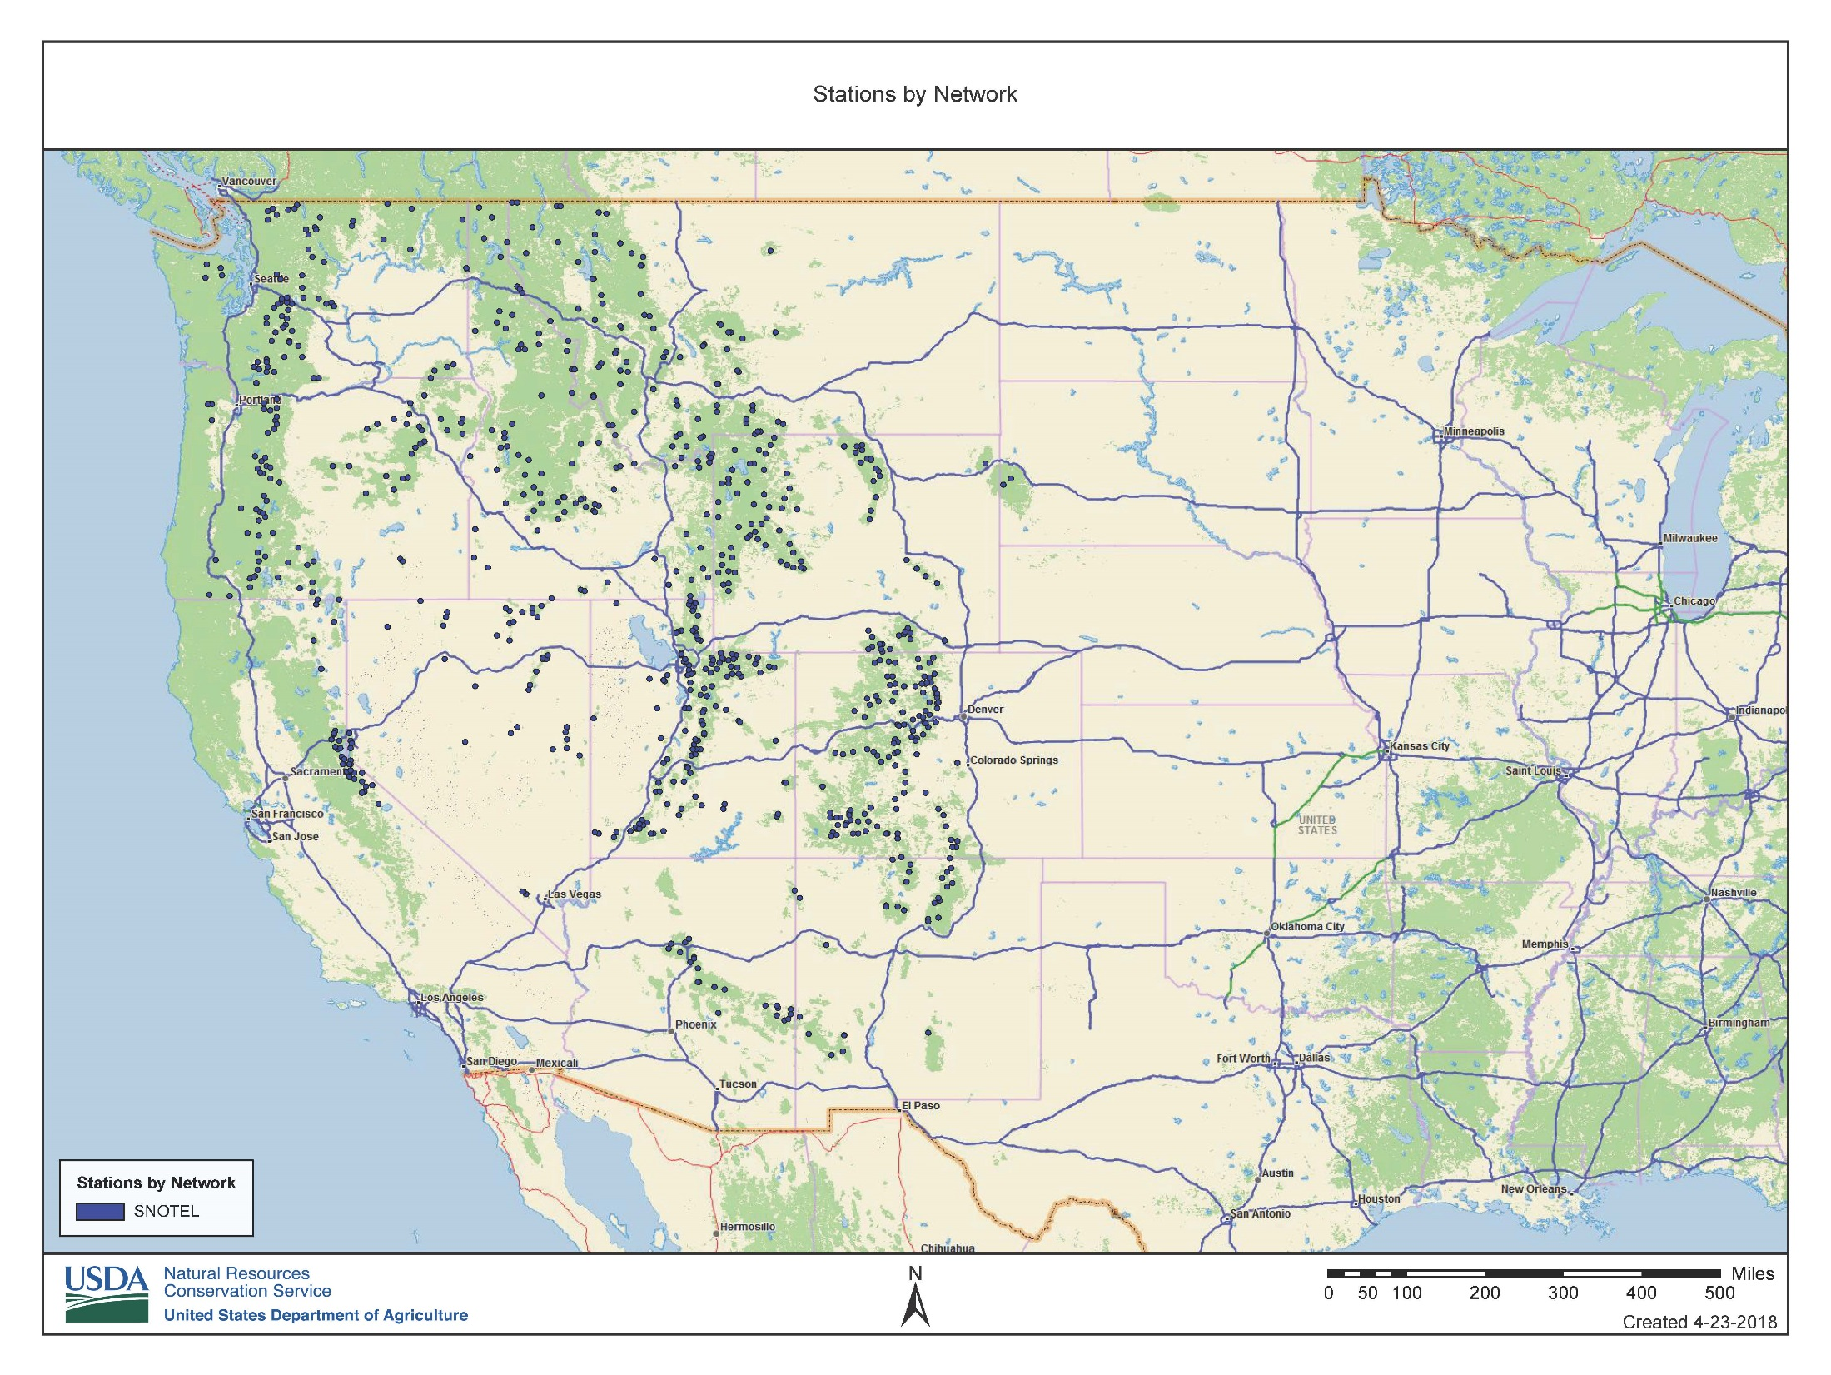
Automated SNOTEL Sites

Slide 16
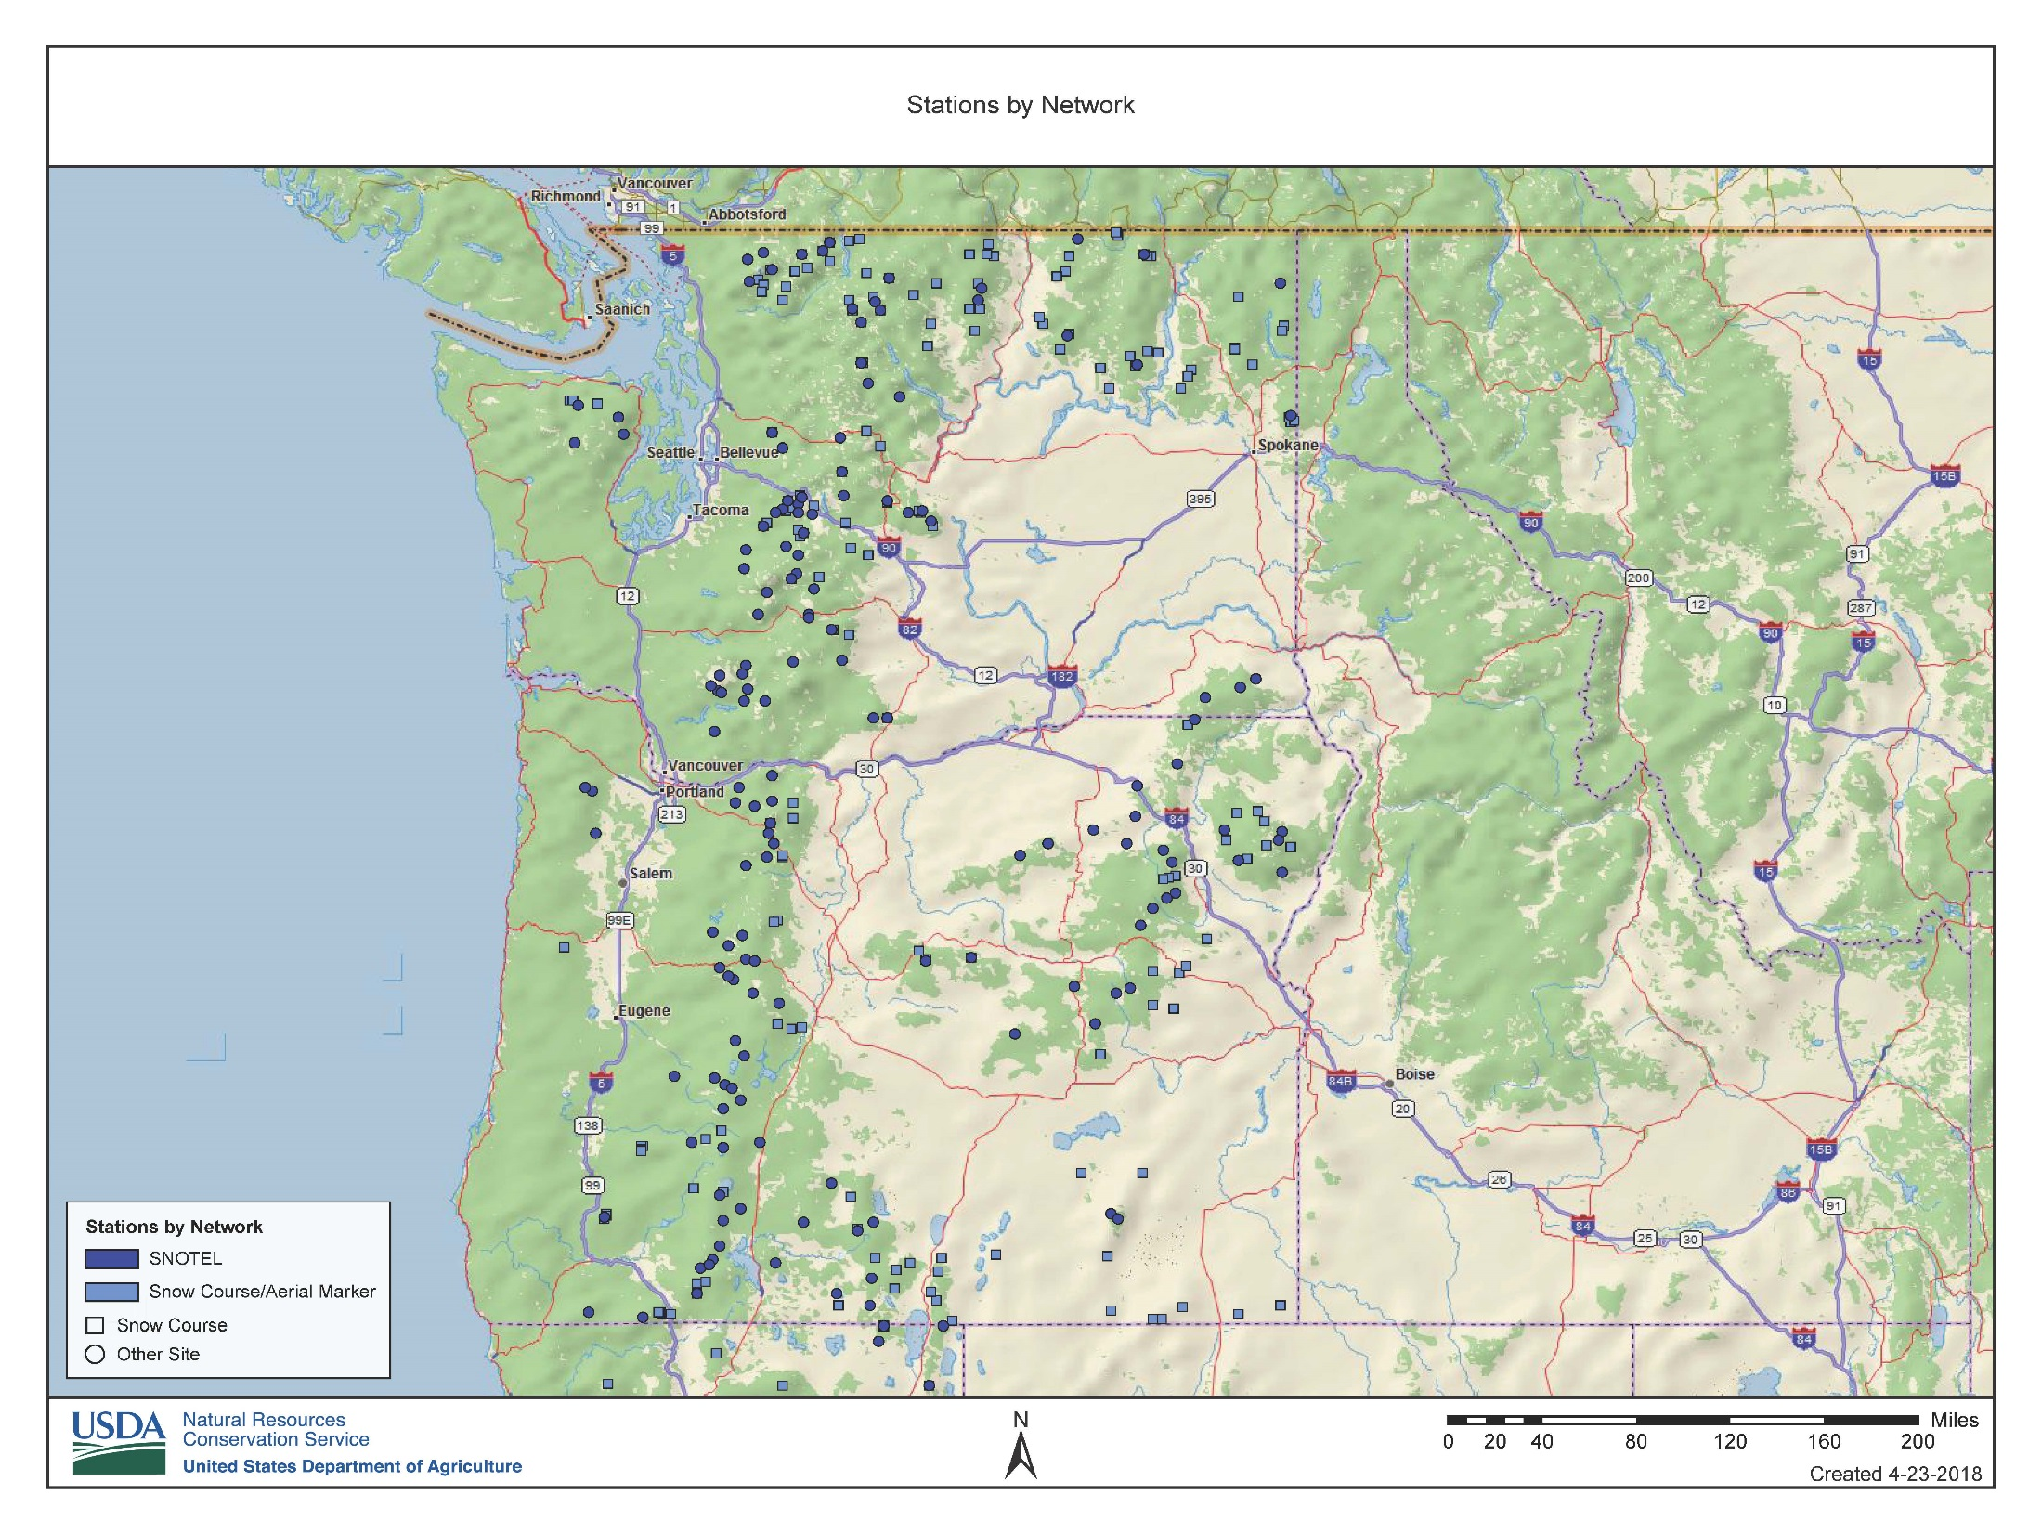
NRCS Oregon Responsibility

Slide 17
NRCS Surface Water
Supply Forecasting
SCS/NRCS forecasting began as a result of legislation to provide water supply forecasts for agriculture in the West in the 1930s.
Forecasts were initially concentrated on small headwater basins, primarily for irrigation purposes such as flow past USGS stream gages, reservoir inflows, and streamflow.

Slide 18
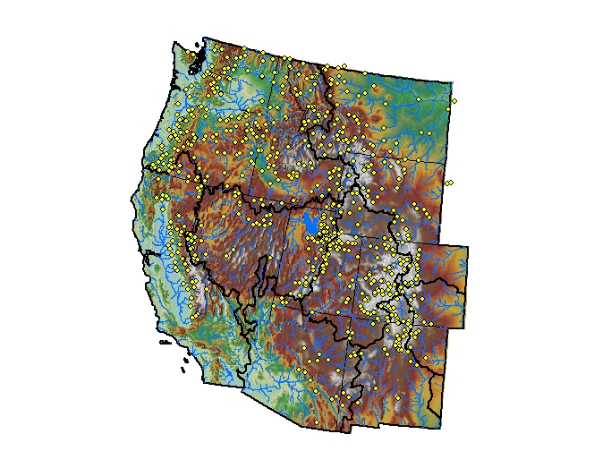
NRCS Forecast Points
OVER 10,000 NRCS Forecasts issued West-wide (Annually)
NRCS uses statistical forecasting models to relate SWE and Water Year Precipitation at SNOTEL sites to USGS or equivalent real-time stream gaging stations
OVER 700
FORECAST POINTS
IN THE WEST
January 13, 2006
Notes:
18

Slide 19
TYPES of FORECASTS
    Seasonal Volume
    Peak or Stage
    Recession
    Full Hydrograph
Notes:
19

Slide 20
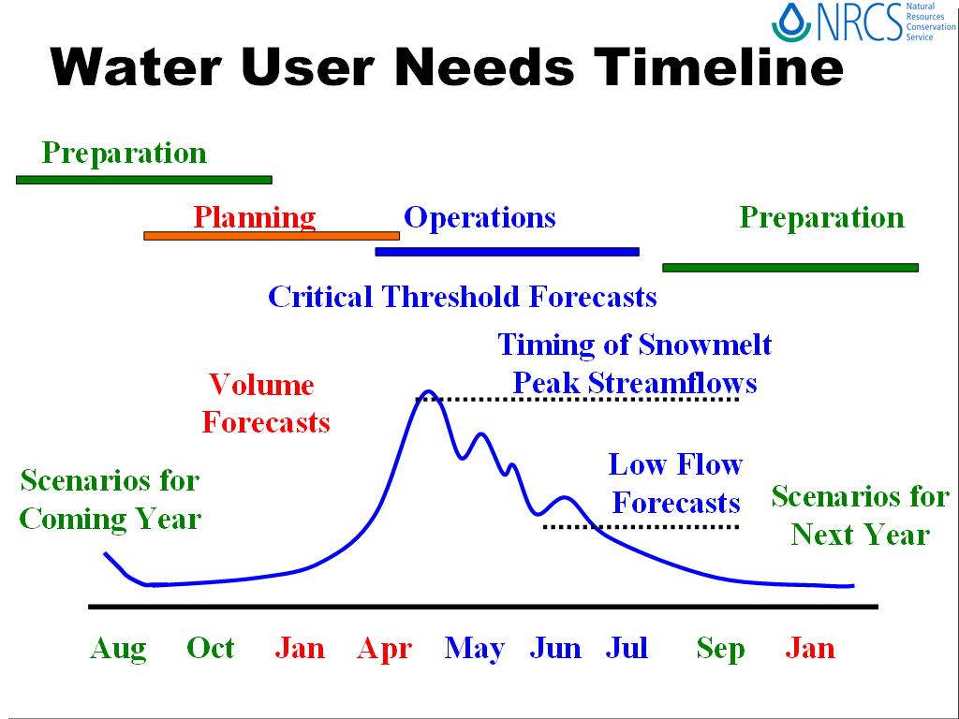

Slide 21
Forecasting Challenges
  Early season forecasts have many unknowns based on future conditions
  Forecasting future weather/climate
    Precipitation and temperature variability
  Unknown basin physical processes
      Geomorphology, Soils, Vegetation Influences
  Extremes
    Record precipitation, temperatures, streamflow
  Multi-year persistence

Slide 22
USERS and USES of NRCS Data, Forecasts,
Products, and Reports
Federal Agencies
USGS
USFS
Other USDA
USACE
USDI-BOR
National Weather Service
NWS - River Forecast Centers
NOAA
NASA
NPS
NIDIS
State and Local Groups
OWRD
ODF
ODFW
ODA
Local Water Managers
Irrigation Districts and Companies
Municipalities
State Water Supply Availability Committee
State Drought Readiness Council
Power Companies
University Researchers
Avalanche Centers
Producers and Ranchers
Recreationists and Tourism Groups
Irrigation is critical to agriculture
in the US. Nearly 50% of the value
of commodities sold comes from
the 16% of irrigated cropland.

Slide 23
Future Developments
Snow measurements:
  Fluidless snow pillow and precipitation systems
  Remote-sensed Gamma, LIDAR, other
  Modeled snowpack (SNODAS)
  Continued manual measurements to supplement automated readings
  Ground-based data collection required to verify remote sensing data
Improving forecasts:
  More accurate data
  Additional data and data types
  Improving weather forecasts
  Development of physical hydrologic models (precipitation-runoff modeling system - PRMS)

Slide 24
2018 Current Conditions

Slide 25
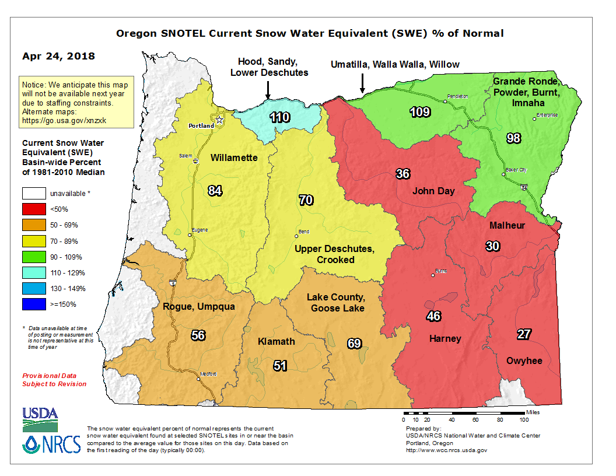
Statewide SNOTEL Snowpack is 78% of normal

Slide 26
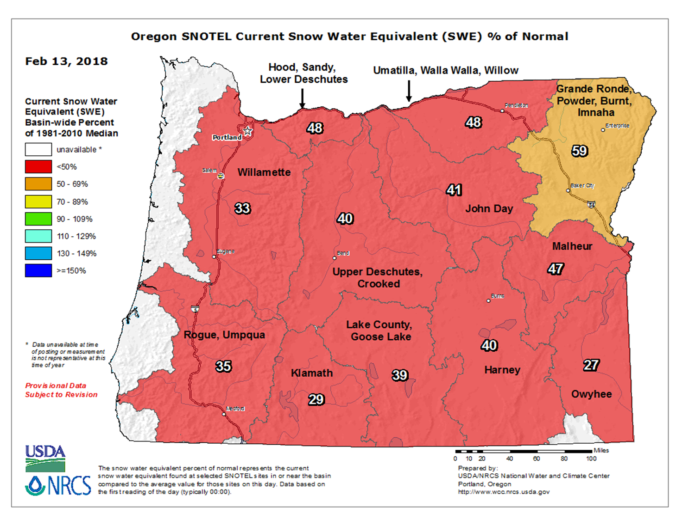
Statewide SNOTEL Snowpack was 38% of normal

Slide 27
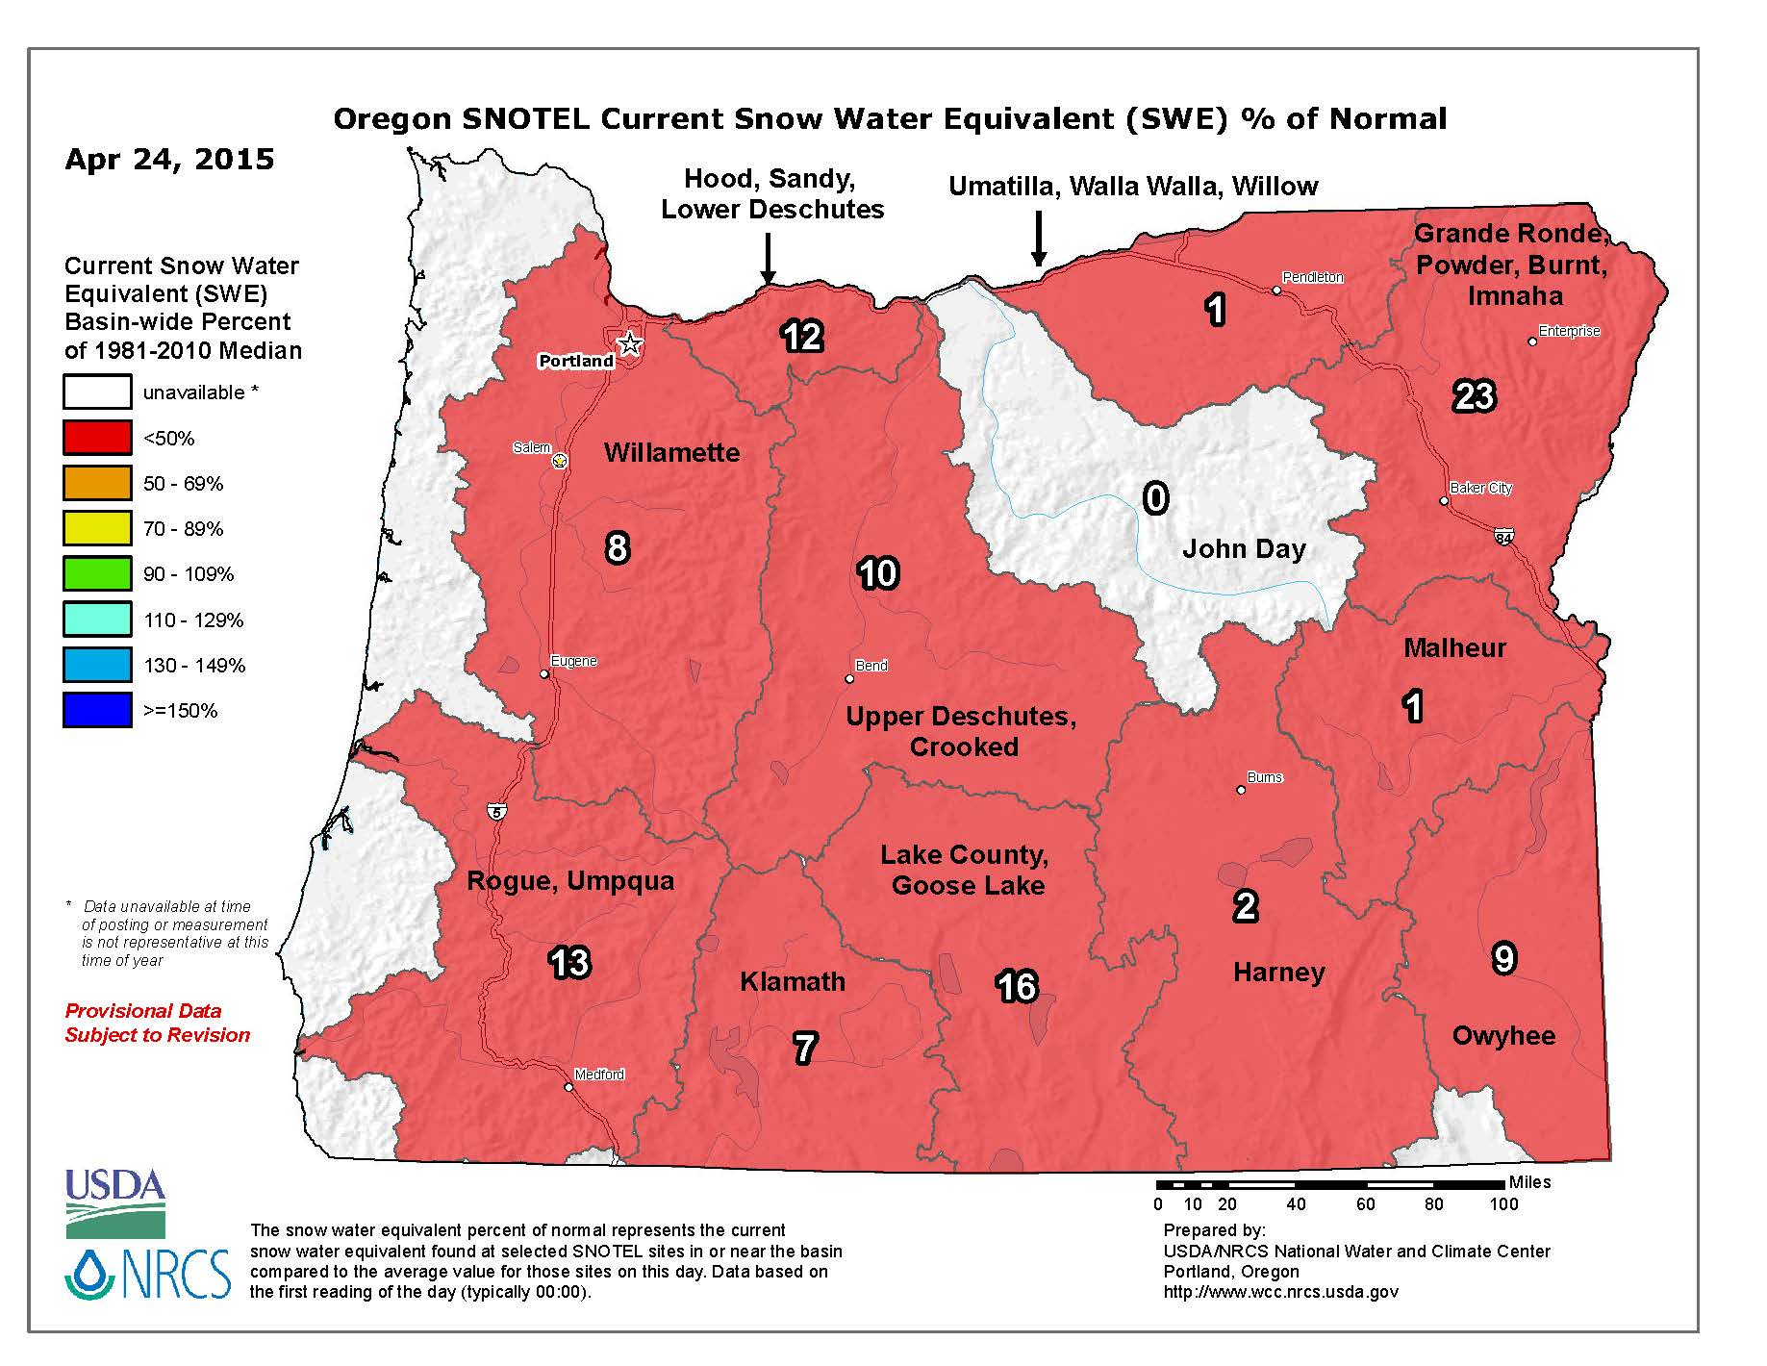
Statewide SNOTEL Snowpack was 13% of normal

Slide 28
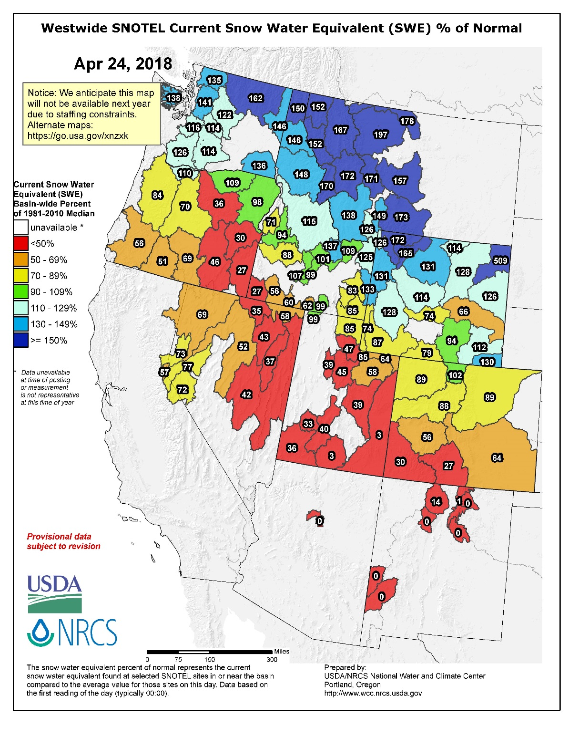
West-Wide Snowpack – April 24, 2018

Slide 29
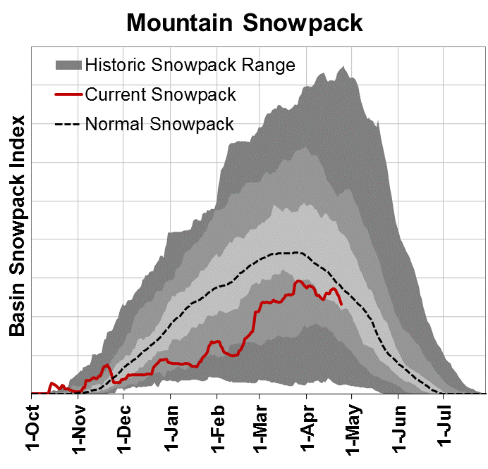
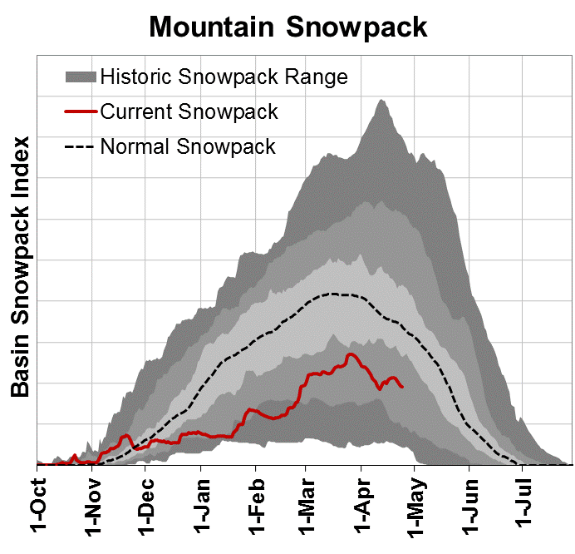
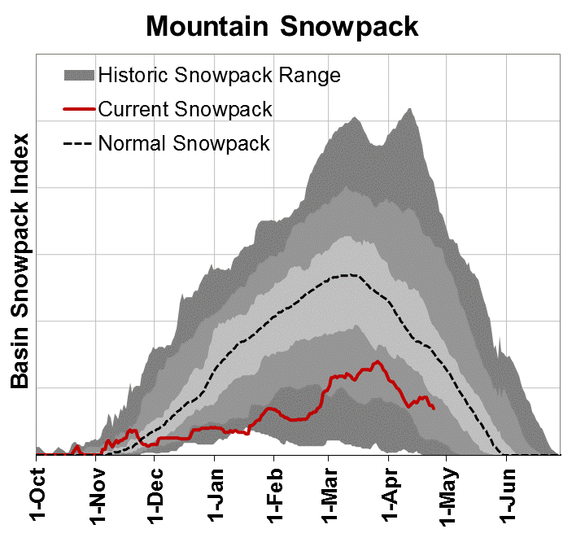
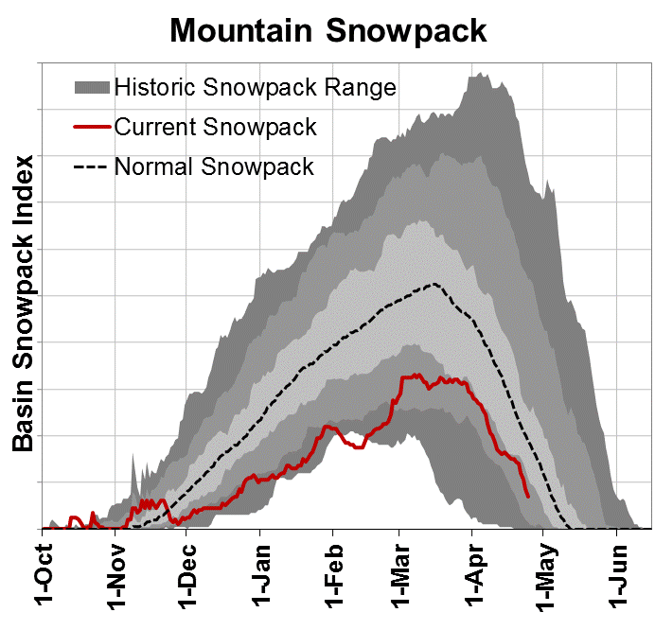
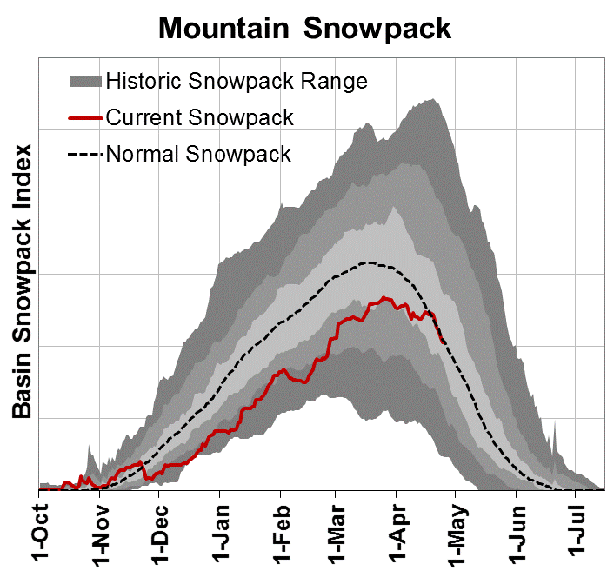
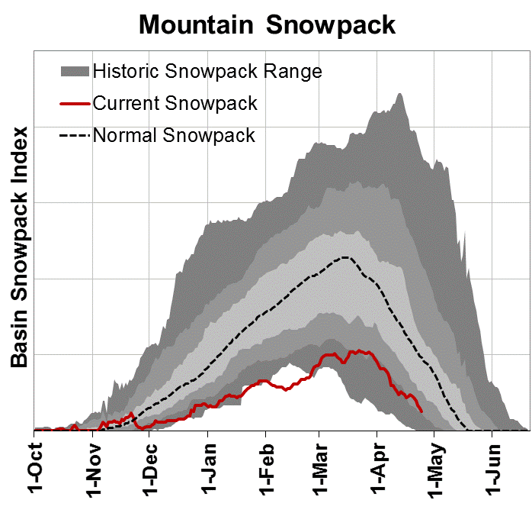
Water Year 2018
Willamette
Rogue/Umpqua
Klamath
John Day
Grande Ronde/Powder/Burnt
Owyhee/Malheur

Slide 30
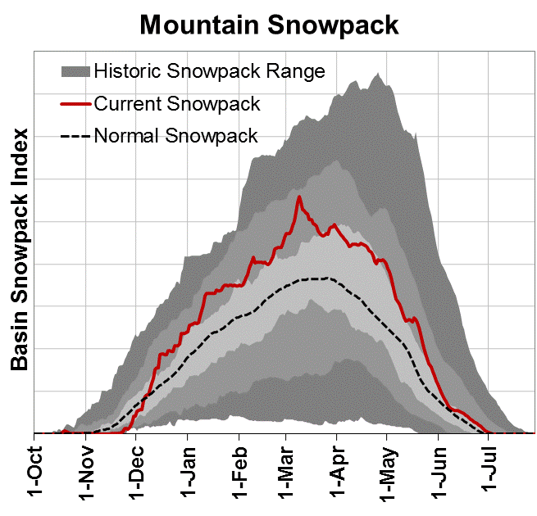
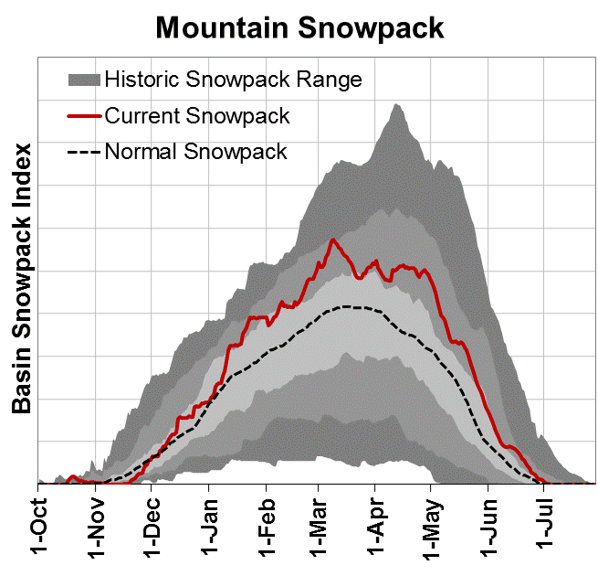
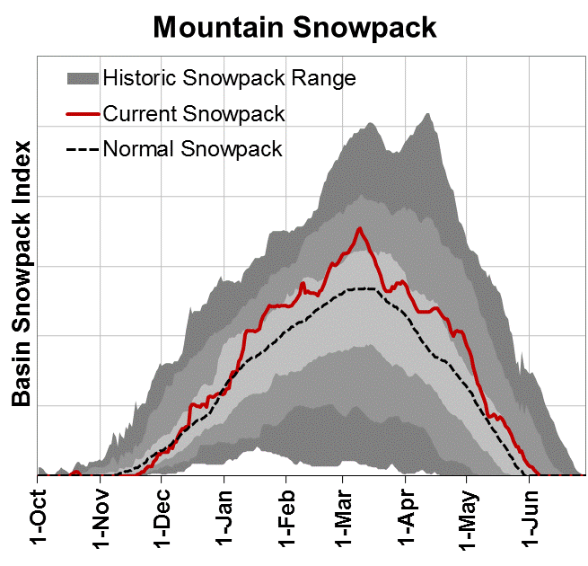

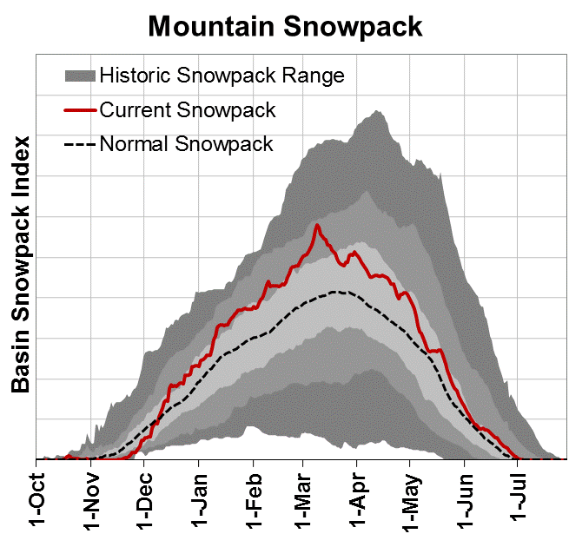
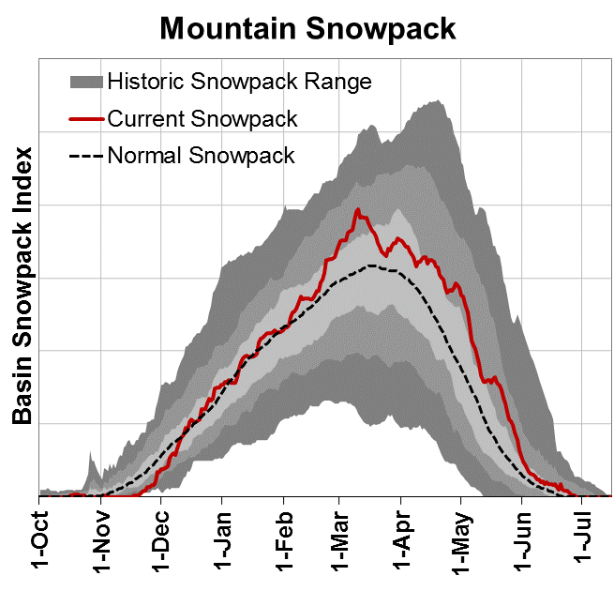
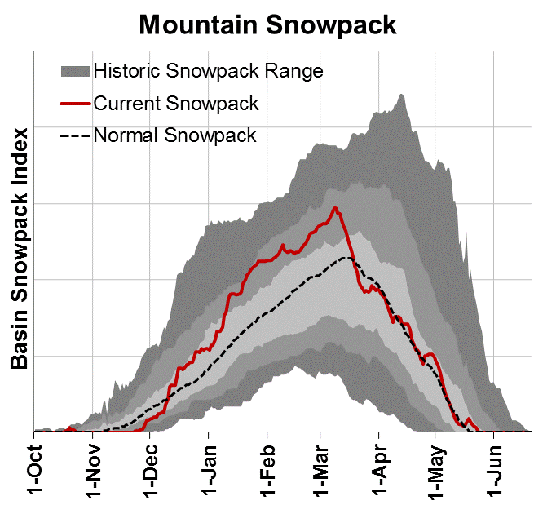
Water Year 2017
Willamette
Rogue/Umpqua
Klamath
Deschutes
Owyhee/Malheur

Slide 31
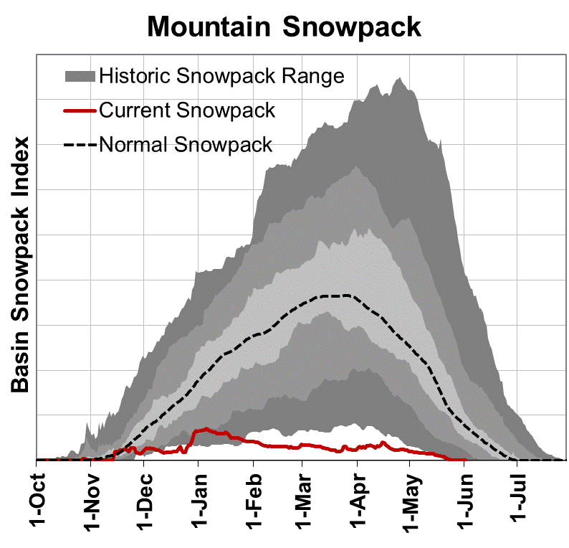
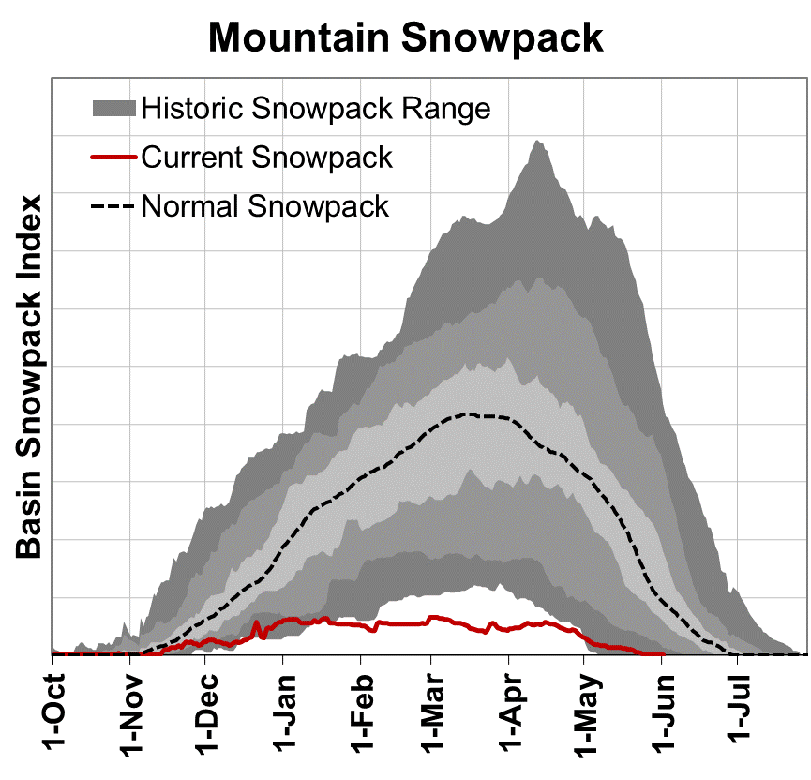
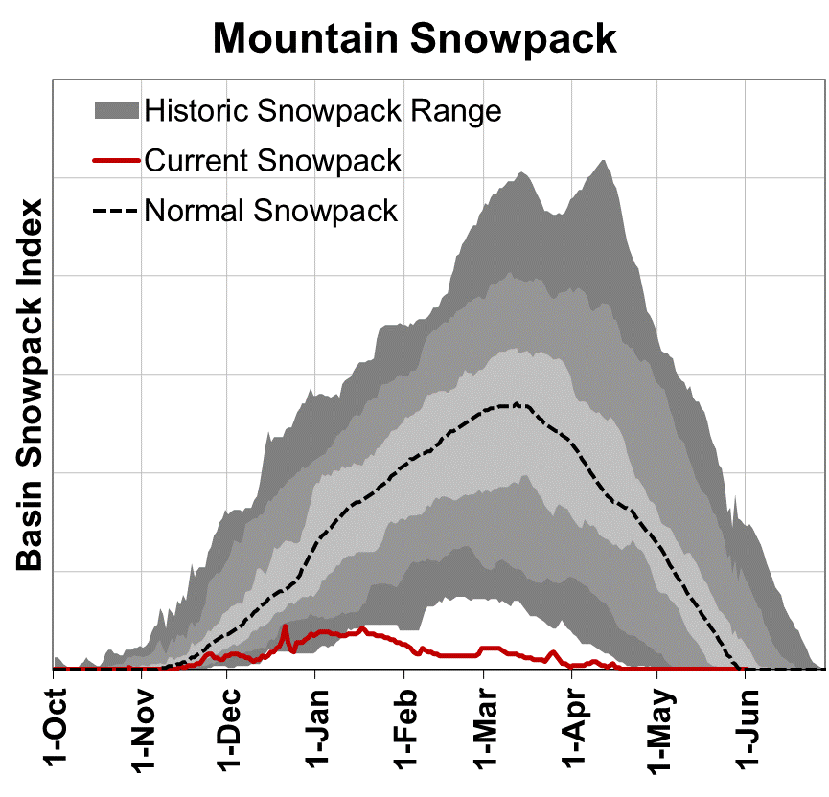
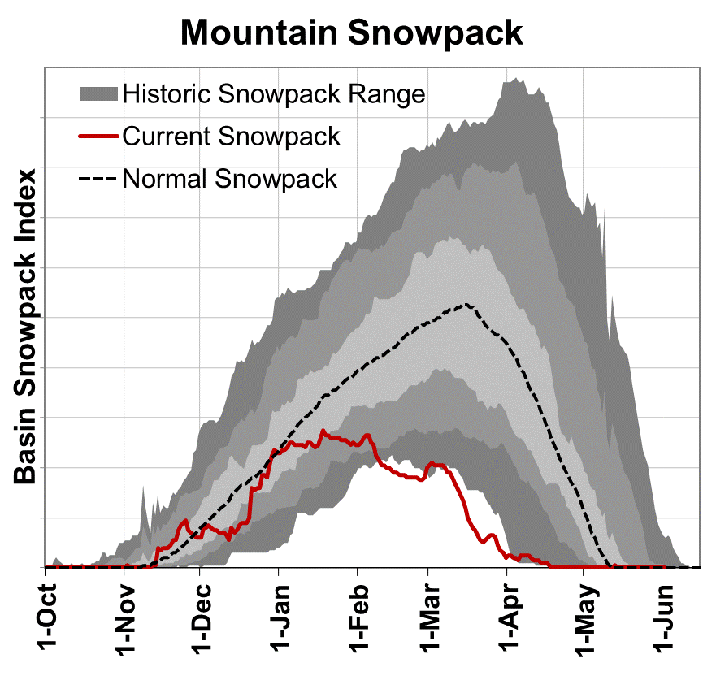
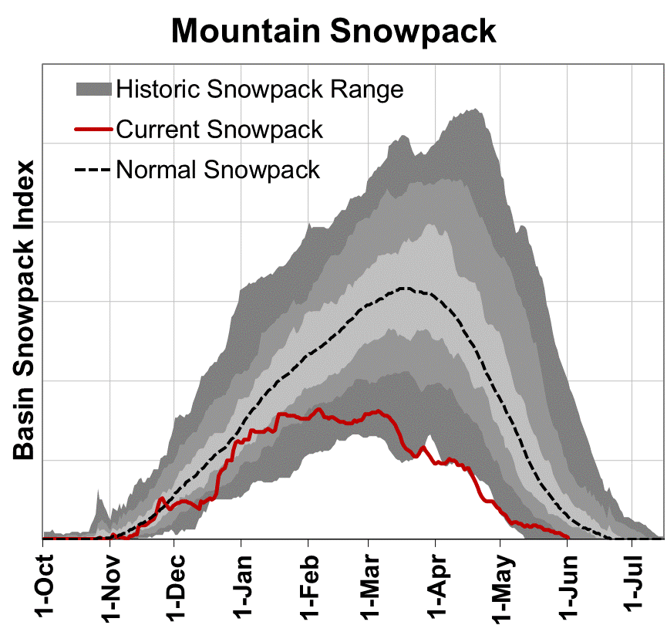
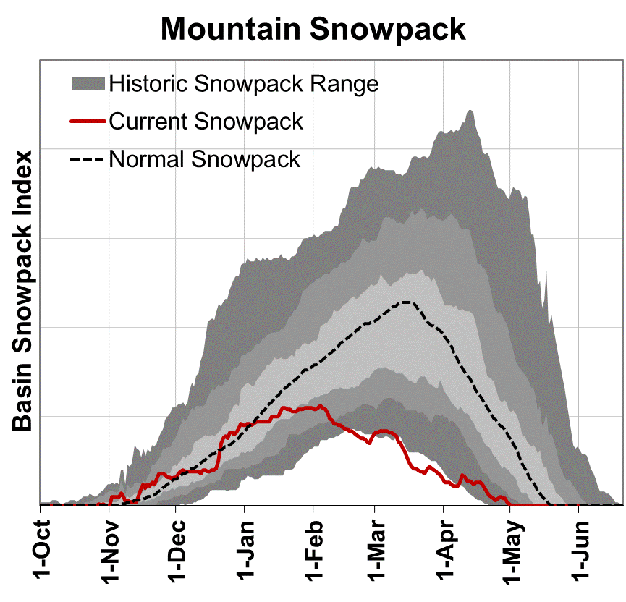
Water Year 2015
Willamette
Rogue/Umpqua
Klamath
John Day
Owyhee/Malheur

Slide 32
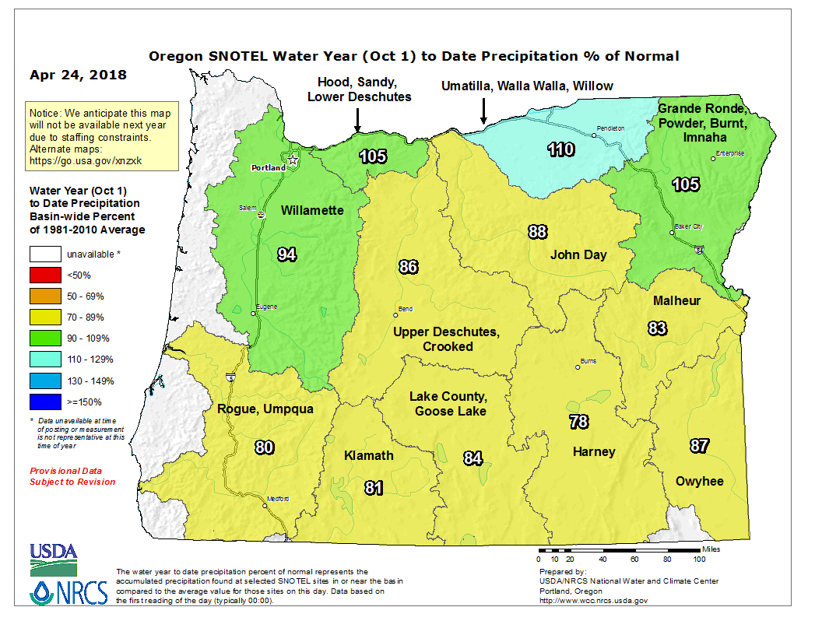
Statewide SNOTEL Water Year Precipitation is 93% of average

Slide 33
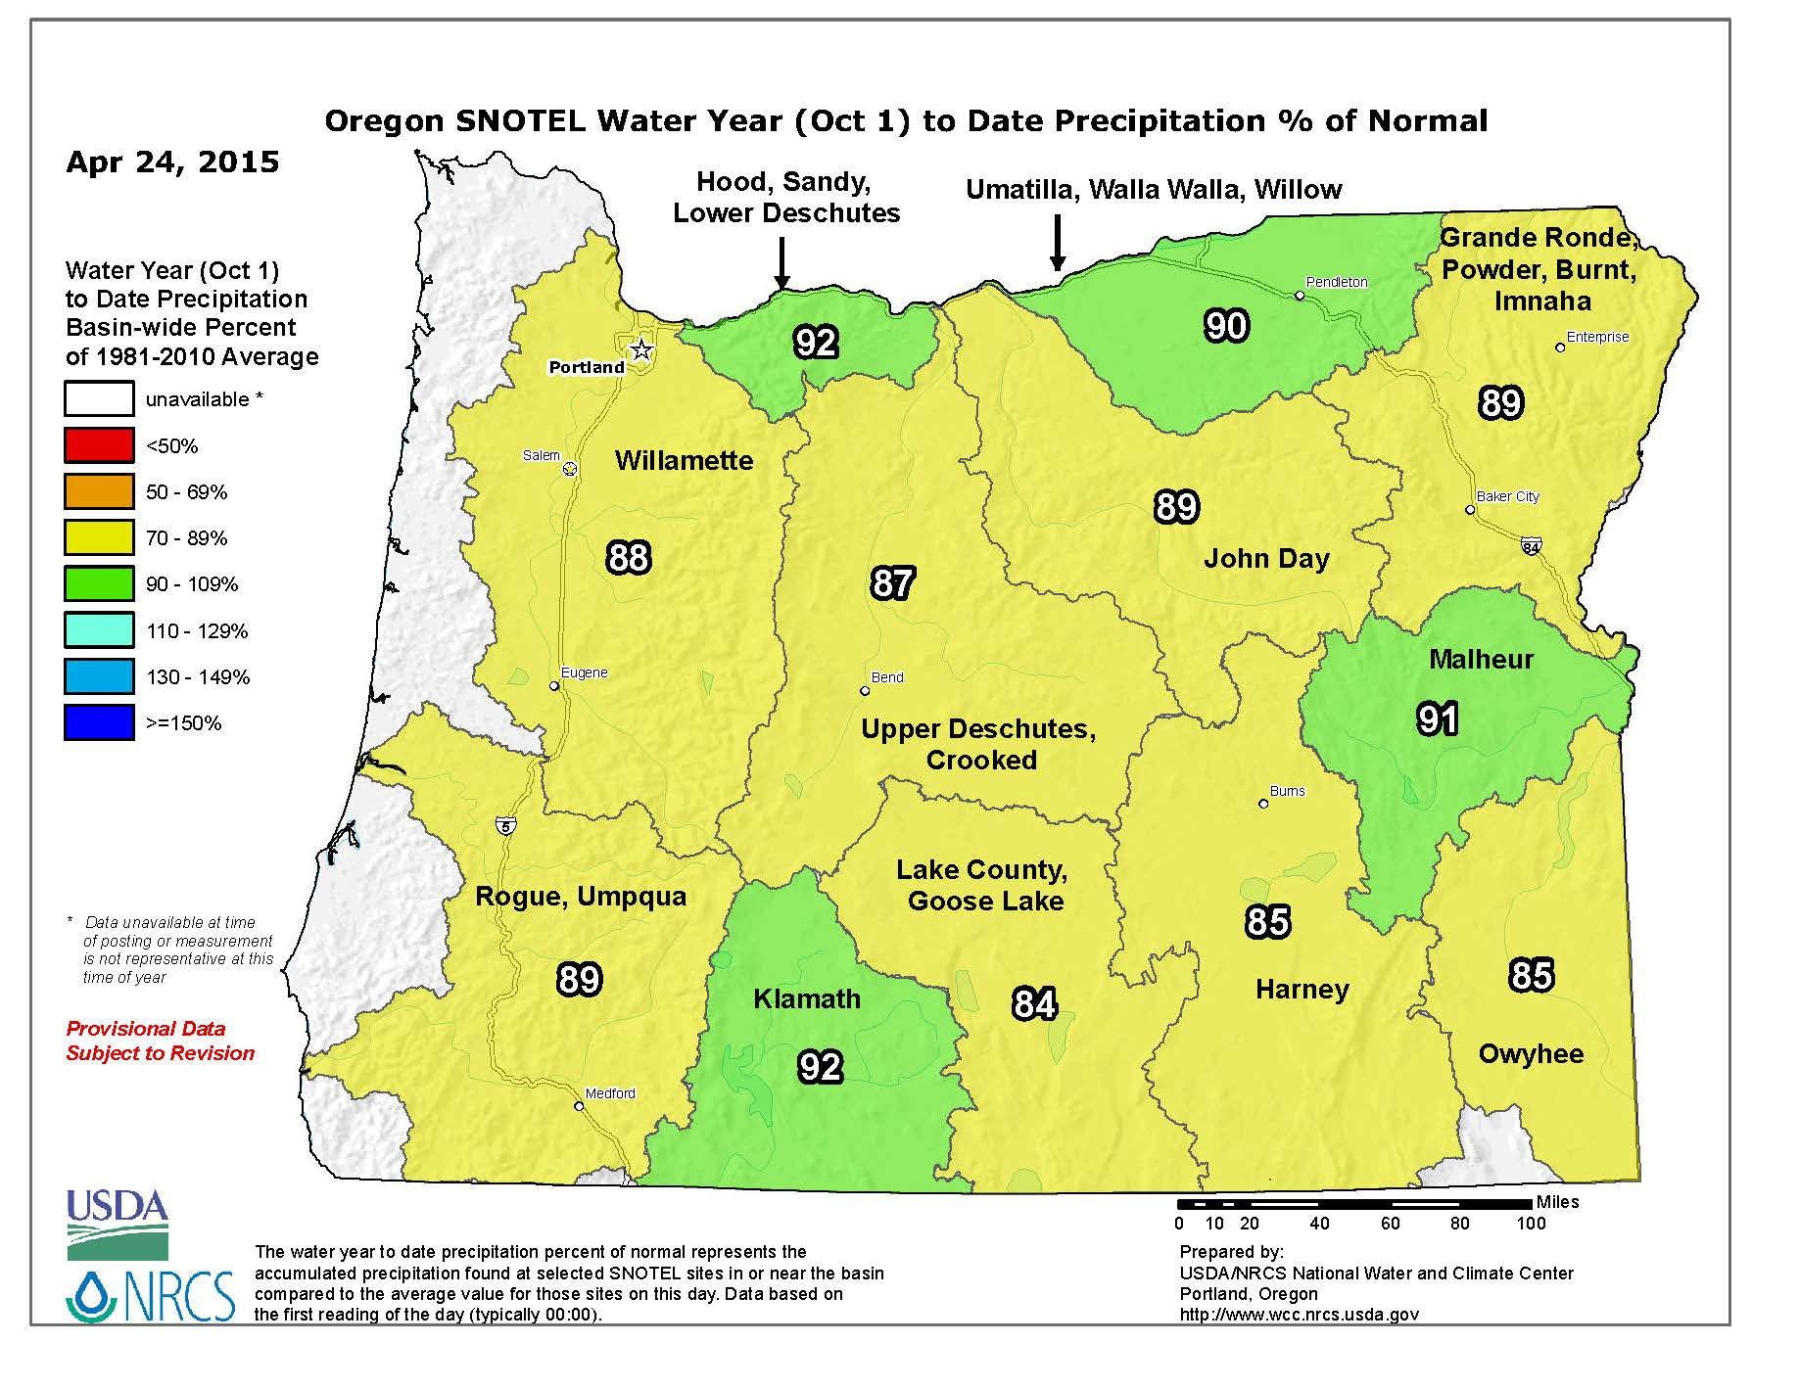
Statewide SNOTEL Water Year Precipitation was 90% of average

Slide 34
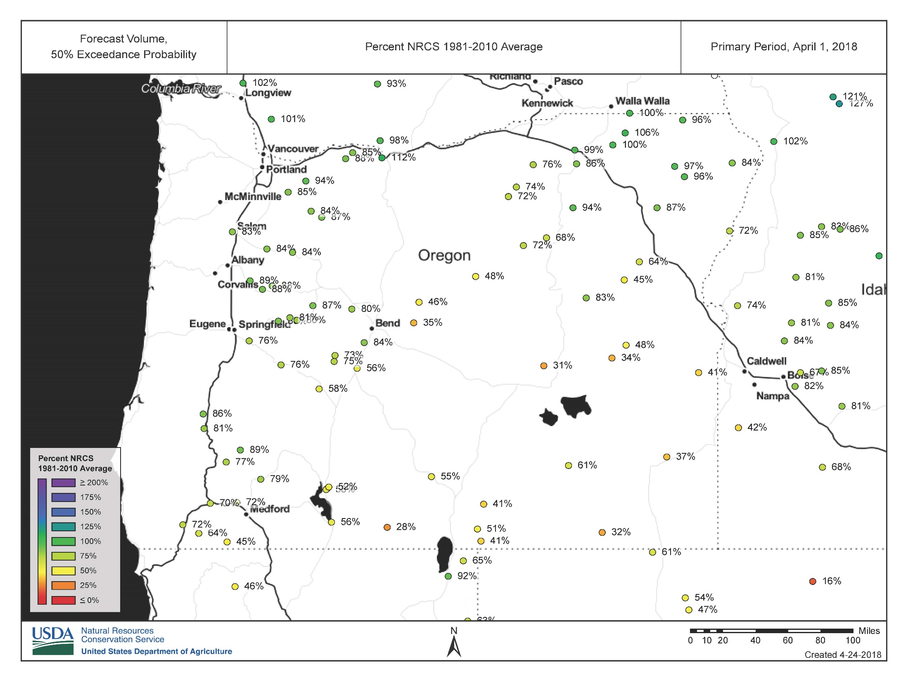

Slide 35
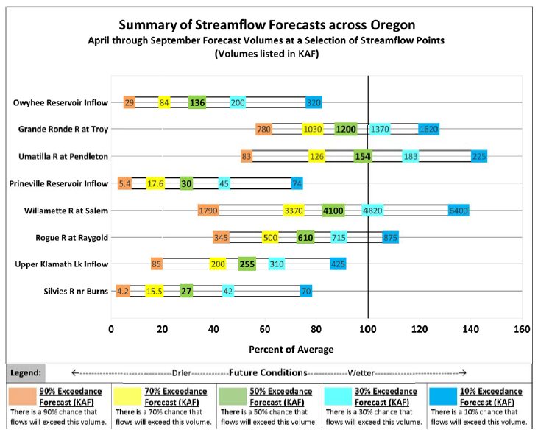
April 1, 2017

Slide 36
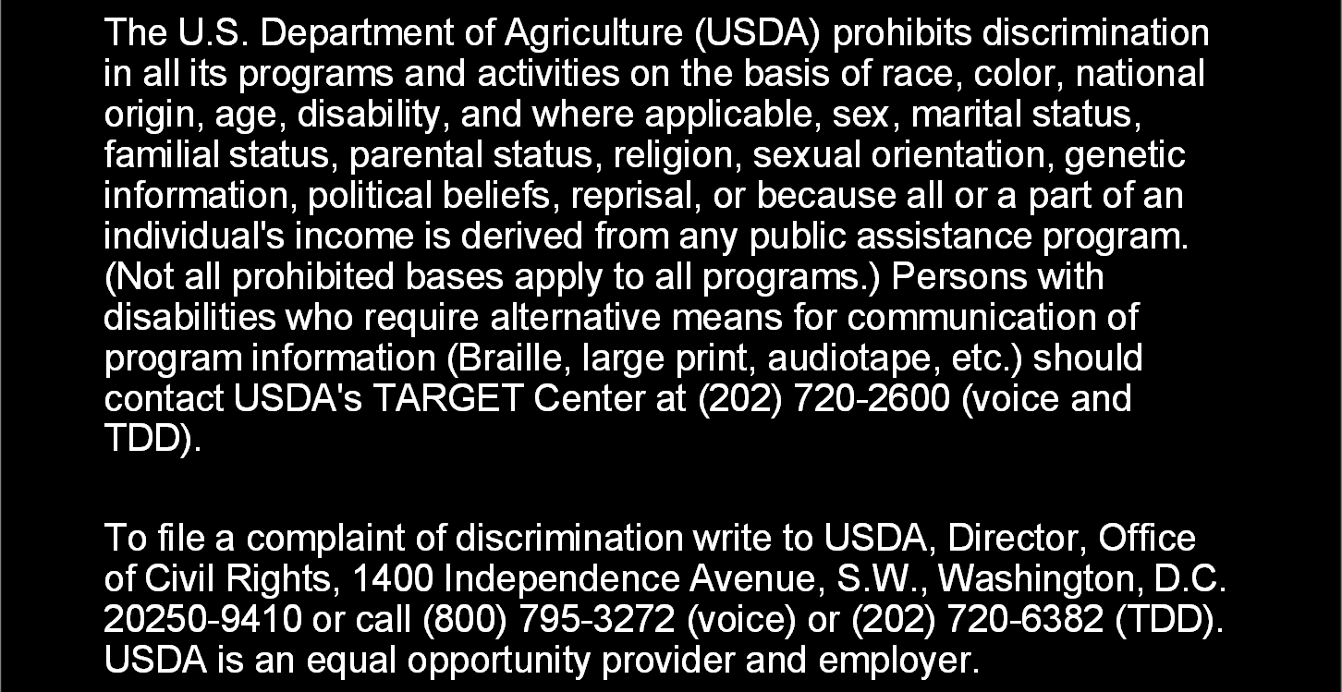
Thank you!

Slide 37
American Meteorological Society - Portland Oregon Chapter Meeting
April 24, 2018
H. Scott Oviatt
Snow Survey Supervisory Hydrologist
USDA Natural Resources Conservation Service
Scott.Oviatt@or.usda.gov
503-414-3271
http://www.nrcs.usda.gov/wps/portal/nrcs/main/or/snow/

