Slide 1

La Niña
A LONG WAIT FOR WEATHER FUN
WINTER 2017-2018
Mark Nelsen

Slide 2
Quick Summary
One of our more “boring” winters; only 3 interesting weather events/periods (east wind, Christmas snow, late February snow)
Warmer and Drier than average in Oregon (La Niña?)
Lowest Cascade Snowfall in La Niña winter since 2000-2001
Back to back decent snow years at PDX!
But not in Salem, less than 1” there
No PACNW Arctic Blast (4th consecutive winter)

Slide 3

OFFICIAL
SNOW TOTAL
7.6”
at PQR (NWS Office)
5.2” Downtown (KGW-TV)

Slide 4
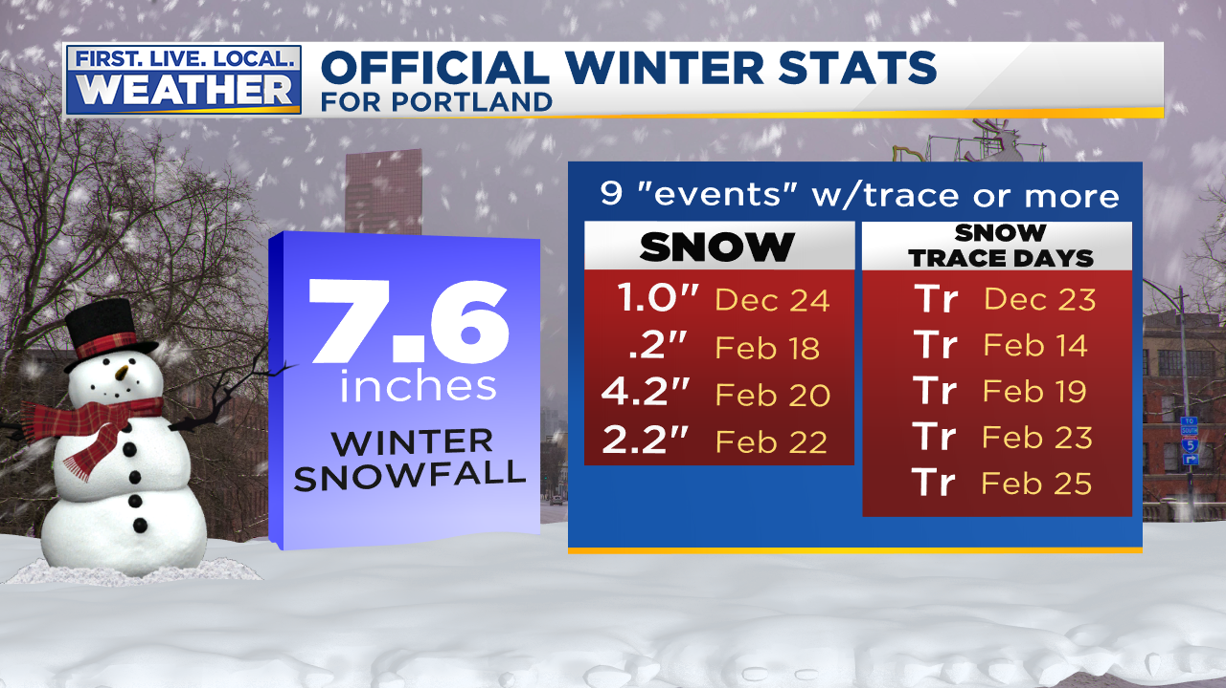

Slide 5
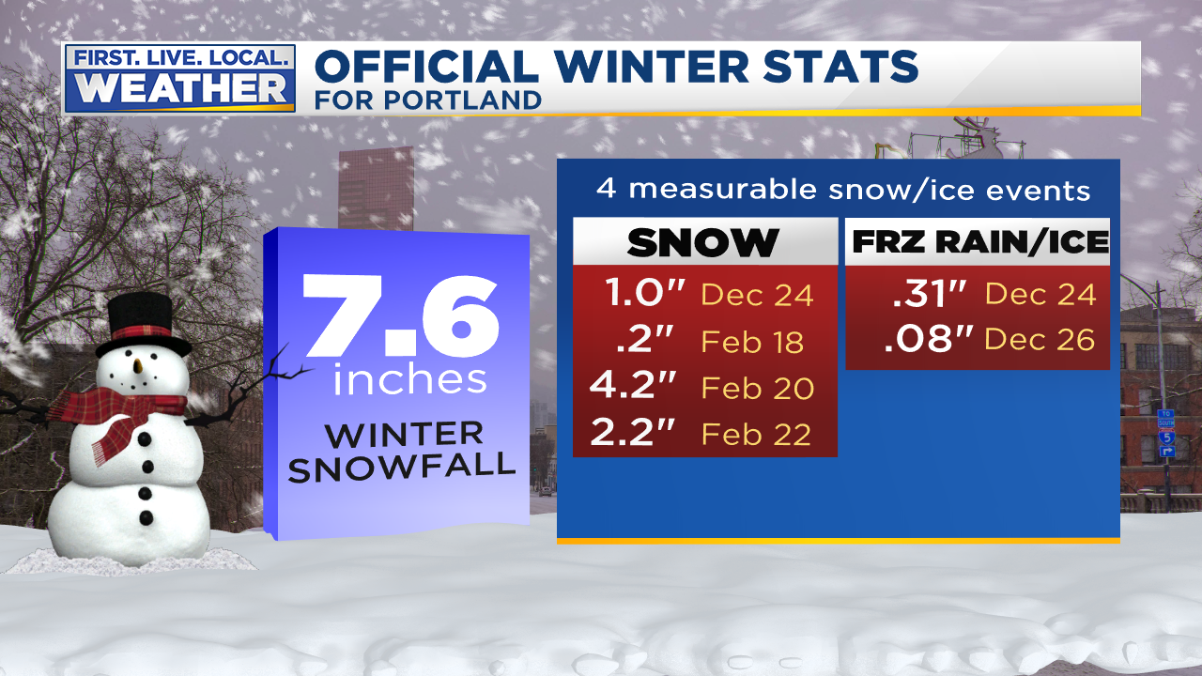

Slide 6
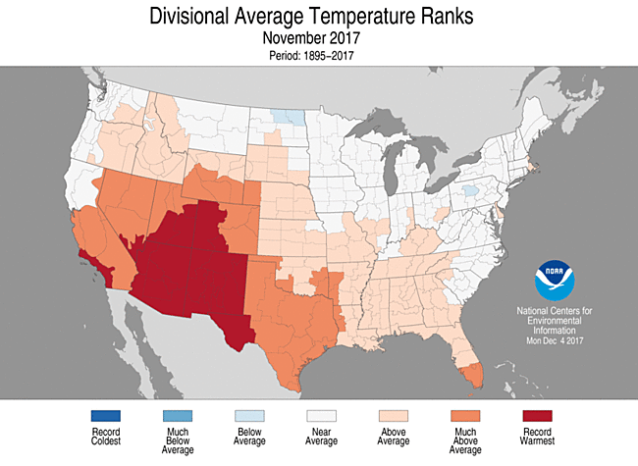
THE USA VIEW

Slide 7
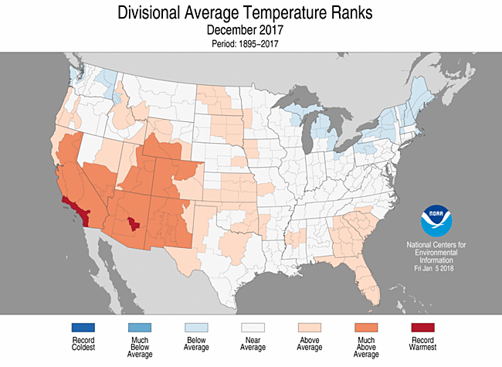
THE USA VIEW

Slide 8
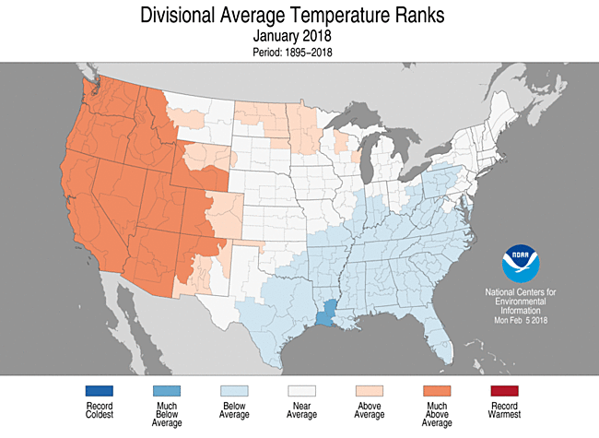
THE USA VIEW

Slide 9
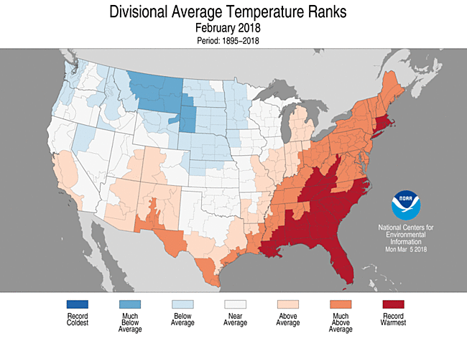
THE USA VIEW

Slide 10
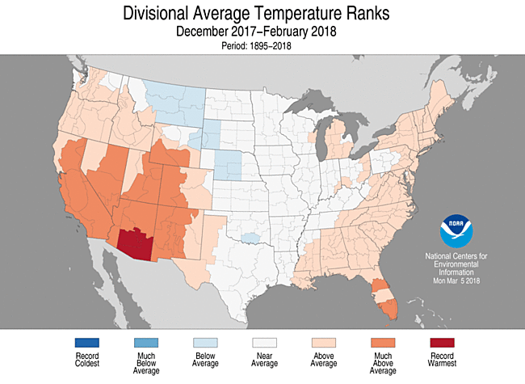
THE 3 MONTH PERIOD

Slide 11
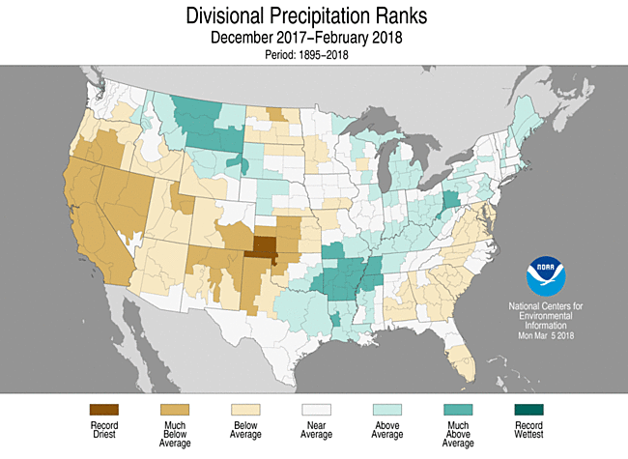
3 MONTH PRECIPITATION

Slide 12
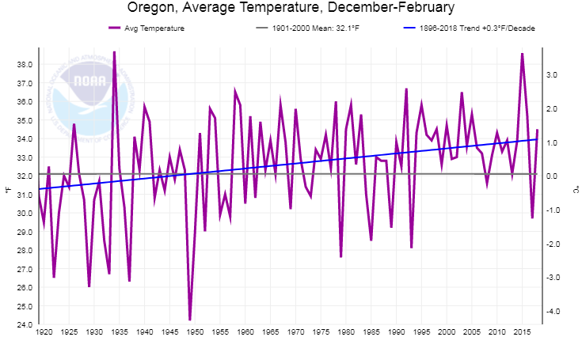
Oregon Winter Temps (the past 100 years)
Warming trend continues

Slide 13
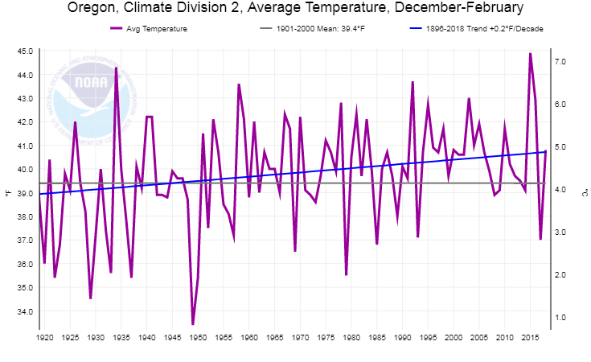
Western Valleys Winter Temps
(the past 100 years)
Milder than last year, above average
This Winter in Oregon Zone 2 (Willamette Valley)

Slide 14
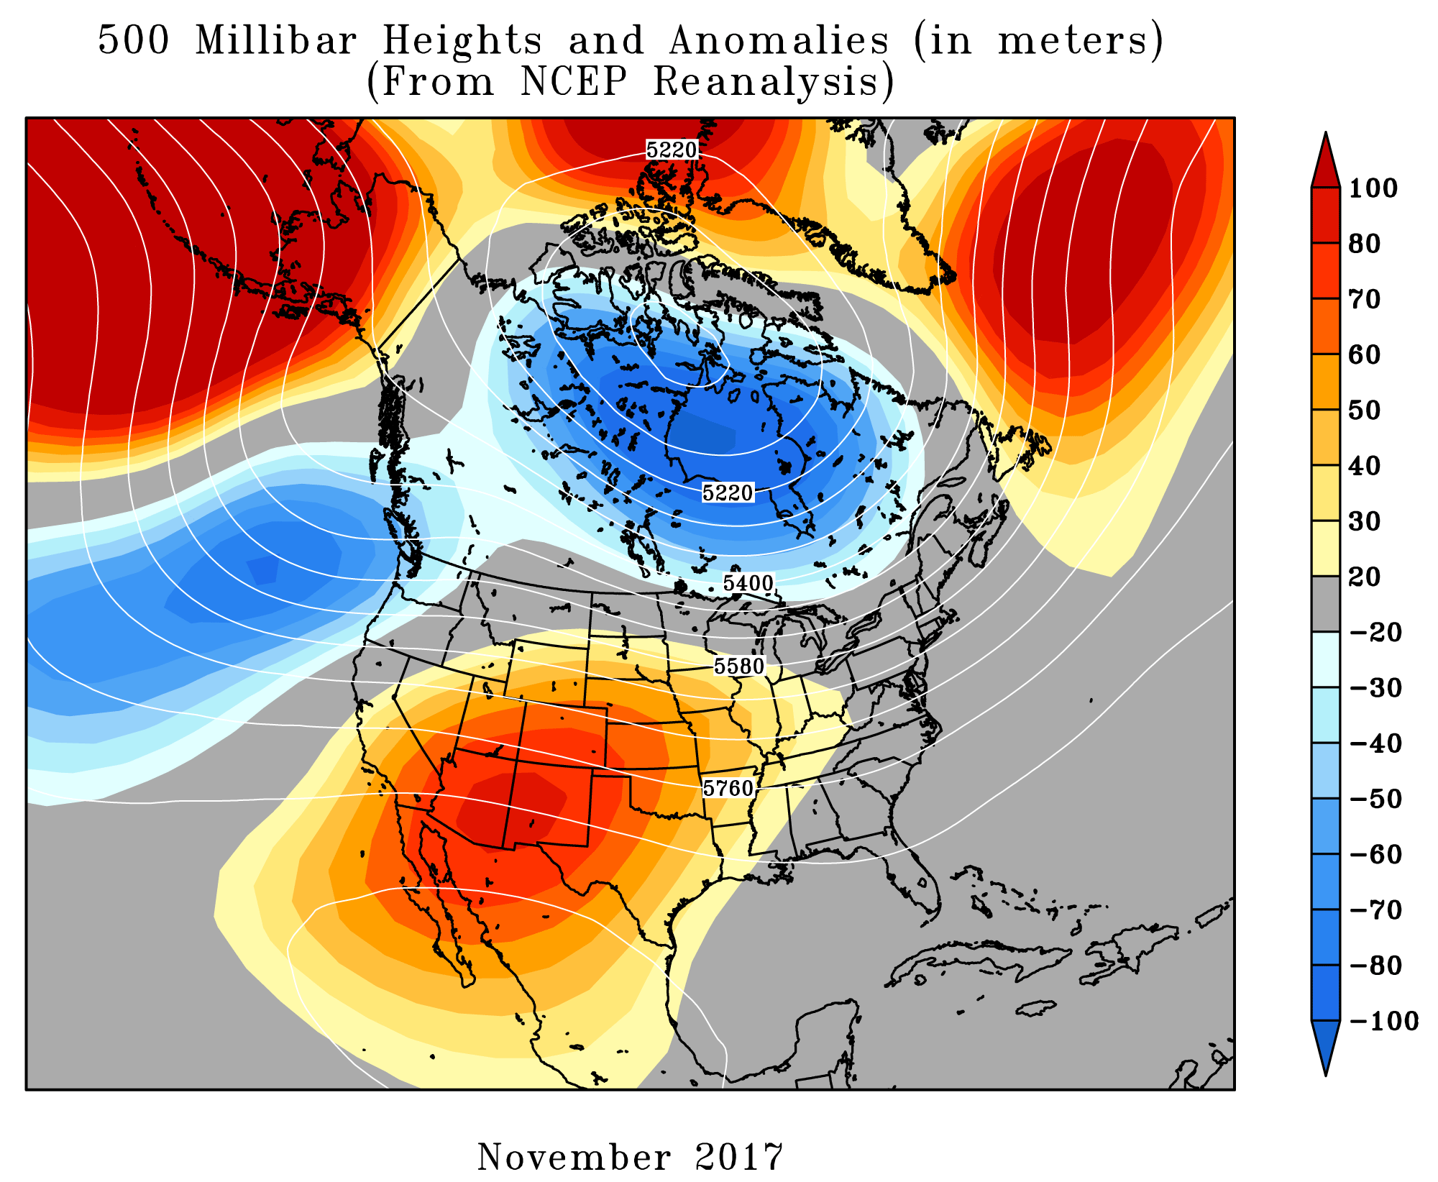
UPPER LEVEL PATTERNS

Slide 15
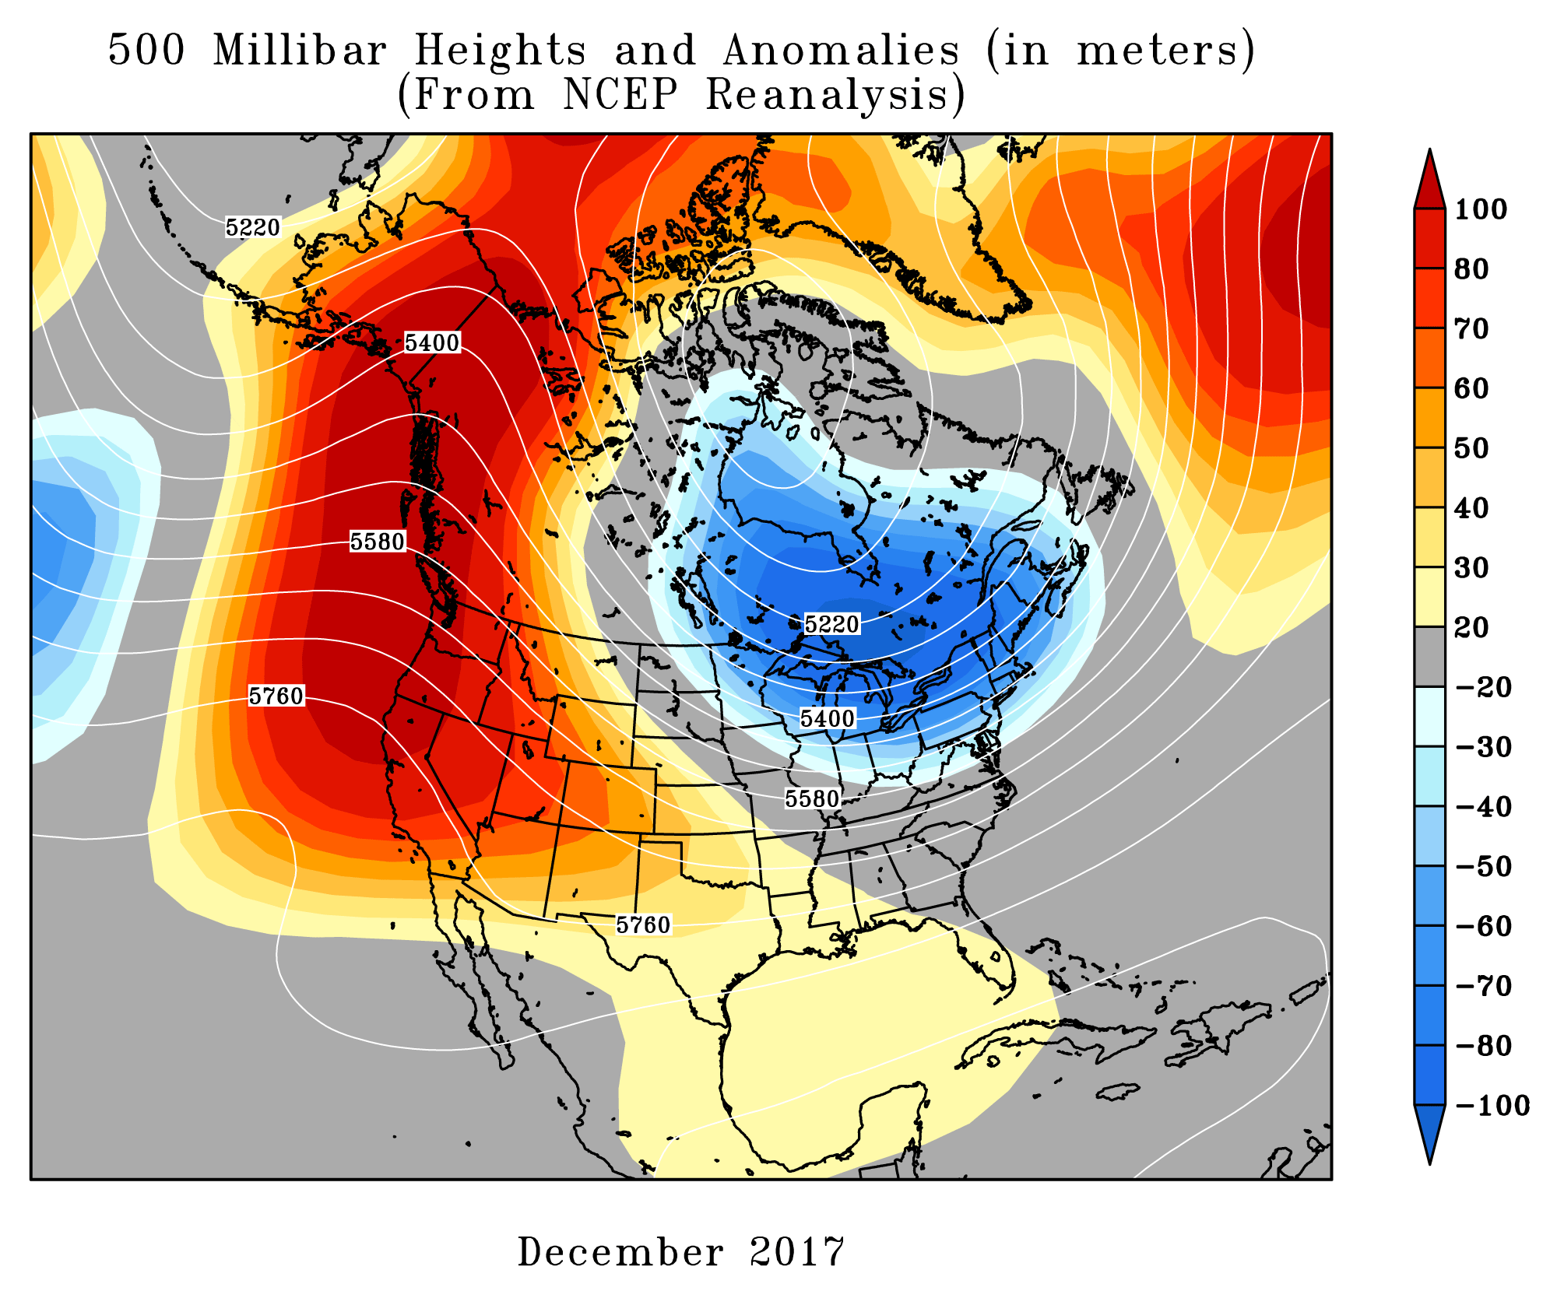
UPPER LEVEL PATTERNS

Slide 16
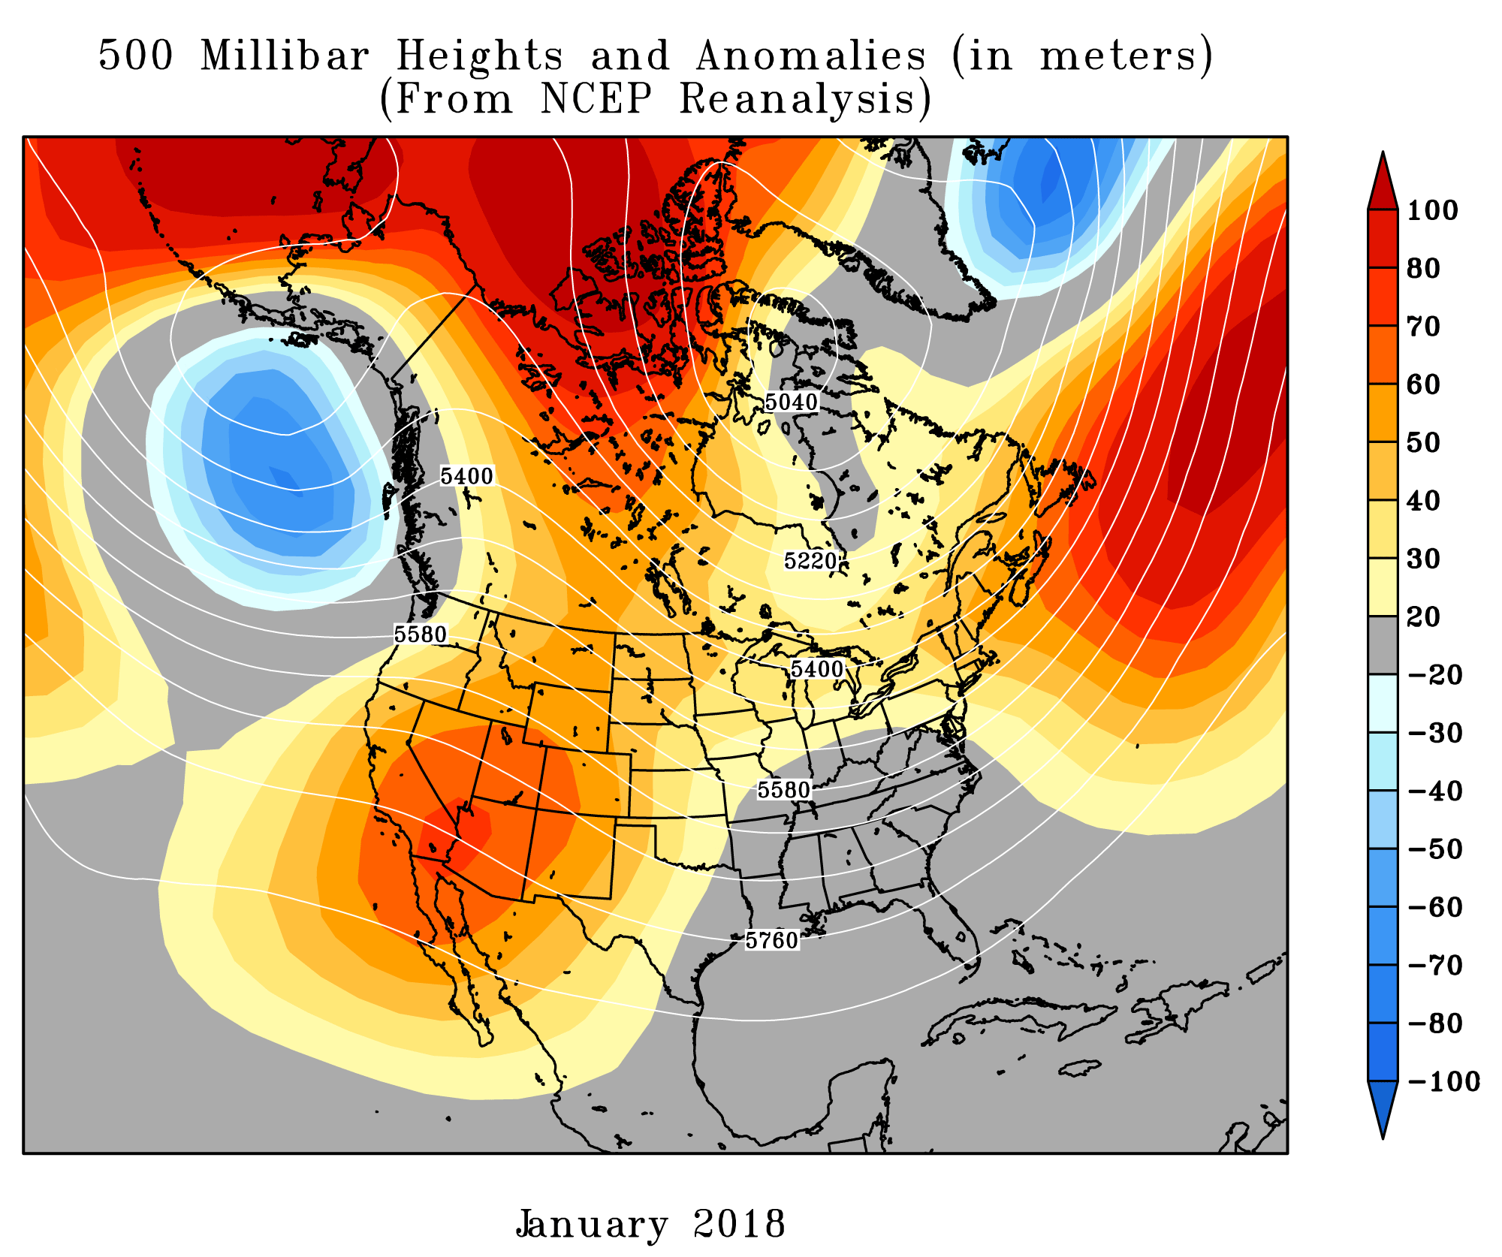
UPPER LEVEL PATTERNS

Slide 17
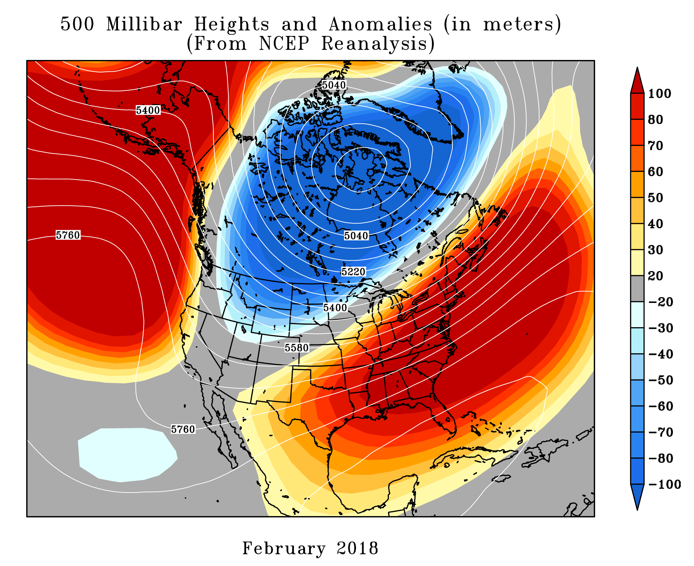
UPPER LEVEL PATTERNS

Slide 18
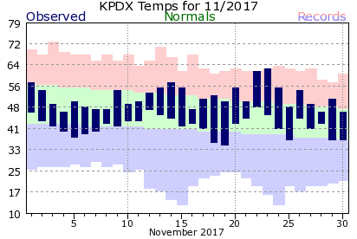
NOVEMBER
Very slow month, nothing remarkable
Record warm temps Thanksgiving Wednesday/Thursday

Slide 19
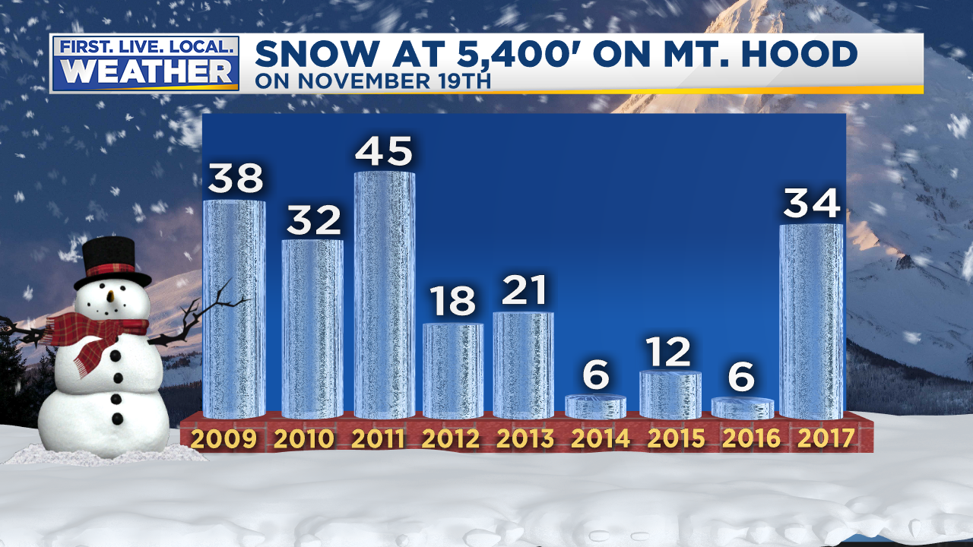
SKI SEASON
Early build of snowpack mid-November gets hopes up
Thanksgiving week washout + warmth closes resorts

Slide 20
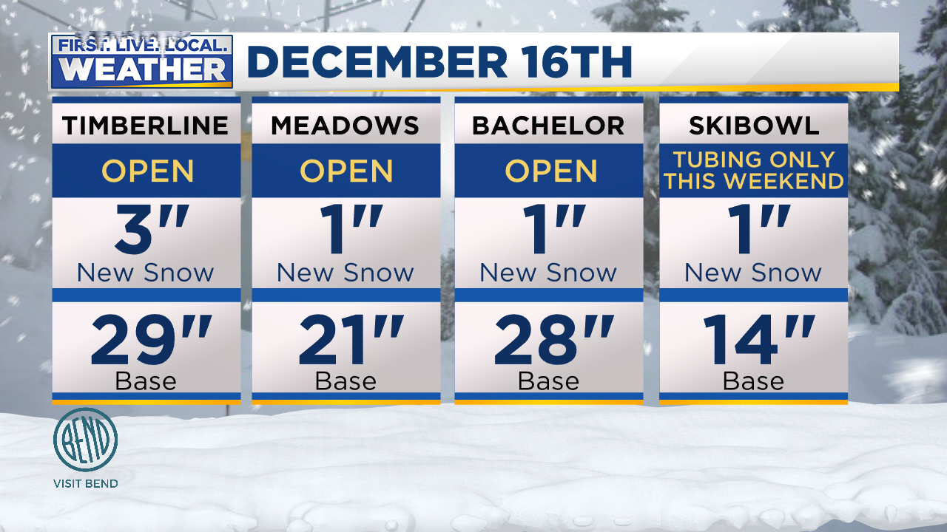
SKI SEASON
Higher resorts able to operate early/mid December
All other resorts remained closed until Christmas Vacation due to dry spell

Slide 21
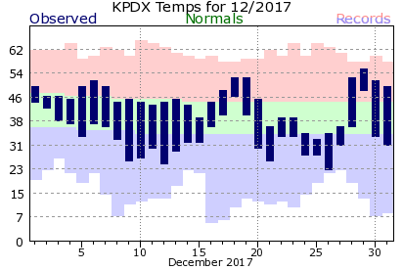
DECEMBER
Gorge wind storm early/mid month
“Backdoor” cold shot 21st to 27th with Christmas Snow/Ice

Slide 22
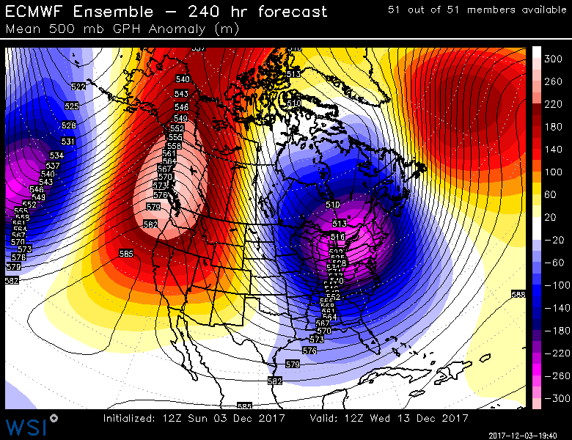
DECEMBER
Early-Mid Month
Big Upper-Level Ridge
Overhead
Only .04” at PDX in two weeks!
Lots of sunshine
w/strong inversion
much of the time

Slide 23
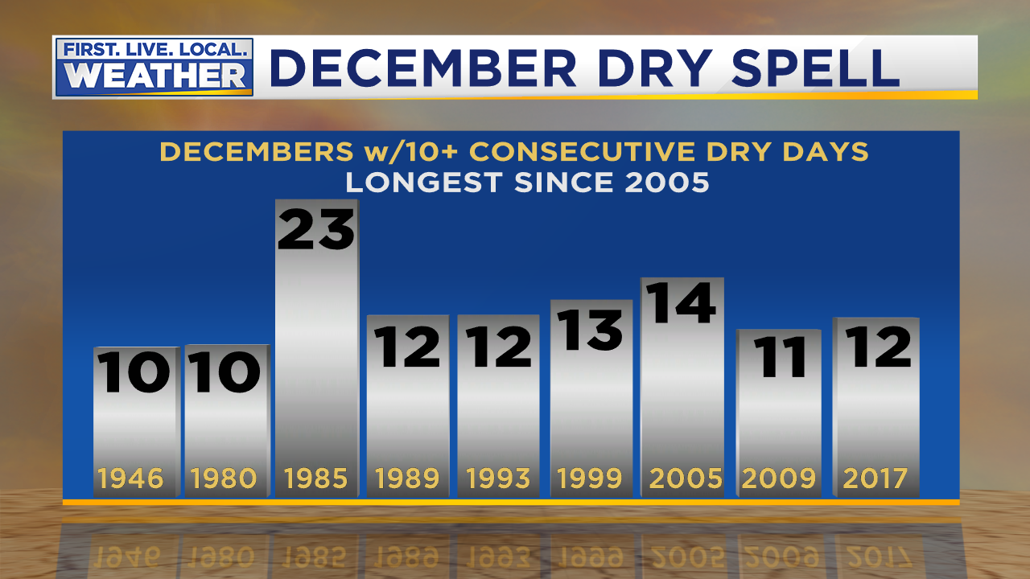
DECEMBER
12 days w/out measurable rain at PDX

Slide 24
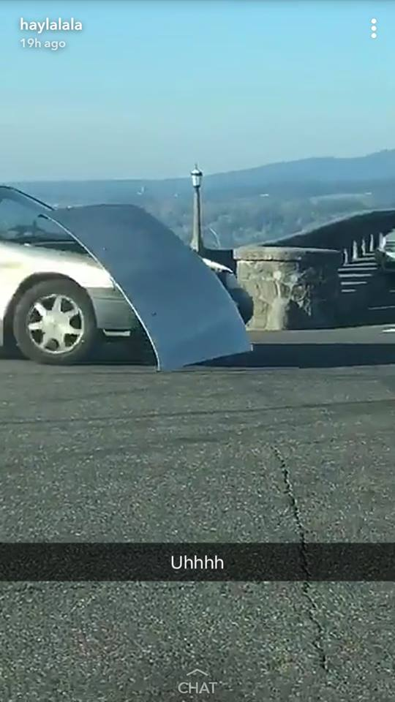
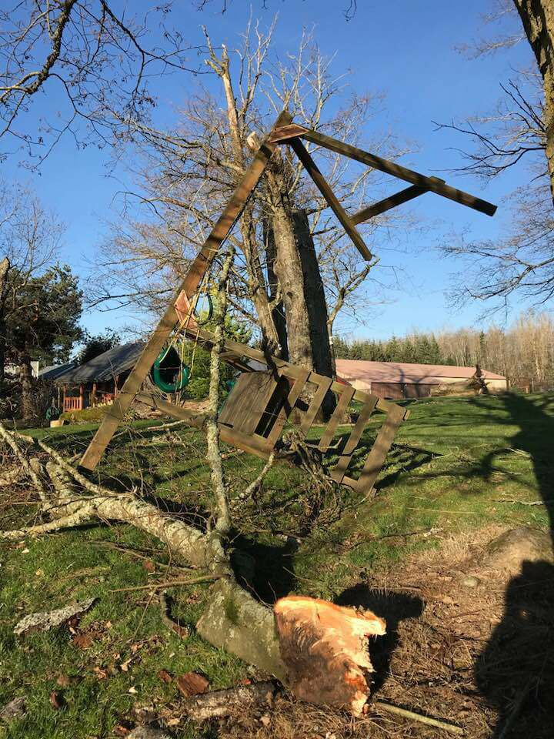
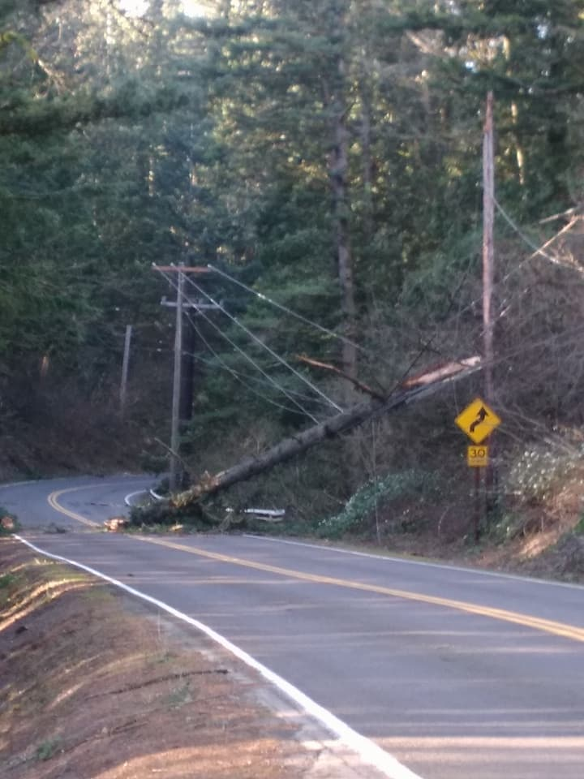
DECEMBER
Strongest wind storm in
western Gorge since Jan. 2009
Lots of recurring power outages
Notes:
Coworker had power go out 4 times (for at least several hours) in 3 days.

Slide 25
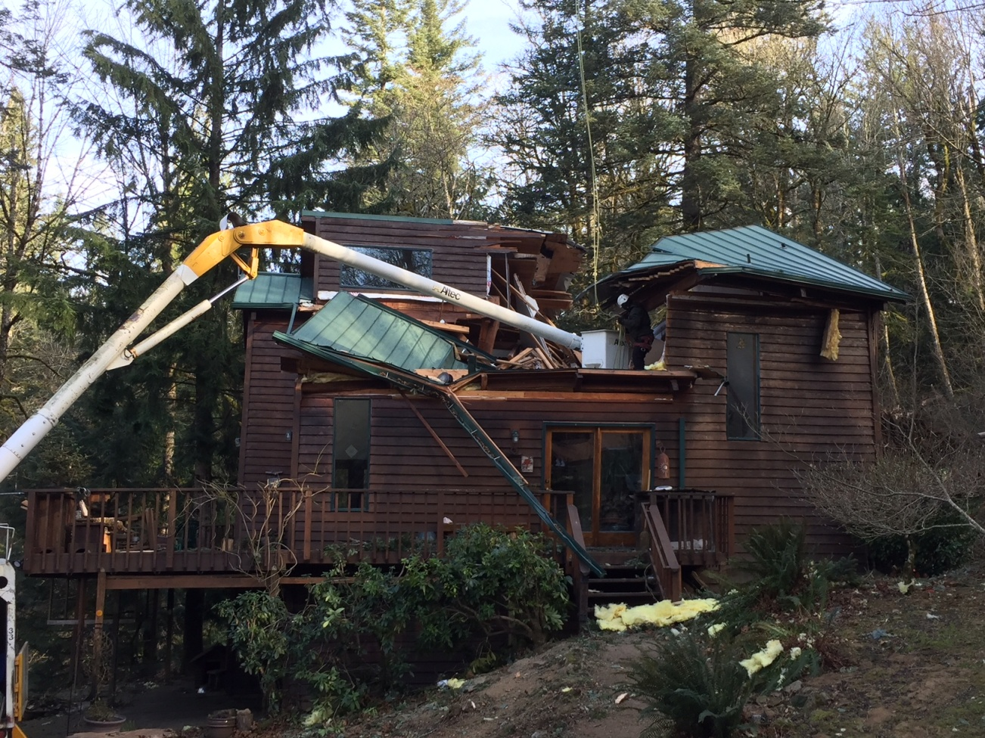
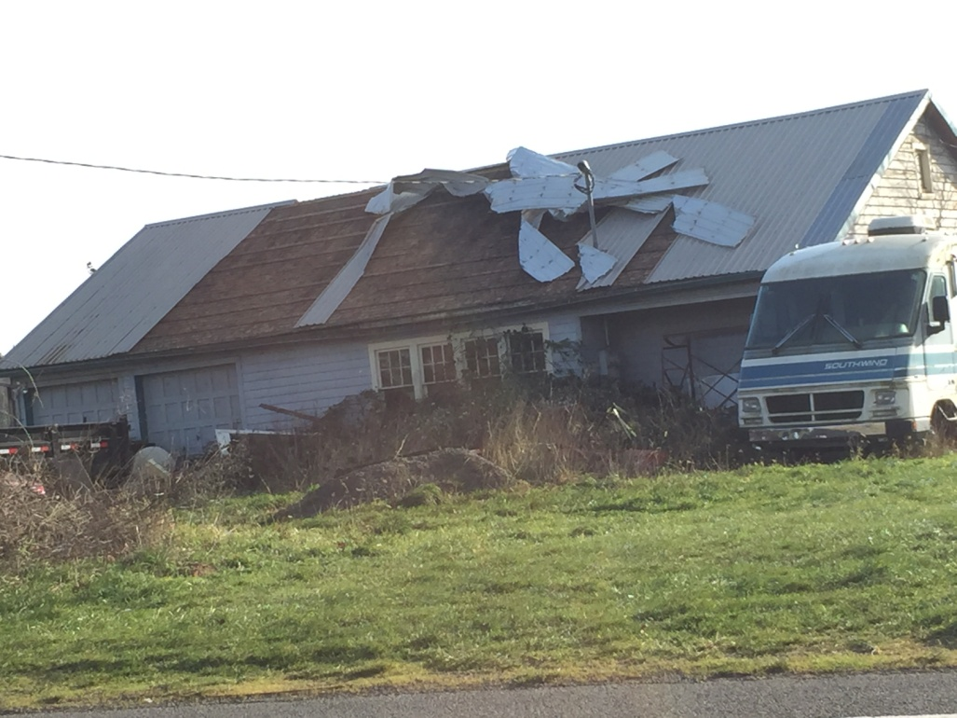
DECEMBER
Strongest wind storm in
western Gorge since Jan. 2009
Woman impaled by tree while sleeping

Slide 26
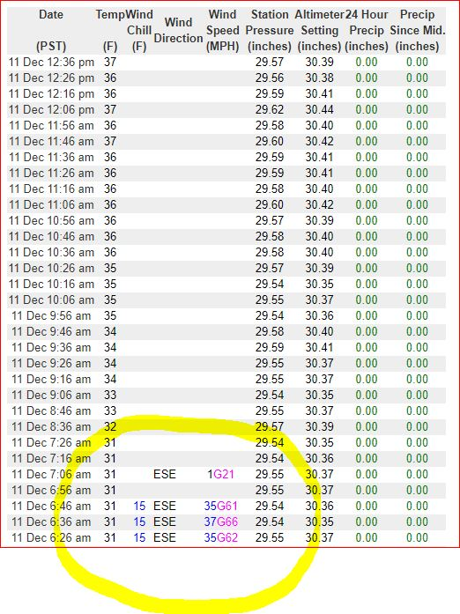
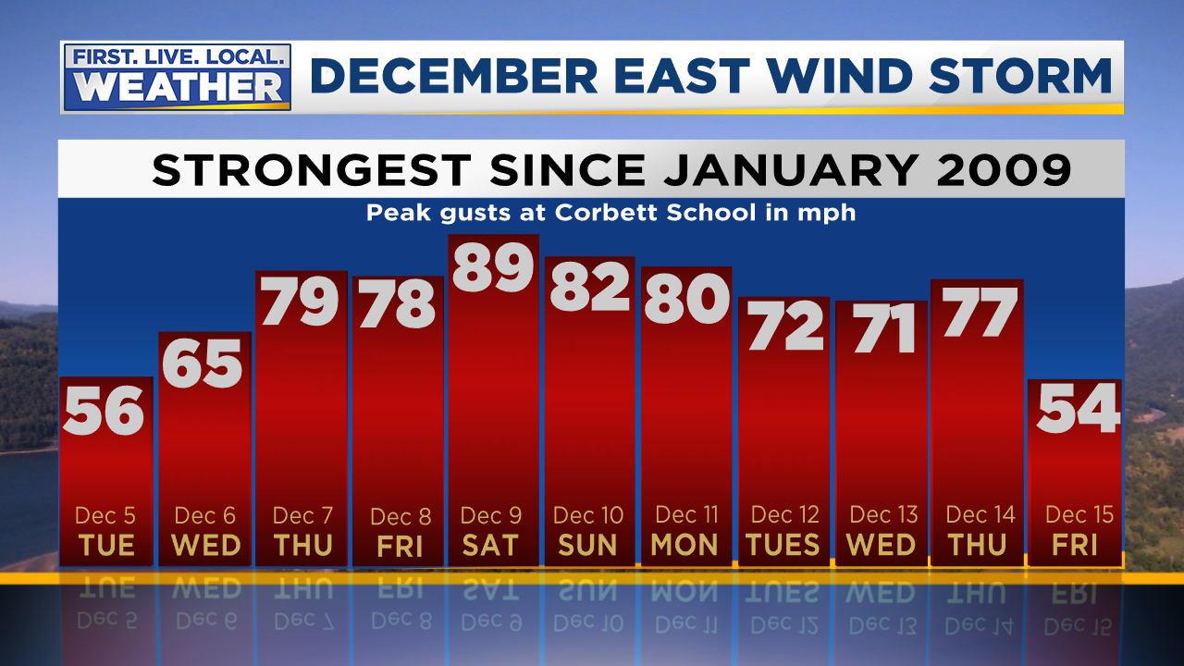
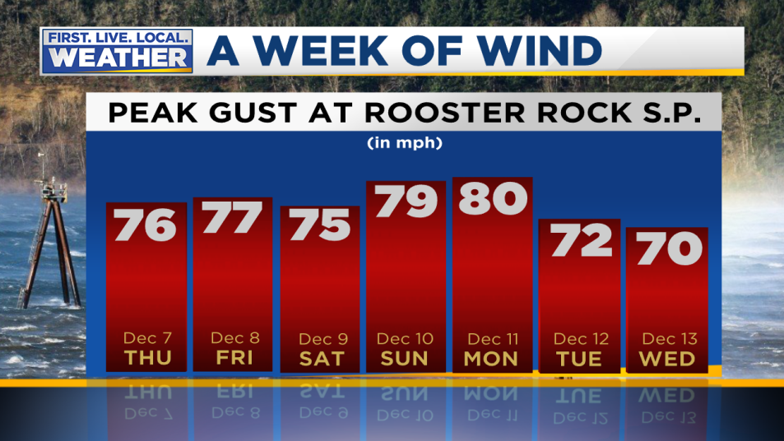
DECEMBER
Strongest wind storm in
western Gorge since Jan. 2009
Vista House anemometer disappeared

Slide 27
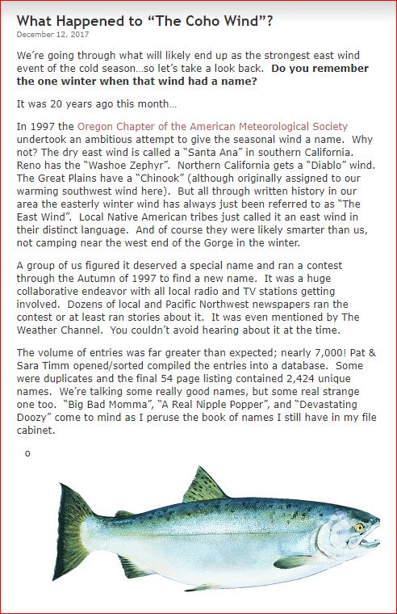
DECEMBER
Who Remembers?
20 years ago
we attempted to name
“The East Wind”
R.I.P. “COHO WIND”
Notes:
Pat Timm has expressed some interest in MAYBE trying again in today’s social media world. ???

Slide 28
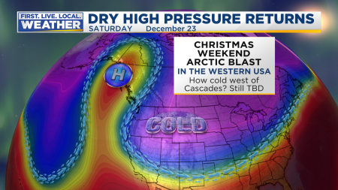
DECEMBER
Upper-level ridge backs up just slightly
Allows cold air to come in at low levels from the east. Arctic blast moves over Rockies and farther east.
Notes:
Models did well showing us right on edge of cold air, 850mb temps never got very cold

Slide 29
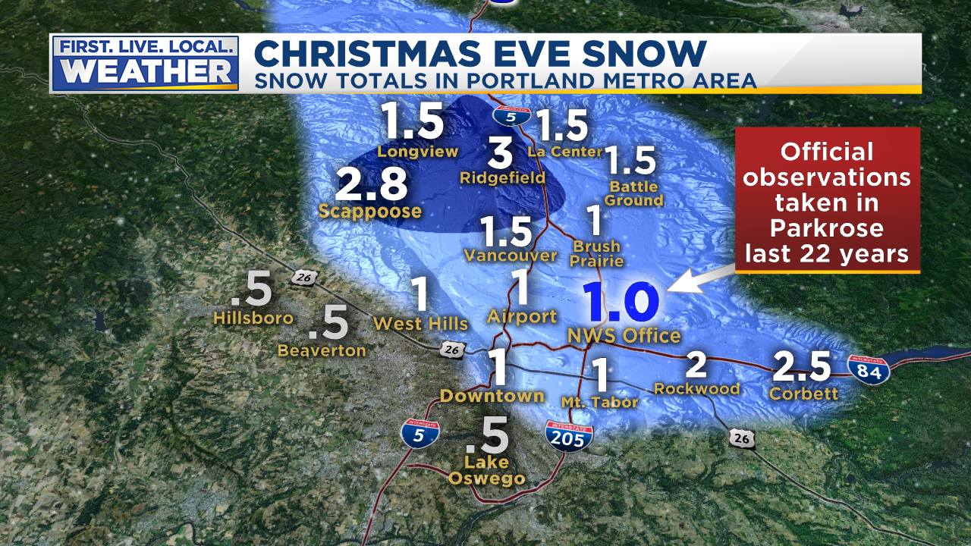
Christmas Eve Snow & Freezing Rain
It snowed on Christmas Eve! (For some of us)
Cold easterly flow out of Gorge
Longview to Portland only; Valley & coastline missed out
Very little south, west, & SE of downtown Portland
Notes:
Entire Willamette Valley was hosed. Very little west of West Hills and south of downtown PDX. 3” Ridgefield number is in doubt

Slide 30
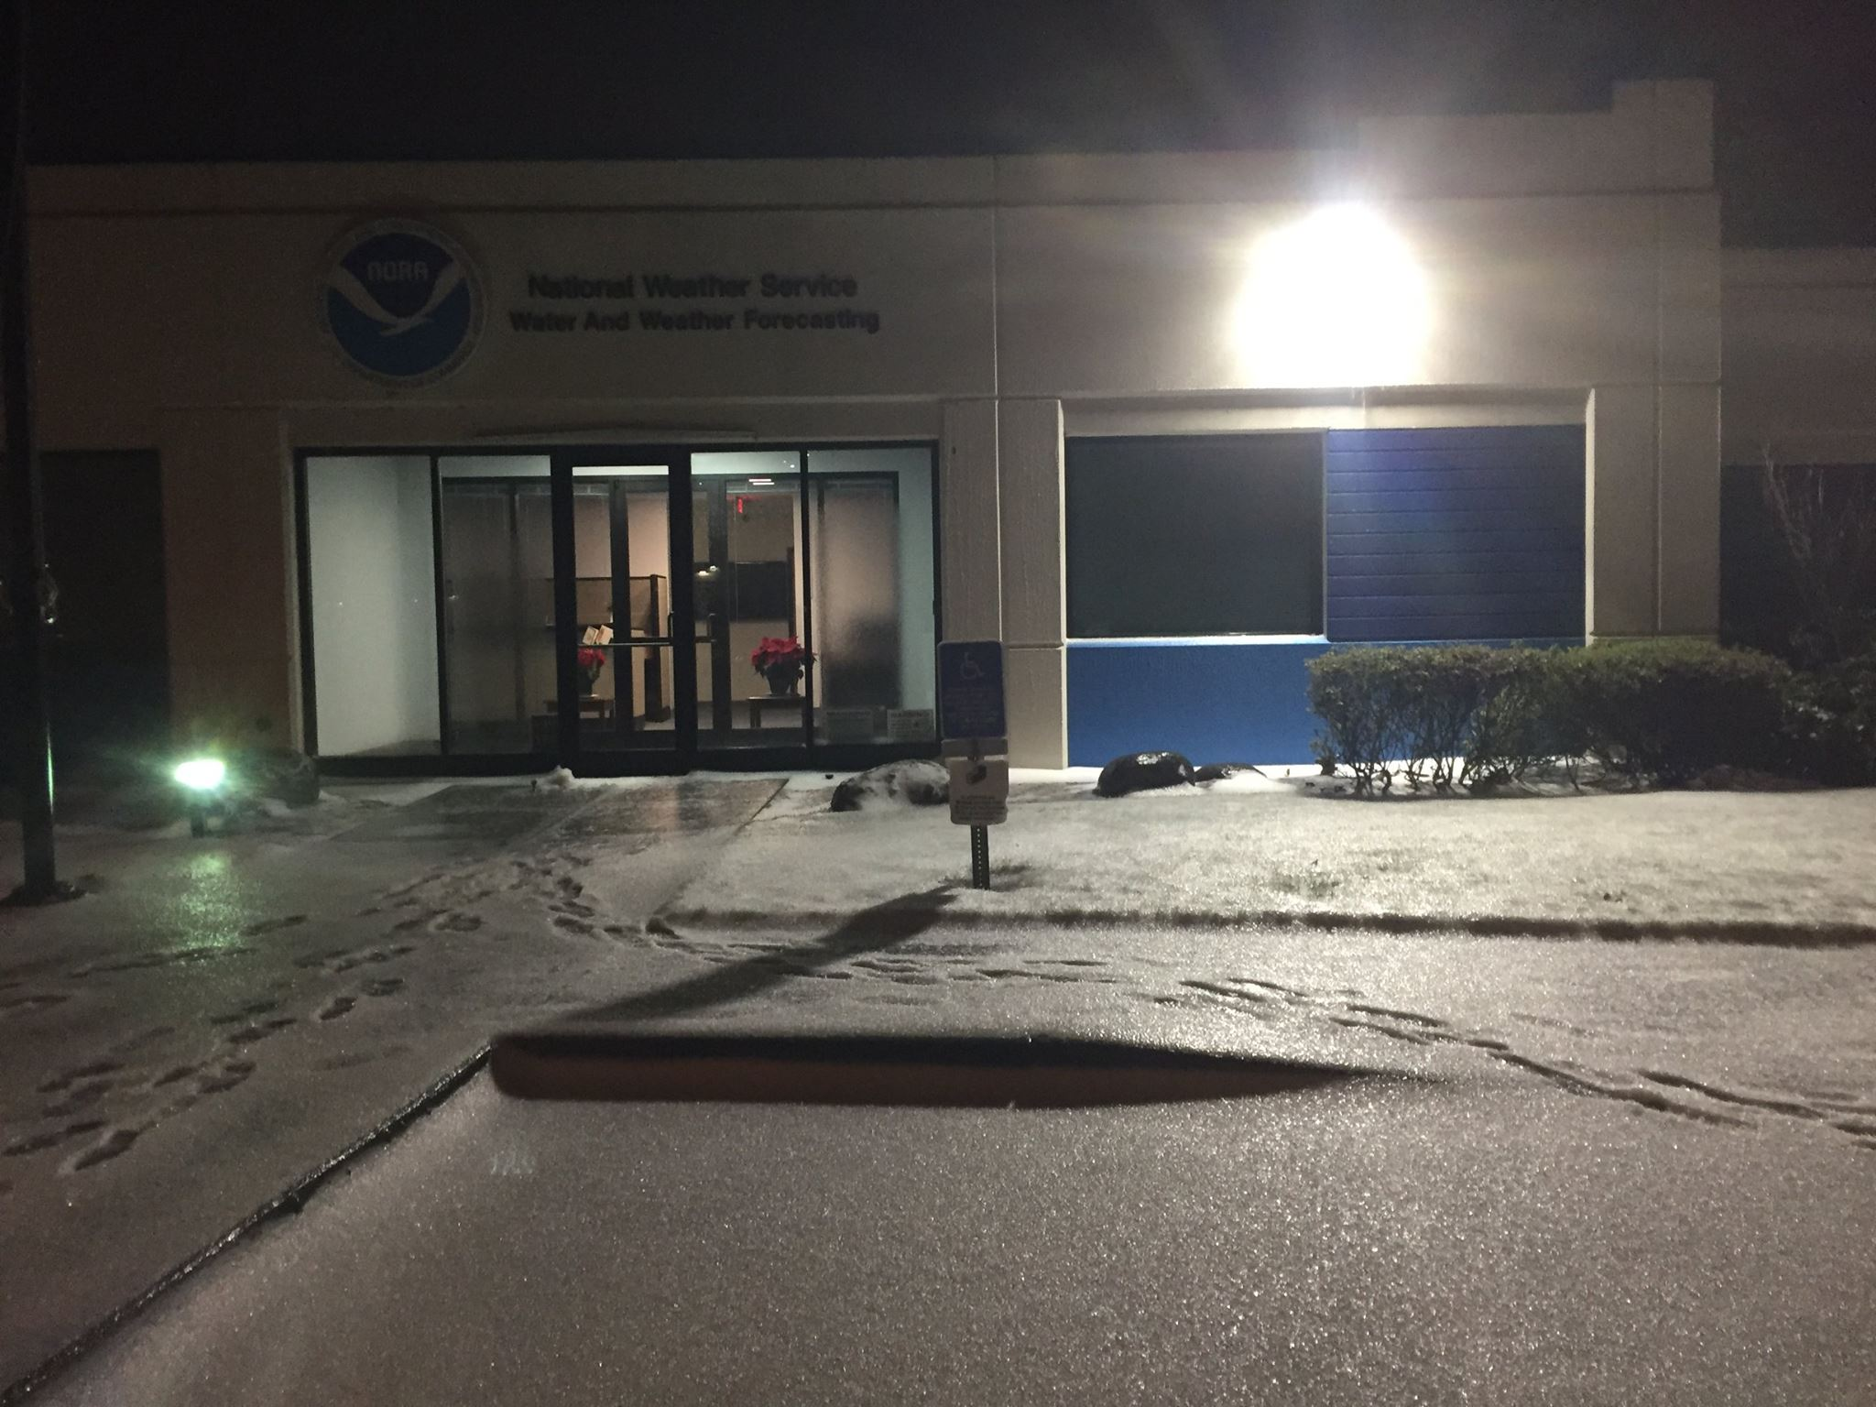
Christmas Eve Snow & Freezing Rain
Freezing rain begins in evening & continues through Christmas AM
Roads glazed over by 9-11pm, cars all over freeways east metro
Most of event = freezing rain = .30” accretion @ PDX by AM
Slow thaw 25th/26th, then quick melt on Wednesday the 27th
Notes:
View at NWS early Christmas Morning

Slide 31
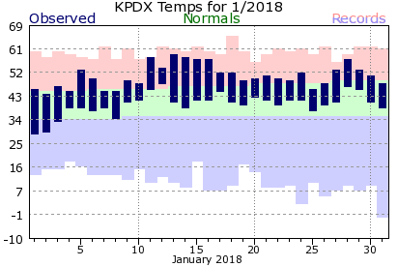
JANUARY
A very warm month
No interesting weather events
Notes:
50+ gusts at TTD, 85 mph gust at Corbett Grade, highest of past 10 years
850mb temps never below -9 this winter
Valley 30-35 during this time
Puget Sound 35-45!

Slide 32
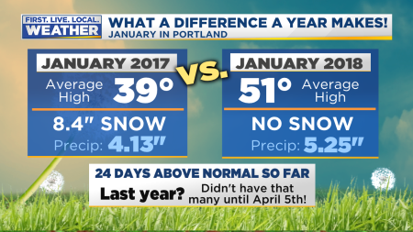
JANUARY
A very warm month; unexpected in La Niña winter
Warmest January in 60+ years at PDX
Notes:
50+ gusts at TTD, 85 mph gust at Corbett Grade, highest of past 10 years
850mb temps never below -9 this winter
Valley 30-35 during this time
Puget Sound 35-45!

Slide 33
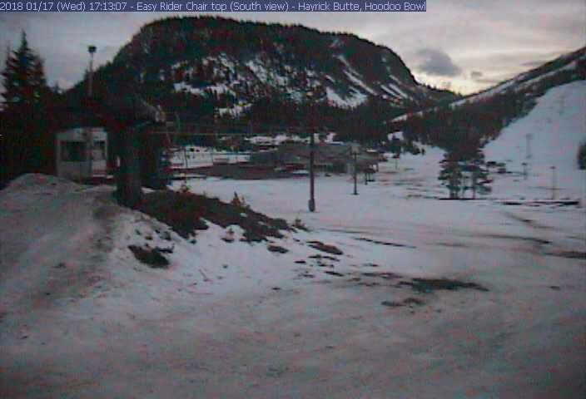
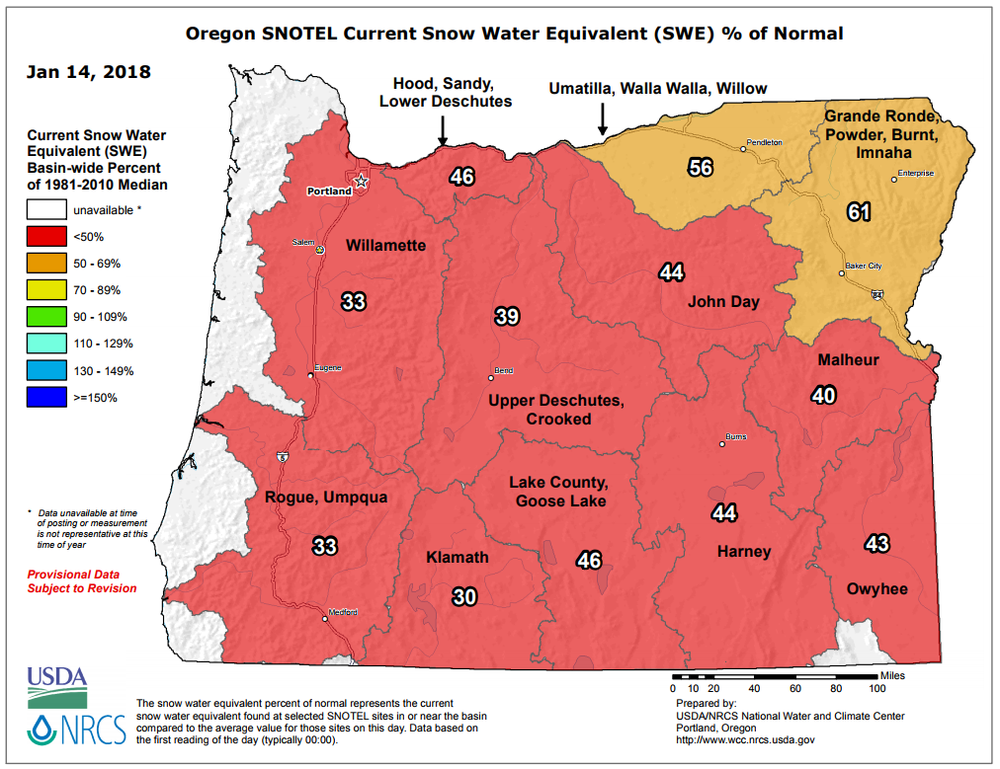
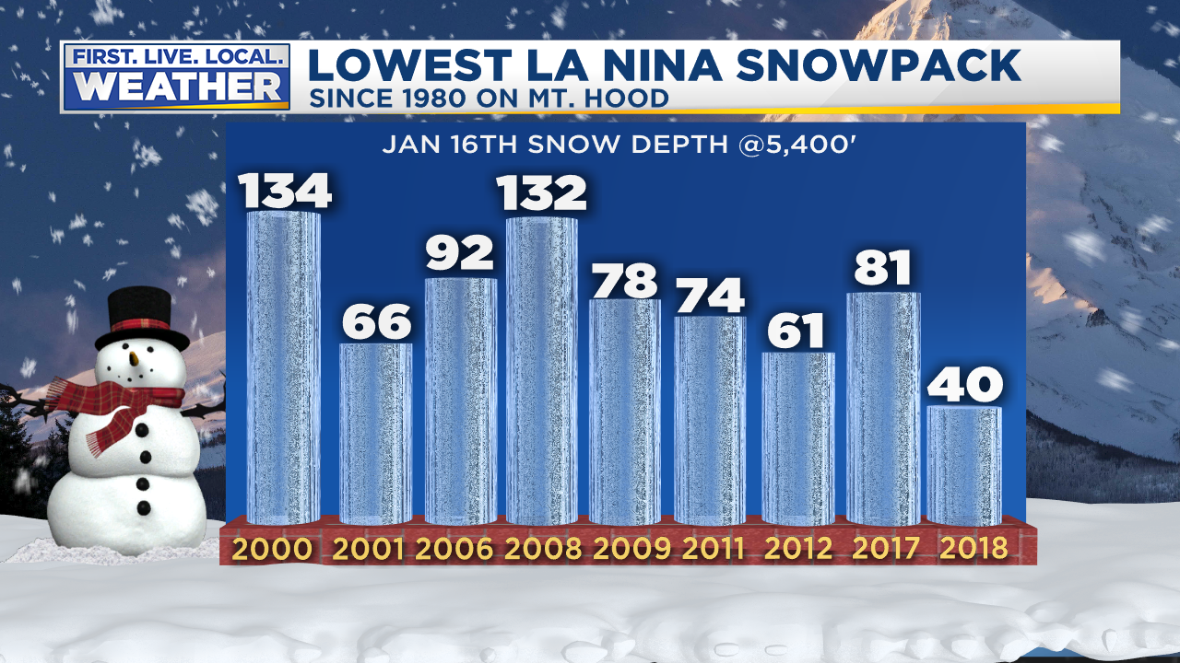
JANUARY
Terrible snowpack in Cascades
Notes:
50+ gusts at TTD, 85 mph gust at Corbett Grade, highest of past 10 years
850mb temps never below -9 this winter
Valley 30-35 during this time
Puget Sound 35-45!

Slide 34
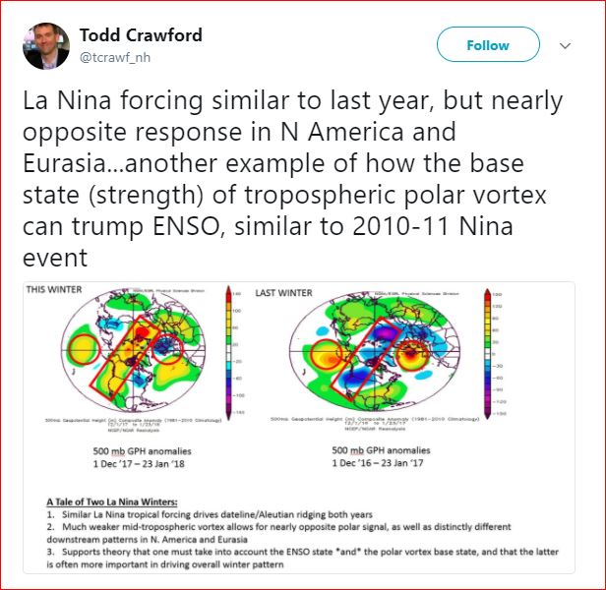
JANUARY
Interesting thoughts on why this La Niña very different
Notes:
ENSO state only part of winter pattern, polar vortex base state is often MORE important.

Slide 35
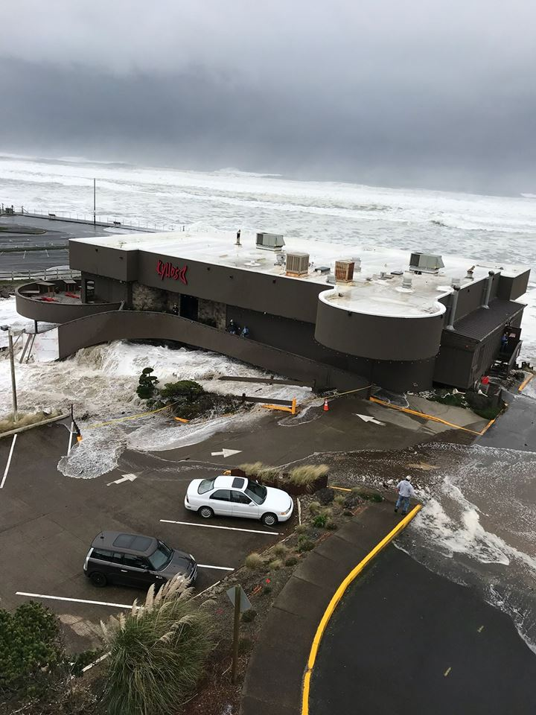
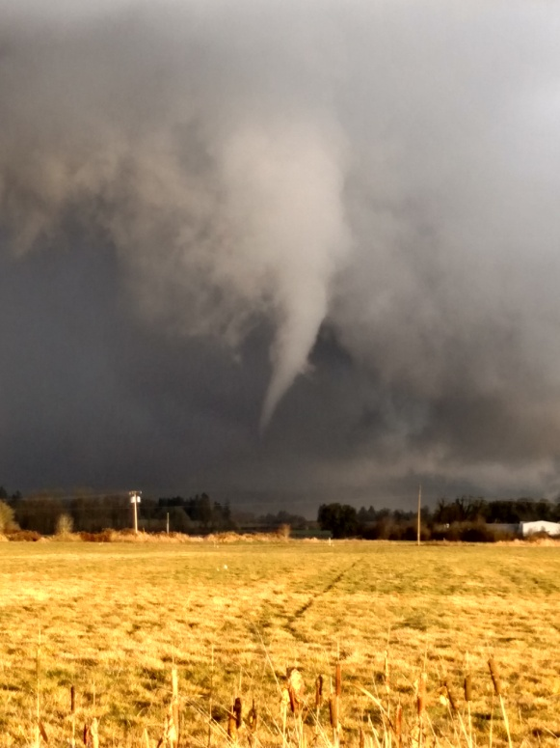
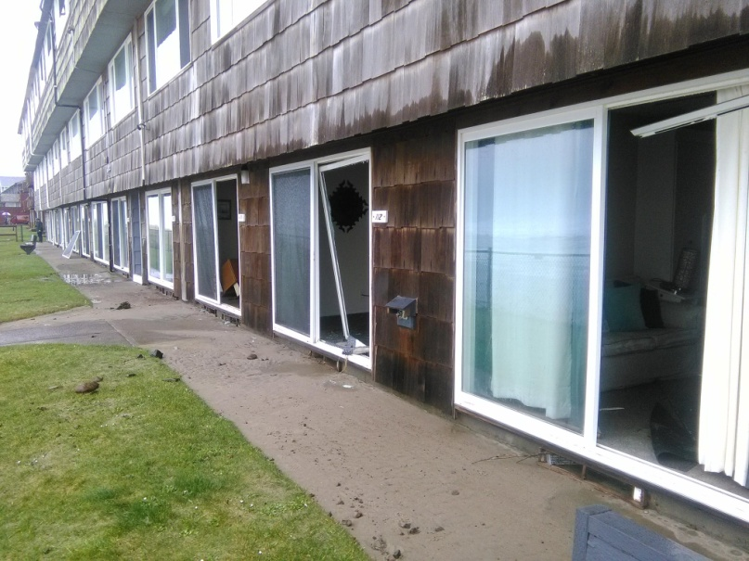
JANUARY
Big waves on coastline January 18th, Scio funnel cloud 11th
Notes:
50+ gusts at TTD, 85 mph gust at Corbett Grade, highest of past 10 years
850mb temps never below -9 this winter
Valley 30-35 during this time
Puget Sound 35-45!

Slide 36
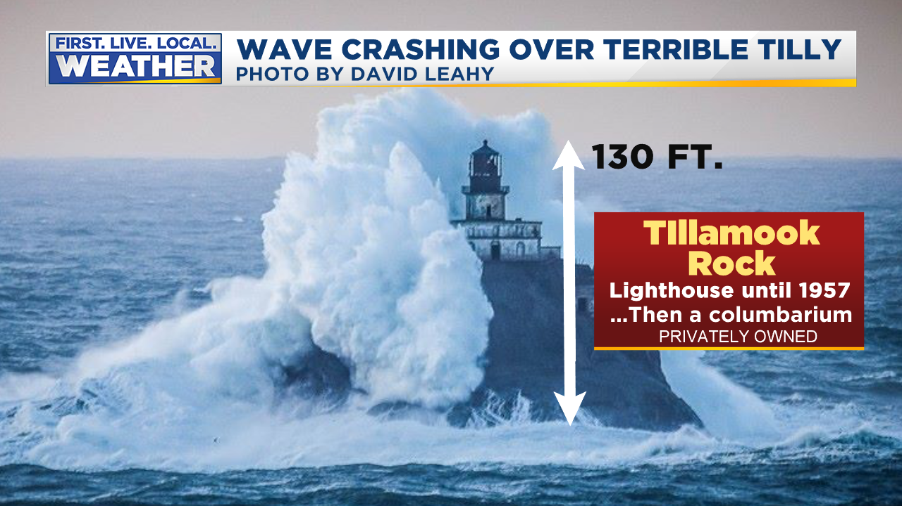
JANUARY
Neat pic!
Notes:
Viewers on FB argue over whether it’s fake or not…drama

Slide 37
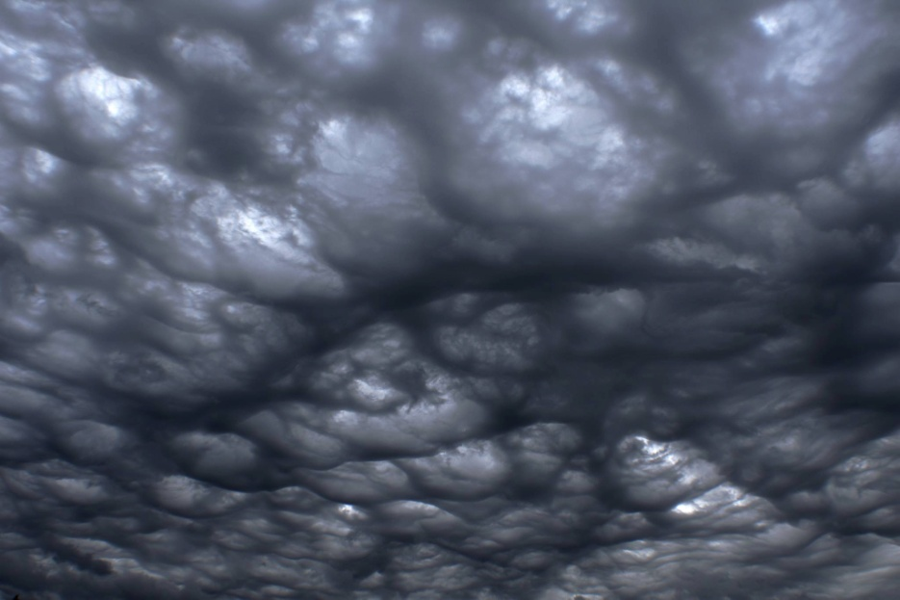
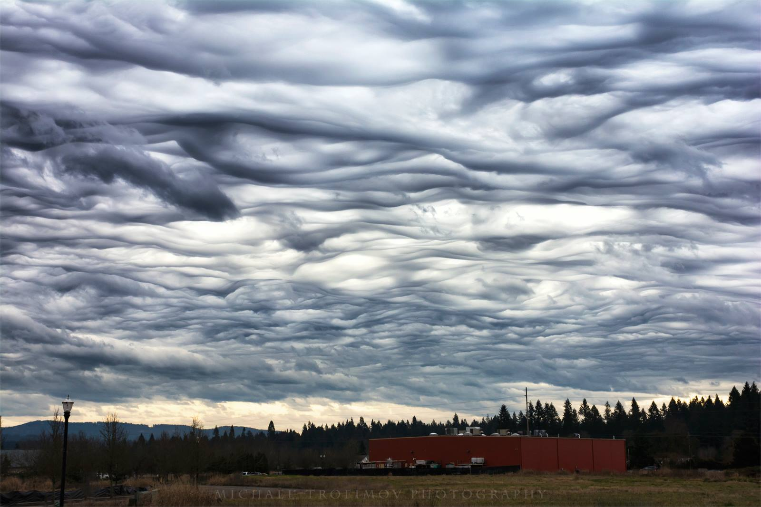
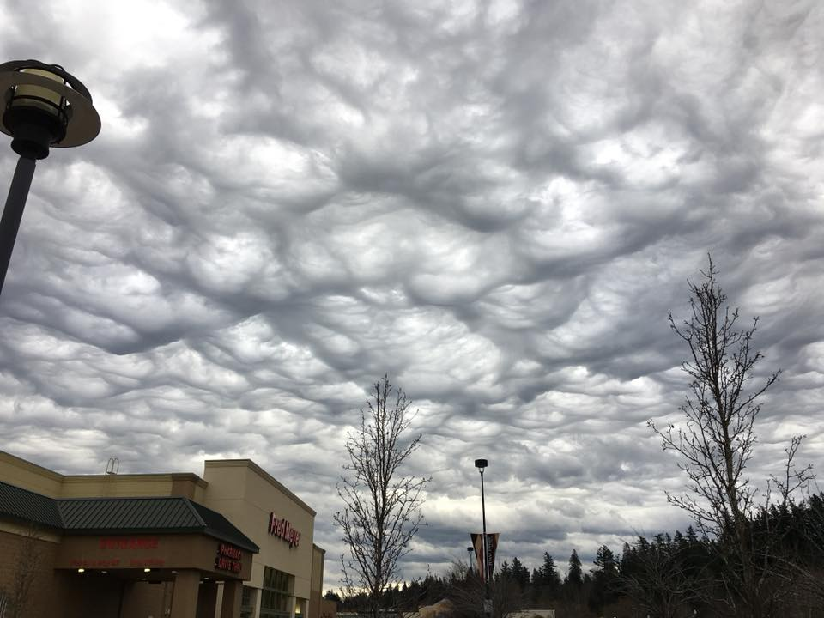
JANUARY
Neat Asperitas clouds late month

Slide 38
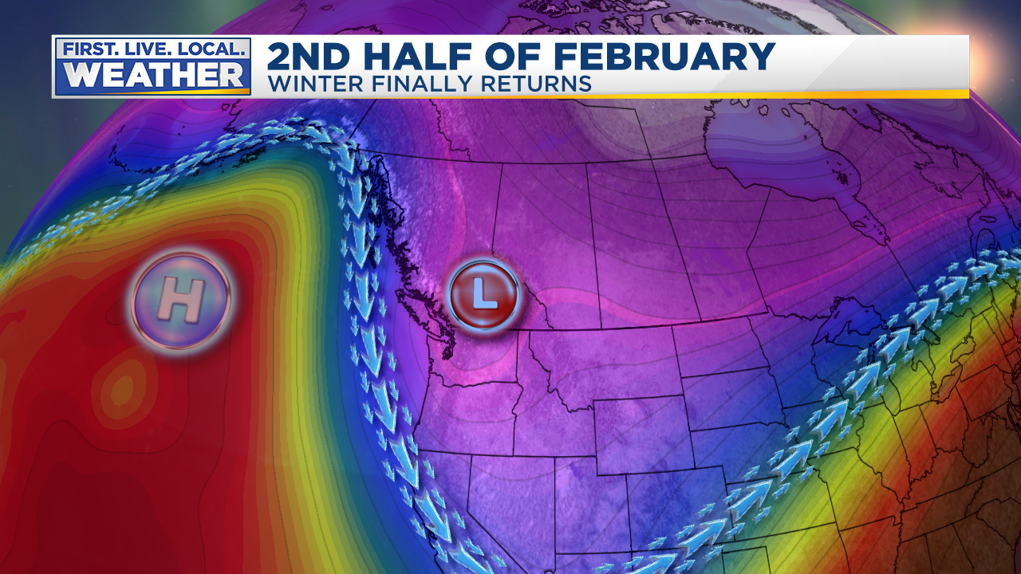
FEBRUARY
Very Warm First 10 Days
Then ridging develops, but farther offshore this time
Cool systems slide down coastline in a more typical La Niña pattern
Notes:
50+ gusts at TTD, 85 mph gust at Corbett Grade, highest of past 10 years
850mb temps never below -9 this winter
Valley 30-35 during this time
Puget Sound 35-45!

Slide 39

FEBRUARY
Models/Maps show coldest pattern
of winter approaching
Notes:
50+ gusts at TTD, 85 mph gust at Corbett Grade, highest of past 10 years
850mb temps never below -9 this winter
Valley 30-35 during this time
Puget Sound 35-45!

Slide 40
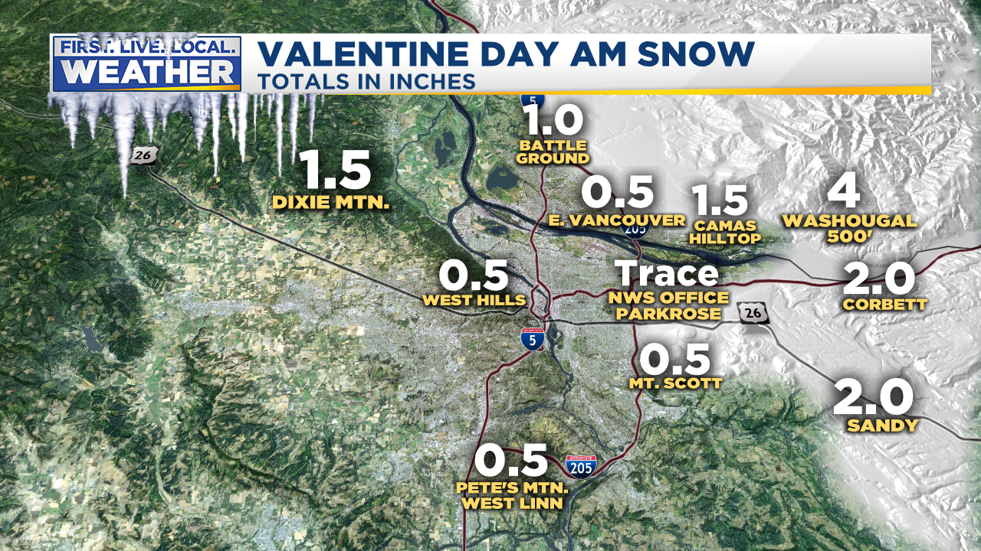
FEBRUARY
Valentine’s AM Snow, a “post-frontal” chilly airmass
Well forecast by models even though observations didn’t seem
to support it in hours ahead of time…impressive!
Notes:
50+ gusts at TTD, 85 mph gust at Corbett Grade, highest of past 10 years
850mb temps never below -9 this winter
Valley 30-35 during this time
Puget Sound 35-45!

Slide 41
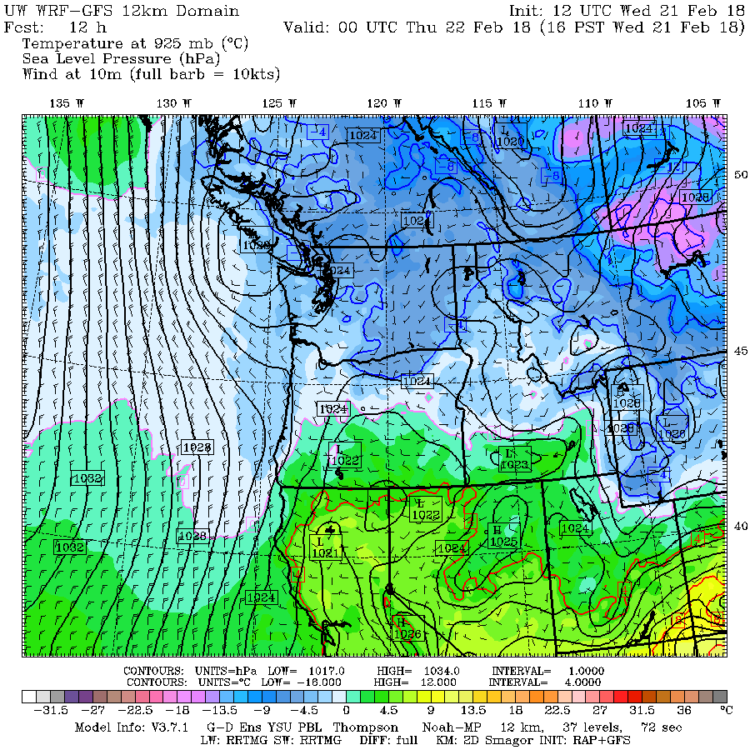
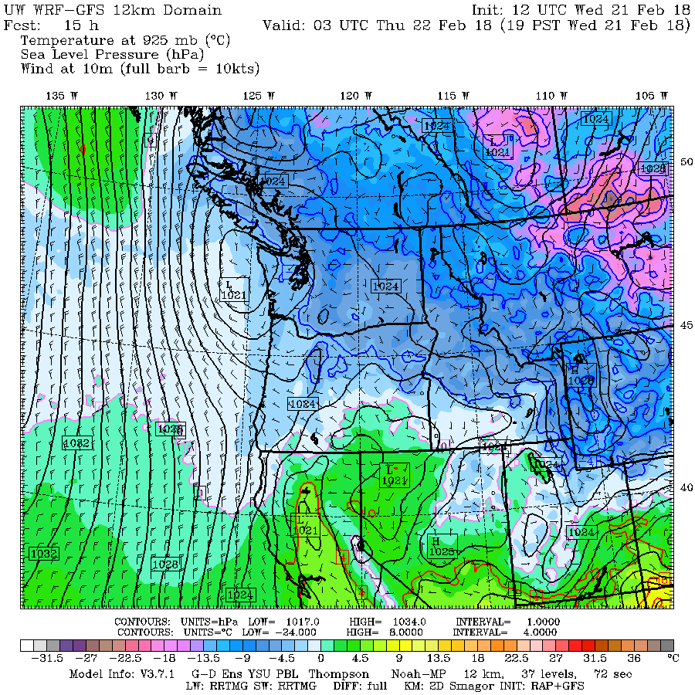
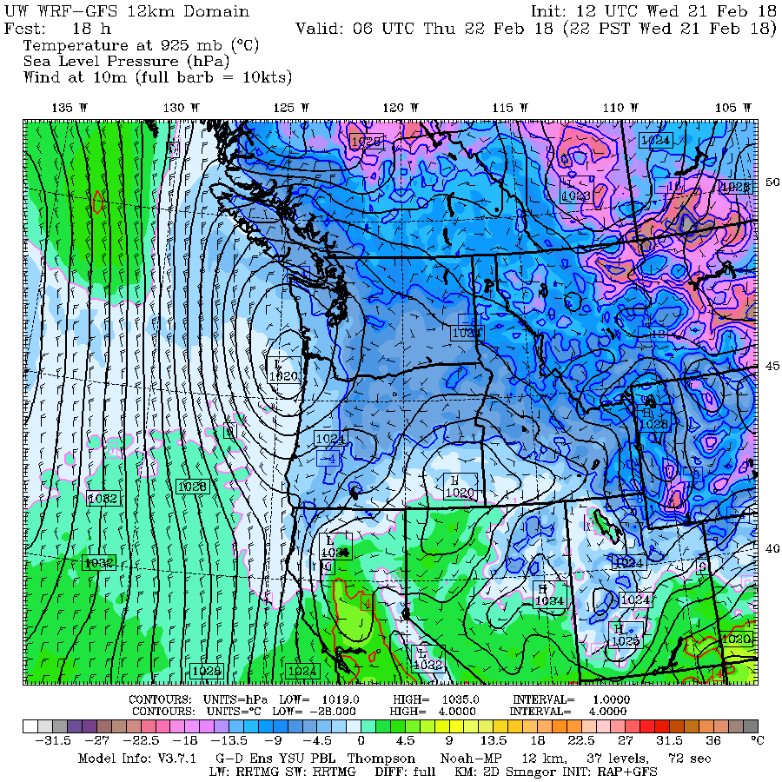


FEBRUARY
3 additional events, 2 as surface lows slide down coast
Could we ask for more? (order for Dec/Jan timeframe?)
Notes:
50+ gusts at TTD, 85 mph gust at Corbett Grade, highest of past 10 years
850mb temps never below -9 this winter
Valley 30-35 during this time
Puget Sound 35-45!

Slide 42

FEBRUARY
Sunday evening snowfall (east metro)
Surprise showers pop up as cold airmass moves in from the east
Notes:
1st system

Slide 43


FEBRUARY
Tuesday Evening Snow
Notes:
50+ gusts at TTD, 85 mph gust at Corbett Grade, highest of past 10 years
850mb temps never below -9 this winter
Valley 30-35 during this time
Puget Sound 35-45!

Slide 44


FEBRUARY
Last one gives us the most widespread snow.
Salem finally gets all of 0.8”! Coast gets some as well
Notes:
50+ gusts at TTD, 85 mph gust at Corbett Grade, highest of past 10 years
850mb temps never below -9 this winter
Valley 30-35 during this time
Puget Sound 35-45!

Slide 45




FEBRUARY
Sunshine between “storms” = beautiful sights
Notes:
50+ gusts at TTD, 85 mph gust at Corbett Grade, highest of past 10 years
850mb temps never below -9 this winter
Valley 30-35 during this time
Puget Sound 35-45!

Slide 46

FEBRUARY
Not as many traffic issues due to…
Timing, most snow on roads was at night & AM
Temperatures barely dropped to/below freezing
ODOT/PBOT are now using salt in some areas
Notes:
50+ gusts at TTD, 85 mph gust at Corbett Grade, highest of past 10 years
850mb temps never below -9 this winter
Valley 30-35 during this time
Puget Sound 35-45!

Slide 47

FEBRUARY
For the hardcore geeks; cold spell stats
Notes:
50+ gusts at TTD, 85 mph gust at Corbett Grade, highest of past 10 years
850mb temps never below -9 this winter
Valley 30-35 during this time
Puget Sound 35-45!

Slide 48

MARCH
Except for “wind storm” March 8th, pretty tame
Notes:
50+ gusts at TTD, 85 mph gust at Corbett Grade, highest of past 10 years
850mb temps never below -9 this winter
Valley 30-35 during this time
Puget Sound 35-45!

Slide 49

No Wind Storms
23 years since we’ve seen a regional MAJOR storm
Notes:
Calmest south wind season of the last 20-30 years

Slide 50


EAST WIND SEASON
Crazy December, Then Very Quiet…1 day in February!

Slide 51

A “SOUTH WIND” INDEX

Slide 52

Cascade Snowfall
Worst La Niña Winter Since 2000-01
Great start in November, then too dry or too warm
Good snow finally arrived mid-February

Slide 53

Cascade Snowfall
Worst La Niña Winter Since 2000-01
March 17th…Well below average across Oregon

Slide 54

Mountain Snowpack @ 5,400’
Bottom of Pucci Lift @Timberline
Water Year Precipitation: AVERAGE
Snowpack: BELOW AVERAGE
Courtesy
NRCS
Oregon Office
Precip: Thin Line = Average
Snow Water
Thin Line
=
Average

Slide 55

Notes:
First time we’ve had two back to back decent snow years since mid 1980s

Slide 56


Slide 57

Two winters to go in this decade
1940-1995 = PDX 1996-Present = PQR
Notes:
3 years to go
These are not totals, but decade snowfall divided by 7

Slide 58


Slide 59


Slide 60

Blue = Widespread Arctic Air Outbreak

Slide 61

HOW DID FORECASTS
TURN OUT?
Big surprise was the “slow” winter.
No one anticipated a terrible Cascade winter snowpack
Remember that every once in awhile we get a “dud” La Niña winter!
We got lucky at the very end of the season

Slide 62

Old Farmer’s Alamanac
Remember the accuracy…

Slide 63

Farmers’ Alamanac
What’s up with those arrows???
Notes:
What does BRISK mean? They got the drier than average part correct

Slide 64

AccuWeather
With a weak La Niña predicted to develop this winter, the Northwest and the Rockies are set to receive an abundance of precipitation…
Notes:
Missed dry weather across much of West

Slide 65

Oregon Dept of Ag/Forestry
(Pete Parsons)
Top Analog
Years
1967-68
1981-82
1996-97
Above-average temperatures in November; cooling to near or below average by January. Above-average storminess and mountain snowfall
Elevated chances for heavy rain/mountain snow. Heightened chances for Arctic events and valley snow, mainly from mid-December onward
Notes:
Missed temperature forecast for extremely warm January. Well below average storminess & mountain snowfall, missed that. Good snow forecast!

Slide 66


Rod Hill’s Winter Outlook
Notes:
Forecast of drier than normal wet season…did well! He forecast cooler than normal, it was warmer than average. Snowpack forecast way off. Good lack of windstorm forecast

Slide 67


Kyle Dittmer Winter Outlook
Notes:
Expected MANY Gorge snow events…but only 11.7” at Bonneville Dam winter total. Expected 266” Govy snow, 119% of average. But average is 274”. Good forecast on above average Columbia River flow though!

Slide 68


WeatherBELL
“…Comparing to recent prior La Nina years, the most similar years were
2016(-17), 2008(-09), 1995(-96).
Only 1995 made the analog list of 24 factors”
Notes:
Way off on snowy NW forecast, at least for mountains/water users. Near/below average temperature forecast was off

