Slide 1

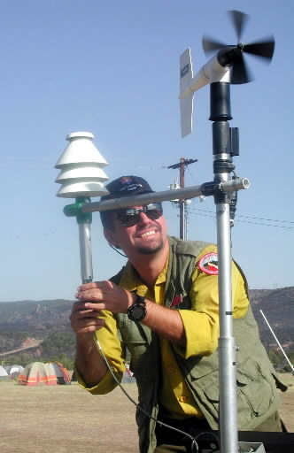


Eagle Creek Fire
Summary
Oregon AMS
Nov 16th 2017
John Saltenberger

Slide 2
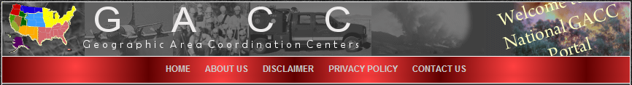
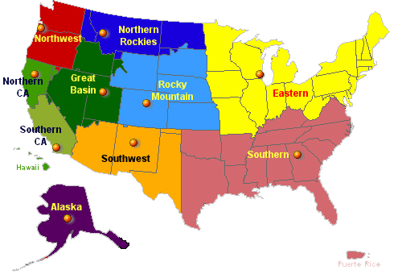


Slide 3
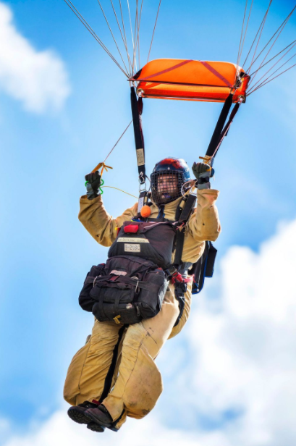
Northwest Interagency Coordination Center
  DAILY MOVEMENT OF:
  Air Tankers
  Hotshot Crews
  Helicopters
  Smoke Jumpers
  Rapellers
  Engines

Slide 4
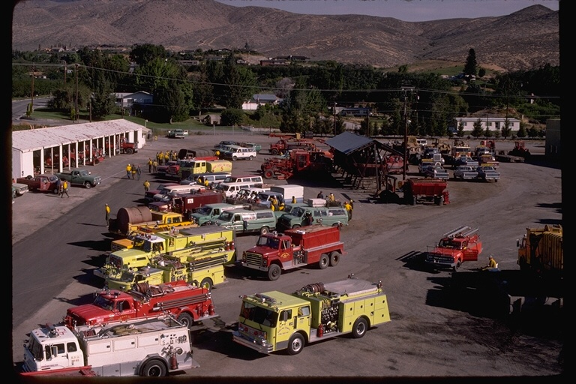
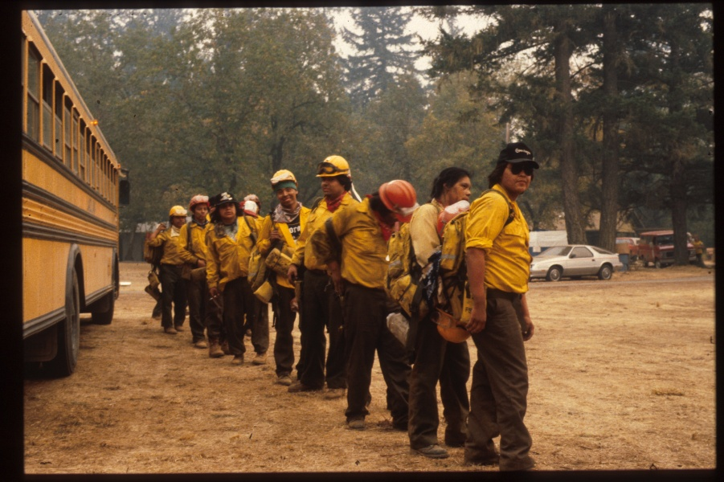
Northwest Interagency Coordination Center
  Fire Workload
  Status Reporting
  Logistic Support
  Planning
    Prioritizing
    Pre-positioning
    3-5 day planning
    window is crucial!

Slide 5
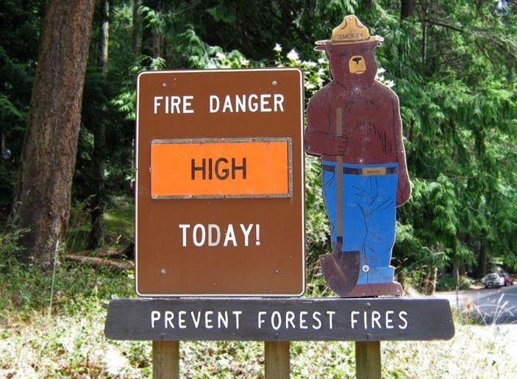
Tracking Daily
Fire Danger
2017

Slide 6
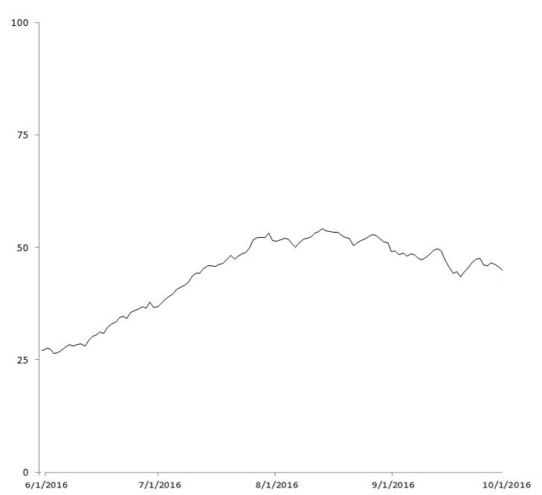
Typical summer rise in Regional Fire Danger
Historical Average Peak
Aug 10
Begin tracking
June 1
End tracking
October 1

Slide 7
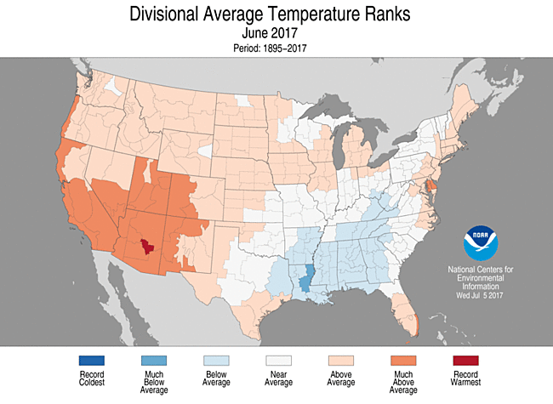

Slide 8
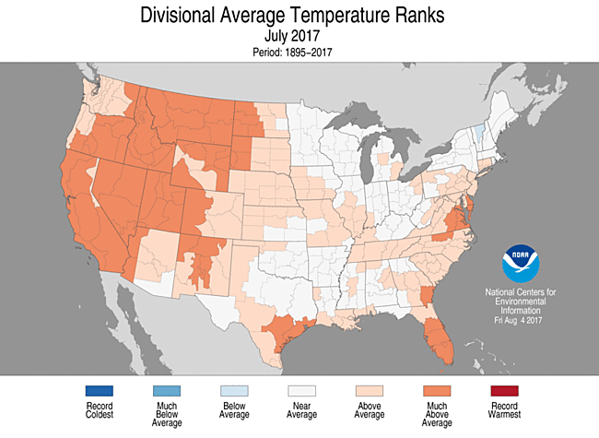

Slide 9
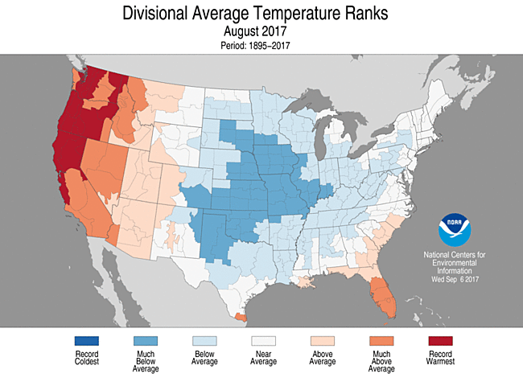

Slide 10
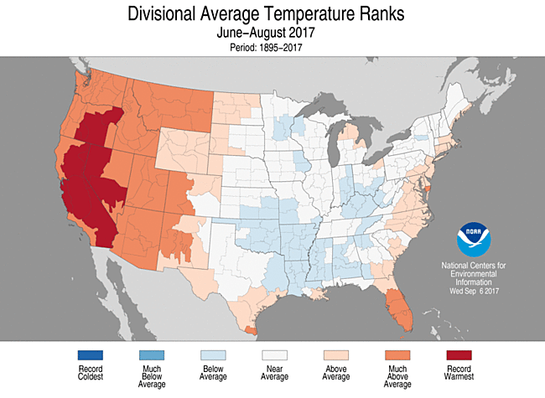

Slide 11
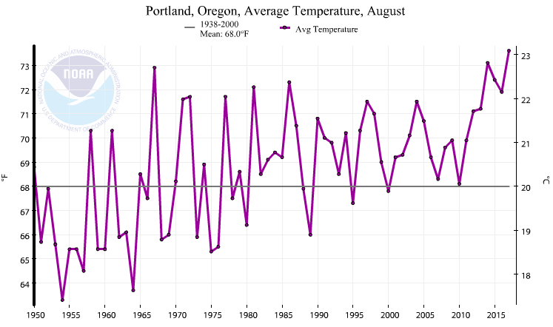
AUGUST – Average Temp KPDX

Slide 12
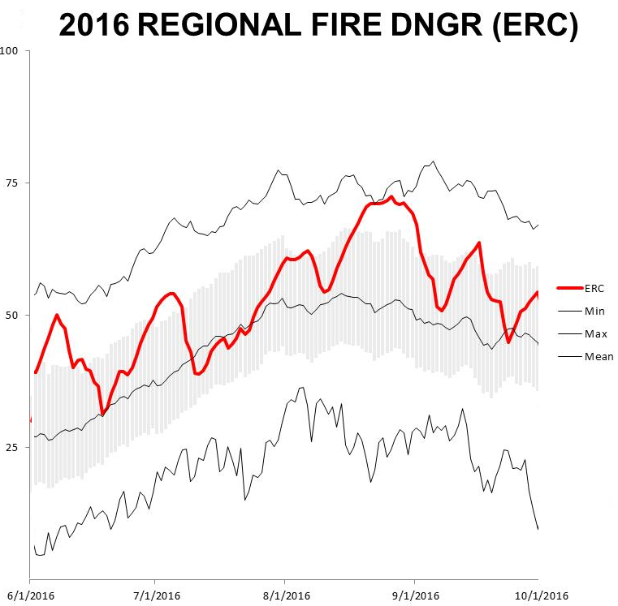

Slide 13
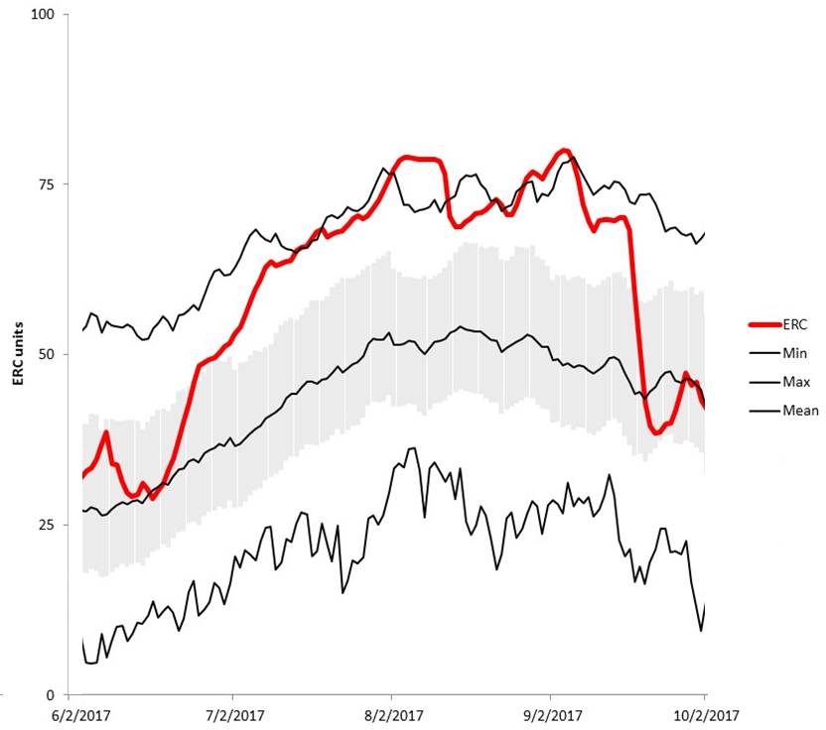
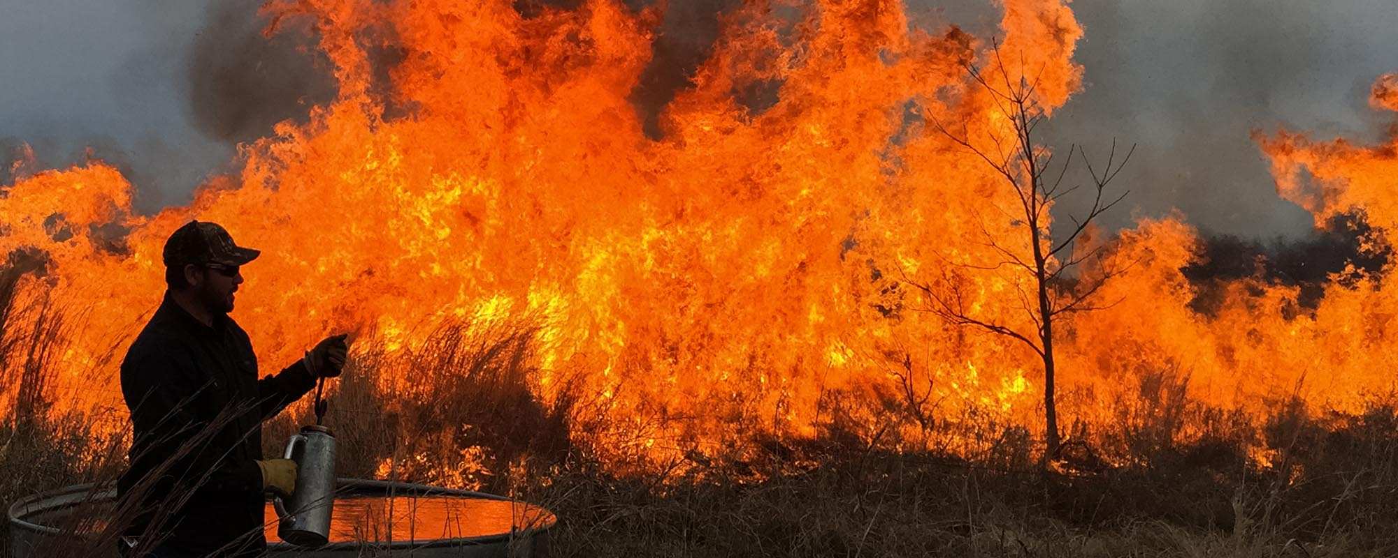
2017 REGIONAL FIRE DANGER (ERC)

Slide 14
2017 Log Creek RAWS FIRE DANGER (ERC)

Slide 15
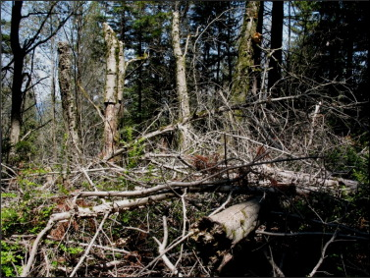
2017 Log Creek RAWS FIRE DANGER (1000hr)

Slide 16
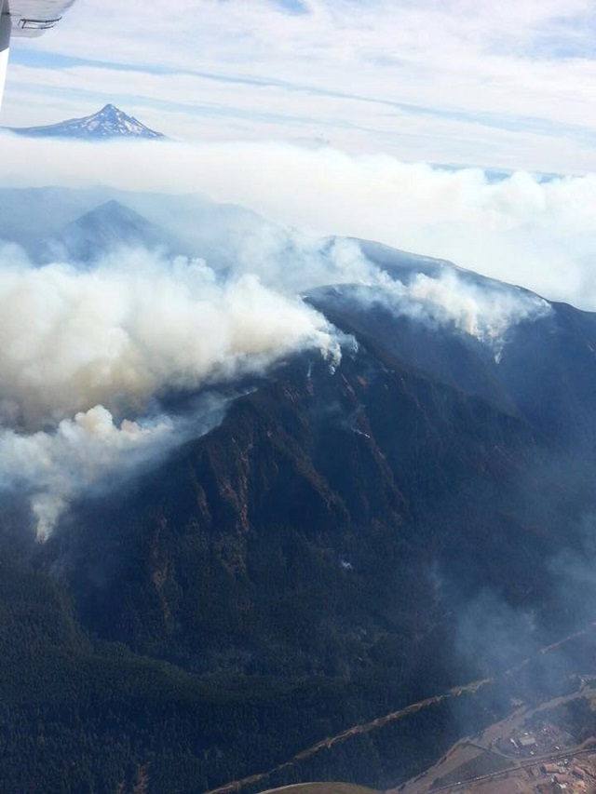
Evolution of the Eagle Creek Sep 2017

Slide 18
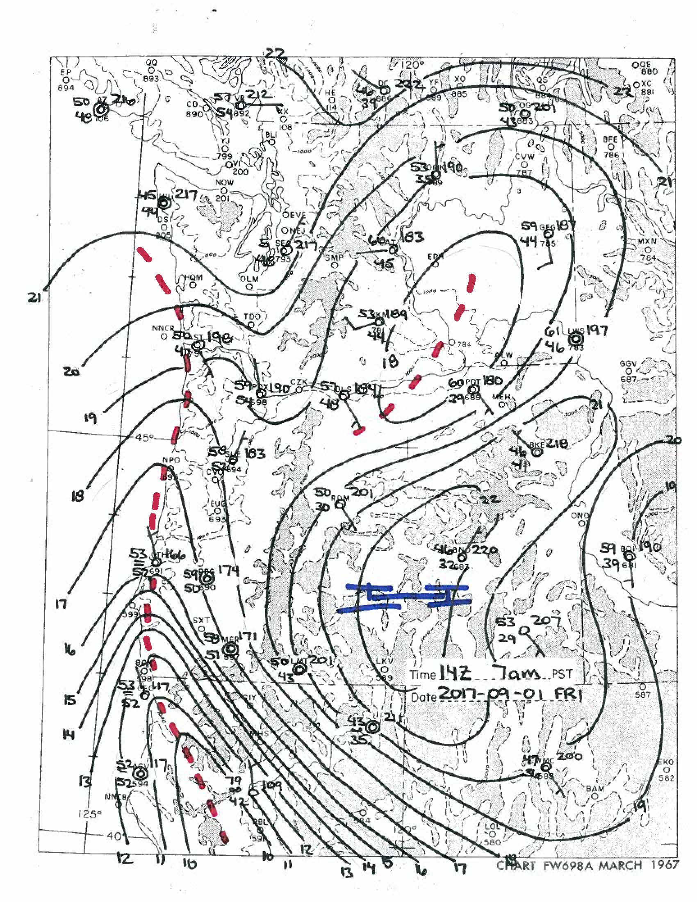
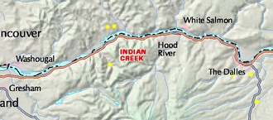
Sep 1st 3pm
Evoluti

Slide 19
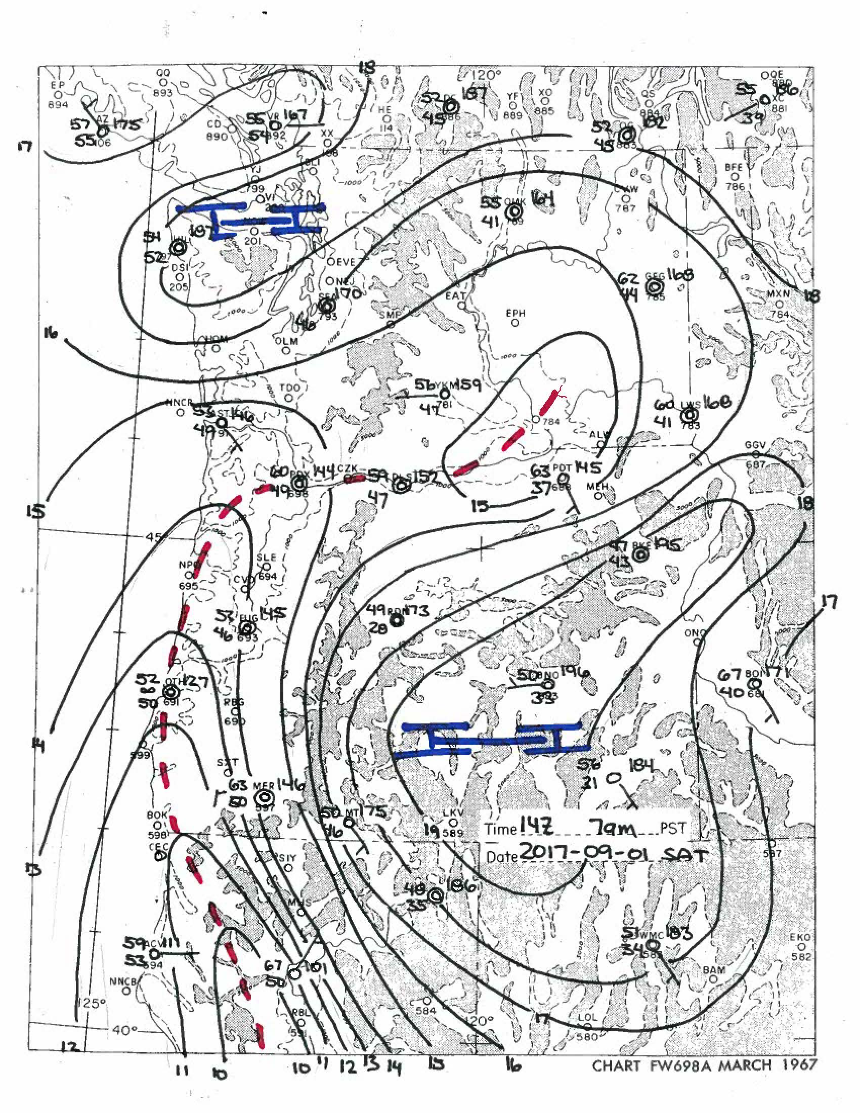
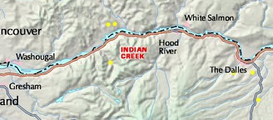
Sep 2nd 3pm
Acres: WS: ?
RH: 20%
WS:

Slide 20
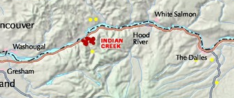
Sep 3rd 3am

Slide 21
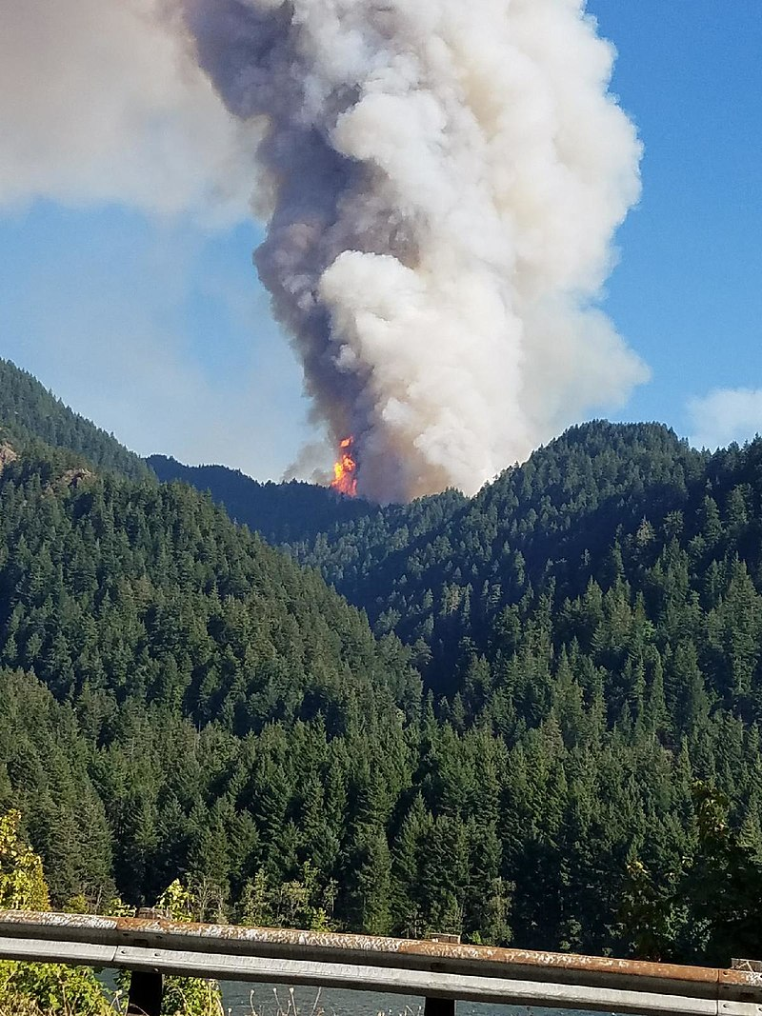
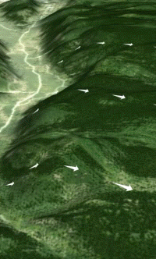

Slide 22
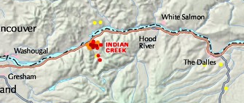
Sep 3rd 3pm
Acres: 1856
RH: 23%
WS:

Slide 23
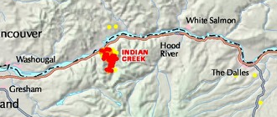
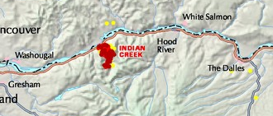
Sep 4th 3am

Slide 24
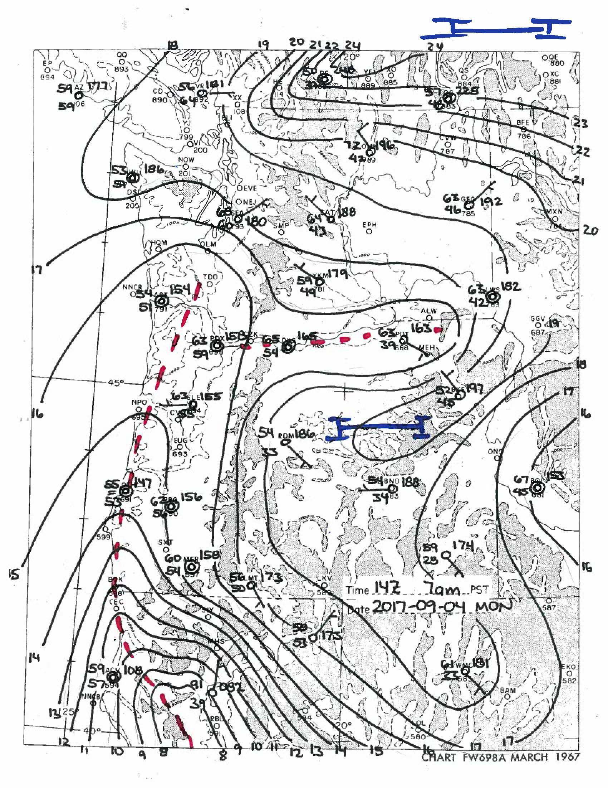
Sep 4th 3pm
Acres: 14457
RH: 24%
WS:

Slide 25
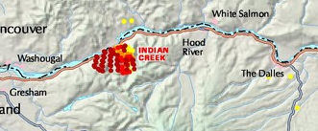
Sep 5th 3am

Slide 26
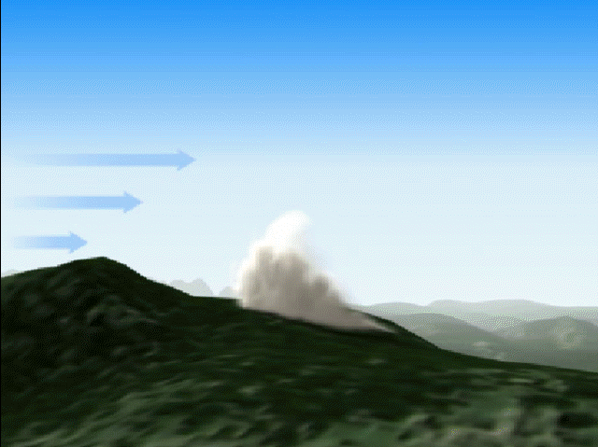

Slide 27
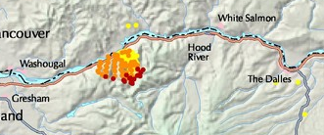
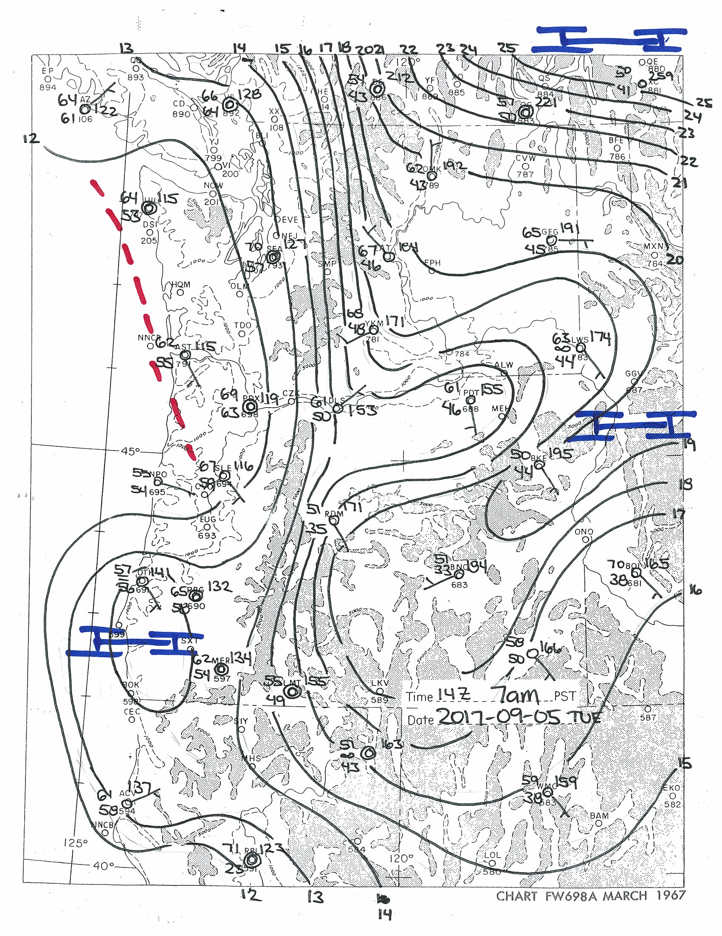
Sep 5th 3pm
Acres: 29885
RH: 19%
WS:

Slide 28
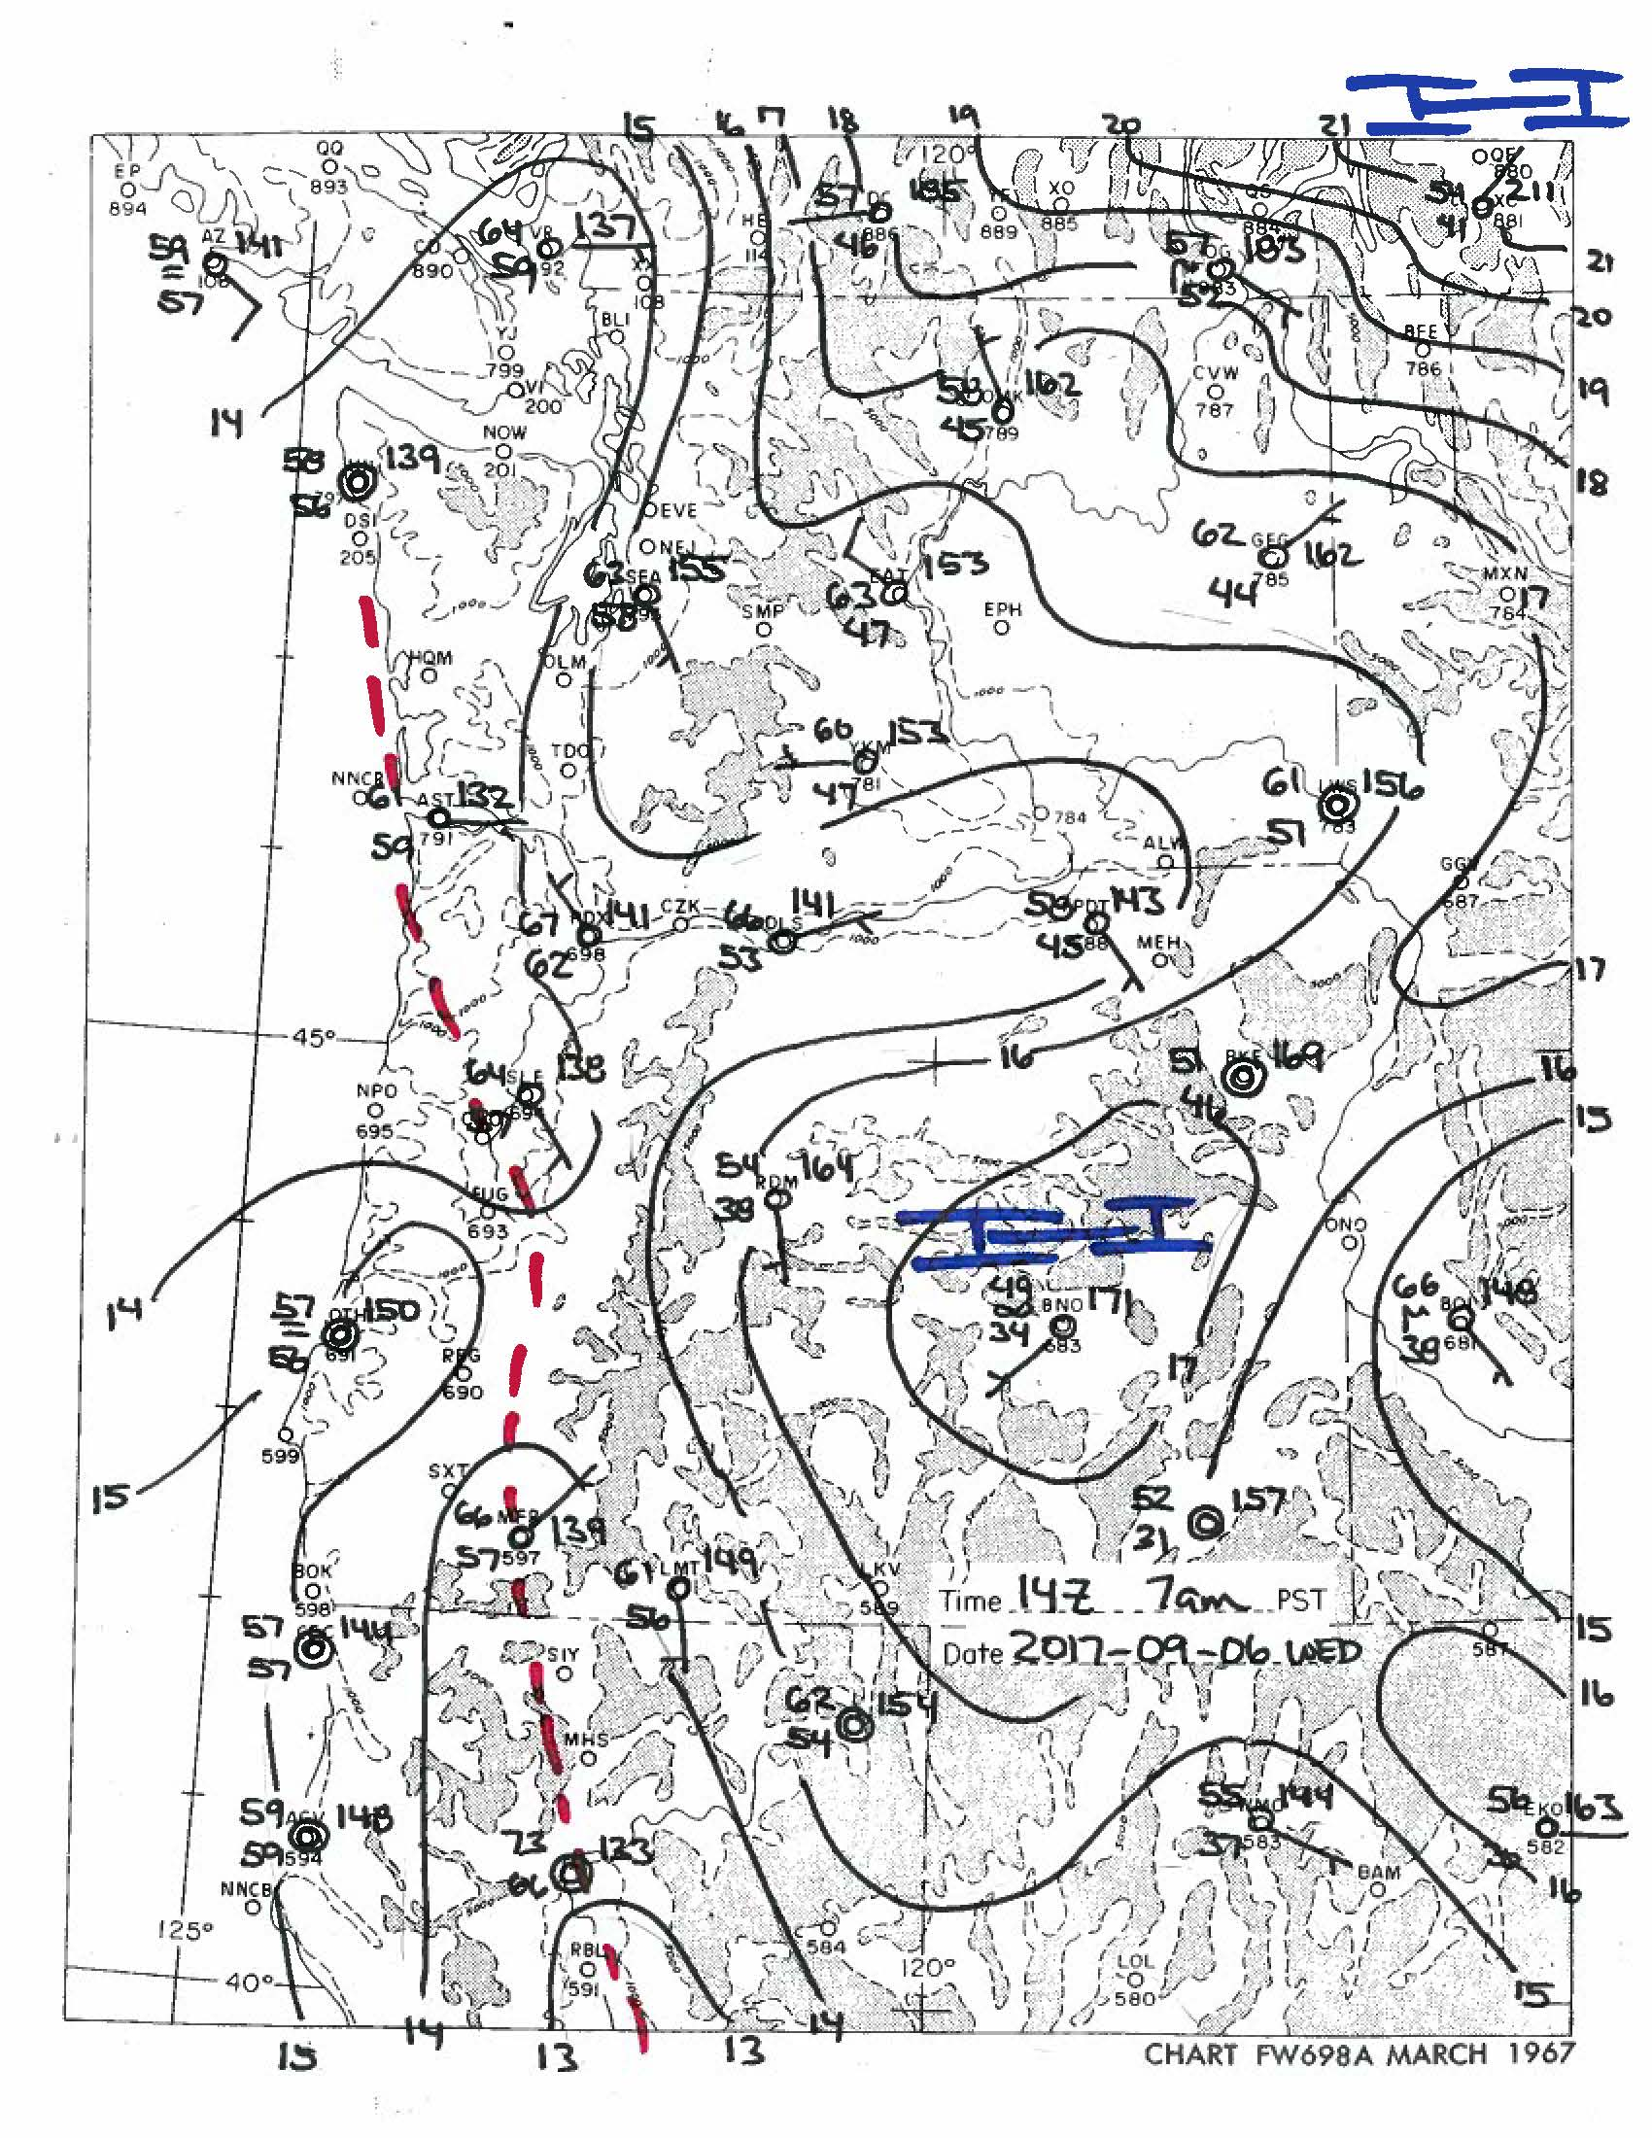
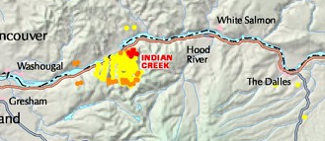
Sep 6th 3pm
Acres: 32241
RH: 53%
WS:

Slide 29
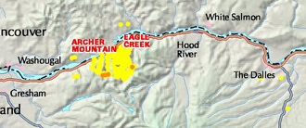
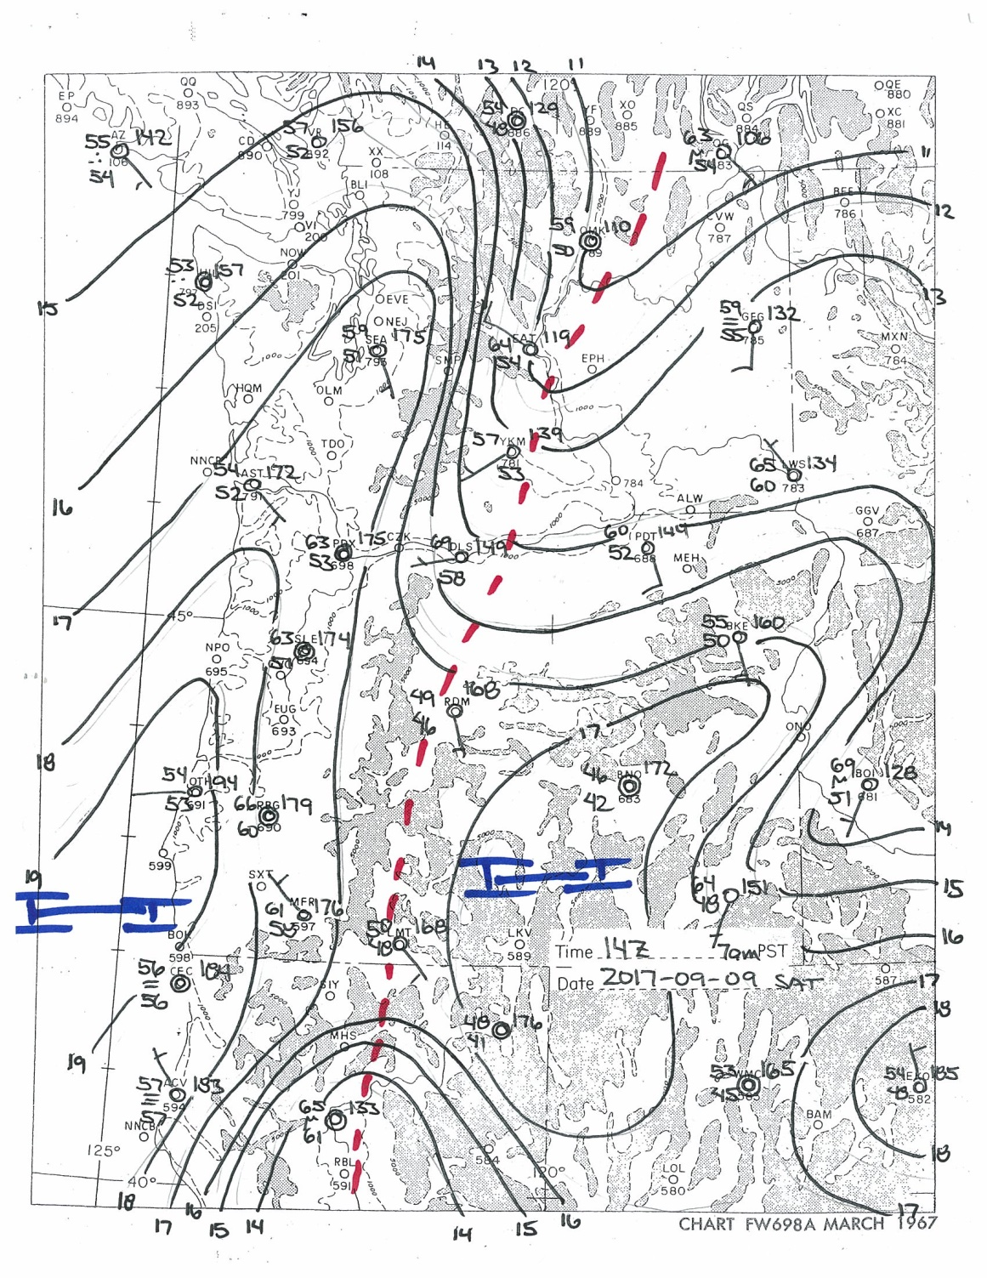
Sep 8th 3pm
Acres: 33660
RH: 65%
WS:

Slide 30
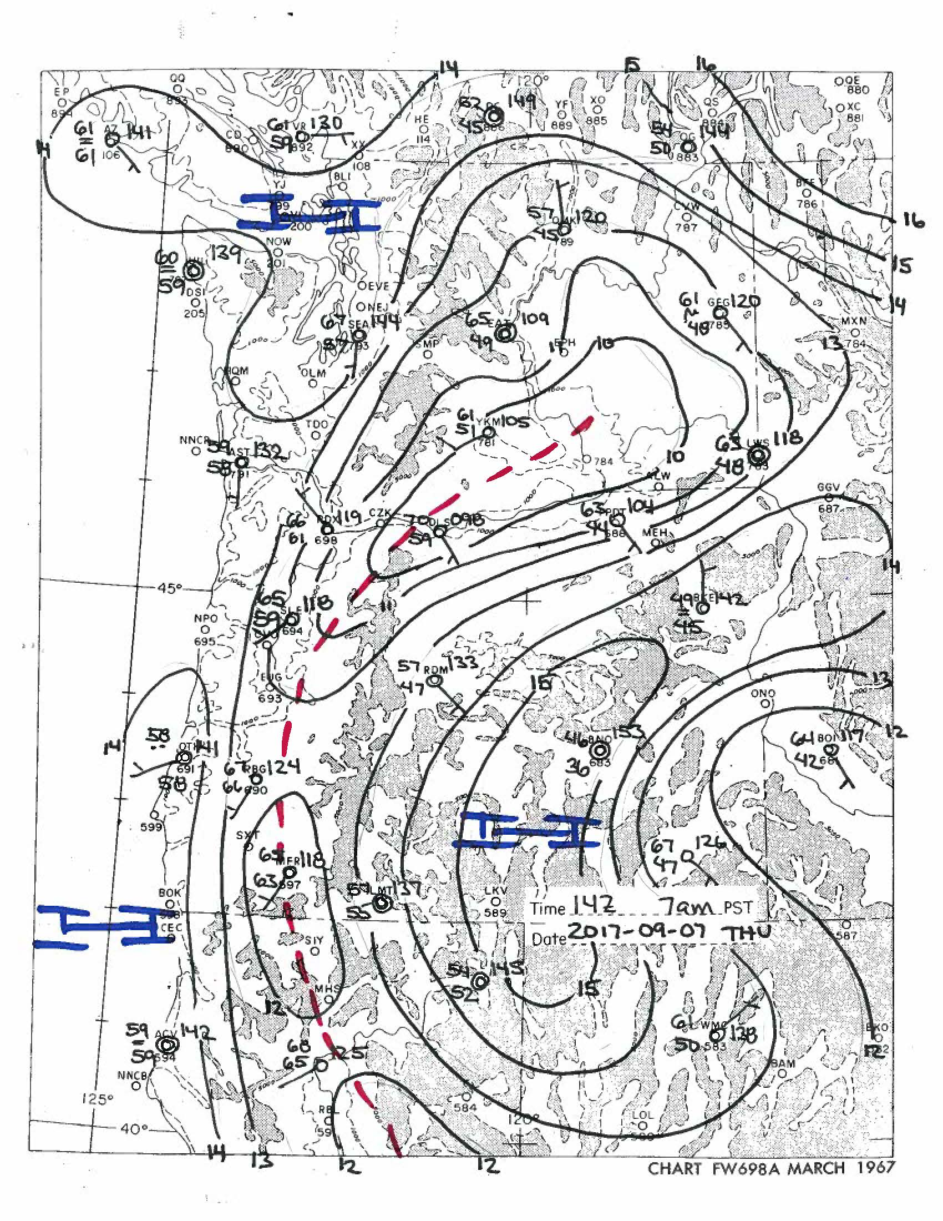
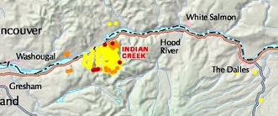
Sep 7th 3pm
Acres: 33400
RH: 63%
WS:

Slide 31

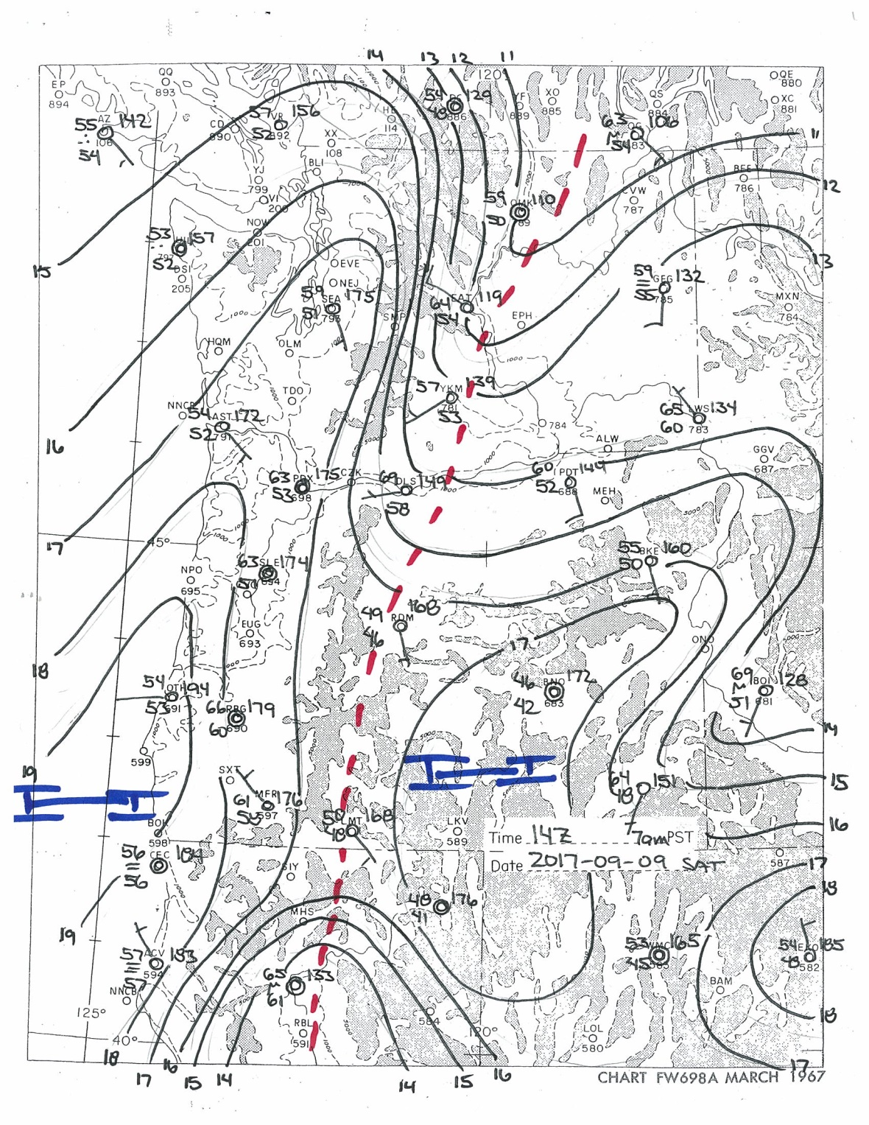
Sep 9th 3pm
Acres: 33920
RH: 94%
WS:

Slide 32

Sep 10th 3pm
Acres: 33985
RH: 53%
WS:

Slide 33
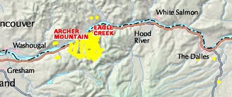
Sep 11th 3pm
Acres: 33496
RH: 20%
WS:

Slide 34
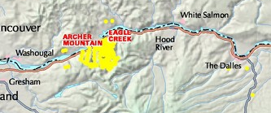
Sep 12th 3pm
Acres: 36636
RH: 35%
WS:

Slide 35
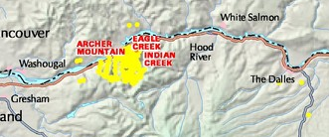
Sep 13th 3pm
Acres: 40411
RH: 26%
WS:

Slide 36
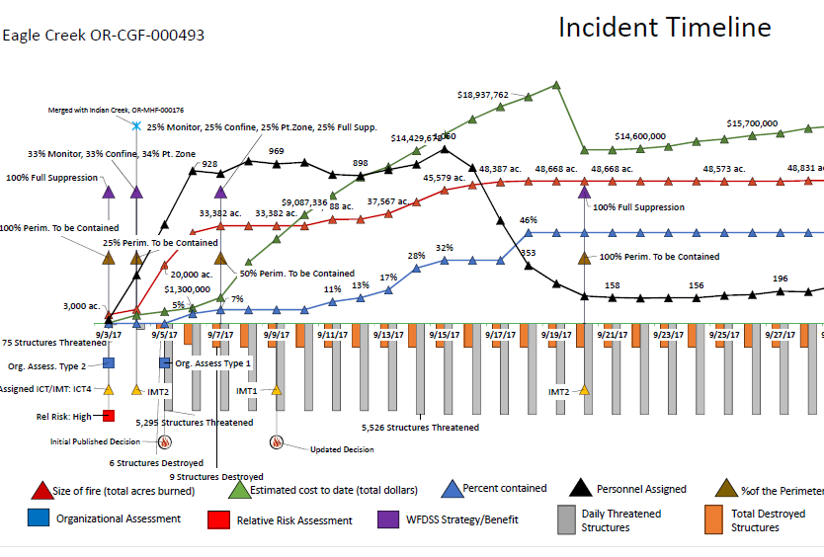

Slide 37
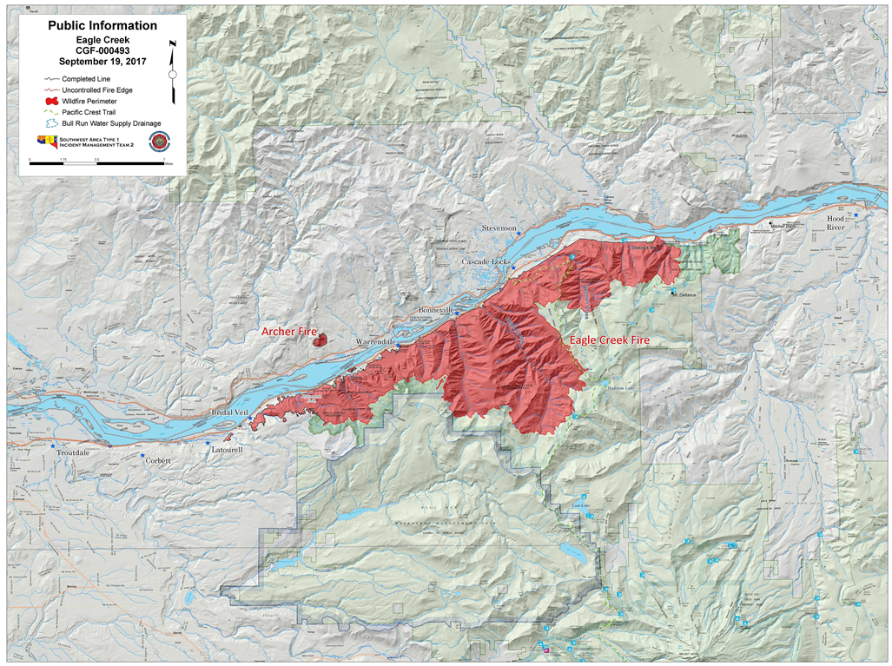
FINAL SIZE: 48,000+ ac

Slide 38
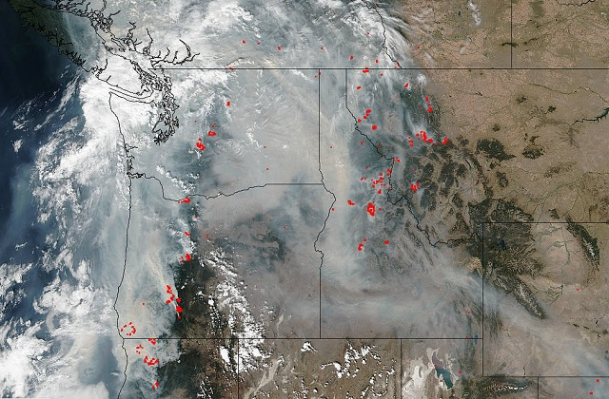
Sep 6th MODIS

Slide 48
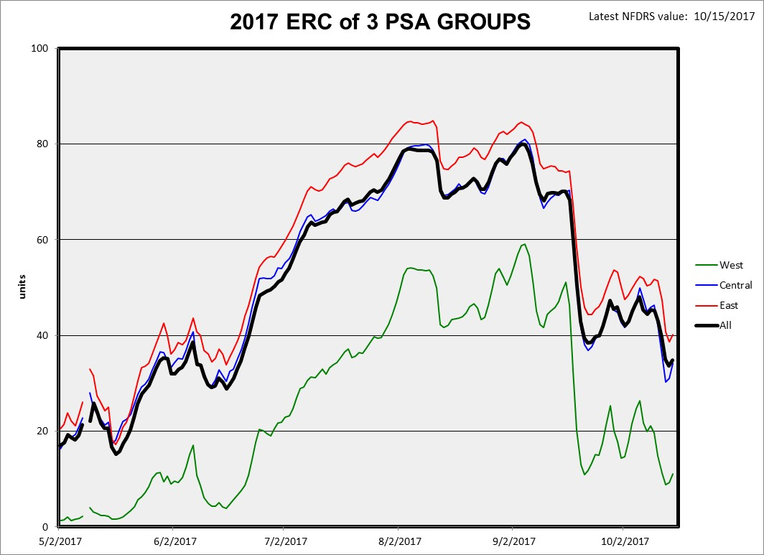
Notes:
asdfasdfad

