Slide 1
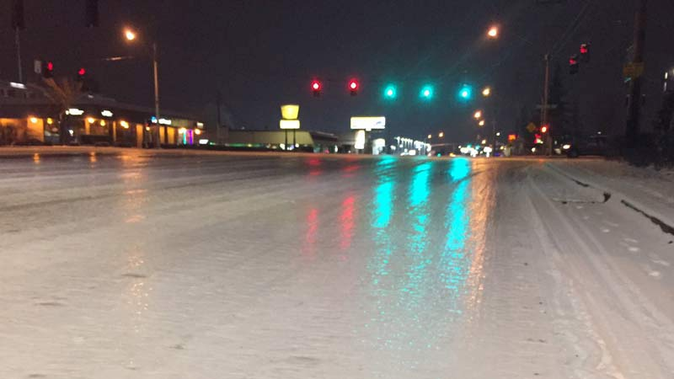
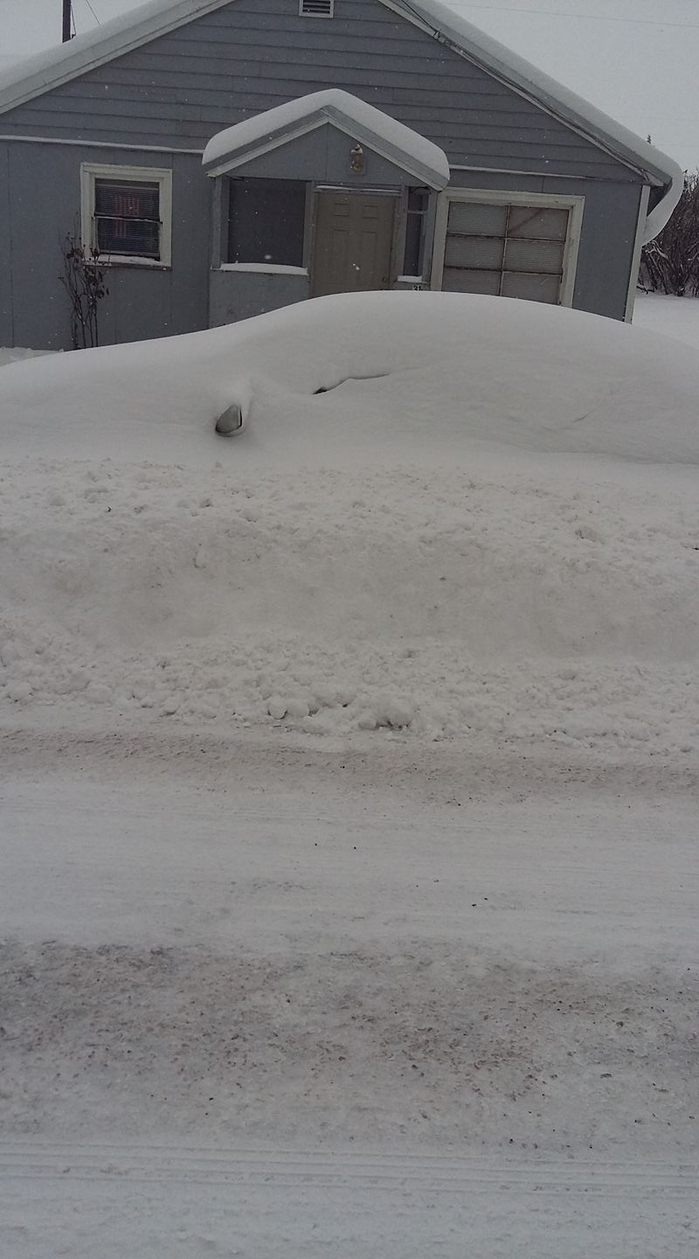
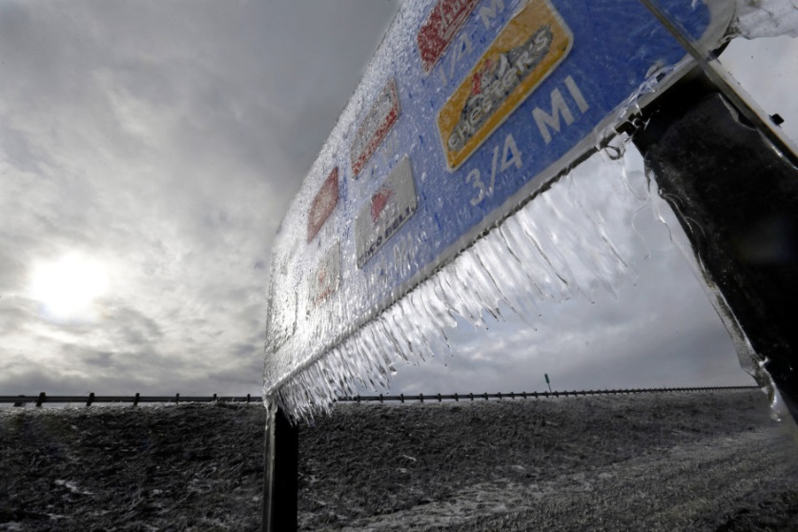
Winter 2017-18 Outlook
2017 OMSI Meeting
NWS Portland
Evan Bentley
Meteorologist
Oct. 28th, 2017

Slide 2
Questions I will Try To Answer
El Nino or La Nina This Winter?
Below, near or above average temperatures this winter?
Below, near or above average precipitation this winter?

Slide 3
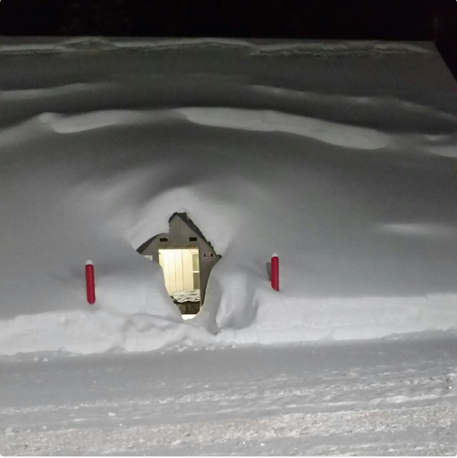
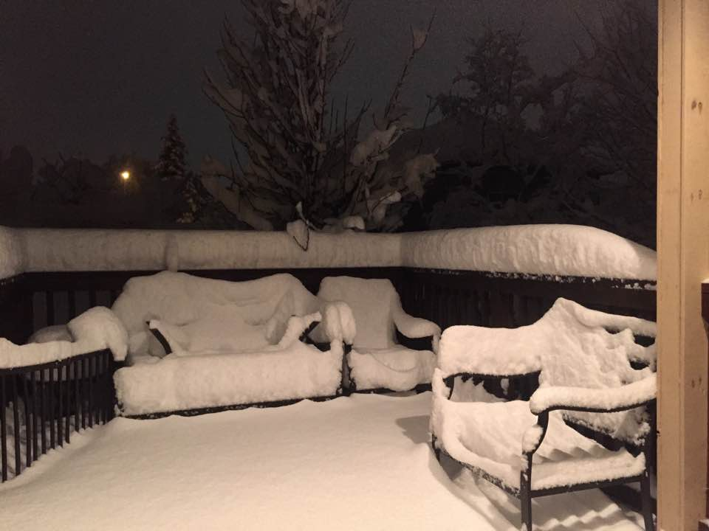
The only questions you really care about…

Slide 4
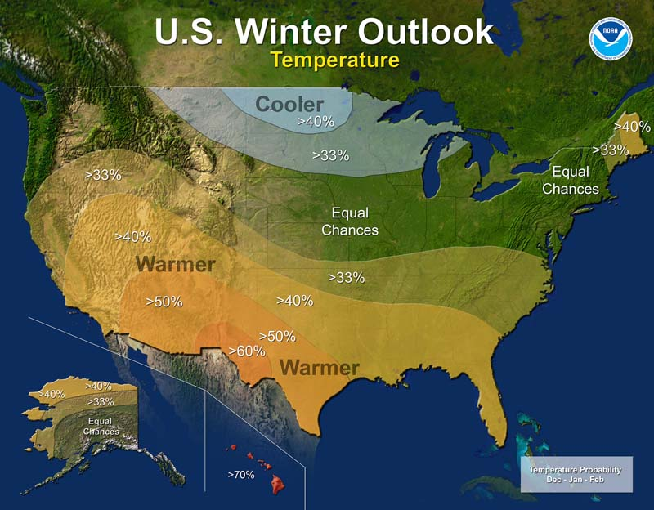
How did we do last year?

Slide 5
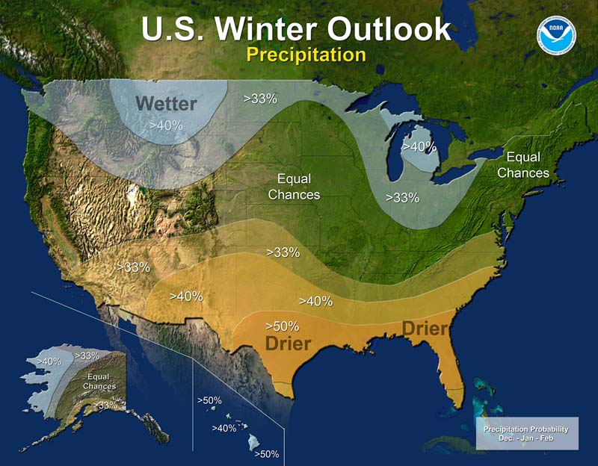
How did we do last year?

Slide 6
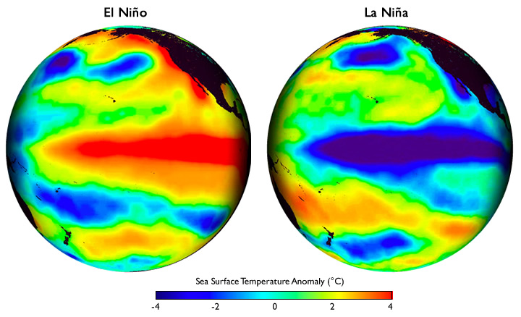
El Niño Southern Oscillation (ENSO)
USA
USA
Pacific Ocean
Pacific Ocean
Warmer than usual
ocean temperatures
Cooler than usual
ocean temperatures

Slide 7
Classifying ENSO Phases
  >1.9°C Very Strong El Niño
  1.5 to 1.9°C Strong El Niño
  1.0 to 1.4°C Moderate El Niño
  0.5 to 0.9°C Weak El Niño
  0.4 to -0.4°C Neutral
  -0.5 to -0.9°C Weak La Niña
  -1.0 to -1.4°C Moderate La Niña
  -1.5 to -1.9°C Strong La Niña
  <-1.9°C Very Strong La Niña

Slide 8
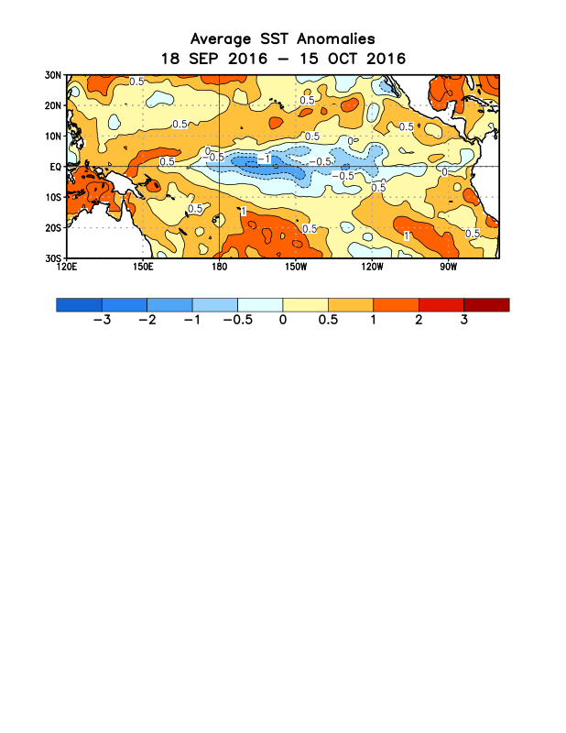
2016 La Niña
Sea Surface Temperature Anomalies
Slightly cooler than usual
Mexico
Australia
Weak
La Niña
La Niña
Neutral
El Niño
-2.0°
(°C)
-1.0°
-0.5°
0.5°
1.0°
2.0°

Slide 9
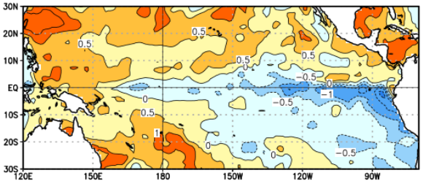
2017 La Niña
Sea Surface Temperature Anomalies
Slightly cooler than usual
Mexico
Australia
Weak
La Niña
La Niña
Neutral
El Niño
-2.0°
(°C)
-1.0°
-0.5°
0.5°
1.0°
2.0°

Slide 10
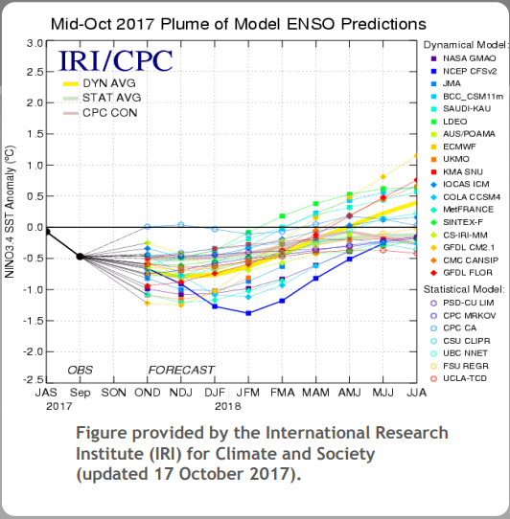
Climate Model Predictions
El Niño
Neutral
Weak
La Niña
Moderate
Strong
Very Strong

Slide 11
Winter 2017-18 Outlook
55%-65% chance of La Niña developing
  Weak and potentially short-lived
  70% chance last year at this time.
Next update from the Climate Prediction Center: November 16

Slide 12
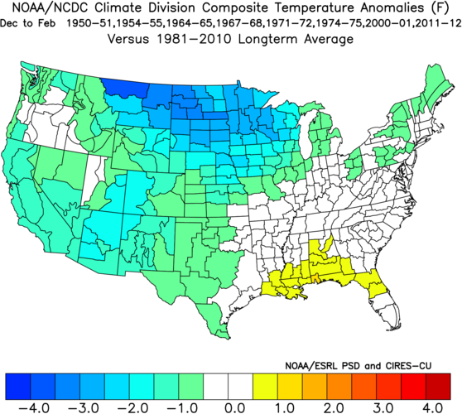
Weak La Niña
Composite Temperature Anomalies

Slide 13
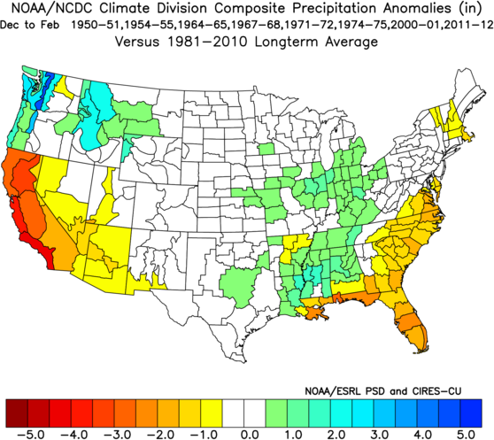
Weak La Niña
Composite Precipitation Anomalies

Slide 14
CPC Outlook Basics
Chance of higher/more than usual
Chance of lower/less than usual
Chance of around usual
100%
Climatology:
  Higher: 33%
  Lower: 33%
  Usual: 33%

Slide 15
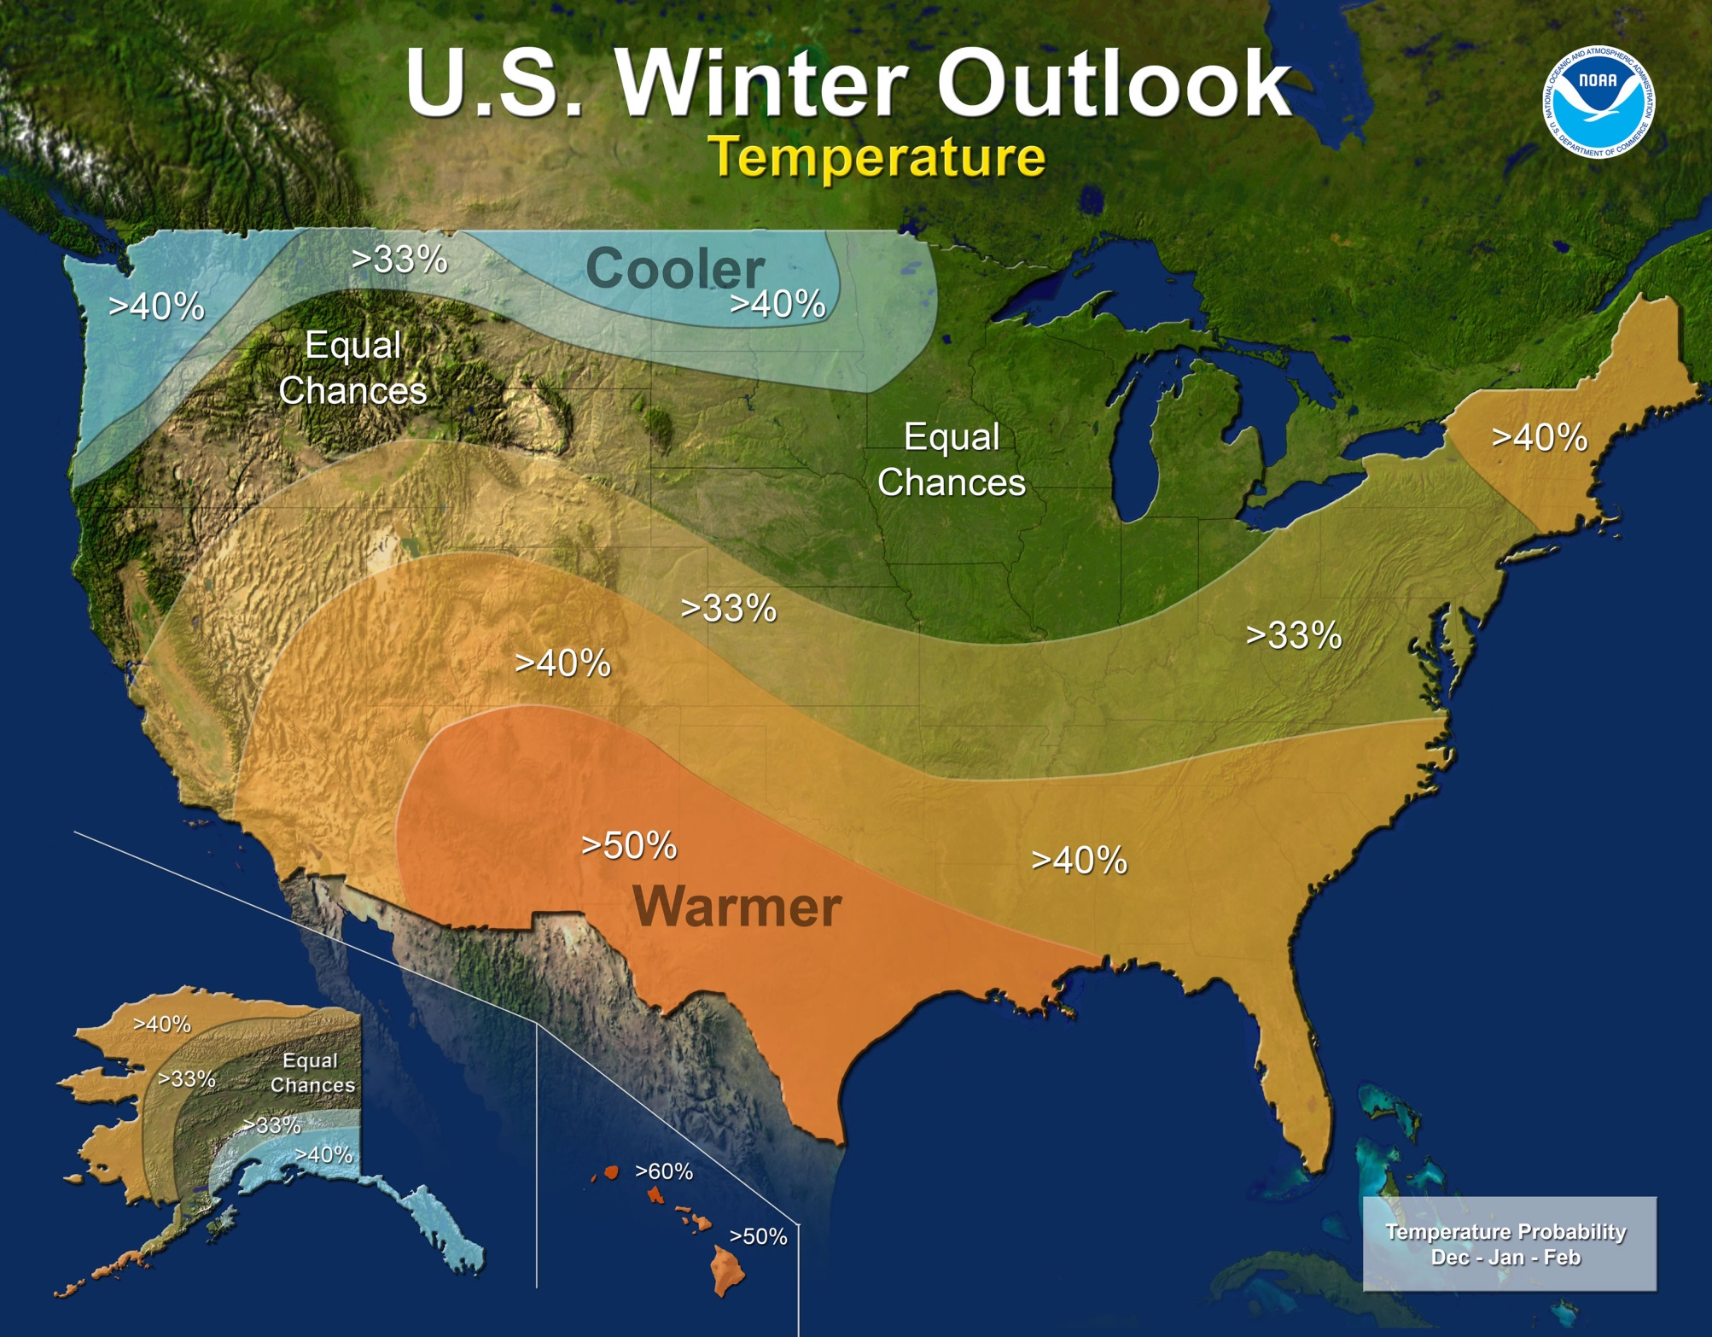
Winter 2017-2018 Outlook

Slide 16
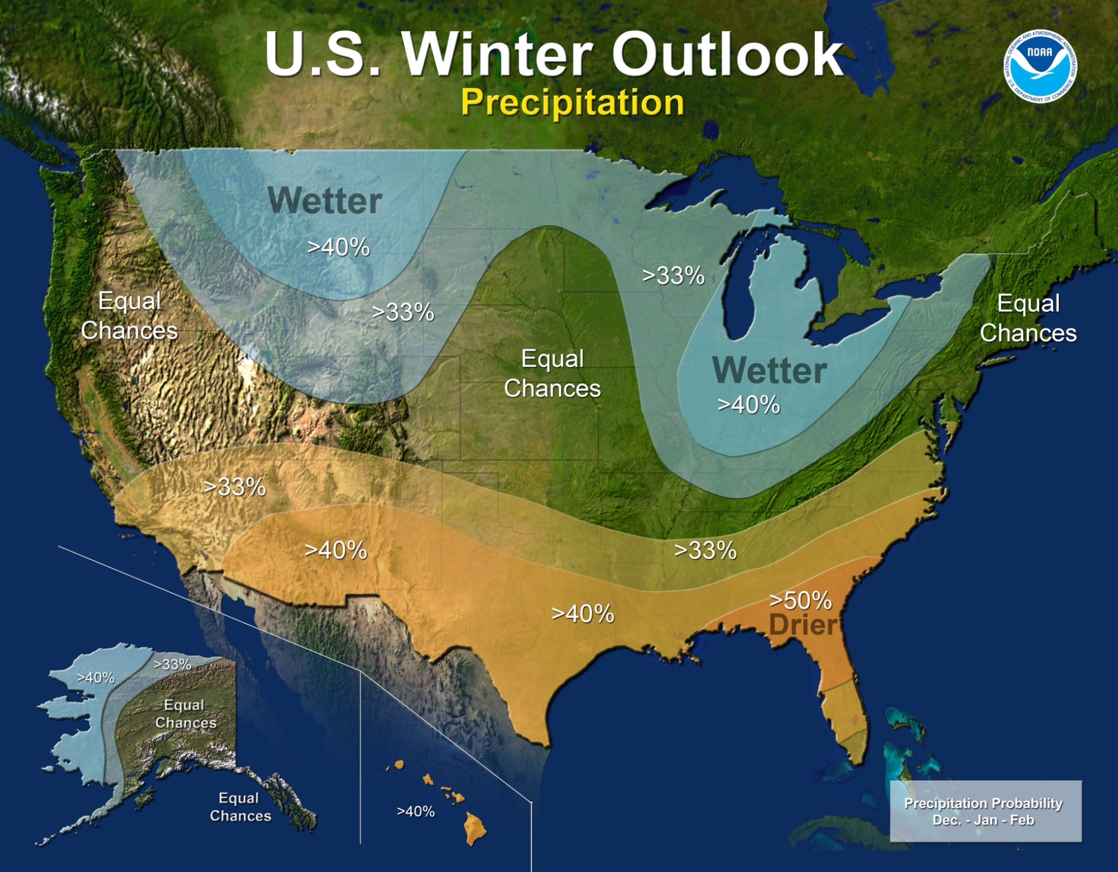

Slide 17
Lowland Snowfall History
1950 to present (DJF period)
Portland Downtown Top 10 Snowiest Winters:
33.4” 1949-50 La Niña
25.7” 1968-69 El Niño
24.4” 1955-56 La Niña
20.3” 1959-60 ENSO Neutral
17.4” 1992-93 ENSO Neutral
16.3” 1979-80 El Niño
15.5” 2016-17 ENSO Neutral
14.7” 1970-71 La Niña
14.3” 2008-09 La Niña
13.4” 1964-65 La Niña
Portland Airport Top 10 Snowiest Winters:
44.5” 1949-50 La Niña
34.0” 1968-69 El Niño
24.2” 2008-09 La Niña
22.4” 1955-56 La Niña
14.1” 1992-93 ENSO Neutral
13.5” 1994-95 El Niño
13.1” 1950-51 ENSO Neutral
12.9” 1959-60 ENSO Neutral
12.4” 1979-80 El Niño
12.3” 2003-04 ENSO Neutral
9.6” 2016-17 ENSO Neutral
30% were ENSO Neutral
50% were La Niña
20% were El Niño
40% were ENSO Neutral
30% were La Niña
30% were El Niño

Slide 18
Root for Neutral!
Portland Downtown 2”+ snow events (since 1990)
10.0” 02/12/95 2.5” 01/18/12
8.0” 12/20/08 2.5” 01/10/98
7.5” 02/19/93 2.0” 02/08/14
6.8” 01/10/17 2.0” 12/24/08
6.0” 01/06/04 2.0” 12/23/08
6.0” 12/31/92 2.0” 12/21/08
5.0” 01/11/17 2.0” 12/24/98
4.0” 01/16/07 2.0” 01/09/98
3.5” 02/06/14 2.0” 12/07/92
3.0” 12/29/09 2.0” 12/19/90
2.5” 02/07/14 2.0” 02/12/90
Portland Airport 2”+ snow events (since 1990)
12.0” 02/12/95 2.5” 01/10/98
7.0” 12/20/08 2.5” 01/23/93
6.6” 01/27/96 2.5” 12/31/92
6.5” 01/10/17 2.3” 12/14/16
6.1” 02/19/93 2.3” 01/04/09
5.2” 02/12/90 2.3” 12/31/03
5.0” 01/11/98 2.3” 02/15/90
4.5” 01/06/04 2.2” 02/08/14
3.8” 02/06/14 2.2” 01/07/04
3.4” 12/22/08 2.0” 12/21/08
3.1” 12/24/08 2.0” 12/24/98
3.0” 01/16/07 2.0” 02/24/94
50% were ENSO Neutral
27% were La Niña
23% were El Niño
58% were ENSO Neutral
29% were La Niña
17% were El Niño

Slide 19
Root for Neutral!
Portland Downtown 2”+ snow events (since 1990)
10.0” 02/12/95 2.5” 01/18/12
2.5” 01/10/98
7.5” 02/19/93 2.0” 02/08/14
6.8” 01/10/17
6.0” 01/06/04
6.0” 12/31/92
5.0” 01/11/17 2.0” 12/24/98
4.0” 01/16/07 2.0” 01/09/98
3.5” 02/06/14 2.0” 12/07/92
3.0” 12/29/09 2.0” 12/19/90
2.5” 02/07/14 2.0” 02/12/90
Portland Airport 2”+ snow events (since 1990)
12.0” 02/12/95 2.5” 01/10/98
2.5” 01/23/93
6.6” 01/27/96 2.5” 12/31/92
6.5” 01/10/17 2.3” 12/14/16
6.1” 02/19/93 2.3” 01/04/09
5.2” 02/12/90 2.3” 12/31/03
5.0” 01/11/98 2.3” 02/15/90
4.5” 01/06/04 2.2” 02/08/14
3.8” 02/06/14 2.2” 01/07/04
2.0” 12/24/98
3.0” 01/16/07 2.0” 02/24/94
61% were ENSO Neutral
11% were La Niña
28% were El Niño
65% were ENSO Neutral
15% were La Niña
20% were El Niño

Slide 20
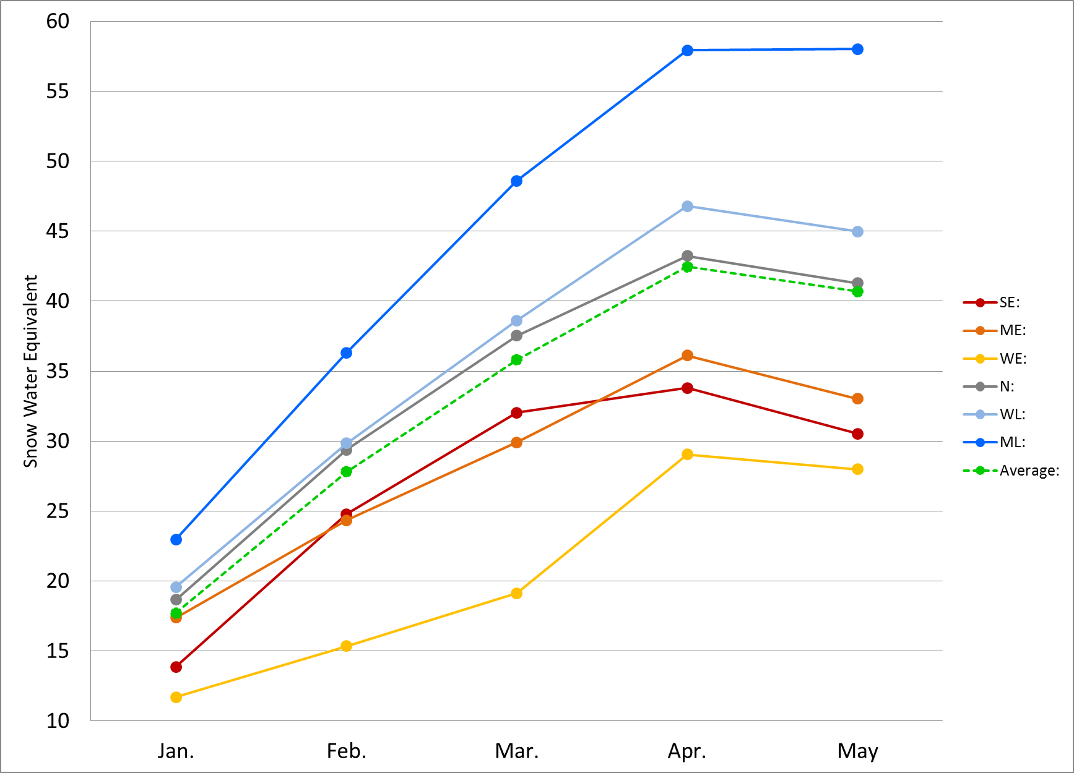
Mt. Hood Snowfall

Slide 21
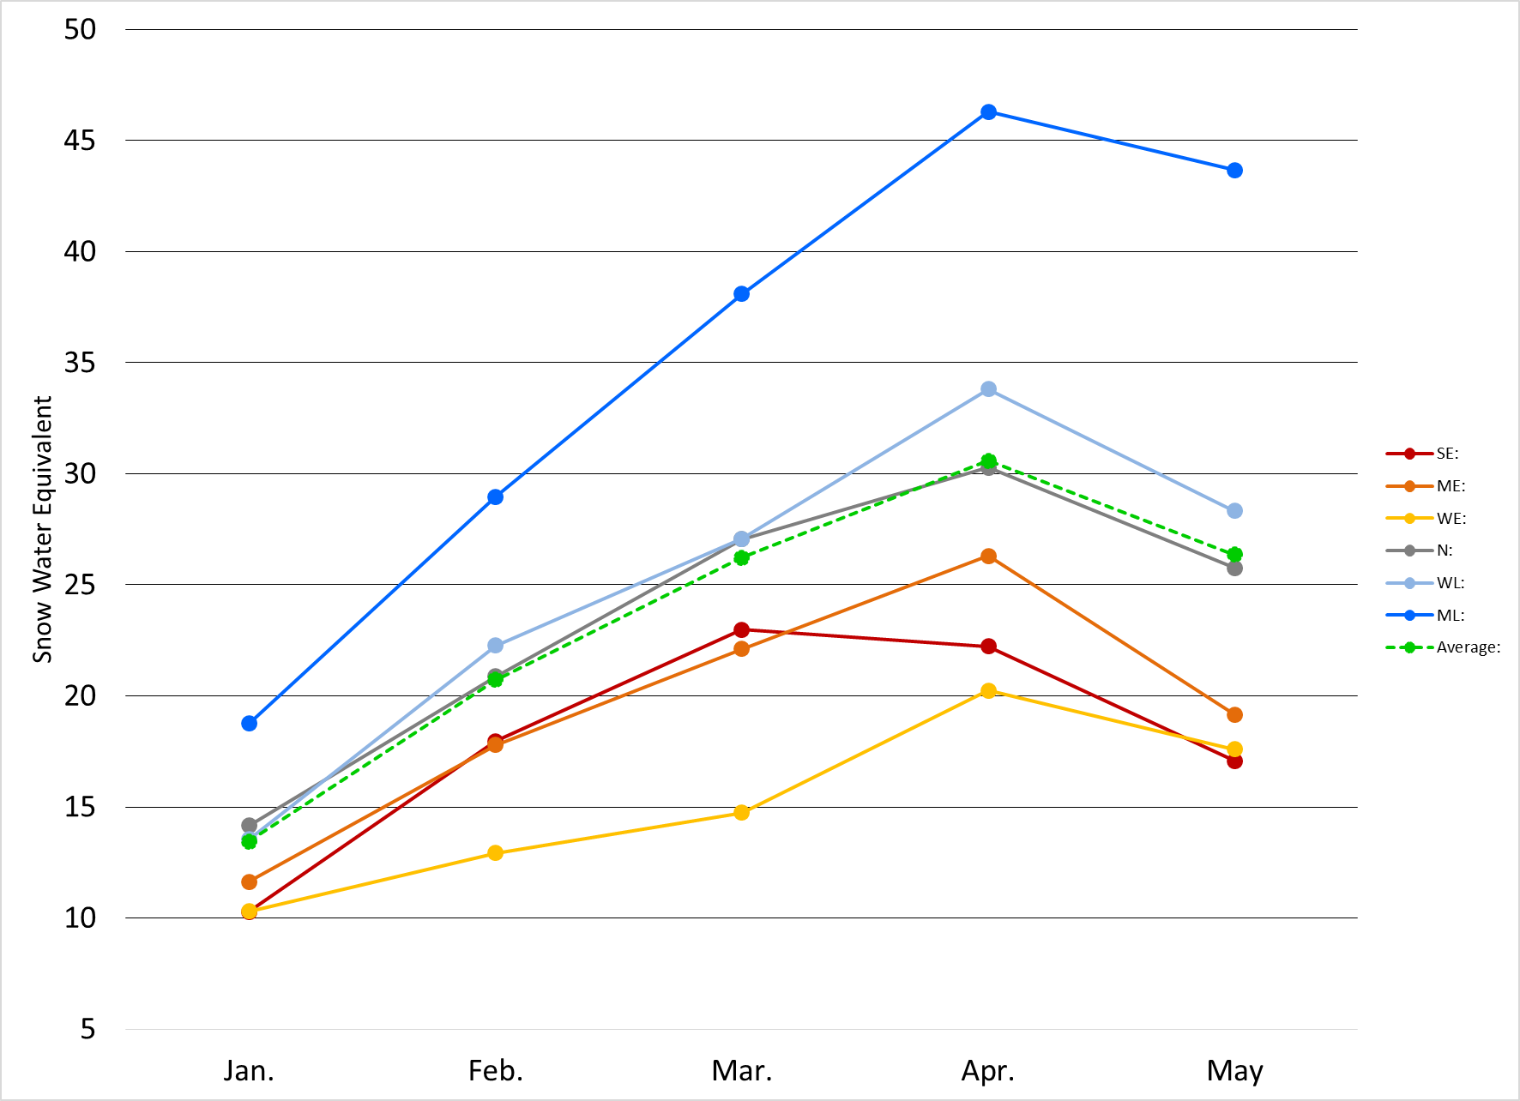
Mt. Bachelor Snowfall

Slide 22
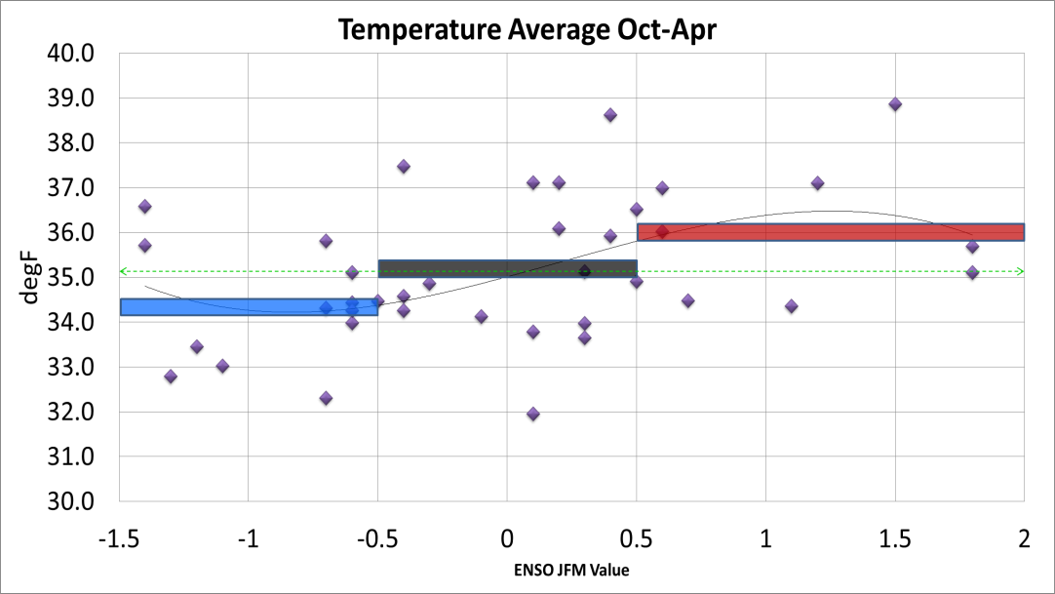
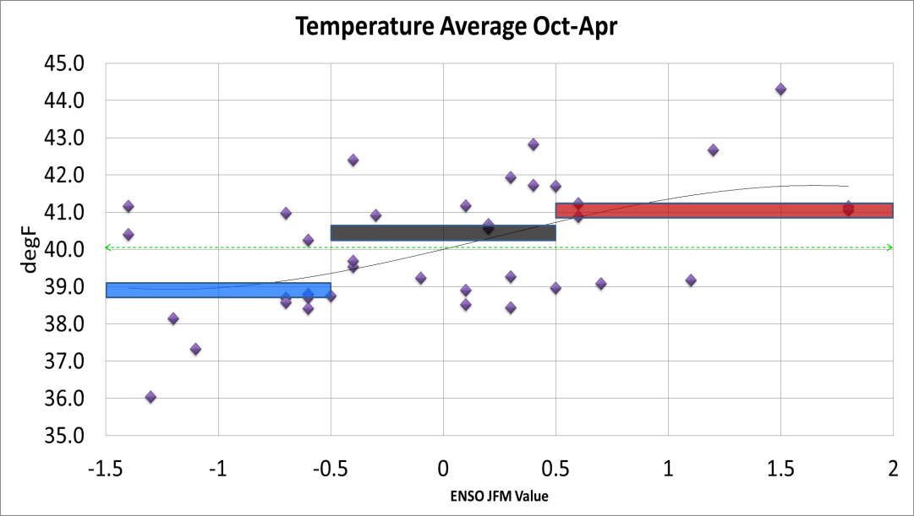
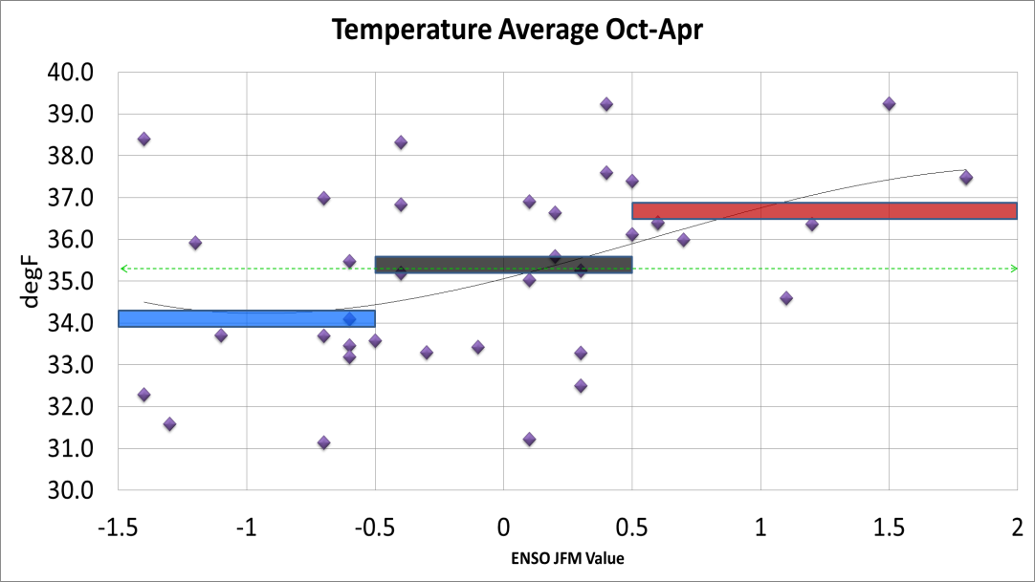
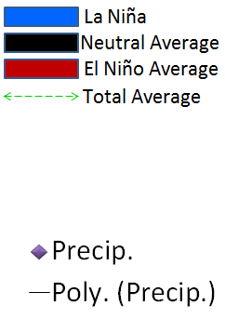
Mountain Temperatures

Slide 23
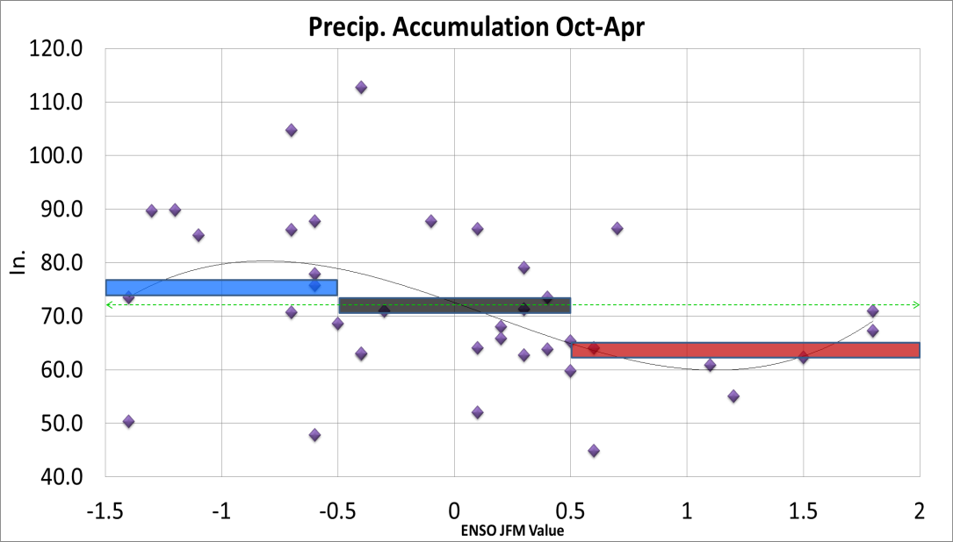
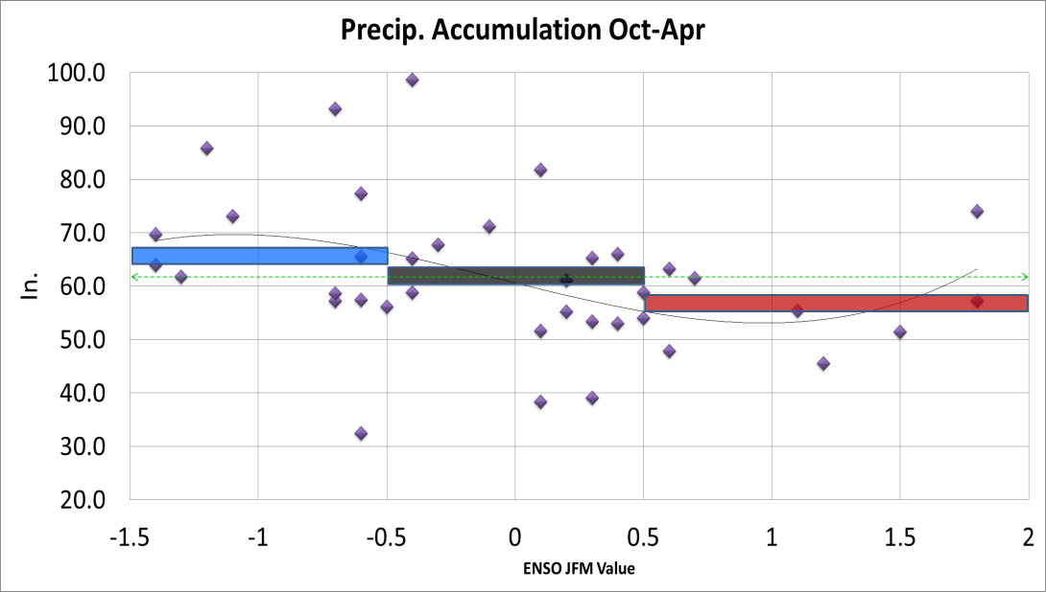
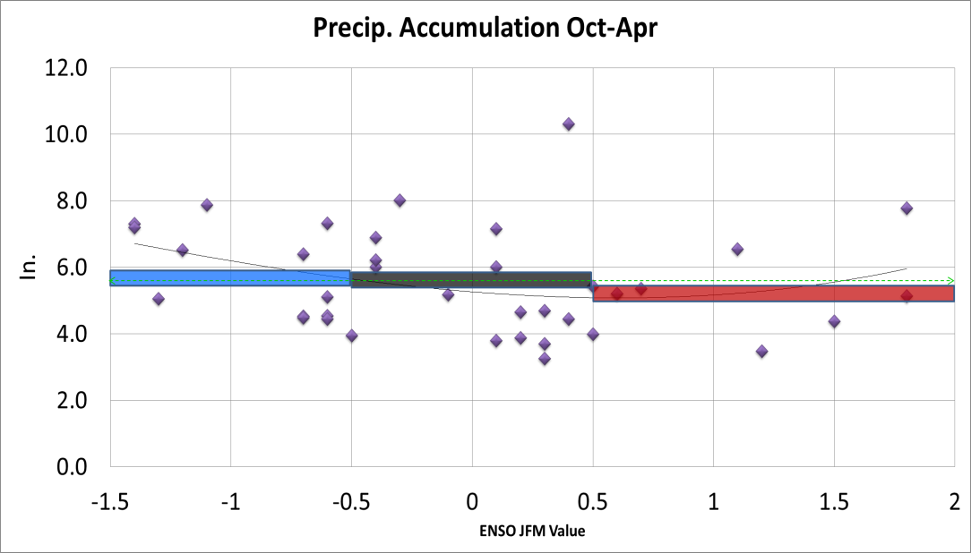
Mountain Precipitation

Slide 24

Questions?

Slide 25
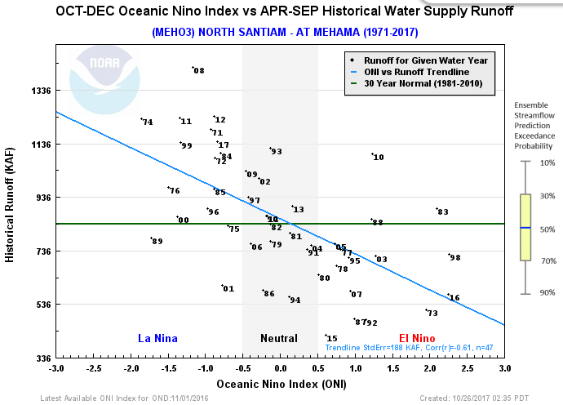
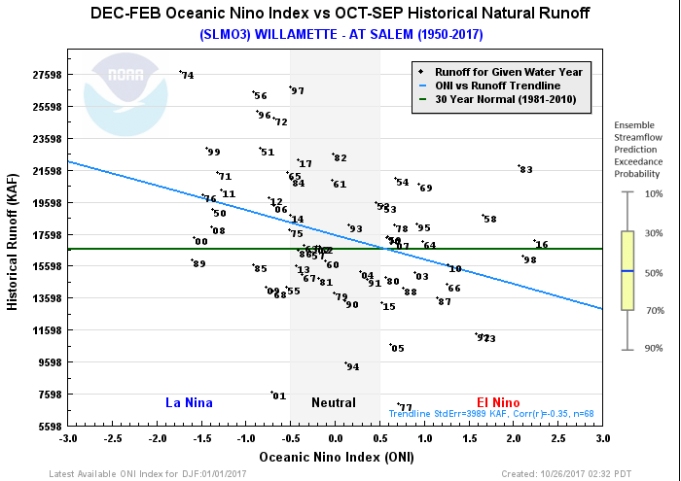
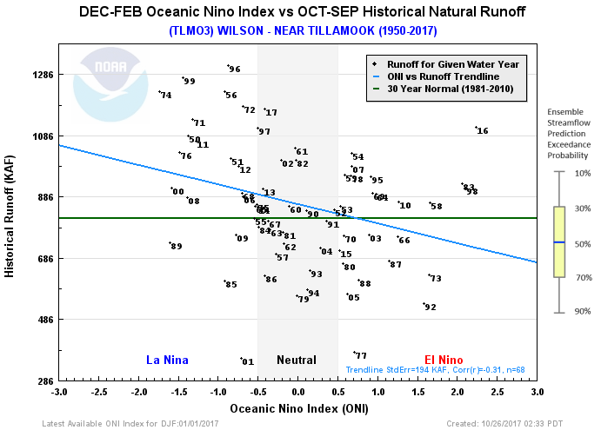
Runoff vs. ENSO

