Slide 1



ROD'S 2017-2018 WINTER FORECAST
Notes:
10/27/17
1
1

Slide 2
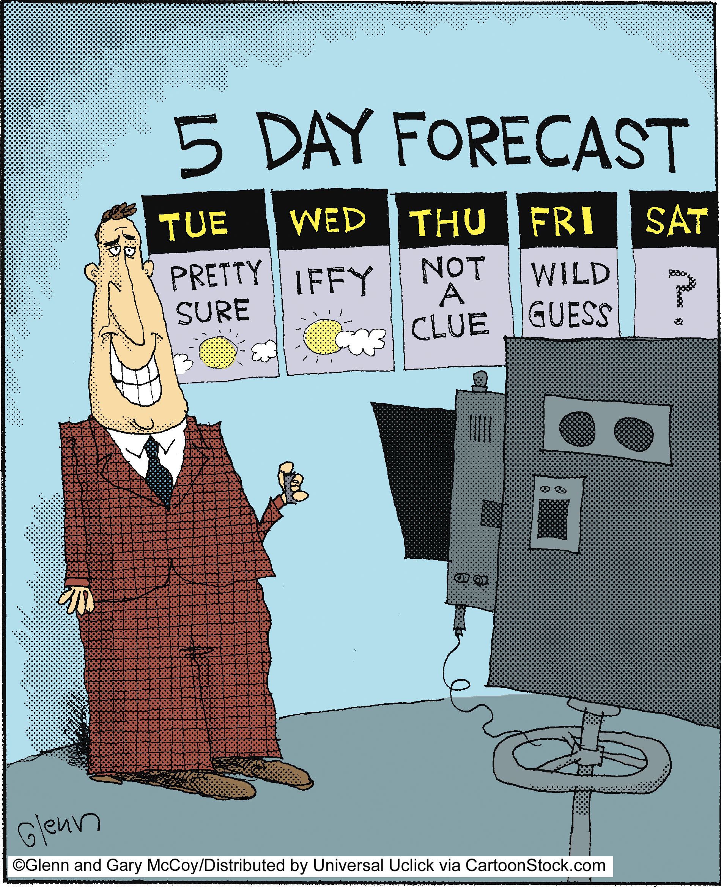
Why?
2
Notes:
10/27/17
2
2

Slide 3
Seasonal Forecast Skill
3 Choices
Below Normal
Normal
Above Normal
33.3%
33.3%
33.3%
3
Notes:
10/27/17
3
3

Slide 4
Rod's Report Card
2016-2017 Winter Forecast
Valley Snow 5-6 inches, plus a good chance of one big event P
Above normal rain fall but no mention of a crazy 51.4 inches X
Slightly above normal temperatures X
Mt. Hood snow year 75% or better P
Notes:
10/27/17
4
4

Slide 5
Rod's Report Card
Seasonal Forecast 2001-2016
Accuracy 66%
Industry Standard 55%
5
Notes:
10/27/17
5
5

Slide 6

Day One on the Job
25+ Hours
Researching Trends
Crunching Numbers
Creating Data Sets
6
Notes:
10/27/17
6
6

Slide 7
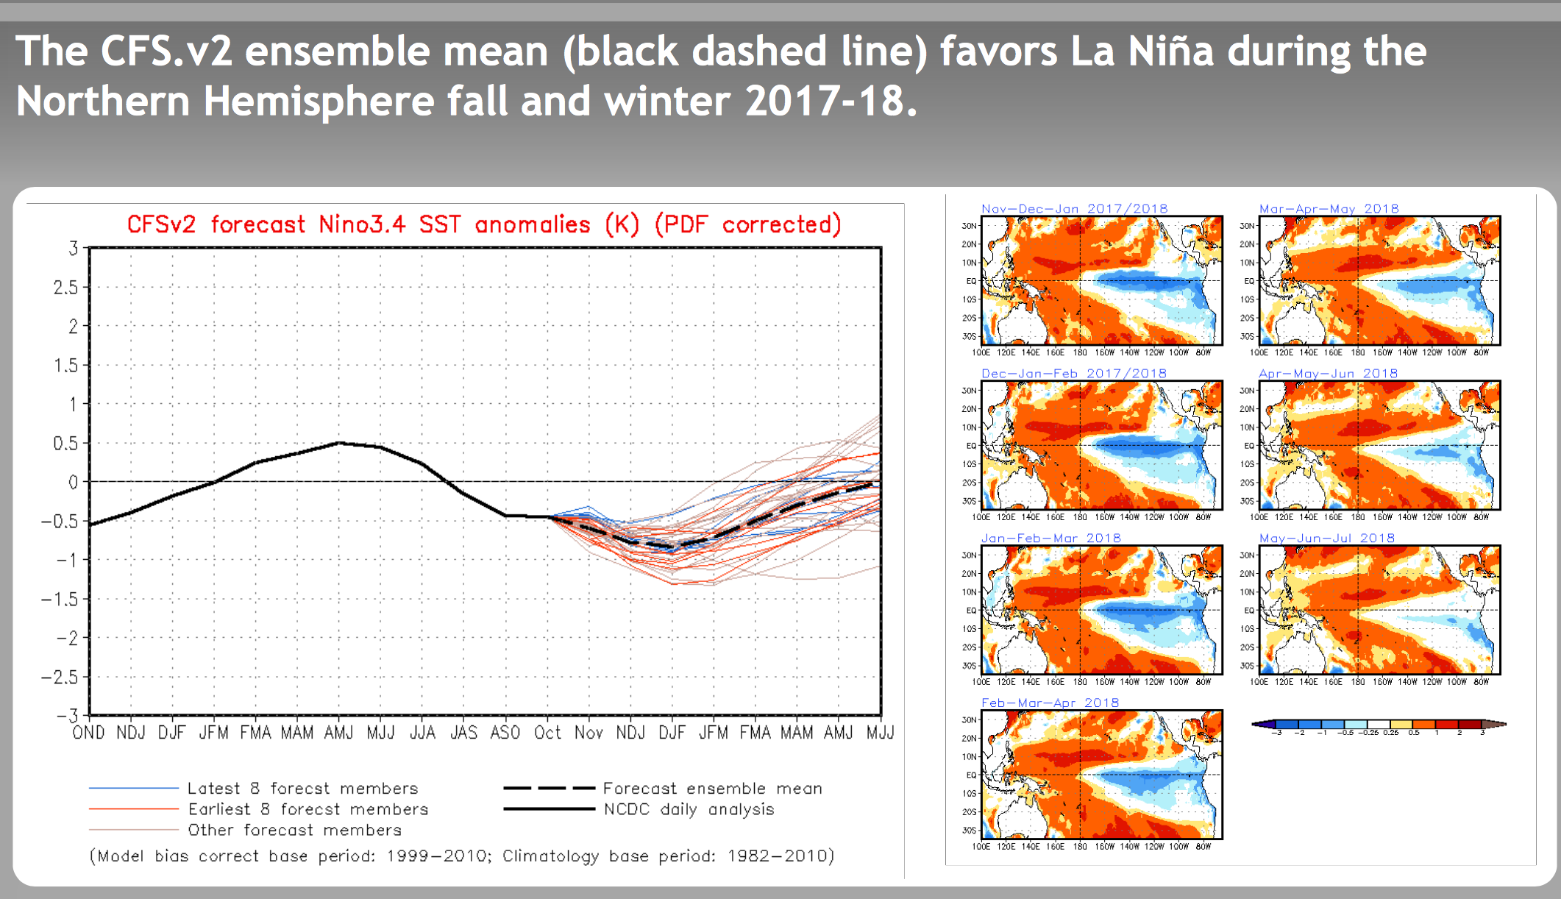
WHERE I BEGIN
Neutral Conditions, into a Weak or Moderate La Nina
Often Unpredictable
Cool and Wet
7
Notes:
10/27/17
7
7

Slide 8
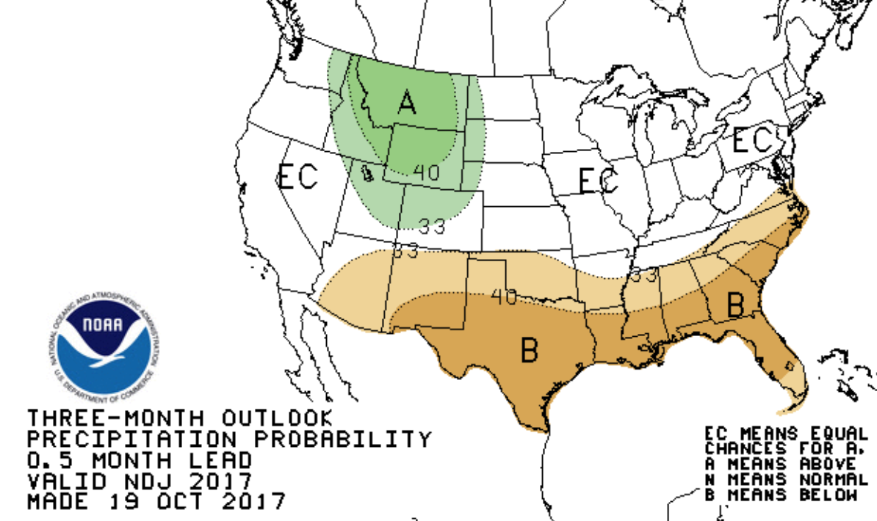
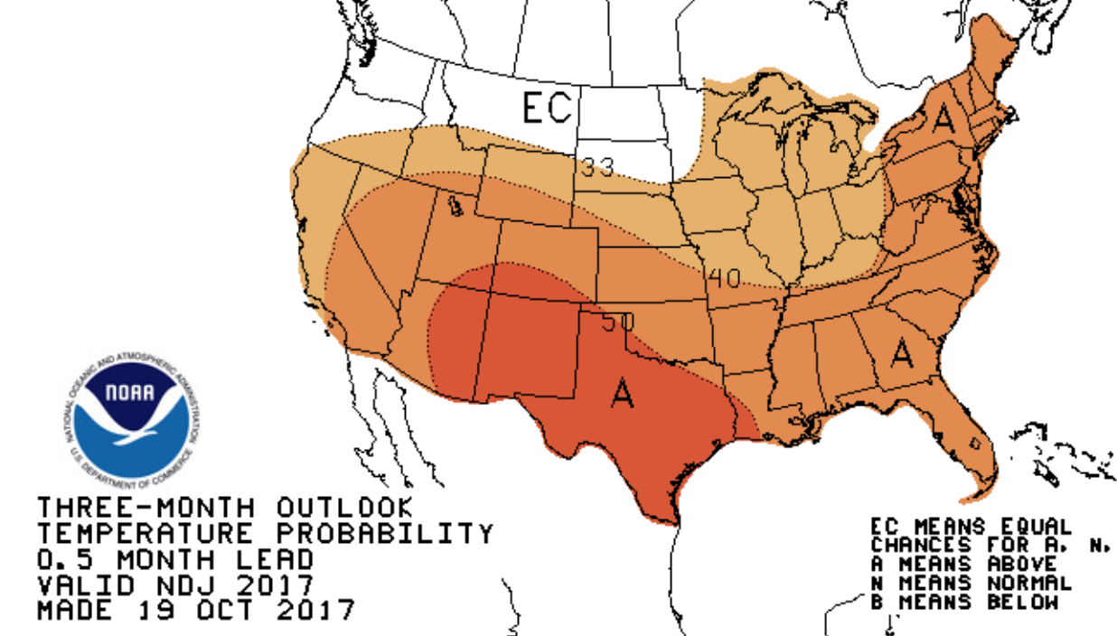
Nov Dec Jan Outlook
Temperature Outlook
Precipitation Outlook
8
Notes:
10/27/17
8
8

Slide 9
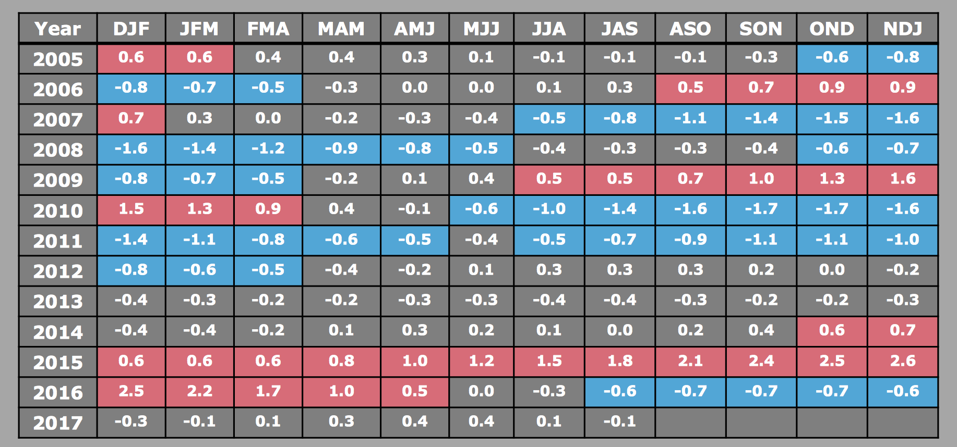
EXAMINE SIMILAR YEARS
Enso Cycles
9
Notes:
10/27/17
9
9

Slide 10
LOOK AT RECENT PATTERNS
Hot Summers, 2017 – 24, 90 degree days
Big Water Years: 2016-2017 - 51.45”
Good Snow Seasons: Jan. Storm 8-15”
10
Notes:
10/27/17
10
10

Slide 11
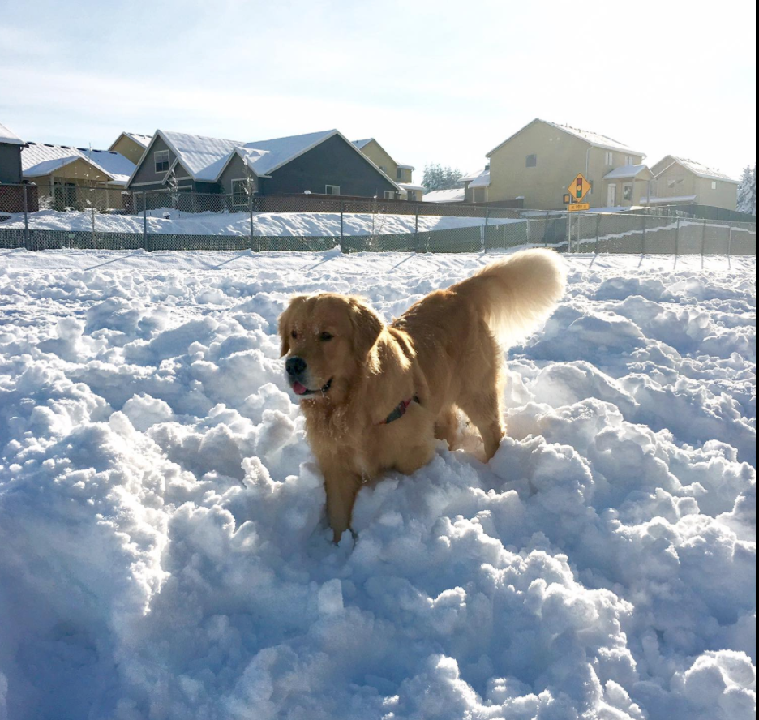
January 2017 Snowstorm
11
Notes:
10/27/17
11
11

Slide 12
Following Top Five Hot Summers
(# of 90° Days)
No La Nina Winters, Weak or Strong
Three out of Five - Dry Winter Seasons
Average Water Year: 36.45 inches
Odds favor 32 inches (4” below normal)
12
Notes:
10/27/17
12
12

Slide 13
Rod’s Analog Years
1980-1981 n | 1985-1986 n | 1996-1997 n
2005-2006 –c | 2008-2009 –c | 2013-2014 n | 2016-2017 n
Analog Precip Average: 39.24”
Best Chance by 43% : 30.10”
13
Notes:
10/27/17
13
13

Slide 14
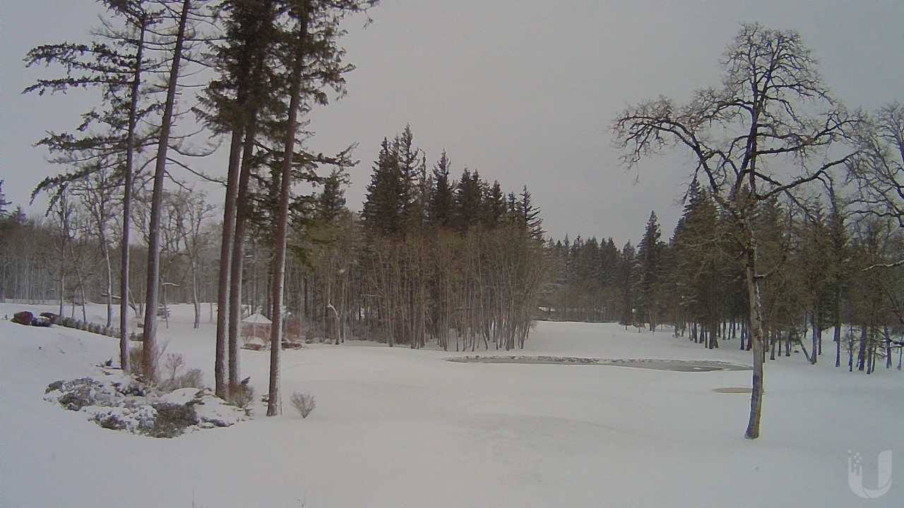
Morning of January 11th
Camas Meadows
14
Notes:
10/27/17
14
14

Slide 15
Valley Snow – 3 Possibilities
Neutral Season Best Odds
  30% - 8 inches or more
  43% 0-2 inches
Weak La Nina
  43% 0-2 inches
Moderate La Nina
50/50 Big Season or Small Season
15
Notes:
10/27/17
15
15

Slide 16
What to Expect
Research shows a quiet winter season?
Below normal rainfall?
Not much valley snow?
16
Notes:
10/27/17
16
16

Slide 17
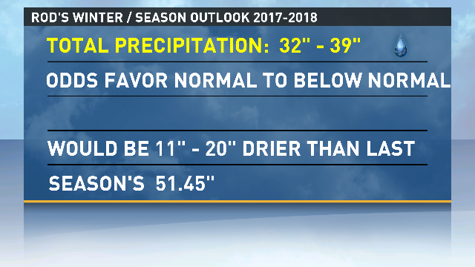
Rod's 2017-2018
Winter Outlook
17
Notes:
10/27/17
17
17

Slide 18
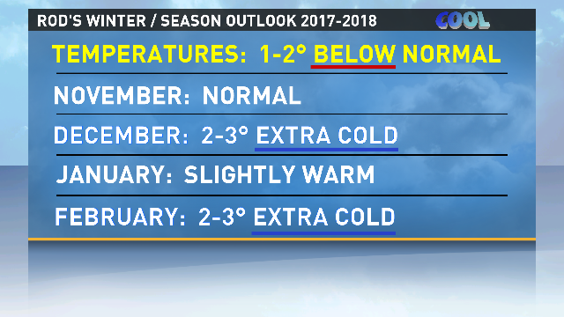
Rod's 2017-2018
Winter Outlook
18
Notes:
10/27/17
18
18

Slide 19
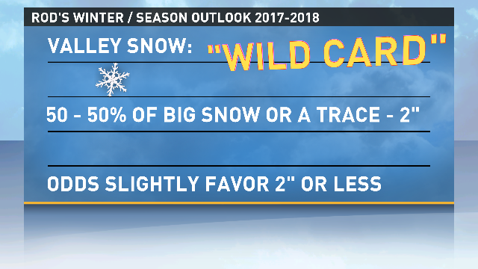
Rod's 2017-2018
Winter Forecast
19
Notes:
10/27/17
19
19

Slide 20
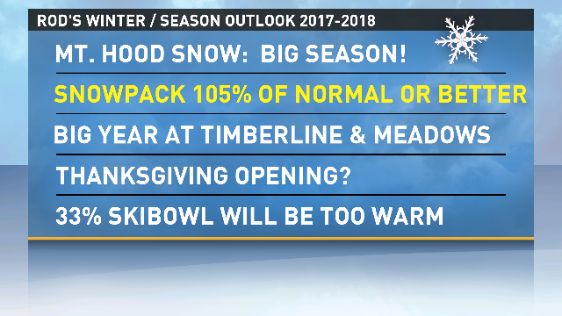
Rod's 2017-2018
Winter Forecast
20
Notes:
10/27/17
20
20

Slide 21
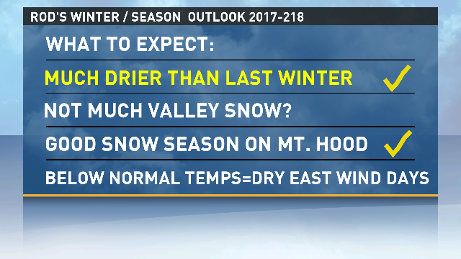
Rod's 2017-2018
Winter Forecast
21
Notes:
10/27/17
21
21

Slide 22

Waiting and Watching…
22
Notes:
10/27/17
22
22

