Slide 1
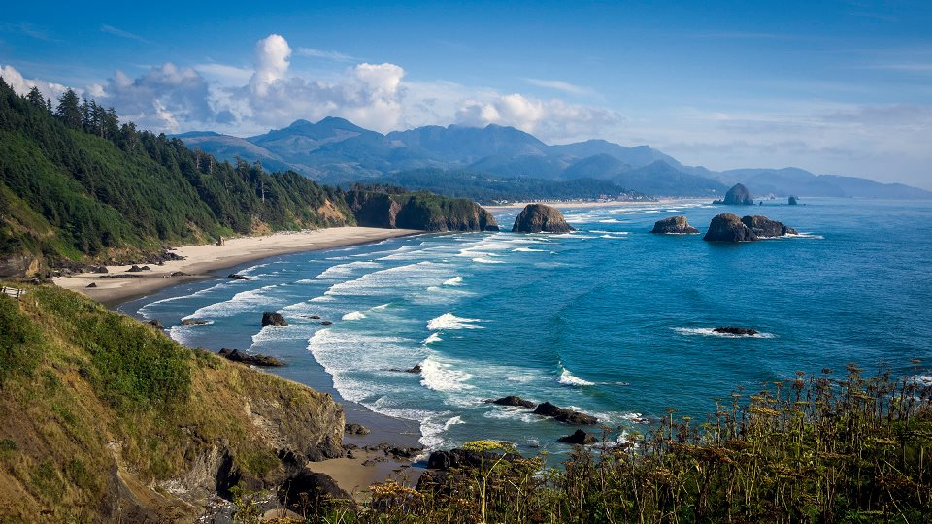
Oregon Coast Radar Committee Update

Slide 2
H.R.353 - Weather Research and Forecasting Innovation Act of 2017
Timeline:
January 6th, 2017 – Introduced to House
January 9th, 2017 – Passes House
March 29th, 2017 – Passes Senate
April 4th, 2017 – Resolving differences approved
April 6th, 2017 – Bill presented to President
April 18th, 2017 – President Trump Signs Bill Into Law
April 18th, 2017 – Became Public Law No: 115-25

Slide 3
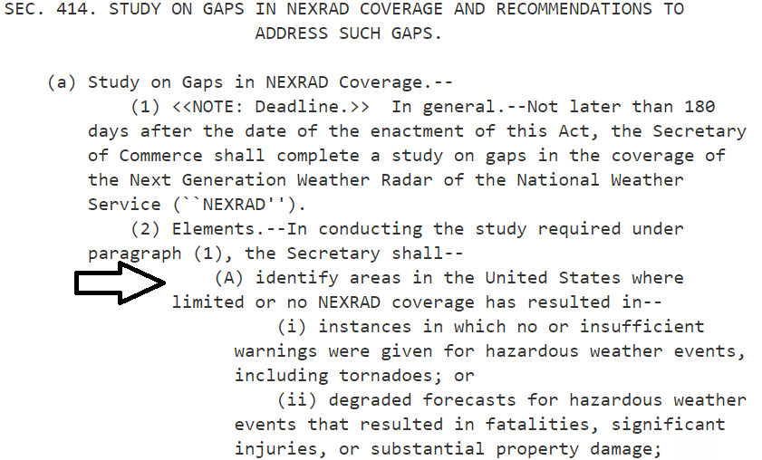
Oregon Coast Radar Committee Update

Slide 4
According to the bill, the Secretary of Commerce, no later than 180 days after the bill becomes law, shall issue a report on the gaps in the NEXRAD NWS system.
180 days expired Oct. 15th, 2017…
Rep. Susan Bonamici, co-sponsor of H.R. 353, office says…
“NOAA/NWS officials don’t have a time table to when the report will be issued.”
Her office will provide updates as they become available.

Slide 5
The Oregon Coast Radar Committee is continuing to spread the word about the need for an Oregon Coast Radar. We are reaching out to civic groups, the public and private sector, and interested parties.
For more information:
Web: https://oregoncoastradar.wordpress.com/
Facebook.com/OregonCoastRadar
Twitter.com/ORCoastRadar

