Slide 1
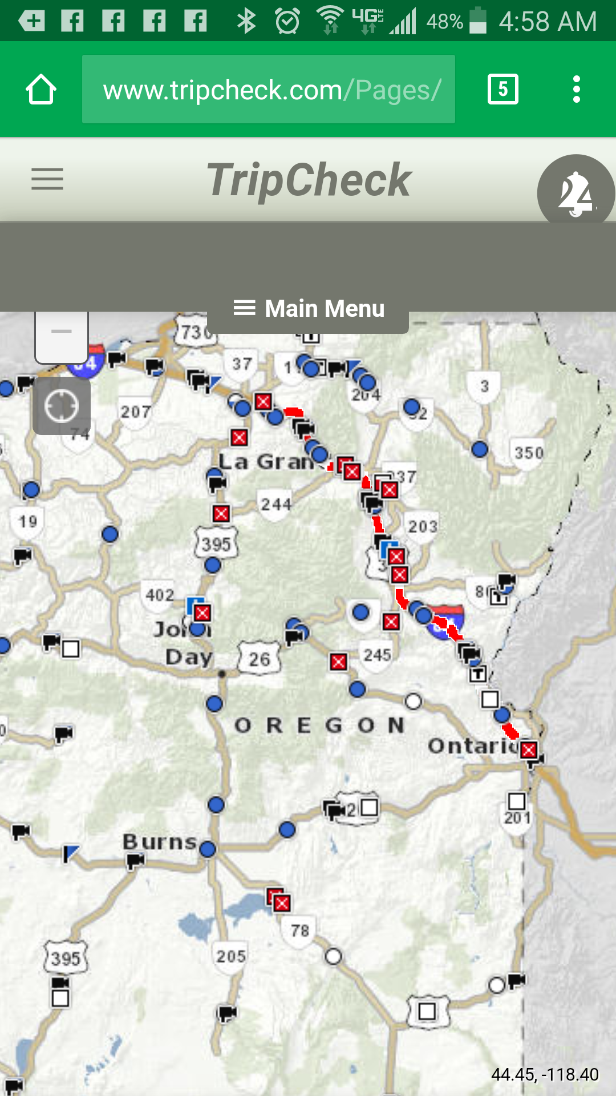
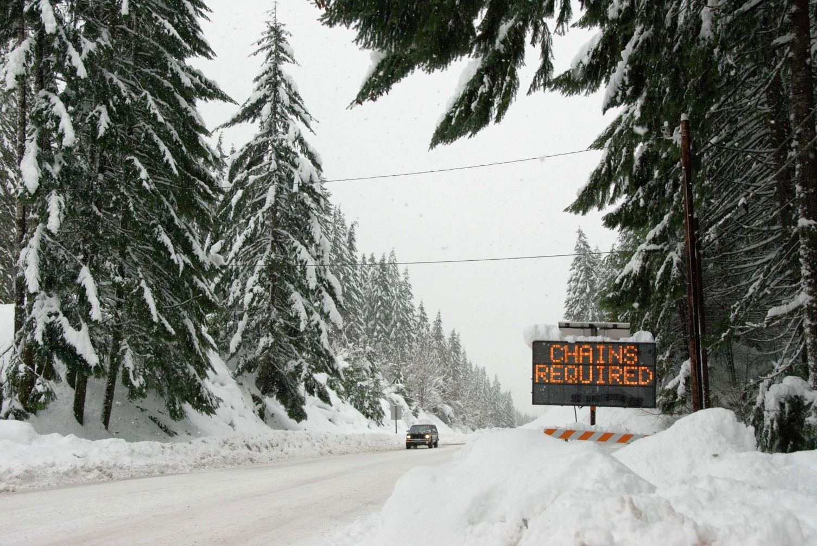
January 2017:
A winter to remember... or not be able to forget
oh, and by the way,
ODOT might occasionally use salt
Dave Thompson, APR

Slide 2
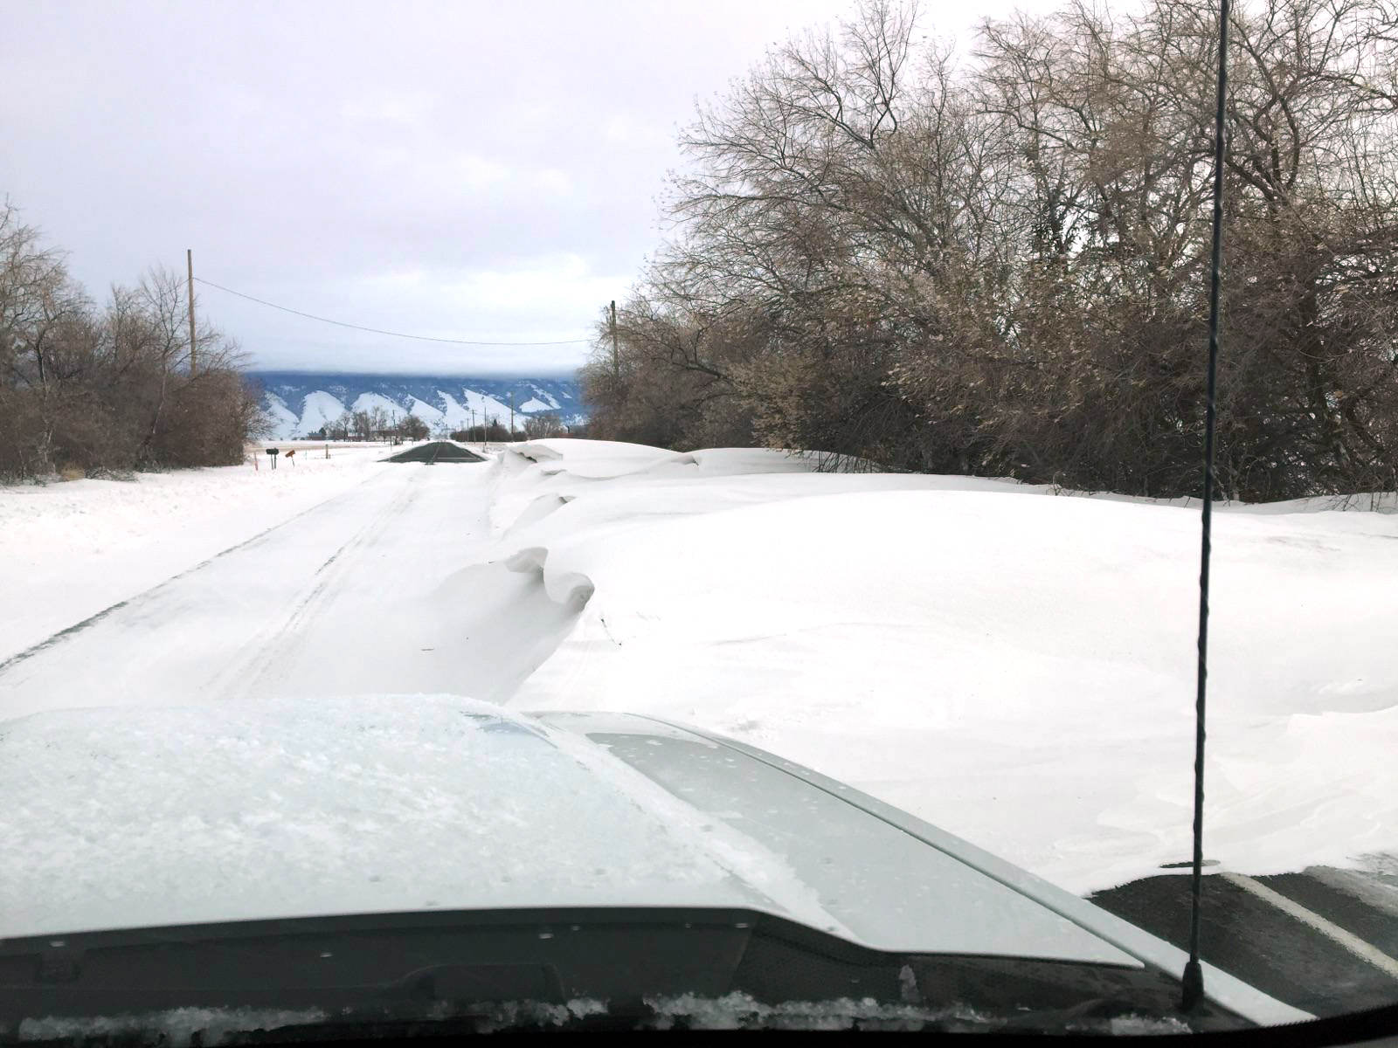
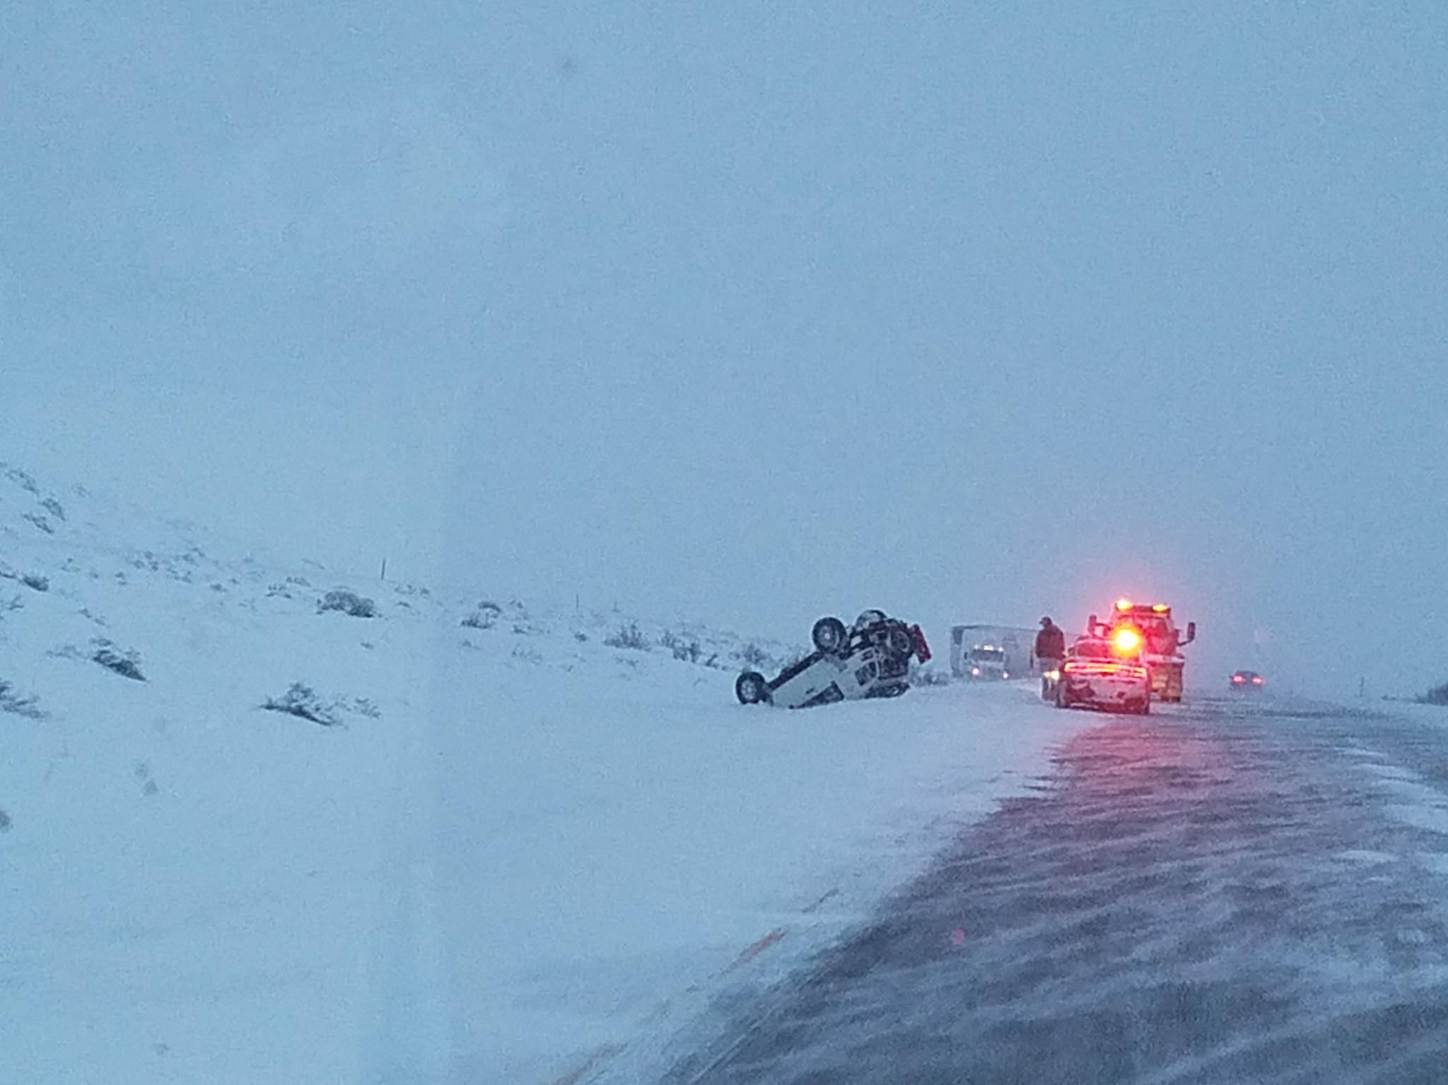
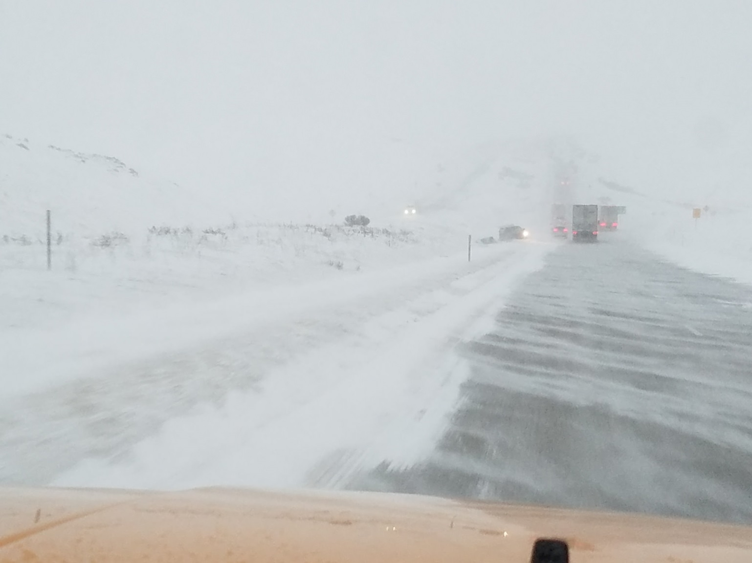
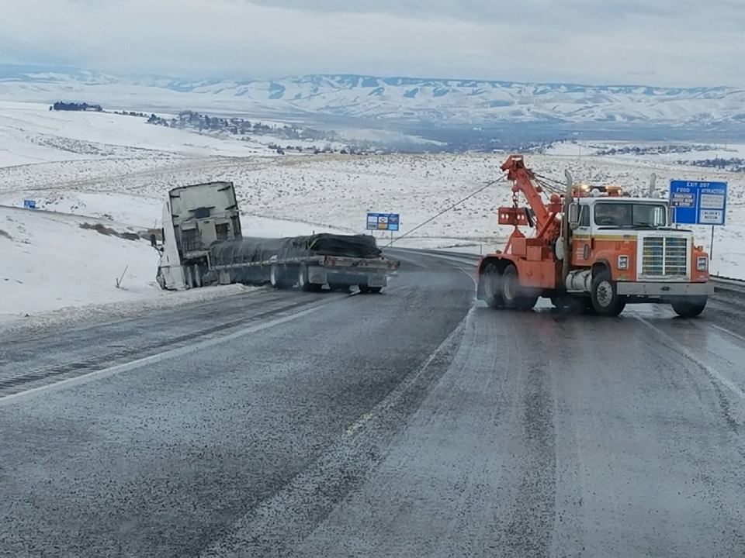
December was brutal, too
2

Slide 3
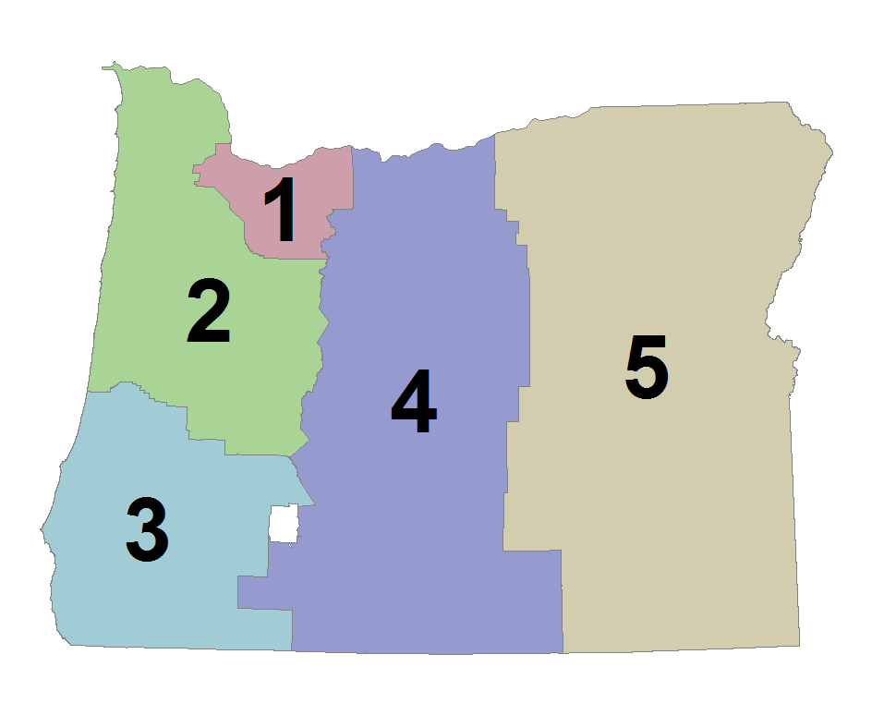
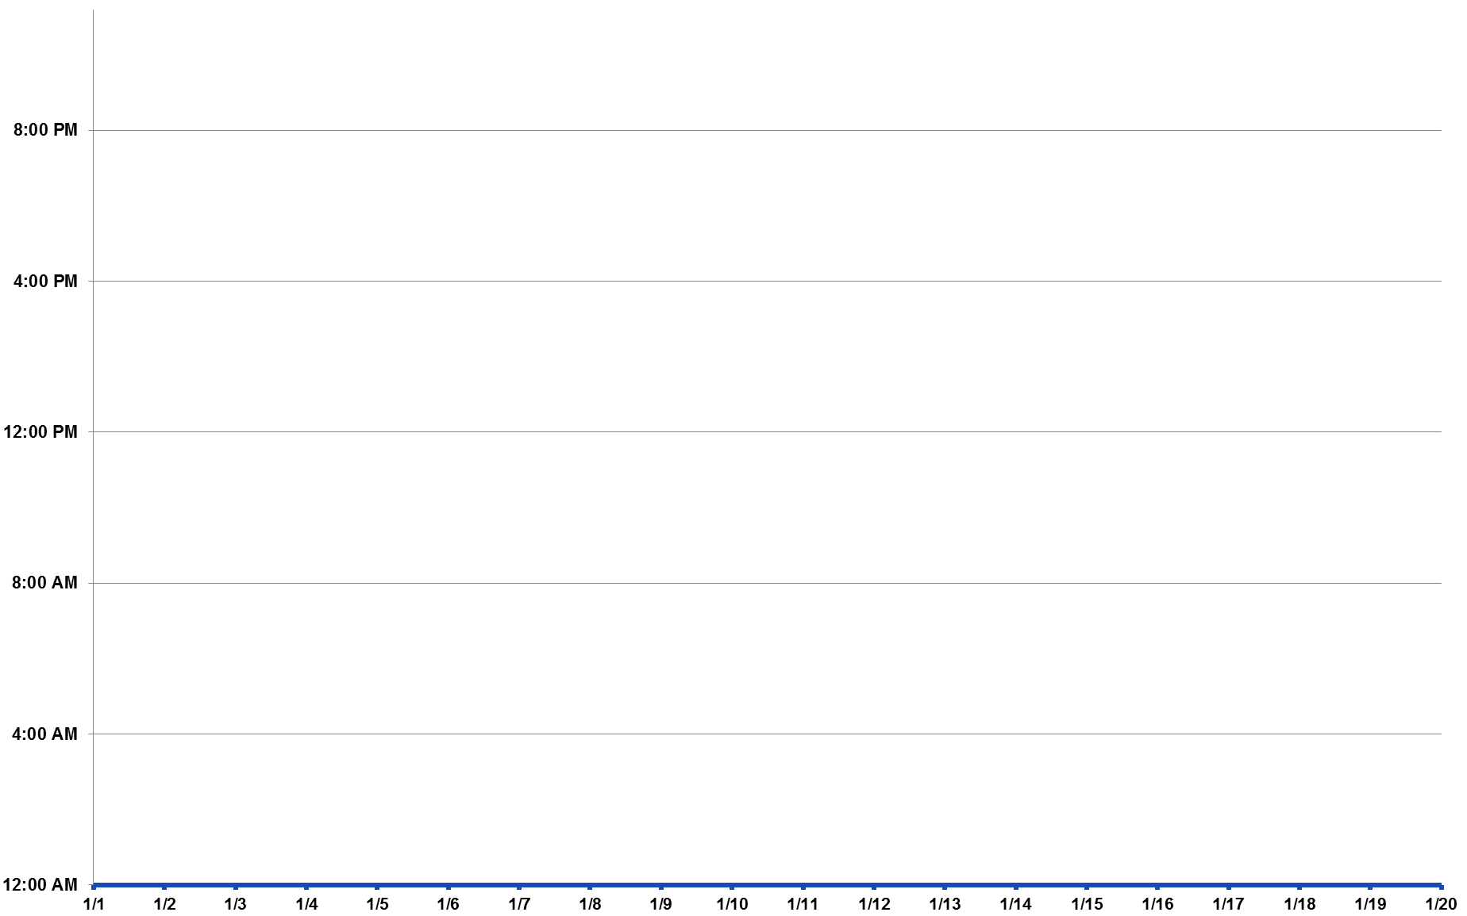
3

Slide 4

4

Slide 5
5

Slide 6
6

Slide 7
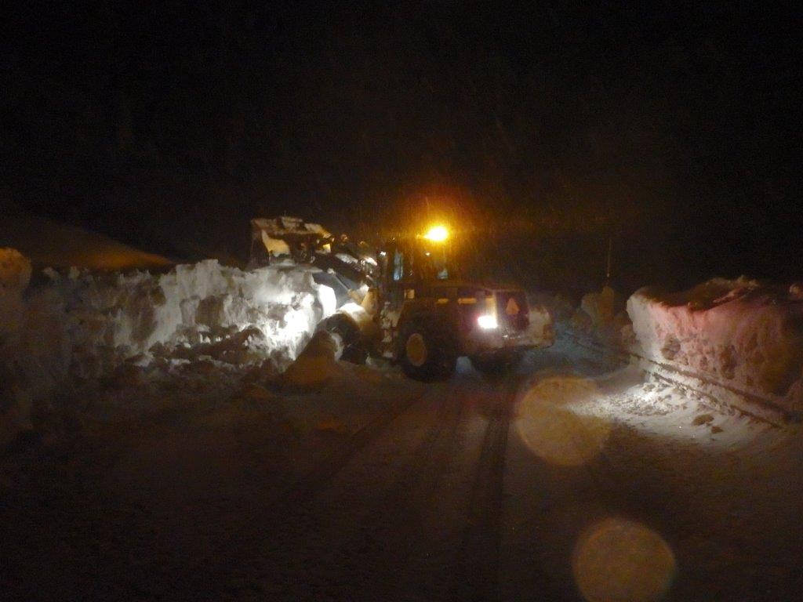
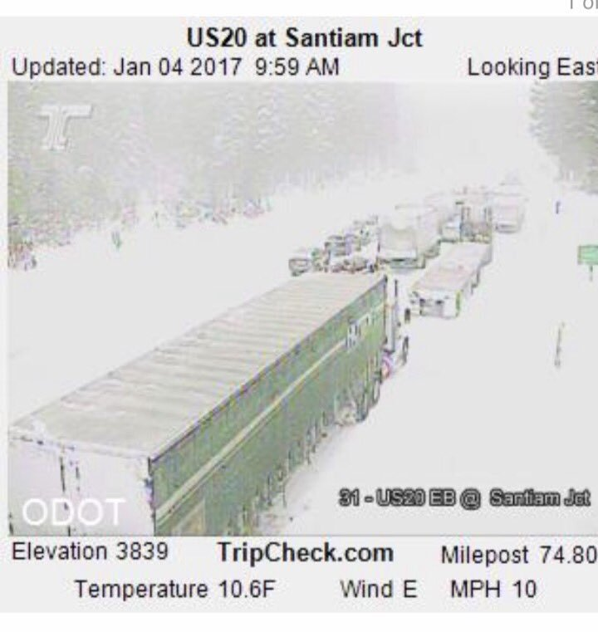

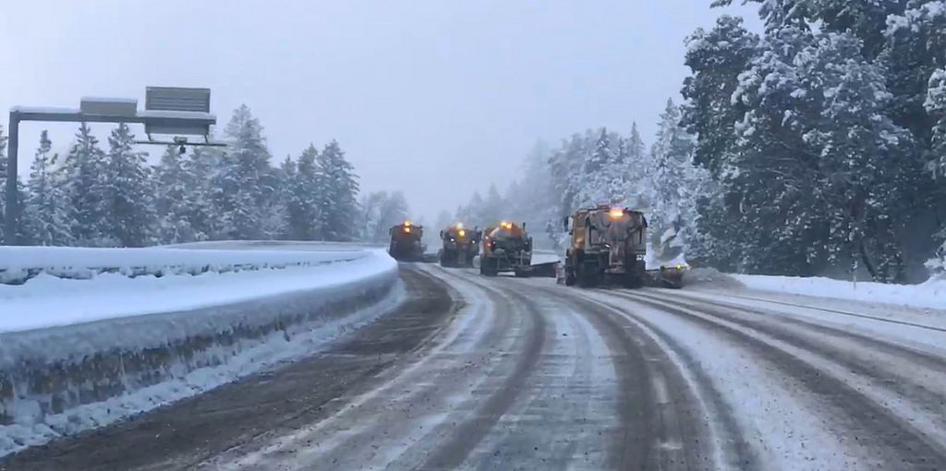
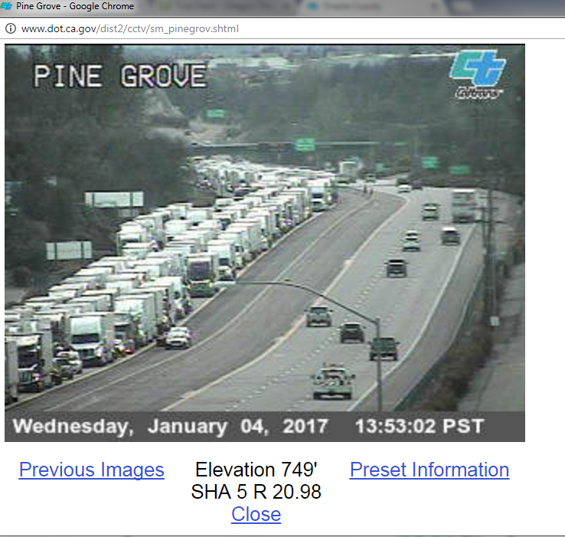
7

Slide 8
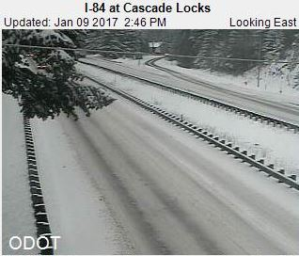
A
A
A
A
B
A
B
8

Slide 9
A
A
C
C
A
B
A
B
C
9

Slide 10
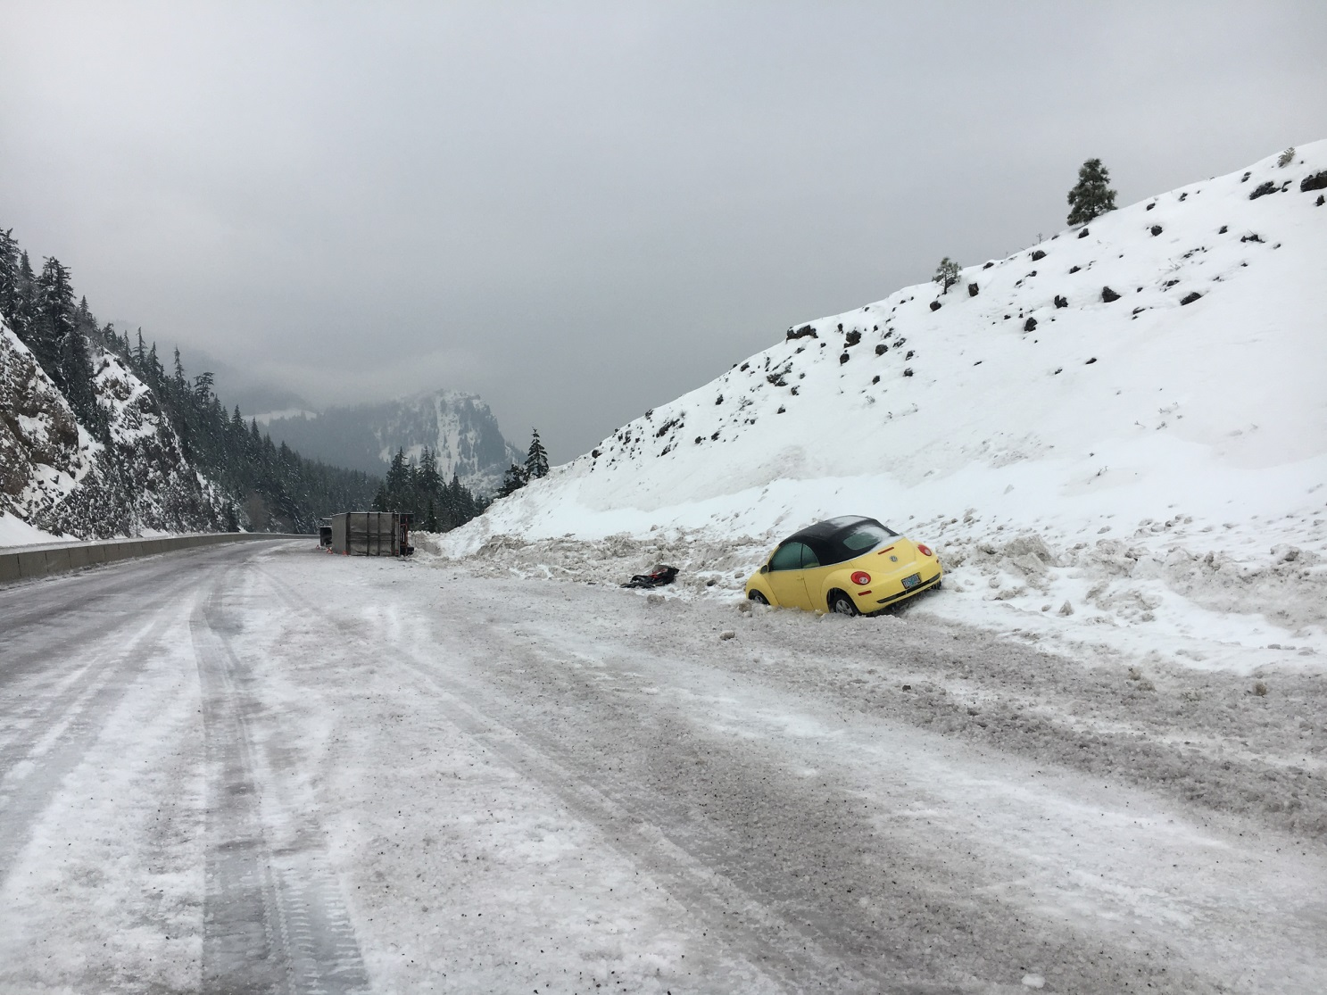
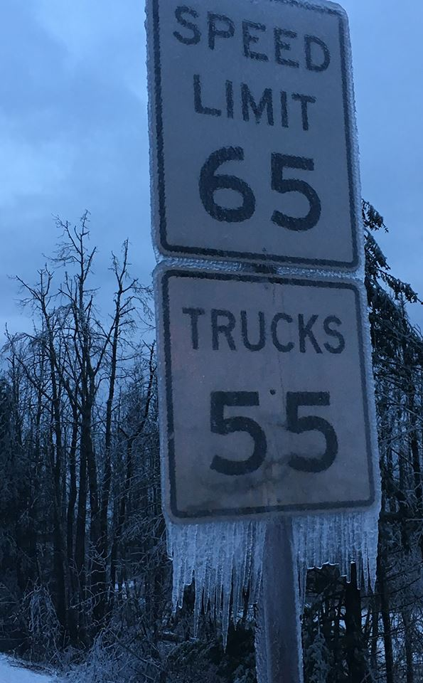
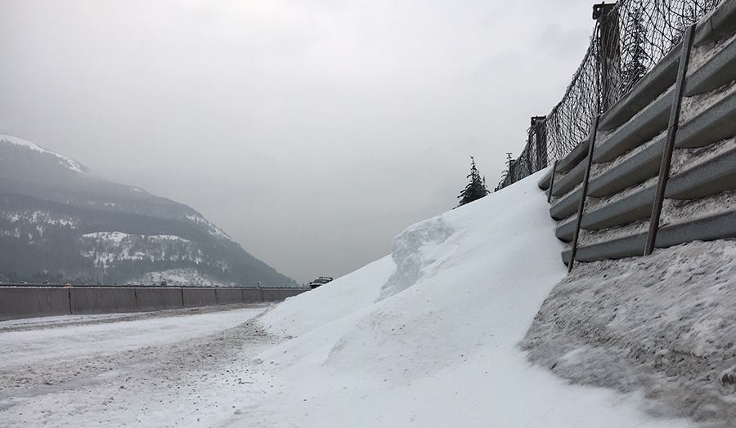

A
A
C
C
A
B
A
B
C
10

Slide 11
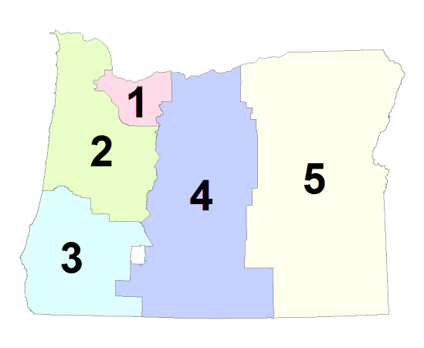


PM



AM

A
B
C
11

Slide 12
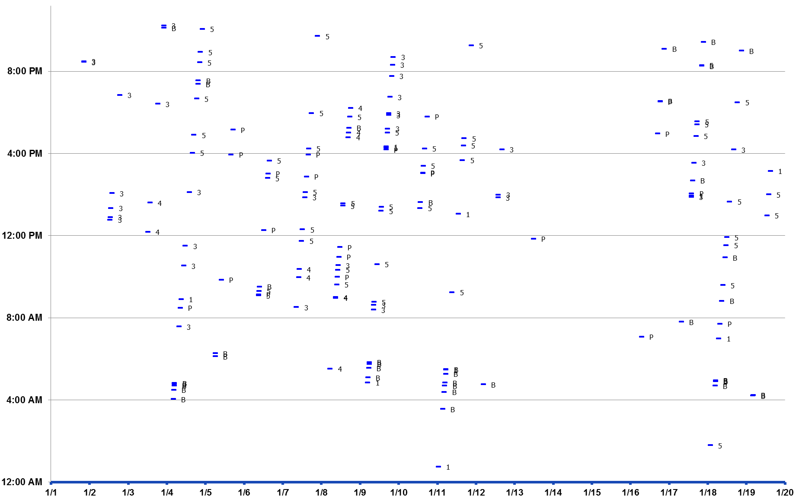


PM



AM

A
B
C
12

Slide 13
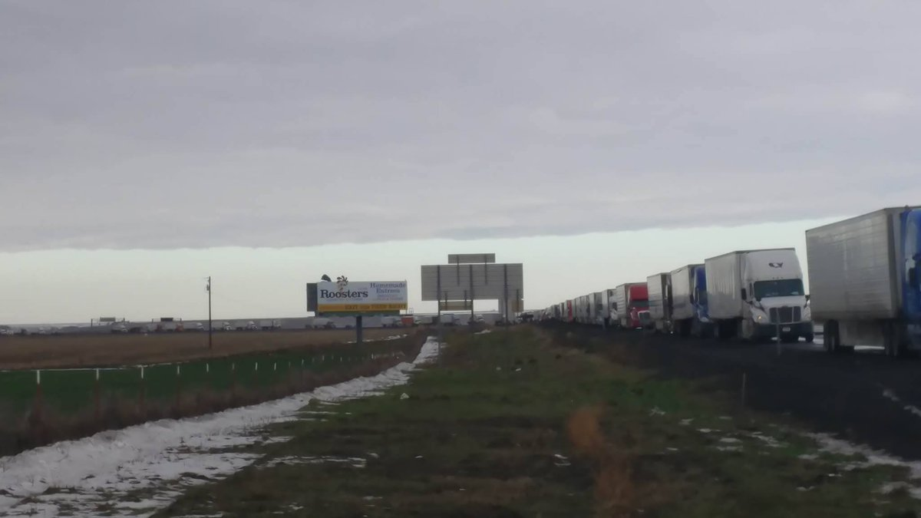
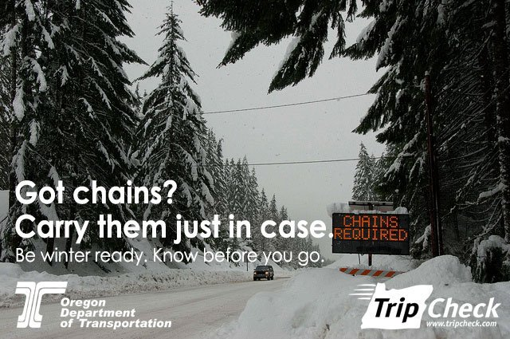



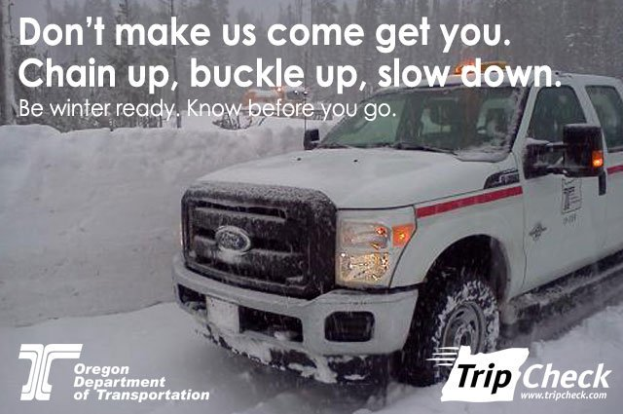


Road conditions; road closures
Notes:
What we’ve done traditionally

Slide 14
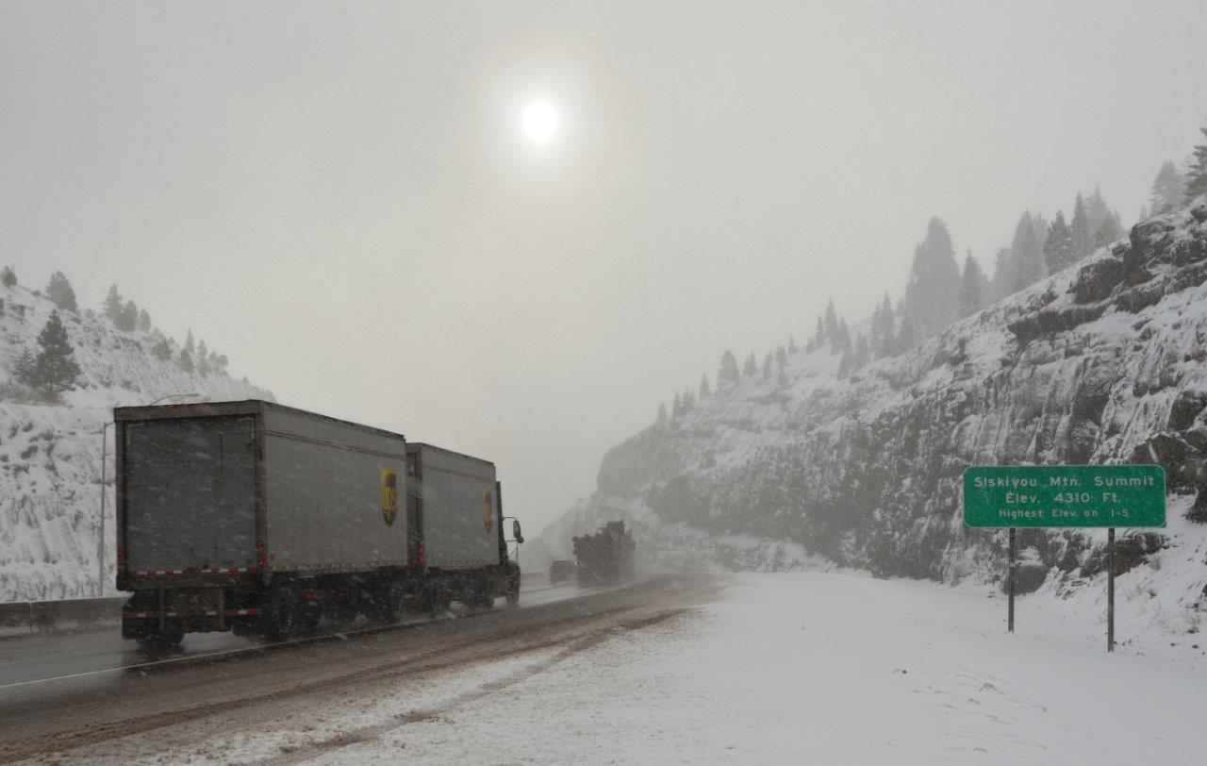
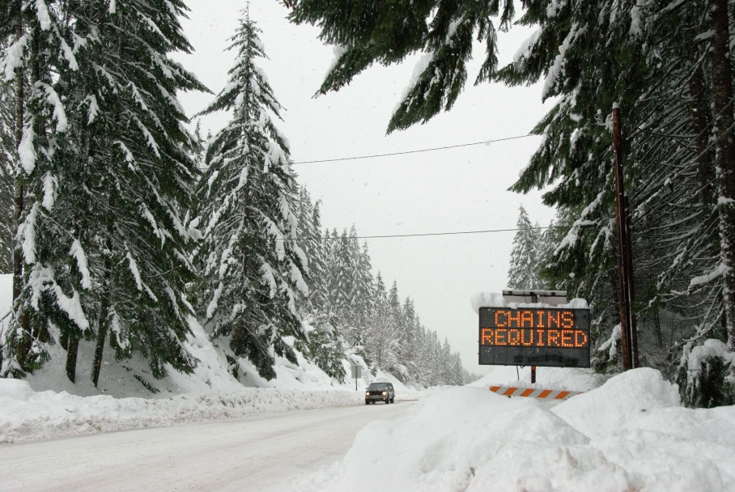
Shared responsibility for safe travel
Recognize your responsibility to travel safely
Wash your vehicle!
Be prepared
Delay trip if it’s not safe
14
Notes:
What we’ve done traditionally

Slide 15
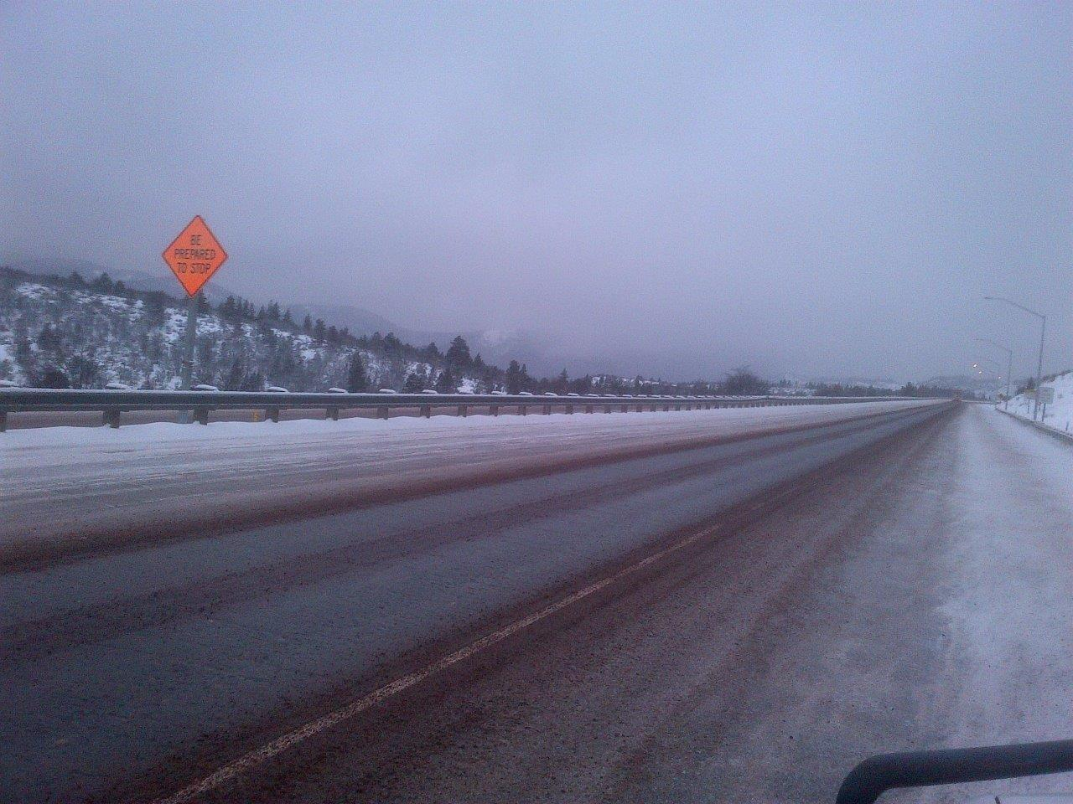
Before
During
After
15

Slide 16
Before
During
After
“Are you ready/surprised?”
16

Slide 17
Before
During
After
“Are you ready/surprised?”
“Give us advice!”
17

Slide 18
Before
During
After
“What’s taking so long?”
“Are you ready/surprised?”
“Give us advice!”
18

Slide 19
Before
During
After
“What’s taking so long?”
“Are you ready/surprised?”
“Why weren’t you ready?”
“Give us advice!”
19

Slide 20
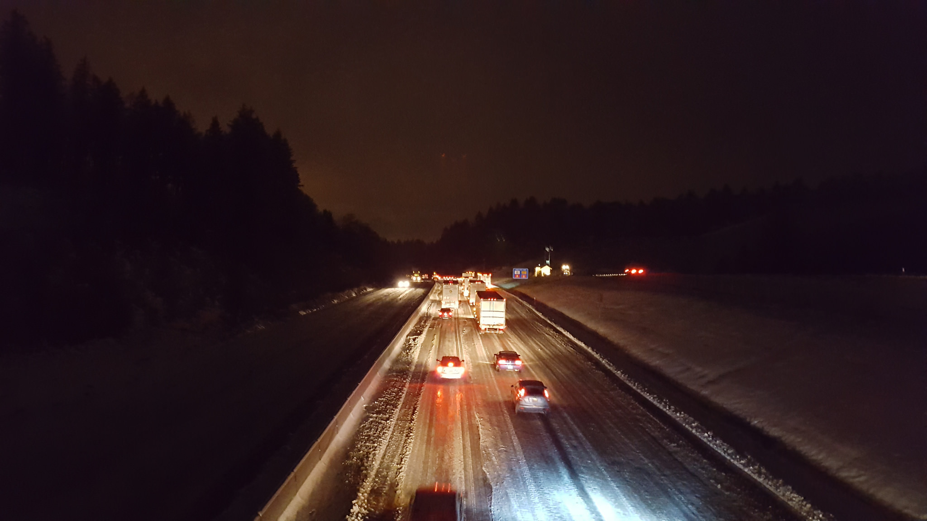
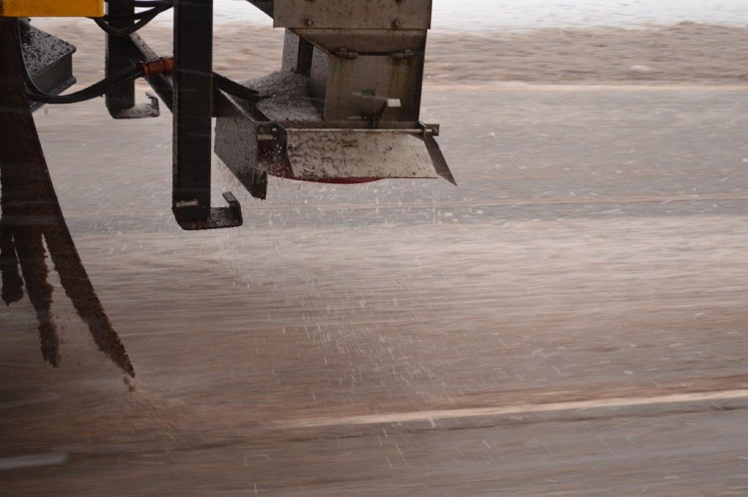
I-5 south of Salem: 12/15/2016
Enchanted Way
20

Slide 21
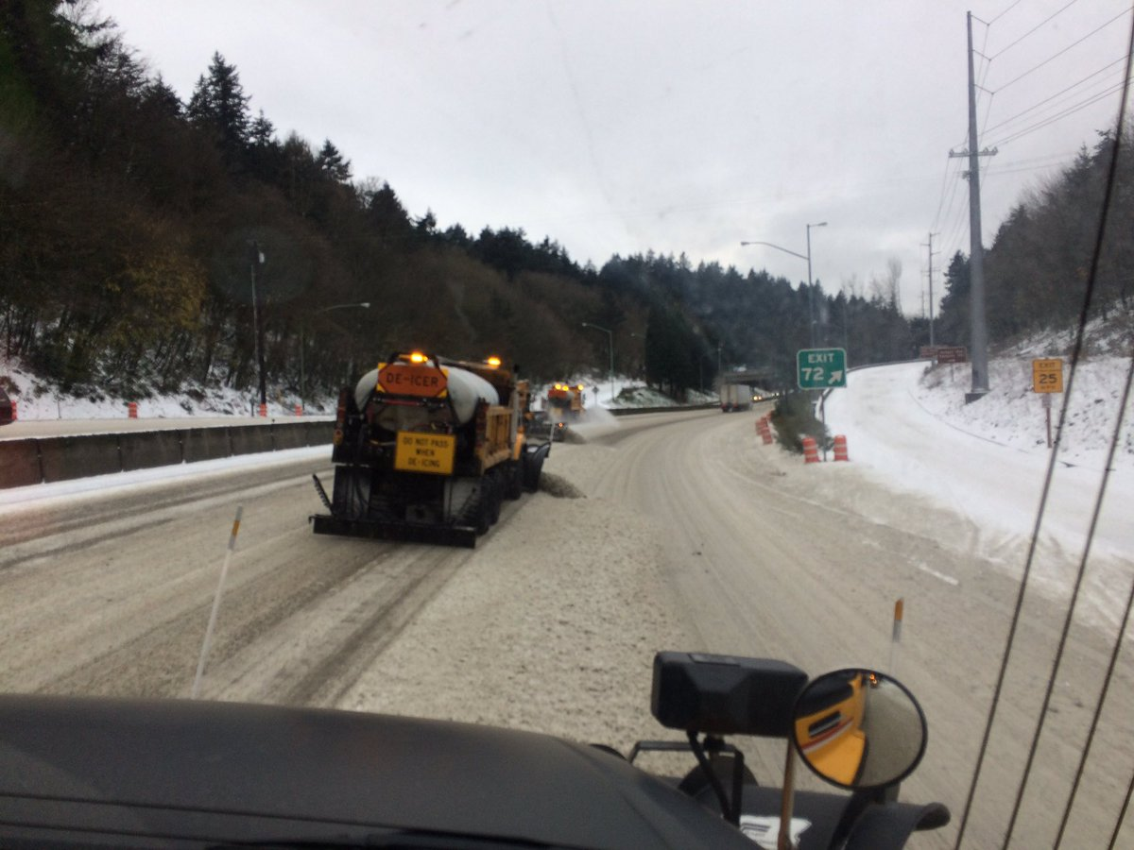
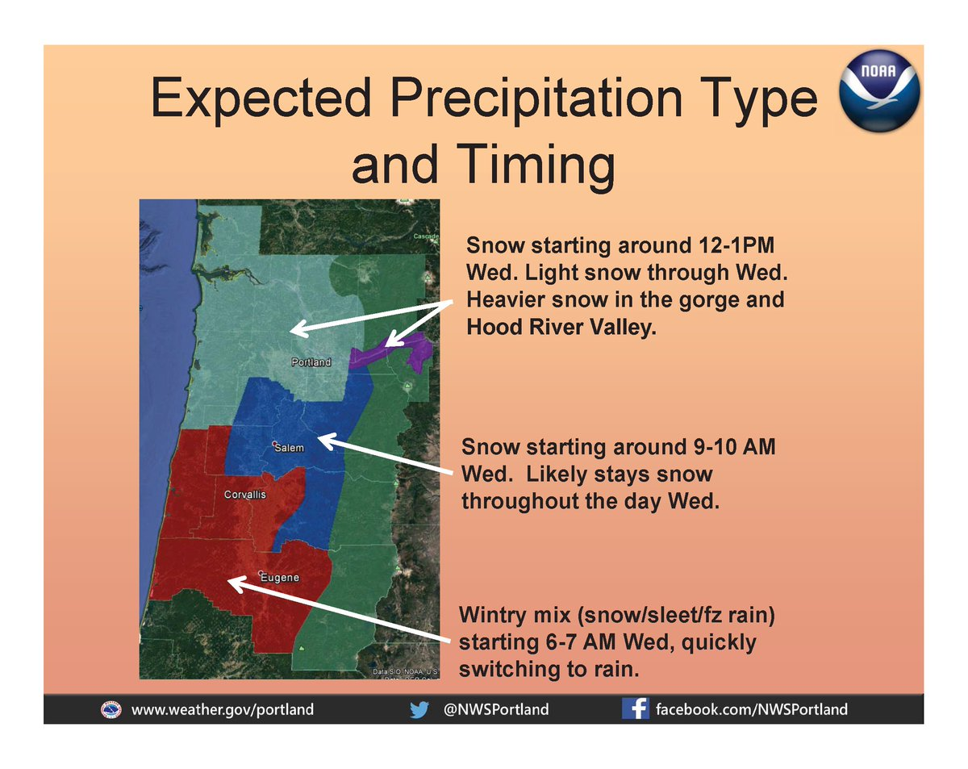
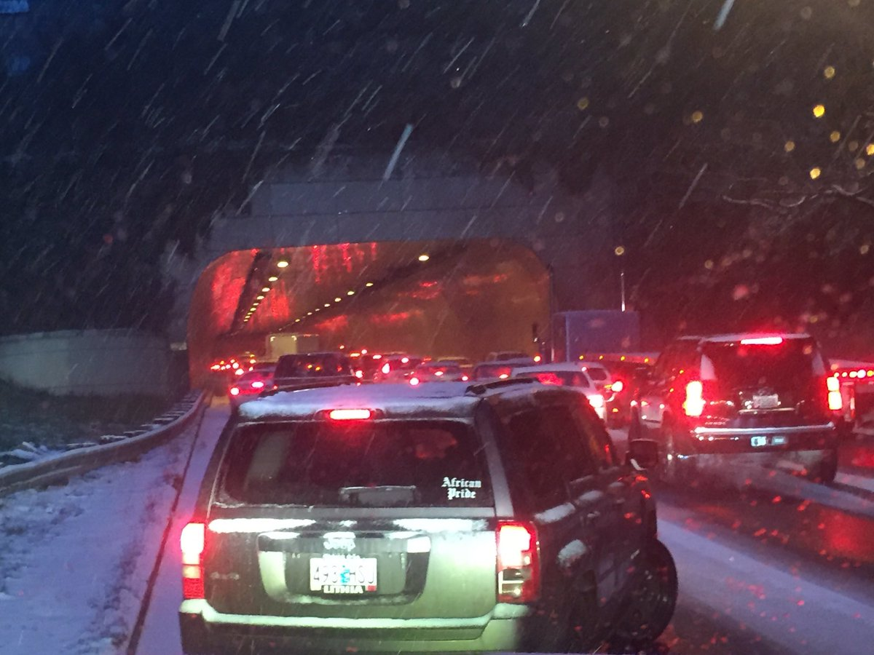
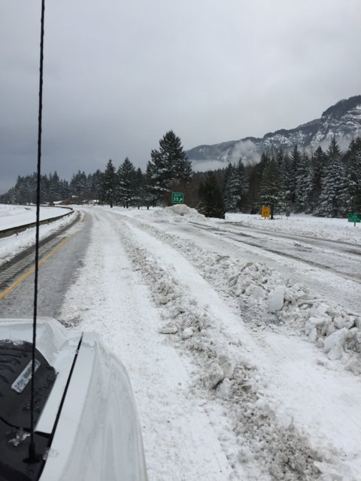
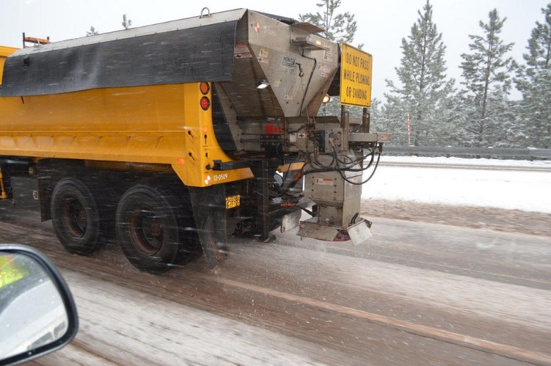
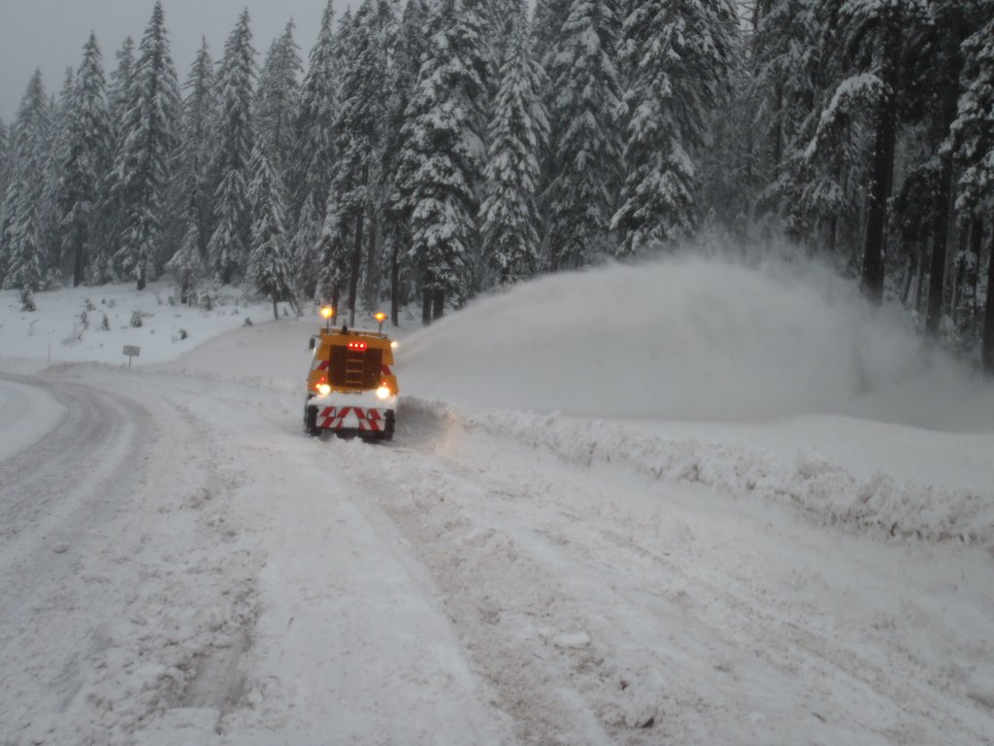
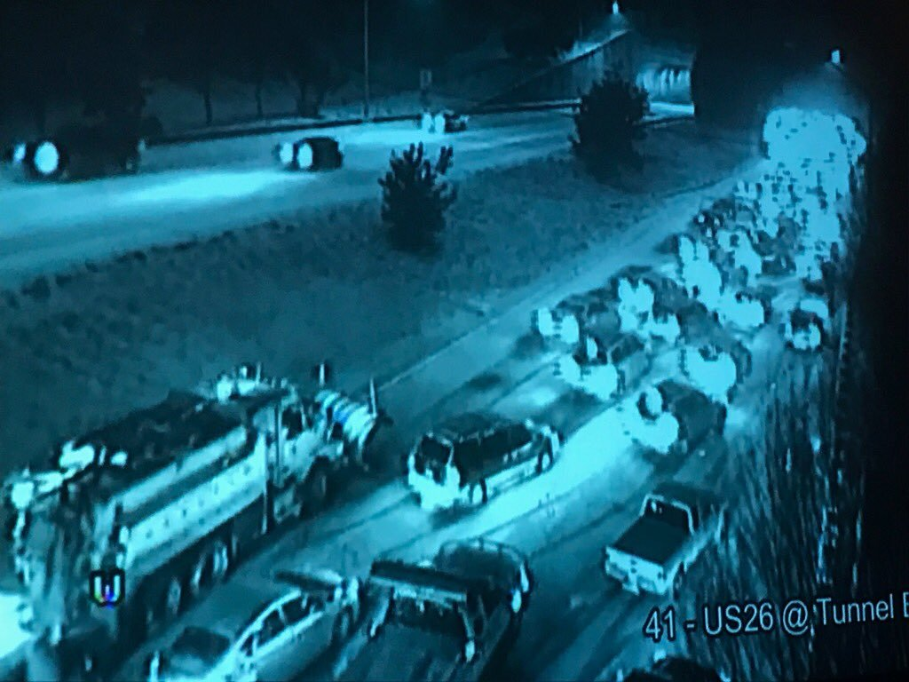
21

Slide 22
Before
During
After
“Are you going to salt?”
22

Slide 23
Before
During
After
“Where are you salting?”
“Are you going to salt?”
23

Slide 24
Before
During
After
“Where are you salting?”
“Why aren’t you salting everywhere?
(everybody else does)”
“Are you going to salt?”
24

Slide 25
Before
During
“The storm would end earlier if you used more salt!”
After
“Where are you salting?”
“Why aren’t you salting everywhere? (everybody else does)”
“Are you going to salt?”
25

Slide 26
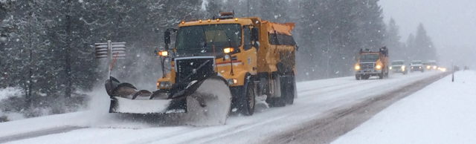
Snow removal—then
Plows
Sanders
Blowers
Salt trucks
Sanding rock
Liquid deicer
—mag chloride
Solid salt
Chains
Traction tires
26
Notes:
What we’ve done traditionally

Slide 27
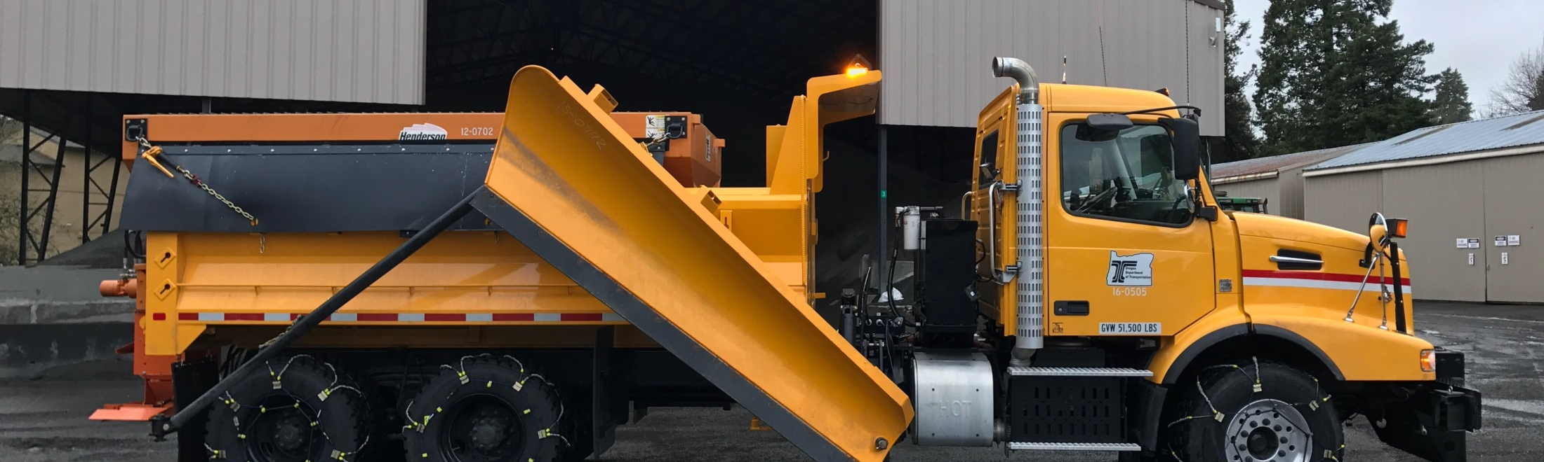
Snow removal—now
* sometimes…
Plows
Sanders
Blowers
Salt trucks*
Sanding rock
Liquid deicer
—mag chloride
Solid salt*
Chains
Traction tires
27
Notes:
What we’ve done traditionally

Slide 28
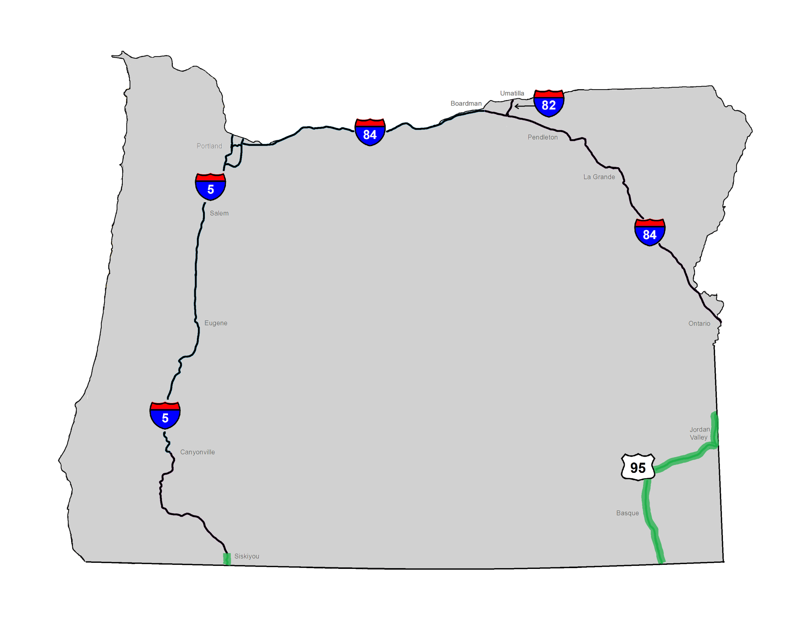
Salt pilot: 5 winters, 2011/12 - 2016/17
Notes:
Phase 1 (2012-2015)
Phase 2 expansion

Slide 29
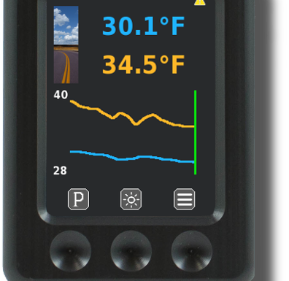
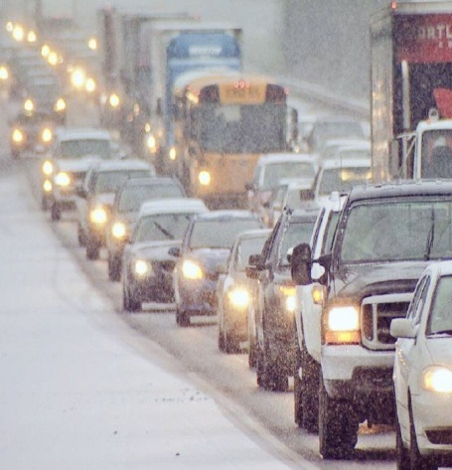
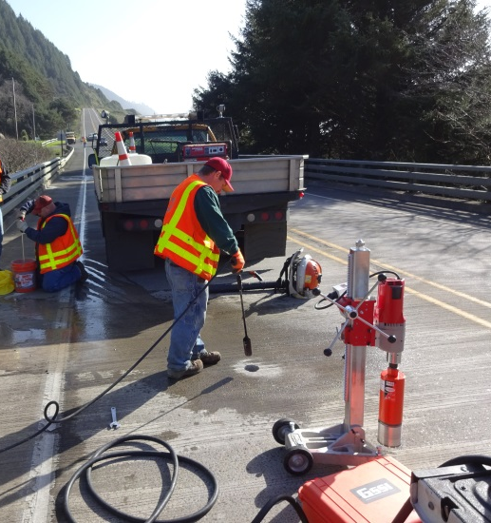
Salt pilot goals
Match other states’ road conditions
Minimize use
Track closures
and crashes
Monitor infrastructure & environment
Notes:
Salt pilot—goals and monitoring
Minimize use: operators are trained and understand how to use salt in conjunction with other tools. Pavement temperature is a big factor in how and when to use salt and at what rate. All salt and deicer application equipment is equipped with pavment temperature sensors.
Winter conditions can result in crashes or driving conditions that warrant highway closures or that vehicles use chains. These situations reduce highway mobility
Chloride deicers can adversely impact the environment and infrastructure. ODOT monitors surface water, soils, and vegetation to observe whether differences can be seen once salt is used. ODOT is also monitoring concrete bridge decks for chloride penetration and damage.

Slide 30
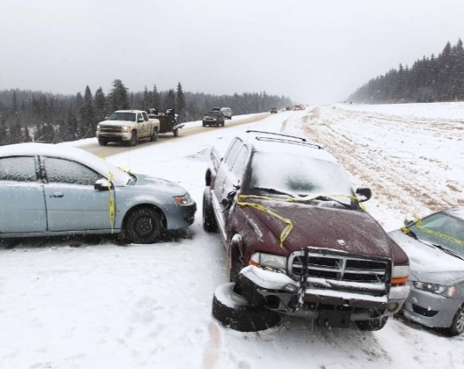
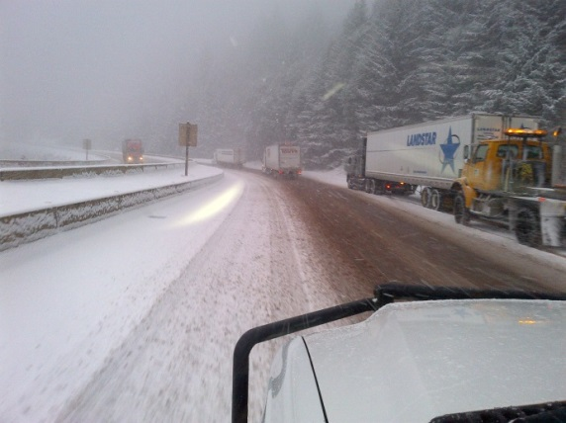
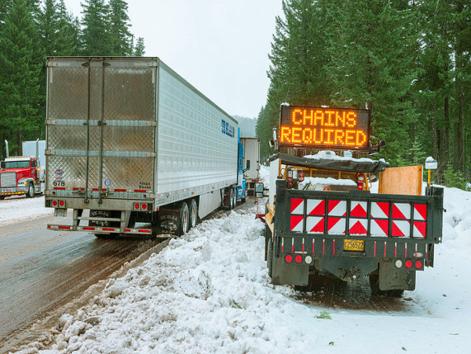
Results on I-5 through 2015/16
Crashes
DOWN 27%
Holds/ closures
DOWN 75%
Chain restrictions
DOWN 78%
Notes:
Salt pilot—results so far
Fewer avg. crashes/year
I-5: 30 to 22 (down 27%)
U.S. 95: 26 to 20 (down 23%)
Fewer avg. holds and closures/year
I-5: 12 to 3 (down 75%)
Fewer avg. chain restrictions/year
I-5: 49 to 11 (down 78%)

Slide 31
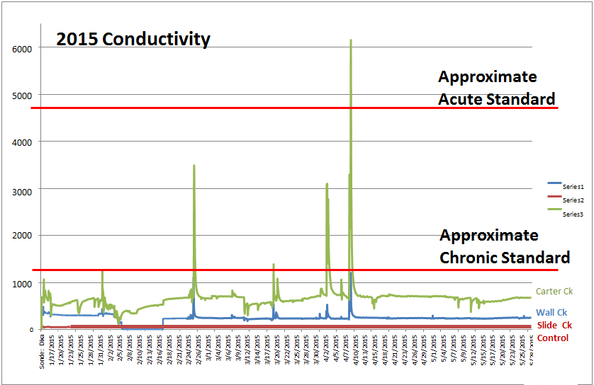
Results on I-5 through 2015/16
No impact to vegetation
Elevated chloride levels in one stream
No observed impacts to roads and bridges
Notes:
Salt pilot—results so far
One stream has shown higher levels of chloride. Spikes that exceed state water quality standards occurred in the middle of winter. Potential indication that highway activities contribute to stream chlorides.

Slide 32
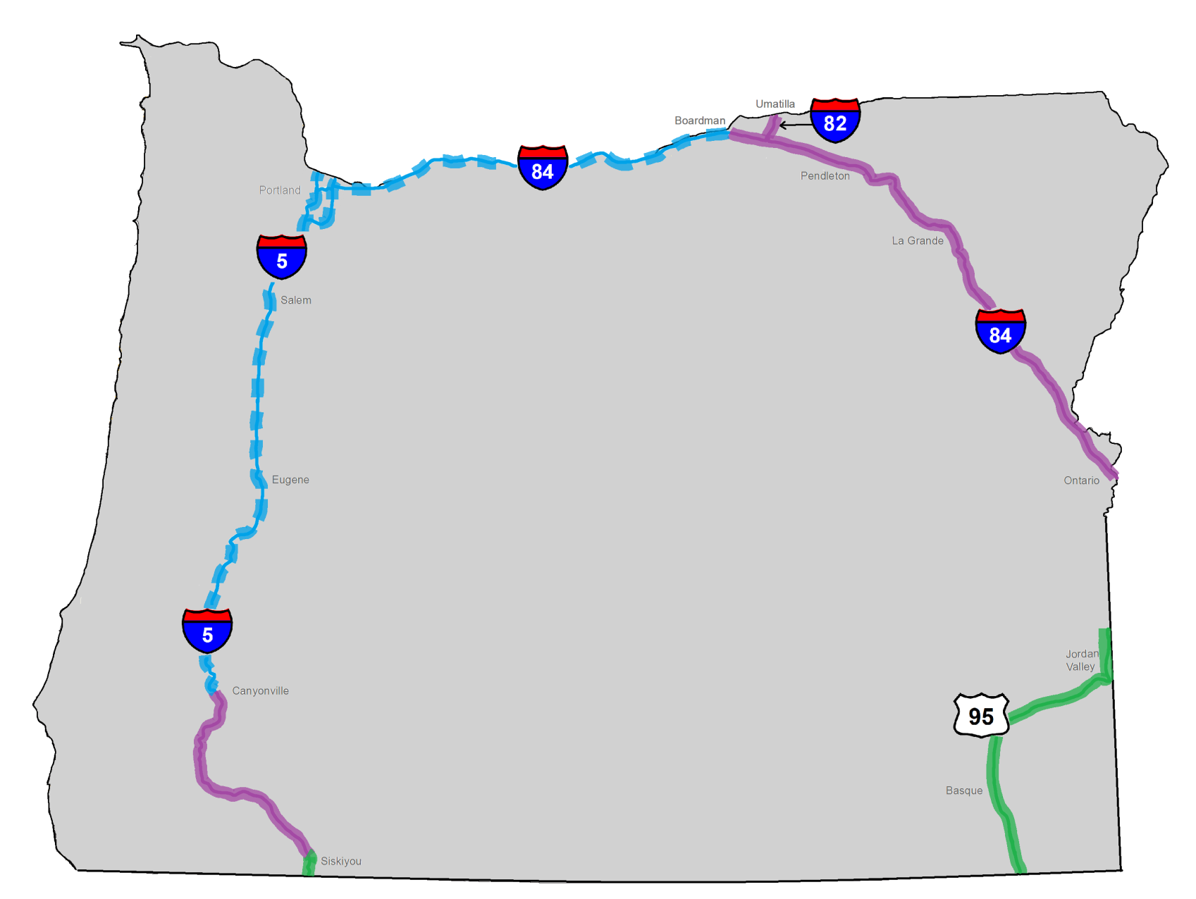
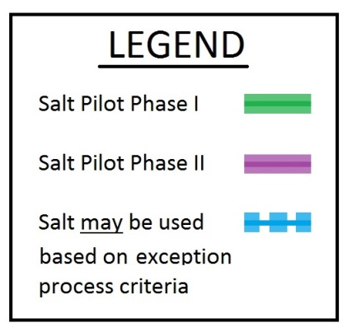
Salt pilot expansion: Yes, yes, maybe & nope!
Notes:
Phase 1 (2012-2015)
Phase 2 expansion

Slide 33
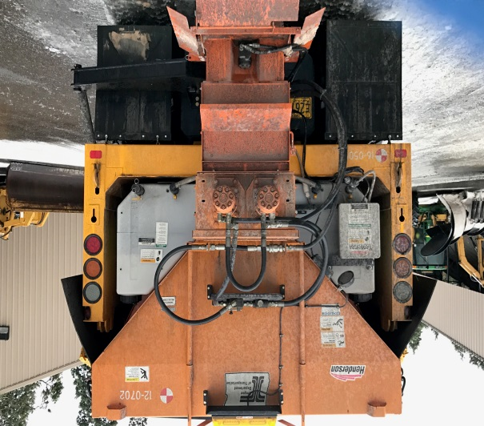
Goals
Minimum
use
Maximum benefit
Target: Storms that are followed by days of freezing temperatures
Notes:
Continue to track use and be transparent with findings.

Slide 34
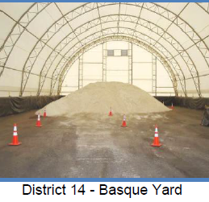
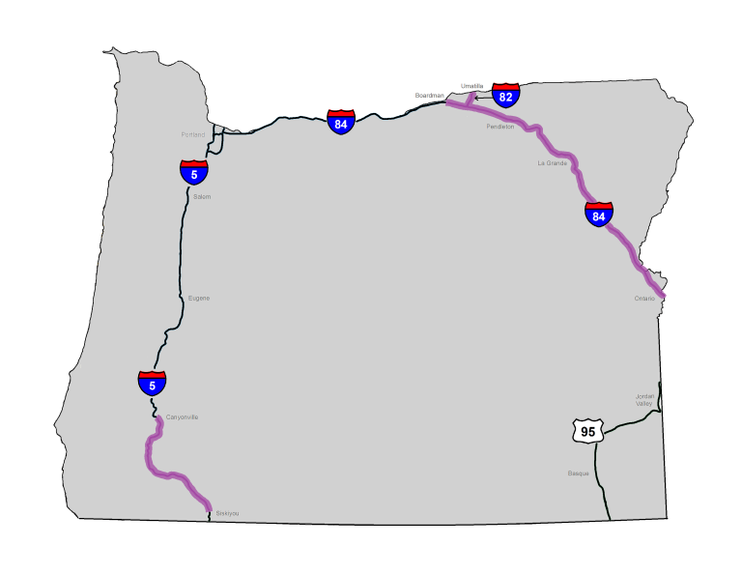
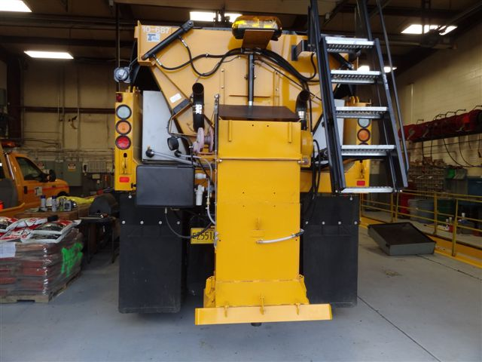
Salt pilot expansion
No sooner than November, 2017
May be later in the winter
Missing:
Salt
Salt sheds
Salt trucks
Training in BMPs

Slide 35
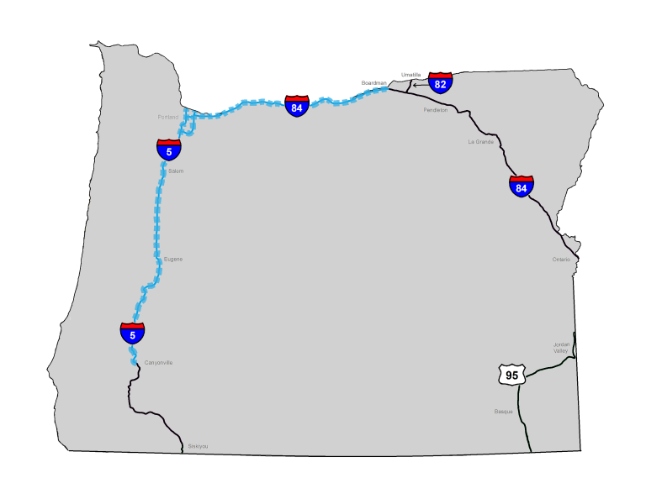
The maybe case
I-5
I-84
Portland-area freeways
In limited areas
In extreme winter conditions—NOT every storm
Notes:
The area where salt may be used via an exception process includes the remainder of Interstate 5, Interstate 84, and Portland Freeways.
ODOT does not have the resources or infrastructure to use salt outside of the phase 2 pilot areas, except in almost one-off, extremely limited circumstances.
We are still working on these details.
Exceptions will be considered in limited areas based on extreme winter conditions such as we experienced in Portland recently.
These areas are ones that receive snow much more infrequently, but where liquid deicers aren’t adequate and the limited and targeted use of salt in a specific location could benefit safety and mobility.
We will refine the spot locations, types of storms and the benefit we see to the rest of the system in order to determine when and where to use salt.
It is important to know that ODOT does not foresee widespread use of salt or even using salt in every storm.
We still need drivers to be prepared for winter conditions and take precautionary measures when snow is in the forecast.
We will continue to work to find the right balance for safety and mobility versus cost and impact to the environment, infrastructure and vehicles.

Slide 36




February was brutal, too

Slide 37







And we’re not done, either
37

Slide 38


Safety: Because we want to get home, too
38

Slide 39

Thanks! Questions/comments?

