Slide 1

La Nina
Lived up to its reputation
WINTER 2016-2017
A Wild ride!
Mark Nelsen

Slide 2
Quick Summary
The most active winter since 1995-1996?
Coldest winter for much of PACNW since 1992-1993 (24 yrs)
Coldest winter since 1979-80 In Portland
3 consecutive COLD months
Historic multi-year warm period finally gone
BUT, no PACNW Arctic Blast (3rd consecutive winter)

Slide 3

OFFICIAL
SNOW TOTAL
11.2”
at PQR (NWS Office)
15.5” Downtown (KGW-TV)

Slide 4
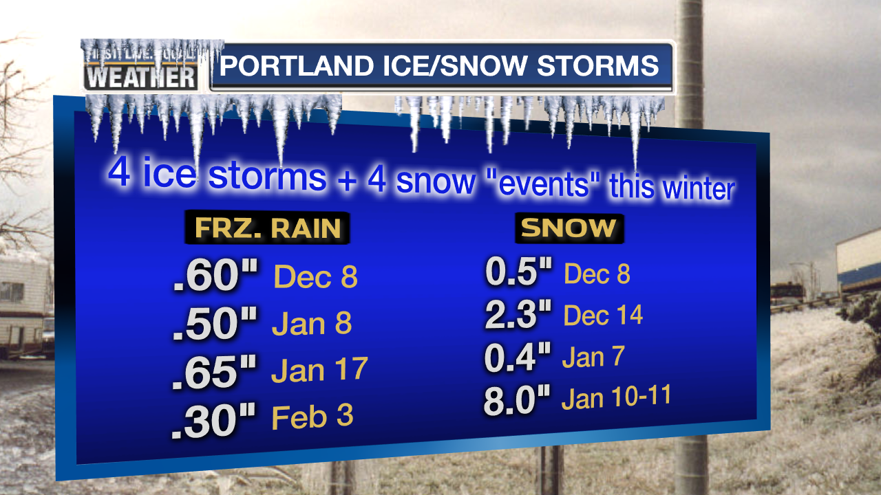

Slide 5
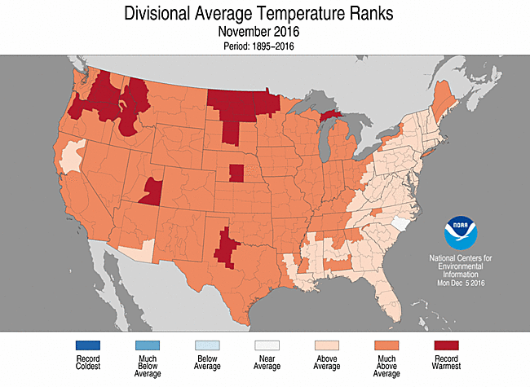
THE USA VIEW

Slide 6
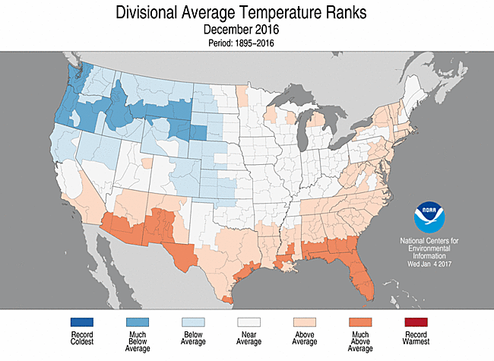
THE USA VIEW

Slide 7
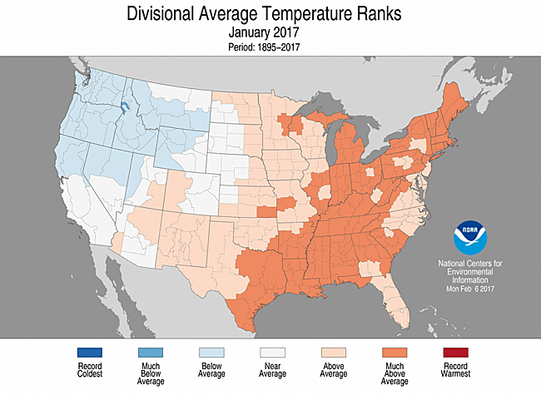
THE USA VIEW

Slide 8
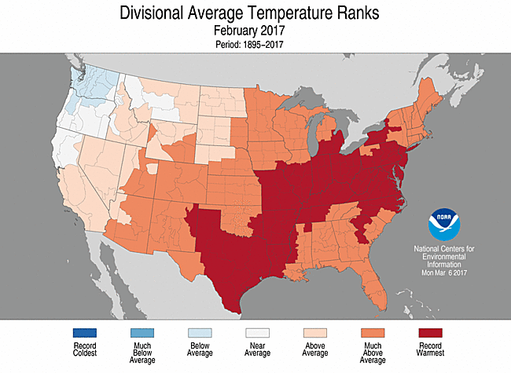
THE USA VIEW

Slide 9
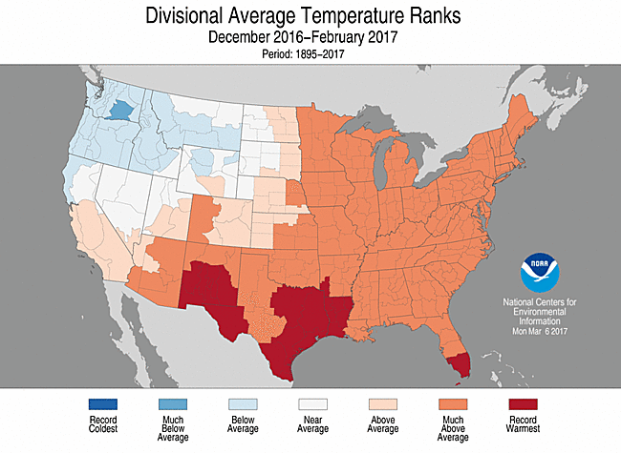
THE 3 MONTH PERIOD

Slide 10
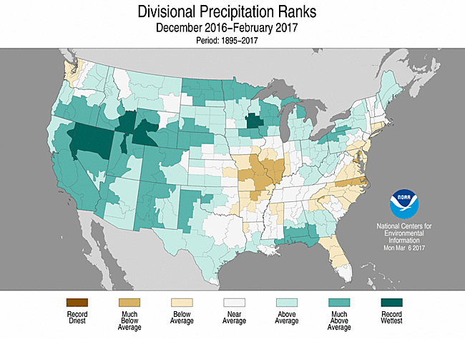
3 MONTH PRECIPITATION

Slide 11
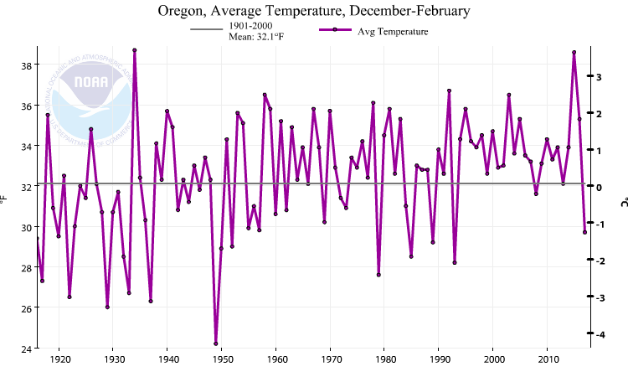
Oregon Winter Temps (the past 100 years)
Coldest since 1992-1993

Slide 12
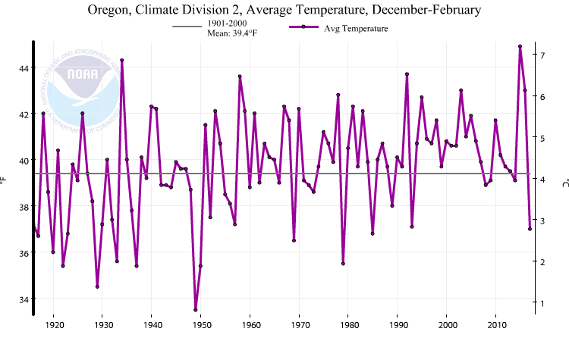
Western Valleys Winter Temps (the past 100 years)
Similar to 1992-1993
This Winter in Oregon Zone 2 (Willamette Valley)

Slide 13
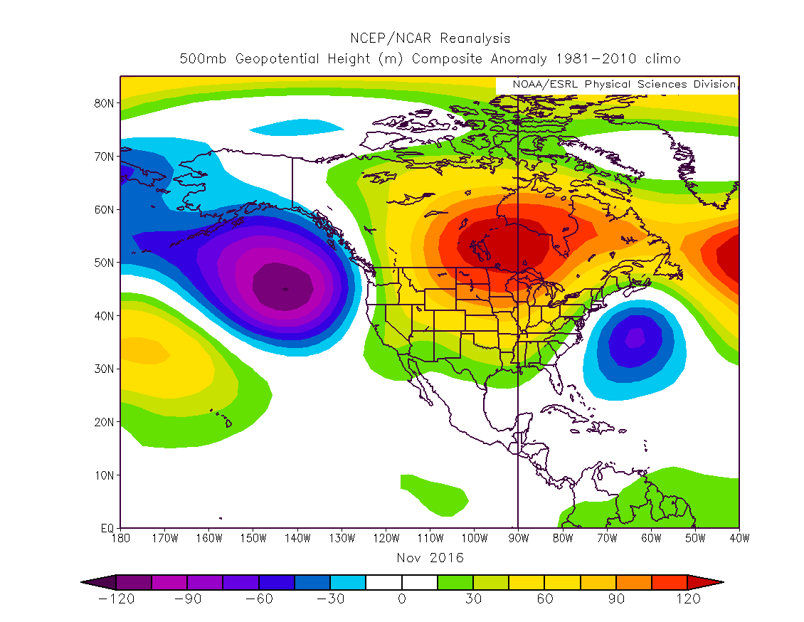
UPPER LEVEL PATTERNS

Slide 14
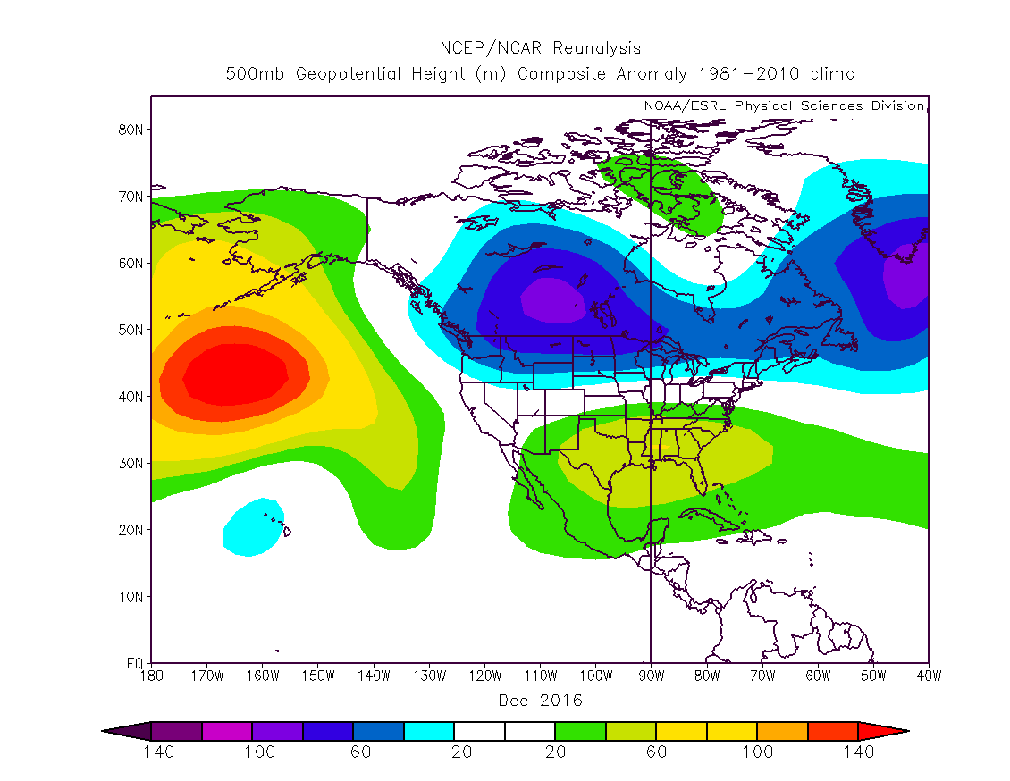
UPPER LEVEL PATTERNS

Slide 15
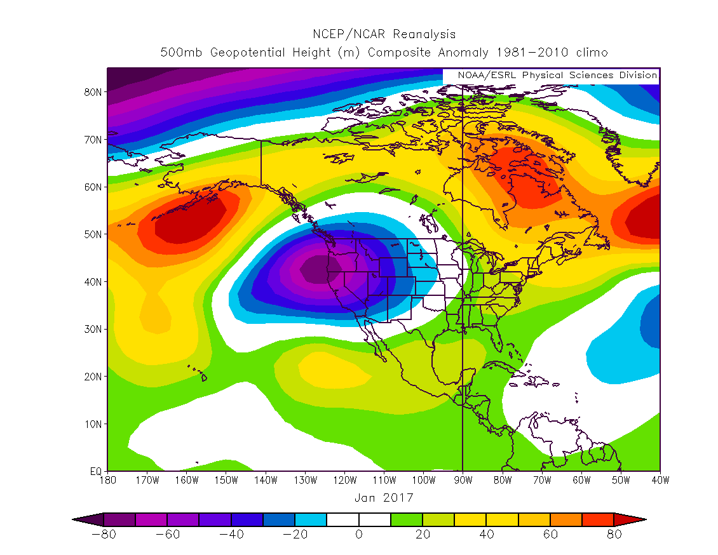
UPPER LEVEL PATTERNS

Slide 16
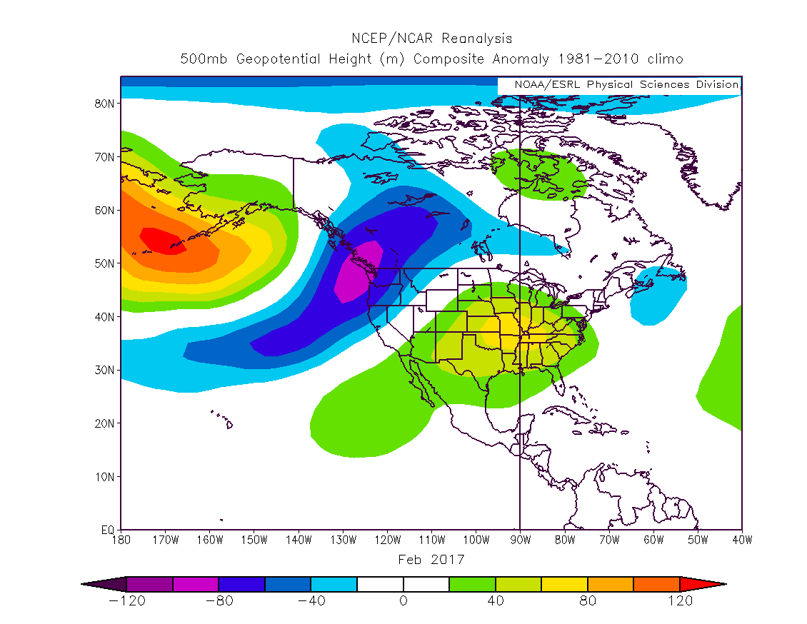
UPPER LEVEL PATTERNS

Slide 17
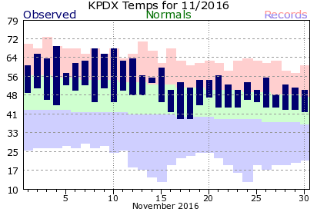
NOVEMBER
Warmest November on Record at PDX
Several record warm temps 1st half

Slide 18
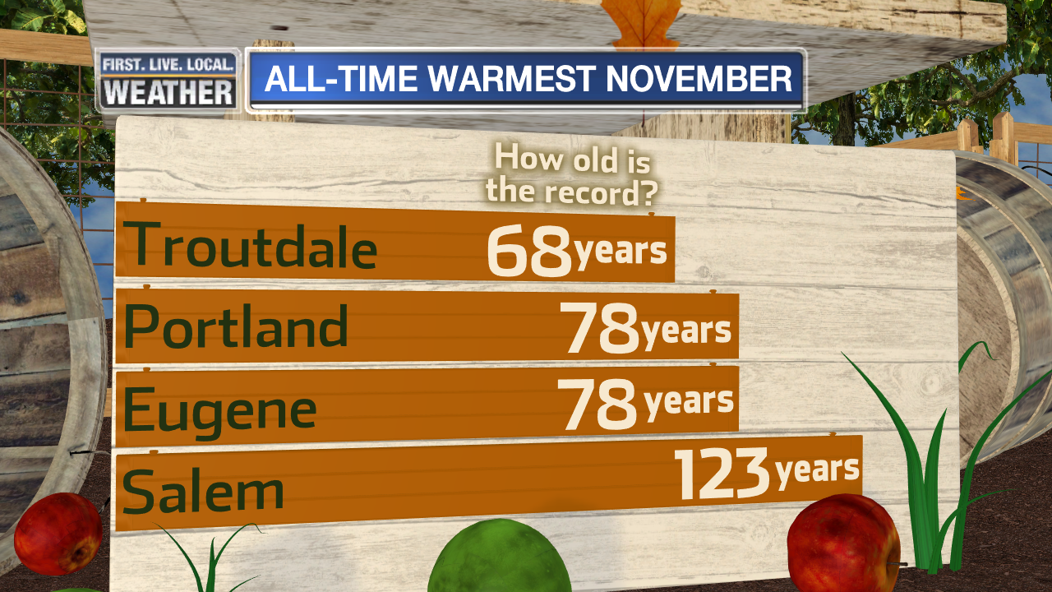
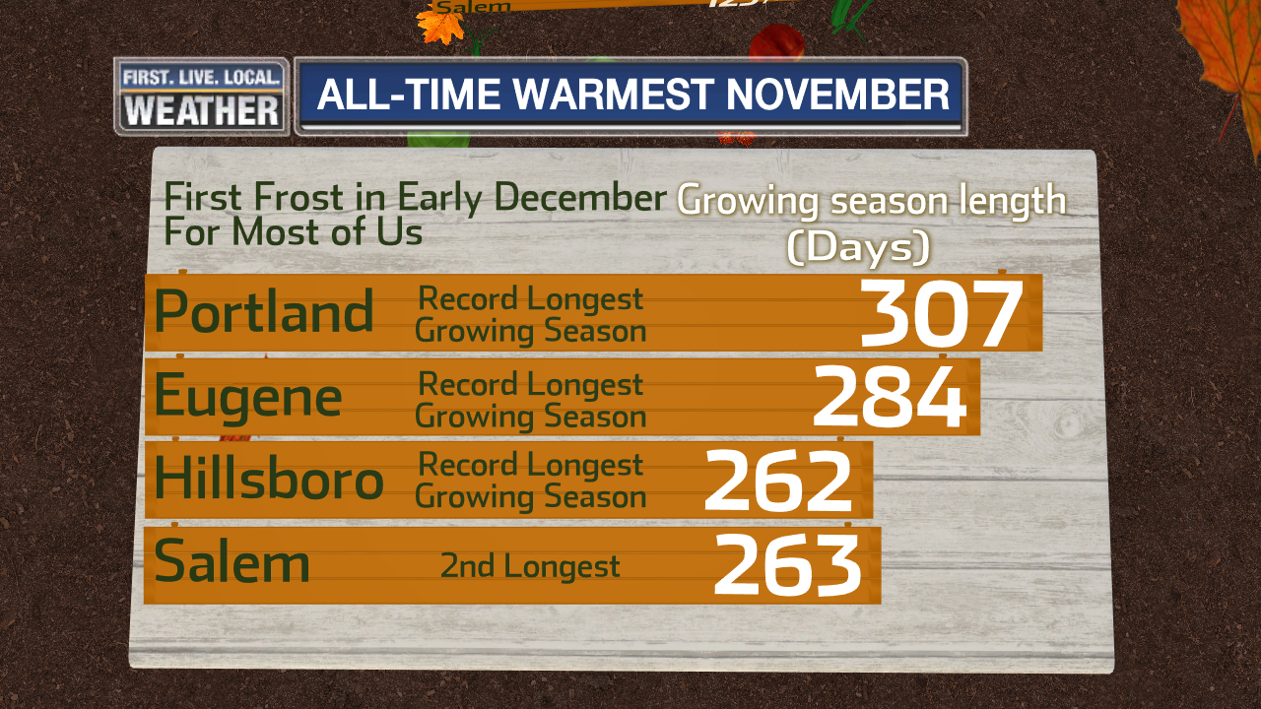
NOVEMBER
Somewhat uneventful month for storms; huge downpour Thanksgiving Day
Record Warm Month + Record Long Growing Season

Slide 19
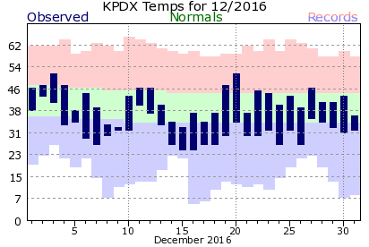
DECEMBER
A cold month, especially before 20th

Slide 20
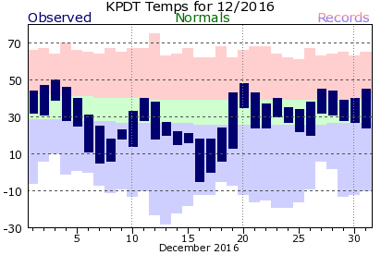
DECEMBER
Very Cold PENDLETON Temps

Slide 21
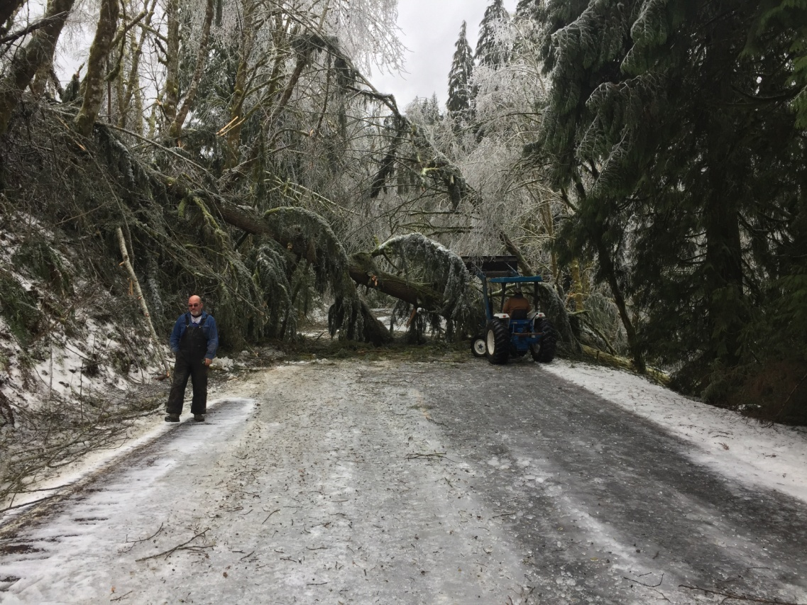
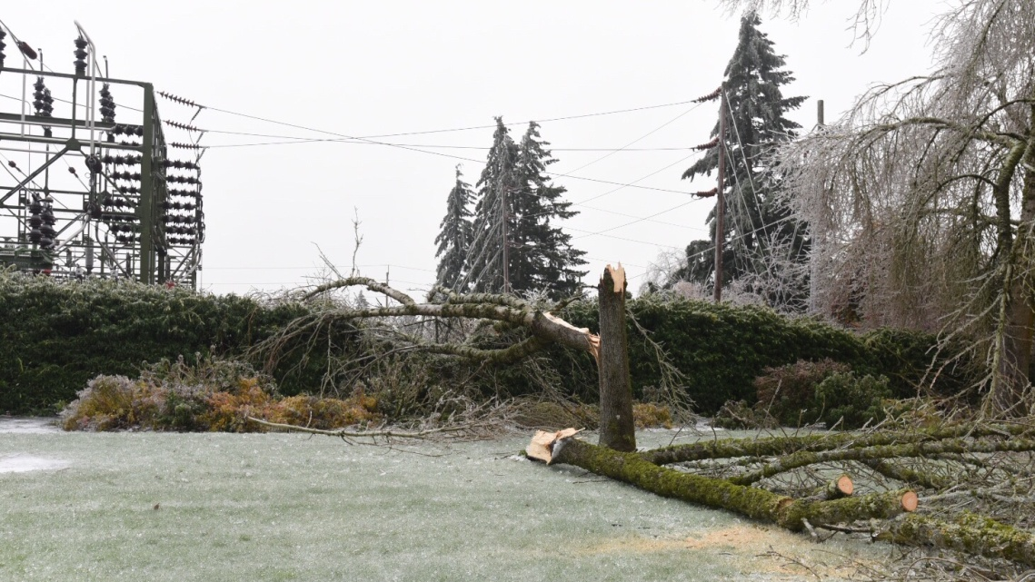
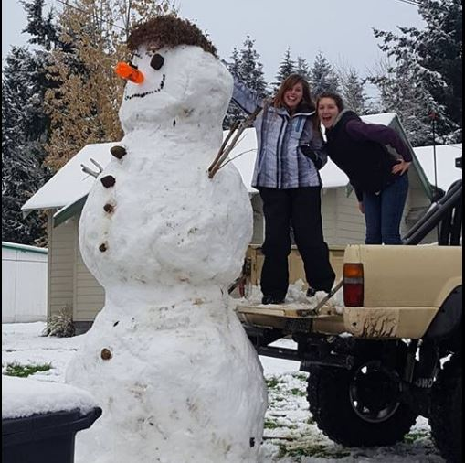
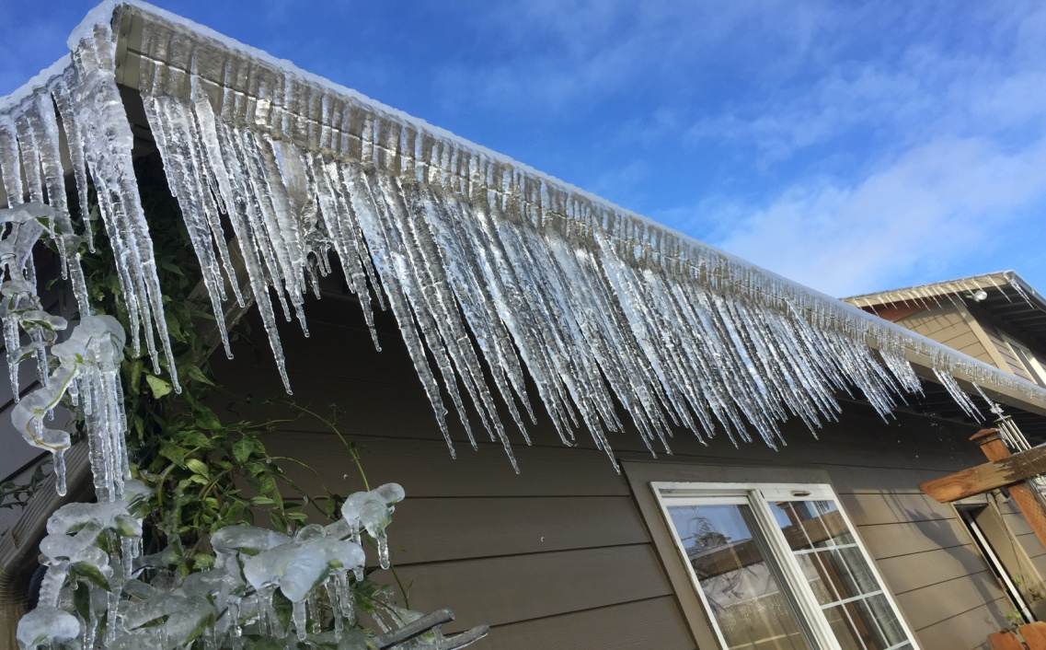
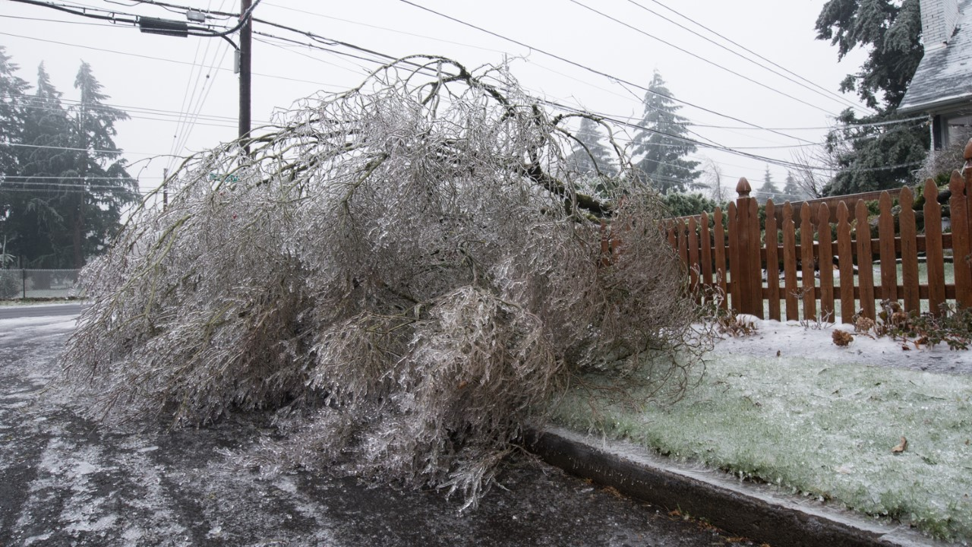
DECEMBER
December 8th
Our first snow to
freezing rain event
Trace to 2” most of metro area
Transitioned to the most damaging
ice storm of winter
In NE & SE Portland
PQR SNOW: 0.50”
ICE ACC: 0.60”
But wait….there will be more!

Slide 22
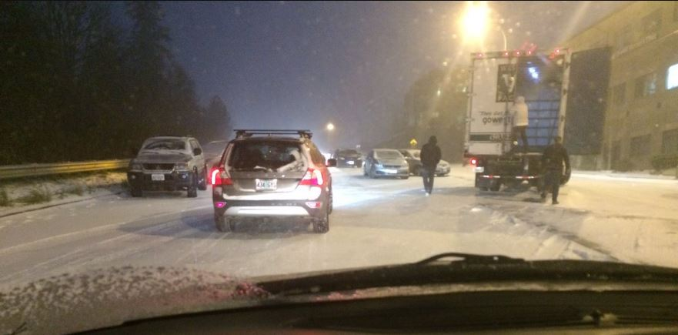
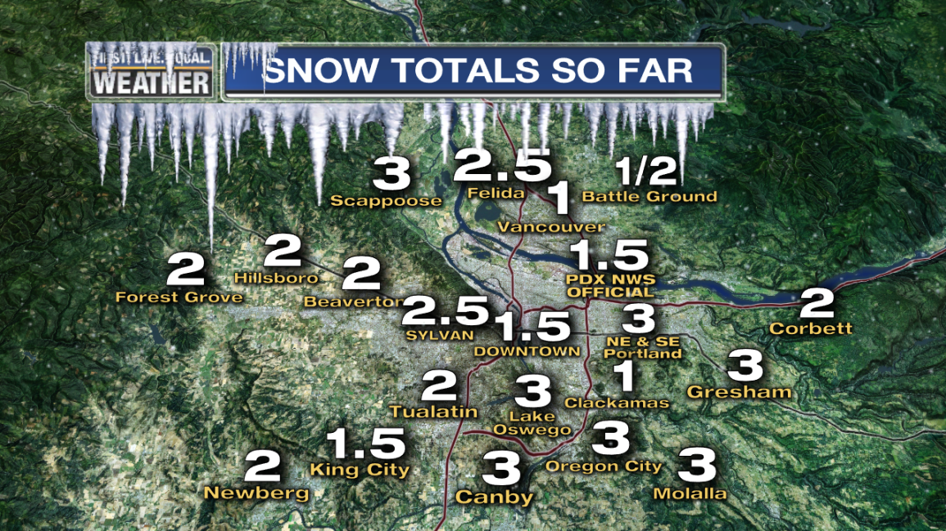
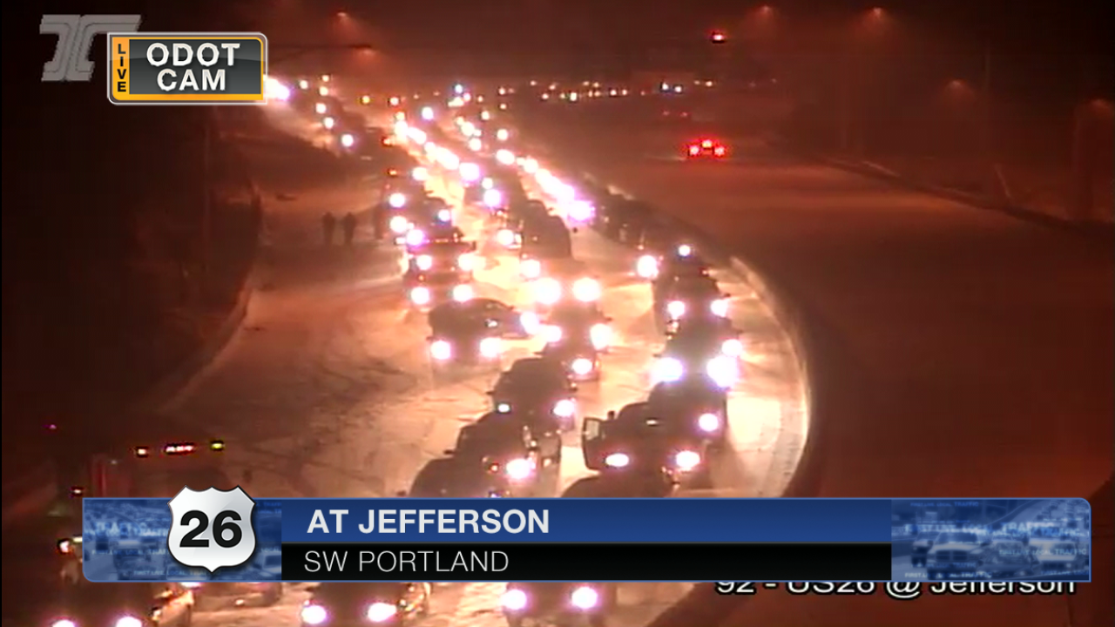
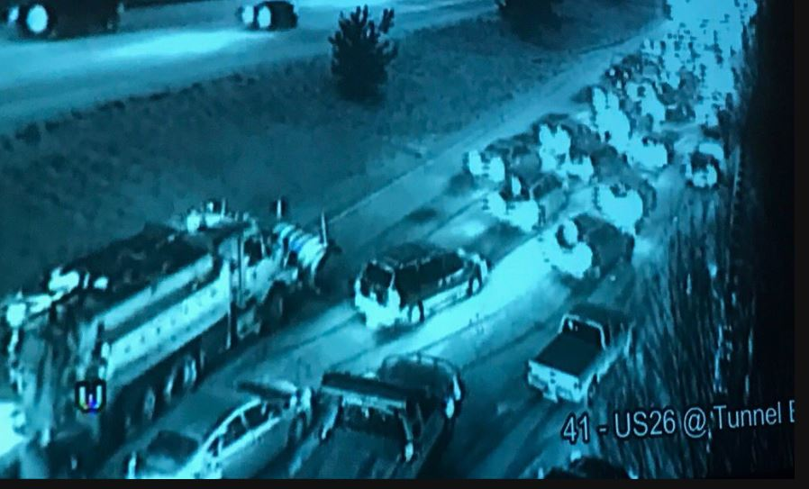
DECEMBER
December 14th
A PERFECT FORECAST
…but worst traffic nightmare
ever in metro area for snowstorm #1
1-4” snow most of metro area
All snow, no ice. Kids stuck on buses and at schools until midnight. Some stuck on freeways for 3-7 hours!
PQR SNOW: 2.3”
But wait….there will be more!

Slide 23
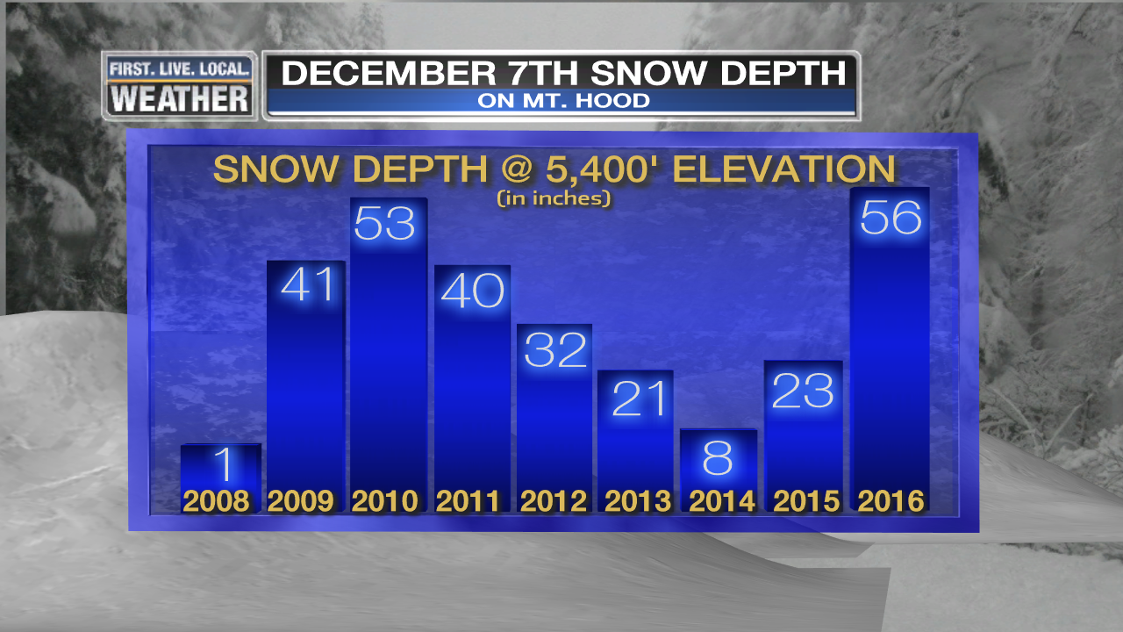
SKI SEASON
Quick start to ski season late Nov/early Dec.
Excellent Conditions Rest of December
3rd Year With An Excellent Christmas Break!

Slide 24
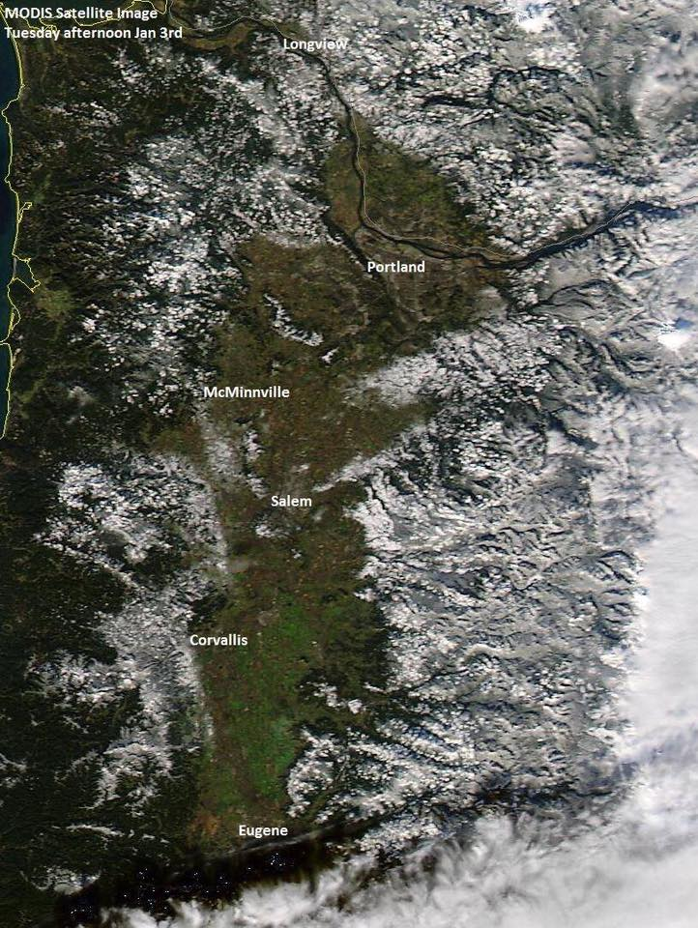
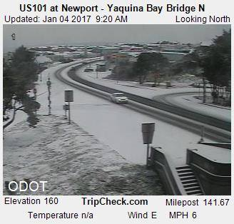
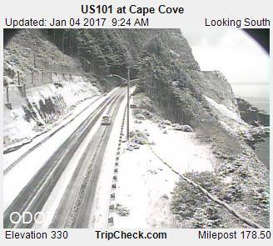
JANUARY
Light snow New Year’s Morning
then a cold east wind first week under sunshine
Chilly northerly flow, then system moves through southern Oregon on 4th

Slide 25
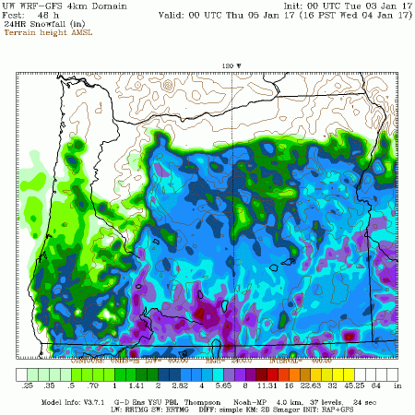
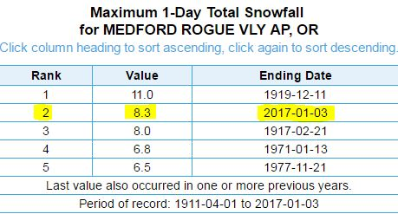
JANUARY
The Repeating Pattern in December & January
Storms move across southern Oregon & N. Cal
Keeps cold air in place up north, lots of snow southern OR
Historic January 3rd/4th snowstorm in Rogue Valley

Slide 26
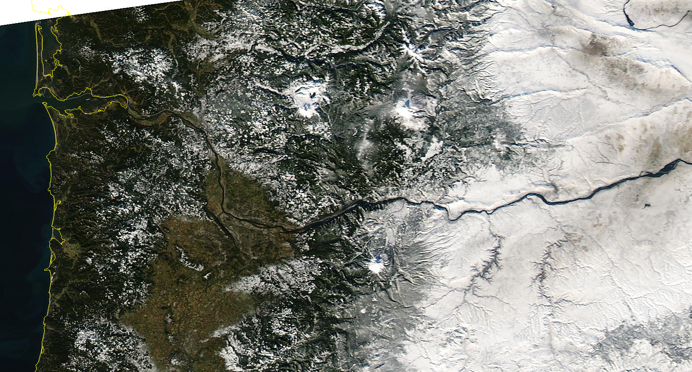
JANUARY
January 5th…a very snow PACNW!
Cold east wind keeps temps in 30s, not an arctic blast, but low level cold air

Slide 27
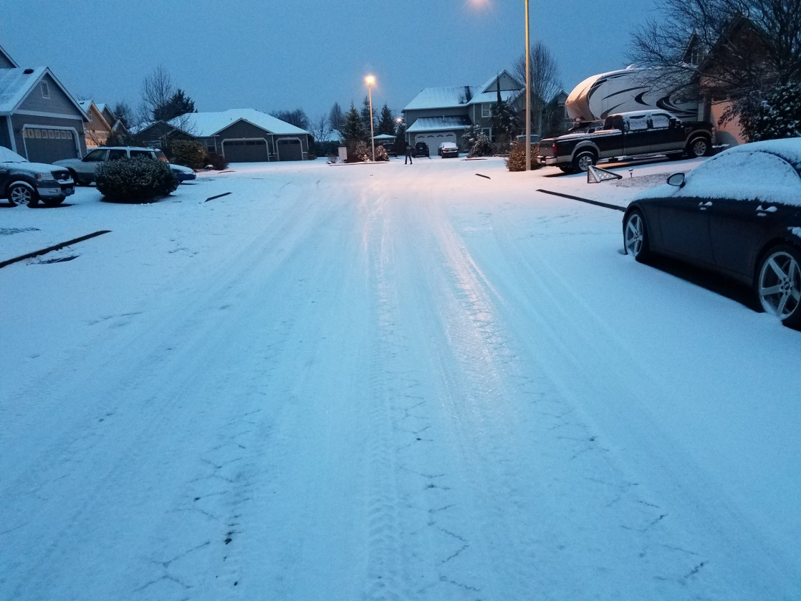
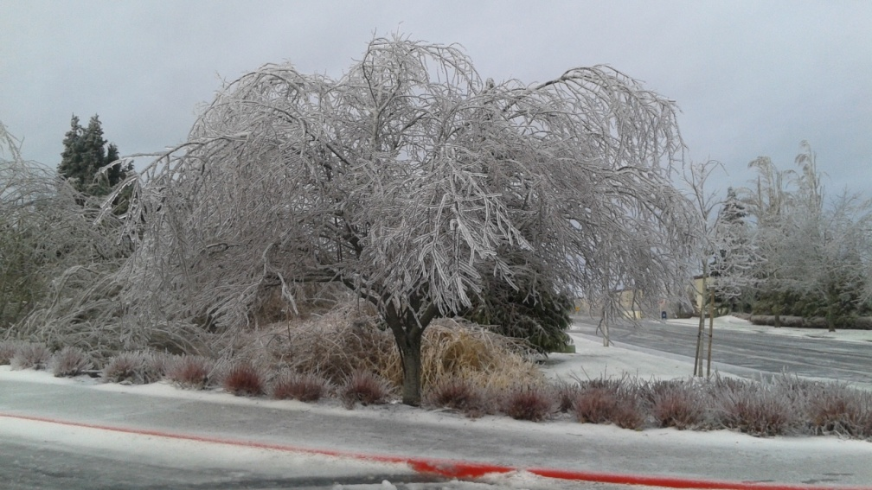
JANUARY
January 7th/8th Snow/Ice transition “event”
Mainly freezing rain, not too much snow
Slow to leave…of course

Slide 28
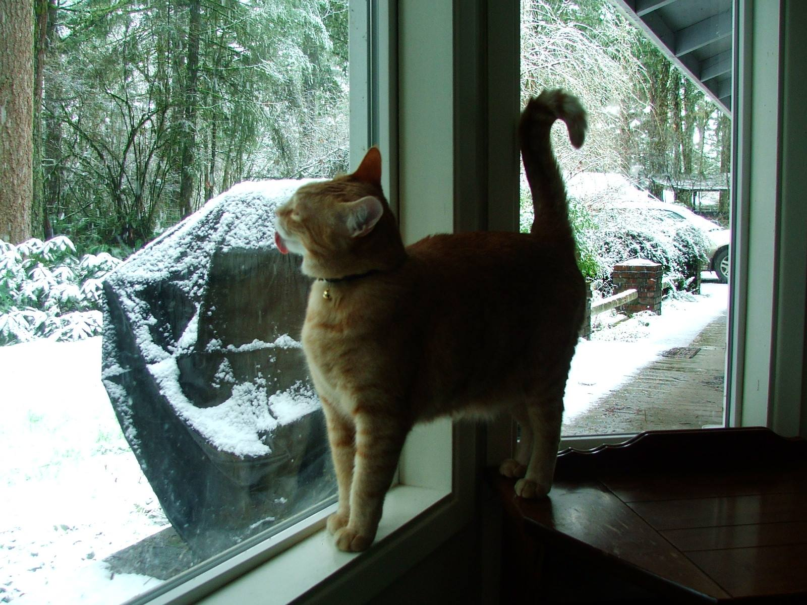
JANUARY
January 7th/8th
3rd metro event…snow to freezing rain
…but on a weekend so not such a big issue.
Snow dusting most of metro area
Up to .80” ice accumulation east metro
PQR SNOW: 0.4”
PDX ICE ACCUM: 0.5”
But wait….there will be more!

Slide 29
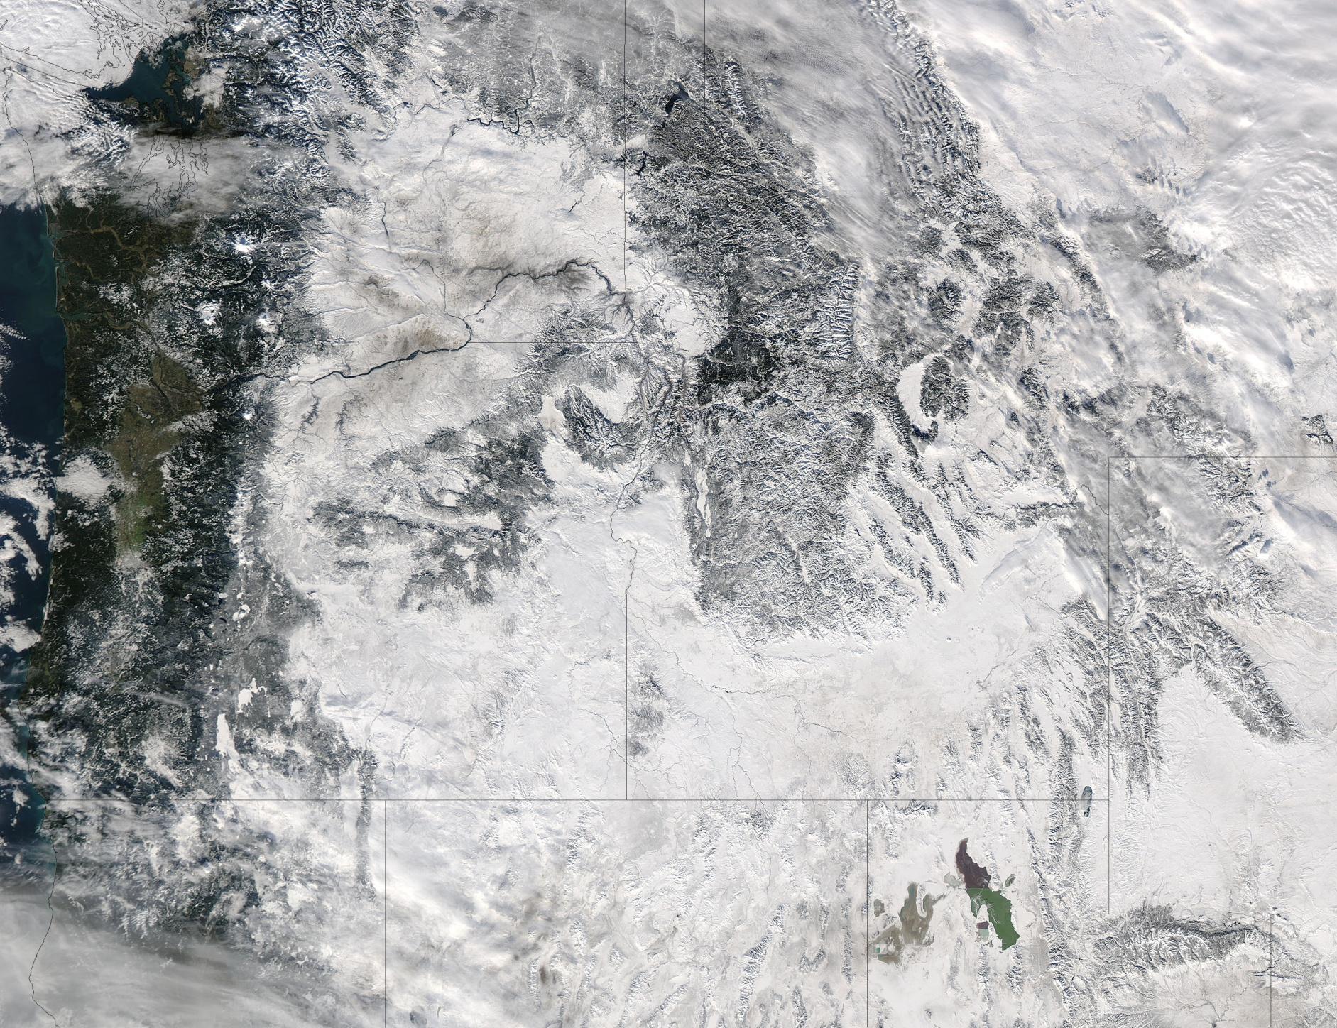
JANUARY
By January 9th
Snow on the ground almost everywhere in PACNW

Slide 30
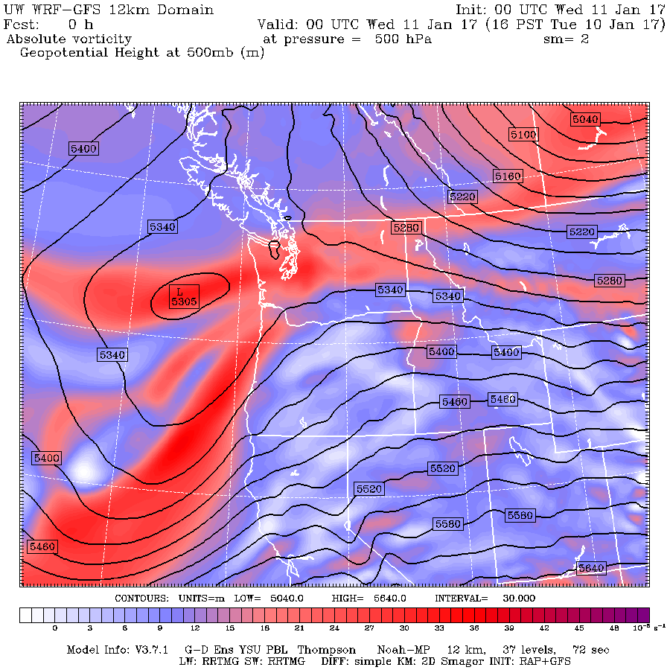
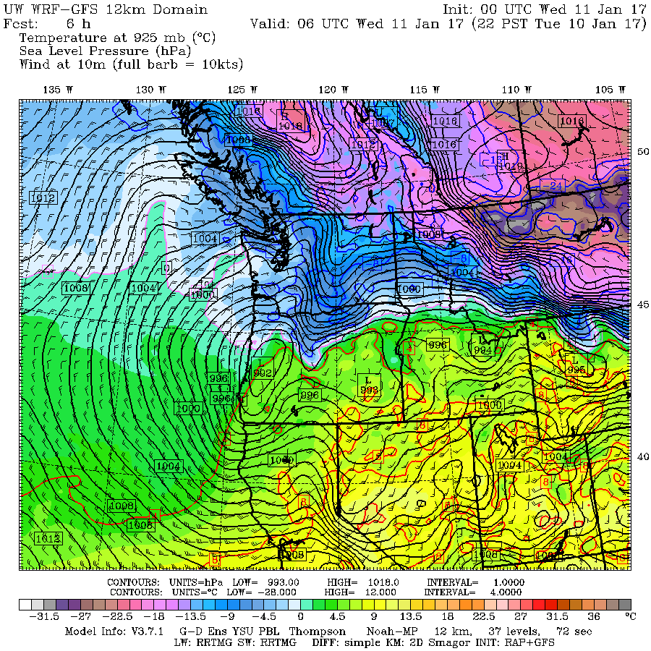
JANUARY
The Big Snowstorm
Models told us a snowstorm was coming, but way underdone on precip

Slide 31
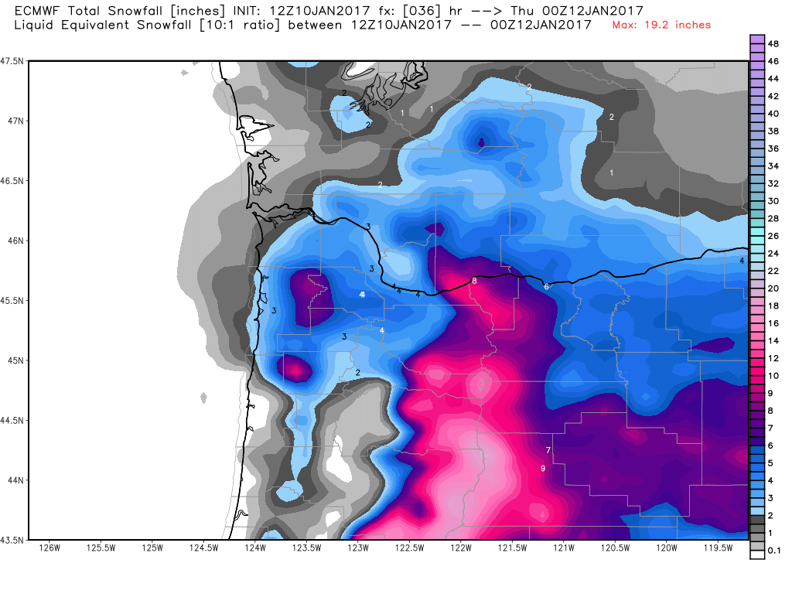
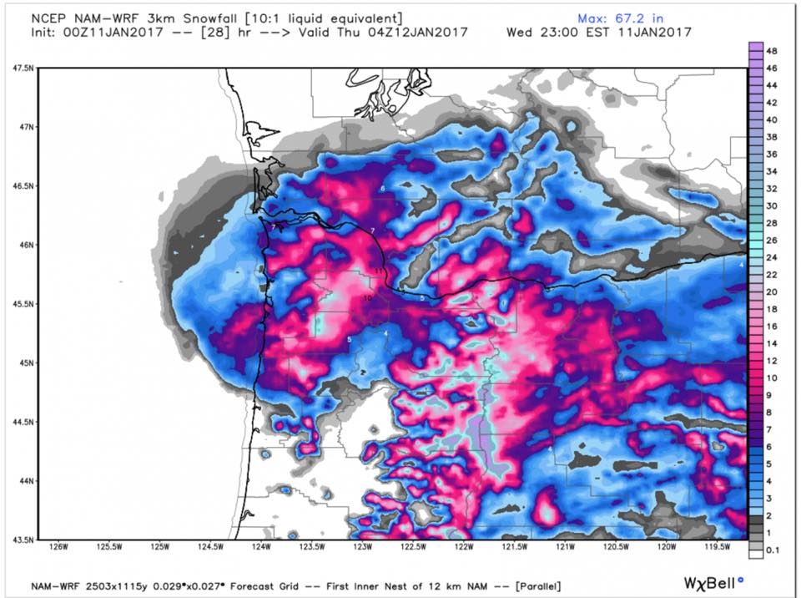
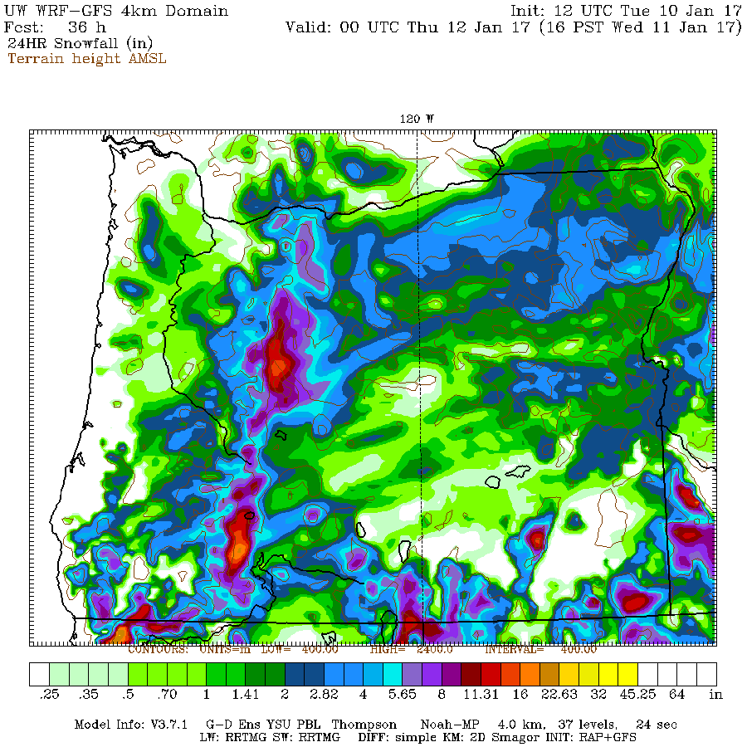
JANUARY
The Big Snowstorm
Models told us a snowstorm was coming, but way underdone on precip

Slide 32
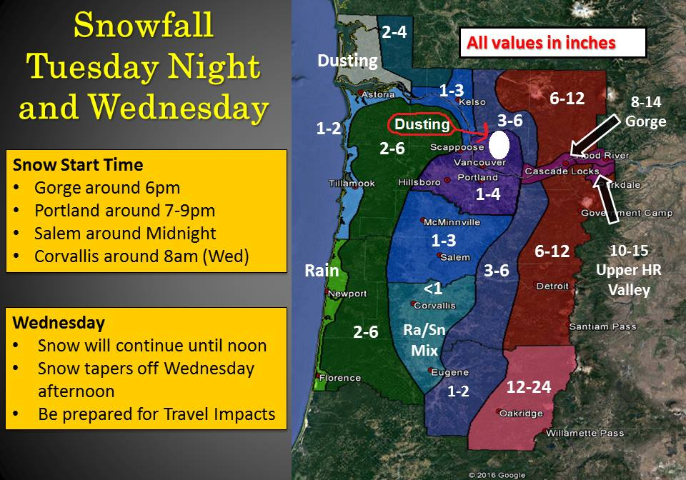
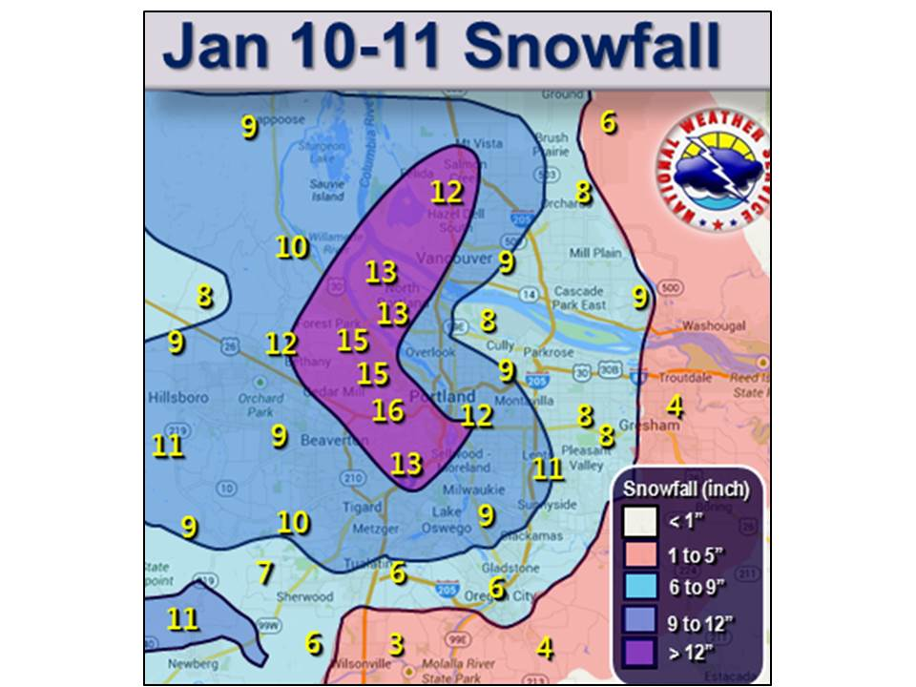
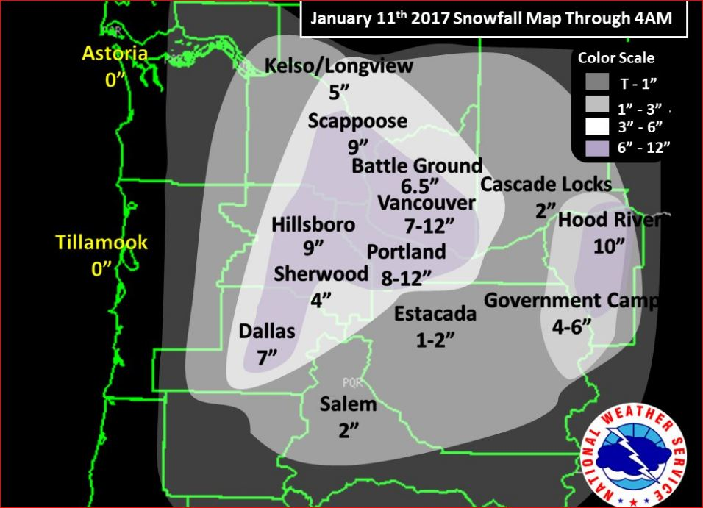
JANUARY
The Big Snowstorm
  Minor Snowstorm Forecast
  Timing okay
  FAR more snow than expected
Rain through most of event south metro and Salem
Light snow fell late night Salem-Wilsonville as air cooled overhead
PQR SNOW: 8.0”

Slide 33
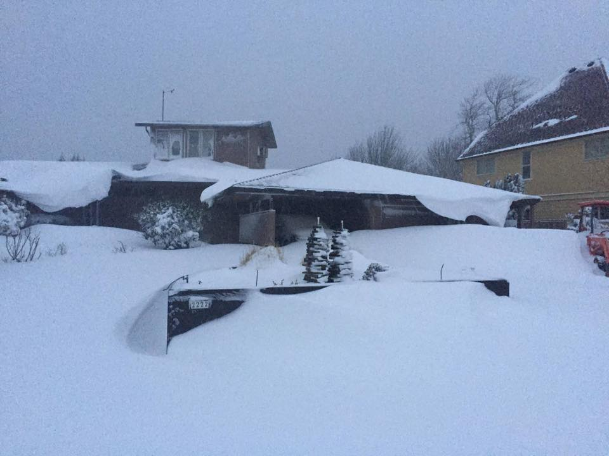
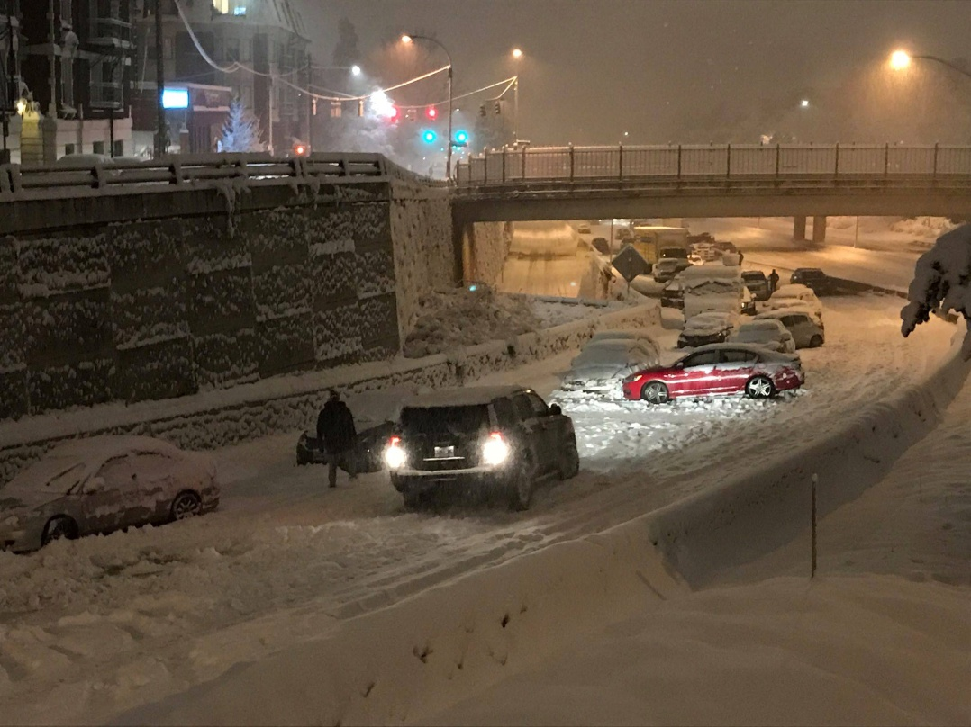
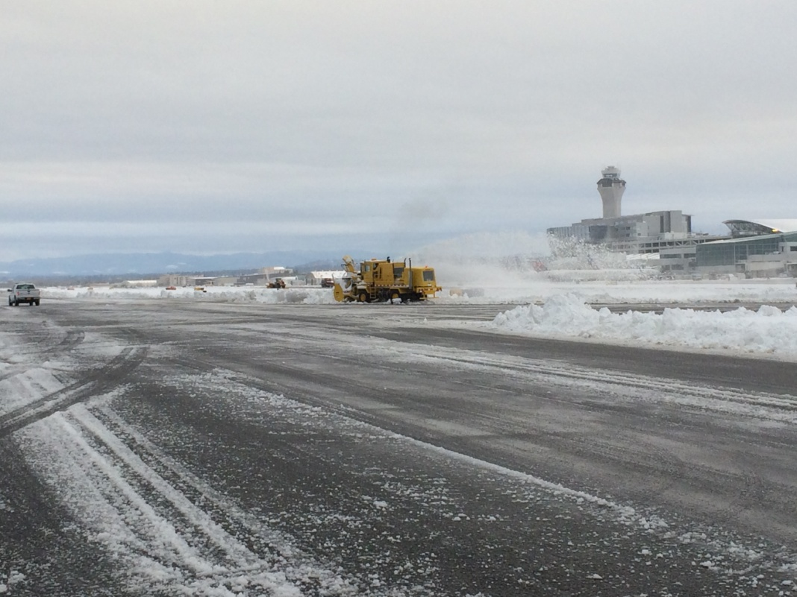
JANUARY
Freeway Nightmare
v2.0
  Commute mainly okay
  Salt used on one lane uphill US26
  Freeways blocked by semis again
Not as bad as December 14th, but people get stuck again
Depending on part of metro area you live in…it was the biggest snow storm since 2008, 1998, 1995, or 1980

Slide 34
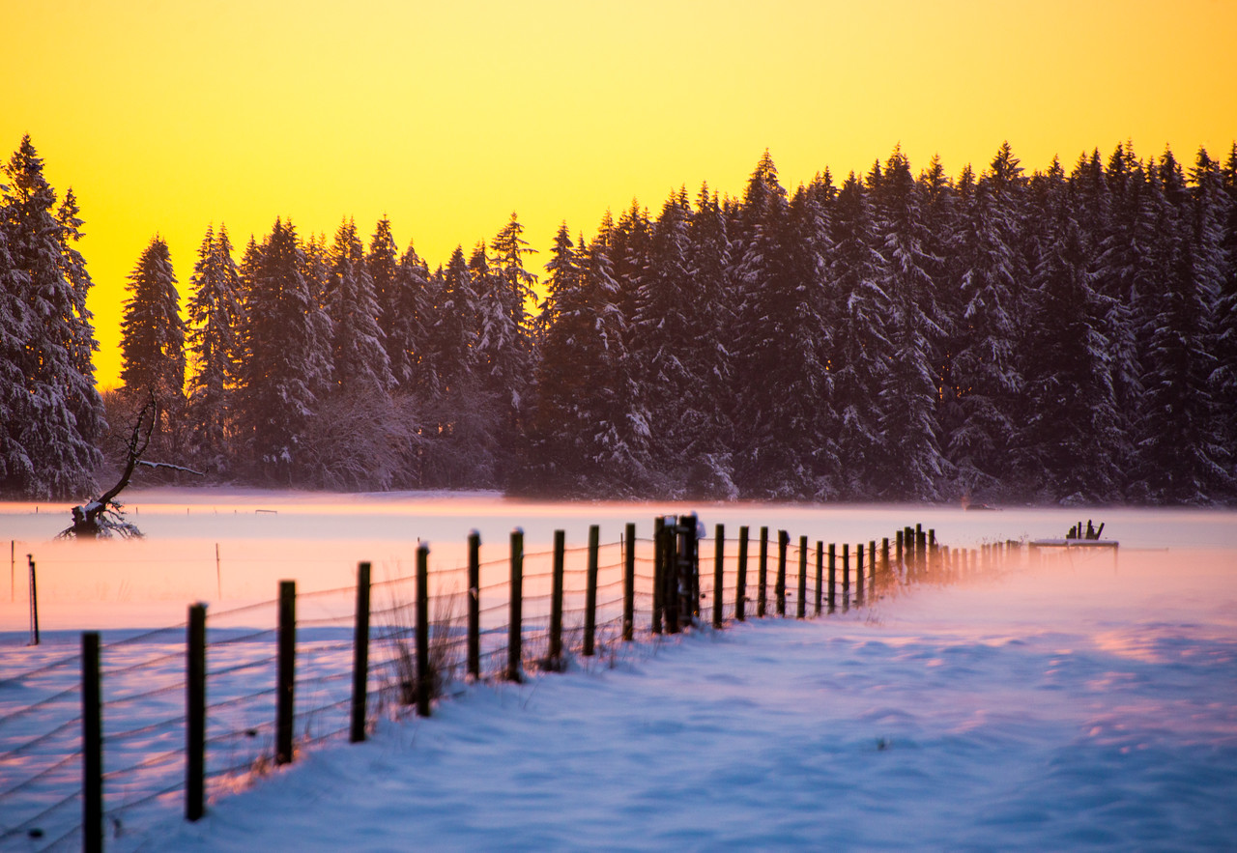



THE BEAUTY OF THE SNOW
Notes:
TYLER MODE PIC

Slide 35

JANUARY
Coldest temps of winter follow snowstorm
6 days of strong east wind + 25-30 deg.
Notes:
50+ gusts at TTD, 85 mph gust at Corbett Grade, highest of past 10 years
850mb temps never below -9 this winter
Valley 30-35 during this time
Puget Sound 35-45!

Slide 36



THE NEXT 6 DAYS: COLD!

Slide 37


INTO THE ‘HOOD TO MAKE SOME MONEY!
(Salmon Creek)
Notes:
$260 in 2.5 hours, but had to buy Steve burger and beer

Slide 38



JANUARY
Big Gorge Ice Storm
#3 of 5 total…Jan 18-20
  Up to 2” solid ice central Gorge
  Lots of damage, on top of snow
  Freeway closed several days
Rain through most of event in metro area and valley
Freezing Rain confined to areas near Columbia river in metro area
PDX ICE: .65” < heaviest of winter

Slide 39
LATE JANUARY
Temps closer to normal
Snow/ice starts to very slowly melt in Gorge

Slide 40

WHAT DAY IS THIS?

Slide 41



Super Bowl Sunday BUST!
Stationary front sits over NW Oregon
February 5th
Models initially forecast big snow
Then do a pretty good job keeping it north
Lots of snow Astoria & Coast Range
Heavy rain all afternoon/evening
in metro area at 33-36 degrees
Snow at Astoria while raining on Mt. Hood
PDX SNOW: 0”

Slide 42

EVERYBODY GETS A SNOWSTORM!
This Winter West of the Cascades

Slide 43




One Last Gorge Ice Storm
February 9th
Notes:
My wife wants to move
5 weeks with snowy/icy driveway began New Year’s Eve
Snowiest winter since 1980 at Bonneville

Slide 44


WET MORNING SNOW
In some areas, Feb 24th & March 6th

Slide 45

South Windstorm Only in October
21 years without a regional MAJOR storm

Slide 46


A 3RD ROUGH EAST WIND SEASON
Only 5 calm days in January!

Slide 47

LA NINA
Lives up to its reputation in Cascades
Average snow up high, very heavy lower slopes
Lots of cool storms, very few pineapple express events

Slide 48

Mountain Snowpack @ 5,400’
Lots of October Rain, then closer to average
Snowpack NEAR NORMAL at high elevations
Courtesy
NRCS
Oregon Office
Precip: Thin Line = Average
Snow Water
Thin Line
=
Average
Mt. Hood Test Site

Slide 49

Mountain Snowpack @ 2,600’
HUGE snow year in lower Cascades…after a big October soaking!
Snowpack has begun melting, but way above normal
Courtesy
NRCS
Oregon Office
Precip: Thin Line = Average
Snow Water
Thin Line
=
Average
Marion Forks SNOTEL

Slide 50


Slide 51


Slide 52

Average so far
1940-1995 = PDX 1996-Present = PQR
Notes:
3 years to go
These are not totals, but decade snowfall divided by 7

Slide 53

Downtown Data Only

Slide 54


Slide 55

Blue = Widespread Arctic Air Outbreak

Slide 56

LET’S FORECAST!
LIGHTNING ROUND
OF WINTER FORECASTS
Organizations or individuals who can’t or don’t want to be here.
OR
They don’t know (or care) that we exist.

Slide 57
TIME FOR SOMETHING NEW…
A LIGHTNING ROUND
OF WINTER FORECASTS
Old Farmer’s Almanac
Farmer’s Almanac
AccuWeather
Pete Parsons (OR Dept of Forestry)
Rod Hill (KGW)
WeatherBELL

Slide 58

Old Farmer’s Alamanac
For the record, it said “Cold & Snowy” last winter too

Slide 59

Farmers’ Alamanac
Freezing, Numbing, & Penetrating Cold???

Slide 60

AccuWeather
…November and December will see the most action, before high pressure builds in and stormy weather eases back in late January and February…

Slide 61

Oregon Dept of Ag/Forestry
(Pete Parsons)
Top Analog
Years
1983-1984
1992-1993
1998-1999
“Analog years also showed a consistent pattern of Arctic air penetrating into Oregon, for at least a few days, in December… Below-average temperatures likely (winter average)
Above-average precipitation and mountain snowfall. Elevated chances for western valley snow”

Slide 62

Rod Hill’s Winter Outlook
Meteorologist – KGW & www.portlandweather.com
QUOTES FROM THE LEGEND HIMSELF
Odds favor (pdx) rain totals near 37.90" / 1.87" above normal
At least 1 or 2 mini-snow events dumping 3-6“
Odds are heightened for valley windstorms
Temperature: Near normal to no more than
2 deg. above normal
CASCADE SNOW: Best bet calls for a solid year with Timberline seeing more than 500" of total snowfall and Meadows more than 400 inches - both would be considered near normal.

Slide 63


WeatherBELL
“with El Niño gone and the La Niña feeble at best, it gives what drove the cold winters of 2013-14 and 2014-15 a chance to overpower the pattern again”

