Slide 1

2015-2016
Winter Weather
Wrap Up
Some Big WEATHER EVENTS!
Mark Nelsen

Slide 2
DECEMBER WAS EXCITING!
A Classic “El Nino WINTER” OTHERWISE

Slide 3
Quick Thoughts
A Crazy Wet & Wild December, otherwise not much memorable
No Arctic Blasts (2nd consecutive winter)
Very few cold post-frontal wet airmasses for 3rd consecutive year; snow level rarely dipped below 2,500’.
4TH Warmest Winter On Record: In Portland
Last COLD Month Was December 2013!
We are in a historic multi-year warm period

Slide 4
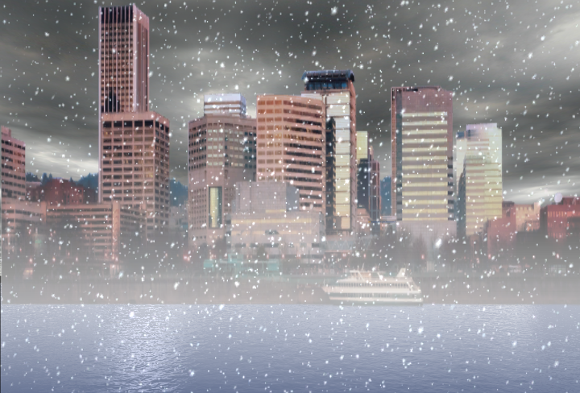
OFFICIAL
SNOW TOTAL
1.1”
at PQR (NWS Office)
1.0” Downtown (KGW on JANUARY 3RD)

Slide 5
Snowfalls at PQR (official site)
.1” December 27th
1.0” January 3rd

Slide 6
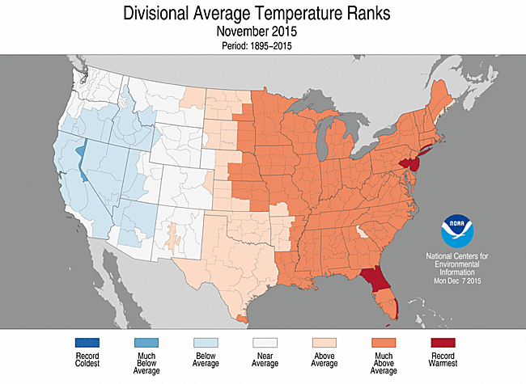
THE USA VIEW

Slide 7
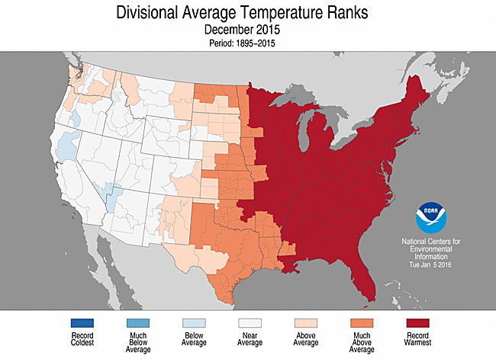
THE USA VIEW

Slide 8
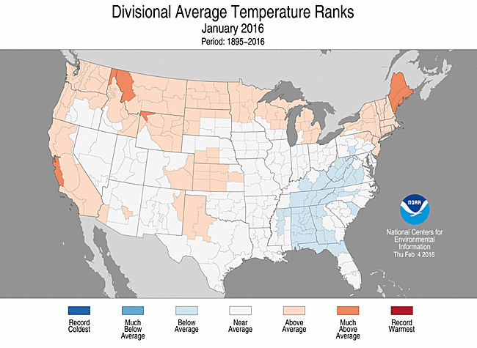
THE USA VIEW

Slide 9
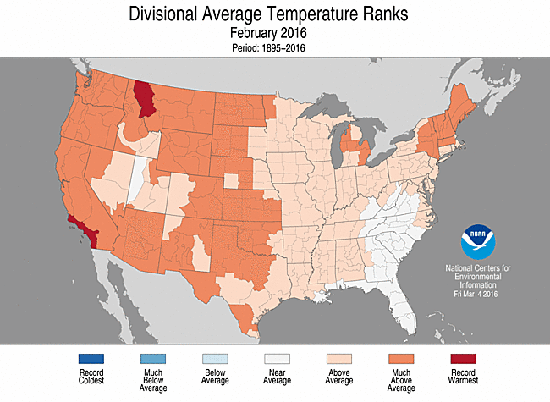
THE USA VIEW

Slide 10
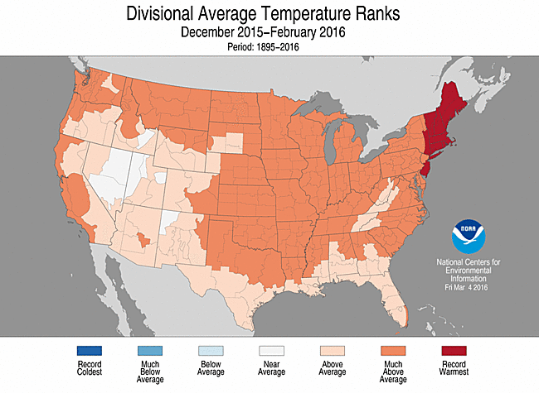
THE 3 MONTH PERIOD

Slide 11
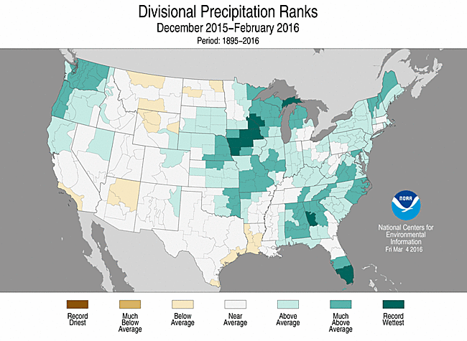
3 MONTH PRECIPITATION

Slide 12
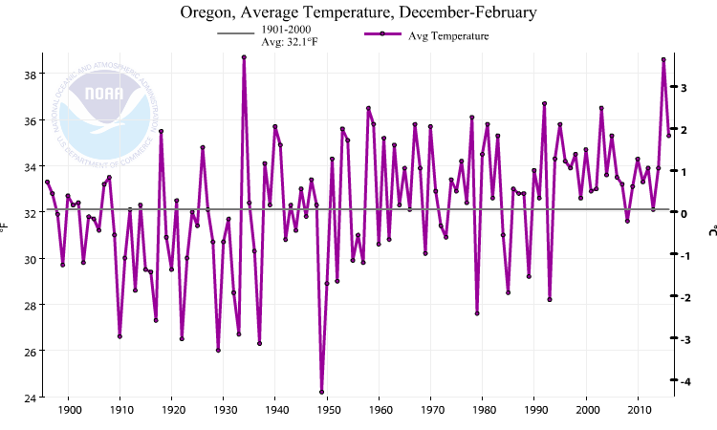
Oregon Winter Temps (the past 100 years)
2nd Warmest in the last 13

Slide 13
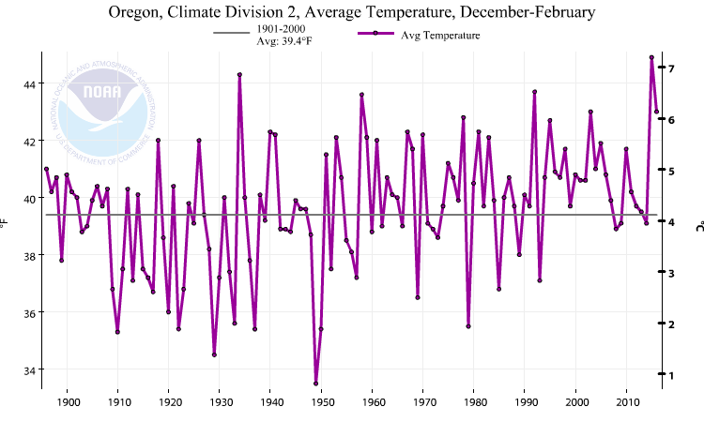
Western Valleys Winter Temps (the past 100 years)
Last cold winter was 1992-1993
This Winter in Oregon Zone 2 (Willamette Valley)

Slide 14
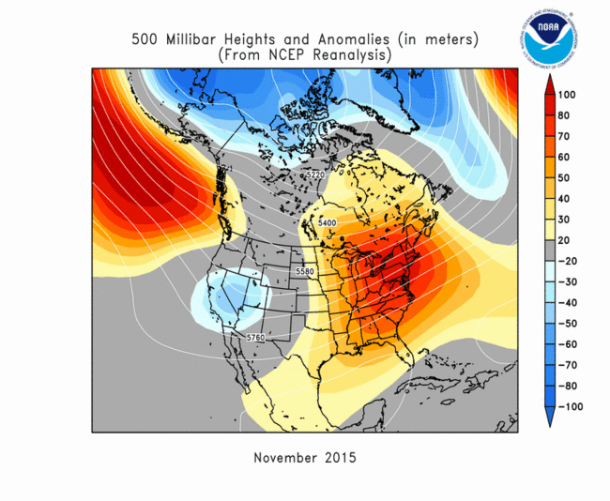
UPPER LEVEL PATTERNS

Slide 15
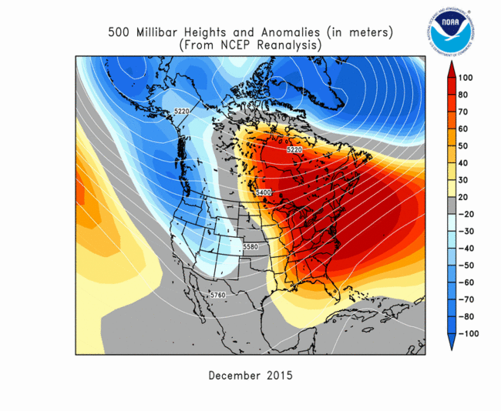
UPPER LEVEL PATTERNS

Slide 16
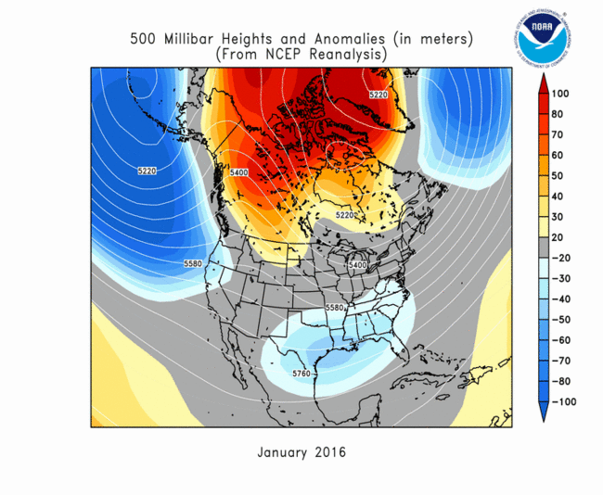
UPPER LEVEL PATTERNS

Slide 17
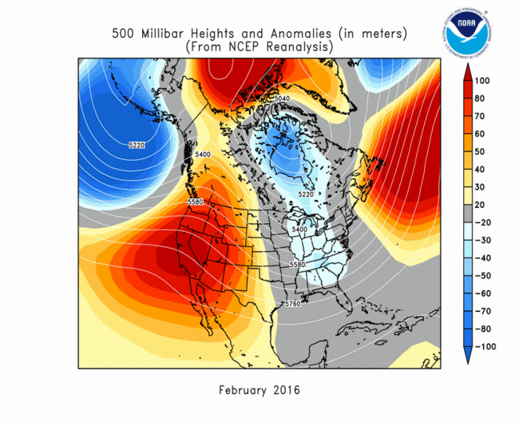
UPPER LEVEL PATTERNS

Slide 18
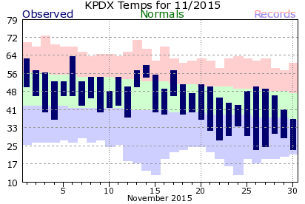
NOVEMBER
Uneventful month, near normal temperatures
    Except cool the last week
24 degree low (twice) was coldest of “winter”

Slide 19
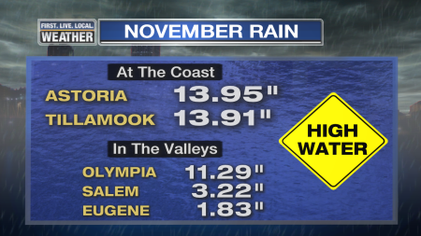
NOVEMBER
Deluge first half of month north and west of Portland
Much drier to the south and east
(RAIN TOTAL 1st-18th)

Slide 20
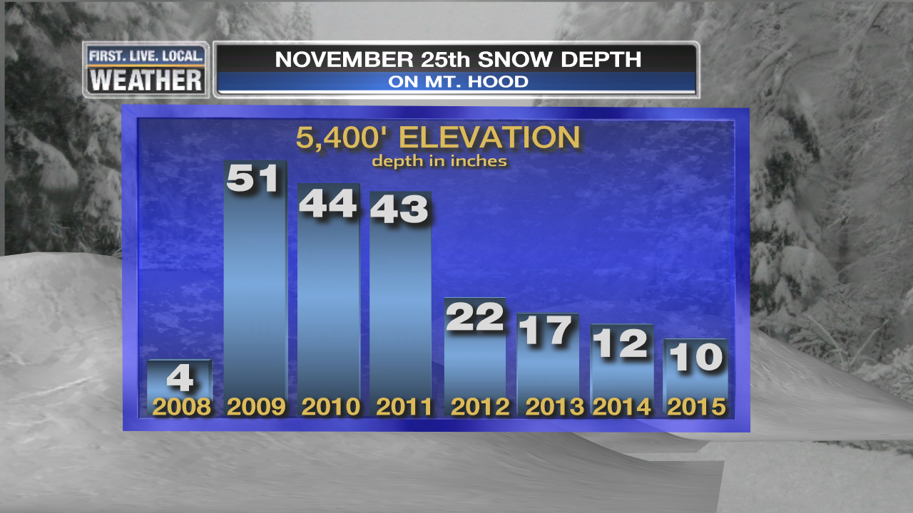
NOVEMBER
Ski season slow to start
Very limited openings through first weekend of December

Slide 21
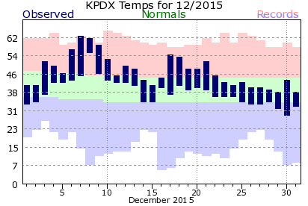
DECEMBER
Mild, except for chilly Christmas to New Year

Slide 22
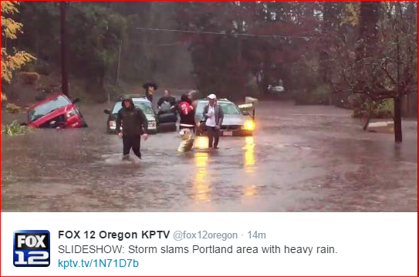
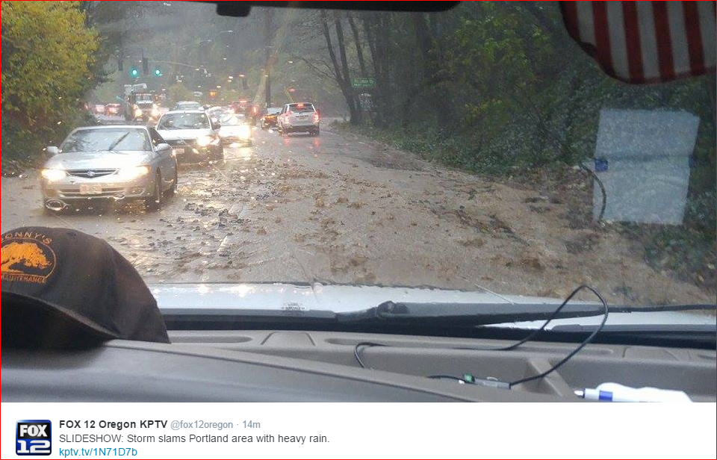
DECEMBER: All Hell Breaks Loose!
Flooding, Windstorm, Mudslides, & Tornado

Slide 23
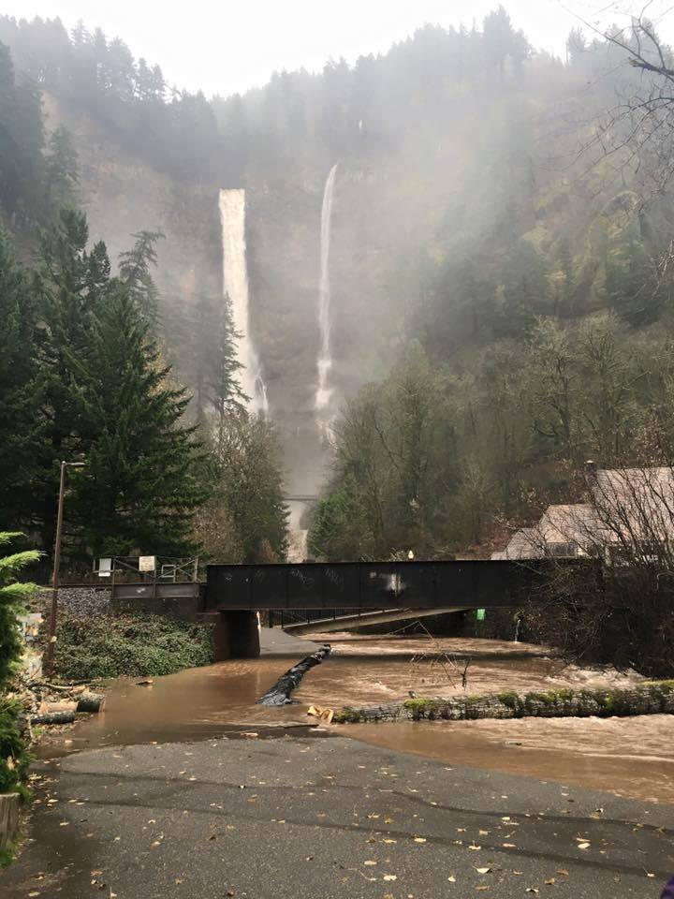
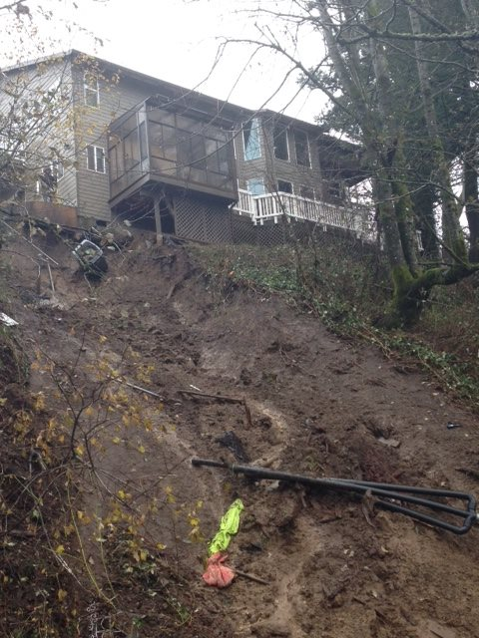
DECEMBER: All Hell Breaks Loose!
Flooding, Windstorm, Mudslides, & Tornado

Slide 24
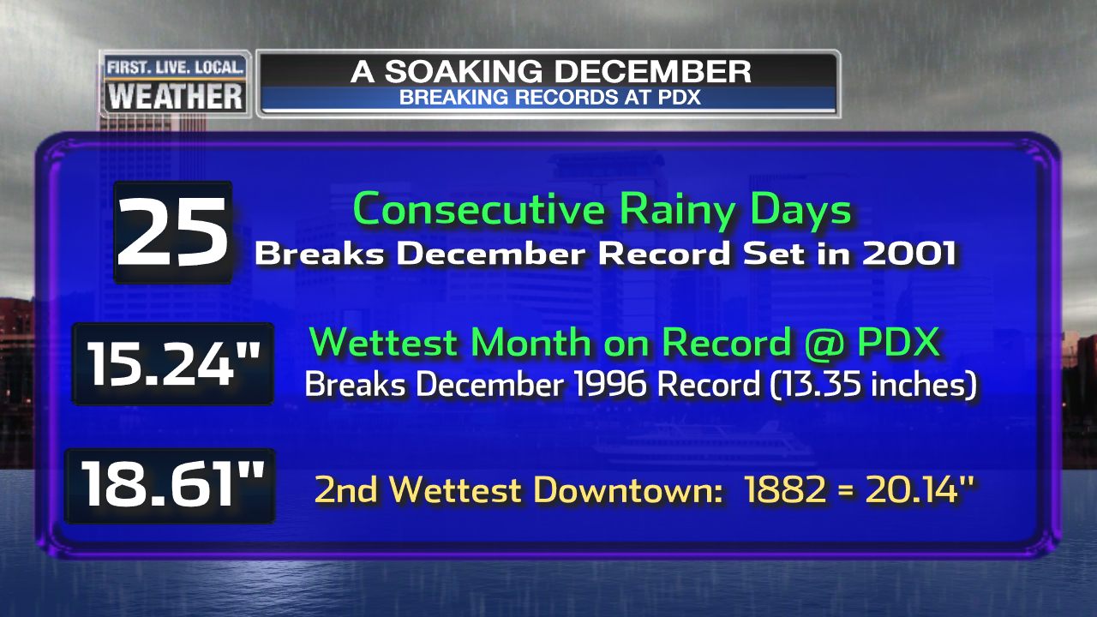
DECEMBER RAIN
Continuous barrage of wet Pacific fronts
Many daily and consecutive day rain records set
Lots of mudslides, landslides, & closed highways

Slide 25
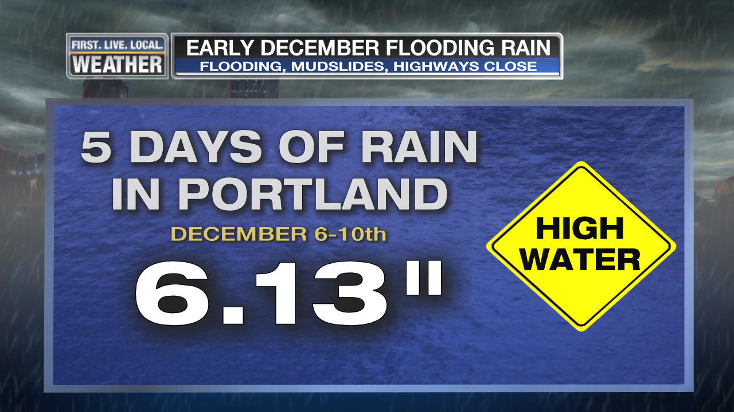
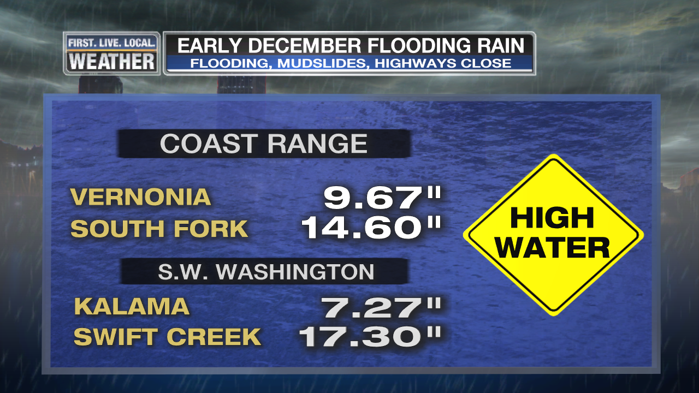
DECEMBER RAIN
Continuous barrage of wet Pacific fronts
Many daily and consecutive day rain records set
Lots of mudslides, landslides, & closed highways

Slide 26
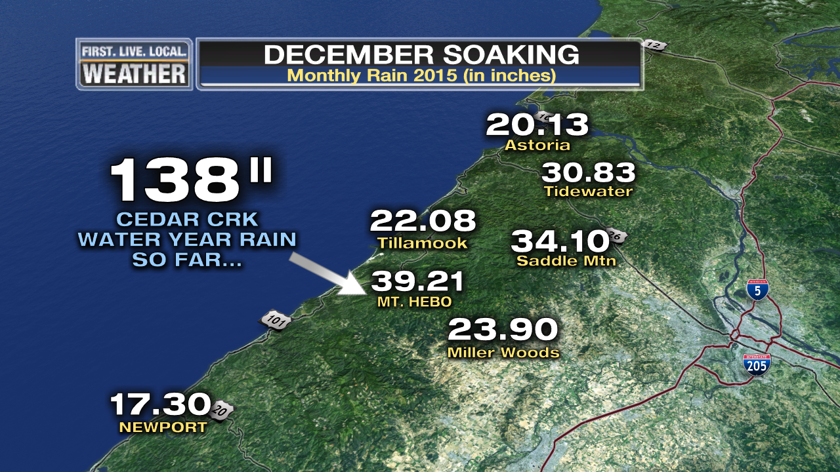
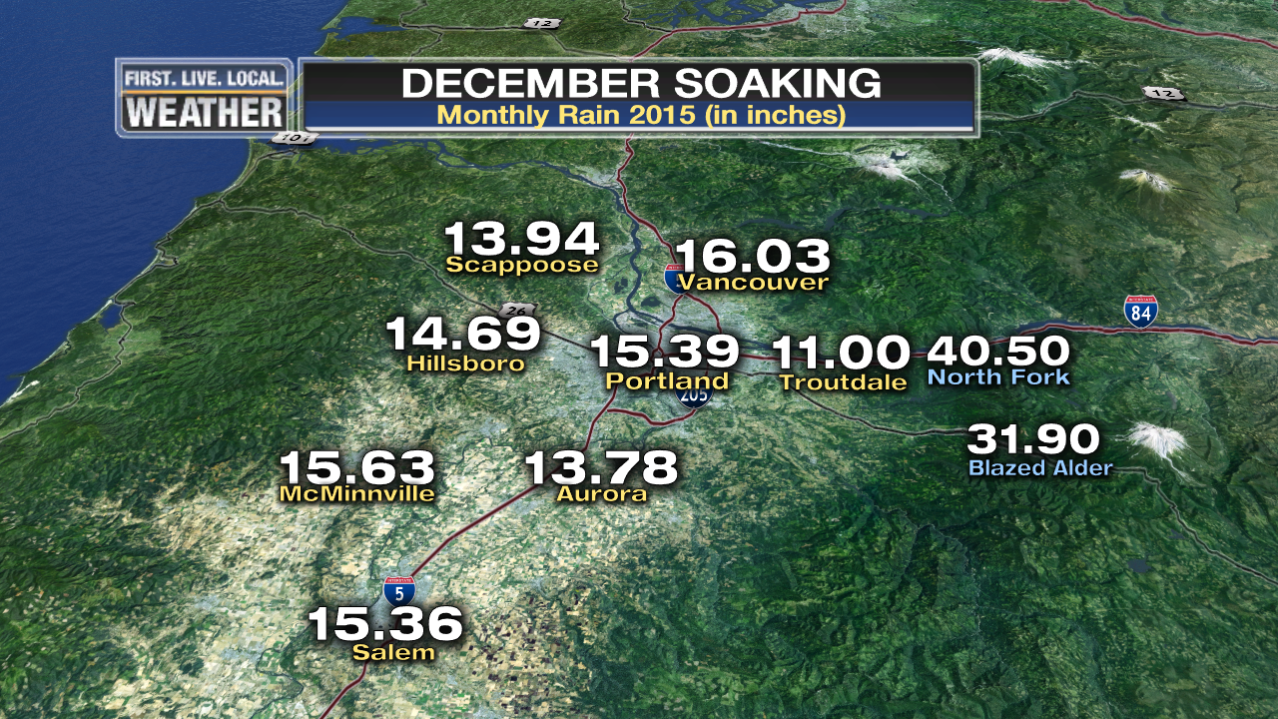
DECEMBER RAIN
Huge Soaking Across the Region

Slide 27
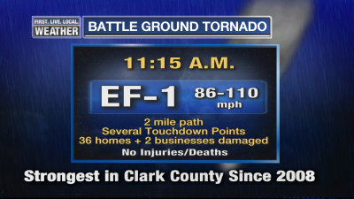
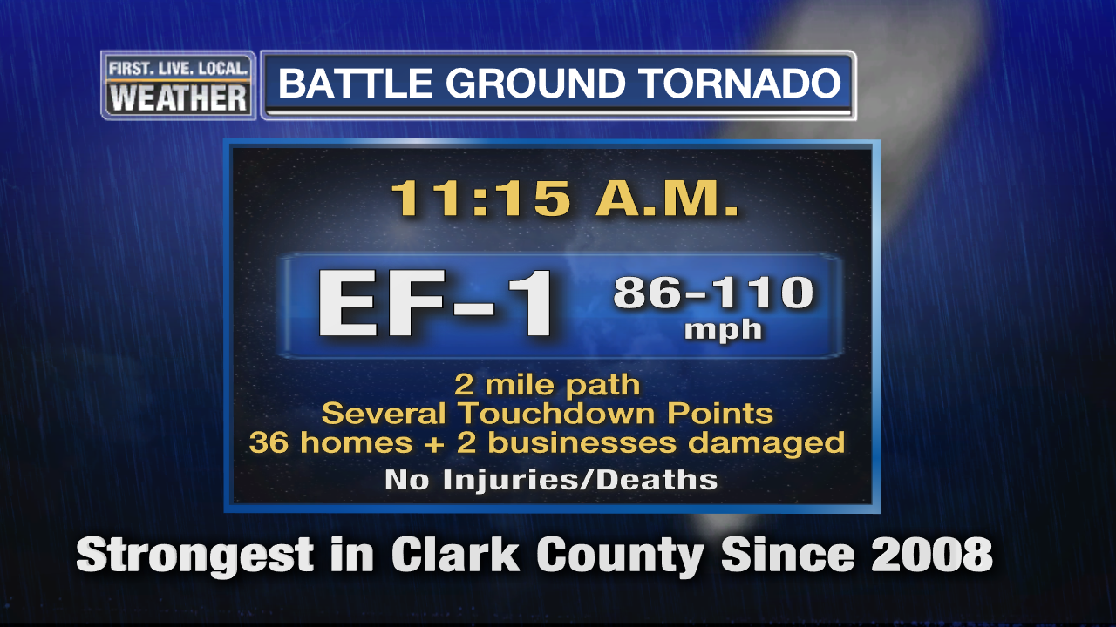
BATTLE GROUND TORNADO
December 10th, 11:15am
Another midday tornado…inconvenient for TV people

Slide 28
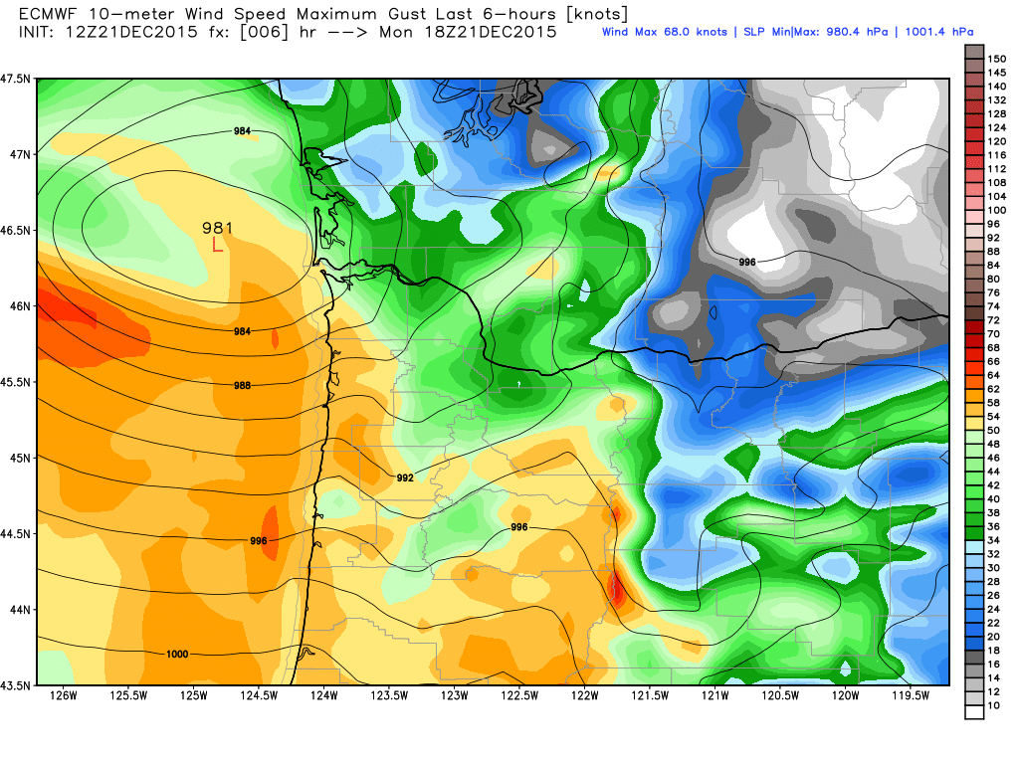
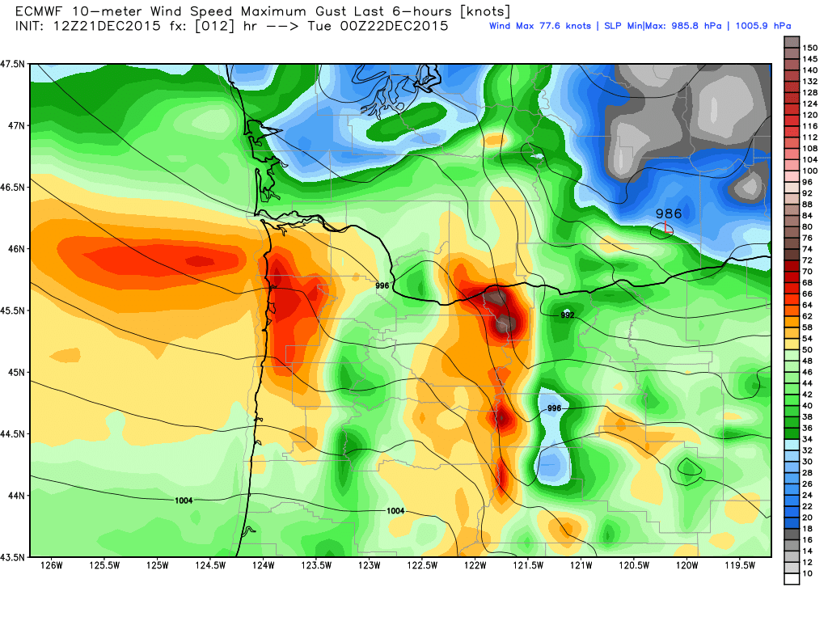
December 21st Wind Storm
Deep low pressure tracks west to east across southern Washington
Relatively minor storm: 35,000 PGE outages at peak

Slide 29
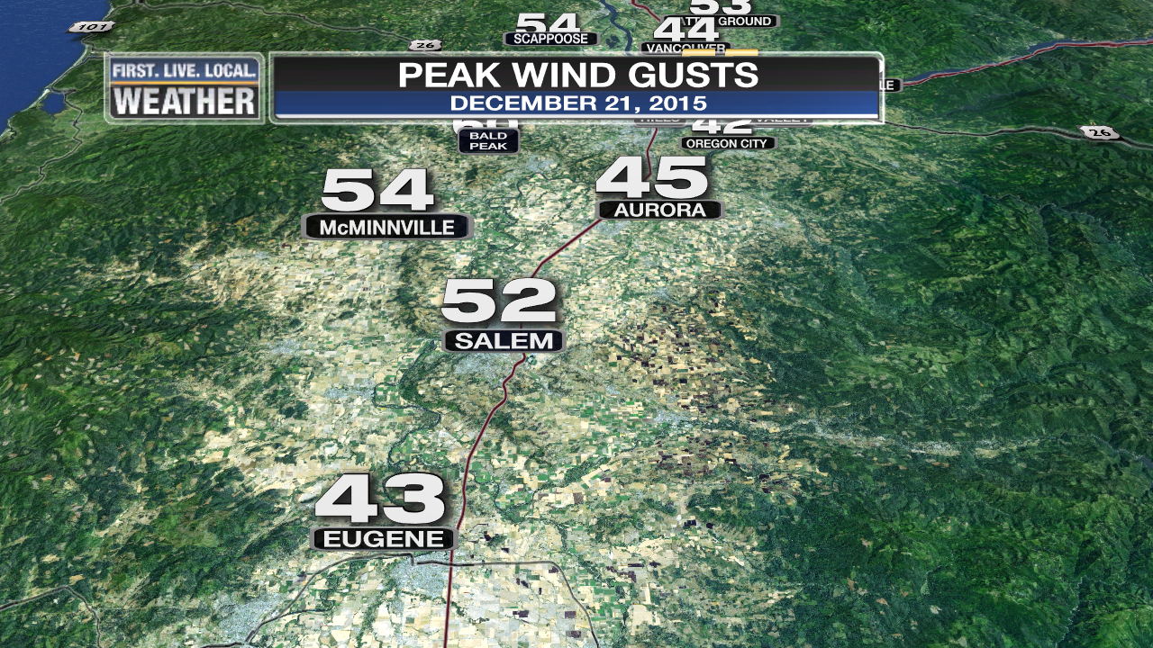
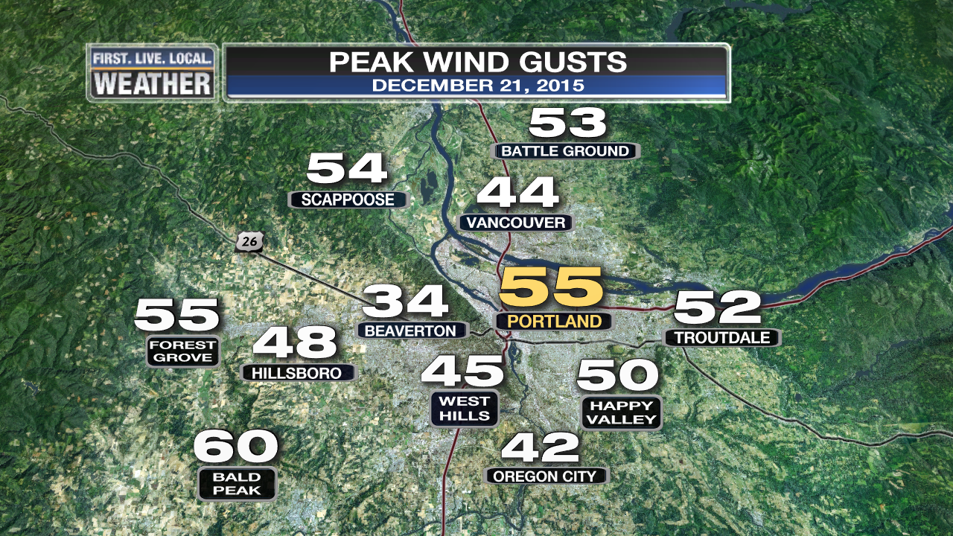
December 21st Wind Storm
Deep low pressure tracks west to east across southern Washington
Relatively minor storm: 35,000 PGE outages at peak

Slide 30
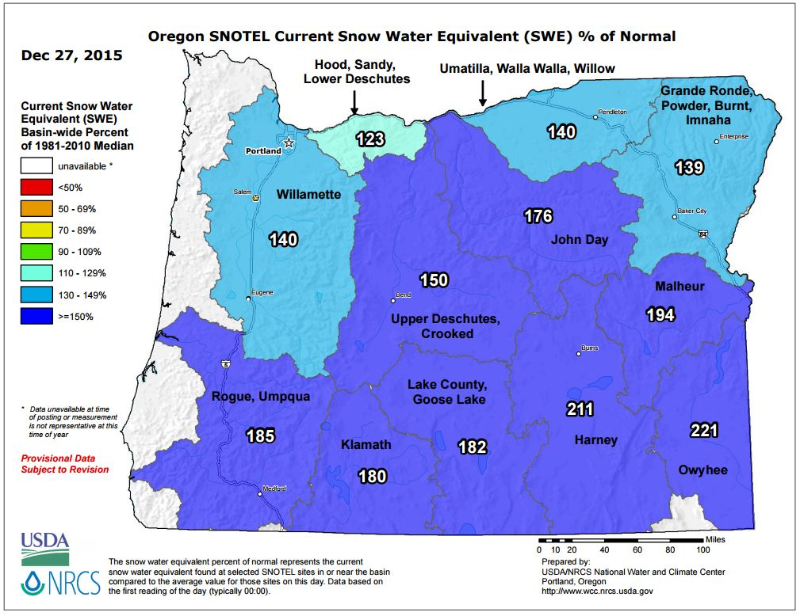
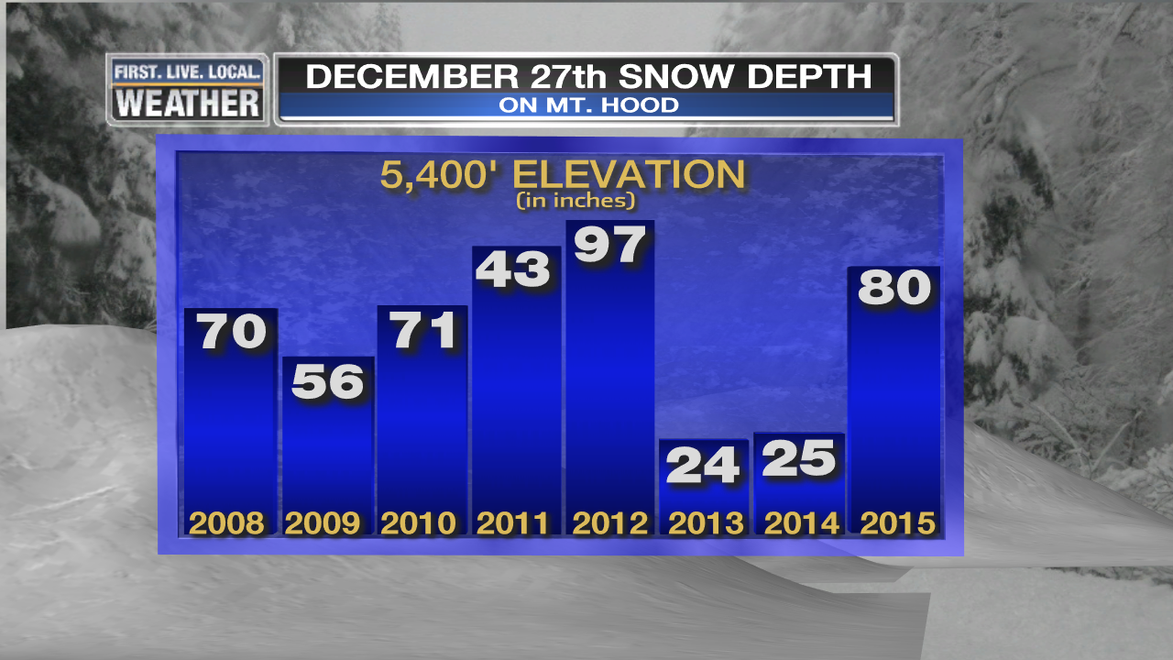
SKI SEASON
Widespread Openings After 2nd Weekend of December
Excellent Conditions Rest of December: Dec 22nd
2nd Year With An Excellent Christmas Break!

Slide 31
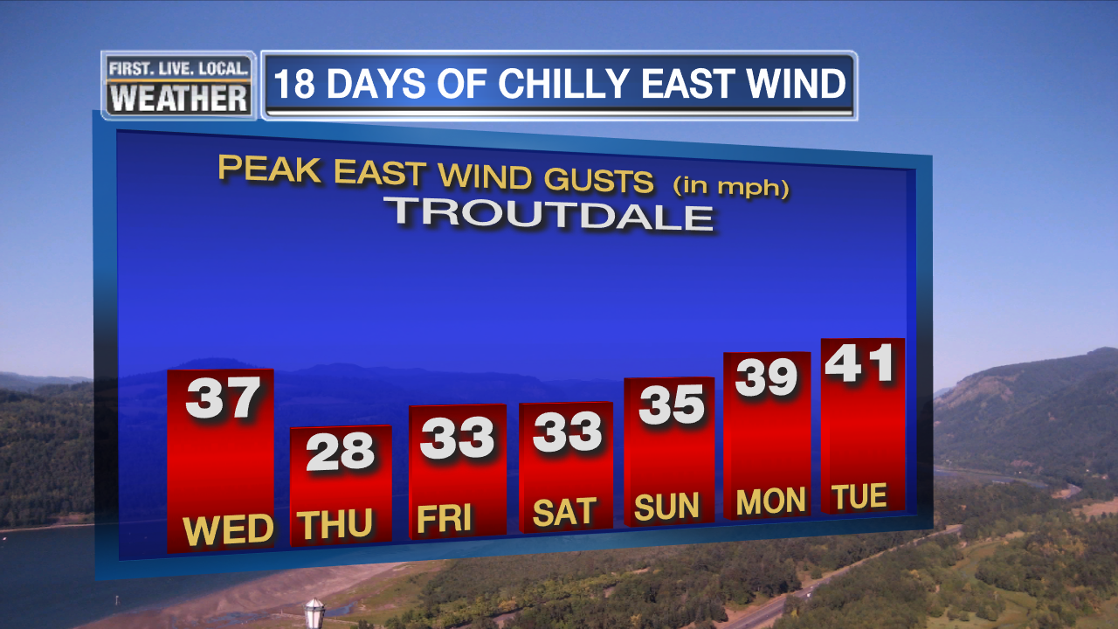
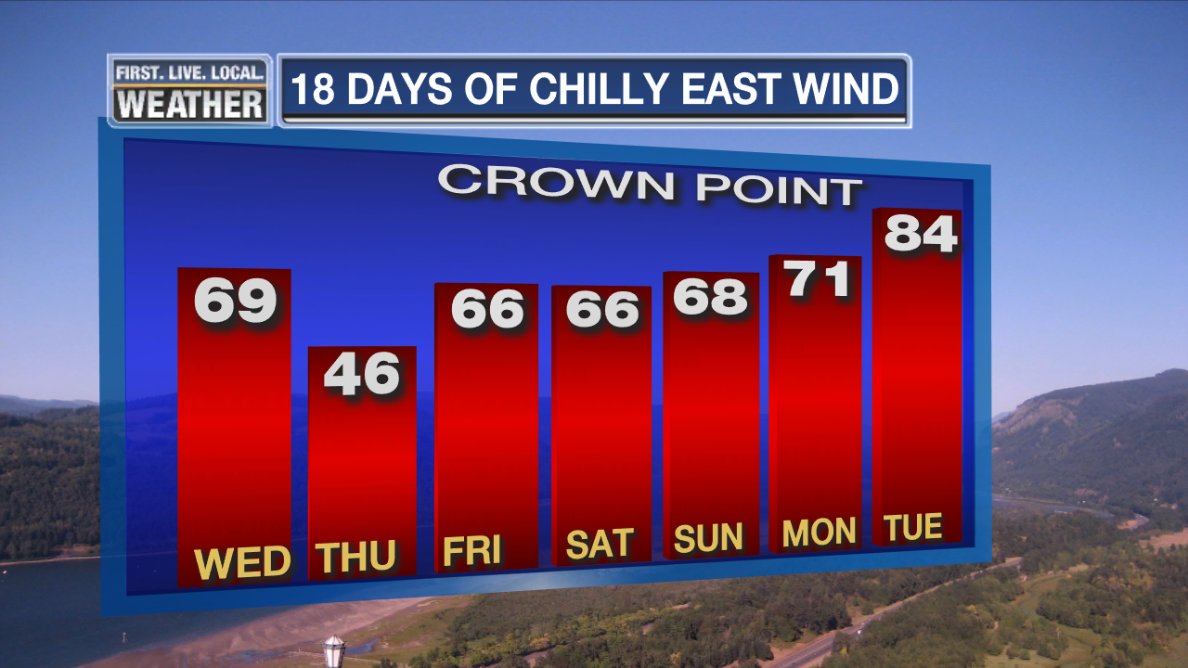
JANUARY & FEBRUARY
Move along, nothing to see…
EXCEPT, a nice little snow/ice storm early January
& gusty east wind for 18 days Christmas to January 12th

Slide 32
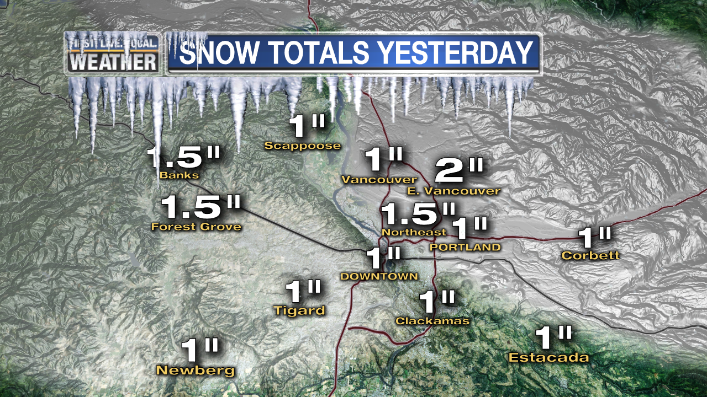

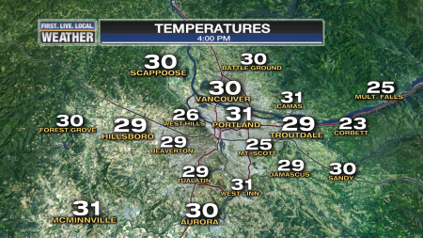
JANUARY 3RD SNOW/ICE
First time in 2 years we get a frozen/snowy day in Portland…from “FAKE” COLD too!
Airmass spilling through Gorge gradually cooled over 4 day period. Cold air formed over Pac. Northwest

Slide 33
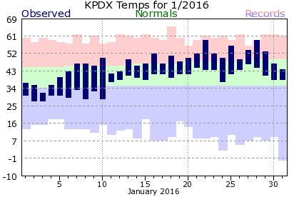
JANUARY
Rest of month was uneventful
A very warm month after the 10th, no freezing last 20+ days

Slide 34
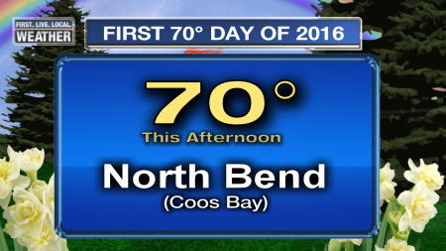
JANUARY
First 70 of the Year In Oregon
January 21st, temps around 70 on the coast

Slide 35
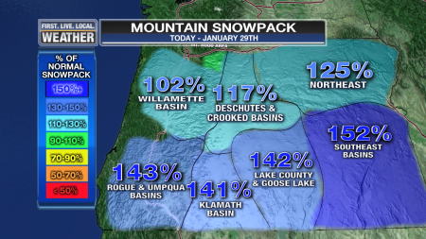
JANUARY
Mild temps take toll on snowpack
Percent of normal drops significantly during month

Slide 36
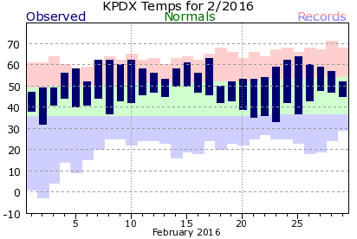
FEBRUARY
Very warm, but near normal precipitation
Last Frost was on February 2nd
* EARLIEST ON RECORD AT PDX *

Slide 37
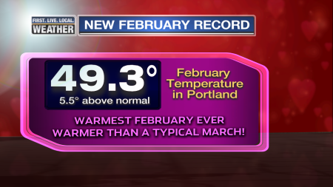
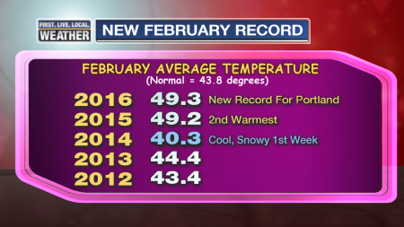
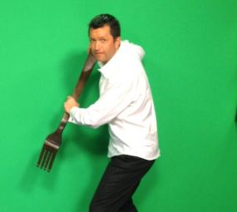
FEBRUARY
Very warm, but near normal precipitation
2nd Consecutive Record February in Portland
Forked
on 15th

Slide 38
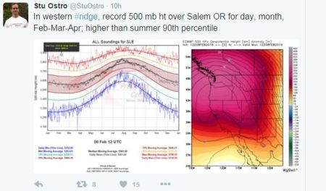
FEBRUARY
Very warm, but near normal precipitation
Historic “Hot” Upper Level Ridge Around the 8th

Slide 39
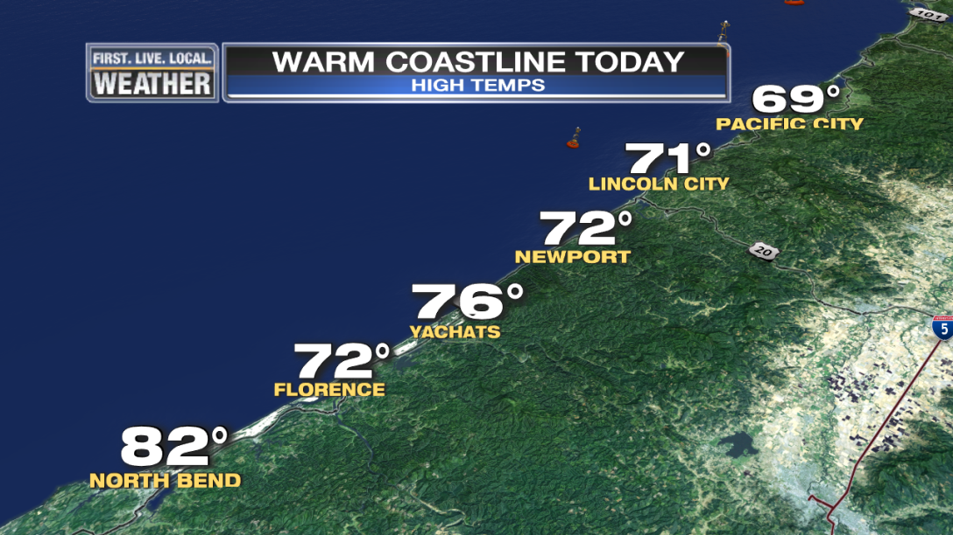
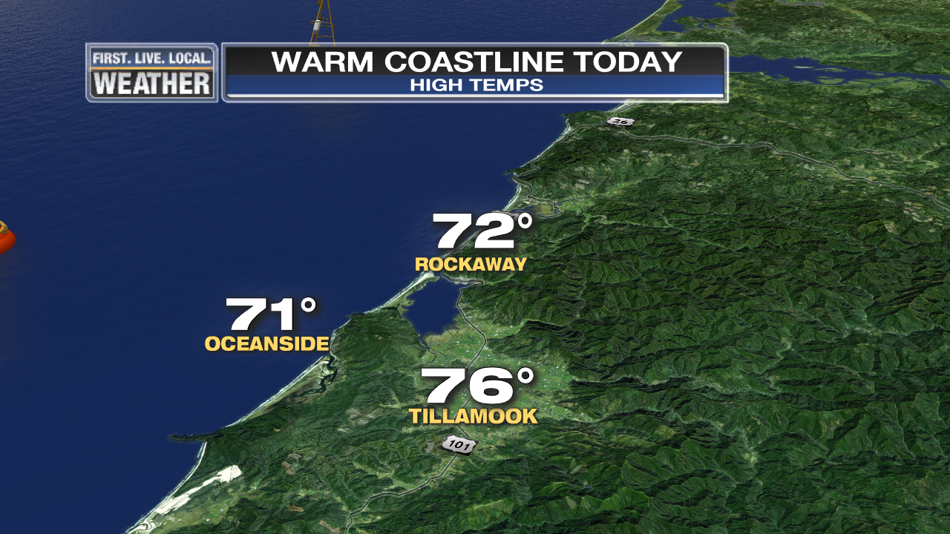
FEBRUARY
Very warm, but near normal precipitation
Record Coastal Heat February 8th

Slide 40
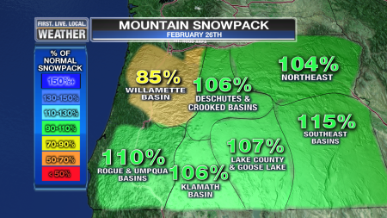
FEBRUARY
Very warm, but near normal precipitation
Snowpack below average in NW Oregon by end of month

Slide 41
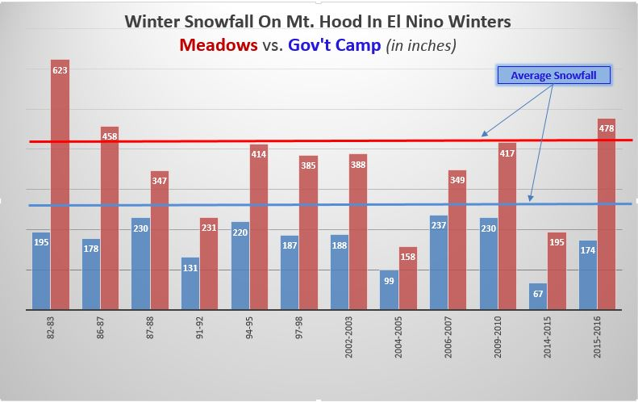


EL NINO
Lives up to its reputation in Cascades
Average to above average snowfall up high, below normal lower areas
Fewer “cold” storms

Slide 42


A Few Minor Windstorms
20 years without a regional MAJOR storm (Emphasis for Wolf Read)

Slide 43


Slide 44



Slide 45


Slide 46

1940-1995 = PDX 1996-Present = PQR

Slide 47

Downtown Data Only

Slide 48


Slide 49

Blue = Widespread Arctic Air Outbreak

Slide 50

Mountain Snowpack @ 5,400’
Fell behind in November, almost normal during Christmas Break, then never caught up.
WARM SPRING = MELT ALMOST 1 MONTH AHEAD OF SCHEDULE!
Courtesy
NRCS
Oregon Office
Precip: Thin Line = Average
Snow Water: Thin = Average
Mt. Hood Test Site

Slide 51

Another Warm Summer
But “Cool” July
Warm June & August. Normal July

Slide 52

Stormy October

Slide 53

Stormy October

Slide 54

Stormy October

Slide 55

LET’S FORECAST!
LIGHTNING ROUND
OF WINTER FORECASTS
Organizations or individuals who can’t or don’t want to be here.
OR
They don’t know (or care) that we exist.

Slide 56
TIME FOR SOMETHING NEW…
A LIGHTNING ROUND
OF WINTER FORECASTS
Old Farmer’s Almanac
Farmer’s Almanac
AccuWeather
Pete Parsons (OR Dept of Forestry)
Rod Hill (KGW)
WeatherBELL

Slide 57

Old Farmer’s Alamanac
For the record, it said “Cold & Snowy” last winter too

Slide 58

Farmers’ Alamanac
Freezing, Numbing, & Penetrating Cold???

Slide 59

AccuWeather
…November and December will see the most action, before high pressure builds in and stormy weather eases back in late January and February…

Slide 60

Oregon Dept of Ag/Forestry
(Pete Parsons)
Top Analog
Years
1983-1984
1992-1993
1998-1999
“Analog years also showed a consistent pattern of Arctic air penetrating into Oregon, for at least a few days, in December… Below-average temperatures likely (winter average)
Above-average precipitation and mountain snowfall. Elevated chances for western valley snow”

Slide 61

Rod Hill’s Winter Outlook
Meteorologist – KGW & www.portlandweather.com
QUOTES FROM THE LEGEND HIMSELF
Odds favor (pdx) rain totals near 37.90" / 1.87" above normal
At least 1 or 2 mini-snow events dumping 3-6“
Odds are heightened for valley windstorms
Temperature: Near normal to no more than
2 deg. above normal
CASCADE SNOW: Best bet calls for a solid year with Timberline seeing more than 500" of total snowfall and Meadows more than 400 inches - both would be considered near normal.

Slide 62


WeatherBELL
“with El Niño gone and the La Niña feeble at best, it gives what drove the cold winters of 2013-14 and 2014-15 a chance to overpower the pattern again”

Slide 63

Mark’s New Toy
GUARANTEES NO SNOW THIS WINTER
…But A Great Deal off Craigslist!

