Slide 1

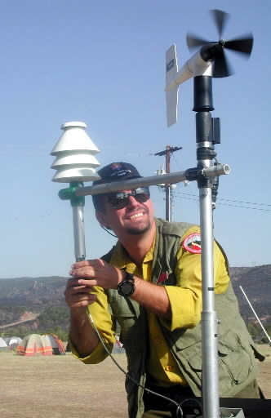


Fire Season 2016
Summary
Oregon AMS
Oct 22nd 2016
John Saltenberger

Slide 2
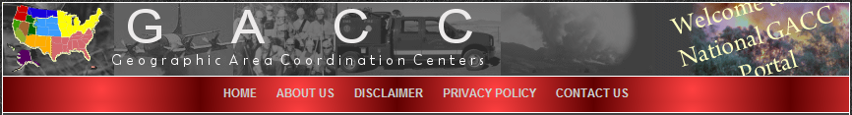
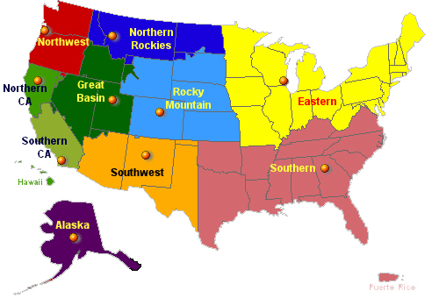


Slide 3
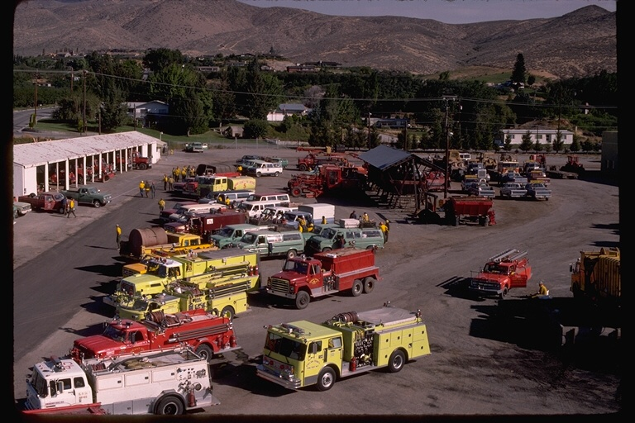
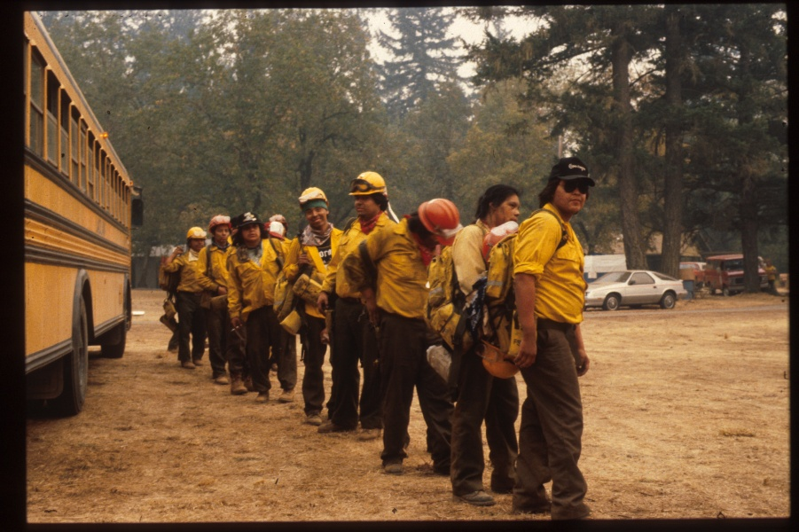
Northwest Interagency Coordination Center
  Incident Workload
  Status Reporting
  Mobilization
  Logistic Support
  Planning
    Prioritizing
    Pre-positioning
    3-5 day planning
    window is crucial!

Slide 4
Number of Wildfires by Year
Since 2000
17 Year Average:
4,039 fires

Slide 5
Number of Wildfires by Year
Since 2000
2016:
2,416 fires
60% of normal
17 Year Average:
4,039 fires

Slide 6
Total Acres burned by Year
Since 2000
17 Year Average:
641,095 acres

Slide 7
Total Acres burned by Year
Since 2000
17 Year Average:
641,095 acres
2016 total:
499,168 acres

Slide 8
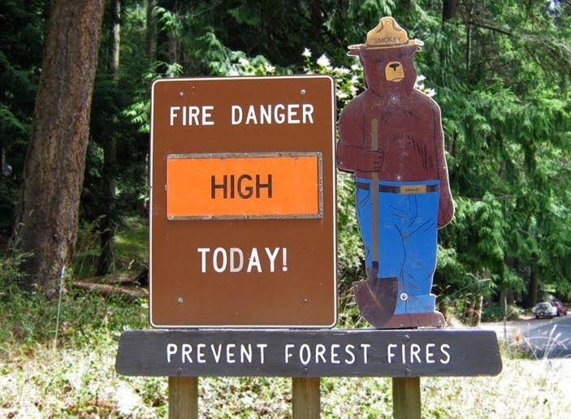
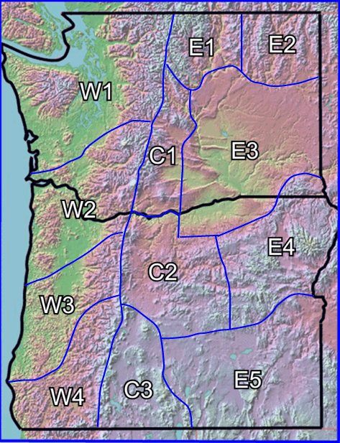
Tracking Daily
Fire Danger

Slide 9
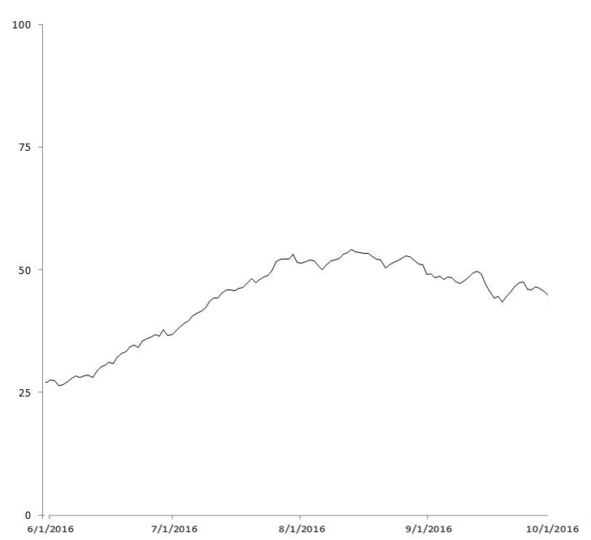
Typical summer rise in Regional Fire Danger
Historical Average Peak
Aug 10
Begin tracking
June 1
End tracking
October 1

Slide 10
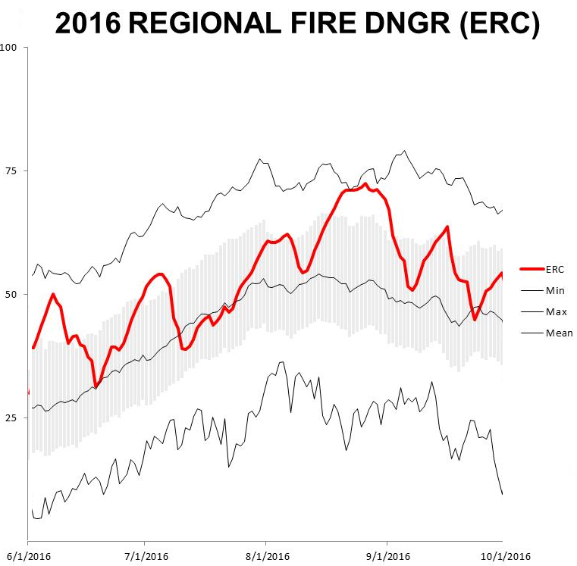

Slide 11
Aug 21-26
Sep 10-16
Jul 28- Aug 7
July 5
Sep 30
June 7
Relative Maxes and Minimums are Important!

Slide 12
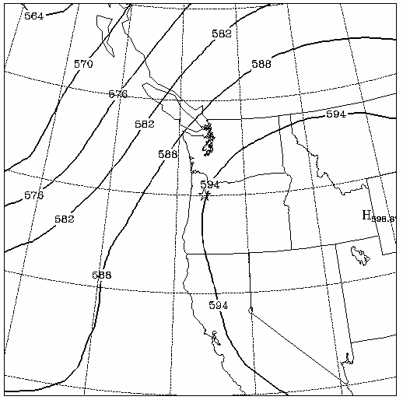
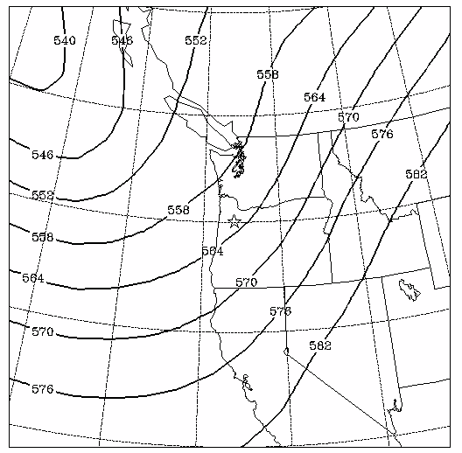
How do the local peaks and troughs come about?
Airmass Changes related to Upper Ridge and Trough transitions
Ridge Type Pattern
Trough Type Pattern

Slide 13
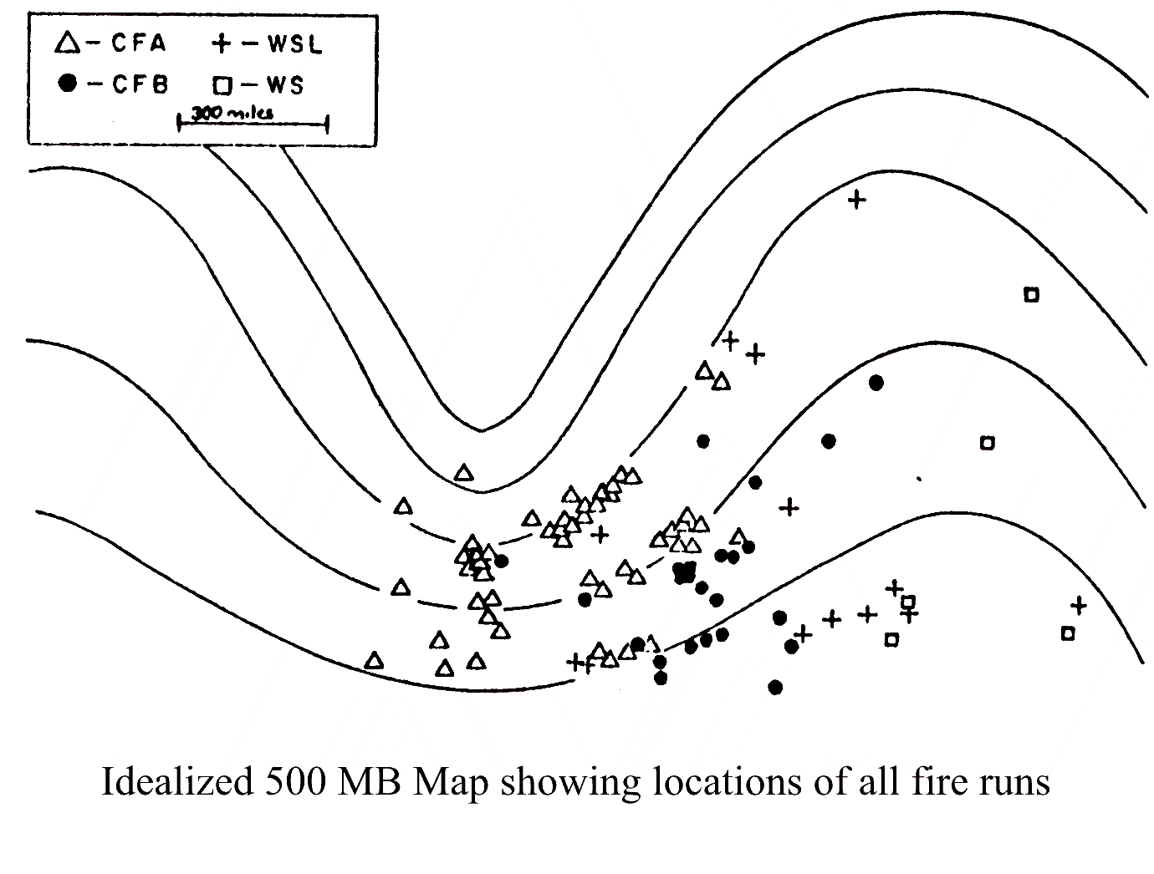
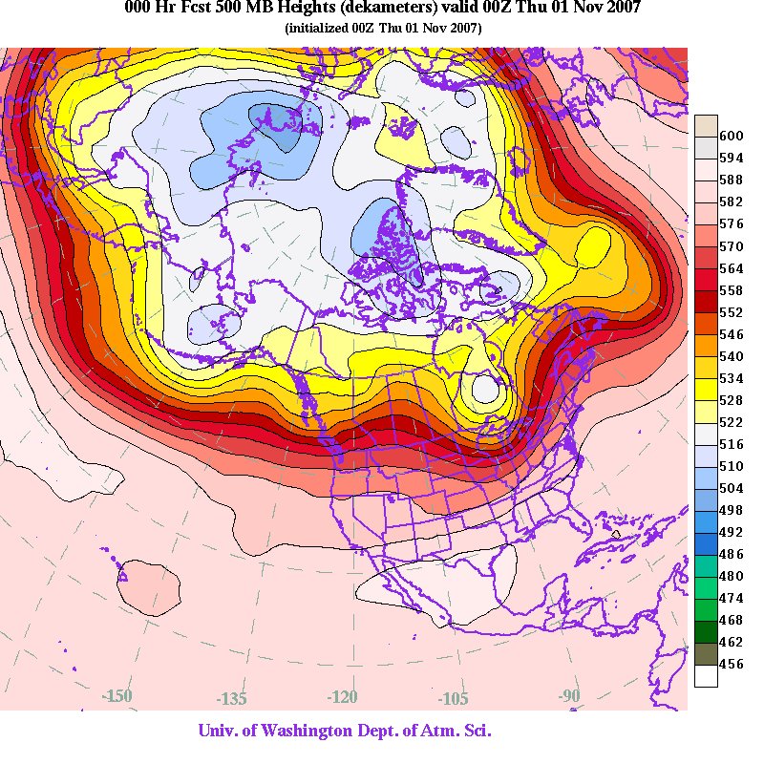
Upper Air and Fire Weather
Wildfires & the jet stream: observable and repeatable patterns

Slide 14
Evolution of Fire Season 2016

Slide 15
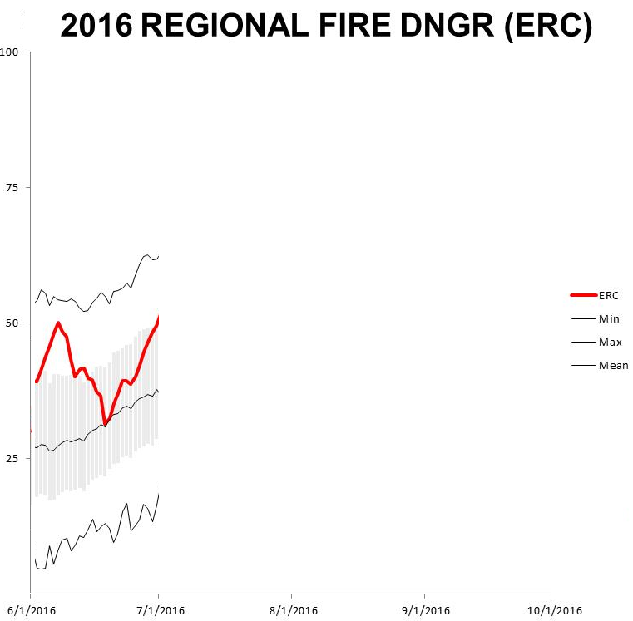
Draw Fire
Akawana Fire
Owyhee Canyon
June 7
$ 4,800,000+

Slide 16
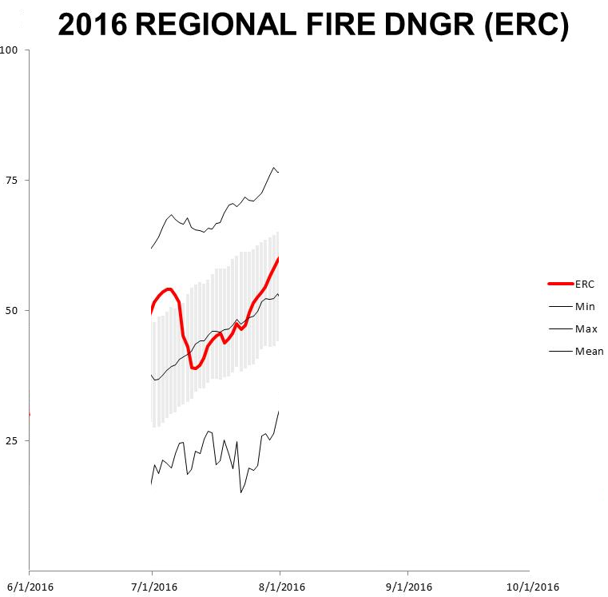
Rocky Ford Fire
July 5
$ 400,000+

Slide 17
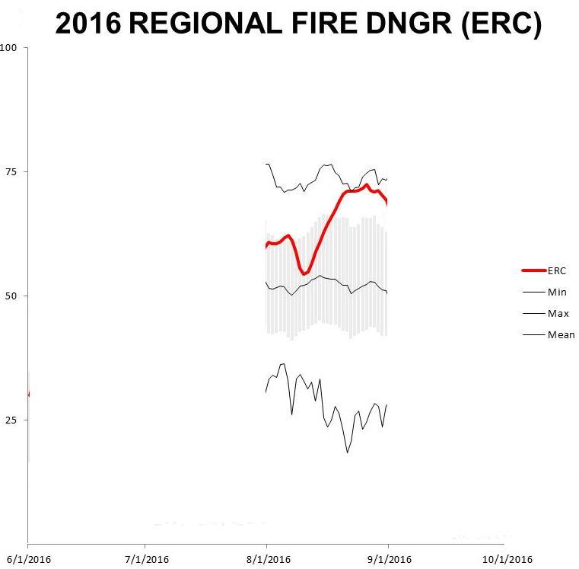
July 28- Aug 7
$ 45,000,000+
Range 12
Rail Fire
Snake Fire
Kewa Fire
Trail Creek
Bybee Crk

Slide 18
Aug 21-26
$ 19,400,000+
Cayuse Mt
Spokane
Cherry Rd
Deep North
Hart
2500 Road

Slide 19
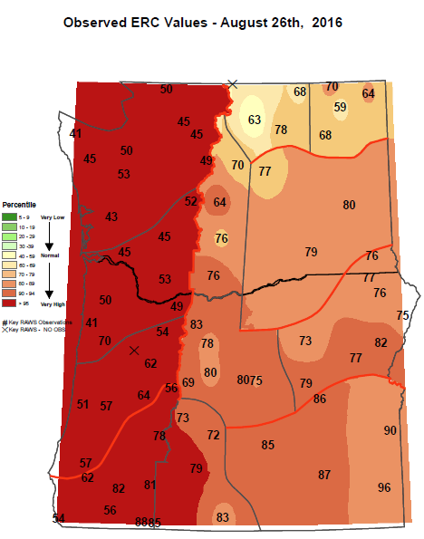
Normalized Fire Danger Values (ERC)
Aug 26th 2016

Slide 20
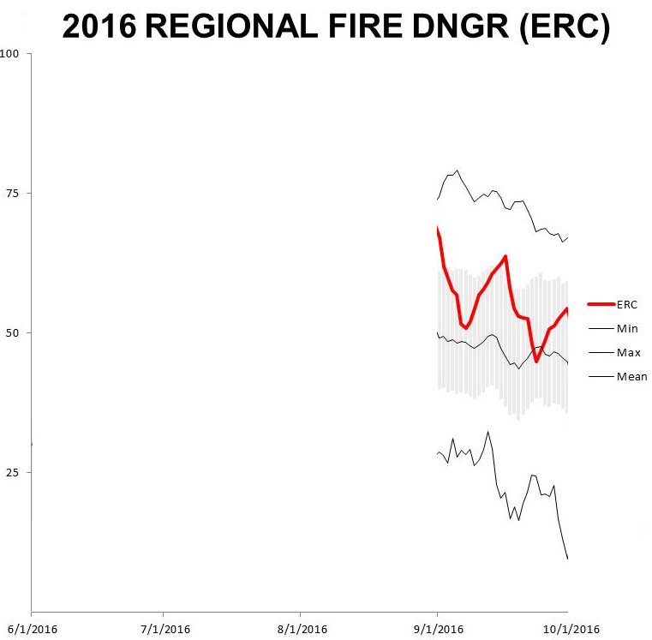
Sep 10-16
Rock Creek
High Pass
Elmer City
$ 13,400,000+

Slide 21
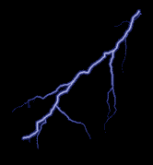
Lightning and Wildfire facts
46% of OR & WA wildfires result from lightning.
Initial attack has an excellent record of keeping human-caused fires small …even on dry, windy, unstable days.
However, of the fires that grow large, up to 75% are caused by lightning.

Slide 22
Fire Season Lightning Strike Count
Jun, Jul, Aug, Sep

Slide 23
Fire Season Lightning Strike Count
Jun, Jul, Aug, Sep
17 Year Average:
79,642 strikes

Slide 24
Fire Season Lightning Strike Count
Jun, Jul, Aug, Sep
249,705 strikes
17 Year Average:
79,642 strikes

Slide 25
Fire Season Lightning Strike Count
Jun, Jul, Aug, Sep
249,705 strikes
17 Year Average:
79,642 strikes
25,598 strikes

Slide 26
Fire Season Lightning Strike Count
Jun, Jul, Aug, Sep
17 Year Average:
79,642 strikes
22,197 strikes
28% of average

Slide 27
Fire Season Lightning Strike Count
Jun, Jul, Aug, Sep
63 days with lightning
Normal: 48
17 Year Average:
79,642 strikes

Slide 28
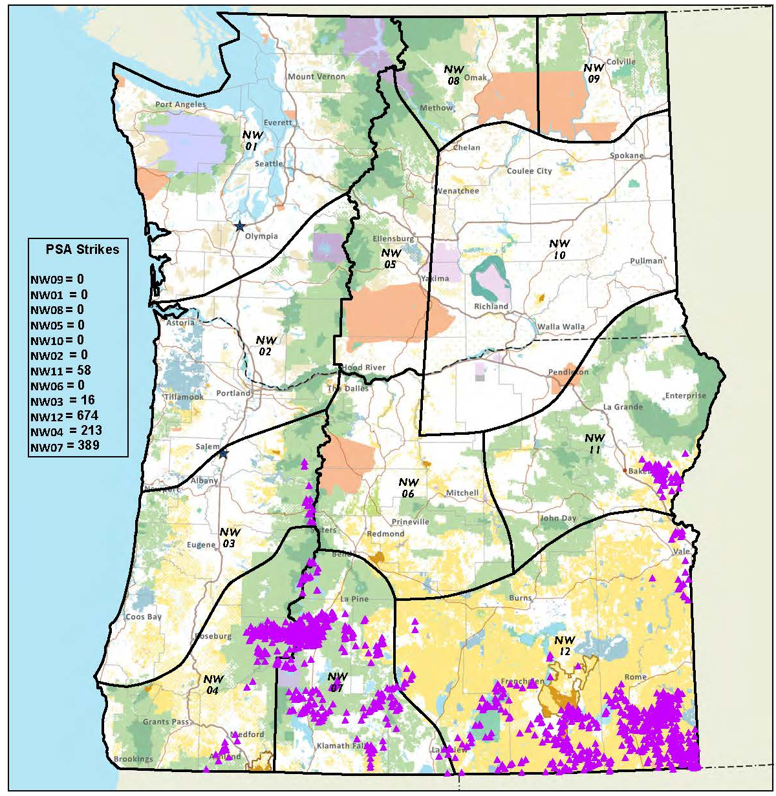
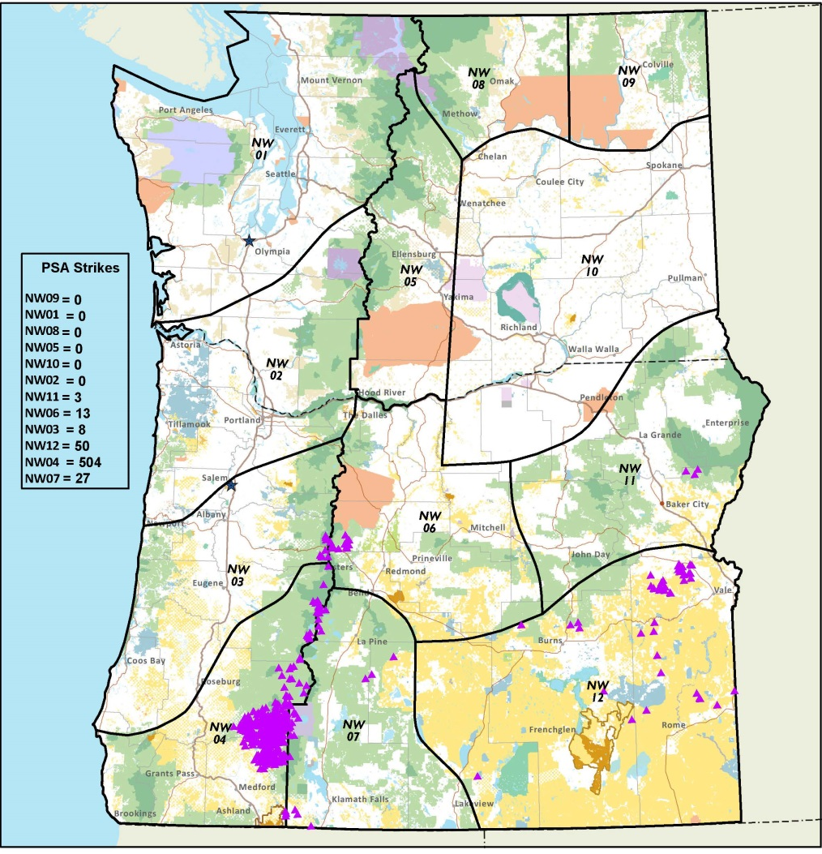
Biggest 24 hour event of 2016
June 5th-6th 2200+ strikes

Slide 31
Lightning Gap
Aug 10-Sep7

Slide 32
2016 Summary Stats
2416 reported Fires in Oregon/Washington
67 Fires met “Large” size criteria
17 mobilizations of Type I or II IMTs
22197 lightning strikes up to Oct 1
Largest WA fire: Range 12 176,600 acres
Largest OR fire: Rail 41,706
$104 million spent
4200 wildland firefighters at peak activity

Slide 33
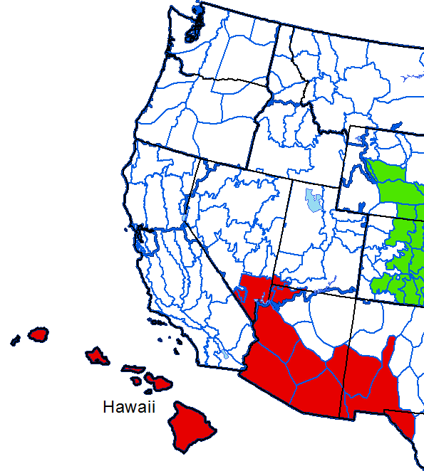
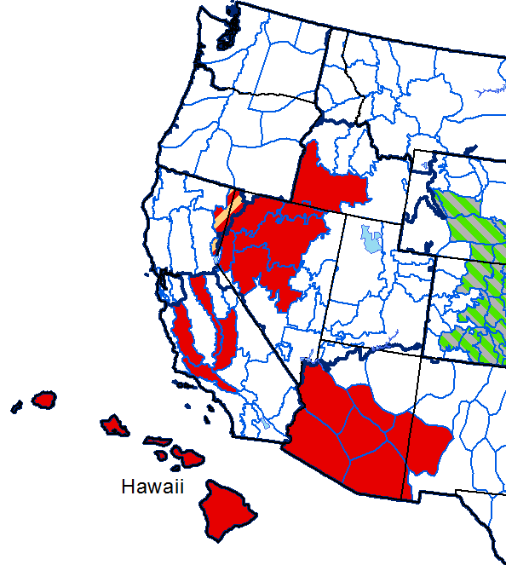
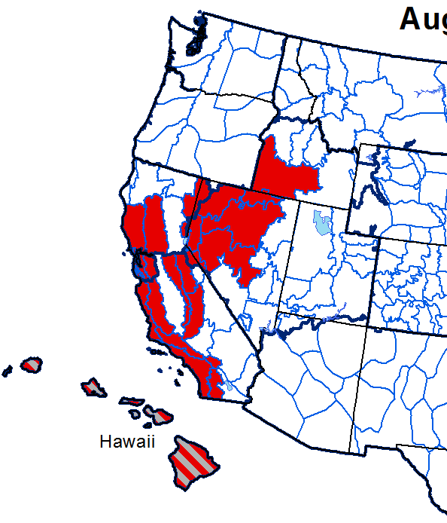
Fire Potential Outlook for 2016
Issued June 1 2016
June July Aug-Sep

Slide 34
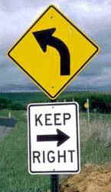
Thank You!

