Slide 1
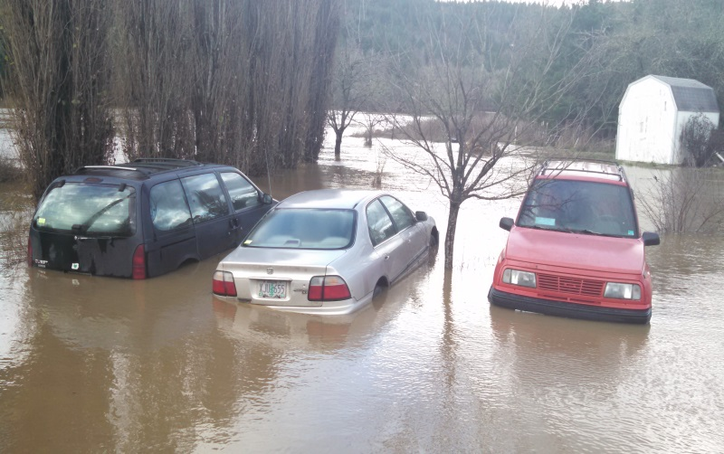
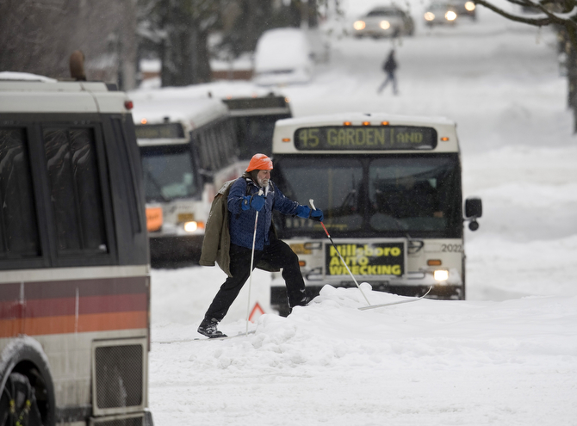
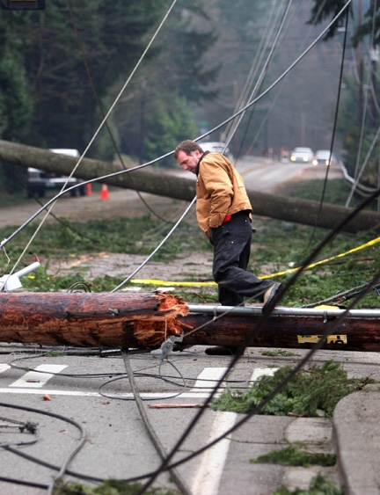

Winter Outlook (2016-2017)
2016 OMSI Meeting
Oct 22nd 2016
Colby Neuman
National Weather Service
Portland, OR

Slide 2
Questions We’ll Try To Answer
El Niño or La Niña This Winter?
Below, near or above average temperatures this winter?
Below, near or above average precipitation this winter?

Slide 3
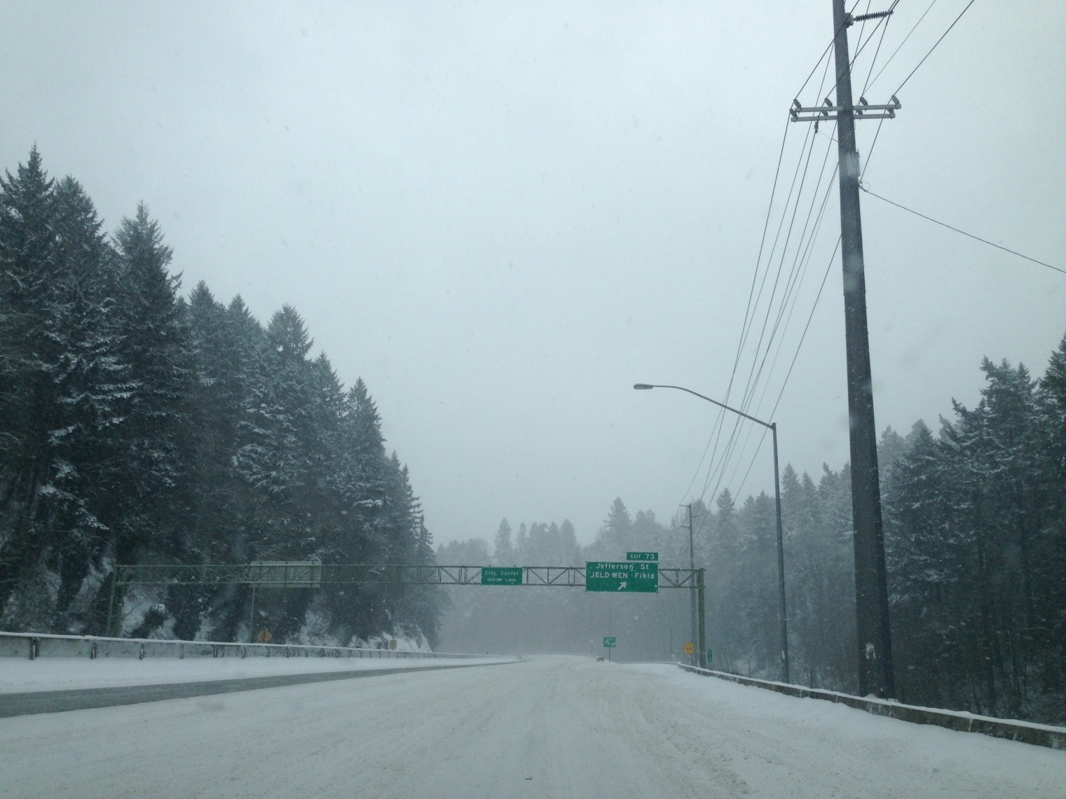
The Question You Most Likely
Want To Know…
Is it going to snow in the Willamette Valley?

Slide 4
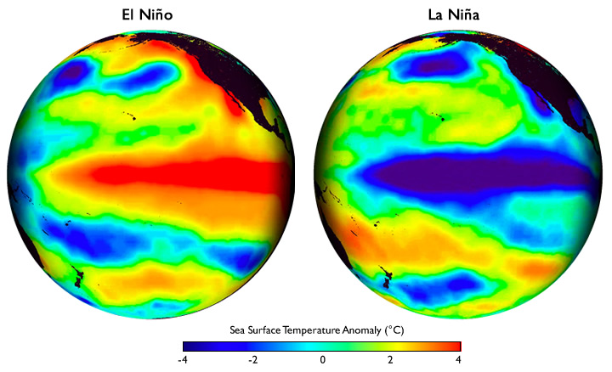
El Niño Southern Oscillation (ENSO)
USA
USA
Pacific Ocean
Pacific Ocean
Warmer than usual
ocean temperatures
Cooler than usual
ocean temperatures

Slide 5
Classifying ENSO Phases
  >1.9°C Very Strong El Niño
  1.5 to 1.9°C Strong El Niño
  1.0 to 1.4°C Moderate El Niño
  0.5 to 0.9°C Weak El Niño
  0.4 to -0.4°C Neutral
  -0.5 to -0.9°C Weak La Niña
  -1.0 to -1.4°C Moderate La Niña
  -1.5 to -1.9°C Strong La Niña
  <-1.9°C Very Strong La Niña

Slide 6
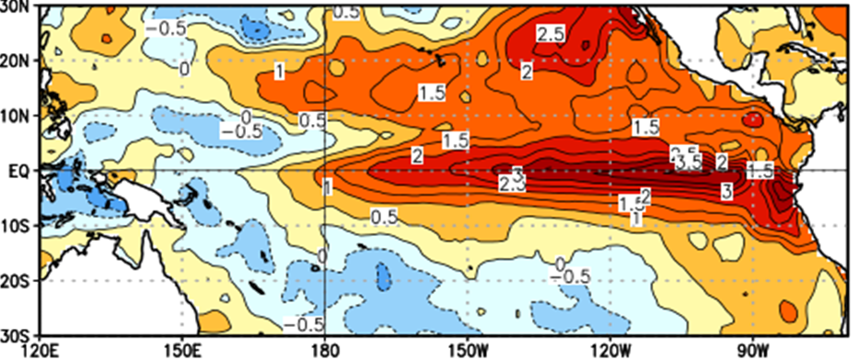
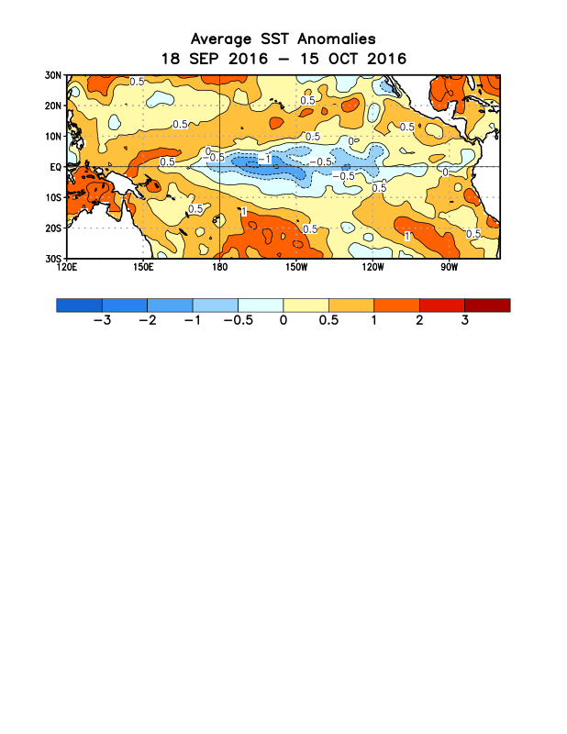
2015 El Niño
Sea Surface Temperature Anomalies
Much warmer than usual
Mexico
Australia
Weak
La Niña
La Niña
Neutral
El Niño
-2.0°
(°C)
-1.0°
-0.5°
0.5°
1.0°
2.0°

Slide 7
2016 La Niña(?)
Sea Surface Temperature Anomalies
Slightly cooler than usual
Mexico
Australia
Weak
La Niña
La Niña
Neutral
El Niño
-2.0°
(°C)
-1.0°
-0.5°
0.5°
1.0°
2.0°

Slide 8
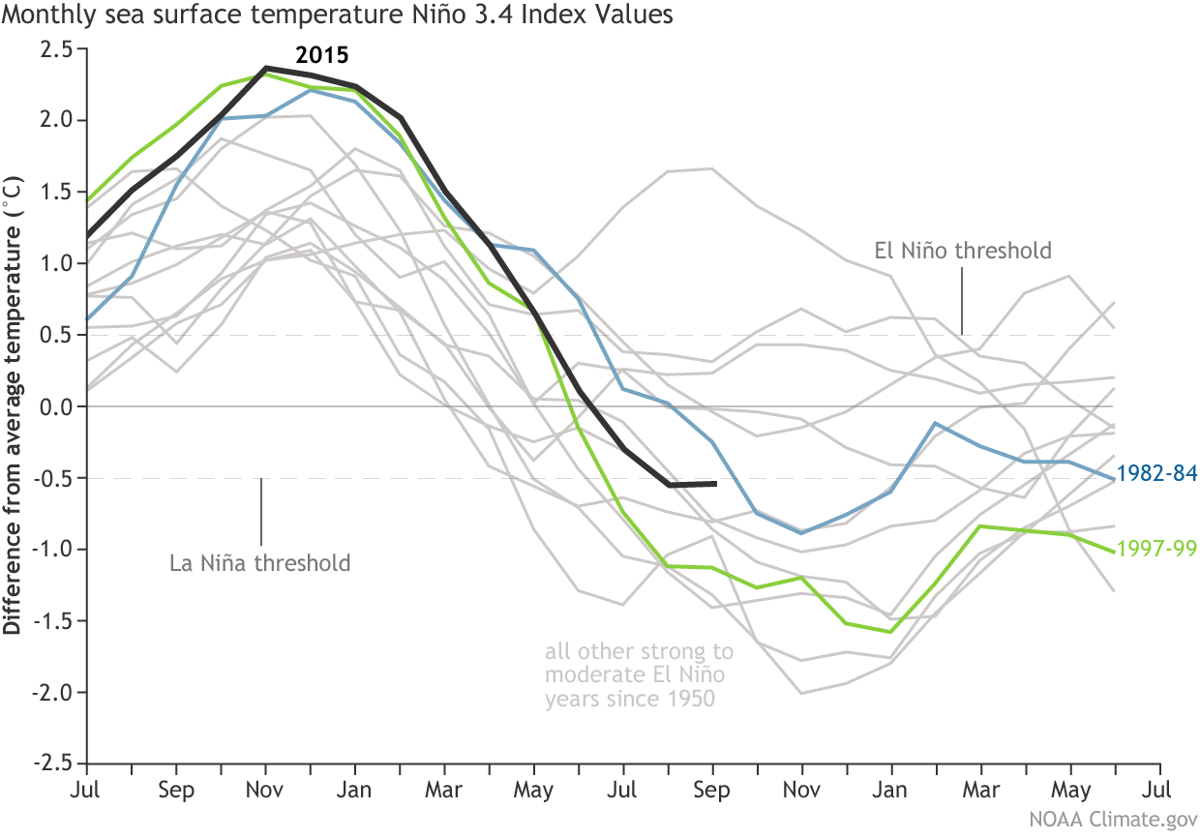
Monthly Niño 3.4 Index Values Following El Niño Events (since 1950)
2015
2016
Monthly ERSST data going back to 1950

Slide 9
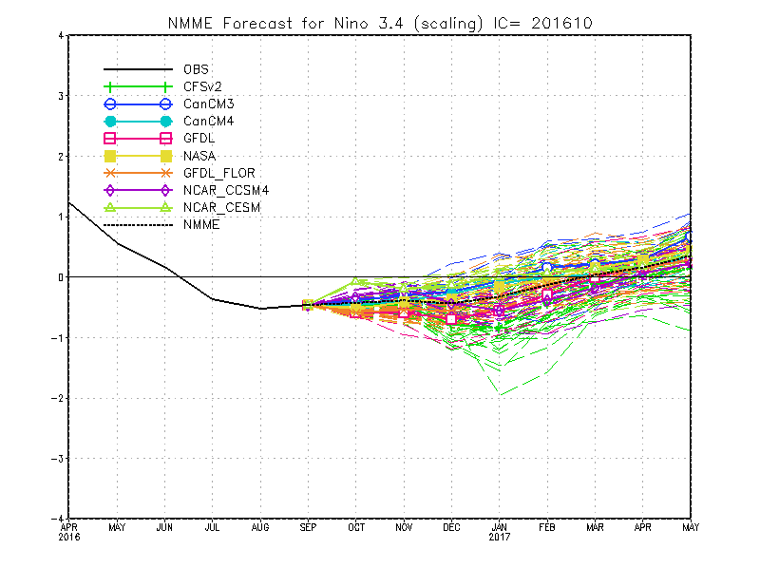
Climate Model Predictions
El Niño
Neutral
Weak
Moderate
La Niña
Strong
Very Strong

Slide 10
CPC ENSO Forecast
La Niña is now favored to develop (~70% chance) during Fall 2016
La Niña only slightly favored to persist (~55% chance) during winter 2016-17.

Slide 11
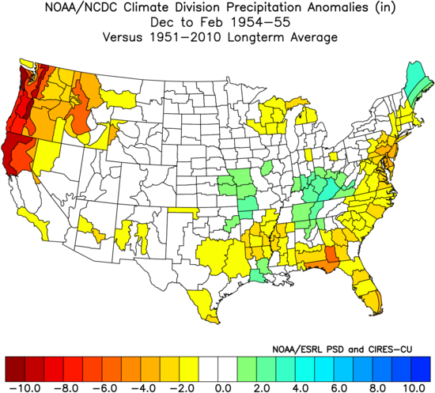
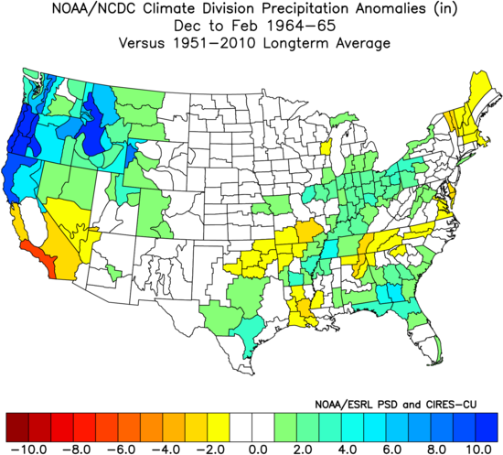
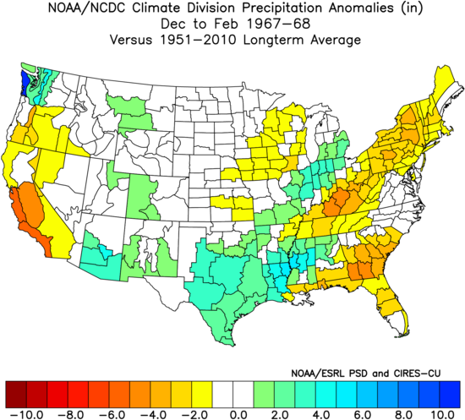
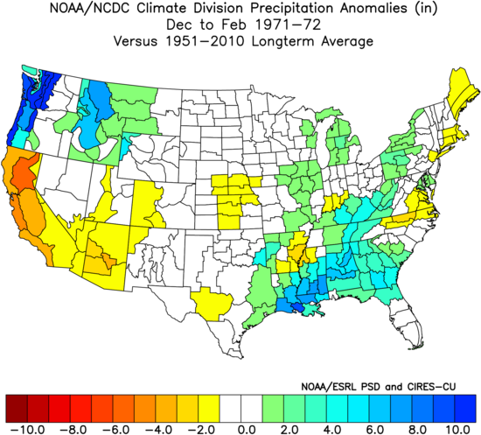
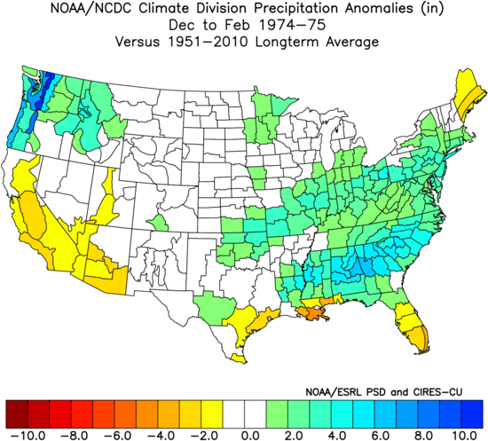
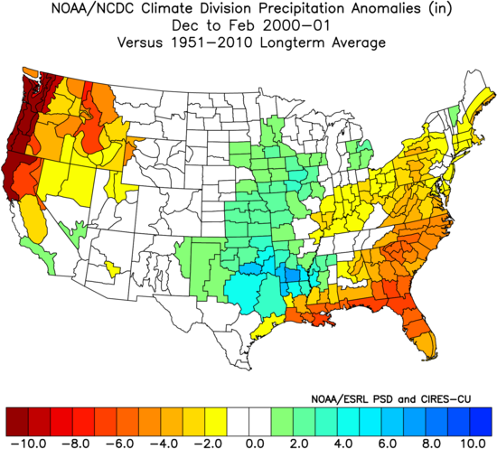
Weak La Niña (-0.5 to -0.9°C)
Precipitation Anomalies
1954-1955
1964-1965
1967-1968
Dec 1964 Flood
Top 10 Snow At PDX
1971-1972
1974-1975
2000-2001
Big Mtn Snow
Jan 1972 Flood
6.23” - 3rd Driest

Slide 12
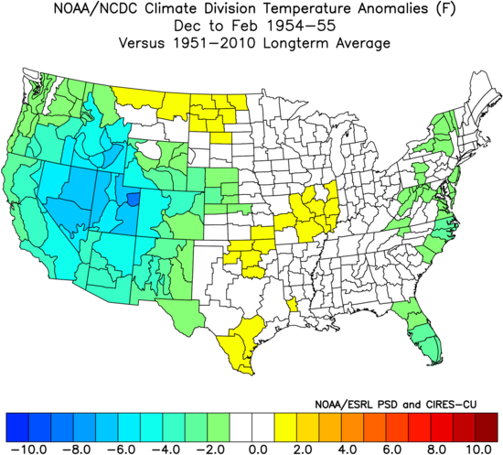
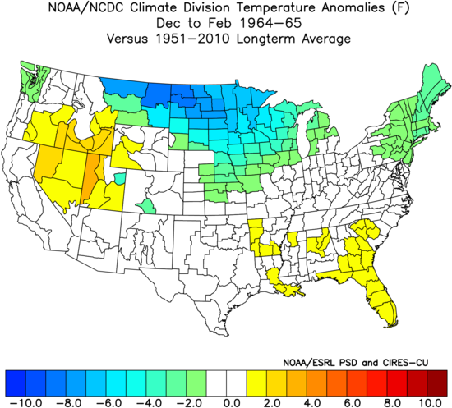
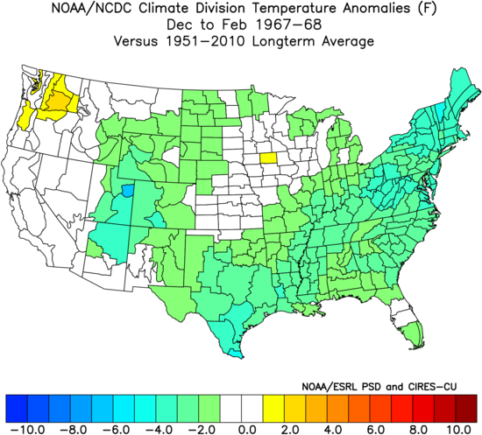
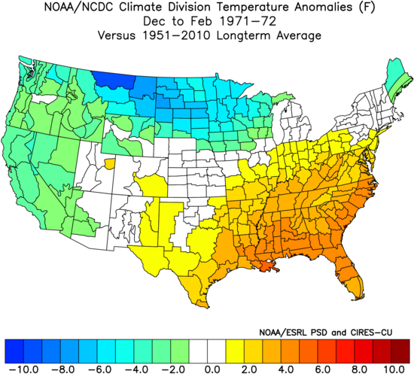
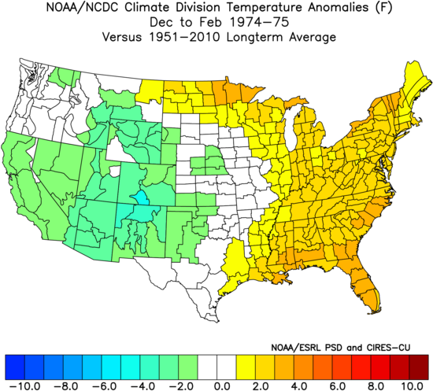
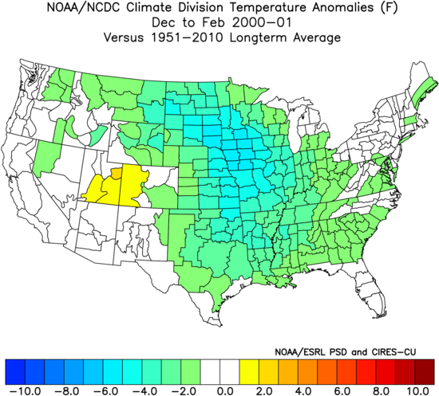
Weak La Niña (-0.5 to -0.9°C)
Temperature Anomalies
1954-1955
1964-1965
1967-1968
Dec 1964 Flood
Top 10 Snow At PDX
1971-1972
1974-1975
2000-2001
Big Mtn Snow
Jan 1972 Flood
6.23” - 3rd Driest

Slide 13
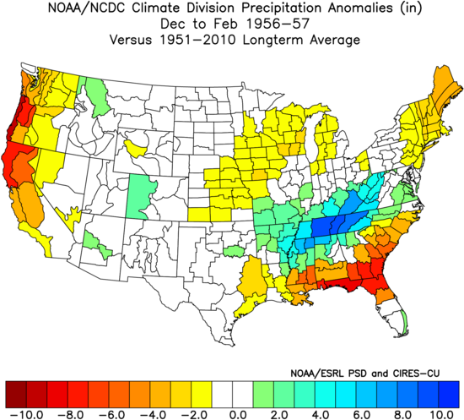
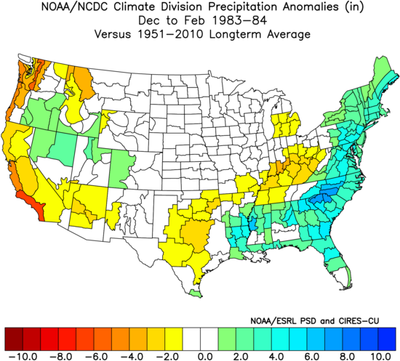
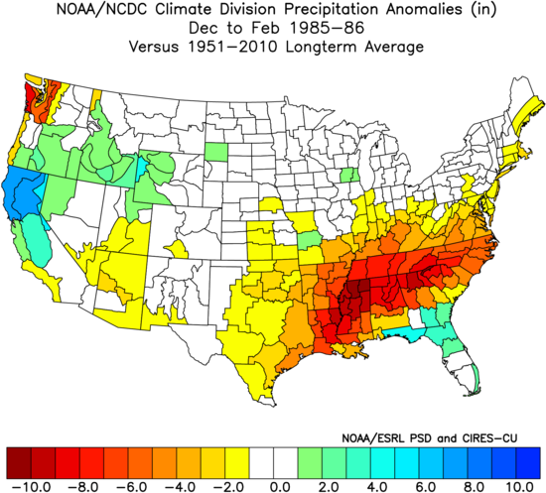
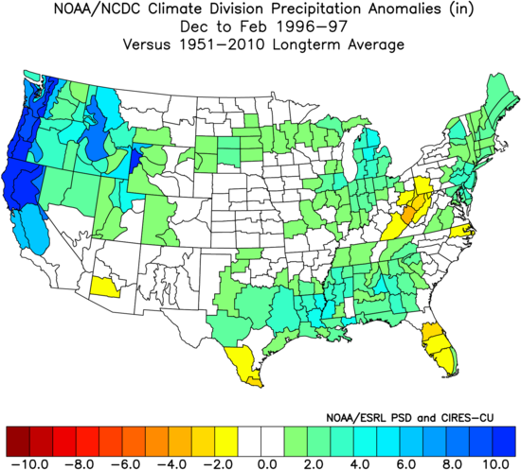
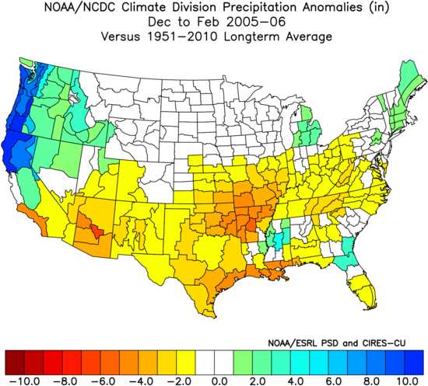
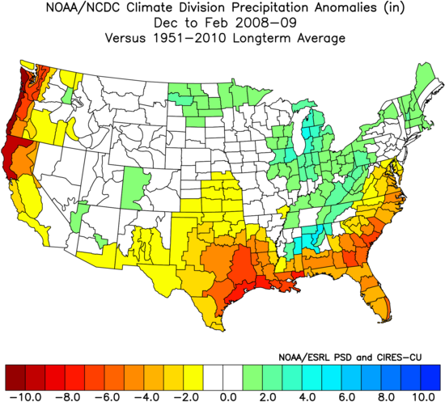
Cool Neutral (0.0 to -0.4°C)
Precipitation Anomalies
1956-1957
1983-1984
1985-1986
1996-1997
2005-2006
2008-2009
22.30” - 7th Wettest
20.59” - 13th Wettest
Big Dec Snow

Slide 14
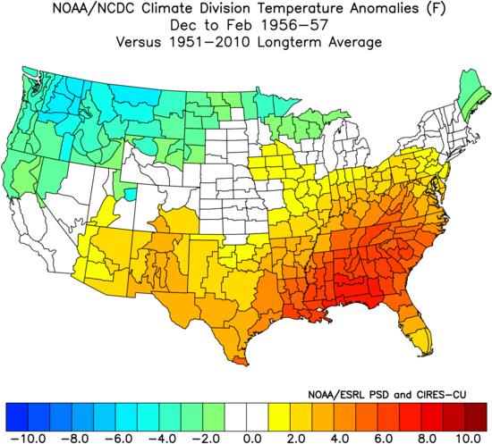
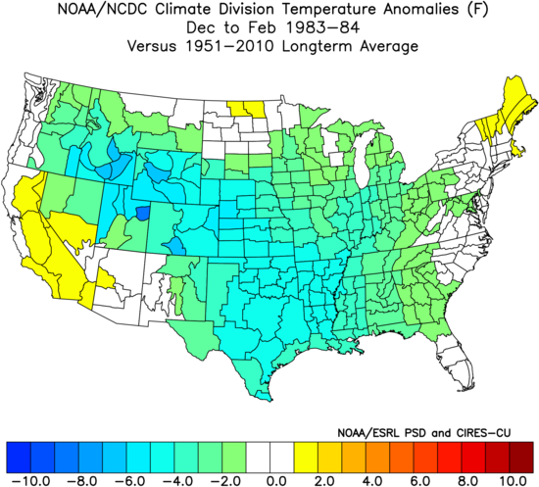
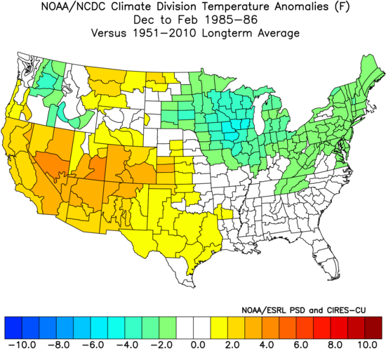
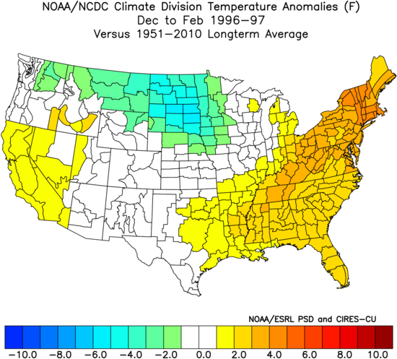
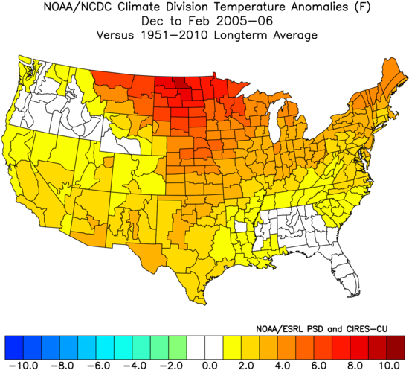
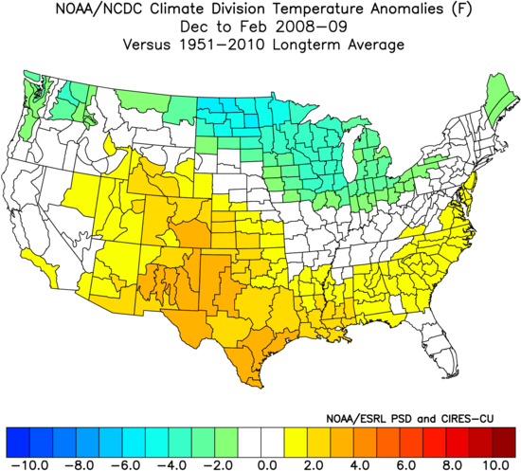
Cool Neutral (0.0 to -0.4°C)
Temperature Anomalies
1956-1957
1983-1984
1985-1986
1996-1997
2005-2006
2008-2009
22.30” - 7th Wettest
20.59” - 13th Wettest
Big Dec Snow

Slide 15
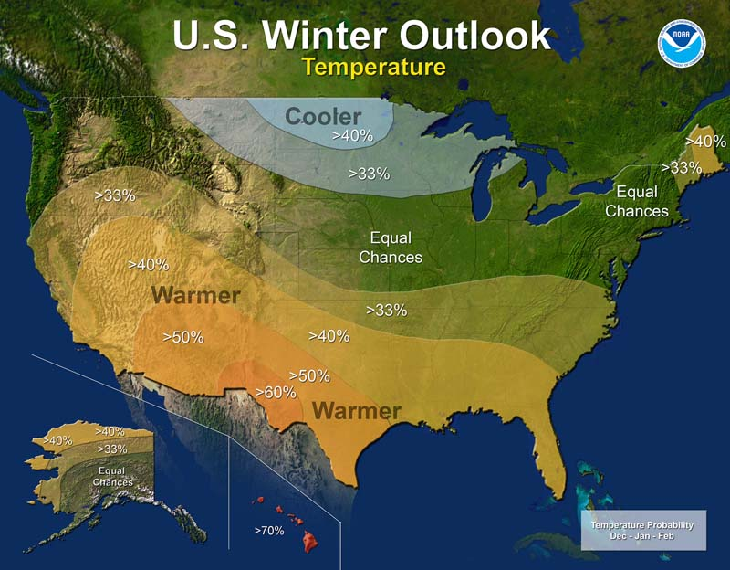
Climate Prediction Center
Dec 2016 – Feb 2017
Temperature Outlook
W Oregon
Below: 33%
Near: 33%
Above: 33%

Slide 16
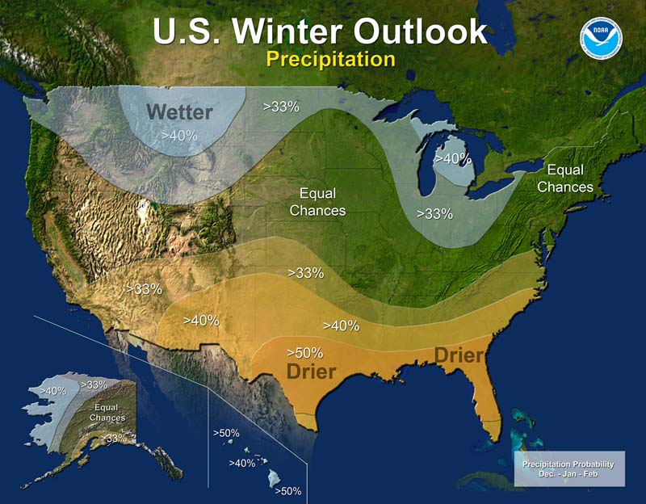
Climate Prediction Center
Dec 2016 – Feb 2017
Precipitation Outlook
W Oregon
Below: 33%
Near: 33%
Above: 33%

Slide 17
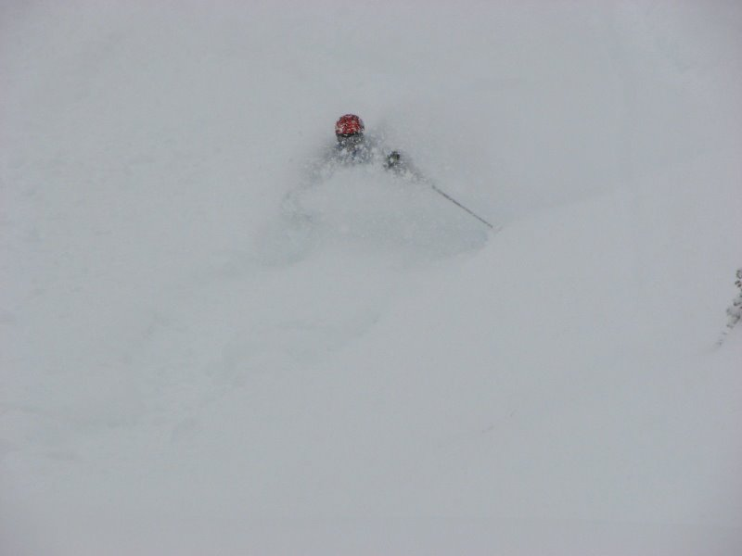
What about ENSO & Snow?

Slide 18
ENSO Occurrence
21%
61%

Slide 19
Top 10 Snowiest PDX Winters
34.0” 1968-69 El Niño
24.2” 2008-09 ENSO Neutral
22.4” 1955-56 La Niña
20.3” 1959-60 ENSO Neutral
17.4” 1992-93 ENSO Neutral
16.3” 1979-80 ENSO Neutral
14.7” 1970-71 La Niña
13.4” 1964-65 ENSO Neutral
12.0” 1994-95 El Niño
10.5” 1953-54 ENSO Neutral
60% were ENSO Neutral
20% were Moderate La Niña or Higher
20% were Moderate El Niño or Higher

Slide 20
Lowland Snowfall History 1950 to 2016
21 snow-shutout winters:
(Trace or zero snowfall)
8 (out of 14) were Moderate or Strong El Niño winters
11 (out of 40) were ENSO Neutral winters (incl. weak ENSO)
2 (out of 12) were Moderate or Strong La Niña winters

Slide 21
Summary
Weak La Niña most likely
A wide range of possibilities this winter
Based off history, at least one accumulating snowfall at PDX is good possibility, but not guaranteed either
Lowland snow can happen in a drier (92-93 & 08-09) and even warmer (15-16) than average winter

Slide 22
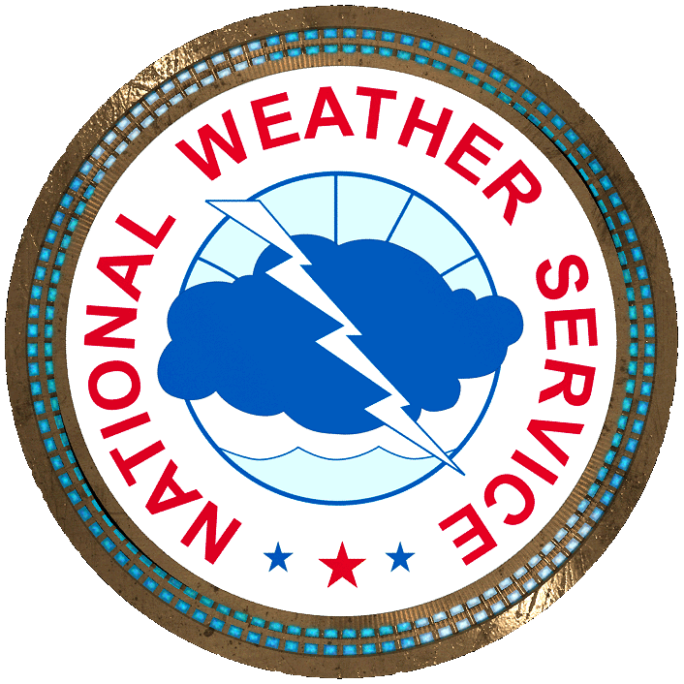
Questions?

