Slide 1
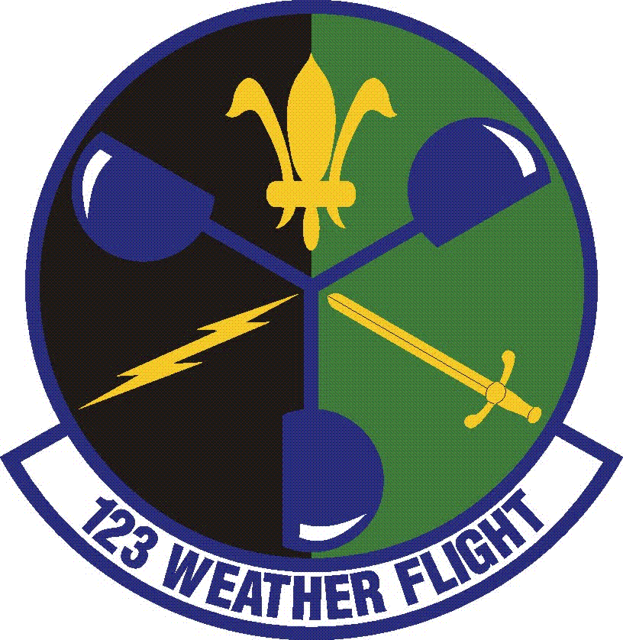
123RD Weather Flight

Slide 2
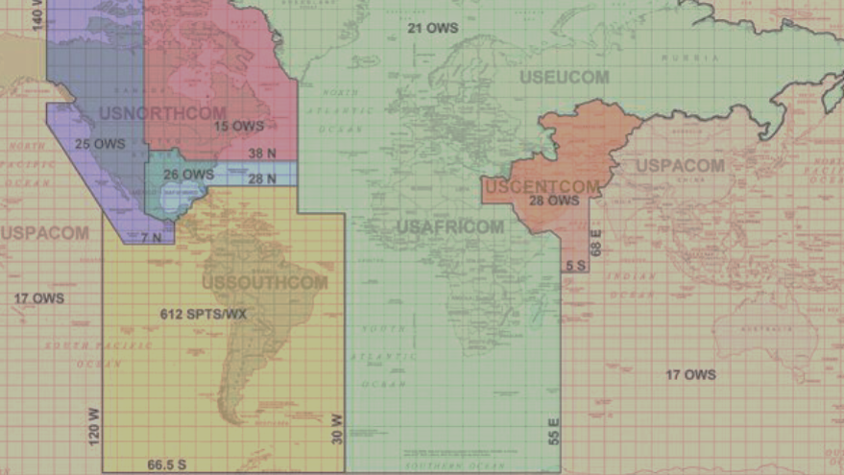
123rd Weather Flight
Mission: Provide weather services to US Army, National Guard, Oregon state and civil authorities.
- Federal missions support US Army
- State missions support emergencies
- 12 Weather Forecasters
- 11 deployments over past 5 years:
Afghanistan
Iraq
Kuwait
Haiti
Africa support

Slide 3
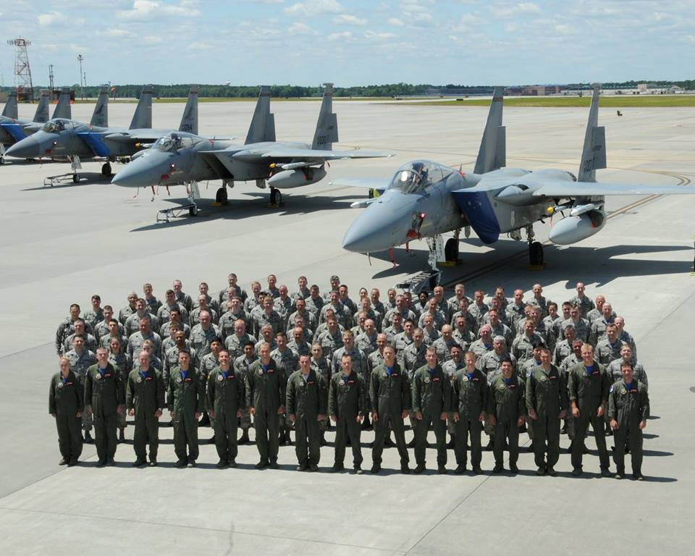
142nd Fighter Wing “Redhawks”

Slide 4
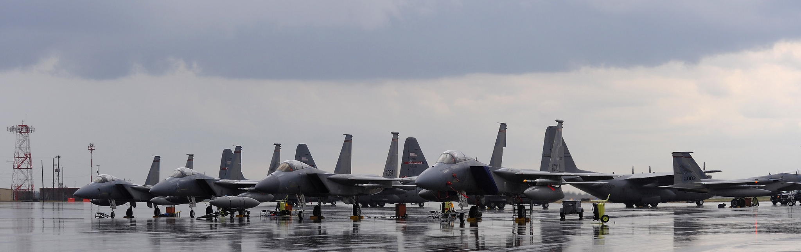
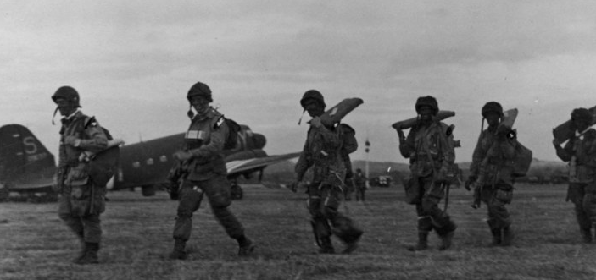
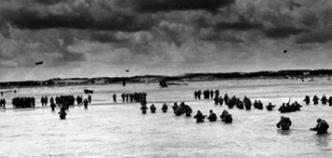
The more things change…

Slide 5
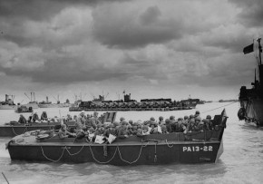
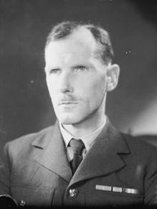
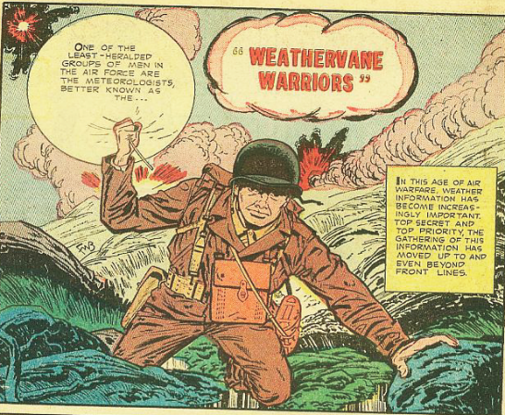
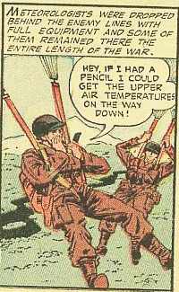
Mission Planning & Risk Mitigation
Captain James Staggs

Slide 6
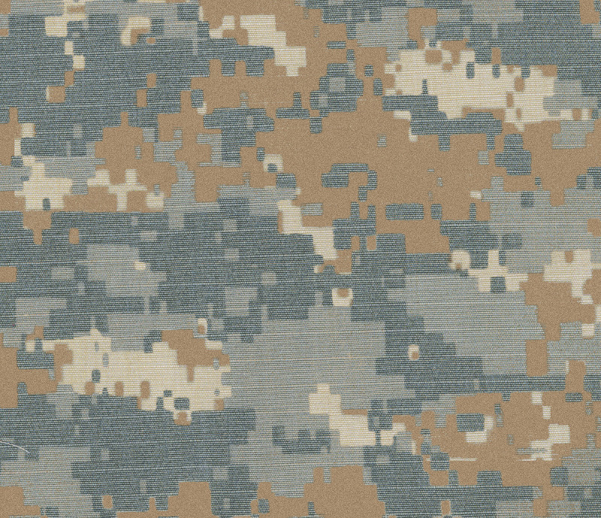
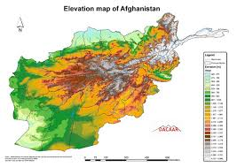

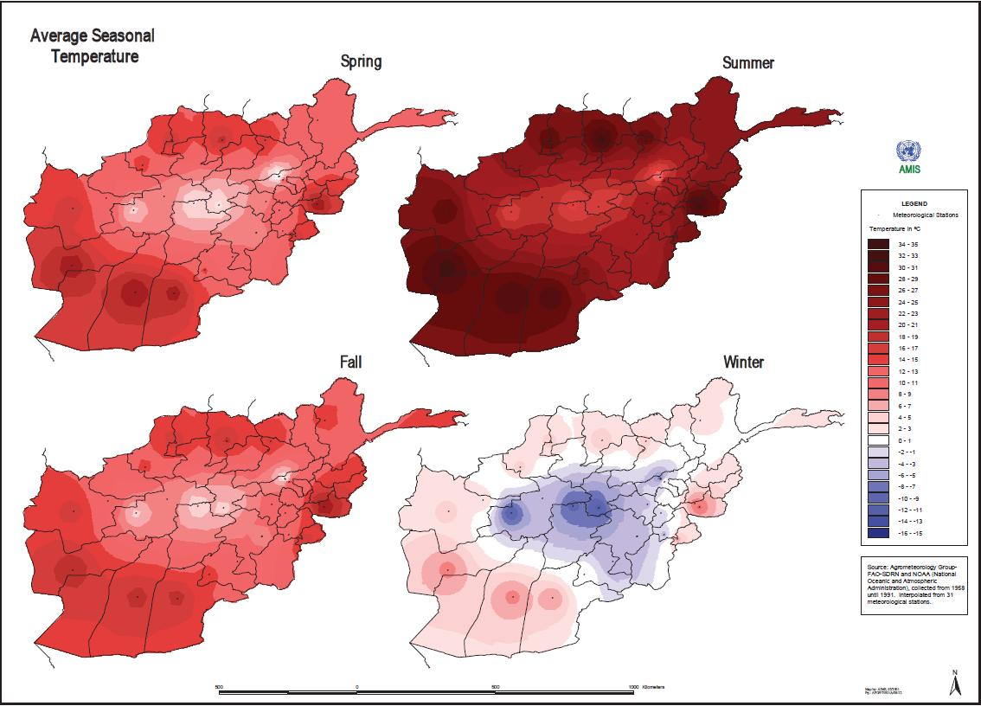
Welcome Back Tech Sergeant Rose Selko!

Slide 7
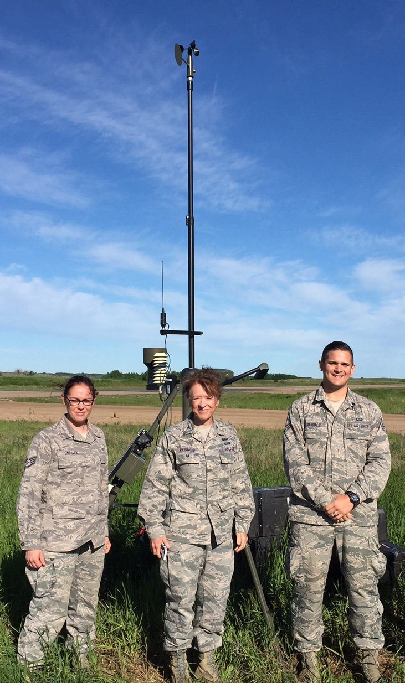

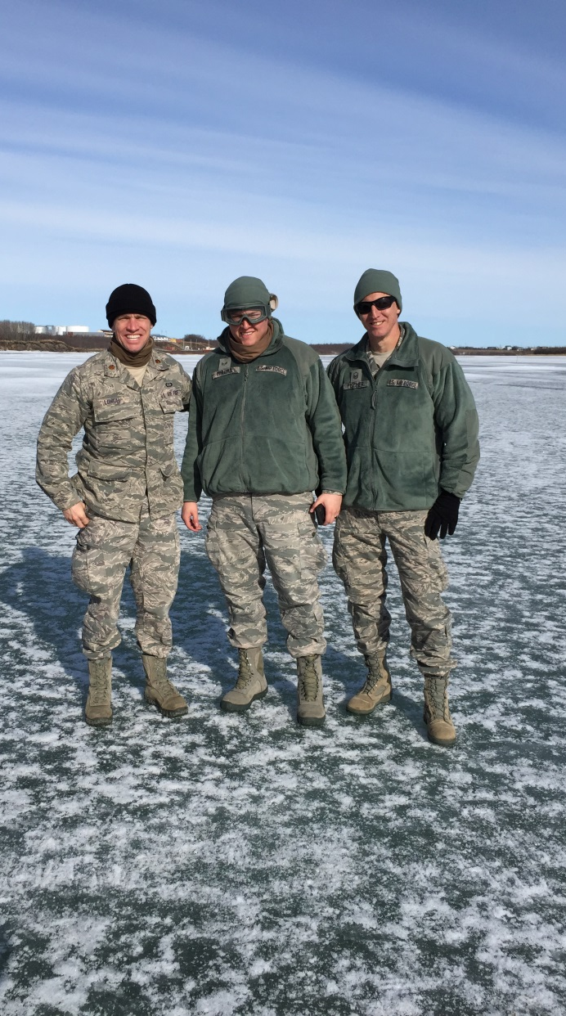
Forecasts in Any Environment

Slide 8

Diverse Skill Sets

Slide 9
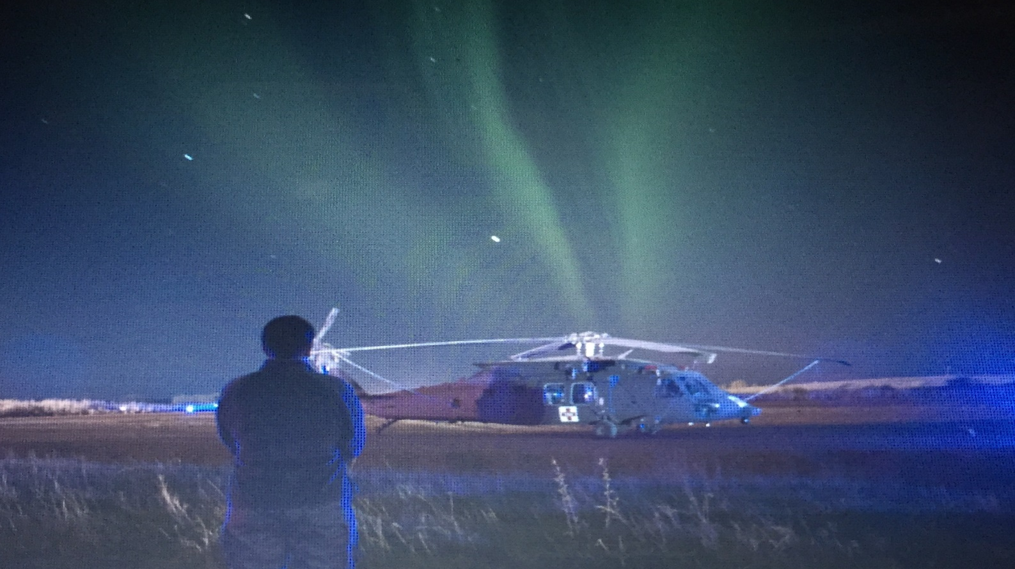
123RD Weather Flight

Slide 10

123RD Weather Flight
Lt Col Joe Lontai
Portland Air National Guard Base
(800) 864-6264

