Slide 1

2015-2016
Winter Weather
Wrap Up
Some Big WEATHER EVENTS!
Mark Nelsen

Slide 2

FROM OCTOBER MEETING
A LIGHTNING ROUND
OF WINTER FORECASTS
Organizations or individuals who can’t or don’t want to be here.
OR
They don’t know (or care) that we exist.

Slide 3
TIME FOR SOMETHING NEW…
A LIGHTNING ROUND
OF WINTER FORECASTS
Old Farmer’s Almanac
Farmer’s Almanac
Accuweather
Pete Parsons (OR Dept of Ag)
Rod Hill (KGW)
WeatherBELL

Slide 4
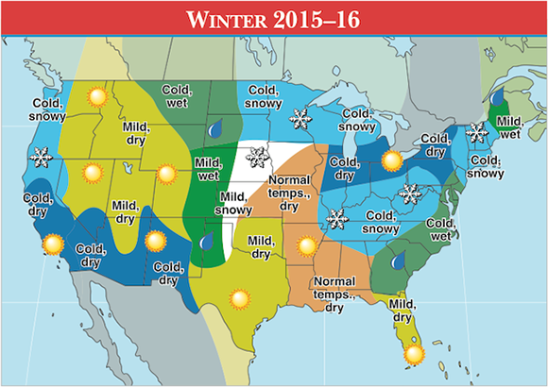
Old Farmer’s Alamanac
Huh?…make sure you note all those details!

Slide 5
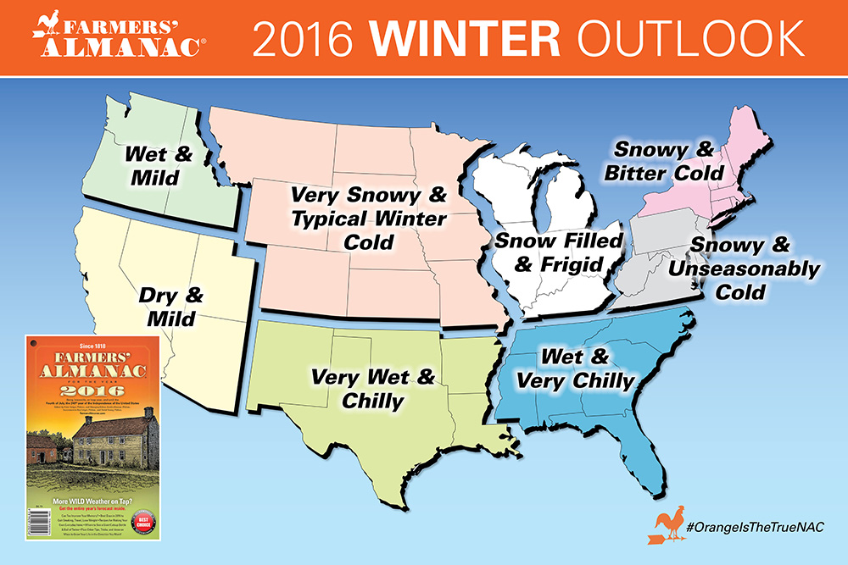
Farmers’ Alamanac
A little easier on the eyes

Slide 6
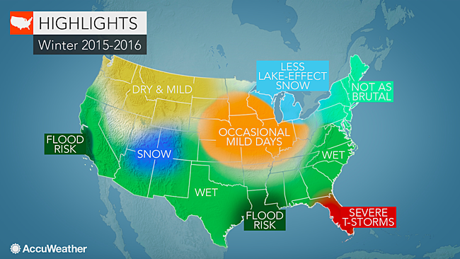
AccuWeather
…rain deficit will continue
to build in
the Northwest…

Slide 7
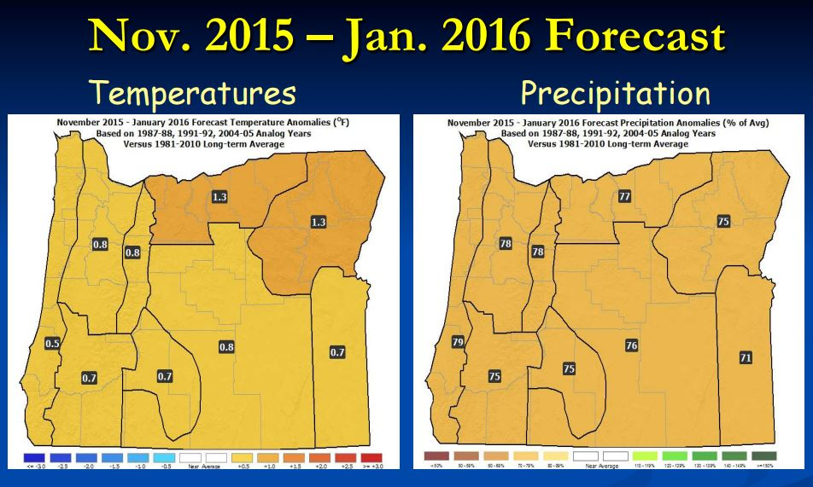
Oregon Dept of Ag/Forestry
(Pete Parsons)
Top Analog
Years
All Strong
El Nino
winters
1987-1988
1991-1992
2004-2005
Above average temperatures, but not nearly as warm as last year.
About 70-80% of average precipitation and mountain snow.
Brief cold periods possible, but extreme/prolonged cold unlikely.

Slide 8

Rod Hill’s Winter Outlook
Meteorologist – KGW & www.portlandweather.com
Near normal rainfall for Portland
with two possible snow events
dropping up to 8" of total snow for the season
1-4 high wind events
50-65 mph south valley wind gusts
Temperature averages will likely be above normal
To be clear, the "WILDCARD" of this up-coming winter is the snow level forecast.
…reason to fear that a warm weather pattern overall could produce another winter
of mostly rain at Government Camp instead of much needed snowfall.

Slide 9
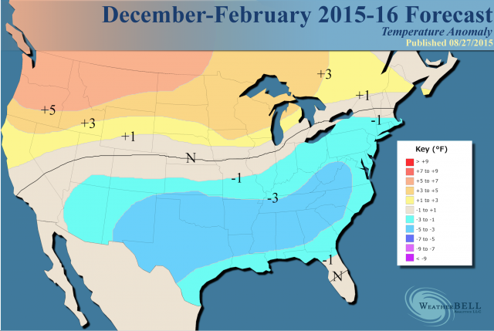
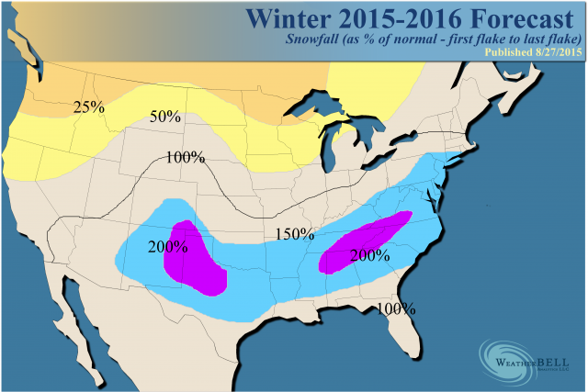
WeatherBELL
“non-winter from
the Northwest
into the
northern Plains”
Top Analog
Years
In order of
importance
1957-58
2014-15
1997-98
2002-03

Slide 10
DECEMBER WAS EXCITING!
A Classic “El Nino WINTER” OTHERWISE

Slide 11
Quick Thoughts
A Crazy Wet & Wild December, otherwise not much memorable
No Arctic Blasts (2nd consecutive winter)
Very few cold post-frontal wet airmasses for 3rd consecutive year; snow level rarely dipped below 2,500’.
4TH Warmest Winter On Record: In Portland
Last COLD Month Was December 2013!
We are in a historic multi-year warm period

Slide 12
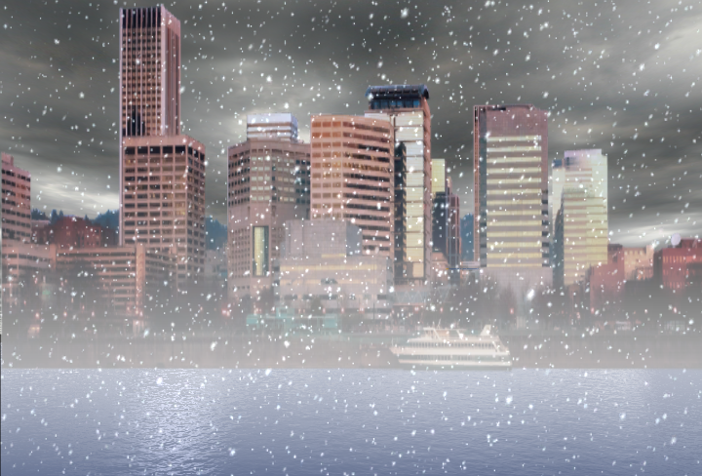
OFFICIAL
SNOW TOTAL
1.1”
at PQR (NWS Office)
1.0” Downtown (KGW on JANUARY 3RD)

Slide 13
Snowfalls at PQR (official site)
.1” December 27th
1.0” January 3rd

Slide 14
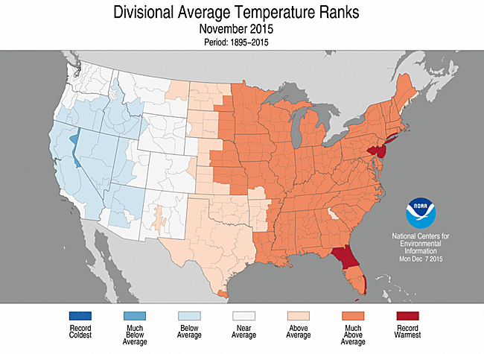
THE USA VIEW

Slide 15
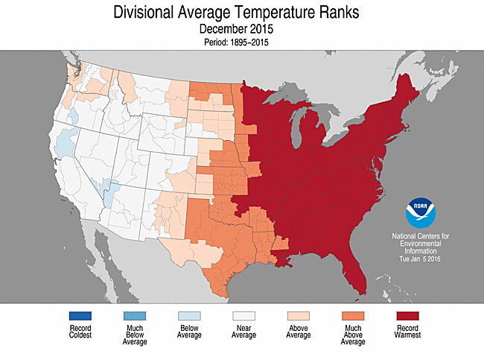
THE USA VIEW

Slide 16
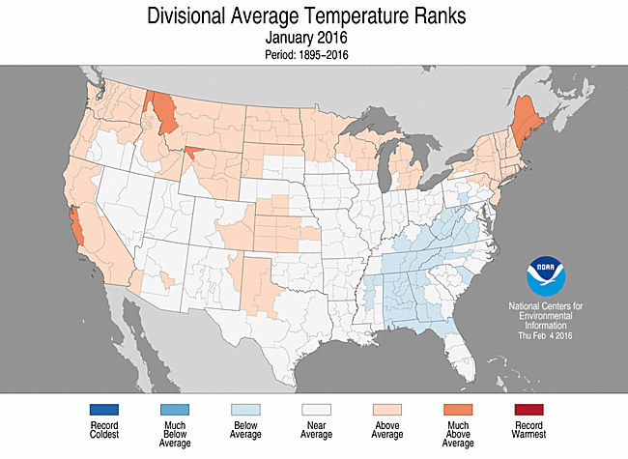
THE USA VIEW

Slide 17
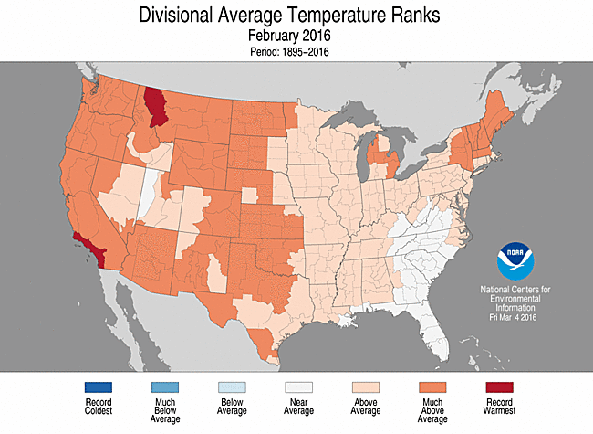
THE USA VIEW

Slide 18
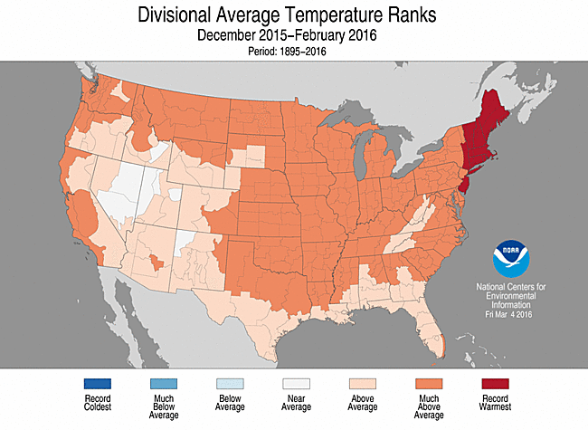
THE 3 MONTH PERIOD

Slide 19
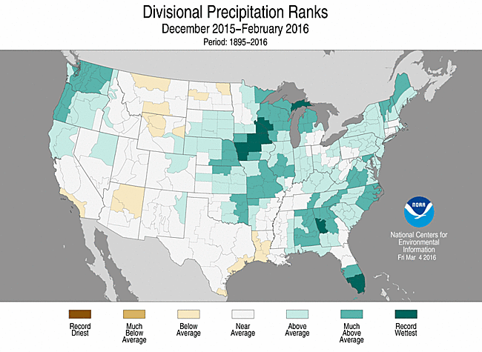
3 MONTH PRECIPITATION

Slide 20
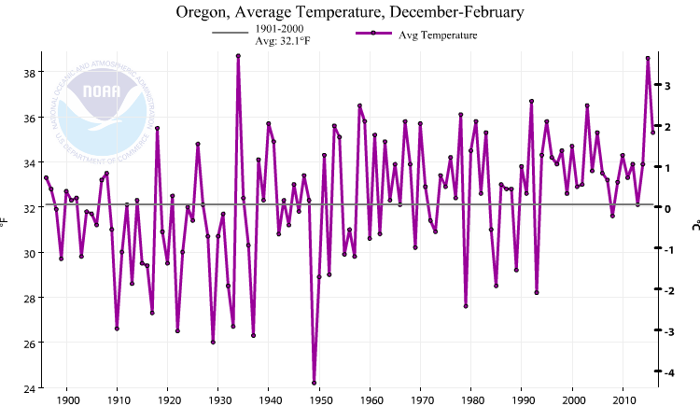
Oregon Winter Temps (the past 100 years)
2nd Warmest in the last 13

Slide 21
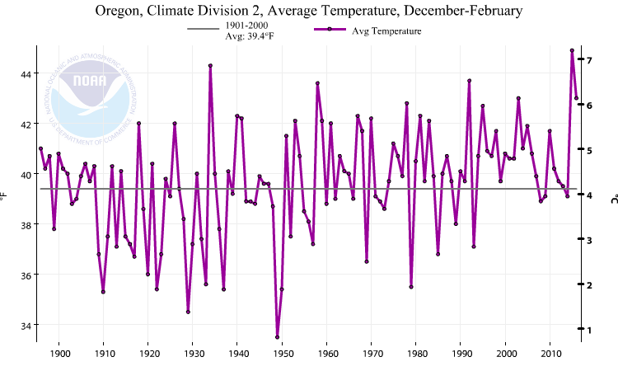
Western Valleys Winter Temps (the past 100 years)
Last cold winter was 1992-1993
This Winter in Oregon Zone 2 (Willamette Valley)

Slide 22
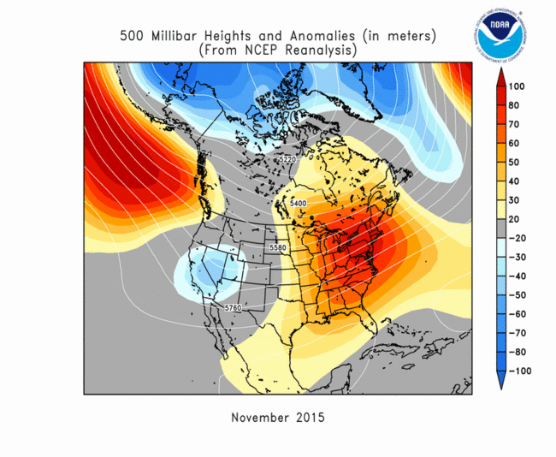
UPPER LEVEL PATTERNS
Ridging near west coast of North America: Pattern continued through March!

Slide 23
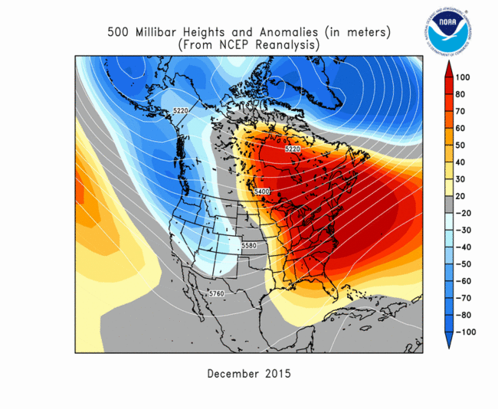
UPPER LEVEL PATTERNS

Slide 24
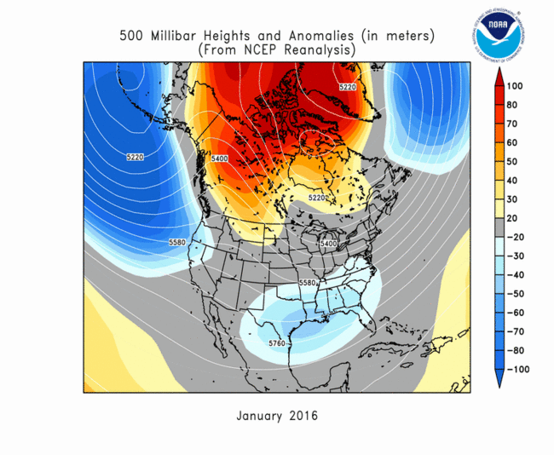
UPPER LEVEL PATTERNS

Slide 25
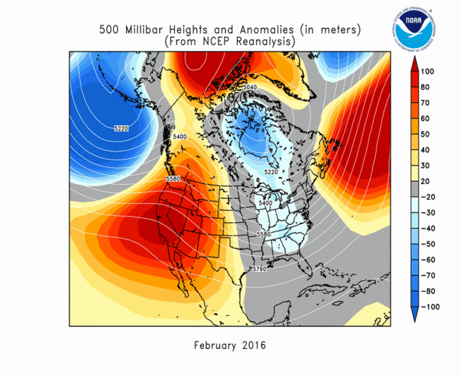
UPPER LEVEL PATTERNS

Slide 26
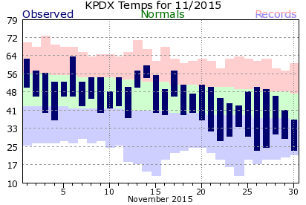
NOVEMBER
Uneventful month, near normal temperatures
    Except cool the last week
24 degree low (twice) was coldest of “winter”

Slide 27
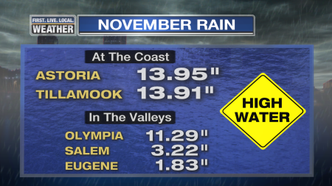
NOVEMBER
Deluge first half of month north and west of Portland
Much drier to the south and east
(RAIN TOTAL 1st-18th)

Slide 28
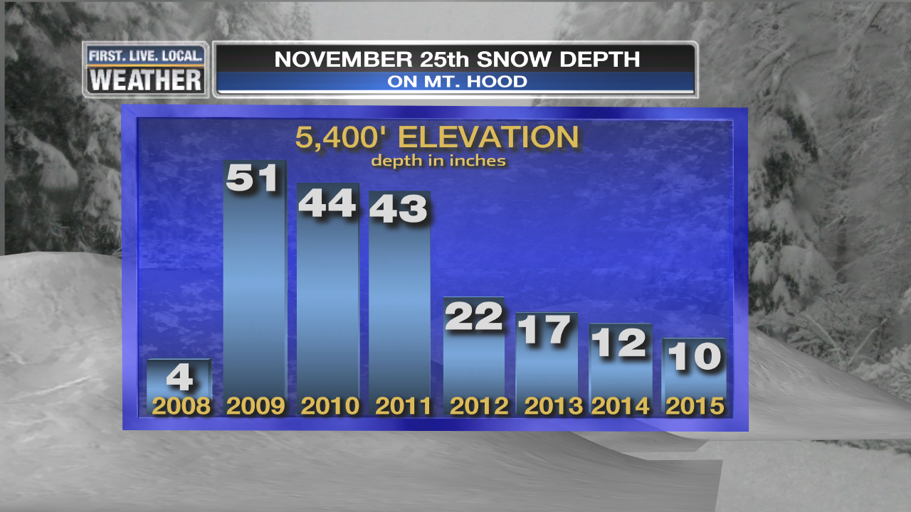
NOVEMBER
Ski season slow to start
Very limited openings through first weekend of December

Slide 29
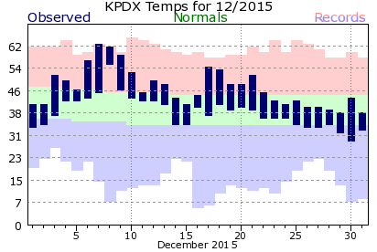
DECEMBER
Mild, except for chilly Christmas to New Year

Slide 30
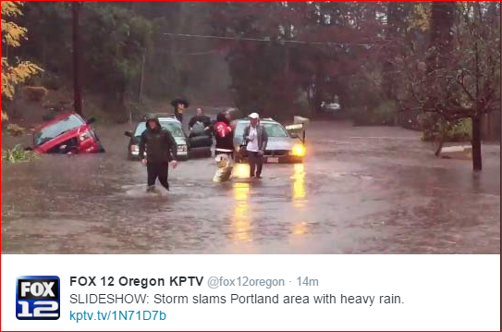
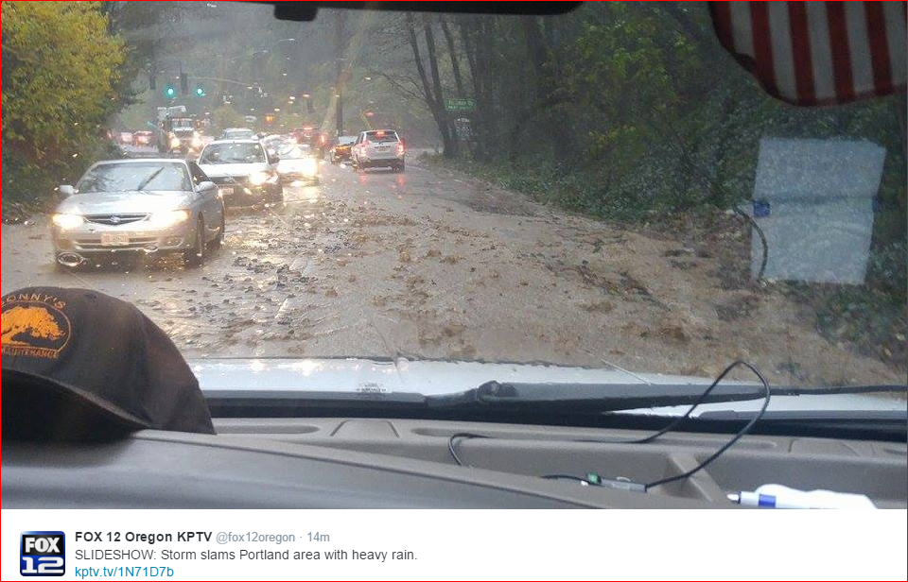
DECEMBER: All Hell Breaks Loose!
Flooding, Windstorm, Mudslides, & Tornado

Slide 31
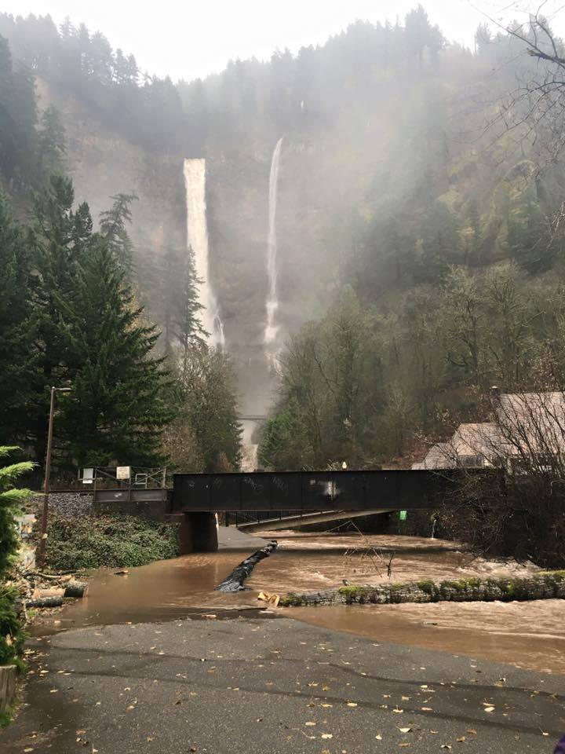
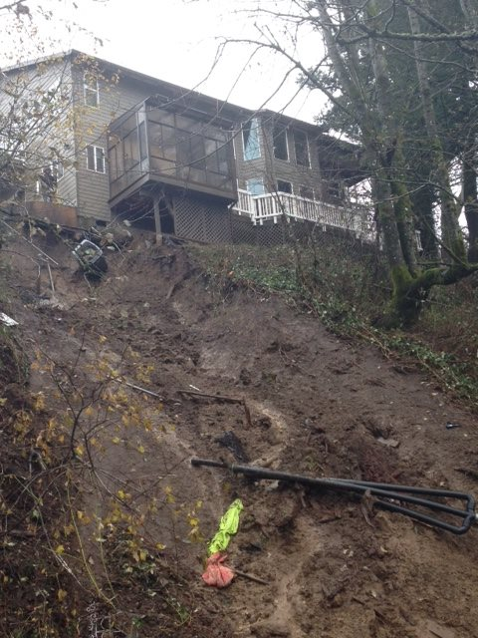
DECEMBER: All Hell Breaks Loose!
Flooding, Windstorm, Mudslides, & Tornado

Slide 32
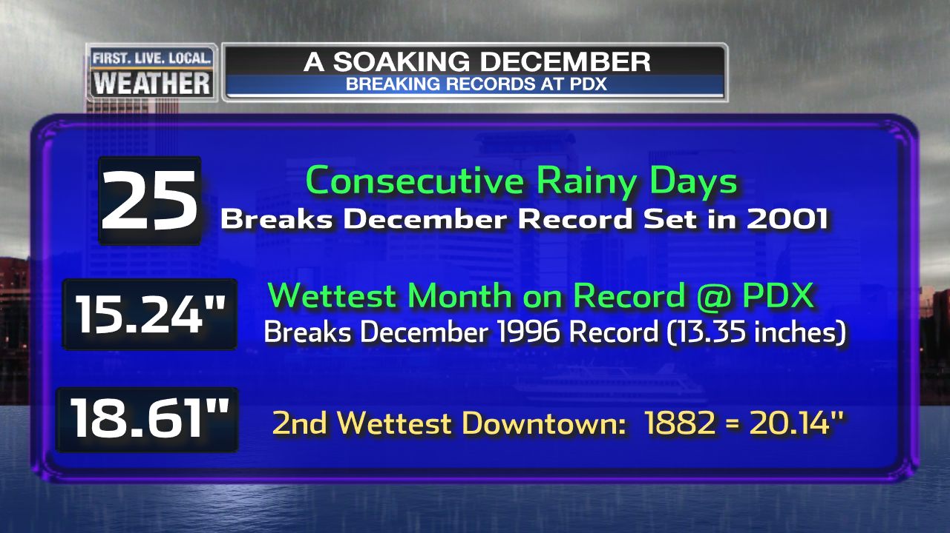
DECEMBER RAIN
Continuous barrage of wet Pacific fronts
Many daily and consecutive day rain records set
Lots of mudslides, landslides, & closed highways

Slide 33
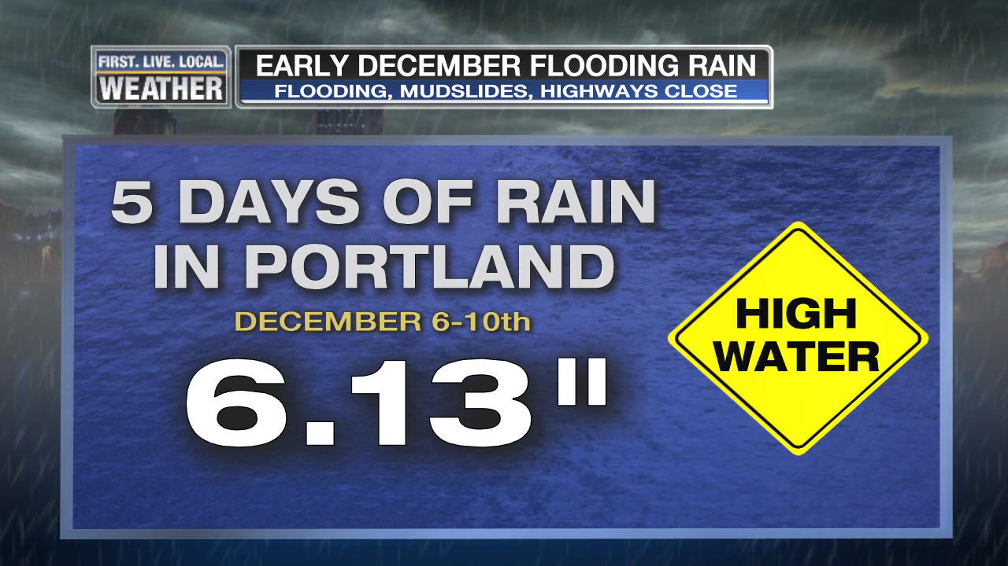
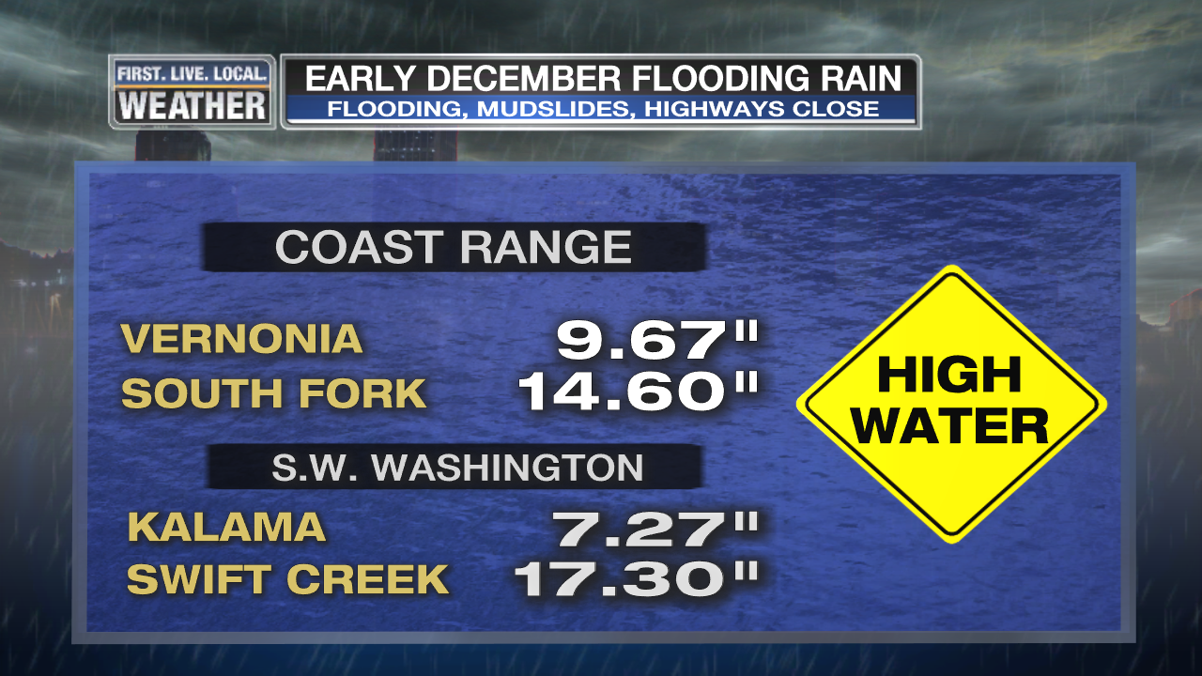
DECEMBER RAIN
Continuous barrage of wet Pacific fronts
Many daily and consecutive day rain records set
Lots of mudslides, landslides, & closed highways

Slide 34
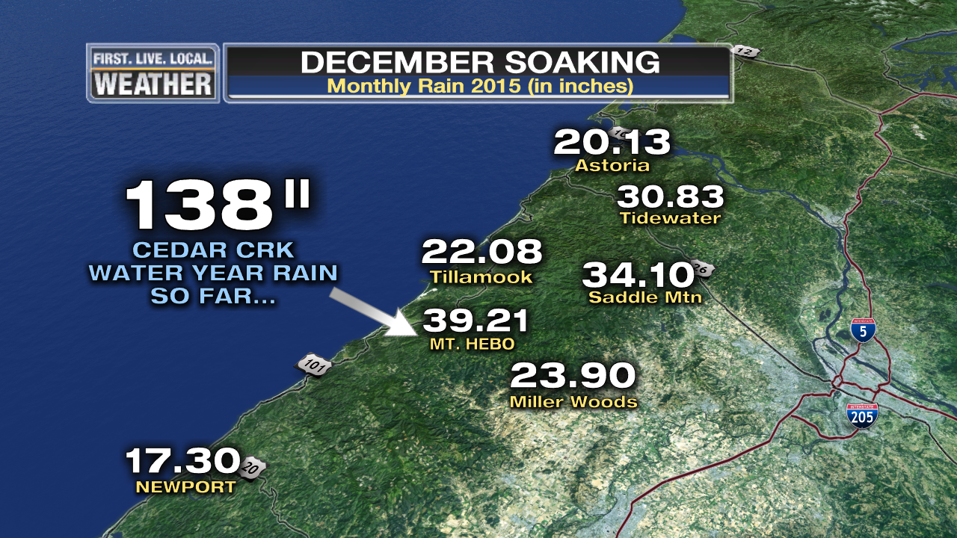
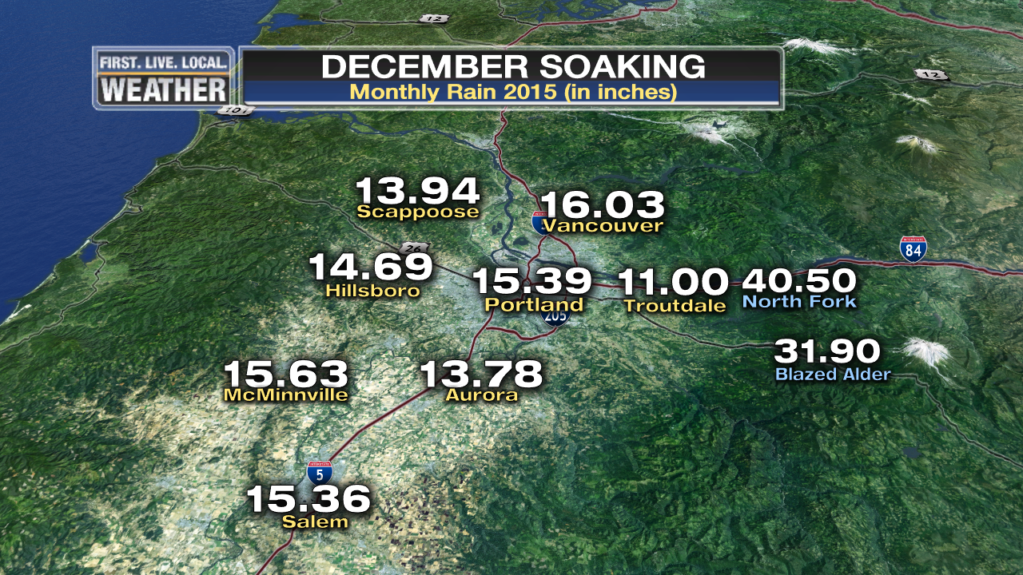
DECEMBER RAIN
Huge Soaking Across the Region

Slide 35
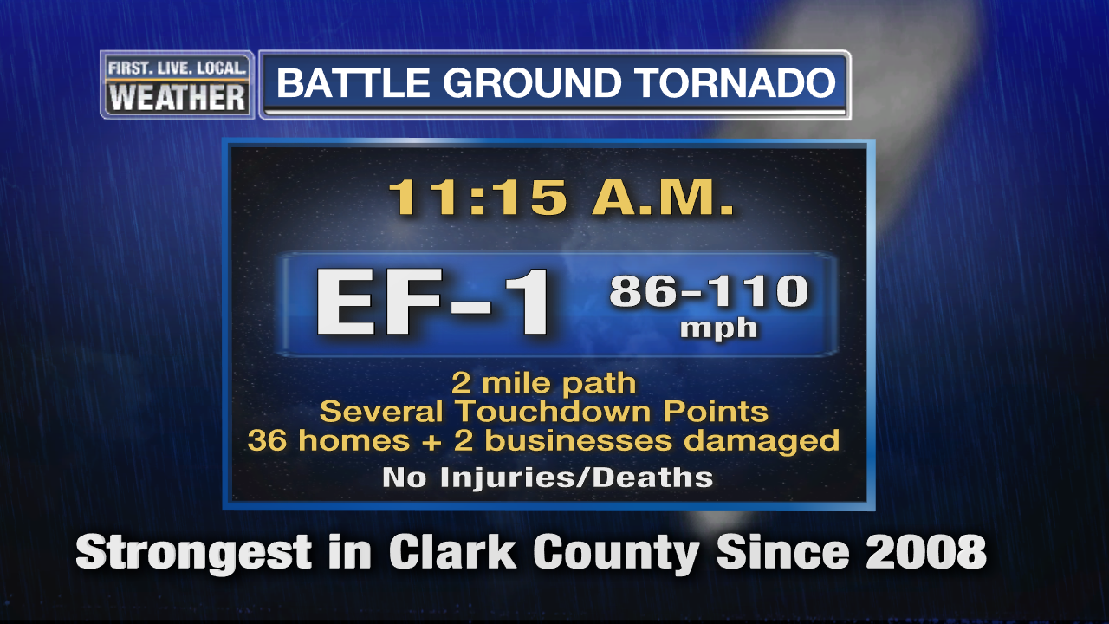
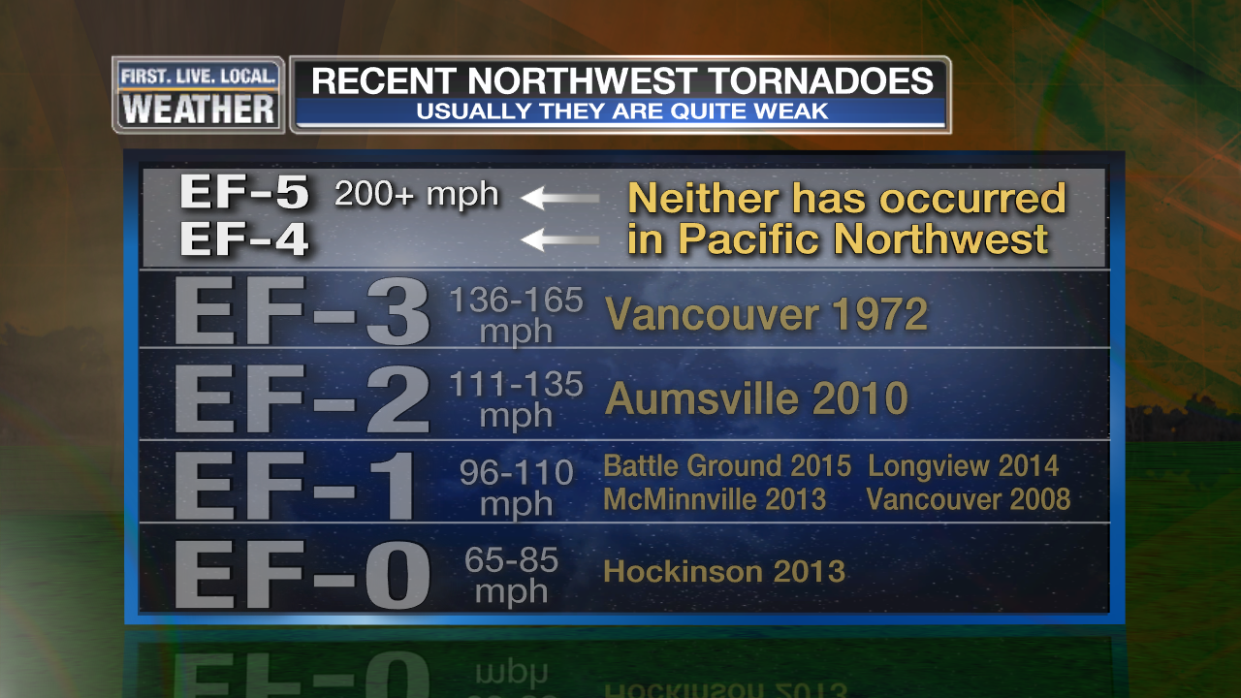
BATTLE GROUND TORNADO
December 10th, 11:15am
Another midday tornado…inconvenient for TV people

Slide 36
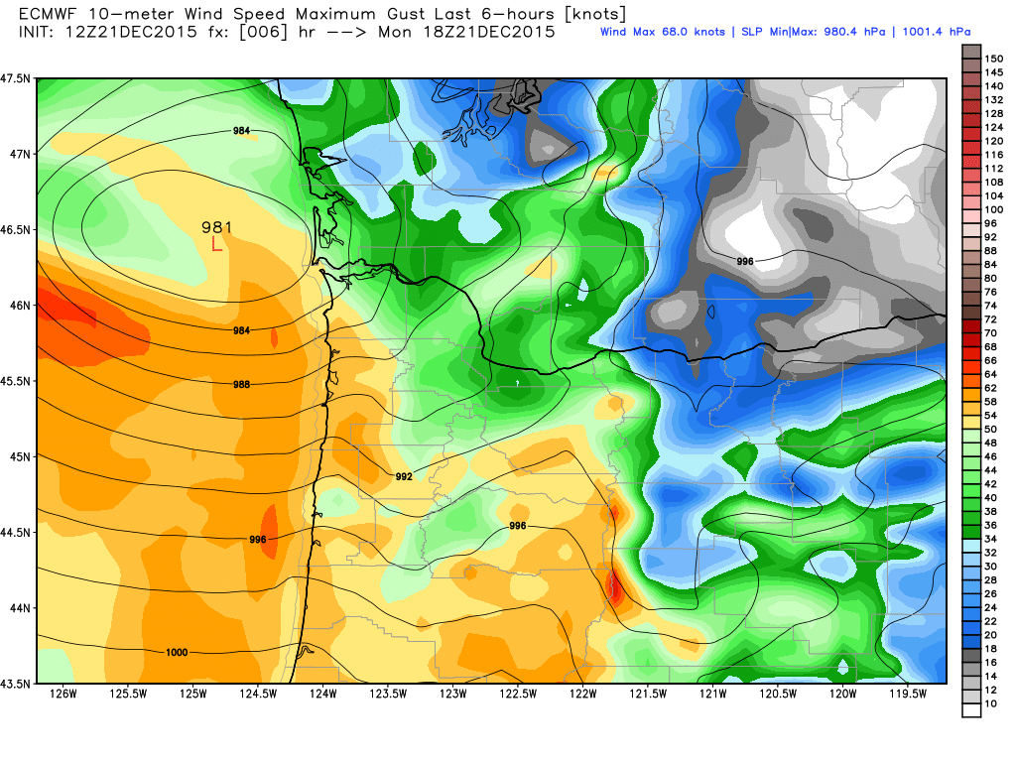
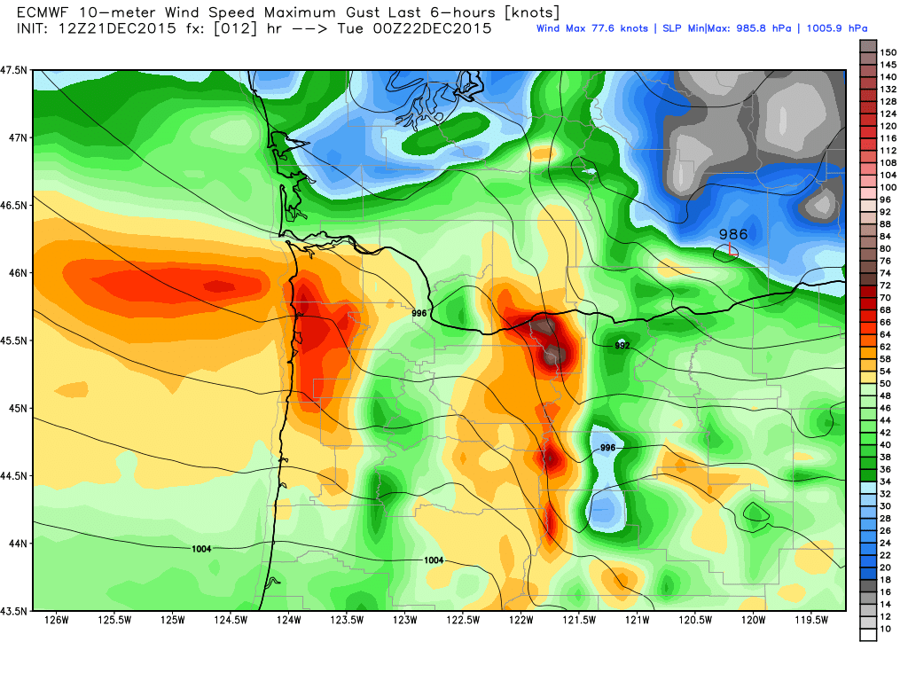
December 21st Wind Storm
Deep low pressure tracks west to east across southern Washington
Relatively minor storm: 35,000 PGE outages at peak

Slide 37
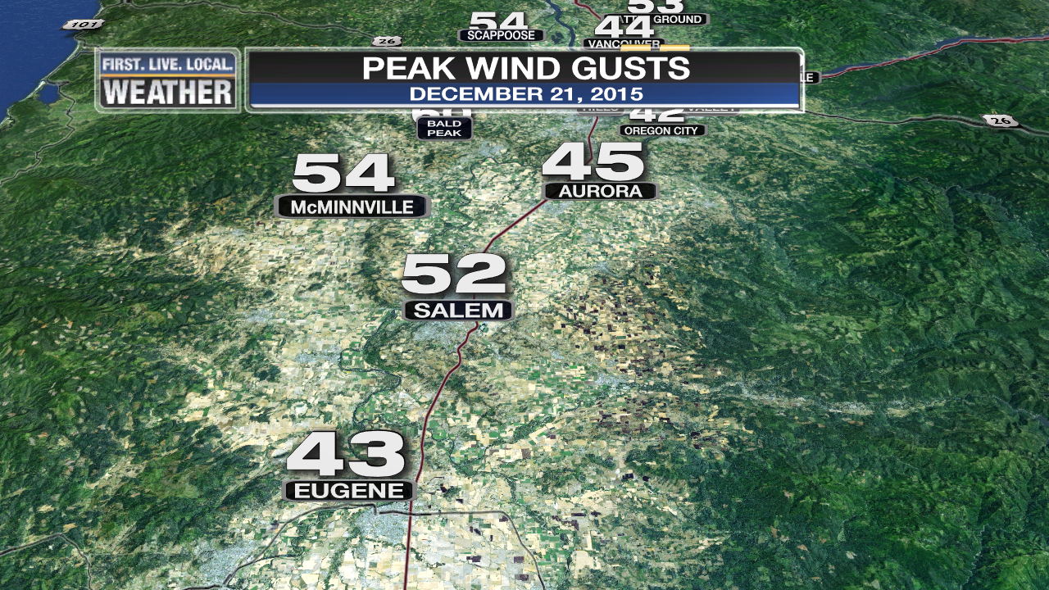
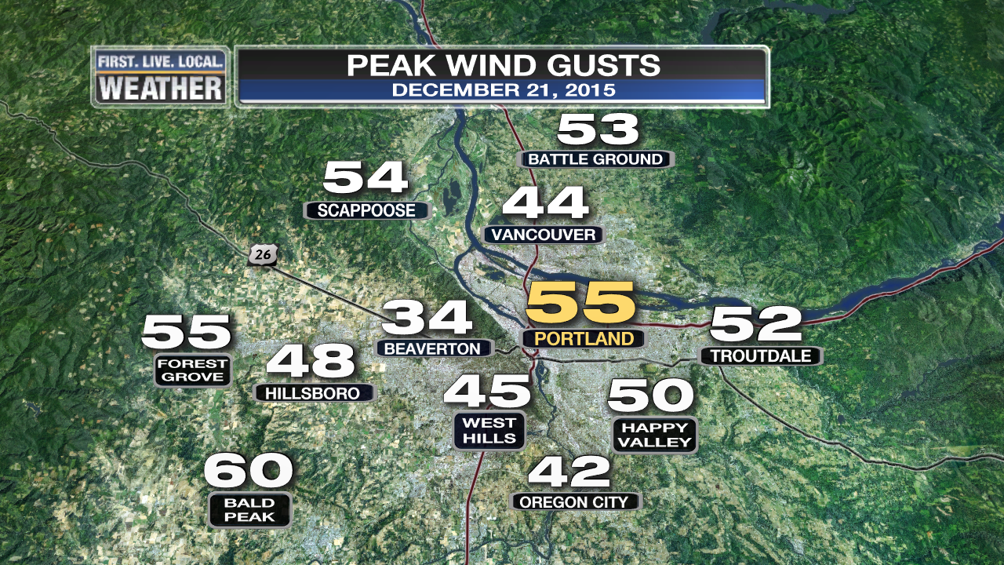
December 21st Wind Storm
Deep low pressure tracks west to east across southern Washington
Relatively minor storm: 35,000 PGE outages at peak

Slide 38
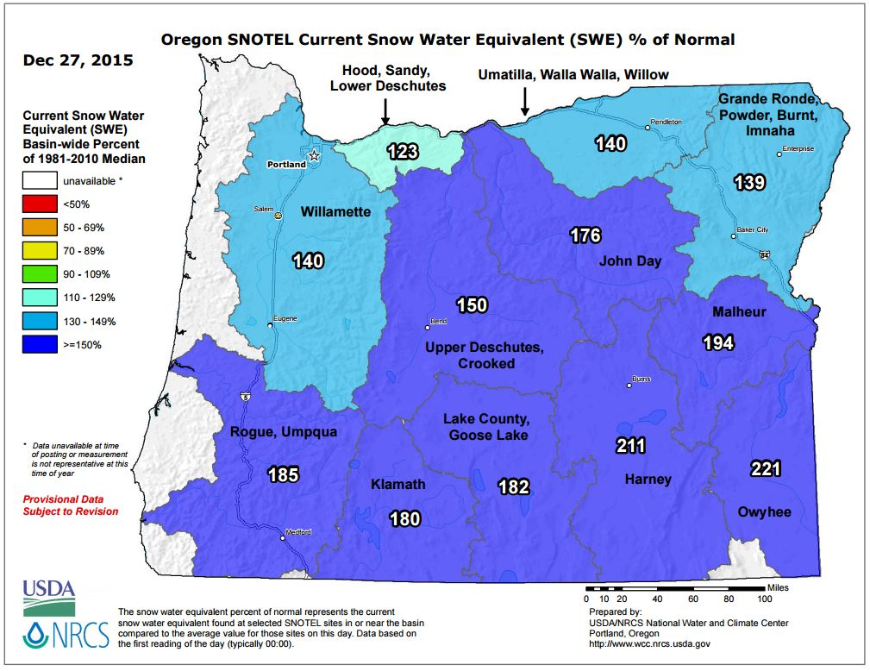
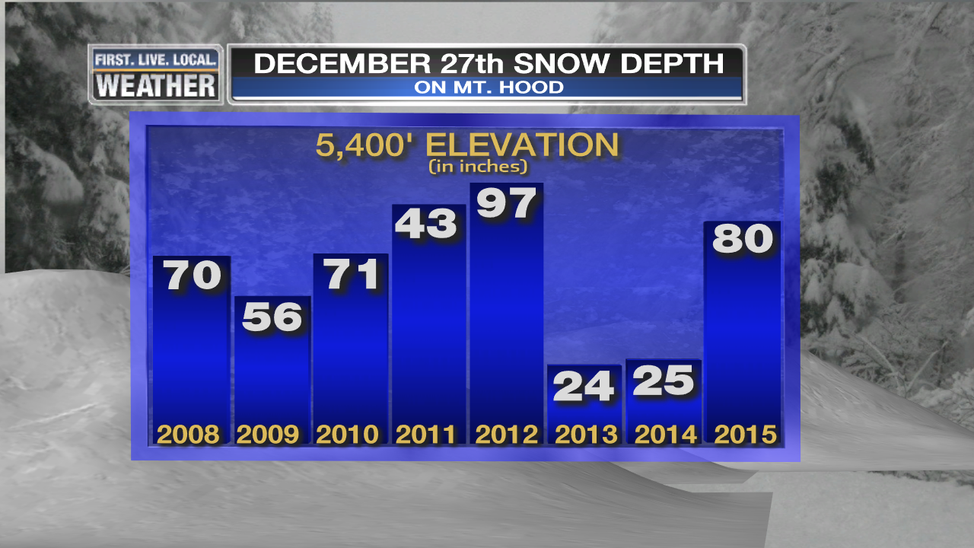
SKI SEASON
Widespread Openings After 2nd Weekend of December
Excellent Conditions Rest of December: Dec 22nd
2nd Year With An Excellent Christmas Break!

Slide 39
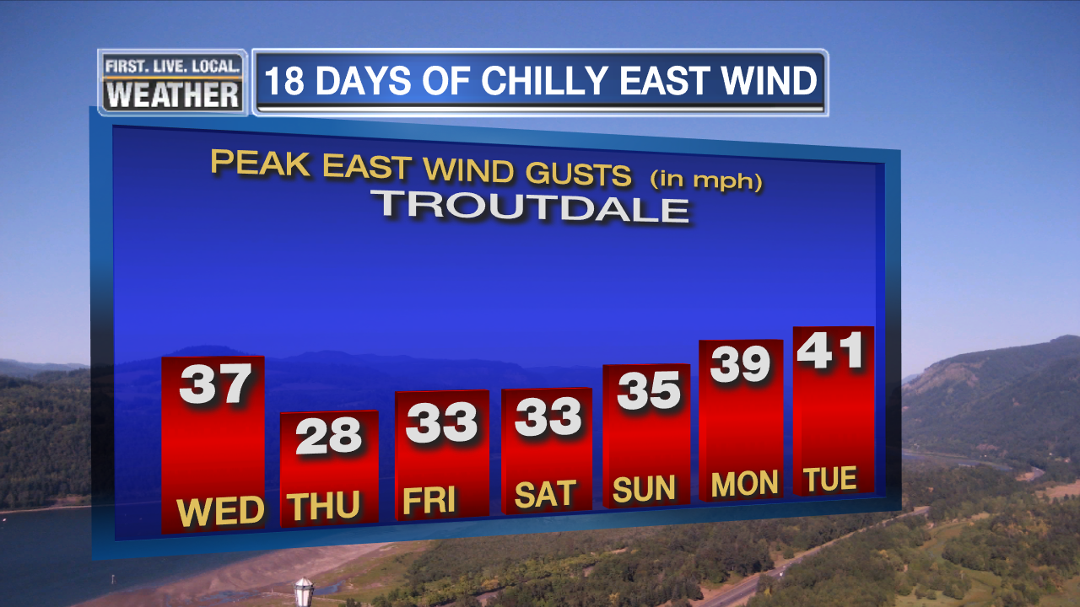
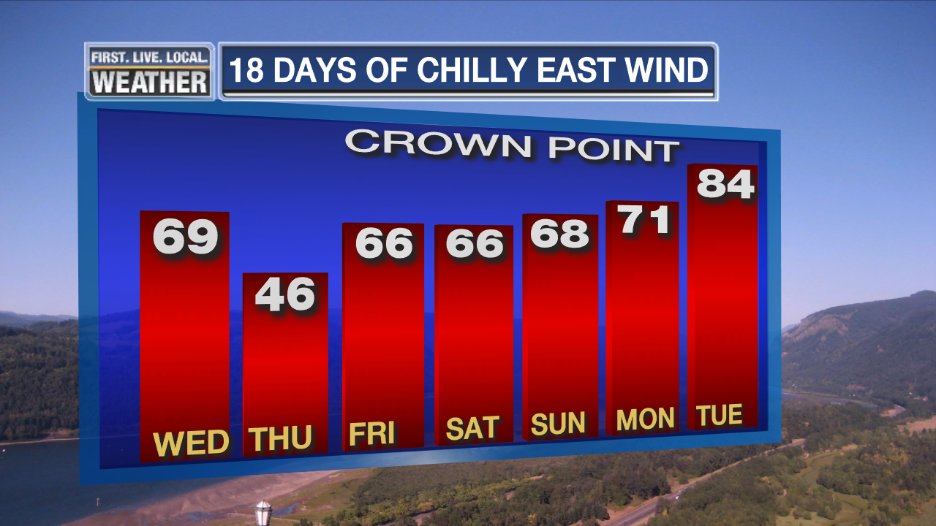
JANUARY & FEBRUARY
Move along, nothing to see…
EXCEPT, a nice little snow/ice storm early January
& gusty east wind for 18 days Christmas to January 12th

Slide 40
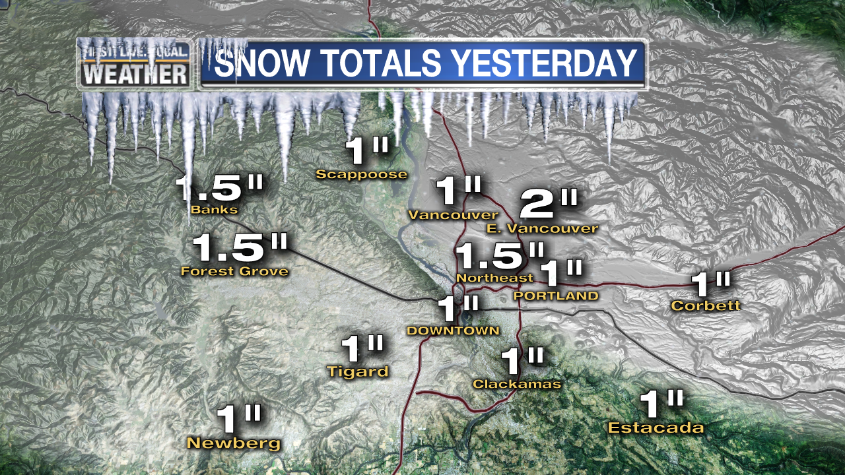

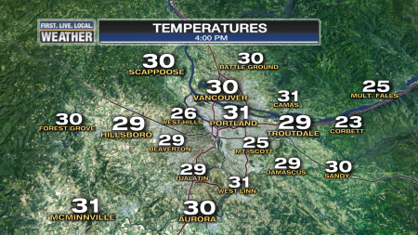
JANUARY 3RD SNOW/ICE
First time in 2 years we get a frozen/snowy day in Portland…from “FAKE” COLD too!
Airmass spilling through Gorge gradually cooled over 4 day period. Cold air formed over Pac. Northwest

Slide 41
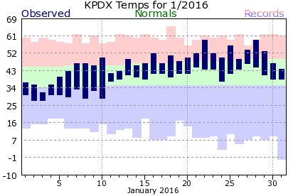
JANUARY
Rest of month was uneventful
A very warm month after the 10th, no freezing last 20+ days

Slide 42
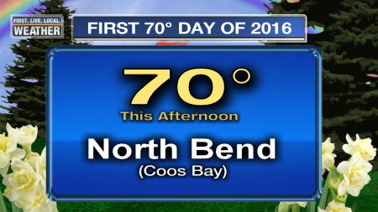
JANUARY
First 70 of the Year In Oregon
January 21st, temps around 70 on the coast

Slide 43
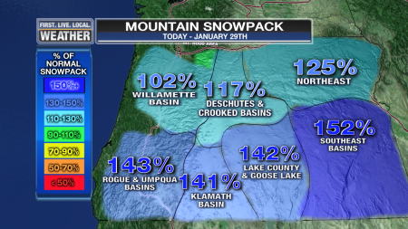
JANUARY
Mild temps take toll on snowpack
Percent of normal drops significantly during month

Slide 44
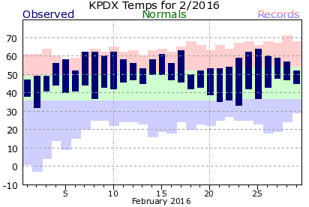
FEBRUARY
Very warm, but near normal precipitation
Last Frost was on February 2nd
* EARLIEST ON RECORD AT PDX *

Slide 45
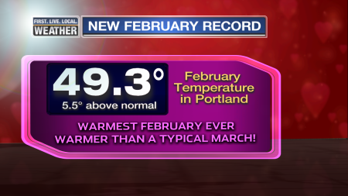
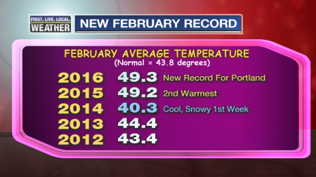

FEBRUARY
Very warm, but near normal precipitation
2nd Consecutive Record February in Portland
Forked
on 15th

Slide 46

FEBRUARY
Very warm, but near normal precipitation
Historic “Hot” Upper Level Ridge Around the 8th

Slide 47


FEBRUARY
Very warm, but near normal precipitation
Record Coastal Heat February 8th

Slide 48

FEBRUARY
Very warm, but near normal precipitation
Snowpack below average in NW Oregon by end of month

Slide 49



EL NINO
Lives up to its reputation in Cascades
Normal snowfall up high, below normal lower areas
Fewer “cold” storms

Slide 50


A Few Minor Windstorms
20 years without a regional MAJOR storm (Emphasis for Wolf)

Slide 51


Slide 52



Slide 53

1940-1995 = PDX 1996-Present = PQR

Slide 54

Downtown Data Only

Slide 55


Slide 56

Blue = Widespread Arctic Air Outbreak

Slide 57

Blob is Gone
But Warm Water Near Coast Remains

