Slide 1

2014-2015
Winter Weather
Wrap Up aka…”64 graphics in 20 minutes”
Mark Nelsen

Slide 2
The biggest dud in 10 years
But some nice windstorm action!

Slide 3
Quick Thoughts
Long periods of upper-level ridging nearby
No arctic blasts, although mid November maybe?
Total absence of cold post-frontal wet airmasses for 2nd consecutive year; snow level rarely dipped below 2,500’.
Warmest Winter On Record: Western OR/WA
Last COLD Month Was December 2013!
We are in a historic multi-year warm period

Slide 4
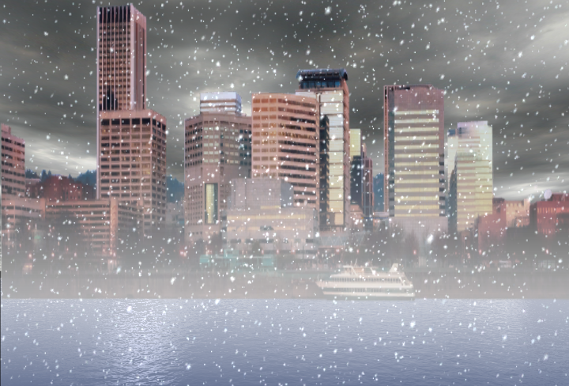
OFFICIAL
SNOW TOTAL
0.0”
No measurable snowfalls at PDX!
0.0” also at Downtown (KGW)

Slide 5
Snowfalls at PDX
Trace November 13th

Slide 6
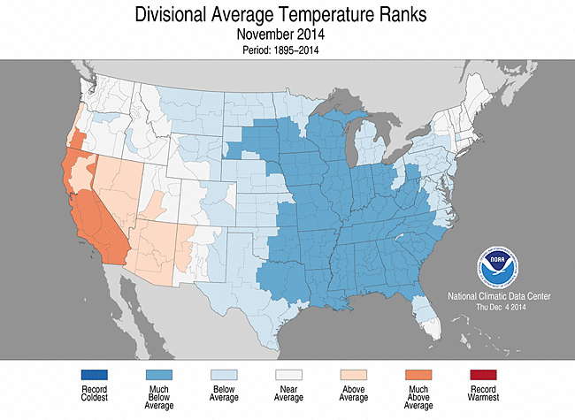
THE USA VIEW

Slide 7
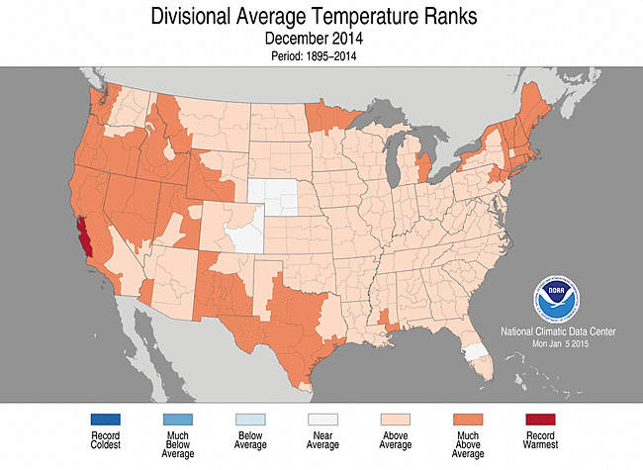
THE USA VIEW

Slide 8
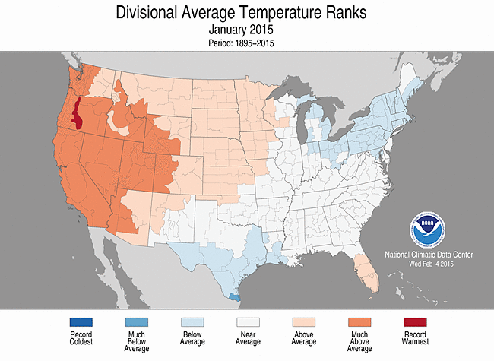
THE USA VIEW

Slide 9
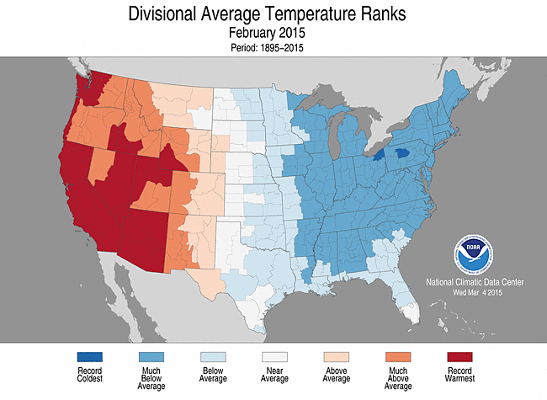
THE USA VIEW

Slide 10
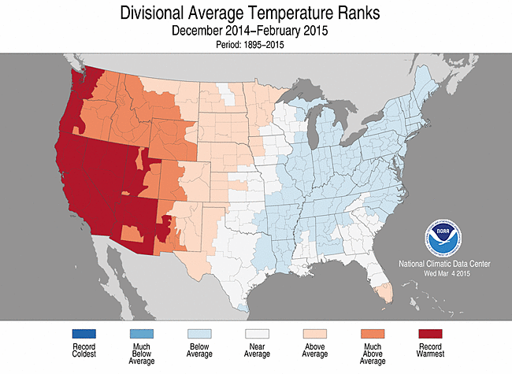
THE 3 MONTH PERIOD

Slide 11
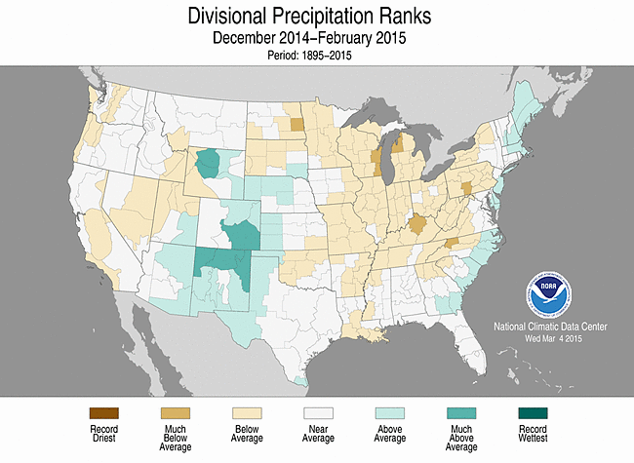
3 MONTH PRECIPITATION

Slide 12
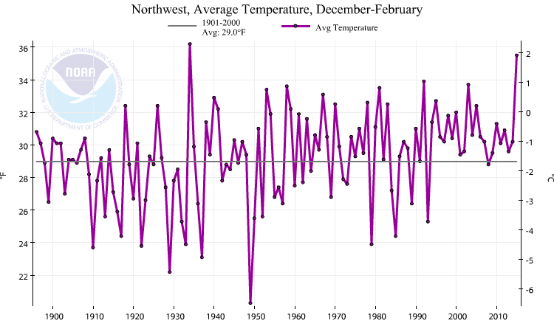
Pacific Northwest Winter Temps (the past 100 years)
2nd Warmest On Record

Slide 13
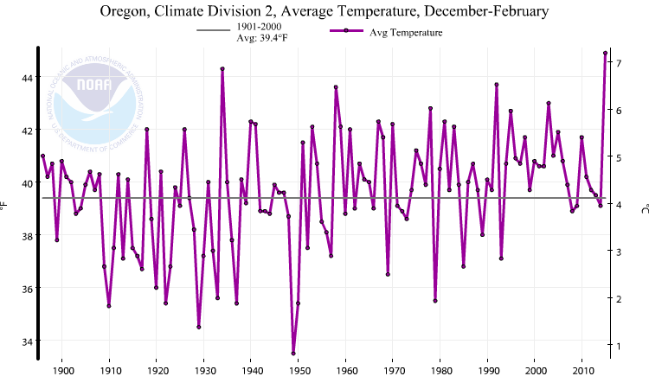
Western Valleys Winter Temps (the past 100 years)
Warmest You’ve Ever Seen!
Warmest on Record in Oregon Zone 2 (Willamette Valley)

Slide 14
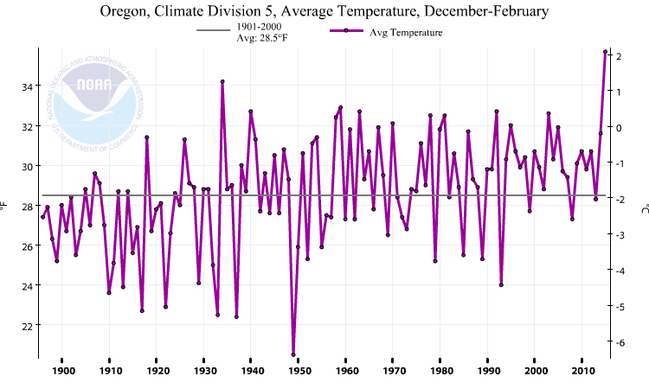
High Desert Winter Temps (Climate Zone 5)
Warmest on record as well

Slide 15
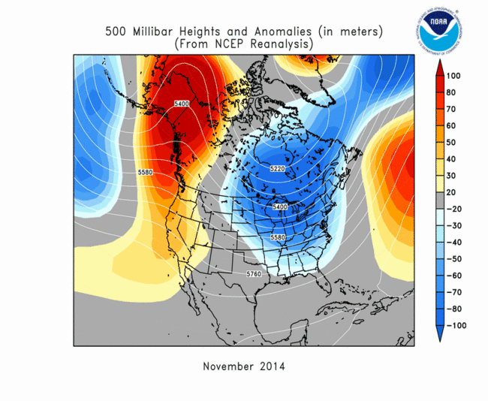
UPPER LEVEL PATTERNS
Ridging near west coast of North America: Pattern continued through March!

Slide 16
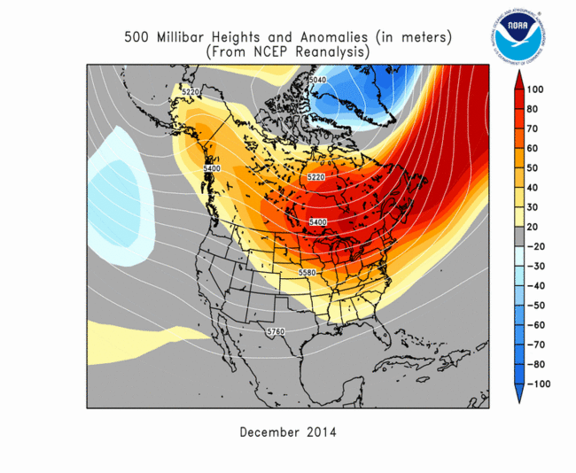
UPPER LEVEL PATTERNS

Slide 17
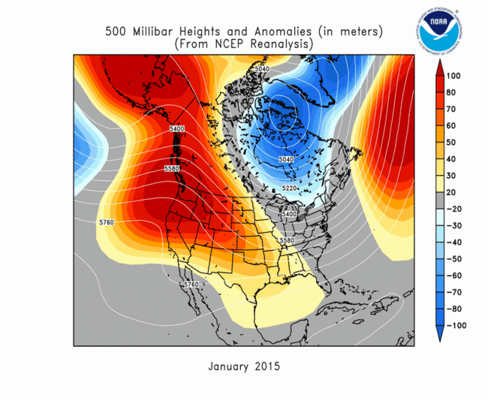
UPPER LEVEL PATTERNS

Slide 18
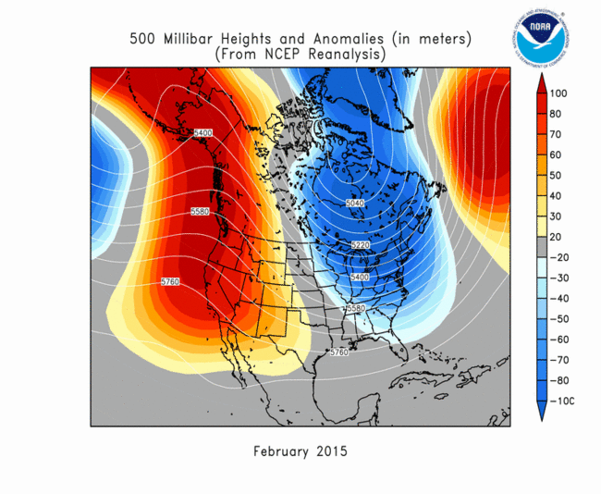
UPPER LEVEL PATTERNS

Slide 19
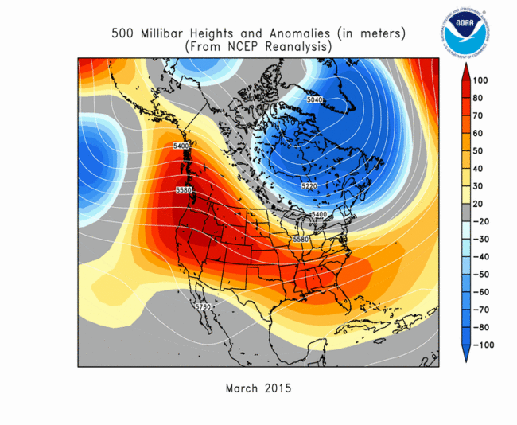
UPPER LEVEL PATTERNS

Slide 20
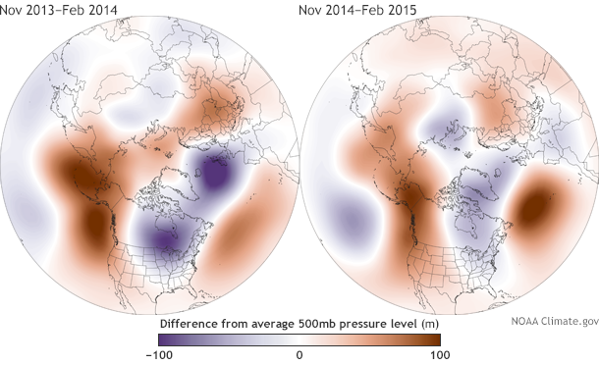
Two Winters Dominated By Upper-Level Ridging

Slide 21
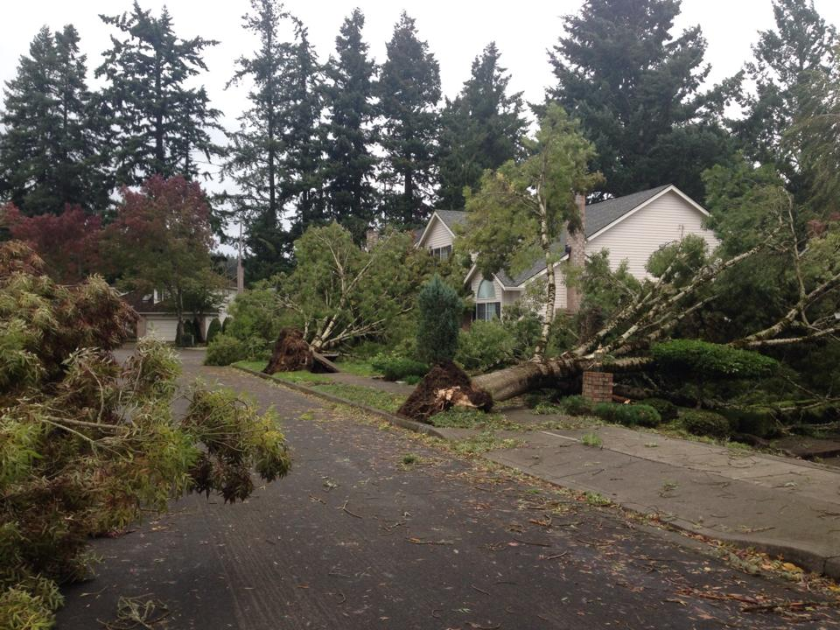
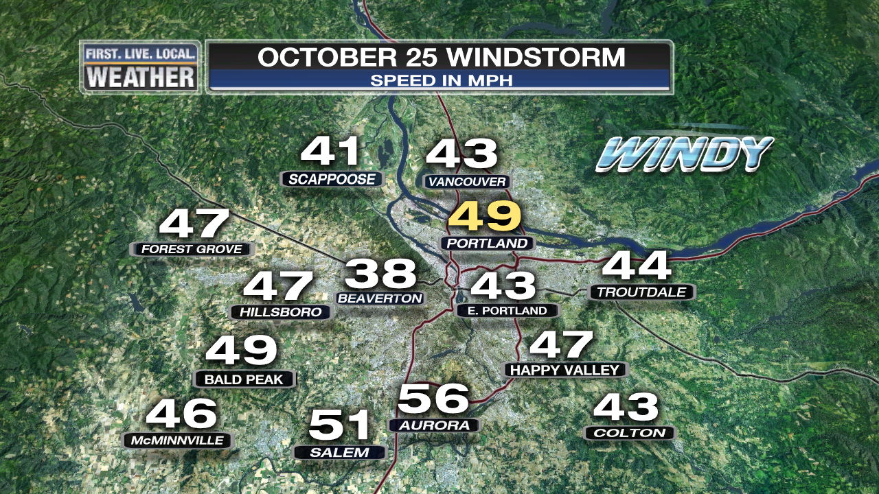
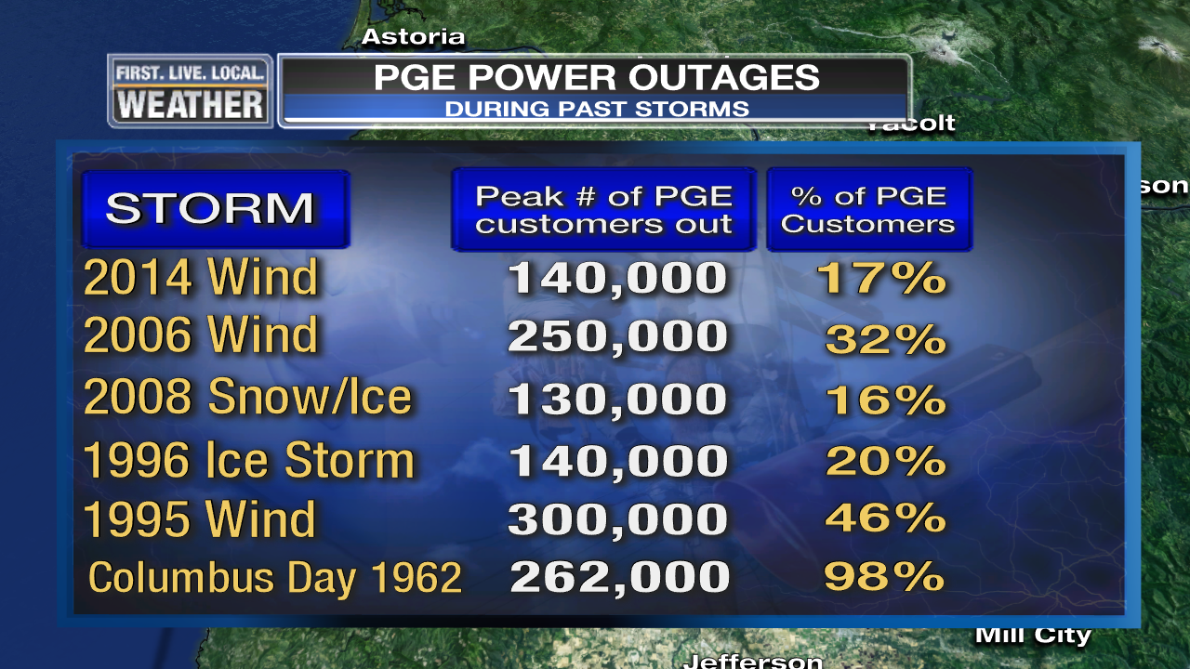
REMEMBER “MEETING DAY” LAST FALL?
A Windstorm! Stormy season starts with a bang
  Lots of tree damage due to leaves on trees
  Strongest October windstorm in 20+ years
  All PGE customers back online in 2.5 days, biggest wind disruption since 2006

Slide 22
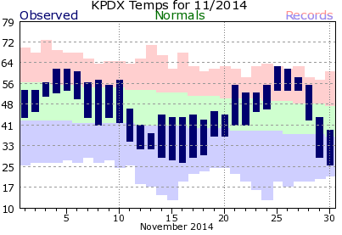
NOVEMBER
Unusually Warm > Record Cold > Record Warm > Then Cold
    Wild swings in temperatures
60s to 30s to 50s/60s

Slide 23
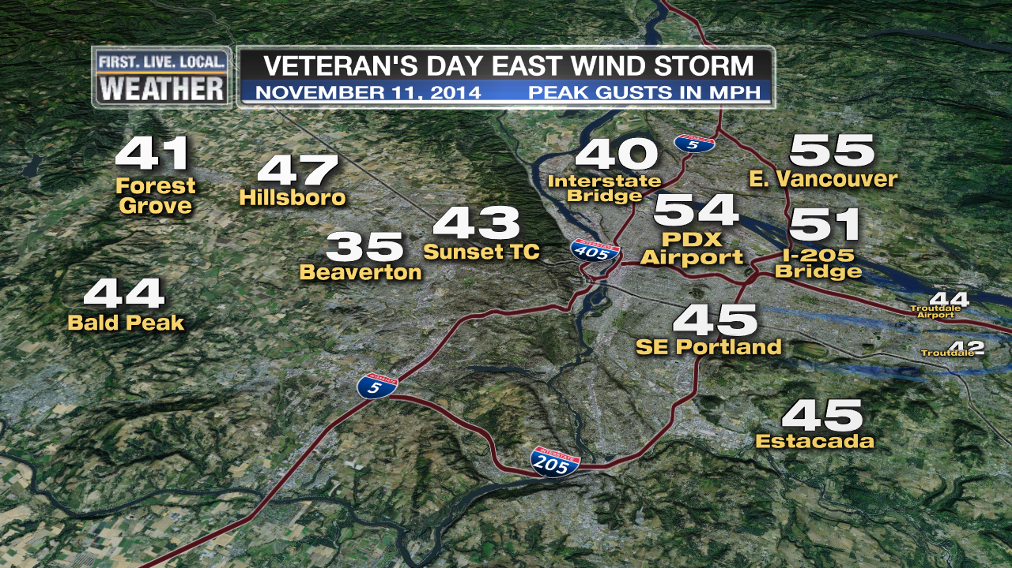
NOVEMBER
Veteran’s Day East Wind Storm
Strongest east wind gust at PDX in 8 years

Slide 24
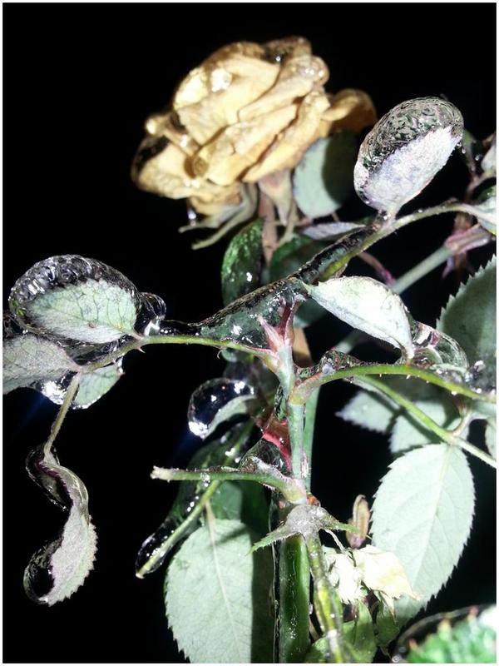
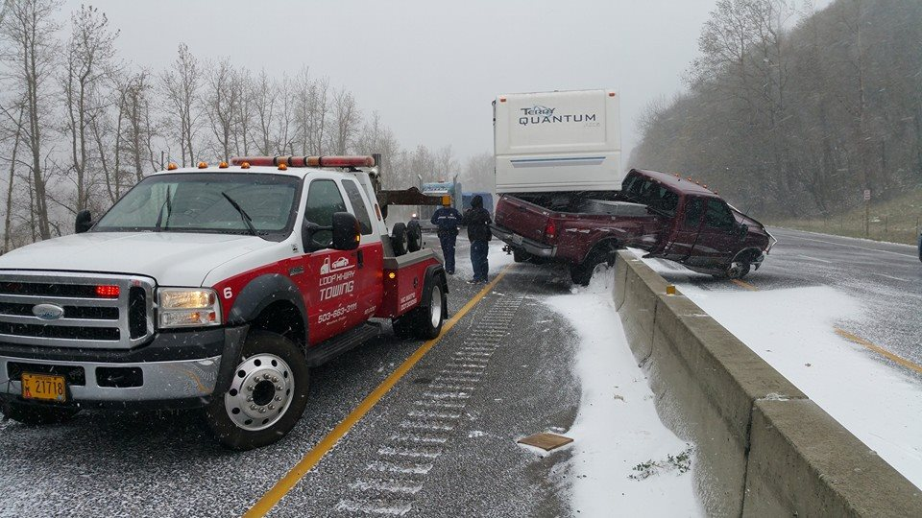
NOVEMBER
Earliest “Arctic Blast” In Years
Damaging early freeze and unusually early ice/snow

Slide 25
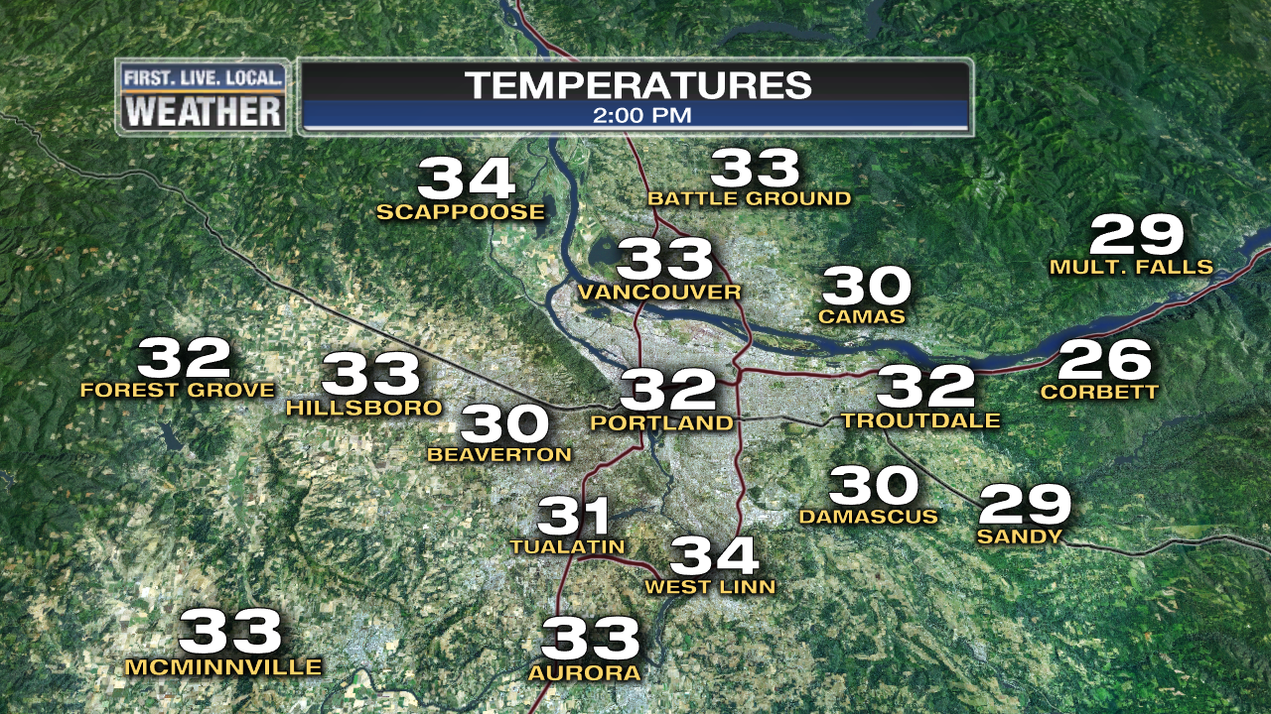
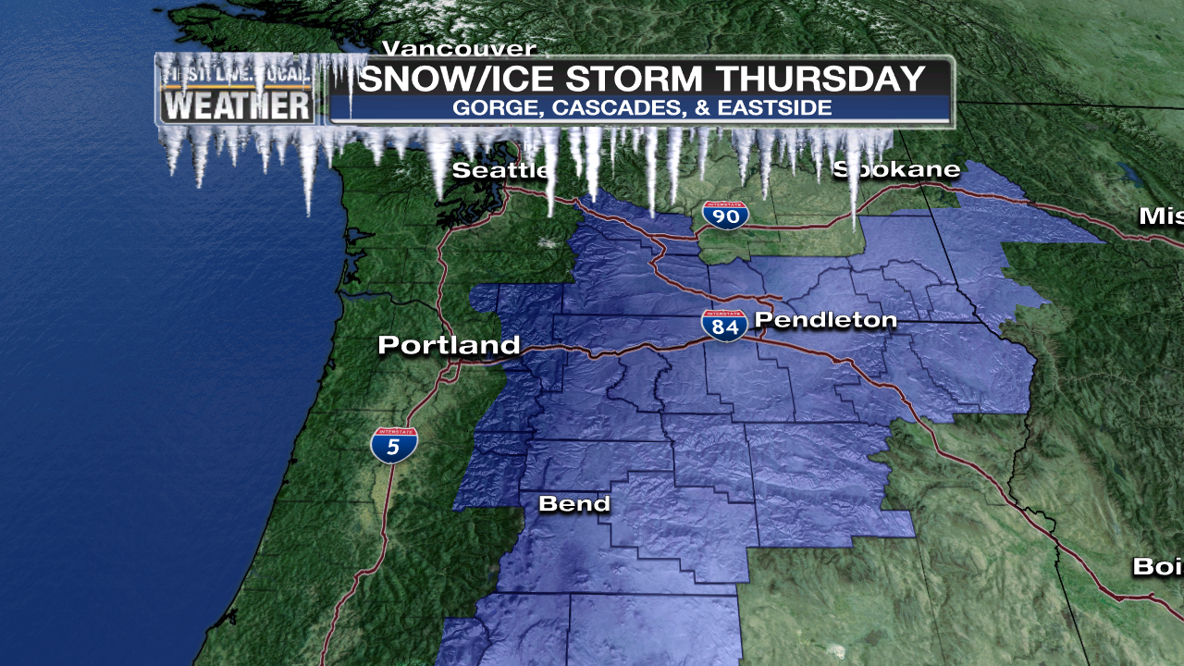
NOVEMBER
Snow/Ice storm in Gorge & Eastern Oregon
Winter Storm Warnings…On November 13th!

Slide 26
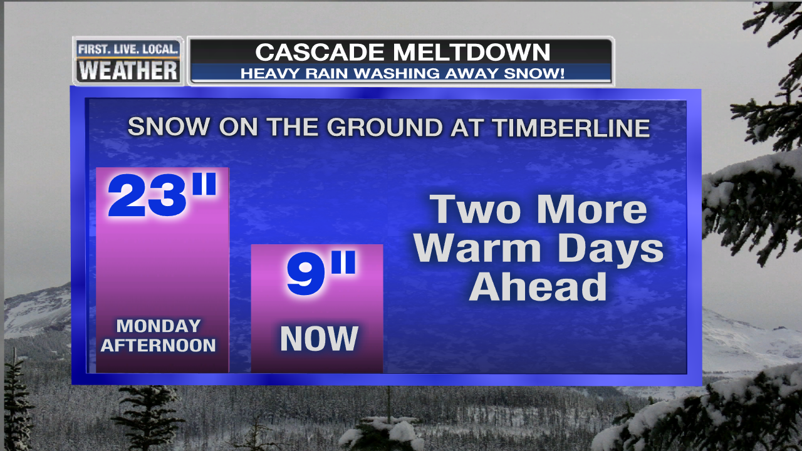
NOVEMBER
1st of Several Winter Mountain Rain Events hits Cascades
      2’ of snow reduced to just a few inches…total on the 25th below
      No widespread ski area openings in November

Slide 27
DECEMBER
Near normal rain
A warm month…
Portland’s 2nd warmest December
27 consecutive days without a frost

Slide 28
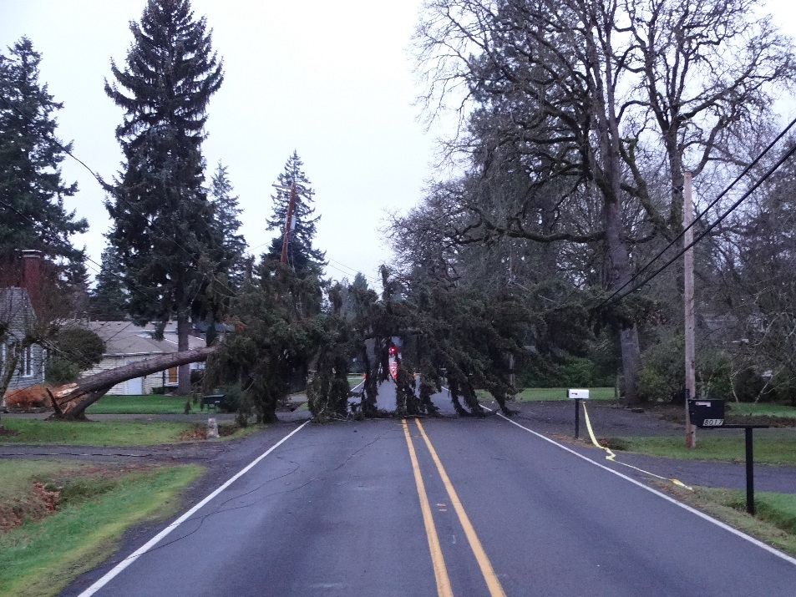
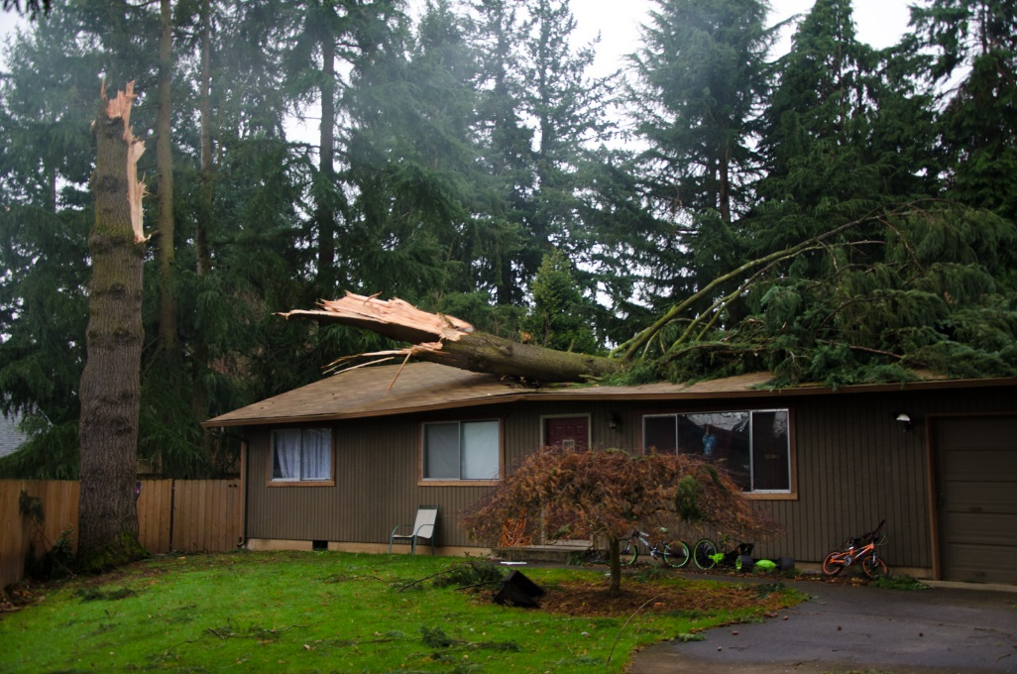
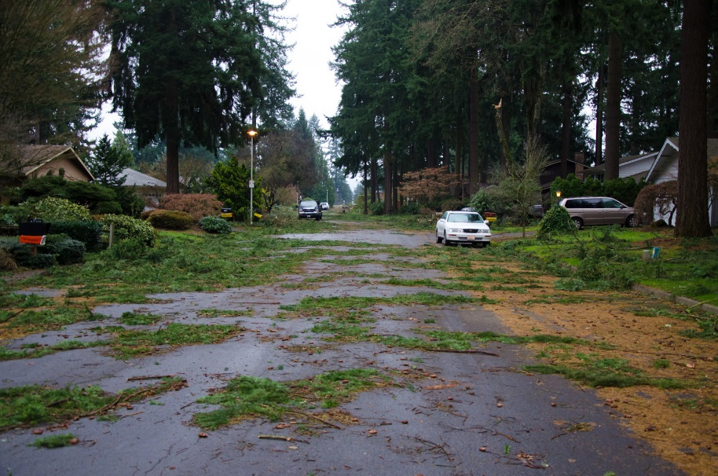
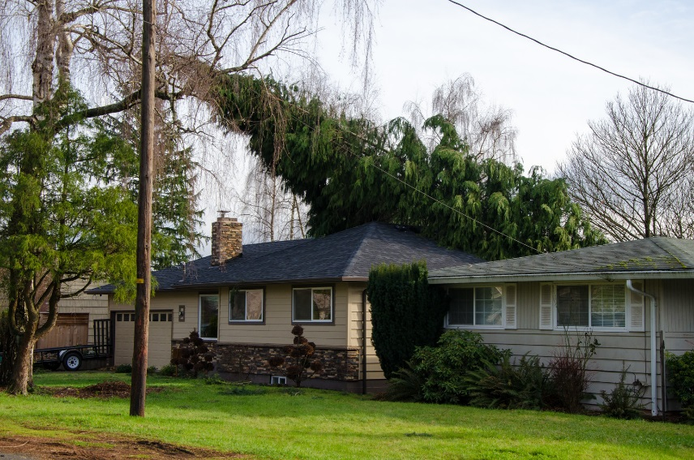
December 11th Wind Storm
Vancouver & N. Portland hit hard, not so bad elsewhere

Slide 29
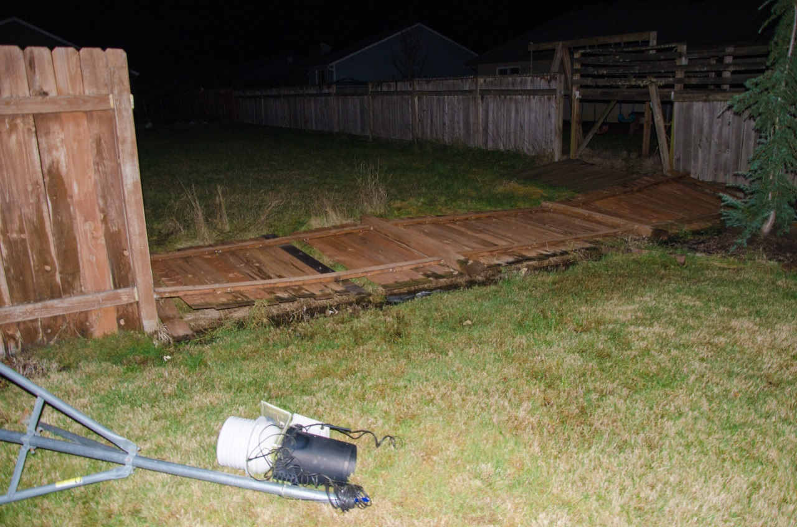
December 11th Wind Storm
The Horror!
Tyler Mode’s Davis instruments toppled in Battle Ground.
They survived!

Slide 30
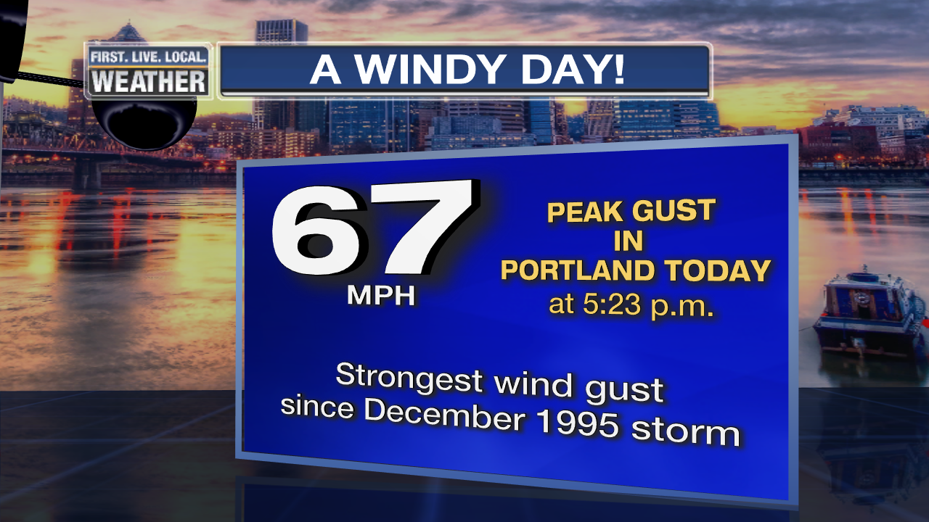
December 11th Wind Storm

Slide 31

December 11th Wind Storm
Apples & Oranges?
Strongest wind gust since the powerful Dec 12, 1995,
or (officially) November 14, 1981 storm.
During 1995 storm, ASOS measured 62 mph gust and “retired” anemometer reached 74 mph.
(ASOS used 5 sec. gust, the other was instantaneous)

Slide 32
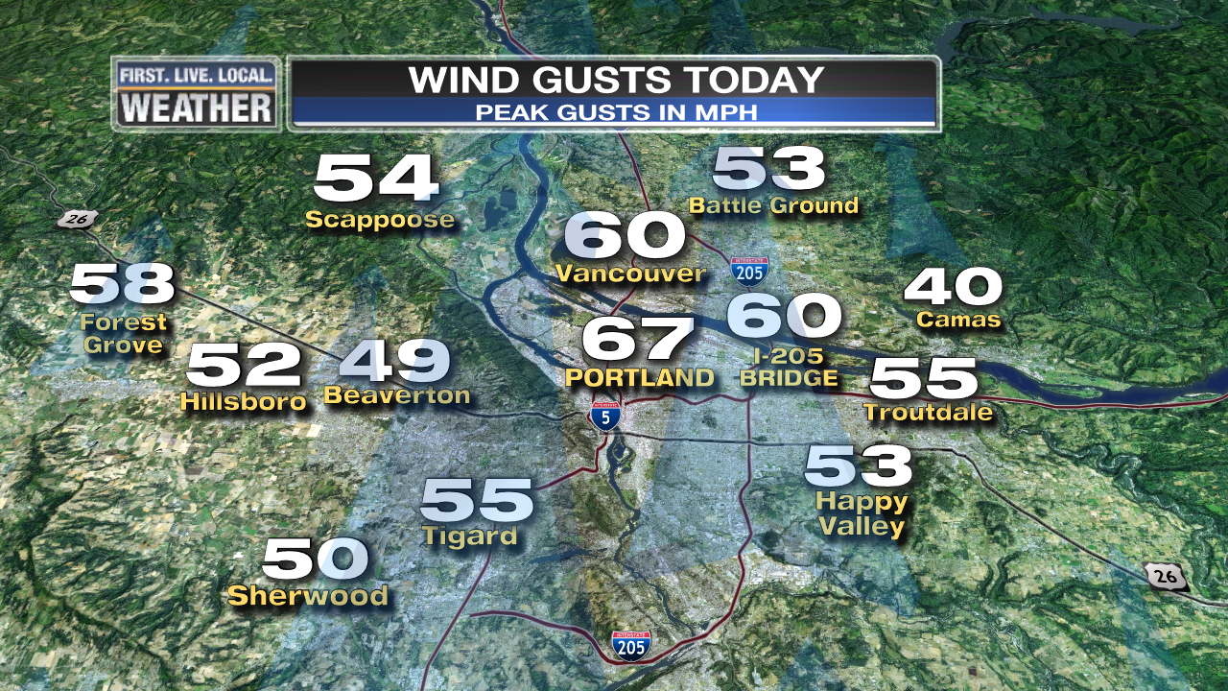
Wildest Wind Gusts: Seemed to be centered on metro area near Columbia River

Slide 33
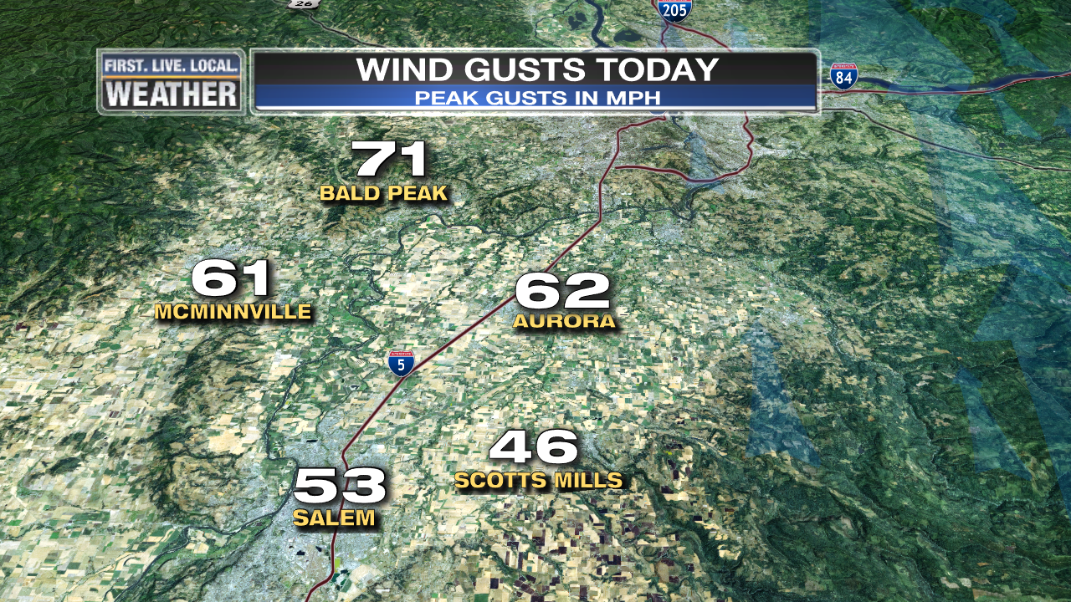
“Non-event” Salem-Eugene & at Coastline (an average storm)

Slide 34
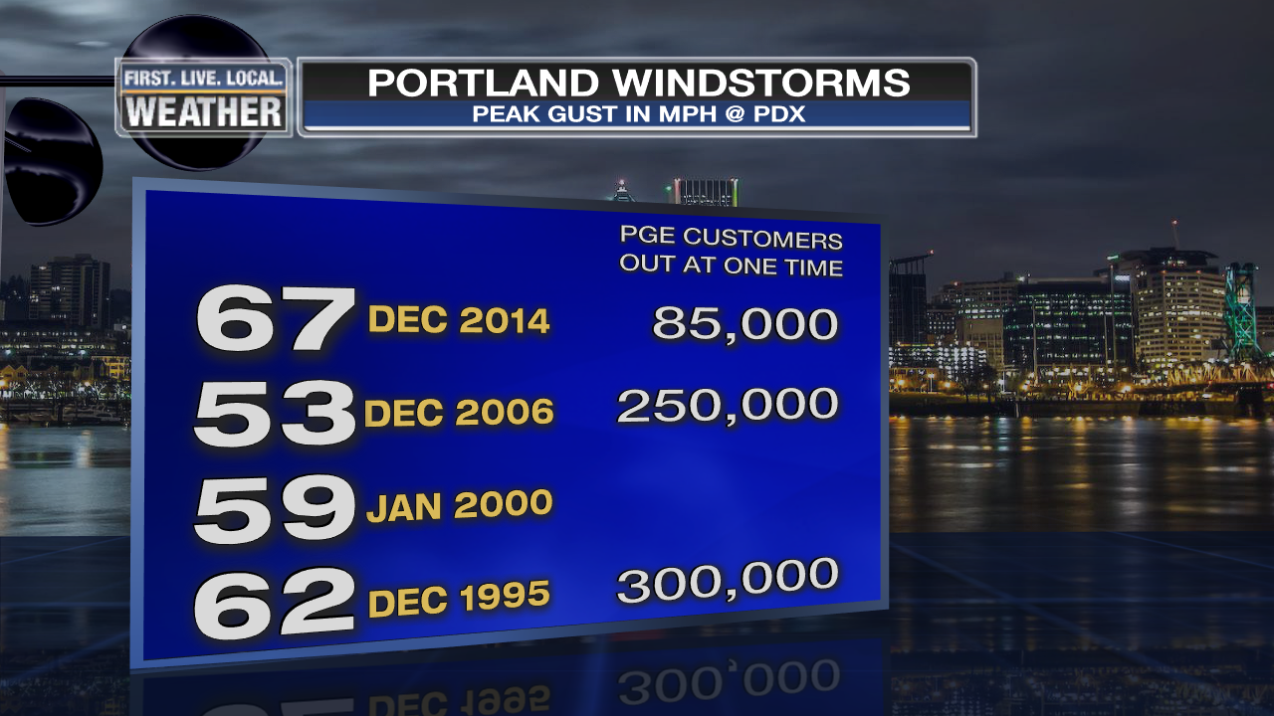
December 11th Wind Storm
Good measure of “non-regional” windstorm…
PGE outages
Just about all customers back online in 24 hours

Slide 35
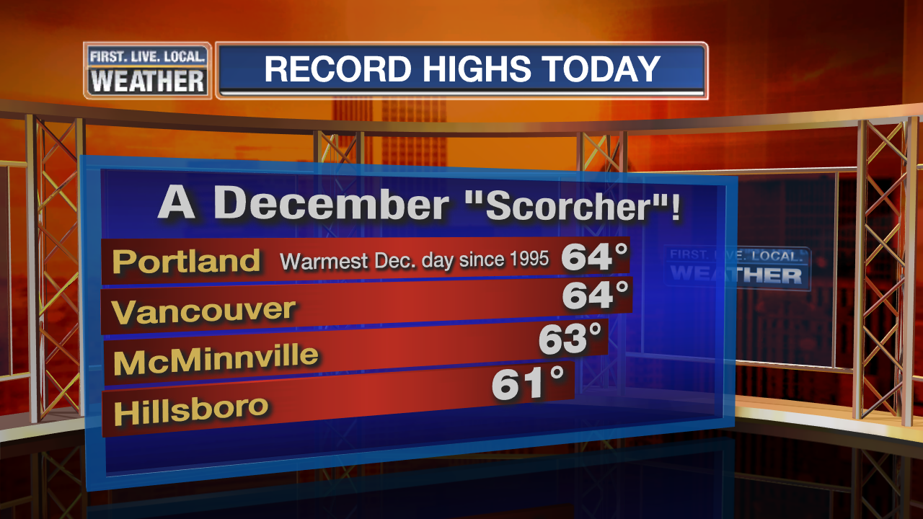
December 11th Wind Storm

Slide 36
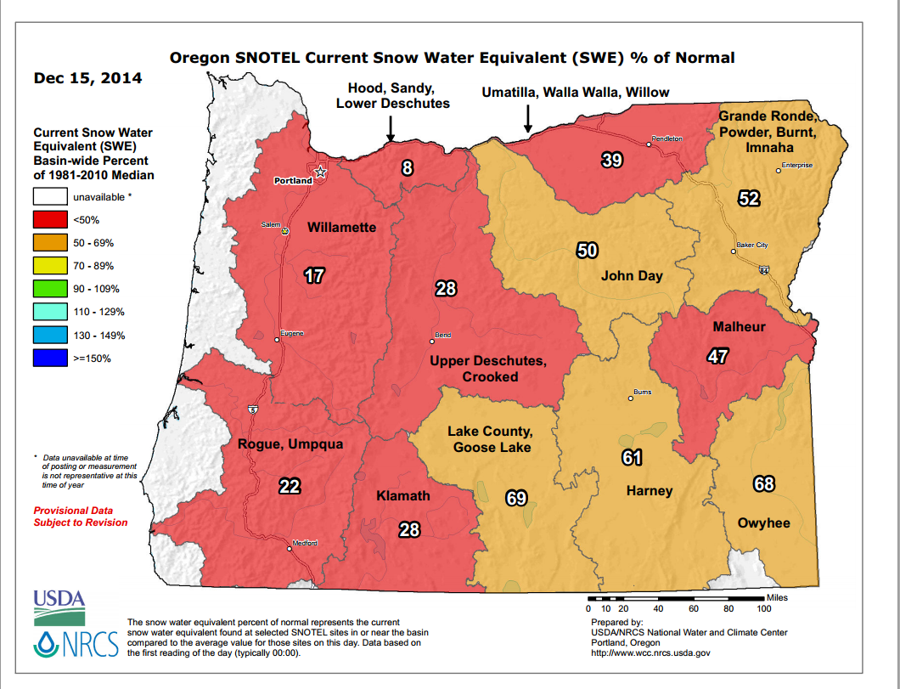
DECEMBER
Not too much weather action other than the wind storm
Surge of cold air early and late; neither really an “arctic blast”
But a terrible start to the ski season…

Slide 37
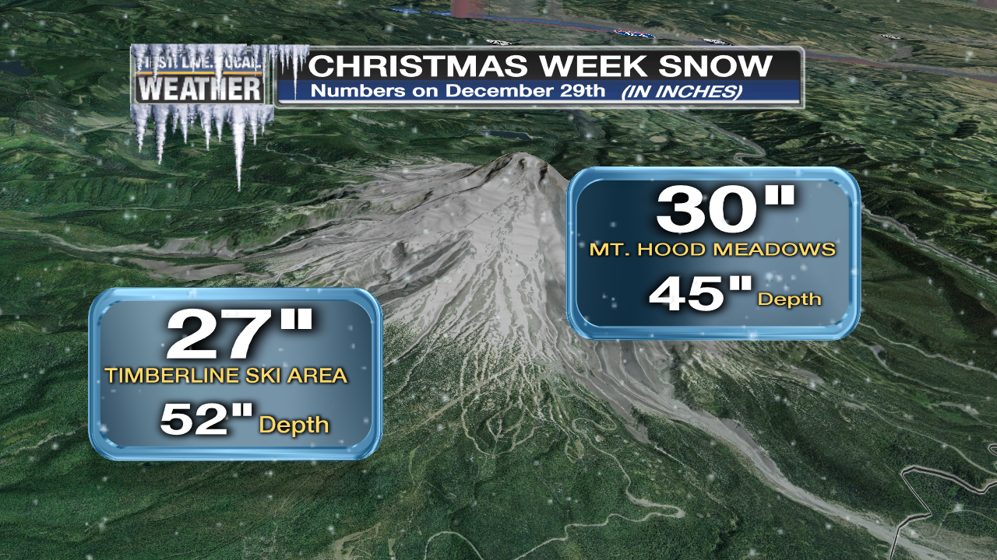
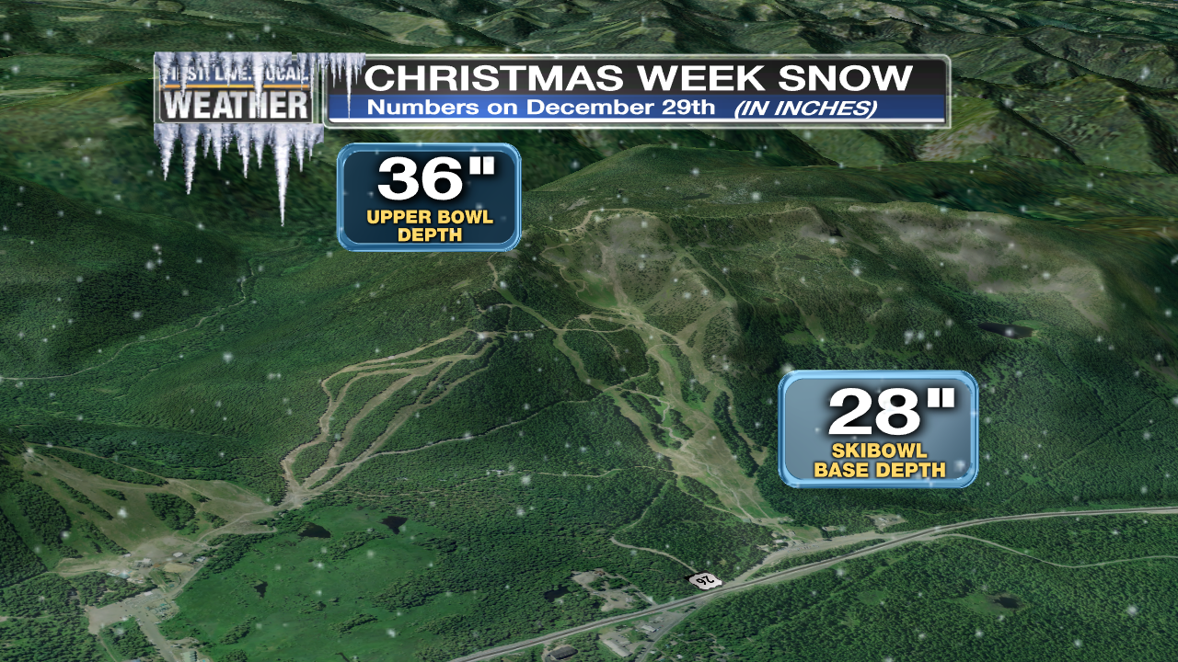
SKI SEASON
Worst start since 1980, possibly since 1976
Latest opening at Meadows in 20+ years = Dec 22nd
Heavy Snow saves most of Christmas Break…Whew!

Slide 38
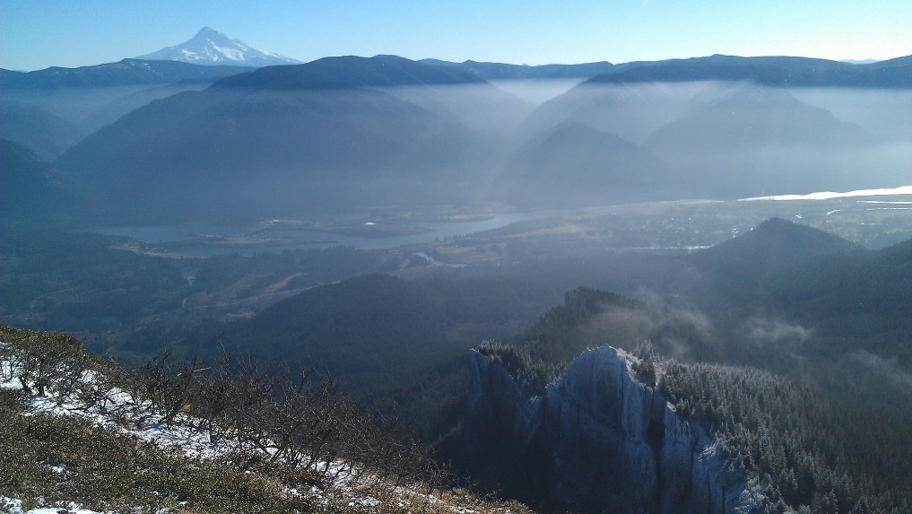
JANUARY
Move along, nothing to see here…
But some beautiful inversions!

Slide 39
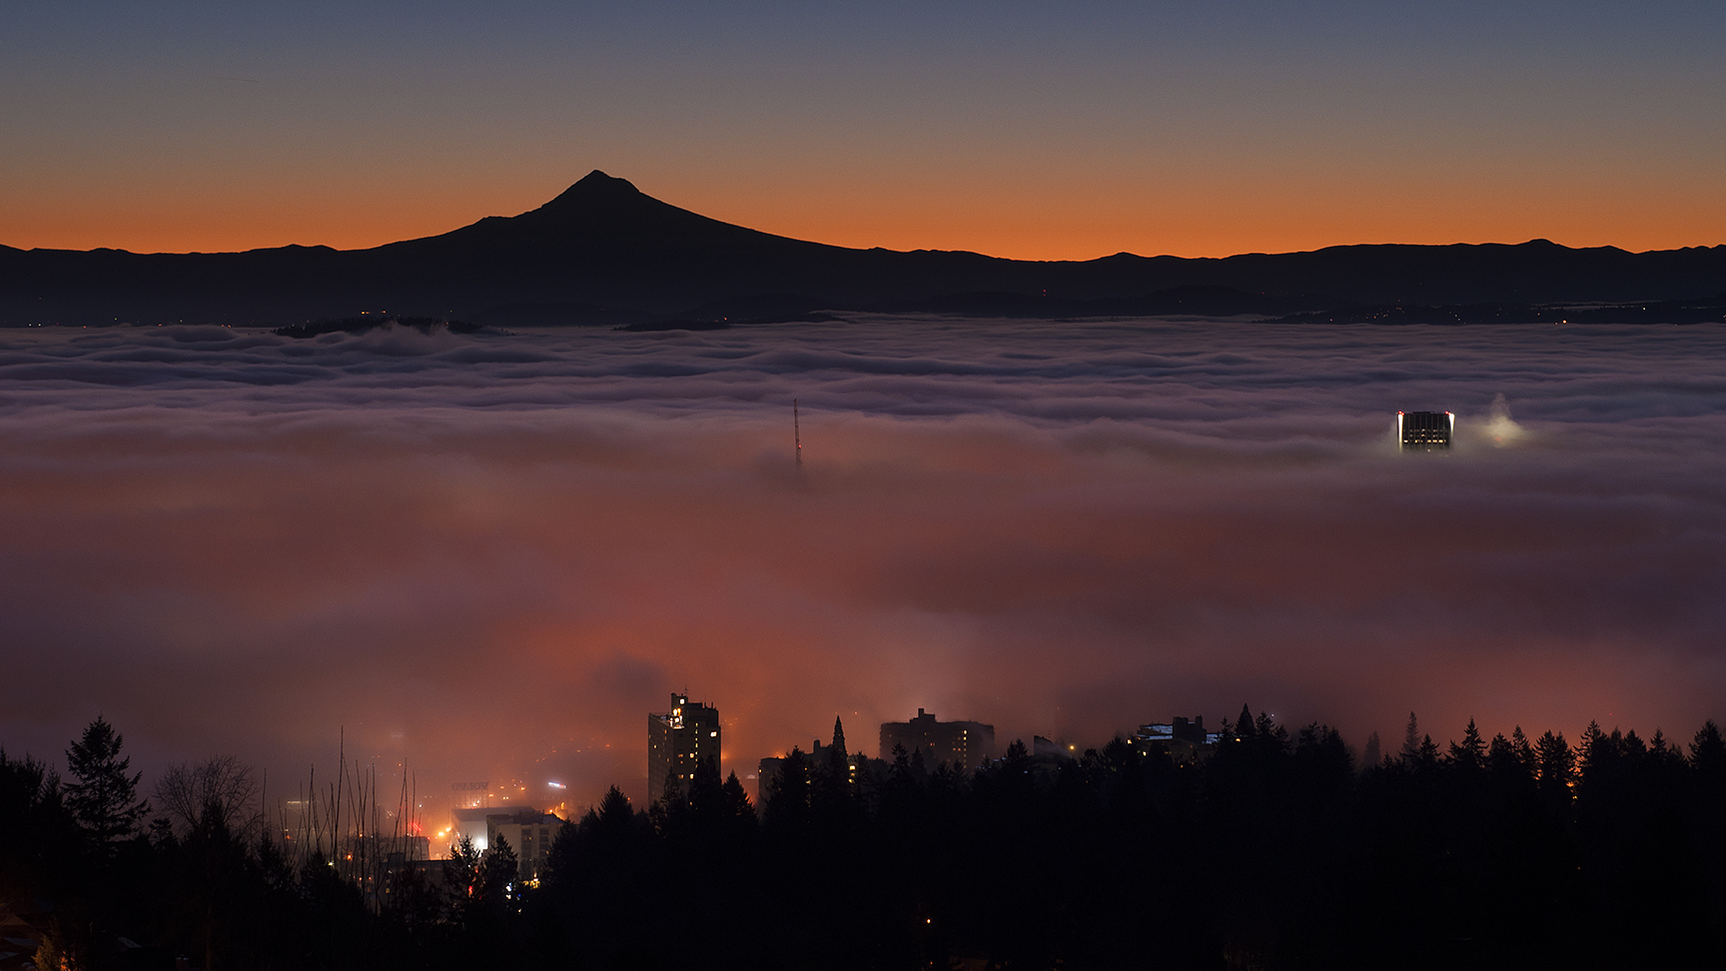
JANUARY
Lots of Fog…And Sun!

Slide 40
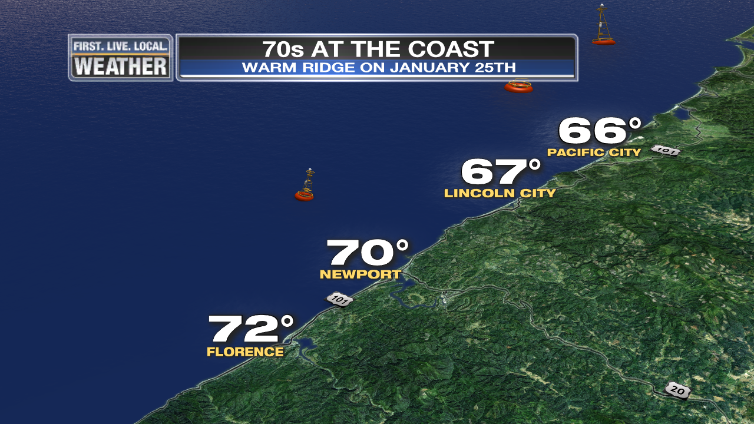
JANUARY
Book your beach trips for January, not July!

Slide 41
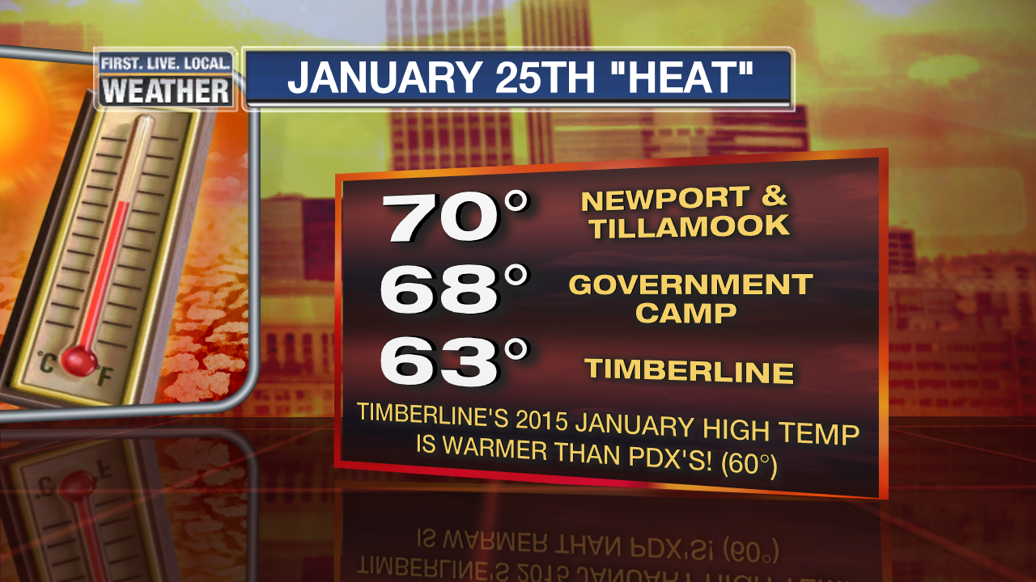
JANUARY
Amazingly warm mountains
Gov’t Camp Hit All-Time January High = 70 deg.

Slide 42
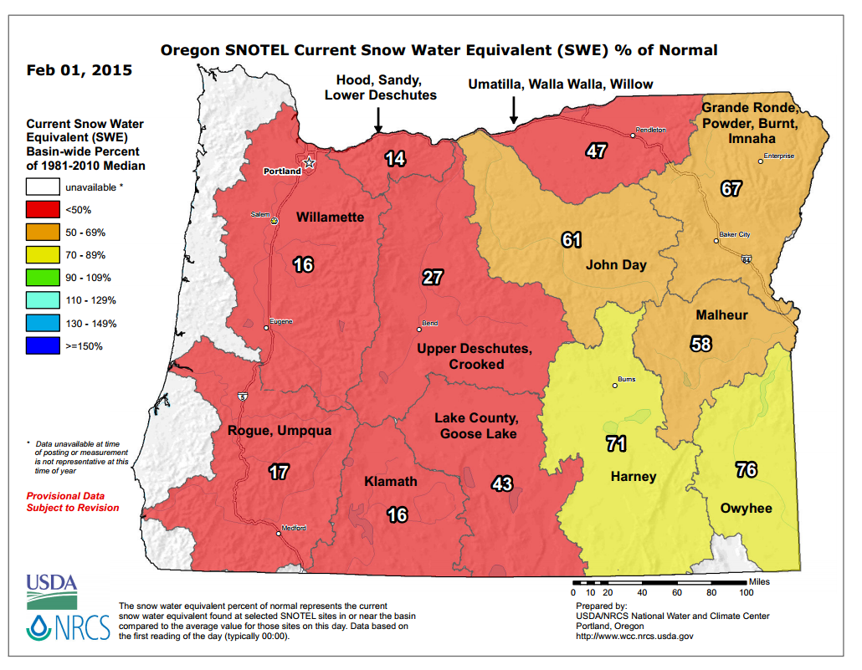
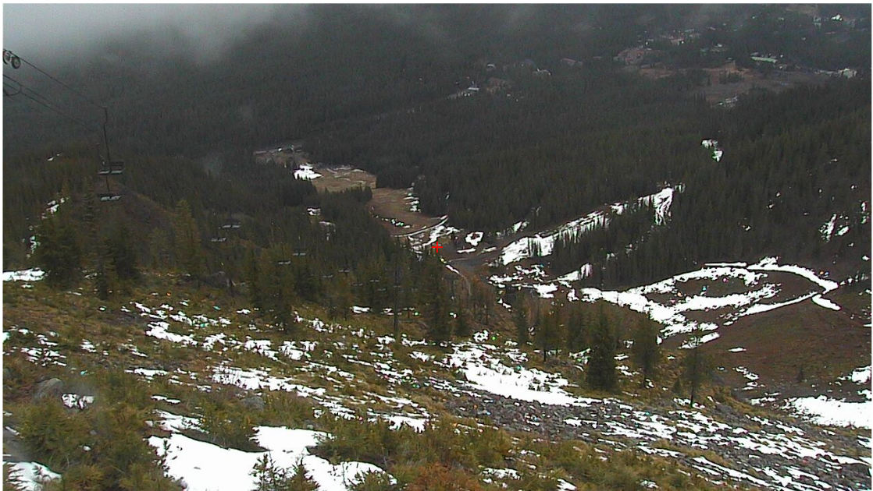
FEBRUARY
Heavy Rain 1st Week, Then Very Dry and Warm
View from 5,000 ft. on Feb. 2nd

Slide 43
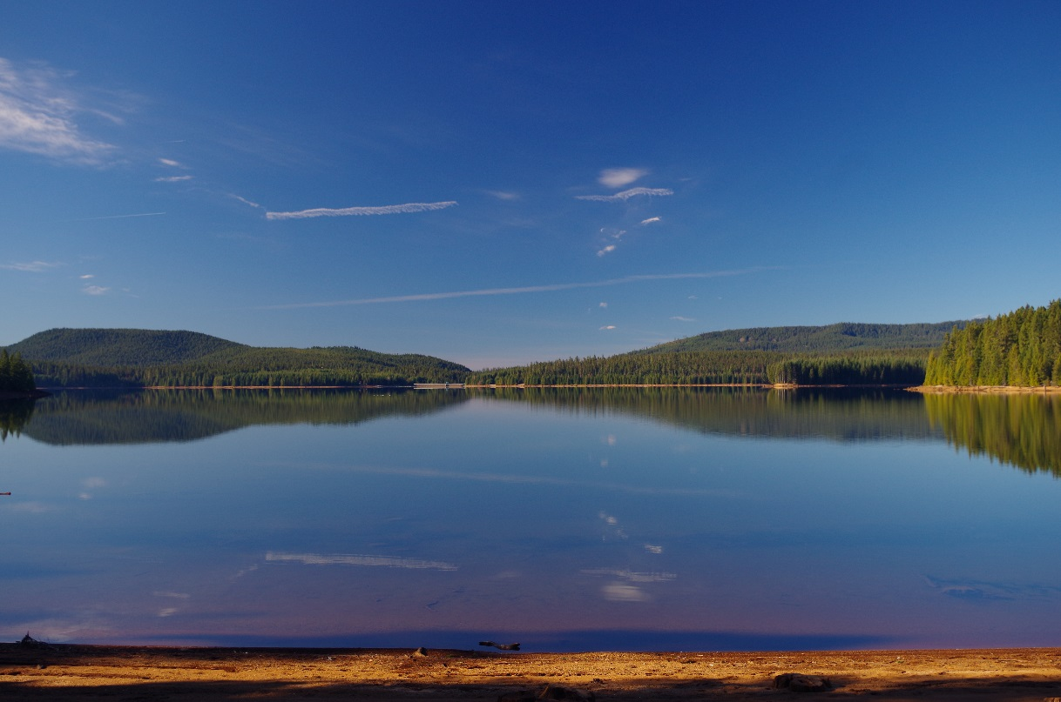
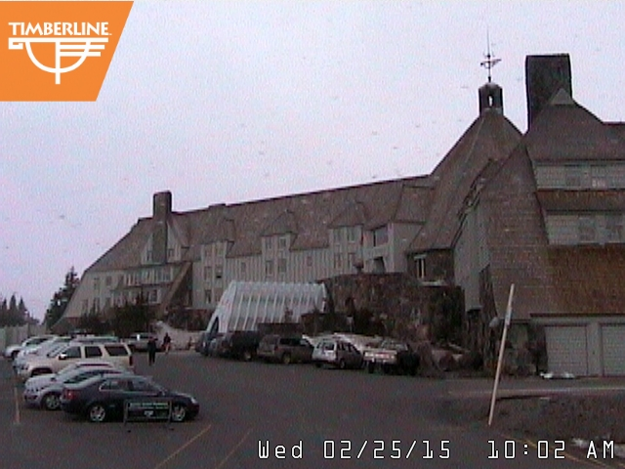
The View On February 24th-25th
Timothy Lake!

Slide 44
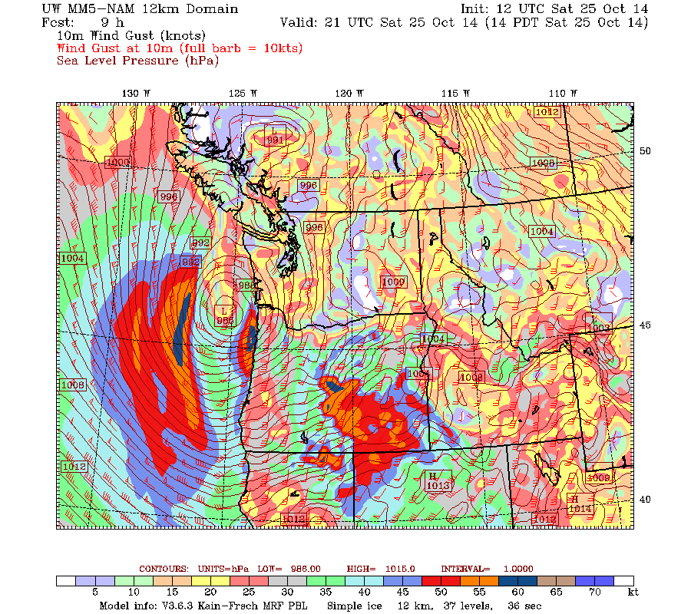
October Windstorm
1st Deep Low of the Season
~985mb Landfall north of Astoria

Slide 45
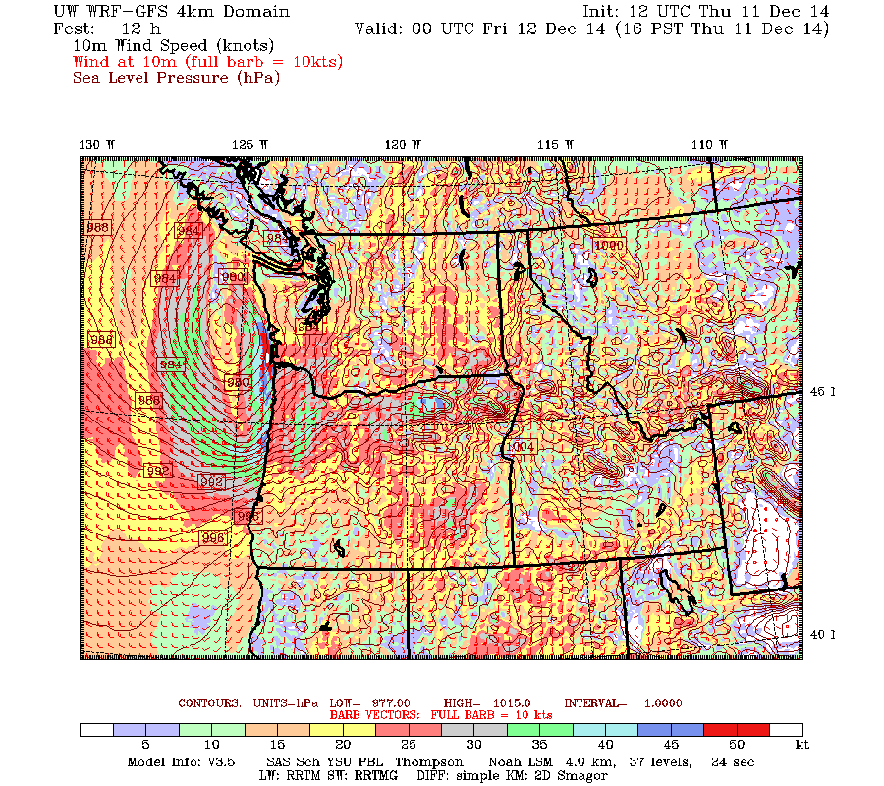
December Windstorm
2nd Deep Low of the Season
~978mb Landfall S. Vancouver Island

Slide 46
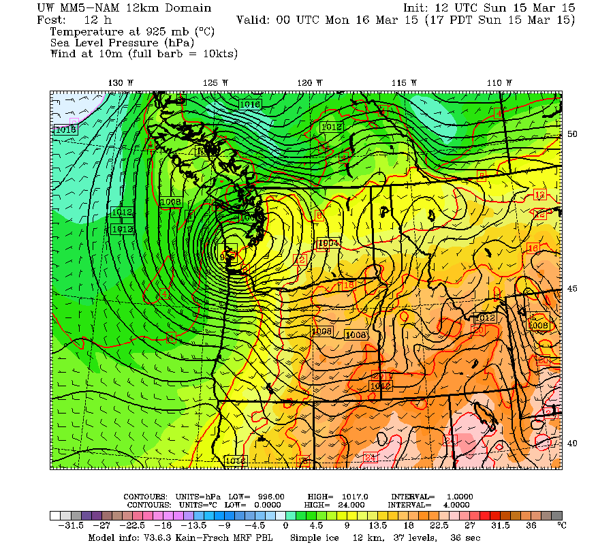
March Windstorm
3rd Deep Low of the Season
~995mb Landfall north of Astoria

Slide 47


We Had A Metro Wind Storm!
20 years without a regional major storm

Slide 48


Slide 49



Slide 50


Slide 51

1940-1995 = PDX 1996-Present = PQR

Slide 52

Downtown Data Only

Slide 53


Slide 54

Blue = Widespread Arctic Air Outbreak

Slide 55

Final Snow Survey…Worst On Record Many parts of Oregon

Slide 56

Mountain Snowpack @ 5,400’
Horrible…precipitation near normal through early February, then below as ridging became stronger. Mainly warm storms…only significant snow was 2nd half of December.
Courtesy
NRCS
Oregon Office
Precip: Thin Line = Average
Snow Water: Thin = Average
Mt. Hood Test Site

Slide 57

Our Historic Hot Summer
Hottest summer on record all of Washington and most of Oregon

Slide 58




HOT JUNE FREAK SHOW

Slide 59

Our Historic Hot Summer

Slide 60



Our Historic Hot Summer
THE GREAT SMOKE OUT
Densest smoke in years cover metro area from eastside fires
Saturday, August 22nd

Slide 61


TIME FOR SOMETHING NEW…
A LIGHTNING ROUND
OF WINTER FORECASTS
Organizations or individuals who can’t or don’t want to be here.
OR
They don’t know (or care) that we exist.

Slide 62
TIME FOR SOMETHING NEW…
A LIGHTNING ROUND
OF WINTER FORECASTS
Old Farmer’s Almanac
Farmer’s Almanac
Accuweather
Pete Parsons (OR Dept of Ag)
Rod Hill (KGW)
WeatherBELL

Slide 63

Old Farmer’s Alamanac
Huh?…make sure you note all those details!

Slide 64

Farmers’ Alamanac
A little easier on the eyes

Slide 65

AccuWeather
…rain deficit will continue
to build in
the Northwest…

Slide 66

Oregon Dept of Ag/Forestry
(Pete Parsons)
Top Analog
Years
All Strong
El Nino
winters
1987-1988
1991-1992
2004-2005
Above average temperatures, but not nearly as warm as last year.
About 70-80% of average precipitation and mountain snow.
Brief cold periods possible, but extreme/prolonged cold unlikely.

Slide 67

Rod Hill’s Winter Outlook
Meteorologist – KGW & www.portlandweather.com
Near normal rainfall for Portland
with two possible snow events
dropping up to 8" of total snow for the season
1-4 high wind events
50-65 mph south valley wind gusts
Temperature averages will likely be above normal
To be clear, the "WILDCARD" of this up-coming winter is the snow level forecast.
…reason to fear that a warm weather pattern overall could produce another winter
of mostly rain at Government Camp instead of much needed snowfall.

Slide 68


WeatherBELL
“non-winter from
the Northwest
into the
northern Plains”
Top Analog
Years
In order of
importance
1957-58
2014-15
1997-98
2002-03

Slide 69

Goodbye Dr. John Walls!
1931-2015
WAS AT KOIN 1974-1986
Remember those cool maps that slid from right to left?
The forecast sky conditions throughout the day?
The first DAYPART forecast in P-Town!

