Slide 1
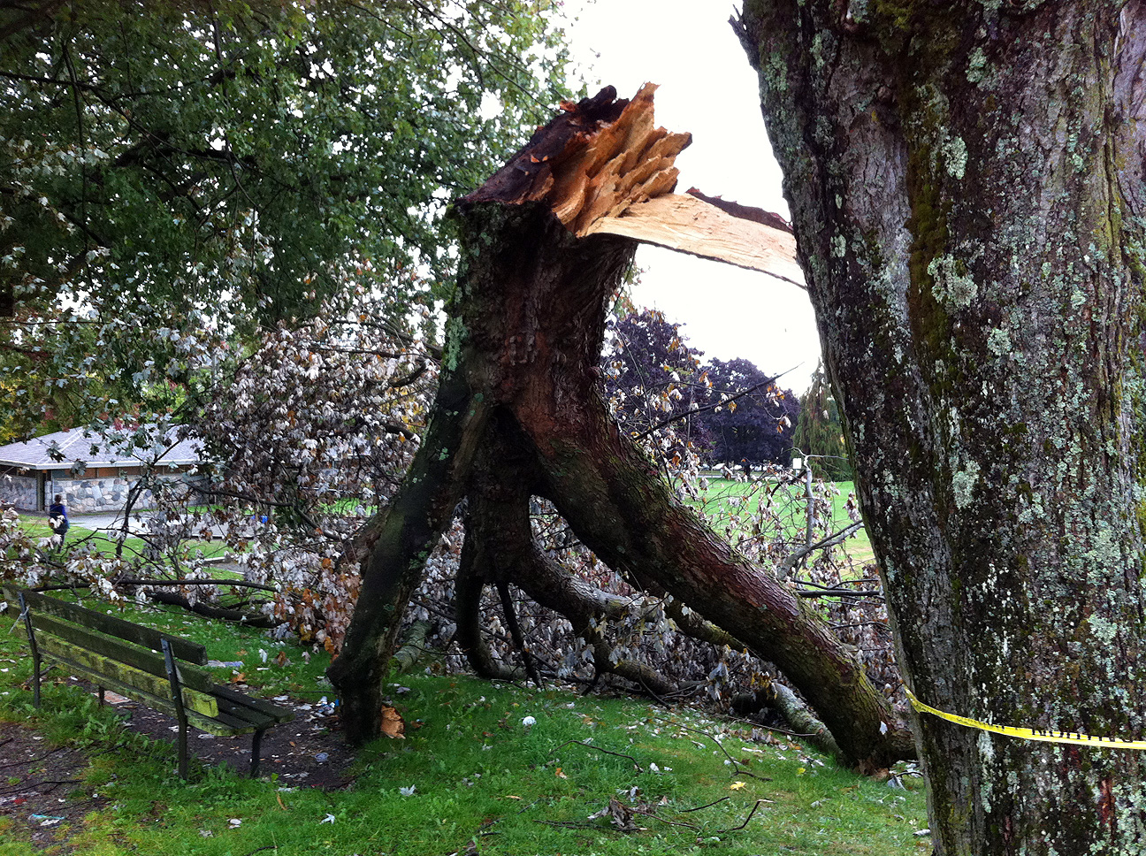
A Rare Summer Windstorm on 29 August 2015
Wolf Read, PhD
wolf@alumni.ubc.ca

Slide 2
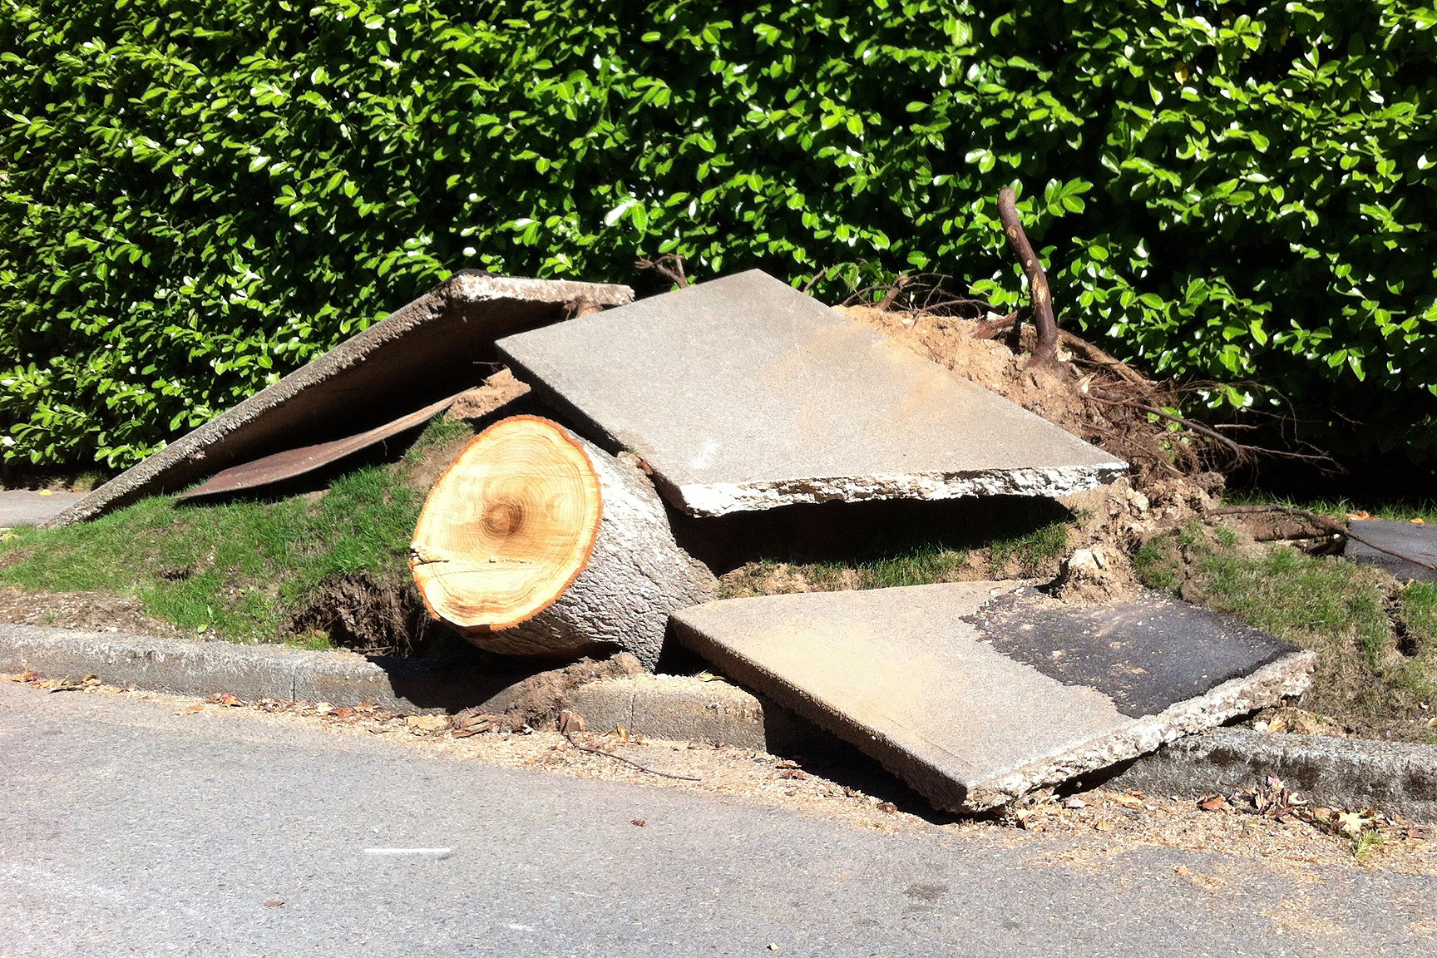
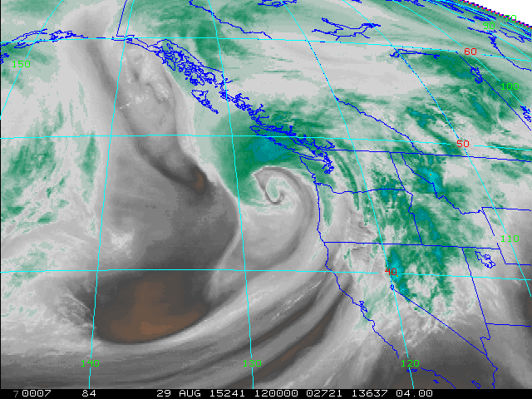
Presentation Overview
Details about the 29 Aug 2015 windstorm
Intercomparison of the 29 Aug 2015 storm and others from the recent and distant past
August windstorms: A climatological analysis
Tree-related factors that may contribute to increased risk of failure during wind load
Satellite photo courtesy of the US. National Weather Service

Slide 3
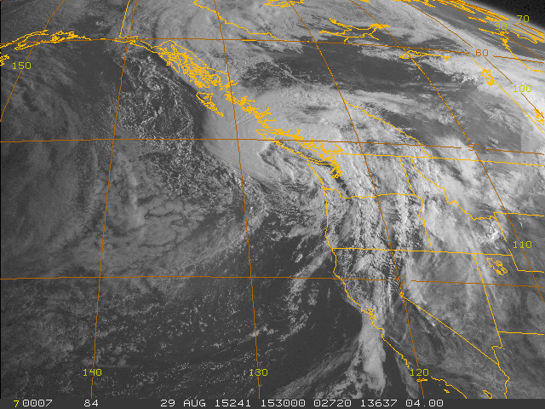
The 29 Aug 2015 Windstorm
Satellite Photo
The extratropical cyclone at 0830 PDT on 29 Aug 2015
Low center is just off the Washington coast, approaching southern Vancouver Island
Key frontal system moving through the Puget Lowlands and the Lower Mainland
  Very heavy rain was associated with this feature

Slide 4
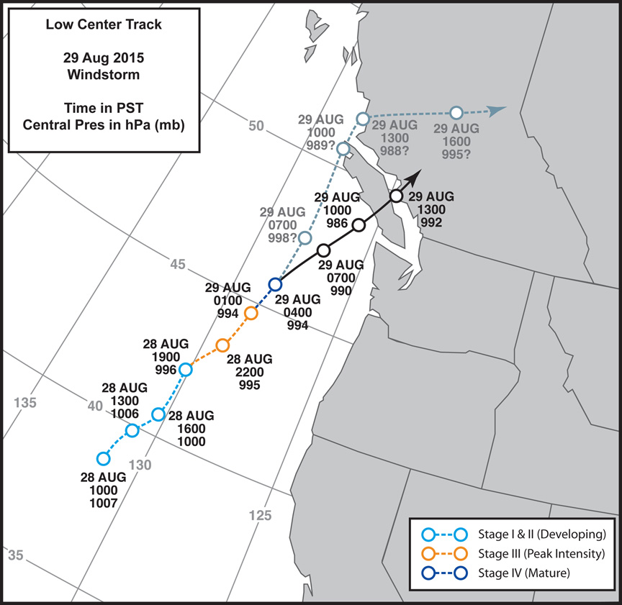
The 29 Aug 2015 Windstorm
Preliminary Storm Track
Low pressure center developed off of northern California in the late morning of 28 Aug
Tracked NNE to the Vancouver Island coast by noon on 29 Aug

Slide 5
The 29 Aug 2015 Windstorm
Preliminary Storm Track
Black track is a preliminary mesoscale interpretation from available surface observation data
The faded blue track marks the surface low positions from the US. National Oceanic and Atmospheric Administration’s Weather Prediction Center

Slide 6
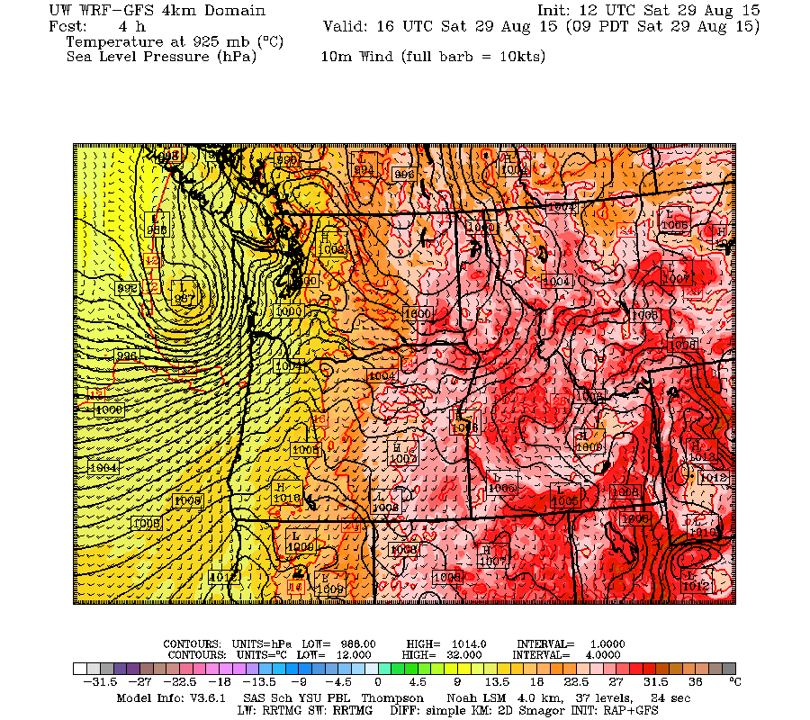
The 29 Aug 2015 Windstorm
Preliminary Storm Track
The numerical weather prediction (NWP) models produced a track similar to the black line
Shown is the University of Washington WRF-GFS 4 km resolution, 1200 UTC 29 AUG 2015 initialization

Slide 7
The 29 Aug 2015 Windstorm
Preliminary Storm Track
The numerical weather prediction (NWP) models produced a track similar to the black line
Shown is the University of Washington WRF-GFS 4 km resolution, 1200 UTC 29 AUG 2015 initialization
Second, broader and deeper low
Compact low center

Slide 8
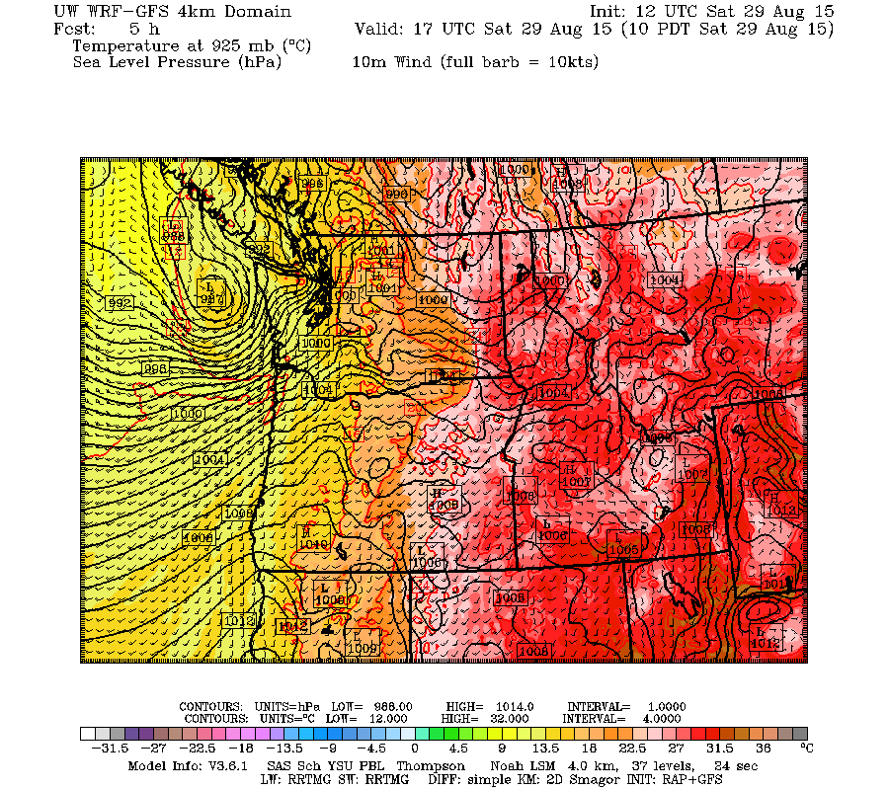
The 29 Aug 2015 Windstorm
Preliminary Storm Track
The numerical weather prediction (NWP) models produced a track similar to the black line
Shown is the University of Washington WRF-GFS 4 km resolution, 1200 UTC 29 AUG 2015 initialization

Slide 9
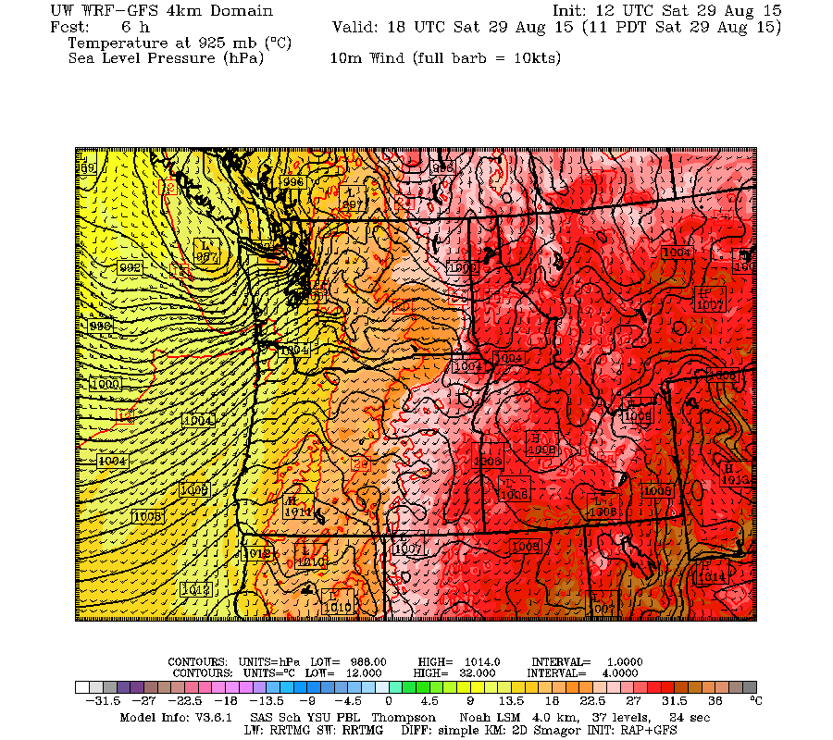
The 29 Aug 2015 Windstorm
Preliminary Storm Track
The numerical weather prediction (NWP) models produced a track similar to the black line
Shown is the University of Washington WRF-GFS 4 km resolution, 1200 UTC 29 AUG 2015 initialization

Slide 10
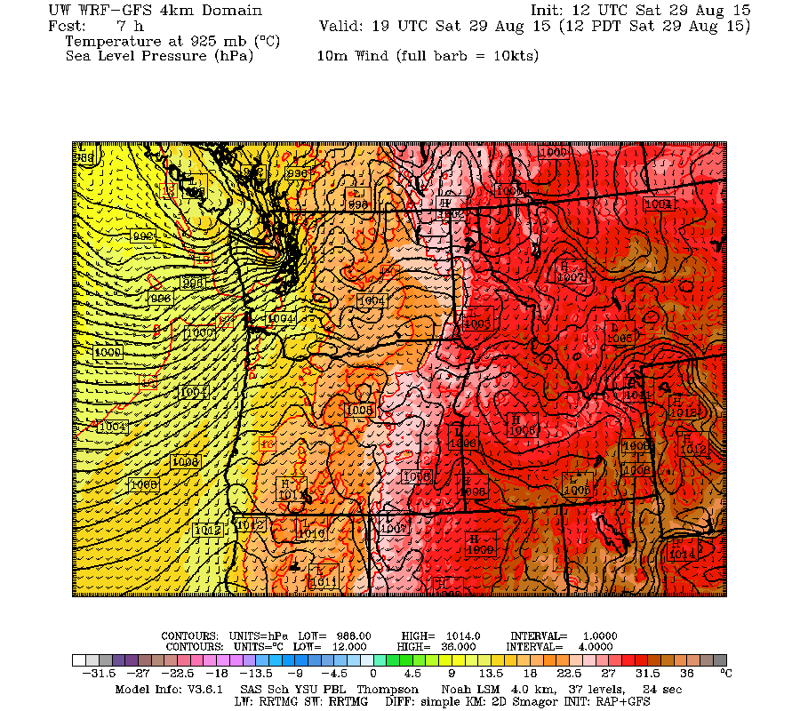
The 29 Aug 2015 Windstorm
Preliminary Storm Track
The numerical weather prediction (NWP) models produced a track similar to the black line
Shown is the University of Washington WRF-GFS 4 km resolution, 1200 UTC 29 AUG 2015 initialization

Slide 11
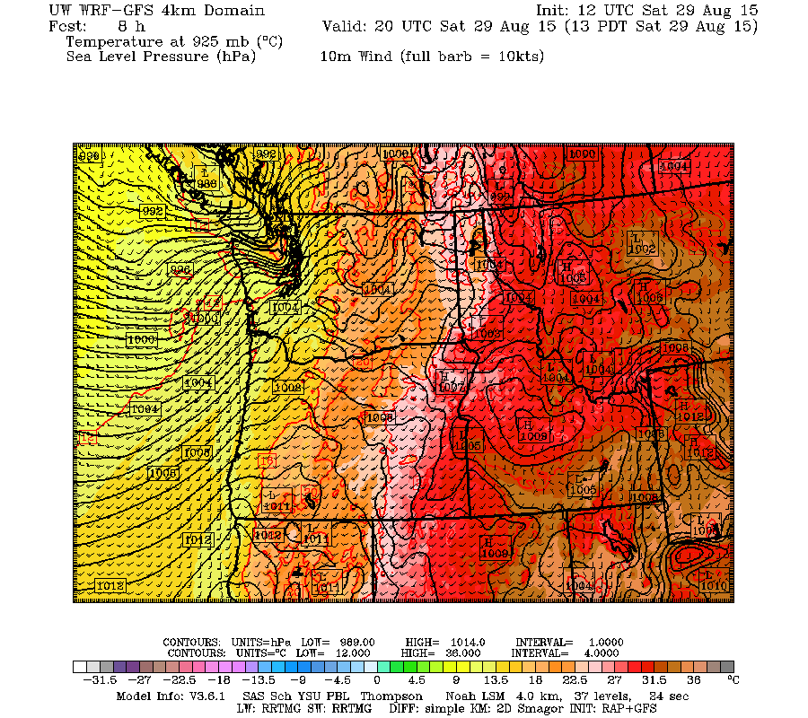
The 29 Aug 2015 Windstorm
Preliminary Storm Track
The numerical weather prediction (NWP) models produced a track similar to the black line
Shown is the University of Washington WRF-GFS 4 km resolution, 1200 UTC 29 AUG 2015 initialization

Slide 12
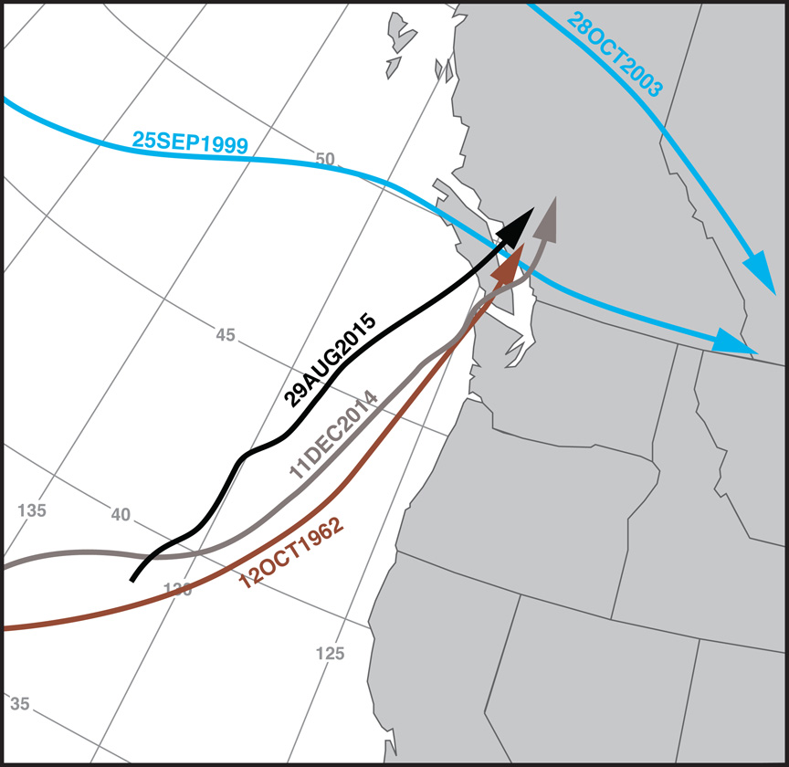
The 29 Aug 2015 Windstorm
Preliminary Storm Track
29 Aug 2015 track (black) compared to a few other storms, many of which were early-season windstorms
12 Oct 1962, or Typhoon Freda, (brown) is the benchmark catastrophic windstorm
11 Dec 2014 (gray) followed a similar track to 1962, but had less intense winds

Slide 13
The 29 Aug 2015 Windstorm
Preliminary Storm Track
The 25 Sep 1999 and 28 Oct 2003 events produced strong westerly windstorms in the Vancouver, BC, region
Only modest impact in Portland
  NW G 26 mph 1999
  NW G 31 mph 2003

Slide 14
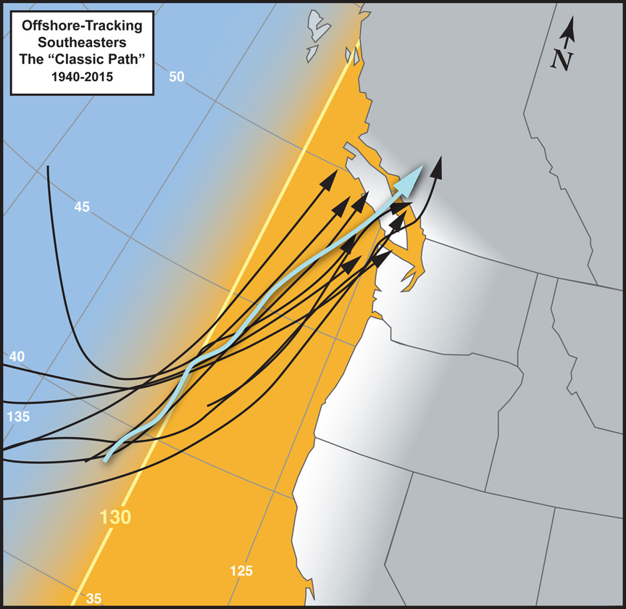
The 29 Aug 2015 Windstorm
Preliminary Storm Track
The 29 Aug 2015 storm track (light blue) falls comfortably within known “Classic Path” windstorms
However, there are some good reasons to put the storm in a “Semi-Classic” category
Peak gust distributions tell part of this story…

Slide 15
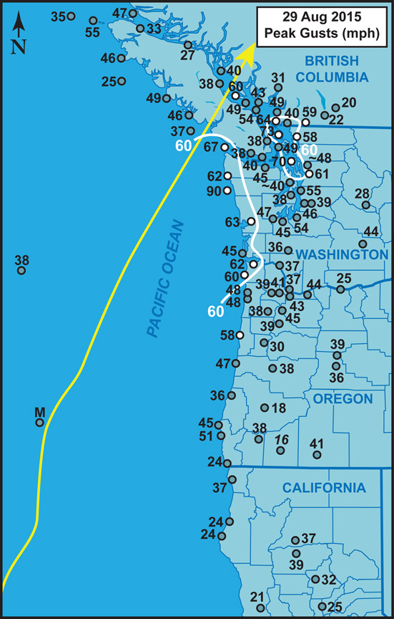
The 29 Aug 2015 Windstorm
Preliminary Storm Track
Peak gusts (mph)

Slide 16
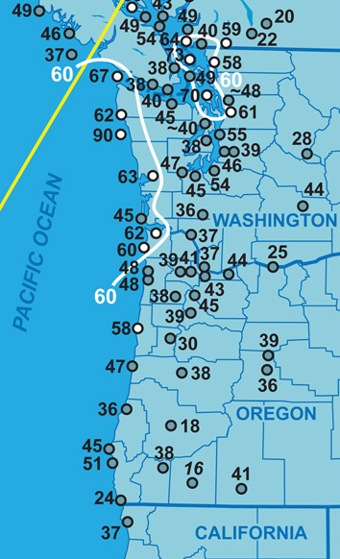
The 29 Aug 2015 Windstorm
Preliminary Storm Track
Peak gusts (mph)

Slide 17
The 29 Aug 2015 Windstorm
Preliminary Storm Track
California barely feels the storm
  Not a typical classic-path characteristic
Oregon receives a glancing blow
  The northwest coast gets high-wind criteria gusts
  Strongest interior winds at the north end of the Willamette Valley—this is a classic-path characteristic
Western Washington is slammed
  High wind over most of the coast
  Also over North Inland Waters

Slide 18
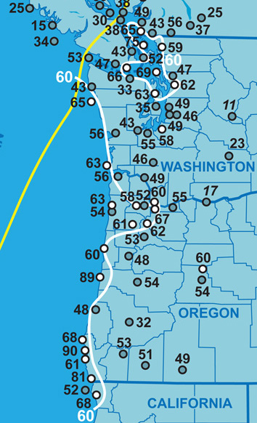
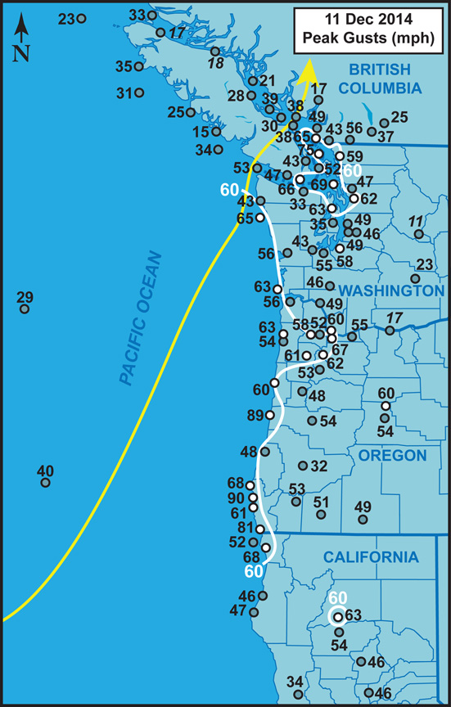
The 29 Aug 2015 Windstorm
Preliminary Storm Track
11 Dec 2014: A good example of a classic path windstorm
  The two storms occurred just 9 months apart and in entirely different seasons, making them interesting to intercompare
California slammed (San Francisco Bay Area: “#Hellastorm”)
Oregon slammed
Washington slammed

Slide 19
The 29 Aug 2015 Windstorm
Preliminary Storm Track
Main reasons for the difference in outcomes:
  The Aug windstorm tracked further offshore, especially for California and Oregon
  Aug windstorm had shallower minimum central pressure (~986 hPa vs. ~974 hPa)
  Upper-wind support configuration also likely different (analysis underway)

Slide 20
The 29 Aug 2015 Windstorm
Strongest August Windstorms
Location | Maximum Wind (1 or 2-minute average)
 | #1 | #2 | #3 | Honorary
Abbotsford (1953-2015) | 29 Aug 2015 35 mph (180º) | 24 Aug 1969 30 mph (200º) | 12 Aug 1965 26 mph (160º) | 01 Sep 1961 35 mph (180º)
Portland (1948-2015) | 29 Aug 2015 29 mph (180º) | 01 Aug 1964 25 mph (190º) | 03 Aug 1956 24 mph (180º) | 01 Sep 1961 16 mph (225º)
Portland peak 2-min wind was actually 32 mph during 29 Aug 2015—but not in the hourly obs
29 Aug 2015 stands above the rest, though the 01 Sep 1961 storm up north, which started affecting BC late on 31 Aug, is a close contender
  There are many similarities between the 1961 and 2015 storms in the northern region (WA and BC) that warrant further analysis

Slide 21
The 29 Aug 2015 Windstorm
Warmest Windstorm On Record?
Location | Max Temperature (ºF) During Main Wind Surge
 | 29 Aug 2015 | 10 Oct 2015 | 12 Oct 1962
Salem | 75 | 74 | 61*
Portland | 76 | 72 | 59
Olympia | 69 | 69 | 56
Sea-Tac | 72 | 70 | 61
Bellingham | 74 | 69 | 58
Abbotsford | 73 | 68 | 56
Vancouver | 70 | 63 | 55
Average | 72.7 | 69.3 | 58.0
* Eugene
Probably!

Slide 22
The 29 Aug 2015 Windstorm
Warmest Windstorm On Record?
Location | Max Temperature (ºF) During Main Wind Surge
 | 29 Aug 2015 | 10 Oct 2015 | 12 Oct 1962
Salem | 75 | 74 | 61*
Portland | 76 | 72 | 59
Olympia | 69 | 69 | 56
Sea-Tac | 72 | 70 | 61
Bellingham | 74 | 69 | 58
Abbotsford | 73 | 68 | 56
Vancouver | 70 | 63 | 55
Average | 72.7 | 69.3 | 58.0
Strong August sun = high temps? Not necessarily: 10 Oct 2015, and…
The other top August windstorms (e.g. 1969, 1965, 1961) did not have the toasty temperatures of 29 Aug or 10 Oct 2015
  Temps were more like warm winter-time storms (55-60ºF)

Slide 23
The 29 Aug 2015 Windstorm
Warmest Windstorm On Record?
Location | Max Temperature (ºF) During Main Wind Surge
 | 29 Aug 2015 | 10 Oct 2015 | 12 Oct 1962
Salem | 75 | 74 | 61*
Portland | 76 | 72 | 59
Olympia | 69 | 69 | 56
Sea-Tac | 72 | 70 | 61
Bellingham | 74 | 69 | 58
Abbotsford | 73 | 68 | 56
Vancouver | 70 | 63 | 55
Average | 72.7 | 69.3 | 58.0
* Eugene
High temps were perhaps aided by the big El Niño?
  Extratropical cyclone had a tropical tap
Or… or...

Slide 24
The 29 Aug 2015 Windstorm
Warmest Windstorm On Record?
Location | Max Temperature (ºF) During Main Wind Surge
 | 29 Aug 2015 | 10 Oct 2015 | 12 Oct 1962
Salem | 75 | 74 | 61*
Portland | 76 | 72 | 59
Olympia | 69 | 69 | 56
Sea-Tac | 72 | 70 | 61
Bellingham | 74 | 69 | 58
Abbotsford | 73 | 68 | 56
Vancouver | 70 | 63 | 55
Average | 72.7 | 69.3 | 58.0
* Eugene
High temps were perhaps aided by the big El Niño?
  Extratropical cyclone had a tropical tap
Or… or...
THE BLOB?!?

Slide 25
The 29 Aug 2015 Windstorm
Lowest August Sea-Level Pressures On Record
Location | Lowest Pressure (hPa)
 | #1 | #2 | #3 | #4
Abbotsford (1953-2015) | 29 Aug 2015 998.3 | 31 Aug 1961 1000.1 | 06 Aug 1995 1000.2 | 25 Aug 2004 1001.2
Portland (1948-2015) | 28 Aug 1951* 997.0 | 29 Aug 2015 1000.5 | 10 Aug 1995 1002.4
* Deep and cold storm (~57-61ºF) for August, but winds were not particularly strong
29 Aug 2015 set new records further north, but not quite in the Portland area
At Abbotsford, the honorary 1961 storm brought a considerably lower pressure than the 2015 event, 991.9 hPa, but at 0200 on 01 Sep, thus not an August reading (so close!)
(To put these numbers in perspective: PDX during 12 Dec 1995 972.9 hPa, Hurricane Patricia 879 hPa [25.96”])

Slide 26
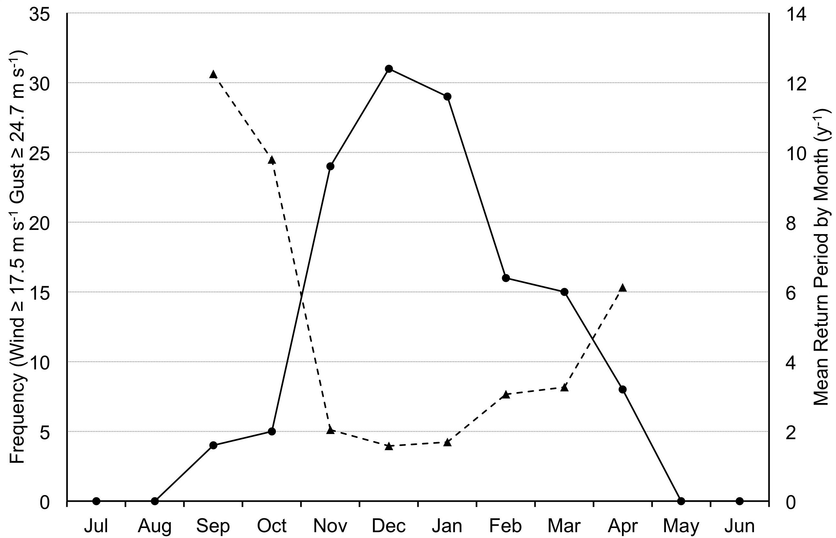
Climatology of Southwest BC Windstorms
Seasonality
1964 to 2012
Windstorm occurrence is seasonal, occurring primarily from November through March
This is congruent with the rainy season and is a product of seasonal changes in the global atmospheric circulation

Slide 27
Climatology of Southwest BC Windstorms
Seasonality
1964 to 2012
High windstorms in August are extremely rare: Zero in the 49 years from 1964 to 2012
Now, extend the timeframe three more years, and you get one August windstorm in 52 years

Slide 28
The 29 Aug 2015 Windstorm
Return Period For August Storms
Table: Frequency of hourly wind (1 or 2 min average) observations in knots for August from 1948-2015
The 29 Aug 2015 windstorm shows up as the one and only observation of 25 knots (out of 29,616 hourly observations shown) for 68 Augusts
Estimated mean return interval = 64 years
In contrast, Abbotsford had a peak 2-min wind of 30 knots, which has an estimated mean return interval = 200 years
Definitely rare wind speeds for August
Wind (kt) | Frequency
5 | 6135
6 | 5341
7 | 4506
8 | 4017
9 | 2792
10 | 2807
11 | 1403
12 | 1085
13 | 639
14 | 389
15 | 262
16 | 115
17 | 62
18 | 39
19 | 7
20 | 8
21 | 4
22 | 4
23 | 0
24 | 0
25 | 1

Slide 29
The 29 Aug 2015 Windstorm
Return Period For August Storms
But for the storm season months, especially November through March, the speeds are not so unusual
This is an important consideration
The 29 Aug 2015 windstorm produced endemic wind speeds—winds that are expected to occur nearly every year during the wet season
But these endemic winds had a terrific impact on trees and the power grid, especially in places north of Portland
Wind (kt) | Frequency
5 | 6135
6 | 5341
7 | 4506
8 | 4017
9 | 2792
10 | 2807
11 | 1403
12 | 1085
13 | 639
14 | 389
15 | 262
16 | 115
17 | 62
18 | 39
19 | 7
20 | 8
21 | 4
22 | 4
23 | 0
24 | 0
25 | 1

Slide 30
The 29 Aug 2015 Windstorm
Power Outages
Location | 29 Aug 2015 | 11 Dec 2014 | 25 Oct 2014
Portland (PGE) | 22,000 (2.6%) | 40,000 (4.8%) | 75,000 (8.9%)
Vancouver (BC Hydro) | 710,000 (50%) | 78,000 (5.5%) | Minor
PGE Customer Base (2015) ~841,000
BC Hydro (2015) ~1,420,000
Not confident in some of the PGE numbers…
However, if the figures are close they show something dramatically different than in the main strike zone of the 29 Aug storm, exemplified by the BC Hydro outcome
For comparison, the 1962 Columbus Day Storm impact on the BC Hydro grid:
  300,000 customers out (67%)
  The 29 Aug 2015 windstorm produced endemic peak wind speeds, but had a catastrophic windstorm outcome

Slide 31
Some Intercomparisons
29 Aug 2015 and 11 Dec 2014
Peak Gusts (mph)
Location | 29 Aug 2015 | 11 Dec 2014
Vancouver | 49 | 49
Abbotsford | 59 | 56
Victoria | 38 | 27
Tsawassen Terminal | 65 | 65
Saturna Island | 73 | 75
Bellingham | 58 | 59
Navy, Whidbey | 70 | 69
Peak gusts for the two storms are remarkably similar for the region
Both were also southeasters

Slide 32
Some Intercomparisons
29 Aug 2015 and 11 Dec 2014
Peak Gusts (mph)
Location | 29 Aug 2015 | 11 Dec 2014
Vancouver | 49 | 49
Abbotsford | 59 | 56
Victoria | 38 | 27
Tsawassen Terminal | 65 | 65
Saturna Island | 73 | 75
Bellingham | 58 | 59
Navy, Whidbey | 70 | 69
The similarity in peak gusts between these two storms, and their close timing being only nine months apart, offers a nice “laboratory” for considering seasonal changes in vegetation and impacts to the power grid

Slide 33
Some Intercomparisons
29 Aug 2015 and 11 Dec 2014
Peak Gusts (mph)
Location | 29 Aug 2015 | 11 Dec 2014
Vancouver | 49 | 49
Abbotsford | 59 | 56
Victoria | 38 | 27
Tsawassen Terminal | 65 | 65
Saturna Island | 73 | 75
Bellingham | 58 | 59
Navy, Whidbey | 70 | 69
Late August: Deciduous trees are nearly fully foliated, soils are likely to be dry, and trees may be water stressed
Mid December: Deciduous trees are completely leaf bare, soils are moist and may be close to saturation, and trees dormant and/or sufficiently hydrated

Slide 34
Some Intercomparisons
29 Aug 2015 and 11 Dec 2014
Peak Gusts (mph)
Location | 29 Aug 2015 | 11 Dec 2014
Vancouver | 49 | 49
Abbotsford | 59 | 56
Victoria | 38 | 27
Tsawassen Terminal | 65 | 65
Saturna Island | 73 | 75
Bellingham | 58 | 59
Navy, Whidbey | 70 | 69
The outcome…
  29 Aug 2015: 710,000 BC Hydro customers without power
  11 Dec 2014: 78,000 customers without power
~Same peak wind speeds, but an order-of-magnitude difference in the number of customers affected

Slide 35
Some Intercomparisons
29 Aug 2015 and 11 Dec 2014
Peak Gusts (mph)
Location | 29 Aug 2015 | 11 Dec 2014
Vancouver | 49 | 49
Abbotsford | 59 | 56
Victoria | 38 | 27
Tsawassen Terminal | 65 | 65
Saturna Island | 73 | 75
Bellingham | 58 | 59
Navy, Whidbey | 70 | 69
Were differences in leaf cover, soil saturation and moisture stress the primary reasons for the difference in power outage magnitude between the two storms?
Probably, but the story is complex

Slide 36

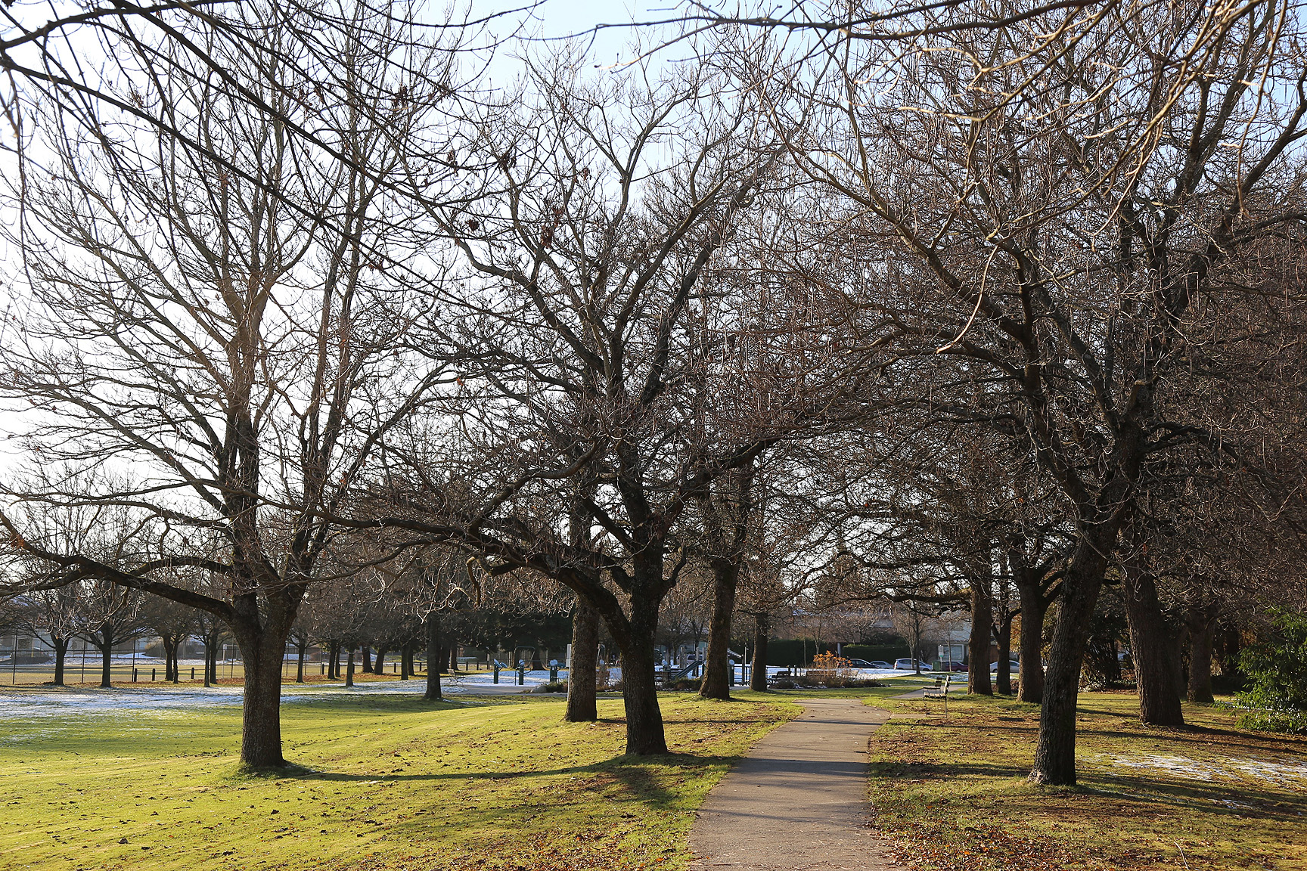
Tree-Related Factors
16 Sep 2014
01 Dec 2014

Slide 37
Tree-Related Factors
Removal of foliage reduces wind drag forces by ~50% (Vollsinger et al. 2005)
  Likely varies between species, but a good rule of thumb
Rochester, NY: Branch failures are four times more likely during the “leafy period” (May-Oct) (Luly et al. 2002)
  This despite high winds being more frequent during the leafless period
  Eastern trees are planted in the West
                Vollsinger, S., Mitchell, S. J., Byrne, K. E., Novak, M. D. and M. Rudnicki, 2005: Wind tunnel measurements of crown streamlining and drag relationships for several hardwood species. Can. J. For. Res., 35, 1238-1249.
                Luly, C. J., Pleninger, A., and S. Sisinni, 2002: The effect of wind gusts on branch failures in the city of Rochester, New York, US. Proceedings of the Tree Structure and Mechanics Conference. How Trees Stand Up and Fall Down, ed. Smiley, E. T., Coder, K. D., International Society of Aboriculture, Champaign, Illinois, October 2001, 103-109.

Slide 38
Tree-Related Factors
Removal of foliage reduces wind drag forces by ~50% (Vollsinger et al. 2005)
  Likely varies between species, but a good rule of thumb
Rochester, NY: Branch failures are four times more likely during the “leafy period” (May-Oct) (Luly et al. 2002)
  This despite high winds being more frequent during the leafless period
  Eastern trees are planted in the West
Counter-point: Drag reduction on leaf-bare trees means more wind forces on evergreens that might be otherwise sheltered by the presence of canopies on nearby deciduous trees

Slide 39
Tree-Related Factors
Summer of 2015 was unusually warm and dry
  Many locations set new all-time highs for warmest month in July
  Though local summers are typically dry relative to the winter months, the higher heat almost certainly contributed to greater tree stress than during a typical summer
  Below normal precipitation for much of the summer added to the stress
Sandy soils can be weaker when very dry (Newson personal communication 2015)
  Soil strength tends to go up with increasing moisture up to a point (close to field capacity) then tends to weaken as soils saturate (in simplified terms)
Soils with high clay content may become stronger as they dry out
Also a given soil has less mass when dry, and may offer less of an anchor for trees

Slide 40
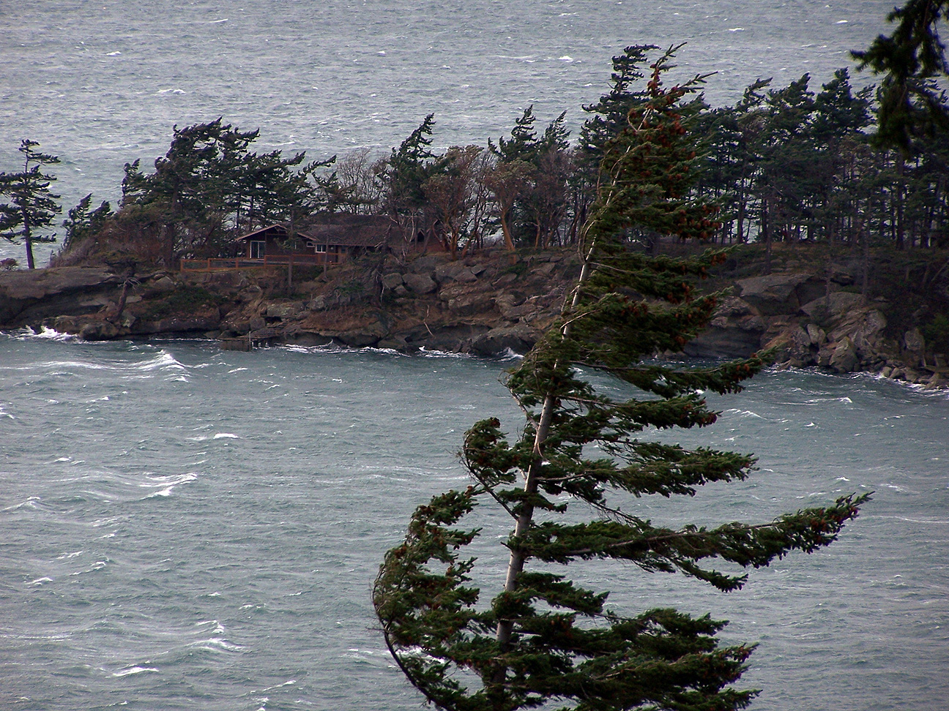
Tree-Related Factors
Dry wood has a higher modulus of rupture compared to moist wood, but it is also more brittle (e.g. bending a dry twig vs. a fresh green twig)
Branches and stems of drought-stressed trees may have been more brittle and prone to failure under heavy wind load
  Trees rely on their flexibility to shed wind load
  Dry soils may have also contributed, as they are less springy

Slide 41
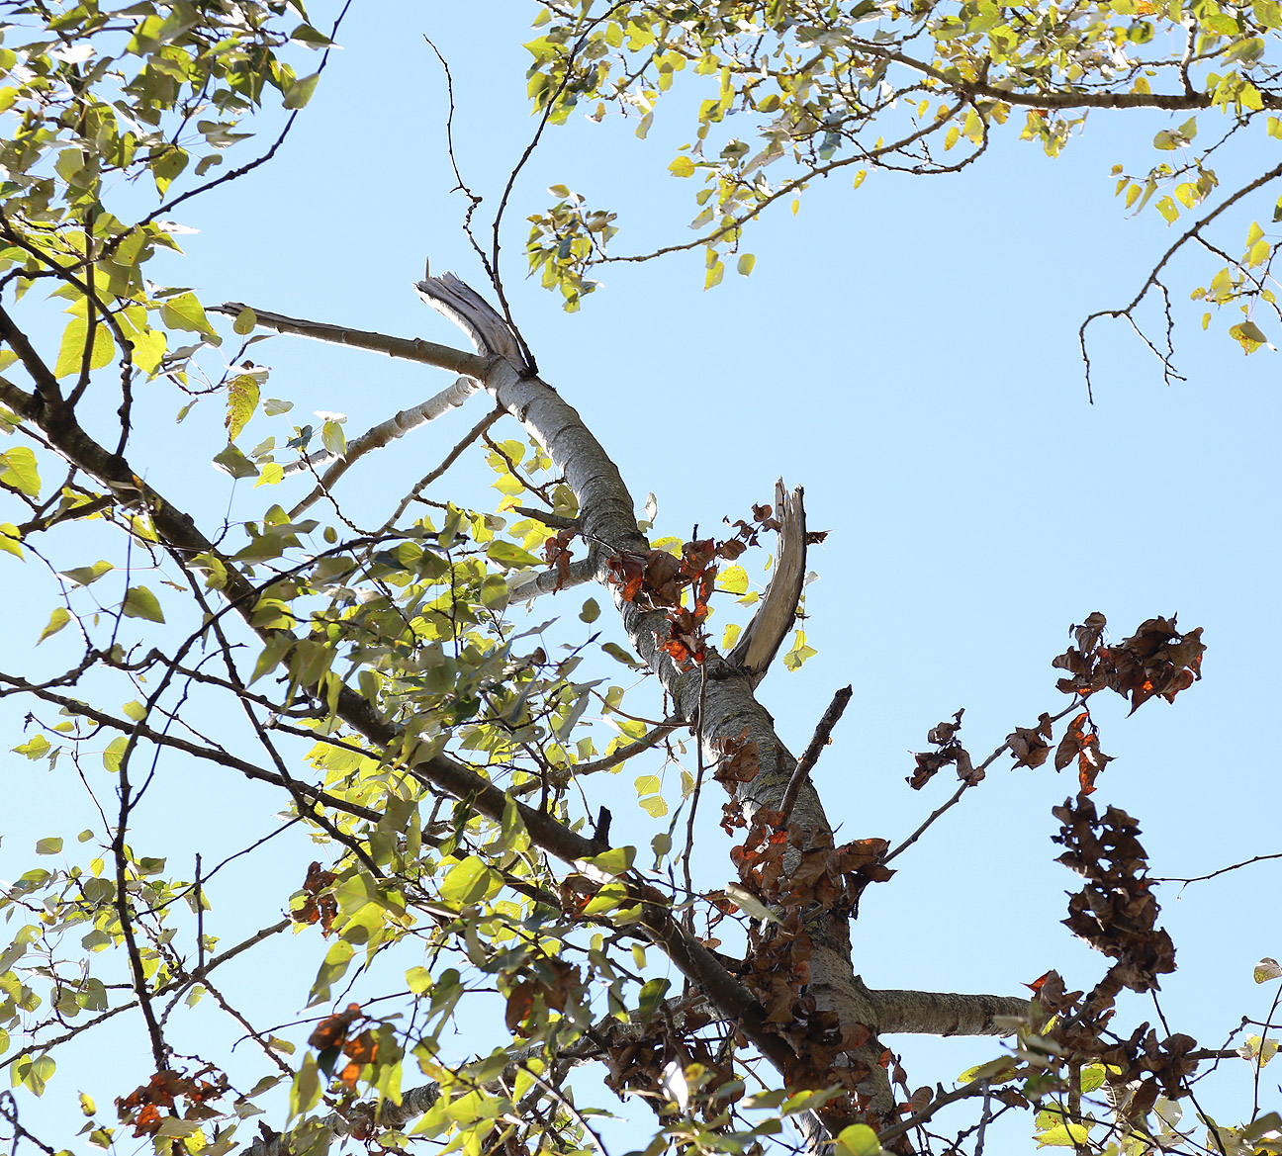
Tree-Related Factors
Tree-tops seemed particularly vulnerable, as this example shows
Drought stress tends to show in the extremities first (furthest away from the water supply)
Also, wind loads tend to be greater at treetop height, but what is pictured (selective top-brach failure) is not a typical wind damage outcome
Moist wood is more flexible than dry

Slide 42
The 29 Aug 2015 Windstorm
Power Outages
Location | 29 Aug 2015 | 11 Dec 2014 | 25 Oct 2014
Portland (PGE) | 22,000 (2.6%) | 40,000 (4.8%) | 75,000 (8.9%)
Vancouver (BC Hydro) | 710,000 (50%) | 78,000 (5.5%) | Minor
PGE Customer Base (2015) ~841,000
BC Hydro (2015) ~1,420,000
A significant part of the different outcomes between the 29 Aug 2015 and 11 Dec 2014 windstorms for the two regions is likely due to differences in peak winds:
  Willamette Valley G 35-45 mph
  Puget Lowlands G 40-55 mph
  Northern Interior G 55-70 mph
  Lower Mainland (BC) G 50-65 mph
Another likely factor: Trees in the Willamette Valley may also be more heat and drought tolerant than those up north

Slide 43
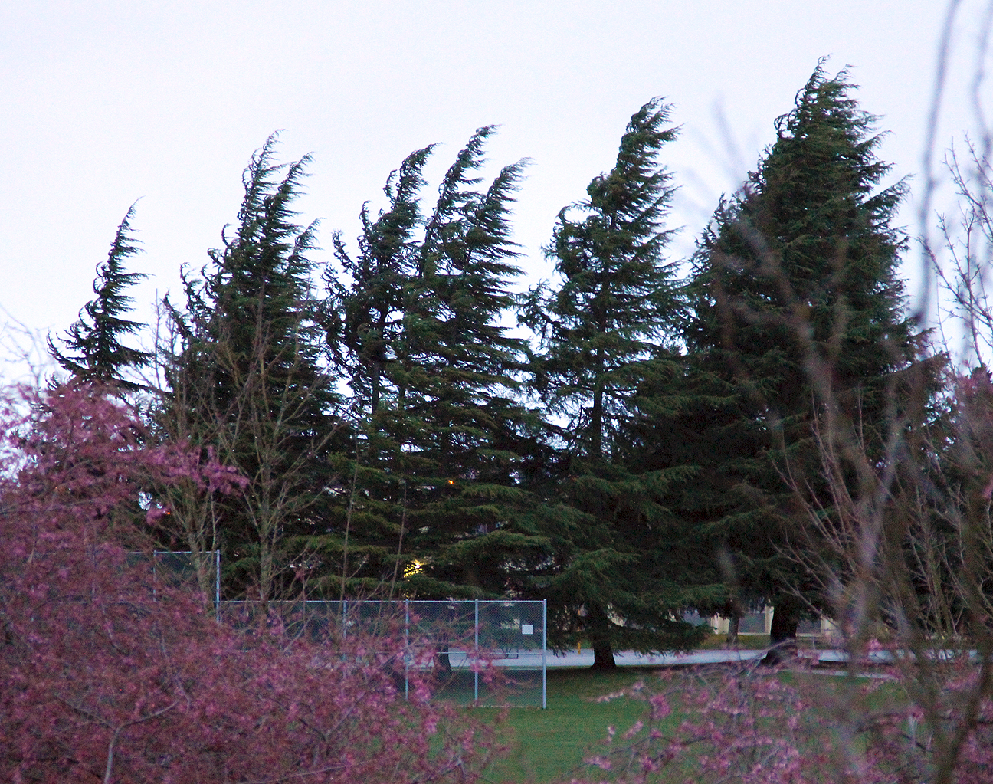
Thank You
Wolf Read, PhD
wolf@alumni.ubc.ca

