Slide 1

Welcome!
The Oregon Chapter of the
American Meteorological Society
23rd annual
“Winter Weather Forecast Conference"

Slide 2
Since the last meeting…

Slide 3
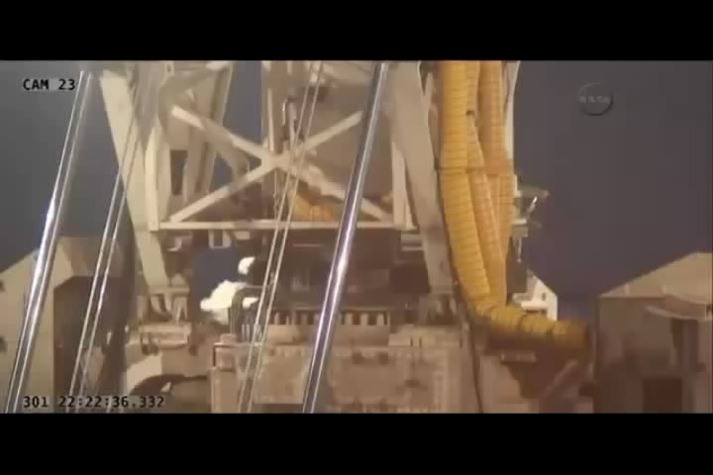
Antares Explodes
October 28, 2014

Slide 4
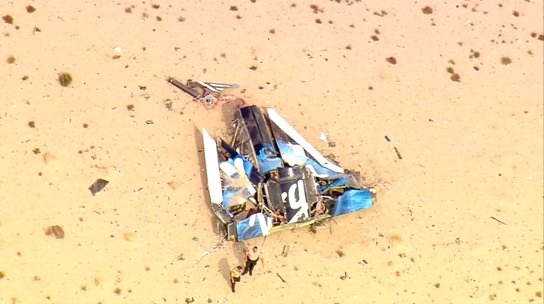
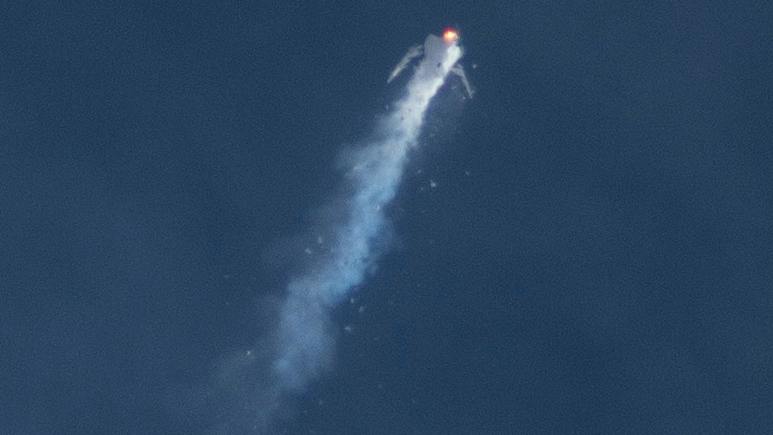
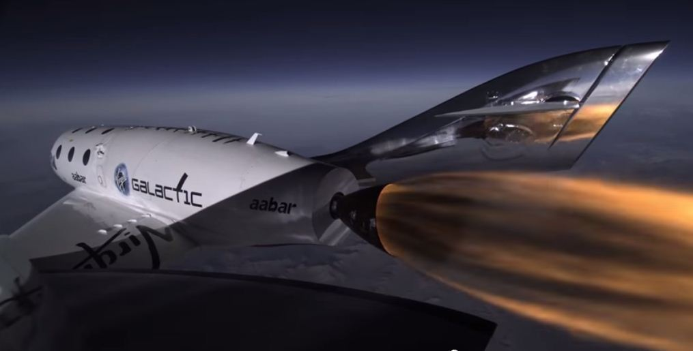
Virgin Galactic Spaceship Two crashes in California
October 31, 2014

Slide 5

Interstellar Movie

Slide 6
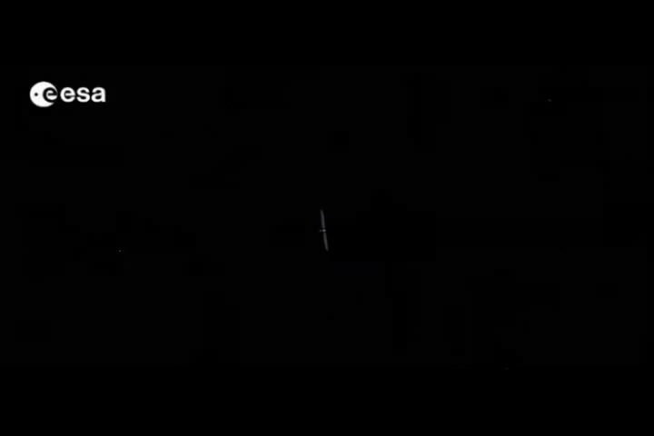

Rosetta
November 12, 2014

Slide 7
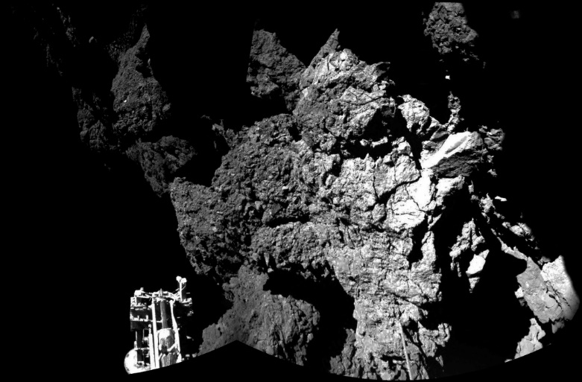
Welcome to a Comet
November 2014
ESA/Rosetta/Philae/CIVA

Slide 8
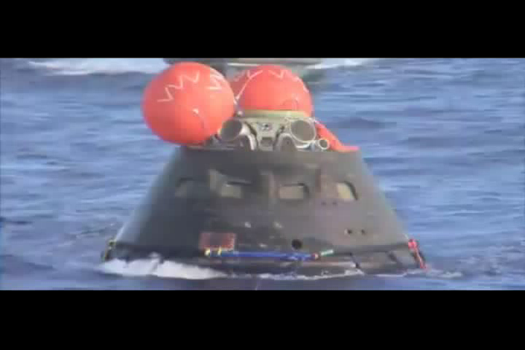

Orion Exploration Mission
December 5, 2014

Slide 9
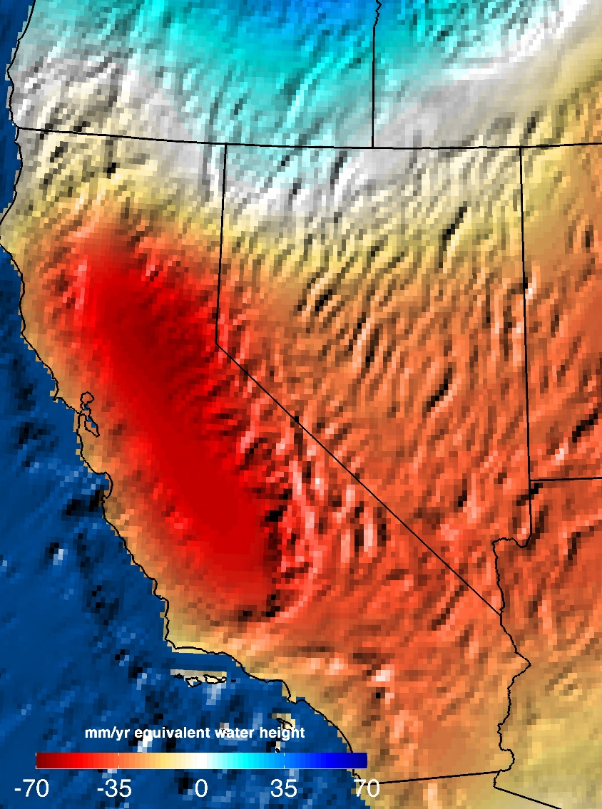
NASA Analysis: 11 Trillion Gallons to Replenish California Drought Losses
December 2015

Slide 10
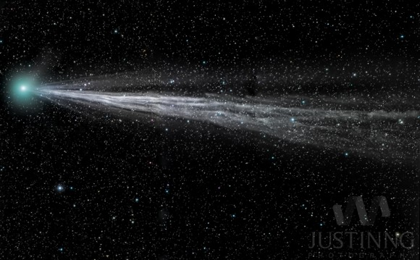
Bright Comet Lovejoy
January 2, 2015
Photo by Justin Ng of Singapore

Slide 11
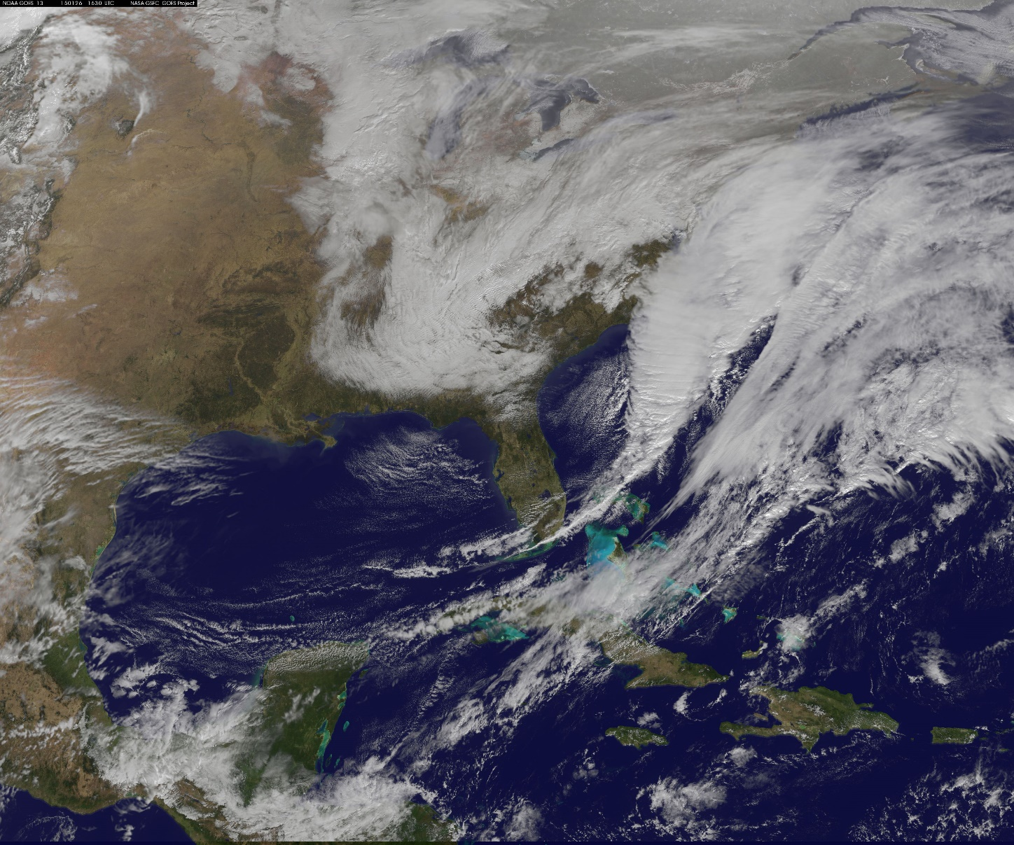
Northeast Blizzard of 2015
January 26, 2015

Slide 12
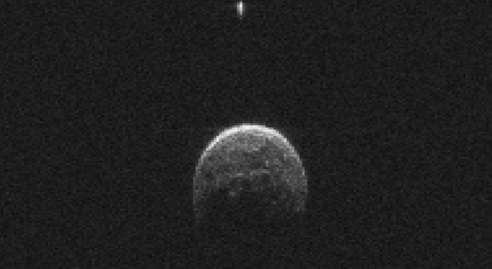
Asteroid That Flew
Past Earth Has Moon
January 26, 2015
NASA Deep Space Network

Slide 13
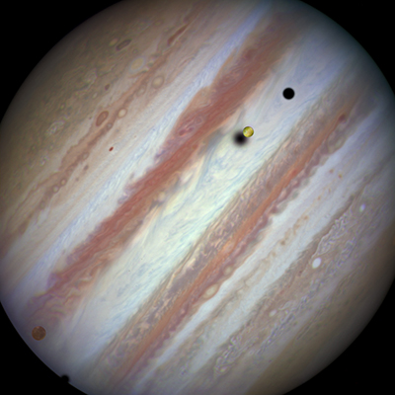
Hubble Captures Rare
Triple-Moon Conjunction
February 5, 2015

Slide 14
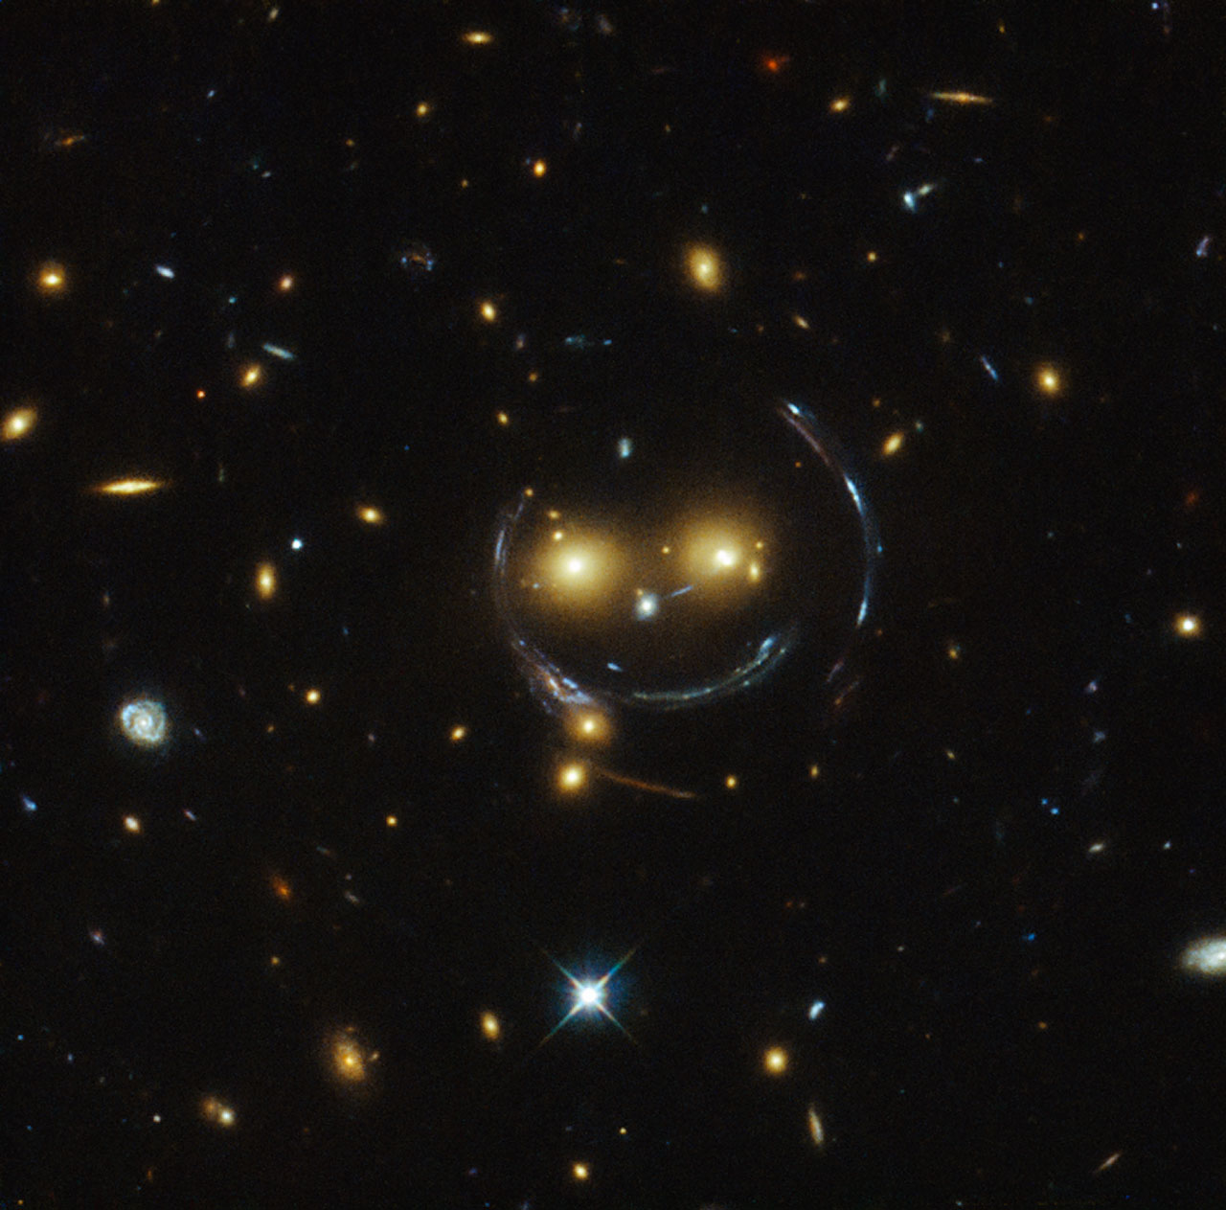
Smile!
February 9, 2015
NASA/ESA Hubble Space Telescope

Slide 15
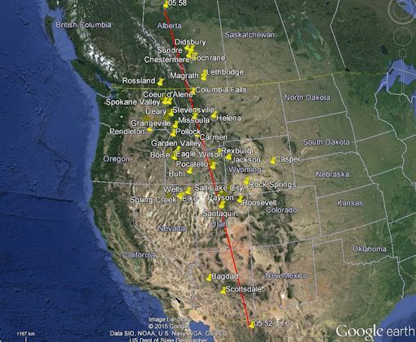
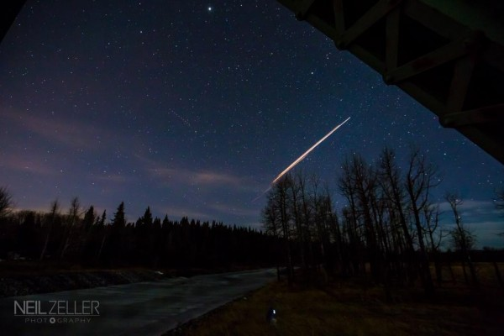
Chinese Rocket Re-Entry
February 24. 2015

Slide 16
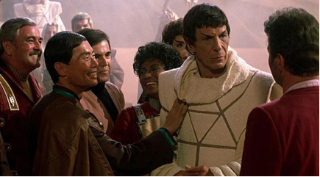
Leonard Nimoy
1931 - 2015

Slide 17
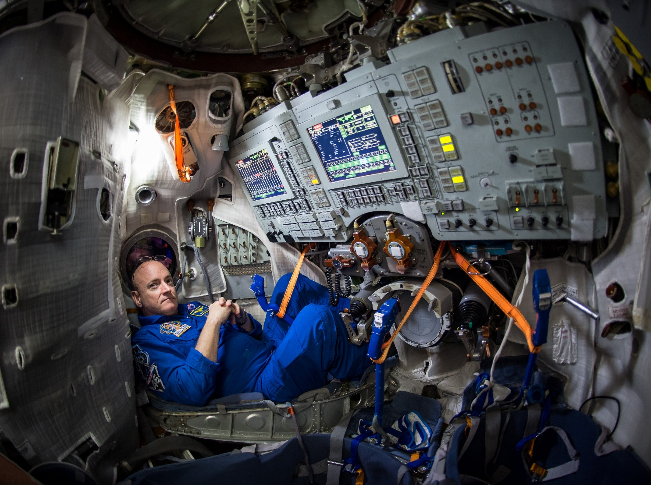
One-Year Crew Ready for
Launch to Space Station
March 2015
NASA astronaut Scott Kelly

Slide 18
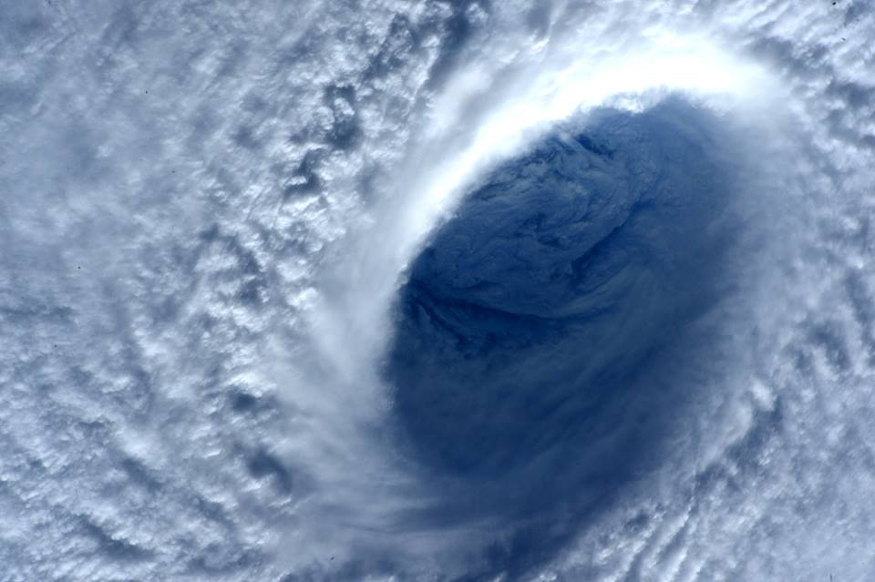
Space Station Flies Over
Super Typhoon Maysak
April 4, 2015
Image Credit: NASA/Terry Virts

Slide 19
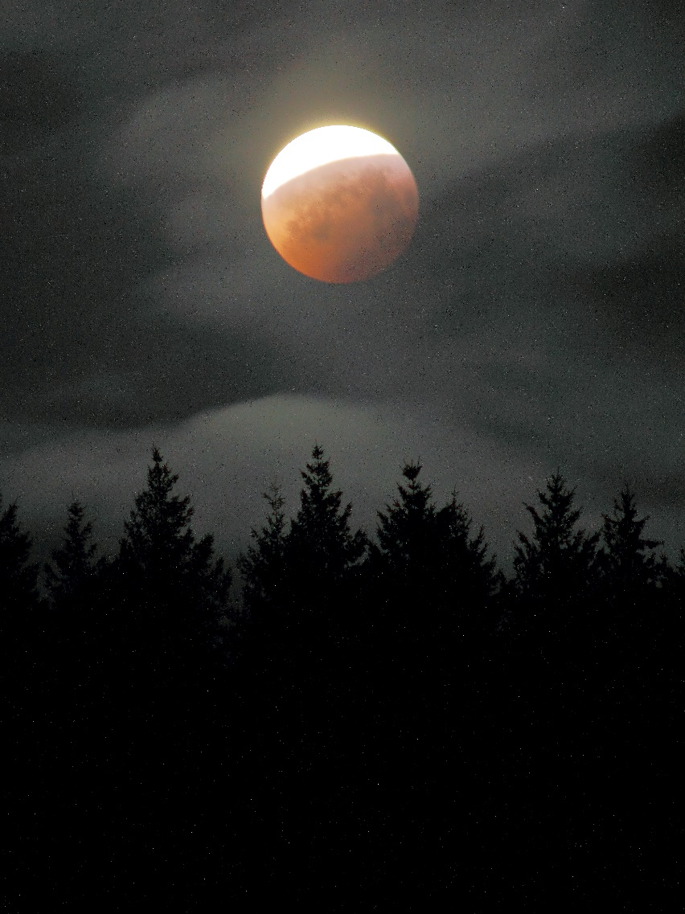
Total Lunar Eclipse
April 4, 2015
Sherylita Mason-Calhoun

Slide 20
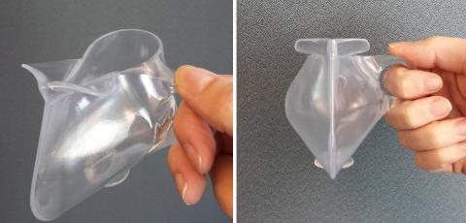
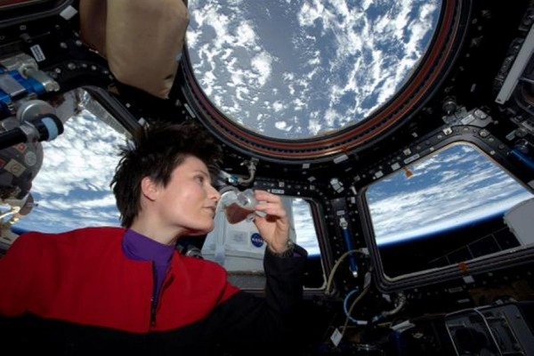

Zero-G espresso cups developed at Portland State University
April 2015

Slide 21
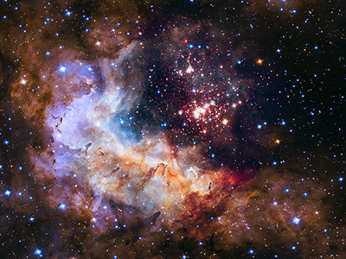
Hubble Space Telescope Celebrates 25 Years of Unveiling the Universe
April 2015
‘Westerlund 2’
20,000 LY
Constellation Carina

Slide 22
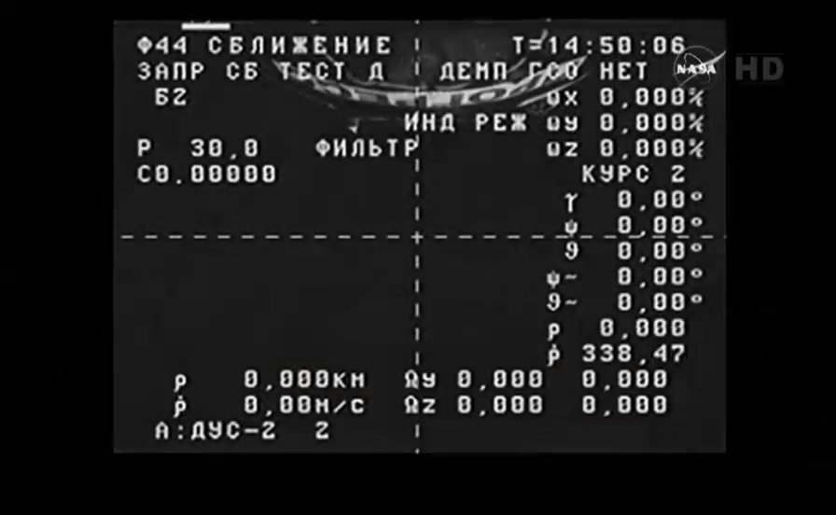
Russian Resupply Ship Experiencing Difficulties
April 28, 2015

Slide 23
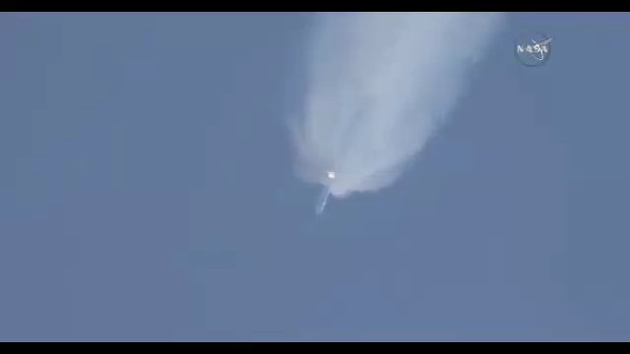
SpaceX Falcon 9 Rocket Breaks Up After Launch With Space Station Cargo
June 28, 2015

Slide 24
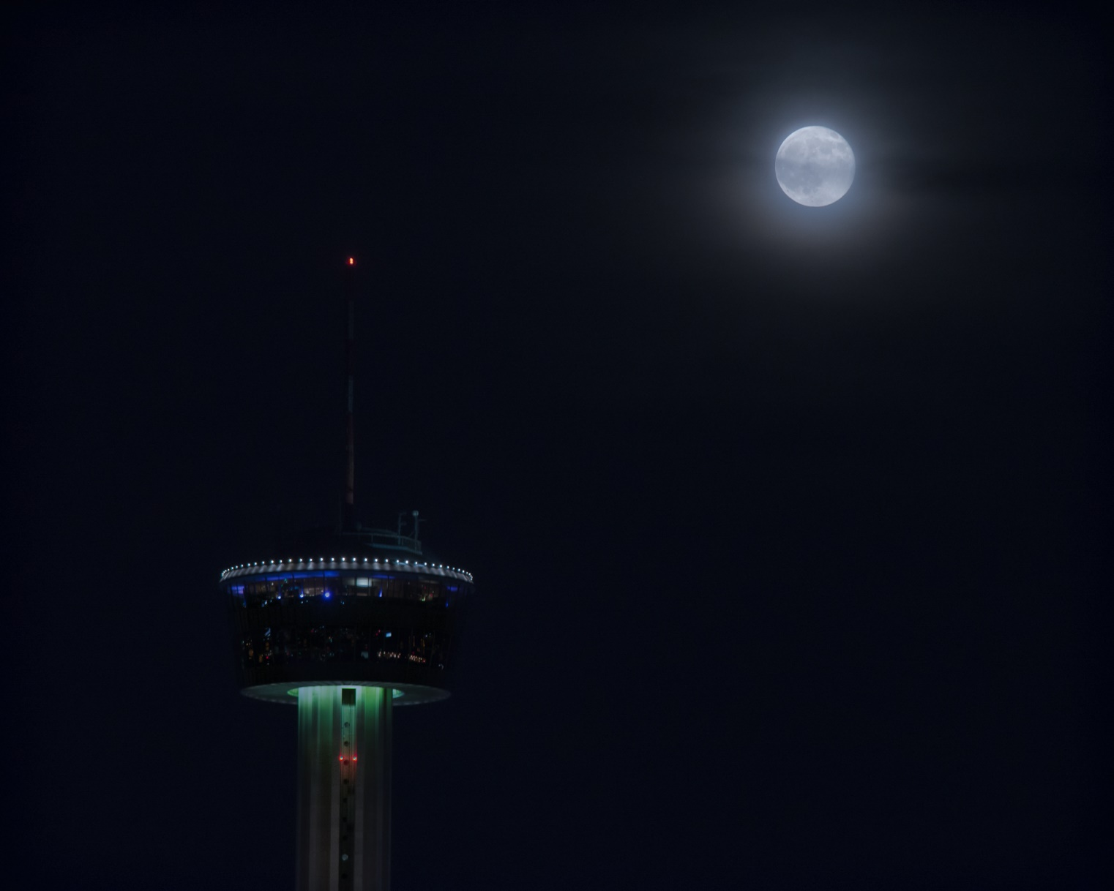
‘Once in a Blue Moon…’
July 31, 2015

Slide 25
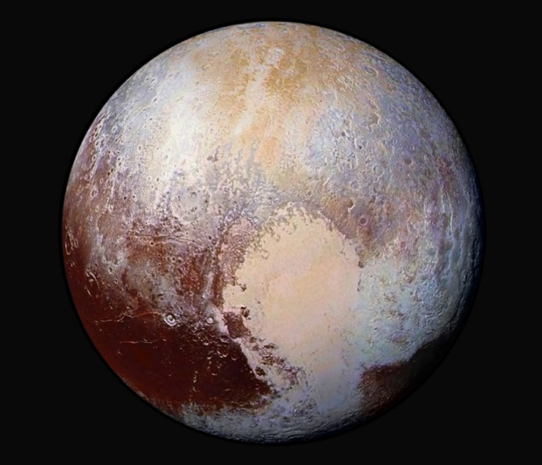
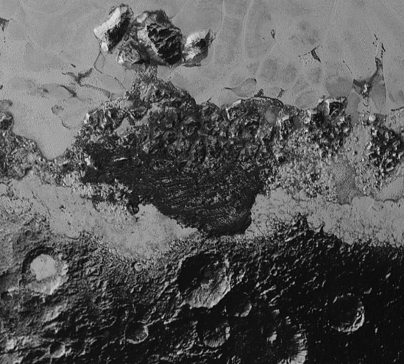
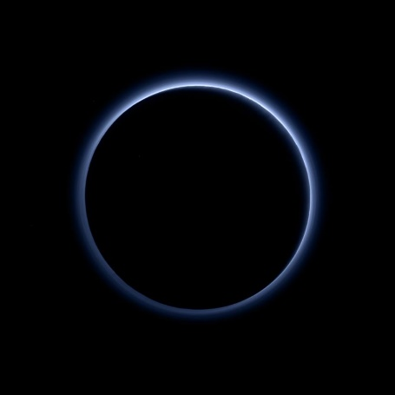
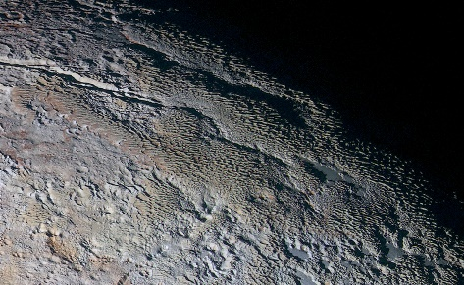
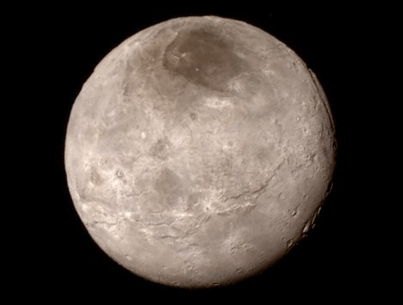

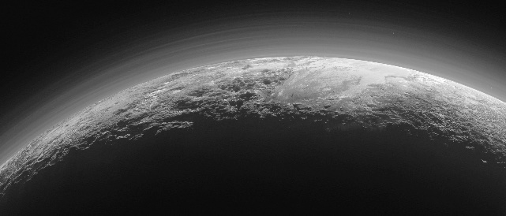
Amazing Pluto Flyby Images
July 2015

Slide 26
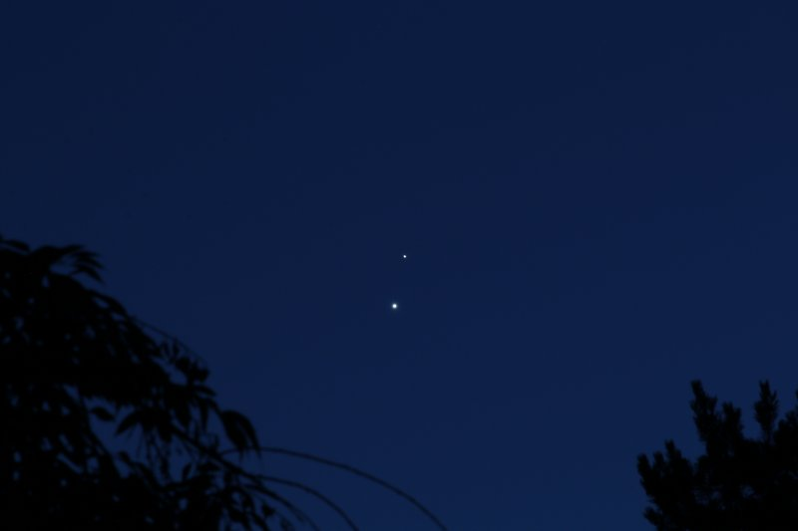
Venus and Jupiter
June 30, 2015
Jim Todd

Slide 27
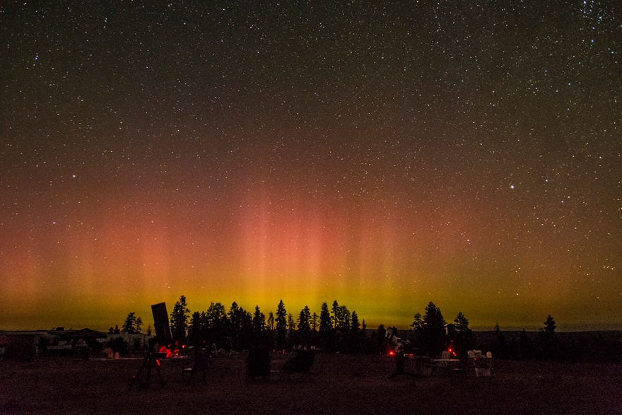
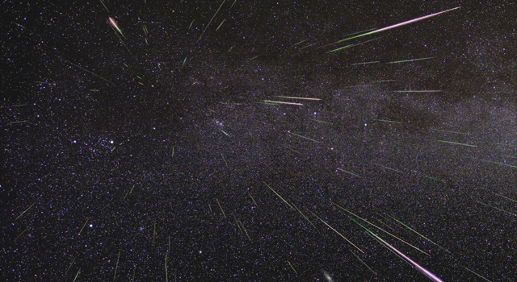
Oregon Star Party 2015
August 11 - 16
Chuck Dethloff

Slide 28
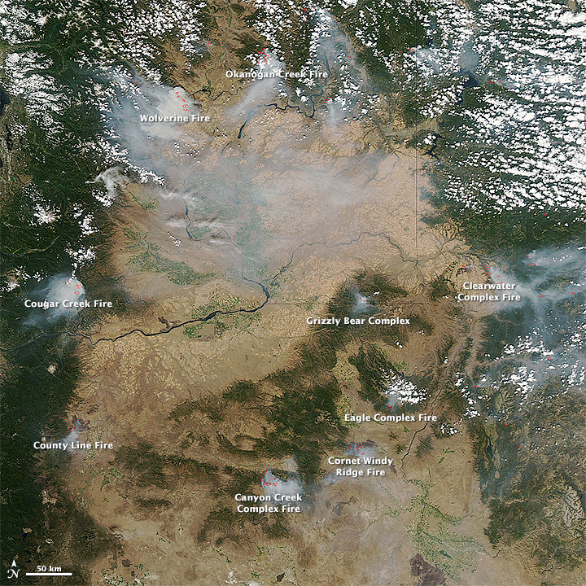
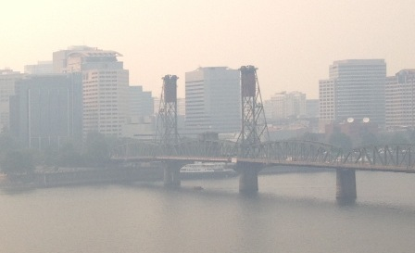
Smoke from Fires in Oregon, California | NASA
August 2015
ODOT
NASA

Slide 29
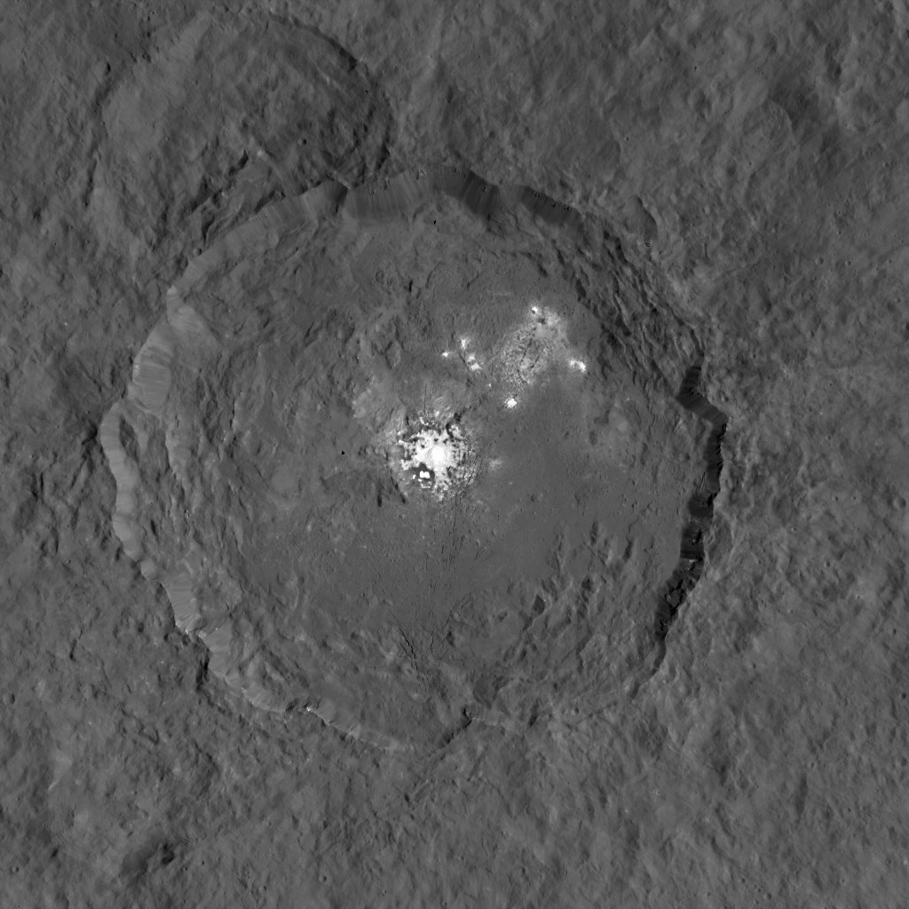
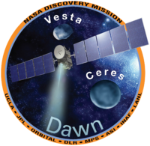
Dawn at Ceres
September 9, 2015

Slide 30
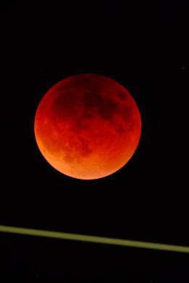
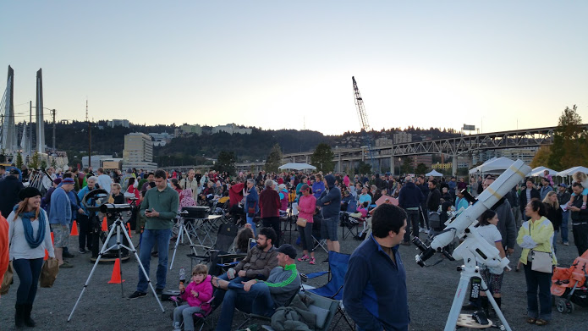

Super Bloody Moon
September 27, 2015
Brett Schaerer

Slide 31
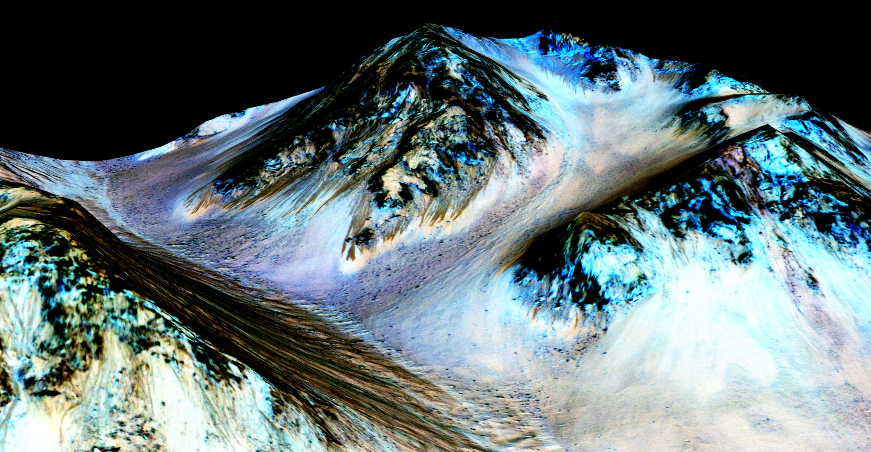
NASA Confirms Evidence That Liquid Water Flows on Today’s Mars
September 28, 2015
Credits: NASA/JPL/University of Arizona

Slide 32

The Martian

Slide 33
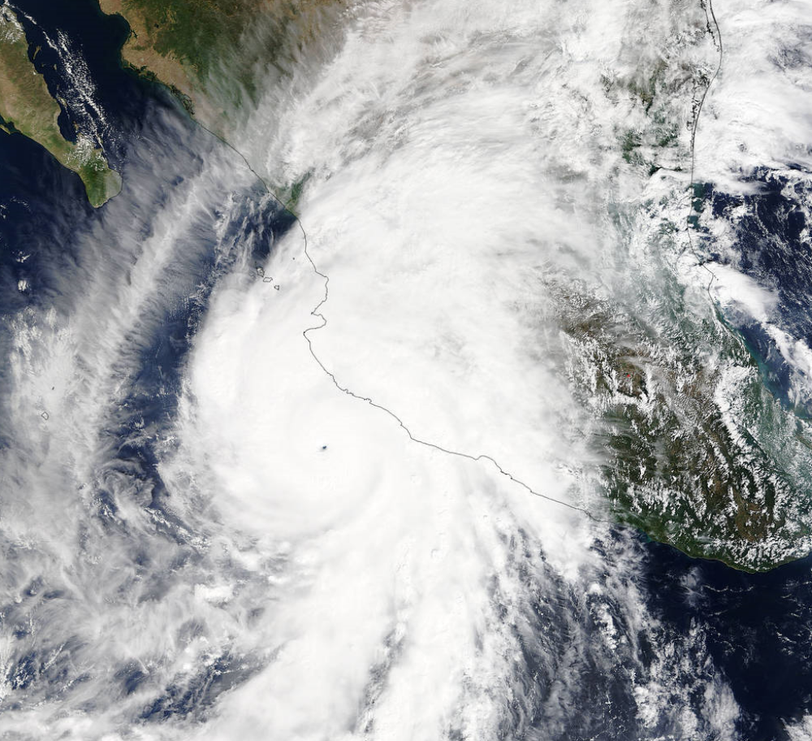
Hurricane Patricia
October 23, 2015

Slide 34
Looking ahead…

Slide 35
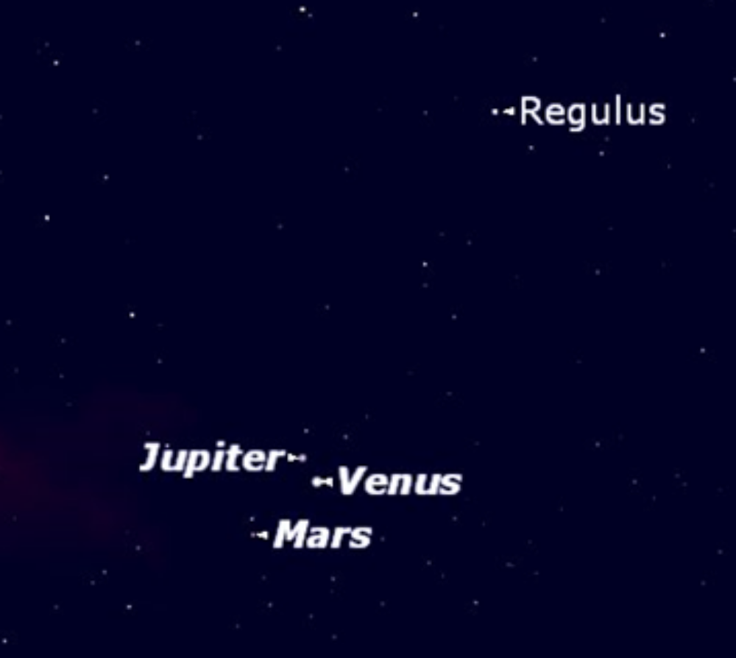
Conjunction of Venus, Mars, and Jupiter
October 28, 2015

Slide 36
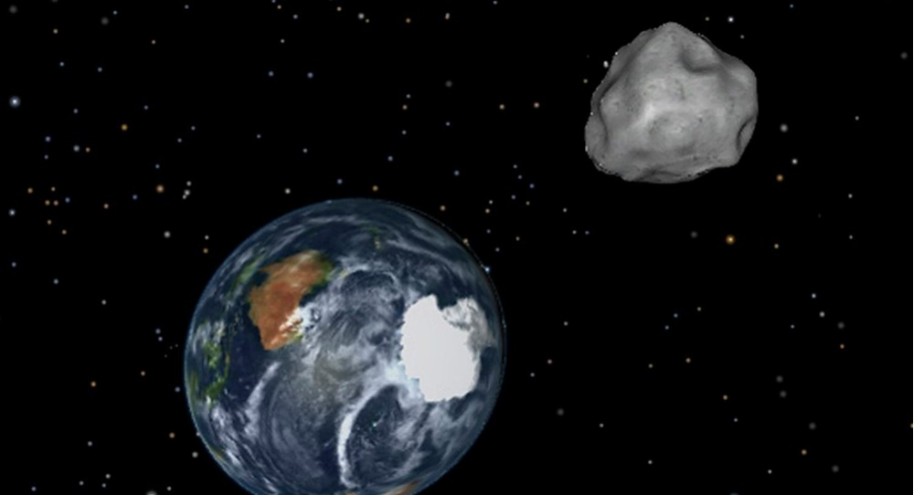

Big asteroid will safely pass Earth on Halloween
October 31, 2015

Slide 37

Star Wars
December 18, 2015

Slide 38
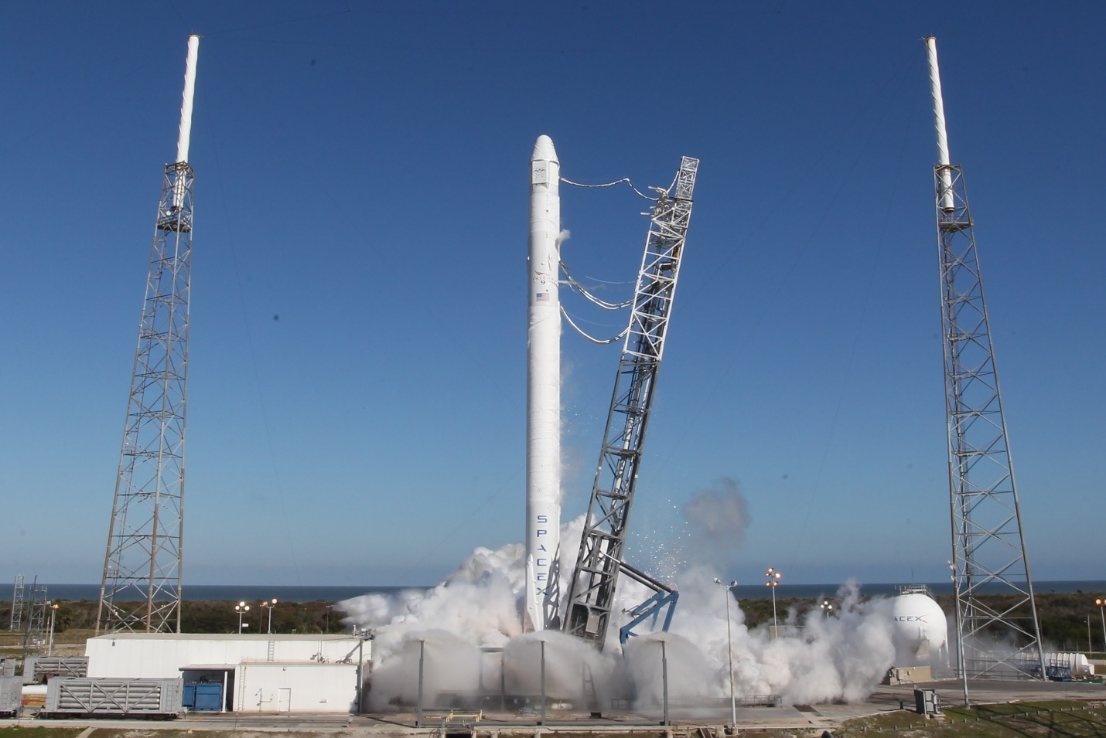
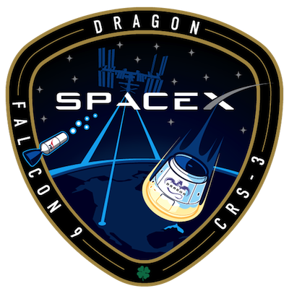
SpaceX Falcon 9 CRS-9
December TBD, 2015

Slide 39
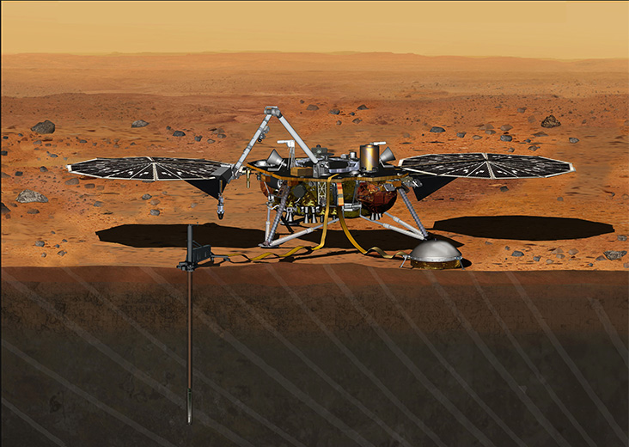
InSight Lander to Mars
March 2016
September 2016
•Launch: March 4 - March 30, 2016
•Landing: Landing: September 28, 2016
•Surface operations: 728 days / 708 sols

Slide 40
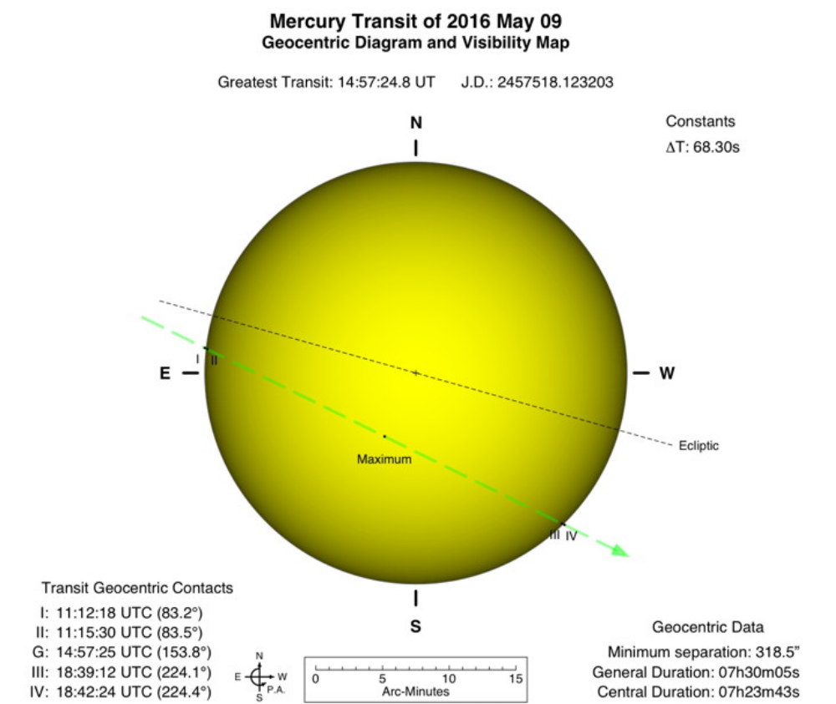
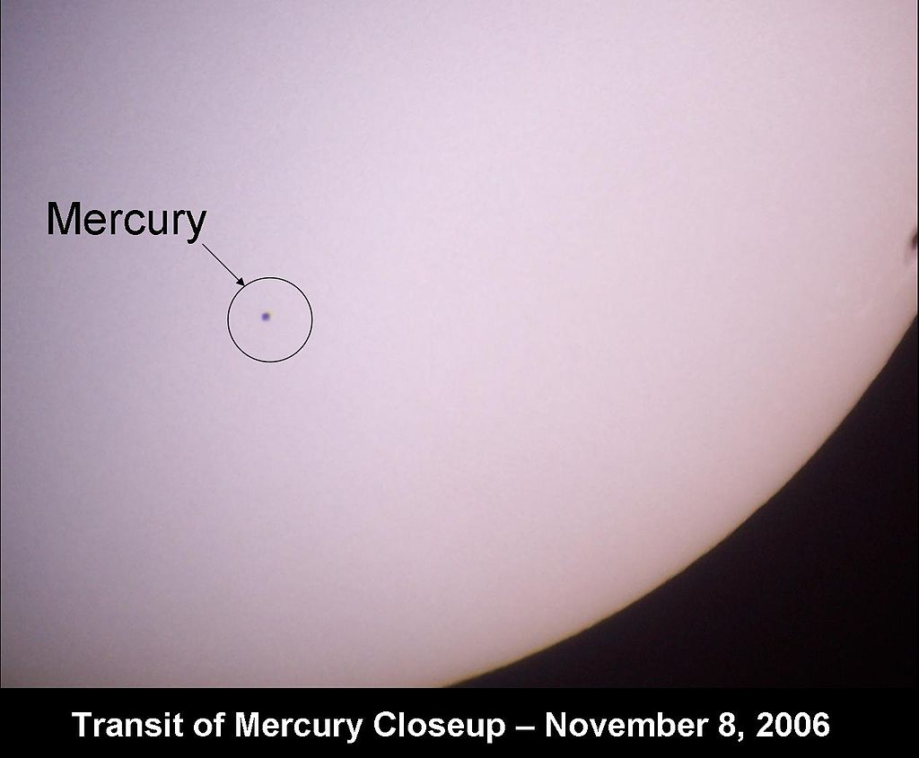
Transit of Mercury
May 9, 2016
First Contact: 4:12 AM
Sunrise: 5:46 AM
Max Transit: 7:13 AM
(21 degrees)
Last Contact: 11:13 AM

Slide 41
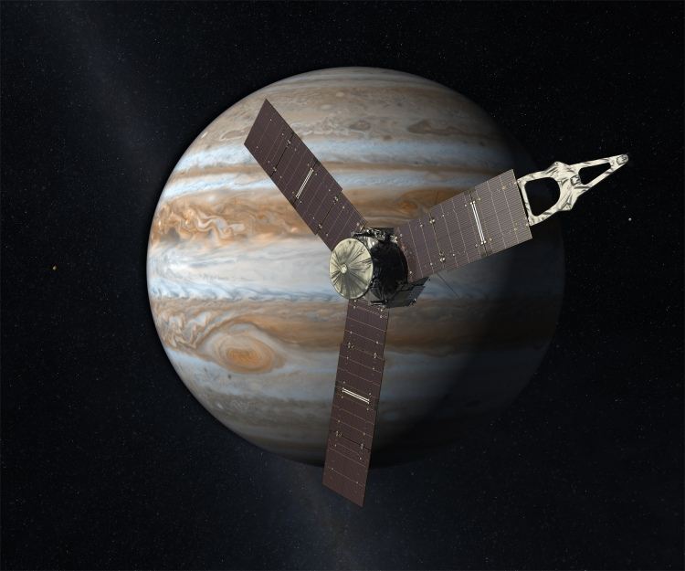
Juno Mission to Jupiter
Arrival on July 4, 2016

Slide 42


Total Solar Eclipse
August 21, 2017

Slide 43
To Be Continued…

