Slide 1
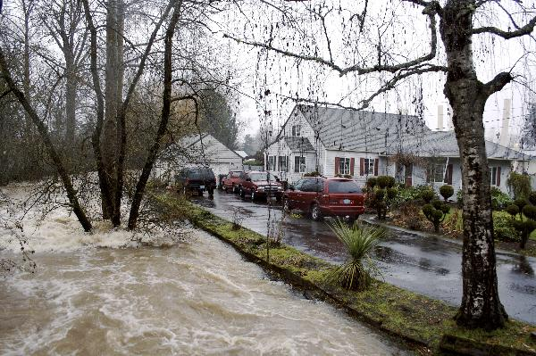
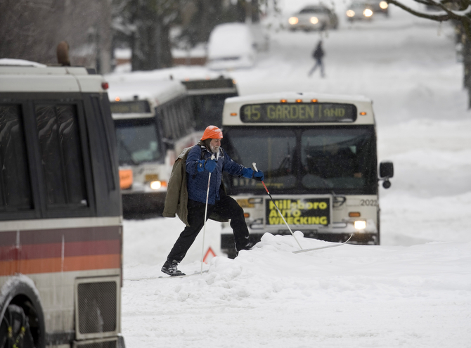
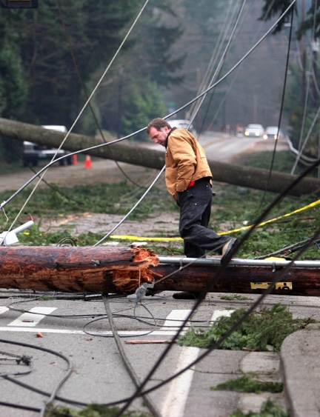
Winter Outlook (2015-2016)
Just tell us if it’s going to snow already
Oregon AMS Chapter
23rd Annual Winter Weather Forecast Conference
October 24, 2015
Amanda Bowen
National Weather Service
Portland, OR

Slide 2
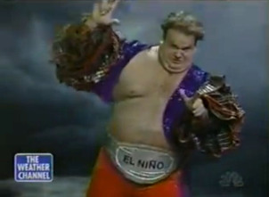
El Niño Background
Translation: The Niño

Slide 3

El Niño Background
Translation: The Niño The boy
Refers to baby Jesus Christ because pattern occurred around Christmas

Slide 4
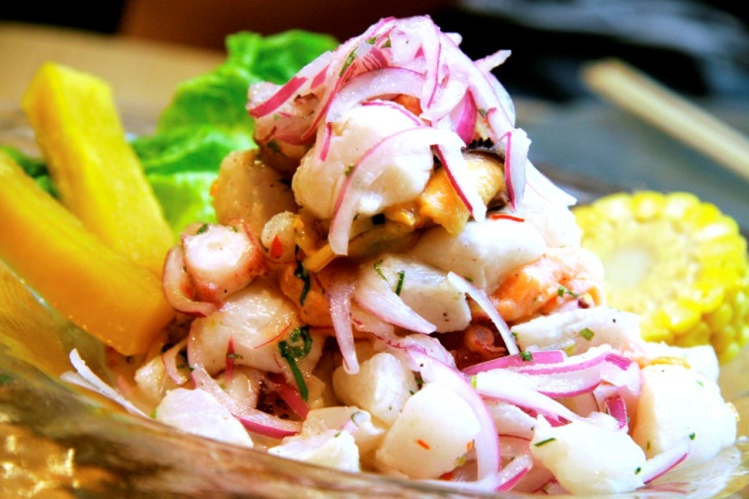
El Niño Background
Translation: The Niño The boy
Named after the birth of Jesus Christ because pattern occurred around Christmas
Noticed first by Peruvian fisherman
  Fun fact: Ceviche is the national food of Peru

Slide 5
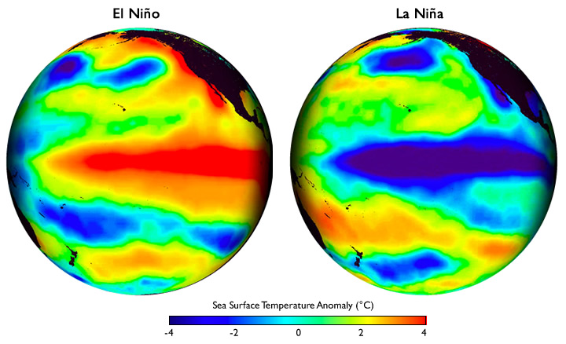
El Niño Southern Oscillation (ENSO)
USA
USA
Pacific Ocean
Pacific Ocean
Warmer than usual
ocean temperatures
Cooler than usual
ocean temperatures

Slide 6
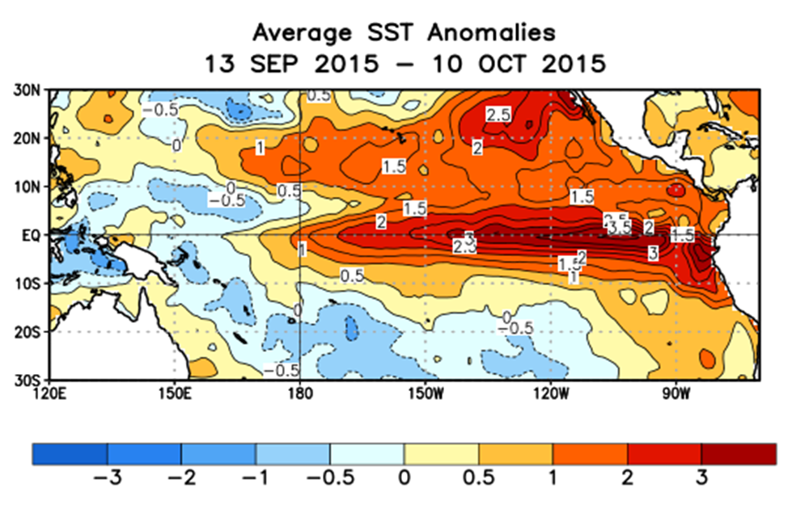
Sea Surface Temperature (SST) Departures from Normal
(°C)
Mexico
MUCH warmer
than usual
Australia
El Niño
La Niña
Neutral
Strong El Niño
(°C)
(°C)

Slide 7
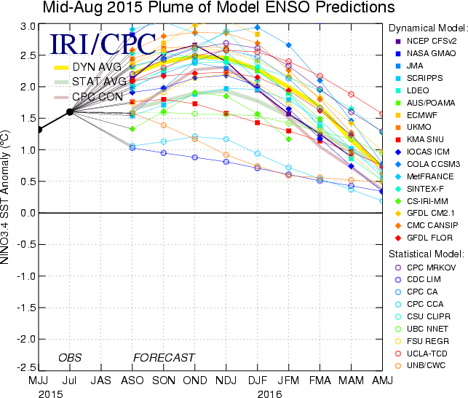
Climate Model Predictions
Strong
El Niño
El Niño
Neutral
La Niña

Slide 8
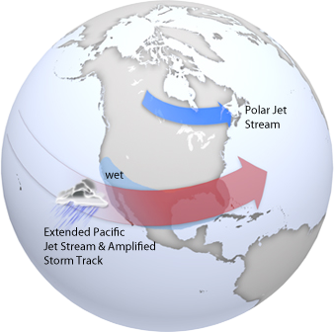
El Niño:
Winter Weather Patterns

Slide 9
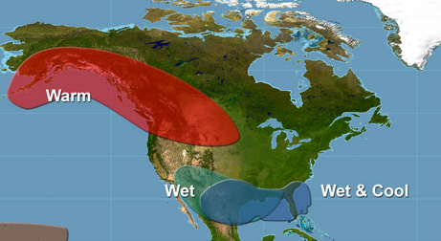
El Niño:
Winter Weather Trends
Pacific NW:
Average Temperature
Precipitation

Slide 10
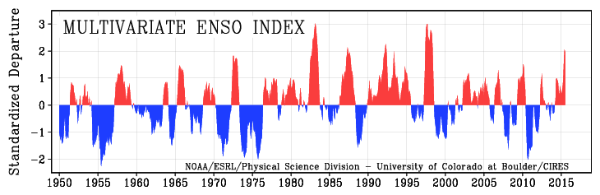
ENSO Historical Trends
1997-98
2015
1957-58
1972-73
1982-83
1991-92
1965-66
1988-89
1998-00
2007-08
Strong El Niño winters:
1957-58
1965-66
1972-73
1982-83
1991-92
1997-98

Slide 11
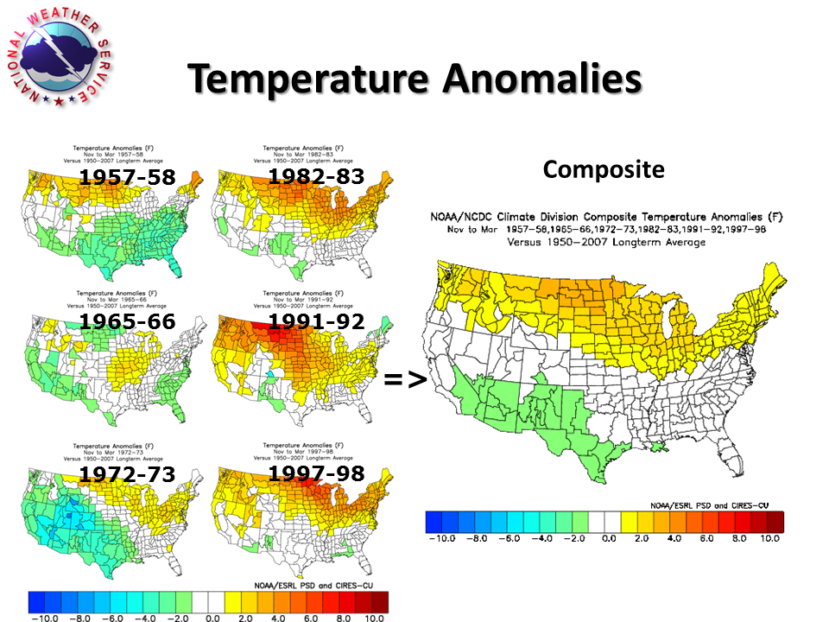

Slide 12
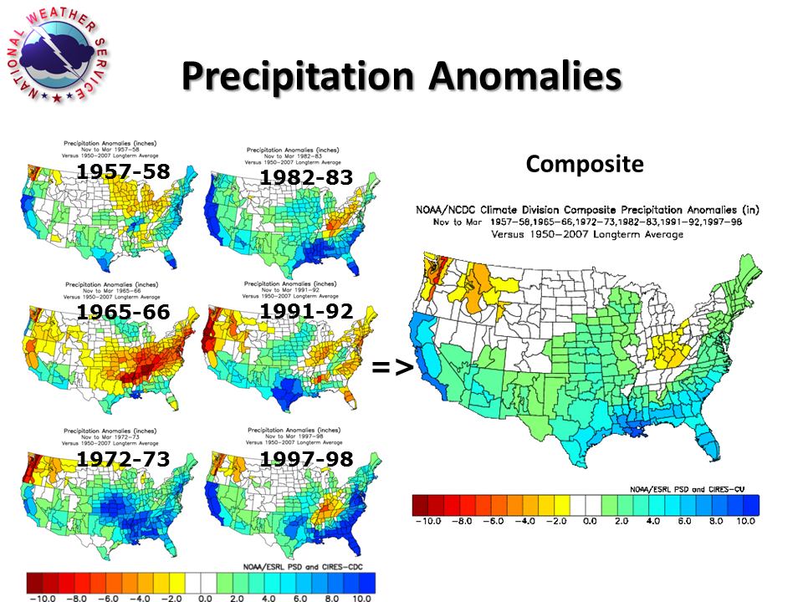

Slide 13
Lowland Snowfall History
1951 to 2010
Portland Top 10 Snowiest Winters:
34.0” 1968-69 El Niño
24.2” 2008-09 ENSO Neutral
22.4” 1955-56 La Niña
20.3” 1959-60 ENSO Neutral
17.4” 1992-93 ENSO Neutral
16.3” 1979-80 ENSO Neutral
14.7” 1970-71 La Niña
13.4” 1964-65 ENSO Neutral
12.0” 1994-95 El Niño
10.5” 1953-54 ENSO Neutral
60% were ENSO Neutral
20% were La Niña
20% were El Niño

Slide 14
Lowland Snowfall History
1951 to 2010
18 snow-shutout winters:
(Trace or 0 snowfall)
8 El Niño winters
7 ENSO Neutral winters
3 La Niña winters
44% were El Niño
39% were ENSO Neutral
17% were La Niña

Slide 15
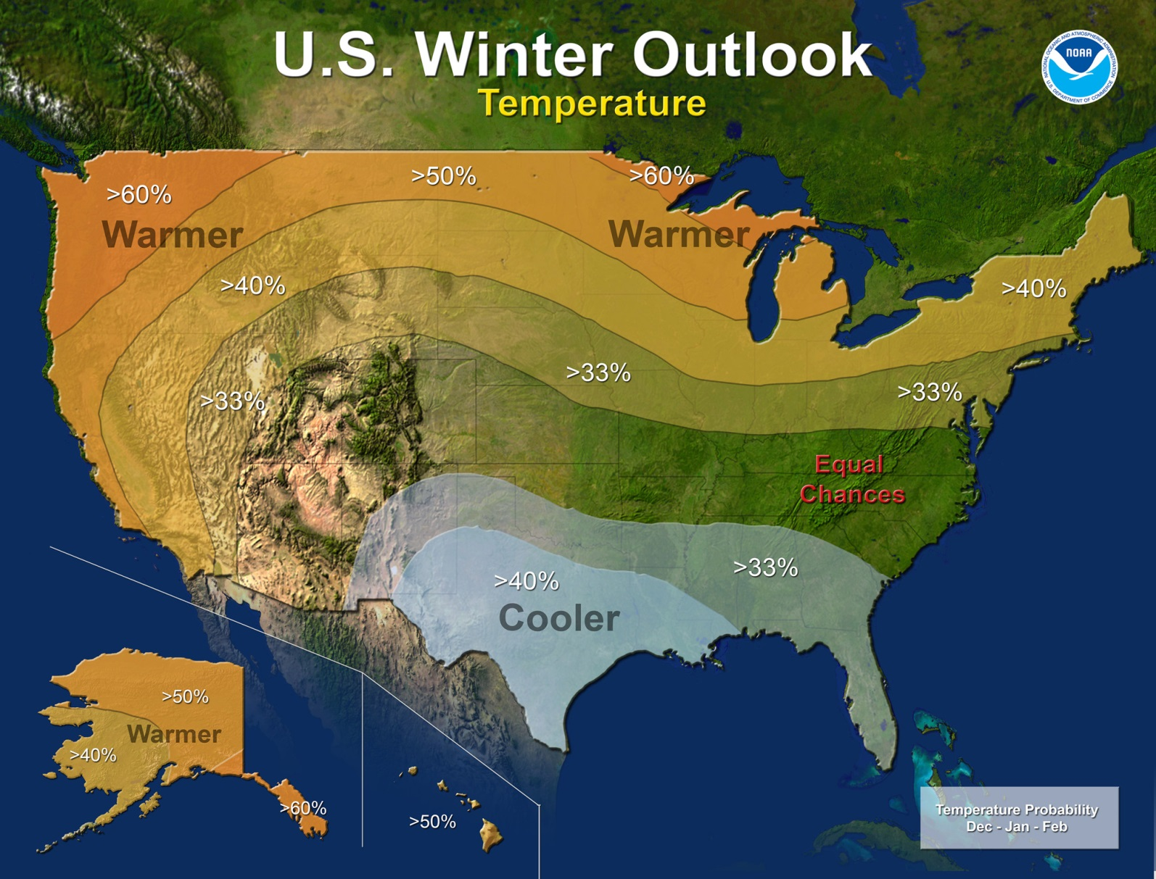
U. S. Seasonal Outlook
December - January - February
Warmer: ~62%
Normal: 33%
Cooler: 5%

Slide 16
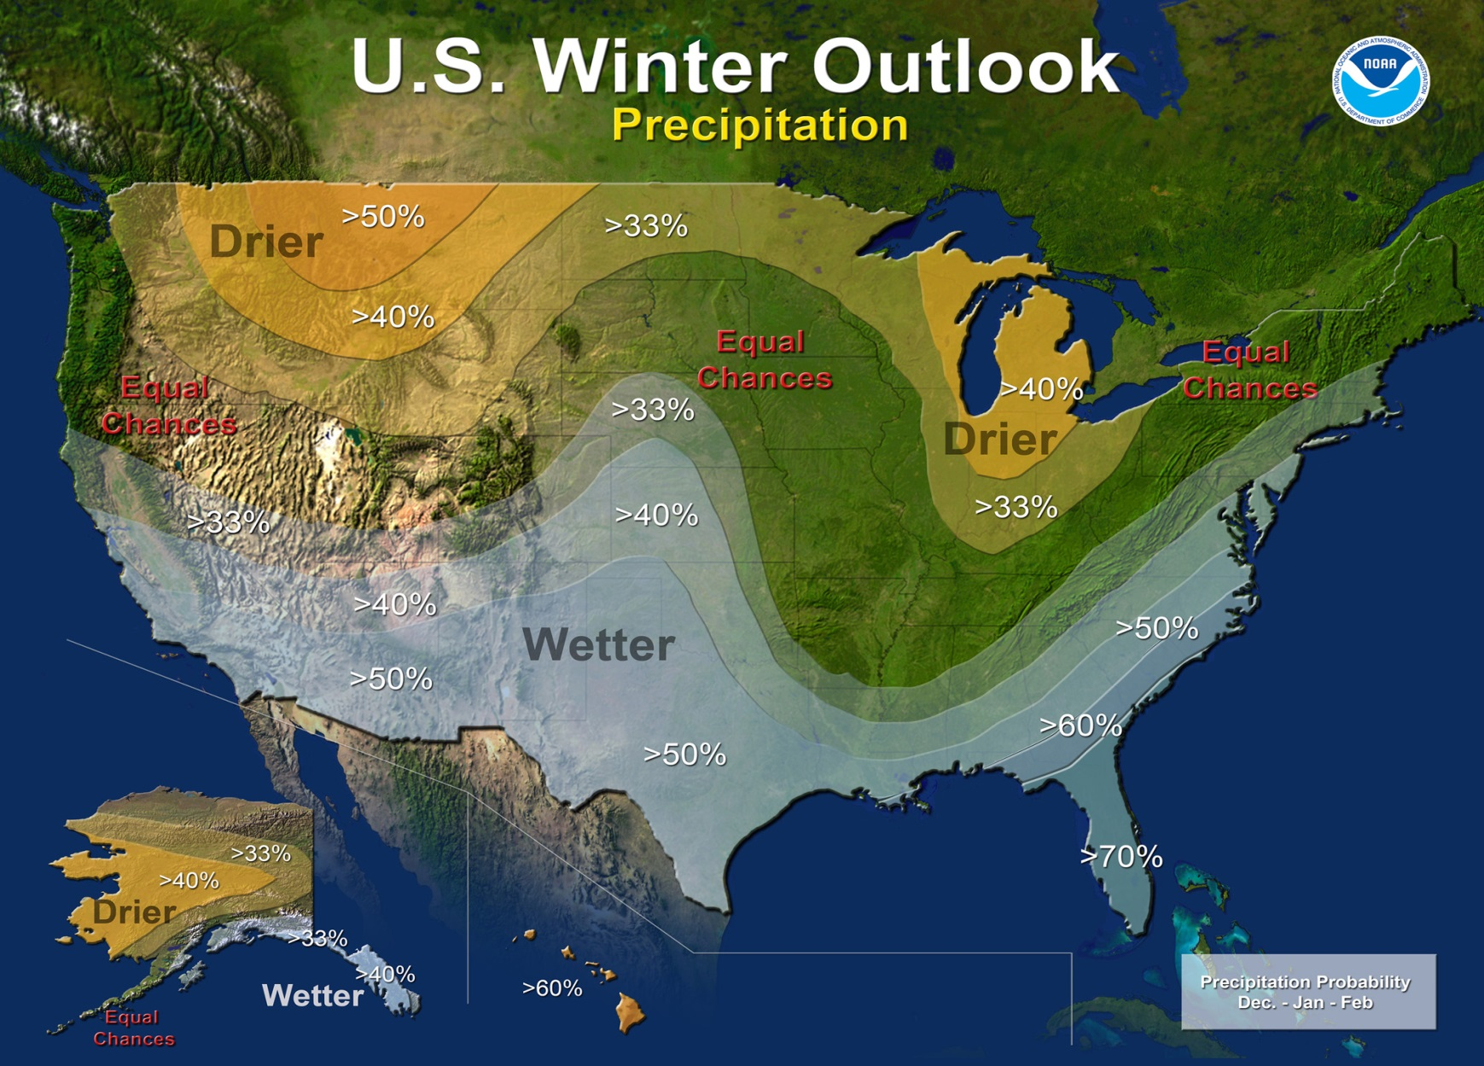
U. S. Seasonal Outlook
December - January - February
Wetter: 33%
Normal: 33%
Drier: 33%

Slide 17

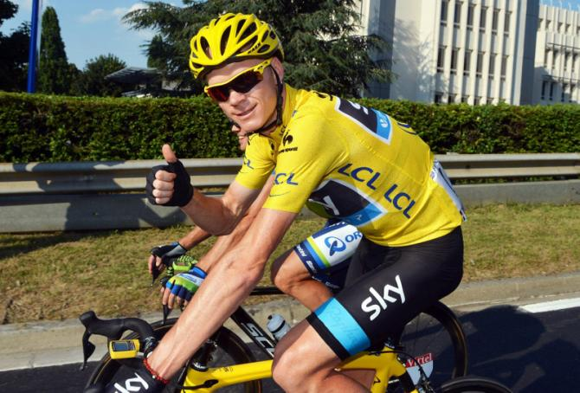
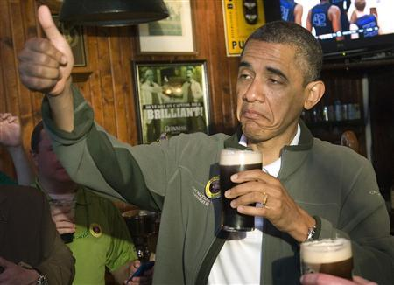
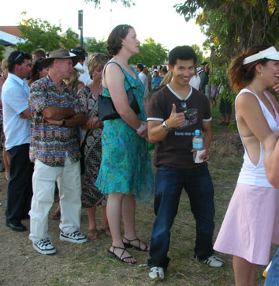
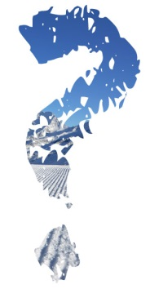
Summary:
Winter Activities Outlook
Drinking your favorite microbrew
Bicycling
Waiting in line for brunch
Skiing

Slide 18

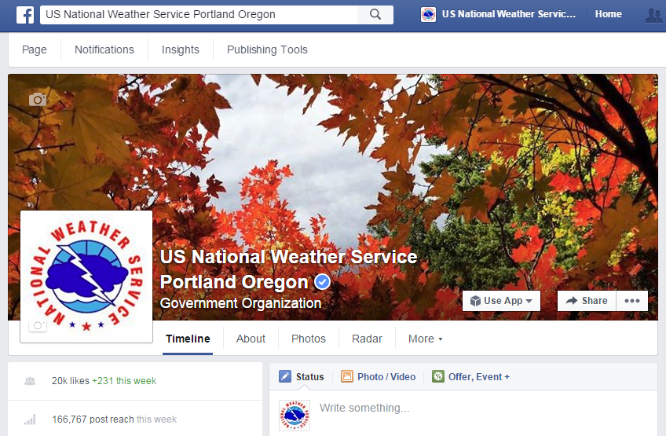

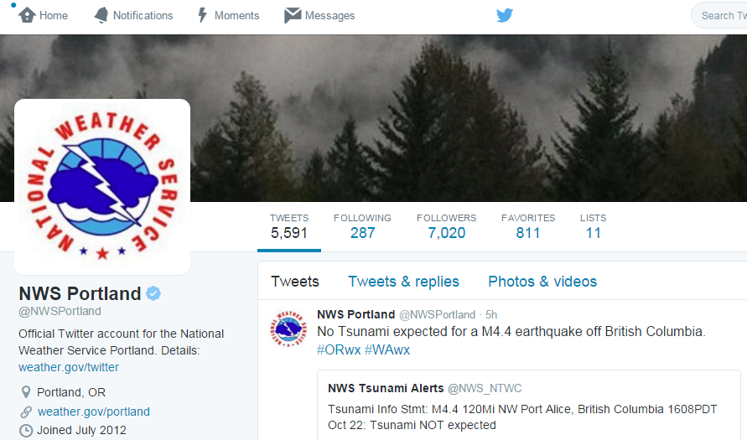
Find us on Social Media
facebook.com/NWSPortland
Twitter: @NWSPortland

Slide 19
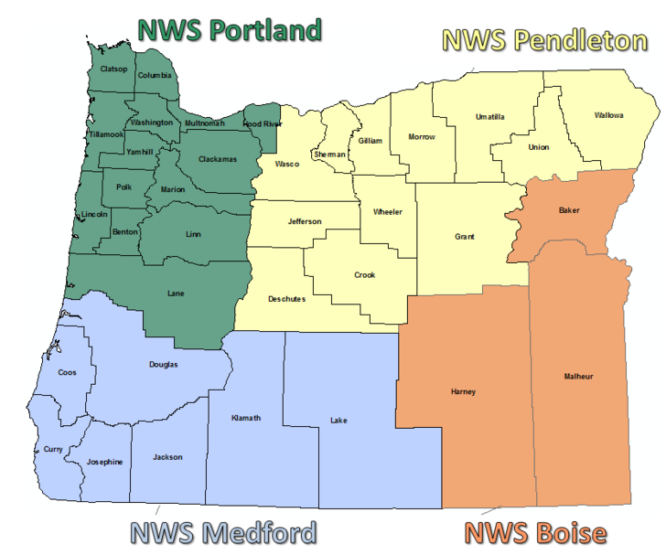
Find us on Social Media

Slide 20
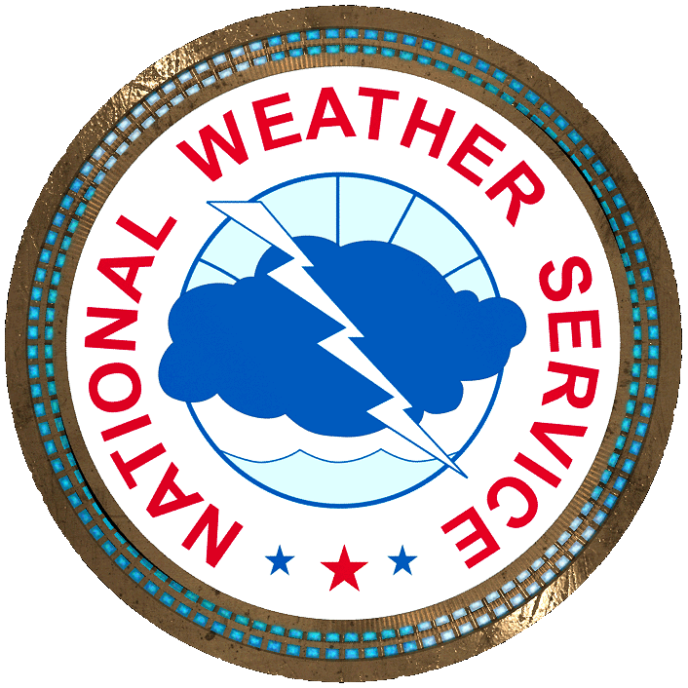
Questions?

Slide 22
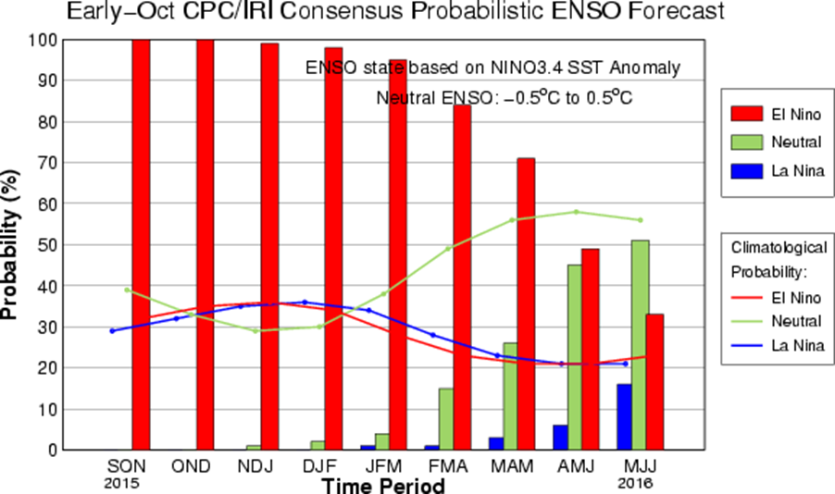
ENSO Outlook
Updated: 8 October 2015

Slide 23
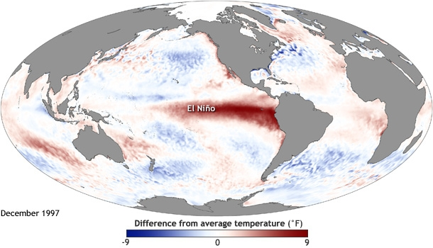
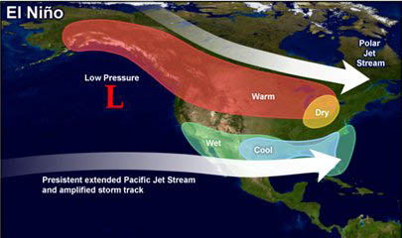
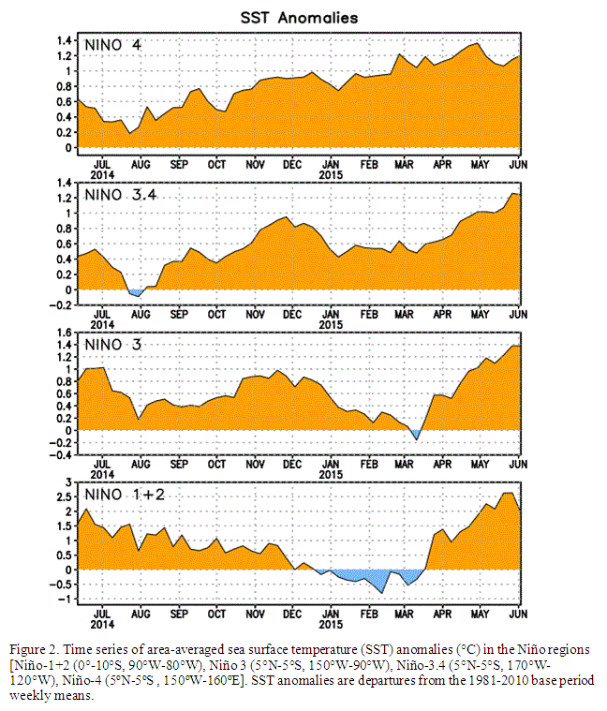
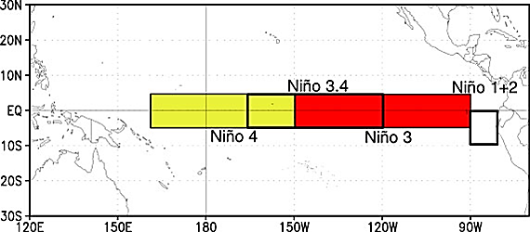
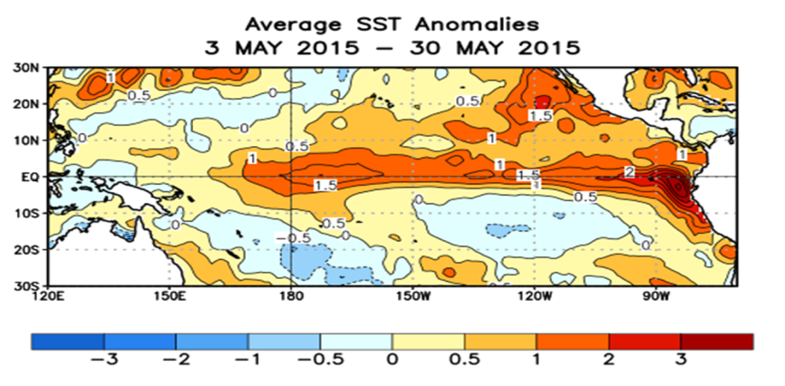
ENSO Status
El Niño conditions present
El-Nino likely to strengthen - Continue through 2016
- Strong event
Typical El-Nino
Pattern
Graphics from NOAA/NWS
Climate Prediction Center

