Slide 1

2014-2015
Winter Weather
Wrap Up
Mark Nelsen

Slide 2
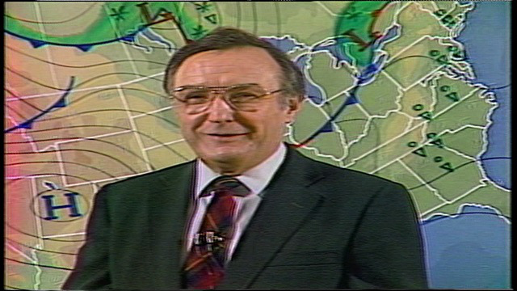
First…Goodbye Dr. John Walls!
1931-2015
WAS HERE AT KOIN 1974-1996
Remember those cool maps that slid from right to left? The forecast sky conditions throughout the day? The first DAYPART forecast in P-Town!

Slide 3
That Inspired Me to Catalog All Portland TV Weather Personalites back to at least 1980…A Fun Task!
Thanks to all who responded to emails and Drew Jackson who kept his own list

Slide 4
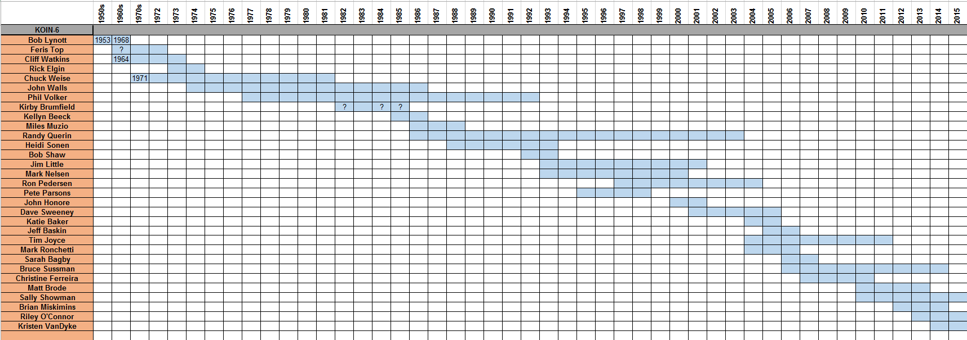
KOIN

Slide 5
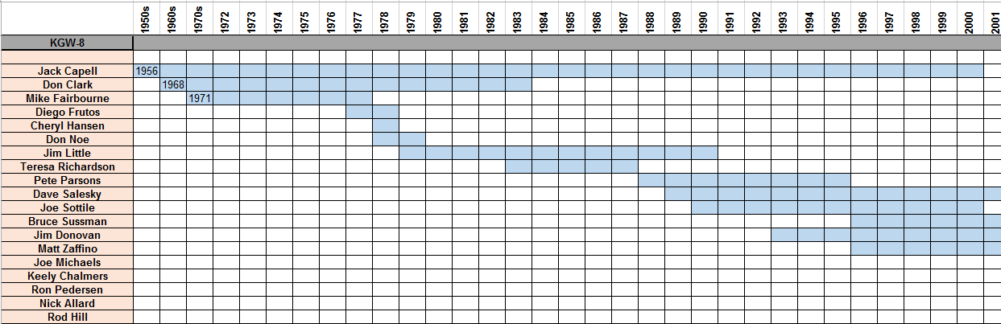
KGW

Slide 6
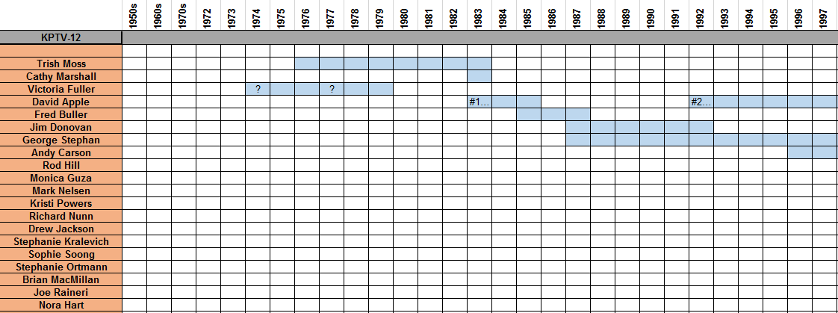
KPTV

Slide 7
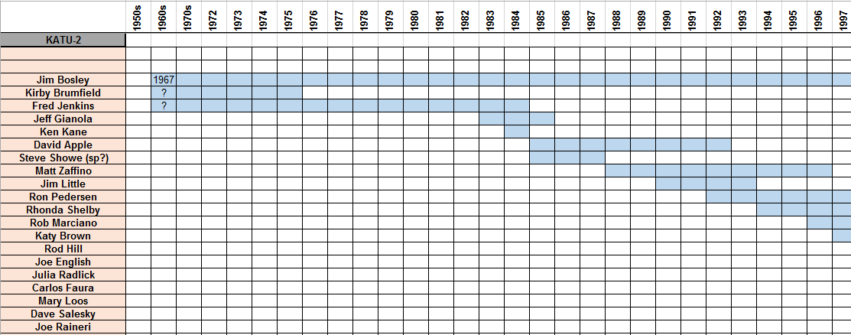
KATU

Slide 8
The biggest dud in 10 years

Slide 9
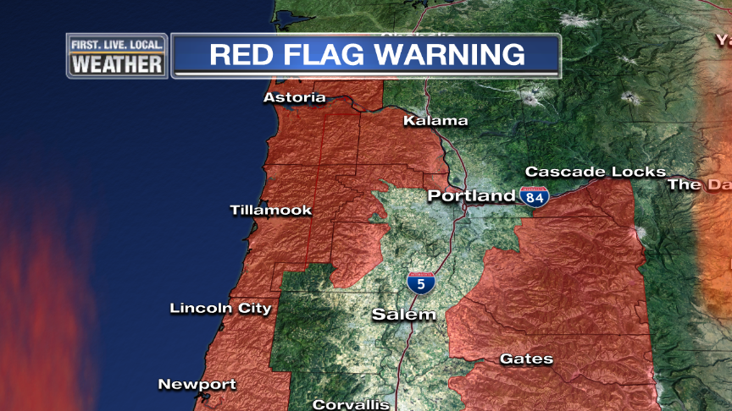
Quick Thoughts
Long periods of upper-level ridging nearby
No arctic blasts, although mid November maybe?
Total absence of cold post-frontal wet airmasses for 2nd year in
a row; snow level rarely dipped below 2,500’.
Warm, Warm, Warm

Slide 10

OFFICIAL
SNOW TOTAL
0.0”
No measurable snowfalls at PDX!
0.0” also at Downtown (KGW)

Slide 11
Snowfalls at PDX
Trace November 13th

Slide 12
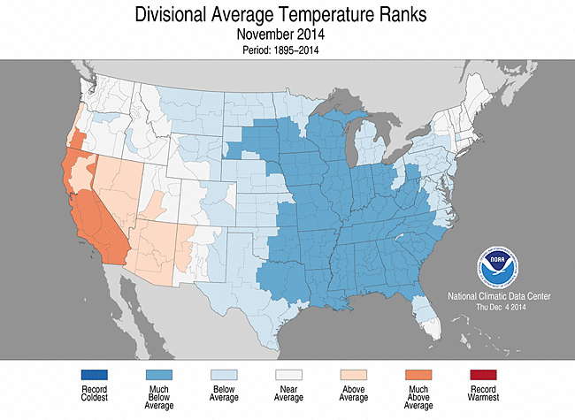
THE USA VIEW

Slide 13
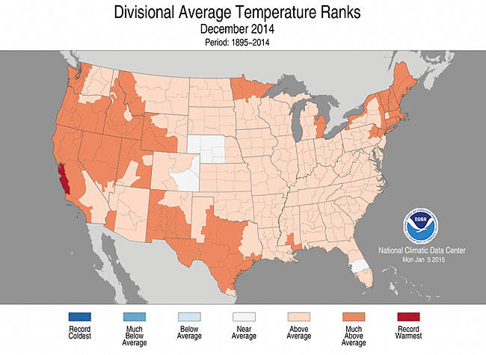
THE USA VIEW

Slide 14
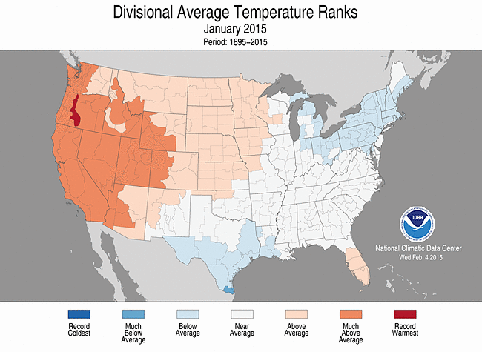
THE USA VIEW

Slide 15
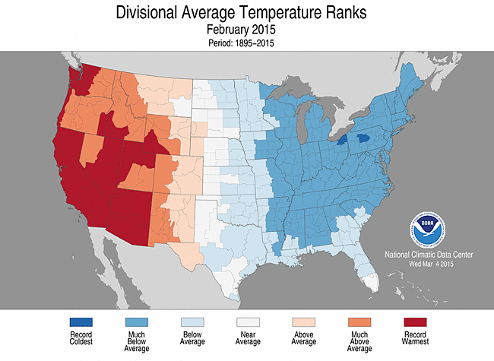
THE USA VIEW

Slide 16
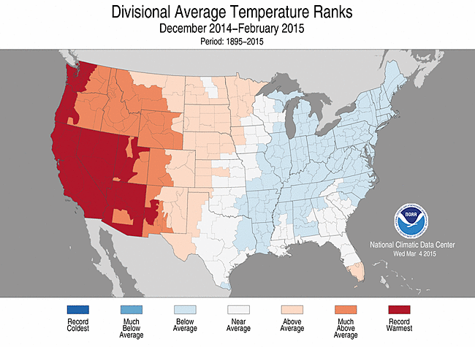
THE 3 MONTH PERIOD

Slide 17
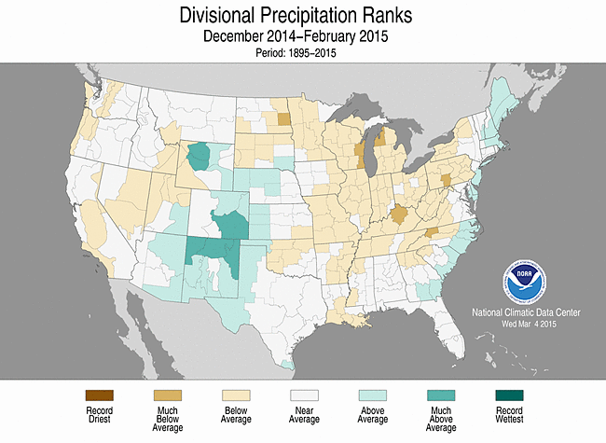
3 MONTH PRECIPITATION

Slide 18
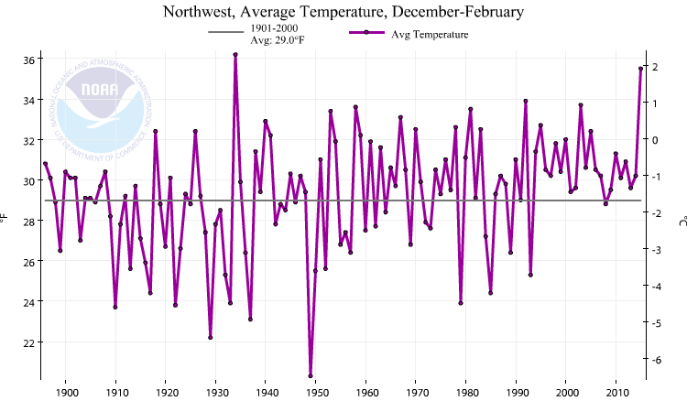
Pacific Northwest Winter Temps (the past 100 years)
2nd Warmest On Record

Slide 19
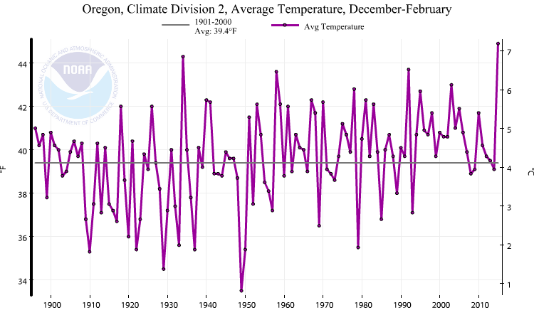
Western Valleys Winter Temps (the past 100 years)
Warmest You’ve Ever Seen!
Warmest on Record in Oregon Zone 2 (Willamette Valley)

Slide 20
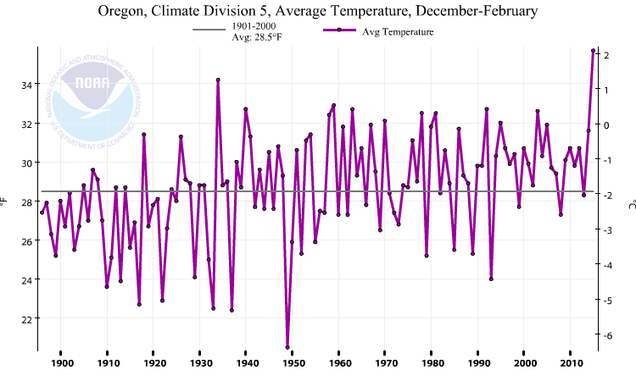
High Desert Winter Temps (Climate Zone 5)
Warmest on record as well

Slide 21
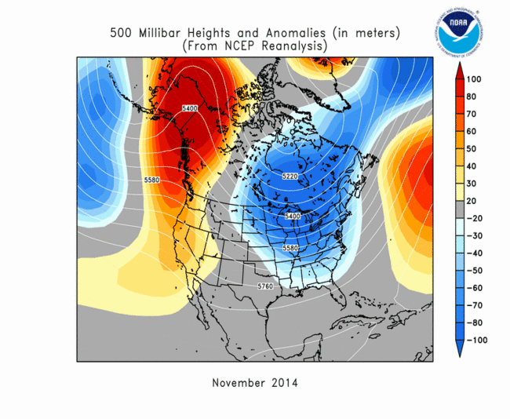
UPPER LEVEL PATTERNS
Ridging near west coast of North America: Pattern continued through March!

Slide 22
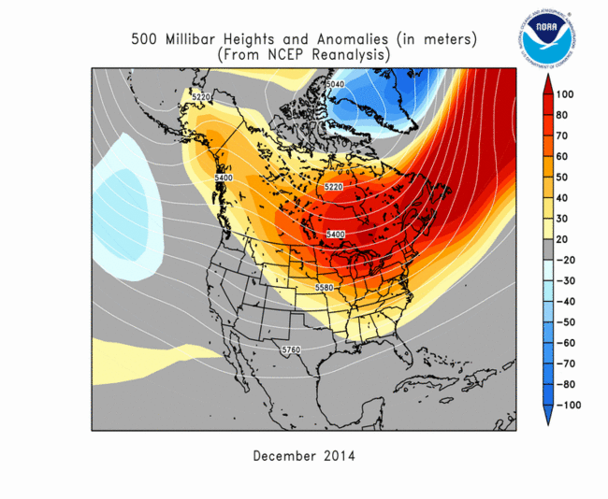
UPPER LEVEL PATTERNS

Slide 23
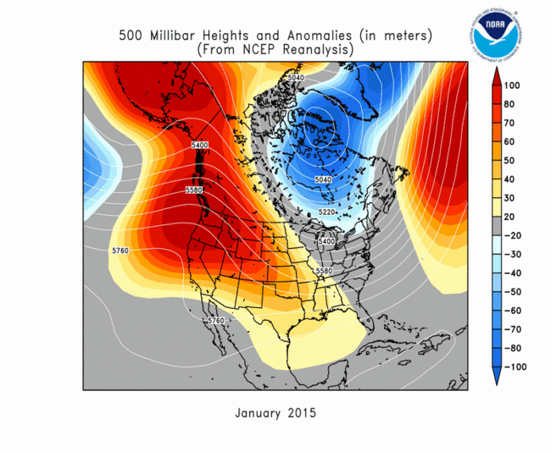
UPPER LEVEL PATTERNS

Slide 24
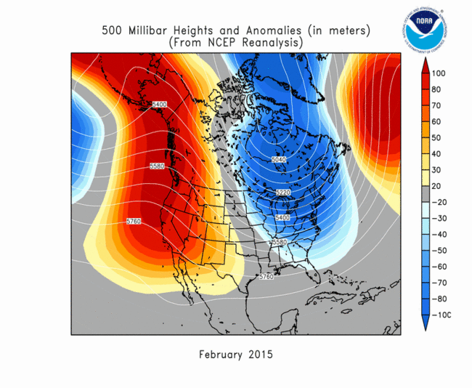
UPPER LEVEL PATTERNS

Slide 25
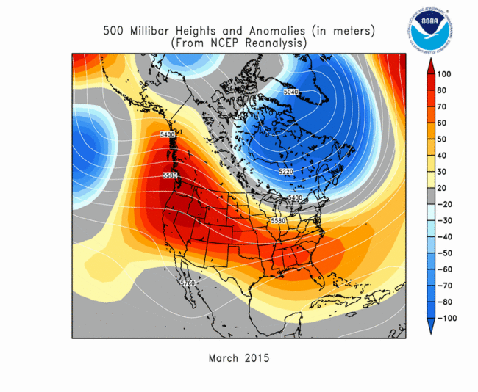
UPPER LEVEL PATTERNS

Slide 26
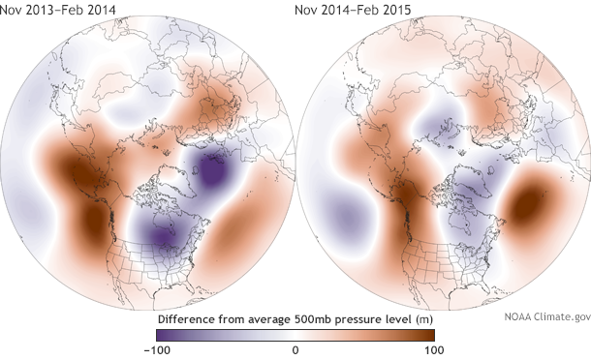
Two Winters Dominated By Upper-Level Ridging

Slide 27
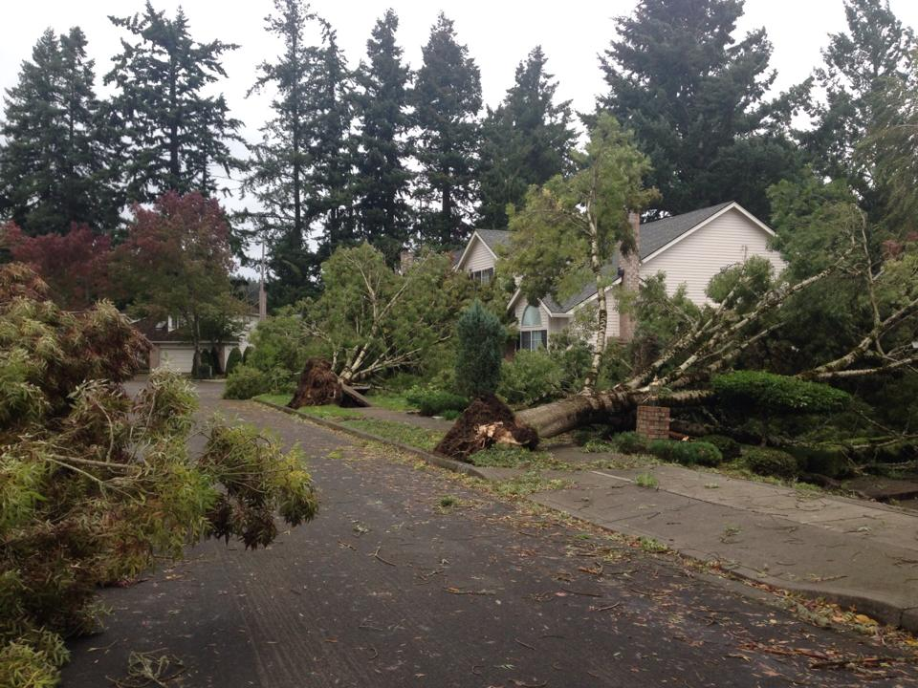
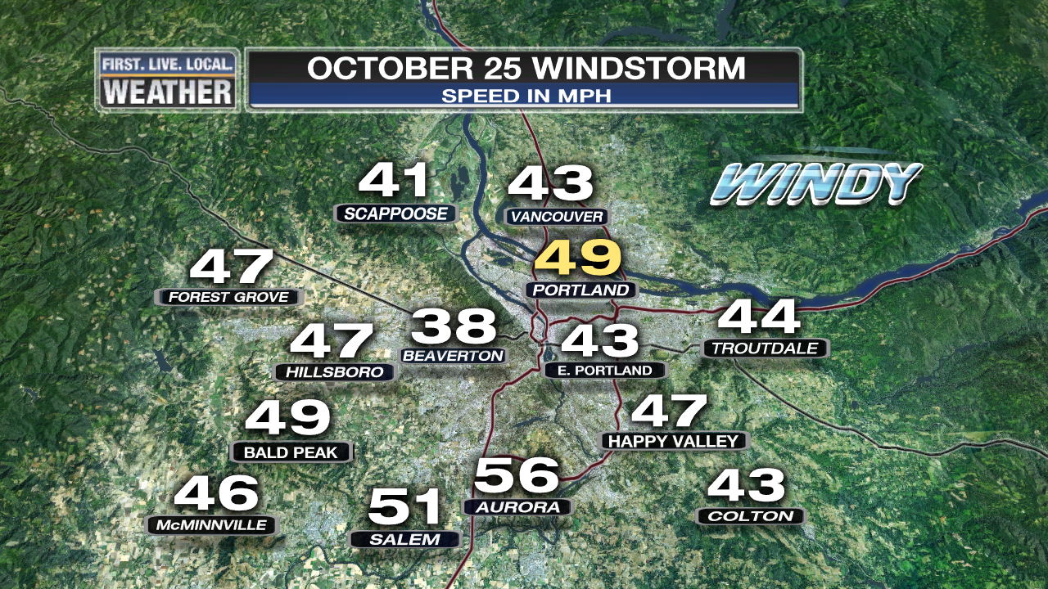
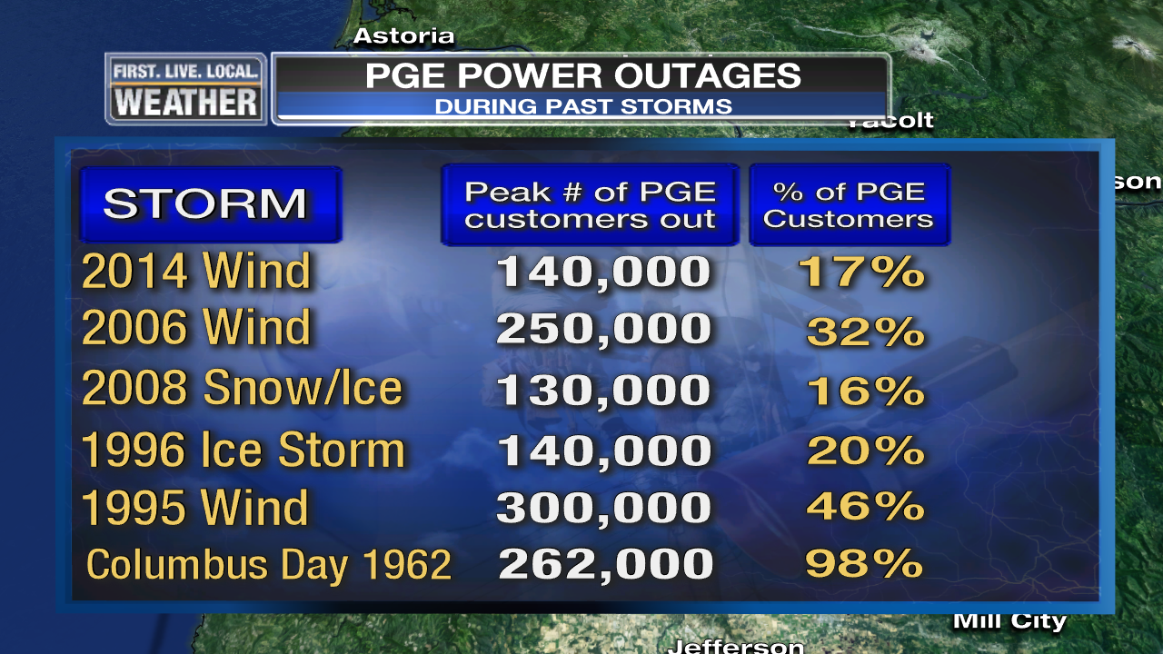
REMEMBER “MEETING DAY” LAST FALL?
A Windstorm! Stormy season starts with a bang
  Lots of tree damage due to leaves on trees
  Strongest October windstorm in 20+ years
  All PGE customers back online in 2.5 days, biggest wind disruption since 2006

Slide 28
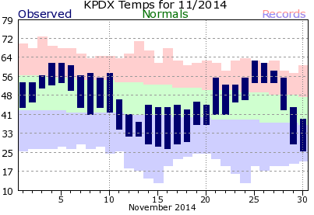
NOVEMBER
Unusually Warm > Record Cold > Record Warm > Then Cold
    Wild swings in temperatures
60s to 30s to 50s/60s

Slide 29
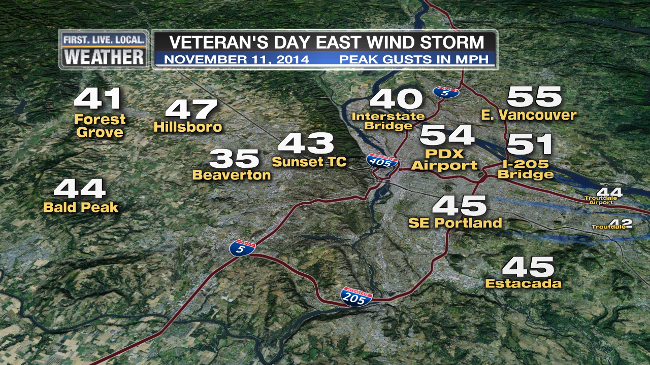
NOVEMBER
Veteran’s Day East Wind Storm
Strongest east wind gust at PDX in 8 years

Slide 30
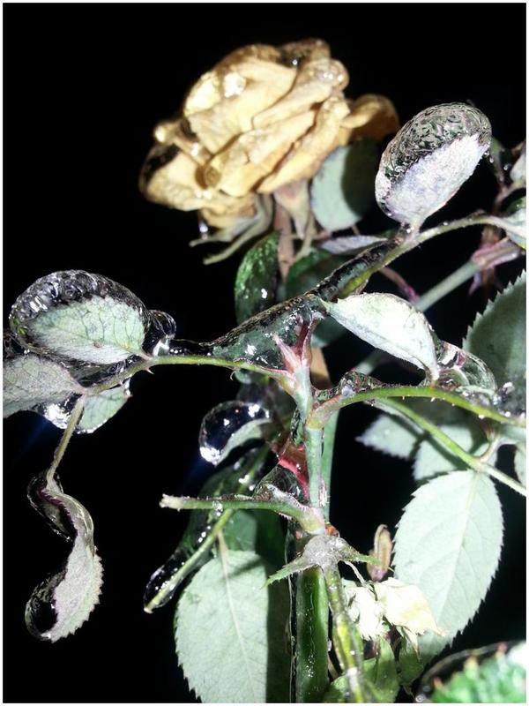
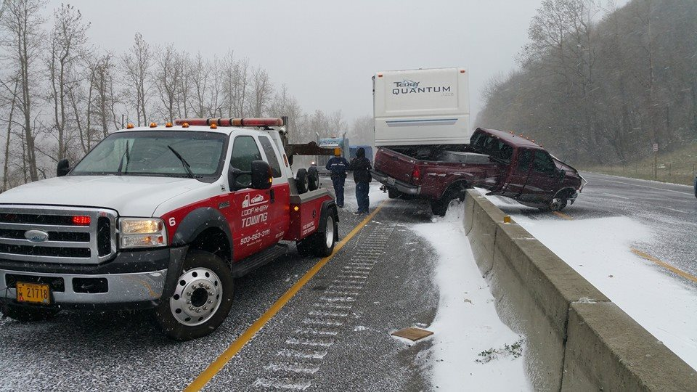
NOVEMBER
Earliest “Arctic Blast” In Years
Damaging early freeze and unusually early ice/snow

Slide 31
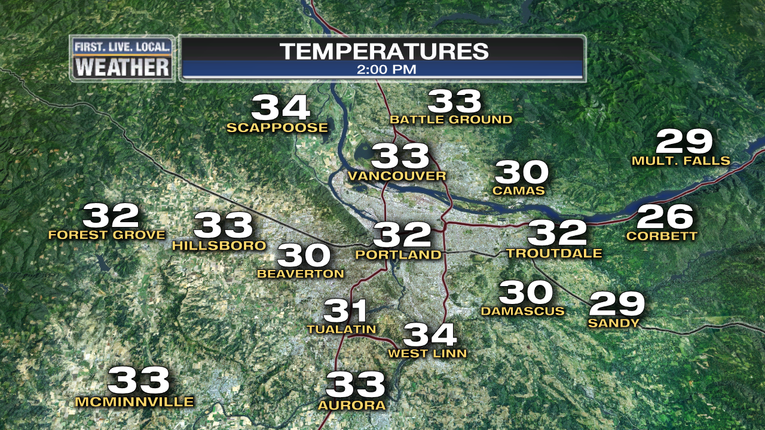
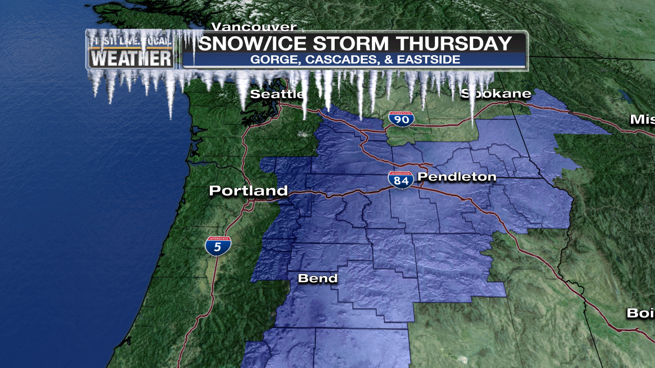
NOVEMBER
Snow/Ice storm in Gorge & Eastern Oregon
Winter Storm Warnings…On November 13th!

Slide 32
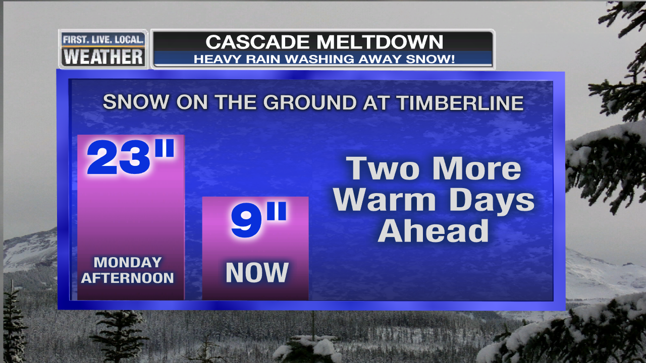
NOVEMBER
1st of Several Winter Mountain Rain Events hits Cascades
      2’ of snow reduced to just a few inches…total on the 25th below
      No widespread ski area openings in November

Slide 33
DECEMBER
Near normal rain
A warm month…Portland’s 2nd warmest December
27 consecutive days without a frost

Slide 34
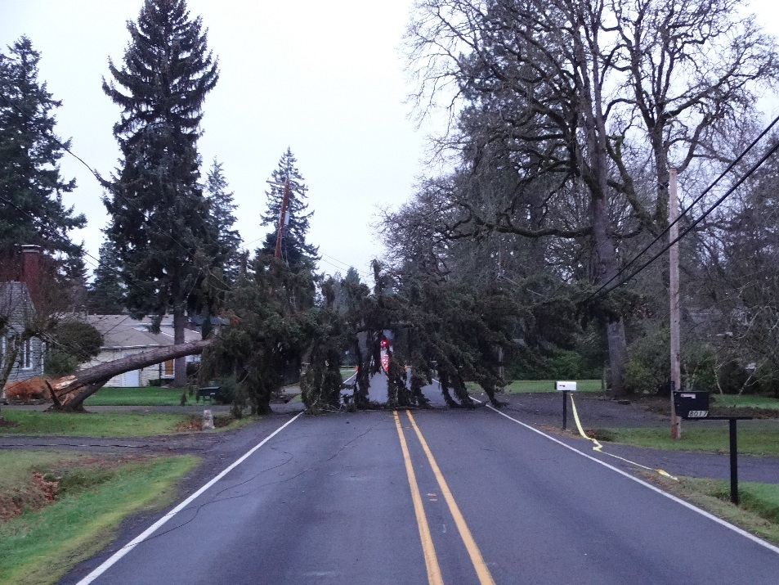
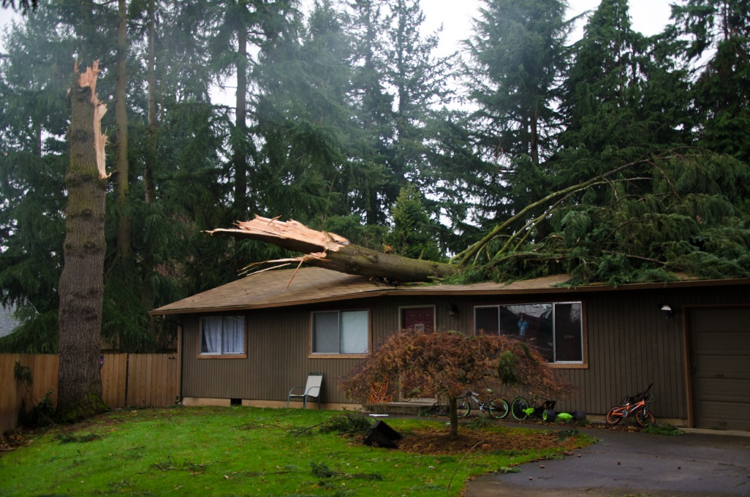
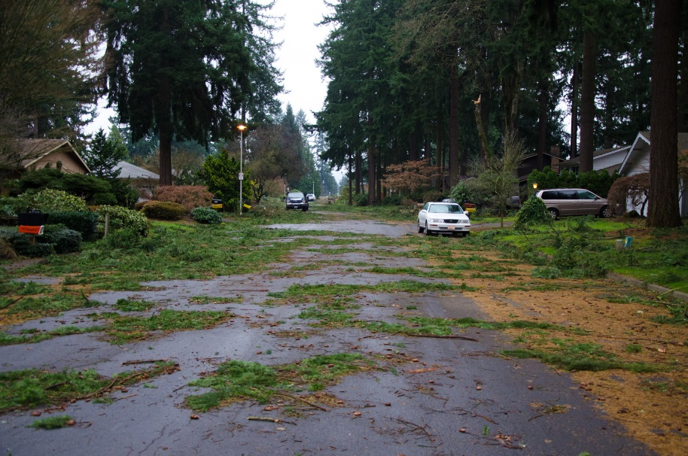
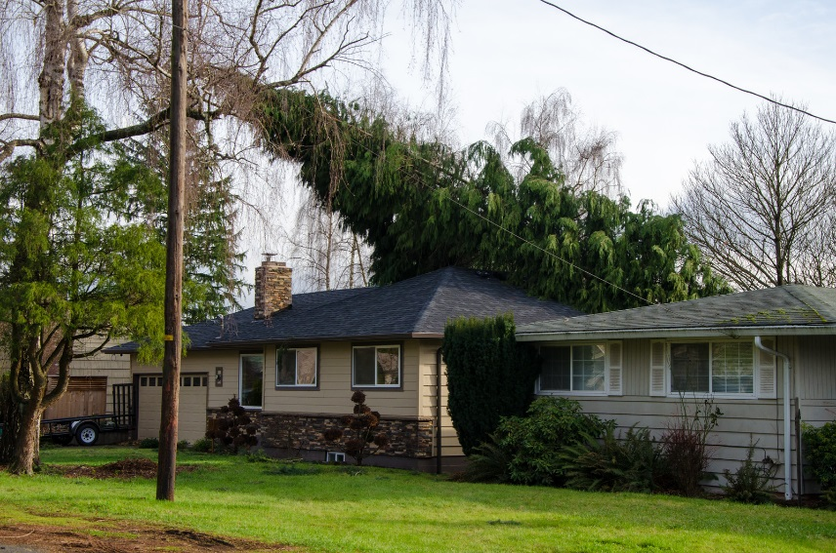
December 11th Wind Storm

Slide 35
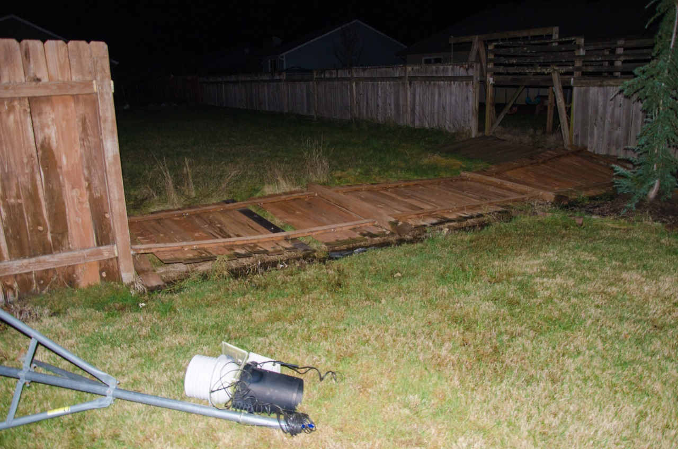
December 11th Wind Storm
The Horror!
Tyler Mode’s Davis instruments toppled in Battle Ground.
They survived!

Slide 36
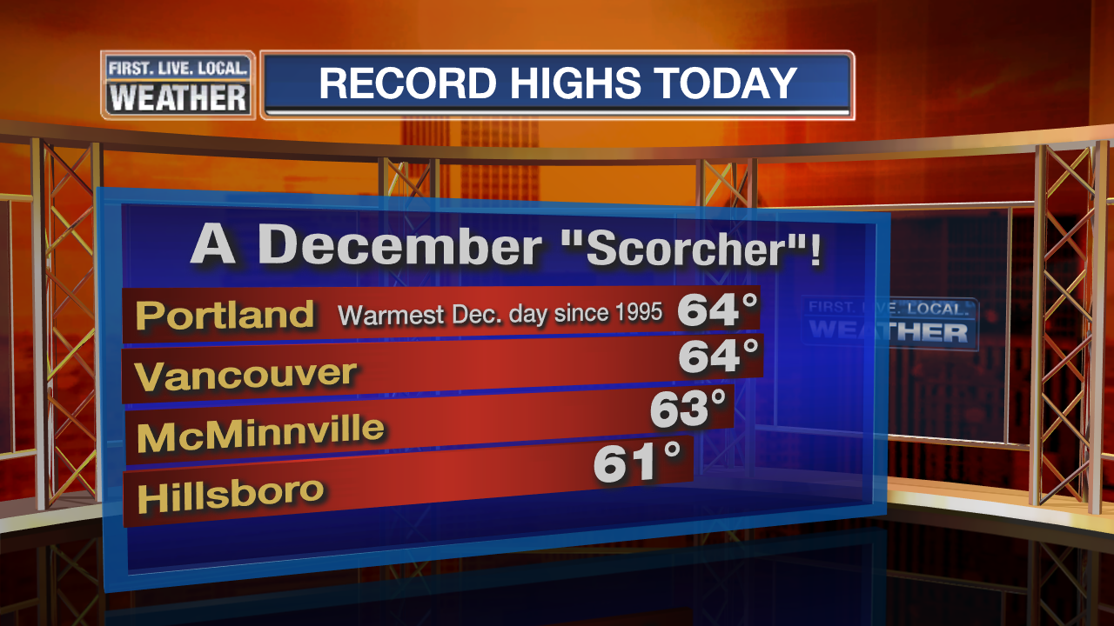
December 11th Wind Storm

Slide 37
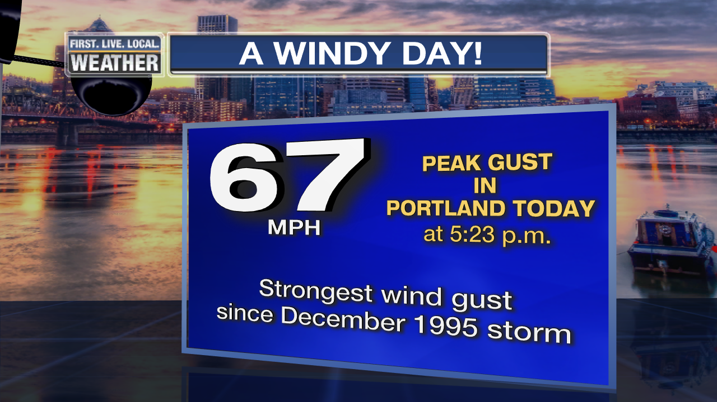
December 11th Wind Storm

Slide 38

December 11th Wind Storm
…AT PDX AIRPORT…
Strongest wind gust since the powerful Dec 12, 1995,
or (officially) November 14, 1981 storm.
During 1995 storm, ASOS measured 62 mph gust and “retired” anemometer reached 74 mph.
(ASOS used 5 sec. gust, the other was instantaneous)

Slide 39
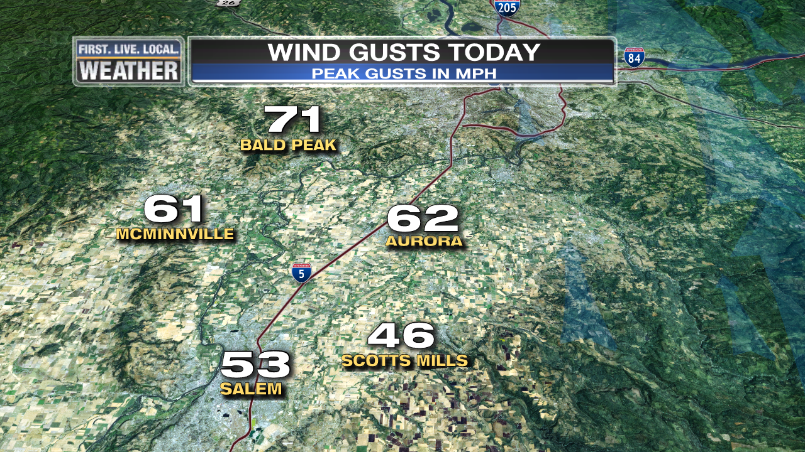
December 11th Wind Storm

Slide 40
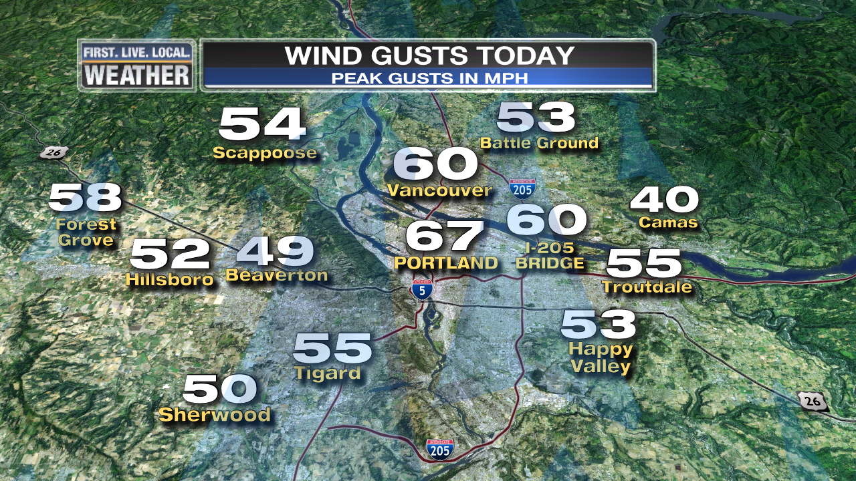
December 11th Wind Storm

Slide 41
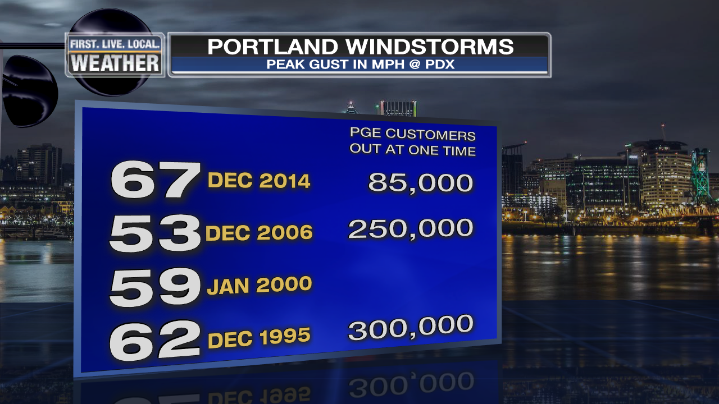
December 11th Wind Storm

Slide 42
December 11th Wind Storm
Mark!
It’s Time For Wolf Read

Slide 43
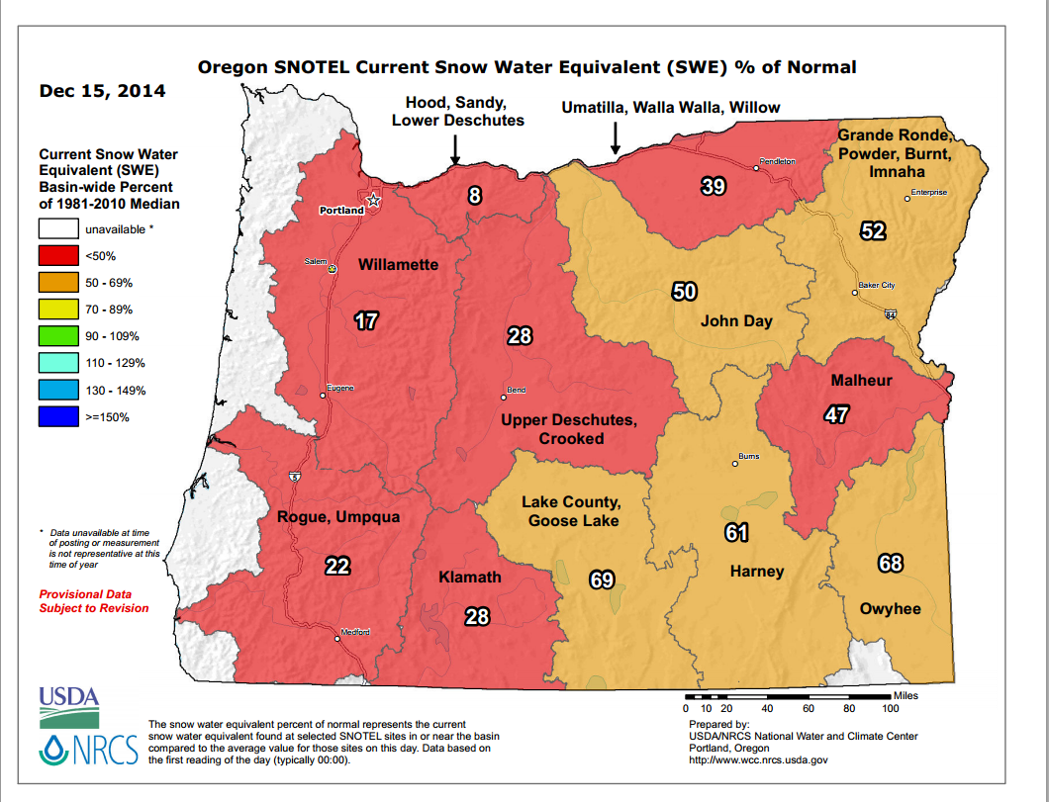
DECEMBER
Not too much weather action other than the wind storm
Surge of cold air early and late, but not really an “arctic blast”
But a terrible start to the ski season…

Slide 44
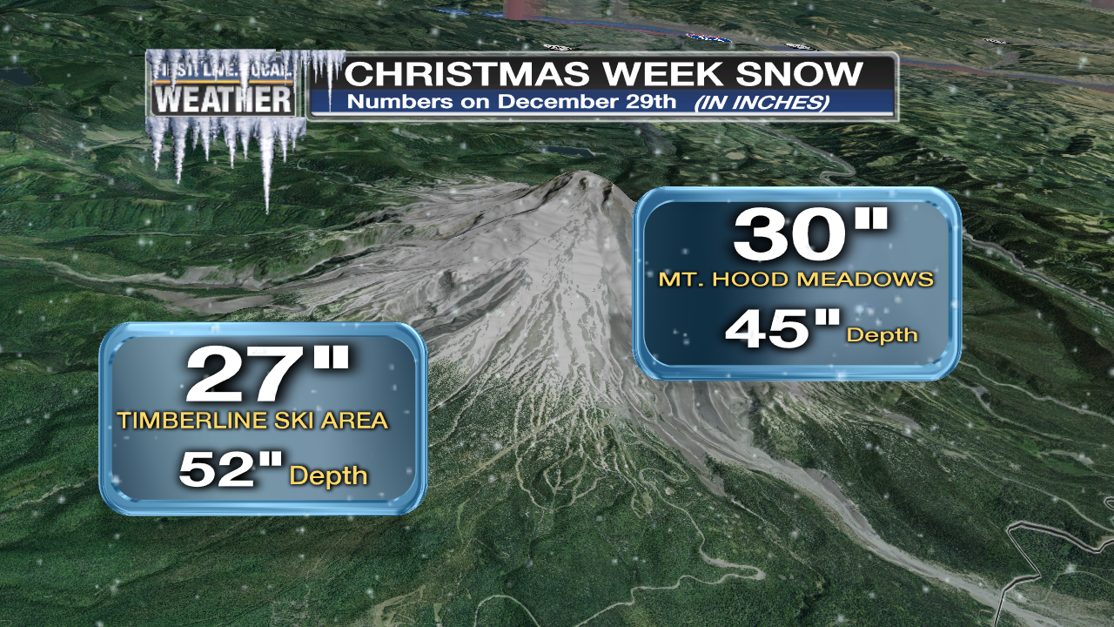
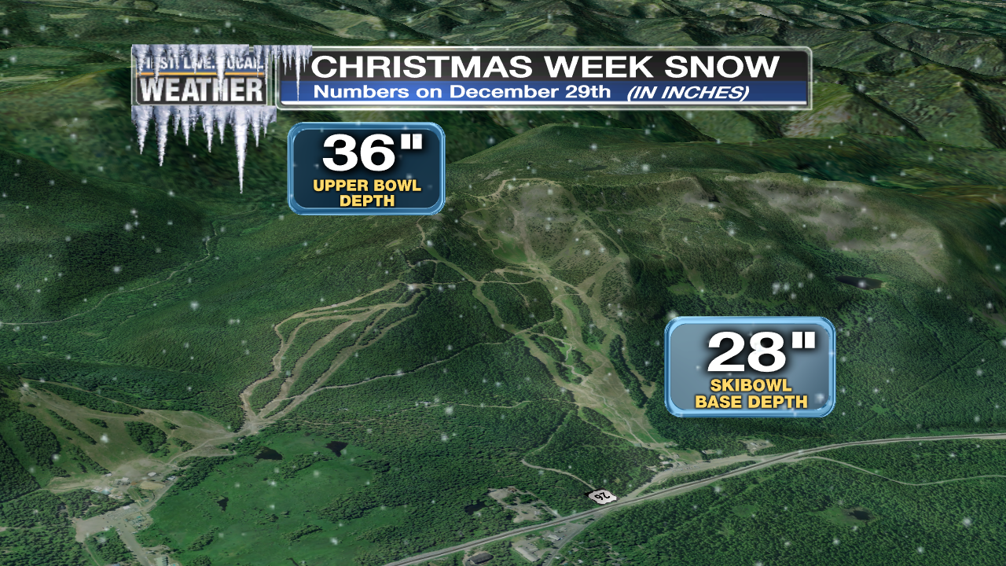
SKI SEASON
Worst start since 1980, possibly since 1976
Latest opening at Meadows in 20+ years = Dec 22nd
Heavy Snow saves most of Christmas Break…Whew!

Slide 45
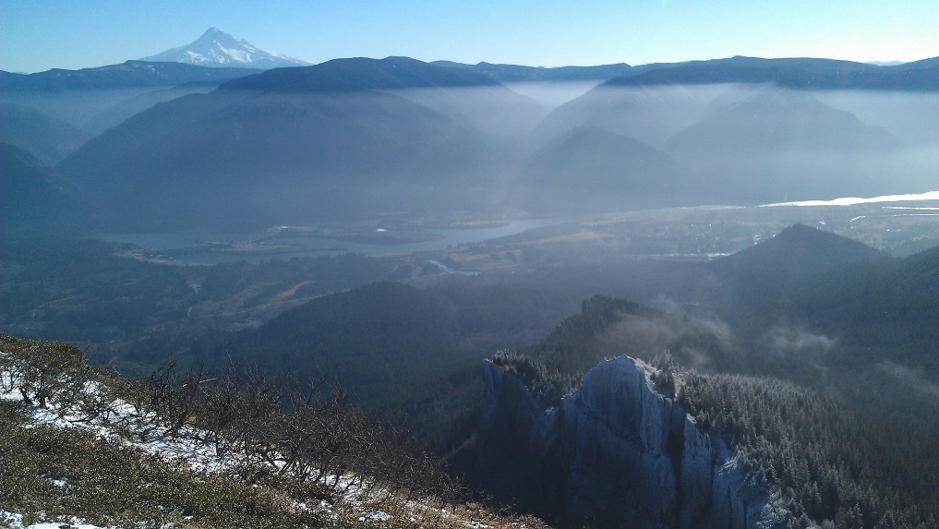
JANUARY
Move along, nothing to see here…
But some beautiful inversions!

Slide 46
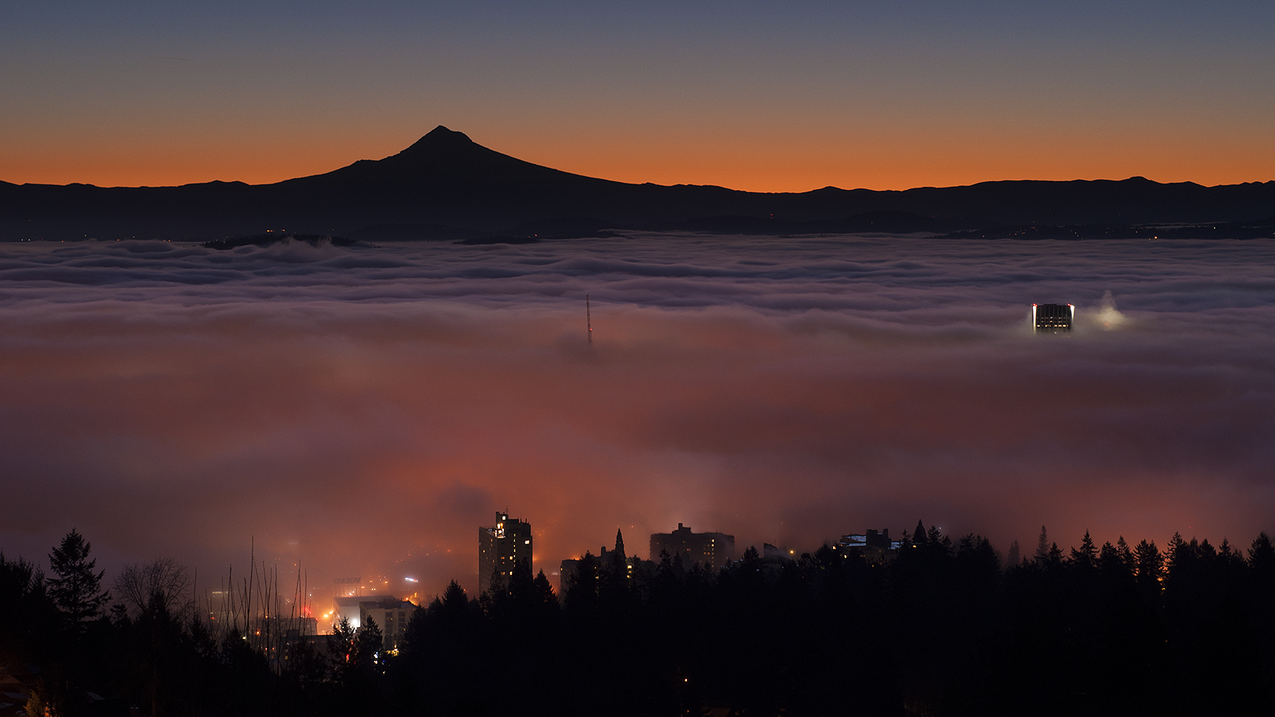
JANUARY
Lots of Fog…And Sun!

Slide 47
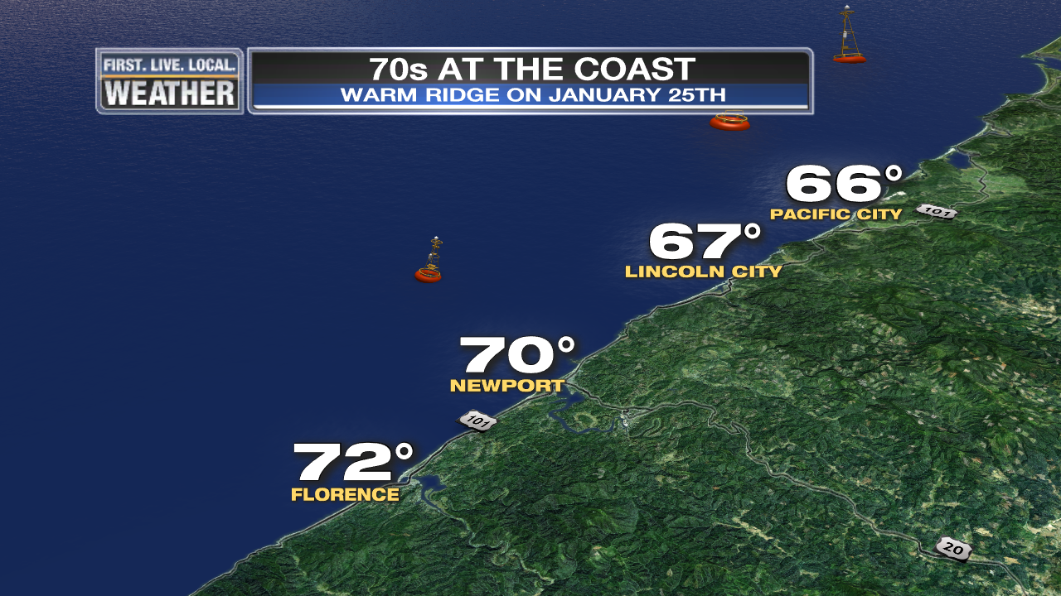
JANUARY
Book your beach trips for January, not July!

Slide 48
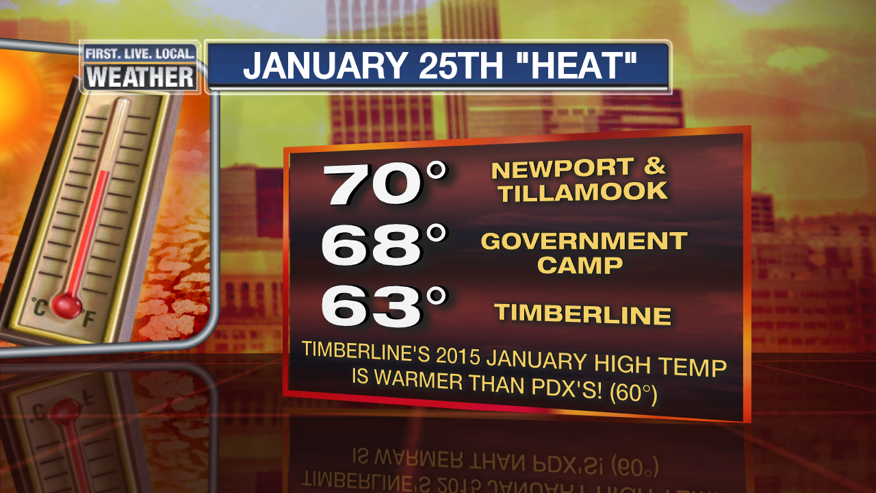
JANUARY
Amazingly warm mountains
Gov’t Camp Hit All-Time January High = 70 deg.

Slide 49
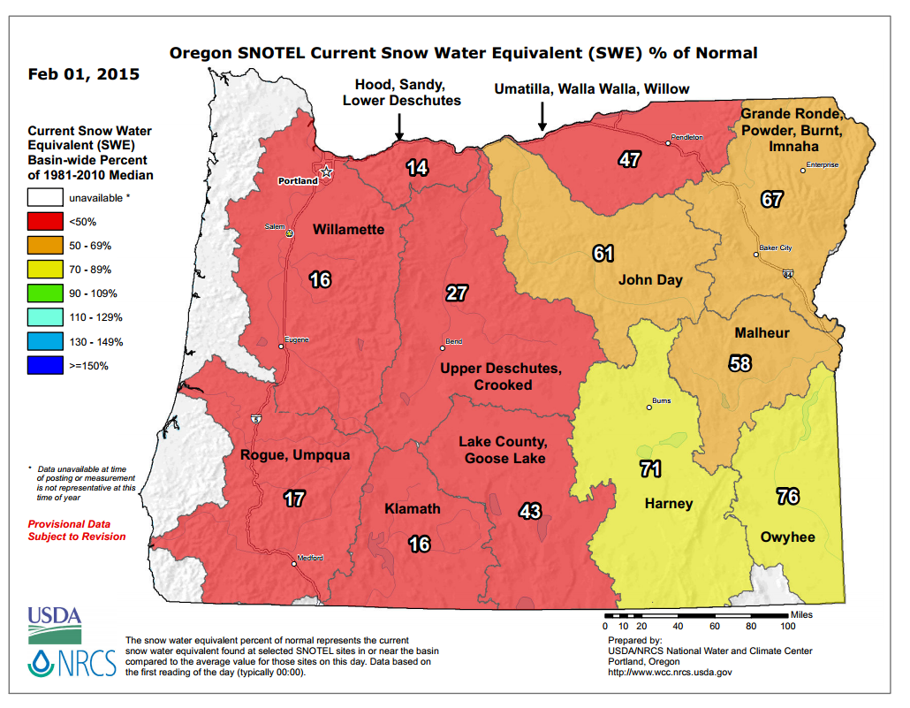
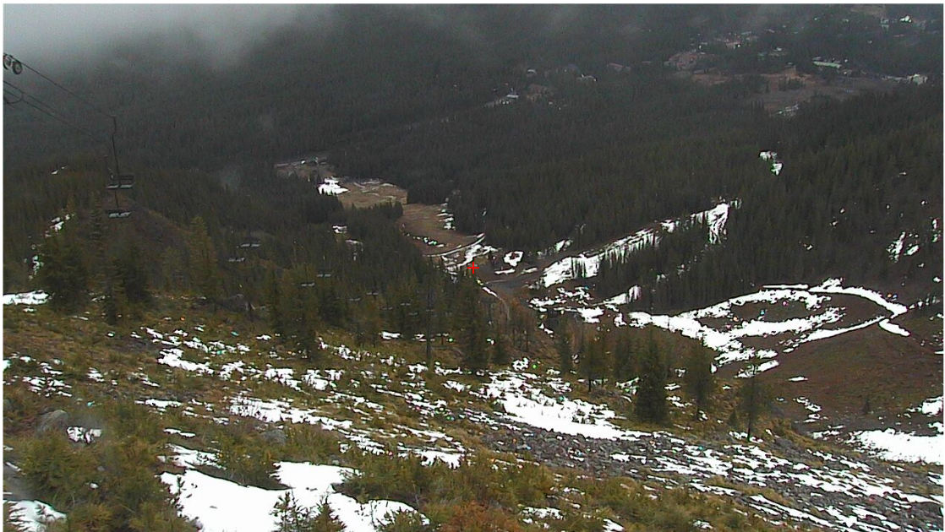
FEBRUARY
Heavy Rain 1st Week, Then Very Dry and Warm
View from 5,000 ft. on Feb. 2nd

Slide 50


The View On February 24th-25th
Timothy Lake!

Slide 51

March Windstorm
3rd Deep Low of the Season
~995mb Landfall north of Astoria

Slide 52

October Windstorm
1st Deep Low of the Season
~985mb Landfall north of Astoria

Slide 53



Slide 54



Slide 55


Slide 56

1940-1995 = PDX 1996-Present = PQR

Slide 57

Downtown Data Only

Slide 58


Slide 59

Blue = Widespread Arctic Air Outbreak

Slide 60

We Had A Metro Wind Storm!
But now almost 20 years without a regional major storm

Slide 61

Final Snow Survey…Worst On Record Many parts of Oregon

Slide 62

Final Snow Survey…Worst On Record Many parts of Oregon

Slide 63

Final Snow Survey…Worst On Record Many parts of Oregon

Slide 64

Mountain Snowpack @ 5,400’
Horrible…precipitation near normal through early February, then below as ridging became stronger. Mainly warm storms…only significant snow was 2nd half of December.
Courtesy
NRCS
Oregon Office
Precip: Thin Line = Average
Snow Water: Thin = Average
Mt. Hood Test Site

Slide 65

McKenzie Pass @ 4,800’
Same thing, warm storms. Only good snowy period was in late December.
Courtesy
NRCS
Oregon Office
Precip: Thin Line = Average
Snow Water: Thin = Average

Slide 66
There’s always NEXT Winter!
Comments & Questions

