Slide 1
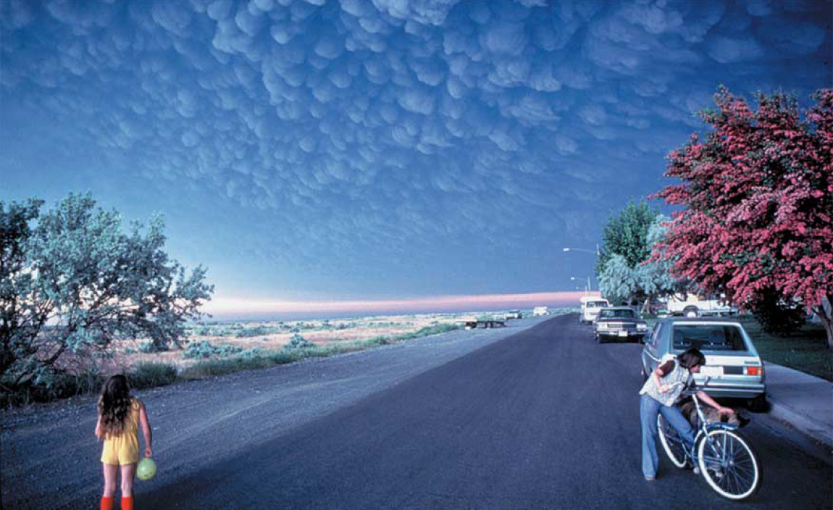
Volcanic ash fall forecasting in the Pacific Northwest
Larry G. Mastin
U.S. Geological Survey
Cascades Volcano Observatory
Ephrata, Washington, May 18, 1980
Copyrighted photo by D. Miller

Slide 2
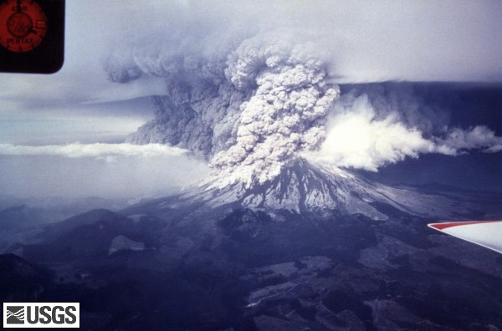
Mount St. Helens, 1980
One of the most significant eruptions of the past 50 years
  Began with the largest landslide in history
  Lateral blast destroys 230 square miles of forest
  Ash cloud to 32 km
  57 people killed
But also--First recorded incident of in-flight engine damage (a C-130 flying from McChord AFB on May 25).
USGS photo; R. Hoblitt

Slide 3
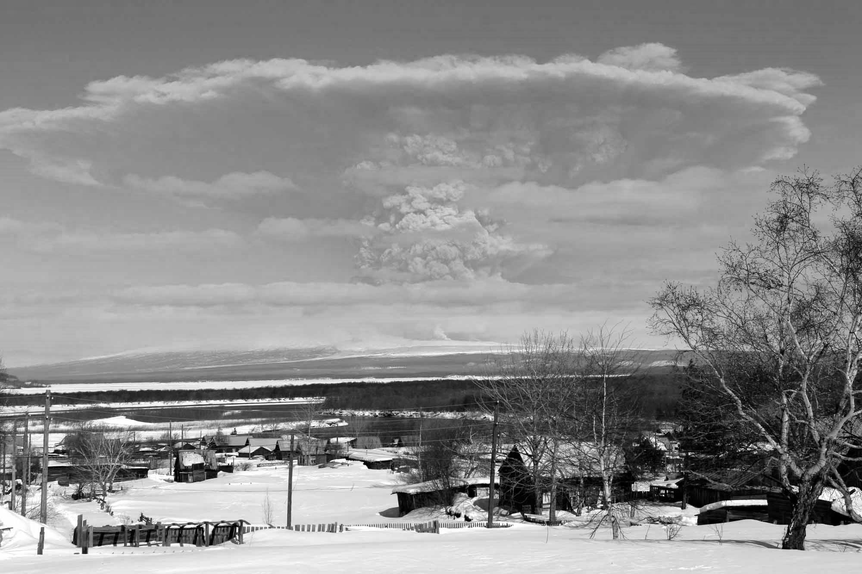
Talk outline
What are volcano hazards?
The hazard of downwind tephra and ash
  Tephra fall
  Ash clouds
How we mitigate the risk from these hazards
Improving our ability to warn, and mitigate
Sheveluch volcano, 2007
Yuri Demyanchuk, photo

Slide 4
What are the main hazards of volcanoes?
It depends on where you are!
Sheveluch volcano, 2007
Yuri Demyanchuk, photo

Slide 5
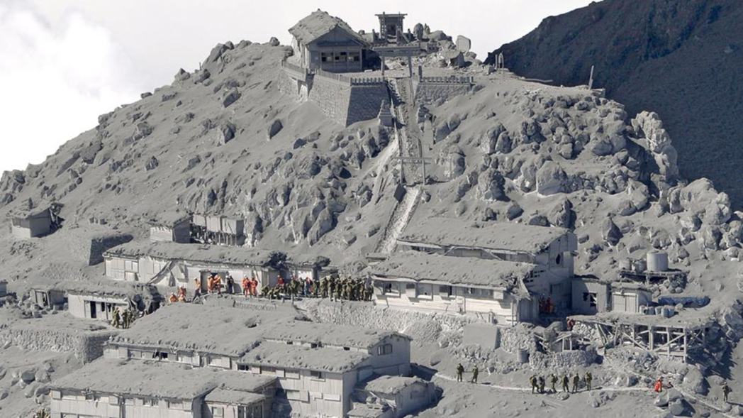
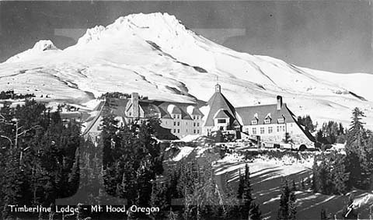

Near the vent, many things could kill you
Ontake, Japan (9/27/2014)
60 casualties, mostly from block fall
No clear precursors
Could it happen here?
Mount Hood
AP Photo/Kyodo News

Slide 6
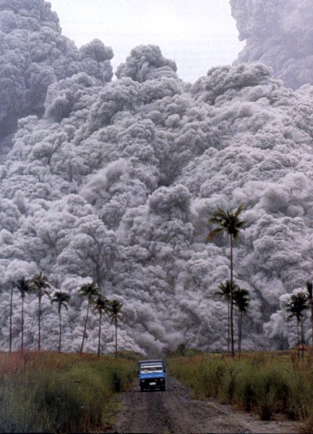
Around the flank and base,
Pyroclastic flows can threaten
Unzen, Japan, 1991
Caused by hot debris avalanches
Destroy all in their path
In the Cascades, most development lies outside this hazard zone
Merapi Volcano, Indonesia,2010

Slide 7
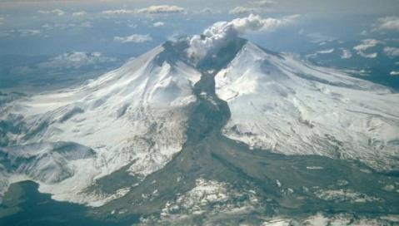
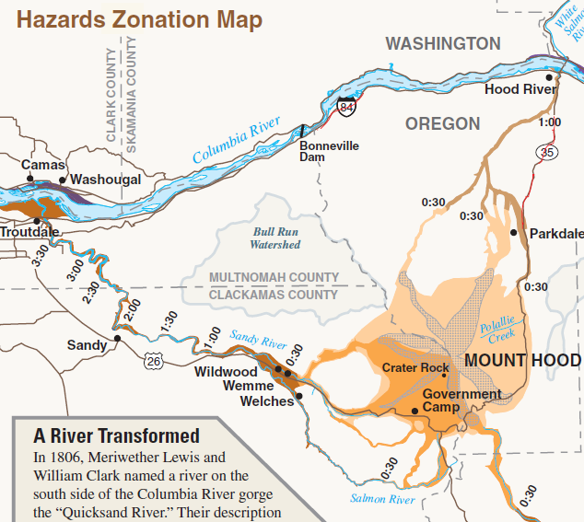
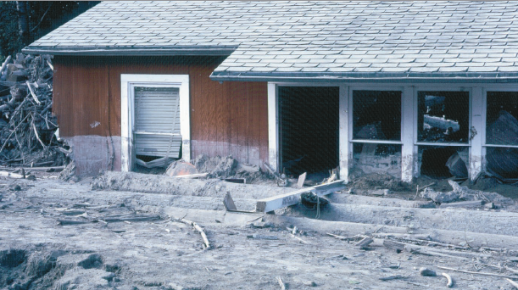
Lahars (Mudflows) go many miles down valleys
St. Helens, 1982
Lahar
Floods of water-saturated sediment
Flow down valleys from the volcano.
Affect reservoirs, transportation & buildings
In the Cascades they can reach populated areas in ~1 hr
~1hr to Hood River
Toutle River, WA, 1980
Travel time
Notes:
7

Slide 8
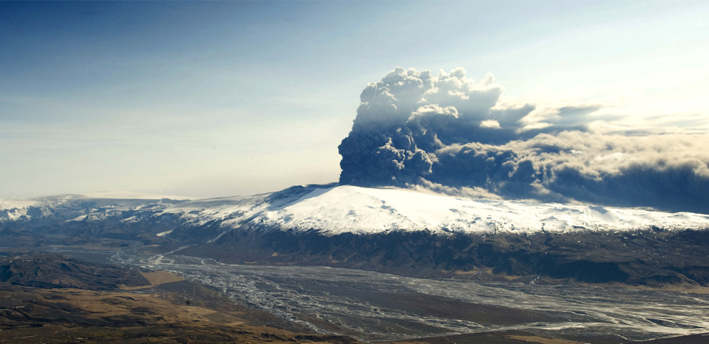
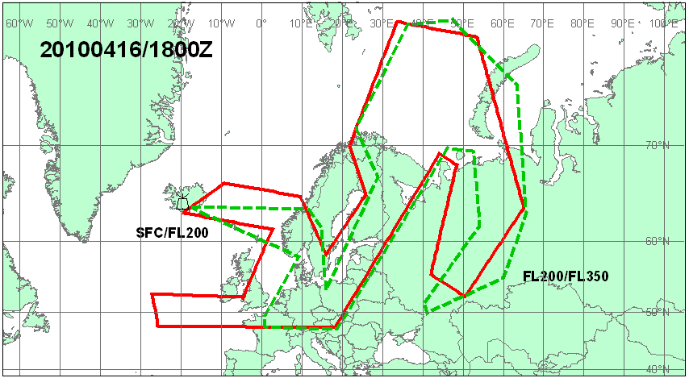
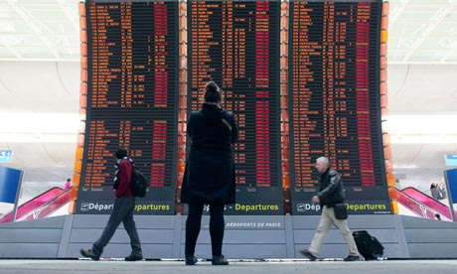
But airborne ash can reach hundreds or thousands of miles downwind
Eyjafjallajökull, Iceland, 2010
Persisted for 3 weeks
Shut down air traffic in Europe ~1 week
~$5B economic loss
The no-fly zone
The eruption that shut down Europe

Slide 9
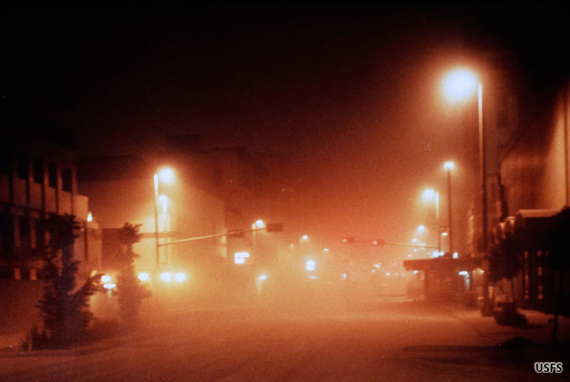
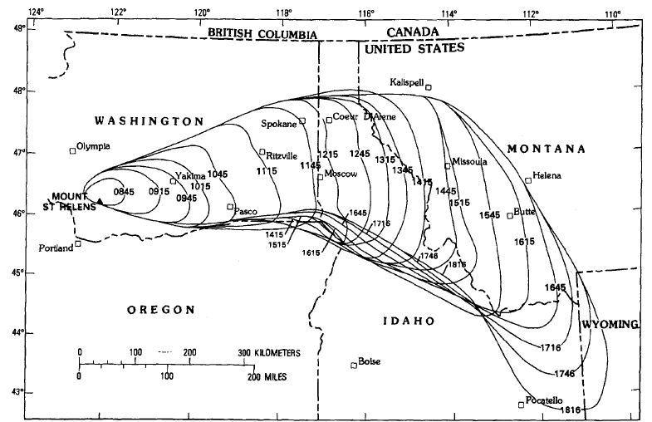
Tephra fall hazards can extend several hundred kilometers downwind
Darkness in Yakima at noon, May 18
Yakima, 140km downwind, May 18, 1980

Slide 10
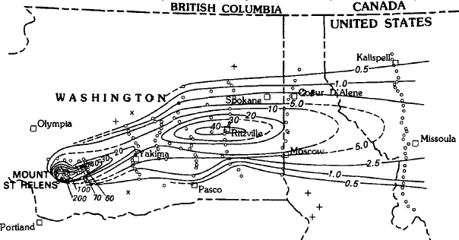
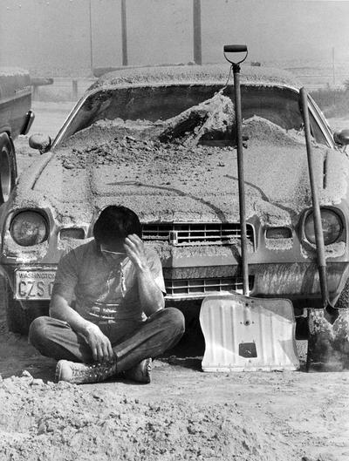
In central Washington
Thickness decreased, then increased
Ritzville
Ritzville, WA, 300 km downwind
A maximum of 40 mm
Spokane Spokesman-Review photo

Slide 11
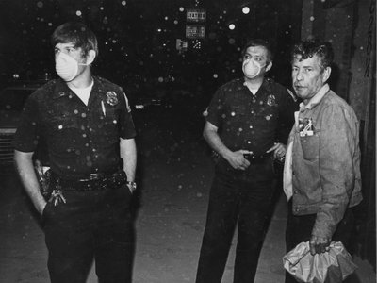
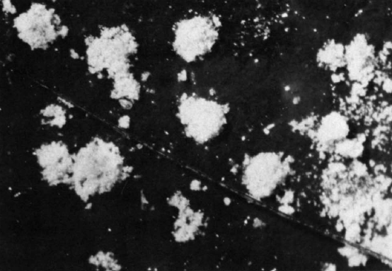
And in Eastern Washington, ash fell as aggregates
Spokane, WA, Spokane Spokesman-Review Photo
Ash clusters?
Then it decreased again, falling in clusters throughout much of eastern Washington
0.5 mm
Ash clusters on painted cardboard
“Much of the ash . . fell in the form of composite clusters, 0.25 to 0.5 mm in diameter”*
*Sorem, 1982, J. Volcanol. Geotherm. Res. 13:63-71.

Slide 12
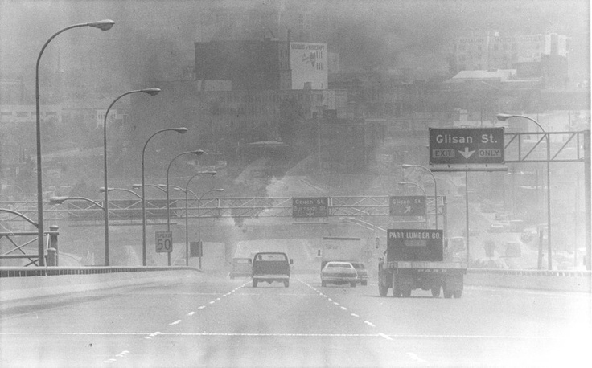
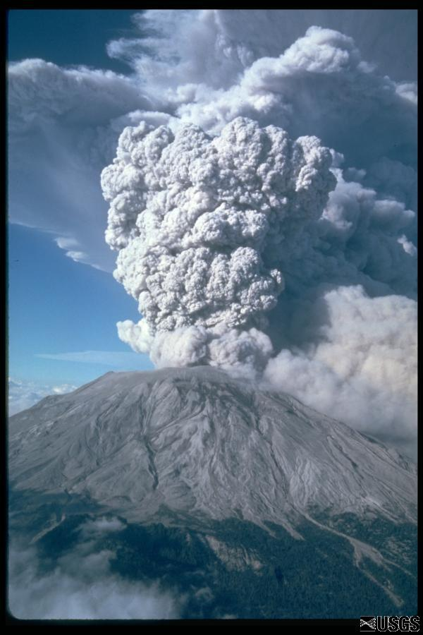
May 18 was followed by other events
Several 1980
1989-91
2004-2008
Flights canceled
Portland, June 12, 1980(?) (photo from Pinterest)
July 22, 1980
M. Doukas photo

Slide 13
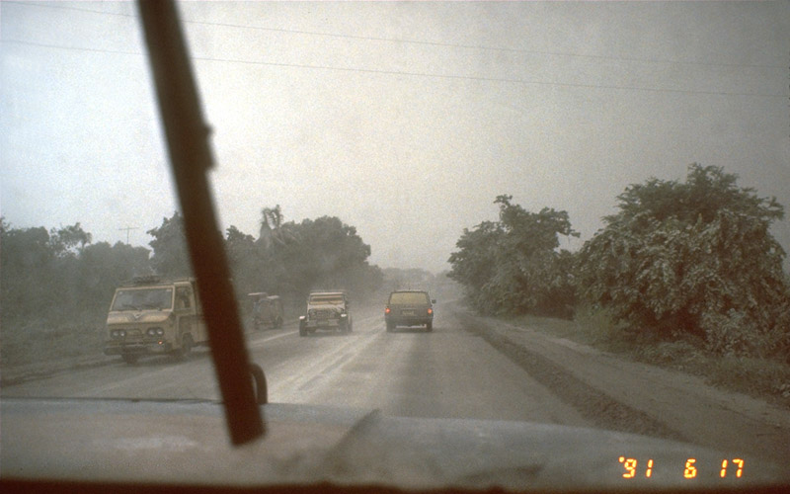
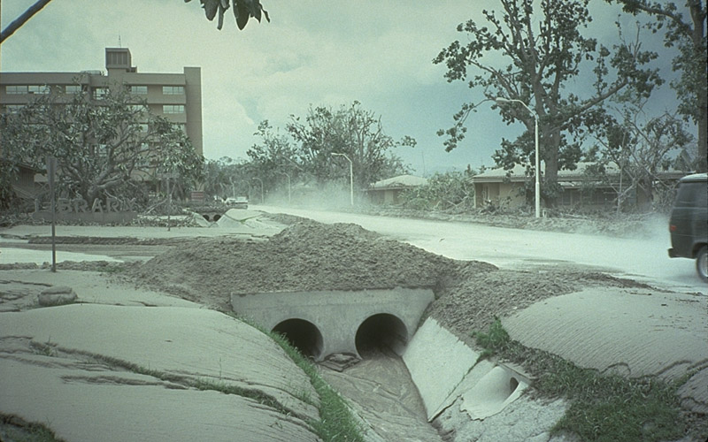
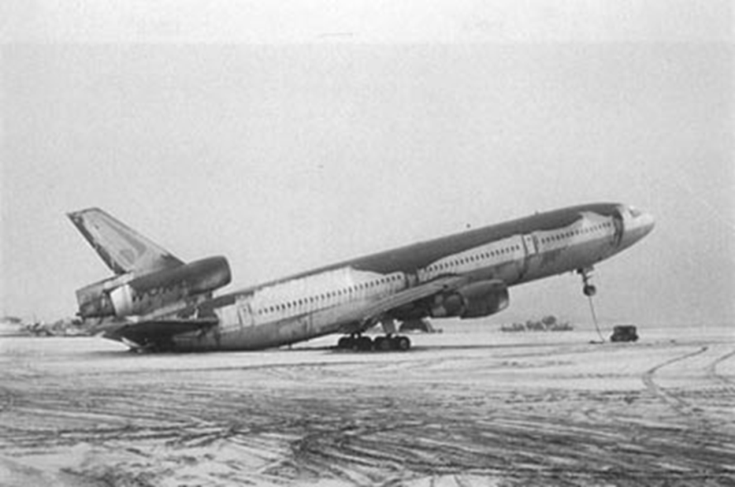
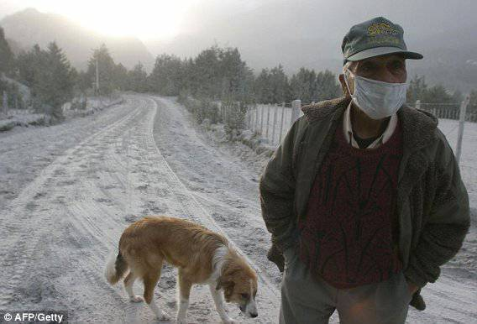
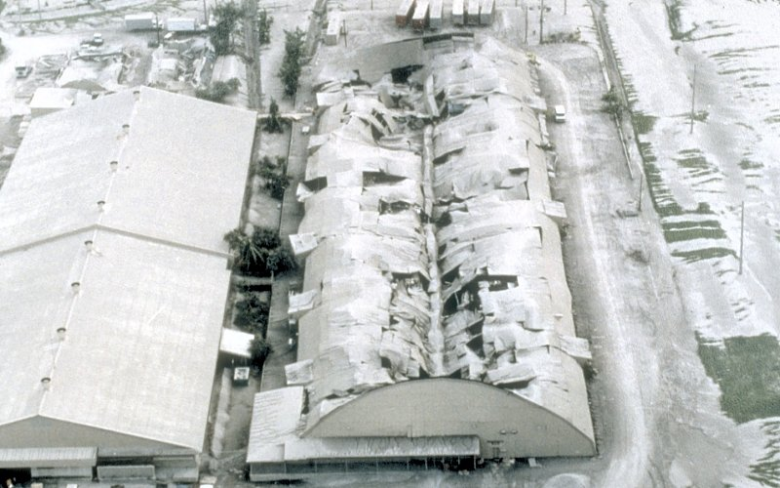
What damage does tephra do?
Pinatubo: USGS photo by R.P. Hoblitt
Reduces visibility
Clogs water & sewer lines
Causes respiratory problems
Can threaten roof collapse (when several cm thick or more)
Can endanger aircraft
Pinatubo: USGS photo by W.E. Scott
Douglas Miller ©
Cubi Point, Philippines, 1991
Futaleufu, Argentina, 2008
Clark Air Base, 1991
U.S. Navy photograph by R. L. Rieger
USGS photo

Slide 14
How ash clouds threaten aircraft

Slide 15
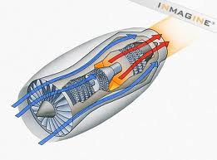
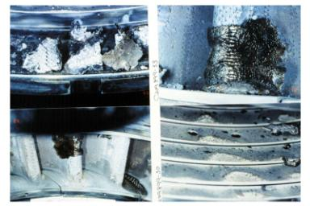
Effects of ash on jet engines
Ash melts in the combustion chamber
Coats & clogs nozzle guide vanes
Turbine
Combustion Chamber
Intake Fan
Damage from 1989 severe ash encounter in Alaska

Slide 16
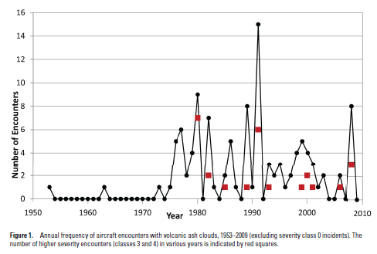
129 Total airline incidents, 1953-2010
94 with engine or airframe damage
26 with “significant to very severe damage” (red dots)
9 with total engine shutdown
Most encounters happen during big events (Pinatubo)
St.
Helens
Pinatubo
Chaitén
Severe
encounters
From Guffanti et al., USGS Data Series 545, 2010
Ash at Jogyakarta Airport during 2014 eruption of Kelut volcano, Indonesia

Slide 17
How has the scientific community responded
Ash clouds and aviation
  Aviation is a global community; requires a global response
Ash deposits
  Affects primarily communities on the ground
  Response is local

Slide 18
The Global response to the ash-cloud hazard
1982: The International Civil Aviation Organization (ICAO) develops procedures to detect and forecast ash-clouds through:
  Meteorological watch offices issue warning messages (SIGMETs) warning of ash clouds
  Volcanic Ash Advisory Centers (VAAC’s) forecast dispersion & trajectories of ash clouds.
Sheveluch eruption of 3/29/07. Photo by Yuri Demyanchuk

Slide 19
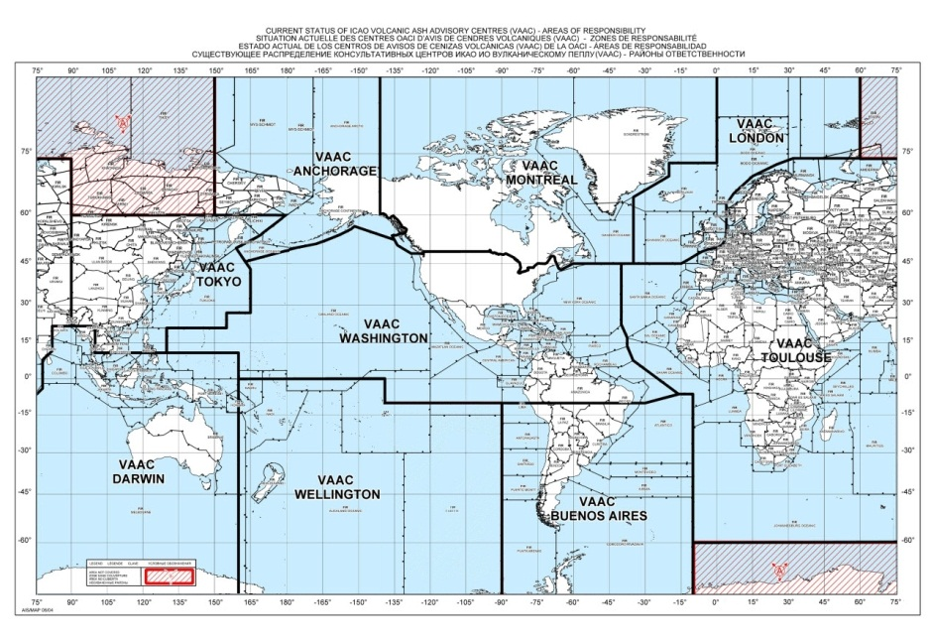
Volcanic Ash Advisory Centers
Nine VAAC regions worldwide
Each center is responsible for:
  Detecting ash clouds it its region
  Forecasting cloud movement
  Communicating ash-cloud warnings

Slide 20
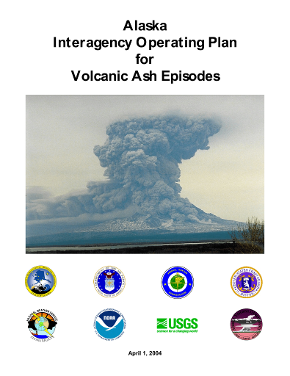
U.S. response
1988: NOAA forms VAACs in
  Anchorage (N. Pacific)
  Washington D. C. (Conus)
1988: Formation of the Alaska Volcano Observatory as a joint venture between:
  USGS
  Univ. AK Fairbanks
  AK Div. of Geol. & Geophysical Sciences
AVO works closely with the Anchorage VAAC
In the U.S., ash-cloud forecasts are officially issued by NOAA (not the USGS)
“if it’s in the air, it’s weather”
“If it’s on the ground, it’s geology”
Sheveluch eruption of 3/29/07. Photo by Yuri Demyanchuk

Slide 21
Responding to ground-based hazards in the Pacific Northwest

Slide 22
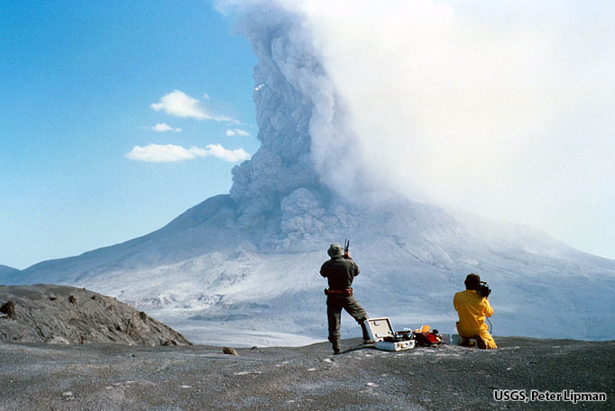
In 1980 the USGS Cascades Volcano Observatory was established to
monitor activity at:
  Mount St. Helens
  Other Cascades volcanoes
Develop tools & techniques to mitigate volcanic crises
Understand volcanic processes
Pyroclastic flows in August, 1980

Slide 23
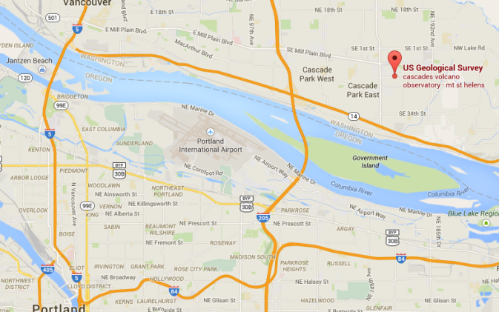
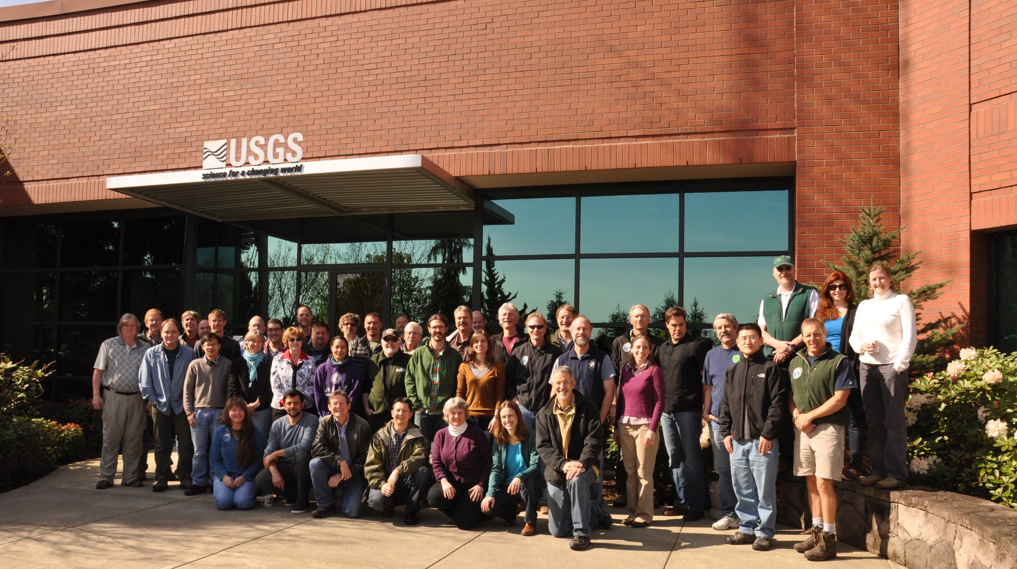

~60 total personnel
~30 Ph.D.-level researchers who study:
  Seismology
  Deformation
  Volcanic gas
  Instrumentation
  Process modeling
  Sediment analysis
CVO in 2015
CVO
PDX
Downtown

Slide 24
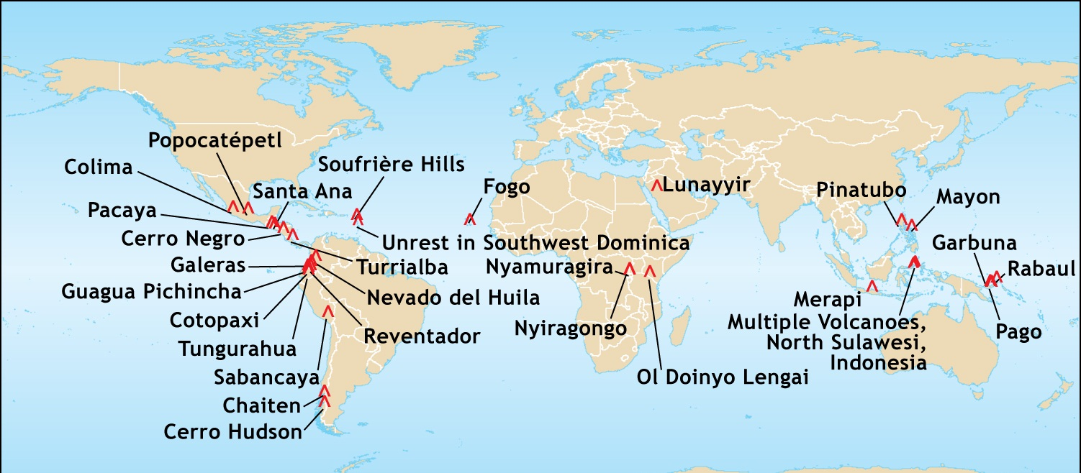

CVO is also home to the
Volcano Disaster Assistance Program (VDAP)
A partnership with USAID
Established in 1985
Provides international assistance
25 major crisis responses
Helped save 10,000’s lives
Built infrastructure in >12 countries
Infrastructure Crisis Response Training Volcano hazard science

Slide 25
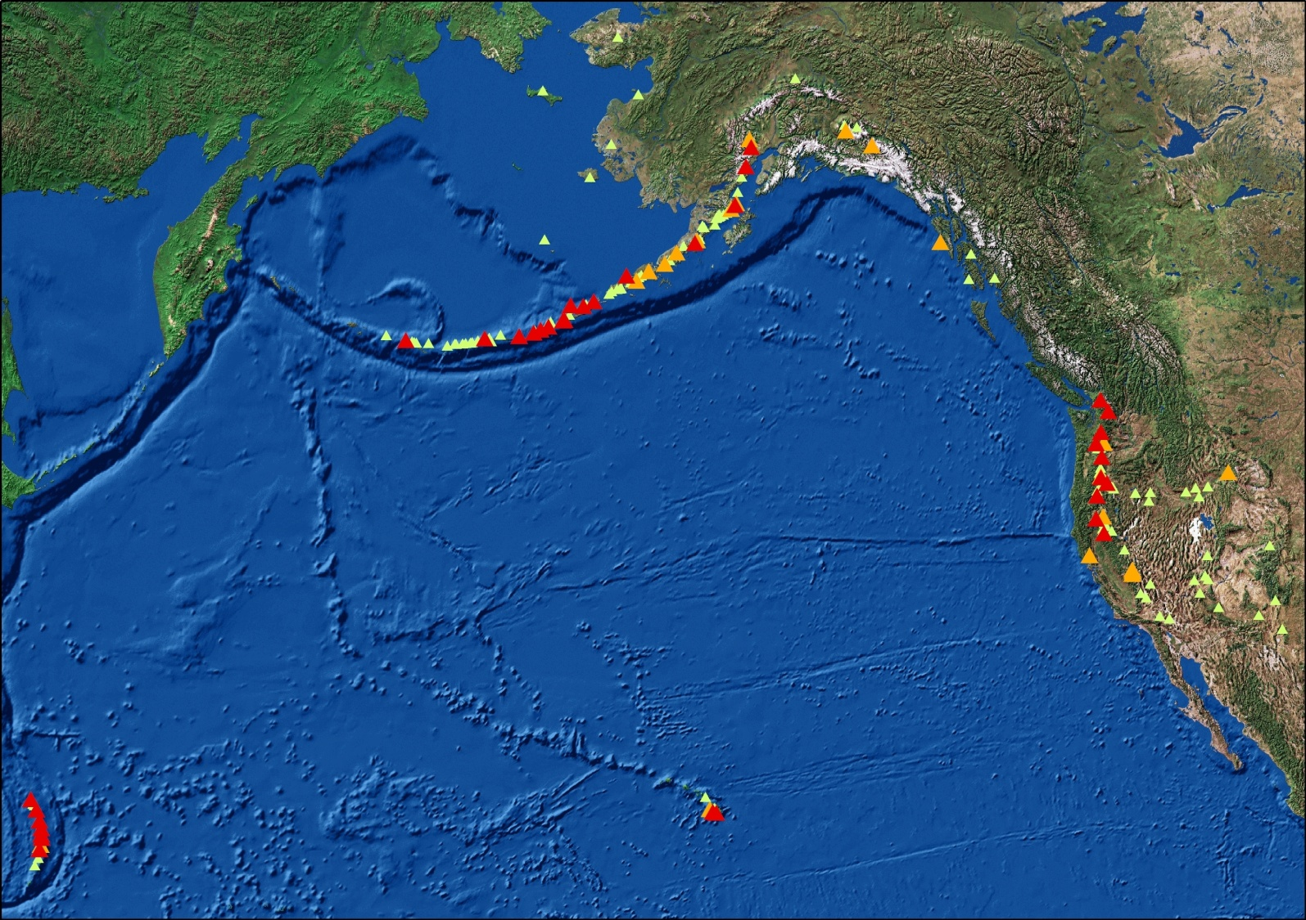
CVO is also part of a national
Volcano Hazards Program
5 volcano observatories operated with other institutions
125 USGS personnel
We monitor ~170 active volcanoes in the U.S. (10% of those in the world)
AVO
CVO
YVO
CalVO
HVO

Slide 26
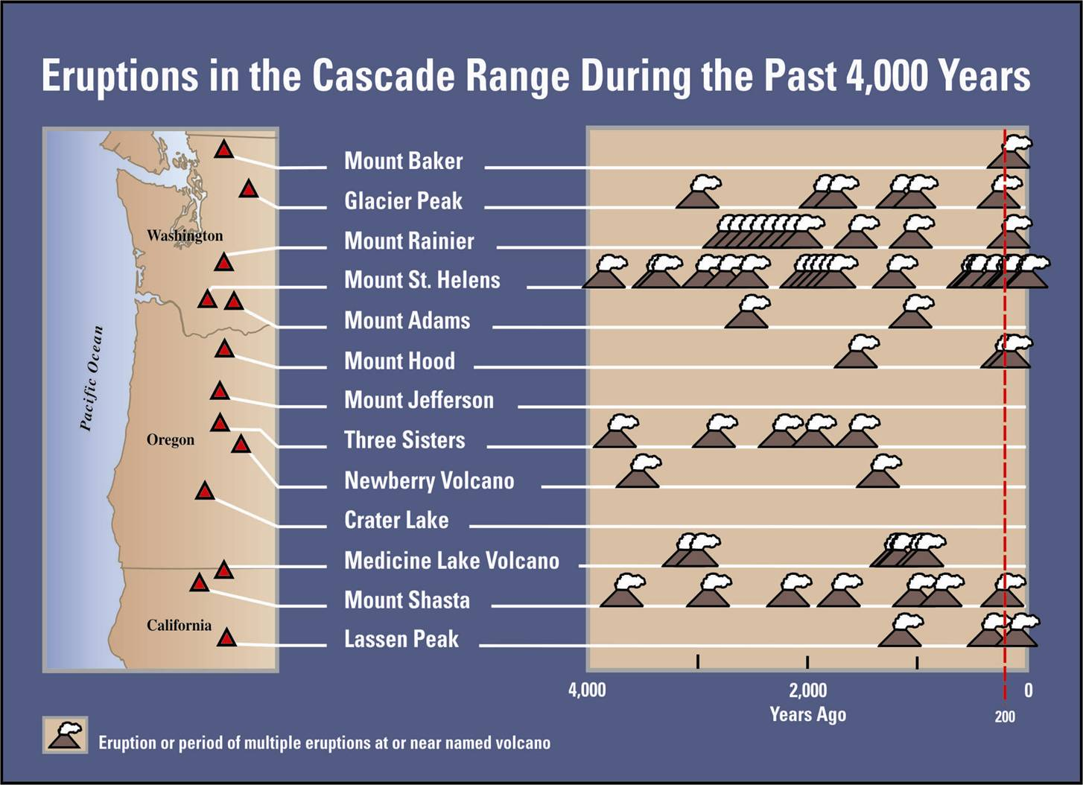
Assessing tephra hazards by studying eruptive history
Nearly all Cascade volcanoes have erupted in the last 2,000 years
On average, we have two multi-year eruptions per century.
St. Helens is by far the most active, and explosive
Notes:
26

Slide 27
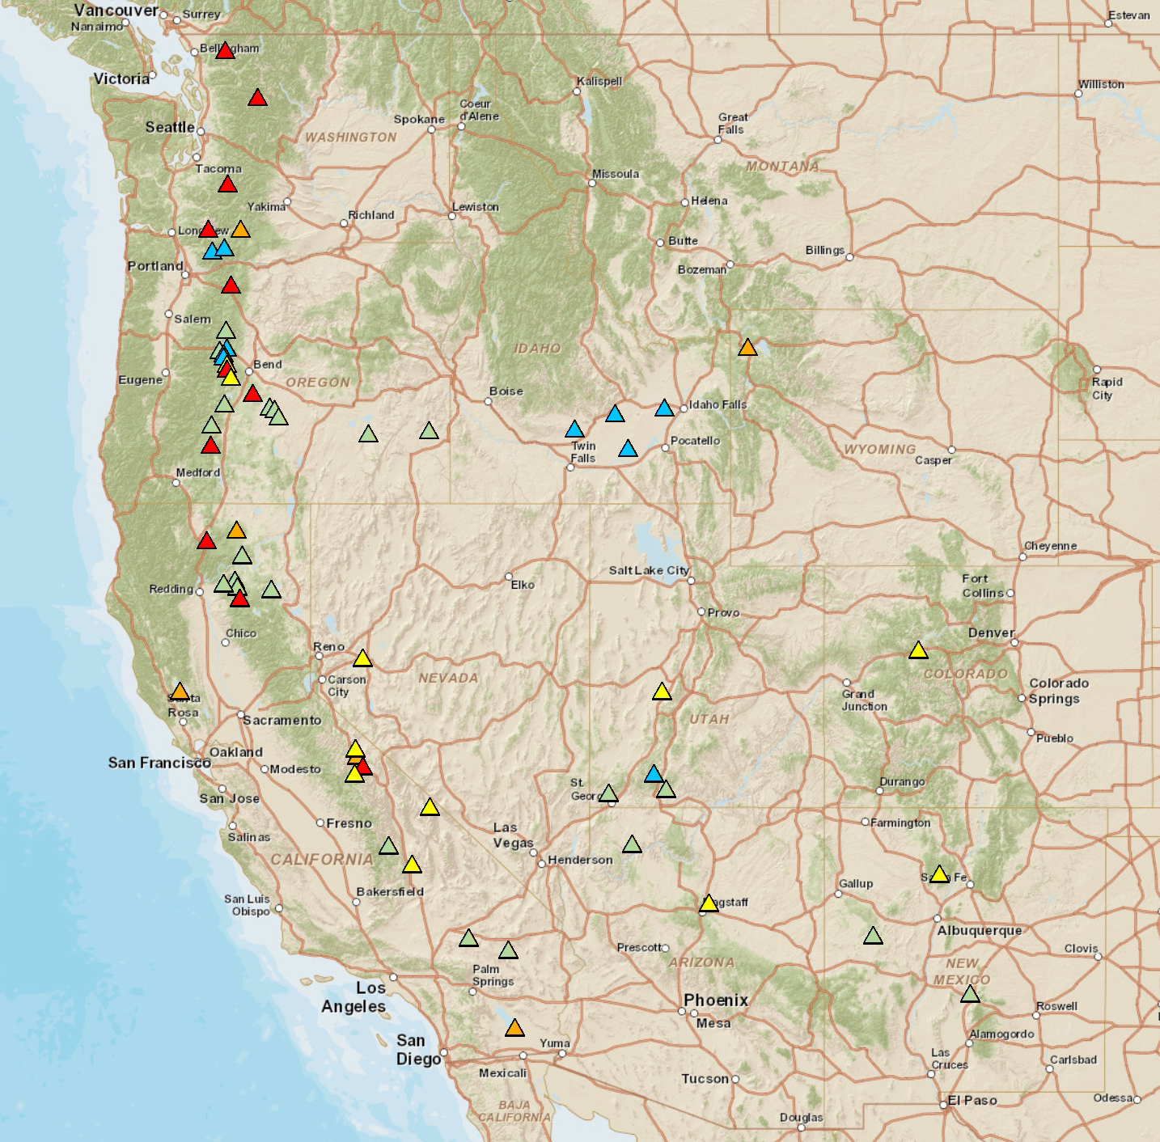
2005 National Volcanic Threat Assessment
We have ranked the U.S. Volcanoes that pose the greatest threat
Threat Level
Mount Hood
Very High
High
Three Sisters
Newberry
Moderate
Crater Lake (Mazama)
Low
Very Low
10 of 17 are in the Cascades
These volcanoes threaten:
  populated areas
  infrastructure

Slide 28
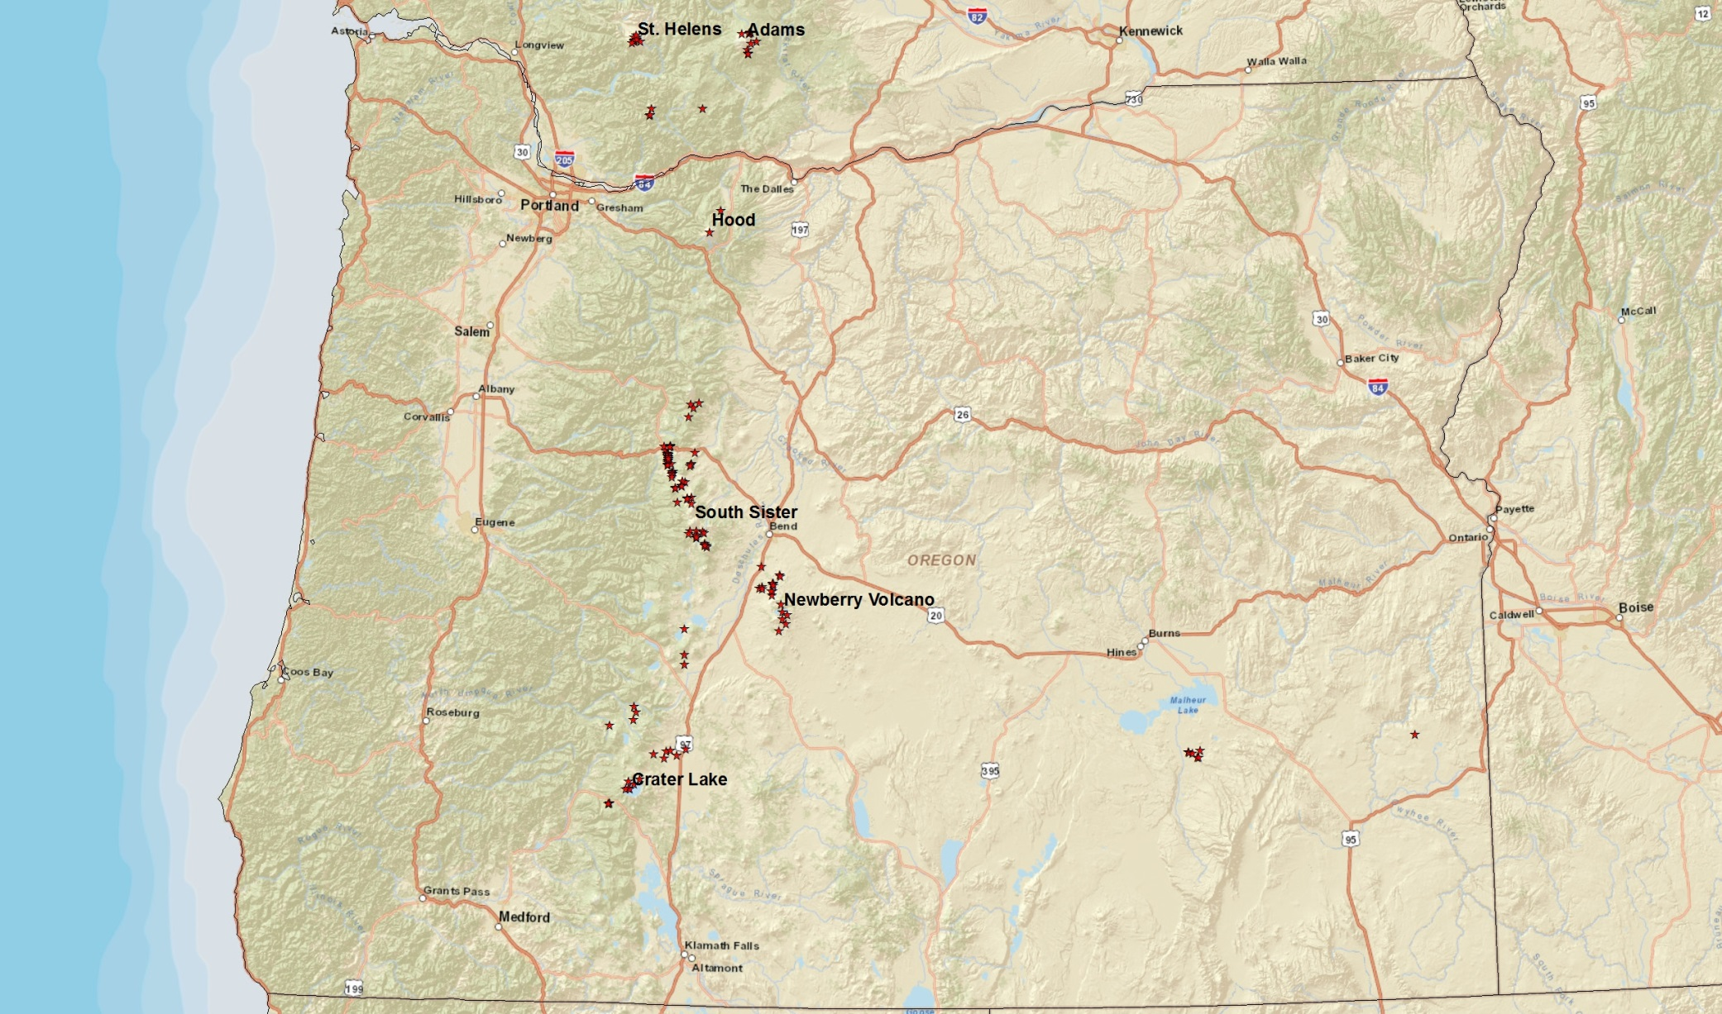
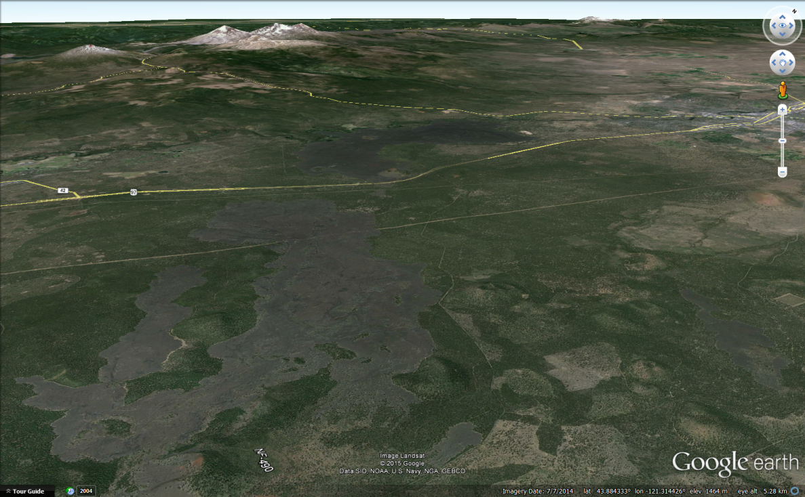
Other volcanoes in Oregon also pose a threat
At least 116 geologically young volcanic vents in Oregon!
2 at Mount Hood
6 at Crater Lake
16 at South Sister
19 at Newberry
3 Sisters
Bend
Lava!

Slide 29
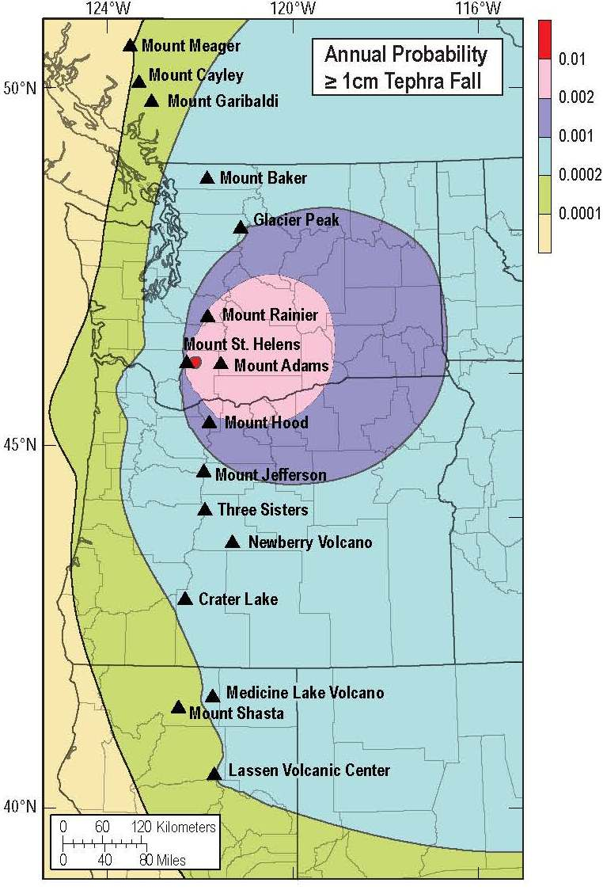
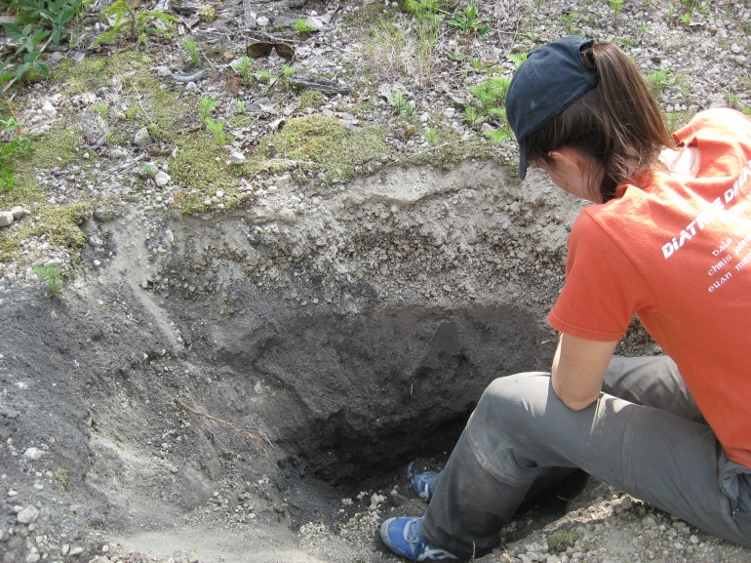
1) We assess long-term tephra-fall hazards from
Past eruptive history
Typical wind patterns
The greatest probability is downwind from the most active tephra-producers (i.e. MSH)
USGS photo—Larry Mastin
Tephra
deposits
Unconditional Probability
Dominated by MSH
Notes:
29

Slide 30
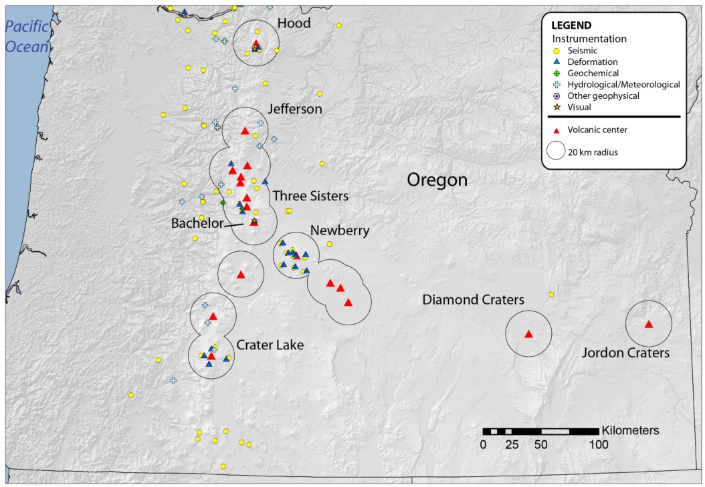
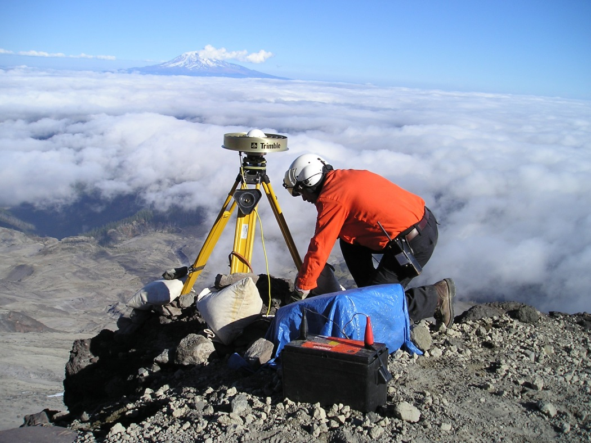
2) We monitor volcanoes
All Cascade volcanoes are monitored for seismicity by the USGS and the Pacific Northwest Seismic Network (Univ. Wash.)
Most are monitored for deformation in real time
Other monitoring:
  Water Geochemistry
  Meteorology (Streamflow, rainfall)
Geodetic monitoring at Mt. St. Helens

Slide 31
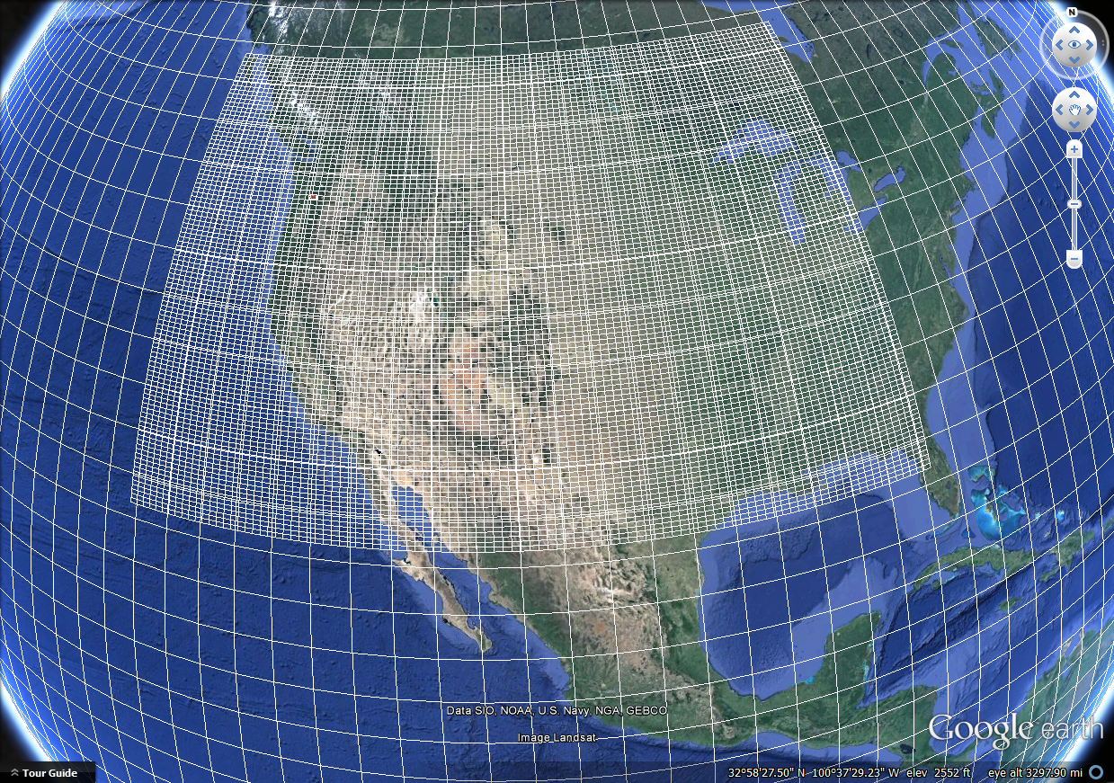
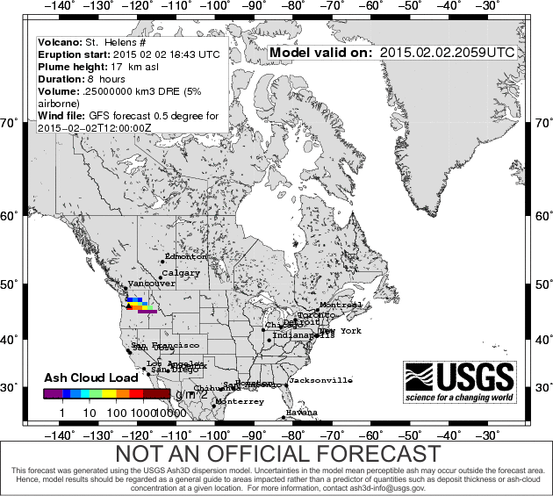
3) We develop models that calculate where ash goes during eruptions
The USGS Ash3d model
Uses meteorology forecast from NWP models (e.g. GFS)
Regrids it
Calculates downwind movement & deposition
Ash3d grid
(different for each simulation)
If May 18, 1980
happened today
See it every day at:
http://volcanoes.usgs.gov/volcanoes/st_helens/monitoring_ash_cloud.html
NOAA Global Forecast System
(GFS) Model grid

Slide 32
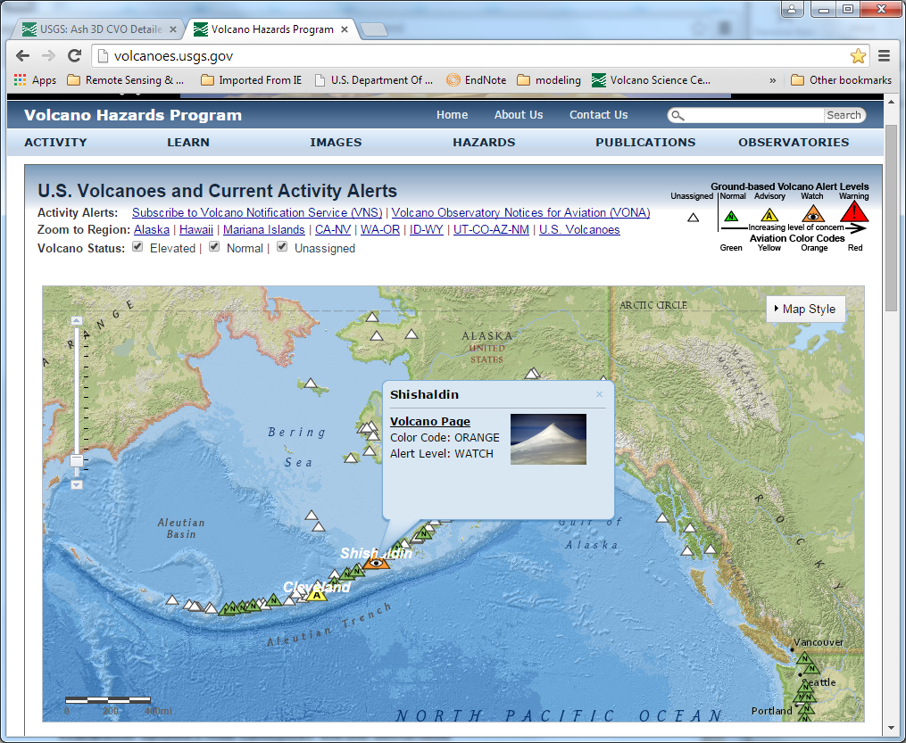
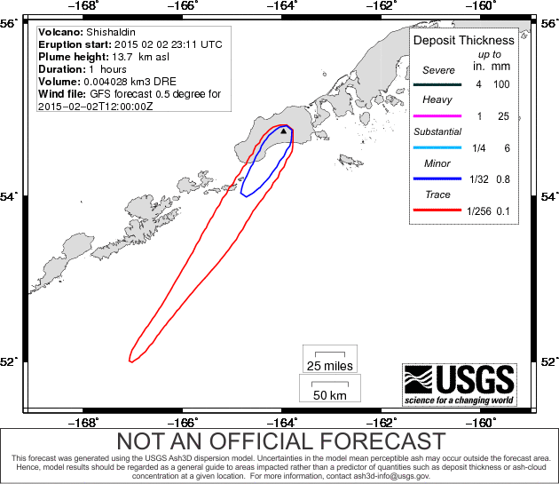
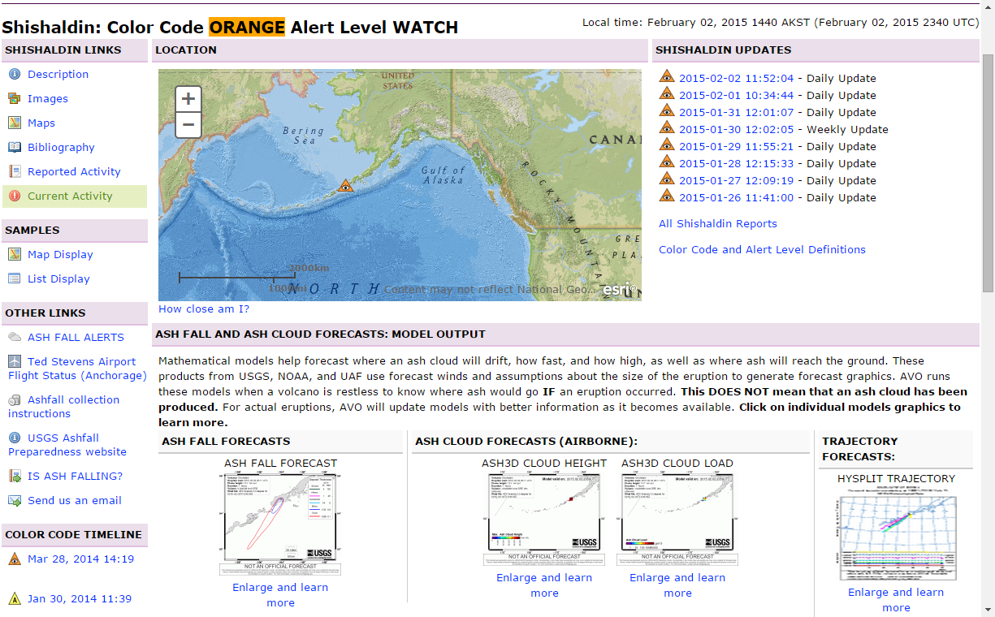
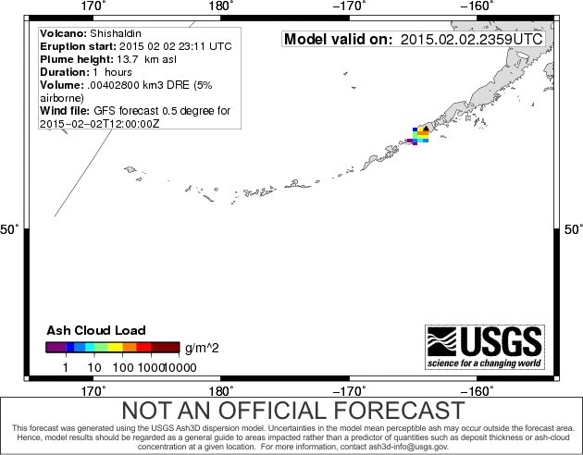
When unrest starts
We step up monitoring, 24/7
We run daily simulations to anticipate where ash might go
Example: Shishaldin
Volcano, Alaska
(currently at orange)

Slide 33
Into the future: How we can improve our forecasts
(from a modeler’s perspective)

Slide 34
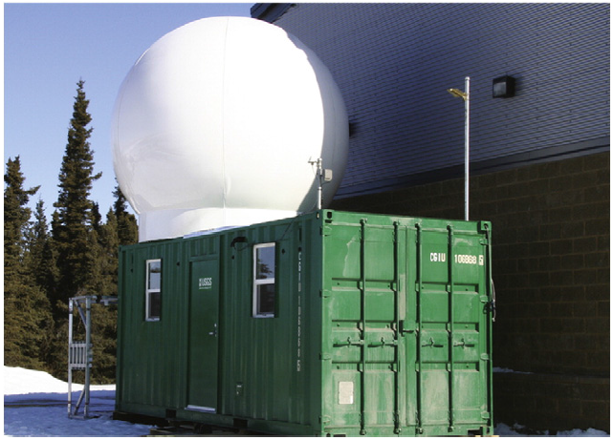

1) Better observations & measurements
USGS photo—David Schneider
USGS C-band Doppler radar, deployed to monitor the 2009 eruption of Redoubt Volcano, AK
Portable Doppler radar to better constrain plume height & variation

Slide 35



The complications:
2) The source: what controls plume rise?
Plumes rise due to buoyancy
Higher plumes imply greater eruption rates
But wind also an effect, less understood
How great is the effect?
  Experiments, with PSU & WSU, will address this
H
4/15/2010
4/16
4/17
4/18
PSU Engineering Wind Tunnel
Raul Cal, PSU
Steve Solovitz, WSU
When wind was high,
The plume was low
Eyjafjallajökull, Iceland, 2010

Slide 36




2) Transport: how ash clouds interact with wind?
In most eruptions, ash moves passively downwind
Big eruptions can drive ash UPWIND
This interaction is now being built into models
wind
No umbrella
cloud
St. Helens
vent
60 km
upwind
Plume
center
vent
200 km
upwind
Eyjafjallajokull
Pinatubo
wind
Upwind extend of small to large eruptions
wind
Etna
Eyja
MSH
Pinatubo

Slide 37


3) The sink: how ash is deposited
Models assume ash settles as separate particles
In reality, it “aggregates” & falls faster
  Delicate ash clusters, ashy hail, & Mud rain are examples
Understanding aggregation is the “holy grail” to accurate deposit forecasts
Aggregation research led by USGS post-doc Alexa Van Eaton (pictured)
2009 eruption in AK²
The 1980 Ritzville Bulge:
A product of aggregation
0.5 mm
1980 MSH Ash clusters from Pullman, WA

Slide 38
The end

