Slide 1

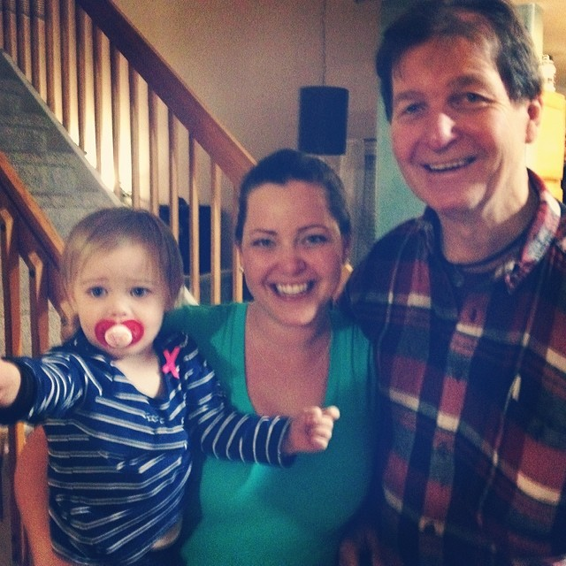
Forecast for 2014-15 Winter
George Taylor
October 2014

Slide 2
As before, I selected “analog years” – years that resemble this year. The ones I chose this time were:
1934
1958
1995
1996

Slide 3
As before, I selected “analog years” – years that resemble this year. The ones I chose this time were:
1934
1958
1995
1996
Ominous!

Slide 4
The two parameters I used to choose the analogs were
Pacific Decadal Oscillation (PDO)
Multivariate ENSO Index (MEI)

Slide 5
Analogs showed above-average temperatures
Notes:
Cool early, mild midwinter, average spring

Slide 6
All analogs showed above-average precipitation

Slide 7

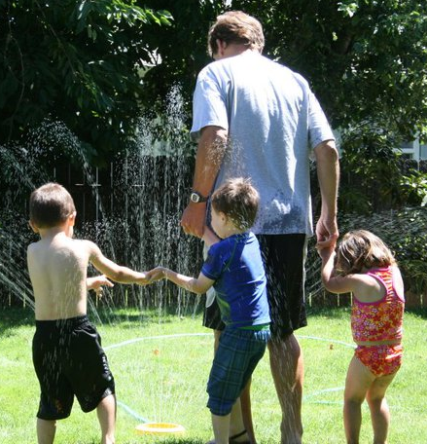
A wet winter!

Slide 8
Mixed message – call it “average” snowfall

Slide 9
Forecast for NW Oregon
Above-average Precipitation (especially December and January)
Above-average Temperatures
Average Snowfall (50-50 chance of ski areas opening by Thanksgiving)
Lowland snow: minimal

Slide 10
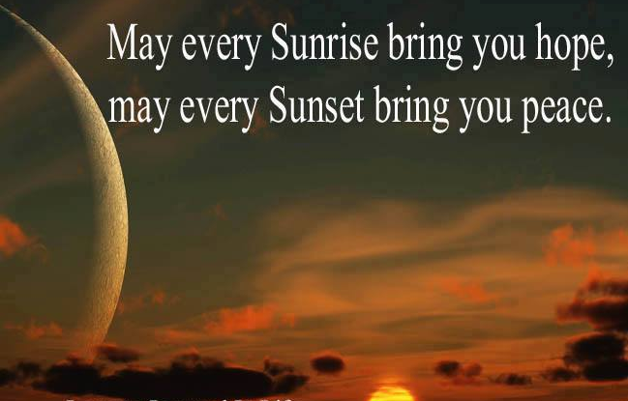
See you next year!

