Slide 1

Trendcasting

Slide 2
Trendcasting
What It Is,
How It Can Help The Forecast

Slide 3
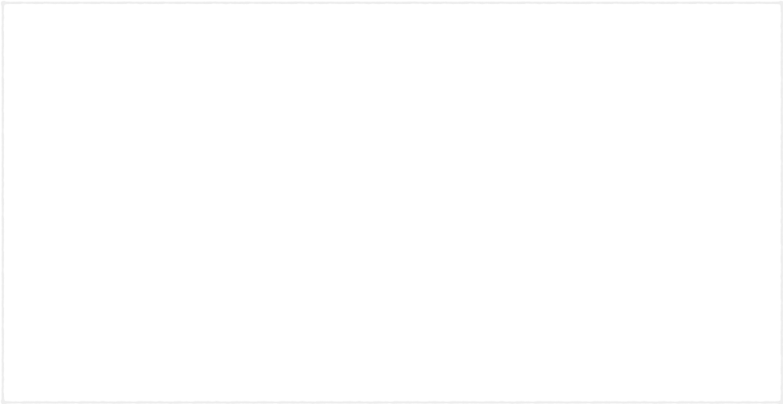
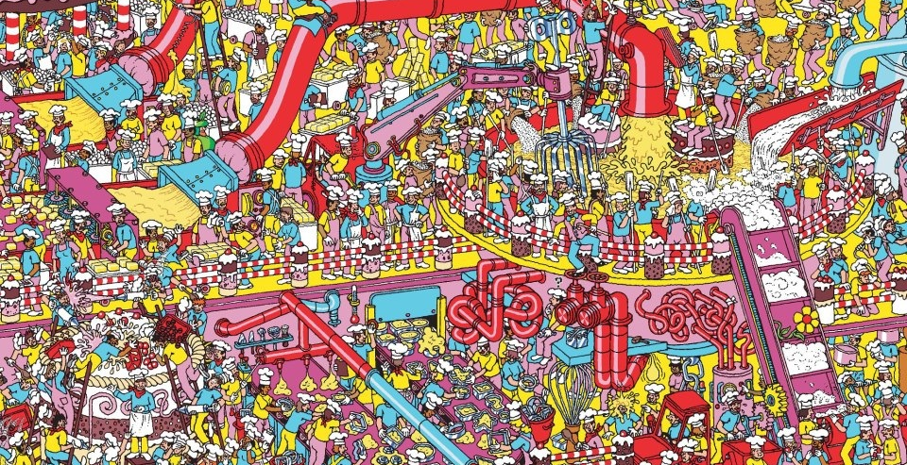
It Is Like Where’s Waldo
For Meteorologists And Weather Watchers

Slide 4


Fun And
Frustrating

Slide 5
Trendcasting:
Looking For
Something That
Stands Out

Slide 6
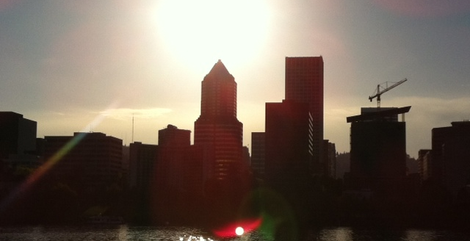
Find The Trend
Then See If It Applies To The Forecast

Slide 7
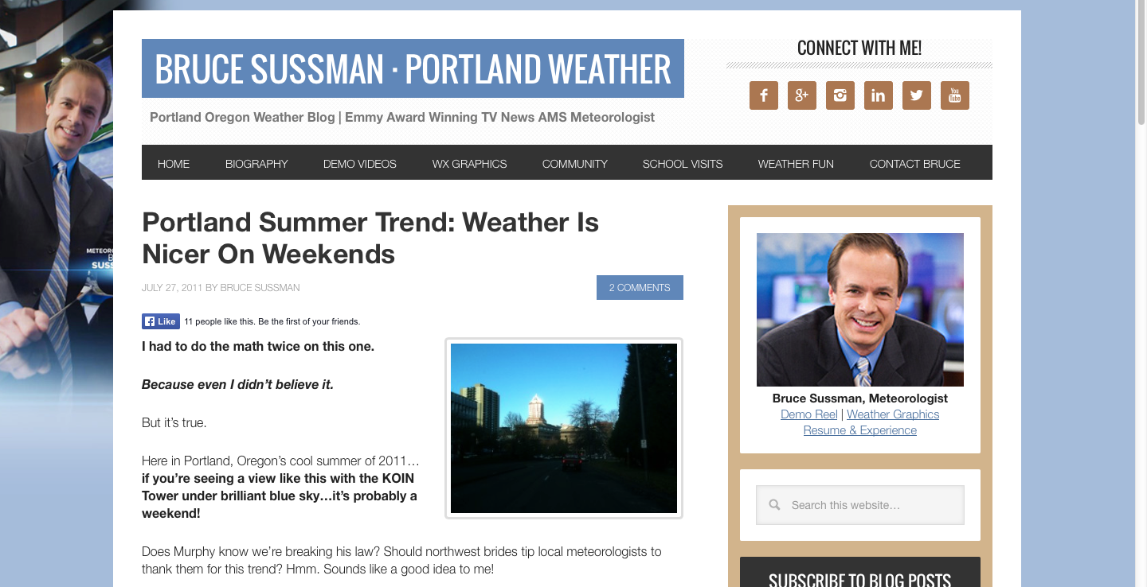
I Love Writing About Trends
brucesussman.com

Slide 8
Summer 2011 Trend
Weekend Days Were Warmest

Slide 9
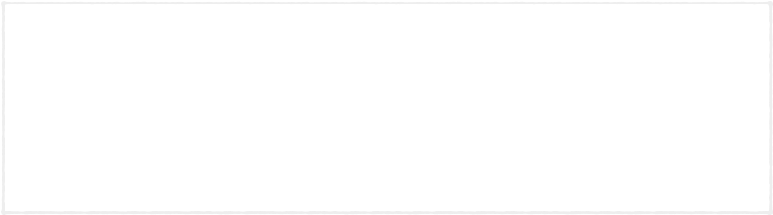
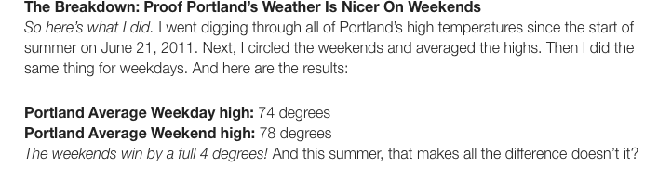
Summer 2011 Trend
Weekend Days Were Warmest

Slide 10
How It Helped:
Each weekend models split on warm & cool,
I could trust the warm solution because of the trend

Slide 11
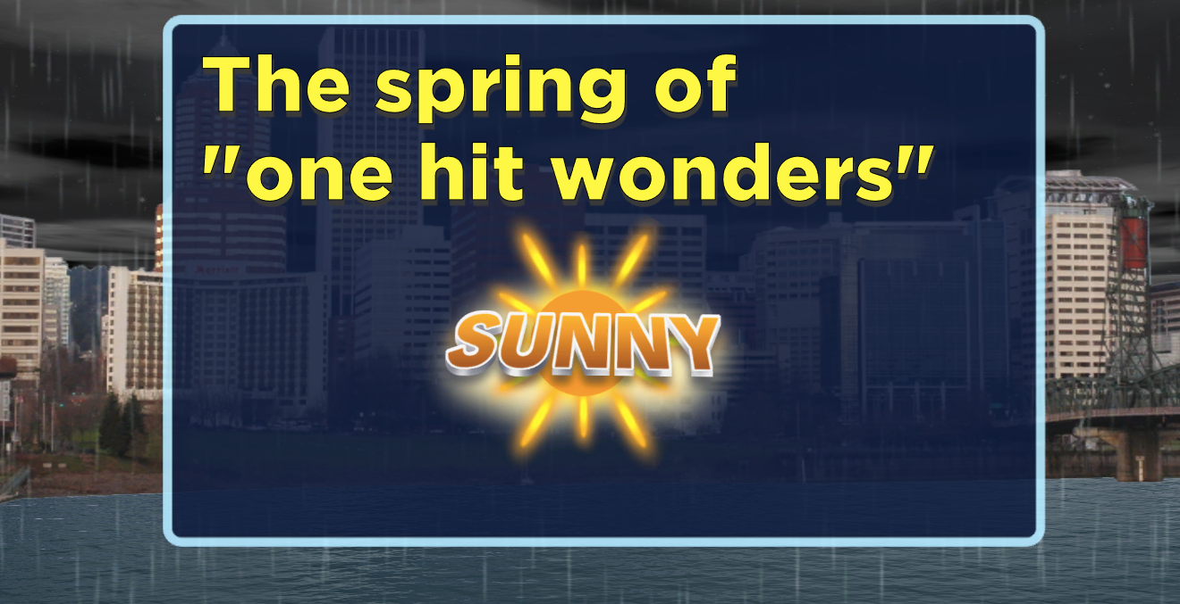
Spring 2011 Trend

Slide 12
Spring 2011 Trend
Only 1 Warm & Sunny Day Per Week

Slide 13
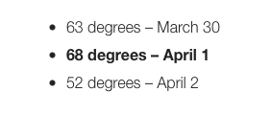
Spring 2011 Trend
Trend Start: April Fool’s Day 2011

Slide 14
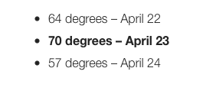
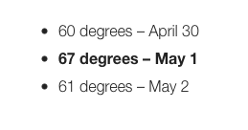
Spring 2011 Trend
Still Going Most Of April…

Slide 15
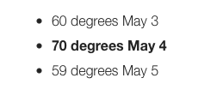
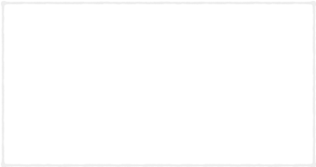
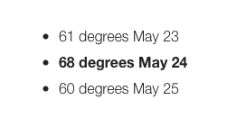
Spring 2011 Trend
Trend Finally Ends: Late May

Slide 16
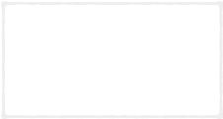
How It Helped:
I rarely was fooled by the models lies
that a “warm stretch” was finally going to happen

Slide 17
How It Helped:
I rarely was fooled by the models lies
that a “warm stretch” was finally going to happen
My wife and I booked a trip to Phoenix

Slide 18
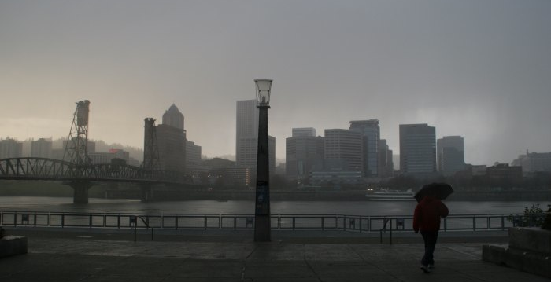
Rainy Season Trend 2012
“The 50-50 Year”

Slide 19
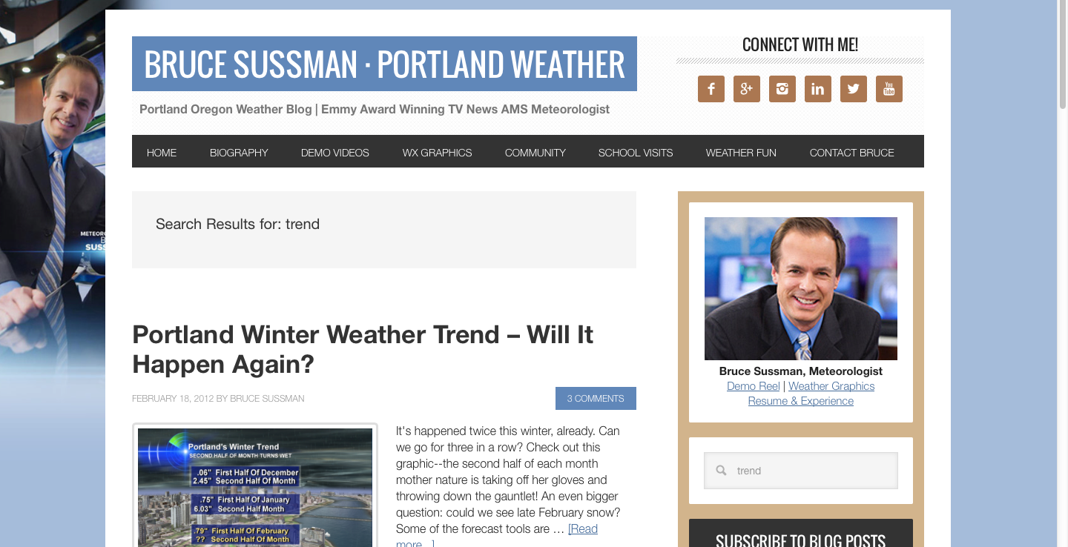
Rainy Season Trend 2012
“The 50-50 Year”

Slide 20
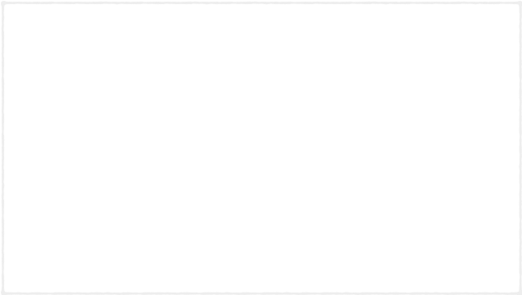
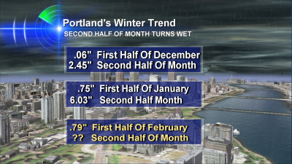
Rainy Season Trend 2012
Trend Start: December

Slide 21
Rainy Season Trend 2012
February: Wetter 2nd Half Of Month

Slide 22
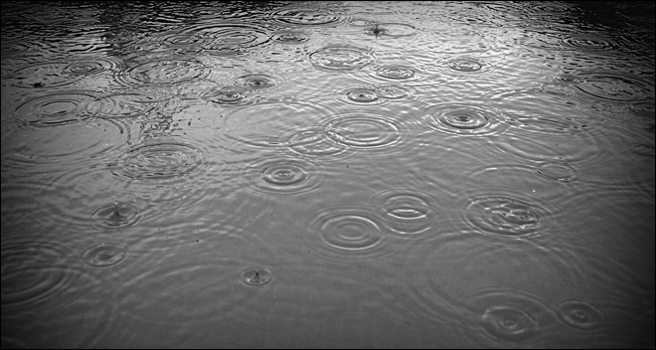
Trend Went Thru March
Helped My Forecast: I could be more confident that
‘wet’ or ‘dry' extended forecast would be right

Slide 23
Trend Went Thru March
Helped My Forecast: I could be more confident that
‘wet’ or ‘dry' extended forecast would be right
My wife and I booked a trip to Phoenix

Slide 24
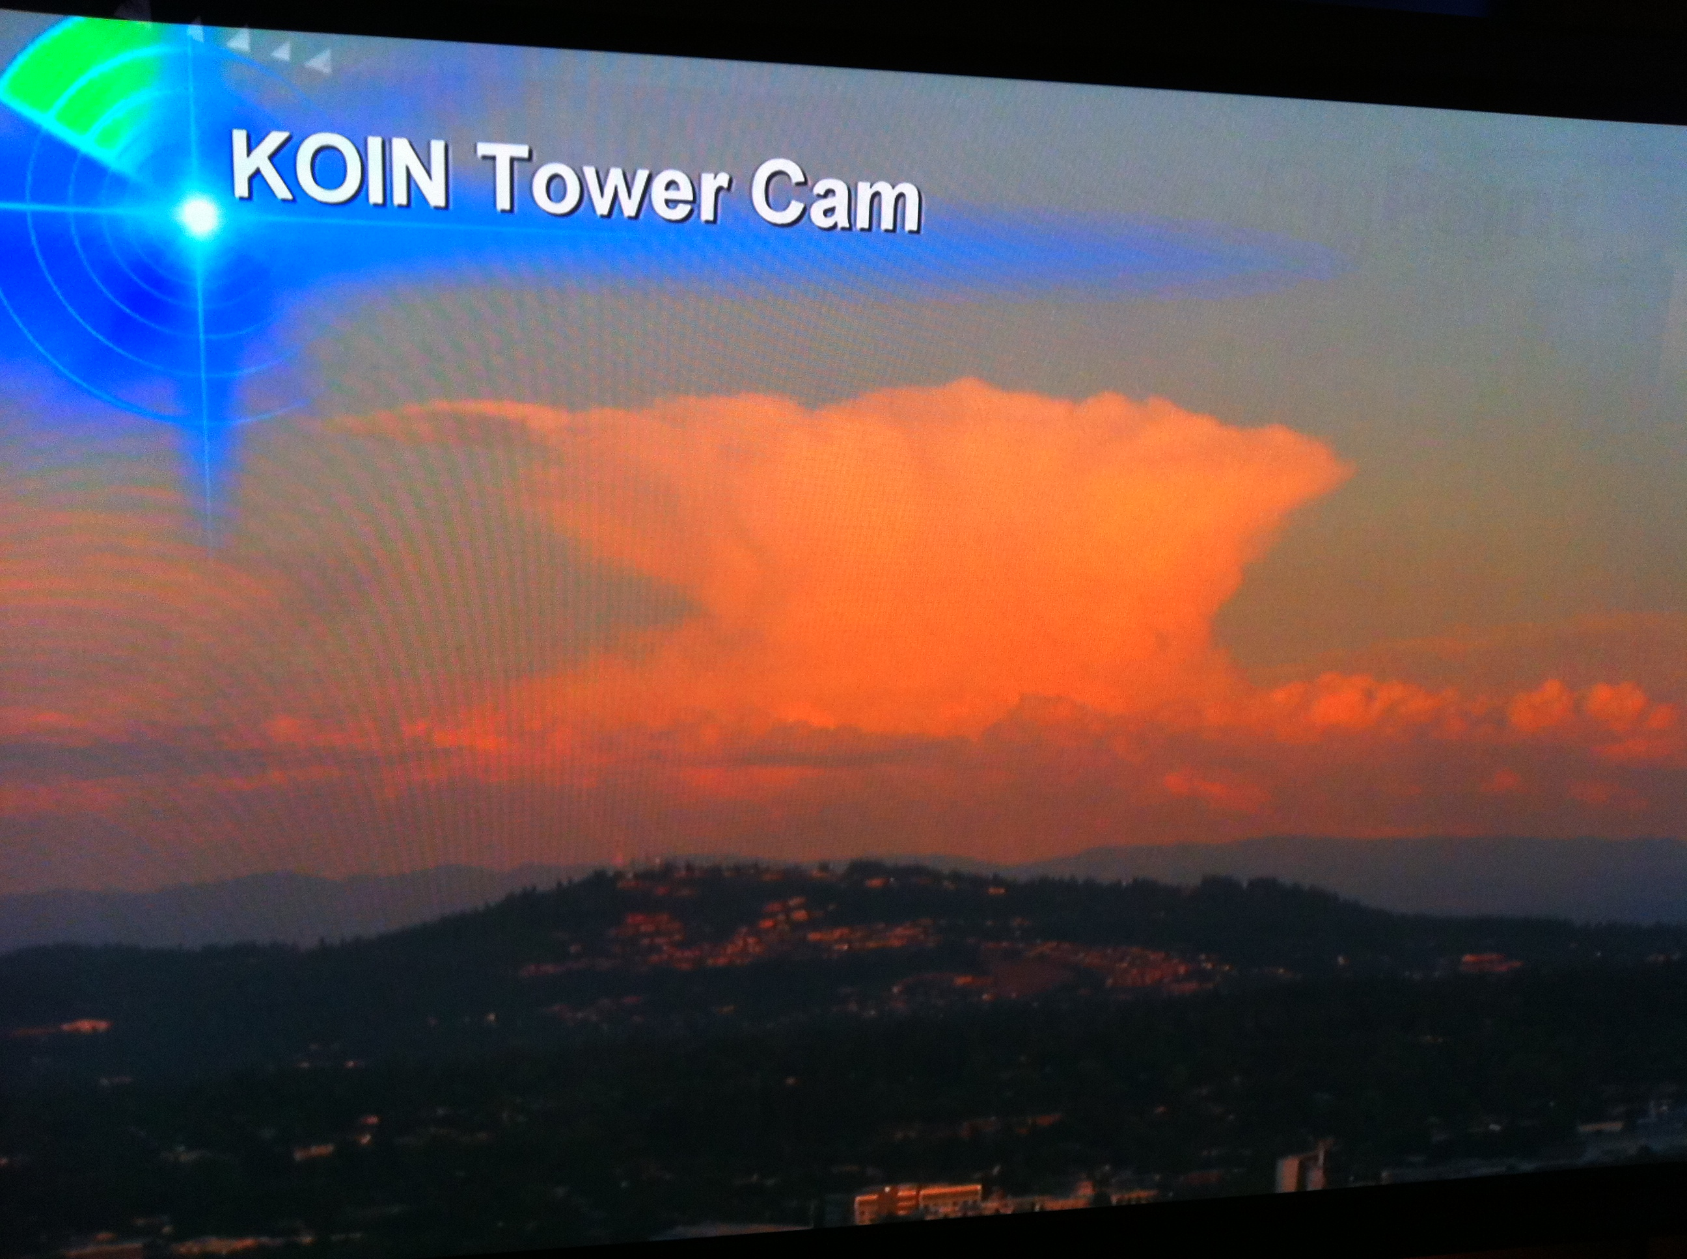
Spring Trend 2014
“Stormy Sundays”

Slide 25
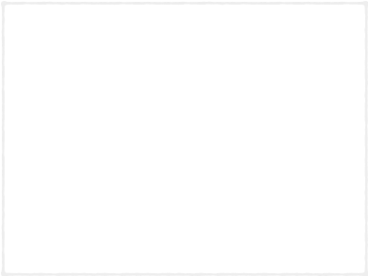
Spring Trend 2014
80% of t-storms occurred on Sundays
during April and May

Slide 26
Spring Trend 2014
80% of t-storms occurred on Sundays
during April and May
How It Helped: It didn't

Slide 27

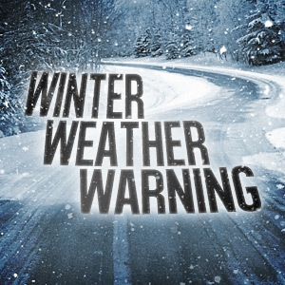
Try To Spot The Trends
Trendcasting Can Be Like…

Slide 28
Where’s Waldo?
For Meteorologists And Weather Watchers

Slide 29
Let me know what you find:
bruce@brucesussman.com / @forecastupdates

