Slide 1

2013-2014
Winter Weather
Wrap Up
Mark Nelsen

Slide 2
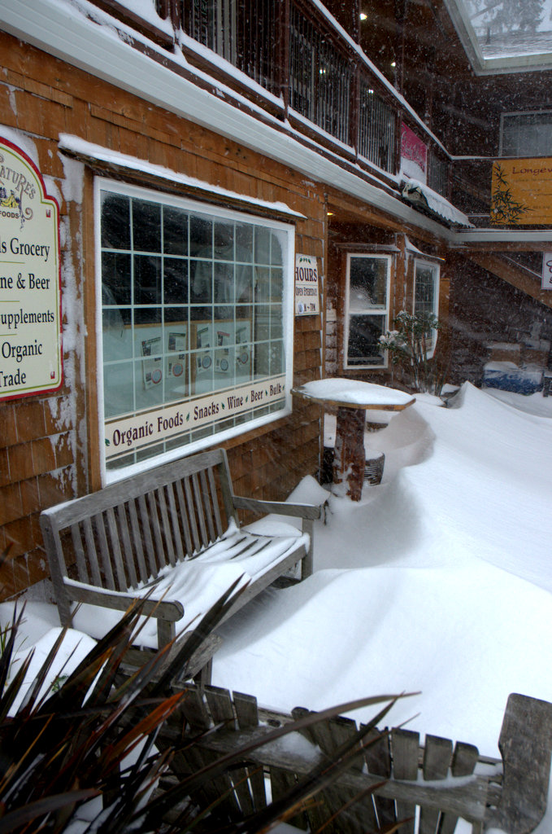
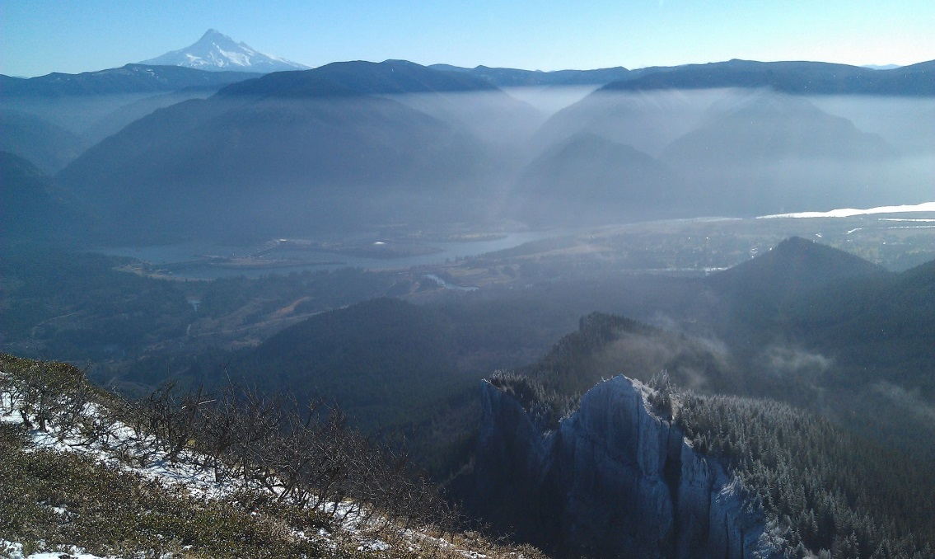
A Weird Winter!
Drought conditions for three months, followed by normal winter weather (wet/windy) for three weeks in late February

Slide 3
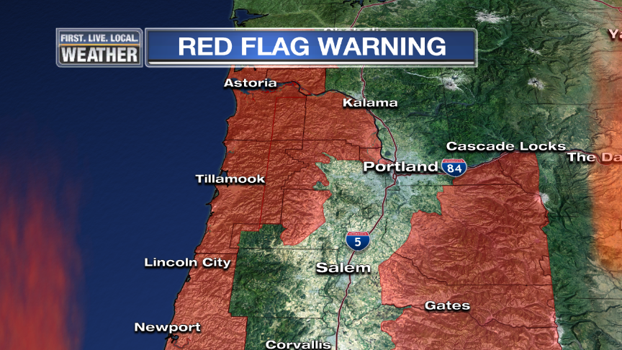
Other WEIRDness…
It was “all or nothing”
Two arctic blasts sandwiched 8 weeks of nothing!
Total absence of cold post-frontal wet airmasses; snow level rarely dipped below 2,500’.
Red Flag Warnings
in January???

Slide 4
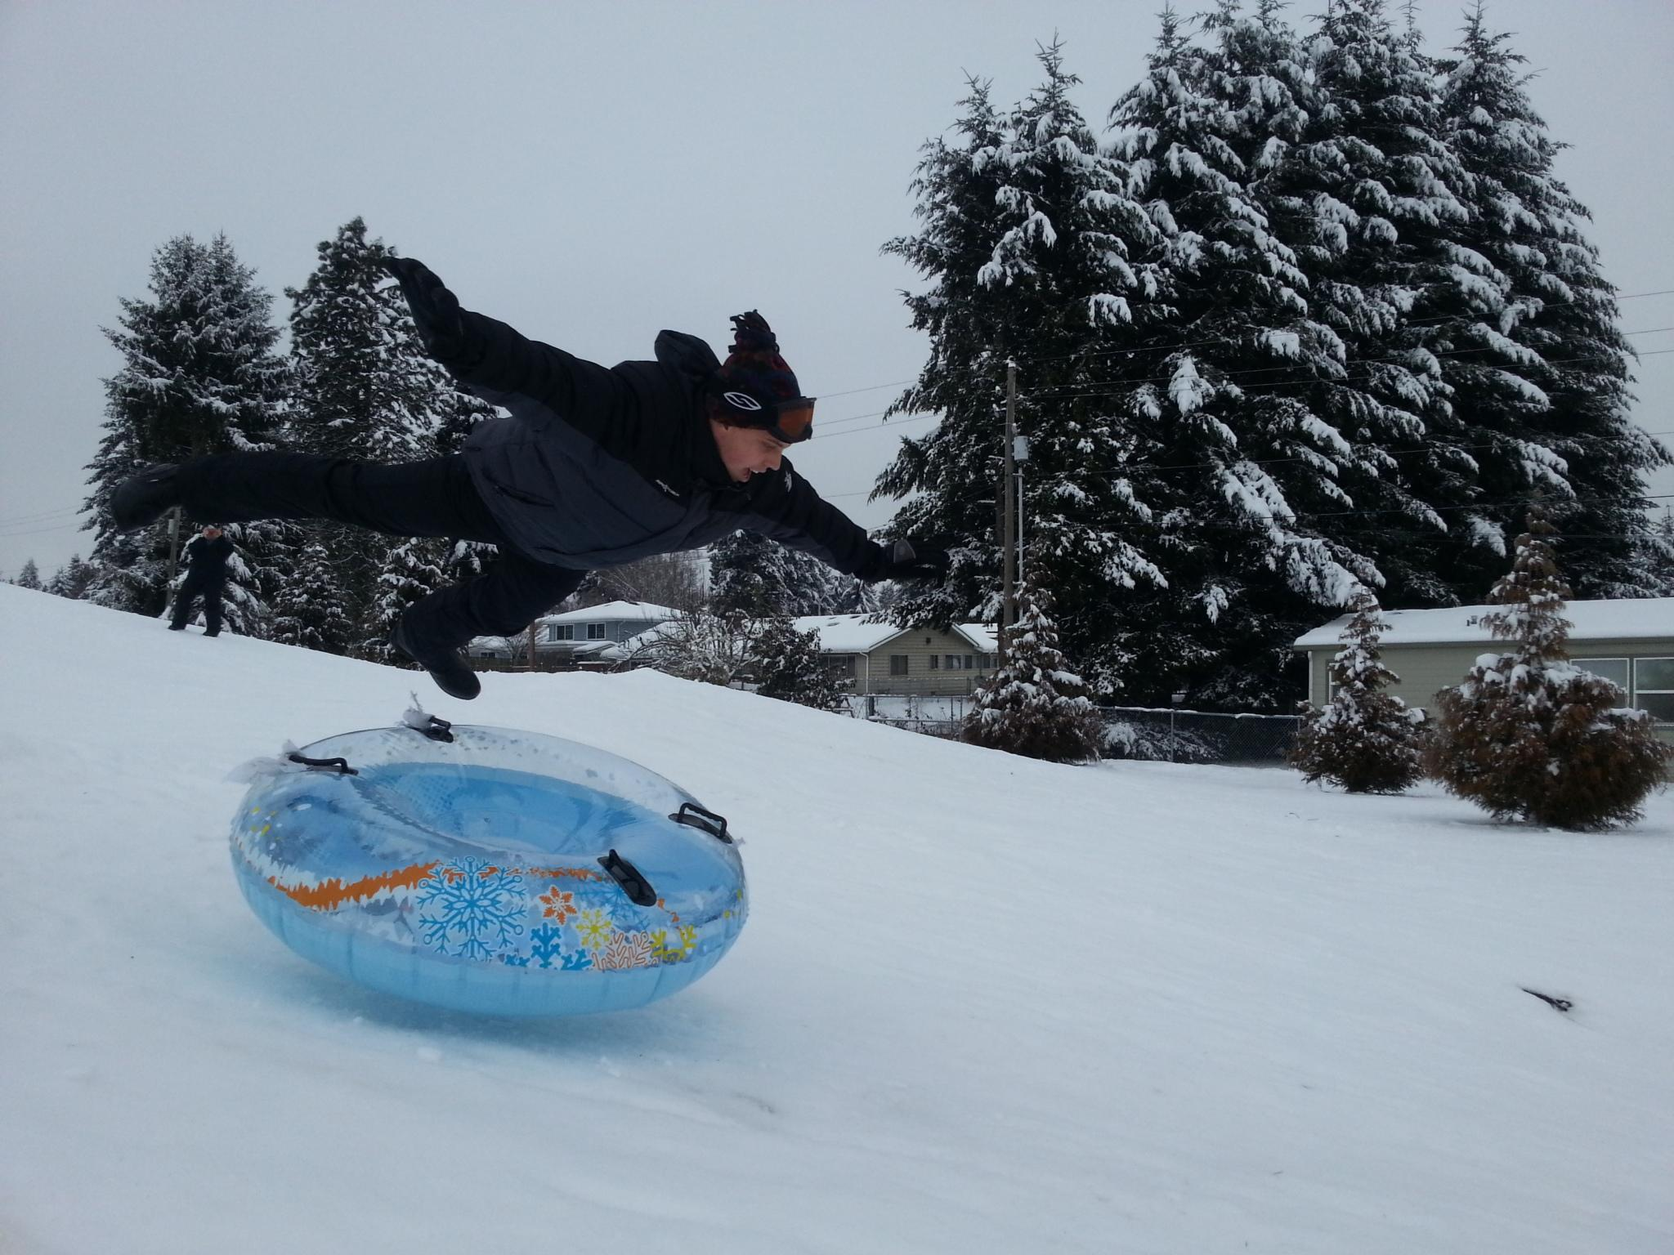
A Wild Ride At Times!

Slide 5
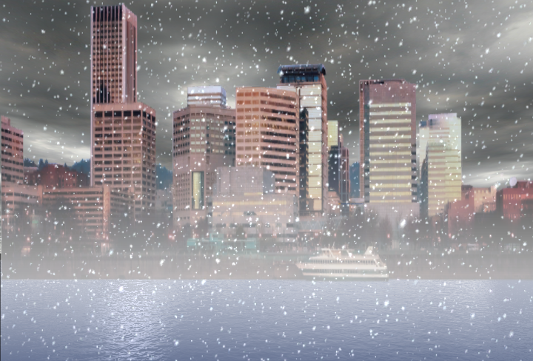
OFFICIAL
SNOW TOTAL
8.0”
5 measurable snowfalls at PDX!
8.0” also at Downtown (KGW)

Slide 6
5 measurable snowfalls at PDX
0.5” December 7
0.2” December 10
3.8” February 6
1.3” February 7
2.2” February 8

Slide 7
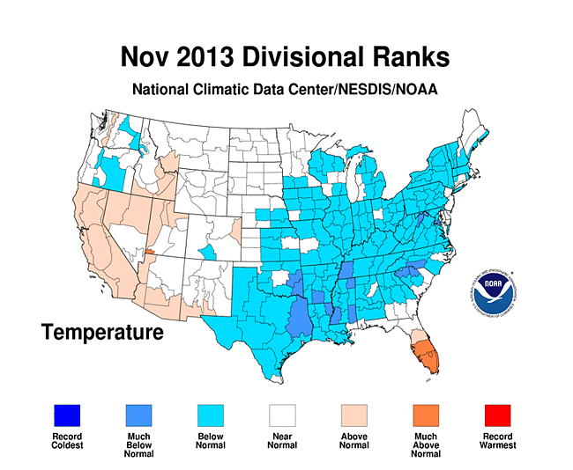
THE USA VIEW

Slide 8
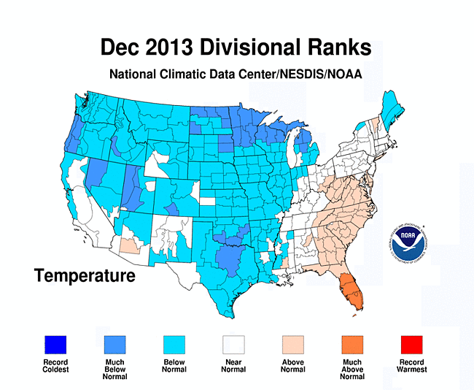
THE USA VIEW

Slide 9
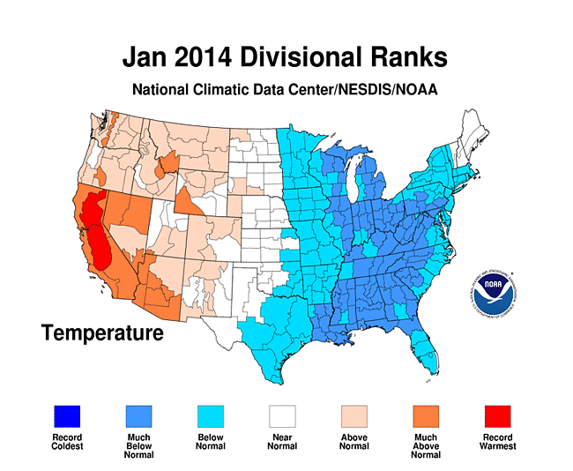
THE USA VIEW

Slide 10
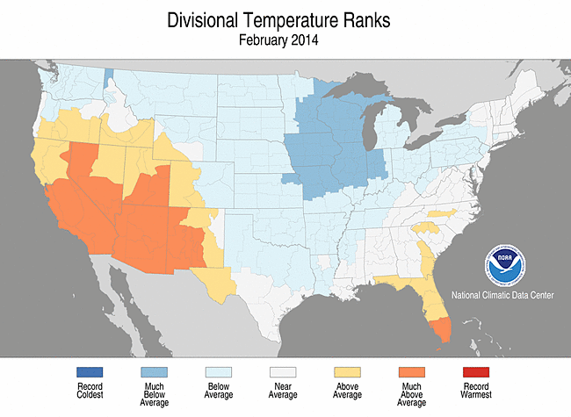
THE USA VIEW

Slide 11
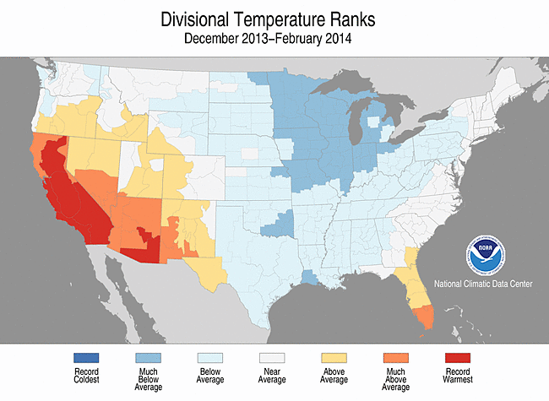
THE 3 MONTH PERIOD

Slide 12
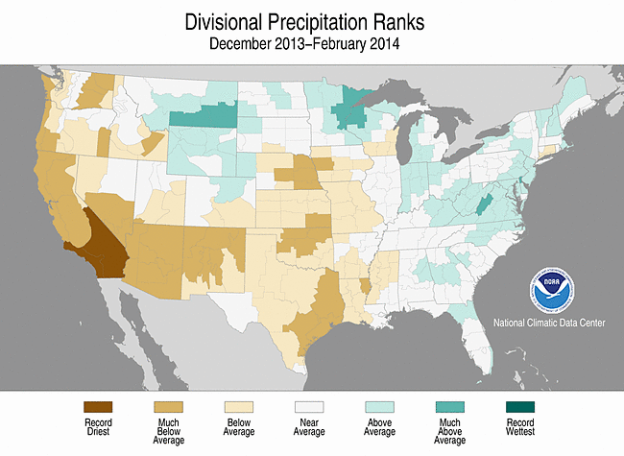
3 MONTH PRECIPITATION

Slide 13
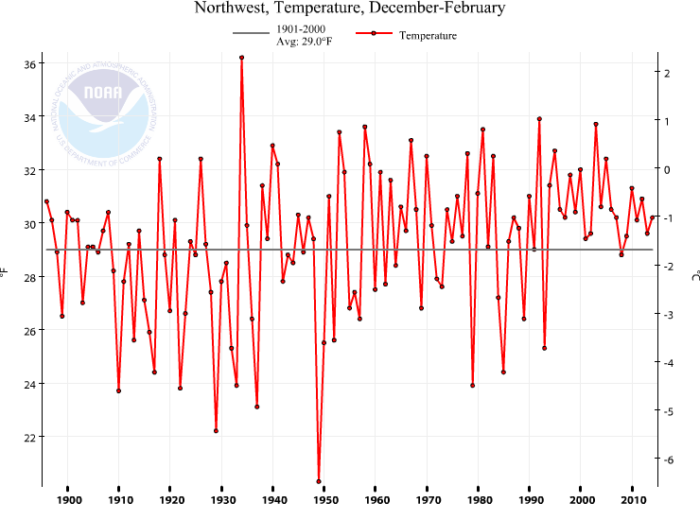
Pacific Northwest Winter Temps (the past 100 years)
Near to Slightly Above Average (Warm southern half)

Slide 14
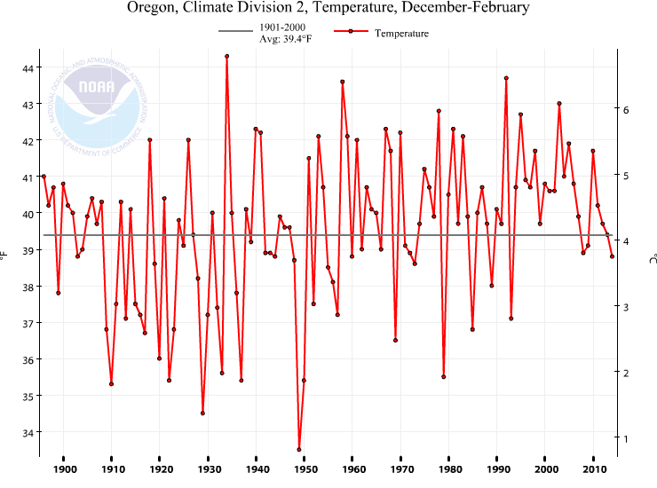
Western Valleys Winter Temps (the past 100 years)
Colder than average (coldest since 1993)
Coldest since 1993!

Slide 15
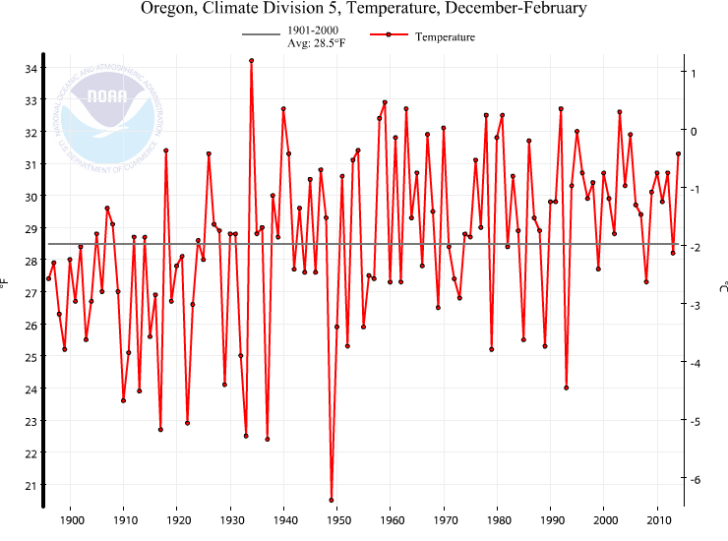
High Desert Winter Temps (Climate Zone 5)
Warmer than average (above inversions December/January)
Warmest in 8 Years!

Slide 16
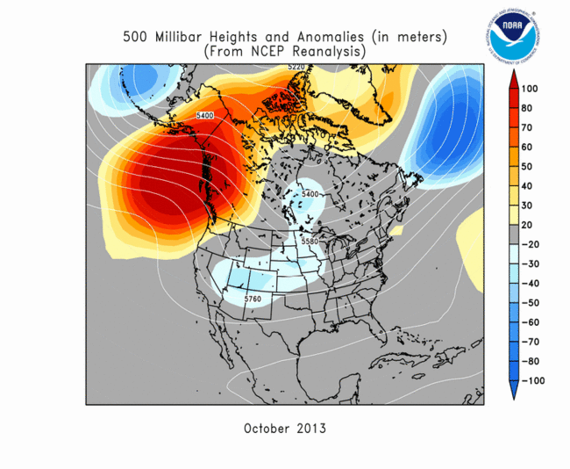
Ridging = Dry (October-January)
WET SEASON BEGINS COOL IN NOVEMBER

Slide 17
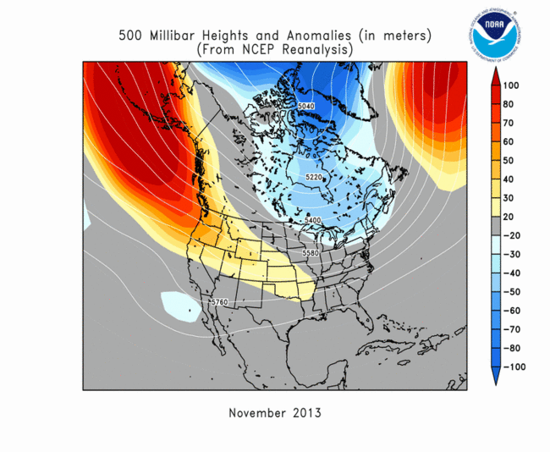
UPPER LEVEL PATTERNS

Slide 18
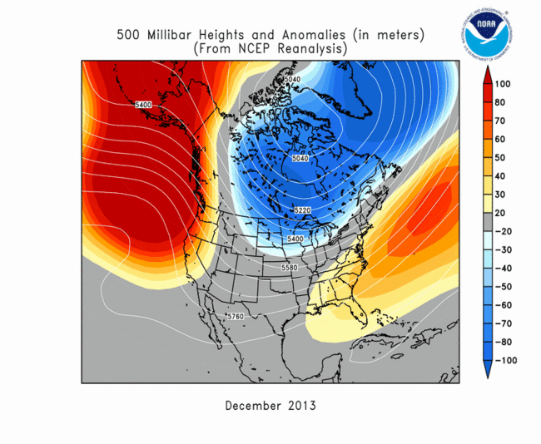
UPPER LEVEL PATTERNS

Slide 19
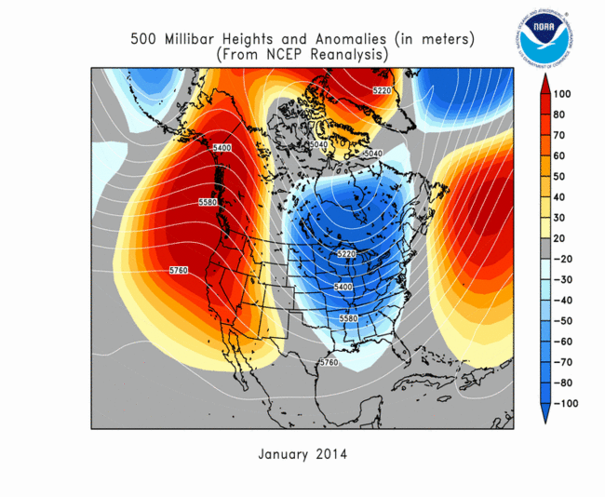
UPPER LEVEL PATTERNS
Strong Ridge Closest to Us

Slide 20
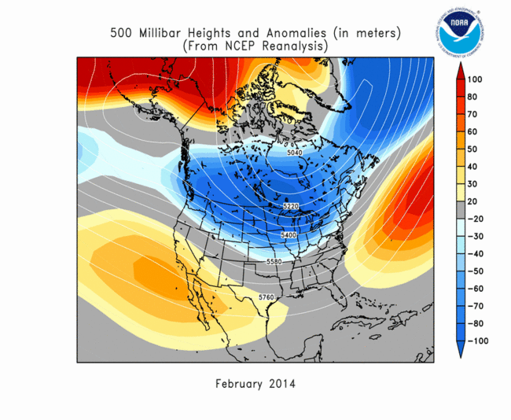
UPPER LEVEL PATTERNS
Ridge finally dies after first few days of month. Wet westerly flow returned

Slide 21
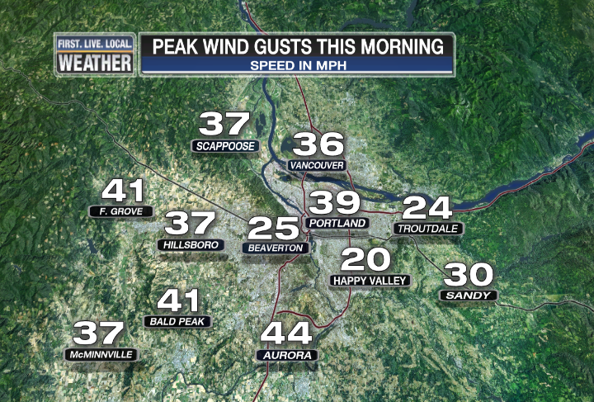
NOVEMBER
Lots of ridging, sunshine, and weak storm systems
    Below average rainfall.
A few ski areas have a very limited opening Thanksgiving
Gusty west wind with cold front on 7th causes some local damage (e70 mph gust in Dallas)

Slide 22
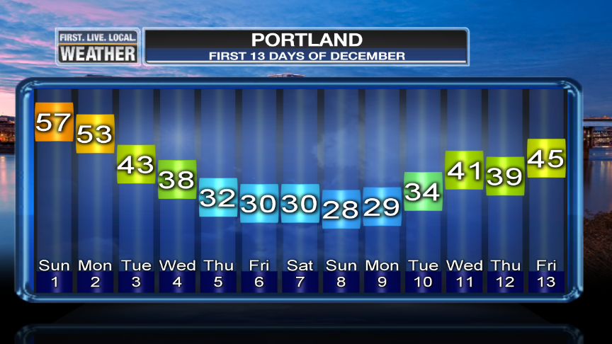
DECEMBER
ARCTIC BLAST #1
5 days at or below 32 degrees

Slide 23
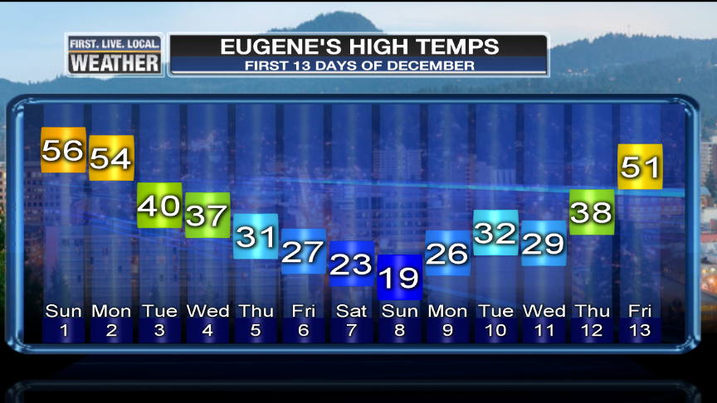
DECEMBER
ARCTIC BLAST #1
A high temp in the teens in Eugene under sunny skies and calm wind

Slide 24
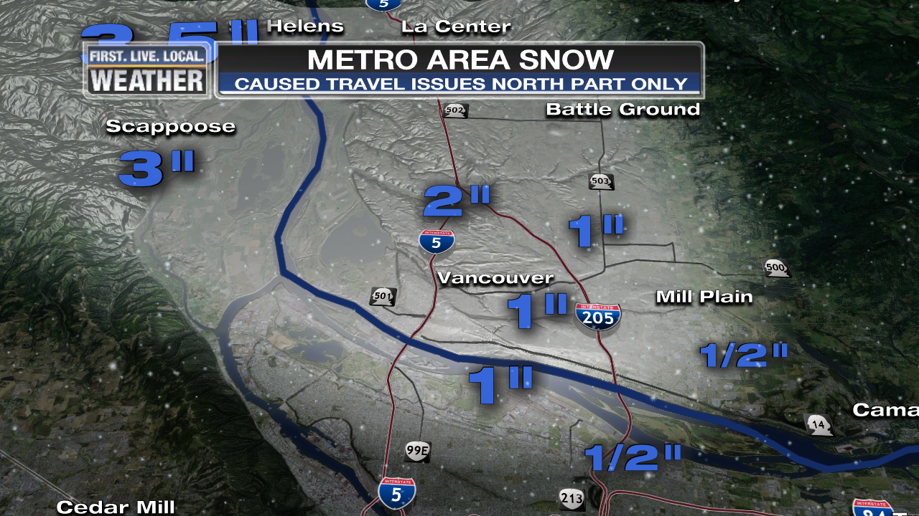
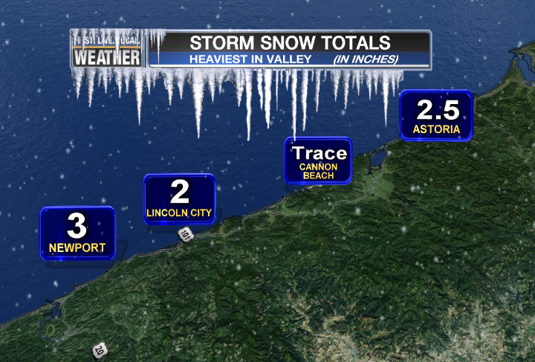
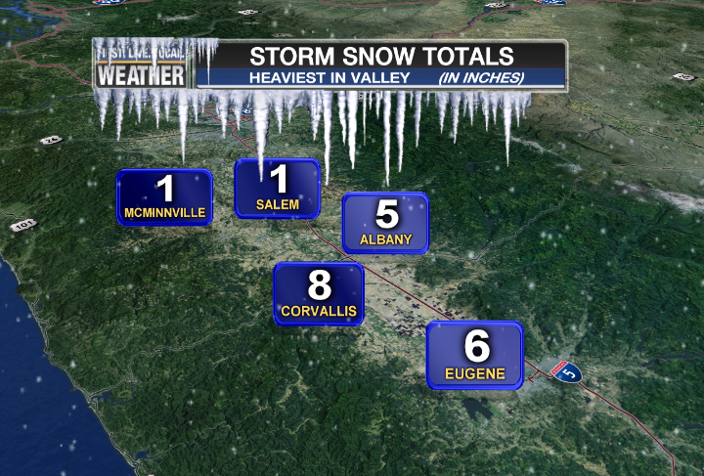
DECEMBER
A (well-forecast) VALLEY SNOW STORM DEC 6th
Hits central/south Willamette Valley, 1-3” north part of metro area too

Slide 25
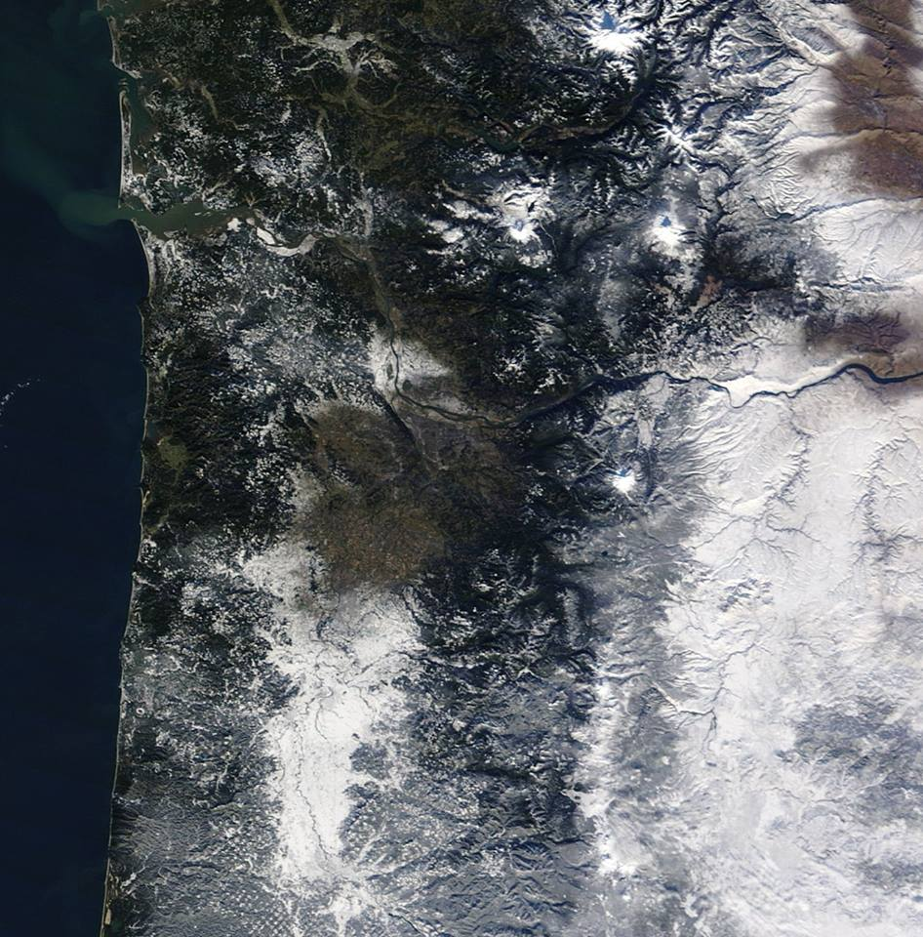
DECEMBER
December 7th
The day after the snow storm
Thick snow cover south valley and extreme northwest part of metro area. A dusting at best Portland to Salem, Cascade foothills, and western Gorge.

Slide 26
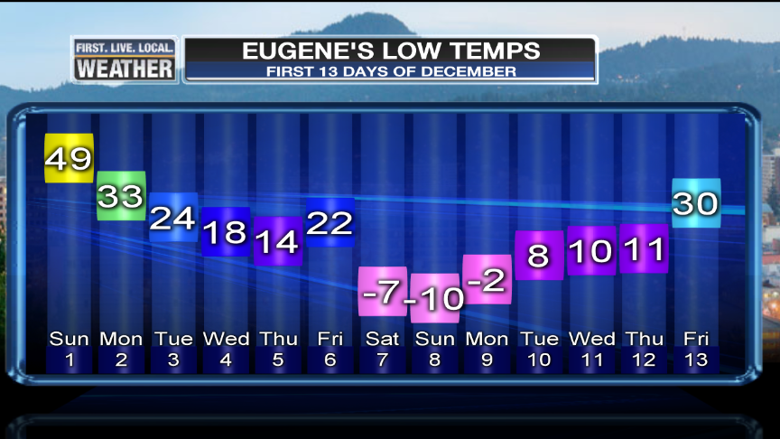
DECEMBER
7th, 8th, 9th
Nearly calm weather and deep snow cover produces record low temps

Slide 27
DECEMBER
Coldest 850mb temp over Salem since 1998
-14.1 deg C
Tillamook
Portland
Salem
Eugene
Redmond
Lakeview
Burns
11
12
8
-10
-27
-27
-30
Coldest since 2009
Coldest since 2009
Coldest since 1990
Coldest since 1972, all-time (-12) on SAME DATE!
2nd coldest on record
All-time coldest temperature
All-time coldest temperature

Slide 28
DECEMBER
Arctic Blast
Went out with just a whimper
.2” snow in Portland
Brief pockets of freezing rain west/southwest metro area
Rest of the month…
Ridging takes hold, a few weak systems move through
Skibowl, Hoodoo, Mt. Ashland, Willamette Pass, Cooper Spur
- ski areas unable to open for 2 week Christmas Break
Other ski areas operate with thin coverage and just a few lifts

Slide 29

JANUARY
Moving on…
Lots of ridging and inversions…like the pic?

Slide 30
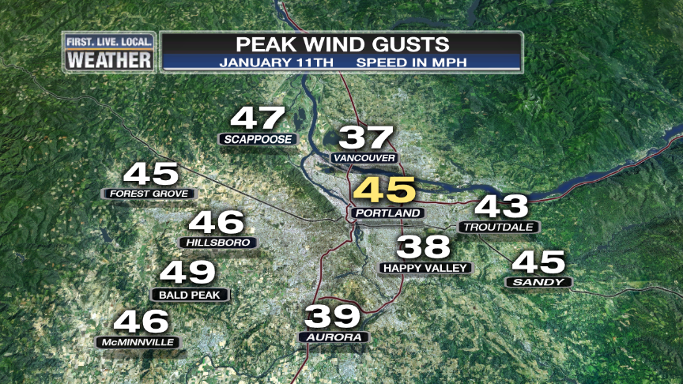
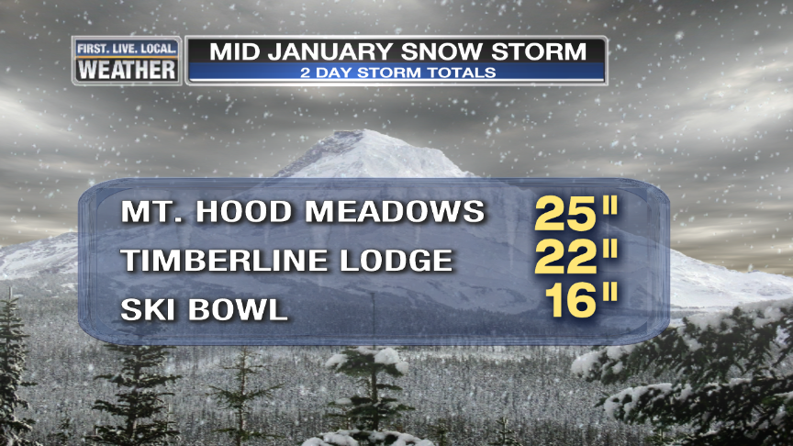
JANUARY
One rainy/windy week in the middle and one big Cascade snow storm

Slide 31
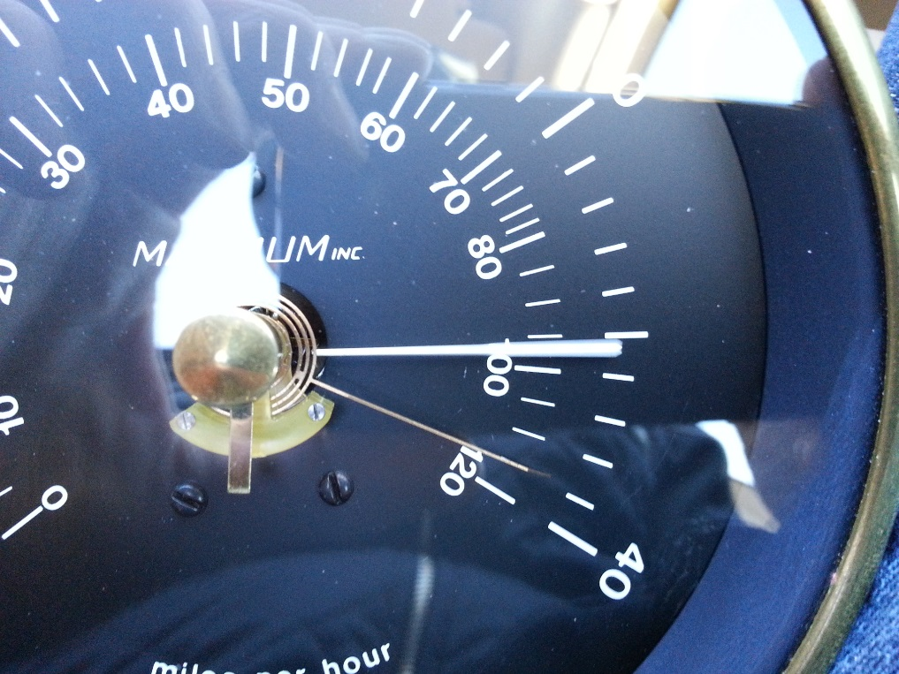
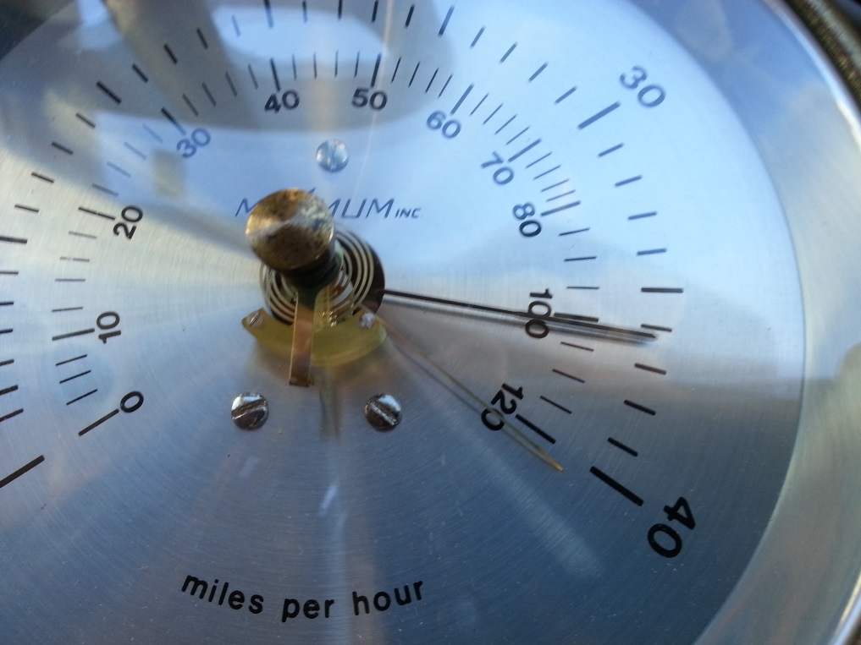
JANUARY
Lots of Strong East Wind
12 consecutive days 30+ gusts at TTD
Matt Sloan recorded gusts to 115 and 120+ on hand-held gauge

Slide 32

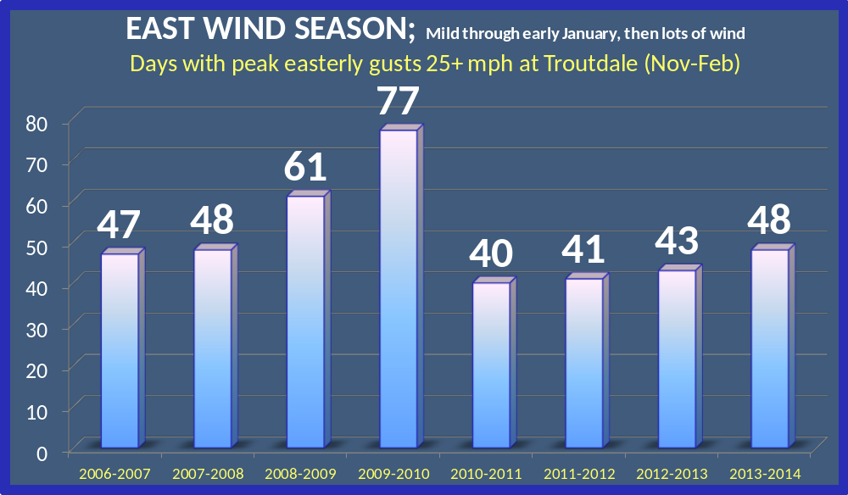

Slide 33
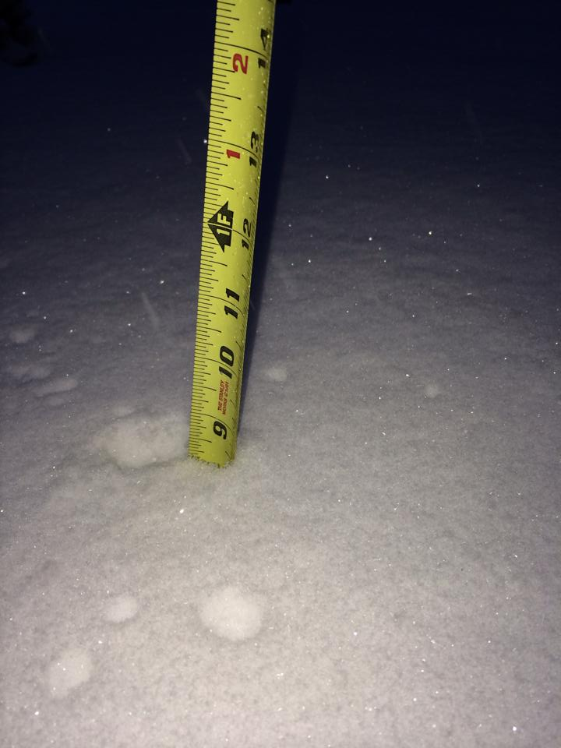
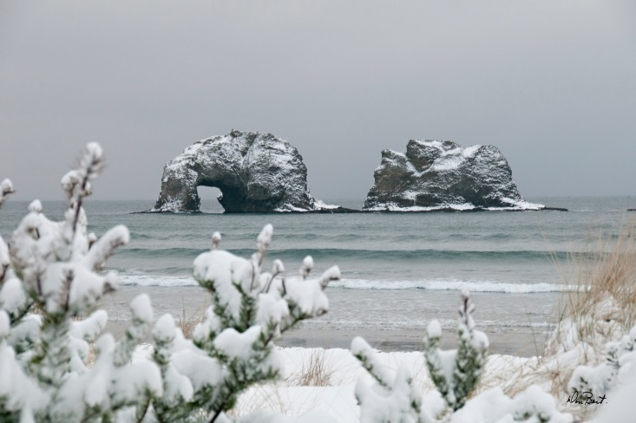
FEBRUARY
Arctic Blast #2
Very rare to have 2 in one season
3 snow/ice storms move across Western Oregon in 3 days
Rockaway
Manzanita
St. Helens

Slide 34
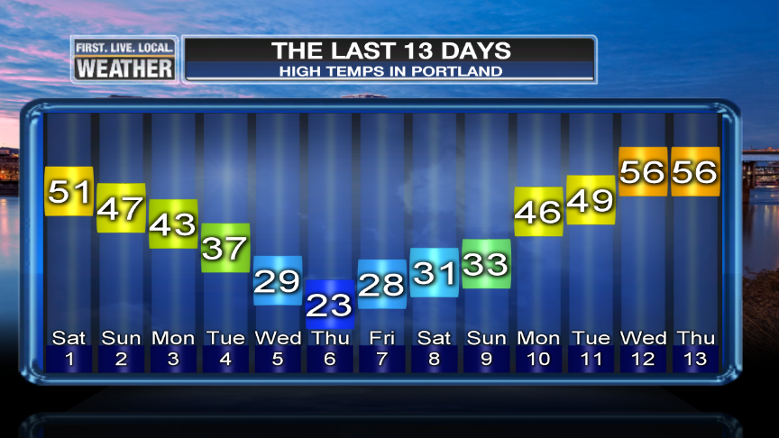
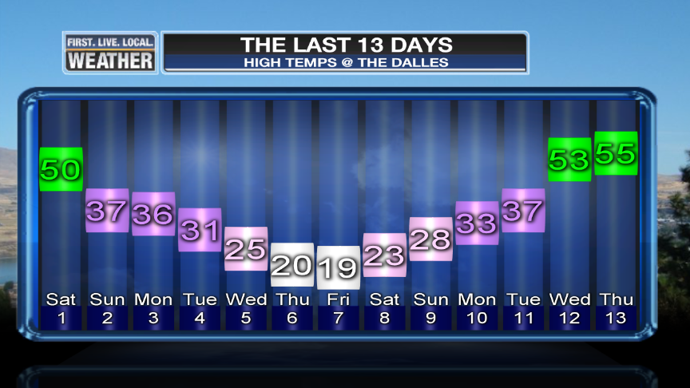
FEBRUARY
High temps the first 13 days of the month
Portland & The Dalles

Slide 35
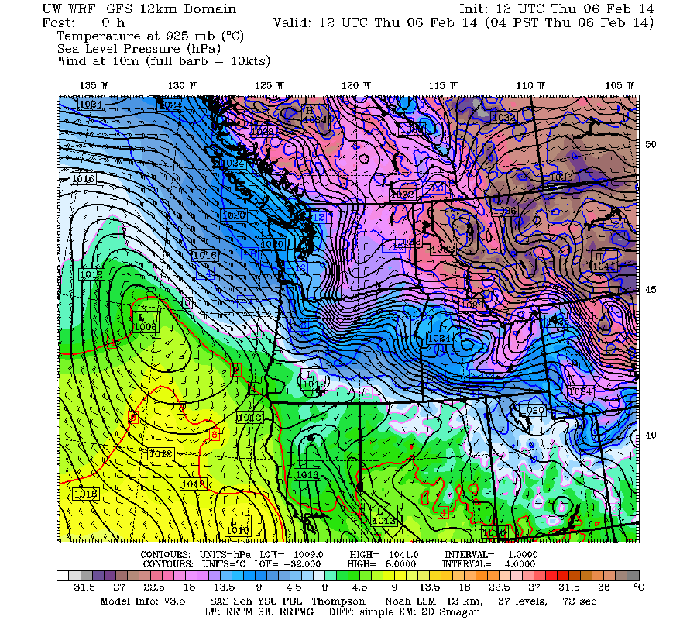
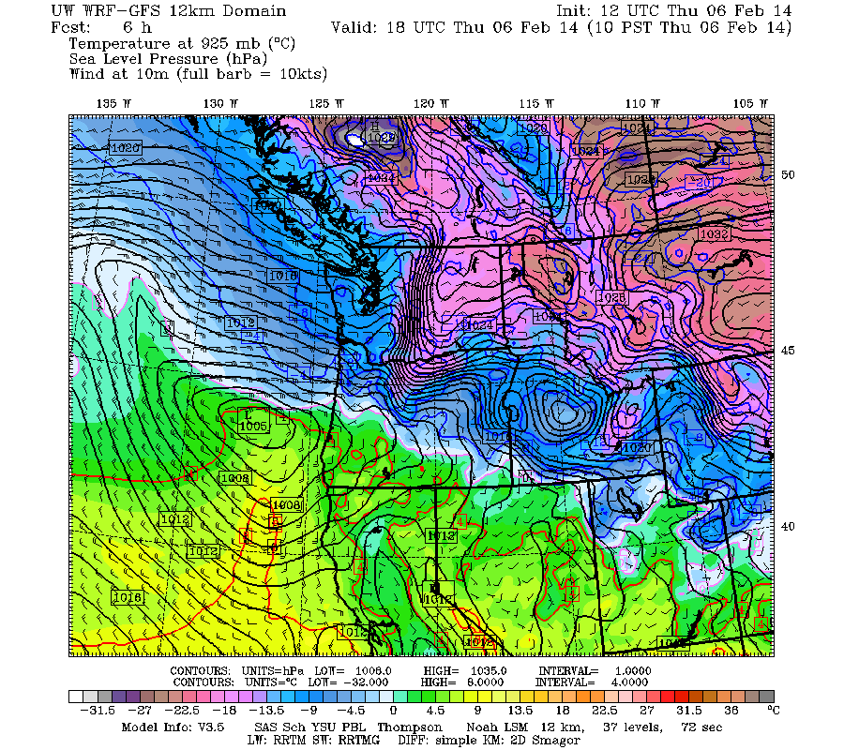
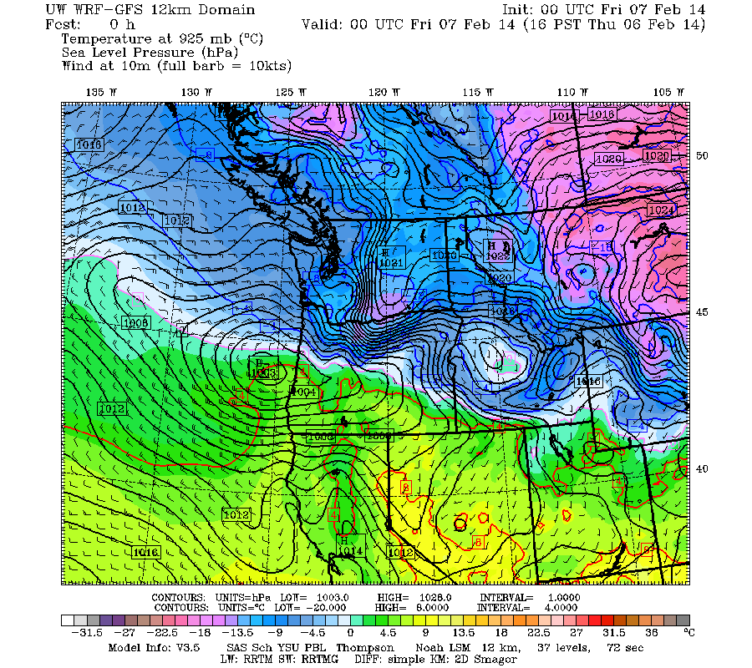
Storm #1 Thursday
Low pressure slides into SW Oregon – Thurs, 6th
Beautiful!

Slide 36
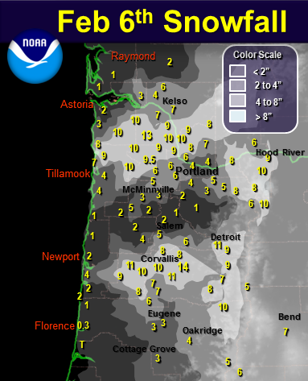
Storm #1 Snow
2nd major snowstorm of winter south Willamette Valley.
Big snowstorm parts of Coast and N. Coast Range
More heavy snow between Portland and Longview

Slide 37
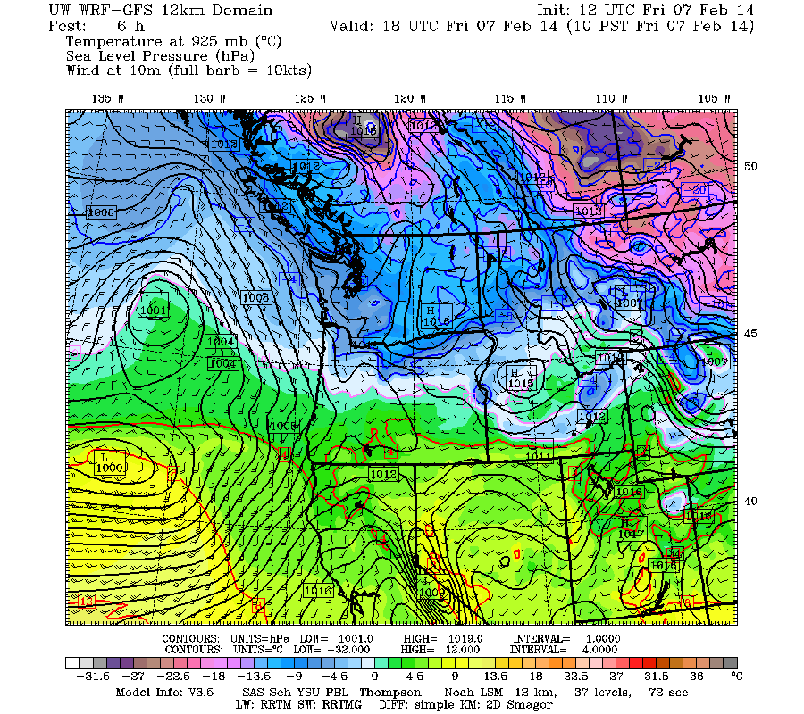
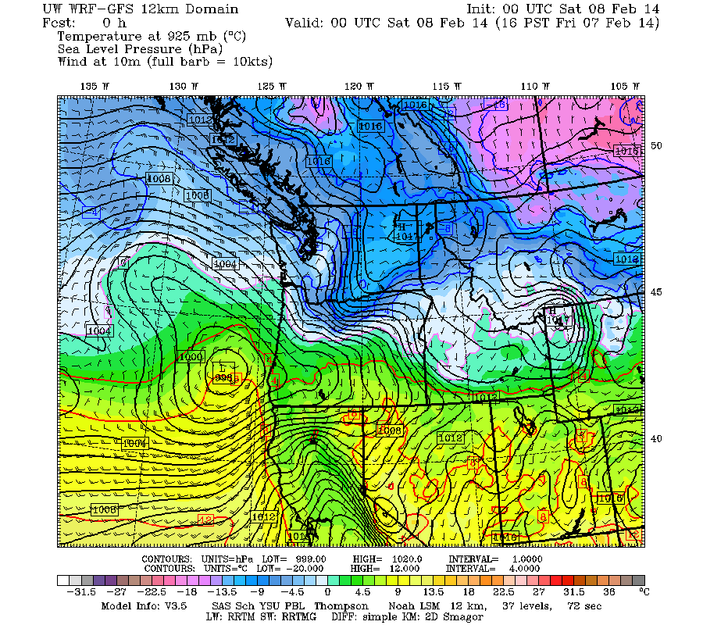
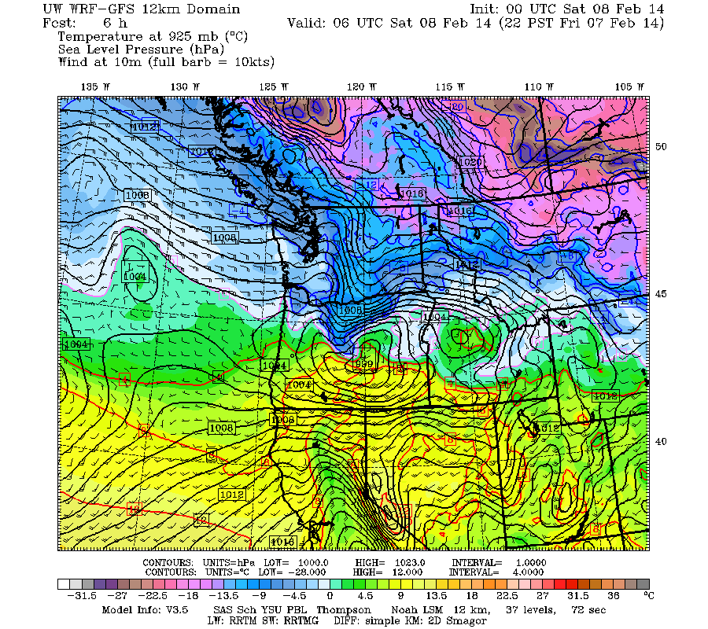
Storm #2 Friday
Low pressure moves ENE, ends up in Central Oregon

Slide 38
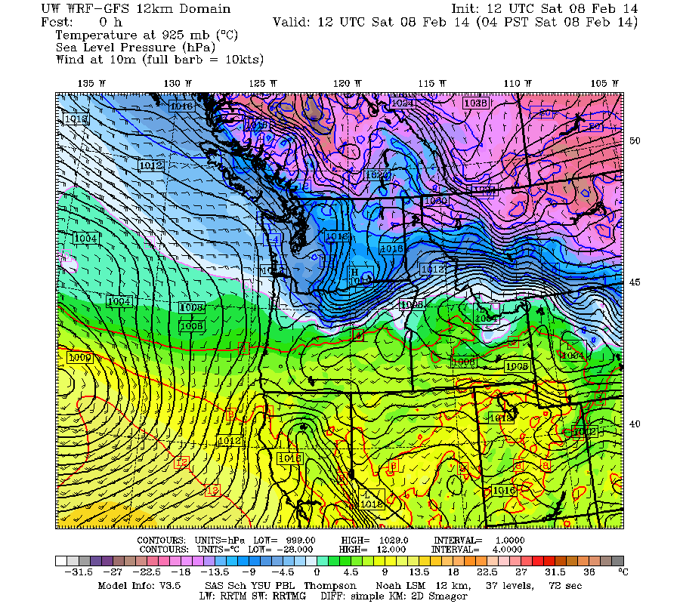
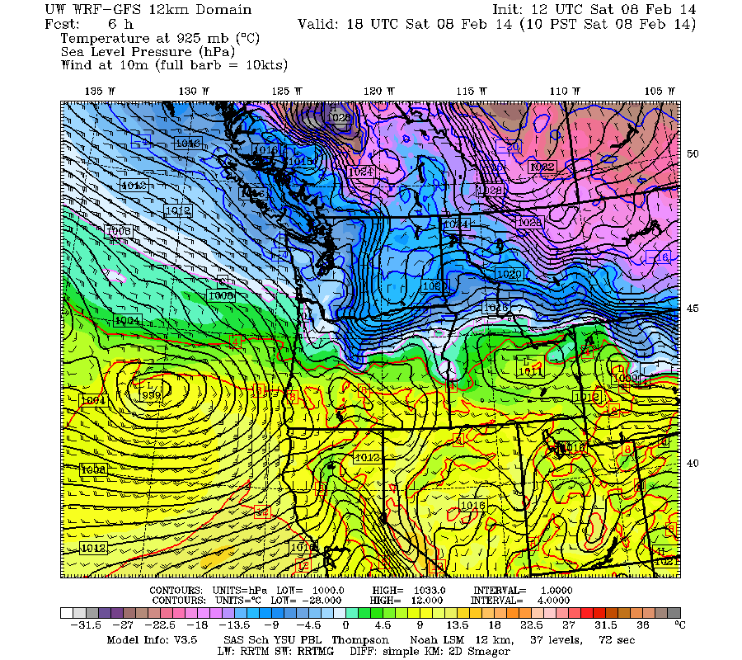
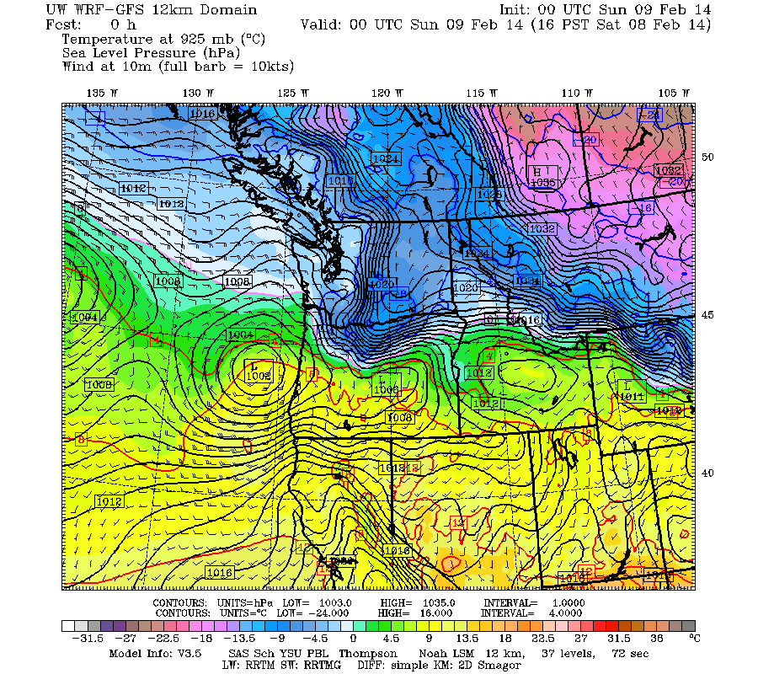
Storm #3
3rd low heads NE…

Slide 39
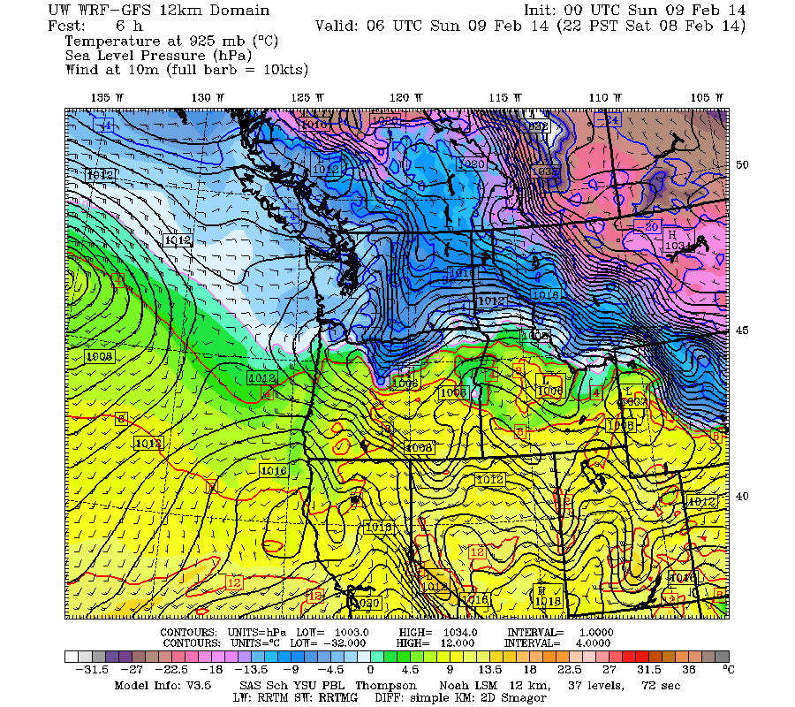
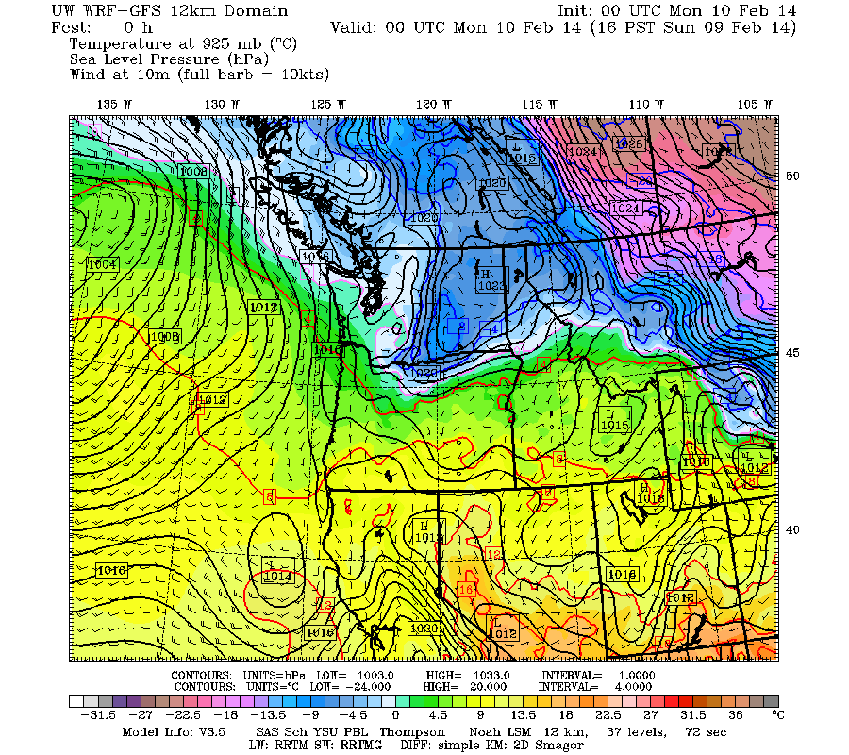
Storm #3
3rd low heads NE…dissipates over Willamette Valley. Kills most of easterly gradient and temperatures rise above freezing Sunday 9th
Snow changes to freezing rain in valley and Portland metro area Saturday afternoon/night

Slide 40
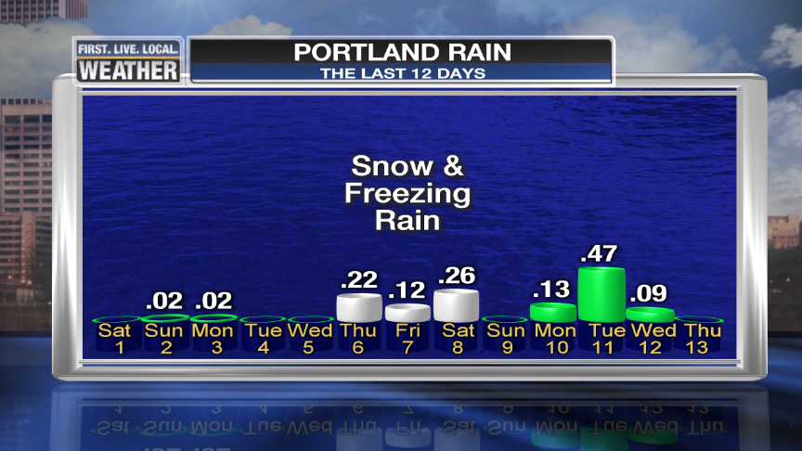
3 Day Precipitation
Portland Metro Area escaped a major snow/ice event…Only .60” liquid equivalent out of 3 storms.
What if it would have been 1-2”?

Slide 41
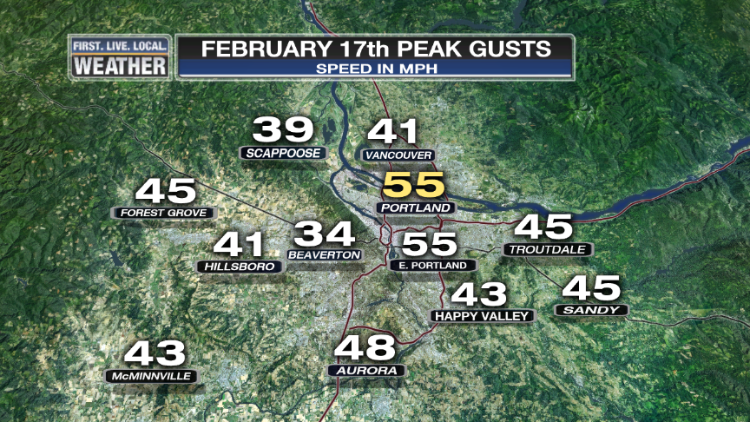
FEBRUARY
Localized windstorm one week later...
Seemed to hit only middle of metro area (on Oregon side), only 20-30,000 outages!
Peak gust 55mph at PDX strongest southerly wind since at least 2006

Slide 42

FEBRUARY
Vista House Anemometer Dies on the 25th
Oregon State Parks has replaced it

Slide 43



Slide 44


Slide 45

1940-1995 = PDX 1996-Present = PQR

Slide 46

Downtown Data Only

Slide 47


Slide 48

Blue = Widespread Arctic Air Outbreak

Slide 49

No Widespread Wind Storm In Valley
Last Storm was 8 Years Ago! Dec. 2006

Slide 50

Terrible snow season in southern Oregon; below average in the north
Some Get It, Some Don’t
Salem 1-4”

Slide 51

Mountain Snowpack @ 5,400’
Extremely poor by early January, then almost recovered in February. Just a little below normal at this elevation by early April
Courtesy
NRCS
Oregon Office
Precip: Thick Line = Average
Snow Water: Thick = Average
Mt. Hood Test Site

Slide 52

Hogg Pass @ 4,500’
Extremely low through early February, closer to normal in mid February. Fell further behind and then quick melt in early April.
Courtesy
NRCS
Oregon Office
Precip: Thick Line = Average
Snow Water: Thick = Average

Slide 53

Early March Ice
Metro area escapes freezing rain by just a degree or two March 1st
Thick ice accumulation western Gorge…ice pellet drifts around Multnomah Falls too

Slide 54
What Did I Miss?
Questions
&
Discussion
Time

